Slide 1
The Future of Atmospheric Chemical Mechanism Development: A Panel Discussion of Possible Forward Paths
A Perspective from a Regulatory Modeler
Heather Simon
US EPA, Office of Air Quality Planning & Standards

Slide 2
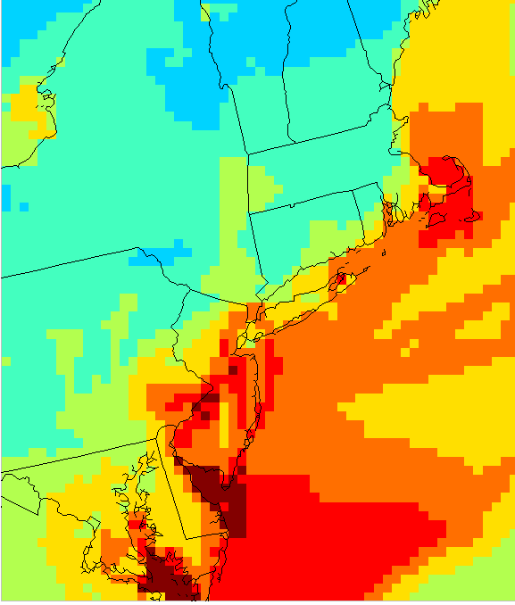
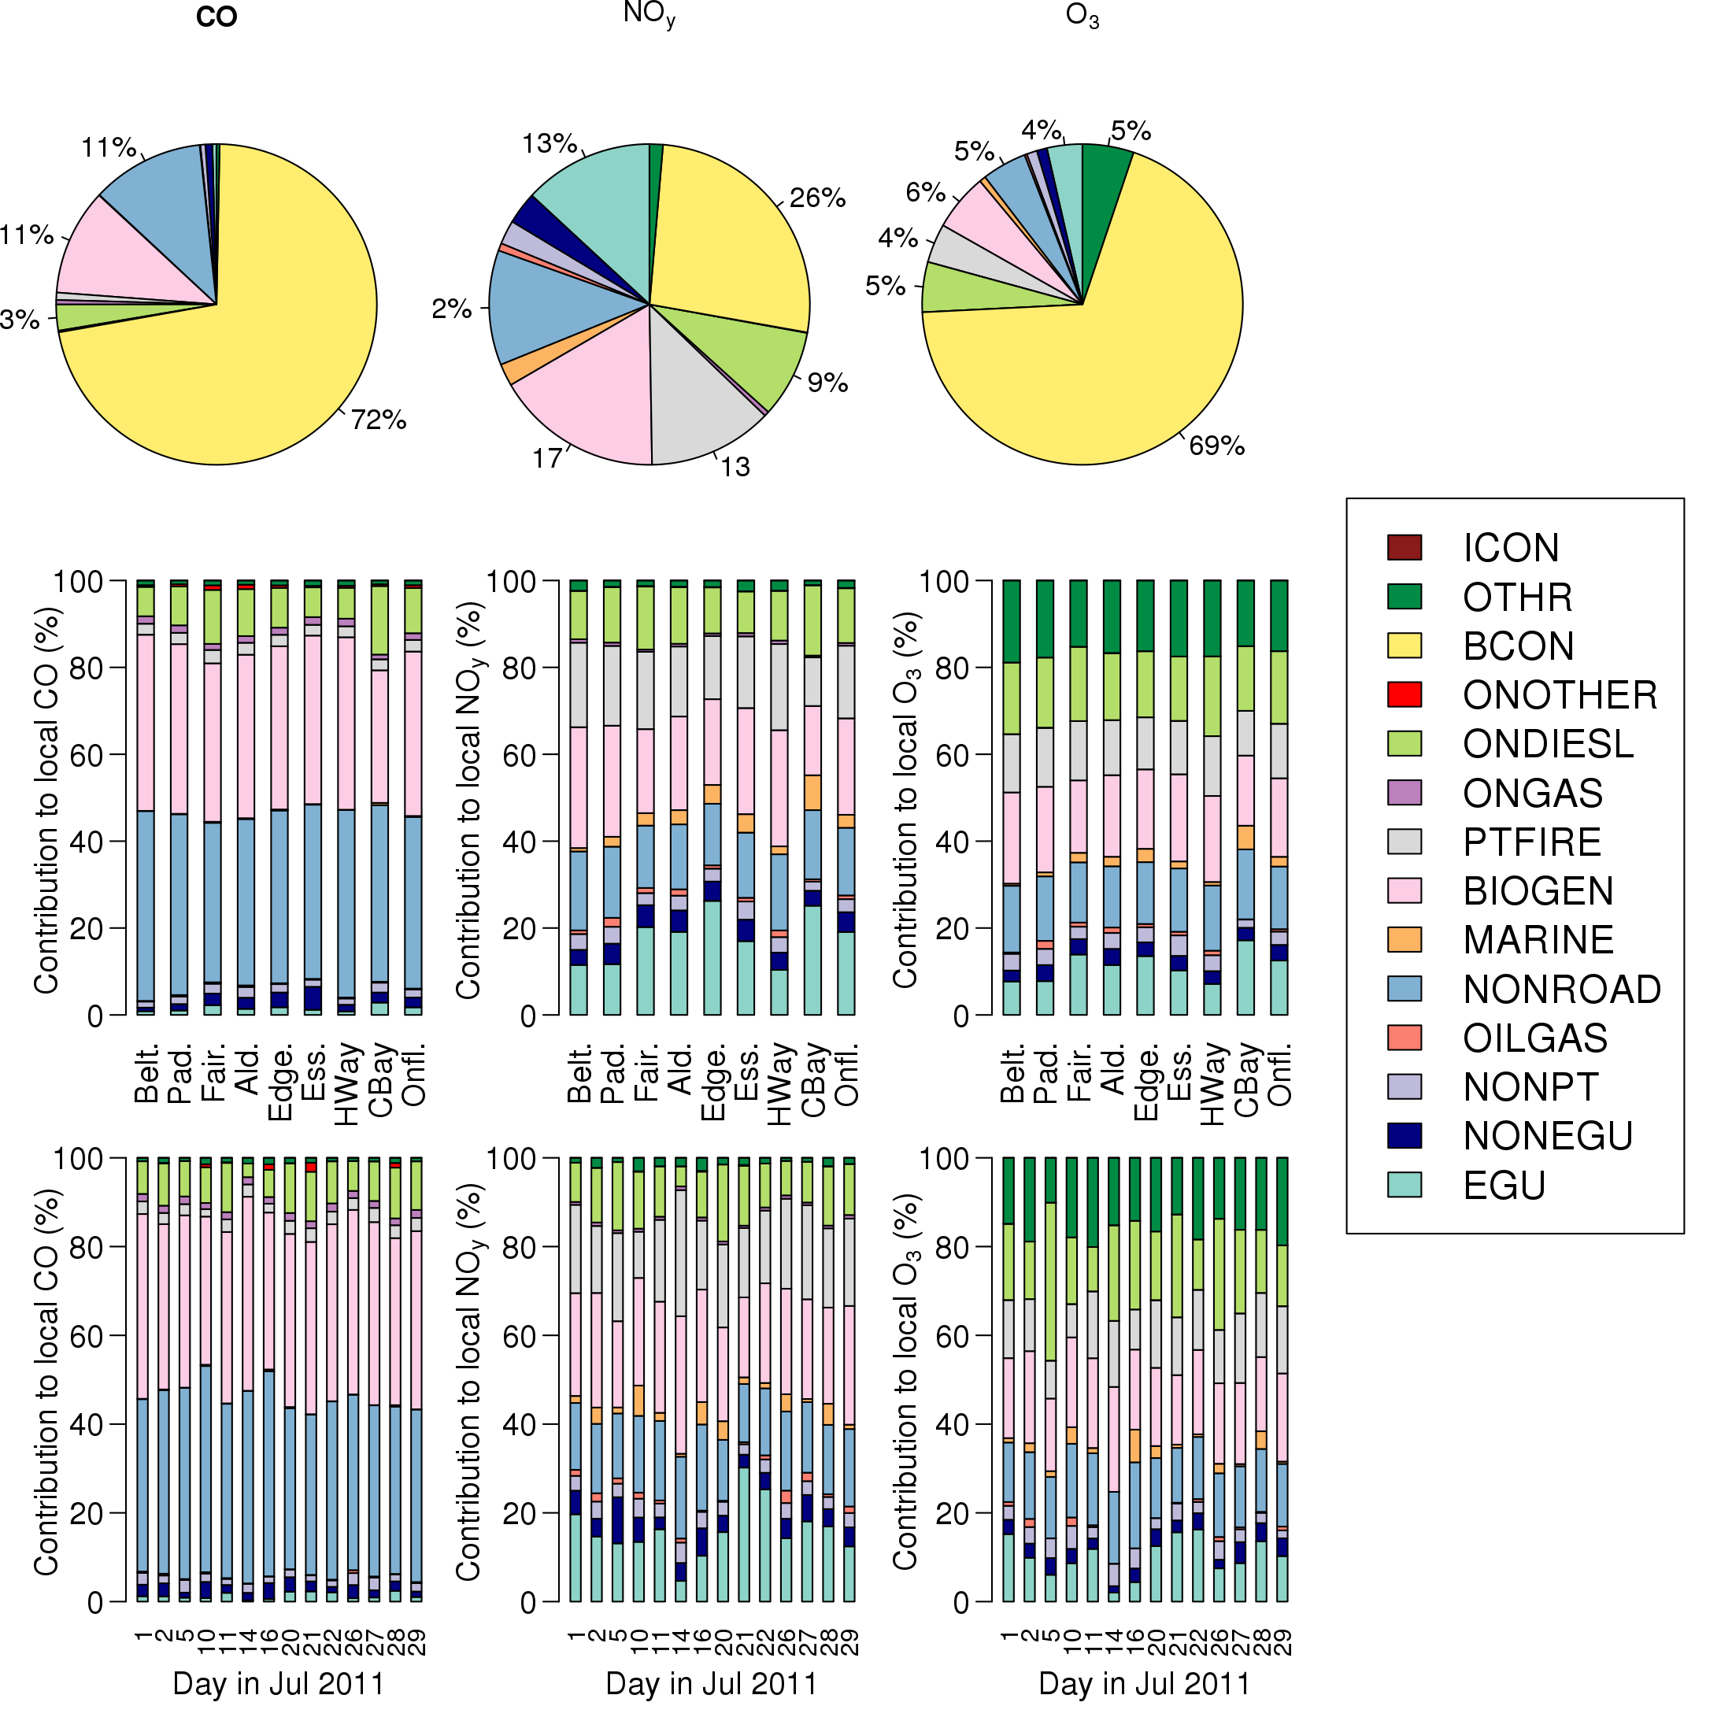
How Do We Use Models to Answer these Questions?
Ozone Concentration
Retrospective Analysis: characterize air quality during a recent period
Enables evaluation of model predictions with real-world measurements to characterize model performance and pollutant formation processes
Enables spatially continuous concentration maps to be developed for health studies by combining modeling and observations
Modeling of retrospective periods forms the basis for future-year projections used in policy-relevant assessments
Policy Planning Analysis: apply models in tailored ways to answer specific policy questions
Future-year projections: determine the location, magnitude, and extent of nonattainment after application of expected control programs
“What if?” scenarios: analyze the influence of alternative policy options in the context of specific regulatory programs or actions
Source contribution analysis: estimate the contributions of individual pollutants and sources to pollutant concentrations
Ozone Contributions
Notes:
Forecasting examples: AQI program, school flag programs, notifications for communities near large wildfires
Observations = ambient pollution data, satellite data, meteorological measurement
Future-year projections: results indicate the location, magnitude, and extent of nonattainment after application of expected control programs
Examine “what if?” scenarios: results allow us to look at impacts of alternate policy scenarios under consideration
Emissions Sensitivity Modeling: indicates on how air quality may respond to emissions changes
Source contribution analysis: useful for estimating the contribution to pollutant concentrations of individual pollutants and sources (or groups of sources)

Slide 3
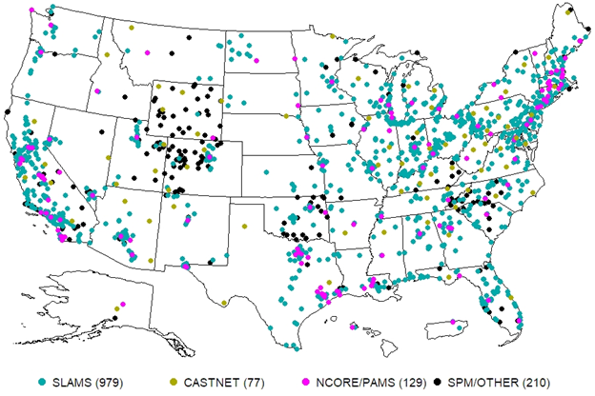
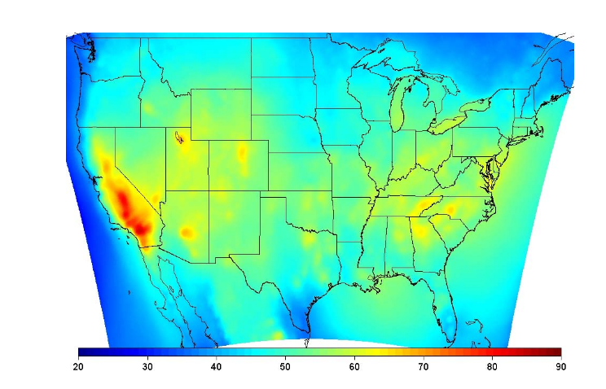
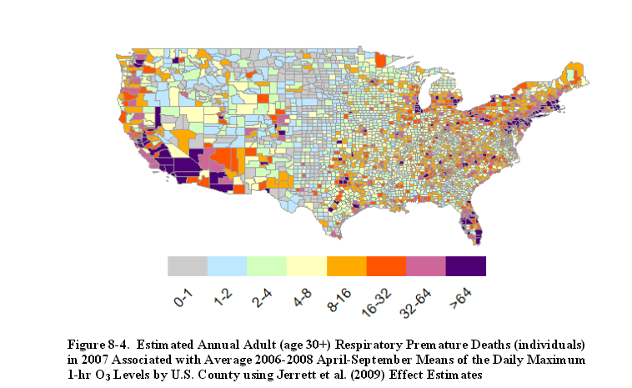

Retrospective Analysis as part of the 2015 Ozone NAAQS Review
Monitors tell us what is, but are limited in space, time, and composition.
Models can provide complete coverage but are limited by our ability to replicate processes in the atmosphere.
Seasonal Mean MDA8 Ozone (2006-2008)
Estimated Number of Respiratory Deaths in 2007 from Ozone
Photochemical model predictions of ozone and measured ozone concentrations are statistically combined (i.e., a fused surface) for input into EPA’s benefits assessment model (BenMAP) to determine health impacts resulting from ozone exposure
Source: US EPA, 2014. Health Risk and Exposure Assessment for Ozone, EPA-452/R-14-004a
Notes:
We can also use modeled air pollution concentrations as inputs into health models to estimate the number of deaths and other health effects resulting from current air pollution levels

Slide 4
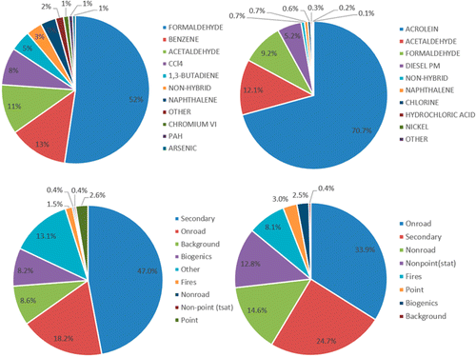
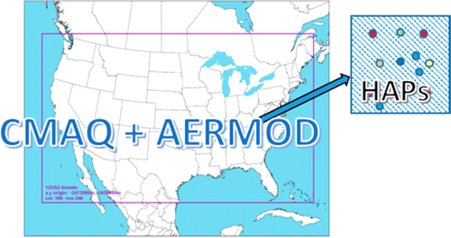
Retrospective Analysis
National Air Toxics Assessment (NATA)
Summary of 2011 relative cancer (left) and noncancer (right) risk results with source attribution (bottom)
The EPA has released national-scale toxics assessments for 1996, 1999, 2002, 2005, 2011 and 2014
Concentrations, exposures, and risks based on air quality modeling of emissions from the National Emissions Inventory (NEI) for Clean Air Act Hazardous Air Pollutants (HAP) and diesel PM (DPM)
Source: Scheffe et al., Environ. Sci. Technol. 2016, 50, 22, 12356–12364

Slide 5
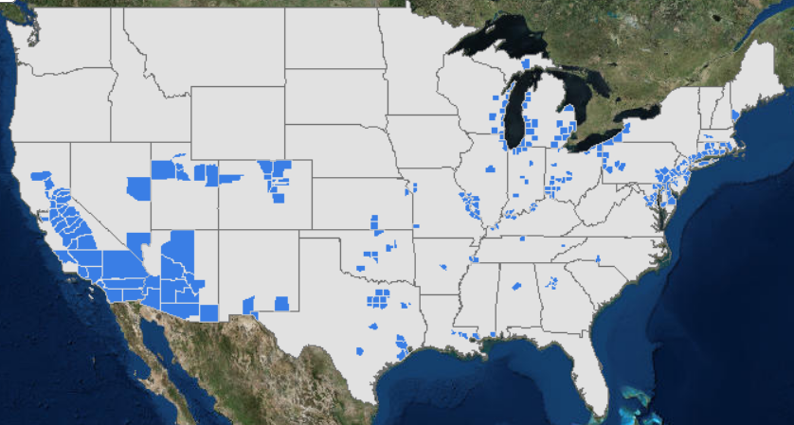
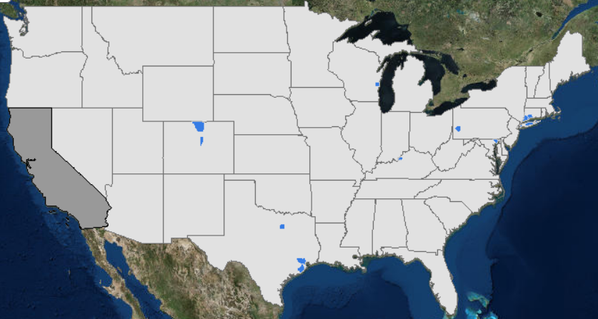
Future-year projections from the 2015 Ozone NAAQS Review
Counties Measuring Ozone Above the Standard in 2014
Future year “base case” or “baseline” scenarios generally include expected impacts from “on-the-books” controls
Fewer Counties are Expected to Exceed the Ozone Standard in the Future (2025)
For future projections, we generally use modeling in a relative sense
Premise: models are better at predicting relative changes in concentrations than absolute concentrations
Source: US EPA, 2016, Our Nation’s Air: Status and Trends Through 2015
Notes:
We use models to predict how EPA regulations will impact pollution levels. The top map shows counties with unhealthy levels of ozone in 2014. Below are model predictions for the year 2025 taking into account EPA rules that will reduce emissions from cars, power plants and other sources

Slide 6
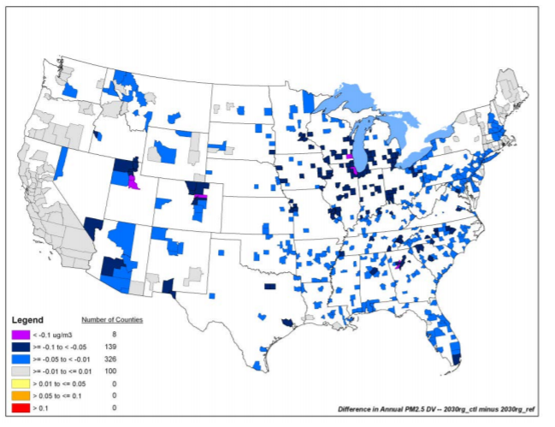
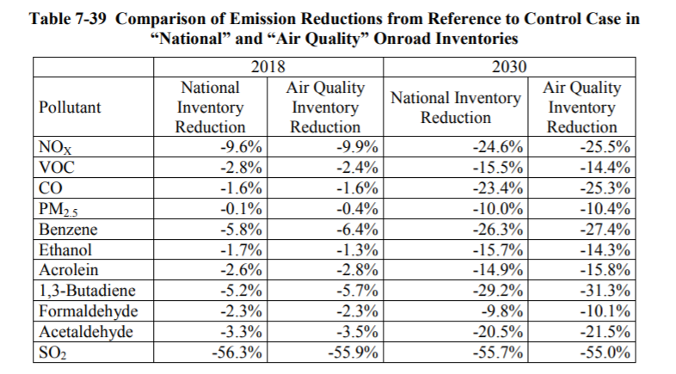
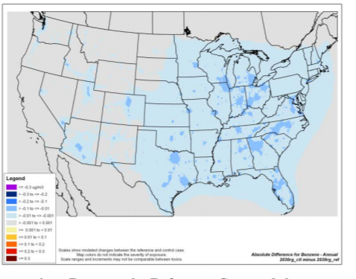
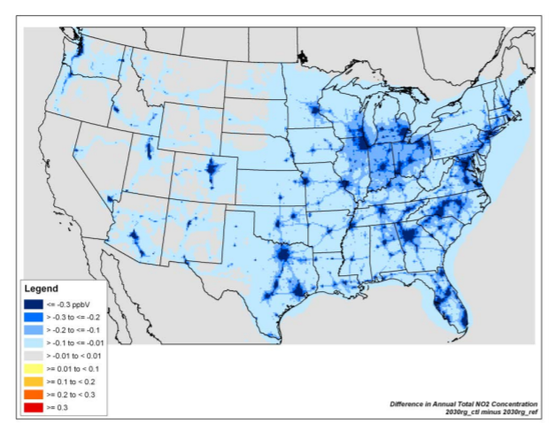
“What-if” Scenario Example: Impacts of the Tier 3 Mobile Source Rule on Air Pollution Concentrations in 2030
Emissions Reductions from Tier 3
Air Pollution Concentration Reductions from Tier 3 in 2030
∆ Annual PM2.5 (µg/m³)
Source: US EPA, 2014. Control of Air Pollution from Motor Vehicles: Tier 3 Motor Vehicle Emission and Fuel Standards Final Rule Regulatory Impact Analysis, EPA-420-R-14-005
∆ Annual benzene (µg/m³)
∆ Annual NO₂ (ppb)

Slide 7
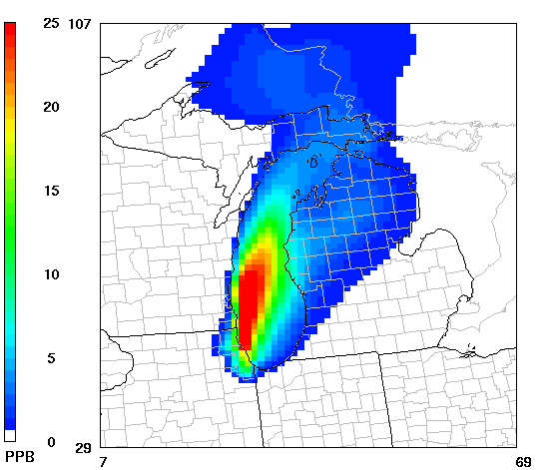
Source Contribution Analysis Is Useful for Different types of Policy Assessments
Sector assessments of ozone and PM2.5 impacts for federal rules implementing technology-based emission standards
Transport rules (Ozone and PM2.5) to comply with the Clean Air Act’s “good neighbor” provision
Modeling is used to estimate contributions of sources in upwind states to monitors in downwind states to assess whether there is a “significant contribution”
Nonattainment area designations for O3 and PM2.5
if states wish to provide this analysis to inform boundaries
Exceptional events demonstrations
Characterizing international contribution
179b demonstrations to provide nonattainment relief to areas affected by international transport of emissions
Inform control strategy development
O3, PM2.5 and Regional Haze State Implementation Plans & Regulatory Impact Assessments
Single source contribution assessments (Ozone and PM2.5)
New source permitting
8-hr maximum O3 contribution from Cook County to all modeled locations for a single day in July, 2005
Not to scale
Local Contribution
Ozone (ppb)
Upwind States
International
Natural
7

Slide 8
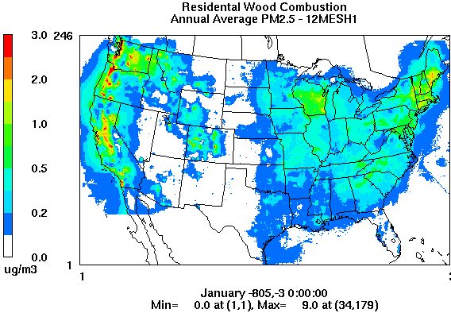
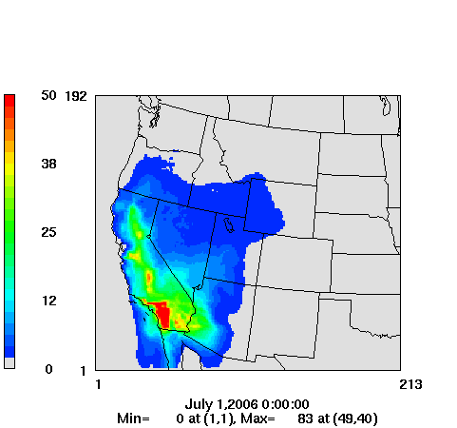
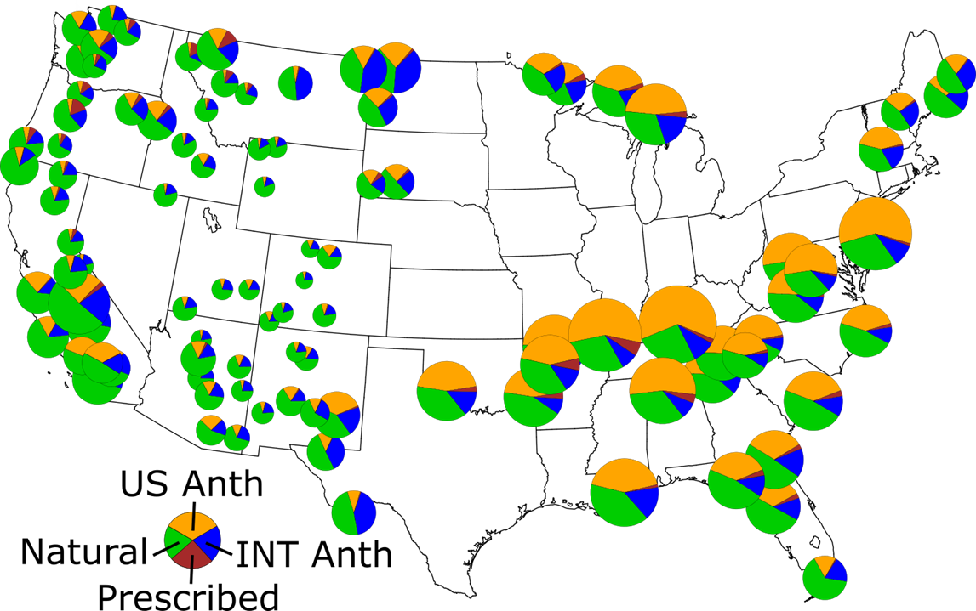
States, sectors, or individual source contributions
Emissions Sector Contribution Example:
Annual Average PM2.5 from residential wood combustion
Source apportionment modeling can be used to assess contributions to ozone, PM2.5, and regional haze
(graphics are illustrative and not part of a specific rule)
State Contribution Example:
Hourly ozone from California emissions sources
Single Source Contribution Example:
1-hr ozone from New Madrid Power Plant
Emissions Sector Contribution Example:
Regional haze from US, international, natural, and prescribed fire sources
Notes:
1-hour Ozone

Slide 9
What does this mean for chemical mechanism development that is applicable to regulatory modeling (1/2)?
Multiple competing needs for regulatory modeling include versatility, technically credibility, transparency/documentation, ease of implementation, computational speed
National modeling exercises require mechanisms that are broadly applicable over a variety of conditions. For instance, a mechanism needs to produce reliable predictions in urban polluted atmospheres, remote locations, wildfire-impacted areas and oil & gas basins alike
Is it possible to develop a single efficient mechanism to account for the important chemistry in each of these types of environments?
Do we have necessary lab and field data to test and QA mechanisms for these various environments?
Do we think these mechanisms are reliable for predicting chemistry out to a future year with potentially different chemistry and meteorological conditions? Does COVID provide a natural experiment with which to test the fidelity of these mechanisms in a lower NOx environment?
Consider the impact of desired end-point on decisions about how to “lump” or “aggregate” chemistry that ultimately results in loss of information. Discussion is necessary with policy makers about which end-points are currently needed and what end-points may become important in the future.
For instance, napthalene is both a PM precursor and a hazardous air pollutant. In developing a VBS SOA scheme lumping naphthalene and its reaction products based solely on volatility could result in a loss of information about population exposure to an air toxic.
Some regulatory applications focus on 1-2 pollutants (e.g. ozone and PM2.5) while others aim to characterize impacts over a suite of pollutants (multi-pollutant assessments).

Slide 10
What does this mean for chemical mechanism development that is applicable to regulatory modeling (2/2)?
Prioritize mechanisms that are designed to be easily instrumented with source attribution and source sensitivity tracking methods (e.g. adjoint, DDM, and source apportionment)
For instance, ISORROPIA does well at predicting inorganic thermodynamics but due to discontinuities when transitioning between aerosol types, ISORROPIA is challenging to modify for DDM, adjoint and other tools.
Consider how mechanism choices impact required model input data (i.e. emissions speciation, meteorological variables). Mechanisms that require non-standard inputs may require substantial effort to implement for regulatory applications.
In parallel with the purely chemistry aspect of mechanism development, the community also needs development of better tools/software and databases that reduce the burden for others to implement new mechanisms. These could include tools for implementing source apportionment (e.g., extension of KPP capabilities), updating emission speciation profiles/mapping when one switches mechanisms, etc.
How should model improvement resources be allocated between chemistry updates versus other model processes or inputs? How do uncertainties in chemical mechanisms compare to other uncertainties in model parameters and inputs (i.e. emissions and meteorology)?

