Slide 1
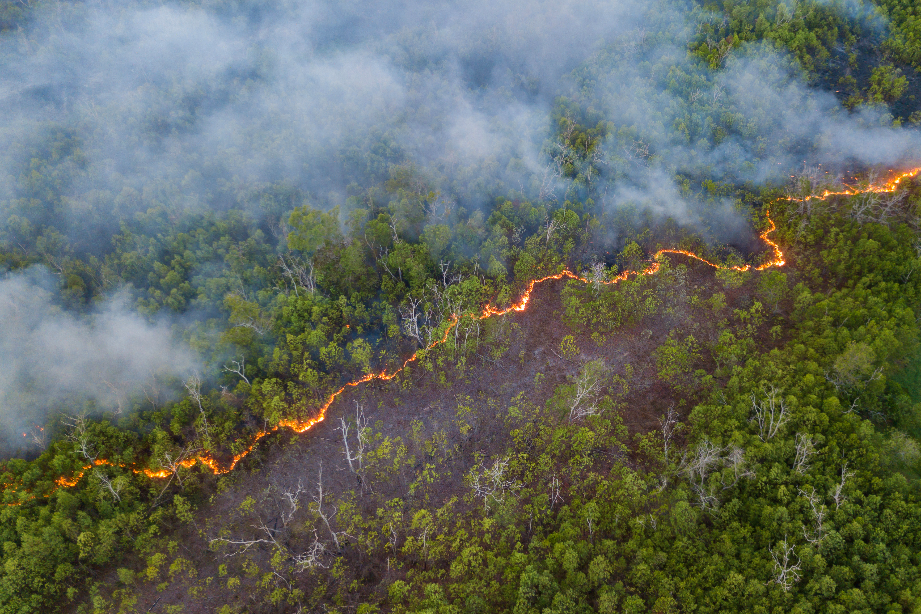
Wildfire Impacts on 2023 Ozone using the Expedited Modeling of Burn Events Results (EMBER) Dataset
A&WMA’s 118th Annual Conference & Exhibition Raleigh, North Carolina June 9 – June 12, 2025
Paper #1999186
Heather Simon, James Beidler, Kirk Baker, Barron Henderson, Loren Fox, Chris Misenis, Patrick Campbell, Jeff Vukovich, Norm Possiel, Alison Eyth

Slide 2
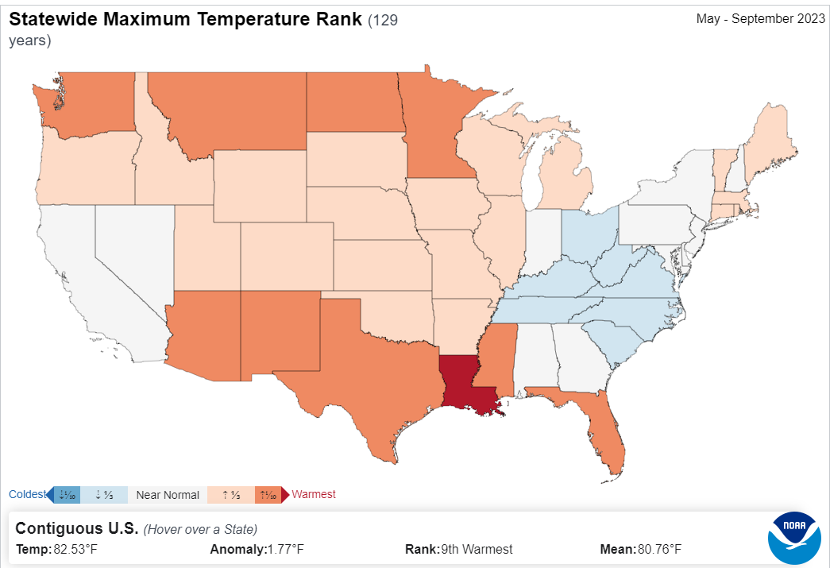
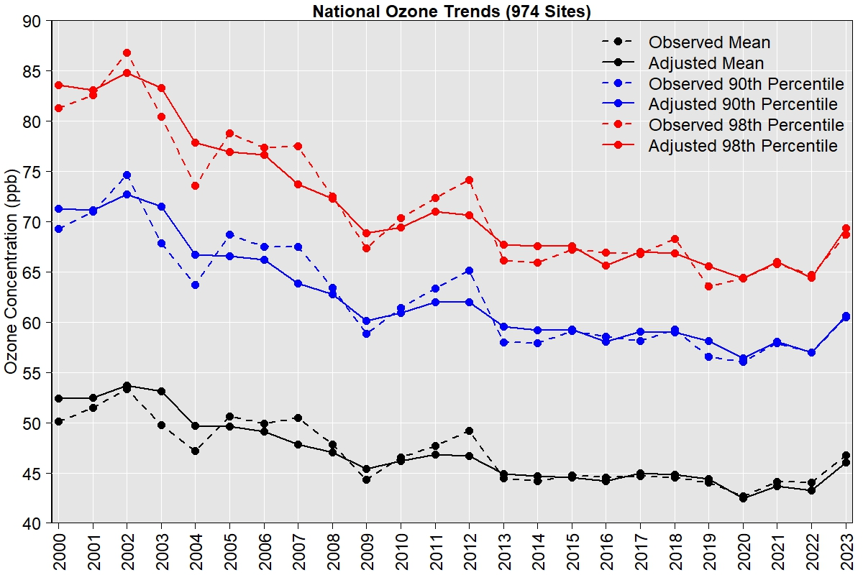
Motivation for EMBER
Summer of 2023
  An unprecedented wildfire year (over 35 million acres burned in Canada) with frequent plumes impacting the Eastern US
  Cooler summer for portions of the Eastern US with unusually warm temperatures along the Northern and Southern borders of the US
  The highest ozone seasons across the US since 2012
NOAA National Centers for Environment Information, Climate at a Glance Statewide Mapping, published June 2024, retrieved on June 13, 2024 from: https://www.ncei.noaa.gov/access/monitoring/climate-at-a-glance/statewide/mapping
https://www.epa.gov/air-trends/trends-ozone-adjusted-weather-conditions
Data source: CIFFC (https://ciffc.ca/)

Slide 3
Motivation for EMBER
Summer of 2023
  An unprecedented wildfire year (over 35 million acres burned in Canada) with frequent plumes impacting the Eastern US
  Unusually hot summer for portions of the Northern and Southern US
  The highest ozone seasons across the US since 2012
Question #1: can we use photochemical modeling to quantify the impacts of wildfires on ozone across the US during summer of 2023?
Question #2: are there tools and datasets available that would allow for quick turnaround modeling without a years-long development process?

Slide 4
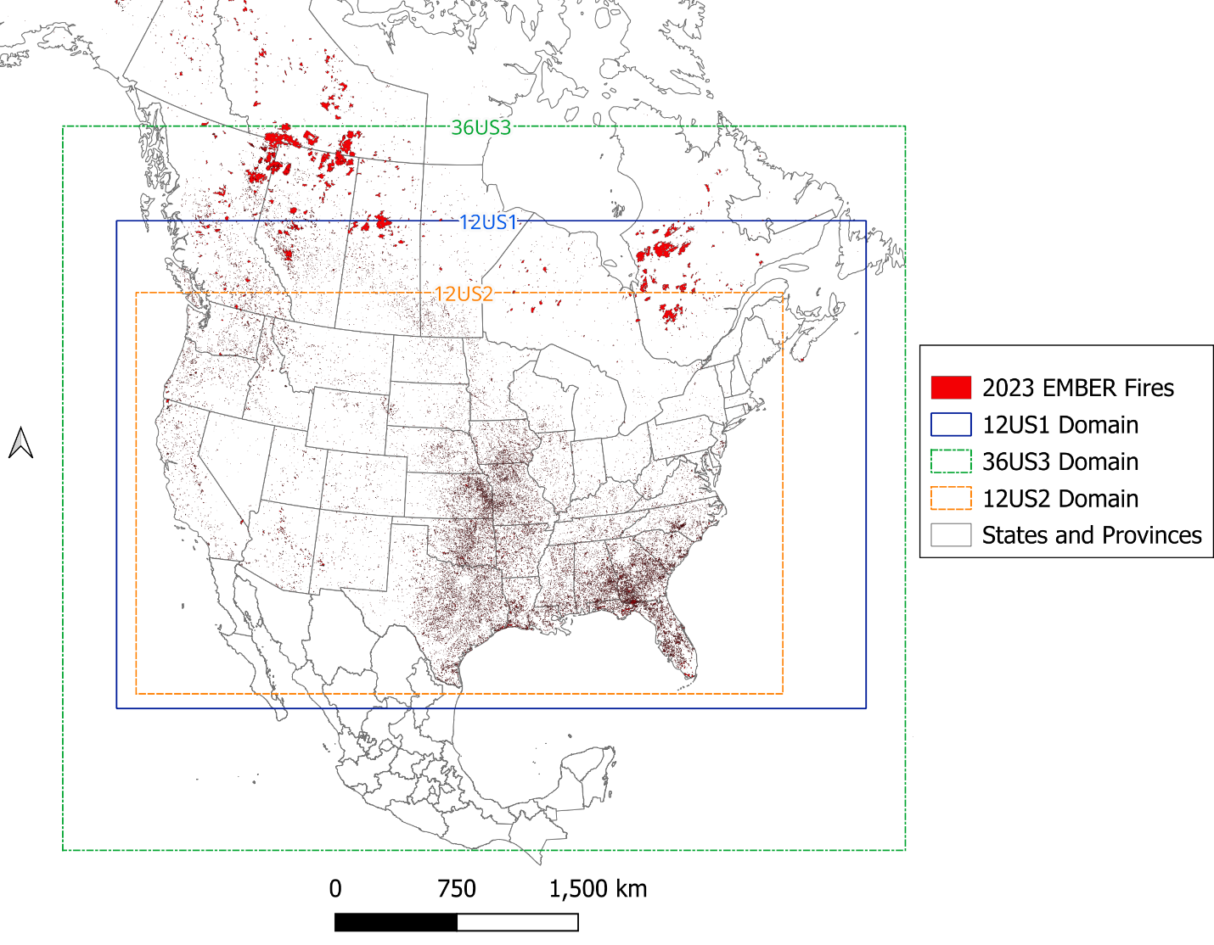
Available CMAQ Modeling Domains
Utilizing existing domain allows for leveraging existing emissions and other datasets
12US1 and 12US2 domains do not cover much of the area with Canadian wildfire emissions
36US3 domain covers the locations of most major Canadian wildfires, although some fires still outside of this domain
Coarse 36km grid resolution allows for more rapid modeling simulations and sensitivity runs as well as smaller data size.
  Is this grid resolution sufficient for screening-level assessment of ozone impacts from fires?

Slide 5
EMBER Modeling Setup
Episode: April 11, 2023 – Sep 30, 2023
  Apr 1-Apr 10 used as spin-up
Domain: 36US3, 35 vertical layers extending up to 50 mb
Meteorology: 2023 NOAA’s Global Forecast System (GFS) model
  NOAA-EPA Atmosphere-Chemistry Coupler (NACC) used to create MCIP files: https://nacc.arl.noaa.gov/nacc/setup
IC/BC: NASA GEOS-CF forecast model
  Python package for downloading GEOS-CF data and processing for CMAQ BCs: https://github.com/barronh/aqmbc/
Anthropogenic Emissions: Average emissions by month and DOW for 2018
  2023 NEI not yet available
US and Canada Fire Emissions: 2023 BlueSky emissions using 2023 fire perimeters, 2023 HMS detects and existing land-use and Efs
  Did not include any fire emissions in Mexico
Model version: CMAQv5.4
  BEIS4

Slide 6
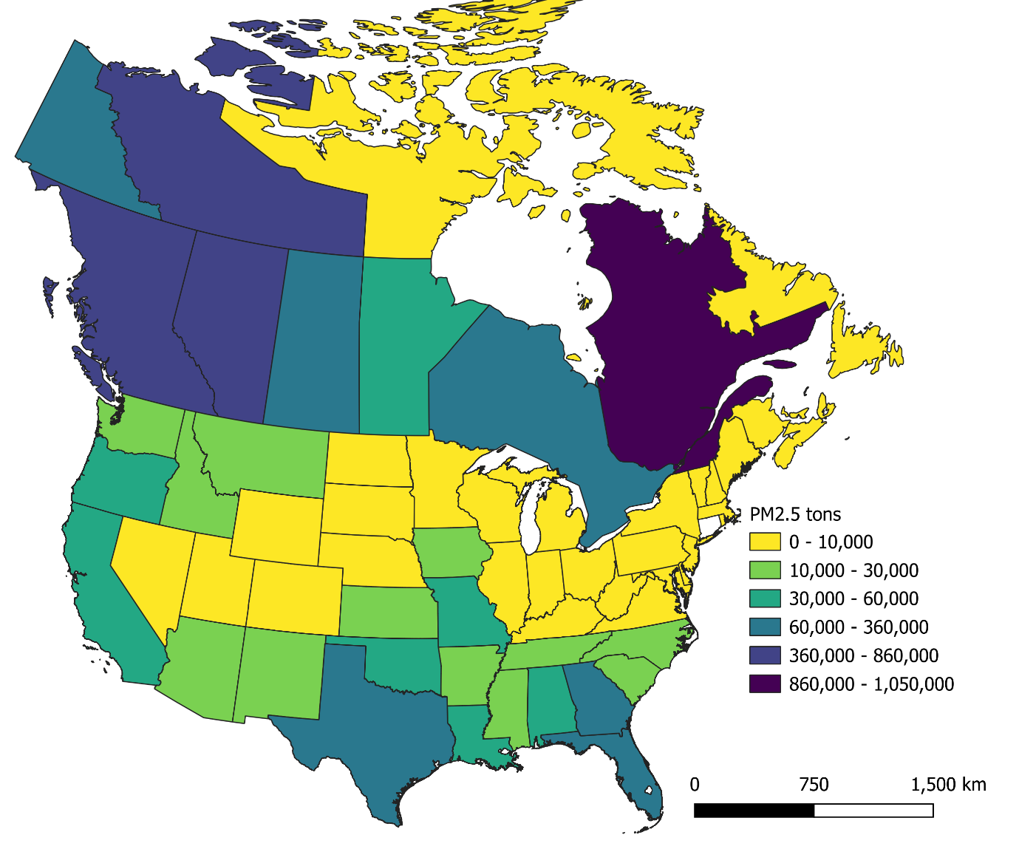
EMBER Fire Emissions
2023 Canada wildland fire emissions (thousand short tons)
Month | CO (tons) | CO2 (tons) | NOx (tons) | PM2.5 (tons) | VOC (tons)
Jan | 175 | 2,944 | 3 | 24 | 54
Feb | 26 | 467 | 0.4 | 4 | 9
Mar | 33 | 597 | 0.5 | 5 | 11
Apr | 29 | 569 | 0.6 | 4 | 10
May | 4,530 | 76,362 | 65 | 607 | 1,346
Jun | 8,573 | 138,754 | 113 | 1,134 | 2,442
Jul | 6,593 | 112,494 | 101 | 884 | 2,046
Aug | 5,765 | 98,807 | 90 | 780 | 1,810
Sep | 3,871 | 65,528 | 56 | 527 | 1,177
Oct | 327 | 5,691 | 5 | 45 | 103
Total | 29,924 | 502,214 | 434 | 4,015 | 9,009

Slide 7
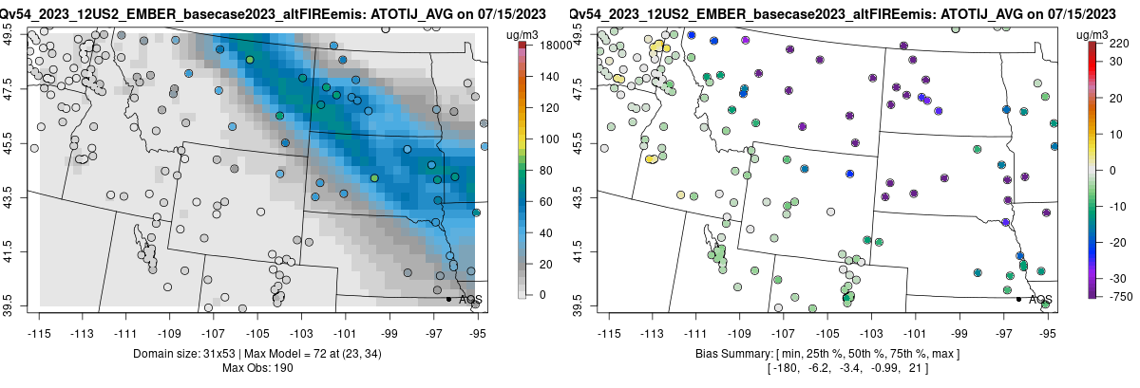
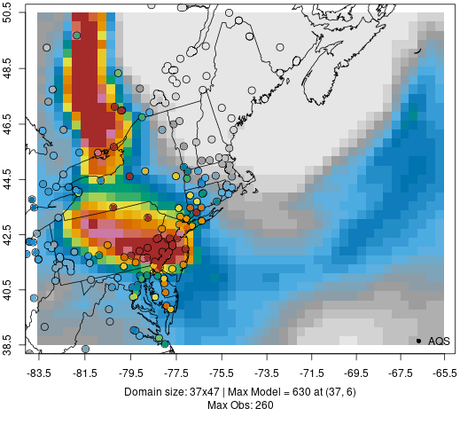
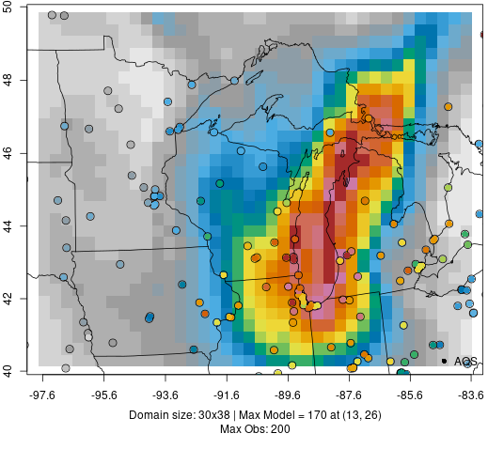
EMBER Captures General Spatial Extent and Magnitude of Major Fire Plumes
24-hr PM_{2.5}: June 7, 2023
24-hr PM_{2.5}: June 27, 2023
24-hr PM_{2.5}: July 15, 2023

Slide 8
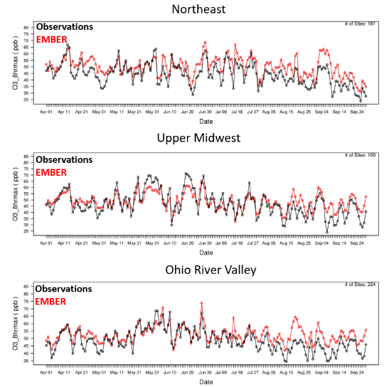
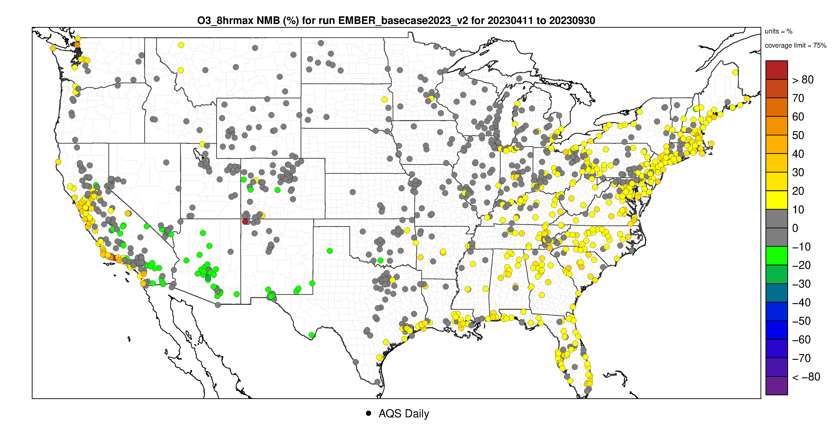
Regional Ozone Model Performance within Range of Recent Studies in the Literature
Region | Normalized Mean Bias (%) | Normalized Mean Error (%) | Correlation
Northeast | 12.9 | 17.2 | 0.76
Upper Midwest | 2.9 | 14.2 | 0.77
Ohio River Valley | 8.0 | 13.8 | 0.71
Southeast | 15.2 | 17.6 | 0.79
Northern Rockies | 1.4 | 10.6 | 0.62
South | 4.4 | 14.1 | 0.78
Northwest | 6.6 | 14.8 | 0.67
West | 3.0 | 15.0 | 0.73
Southwest | -7.4 | 12.2 | 0.54
Additional model evaluation necessary to build confidence in specific episodes/locations
MDA8 Ozone NMB (%)

Slide 9
Zero Out Modeling was Used to Quantify Fire Impacts
Two zero out simulations
  Zero out emissions from all US and Canadian wildfires and prescribed fires (ZERO_FIRES)
  Zero out emissions from only Canadian wildfires (ZERO_CAFIRES)
Calculate fire impacts on 8-hr daily maximum ozone concentrations as: EMBER – ZERO_FIRES
EMBER data has been processed to allow users to view data in multiple ways from a web interface
  Data table providing daily information at location of monitors
  Daily regional maps of modeled and observed ozone and modeled ozone impacts from fires
  Time series plots showing modeled and measured total ozone and fire contribution at each monitoring site
At times/locations where model performance is reasonable, EMBER provides a credible estimate of general magnitude of fire impacts on ozone (none, some, large) but probably should not be used for precise quantitative estimates

Slide 10
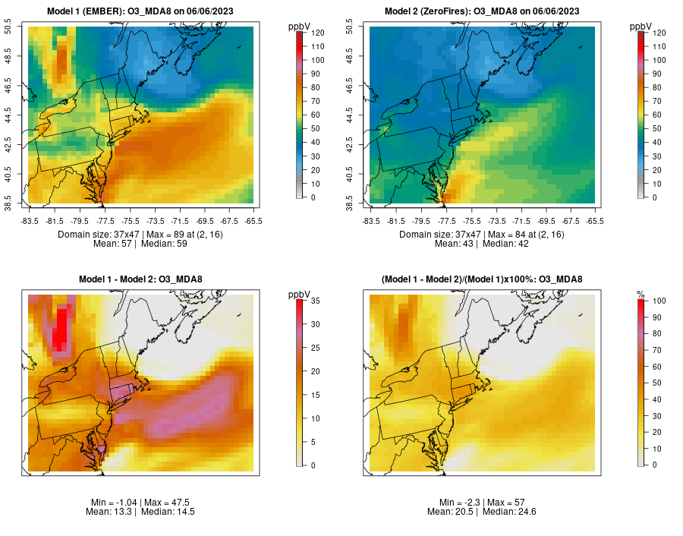
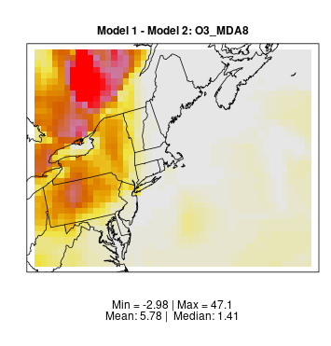
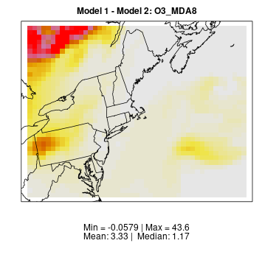
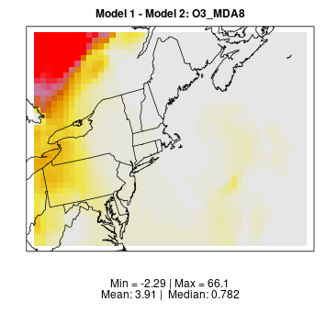
Example of EMBER Ozone Impacts in the Northeast from Canadian Fires
EMBER – ZERO_FIRES: MDA8 O3
June 3, 2023
June 4, 2023
June 5, 2023
June 6, 2023
Fire impacts on ozone

Slide 11
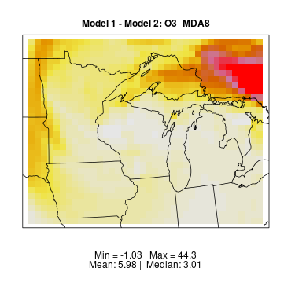
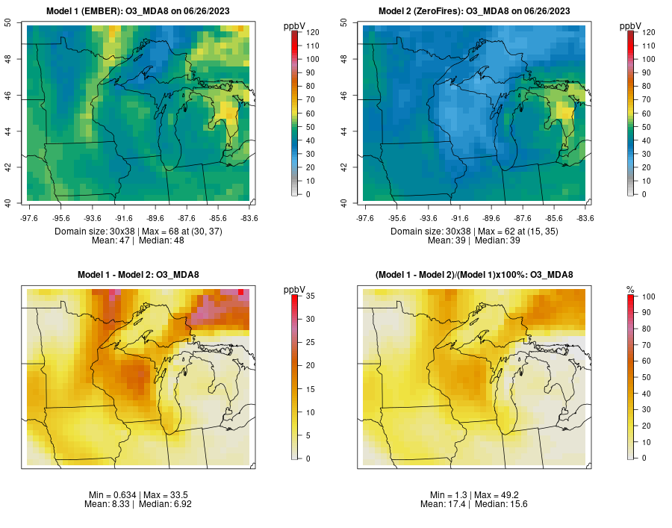
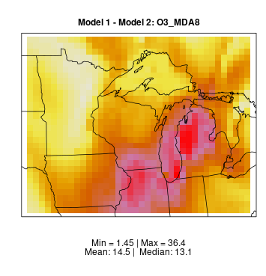
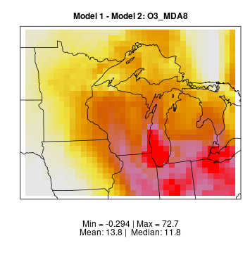
Example of EMBER Ozone Impacts in the Midwest from Canadian Fires
EMBER – ZERO_FIRES: MDA8 O3
June 25, 2023
June 26, 2023
June 27, 2023
June 28, 2023
Fire impacts on ozone

Slide 12
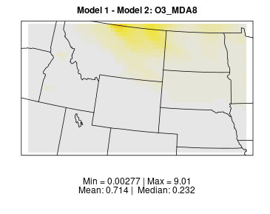
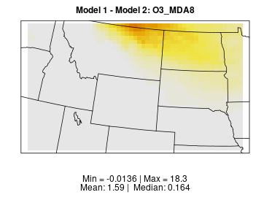
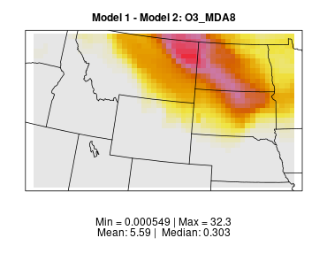
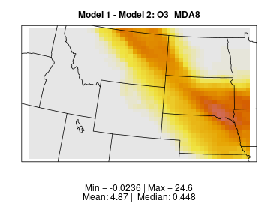
Example of EMBER Ozone Impacts in the Northern Plains from Canadian Fires
EMBER – ZERO_FIRES: MDA8 O3
July 12, 2023
July 13, 2023
July 14, 2023
July 15, 2023
Fire impacts on ozone

Slide 13
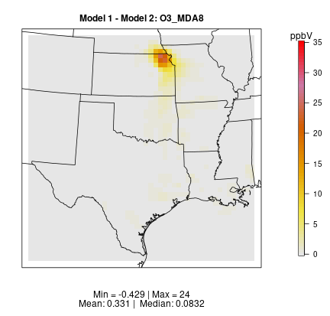
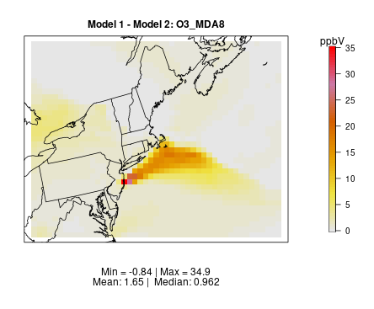
EMBER Predicted Localized Impacts Near Smaller US Fires
Flint Hill Prescribed Burns
April 17, 2023
Wildfires in NJ
April 12, 2023

Slide 14
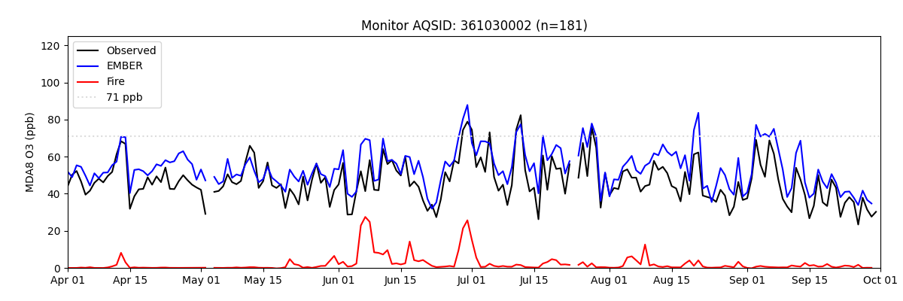
Distinct Episodes of Fire Impacts Are Also Evident in Ozone Timeseries at Specific Monitors
Long Island, NY

Slide 15
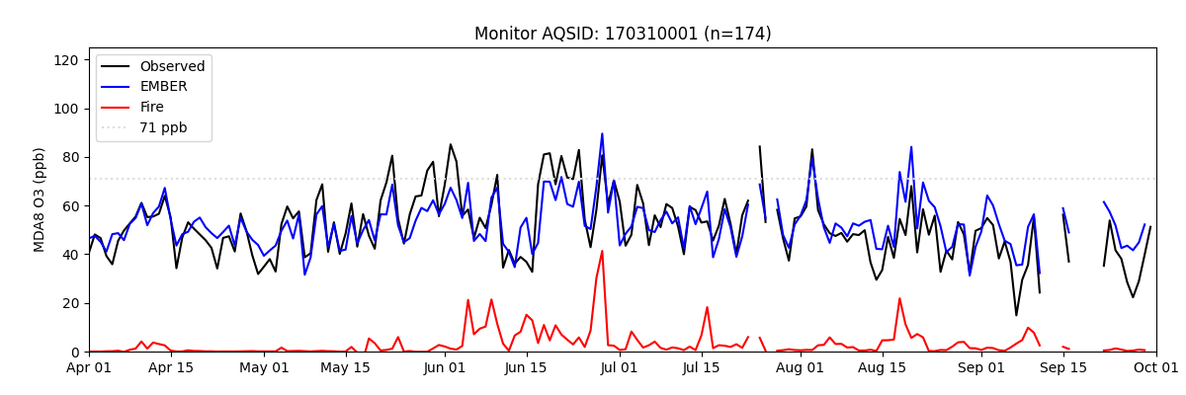
Distinct Episodes of Fire Impacts Are Also Evident in Ozone Timeseries at Specific Monitors
Chicago, IL

Slide 16
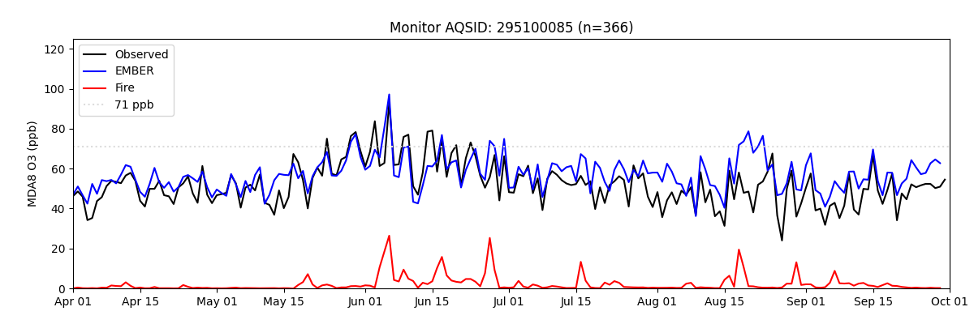
Distinct Episodes of Fire Impacts Are Also Evident in Ozone Timeseries at Specific Monitors
St. Louis, MO

Slide 17
Next Steps
EMBER documentation published Data-in-Brief (https://doi.org/10.1016/j.dib.2024.111208)
  Article serves a complete documentation of data and methods
  Zenodo data archive (https://zenodo.org/records/13737754) includes
    emissions inputs
    Run scripts
    IOAPI files of layer-1 daily ozone from EMBER, ZERO_FIRES and ZERO_CAFIRES
    csv files of paired monitor and model MDA8 values from all 3 simulations
  Qlik application on EPA website allows easy browsing of EMBER dataset: tabulated results, maps of total ozone and fire impacts on ozone, timeseries plots
EMBER dataset will allow further investigation of the conditions leading to ozone formation from fire emissions
  Comparison to other published methods of estimating fire impacts
  Use model sensitivity runs and tracking tools to determine which precursors and/or conditions lead to ozone formation from fires

