Slide 1

Nowcasting applications of geostationary satellite hourly surface PM2.5 data
H. Zhang¹, Z. Wei¹, B. Henderson², S. Anenberg³, K. O’Dell³, S. Kondragunta⁴
Published in Weather and Forecasting
https://doi.org/10.1175/WAF-D-22-0114.1
¹IMSG@NOAA | ²EPA | ³GWU | ⁴NOAA
Disclaimer: The scientific results and conclusions, as well as any views or opinions expressed
herein, are those of the author(s) and do not necessarily reflect those of NOAA or
the Department of Commerce.

Slide 2
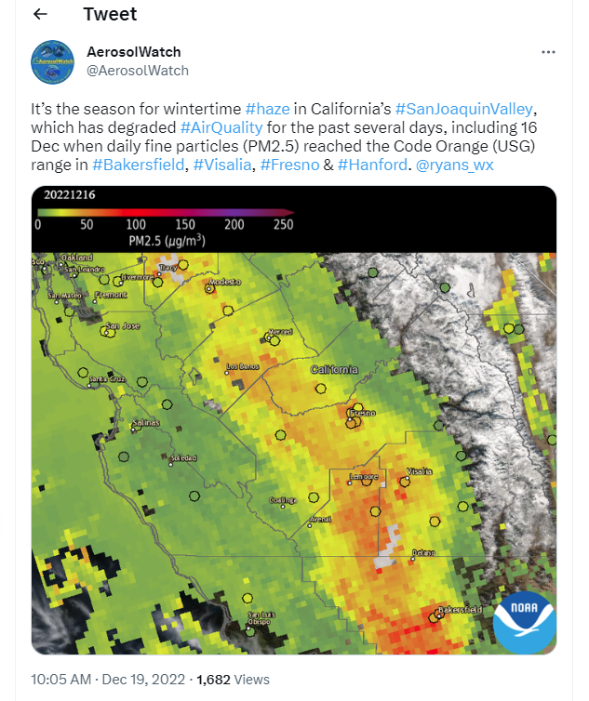
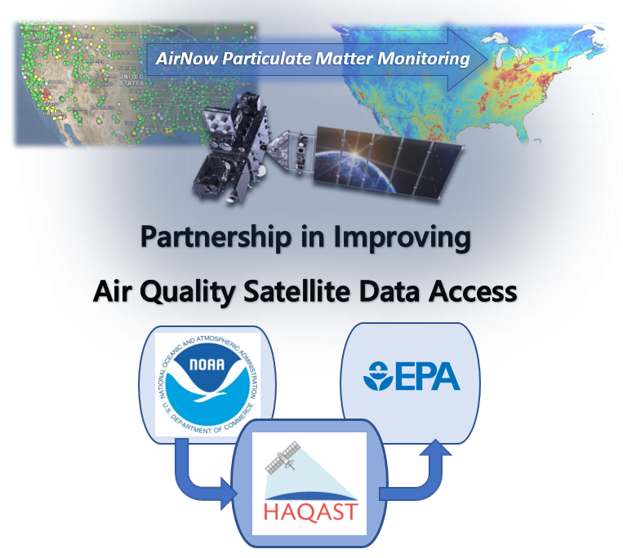
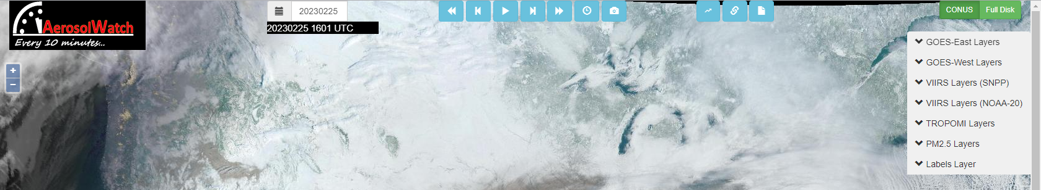
Motivation
Gupta et al., HAQAST Tiger Team project

Slide 3
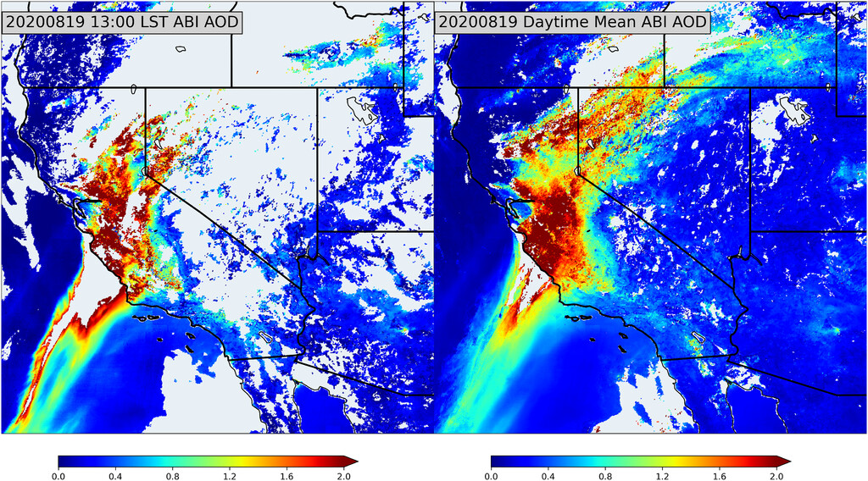
Multiple observations lead to enhanced spatial coverage

Slide 4
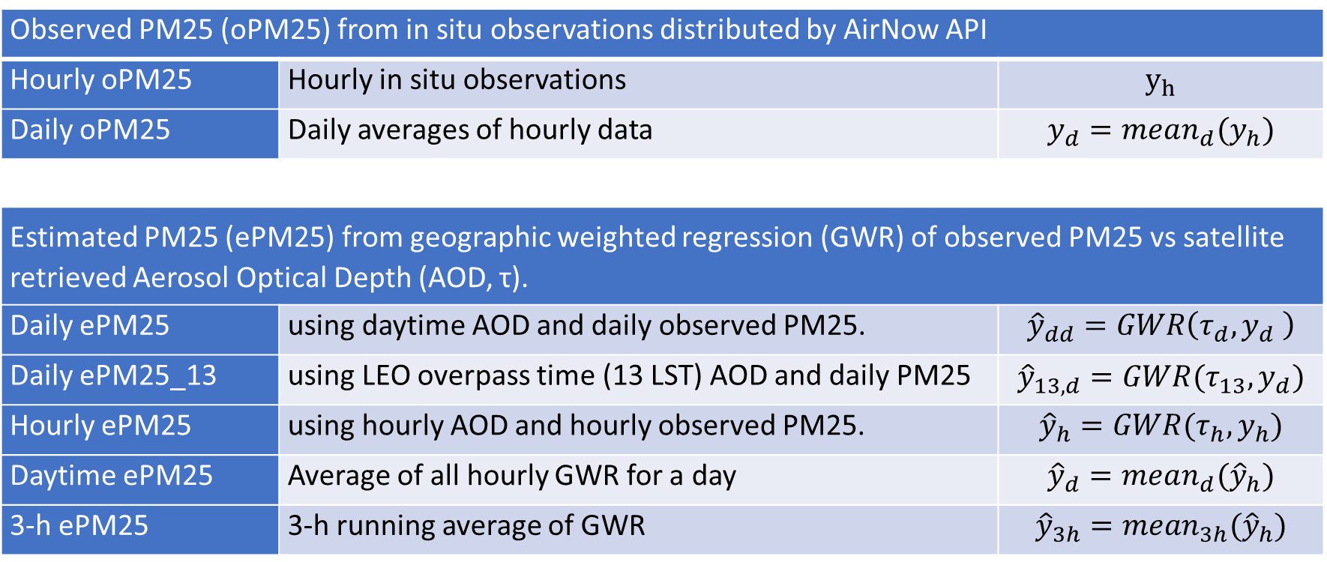
Quantities for Evaluation
Observed PM25 (oPM25) from in situ observations distributed by AirNow API
Hourly oPM25 | Hourly in situ observations | $$y_{h}$$
Daily oPM25 | Daily averages of hourly data | $$y_{d}=mean_{d}(y_{h})$$
Estimated PM25 (ePM25) from geographic weighted regression (GWR) of observed PM25 vs satellite retrieved Aerosol Optical Depth (AOD, τ).
Daily ePM25 | using daytime AOD and daily observed PM25. | $${\hat{y}}_{dd}=GWR\left(τ_{d},y_{d} \right)$$
Daily ePM25_13 | using LEO overpass time (13 LST) AOD and daily PM25 | $${\hat{y}}_{13,d}=GWR(τ_{13},y_{d})$$
Hourly ePM25 | using hourly AOD and hourly observed PM25. | $${\hat{y}}_{h}=GWR(τ_{h},y_{h})$$
Daytime ePM25 | Average of all hourly GWR for a day | $${\hat{y}}_{d}=mean_{d}({\hat{y}}_{h})$$
3-h ePM25 | 3-h running average of GWR | $${\hat{y}}_{3h}={mean}_{3h}({\hat{y}}_{h})$$

Slide 5
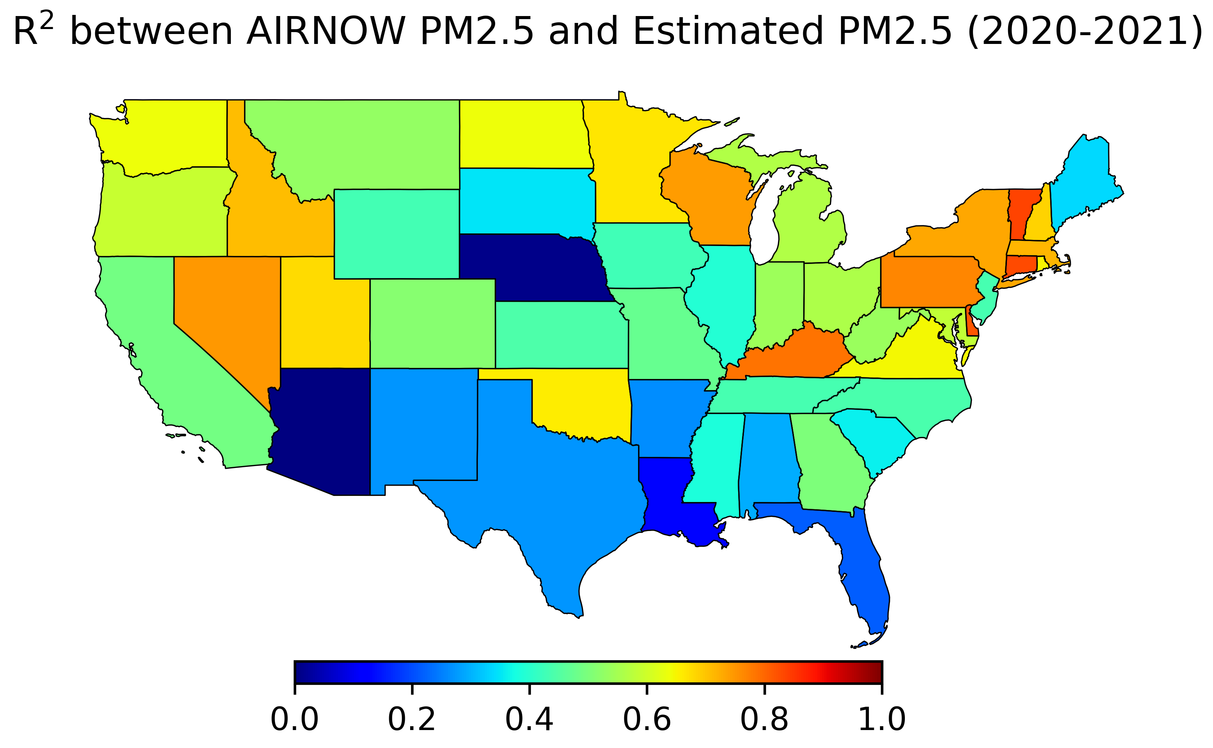
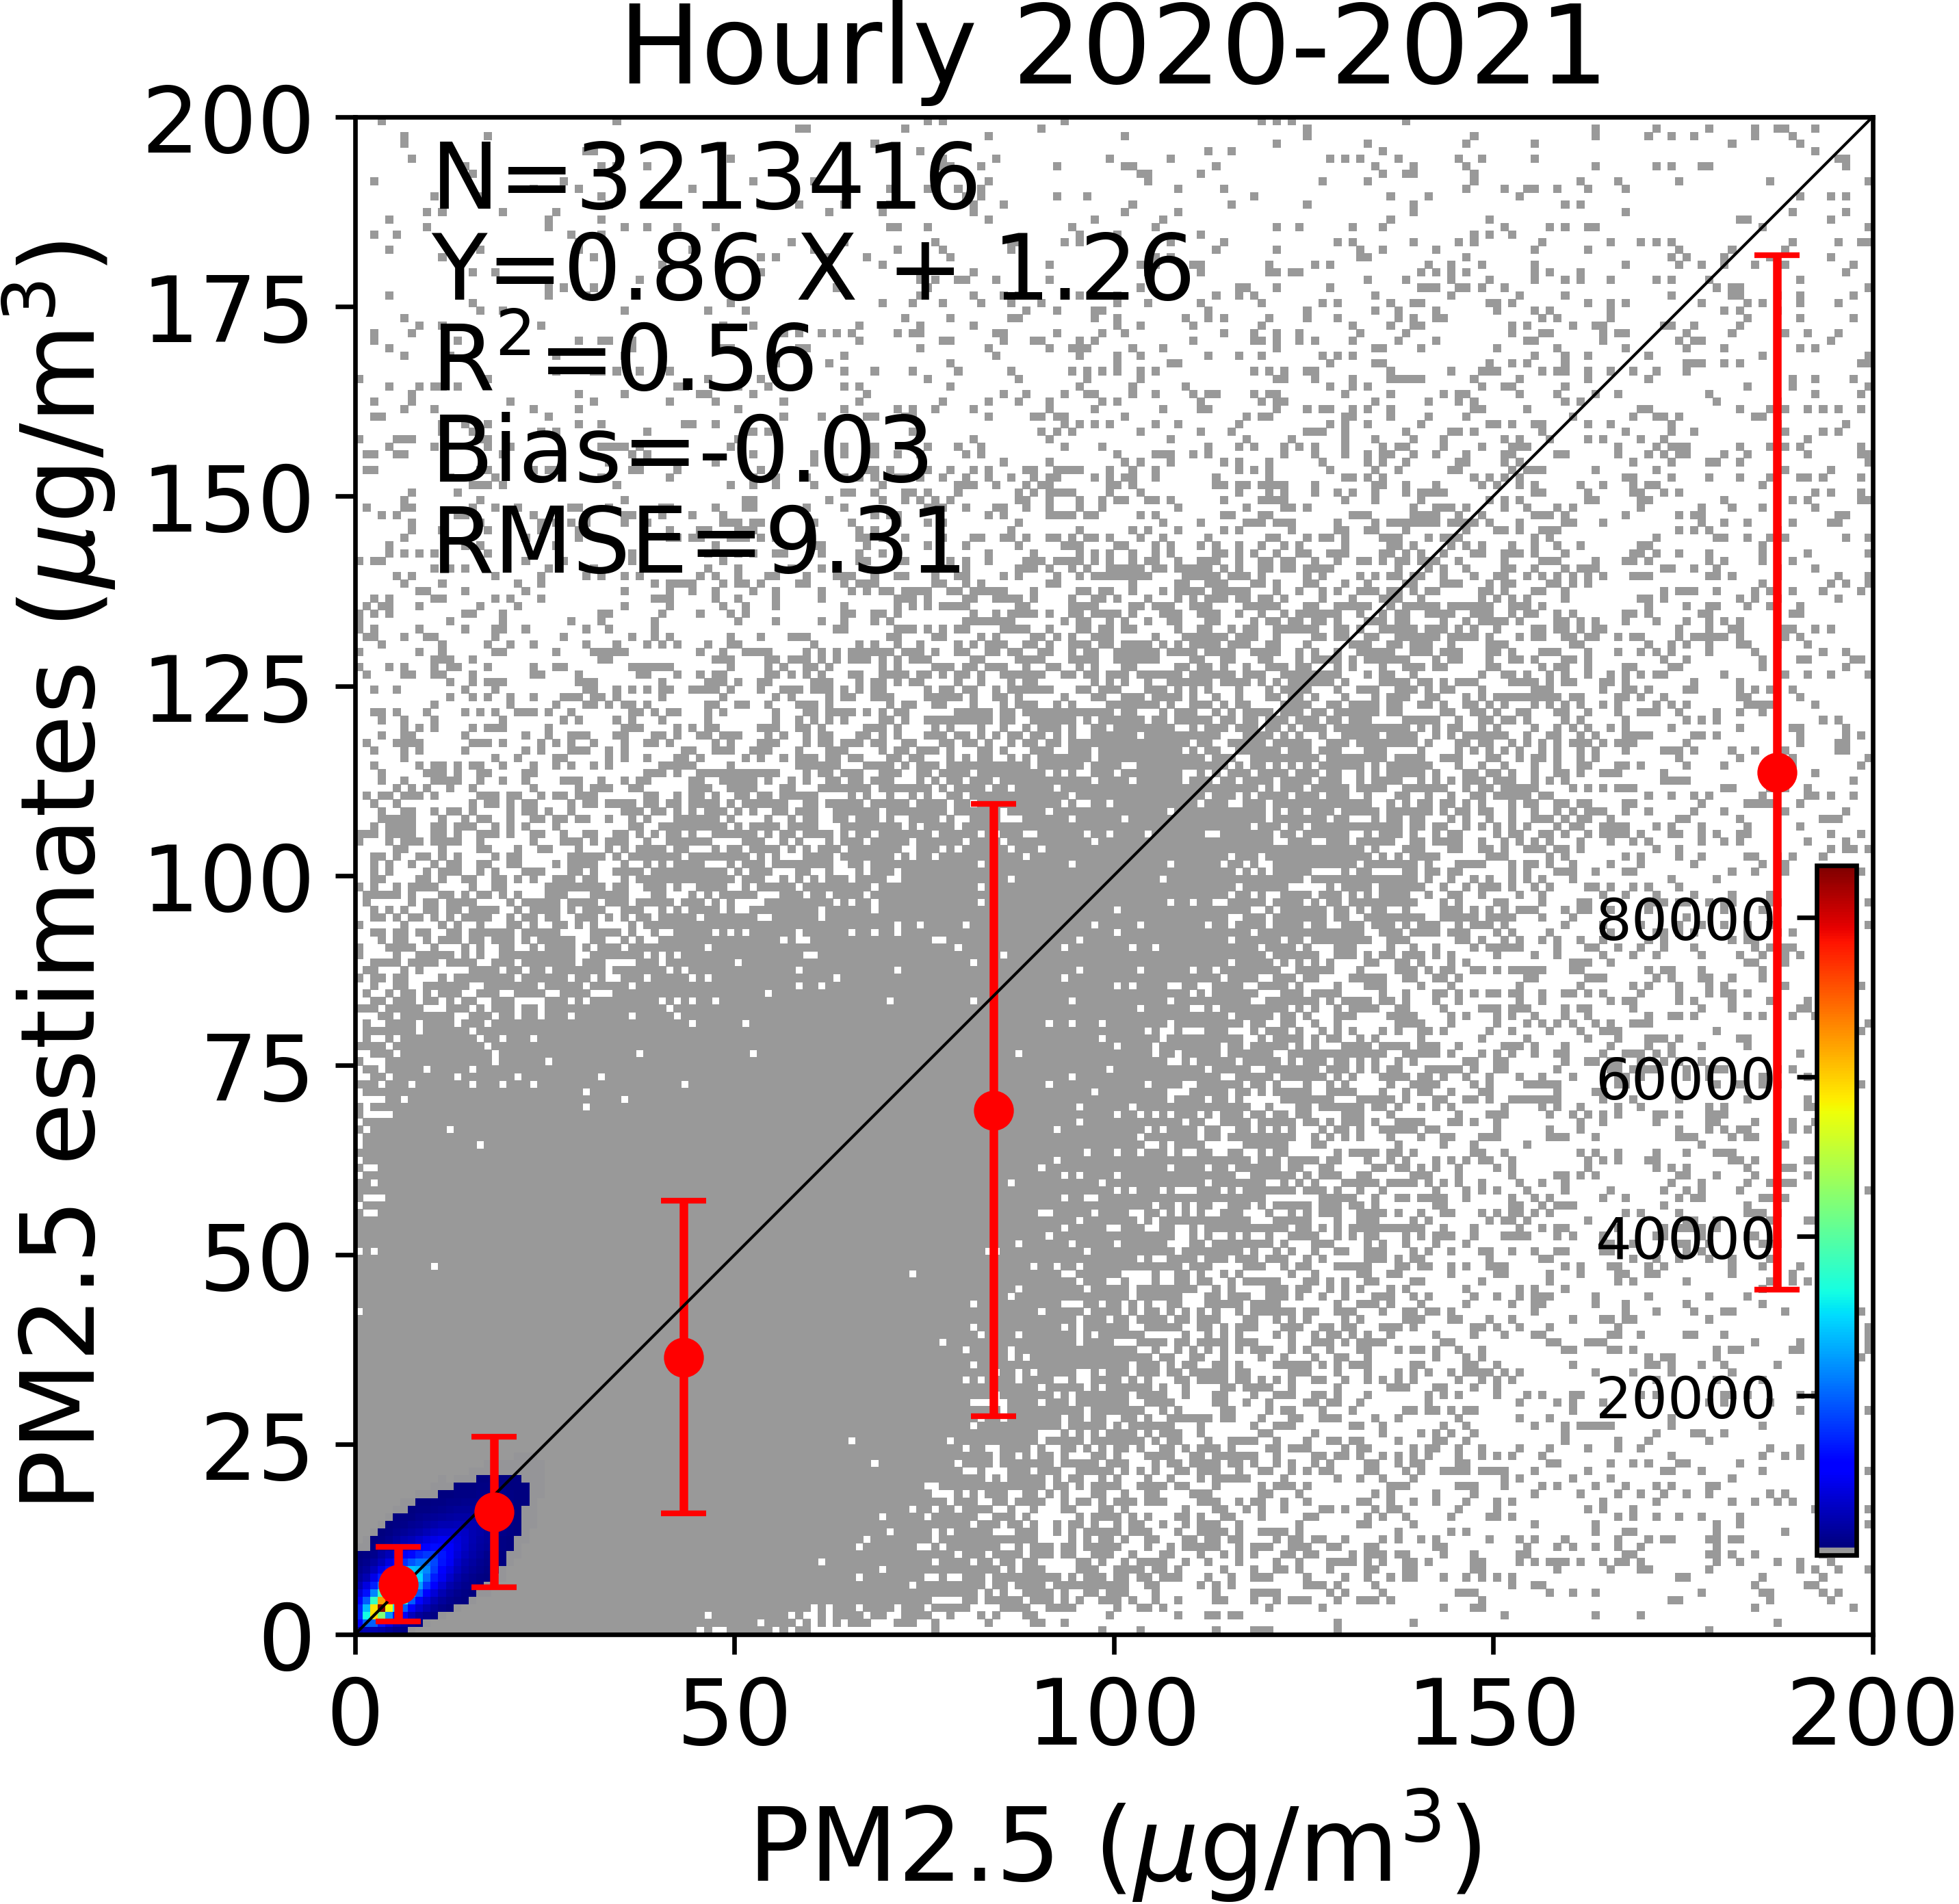
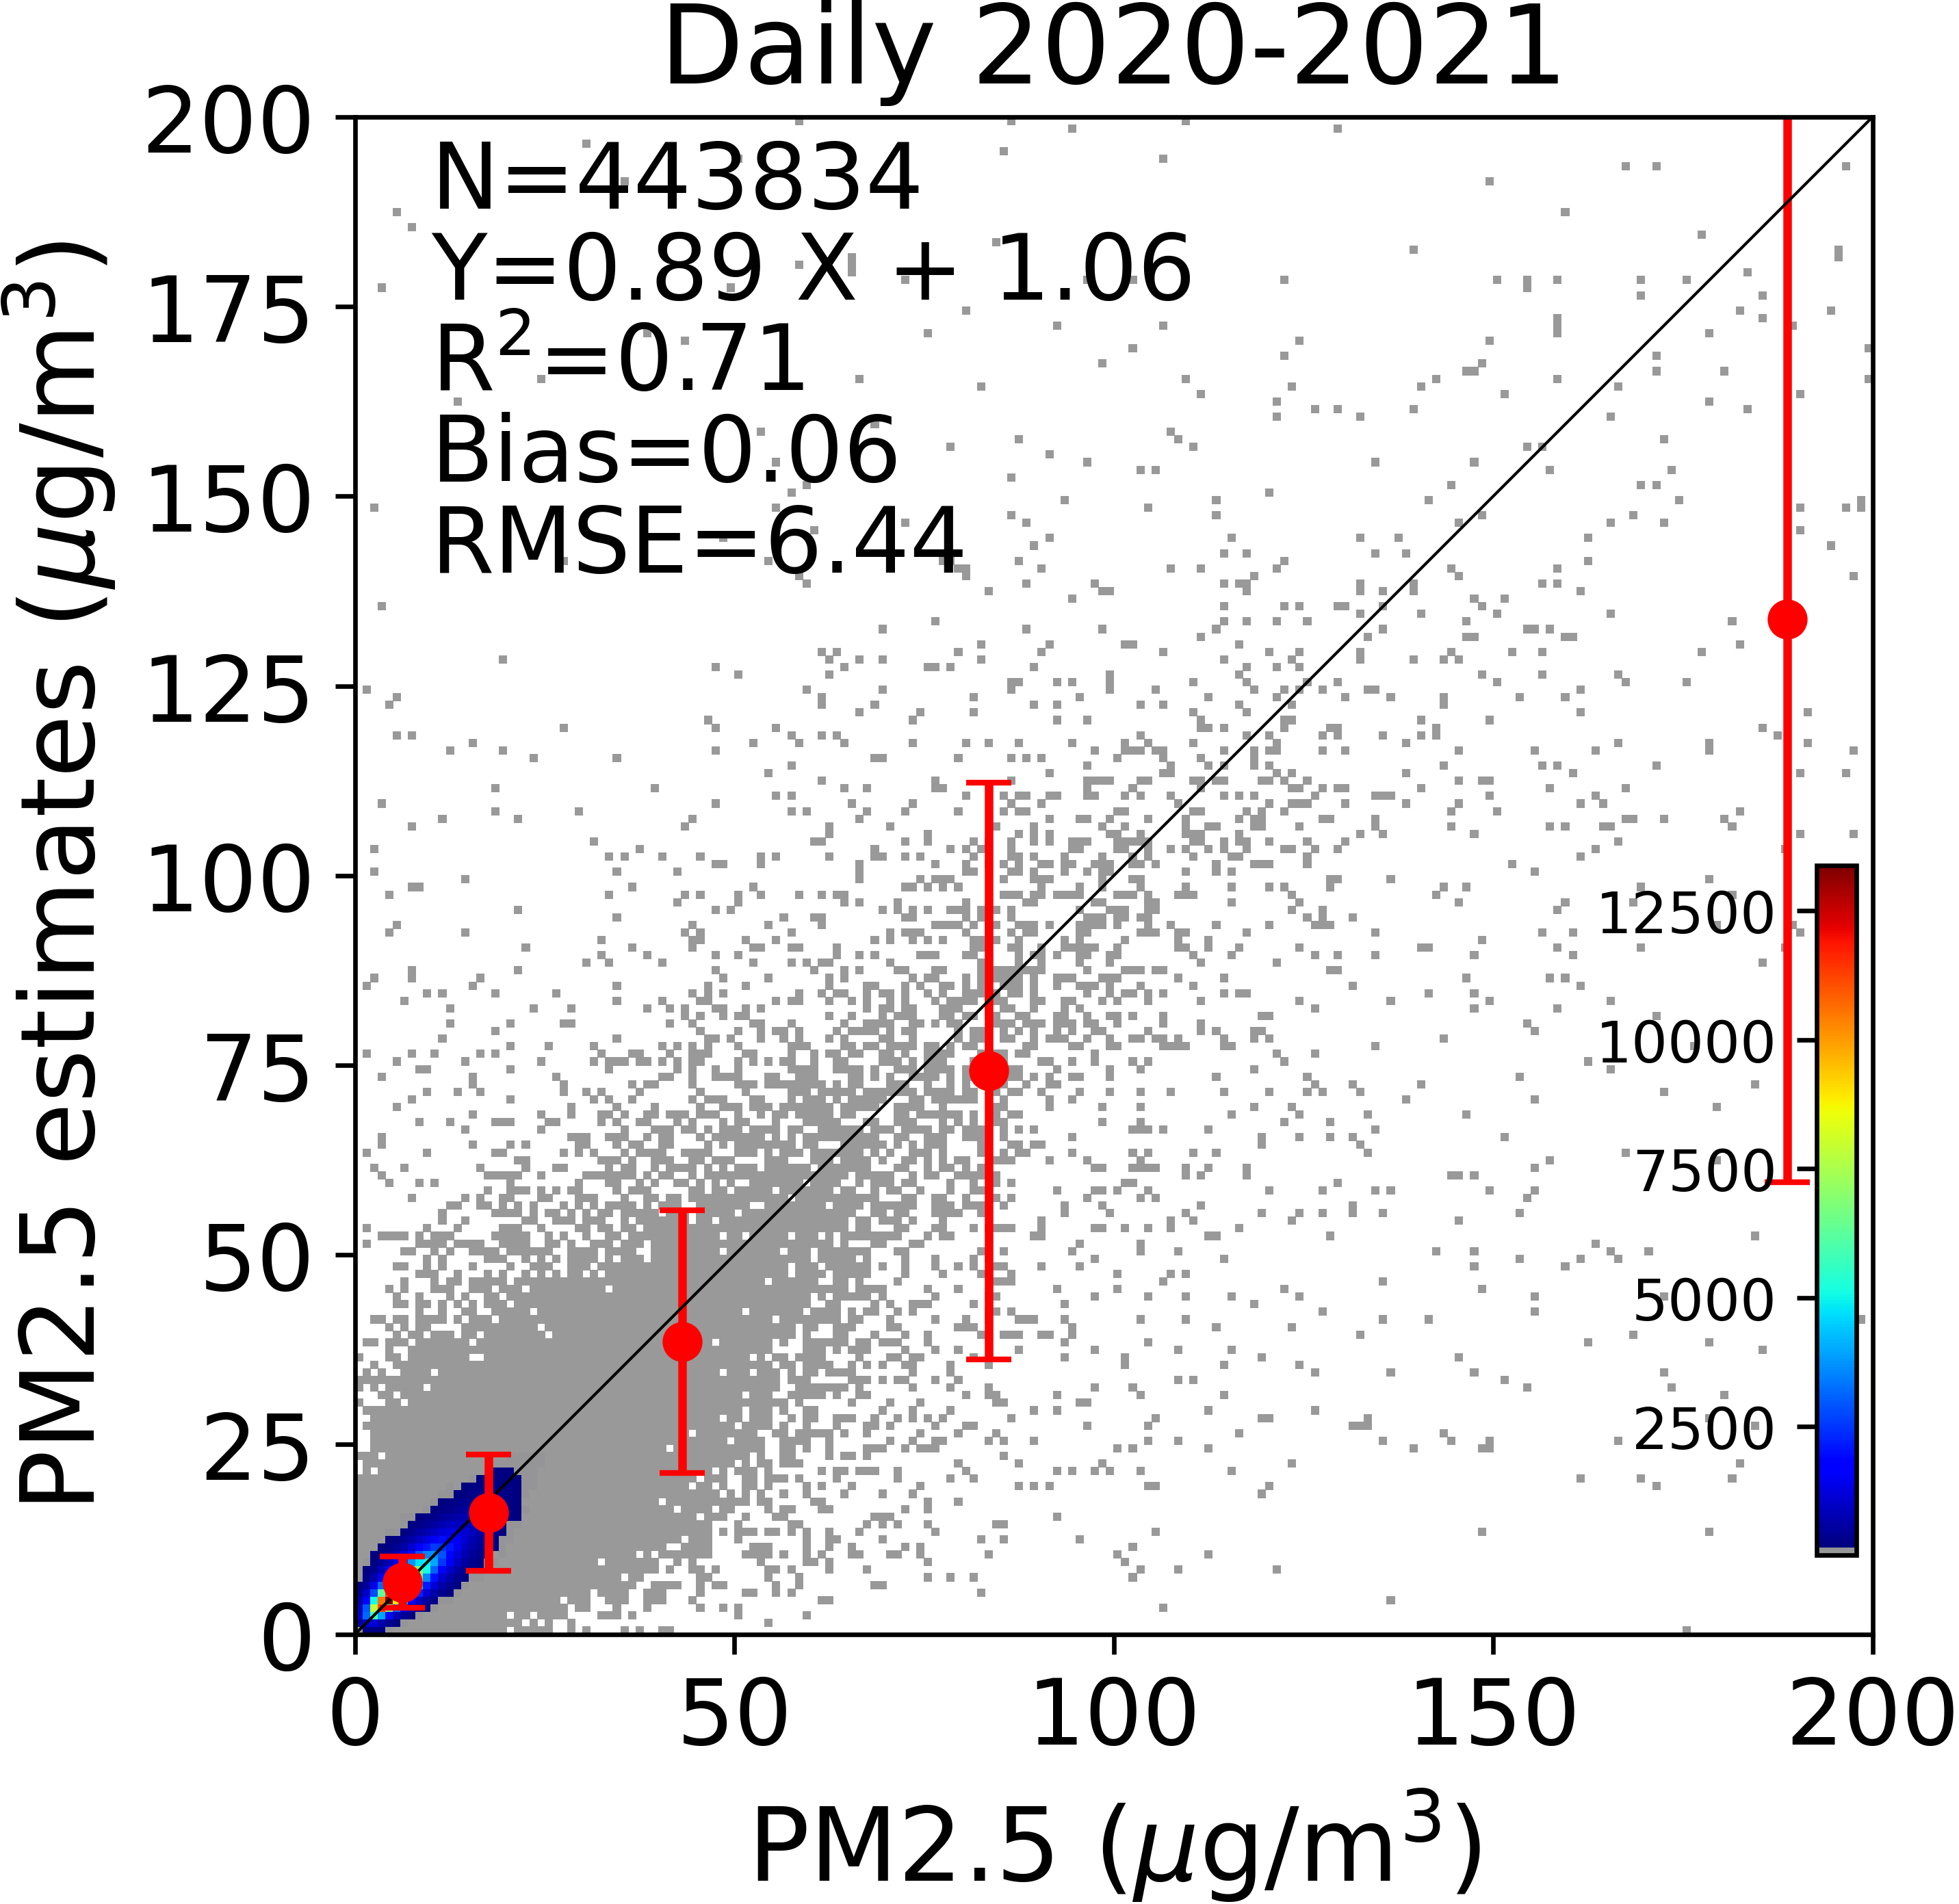
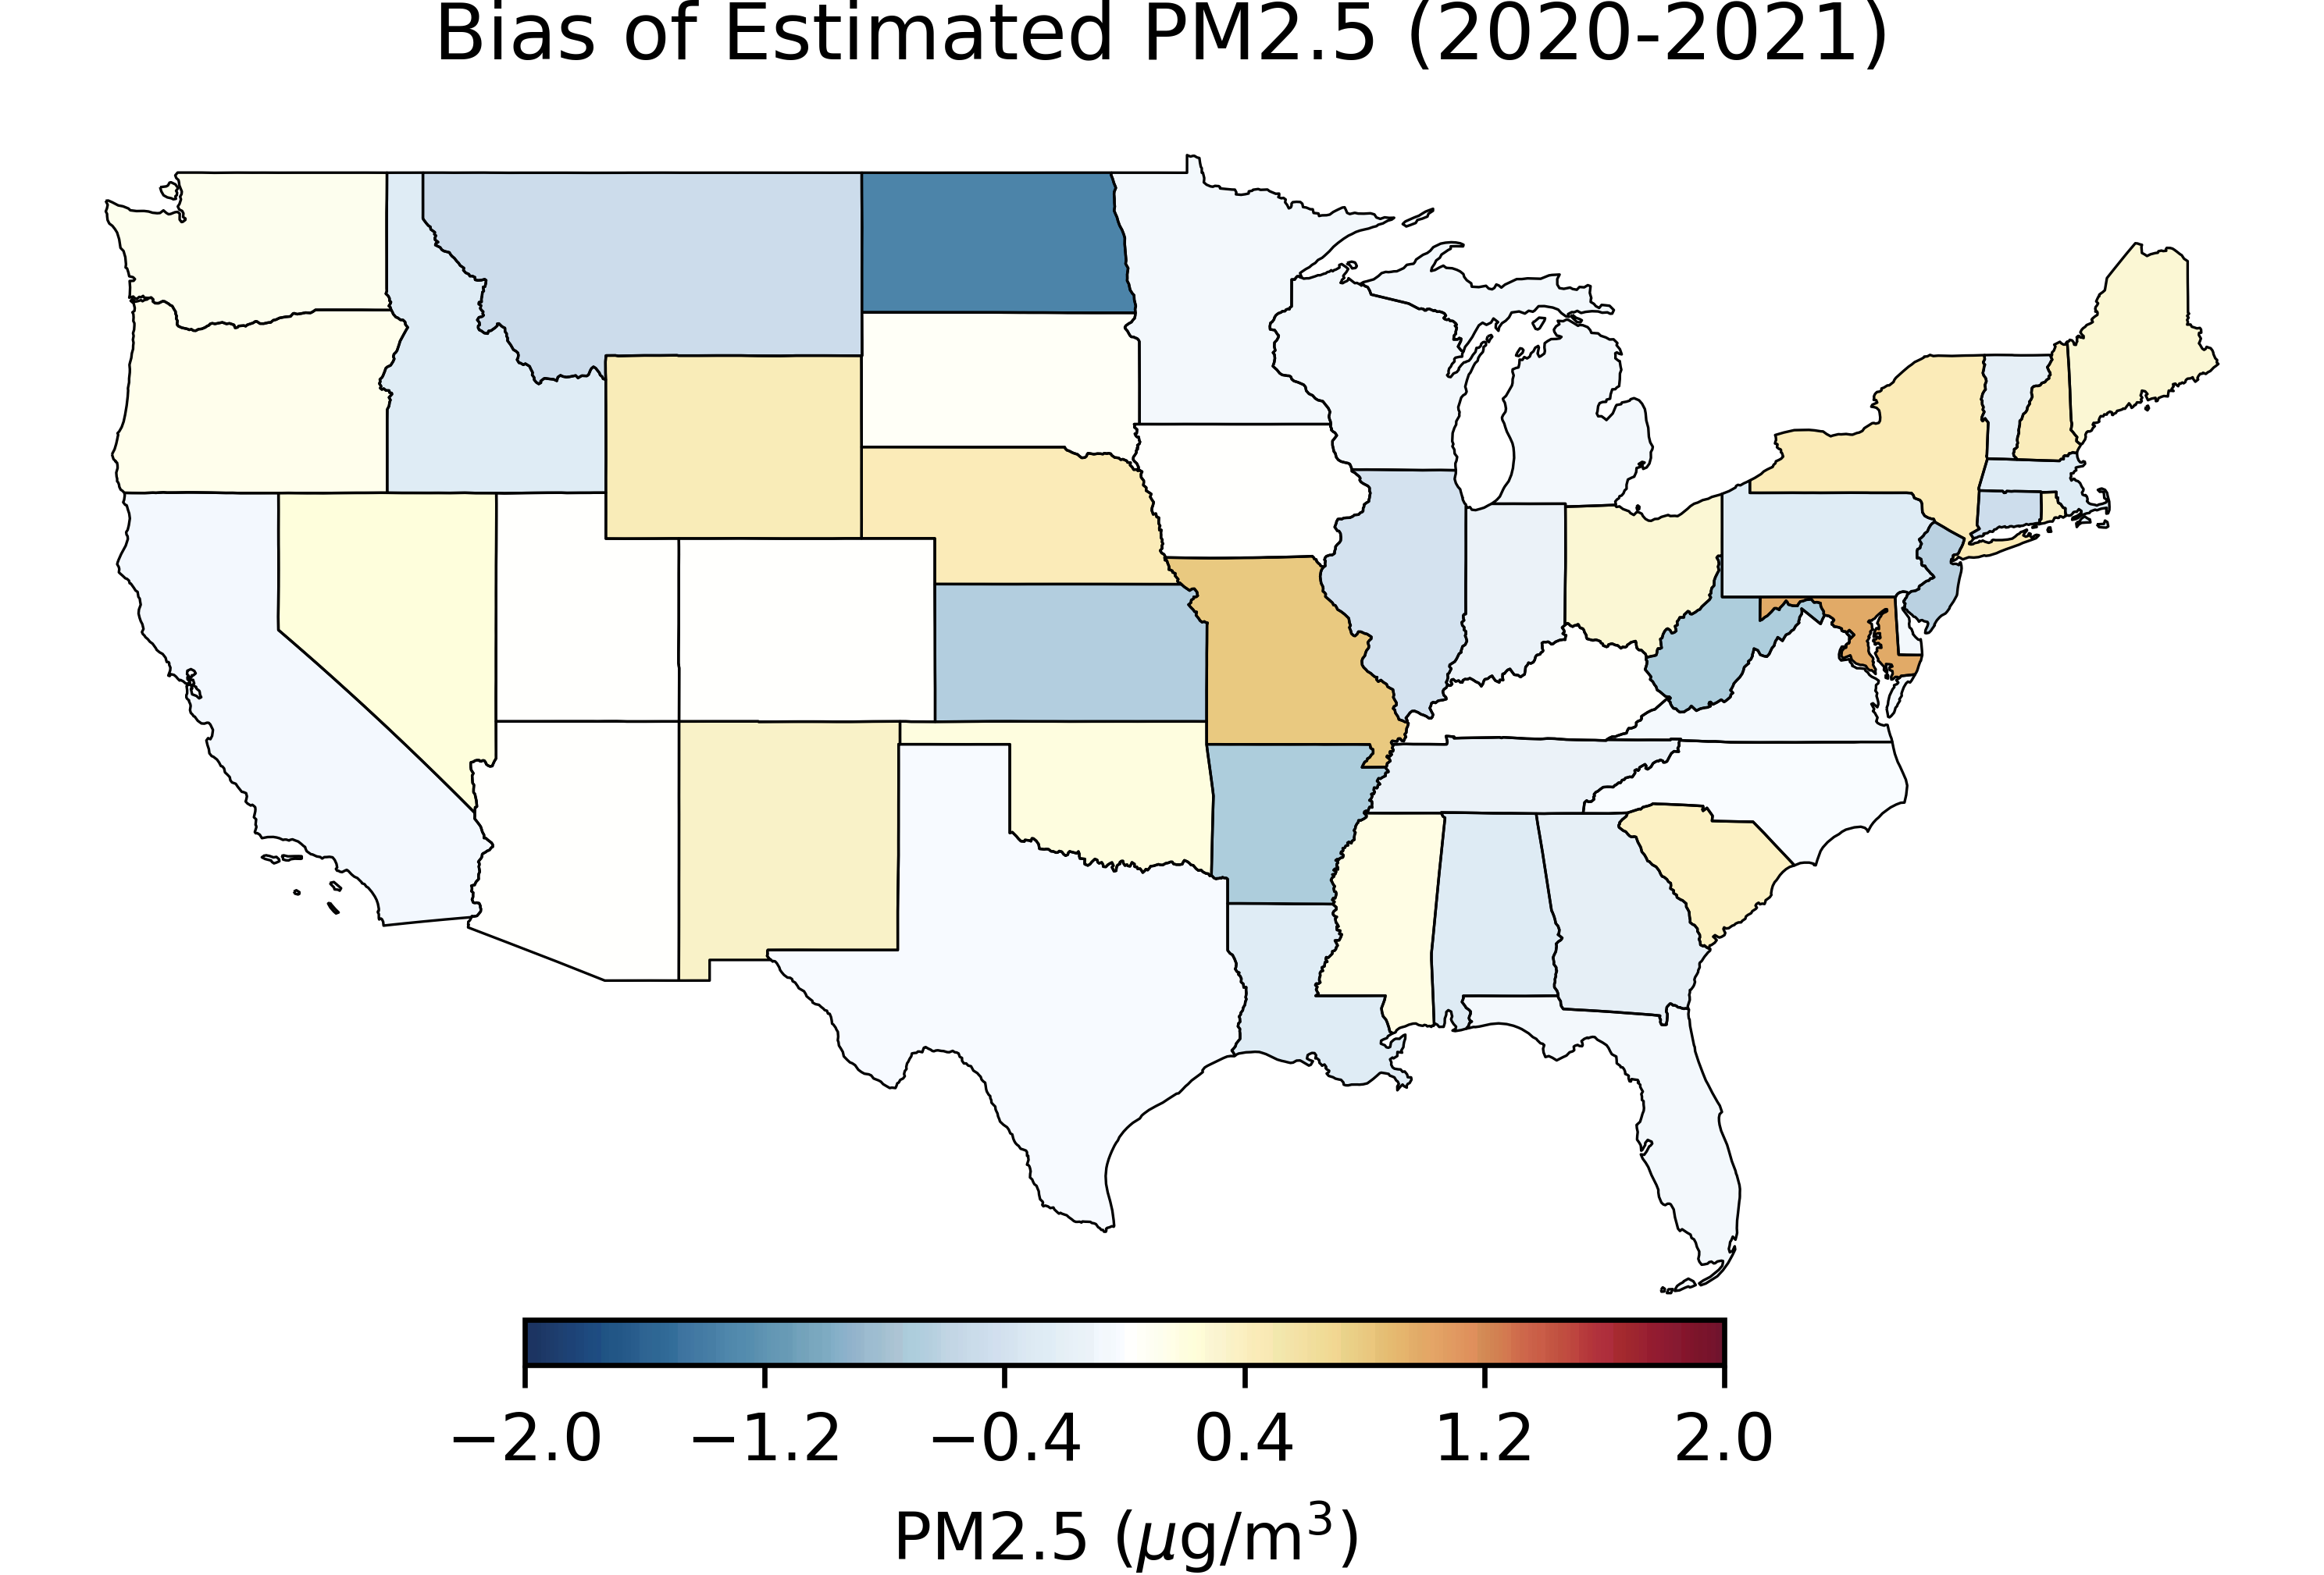
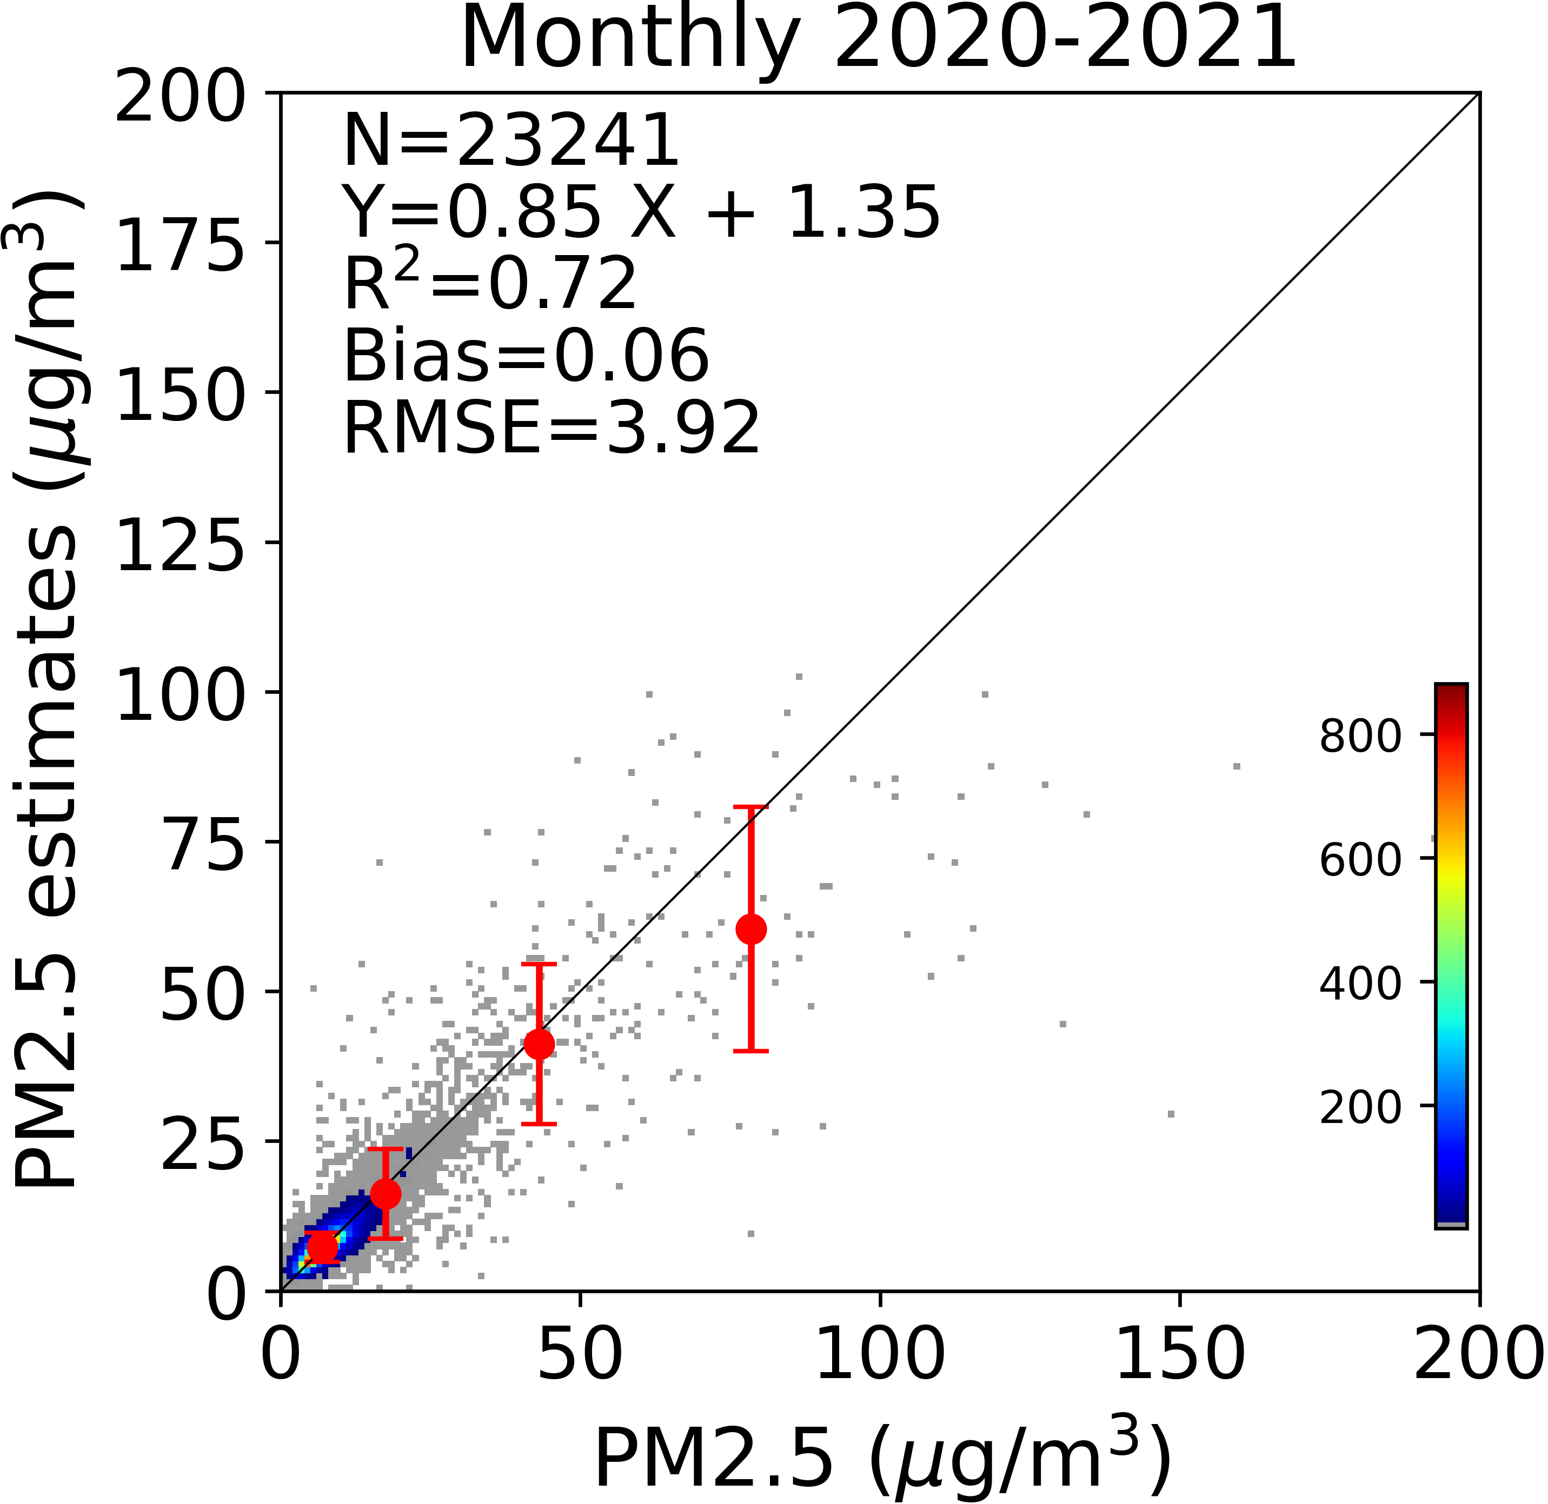
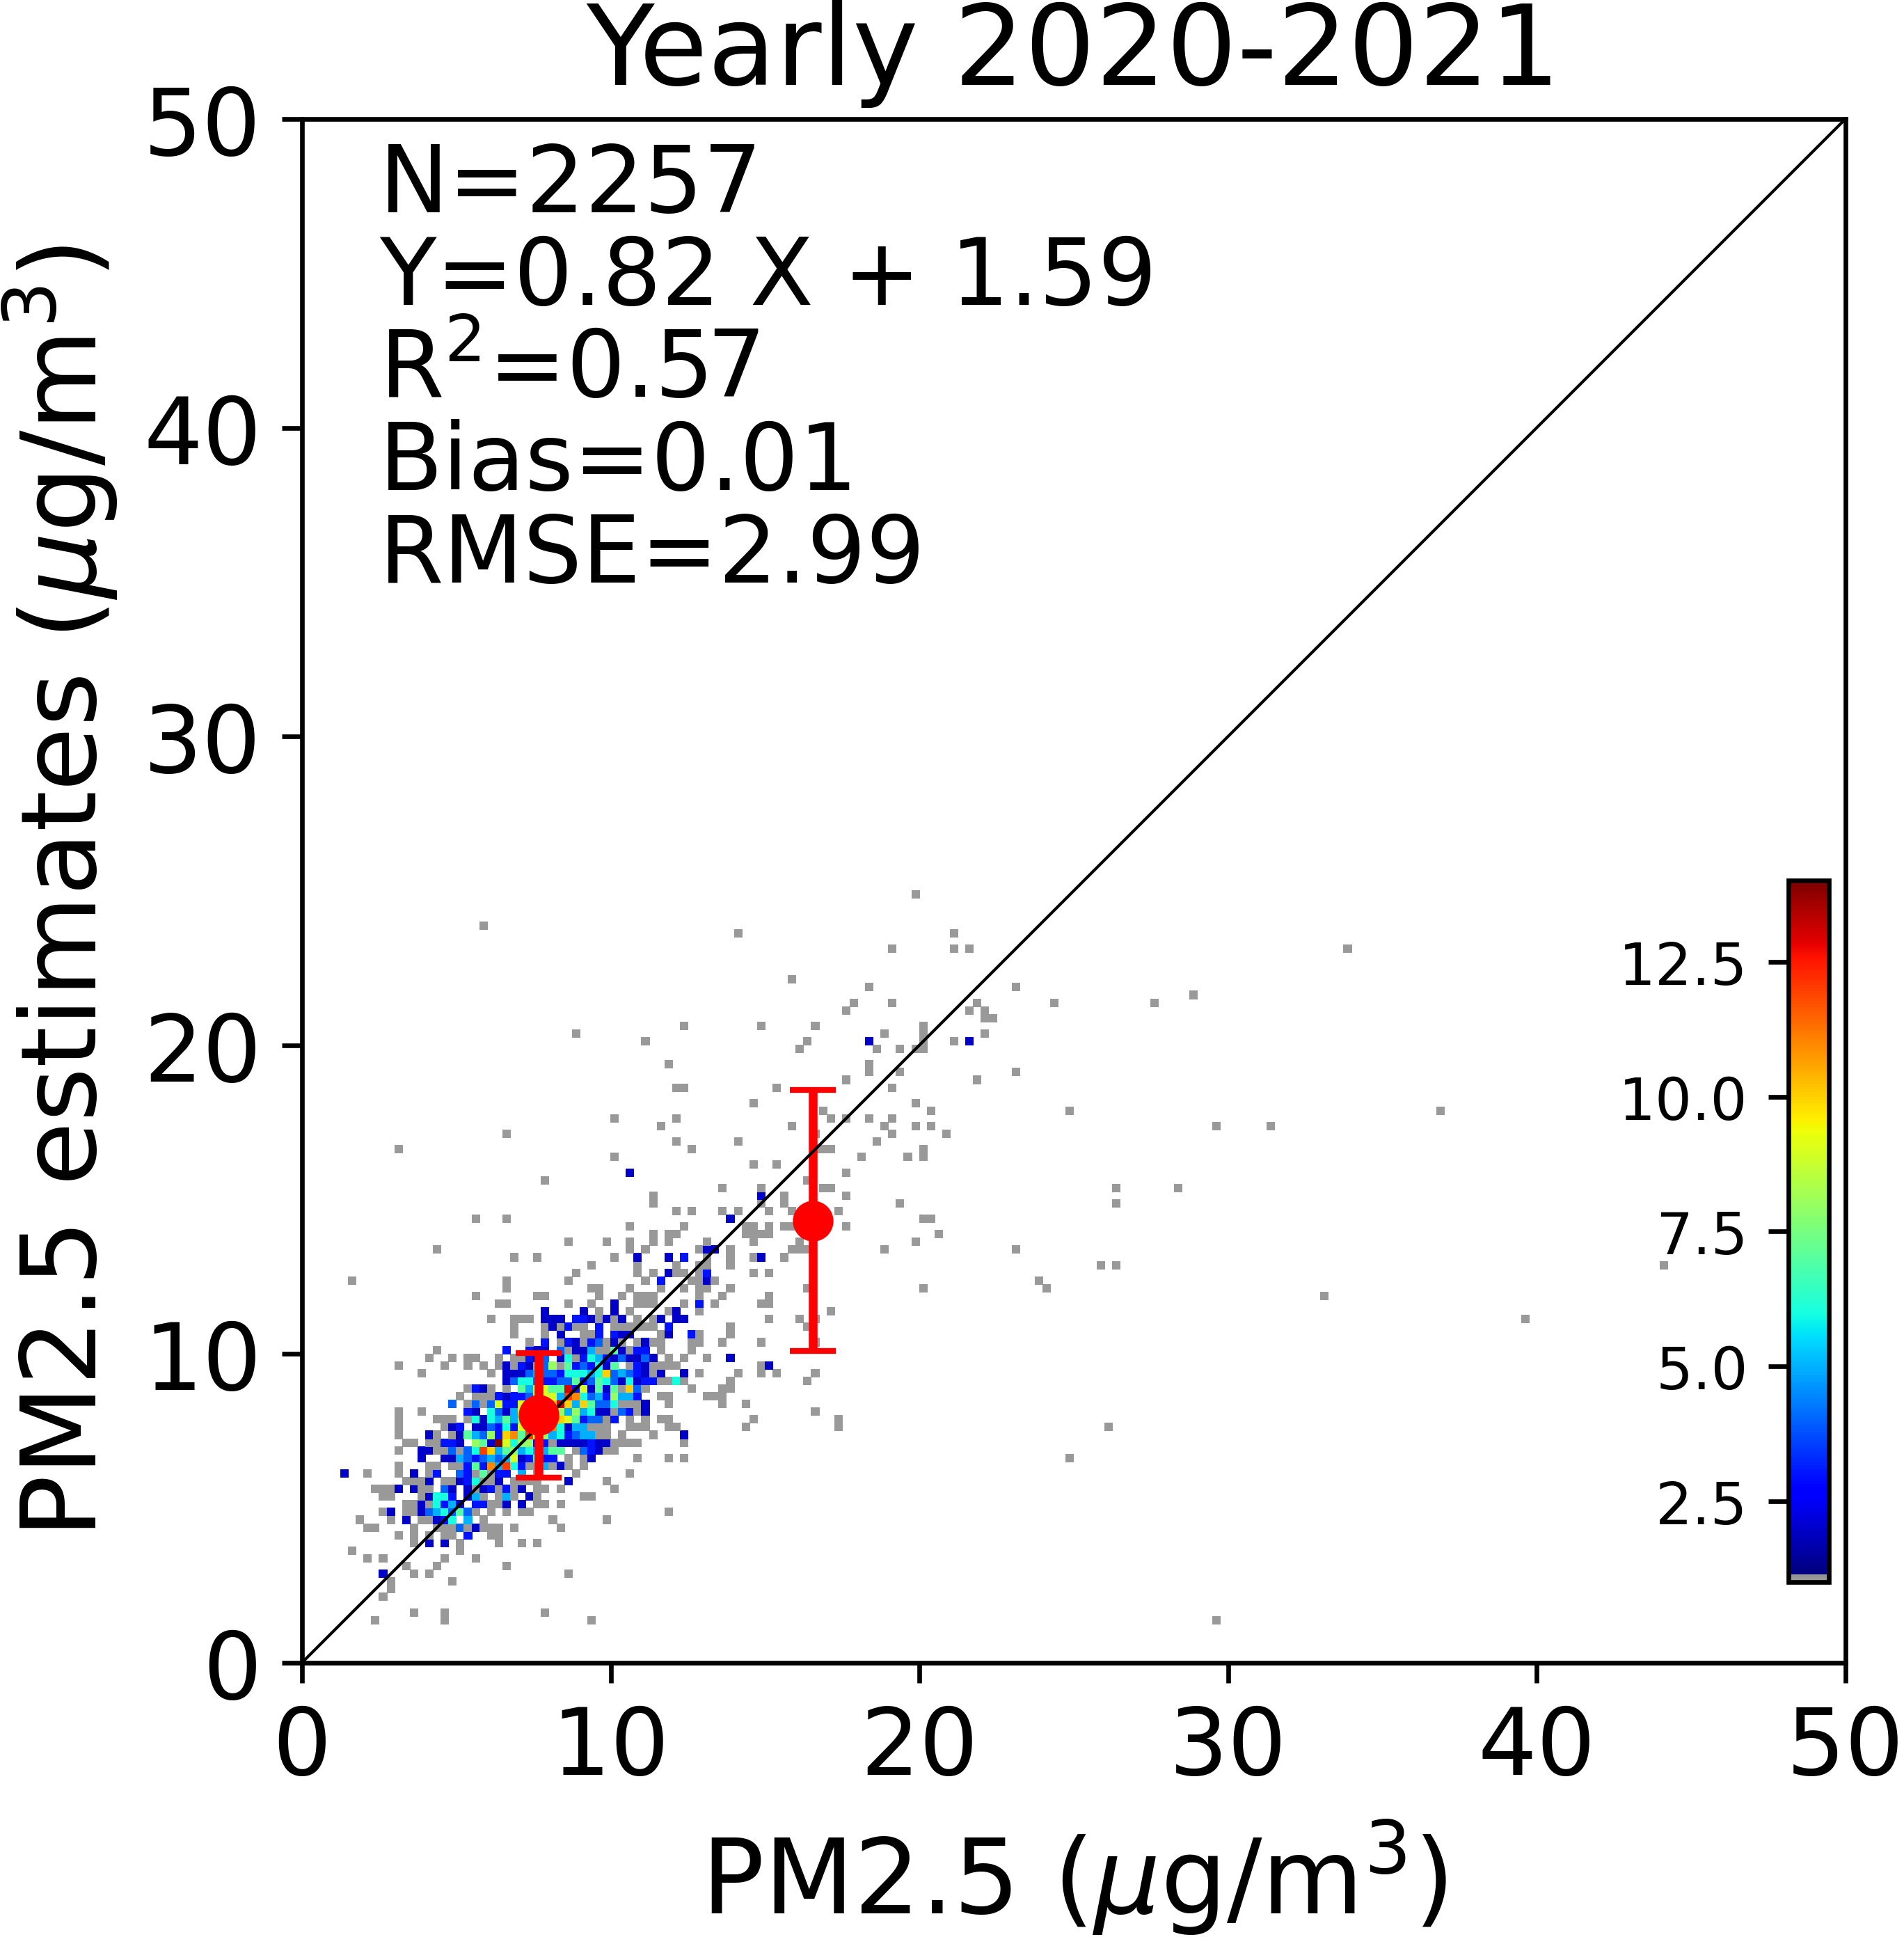
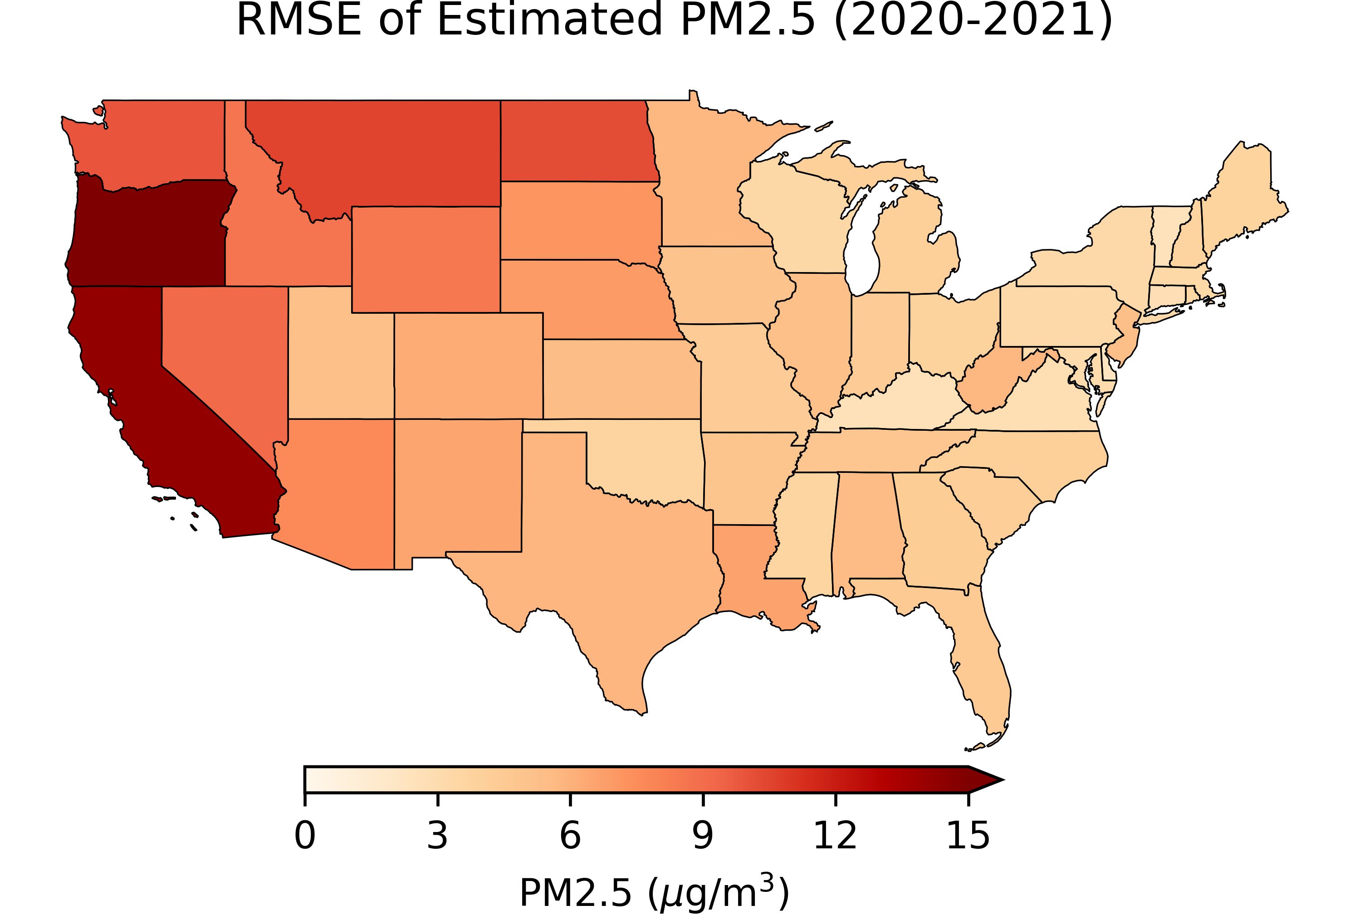
10-fold Cross Validation on Different Time Scales
10-fold Cross Validation of Hourly PM2.5 Estimated from GOES-16/17 ABI AOD

Slide 6
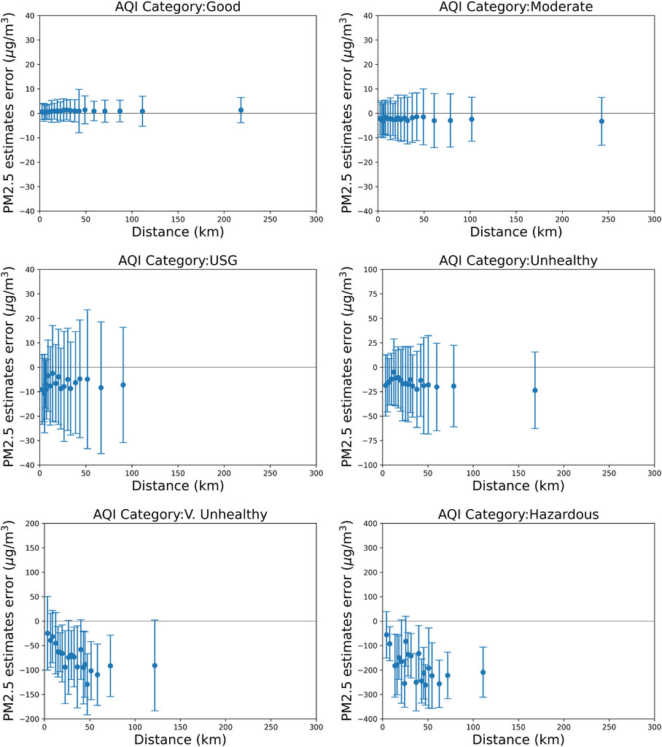
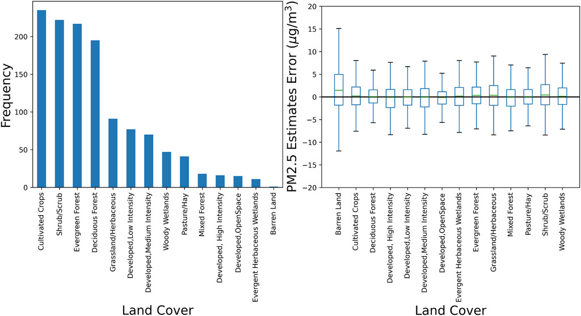
Validation

Slide 7
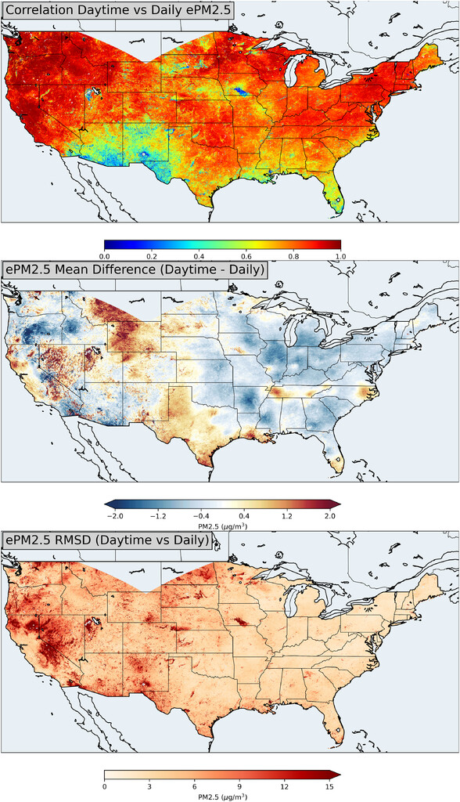
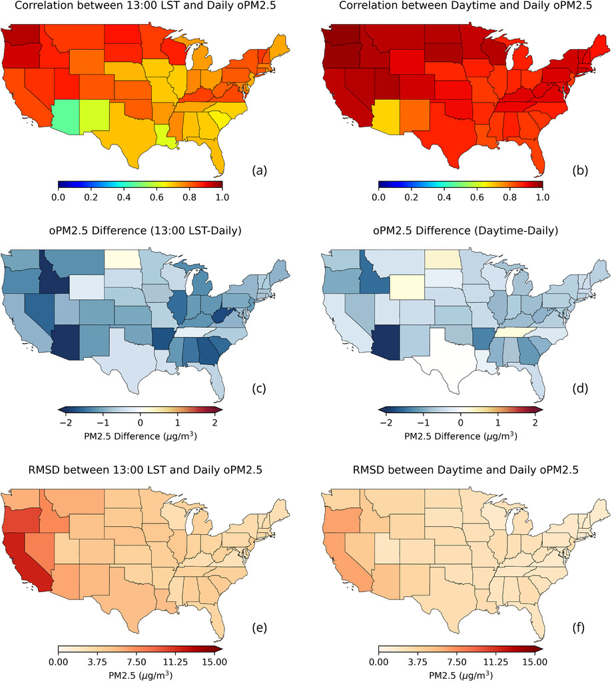
1300 LST vs. Daytime vs. Daily

Slide 8
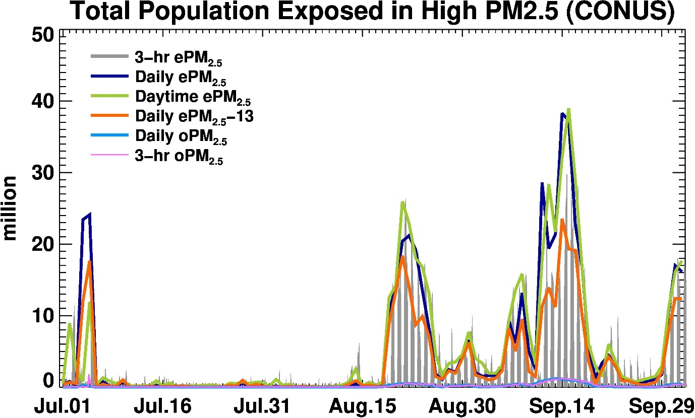
During the Giga fire event of 2020, number of people exposed to harmful levels of particulate pollution (>35 ug/m3) is calculated using GOES ABI across the CONUS
Using 3-hr running mean, daily (24-hr) mean, daytime mean values give a better estimate of millions of people exposed compared to LEO estimates or ground monitors
SIGNIFICANCE: On average, 1.8 million people per hour can be informed about harmful air quality using geostationary satellite data compared to 0.17 million people per hour based on ground observations alone. Monitor data estimate is a lower bound because we only counted people in the census tracts where monitors are located.

Slide 9
Some of the Outstanding Challenges

Slide 10
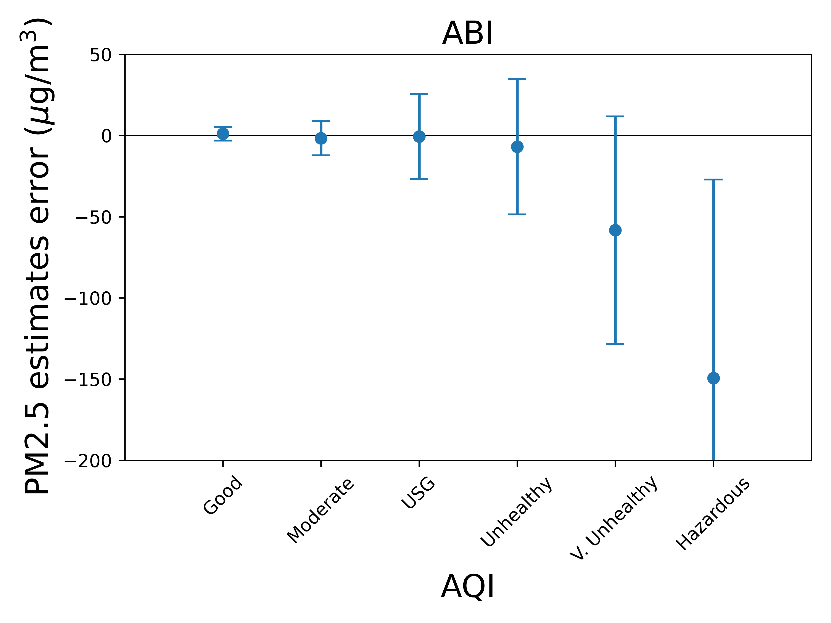
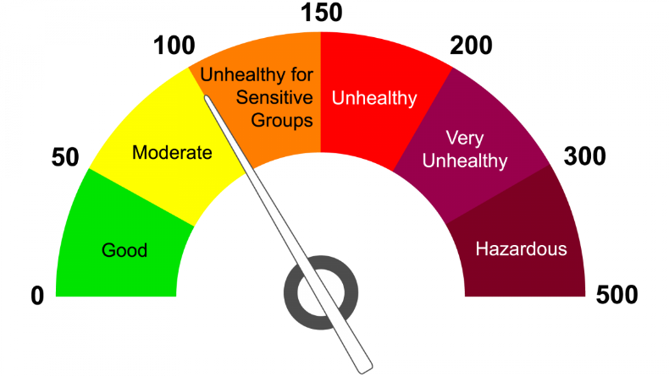
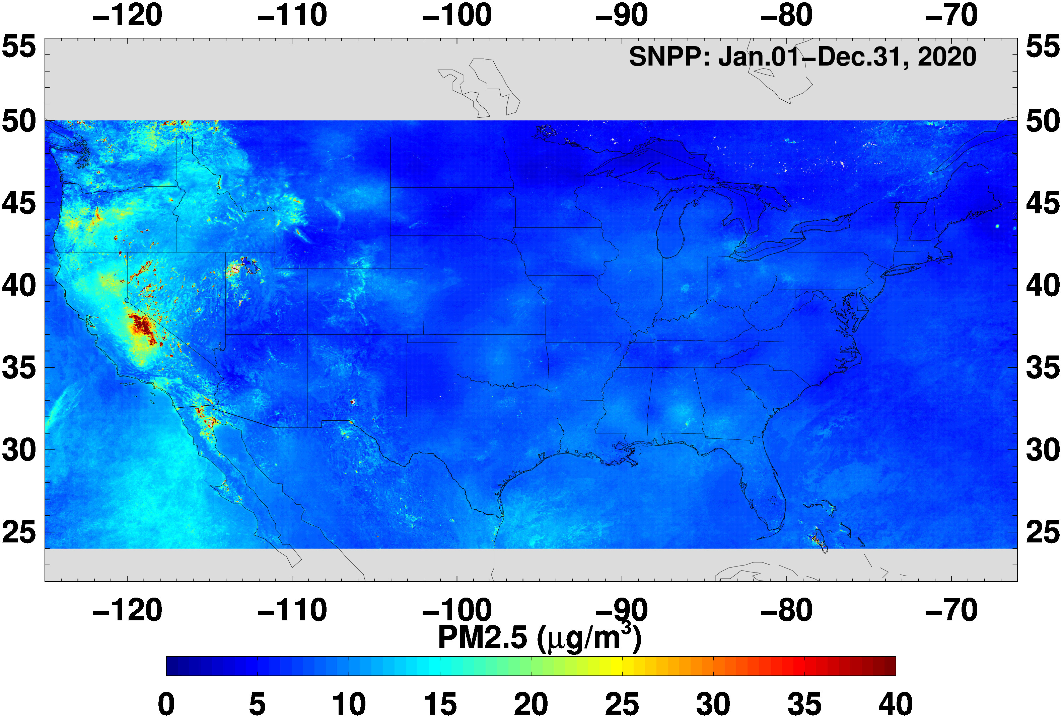
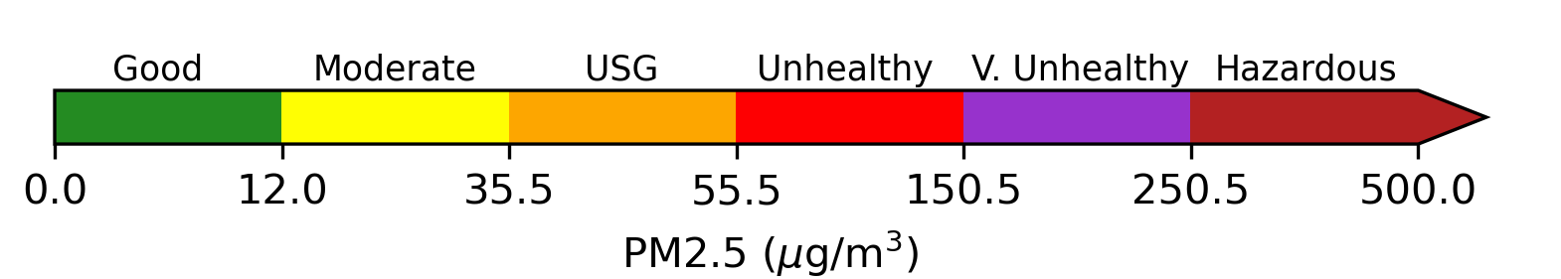
Do we trust satellite-derived PM2.5 if we cannot retrieve (observe) high AODs?
Daily AQI Scale
H. Zhang and S. Kondragunta, Earth and Space Science, 2021
10

Slide 11
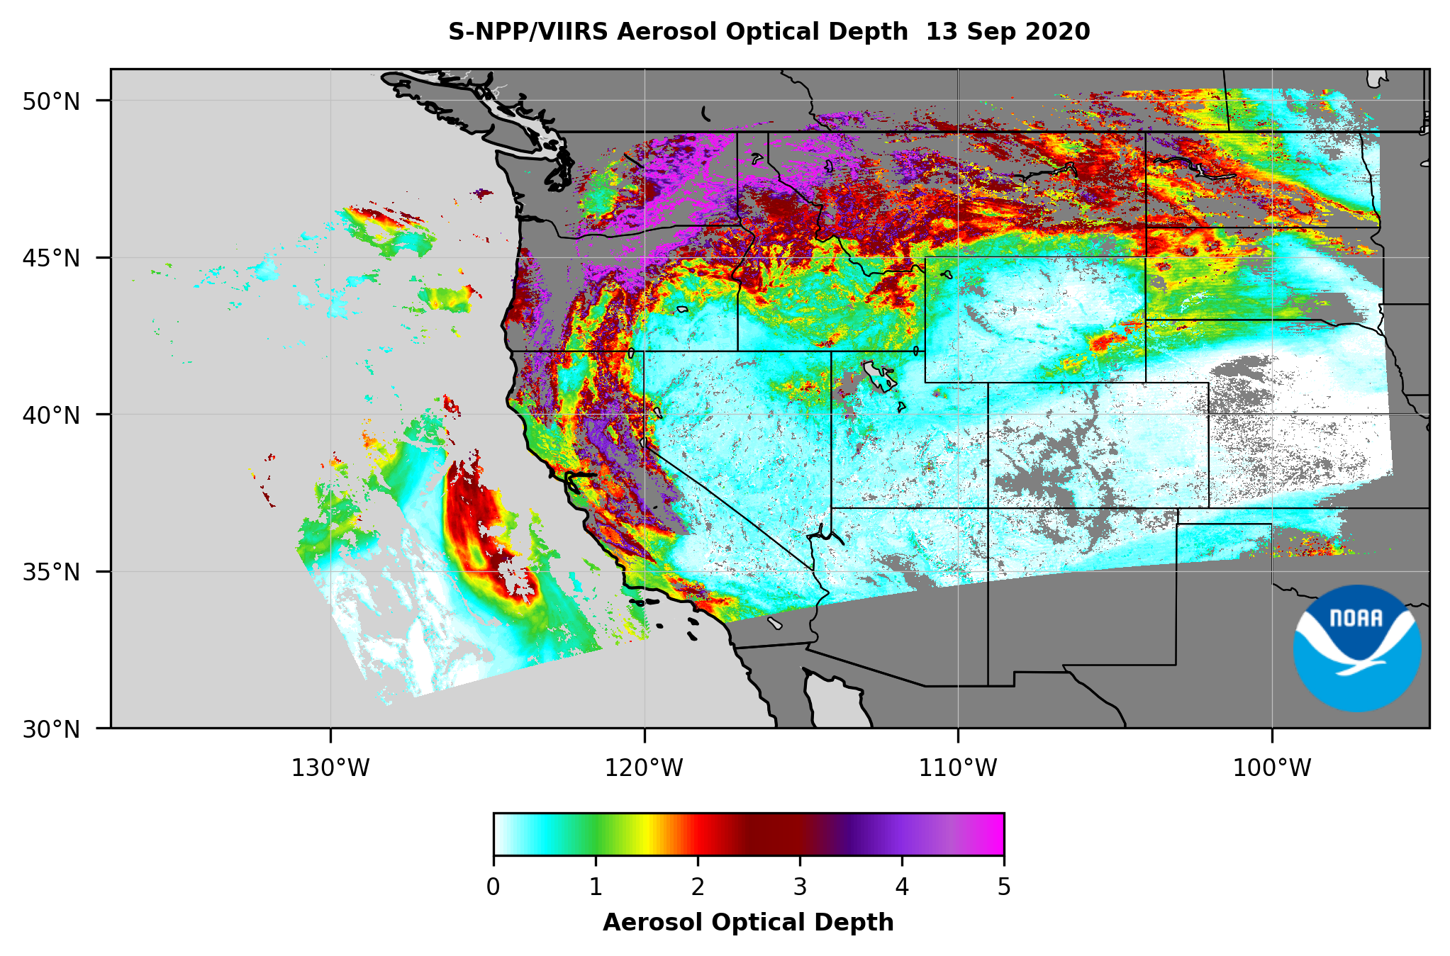
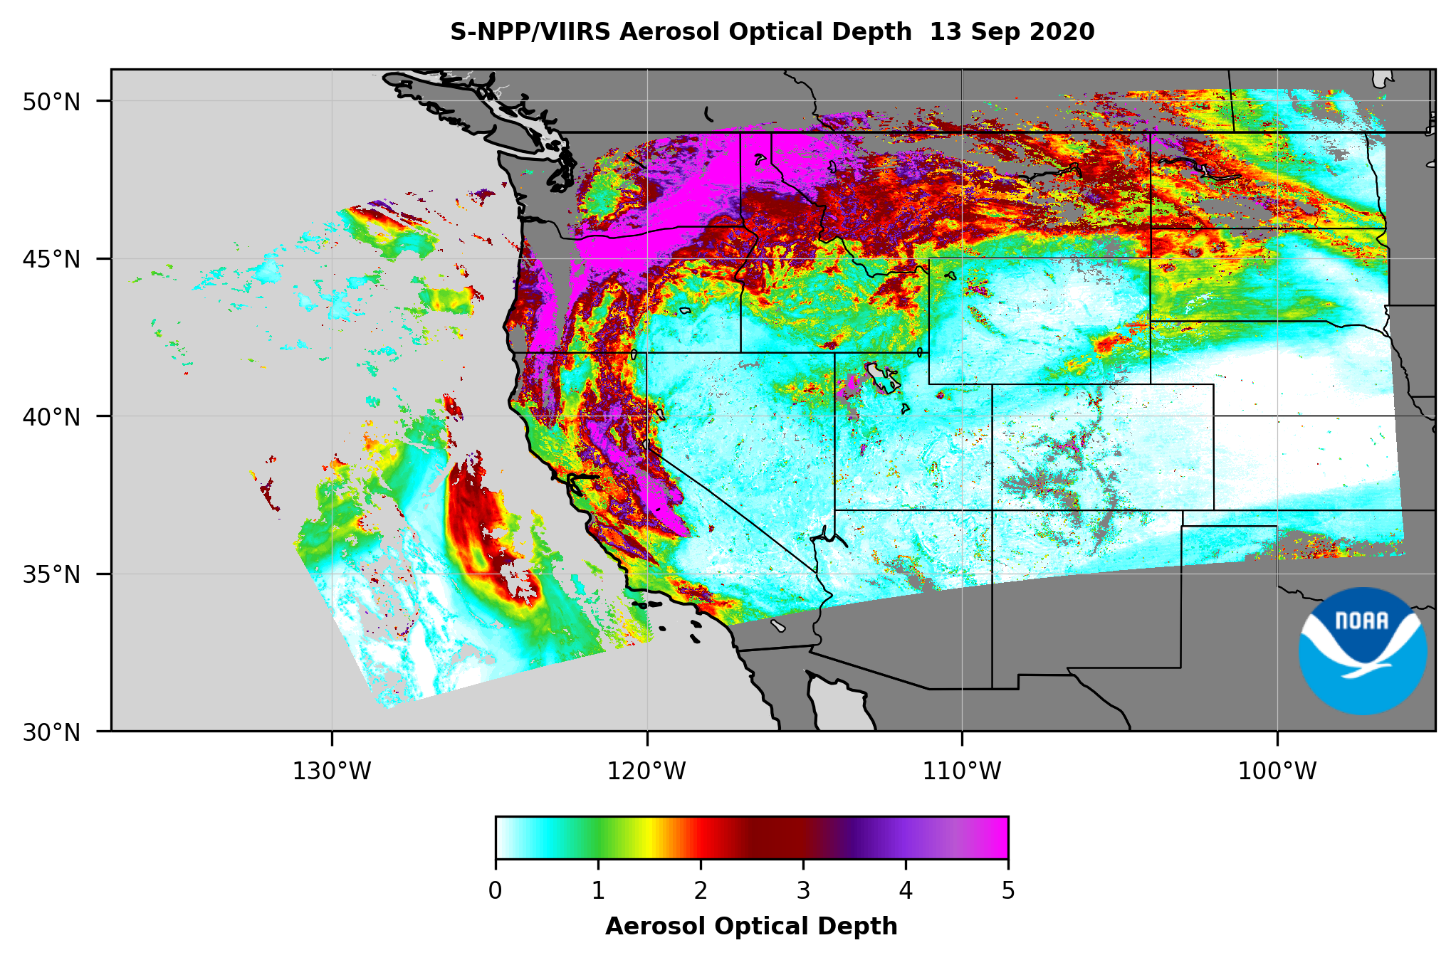
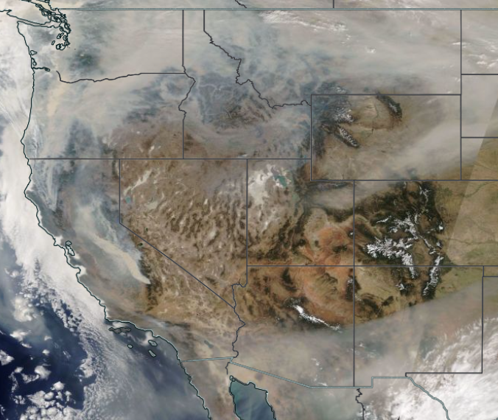
Satellite retrieval algorithms have a difficulty sometimes discriminating smoke and clouds
High+Medium+Low Quality
High+Medium Quality
11

Slide 12
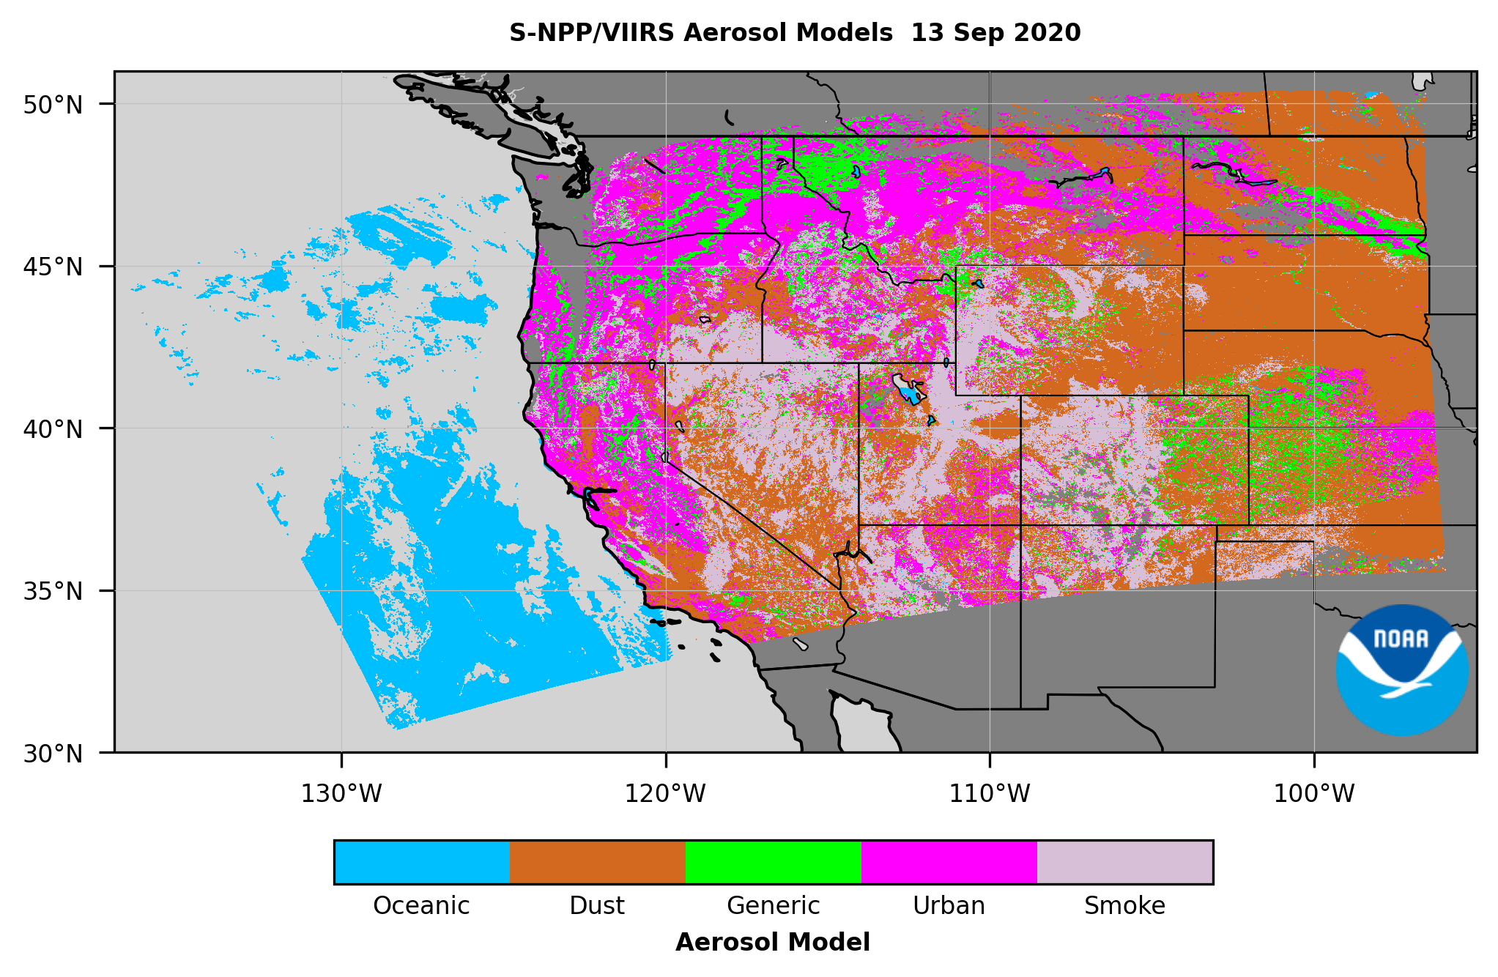
Satellite retrieval algorithms do not always select the right look-up-table
12

Slide 13
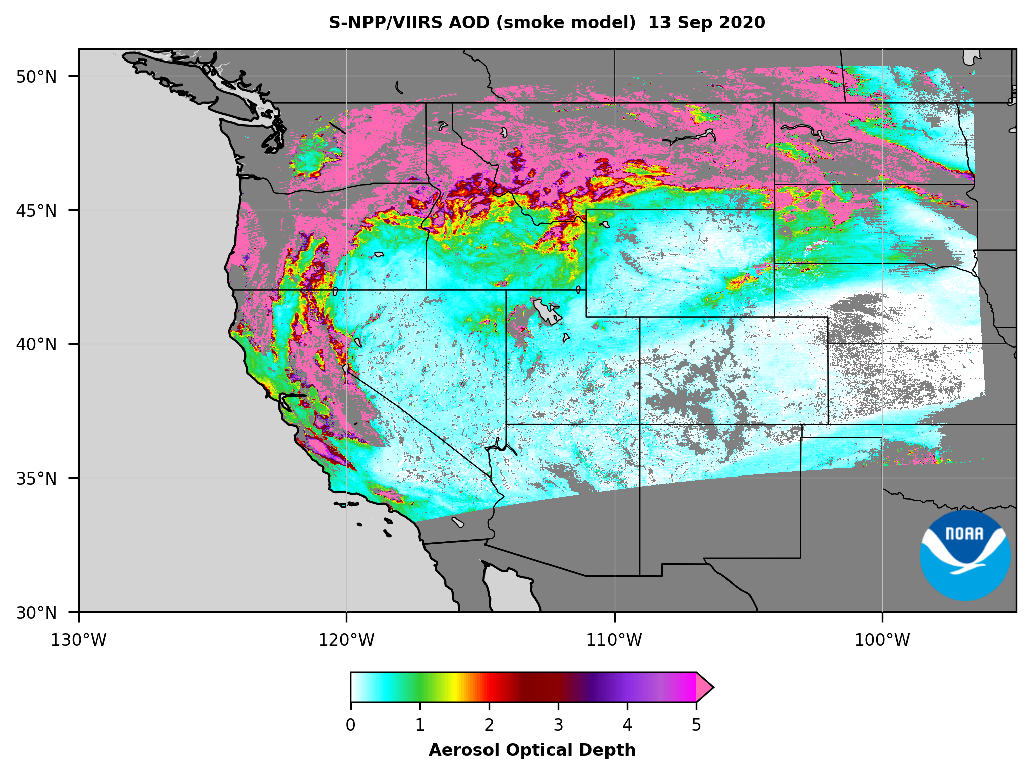
Knowing a priori that it is smoke and forcing the algorithm to use “smoke aerosol model look-up-table” can help retrieve AODs > 5.0
Question: do we trust those high AODs?
13

Slide 14
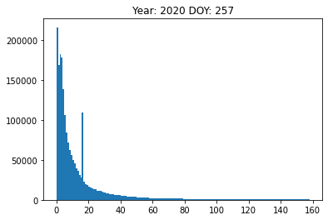
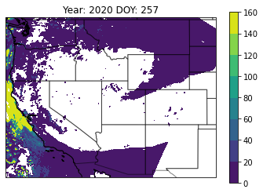
Satellite retrieval algorithms have a difficulty sometimes discriminating smoke from clouds
COD
COD
14

Slide 15
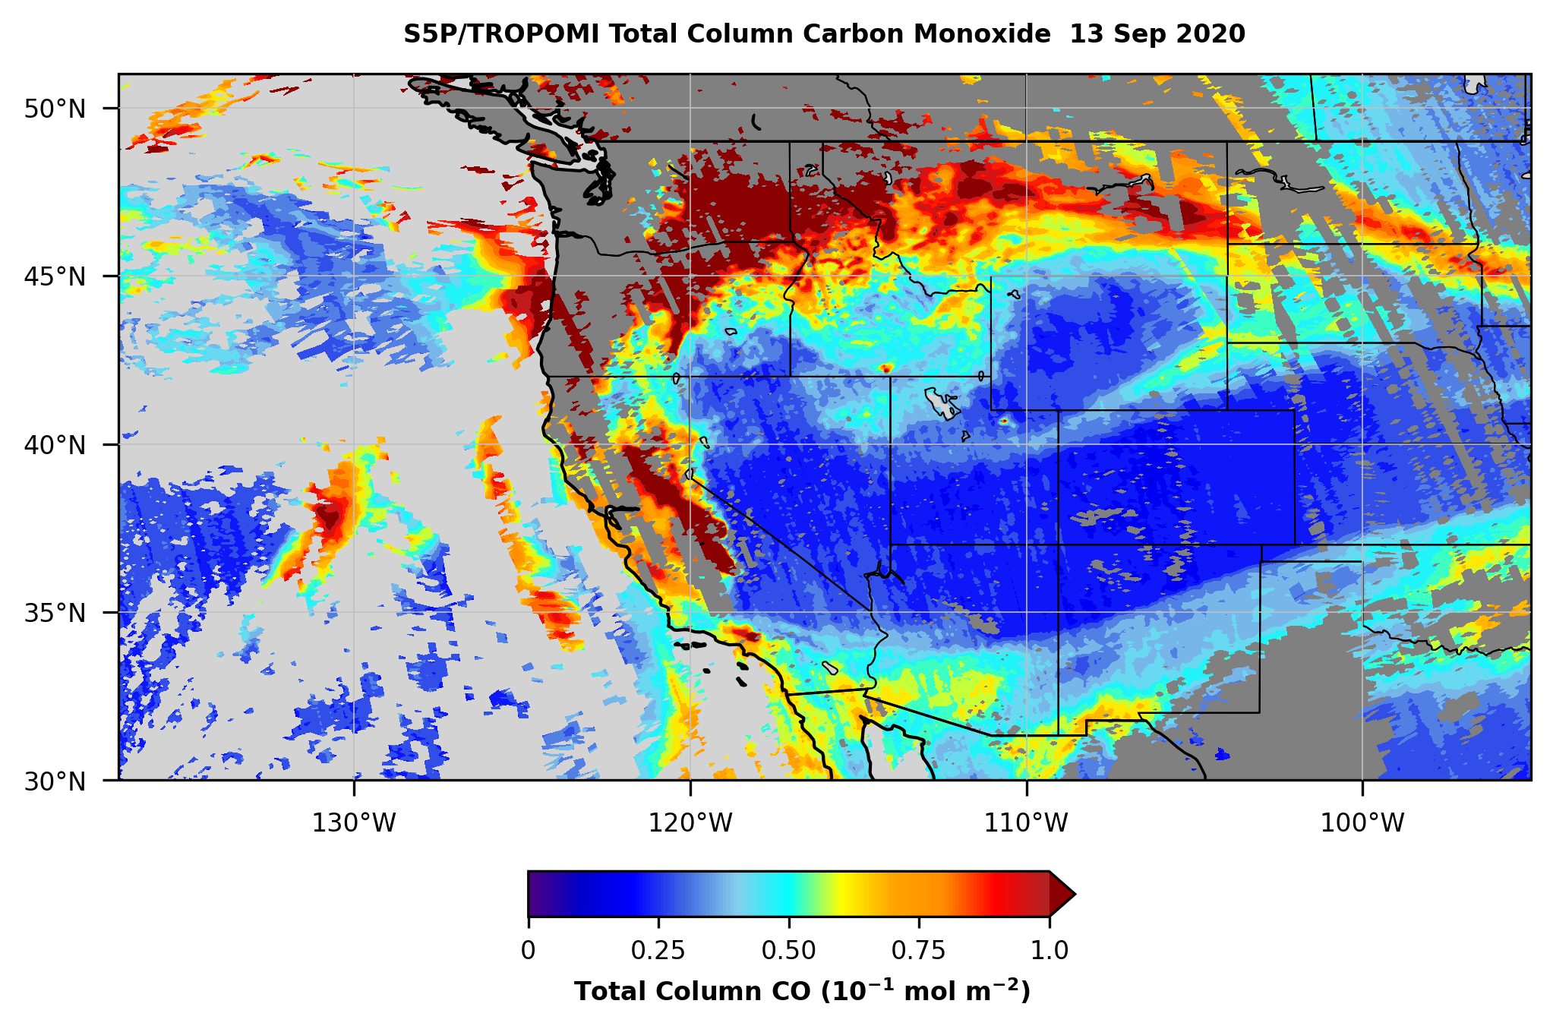
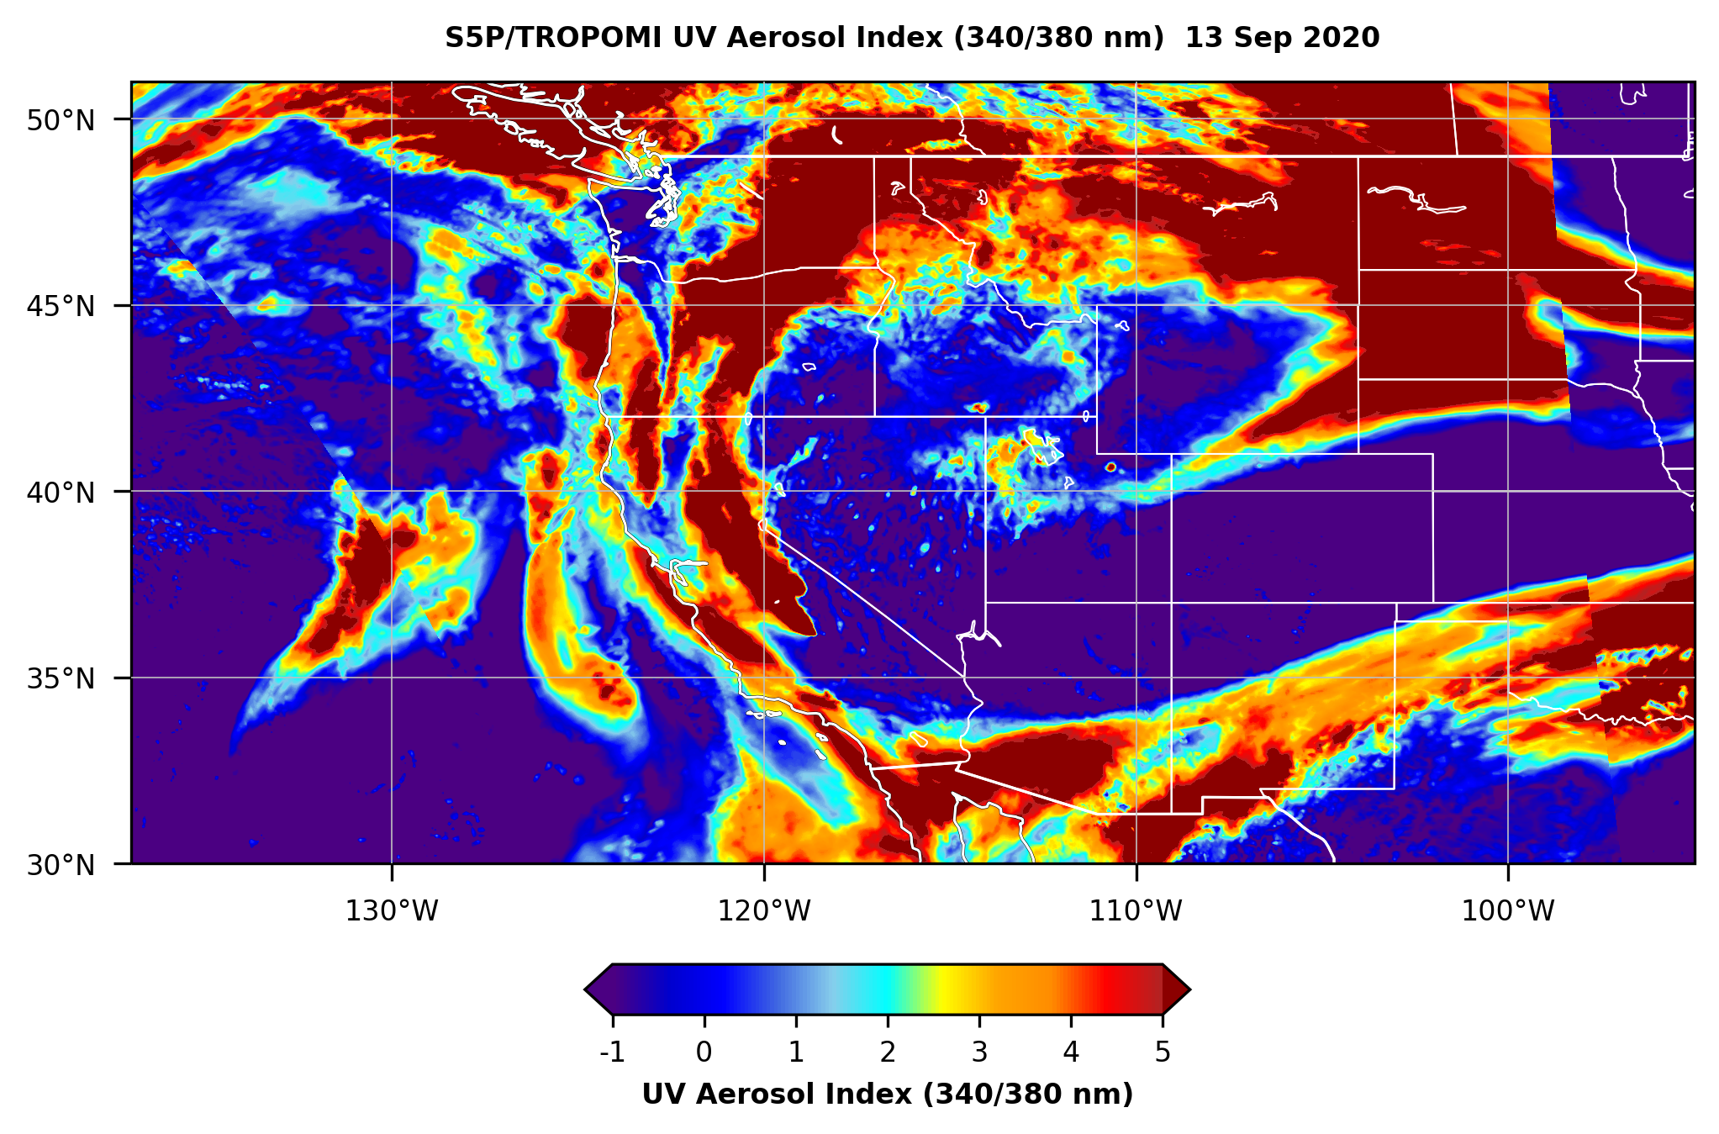
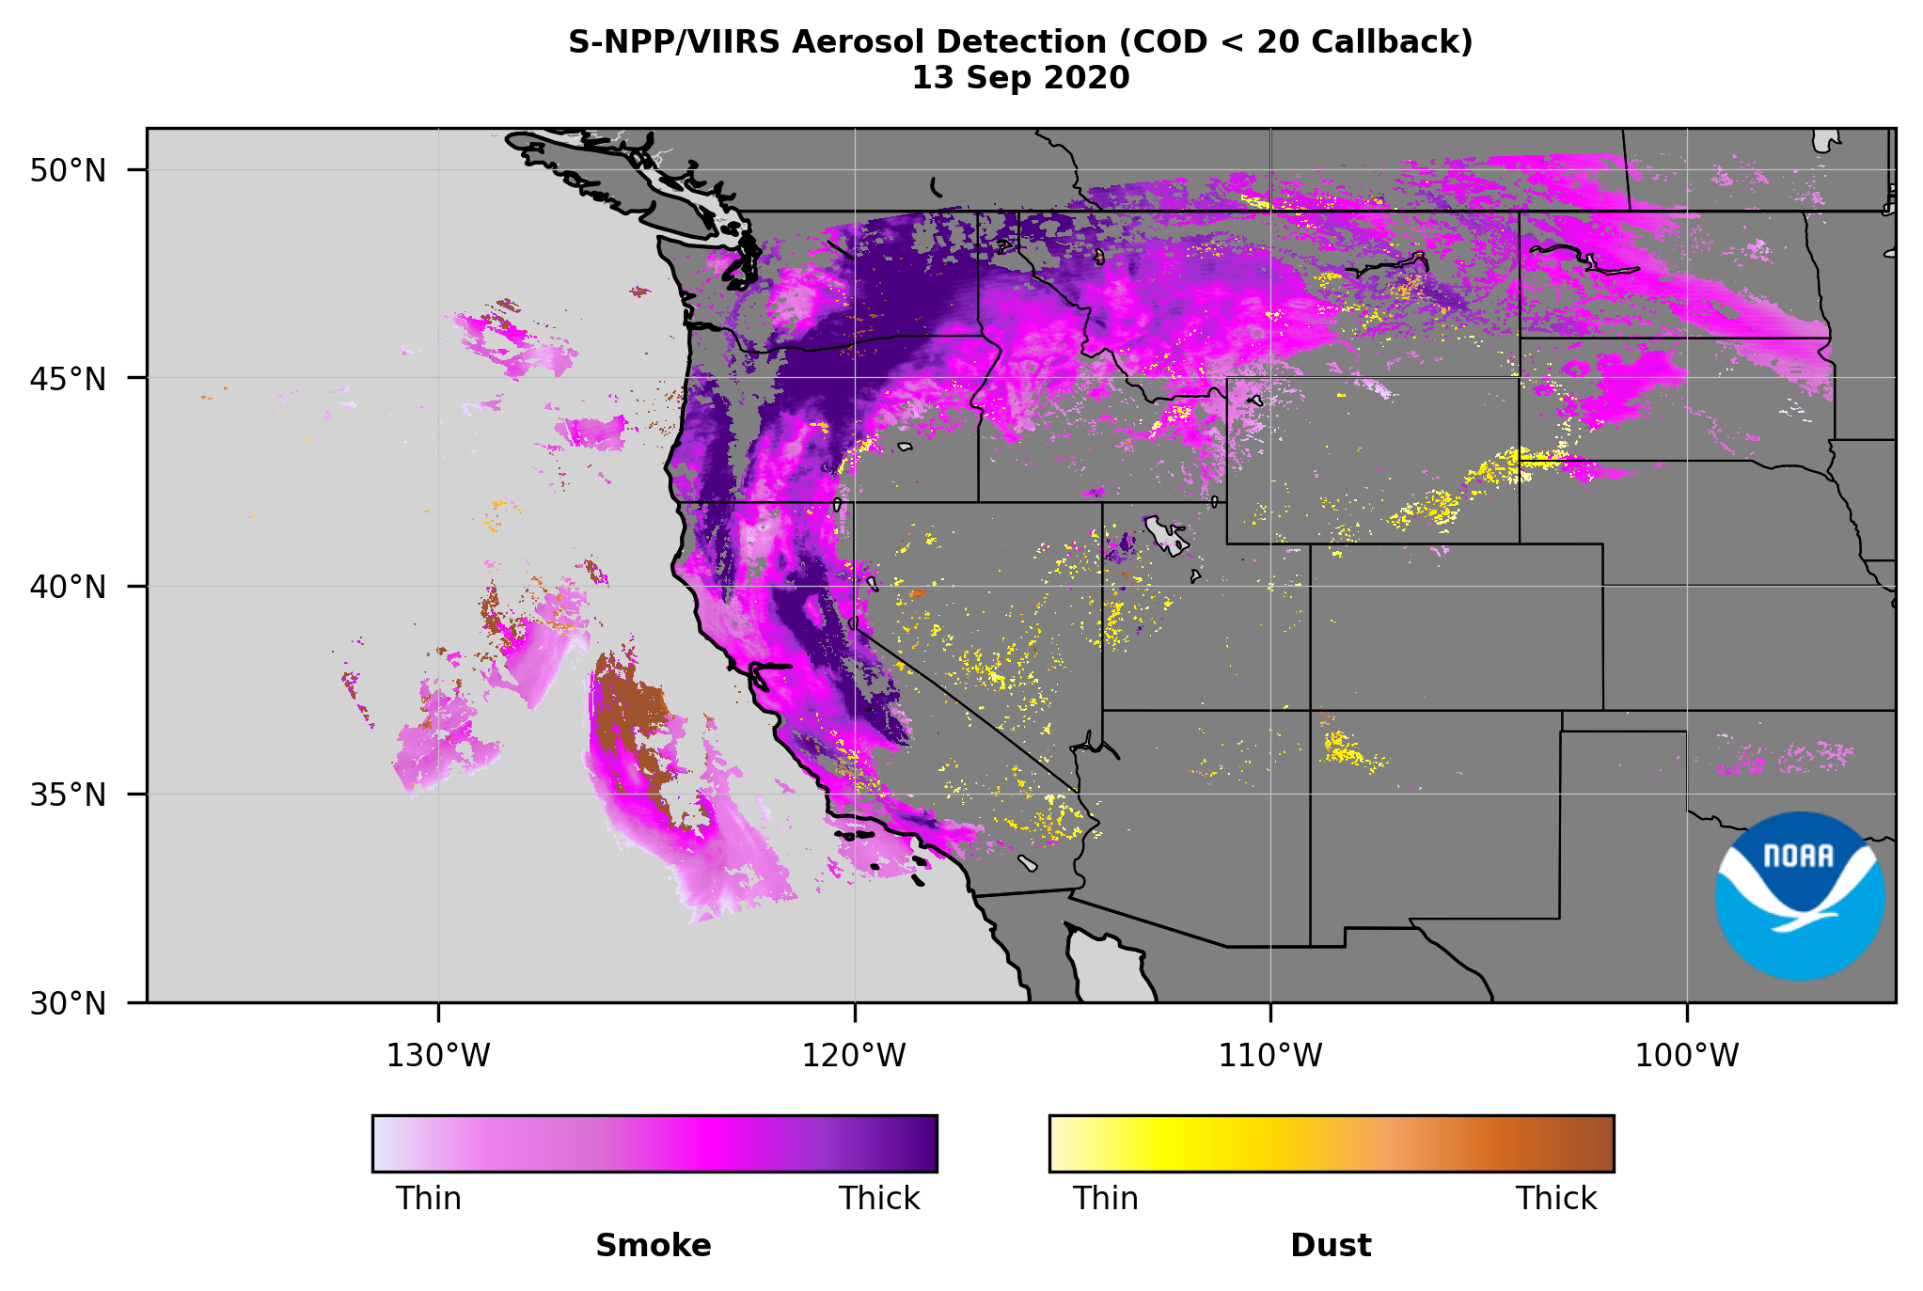
Methods to call back missing AOD retrievals
Use VIIRS smoke mask
Use TROPOMI Carbon Monoxide
Use TROPOMI UV Aerosol Index
15

Slide 16
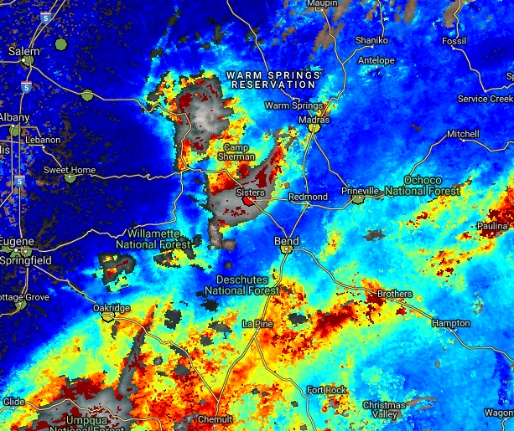
Sampling issues
  Missing high AODs in satellite products
  Gaps in AODs due to clouds
For natural sources of aerosols such as smoke and dust:
  Understand optical and physical properties and improve look-up-tables in AOD retrieval algorithm

