Slide 1
AC-VC Atmospheric Composition Virtual Constellation Whitepaper: “Monitoring Surface PM_{2.5}: An International Constellation Approach to Enhancing the Role of Satellite Observations” B. Veihelmann, ESA, AC-VC Co-Chair S. Kondragunta, NOAA, AC-VC Topical Lead

Slide 2
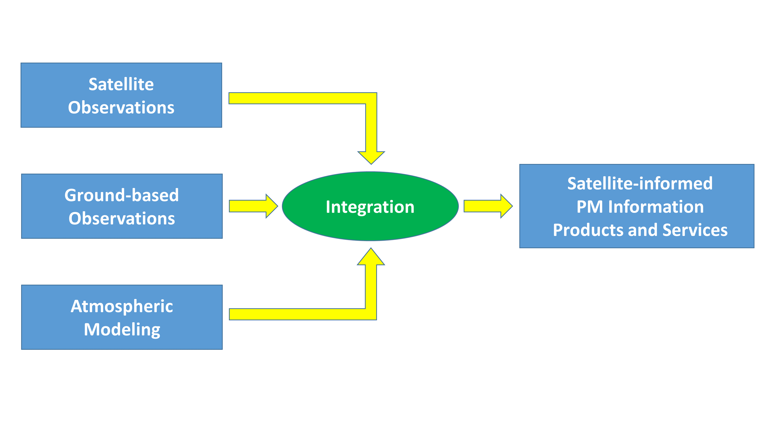
Purpose
Objective: Strengthen the role of satellite missions with aerosol observation capabilities in monitoring particulate pollution of air
Room for improvement
Collaborative constellation approach
Not covered by other inter-agency coordinating groups
AC-VC gathered experts on
aerosol observations
air quality modelling
Whitepaper with actionable recommendations

Slide 3
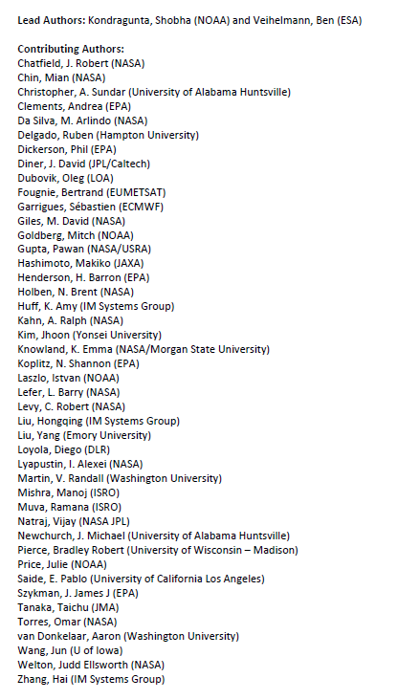
White Paper
Title: “Monitoring Surface PM_{2.5}: An International Constellation Approach to Enhancing the Role of Satellite Observations”
Authors: 46 from academia and space agencies, led by S. Kondragunta (NOAA) and B. Veihelmann (ESA)
Executive Summary (1/2 page)
Recommendations (1 page)
Detailed discussion: status, needs, best practices
Satellite sensors that bring PM information
Satellite products and consistency
Approaches to constrain particulate pollution levels
Validation
References
Appendices

Slide 4
White Paper Recommendations
Exploit NRT information from meteorological imagers
Exploit information from multi-angle polarimetric imagers
Exploit vertical information from spectrometers
Develop synergetic aerosol retrievals from multiple sensors
Enhance consistency of aerosol products (→ AEROSAT)
Enhance radiometric consistency of space-borne sensors (→ GSICS)
Develop fast forward operators for assimilation of satellite observations
Improve consistency of aerosol representation in models and satellite products
Improve uncertainty estimates in satellite aerosol products,
Develop schemes for assimilation of Level-1 satellite data
Improve aerosol models and Level-2 assimilation schemes (→ AEROCOM)
Develop data processing tools incl. machine learning
Create ground-based validation supersites with comprehensive sets of sensors
Enhance ground-based observation infrastructure including low-cost PM sensors
Facilitate data access
Satellite Products
Interface with Model
Validation

Slide 5
Way Forward: Roadmap for the implementation of the white paper
Use cases (proposed by AC-VC leadership)
Integrating Satellite Derived PM_{2.5} into EPA’s AirNow System
Copernicus Atmospheric Monitoring System use of satellite aerosol products
Enhancing Air Quality Decision-making Activity in Indian Megacities through Assimilation of NASA Earth Observations and Development of a Decision Support System
Monitoring, Forecasting Air Quality and Building Capacity in Asia through NASA-USAID Partnership

Slide 6




GeoXO Atmospheric Composition Capabilities
Presented by Shobha Kondragunta
Joanna Joiner
Instrument Scientist
Shobha Kondragunta
Product Scientist
Greg Frost
User Scientist
Disclaimer: The scientific results and conclusions, as well as any views or opinions expressed
herein, are those of the author(s) and do not necessarily reflect those of NOAA or
the Department of Commerce.

Slide 7
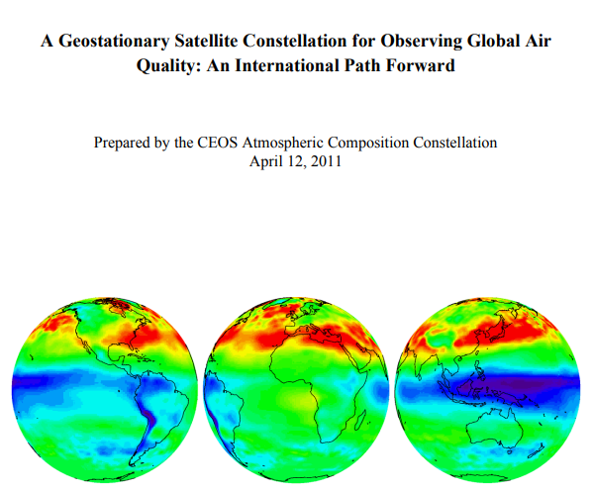
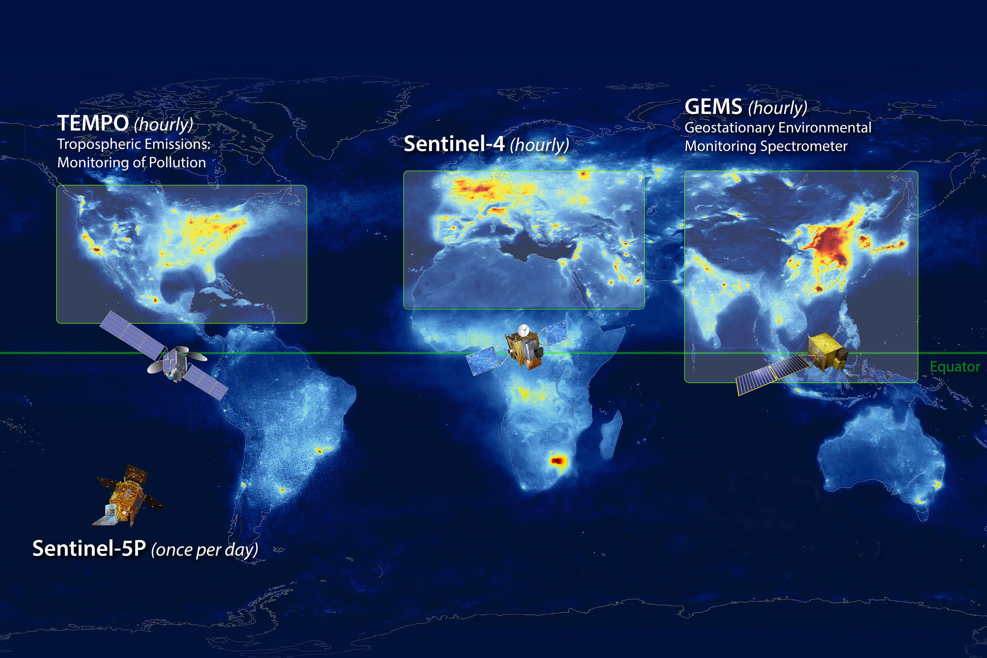
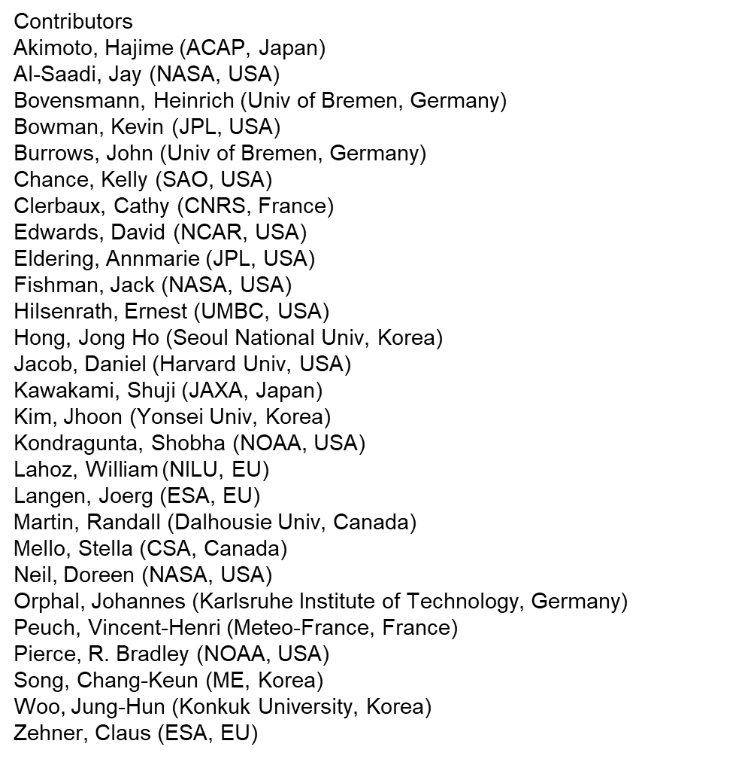
Notes:
Geo-ring for air quality concept originated originally under CEOS atmospheric composition virtual constellation discussion. A white paper was written in 2011 with all space agencies agreeing that identical instruments (spectrometers) should be flown on geostationary satellites to capture changing global diurnal air quality. NOAA/NESDIS was part of this study and contributed to the white paper. It is a very good thing that NOAA is onboard with its GeoXO ACX instrument as an operational follow-on to TEMPO as both Sentinel-4 and GEMS have operational follow-ons.

Slide 8
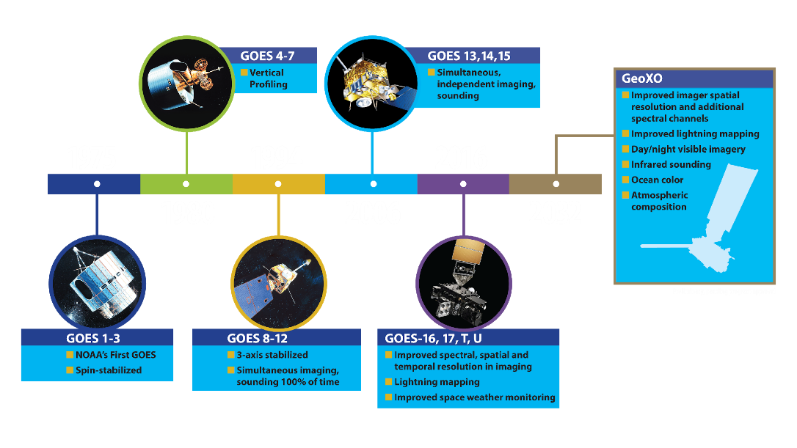
NOAA’s Legacy of Geostationary
Operational Environmental Satellites
1975
1994
2016
1980
2006
2032

Slide 9
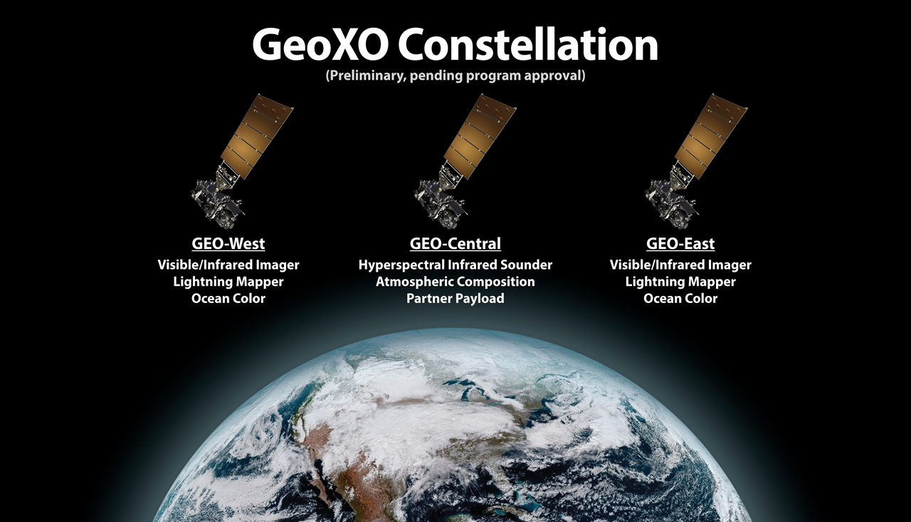
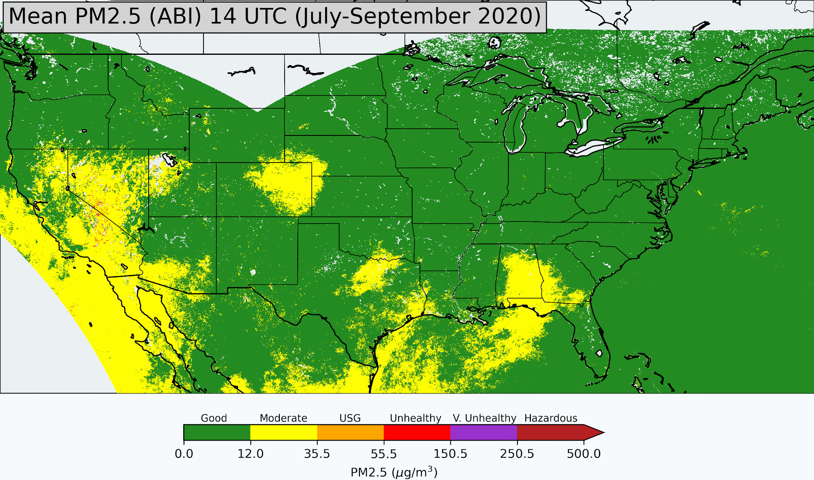
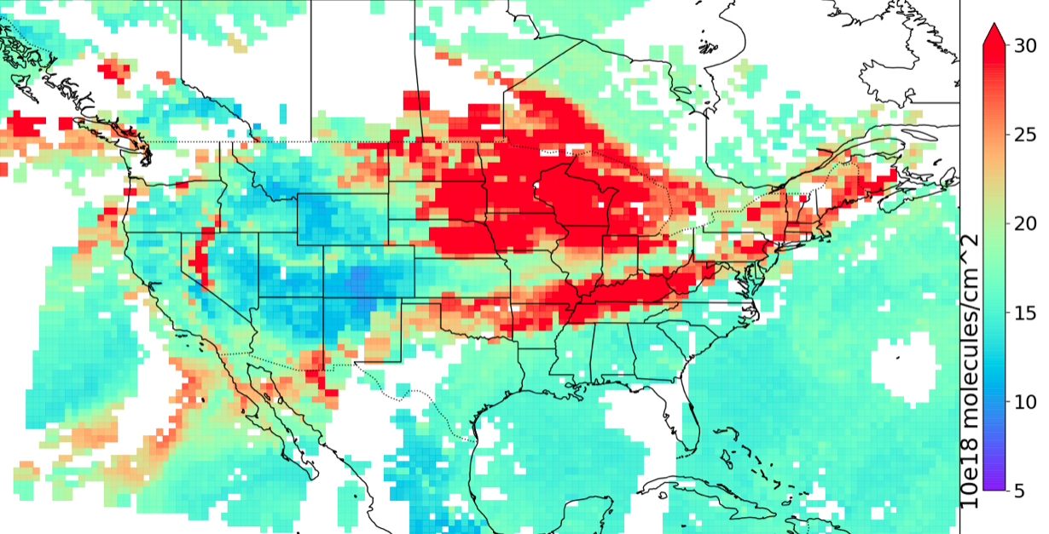
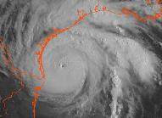
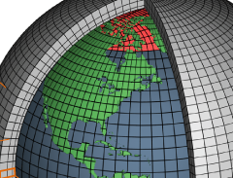
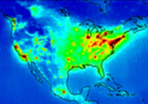
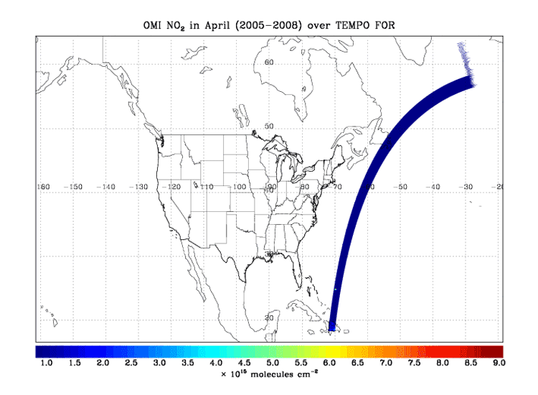
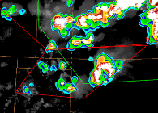

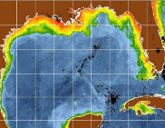
Atmospheric Composition: A Multi-Instrument Synergy
Vis/IR Imager (GXI)
Fire detection
Fire radiative power
Aerosol type
Aerosol optical depth
Aerosol concentration
IR Sounder (GXS)
Ozone
Carbon monoxide
Carbon dioxide
Ammonia
Vis/Near-IR Imagery
IR Sounding
Atmos. Composition
UV/Vis Spectrometer (ACX)
(TEMPO analog)
Ozone
Nitrogen dioxide
Sulfur dioxide
Formaldehyde
Aerosol layer height
UV AI
UV aerosol optical depth
CO total column, CrIS on NOAA-20, 14 Sep 2020
OMI NO₂ over TEMPO field of regard
Lightning Mapping
Day/Night Imagery
Ocean Color
Joint ABI/VIIRS Flood Product used to help response in Nicaragua

Slide 10
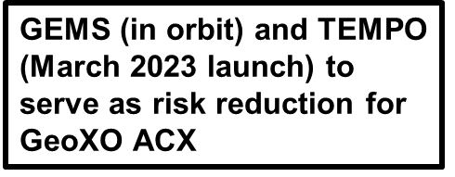
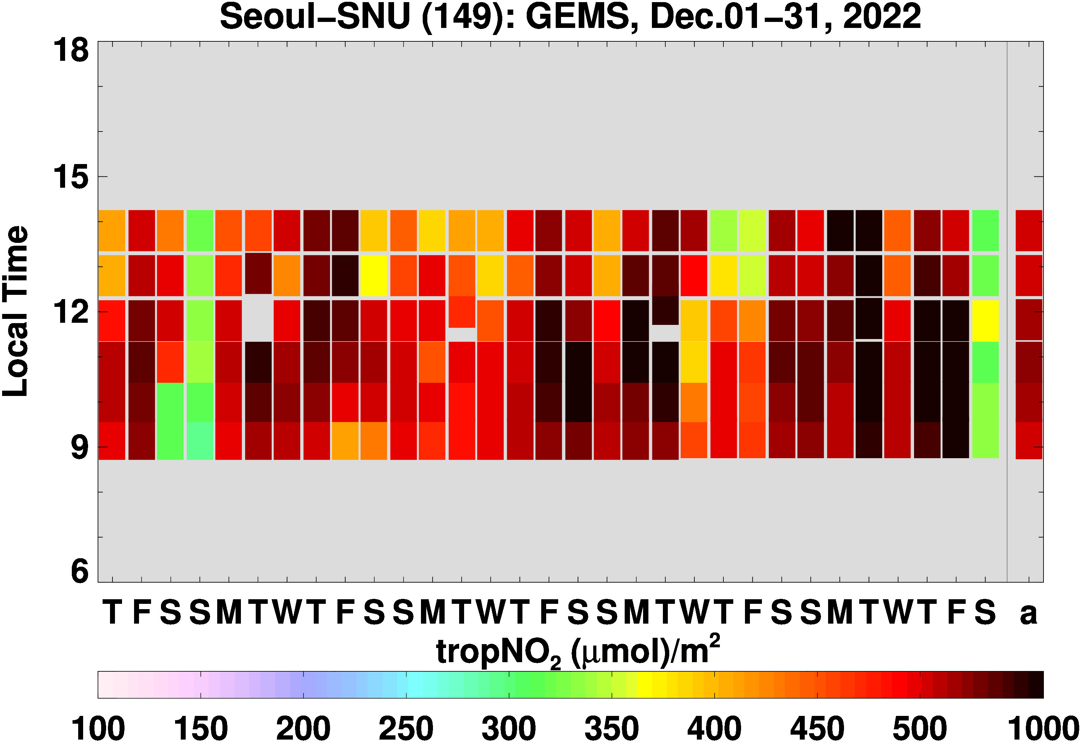
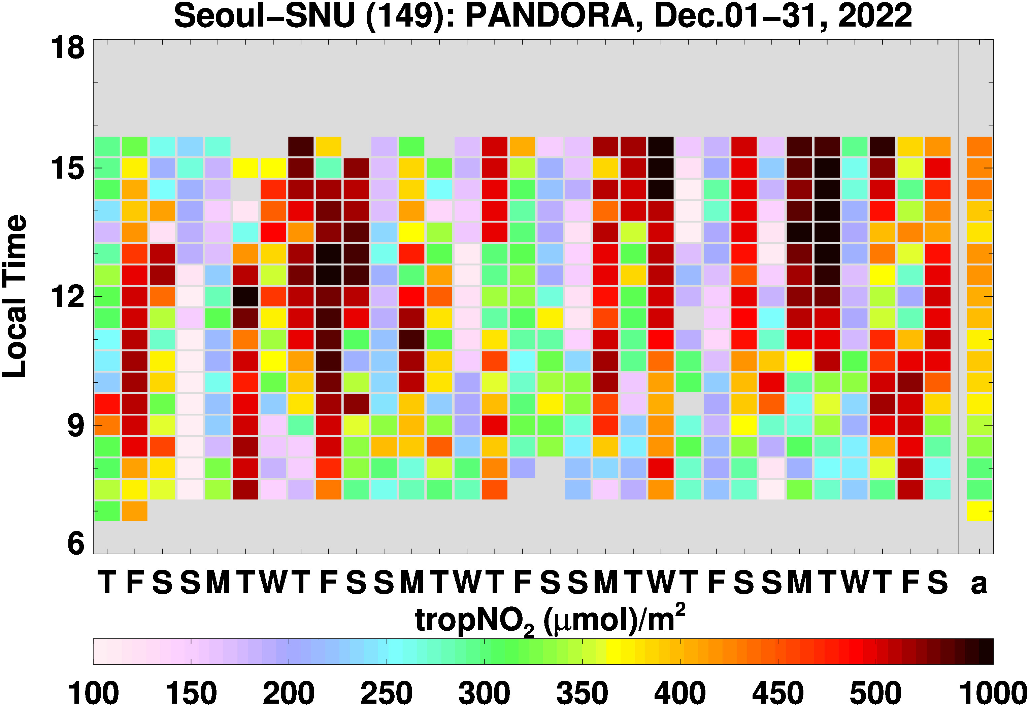
GeoXO ACX Instrument
Attribute |  | What |  | Why
Coverage |  | CONUS, southern Canada, northern Mexico, Caribbean |  | Hourly inputs to national air quality, hazard and fire forecasting capabilities and warnings.
Spatial Resolution |  | 8x3 km² @ nadir |  | Resolve sources, including cities, highway corridors, airports, oil/gas fields, large point sources like fires and power plants.
Temporal Resolution |  | 60 min |  | Capture diurnal variations in pollution emissions, photochemistry, and exposure. Detect episodic events like wildfires and volcanoes. Select for cloud-free conditions. Increase geographic coverage compared with LEO or surface observations.
Spectral Coverage / Resolution |  | UV: 300-500 nm Vis: 540-740 nm Both @ 0.6 nm |  | UV: ozone, nitrogen dioxide, formaldehyde, sulfur dioxide, absorption aerosol optical depth. Vis: cloud/aerosol layer height, PBL ozone, vegetation.
Analysis by Zigang Wei (IMSG at NOAA)
Notes:
GeoXO ACX attributes are similar to NASA’s TEMPO instrument. GEMS which is already in orbit does not have the second visible detector to do boundary layer ozone and aerosol layer height using oxygen absorption. NOAA is working with GEMS data and adapting some of its algorithms to run on GEMS radiances in preparation for TEMPO and ACX. The diurnal variations of NO2 over Seoul, New York, and Los Angeles shows the complexity of understanding air quality issues as these are region specific and source specific.

Slide 11
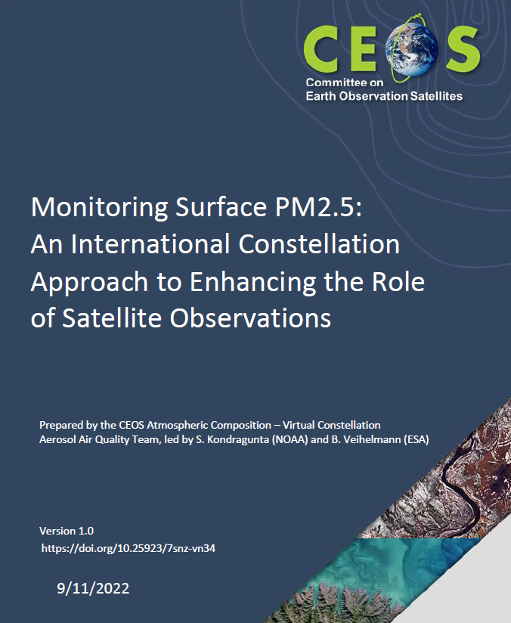
Pursue the exploitation of the near-real time (NRT) information on Particulate Matter (PM) from meteorological imagers.
Pursue the use of aerosol height information from hyperspectral imagers for constraining surface PM. Pursue the development of related fast forward operators.
Top 1 and 3 recommendations
Notes:
CEOS atmospheric composition virtual constellation just completed writing a 100-page white paper on monitoring fine particulate matter from satellites. The top 2 recommendations of the white paper are use met imagers to derive information and work with spectrometers like GEMS, TEMPO, and ACX to derive aerosol layer height. NOAA has begun investing in the development of aerosol layer height product that will be discussed in the next few slides.

Slide 12
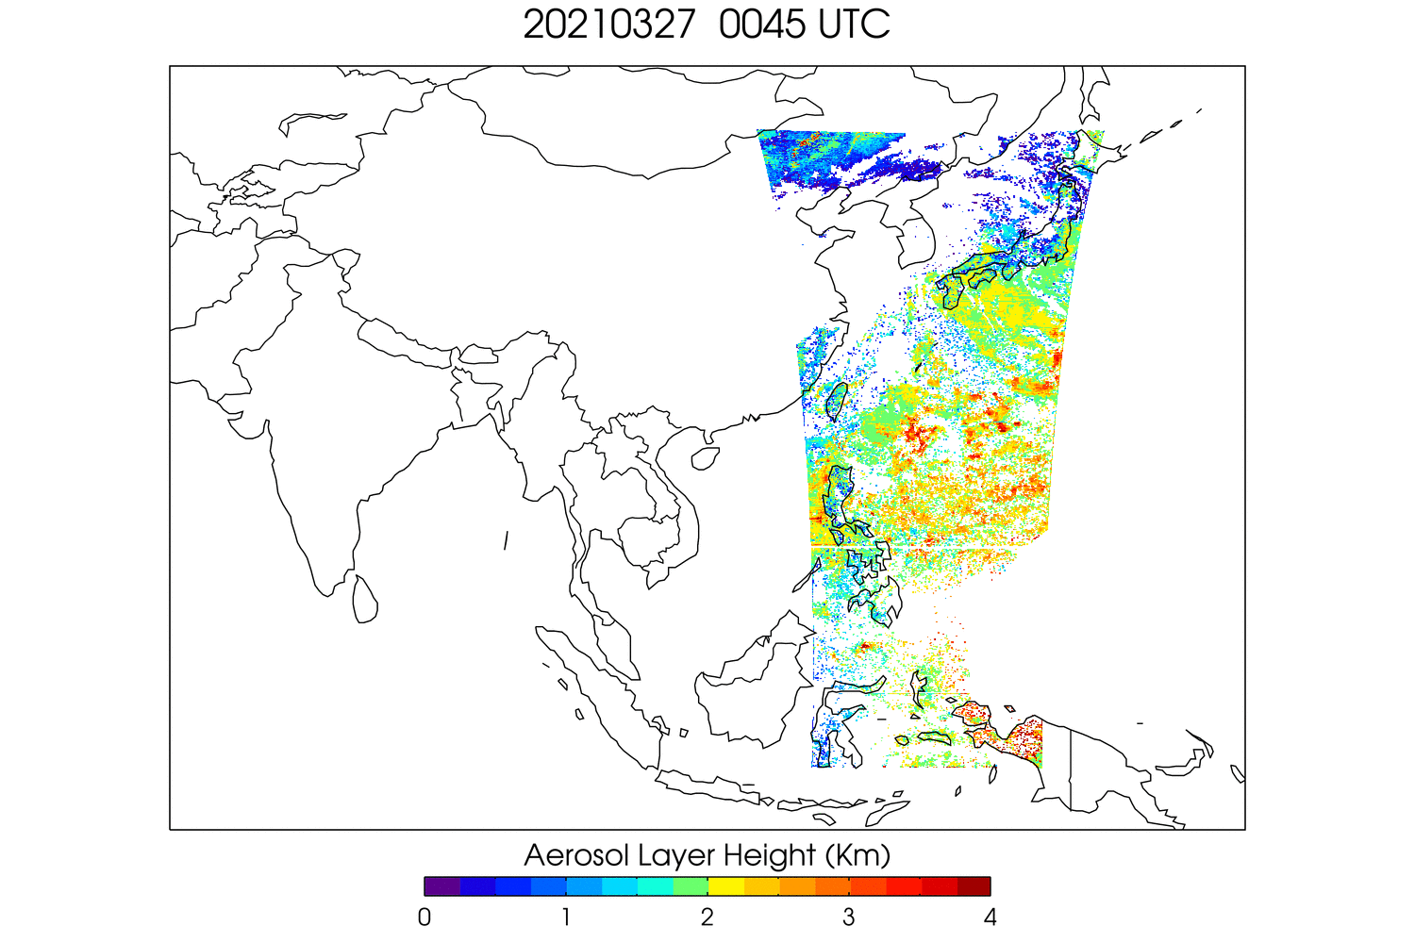
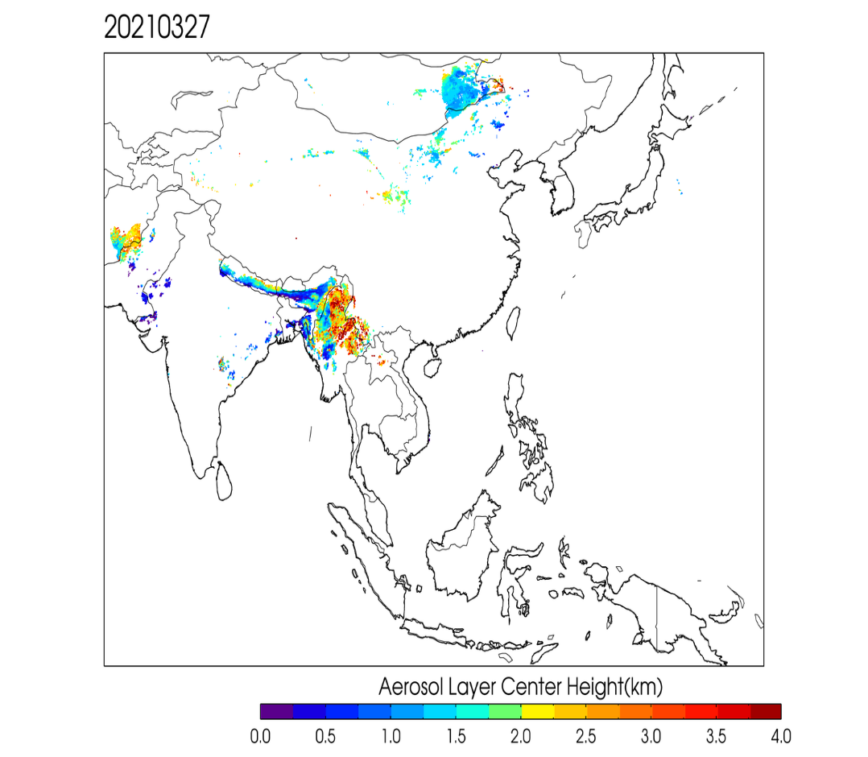
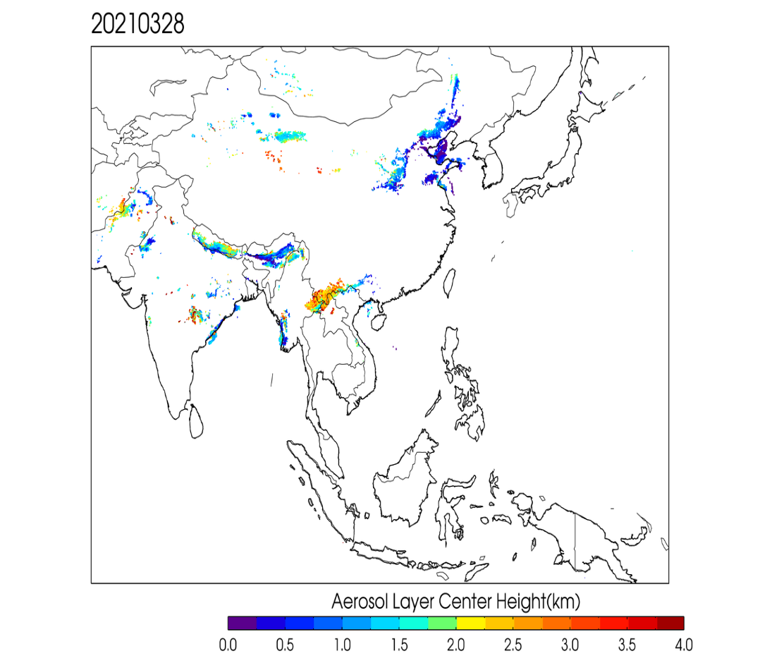
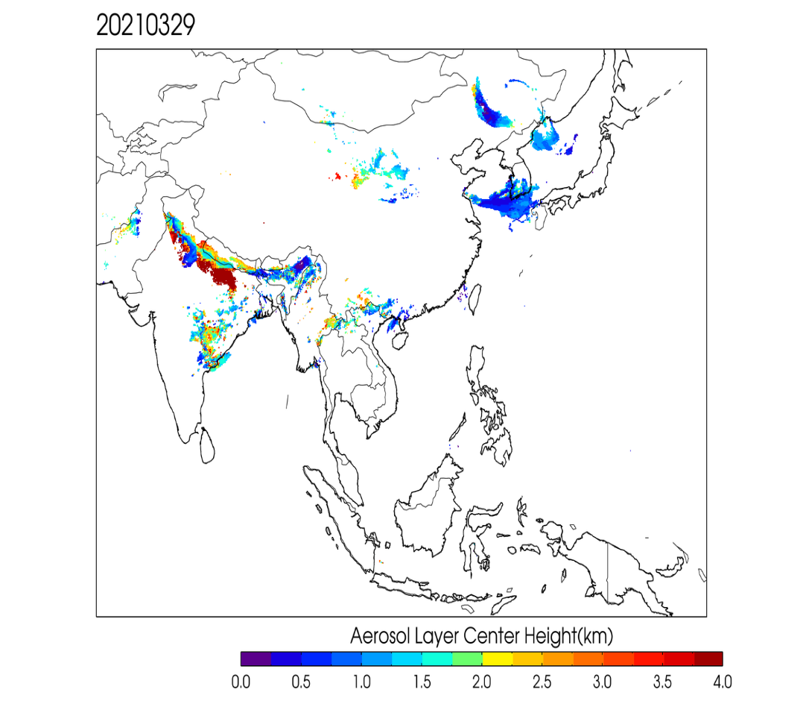
Preparing for GeoXO ACX and TEMPO using GEMS Data
S5P TROPOMI ALH
GEMS provides eight hourly observations per day. Three-day animation of aerosol layer height is shown on the left
TROPOMI provides one observation per day. Daily images of TROPOMI shows lack of spatial coverage as well as diurnal changes
Analysis by Pubu Ciren (IMSG at NOAA)

Slide 13
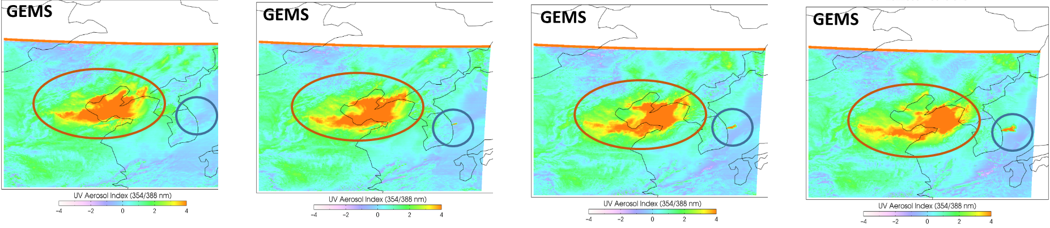
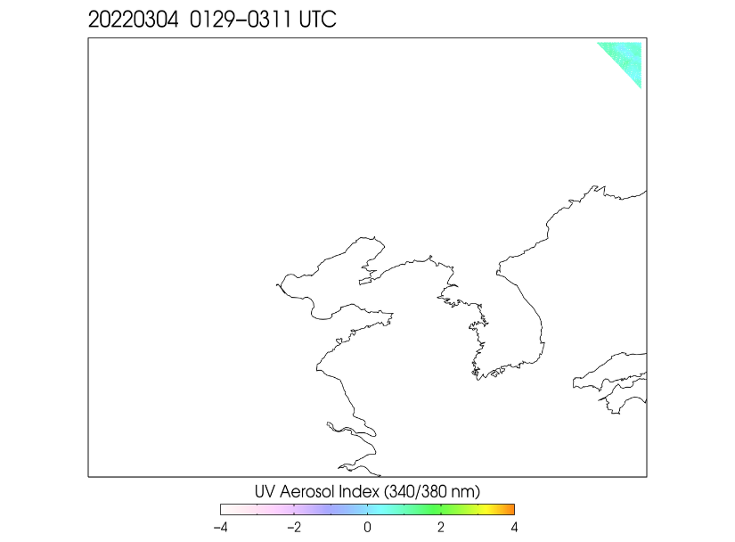
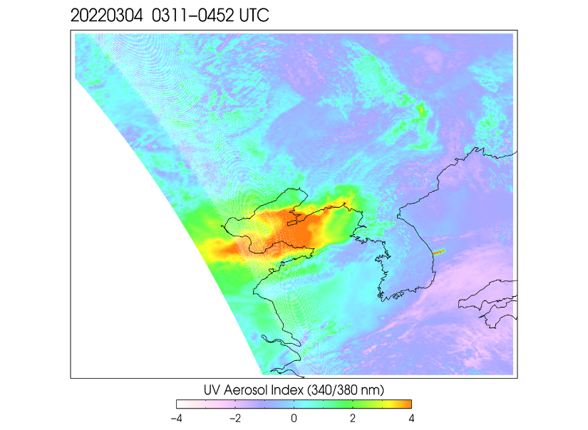
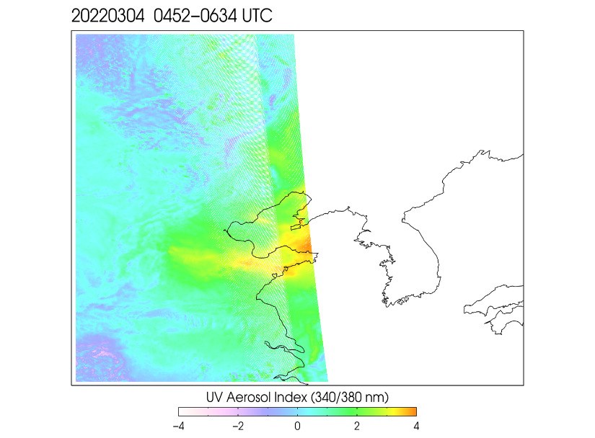
UV Aerosol Index (March 4, 2022)
0245 UTC 0345 UTC 0445 UTC 0545 UTC
TROPOMI
TROPOMI
TROPOMI
Analysis by Pubu Ciren (IMSG at NOAA)

Slide 14
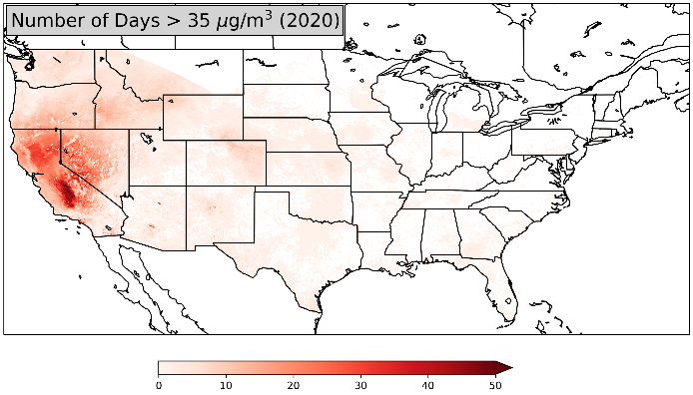
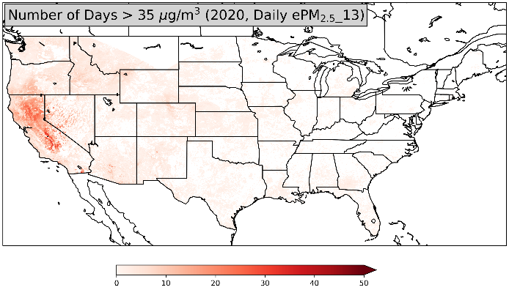
Value of Geostationary Satellite Observations of Air Quality
GEO imager observations provide better estimates of fine particulate pollution (PM2.5) and the resulting exposure of harmful levels of pollution compared to LEO or surface observations.
GEO
Example: 2020 Gigafire event
On a daily basis, about 40% more people would be informed about harmful air quality using GEO observations compared with LEO data.
On an hourly basis, 10 times as many people would be informed about air pollution using GEO observations compared with surface-based data.
GEO sampled as LEO
Zhang et al., Nowcasting applications of geostationary satellite hourly surface PM2.5 data, Weather and Forecasting, 2022
Number of Days
Notes:
Using NOAA’s operational geostationary satellite estimates of hourly surface fine particulate matter concentrations, we also investigated to see how many days in a year do we have air quality standard violated? When we did this study using geo vs. leo, we quickly found that the information content from geo is so much more than leo due to density of observations. Again, most of the air quality standard violations are in the west because that is where most of the fire activity is. In the east, due to pollution control strategies, we no longer see air quality standard violations.

Slide 15
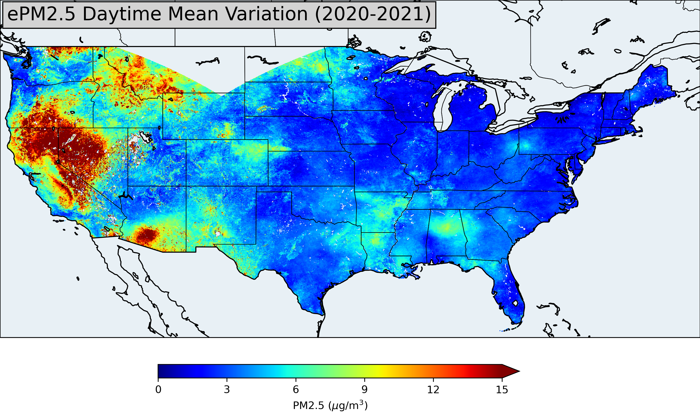
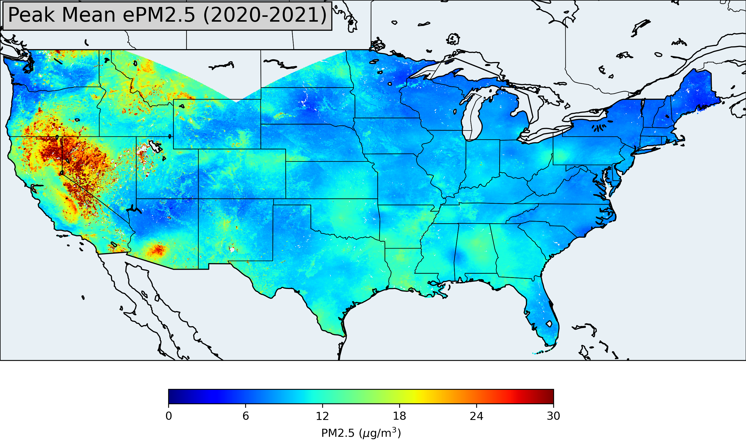
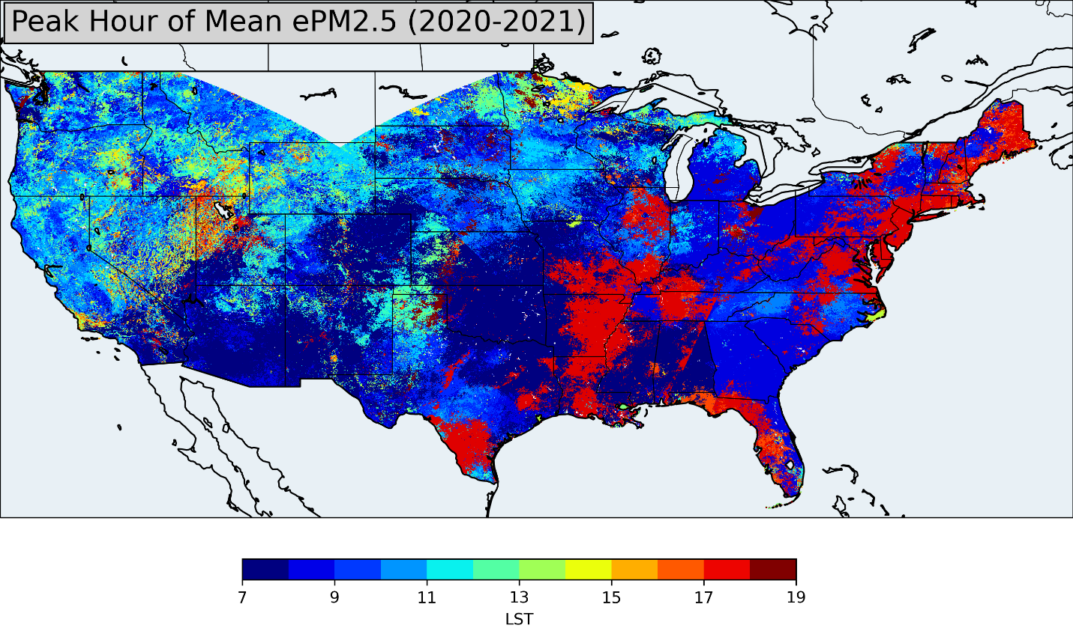
Value of Geostationary Satellite Observations of Air Quality
Zhang et al., Nowcasting applications of geostationary satellite hourly surface PM2.5 data, Weather and Forecasting, 2022
Notes:
This slide and next slide show why having geostationary satellite data are beneficial. NOAA has been flying an imager for several decades and now we have an advanced baseline imager with onboard calibration that can provide good aerosol retrievals. For air quality applications, we converted the aerosol optical depth to surface fine particulate matter concentrations to conduct some scientific studies. This map shows what time of the day pollution peaks. Indeed, consistent with our understanding of planetary boundary layer dynamics, sources, and chemistry pollution peaks either in the late evening or early morning associated with rush hour traffic. Whereas in the west where wildfires dominate fine particulate pollution, it peaks during the day because fires have strong diurnal variation and peak during the day.

Slide 16
ACX Science Team Members
Susan Anenberg | Laura Judd
Jerome Barre | Shobha Kondragunta²
Trevor Beck | Istvan Laszlo
Patricia Castellanos | Randall Martin
David Edwards | Brian McDonald
Lawrence Flynn | R. Bradley Pierce
Gregory Frost³ | Ivanka Stajner
Gonzalo Gonzalez Abad | James Szykman
Katherine Hawley | Omar Torres
Barron Henderson | Luke Valin
Daven Henze | Jun Wang
Joanna Joiner¹
Advisors:
Andrew Heidinger
Dan Lindsey
Mitch Goldberg
Walter Wolf
Monika Kopacz
Kathryn Mozer
Barry Lefer
Support:
Victoria Breeze
Shiv Das
‡Starting May 2024
¹ACX Instrument Scientist
²ACX Product Scientist
³ACX User Scientist

