Slide 1

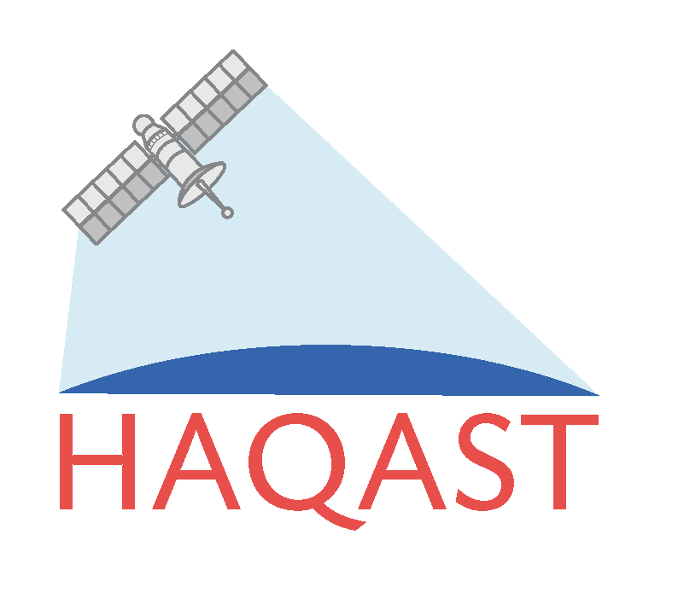


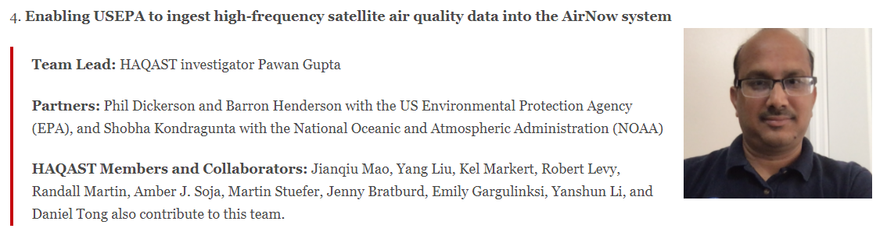


AirNow HAQAST “Tiger Team”
John Haynes
Health and Air Quality Applied Science Team (said hay-cast)
  Program Manager: John Haynes; Team Lead: Tracey Holloway
  Similar to Air Quality Applied Science Team (AQAST)
  Combines PI-specific projects and Tiger Teams
Tracey Holloway
Pawan Gupta
Tiger Team Goal: Integrate near-real-time satellite-derived PM2.5 from NOAA’s GOES-East/West into AirNow.
https://haqast.org/tiger-teams/
Notes:
I want to start by highlighting the unique role that HAQAST plays. John Haynes and Tracey Holloway have built on previous programs, and created a collaborative space where satellite assets bring teams together.
Today, I’ll be highlighting the great work that Pawan is leading with Phil Dickerson and I at the EPA and Shobha Kondragunta at NOAA. Bringing together academics and three federal agencies. The goal here is to bring Geostationary satellite data into the AirNow system at EPA.

Slide 2
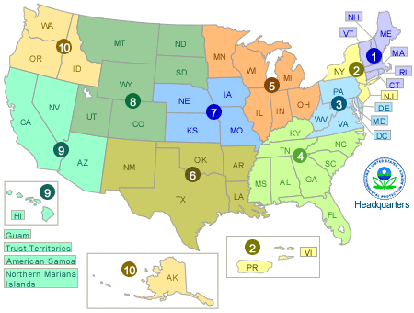
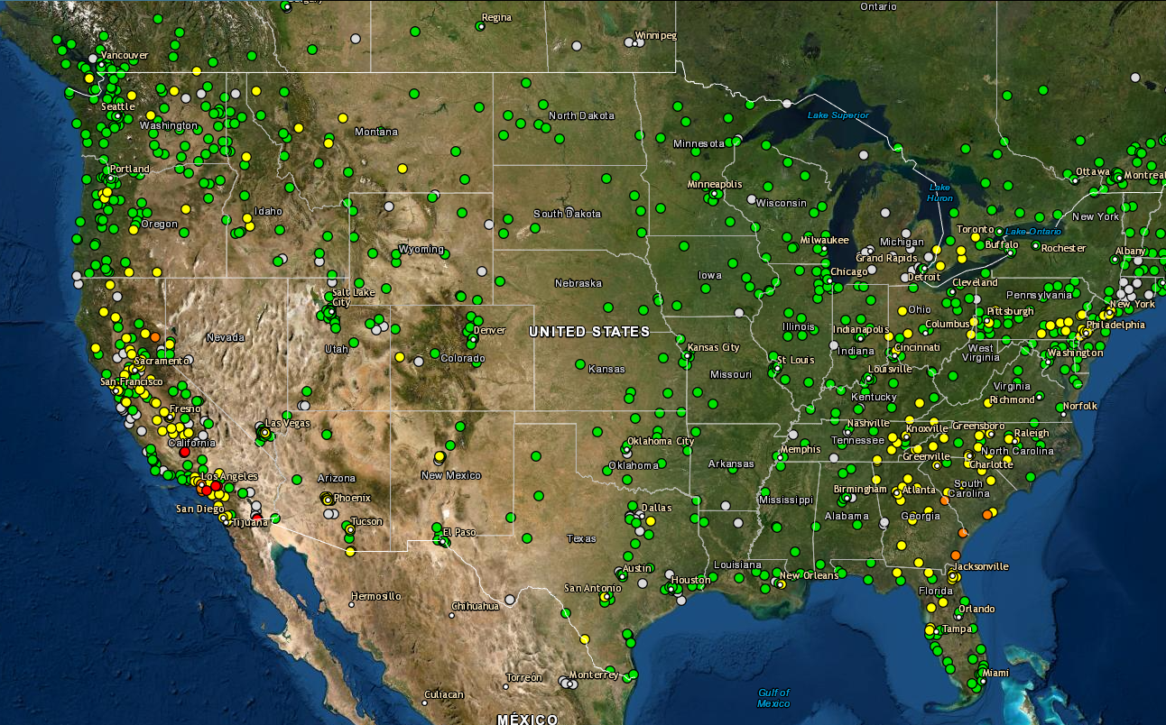

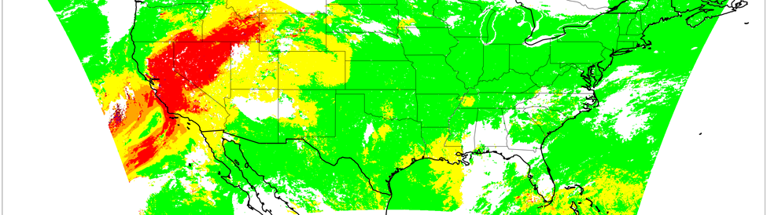
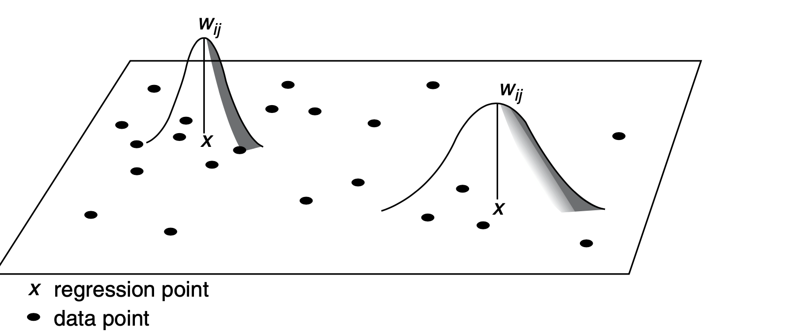

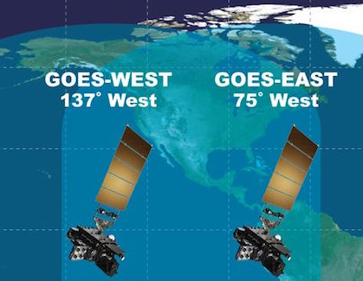
Final Product Data/Process Flow
State/Local/Tribe
Monitor Data
AirNow API
Combines established data links, operationalization of existing data, and new developments from HAQAST.
SLT Monitor reporting
  Received by AirNow
  Distributed via API
  QA and processing: ~1 hourly
NOAA GOES Satellite Products
  ~5-minute scans
  L0,L1,L2 on AWS < 10min
  Adjustments to over water cells.
NOAA GWR starts after monitors and L2 data is retrieved
  Zhang and Kondragunta (2021)
  Updates and further evaluation in manuscript
GWR Adjustments: Post-processed based on error characterization
Estimated initial latency: 2-hours
  Meets current analysis of time needs
  Also, considering methods of “NowCasting” satellite-derived PM2.5
How would this be brought in?
Project
Development
Web Service
Periodic Error Eval
Error Correction
Operationalizing
NOAA GOES AOD
AOD Correction
AOD CONUS Files
L0,L1 Files
Zhang and Kondragunta (2021) doi: 10.1029/2020EA001599
Notes:
This flow chart explains how the system works. AirNow collects data from state, local, and tribal agencies. The AirNowAPI shares that data with anyone including our federal partners. NOAA captures the satellite aerosol optical depth and pairs it with EPA’s surface monitors. NOAA then develops a linear relationship that spatially varies and accounts for spatial correlation. That product will then go through an error correction algorithm, and be delivered in standard geospatial formats. The standard geospatial formats can then be displayed via AirNow to the public.

