Slide 1


AirFuse
A multi-pollutant fusion system
Barron H. Henderson^{1,4}
Contributors: Phil Dickerson^{1,4} Pawan Gupta^{2,4}, Shobha Kondragunta^{3,4}, Yang Liu^{4,6}, Meng Qi⁶, Alqamah Sayeed, Hai Zhang^{3,4}, Janica Gordon⁵, Halil Cakir¹, Brett Gantt¹, Benjamin Wells¹, Marcus Hylton⁷, Youngsun Jung⁹, and the HAQAST AirNow Teams⁴
¹US EPA Office of Air Quality Planning and Standards; ²National Aeronautics and Space Administration; ³National Oceanic and Atmospheric Administration / National Environmental Satellite, Data, and Information Service; ⁴NASA Health and Air Quality Applied Sciences Team and Tiger Teams; ⁵North Carolina Agricultural and Technical State University; ⁶Emory University; ⁷AirNow Data Management Center; ⁹National Oceanic and Atmospheric Administration / National Weather Service
Disclaimer: The views expressed in this presentation are those of the authors and do not necessarily reflect the views or policies of the U.S. Environmental Protection Agency.

Slide 2
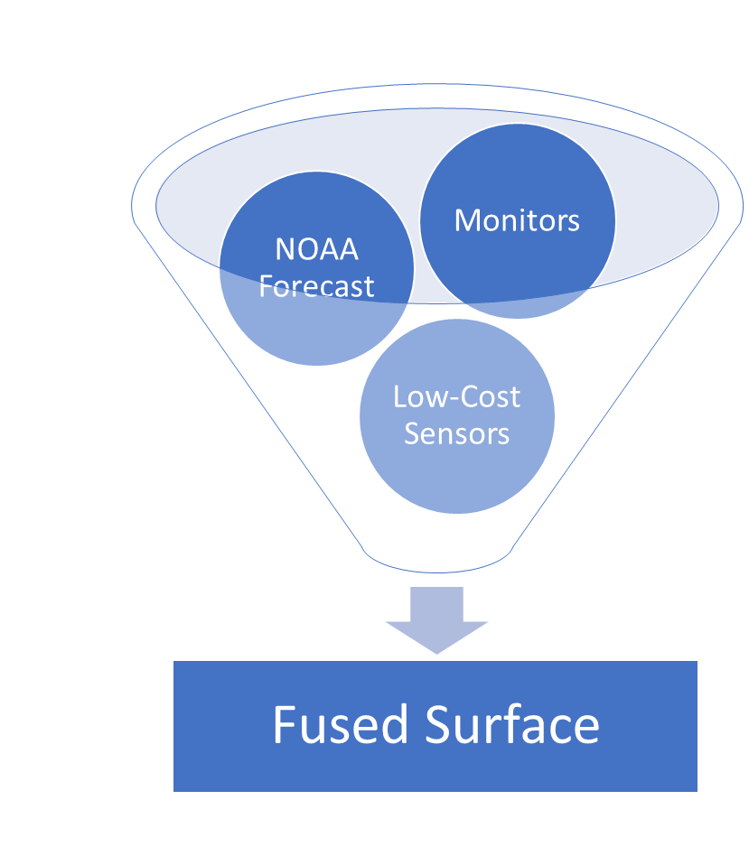
AirFuse: hourly maps of PM_{2.5} and ozone for AirNow
Satellite
Fuses best available data sources
NOAA Forecast w/bias correction
AirNow monitors (~1000 per hour)
PurpleAir sensors (~9k per hour)
Near-real-time satellite observations
  Recent development by NOAA/NESDIS/STAR
  NASA HAQAST project connecting AirNow to NOAA geostationary satellite data
Ozone too, but no sensor or satellite data.
Available on airnowtech.org since March 2024
Notes:
Available on airnowtech.org

Slide 3
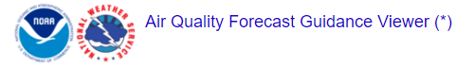
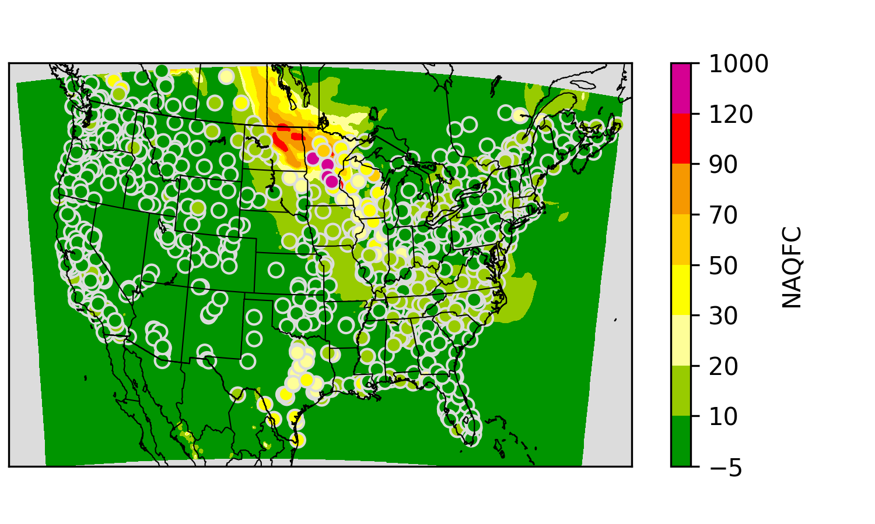
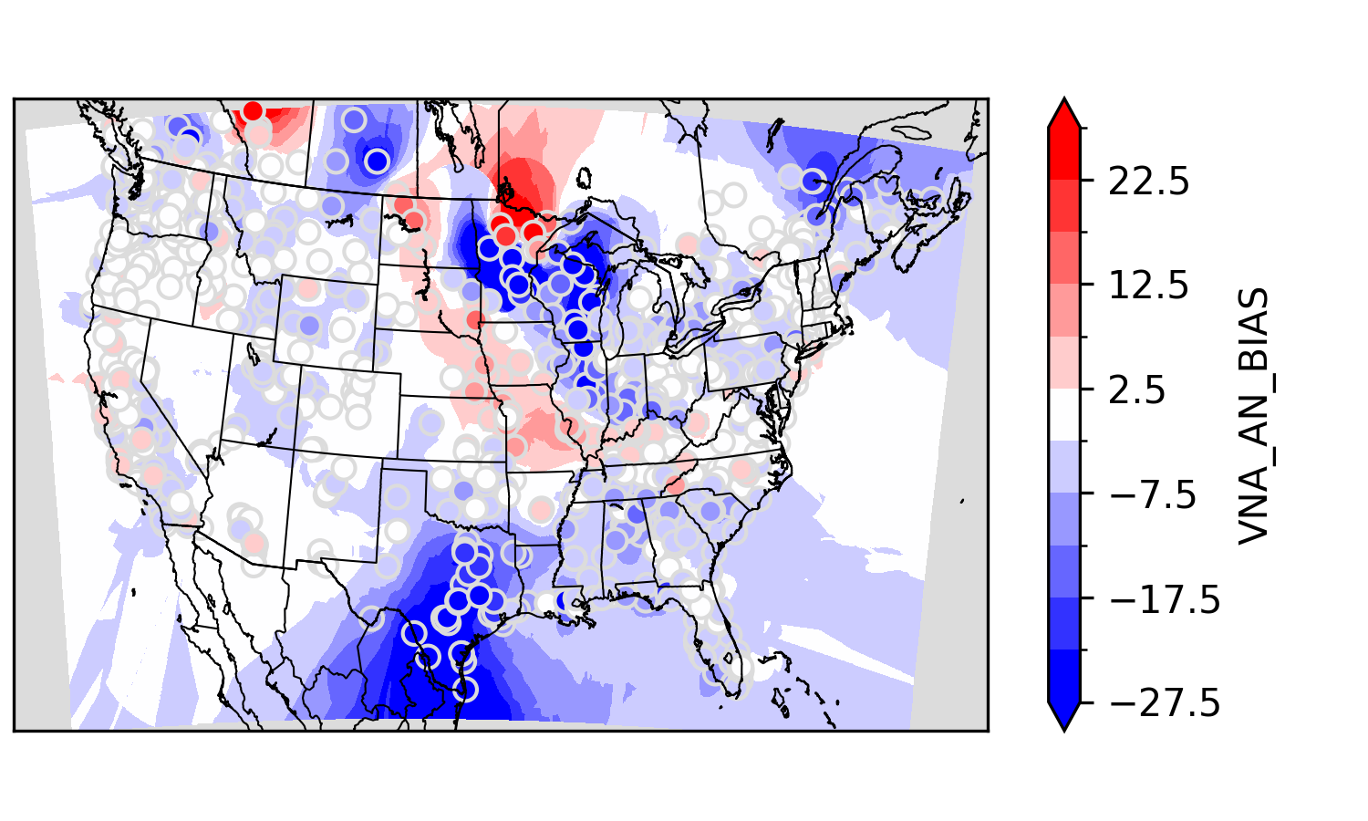
Calculate the bias of NOAA’s forecast
https://digital.mdl.nws.noaa.gov/
NOAA’s National Air Quality Forecast
  CMAQ forecasts concentration
  Kalman filter analog system forecasts bias
  Bias interpolated to grid cells (Glahn et al.) to “correct” model
Why not use this directly?
  AirFuse corrects using multiple sources.
  In AirNow bias has already happened, so the correction can be updated.
Identify bias based on past observations
  Bias using near-real-time observations.
  Interpolation using Delaunay diagram
NAQFC+
AirNow Obs
Real-time Bias
Notes:
EPA Fire and Smoke Map

Slide 4
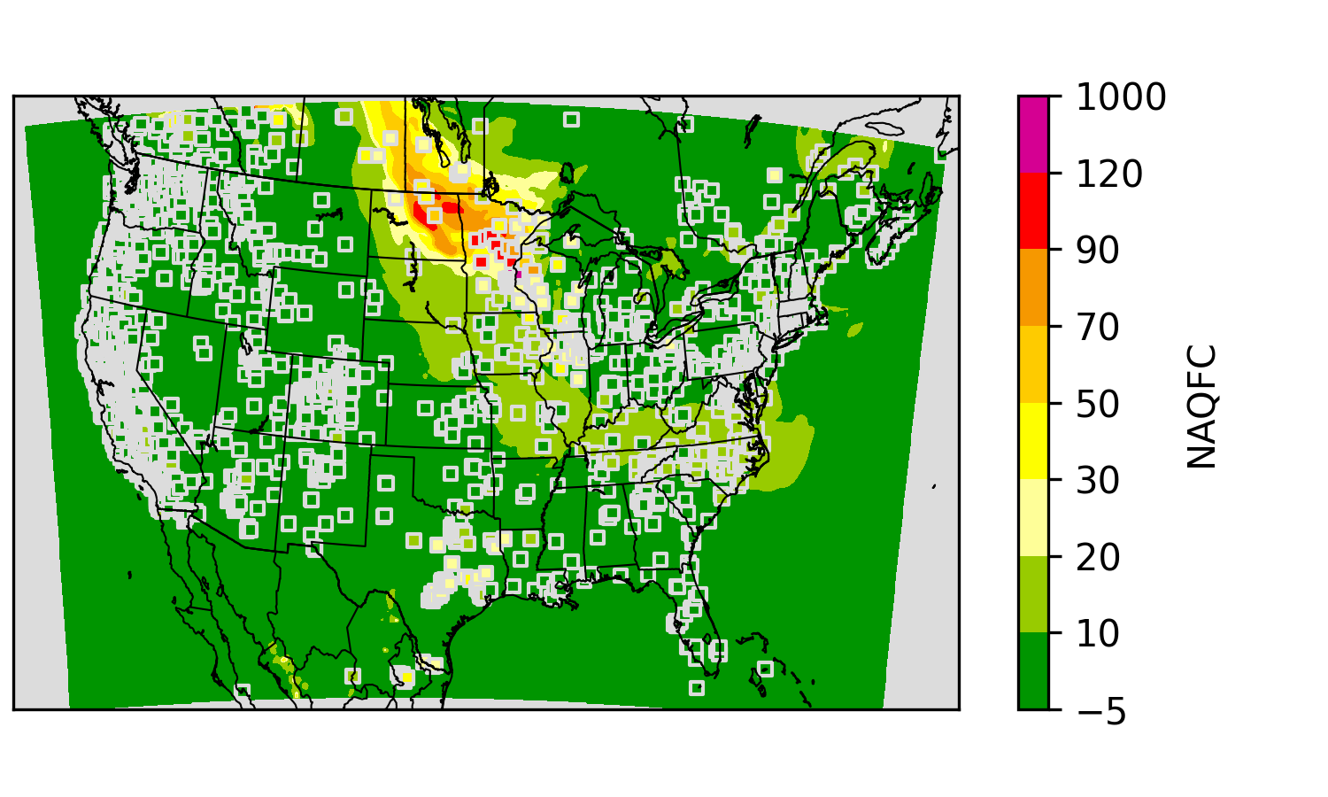
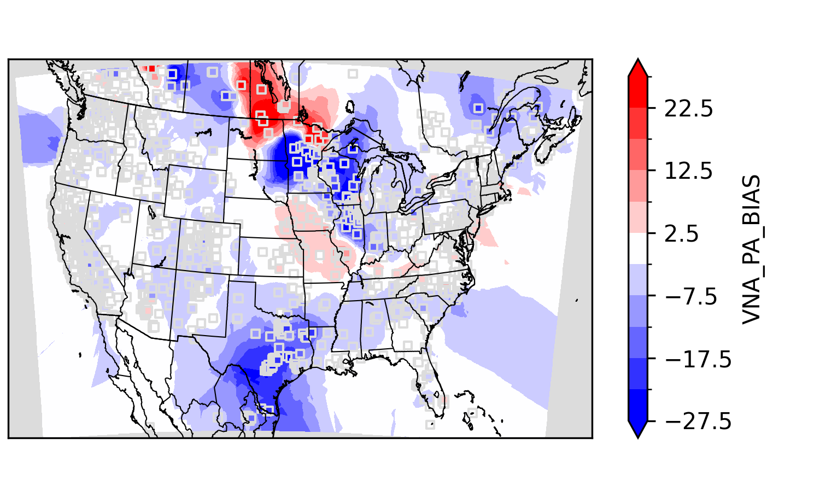
Calculate bias from sensors
NAQFC+ with PurpleAir
Schulte et al 2020 used PurpleAir
  Model Correction : Y = M_{n} - Krig(M_{n} – O_{n})
  Observations (O) from both AirNow and PurpleAir
  Improved validation statistics!
Using the EPA national correction
  Barkjohn et al. 2021 developed a national correction
  When PurpleAir is less than 210 micrograms/m3, PM is reduced by 0.0862 x Relative Humidity% (50%: -4.31 and 35%: -3.02)
Identify bias based on past observations
  Bias using near-real-time observations.
  Interpolation using Delaunay diagram
NAQFC+ Bias According to PurpleAir

Slide 5
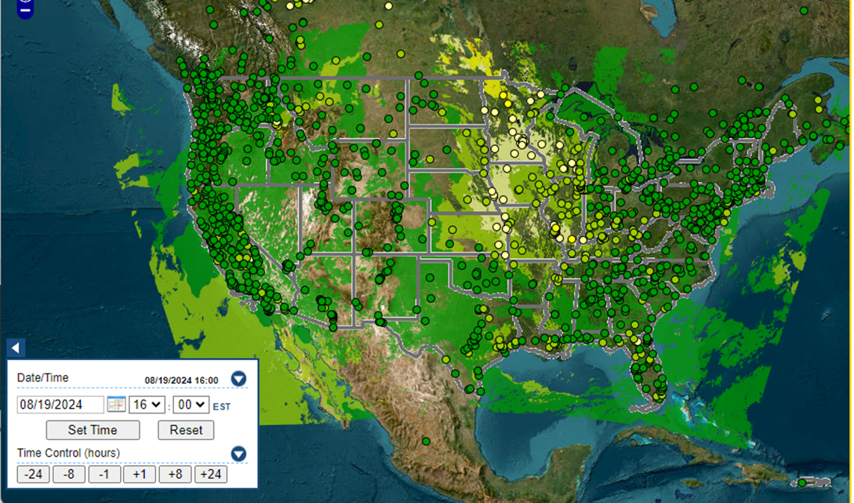
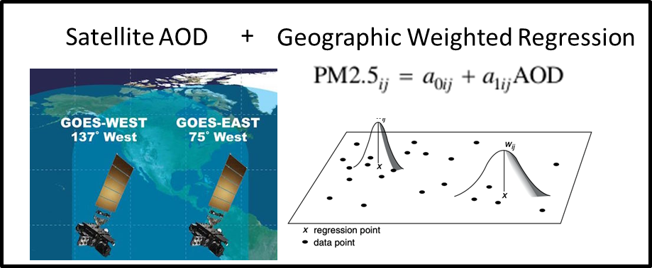
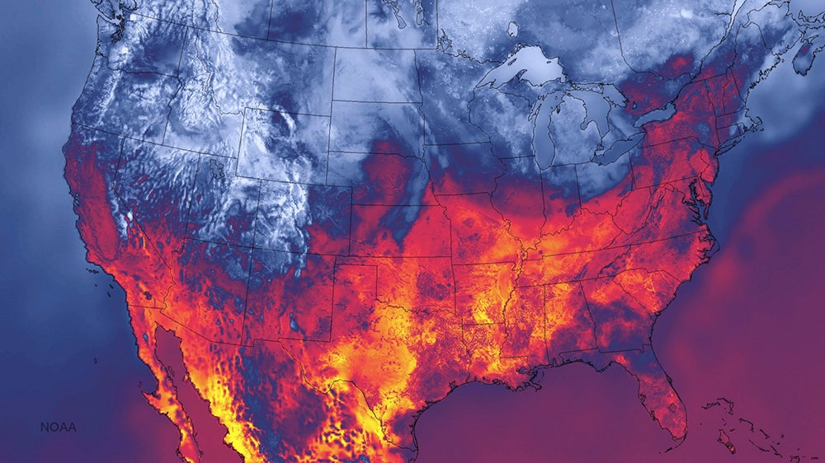
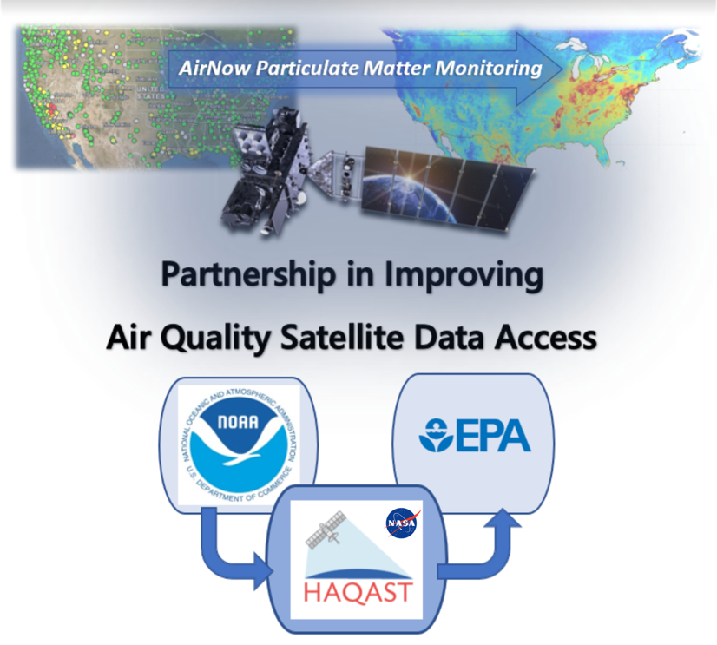
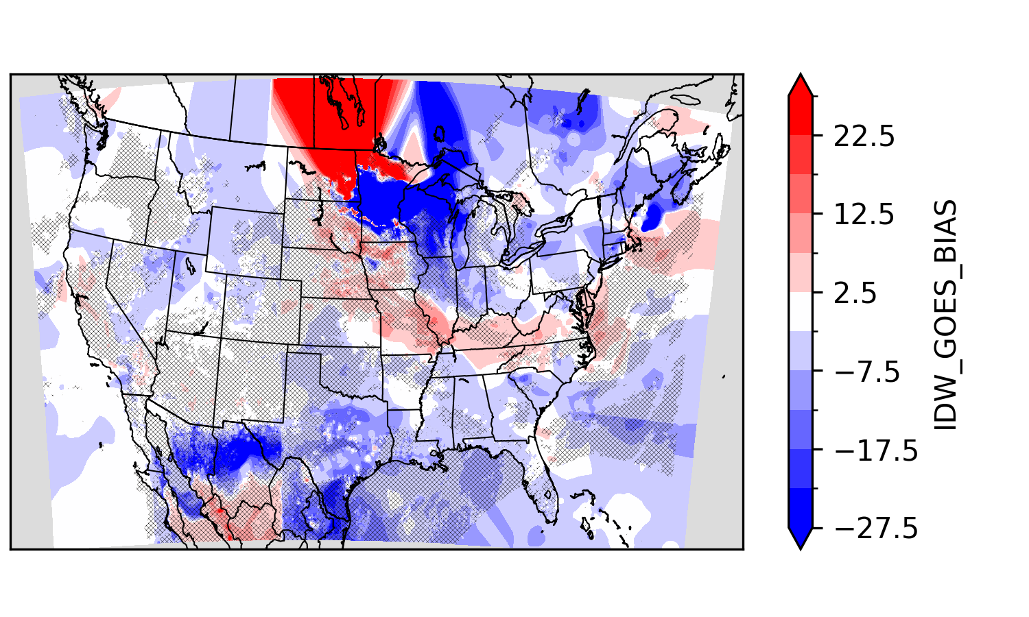
Calculate bias from geostationary satellite
Available on AirNow Tech
GOES AOD
[2]
Machine Learning
14 Blended
Deep Neural Networks
[3]
Hourly product with gaps
NOAA HRRR Model (3km)
NAQFC Bias*
[1]
HAQAST Tiger Team Leads: Pawan Gupta and Yang Liu
Partners: Phil Dickerson and Barron Henderson (EPA), and Shobha Kondragunta (NOAA)
Bratburd et al.: Air Quality Data When You Need It: Incorporating Satellite Data Updates into AirNow, EM Plus, 2022.
Zhang et al.: Nowcasting Applications of Geostationary Satellite Hourly Surface PM2.5 Data. Weather and Forecasting, 37(12), 2313-2329, 2022. doi: 10.1175/WAF-D-22-0114.1
Sayeed et al: Deep Neural Network bias corrections (submitted);
O'Dell et al.: Public Health Benefits from Improved Identification of Severe Air Pollution Events with Geostationary Satellite Data, GeoHealth, 2023.
Notes:
Available on AirNowTech
Geostationary satellites are home bodies while polar satellites are globe trotters.
Geostationary Operational Environmental Satellites (GOES) stare at the US all day long.
Not like polar satellites passing once at 10am and once at 2pm (if you have two satellites)
From an US perspective, GOES satellites view the western US from the pacific and the eastern US from the atlantic.
Shobha Kondragunta and Hai Zhang fused with AirNow monitors by a geographic weighted regression.
Pawan led a tiger team to connect that data back to EPA.
There are a lot of technical details, but the upshot is simple.
We extensively evaluated the data, applied machine learning corrections, and we’re putting that data into various airnow systems like AirNowTech.
This is a great idea: federal agencies working together to provide tangible benefits to the American people from satellite data.
This project is taking that data a step further.
We’re going to bring the satellite data

Slide 6
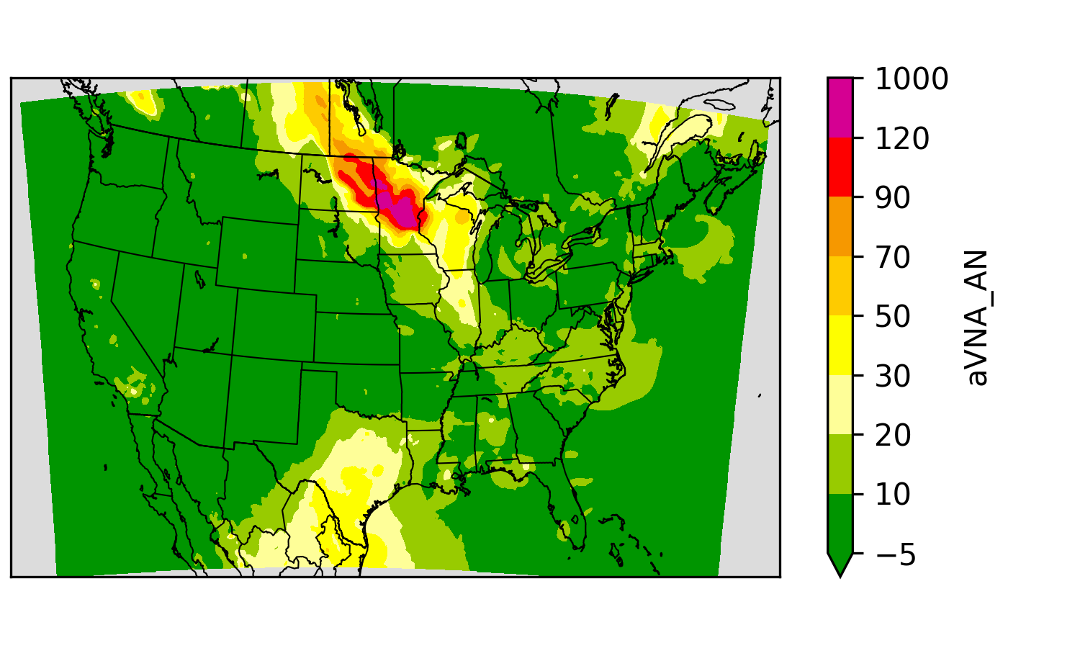
Hourly National-scale Fusion Ensemble
One layer from AirNow monitor (Y_{A}) observations:
  mostly regulatory grade hourly observations
  paired with collocated grid cell.
Model
Monitor Bias
Y_{A} = f(model, monitor)
*A multiplicative corrector of this type is called extended VNA (eVNA)
**Piece-wise regression as in Fire and Smoke Map
Notes:
NAQFC

Slide 7
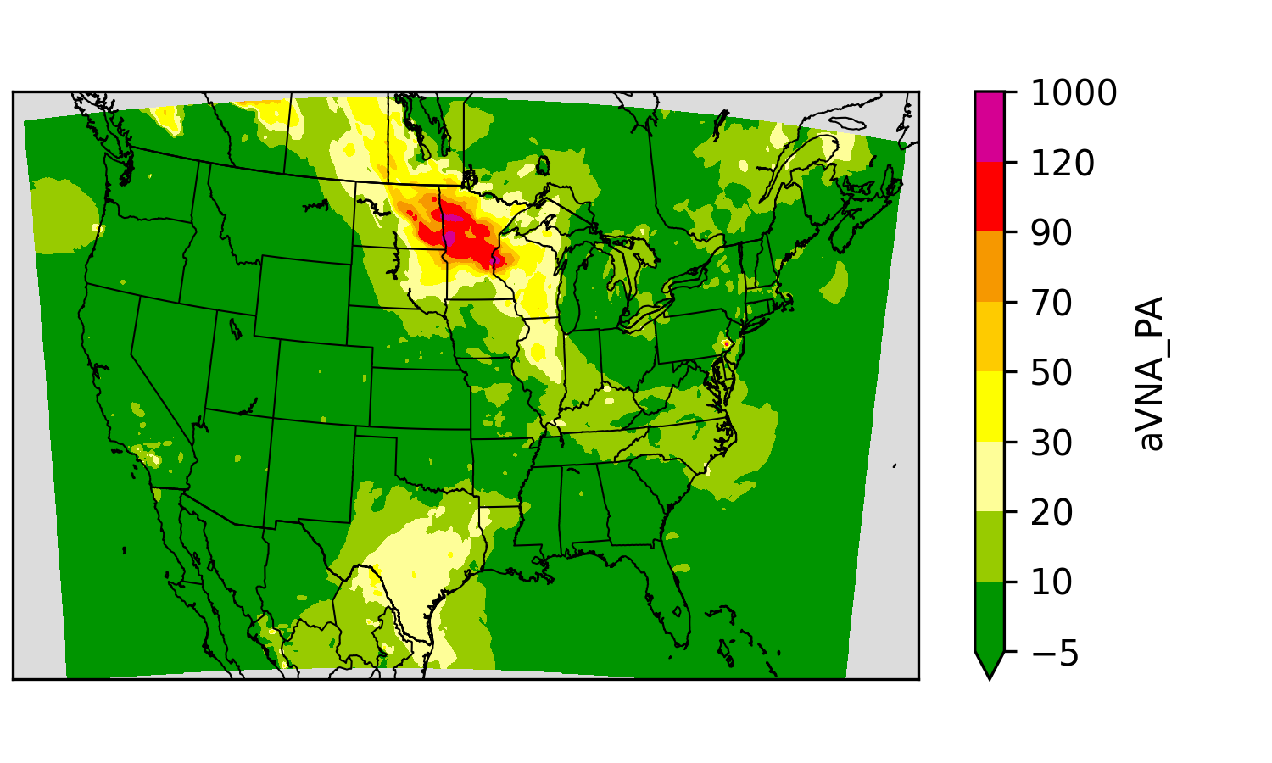
Hourly National-scale Fusion Ensemble
One layer from AirNow monitor (Y_{A}) observations:
  mostly regulatory grade hourly observations
  paired with collocated grid cell.
One layer from PurpleAir (Y_{P}) observations:
  low-cost sensor hourly observations with calibration**
  Aggregated within grid cells to create a pseudo-observation
Model
PurpleAir Bias
Y_{P}=f(model, sensors)
Y_{A}
Notes:
NAQFC

Slide 8
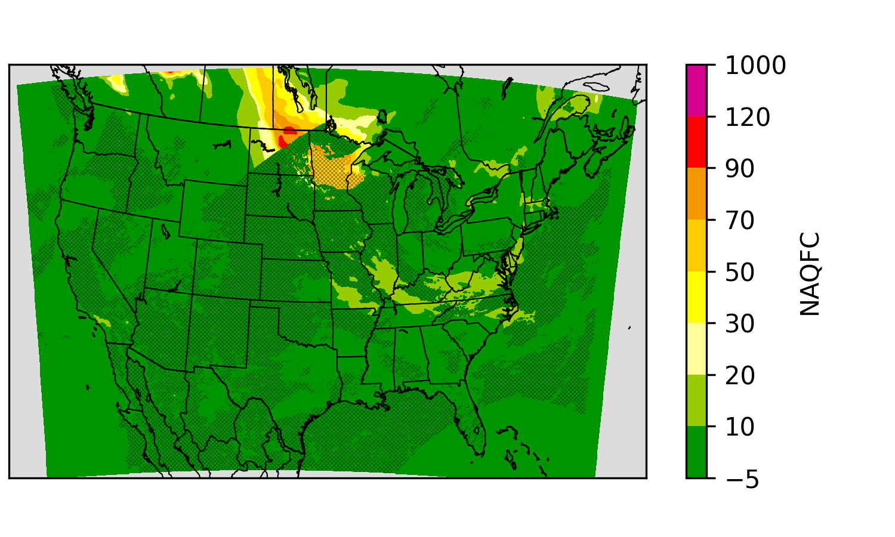
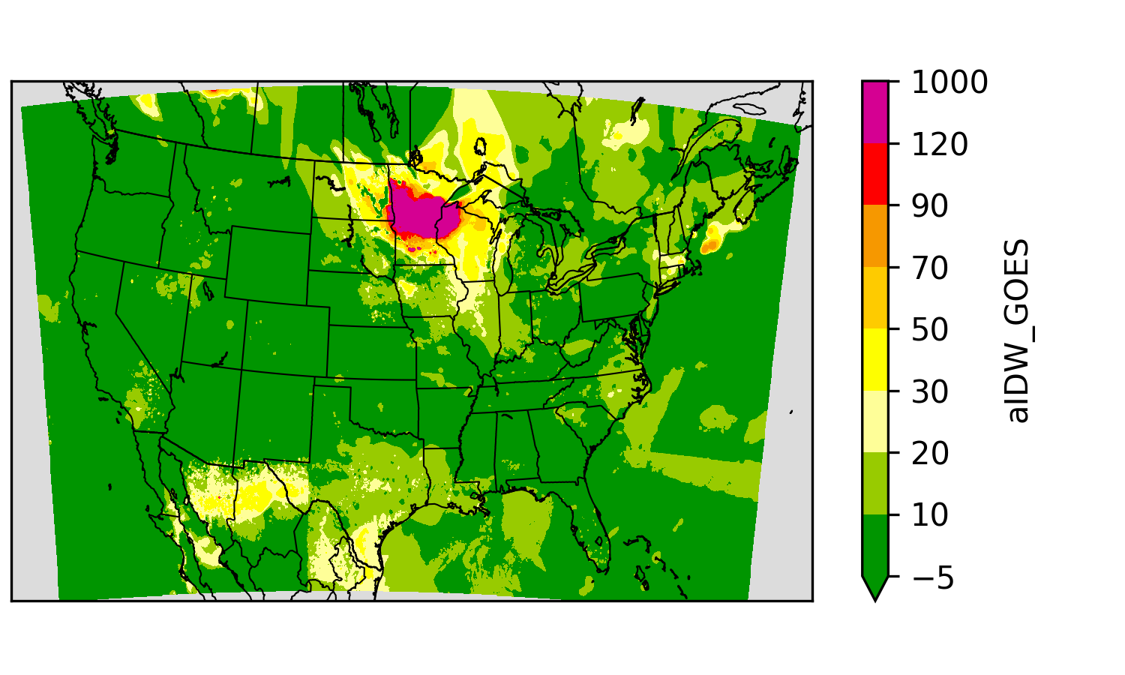
Hourly National-scale Fusion Ensemble
One layer from AirNow monitor (Y_{A}) observations:
  mostly regulatory grade hourly observations
  paired with collocated grid cell.
One layer from PurpleAir (Y_{P}) observations:
  low-cost sensor hourly observations with calibration**
  Aggregated within grid cells to create a pseudo-observation
One layer from GOES-PM25 (Y_{G}) “observations”
  Geostationary Operational Environmental Satellite (GOES)
  Not clustered like monitors, so VNA interpolation is not necessary.
Model
GOES-PM25 Bias
Y_{G} = f(model, satellite)
Y_{A}
Y_{P}
Notes:
NAQFC

Slide 9
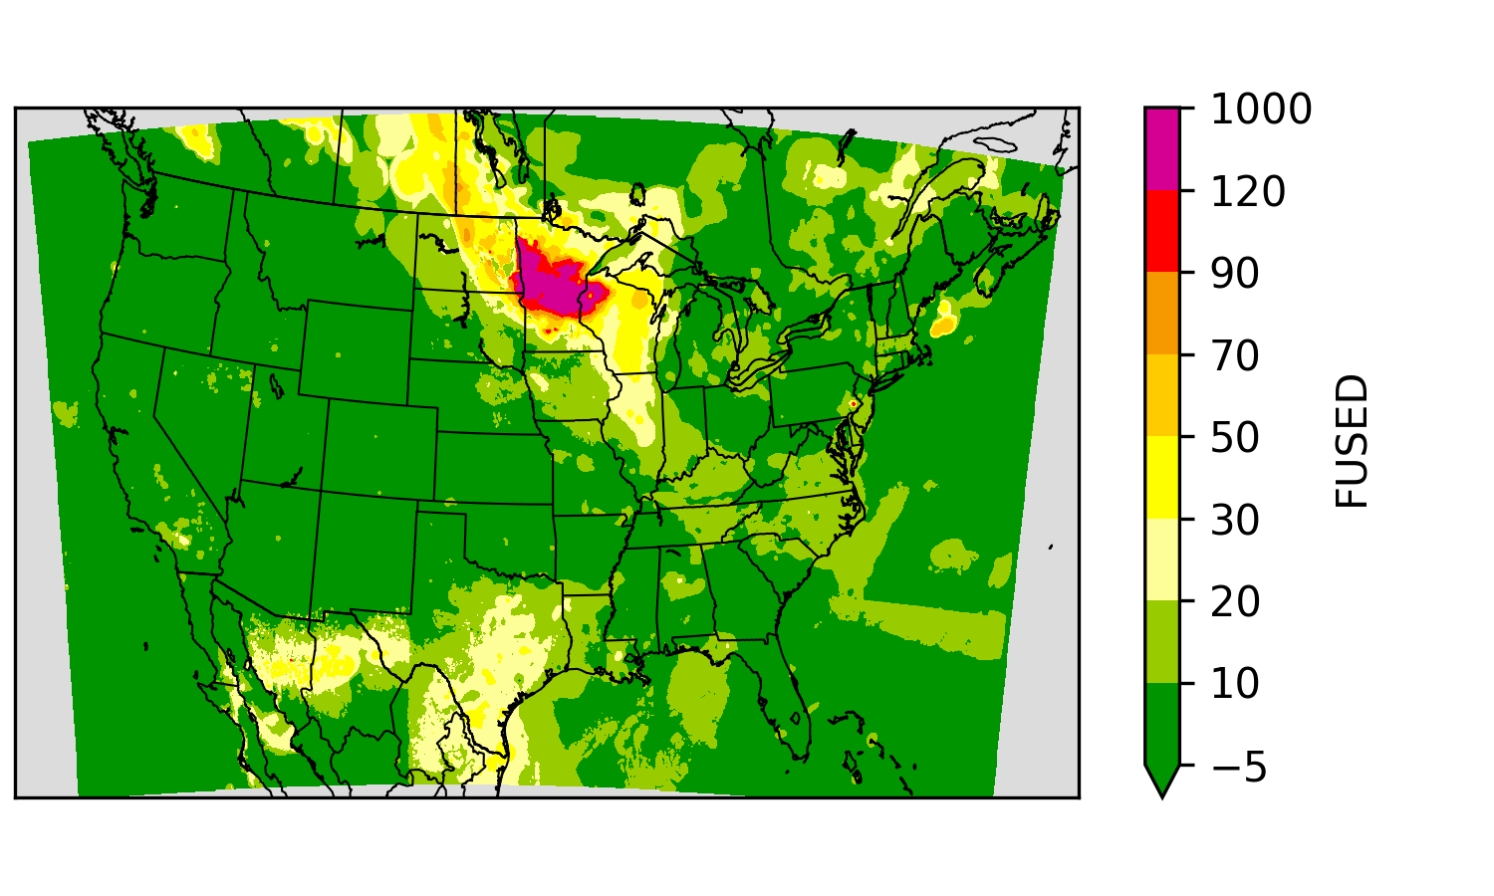
Hourly National-scale Fusion Ensemble
One layer from AirNow monitor (Y_{A}) observations:
  mostly regulatory grade hourly observations
  paired with collocated grid cell.
One layer from PurpleAir (Y_{P}) observations:
  low-cost sensor hourly observations with calibration**
  Aggregated within grid cells to create a pseudo-observation
One layer from GOES-PM25 (Y_{G}) “observations”
  Geostationary Operational Environmental Satellite (GOES)
  Not clustered like monitors, so VNA interpolation is not necessary.
Weight based on distance (w_{A}, w_{p}, w_{g})
w_{A}Y_{A} + w_{P}Y_{P} + w_{G}Y_{G}
Y_{A}
Y_{P}
Y_{G}
Notes:
NAQFC

Slide 10
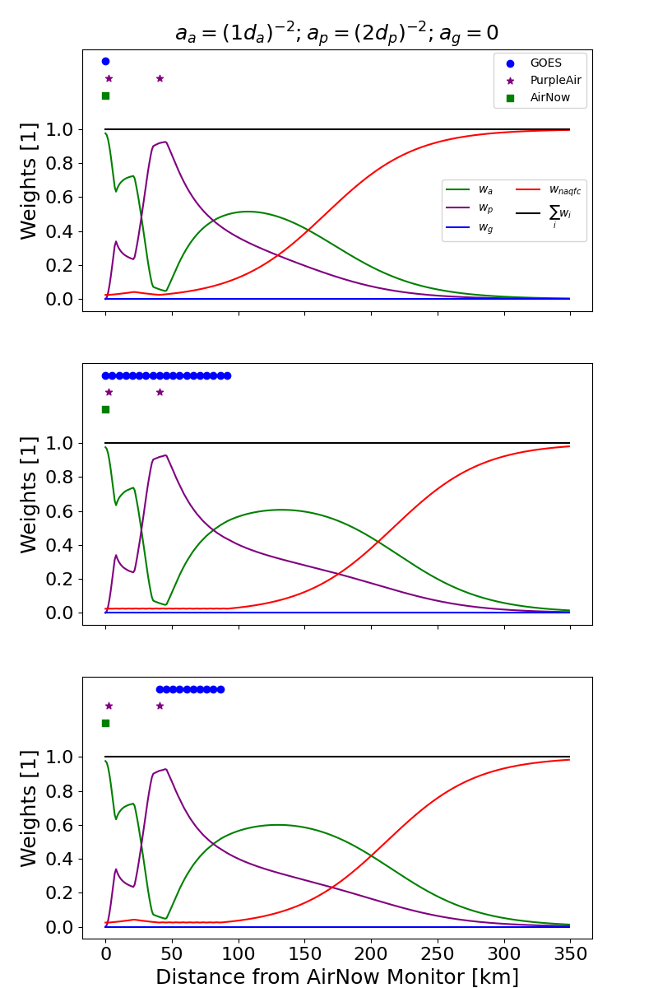
Weight the ensemble of surfaces on distance
Cloudy upwind of monitor
Three scenarios to illustrate weights
  AirNow on at the left.
  PurpleAir near and a bit downwind.
  GOES-PM25 coverage varies
Pilot project began without satellite data
Y = w_{A}Y_{A} + w_{P}Y_{P} + w_{G}Y_{G} + w_{N}Y_{N}
  a_{a} = (1 x d_{AN})⁻²
  a_{p} = (2 x d'_{PA})⁻² : d'_{PA} = max(d_{PA}, 3.6)
  a_{g} = 0
  Normalize
    w_{n} = 1 / (1 + exp(k * (d_{apg} - x₀)))
    w_{a} = a_{a} (1 - w_{n}) / (a_{a} + a_{p} + a_{g})
Performance
  Adding PurpleAir improved performance.
  Optimized weight of PurpleAir
  Statistical performance is good even without satellite
  But, the AirNow monitor is no the best data downwind.
Cloudy downwind of monitor
Cloudy downwind of monitor
*Optimized parameters

Slide 11
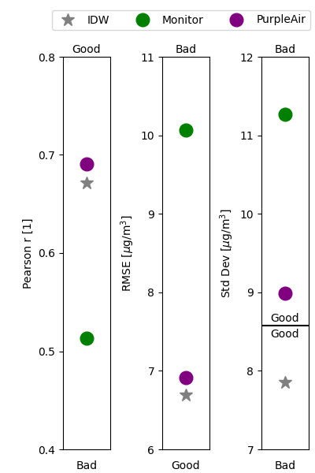
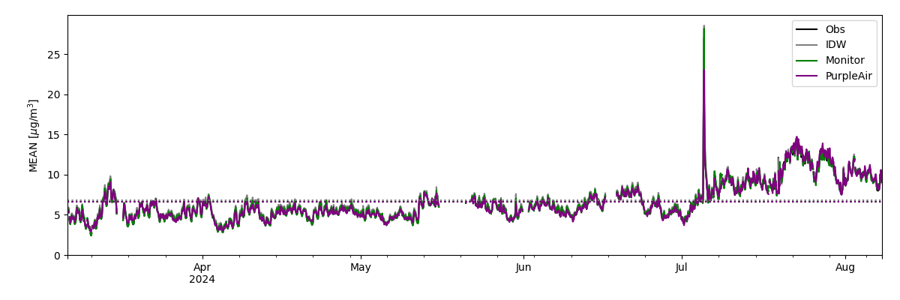
Pilot Validation Summary
Using only monitors aVNA performing worse than IDW
Including PurpleAir improves:
  Prediction standard deviation,
  Prediction correlation, and
  Root mean squared error.
Hourly National Mean Concentration
Notes:
Hourly National Mean Concentration

Slide 12
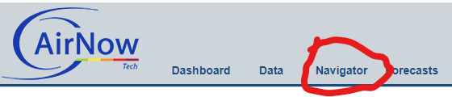
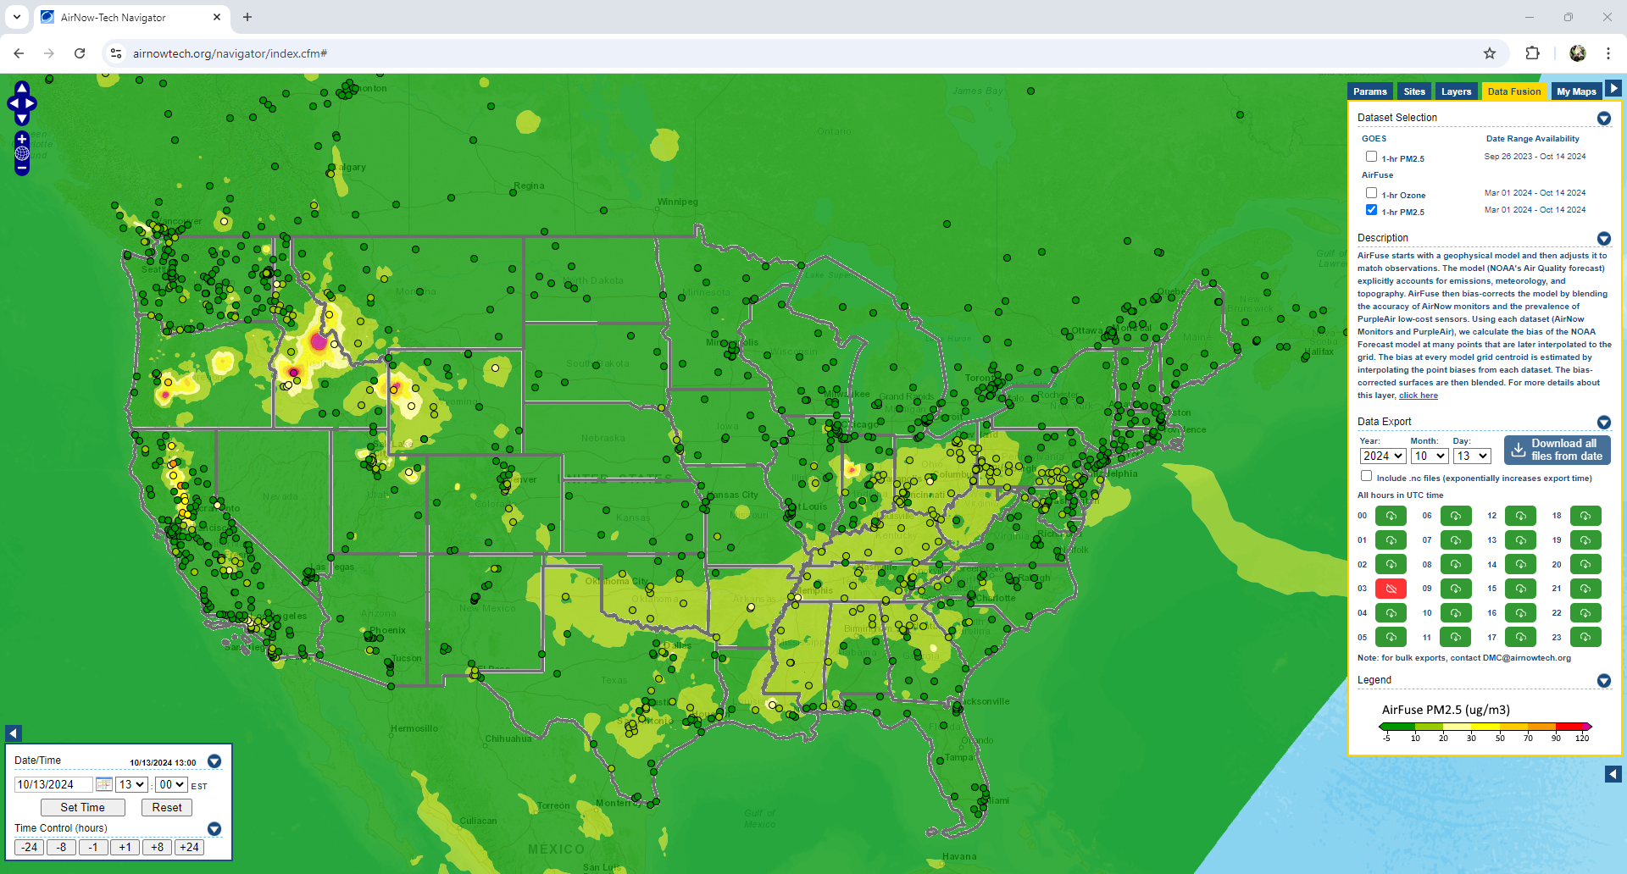
Data on: https://airnowtech.org/
Login to ANT
Choose Navigator
On Navigator, choose the Data Fusion tab.
Select an AirFuse or GOES Layer
October 13 at 18Z
Thanks AirNow team!

Slide 13
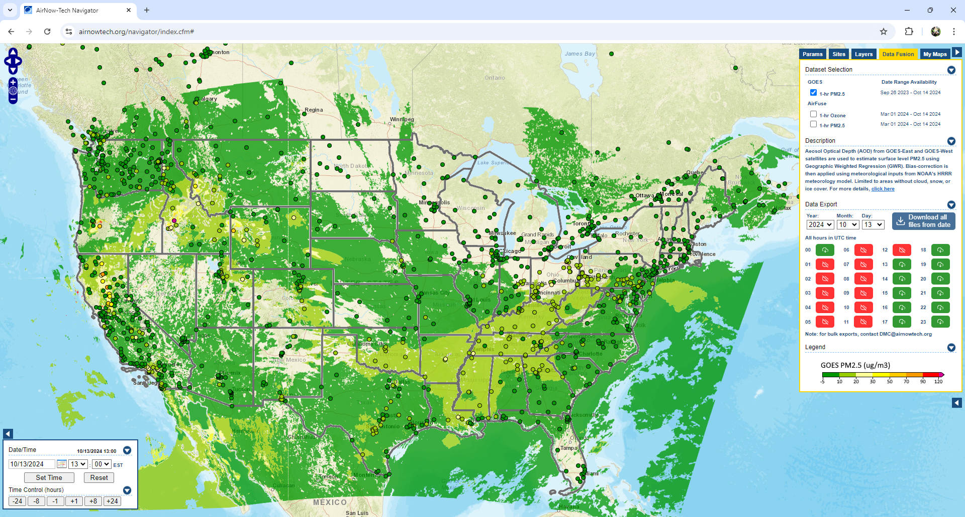
Data on: https://airnowtech.org/
Login to ANT
Choose Navigator
On Navigator, choose the Data Fusion tab.
Select an AirFuse or GOES Layer
October 13 at 18Z
Thanks AirNow team!

Slide 14
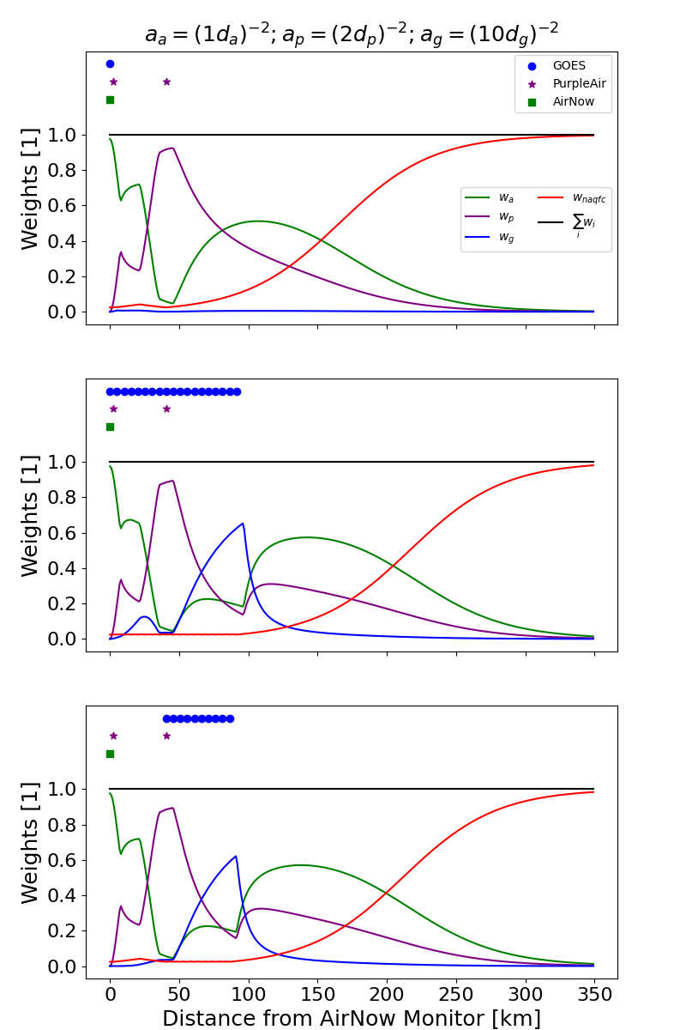
Weight the ensemble of surfaces on distance
Cloudy upwind of monitor
Three scenarios to illustrate weights
  AirNow on at the left.
  PurpleAir near and a bit downwind.
  GOES-PM25 coverage varies
Including satellite using the same functional form
Y = w_{A}Y_{A} + w_{P}Y_{P} + w_{G}Y_{G} + w_{N}Y_{N}
  a_{a} = (1 x d_{AN})⁻²
  a_{p} = (2 x d'_{PA})⁻² : d'_{PA} = max(d_{PA}, 3.6)
  a_{g} = (10 x d'_{G})⁻²: d'_{G} = max(d_{G}, 3.6)
  Normalize
    w_{n} = 1 / (1 + exp(k * (d_{apg} - x₀)))
    w_{i} = a_{i} (1 - w_{n}) / (a_{a} + a_{p} + a_{g})
Performance
  Statistical performance is better with satellite!
  Created artificial “hard edges” when satellite and AirNow/PurpleAir diverge.
Does it matter? Need method of identifying artifacts and then a new method to reduce artifacts.
Cloudy downwind of monitor
Cloudy downwind of monitor
*Optimized parameters

Slide 15
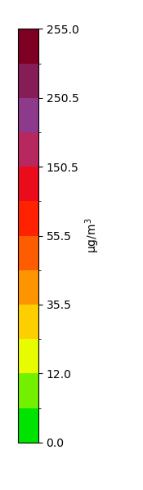
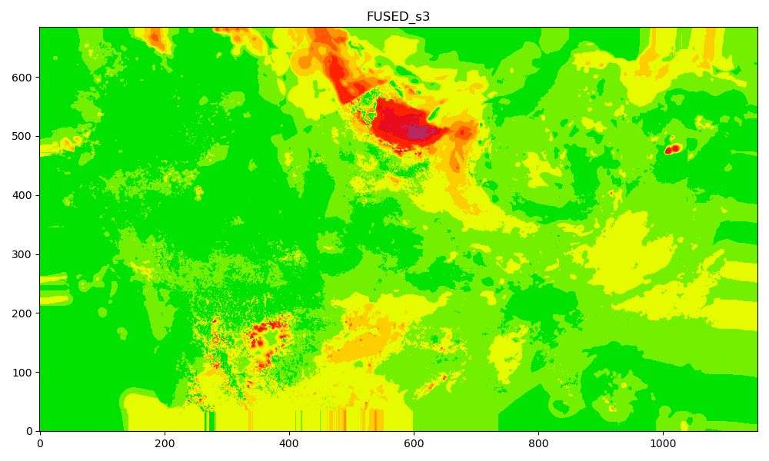
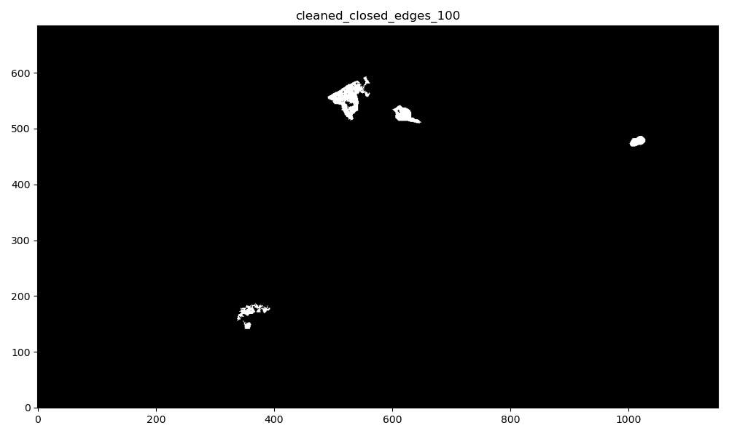
Finding anomalies in hourly surfaces
Current anomaly detection criteria:
Step 1:
1.1 Large AN-GOES difference (> 55.5 µg/m³)
1.2 Edge detection applied on FUSED results and GOES_WGT
Step 2: Morphological image processing
- fill the edges to capture the anomaly area
Step 3: filter the closed edge by large AN-GWR difference again
Step4: Only keeping detected areas with connected size larger than 100
Type 1: AN_WGT < 0.4
Type 2: AN_WGT > 0.8
Type 1.1: AN >> GOES
Type 1.2: AN << GOES
source: Meng Qi at Emory University
Notes:
Meing Qi

Slide 16
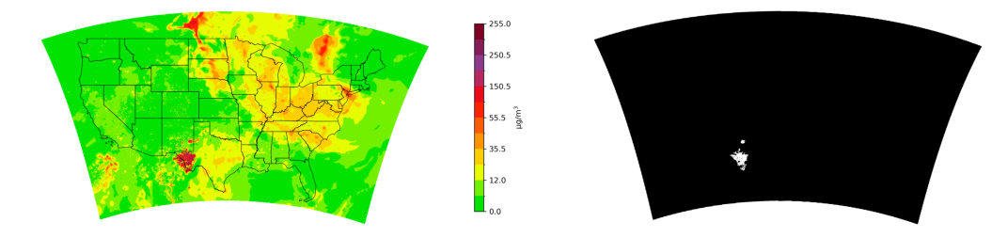
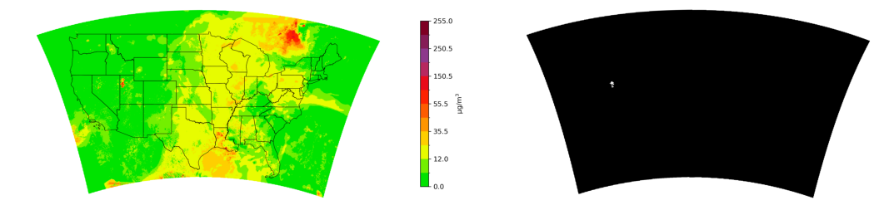
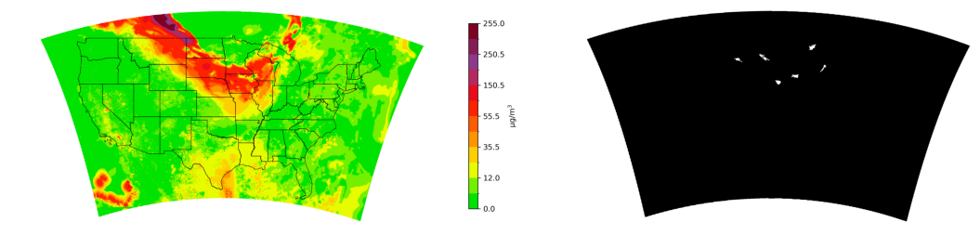
Example Edge Detections
source: Meng Qi at Emory University
Emory University developed an edge detection algorithm to process years of data.
Plume in Texas Pan Handle
  2023-06-18T01Z
Interesting feature in west Utah
  2023-06-20T18Z
Fire plume from Alberta Canada with missing data
  2023-07-15T23Z

Slide 17
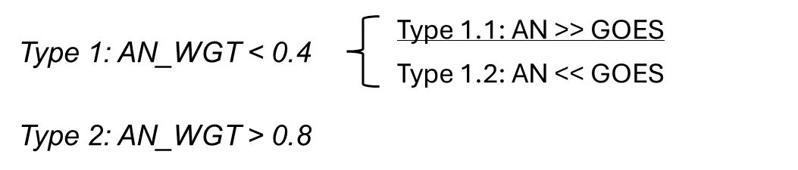
Number of anomalies detected
Month | 2020
 | Type 1.1 | Type1.2 | Type 2
5 | 0 | 2 | 29
6 | 3 | 116 | 21
7 | 22 | 67 | 9
8 | 291 | 401 | 64
9 | 1021 | 615 | 497
10 | 135 | 120 | 24
Month | 2023
 | Type 1.1 | Type1.2 | Type 2
5 | 108 | 130 | 77
6 | 124 | 195 | 56
7 | 79 | 186 | 72
8 | 192 | 192 | 40
9 | 26 | 117 | 26
10 | 3 | 32 | 13
In 2020, anomalies increase in the fire season when AOD retrievals are difficult.
  Total detections 1472
  NOAA improved QA and updated DNN
In 2023, fewer detections (532)
  More often during spring and early summer.
Path forward
  Use edge detection to identify the types of situations that cause artifacts.
  Likely use edge detections to constrain interpolations.
  Find weights that smoothly transition even with large differences between products.
source: Meng Qi at Emory University
Notes:
2020: 1472
2023: 532

Slide 18
Reminder of weighting scheme
Cloudy upwind of monitor
Three scenarios to illustrate weights
  AirNow on at the left.
  PurpleAir near and a bit downwind.
  GOES-PM25 coverage varies
Including satellite using the same functional form
Y = w_{A}Y_{A} + w_{P}Y_{P} + w_{G}Y_{G} + w_{N}Y_{N}
  a_{a} = (1 x d_{AN})⁻²
  a_{p} = (2 x d'_{PA})⁻² : d'_{PA} = max(d_{PA}, 3.6)
  a_{g} = (10 x d'_{G})⁻²: d'_{G} = max(d_{G}, 3.6)
  Normalize
    w_{n} = 1 / (1 + exp(k * (d_{apg} - x₀)))
    w_{i} = a_{i} (1 - w_{n}) / (a_{a} + a_{p} + a_{g})
Performance
  Statistical performance is great without satellite and satellite improves performance!
  Created artificial “hard edges” when satellite and AirNow/PurpleAir diverge.
Need method of identifying artifacts and then a new method to reduce artifacts.
Cloudy downwind of monitor
Cloudy downwind of monitor
*Optimized parameters

Slide 19
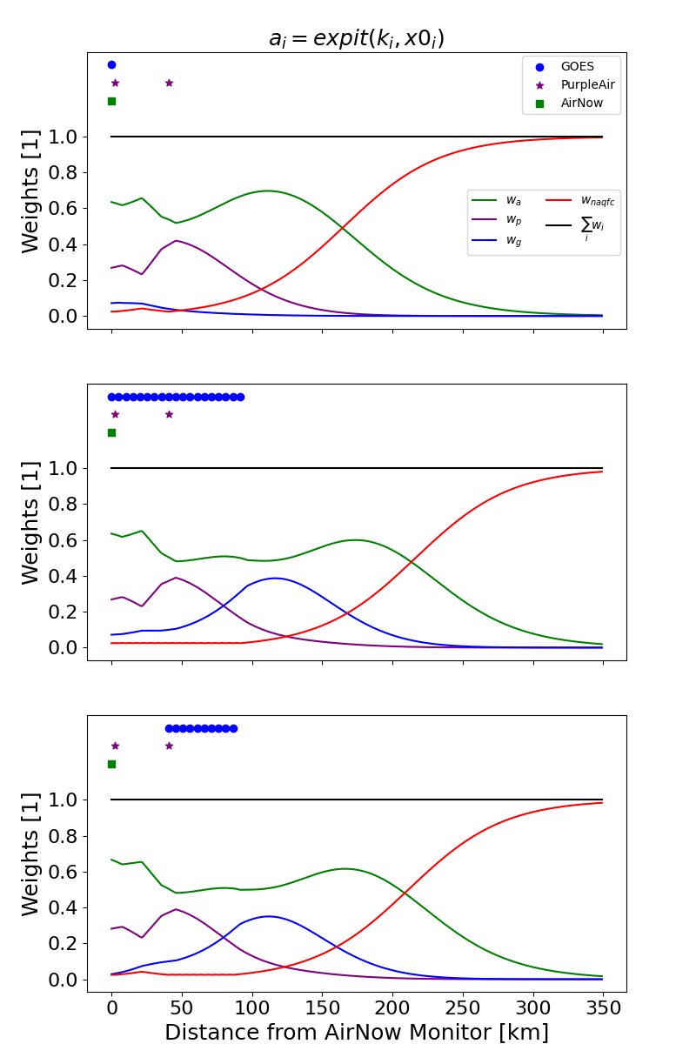
Logistic alternative weight scheme
Cloudy upwind of monitor
Three scenarios to illustrate
  AirNow on at the left.
  PurpleAir near and a bit downwind.
  GOES-PM25 coverage varies
Y = w_{A}Y_{A} + w_{P}Y_{P} + w_{G}Y_{G} + w_{N}Y_{N}
  a_{A} = expit(d_{A}, k_{A}, r_{A})
  a_{P} = expit(d_{P}, k_{P}, r_{P})
  a_{G} = expit(d_{G}, k_{G}, r_{G})
  Normalize
    w_{n} = expit(d_{APG}, -k_{N}, r_{N})
    w_{a} = a_{a} (1 - w_{n}) / (a_{a} + a_{p} + a_{g})
Ideally, optimize k and r parameters
Need to test with edge detection and categorize outliers.
Cloudy downwind of monitor
Cloudy downwind of monitor
expit(d, k, r) = 1 / (1 + exp(k * (d – r)))

Slide 20
Summary
Fusion with PurpleAir is running as a pilot without satellite
  Schulte et al. demonstrated including models and PurpleAir improved on simple interpolations and applied it in an AirNow-like system.
  Discontinuities are less stark than GOES because datasets are more spatially consistent (ie sparse in the same places).
  Statistical value of PurpleAir in cross-validation is high because sensors are dense near monitors.
Working on ensemble weighting with HAQAST team
  HAQAST Tiger Team 2021 (Gupta) – now 2023 (Yang Liu)
  Evaluated GOES PM25 for real-time-applications.
  Developed edge detection algorithm for testing weighting schemes.
  Finalizing weighting scheme and testing updated weighting methodology.
  Harder to statistically quantify benefit because the value is further from monitors.
Need your feedback on pilot!
  Statistics will only tell us so much.
  How does your area look?
  When does AirFuse give weird answers?

Slide 21
Questions?
henderson.barron@epa.gov

Slide 22
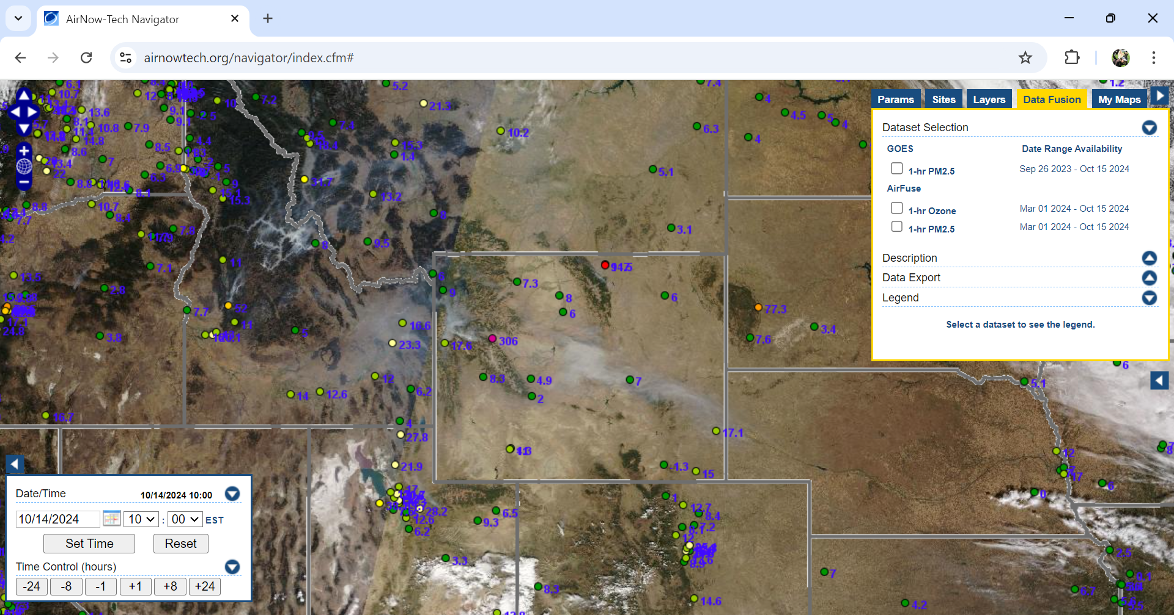

Slide 23
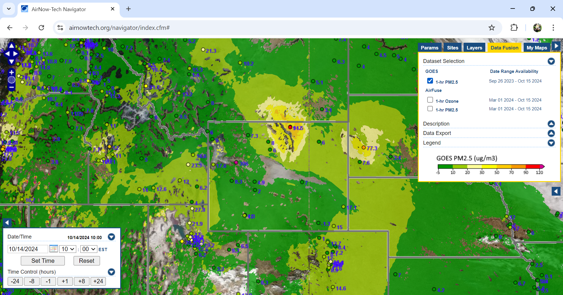

Slide 24
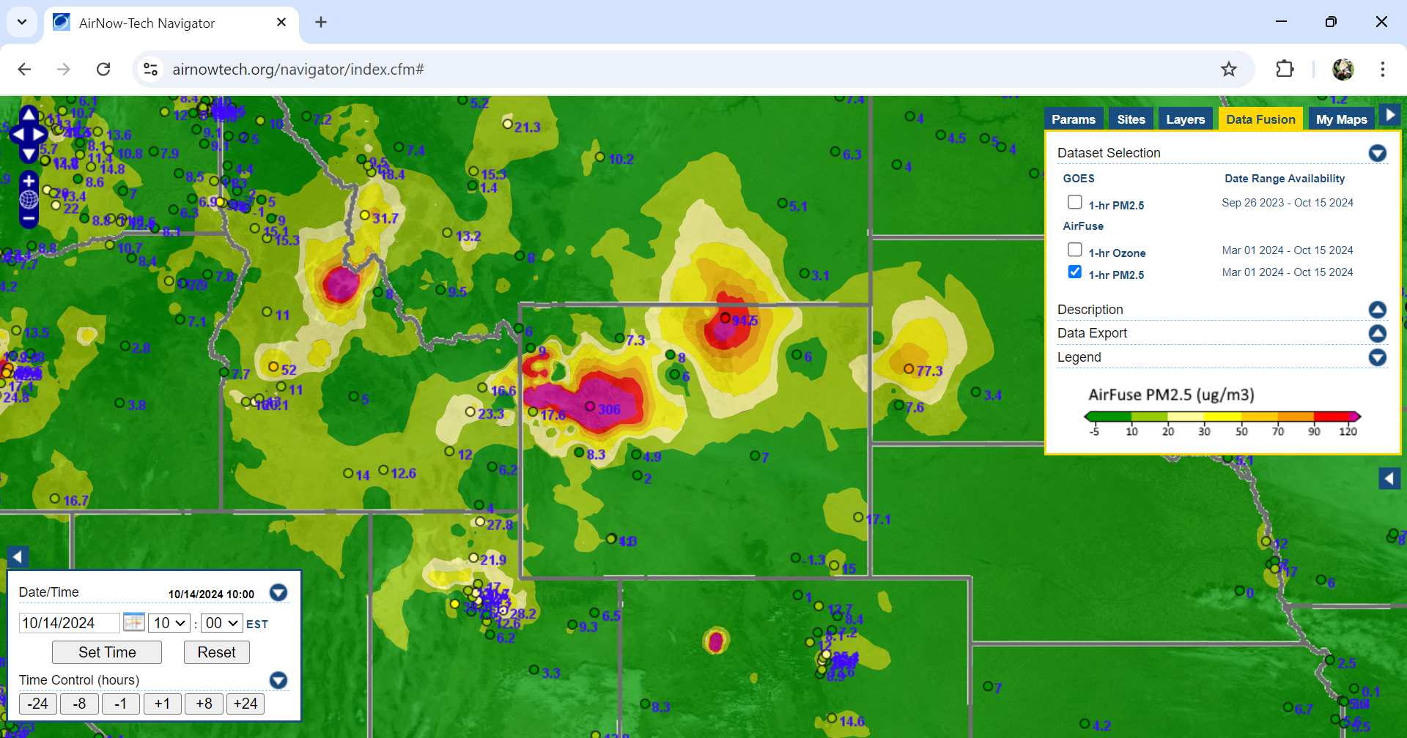

Slide 25
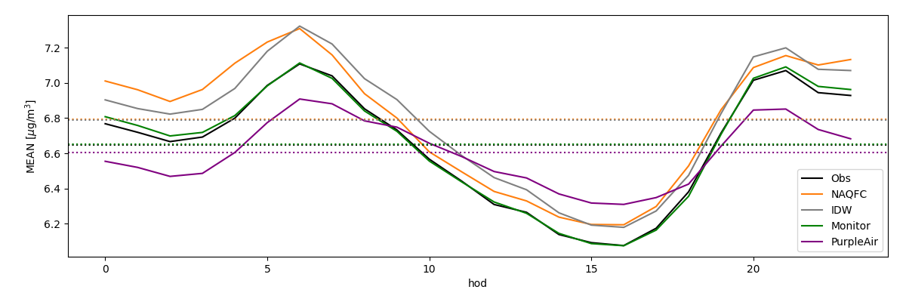
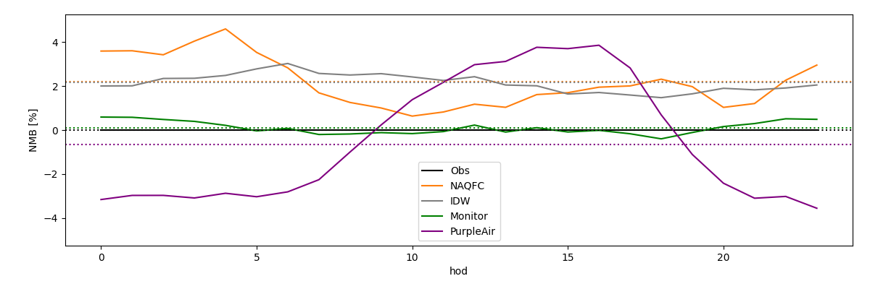
Diurnal Variation of PM and AirFuse
Hourly particulate matter is highest at night during high humidity.
CMAQ forecast over does the variability
IDW and AirFuse w/out PurpleAir capture that variability.
Adding PurpleAir mutes the diurnal variability.*
Mean Conc Hour of Day [LST]
Normalized Mean Bias
*Correction was developed from daily averages, so investigating update to correction.
Notes:
*Correction was developed from daily averages, so investigating update to correction.

