Slide 1






CEOS AC-VC Meeting #20
15-18 October 2024
Validation of TEMPO NO2 and HCHO
Nitrogen dioxide and Formaldehdye using Pandora and TropOMI
Barron Henderson, US EPA
James Szykman and Luke Valin
US EPA
Xiong Liu, Kelly Chance, Gonzalo Gonzalez Abad, Caroline Nowlan
SAO TEAM
Katherine Travis, Prajjwal Rawat
NASA LaRC
Thomas Hanisco, Nader Abuhassan, and Alexander Cede
NASA GSFC / SciGlob / Luftblick
Thanks to the rest of the TEMPO Validation Team!
Disclaimer: The views expressed in this presentation are those of the authors and do not necessarily reflect the views or policies of the U.S. Environmental Protection Agency.

Slide 2
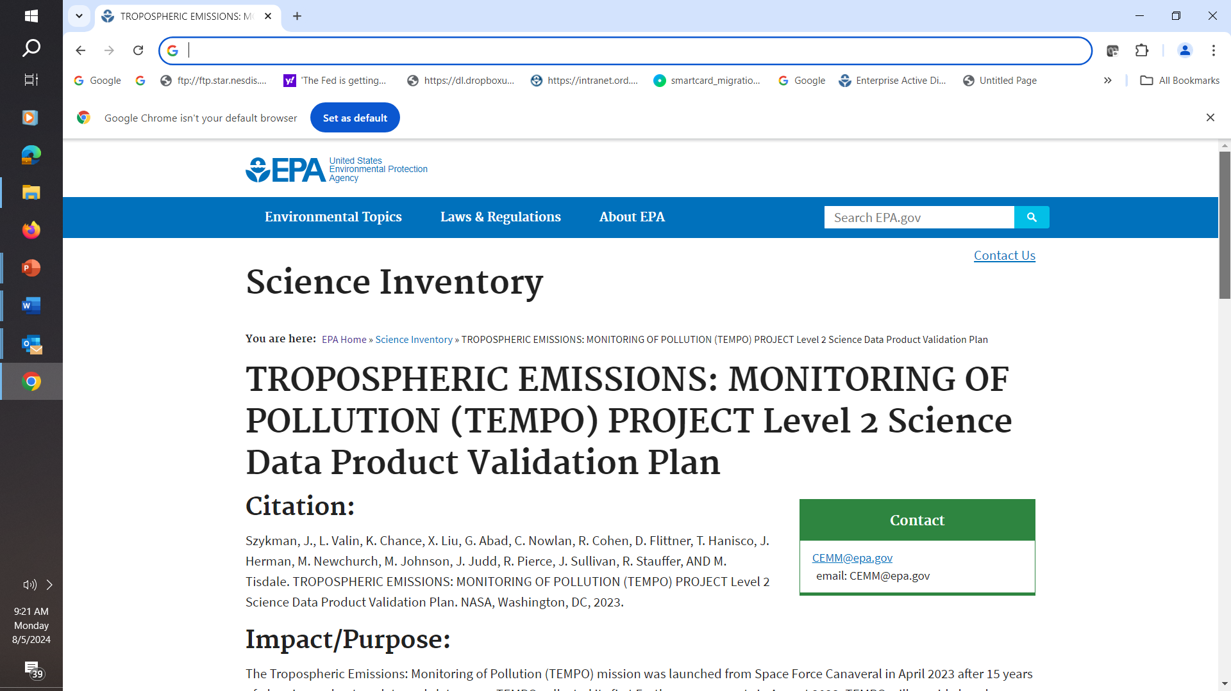

Validation Efforts Help Advance TEMPO
Facilitated and led by EPA in collaboration with TEMPO Validation and Science Team, NASA, and NOAA.
Developed the validation plan
Expanded the Pandonia Global Network of Pandoras
Validated baseline L2 data products: ozone, nitrogen dioxide, and formaldehyde.
Providing real-time feedback to TEMPO algorithm developers and science team.
Early results identified a priori profile issues.
Early results identified unrealistic AMF spatial variation.
Development team updated algorithm to V2 and V3
EPA’s Automated Analysis System now V3
V3 Nitrogen dioxide correlating well with Pandora and TropOMI.
V3 Formaldehyde correlating well with Pandora
Comparison to surface monitors useful for air quality managers
Validation report anticipated soon…
EPA Science Inventory: 362165
or
https://tempo.si.edu under documents
Notes:
Key takeaway: EPA has been engaged in ensuring success of the TEMPO mission. By ensuring validation, that success can be both scientific and applications.
The TEMPO Validation Team developed and implemented a plan for validating L2 products from TEMPO.
That included expanding the Pandonia Global Network for validation measurements.
The validation results provided real-time feedback to the algorithm developers.
The feedback helped to accelerate improvements leading to V2 and now V3.
I’m going to share validation results from the Pandonia global network as well as comparisons to the TropOMI for the version 3 product, which has nearly a year of data.

Slide 3
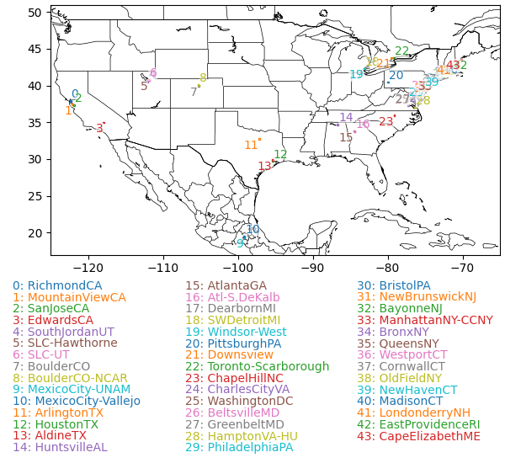
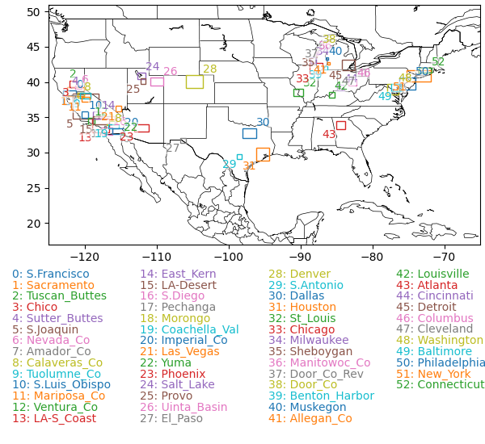
TEMPO Validation Methodologies
Correlative measurements : TropOMI and Pandora
Pandora stations: best ground-based validation dataset available for total vertical columns.
TropOMI: state-of-the-art satellite retrievals at similar spatial resolution.
Analysis Regions: Pandonia Global Network and Ozone Nonattainment Areas.
44 Pandora stations
Most stations in the east
52 Nonattainment Areas
Better spatial coverage
Of special interest for emissions control
Notes:
44 Pandora stations
Density of stations in the east
52 Nonattainment Areas
Better spatial coverage
Of special interest for understanding emissions

Slide 4

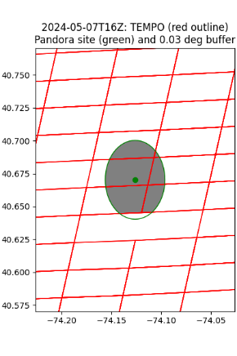
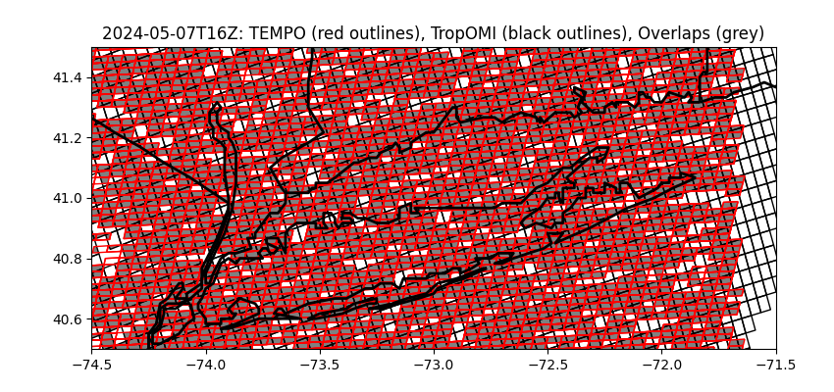
TEMPO Validation Methodologies
Get level 2 data for TEMPO, TropOMI, and Pandora
Python bindings for EPA’s Remote Sensing Information Gateway (pyrsig)
Trainings available – see QR code
Find time intersections
TropOMI: same hour (e.g., 19:00:00Z to 19:59:59Z)
Pandora: overpass within 15min of observation
Find spatial intersections
TropOMI: pixels overlap
Pandora: overlap a buffer
Pool intersections for
statistical analyses

Slide 5
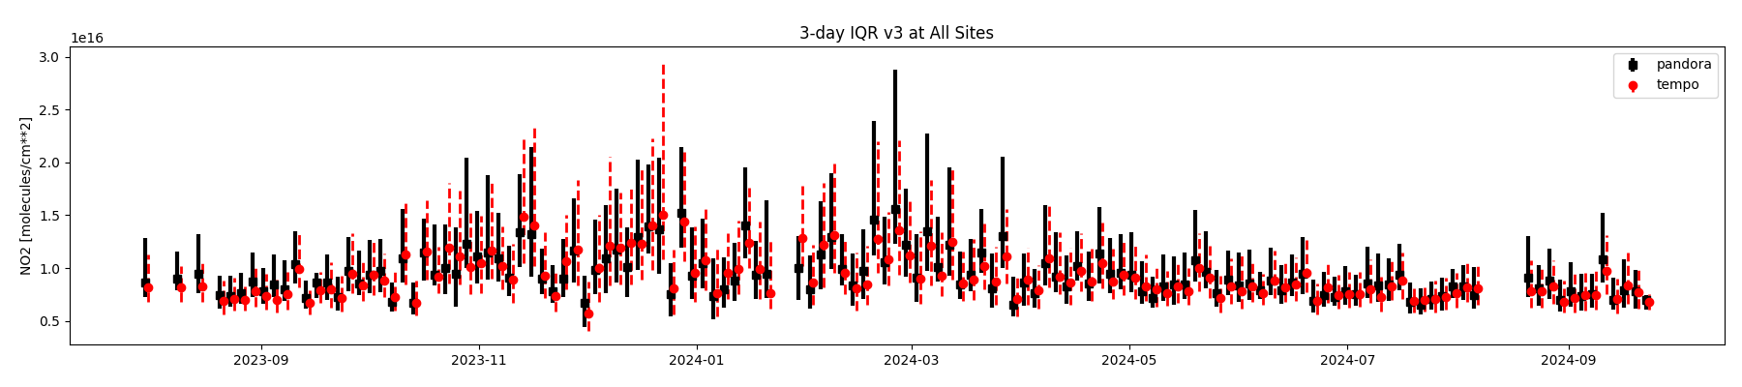

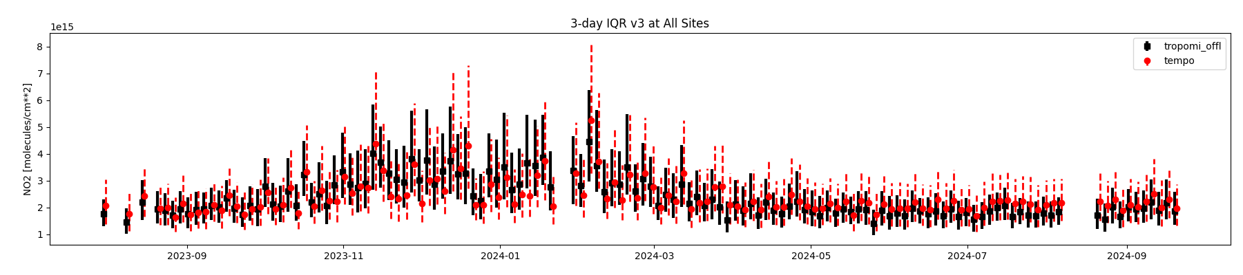

NO2 Data Record Overview August 2023 to Sept 2024
dot: 50% bars: 25%-75%
Generally consistent agreement over time for Pandora
First Light
Command Validation
v3 Gap
dot: 50% bars: 25%-75%
Generally consistent agreement over time for TropOMI

Slide 6
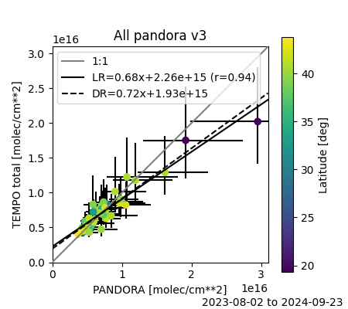
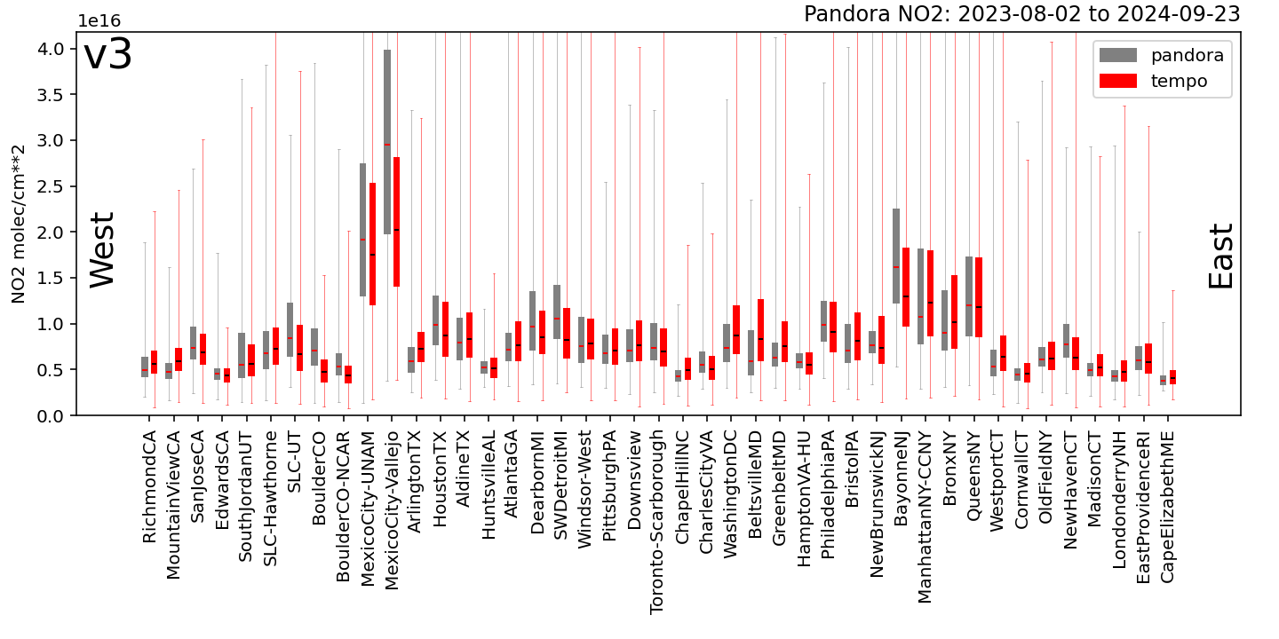

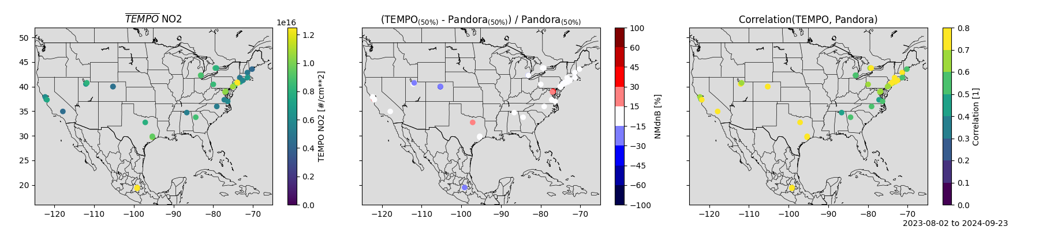
TEMPO NO2 Agrees well with Pandora TEMPO L2 vs Pandora Total NO₂
1: Spatial Variability
Compared to Pandora direct sun measurements, TEMPO:
Reproduces spatial variability
Low fractional biases by locations.
Reproduces dynamic range by site
Correlates well at most sites.
Even reproduces relatively small intra-regional urban/rural gradients quite well.
3: Dynamic Range
2: Good Biases
4: Correlation
1: Spatial Variability
Notes:
Key point: TEMPO compares very well across space and time.
Pandora measurements are the closest thing to a true validation product that we have.
Yesterday, you saw the scatter plot that highlights the good spatial correlation between TEMPO and Pandora.
The box plot on the top shows TEMPO in read and Pandora in black – highlighting that the dynamic range at individual sites is also well represented.
The map on the bottom-middle shows that most pandora have biases within 30% and many within 15%.
The map on the bottom right shows a strong degree of temporal correlation at many sites.
Lastly, TEMPO is able to capture variability between Pandora’s within regions that really highlights the skill.
The scatter plot gives the statistical sense while the first two maps give a spatial view.
Less than 30% biases at all locations and less than 15% at most.
TEMPO also captures the dynamic range of concentrations at each site with a high degree of temporal variation.
Lastly, TEMPO is capturing the differences in range within regions.

Slide 7
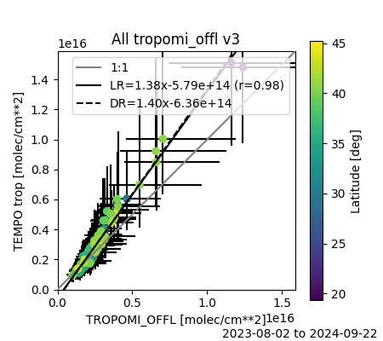
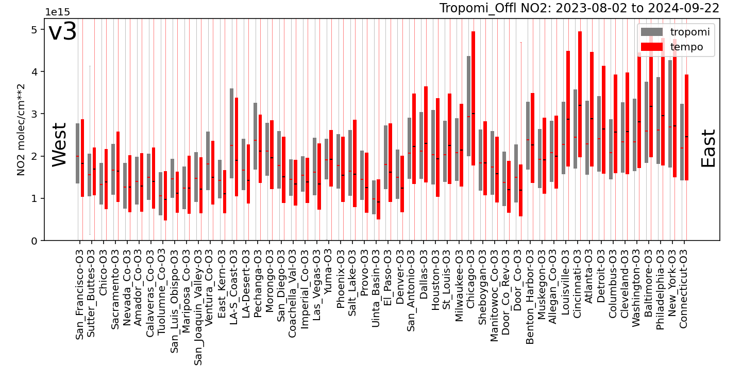
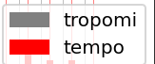
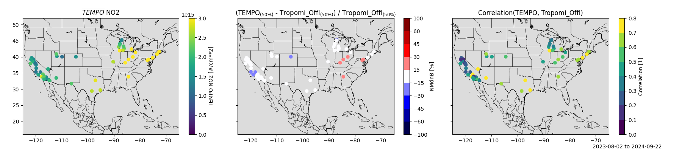
TEMPO Agrees well with TropOMI TEMPO L2 vs TropOMI Tropospheric NO₂
1: Spatial Variability
TropOMI correlation is useful because we don’t have Pandora everywhere.
Here we explore comparisons at Ozone Nonattainment Areas
Similar story to Pandora/TEMPO, captures spatial variability, dynamic range with a mix of site-specific correlations.
Higher slope than Pandora, but this is tropospheric column.
3: Dynamic Range
2: Good Biases
4: Correlation
1: Spatial Variability
Notes:
Here I am using TropOMI tropospheric columns as a surrogate reference to capture how well TEMPO performs in Ozone Nonattainment areas, which are of particular practical importance.
The story is largely the same as with the Pandora. TEMPO captures the differences between sites, the site dynamic range at sites with good correlations in most of the selected locations.

Slide 8
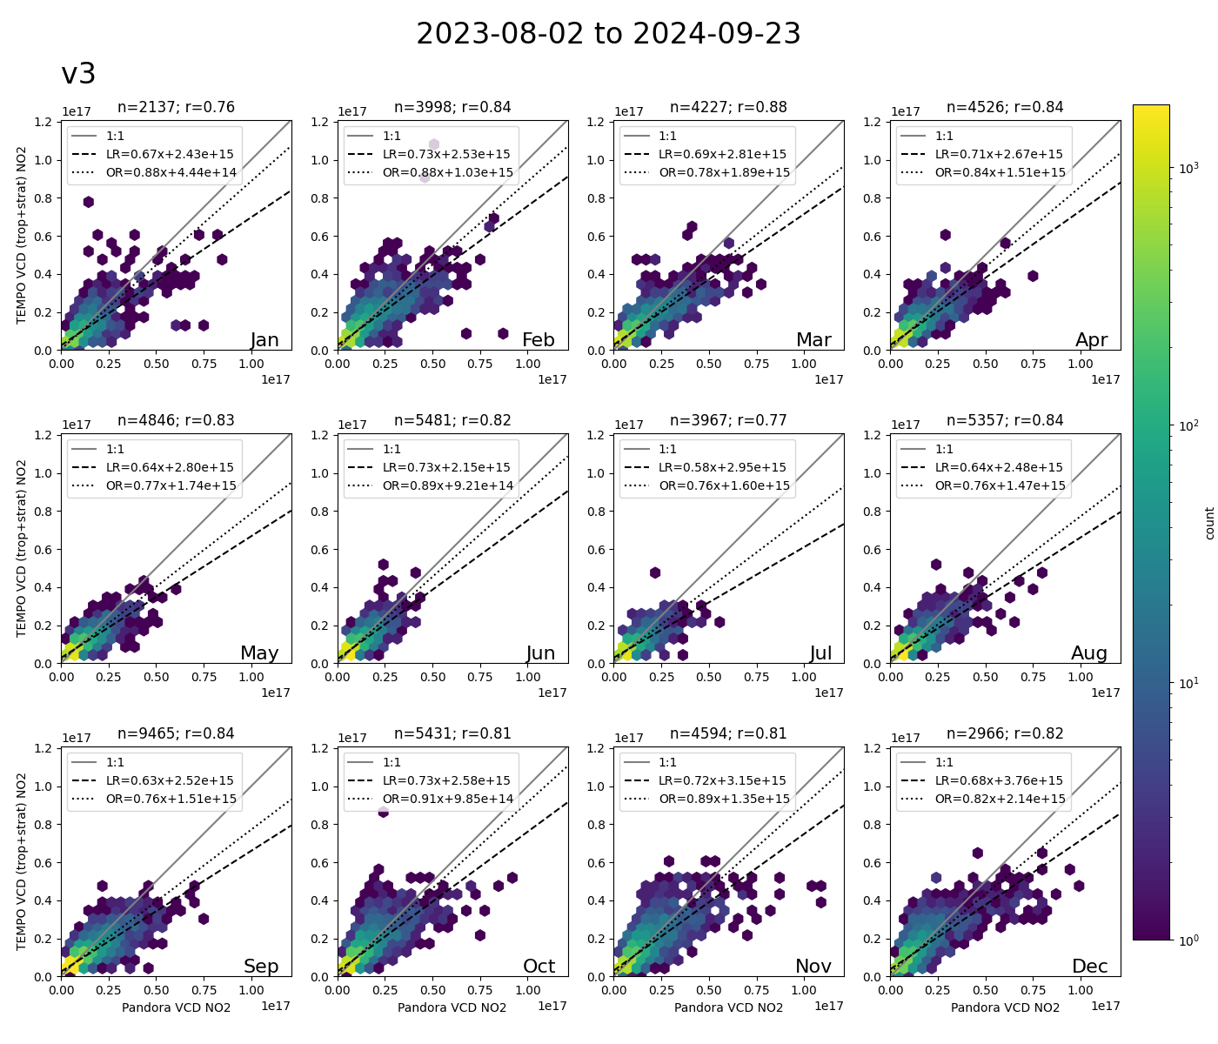
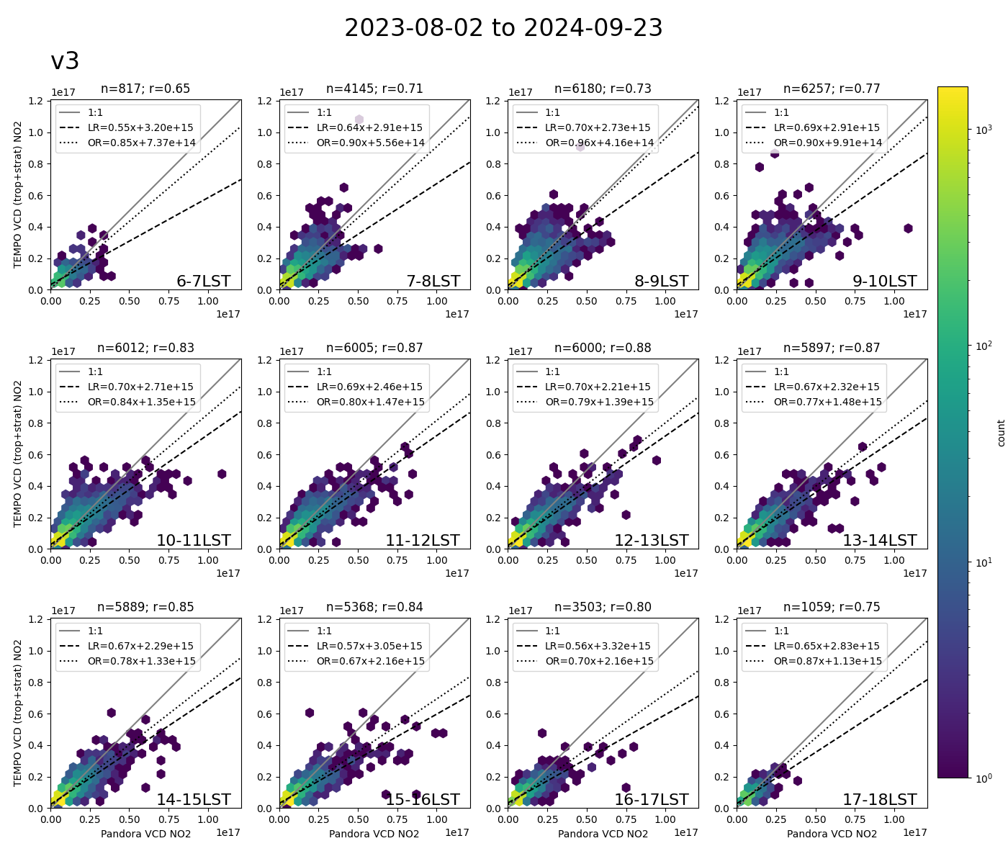
Seasonal and Diurnal Performance is Consistent TEMPO L2 vs Pandora Total NO2
Consistent monthly performance
Dynamic range varies by month as expected
Orthogonal slopes consistent by month
Consistent diurnal performance
Dynamic range varies by time of day as expected
Orthogonal important due airmass sampling.
Count
Count
1000
1000
Jan
Feb
Mar
Apr
6am
7am
8am
9am
100
100
May
Jun
Jul
Aug
10am
11am
noon
1pm
10
10
Sep
Oct
Nov
Dec
1
2pm
3pm
4pm
5pm
1
scale: 0 to 10e16
Notes:
The take away here is that performance is consistent across season and across hours of the day when sites are lumped..
Correlations are near 0.7 or above every month and every hour.
Because TropOMI and Pandora have different spatial scales and uncertainties, I’m highlighting that the orthogonal regression consistently gives a slope closer to 1. This will come up again.
I mostly want to highlight that the 6 and 7am hours have a reasonable correlation, which is encouraging! Of course, this will very by site.
Generic comment - not sure what the network.
Note that there are two regression lines here – linear and orthogonal. Orthogonal is preferred because of the differences in air mass sampling and spatial coverage. We wouldn’t expect TEMPO and TropOMI to see the same thing.
The consistently large orthogonal slopes across seasons and hours of day are encouraging! As Caroline said, some of the skill when the solar zenith angle is large may be due to the prior.
It’s also important to note that individual site performance varies.

Slide 9
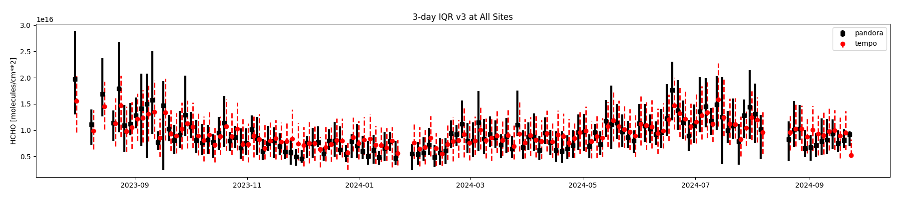
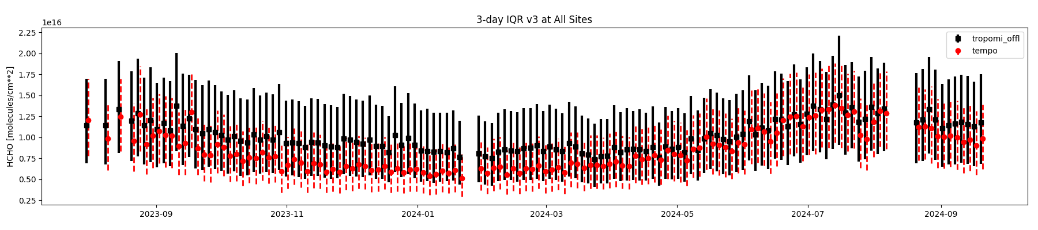
HCHO Data Record Overview August 2023 to Sept 2024
dot: 50% bars: 25%-75%
Generally consistent agreement over time for Pandora
Matches Pandora Winter Low
First Light
Command Validation
dot: 50% bars: 25%-75%
v3 Gap
Underestimates TropOMI Winter
Better agreement in summer for TropOMI
Notes:
Pandora Winter Low

Slide 10
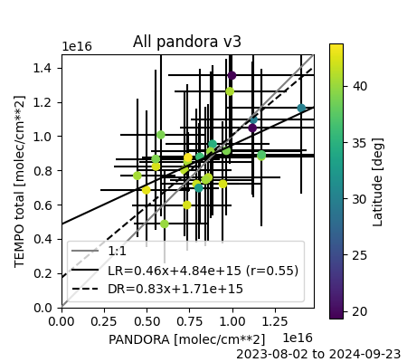
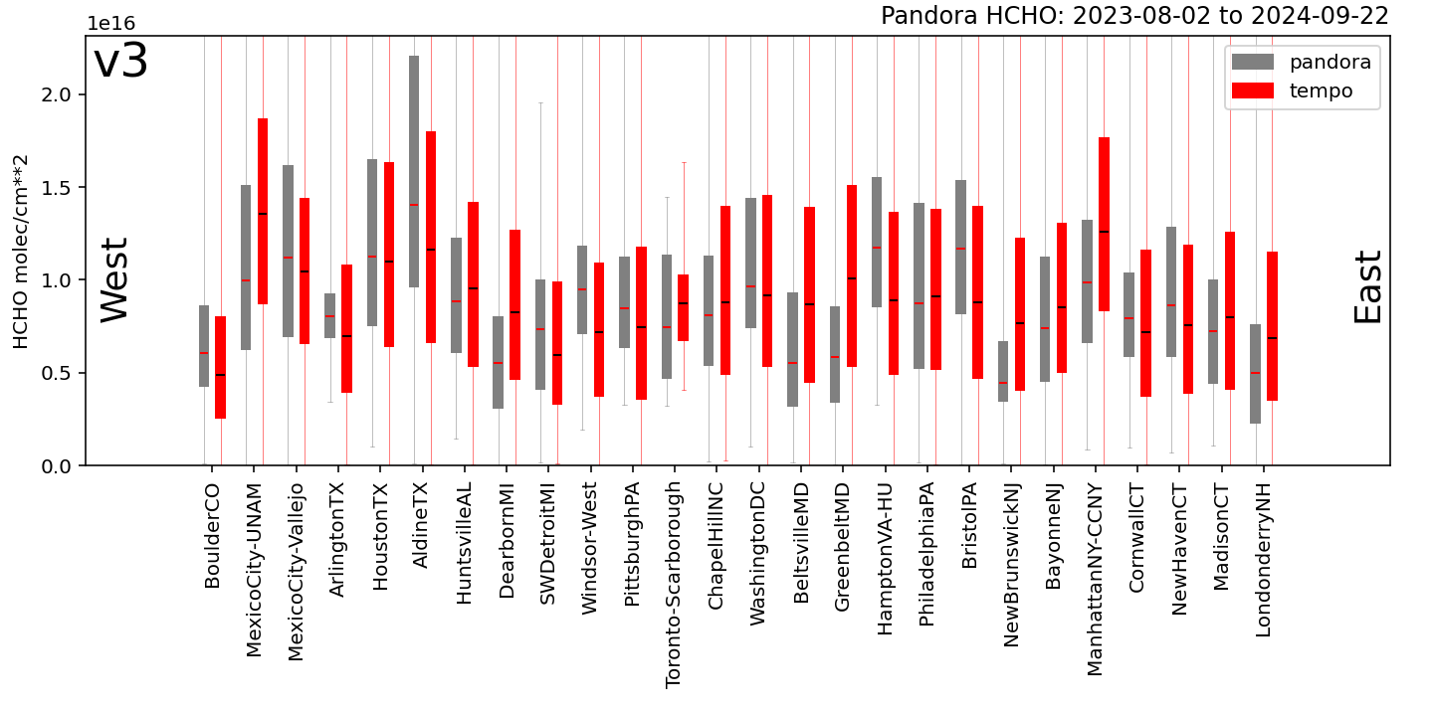
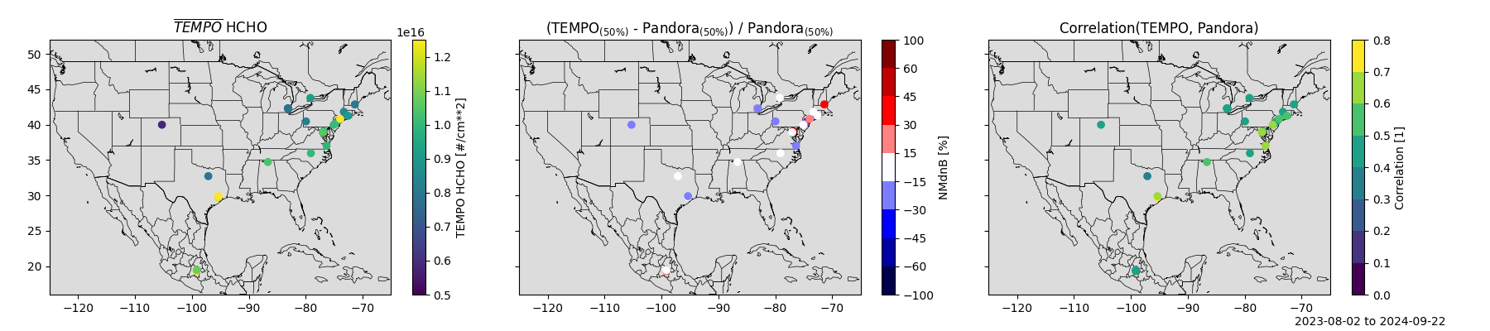
TEMPO HCHO Agrees well with Pandora TEMPO L2 vs Pandora Total HCHO
1: Spatial Variability
Using direct sun with pixel averaging
Site selection: direct sun vs sky scan
See Prajjwal Rawat for more details
Compared to Pandora, TEMPO:
Correlates at the site-level
Has reasonable bias with some individual sites needing investigation.
Captures regional-specific dynamic range.
Site-specific time correlation.
Intra-regional site-level gradients are challenging, perhaps due to pixel averaging
3: Dynamic Range
2: Good Biases
4: Correlation
1: Spatial Variability
Notes:
TEMPO compares well across space and time.
The scatter plot gives the statistical sense while the first two maps give a spatial view.
Less than 30% biases at all locations and less than 15% at some.
TEMPO also captures the dynamic range of concentrations – better some place than others.
And has a reasonable degree of temporal variation.
I’ll note that several places where there are regional clusters of Pandora, TEMPO tends to have a consistent dynamic range while the sites vary. More to look into.

Slide 11
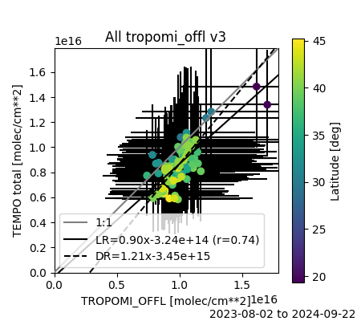
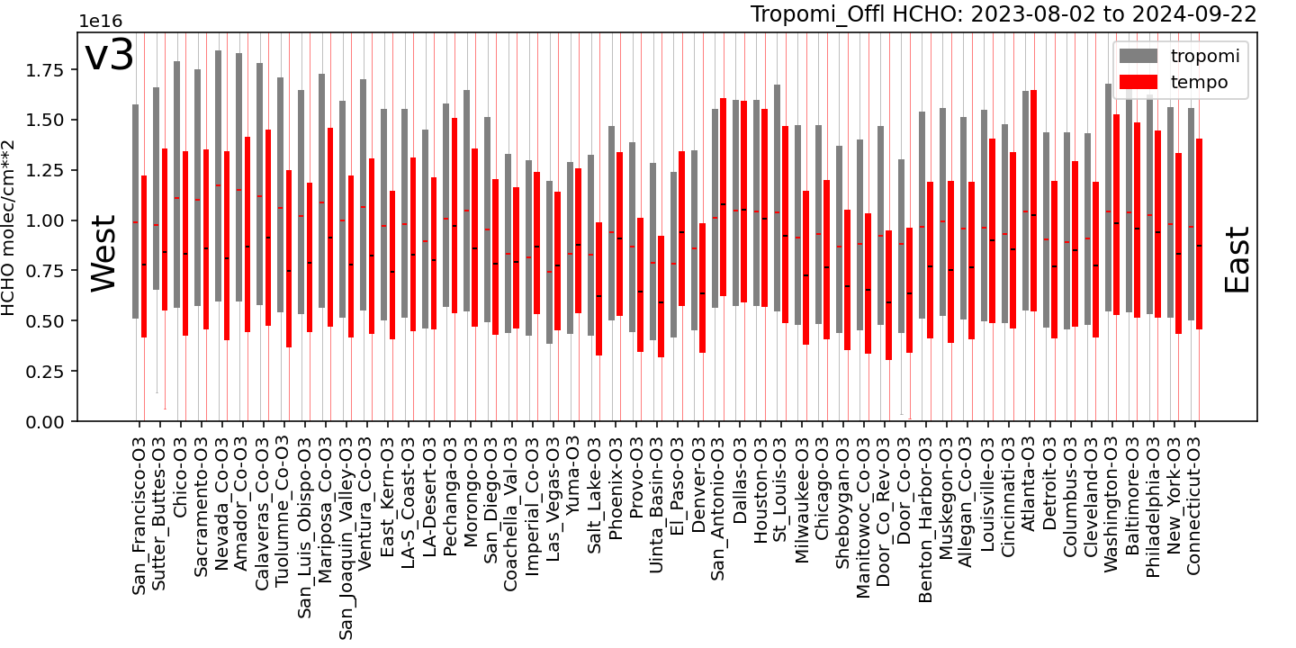
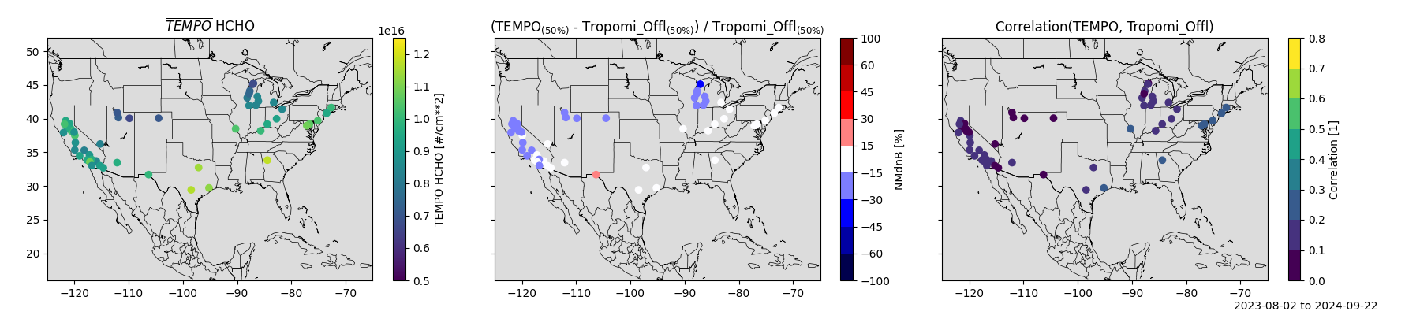
Example Routine Evaluation Analysis TEMPO L2 vs TropOMI Tropospheric HCHO
1: Spatial Variability
TropOMI correlation is useful because we don’t have Pandora everywhere.
Here we explore comparisons at Ozone Nonattainment Areas
Unlike NO2, the diurnal cycle of HCHO is not strong many places which implicitly makes temporal correlation more challenging.
3: Dynamic Range
2: Good Biases
4: Correlation
1: Spatial Variability
Notes:
Here I am using TropOMI columns as a surrogate reference to capture how well TEMPO performs in Ozone Nonattainment areas, which are of particular practical importance.
With the greater spatial coverage, you start to see a more systematic low bias in Northern California.
The story is largely the same as with the Pandora. TEMPO captures the differences between sites, the site dynamic range at sites with good correlations in most of the selected locations.
I’ll note that the TropOM

Slide 12
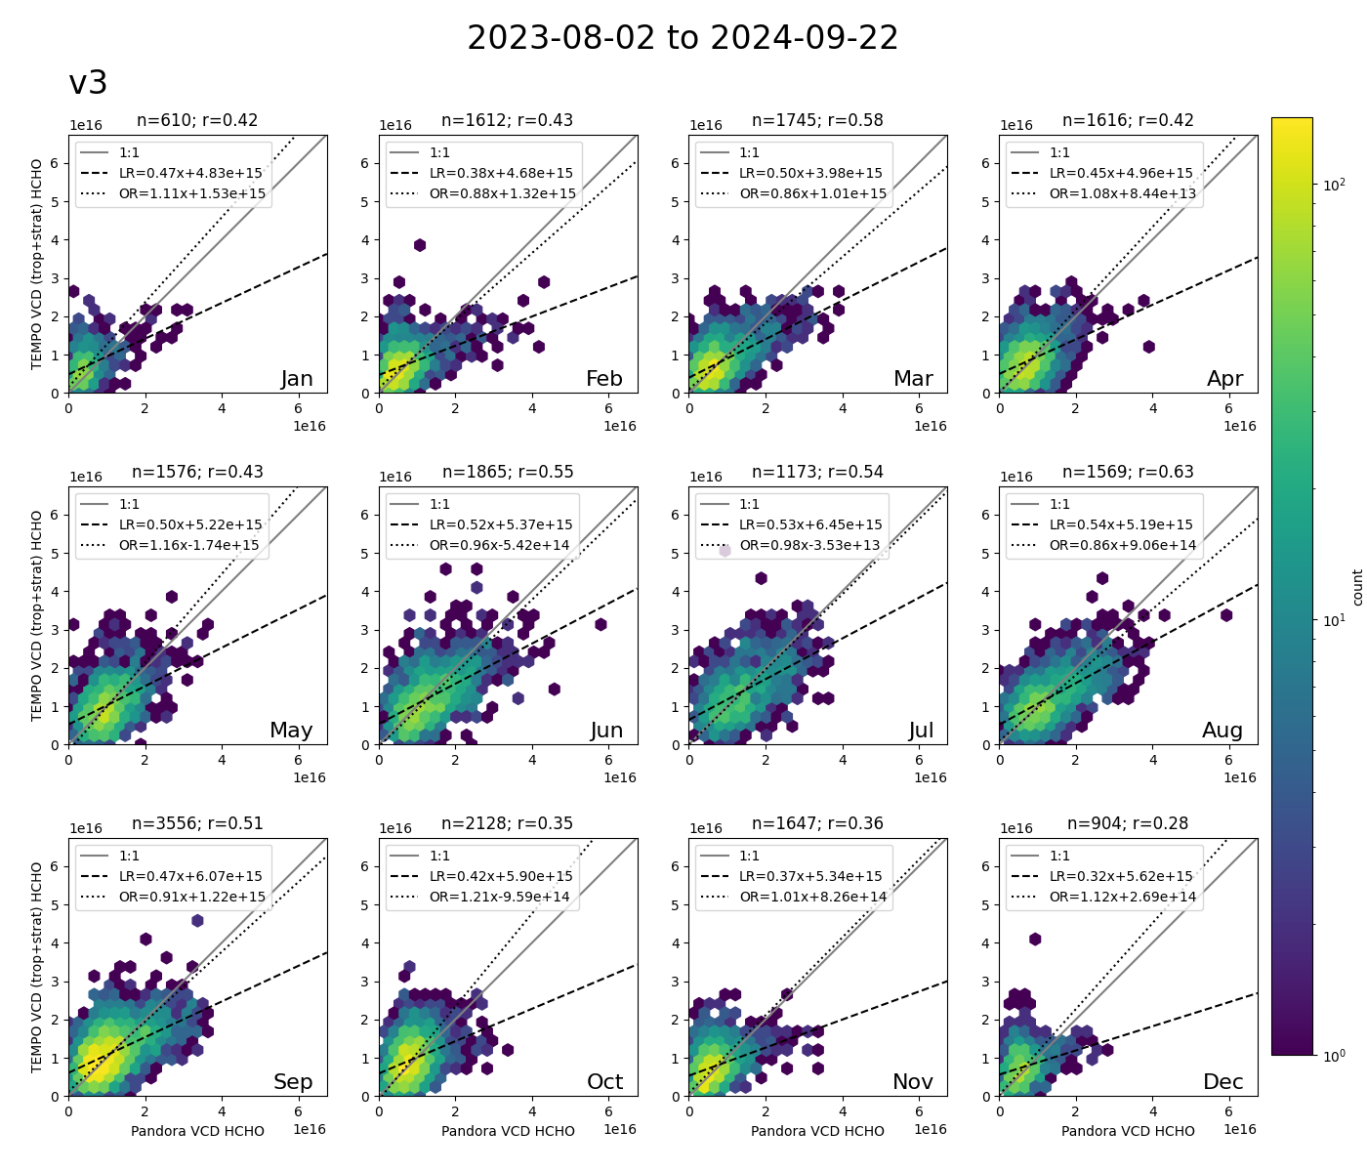
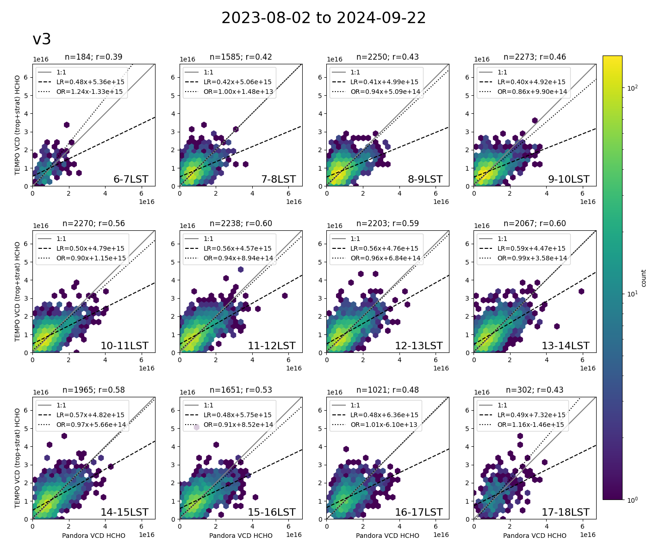
Seasonal and Diurnal Performance is Consistent TEMPO L2 vs Pandora Total HCHO
Consistent monthly performance
Dynamic range varies by month as expected
Orthogonal slopes consistent
Consistent diurnal performance
Dynamic varies less by time of day
Orthogonal important due airmass sampling.
Count
Count
100
80
Jan
Feb
Mar
Apr
6am
7am
8am
9am
60
scale: 0 to 6e16
10
40
May
Jun
Jul
Aug
10am
11am
noon
1pm
20
Sep
Oct
Nov
Dec
1
2pm
3pm
4pm
5pm
1
Notes:
Formaldehyde has lower correlations in winter when the dynamic range is low and the measurement uncertainty is closer to the measured value.
Formaldehyde required spatial averaging to reduce noise, but that means that TEMPO and Pandora measurements have larger spatial discrepancies. The orthogonal regression attributes some of the difference to both products, which is probably more appropriate. You can see that it dramatically changes the slopes.

Slide 13
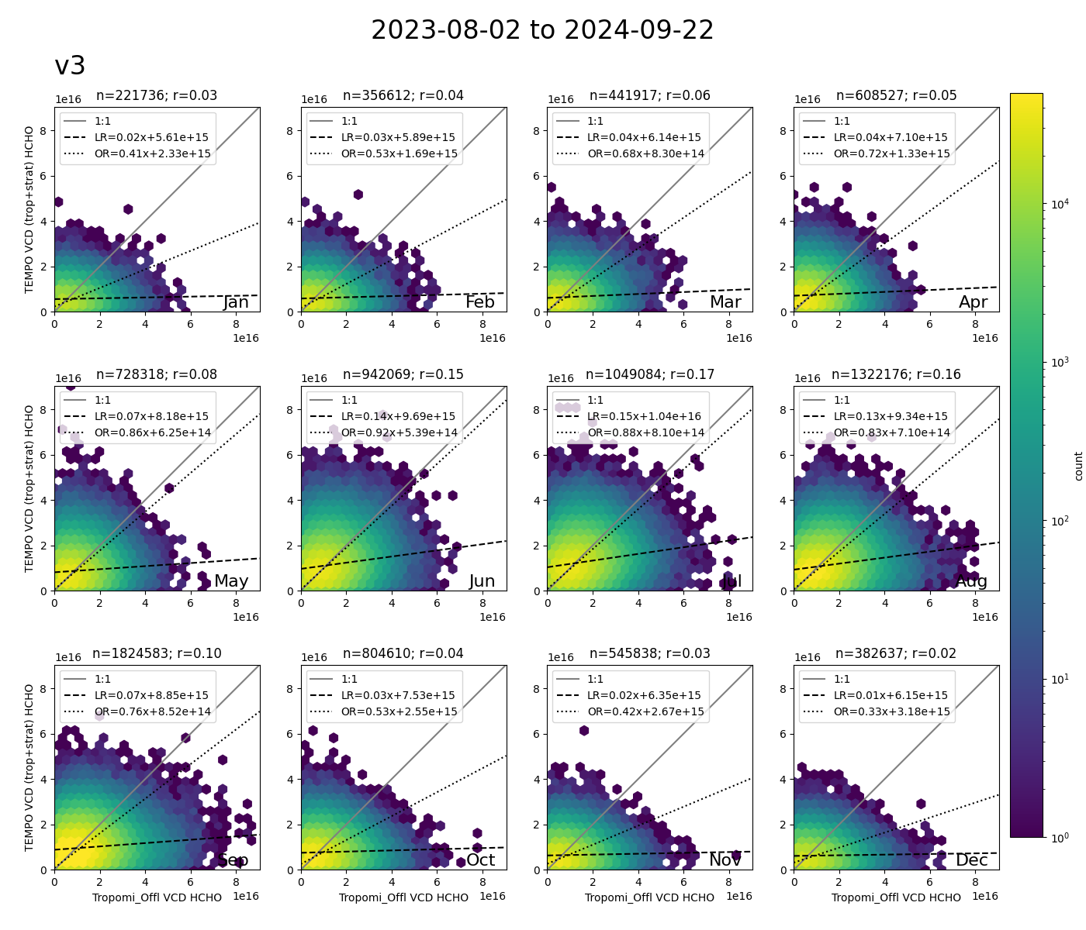
Seasonal and Diurnal Performance is Consistent TEMPO L2 vs TropOMI Total HCHO
Better Agreement in Summer
Dynamic range varies by month as expected
Larger seasonal changes in TEMPO than TropOMI.
Orthogonal slopes lowest in winter
Steadily increasing from January to May
Decreasing after August
By comparison, Pandora slopes were quite consistent.
Suggest looking into potential TropOMI high-bias in Winter/Spring
Count
100
Jan
Feb
Mar
Apr
scale: 0 to 6e16
10
May
Jun
Jul
Aug
Sep
Oct
Nov
Dec
1
Notes:
Formaldehyde has lower correlations in winter when the dynamic range is low and the measurement uncertainty is closer to the measured value.
Formaldehyde required spatial averaging to reduce noise, but that means that TEMPO and Pandora measurements have larger spatial discrepancies. The orthogonal regression attributes some of the difference to both products, which is probably more appropriate. You can see that it dramatically changes the slopes.

Slide 14
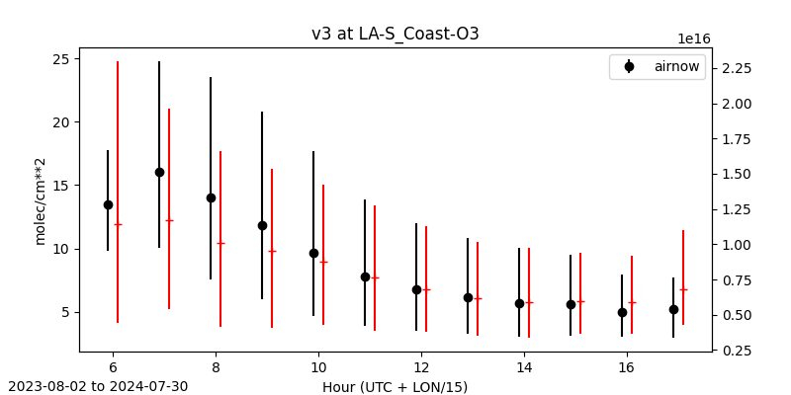
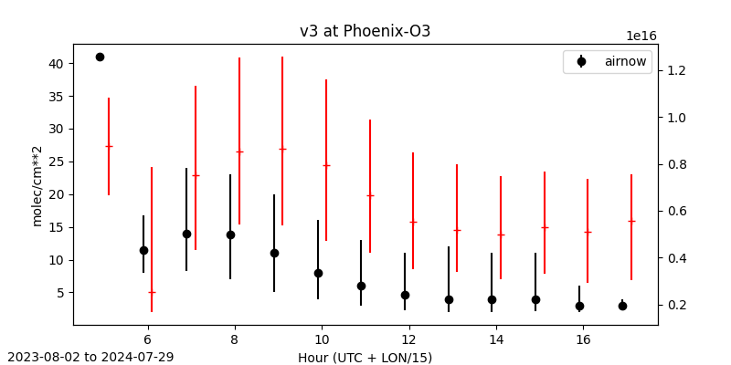
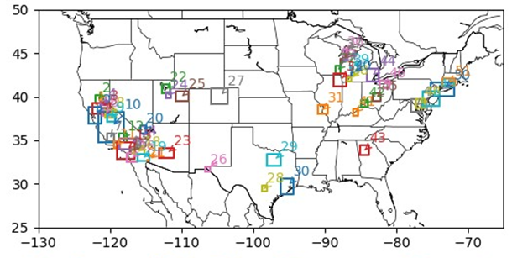
Connecting TEMPO to Air Quality Management TEMPO L2 vs AirNow Surface NO₂
Looking towards future applications.
We know that columns and surface concentrations shouldn’t always correlate well.
Where do they correlate well enough and why?
How can we transform columns to better correlate with surface?
How can this be useful for nonattainment or near-realtime mapping? What about annual mean surfaces for exposure?
NO2 [ppb]
NO2 [molec/cm²]
NO2 [ppb]
NO2 [molec/cm²]

Slide 15

Summary of Validation
Thanks to:
Kelly, SAO Team, and NASA TEMPO Project Team for delivering on the promises of TEMPO!
NASA LaRC ASDC for assistance to connect TEMPO to RSIG APIs and increase accessibility!
Pandonia Global Network and State and Local agencies for working with EPA to expand Pandora measurements!
Research groups and researchers who have contributed their time and analysis in support of TEMPO validation!
Given the short timeline for TEMPO baseline mission, early data access to support a community led validation effort was critical.
Nitrogen dioxide and formaldehyde results contribute to both the beta and provisional maturity levels outlined in the validation plan.
Assessing bias, precision and uncertainty (NO2-02, NO2-04, HCHO-02 and HCHO-04)
Inter-site gradients contributes to urban/rural gradient assessments (NO2-01 and HCHO-01)
EPAs automated validation software will continue to assess TEMPO L2 products!
Henderson.Barron@epa.gov
Slides at:
Notes:
Slide at:

