Slide 1
Data Fusion Tool
Demo
For Ozone and PM2.5
The Data Fusion Tool v.2.1 package (“Data Fusion Tool_ Setup v2.1.exe” and “Data Fusion Tool_Data v2.1.exe” : run both to install) is available at EPA’s NewFTP site under:
https://gaftp.epa.gov/Air/aqmg/cjang/Data_Fusioin_Tool/DFTool_2.1/
AQMG demo, Carey Jang

Slide 2
“Data Fusion” Tool
(Fusing Model and Monitor and/or other data)
Inputs:
Model & Monitor or other data
(dispersion model, satellite data, LUR, etc.)
Spatial: grid & non-grid (census)
Temporal: annual/monthly/daily
Techniques:
eVNA, VNA,
Downscaler, etc.
Data
Fusion
Open-Source & User-Friendly
Cross-Validation
(QA, Multi-fold, Leave-one-out, etc)
Method Development, Evaluation & Research
Regulatory Applications
(PM & O3 RIA, REA)
BenMAP-CE,
CDC Health Studies
SMAT-CE
Attainment Test
Notes:
This is a conceptual framework for the potential standalone data fusion tool. The idea is actually coming from EPA so I will let our EPA friends to elaborate.

Slide 3
Data Fusion Tool (DFT): Recent Progress
Completed a functional DF tool with 5 major modules (Data input option, DF option, Receptor option & Cross-Validation), Updated monitoring data to 2017 (2002-2017).
Expand functions to add new capabilities for temporal & spatial data fusion and cross-validation:
  Temporal fields: allow to create annual, quarterly, monthly & daily spatial fields
  Spatial fields: grid, no-grid receptor (GIS shapefile), & allow to select subdomain (partial domain)
  Cross-validation: “Multi-fold” and “Leave-one-out” with “selected monitor” (subdomain) options
  Output model comparison files (support PM NAAQS)
Conduct the DF tool tests using various cases (compare CMAQ/DS/eVNA/VNA): National cases (2013 CDC & 2011), CA CV/SC cases, NY-OH-PA cases, KS case
AQMG demo, Carey Jang, 2018

Slide 4
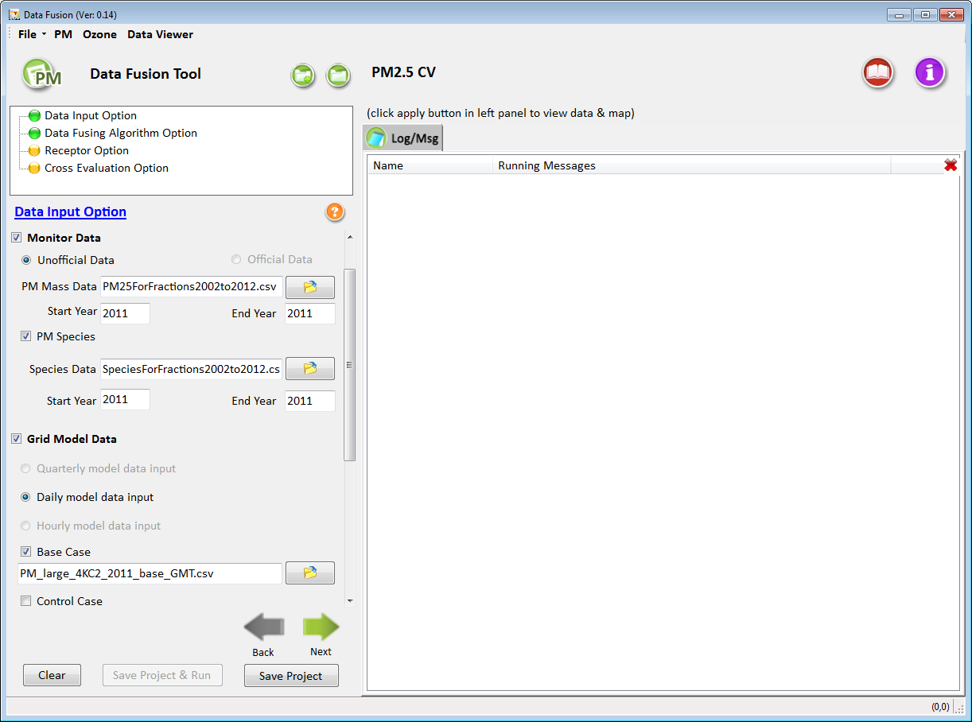
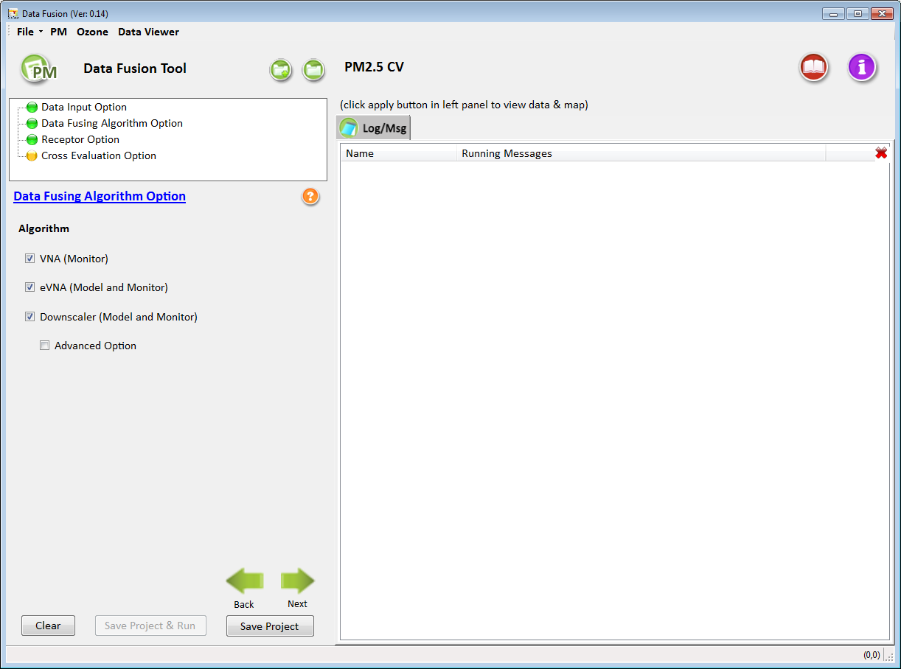
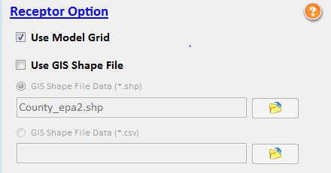
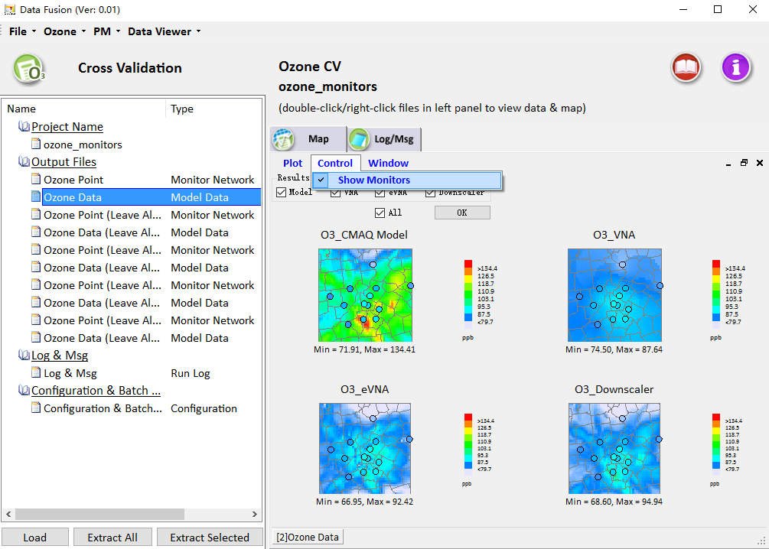
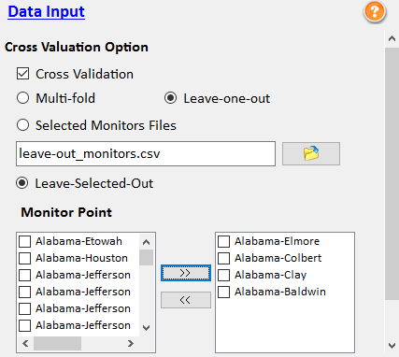
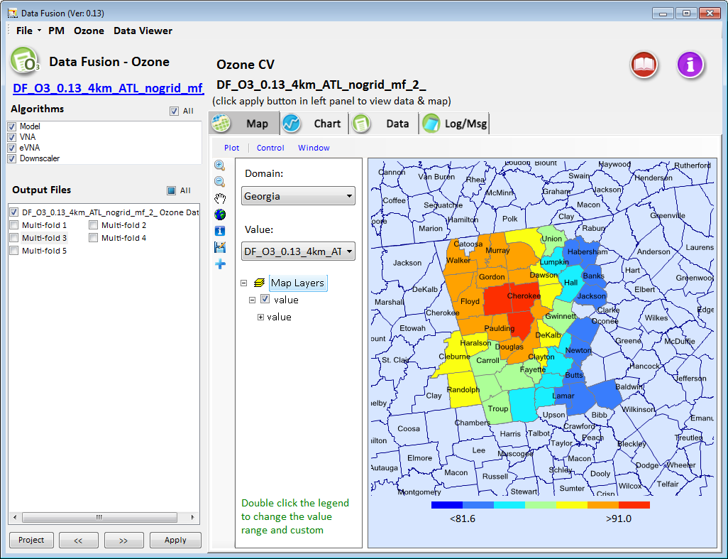
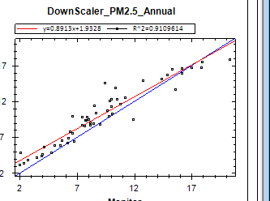
“Data Fusion” Tool: Main GUI
2. DF Technique Option
eVNA/VNA/Downscaler
1. Data Input Option
Model data
Monitor data
Other
3. Spatial & Temporal Option (new)
Spatial DF option
Temporal DF option
4. Receptor Option
Grid (model)
Non-grid (GIS shape file)
Data Viewer
5. Cross-Validation Option
Multi-fold (random %)
Leave-one-out (input file)
Leave-one-out (selected)

Slide 5
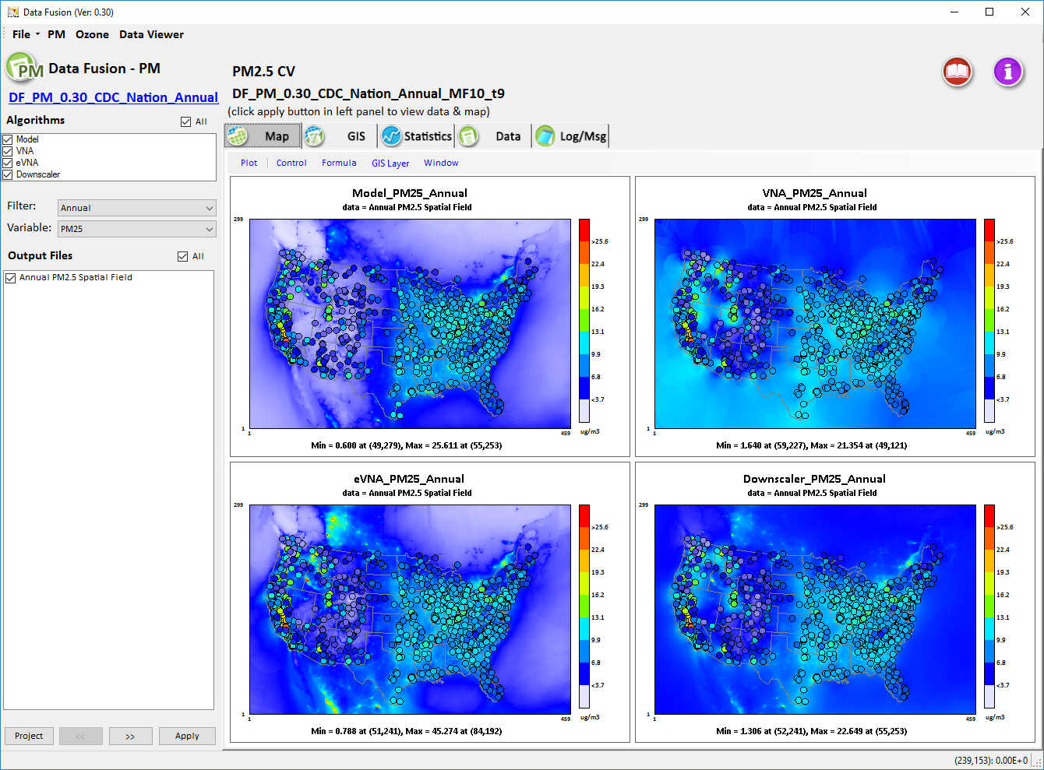
PM2.5 Data Fusion: CDC case
Annual Spatial Fields (2013)
CMAQ
VNA
eVNA
DS

Slide 6
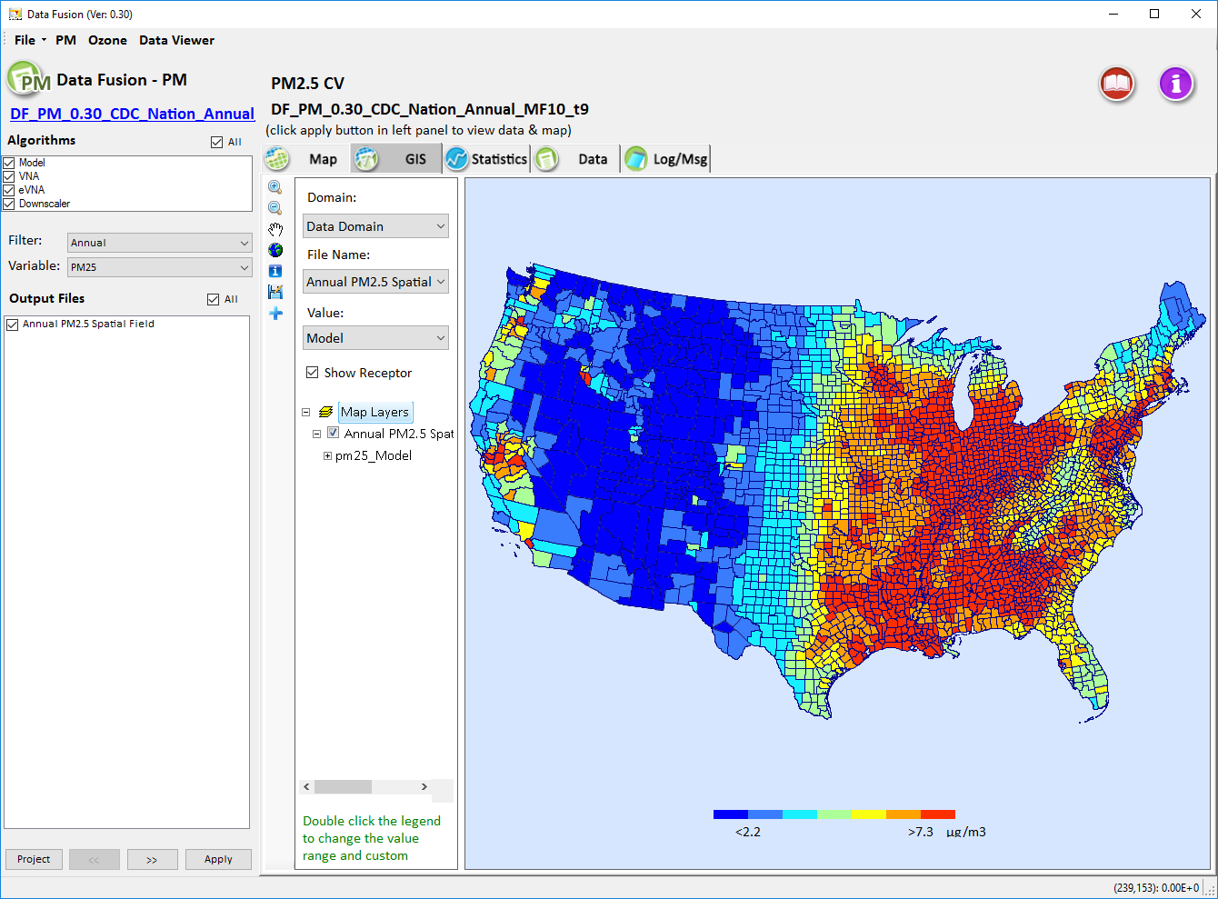
Non-Grid Receptor
(GIS Shapefile)

Slide 7
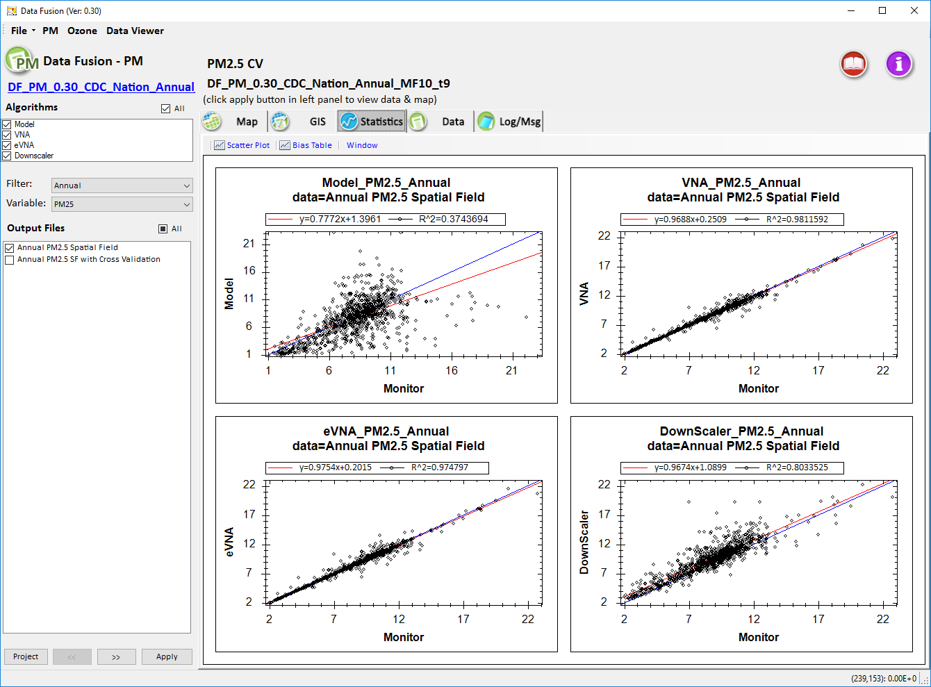
PM2.5 Spatial Fields (CDC 2013 National)
(No Cross-Validation)
CMAQ
VNA
R² = 0.37
R² = 0.98
eVNA
DS
R² = 0.97
R² = 0.80

Slide 8
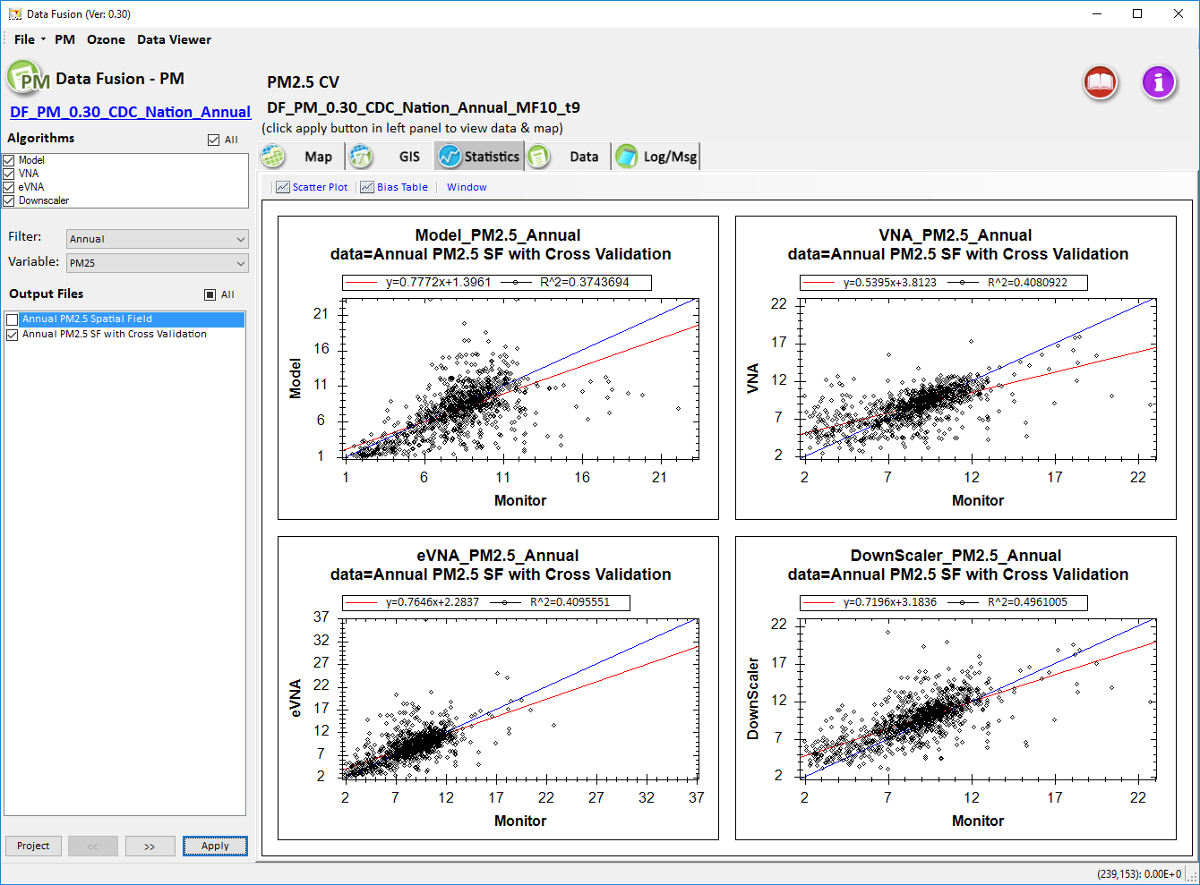
Cross-Validation (CDC 2013 Annual National)
PM2.5 (Multi-Fold of 10)
CMAQ
VNA
R² = 0.37
R² = 0.41
R² here represent spatial correlation (instead of temporal correlation since it is annual avg.)
eVNA
DS
R² = 0.41
R² = 0.49

Slide 9
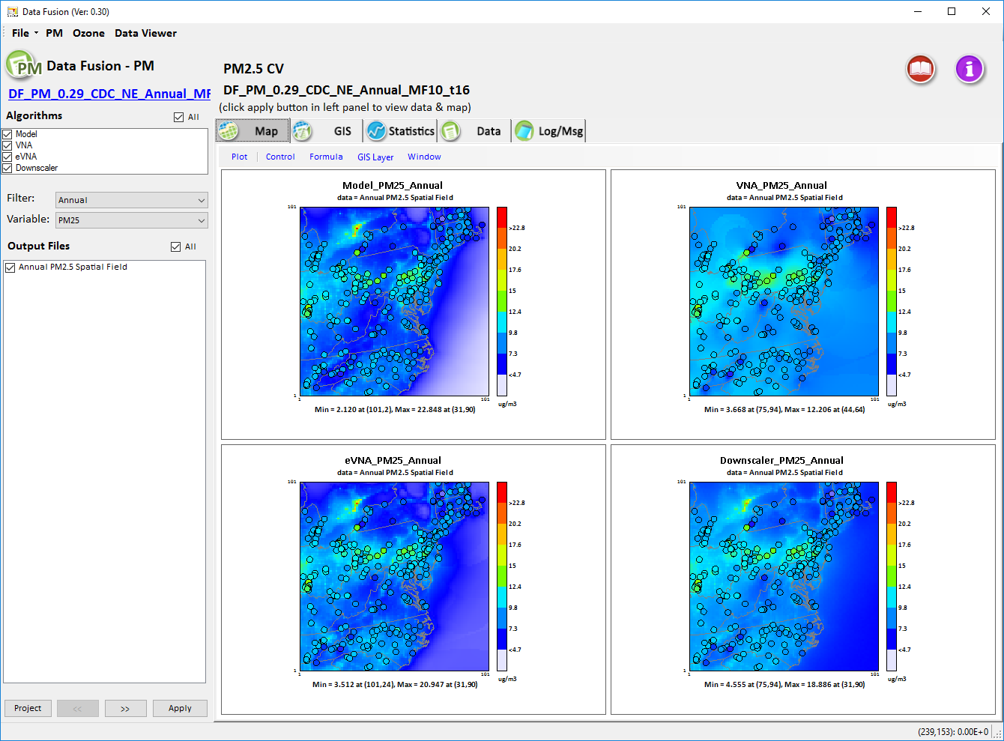
PM2.5: CDC NE-US case
Annual SP (2013)
CMAQ
VNA
eVNA
DS

Slide 10
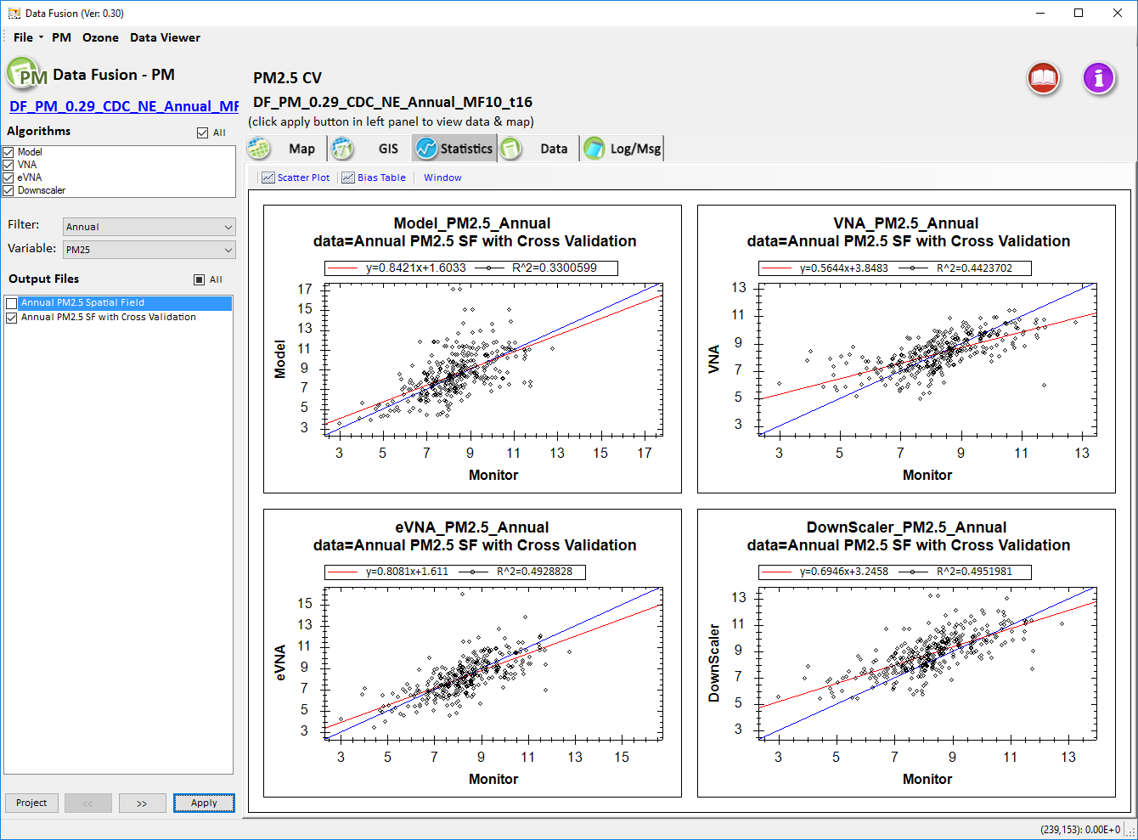
Cross-Validation (CDC NE 2013 Annual)
(Multi-Fold of 10)
CMAQ
VNA
R² = 0.33
R² = 0.44
eVNA
DS
R² = 0.49
R² = 0.50

Slide 11
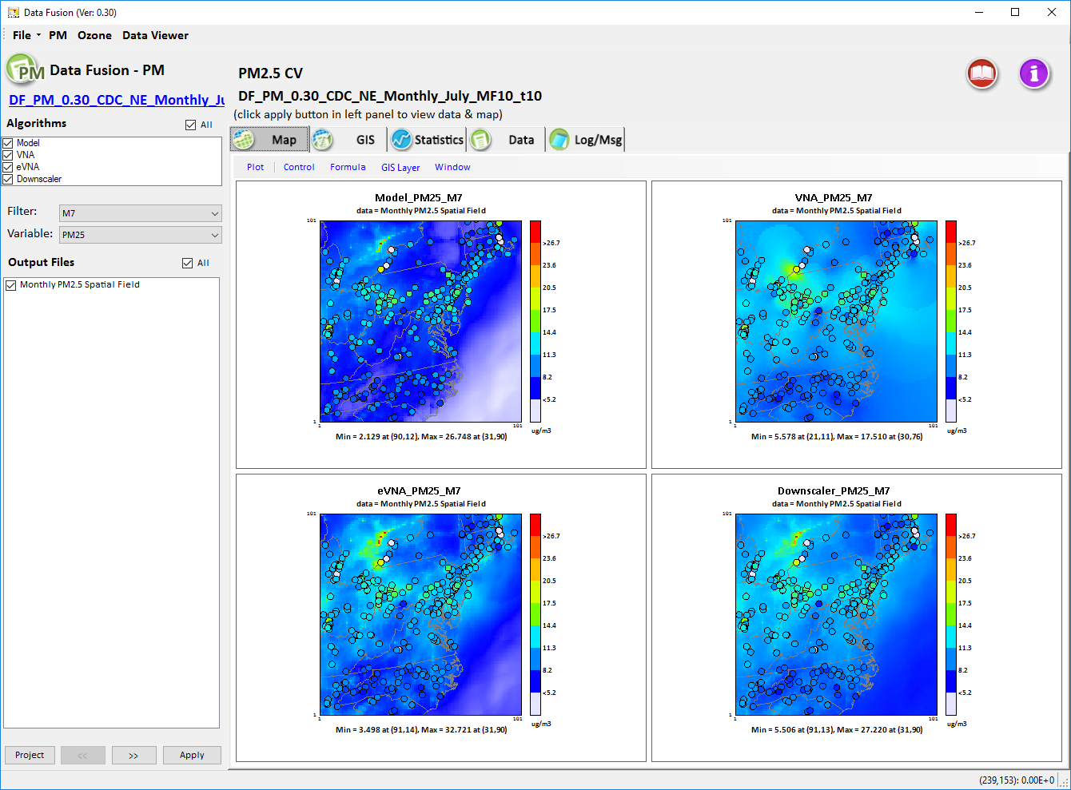
PM2.5: CDC-NE case
Monthly SP (July 2013)
CMAQ
VNA
eVNA
DS

Slide 12
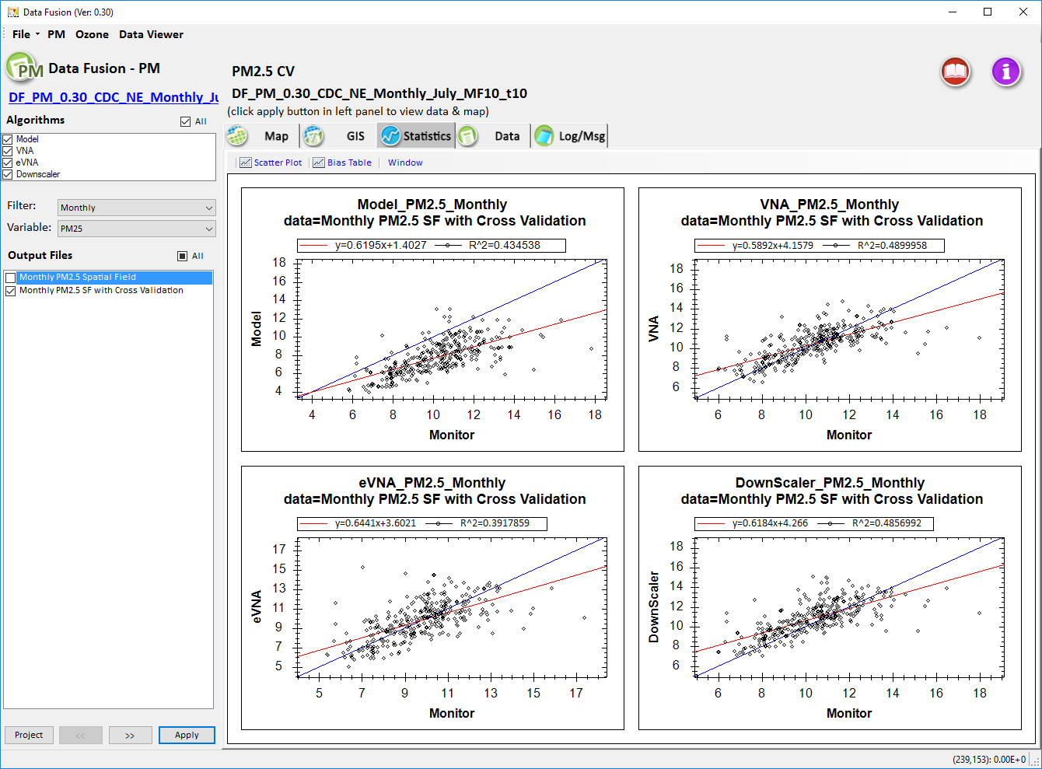
Cross-Validation (CDC NE 2013 Monthly July)
(Multi-Fold of 10)
CMAQ
VNA
R² = 0.43
R² = 0.49
eVNA
DS
R² = 0.39
R² = 0.49

Slide 13
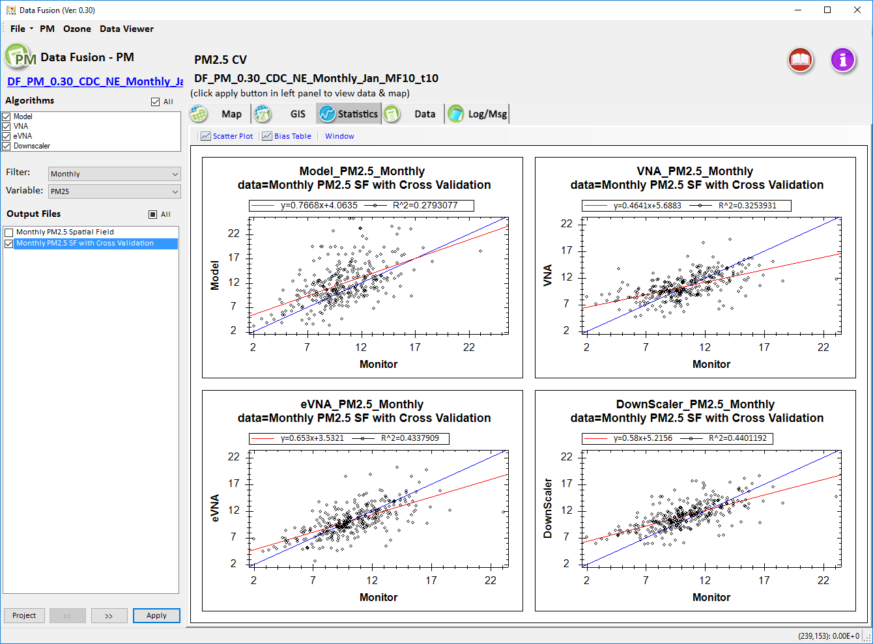
Cross-Validation (CDC NE 2013 Monthly Jan.)
(Multi-Fold of 10)
CMAQ
VNA
R² = 0.27
R² = 0.32
eVNA
DS
R² = 0.43
R² = 0.44

Slide 14
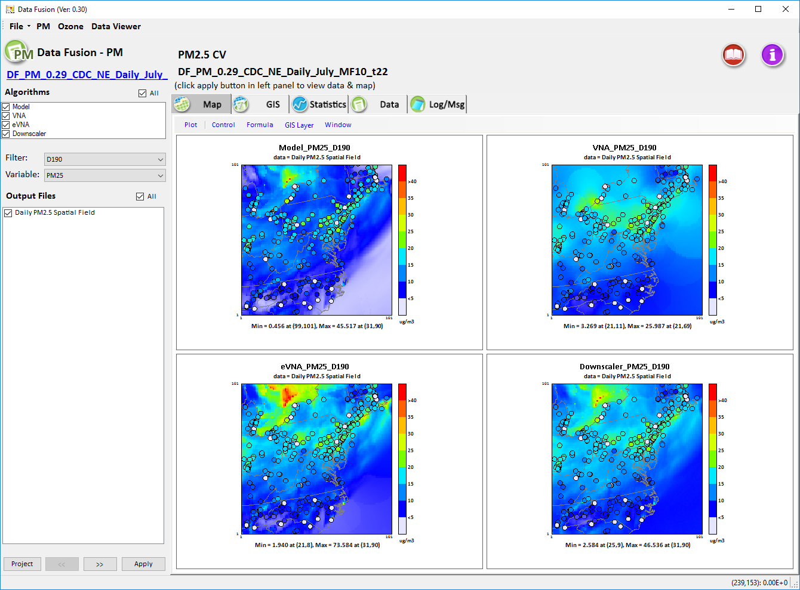
PM2.5: CDC NE case
Daily SP (July 9, 2013)
CMAQ
VNA
eVNA
DS

Slide 15
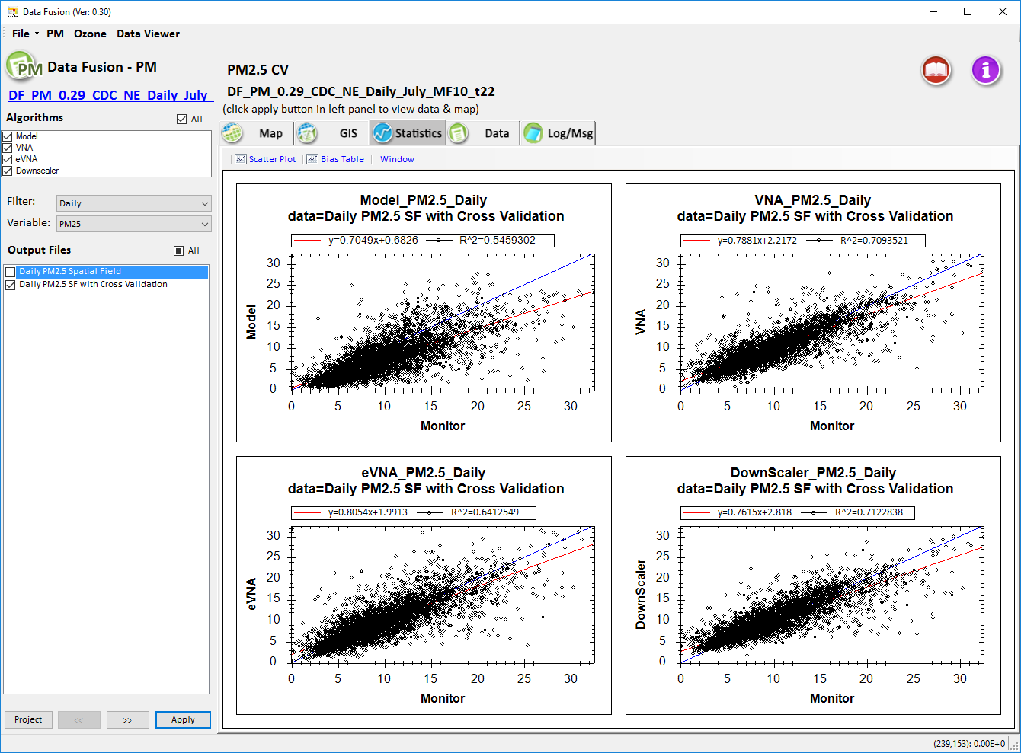
Cross-Validation (CDC NE 2013 Daily July)
(Multi-Fold of 10)
CMAQ
VNA
R² = 0.54
R² = 0.71
Higher R² indicates that DF appears to provide higher temporal correlation than spatial correlation
eVNA
DS
R² = 0.64
R² = 0.71

Slide 16
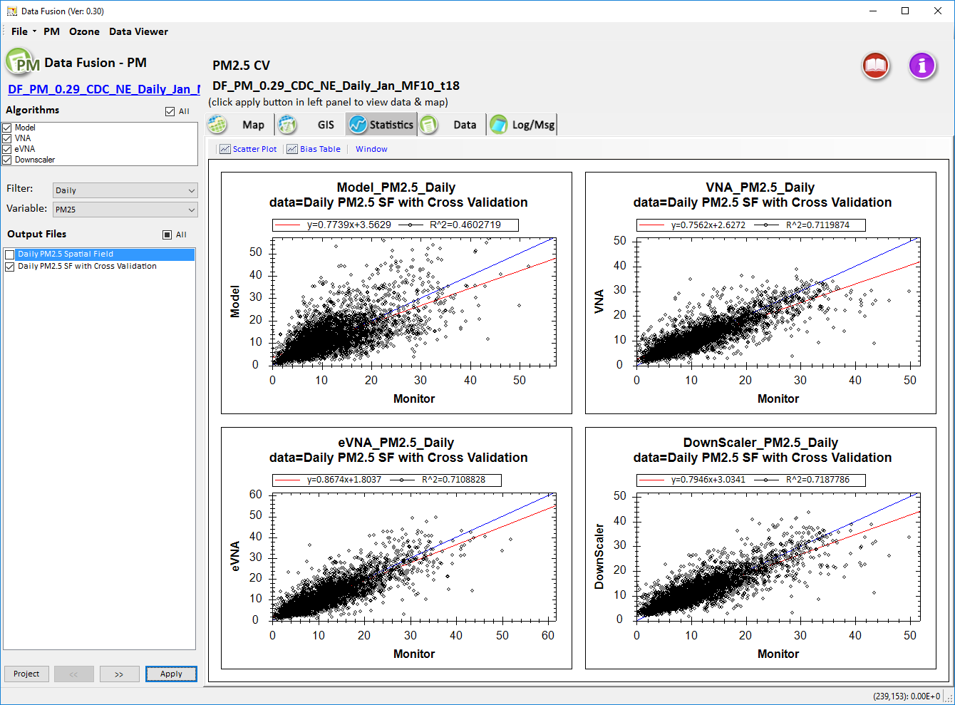
Cross-Validation (CDC-NE 2013 Daily Jan.)
(Multi-Fold of 10)
CMAQ
VNA
R² = 0.46
R² = 0.71
Higher R² indicates that DF appears to provide higher temporal correlation than spatial correlation
eVNA
DS
R² = 0.71
R² = 0.72

Slide 17
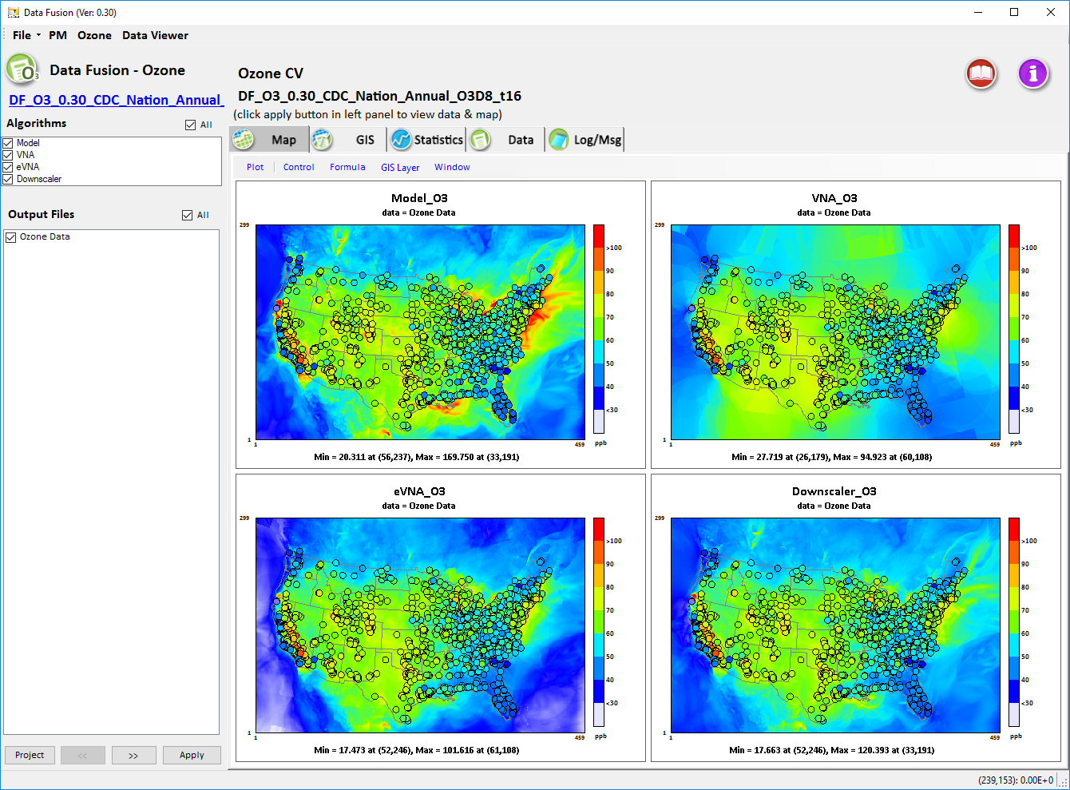
O3 Data Fusion: CDC case
Annual Spatial Fields (2013)
CMAQ
VNA
eVNA
DS

Slide 18
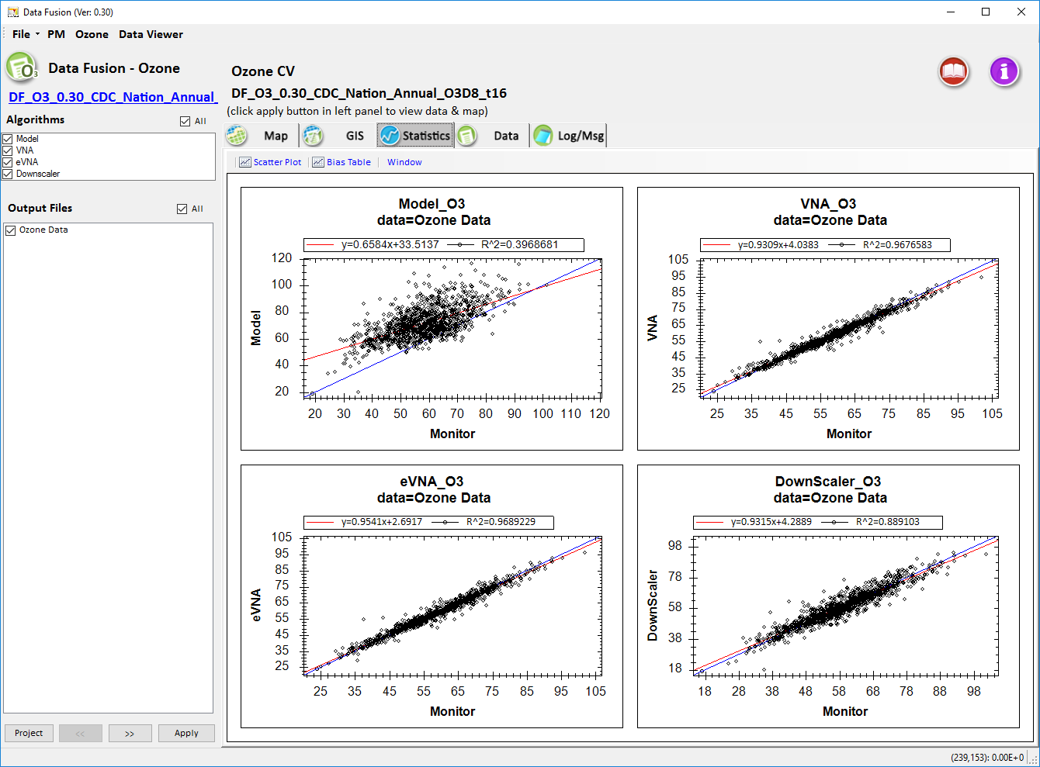
O3 Spatial Fields (CDC 2013 National)
(No Cross-Validation)
CMAQ
VNA
R² = 0.40
R² = 0.97
eVNA
DS
R² = 0.97
R² = 0.89

Slide 19
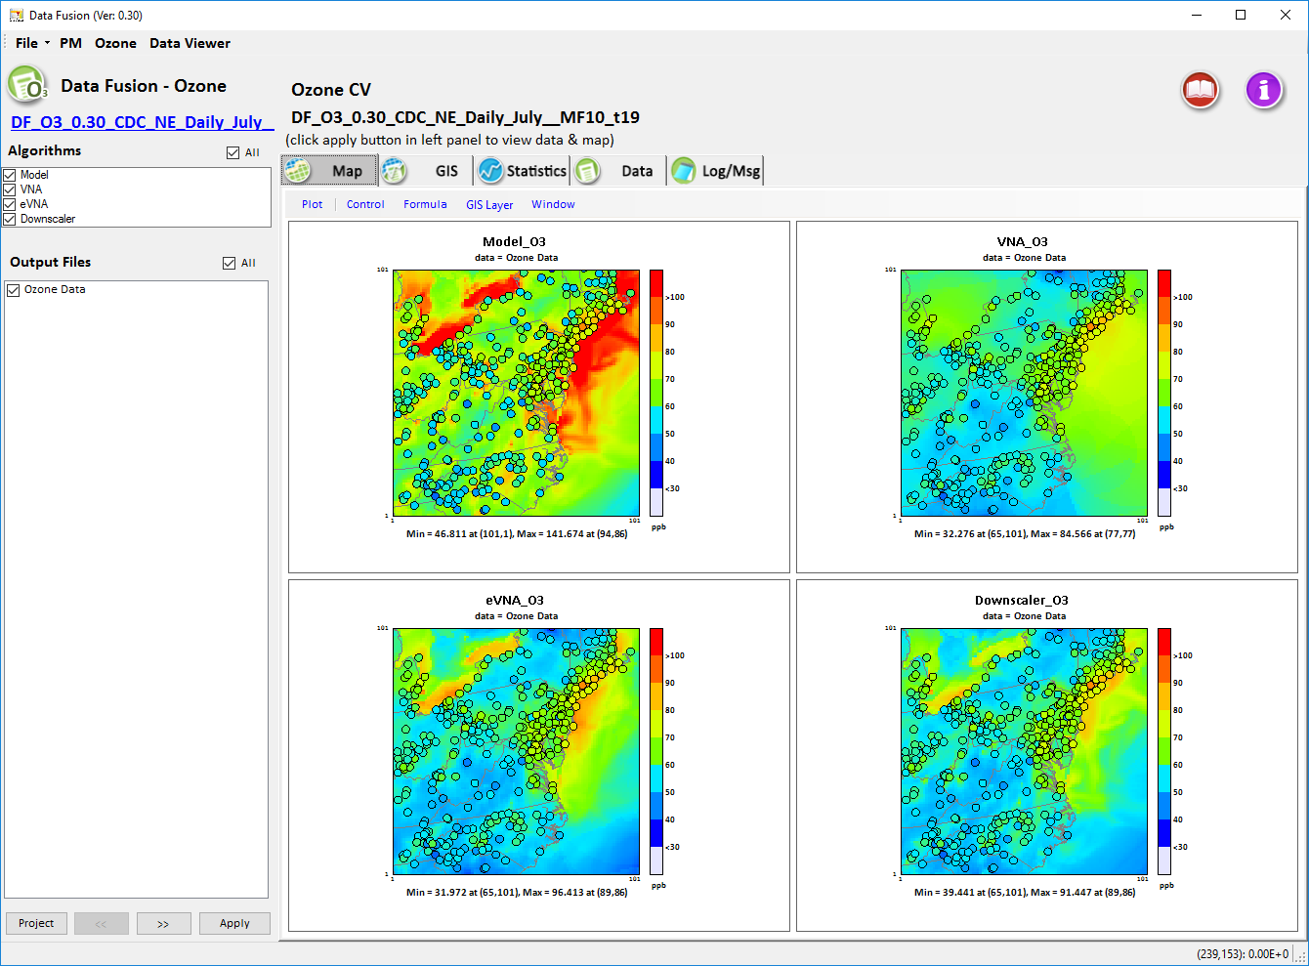
O3 Data Fusion: CDC NE case
Daily Spatial Fields (July 2013)
CMAQ
VNA
eVNA
DS

Slide 20
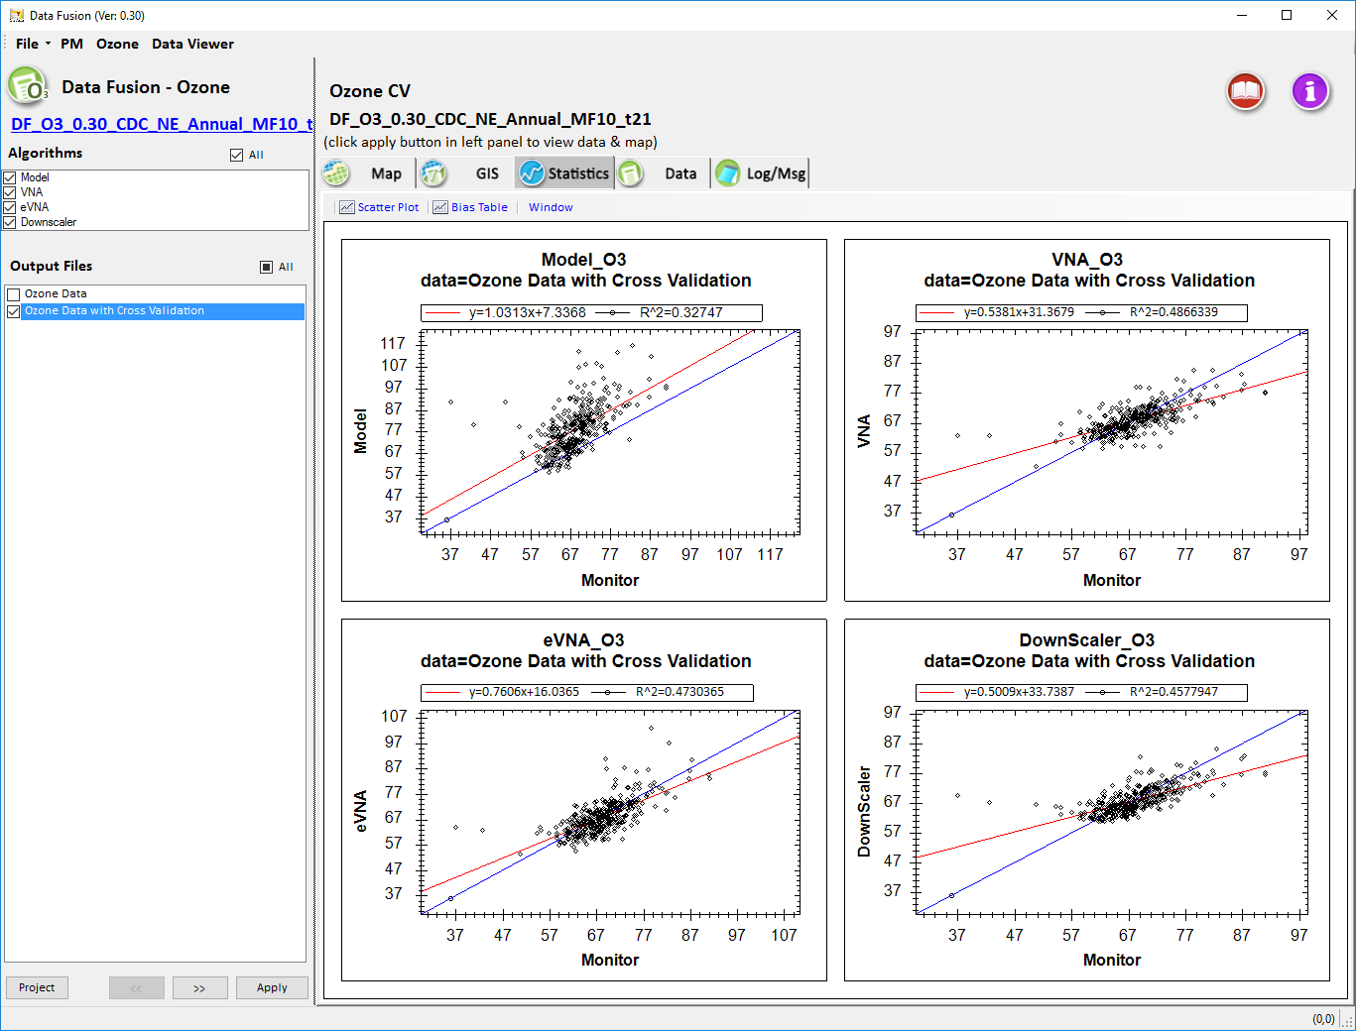
Cross-Validation (CDC NE 2013 Annual)
(Multi-Fold of 10)
CMAQ
VNA
R² = 0.32
R² = 0.48
eVNA
DS
R² = 0.47
R² = 0.46

Slide 21
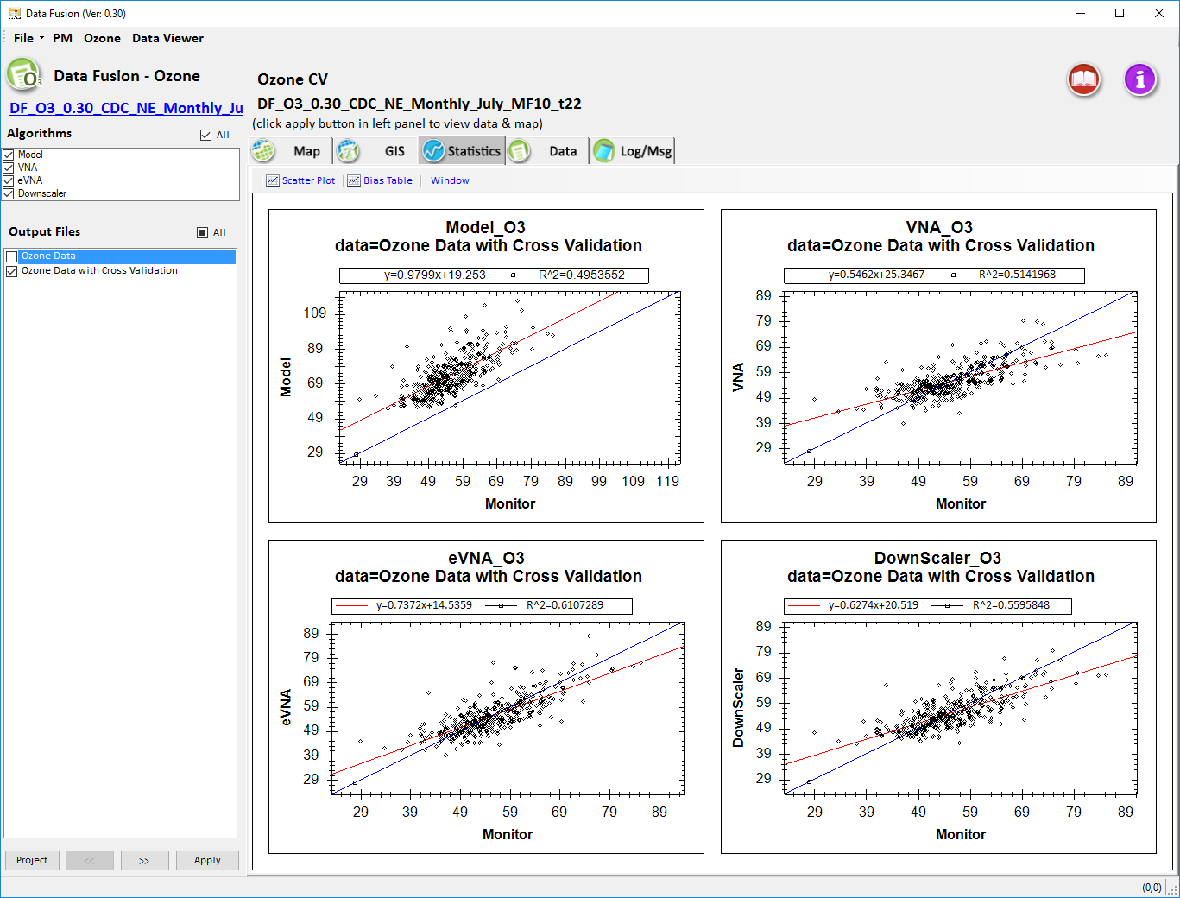
Cross-Validation (CDC NE 2013 Monthly July)
(Multi-Fold of 10)
CMAQ
VNA
R² = 0.49
R² = 0.51
eVNA
DS
R² = 0.61
R² = 0.56

Slide 22
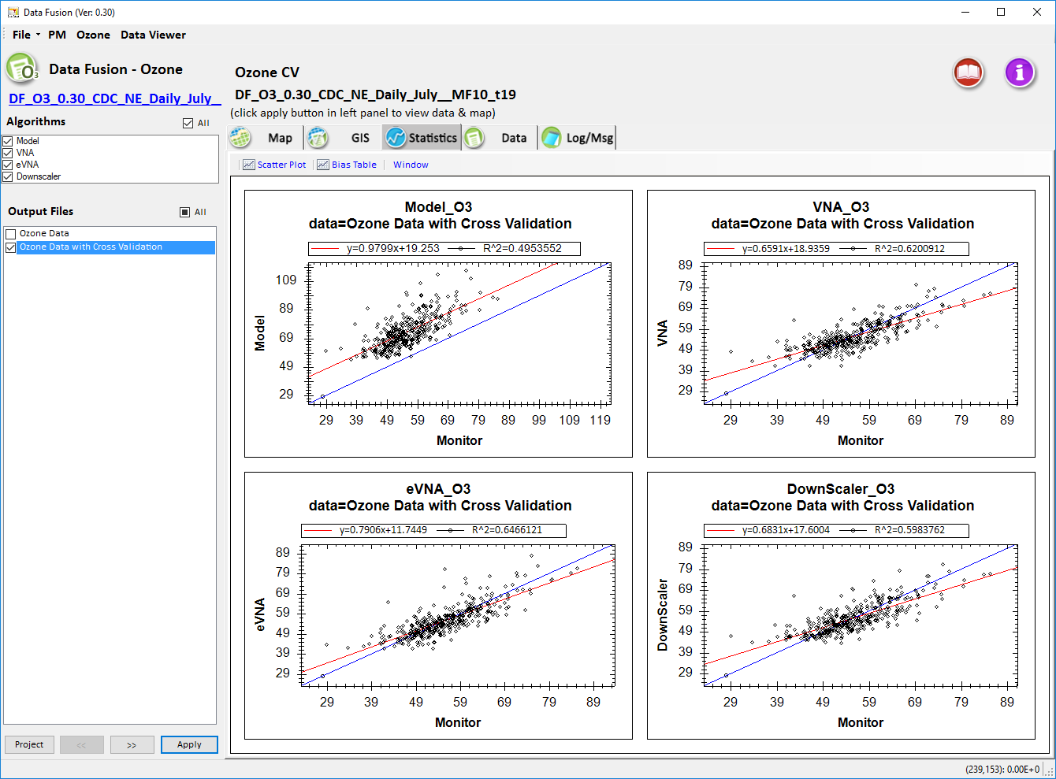
Cross-Validation (CDC NE 2013 Daily July)
(Multi-Fold of 10)
CMAQ
VNA
R² = 0.50
R² = 0.62
eVNA
DS
R² = 0.65
R² = 0.60

Slide 23
Comparison of Data Fusion Techniques
(DS, eVNA & VNA vs. CMAQ)
In Responding to High PM2.5 Areas
(e.g., due to Forest Fire Events)
Example case:
CA Central Valley Case in August 2013

Slide 24
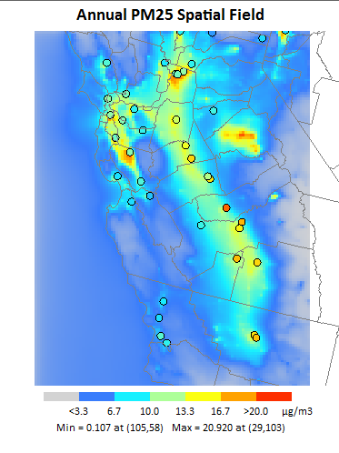
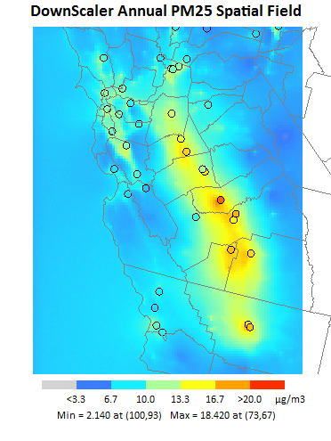
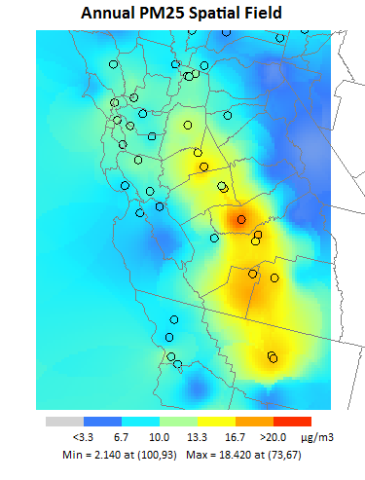
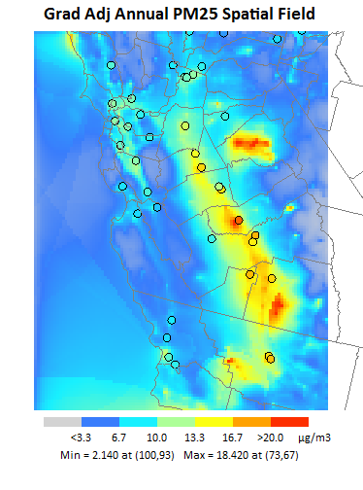
SMAT-CE Test Case: DS vs. eVNA & VNA
Central Valley 4-km GMT Domain: PM2.5 (Annual) Annual
(a) Base_PM2.5_model
(b) Base_PM2.5_DS
CMAQ
model
DS
(c) Base_PM2.5_VNA
(d) Base_PM2.5_eVNA
VNA
eVNA
Note: This SMAT-CE test case uses 2013 model data & 2011 monitoring data
(due to SMAT-CE’s PM.25 data availability at that time up to 2011)

Slide 25
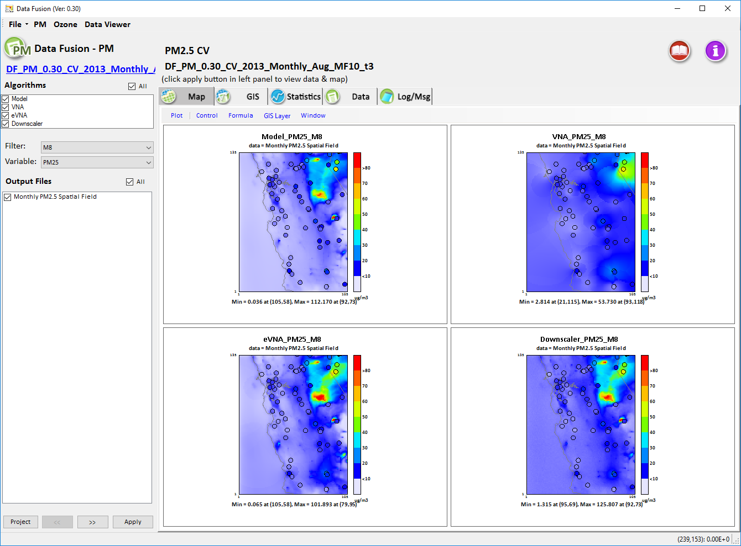
PM2.5: CA Central Valley (CV) case
(Monthly avg. - Aug. 2013)
CMAQ
VNA
Downscaler & eVNA appear to fuse model & monitor data quite well over this high emissions case (fire events)
eVNA
DS
Note: This DFT case uses both 2013 model data & monitoring data

Slide 26
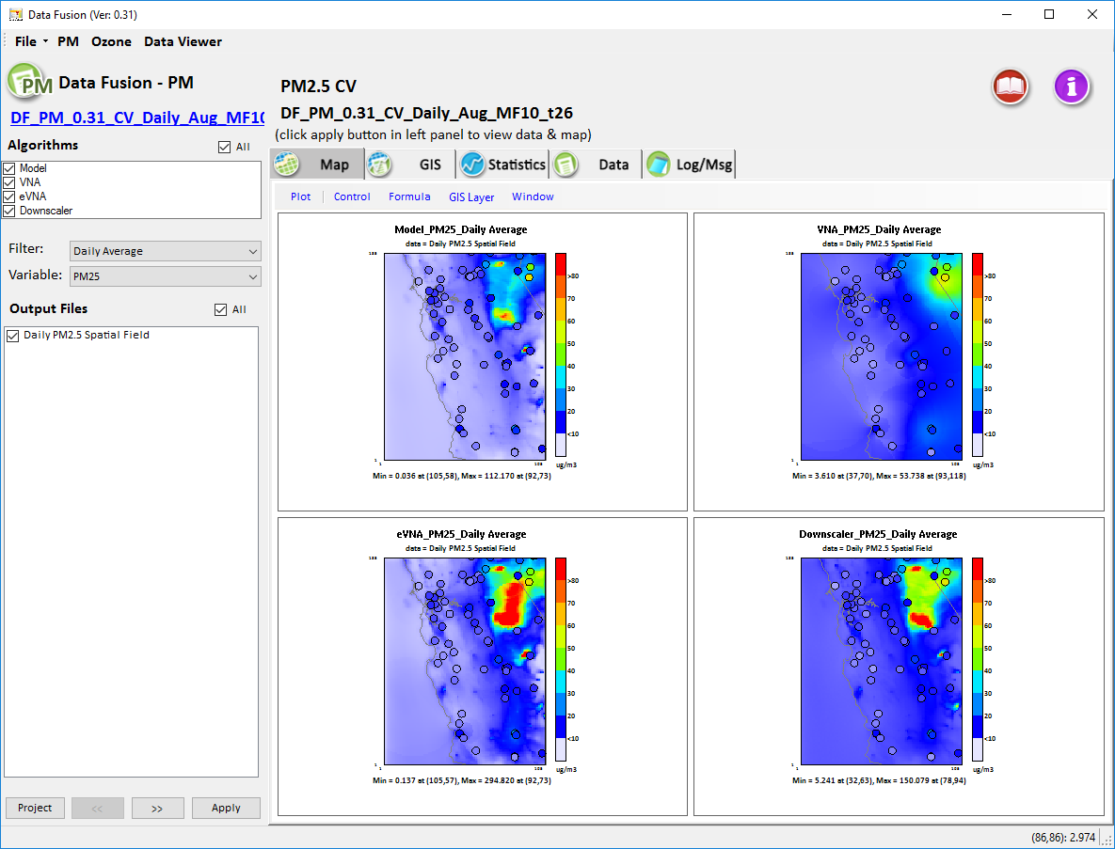
PM2.5: CA Central Valley (CV) case
(Daily avg. - Aug. 2013)
CMAQ
VNA
But Daily spatial fields show higher eVNA & Downscaler results in this high emissions case (fire events)
eVNA
DS
August Monthly: 101 -> Daily 295 ug/m3
(125 -> 150)

Slide 27
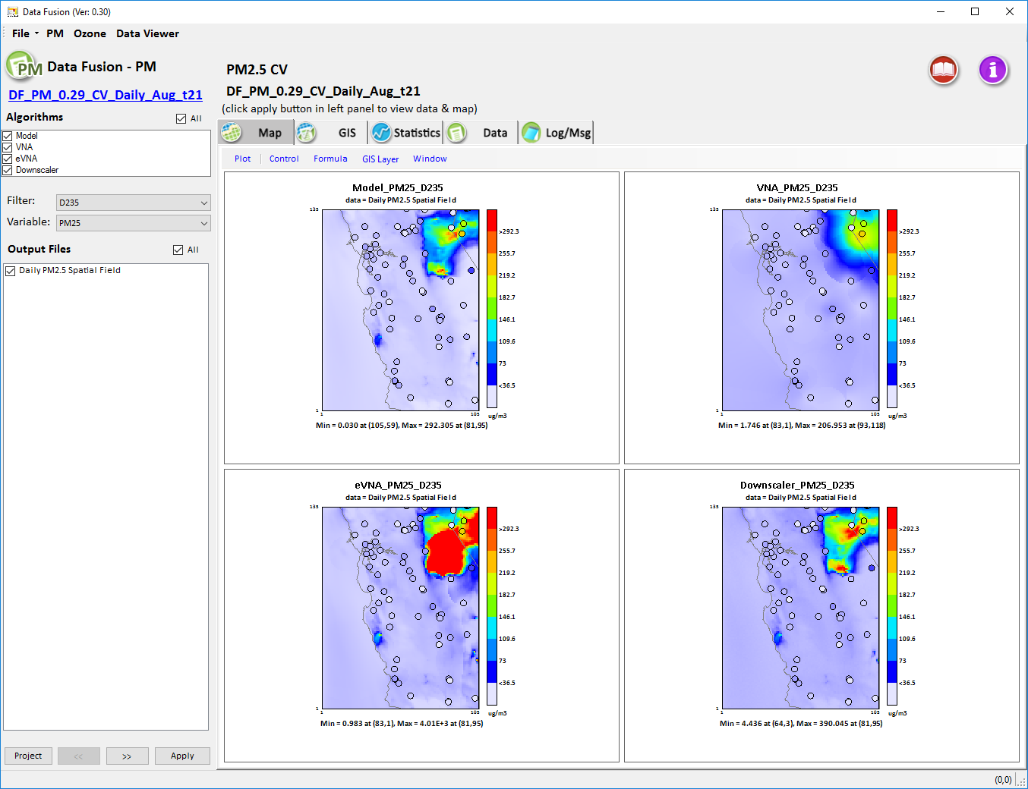
PM2.5: CA Central Valley (CV) case
(Daily avg. - Aug. 25, 2013)
CMAQ
VNA
Daily DF shows that eVNA has an overshooting (model gradient-adjusted) issue over this high emissions case
eVNA
DS
4,010 ug/m3

Slide 28
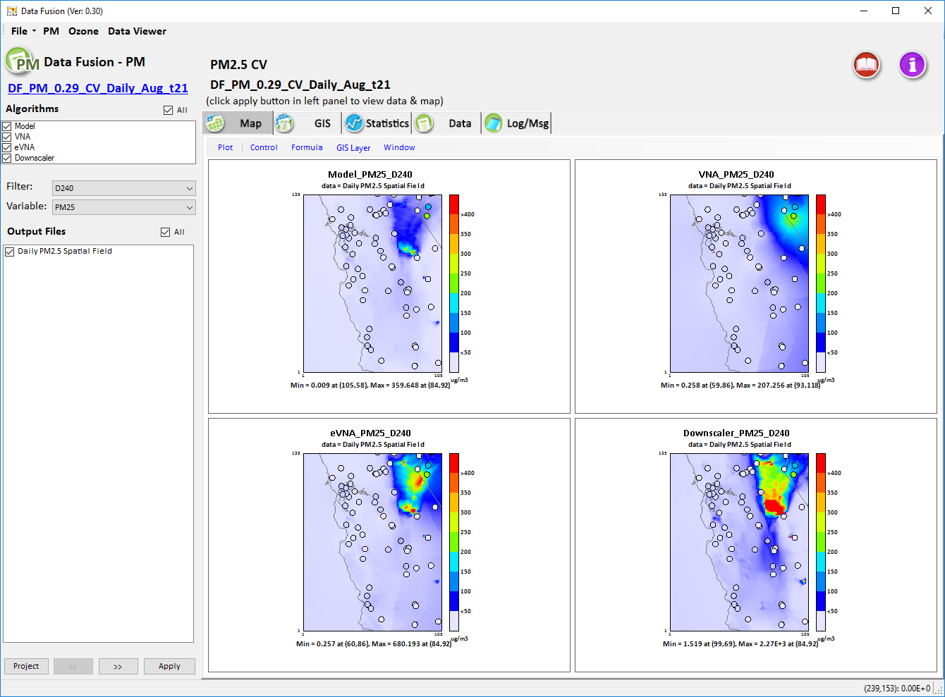
PM2.5: CA Central Valley (CV) case
(Daily avg. - Aug. 30, 2013)
CMAQ
VNA
Downscaler may have a similar overshooting issue over in this daily DF high emissions case study
eVNA
DS
2,270 ug/m3

Slide 29
Data Fusion Tool (DFT): Summary
The DFT can be very useful in providing in-depth analyses and comparisons of spatial fields generated from a suite of data fusion techniques used at EPA
Cross-validation results show that DF techniques predict higher temporal correlations (daily spatial fields at regional scale) than spatial correlations (annual/monthly average spatial fields at national scale)
Potential “overshooting” issues over high emissions area using eVNA and Downscaler may need further investigation

Slide 30
Data Fusion Tool (DFT): Future Work
Complete and test “Spatial & Temporal Spatial Fields” and “Cross-Validation” functions for O3
Conduct sensitivity test & investigate potential improvements for eVNA and Downscaler (e.g., overshooting issues)
Add “Dispersion Model” as part of model DF option
Develop on-line “User’s Guide”
Check DF impact issue using “FRM only” or “FRM+FEM”
Apply the DF tool for supporting PM2.5 & O3 NAAQS and CDC projects

Slide 31
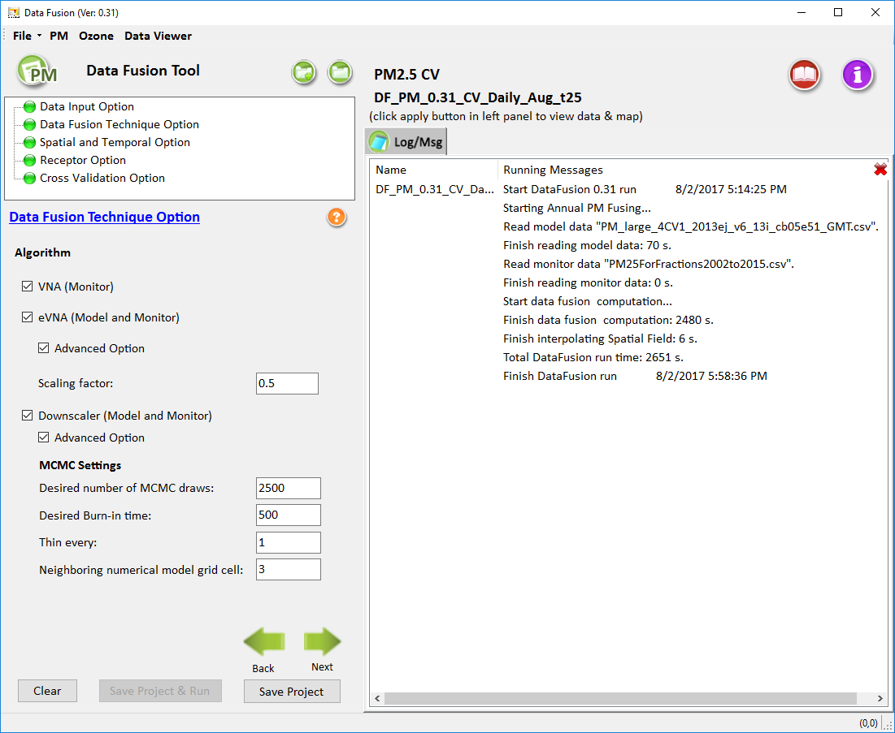
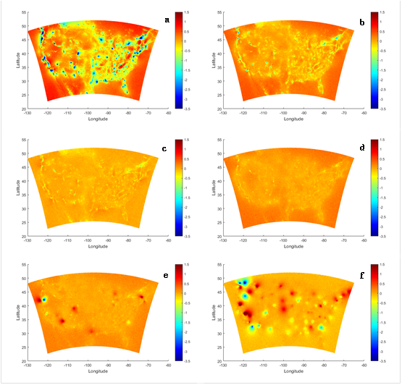
NGCW: 3 - 1
NGCW = 5 - 3
NGCW = 7 - 5
NGCW = 9 - 7
NGCW = 11 - 9
NGCW = 13 - 11
Investigate potential improvements for eVNA and Downscaler (e.g., overshooting issues)

Slide 32
Thank you!
Carey Jang, OAQPS/AQAD/AQMG, 8/08/2017

Slide 33
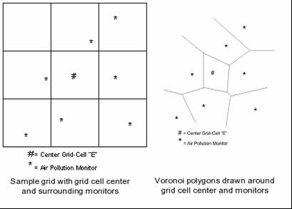
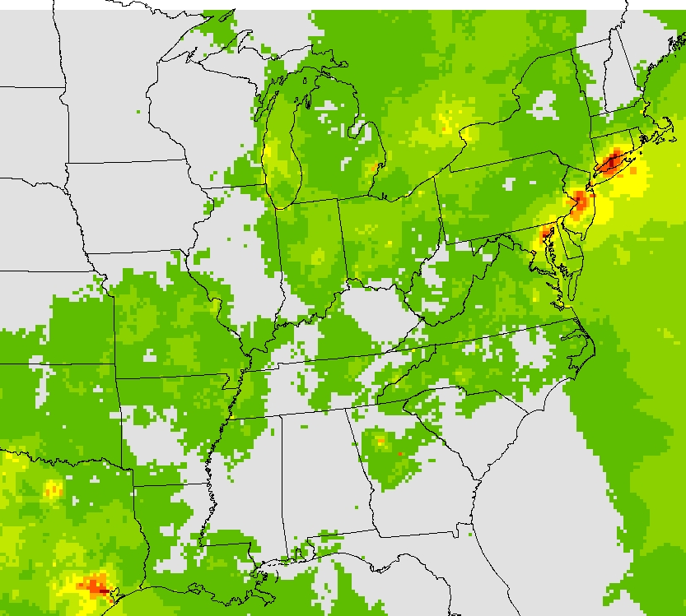
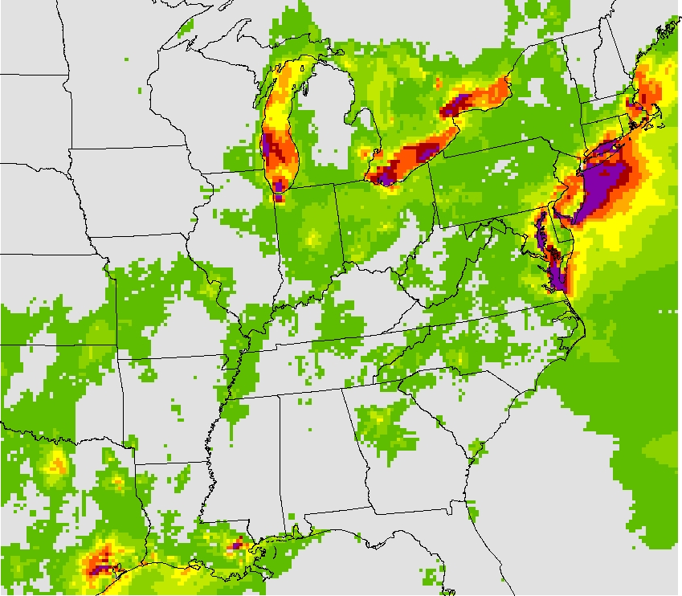
Data Fusion (Spatial Fields) in SMAT-CE Attainment Tool
Data Fusion
SMAT-CE provides attainment test for PM2.5 & O3 “Non-attainment” & visibility Class-I areas
Data fusion (spatial fields) is used for:
  Providing model RRF to monitoring data point (to calculate future Design Value)
  Health benefits calculations (BenMAP)
Spatially interpolated concentration fields - VNA
  monitoring data points interpolated to grid cells
  For annual/daily PM2.5 & O3 design values
Fused spatial fields (gradient adjusted) - eVNA
  Interpolated monitoring data is combined with gridded model data to adjust fields based on modeled gradients
New development in SMAT-CE - Downscaler
VNA
eVNA
(VNA: Voronoi Neighbor Averaging)

