Slide 1
Climate Energy Scenario Efforts

Slide 2
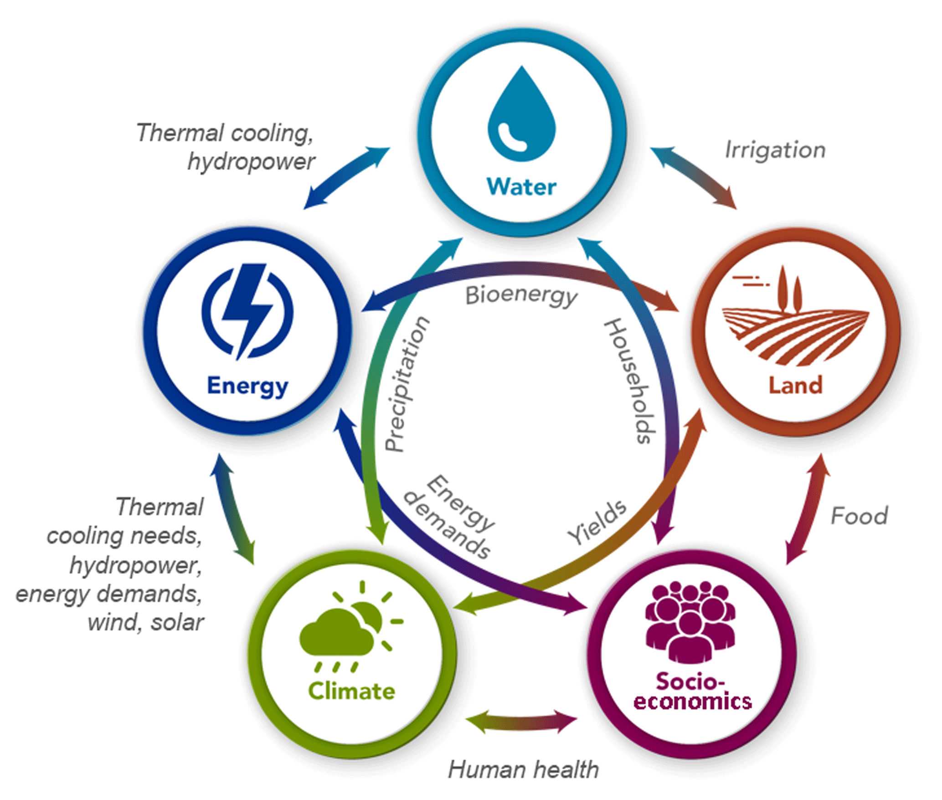
Implications of changing energy systems for climate-air quality
Changes in the energy system affect emission rates of pollutants of concern for OAQPS (e.g. CAPs, toxics, short-lived climate forcers like black carbon)
Having tools that can effectively quantify and track these energy-emission-air quality connections across local, state, national, and global scales is important given the variable scale of relevant energy/climate policy decisions in play (e.g. city, state, country, international)
Streamlining the connectivity between in-house EPA tools for energy systems modeling and air quality impact assessments would allow more robust estimates of air quality changes associated with different energy/climate policy scenarios
GCAMv5.1 info graphic, from Calvin et al., 2019

Slide 3
Energy Systems Modeling across scales
Sector level models (e.g., IPM, MOVES, industry sector models):
  Characterize individual sectors within an energy system in detail at high spatial/temporal resolution
Multi-sector optimization approaches (e.g., MARKAL):
  Represent connections across different components and sectors of an energy system
Integrated Assessment Models (IAMs; e.g. GCAM-USA):
  Represent national/global scale interactions between the energy system and other social, economic, and environmental components of the GHG emission landscape
Shi et al., 2017, Applied Energy

Slide 4
AQMG-ORD pilot linking GCAM-USA to FAST-CE
AQMG pilot project linking GCAM to FAST-CE is underway: linking to reduced form tools like FAST-CE would allow for more rapid estimation of air quality impacts associated with individual energy/climate policy options
FAST-CE relationships are based on instrumented modeling results (e.g. source apportionment modeling) that is resource intensive (both time and money)
Funding for additional source apportionment modeling could expand source-receptor relationships implemented in FAST-CE to increase coverage of:
  Geographic regions: most existing SA results focus on Northeast U.S.
  Emissions sectors: focus of existing SA is mainly EGUs - relationships for mobile, residential, industrial sectors would allow for more comprehensive air quality estimates
  Pollutants of interest: historical focus on NOx/ozone relationships in SA modeling and reduced form tools, applications for PM require additional development

Slide 5
Ongoing OAQPS Coordination with ORD/OAP/OTAQ on Energy Systems Modeling
AQAD/EIAG – ongoing coordination with OTAQ on MOVES modeling results for use in regulatory applications (Alison Eyth)
AQAD/EIAG – ongoing coordination with CAMD on IPM modeling results for use in regulatory applications (Alison Eyth, Norm Possiel)
HEID/Economics group – NOx cost-abatement curves (Region 3 RARE project, Alex Macpherson)
AQAD/AQMG – pilot project with ORD connecting GCAM-USA with FAST-CE (Shannon Koplitz, Kirk Baker, Carey Jang)
AQAD/AQMG – coordination with ORD, Regions, and states to harmonize existing reduced form modeling tools with available energy systems approaches (Kirk Baker)

Slide 6
Funding needs to support ongoing energy systems-AQ work across HEID/AQAD
Emissions modeling for sector specific interactions and rules (IPM, MOVES/coordination with CAMD and OTAQ) – AQAD/EIAG
Development of energy system-economics linkages (coordination with ORD, Regions) - HEID
Additional source apportionment modeling to strengthen connectivity between in-house energy systems modeling tools (GCAM-USA, COMET) and reduced form air quality approaches (FAST-CE, COBRA; coordination with ORD, Regions) – AQAD/AQMG

Slide 7
Key Questions Related to Methane and Climate
Changes in the energy system could also result in changes in methane, either through targeted reductions or as a by-product of system dynamics
Methane affects oxidant budgets and therefore the atmospheric chemical environment relevant for formation of other pollutions (e.g. ozone)
Some key questions to address related to representing changing methane budgets in atmospheric models:
How can we better characterize/bound the impacts of methane chemistry assumptions in existing modeling tools/chemical mechanisms?
How can we improve the characterization of methane in model-ready emission inventories?
How might changes in methane concentrations and other species affecting atmospheric oxidants (e.g. NO_{x}) due to changes in climate/energy policies further affect pollutant distributions?

