Slide 1
CMAQ v53 2017ga Northern Hemispheric Evaluation
Presenter: Barron H. Henderson
Contributors: EIAG and AQMG
2021-04-07

Slide 2
Outline
Model setup
Ozone Evaluation
Sondes - ppm
AQS – MDA8 ppb
OpenAQ – daytime average
Summary

Slide 3
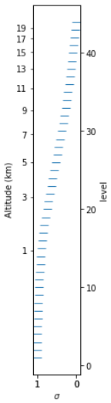
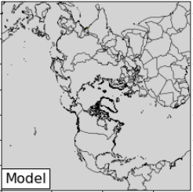
Model Setup: v5.3 2017ga_hemi_cb6_17jh
17jh meteorology (thanks Chris M)
WRF v4.1.1; Hybrid; Kain-Fritsch, Morrison 2
PX LSM, ACM2 mixing, MODIS LULC, RRTMG
GRID Nudging
2017ga emissions (4 streams, thanks EIAG/GDIT)
nobeis_withrwc:
Has land-based anthro, aircraft anthro
has lightning, has ocean cl2 <- future move thesejjjjq
no beis, no fires, no shipping
+fires + beis + shipping
CAMS MEGAN: (thanks Katerina Sindelarova[1])
CAMS Soil NOx (thanks David Simpson[2])
CMAQ v5.3 release (thanks Heather Simon for DESIDE setup)
CB6 with AE7 nvPOA
Linear halogen chemistry (redone for v5.3, more updates in pull request)
Stratosphere represented by potential vorticity scaling (>100hPa; more layers with hybrid coordinate
108NHEMI2 domain with 44 layers
[1] Sindelarova et al., Global data set of biogenic VOC emissions calculated by the MEGAN model over the last 30 years, Atmos. Chem. Phys., 14, https://doi.org/10.5194/acp-14-9317-2014, 2014.
[2] Simpson: CAMS_81 - Global and Regional Emissions: Soil N emissions for 2000-present. Aug 2020, Ref: CAMS81_2017SC1_D81.3.8.2-202008_v1.docx

Slide 4

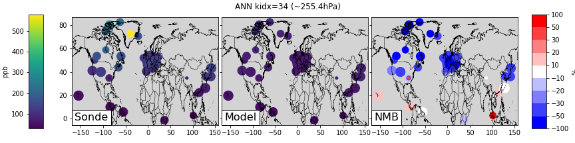
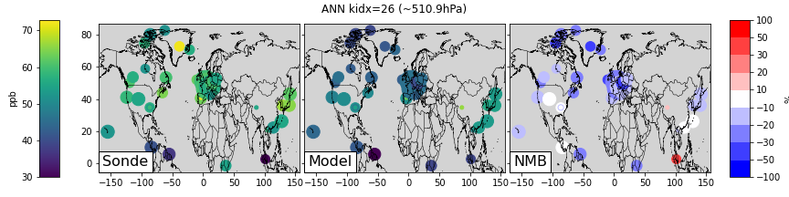
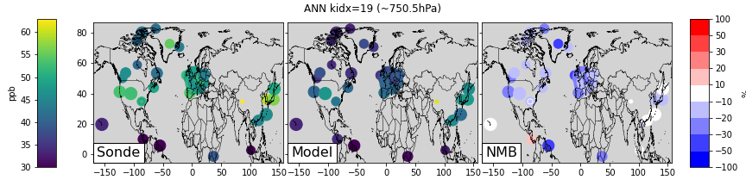
WOUDC Sondes – Annual
https://woudc.org/
World Ozone and Ultraviolet Data Centre
Operated by Env Clim Chg Canada
World Meteo Org
Global Atmos Watch
Averaged within layers, sigma approximation…
1,525 releases in 2017
Each dot is sized by quantity
Summary:
Near surface: +2%
750hPa: -17%
500hPa: -18%
250hPa: -44%
250hPa
Up
500hPa
Up
750hPa

Slide 5
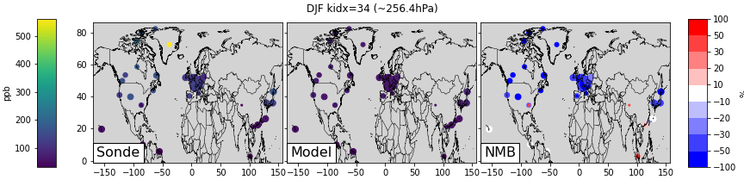
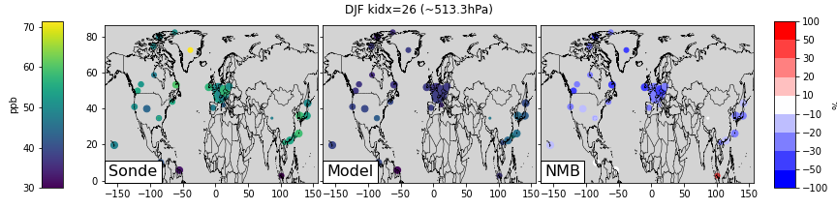
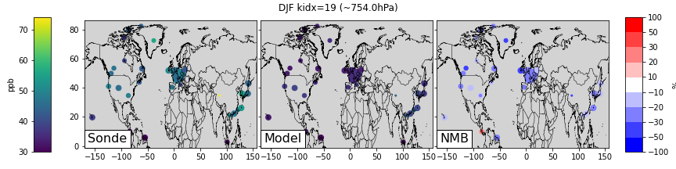
WOUDC Sondes – Winter (Dec17, Jan, Feb)
392 releases in 2017
Each dot is sized by quantity
Summary:
Near surface: +4%
750hPa: -22%
500hPa: -25%
250hPa: -49%
250hPa
Up
500hPa
Up
750hPa

Slide 6
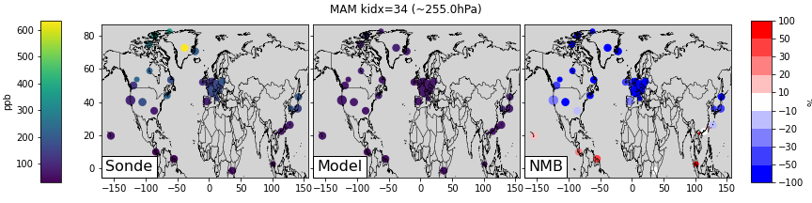
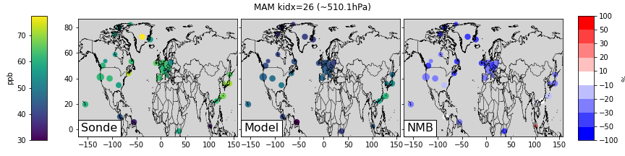
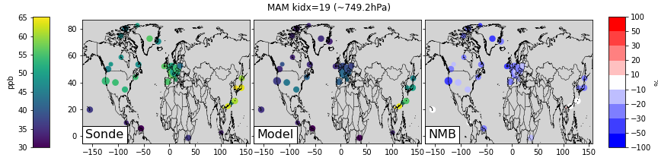
WOUDC Sondes – Spring (Mar, Apr, May)
455 releases in 2017
Each dot is sized by quantity
Summary:
Near surface: -6%
750hPa: -22%
500hPa: -26%
250hPa: -55%
250hPa
Up
500hPa
Up
750hPa

Slide 7
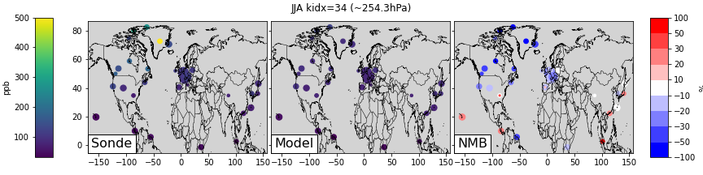
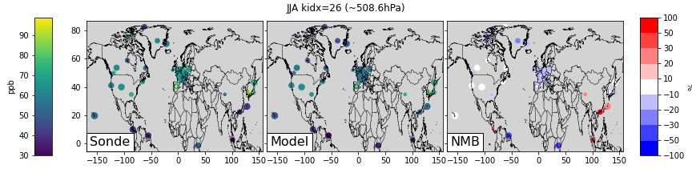
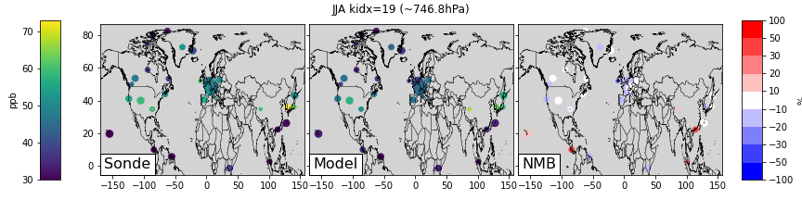
WOUDC Sondes – Spring (Jun, Jul, Aug)
350 releases in 2017
Each dot is sized by quantity
Summary:
Near surface: +5%
750hPa: -7%
500hPa: -10%
250hPa: -30%
250hPa
Up
500hPa
Up
750hPa

Slide 8
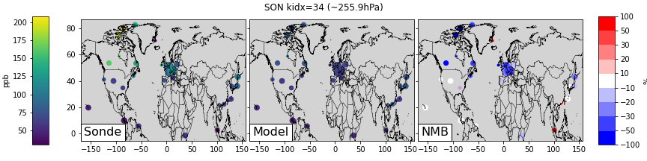
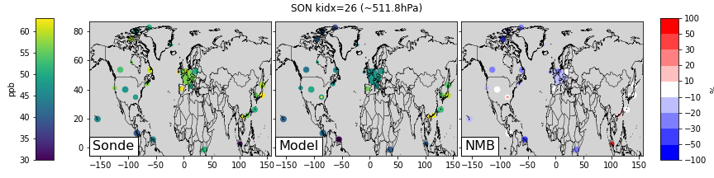

WOUDC Sondes – Spring (Sep, Oct, Nov)
332 releases in 2017
Each dot is sized by quantity
Summary:
Near surface: +7%
750hPa: -11%
500hPa: -5%
250hPa: -30%
250hPa
Up
500hPa
Up
750hPa

Slide 9
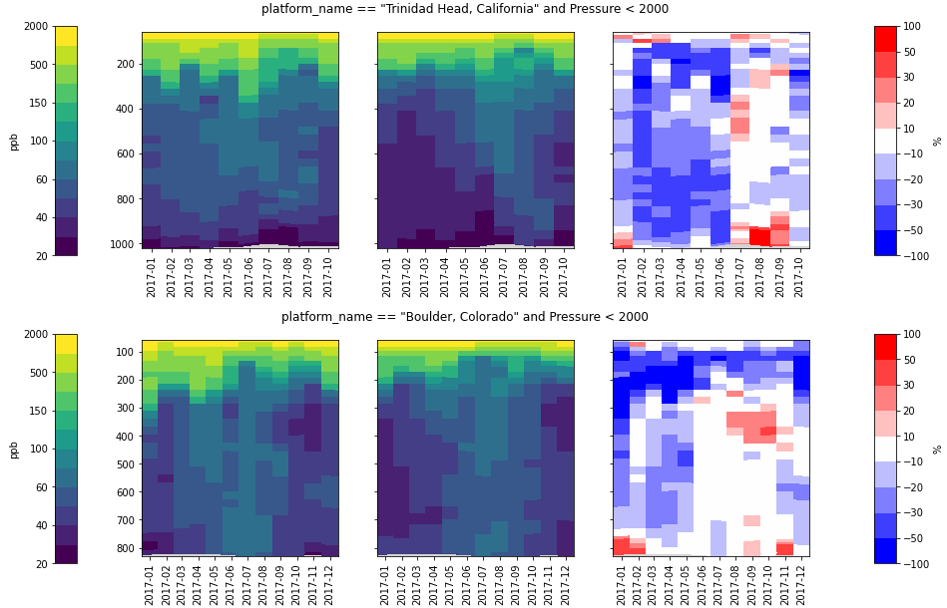
Western US Sondes – Seasonality
 | 1-0.8 | 0.8-0.6 | 0.6-0.4 | 0.4-0.2
DJF | -7% | -26% | -26% | -30%
MAM | -22% | -33% | -25% | -18%
JJA | +11% | -11% | 2% | -14%
SON | +19% | -14% | -9% | -6%
ppb
Trinidad Head, California
 | 1-0.8 | 0.8-0.6 | 0.6-0.4 | 0.4-0.2
DJF | +7% | -17% | -12% | -49%
MAM | -8% | -20% | -22% | -35%
JJA | -7% | -4% | +1% | +1%
SON | +12% | -4% | +5% | +3%
ppb
Boulder, Colorado
JFMAMJJASOND
JFMAMJJASOND
JFMAMJJASOND
Sonde
Model
NMB%
Notes:
Trinidad Head, California

Slide 10
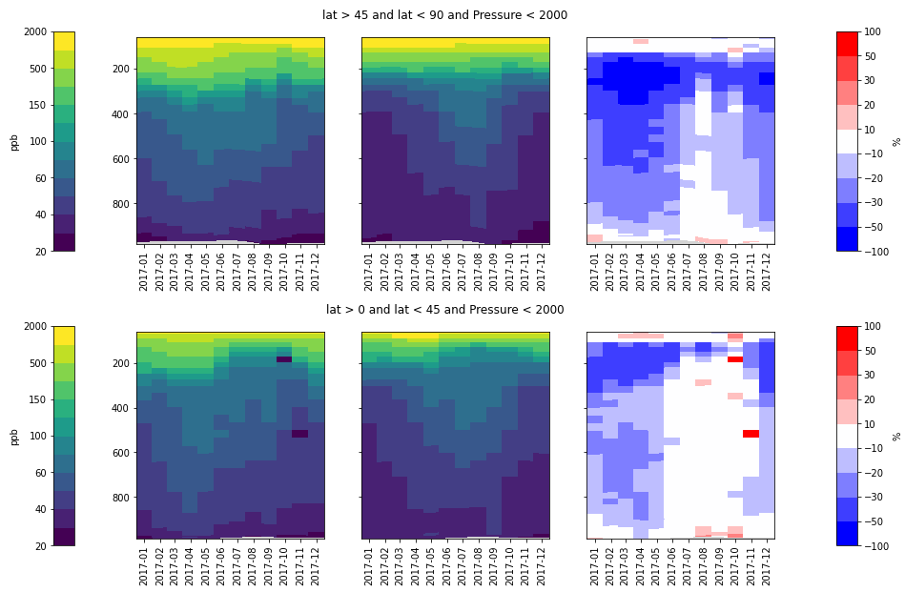
WOUDC Sondes – Seasonality
Broader Context
Seasonality is clear across N. Hemi Sondes
Worse farther north
Tropopause at higher pressure further north
ppb
45N to 90N
0N to 45N
ppb
JFMAMJJASOND
JFMAMJJASOND
JFMAMJJASOND
Sonde
Model
NMB%
Notes:
Broader Context

Slide 11
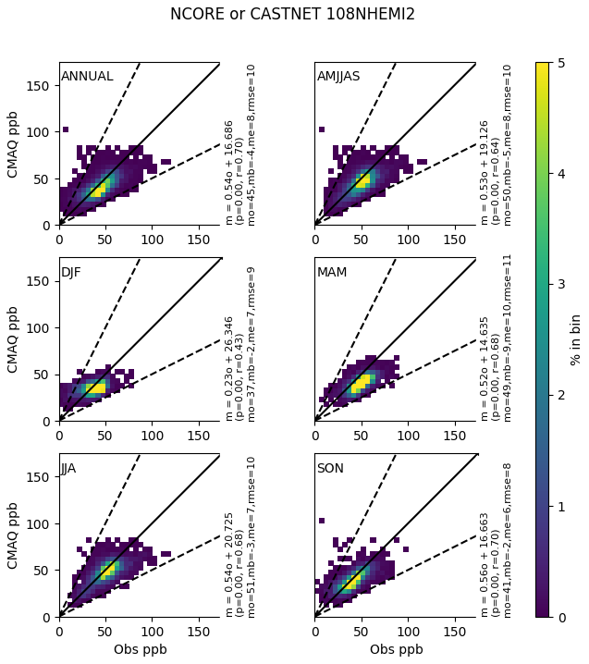
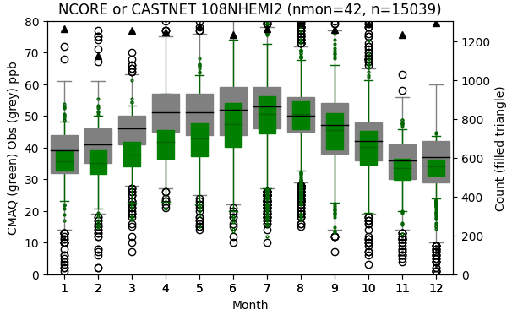
NCORE/CASTNet: West

Slide 12
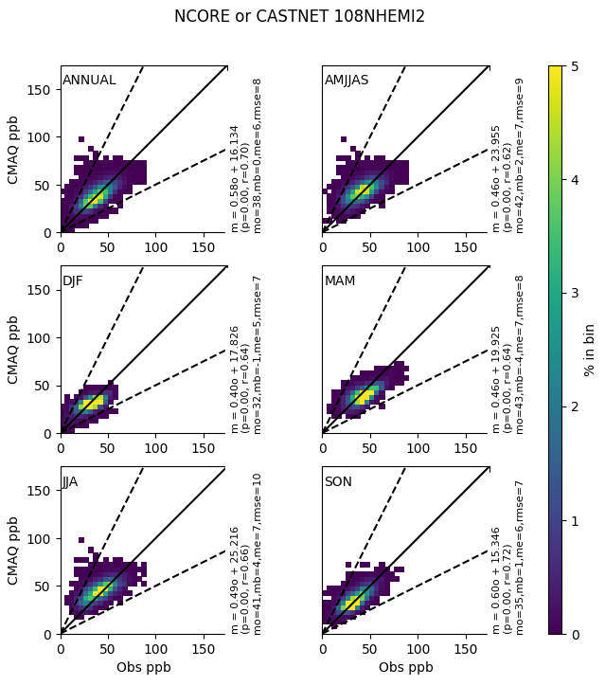
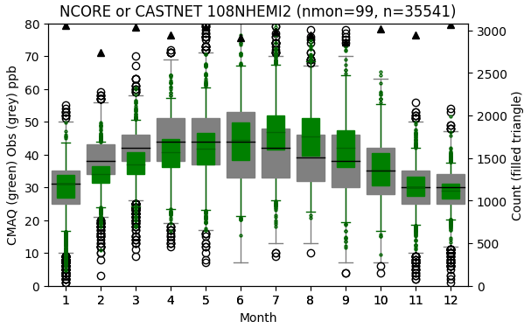
NCORE/CASTNet: East

Slide 13
Other network/regions?
Your favorite region?
Your favorite network?

Slide 14
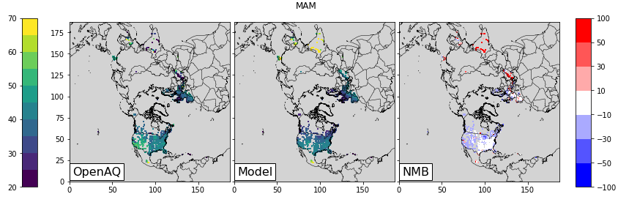
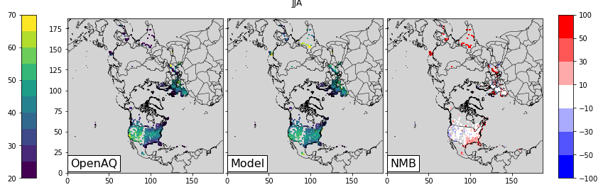
OpenAQ via ScrapenAQ – 10-17 LST average
github.com/barronh/scrapenaq

Slide 15
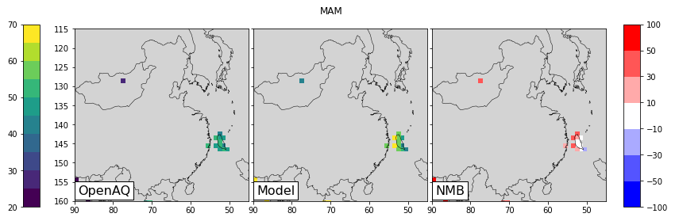
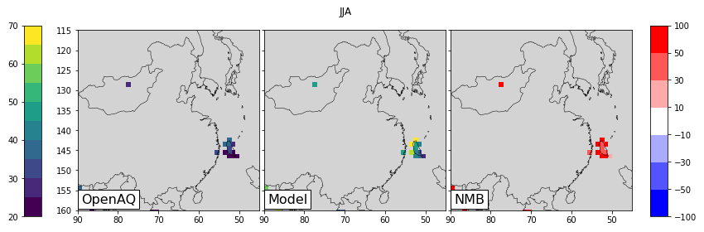
OpenAQ via ScrapenAQ – 10-17 LST average
github.com/barronh/scrapenaq
Taiwan monitor cluster has medium performance in the Spring
Taiwan monitor cluster has high bias in Summer
Notes:
Taiwan monitor cluster

Slide 16
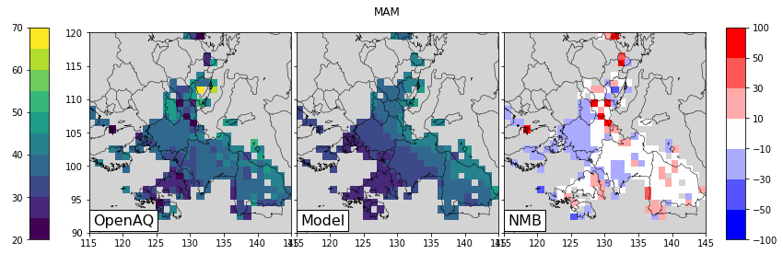
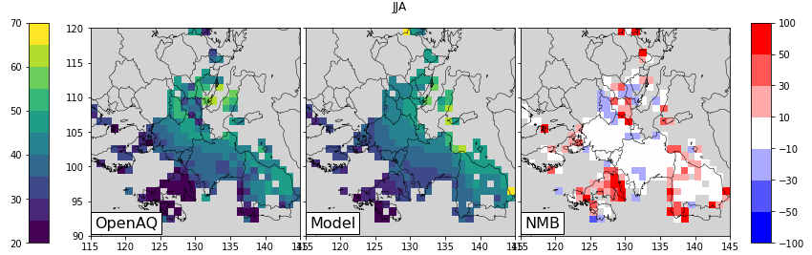
OpenAQ via ScrapenAQ – 10-17 LST average
github.com/barronh/scrapenaq
Europe has mixed performance, but unbiased or low during in the Spring
tends higher biased in the Summer

Slide 17
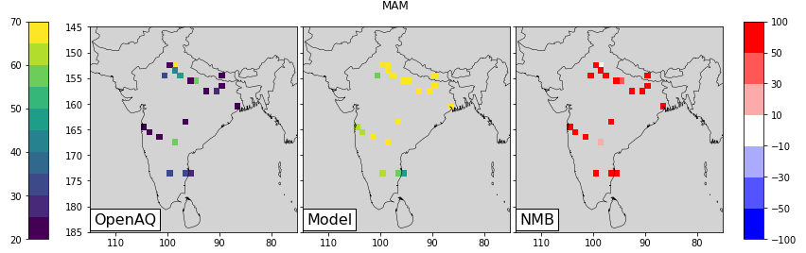
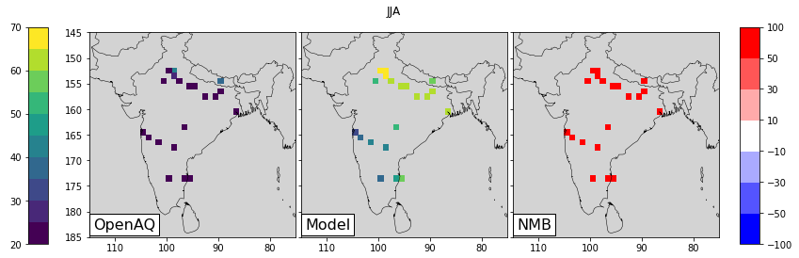
OpenAQ via ScrapenAQ – 10-17 LST average
github.com/barronh/scrapenaq
India has consistent over-predictions, but this may be an artifact.
Could these simply be in the wrong unit?
Reported in ug/m3 according to meta-data
Converted to ppb for comparison to the model
For reference, 80 ug/m3 is ~40 ppb
Notes:
Could these simply be in the wrong unit?

Slide 18
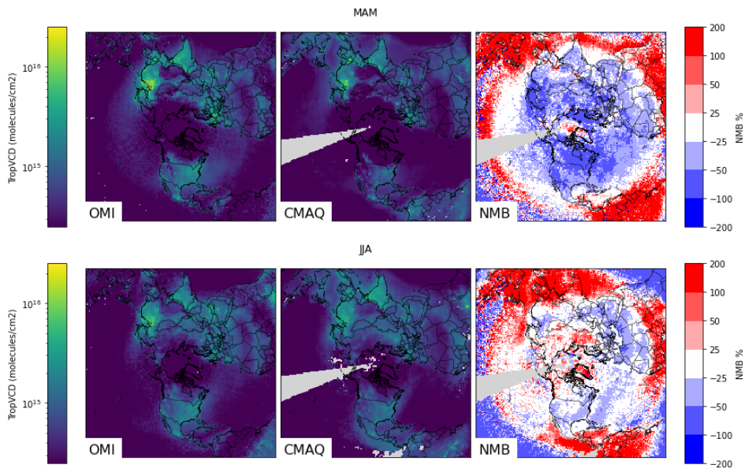
OMI NO2
Colorscale
Dark: +/- 50-100%
Medium: +/- 25-50%
White: +/- 25%
Grey: missing
Spring on top
Lower-bias than 2016 modeling
Summer on bottom
Low-bias similar to the 2016 platform
Notes:
mMolecules/cm2

Slide 19
Summary
Hemispheric CMAQ has a persistent Ozone low-bias in the spring
Worse at higher latitudes and altitudes
Hemispheric CMAQ has a persistent NO2 low-bias in winter
GEOS-Chem shows better spring-time performance (not shown)
Current plan, build BCON from GEOS-Chem instead of HCMAQ for 2017-2019
Problems likely related to halogens and stratosphere
ORD has been improving halogen chemistry, but not included here.
GEOS-Chem has often seen similar problems when updating halogens.
Run with halogens disabled?

