Slide 1
CAMx v7.1 Model Performance for
MDA8 O3

Slide 2
CB6r4 vs CB6r5
TCEQ sponsored Ramboll to review reaction rate constants and reaction products and update CB6 in CAMx
152 reactions were reviewed for the update from CB6r4 to CB6r5
CB6r5 has one more reaction than CB6r4 (reaction 234 is new)
47 reaction rates are changed in CB6r5 from CB6r4 because newer data are available
41 of 47 changes are for rate constants and there are new CAMx chemistry parameter input files for CB6r5
6 of 47 changes are for photolysis reactions, for FORM (2 reactions), ALD2, ALDX, GLY and GLYD, and there is an updated TUV photolysis rate model for CB6r5 in CAMx
The largest reaction rate increase (CB6r5/CB6r4 = 9.1) is for GLY photolysis
The largest reaction rate decrease (CB6r5/CB6r4 = 0.15) is for NO3 + GLY
CB6r5 and CB6r4 have identical chemical species; no changes are needed to CAMx inputs (emissions, boundary conditions) for CB6r5 from CB6r4.
In addition to rate constant updates, there were several changes to reaction products for CB6r5
Details can be found in the Ramboll report:
https://www.tceq.texas.gov/assets/public/implementation/air/am/contracts/reports/pm/5822011221014-20200730-Ramboll-CB6r5MechanismChanges.pdf

Slide 3
Analytics
CAMx v7.1 CB6r4 vs CAMx v7.0beta6 CB6r4
  Difference in ozone season MDA8 O3 >= 60 ppb mean bias
CAMx v7.1 CB6r5 vs CB6r4 Model Performance
  Model to model MDA8 O3
  Performance metrics for OS MDA8 >= 60 ppb, MDA8 >= 70 ppb, and MDA8 50 to 70 ppb
  Box plots of monthly MDA8 O3 by climate region
  Box plots of hourly O3 by climate region
CB6r5 vs CB6r4 Model Response

Slide 4
Summary of Findings
There is little difference in MDA8 O3 > 60 ppb between CAMx v7.10 and v7beta6, both run with CB6r4
Ozone predictions using CB6r5 are typically several ppb higher than CB6r4; the magnitude of the difference increases with concentration
CB6r5 predictions have less bias for high concentrations
Seasonal and diurnal model performance issues in various regions with CB6r4 are not resolved with CB6r5

Slide 5
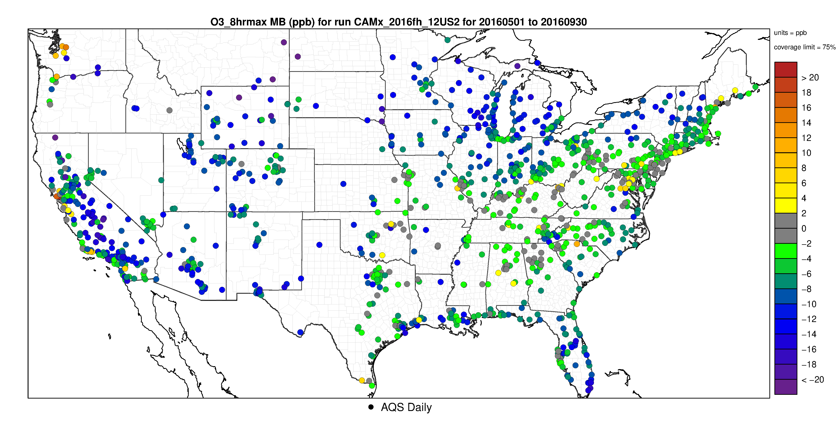
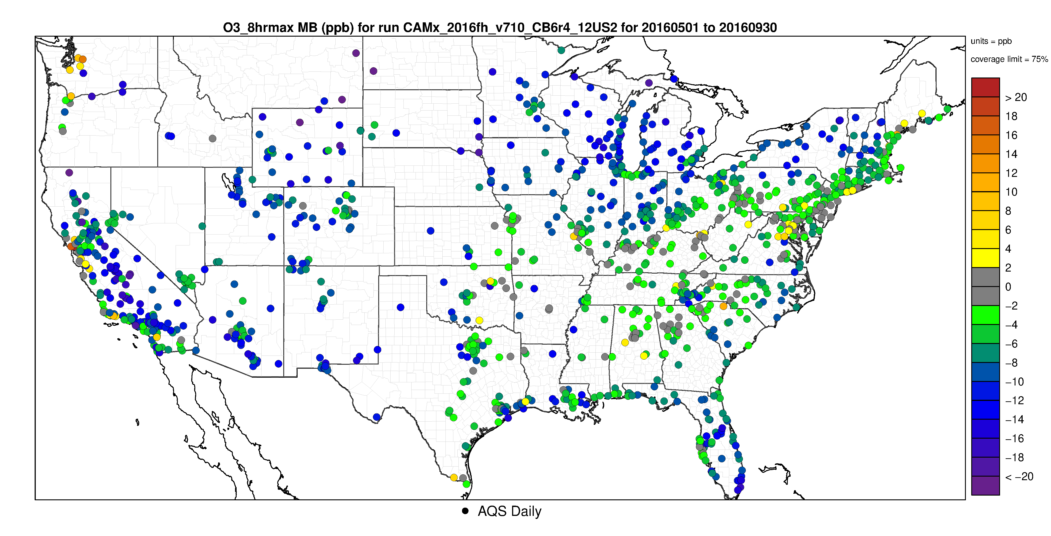
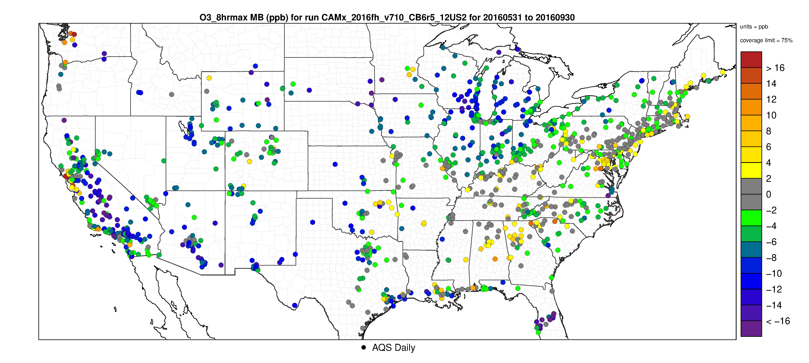
v7beta6 CB6r4
v7.1 CB6r4
v7.1 CB6r5
Mean Bias May thru Sept MDA8 O3 > 60 ppb
Performance with v7.1 CB6r4 and v7beta6 CB6r4 are similar
Less under prediction and more overprediction with CB6r5 for ozone season (May-Sept) MDA8 O3

Slide 6
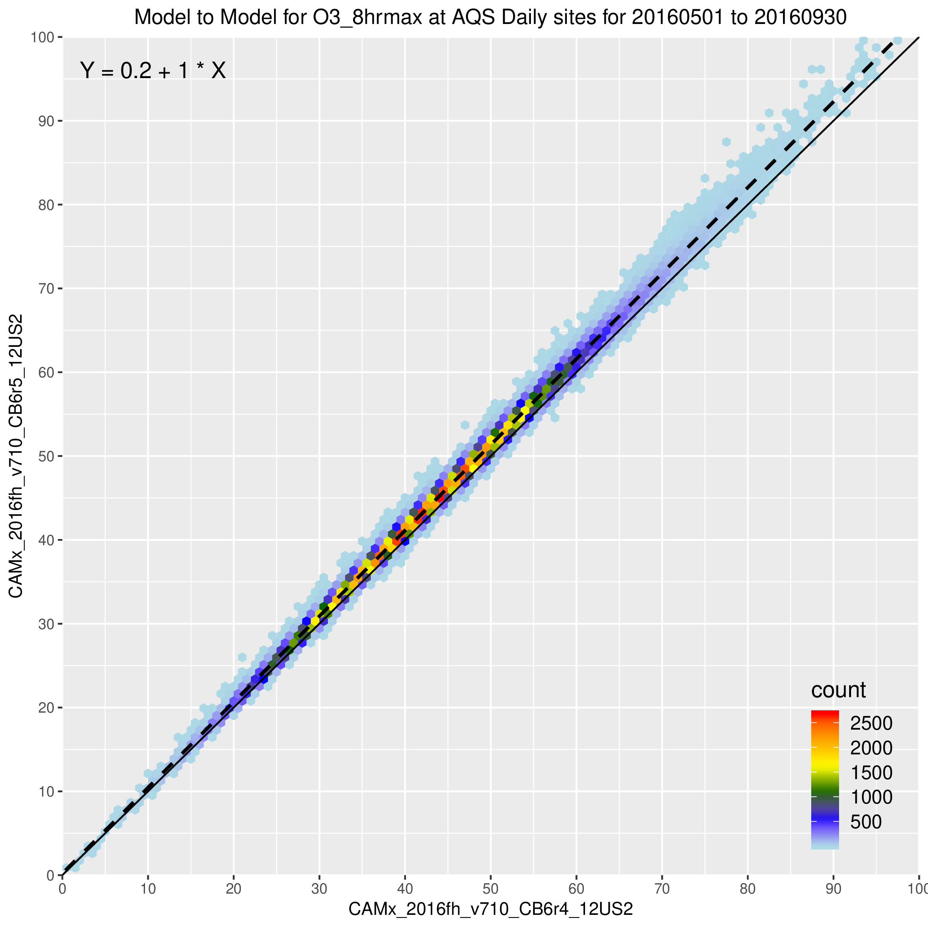
May-Sept MDA8 O3 with CB6r4 (x-axis) and CB6r5 (y-axis) paired by site nationwide
CB6r5 predicts higher MDA8 O3 compared to r4 through the distribution of values
The absolute magnitude of the differences seems to increase with magnitude of concentration
Results are similar for individual climate regions

Slide 7
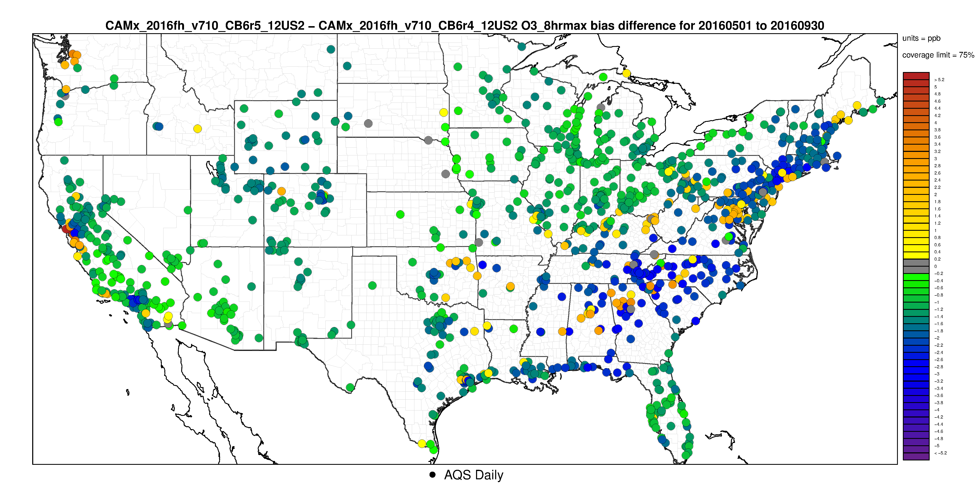
CAMx v7.1 CB6r5 Bias – CB6r4 Bias for MDA8 >= 60 ppb
Bias in MDA8 O3 > 60 ppb is less at most sites with CB6r5 vs CB6r4.
Interesting that from Oklahoma east and northeastward into the Northeast the basis with CB6r5 is generally less, but there are pairs of relatively nearby monitors where the change in bias goes in different directions.

Slide 8
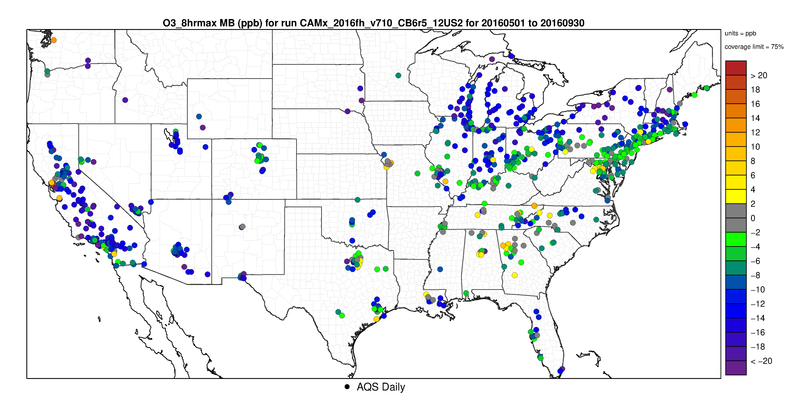
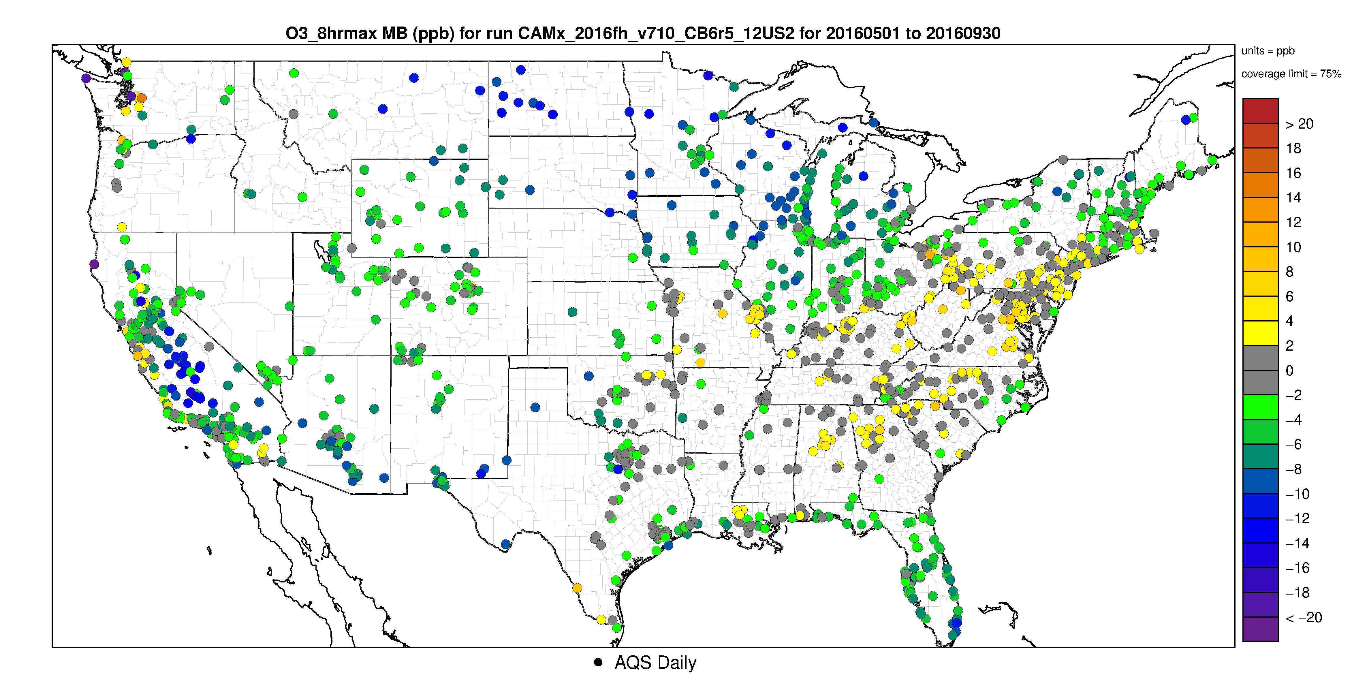
Mean Bias for MDA8 > 70 ppb
O3 > 70 ppb is generally under predicted.
The magnitude of under prediction is less in portions of the Southeast, Ohio Valley and Northeast compared to other areas of the US.
O3 in the range of 50 to 70 ppb is over-predicted at many sites in these regions.
In other areas, under prediction bias is less for MDA8 O3 in the range of 50 to 70 ppb, compared to O3 > 70 ppb.
Mean Bias for MDA8 50 to 70 ppb

Slide 9
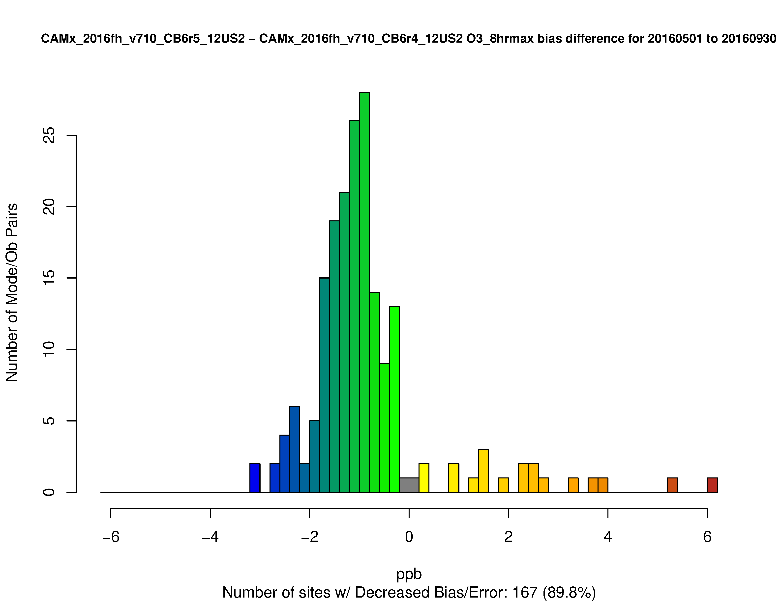
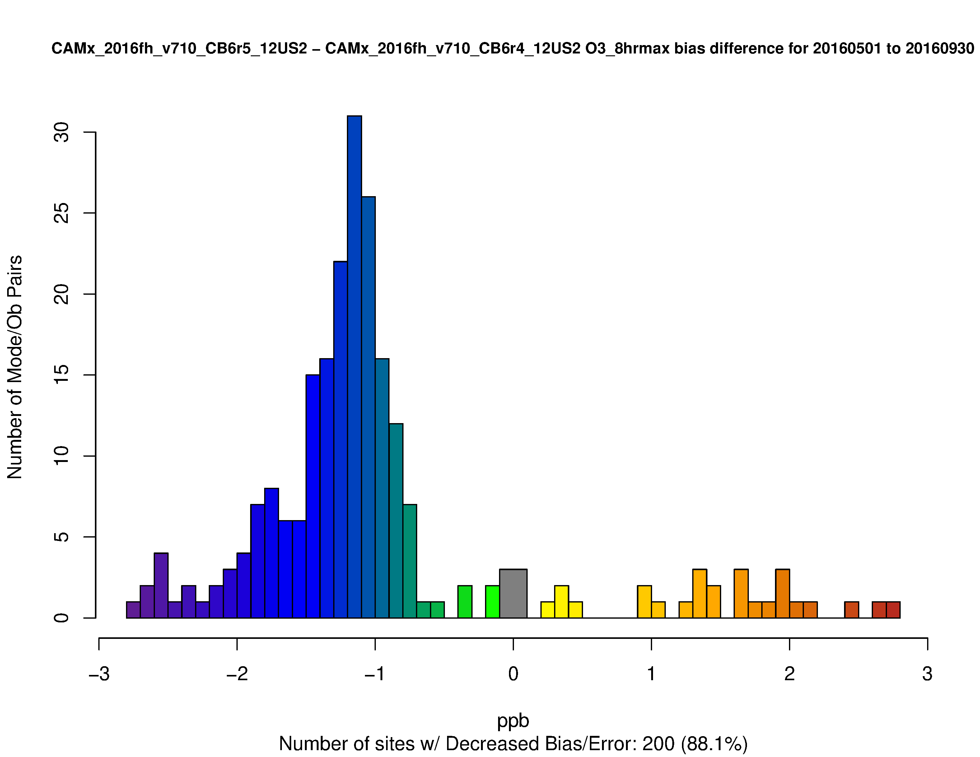
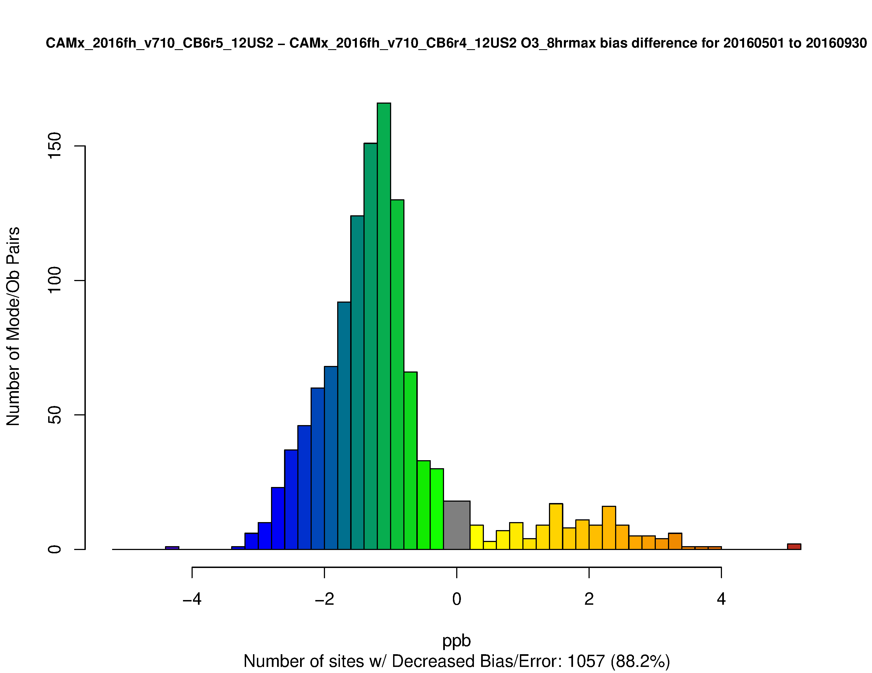
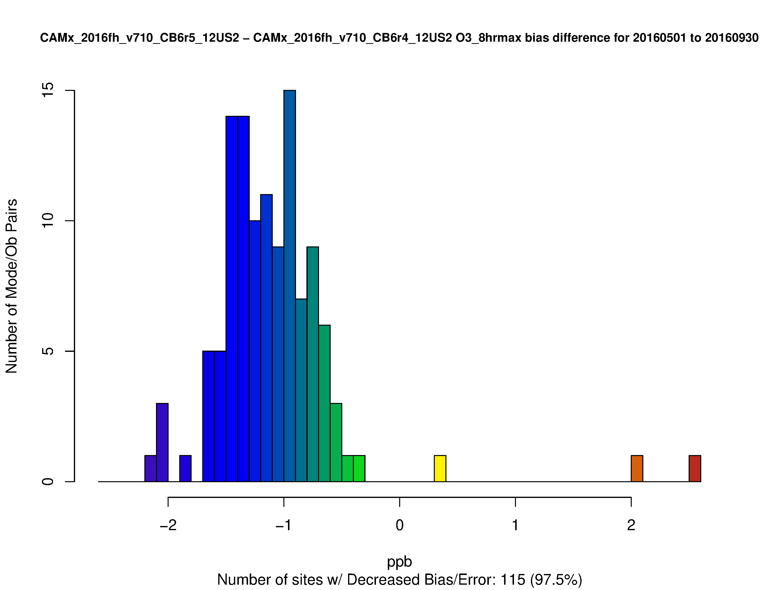
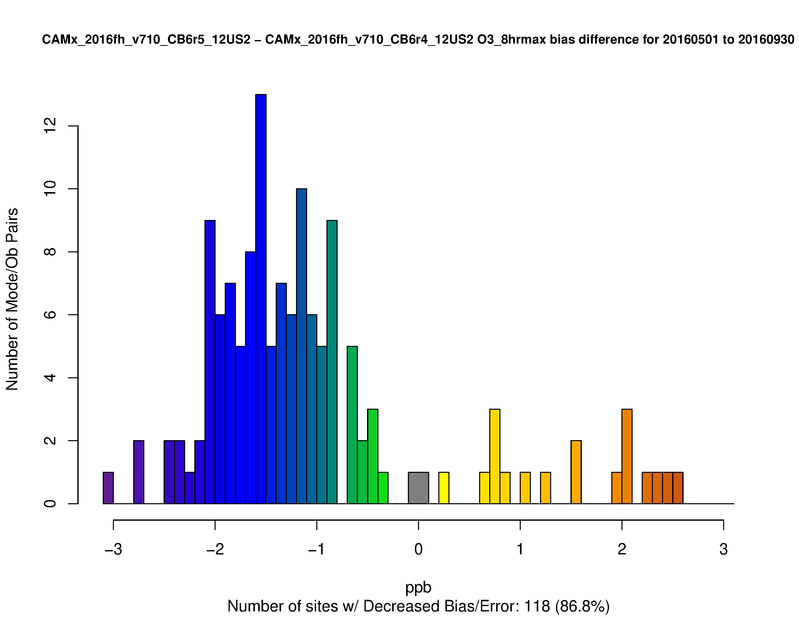
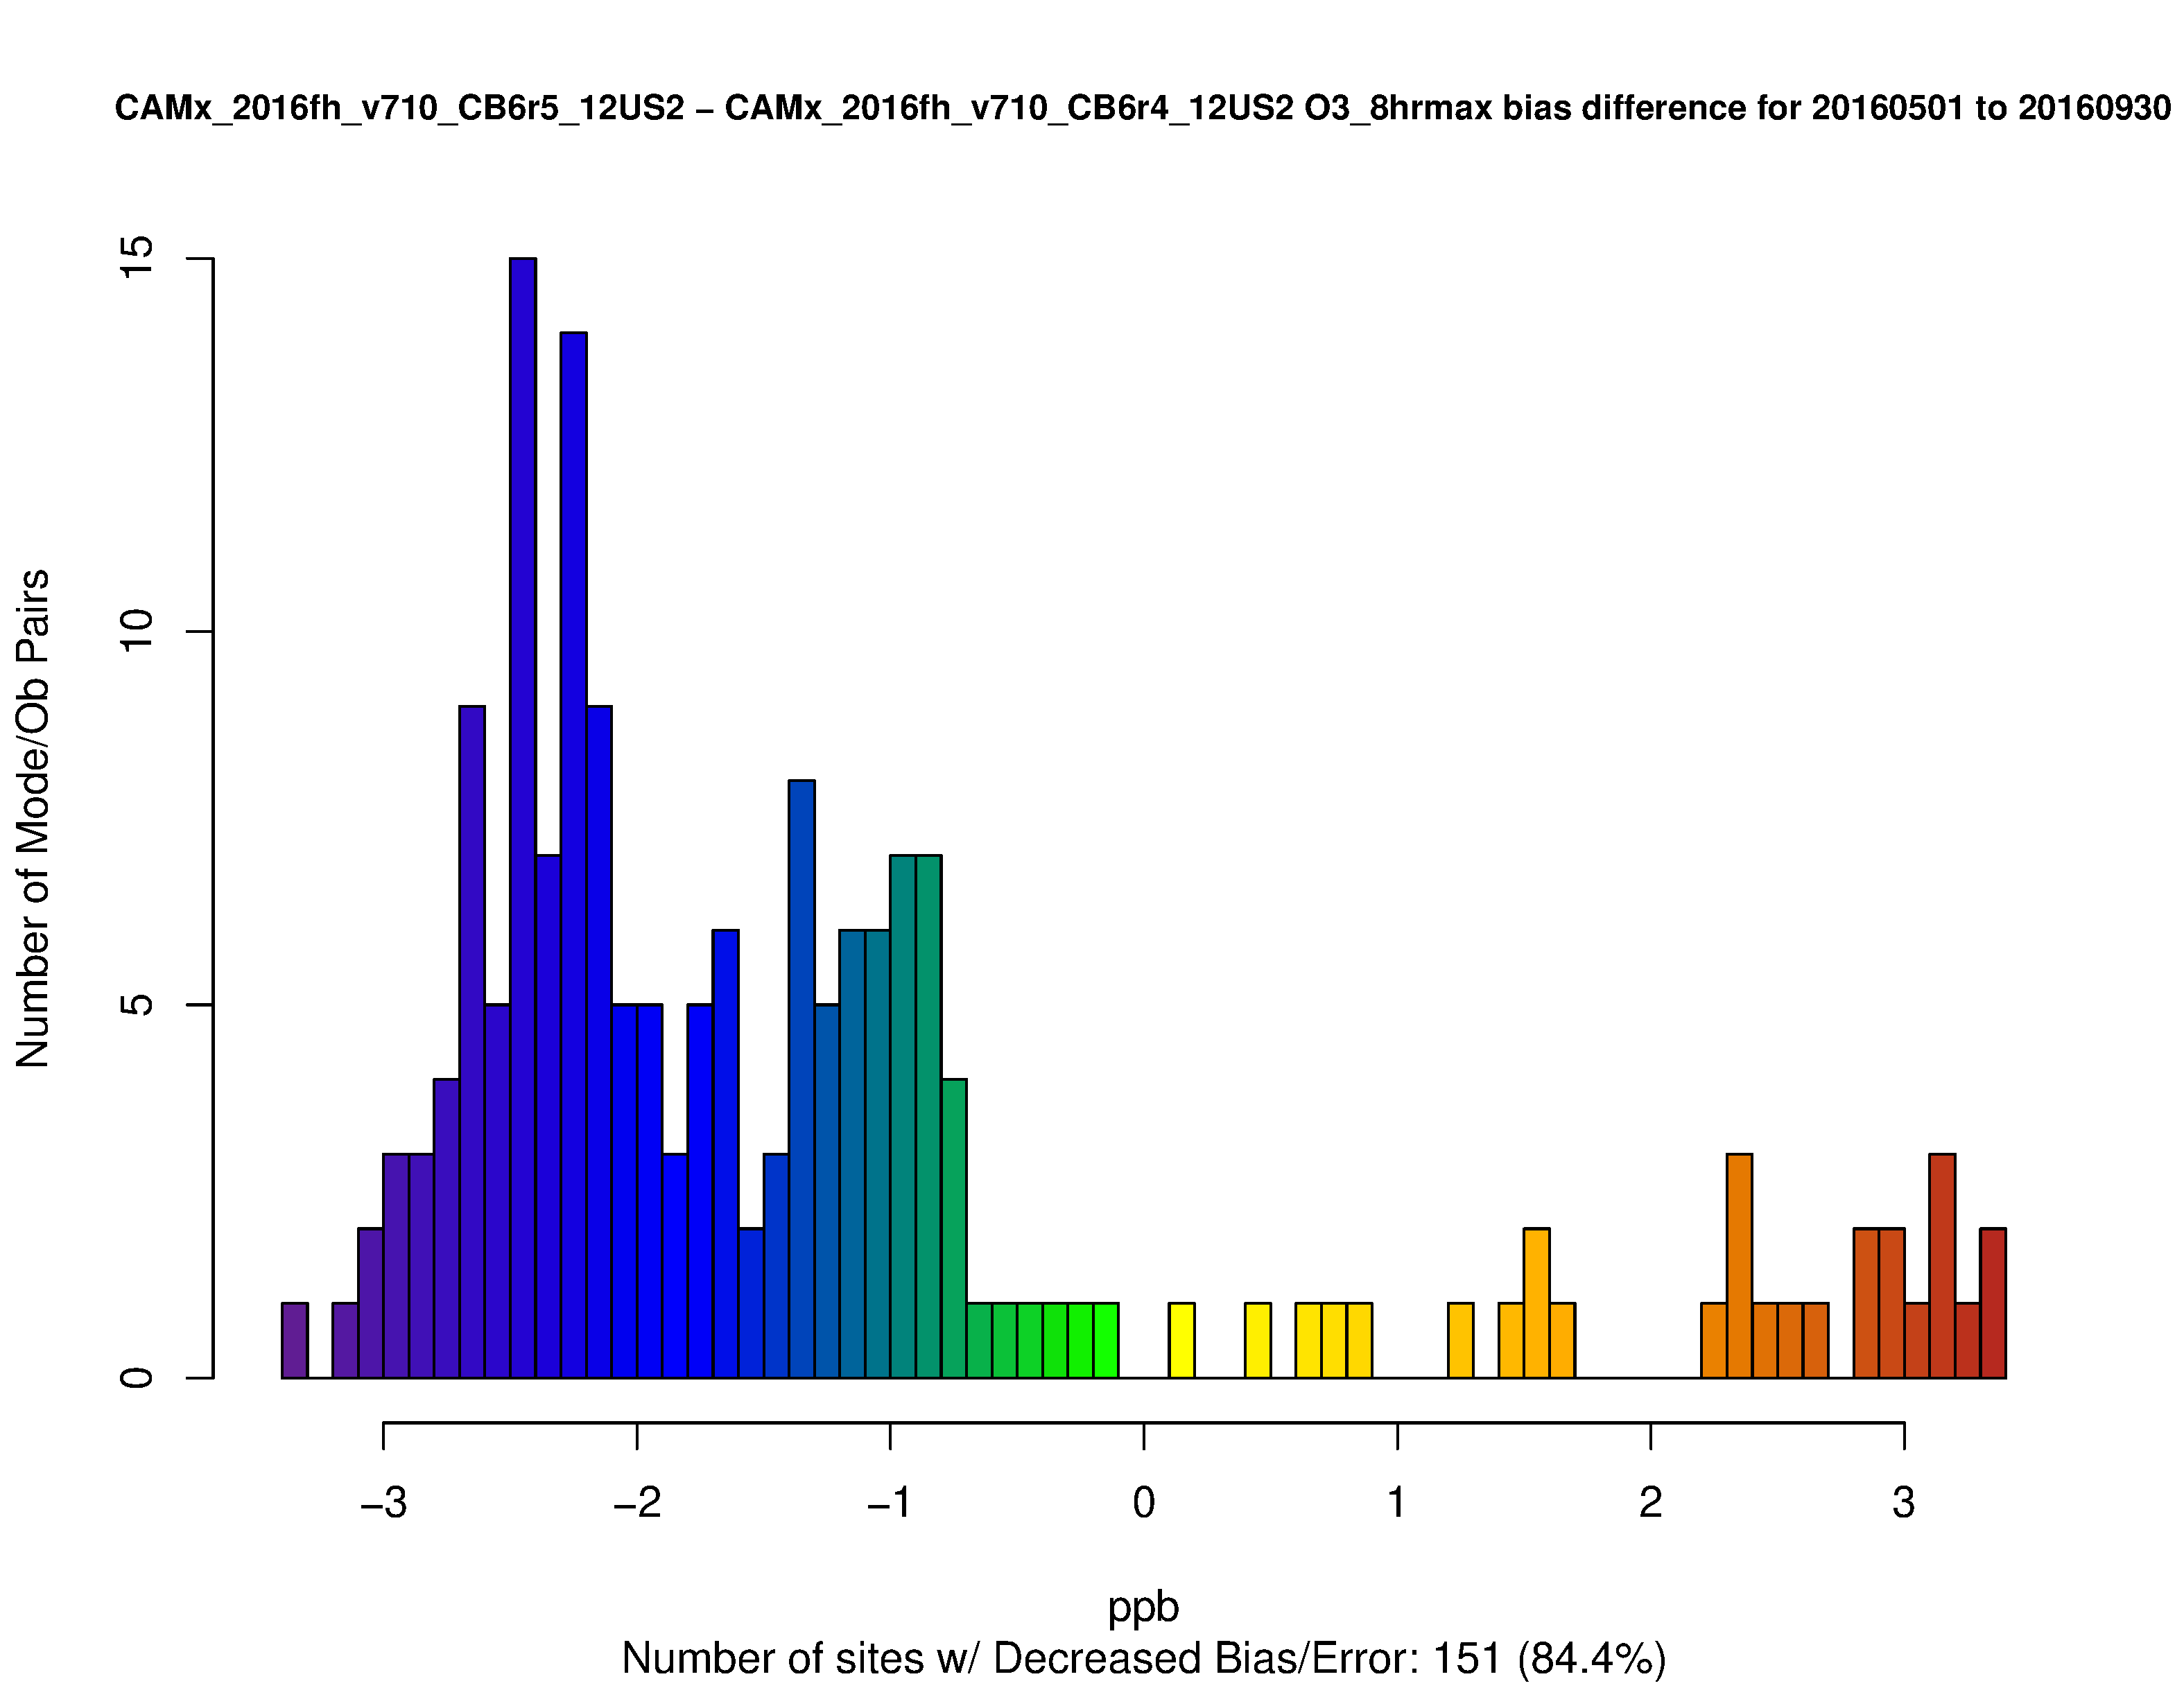
Change in Bias for MDA8 O3 >= 60 ppb by Region
CB6r5 Bias – CB6r4 Bias
Mean bias is reduced by 1 to 2 ppb at most sites in each region
Increases in bias are most notable in the South and Southeast
West
Ohio Valley
Northeast
Southwest
South
Southeast

Slide 10
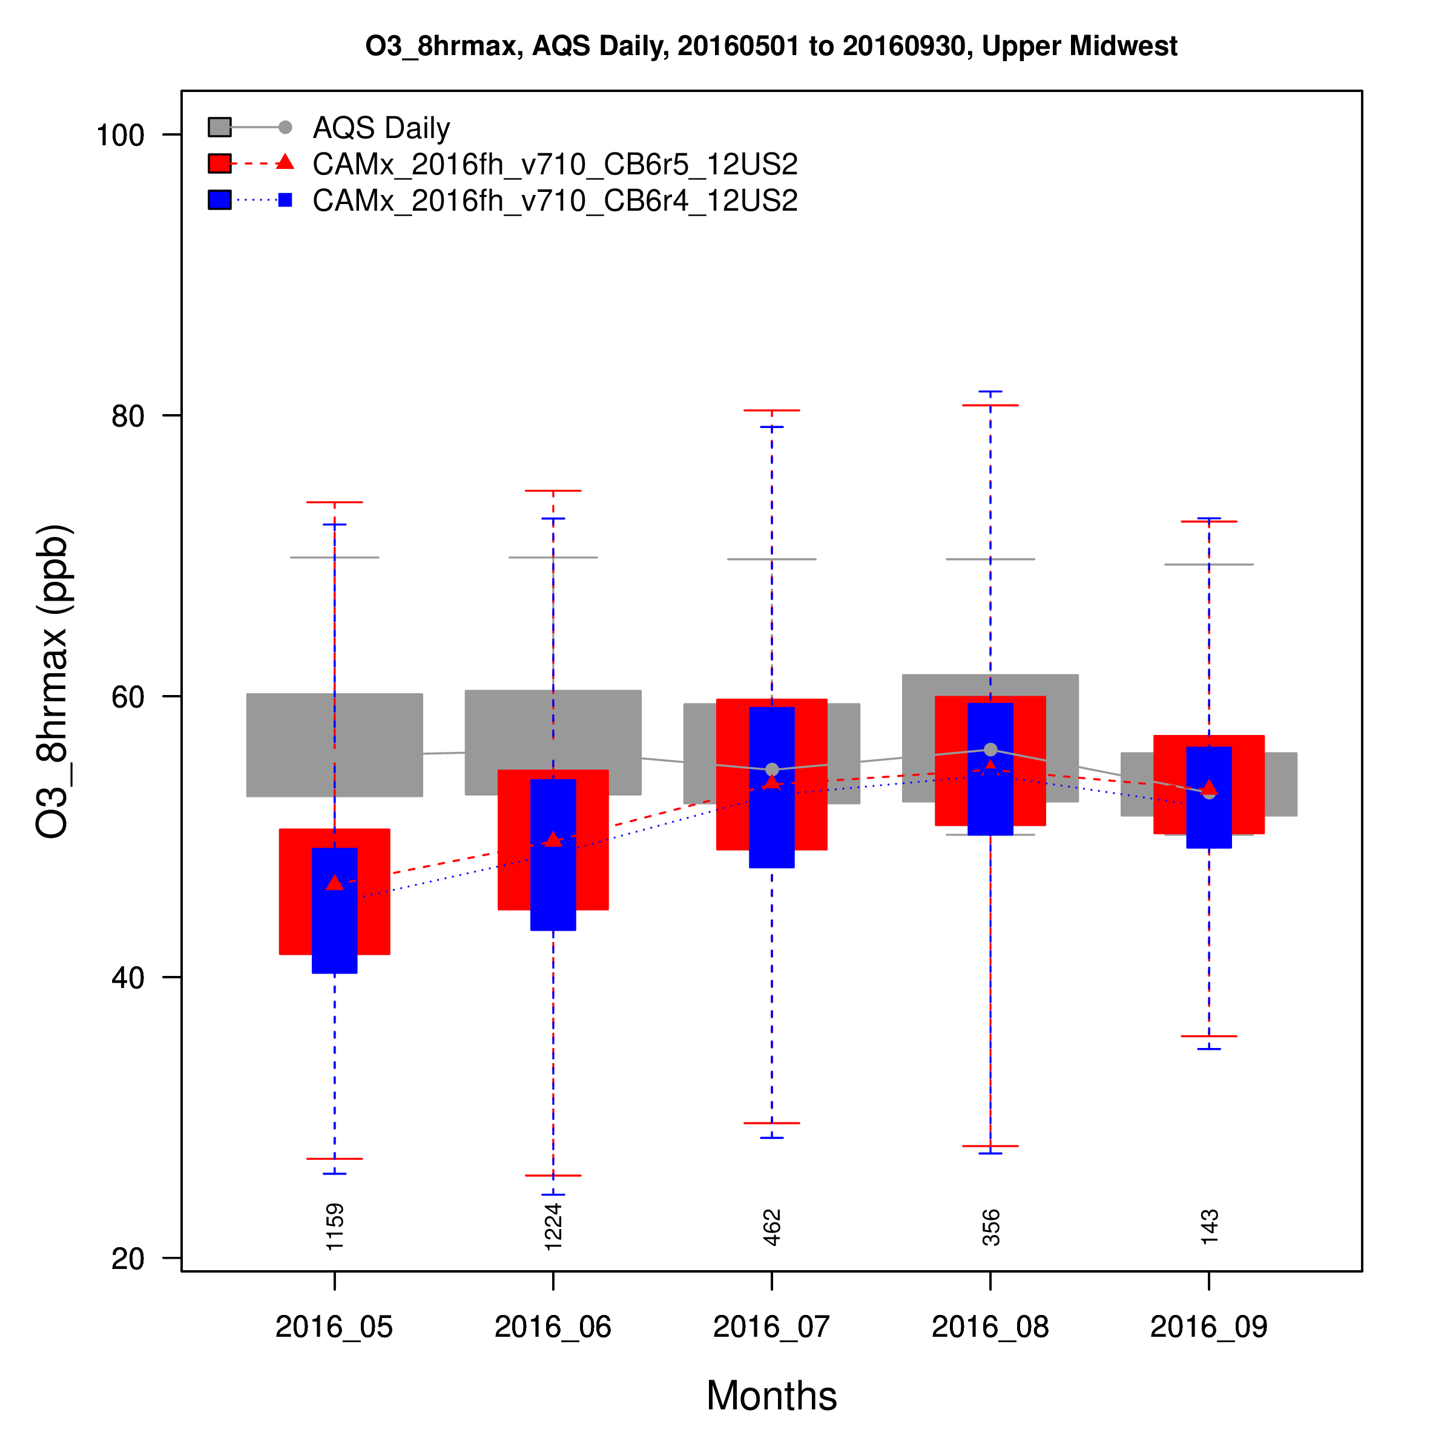
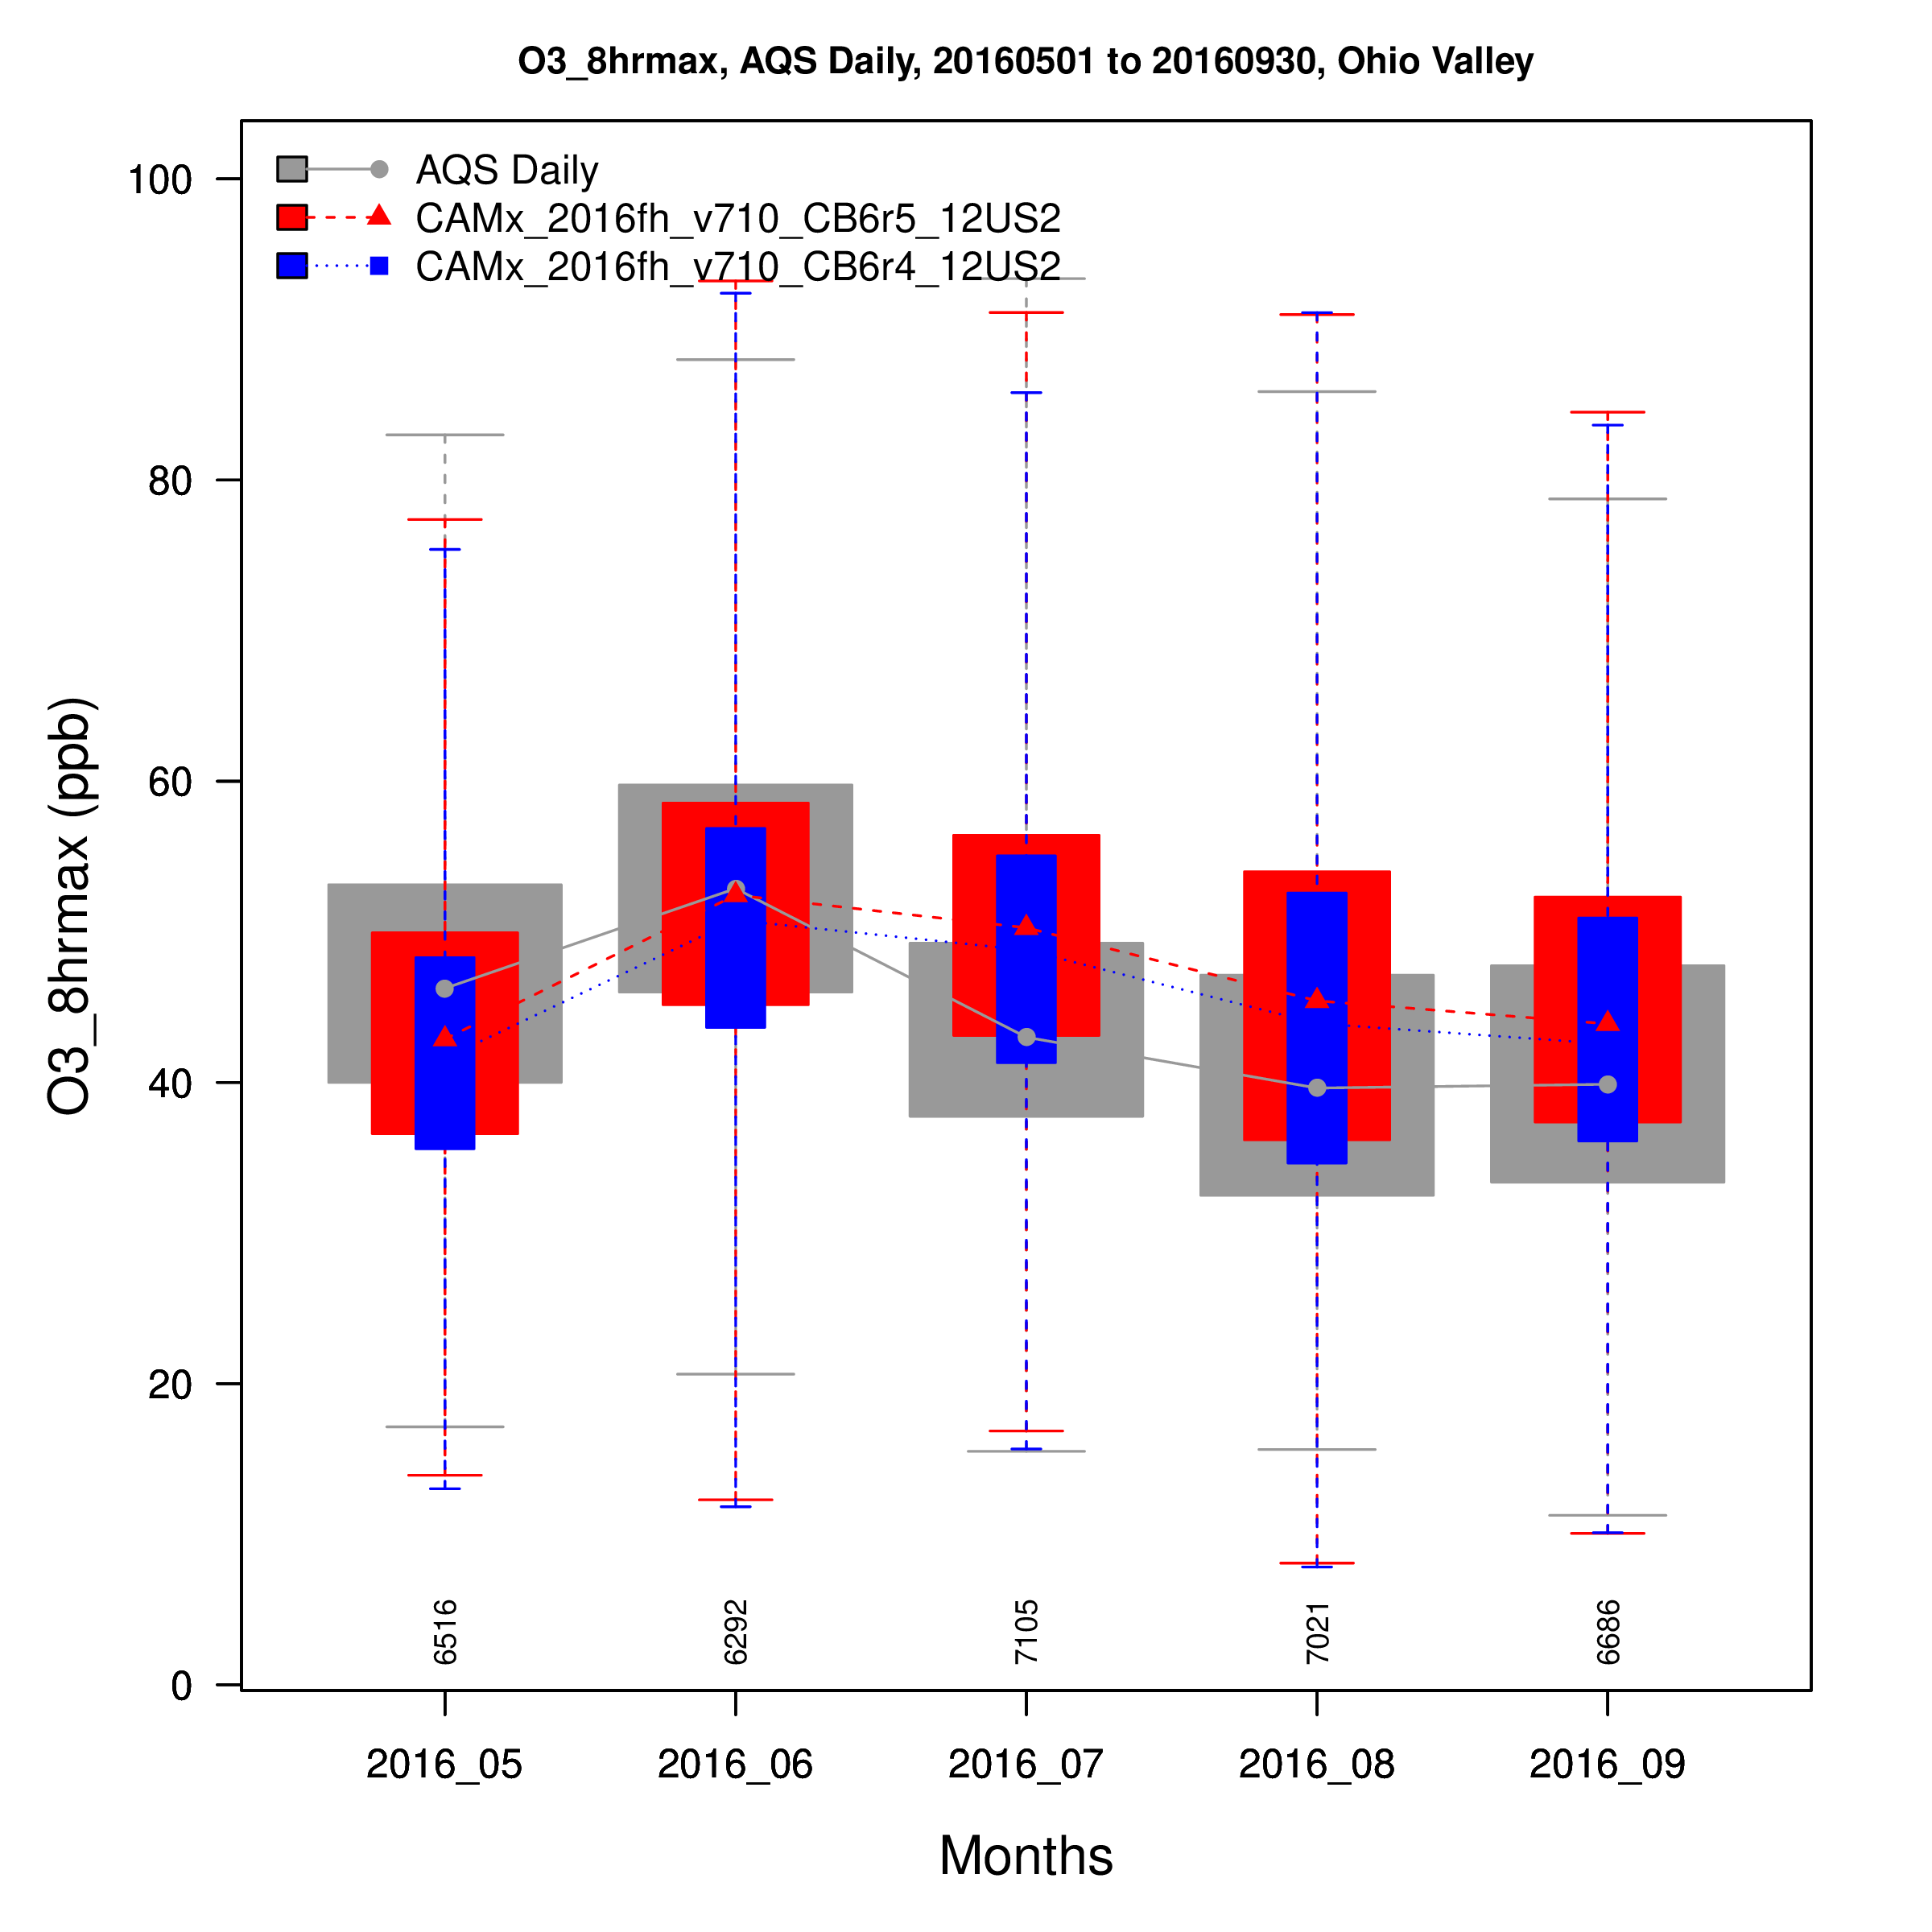
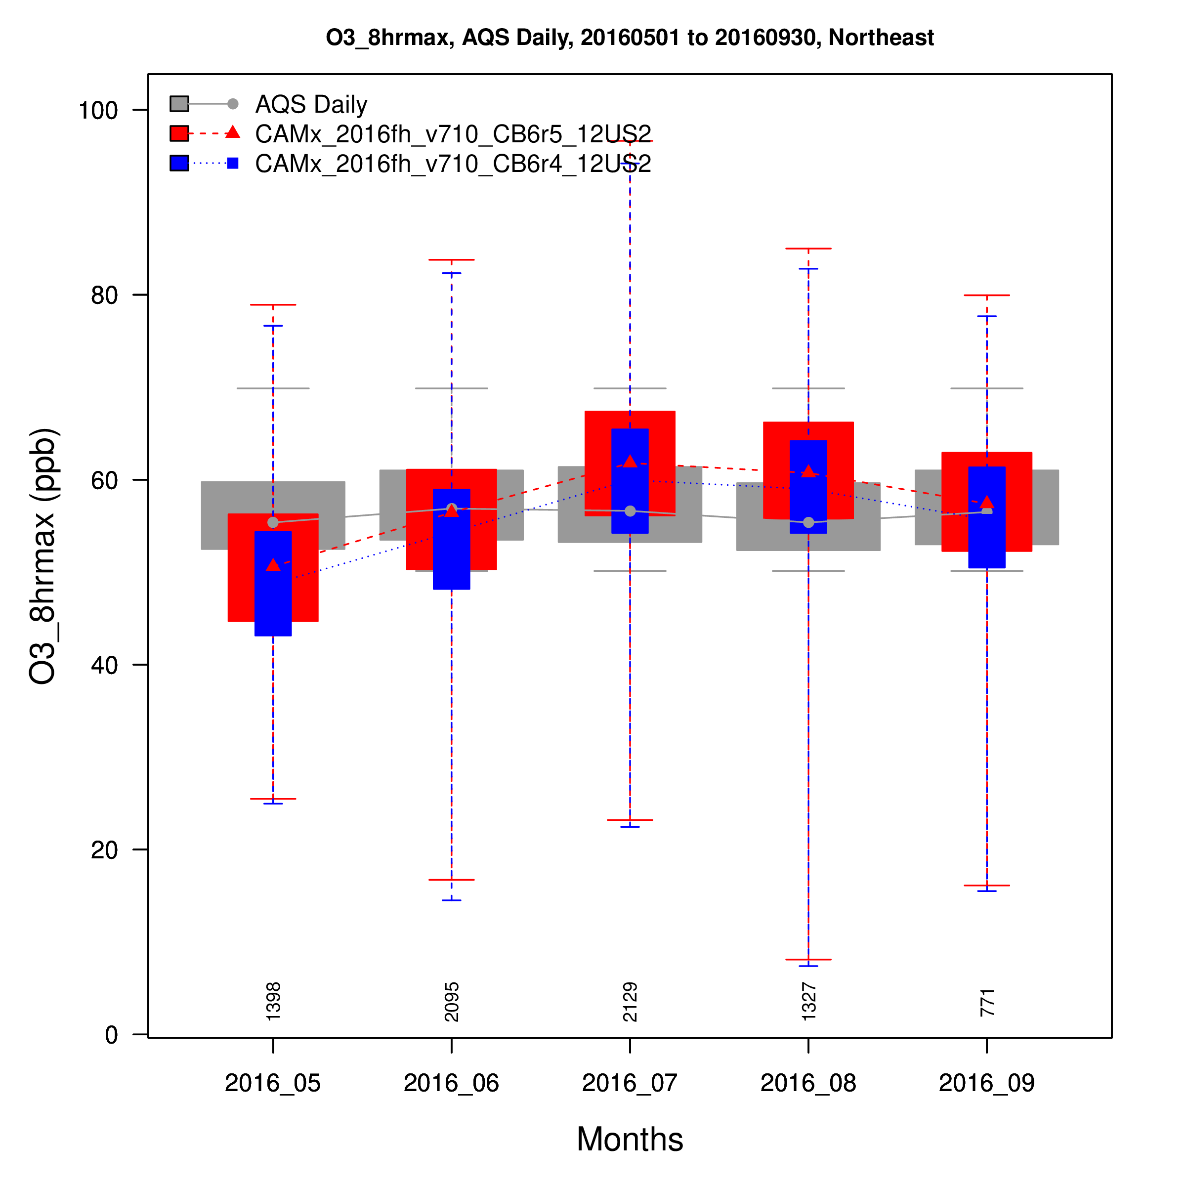
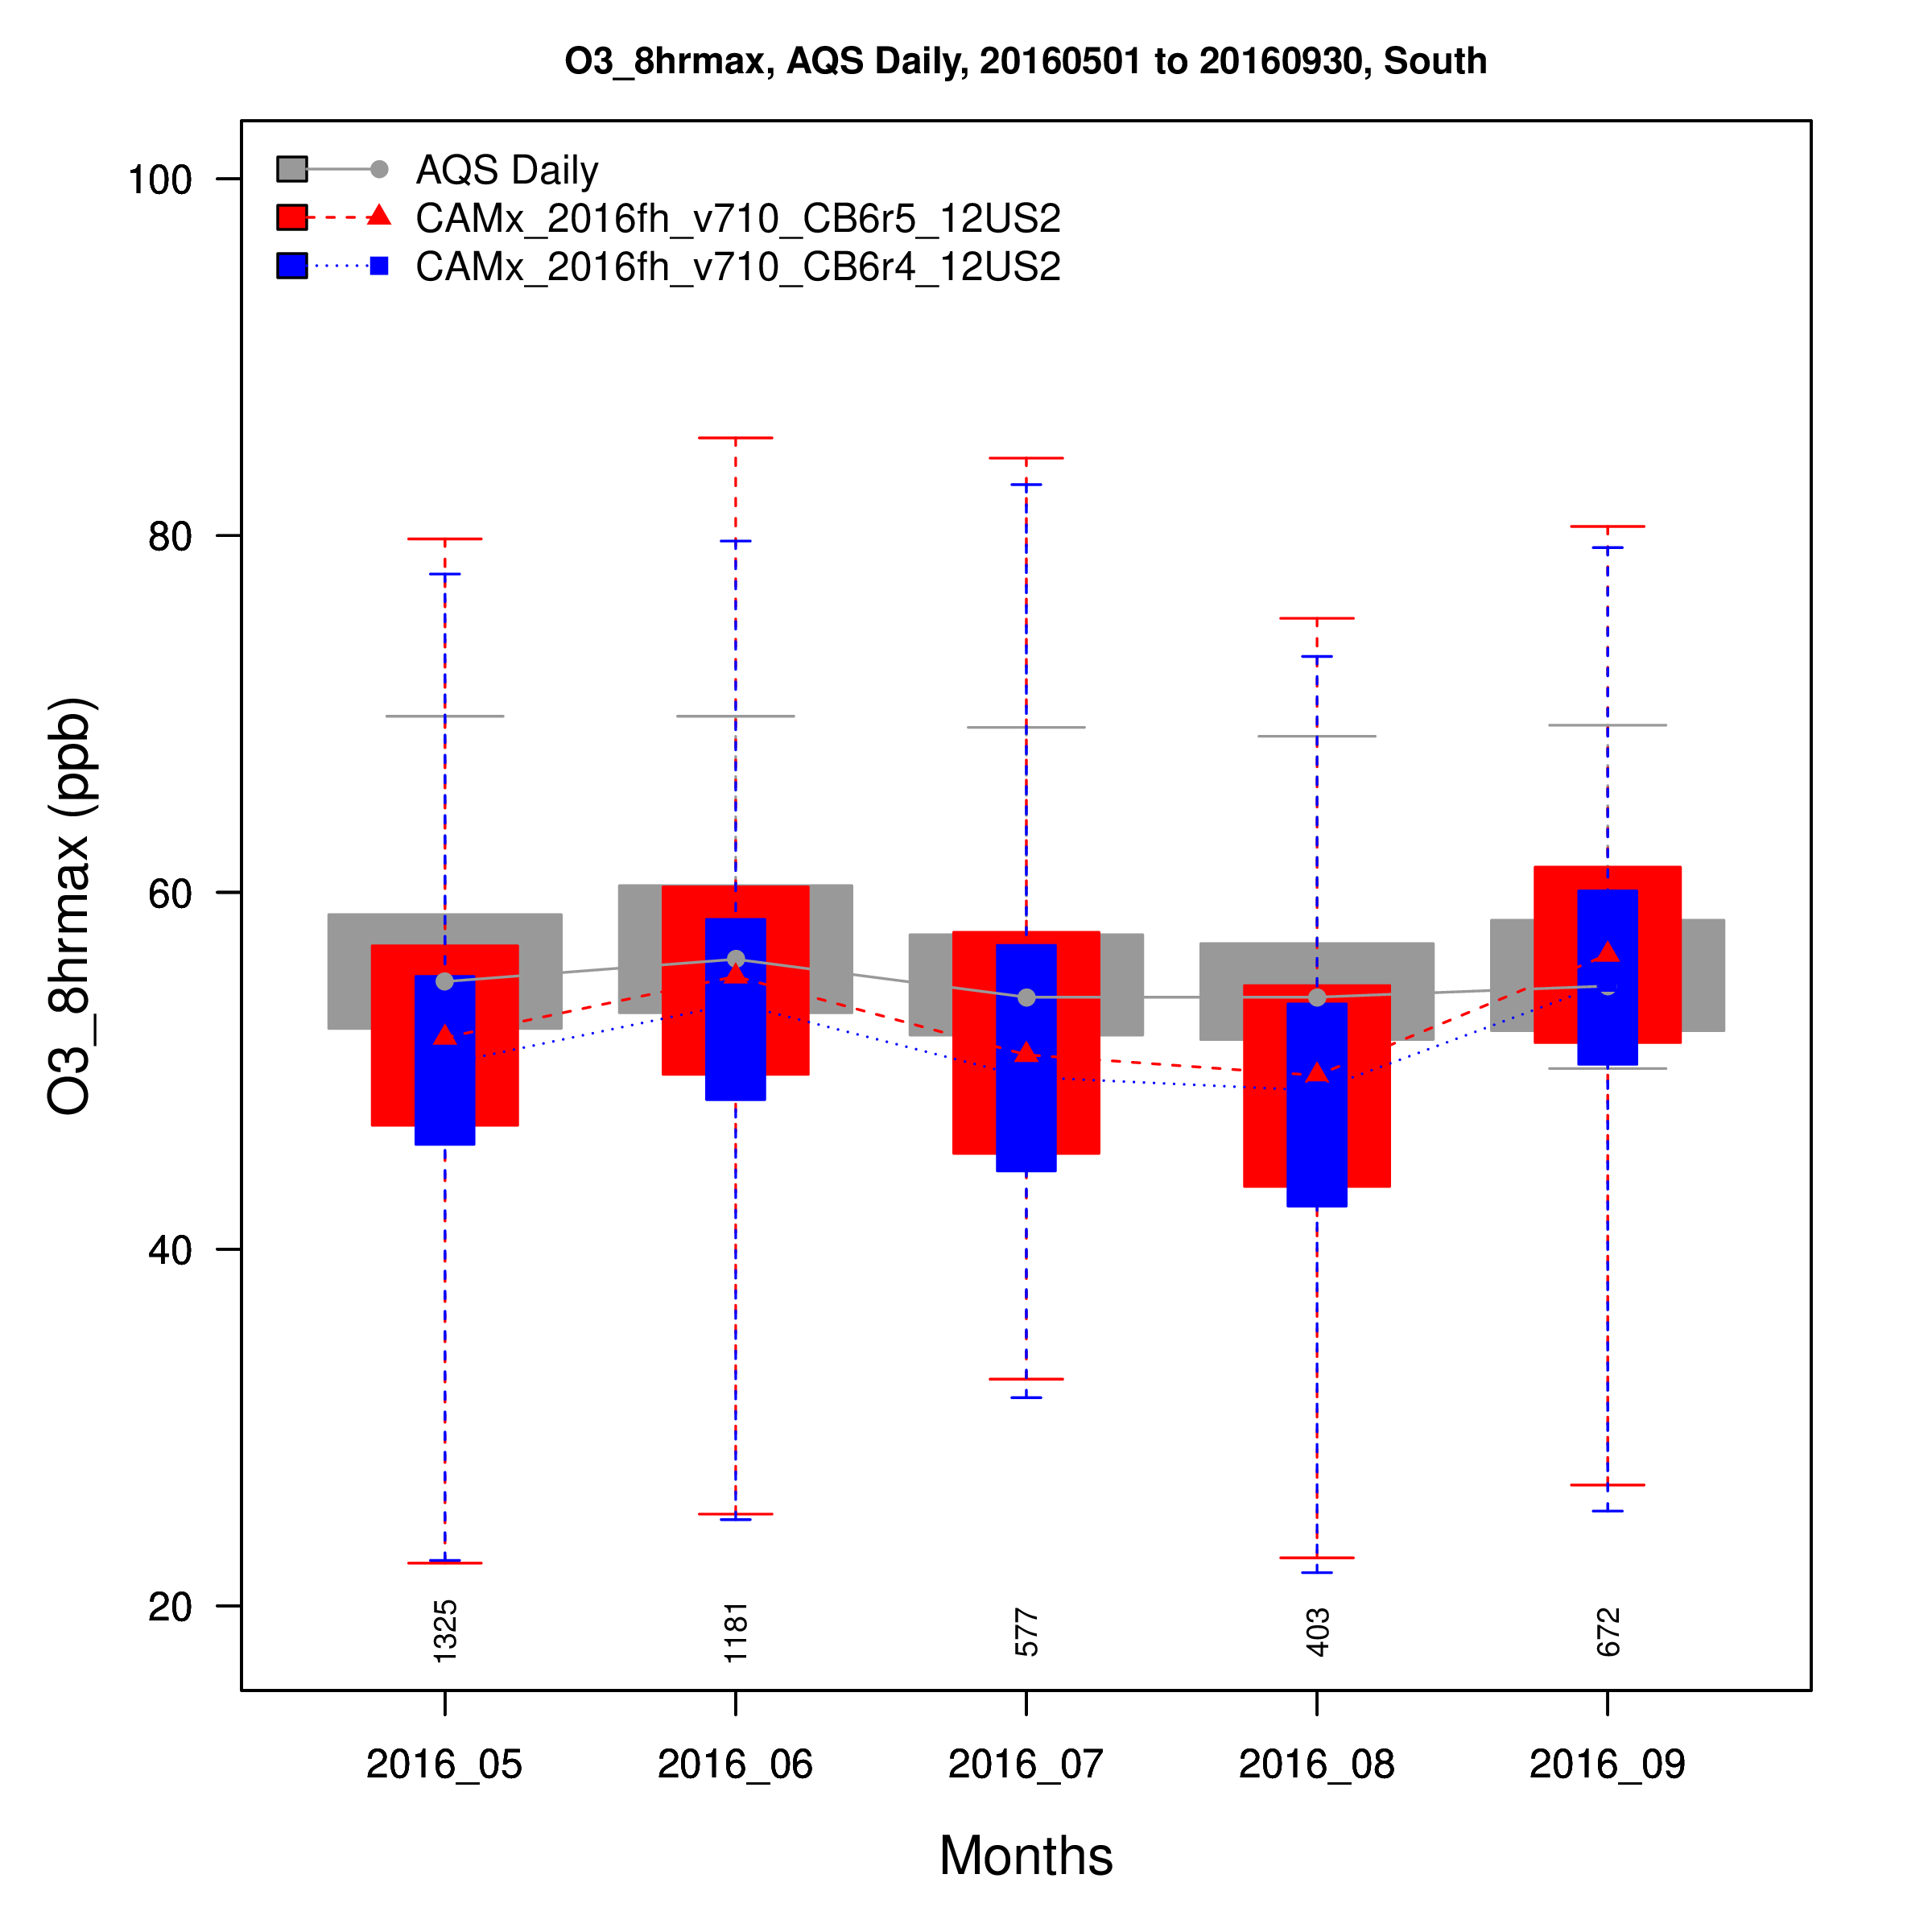
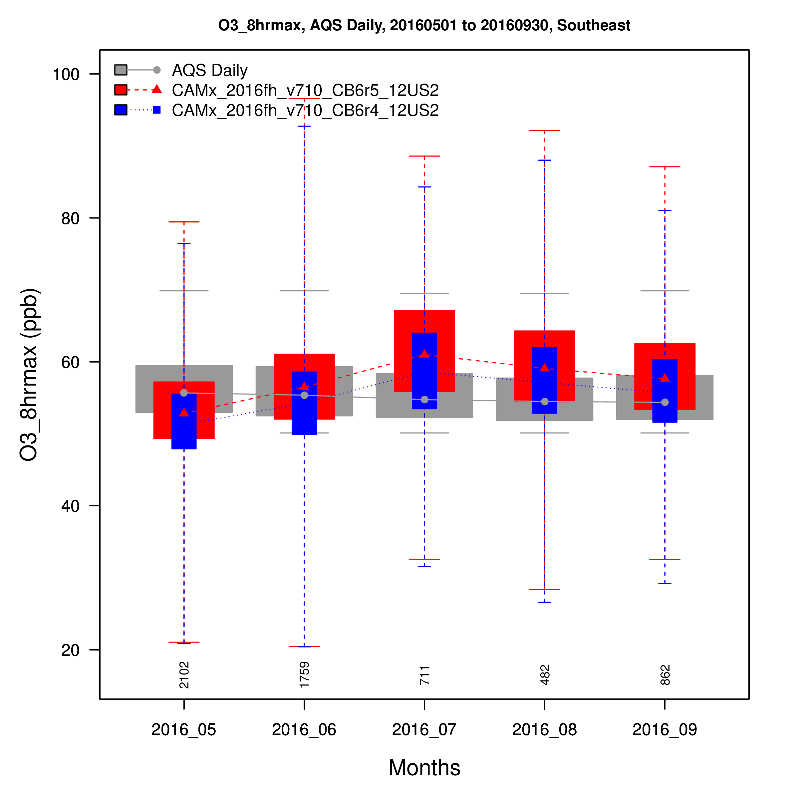
Upper Midwest
Ohio Valley
Northeast
Distribution of MDA8 O3 by Month
Model performance issues found with CB6r4 in the East are also evident with CB6r5
South
Southeast

Slide 11
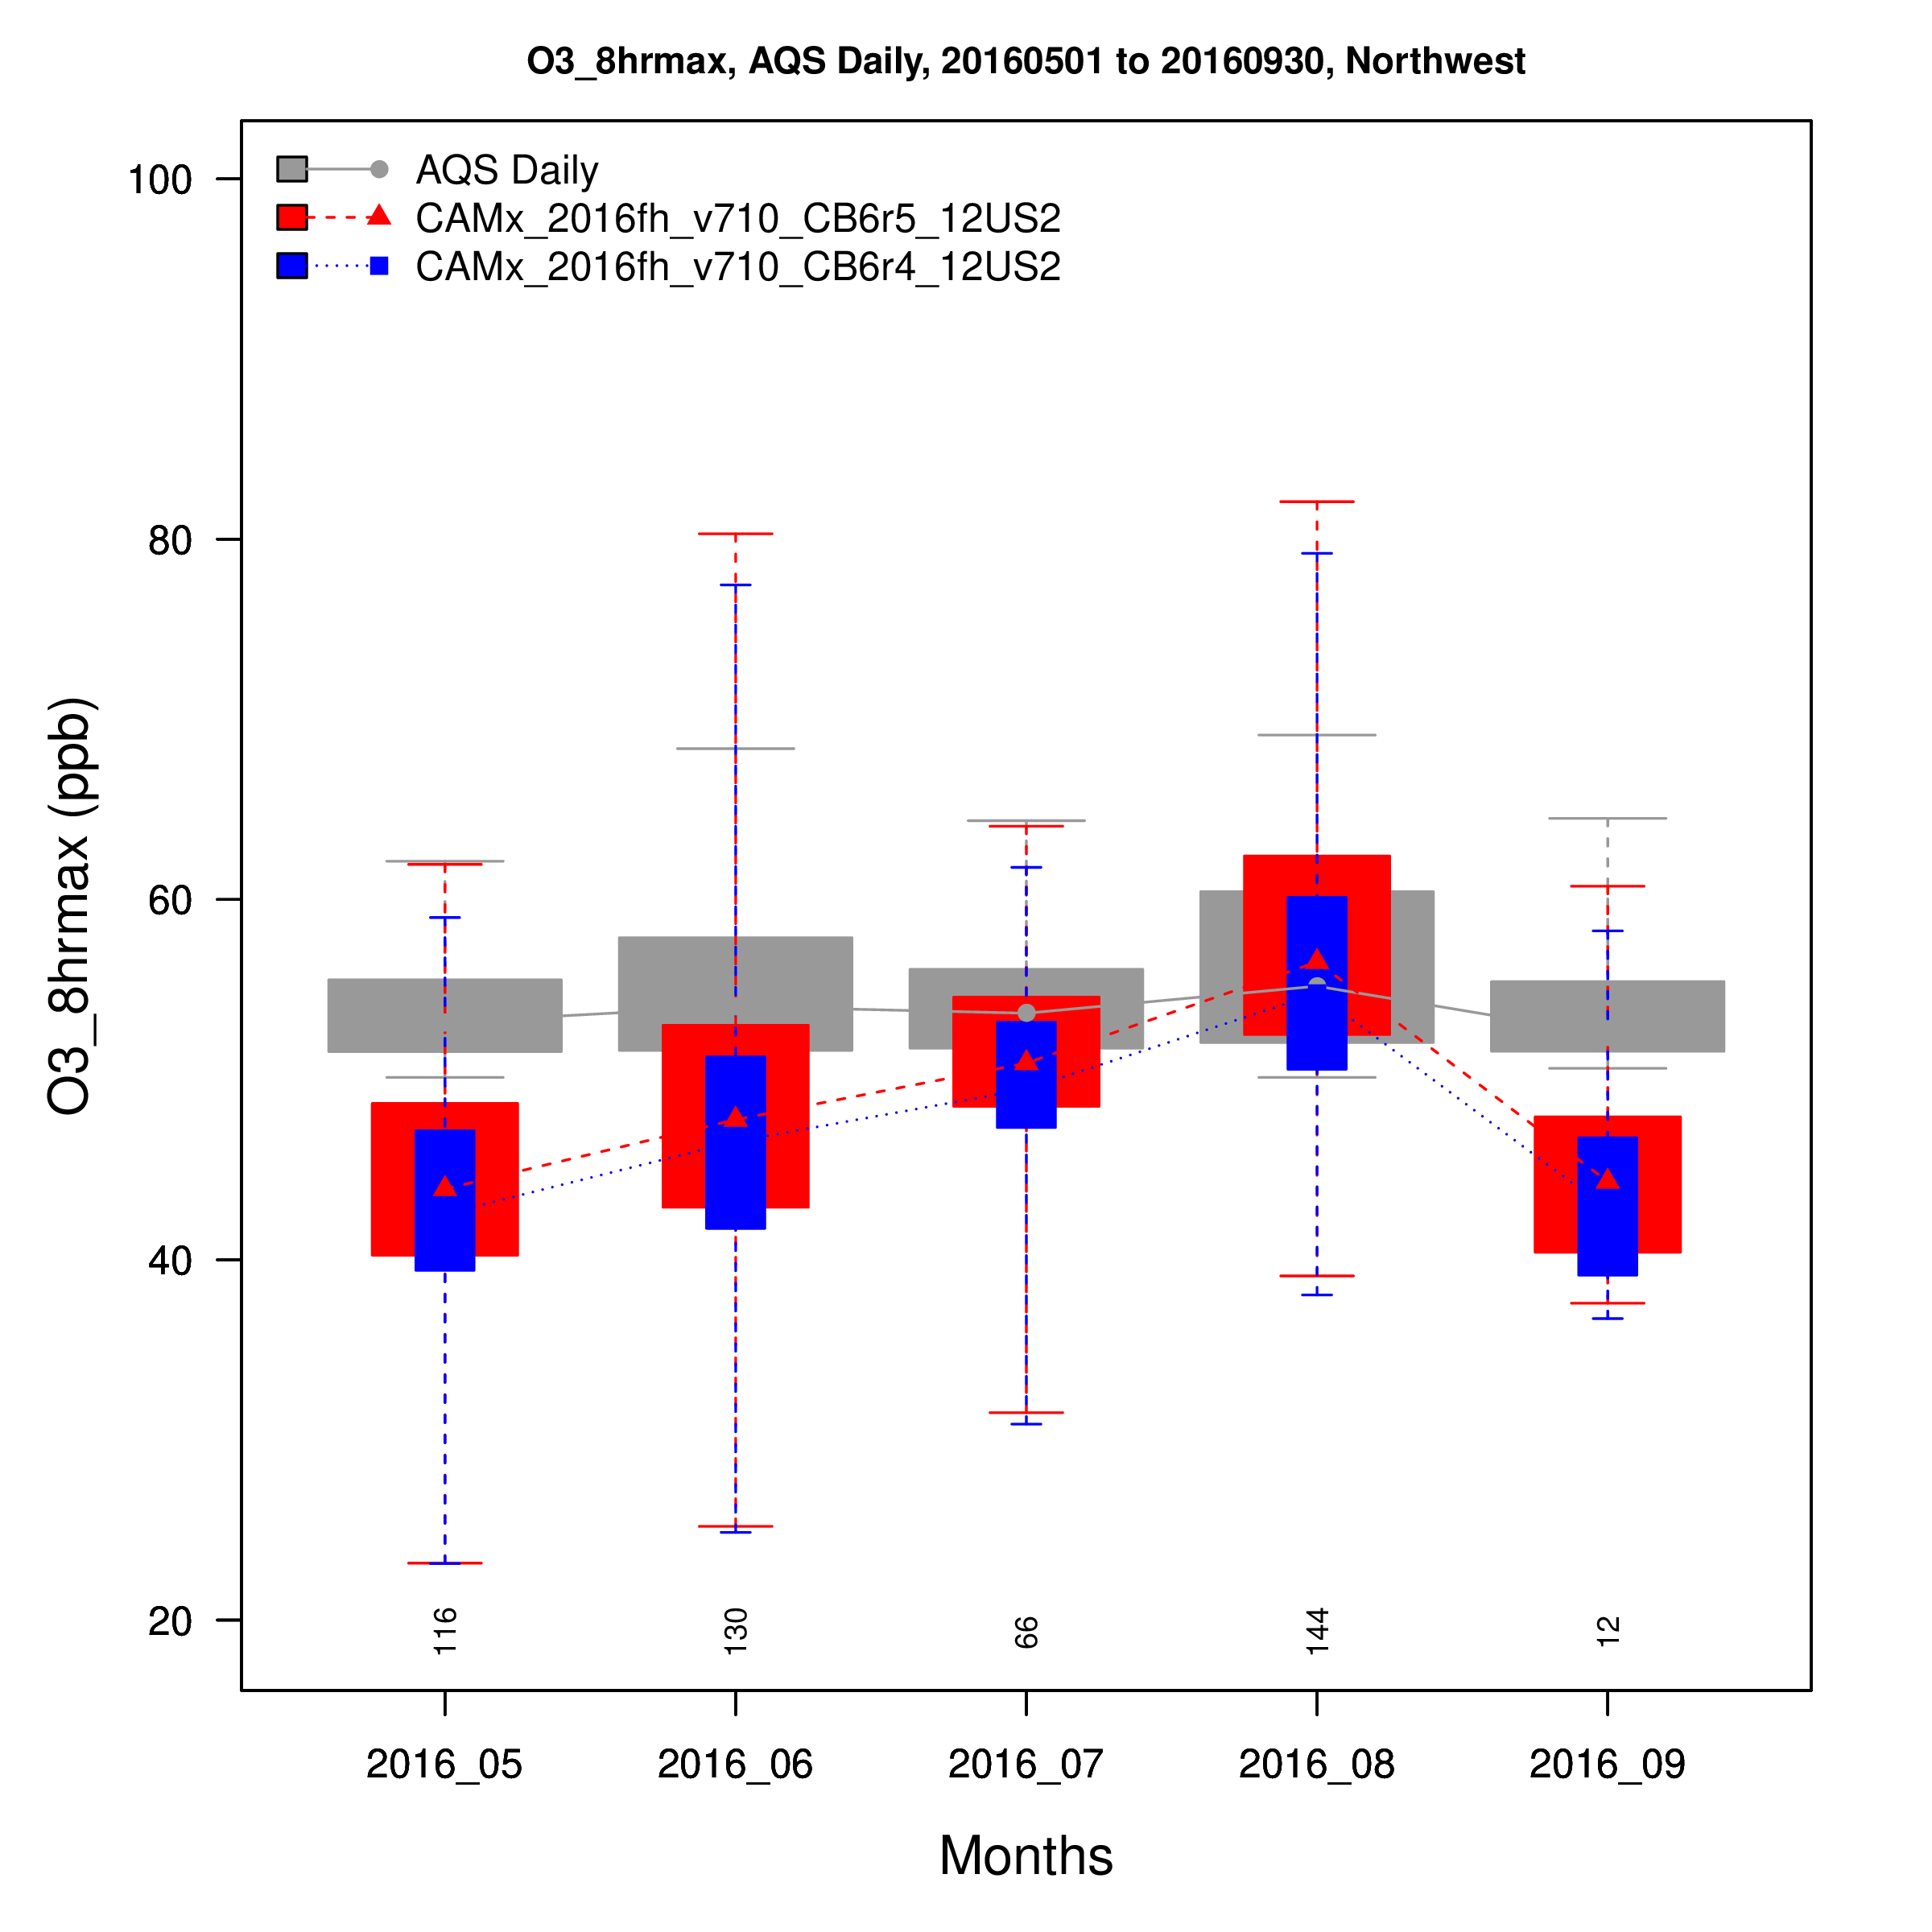
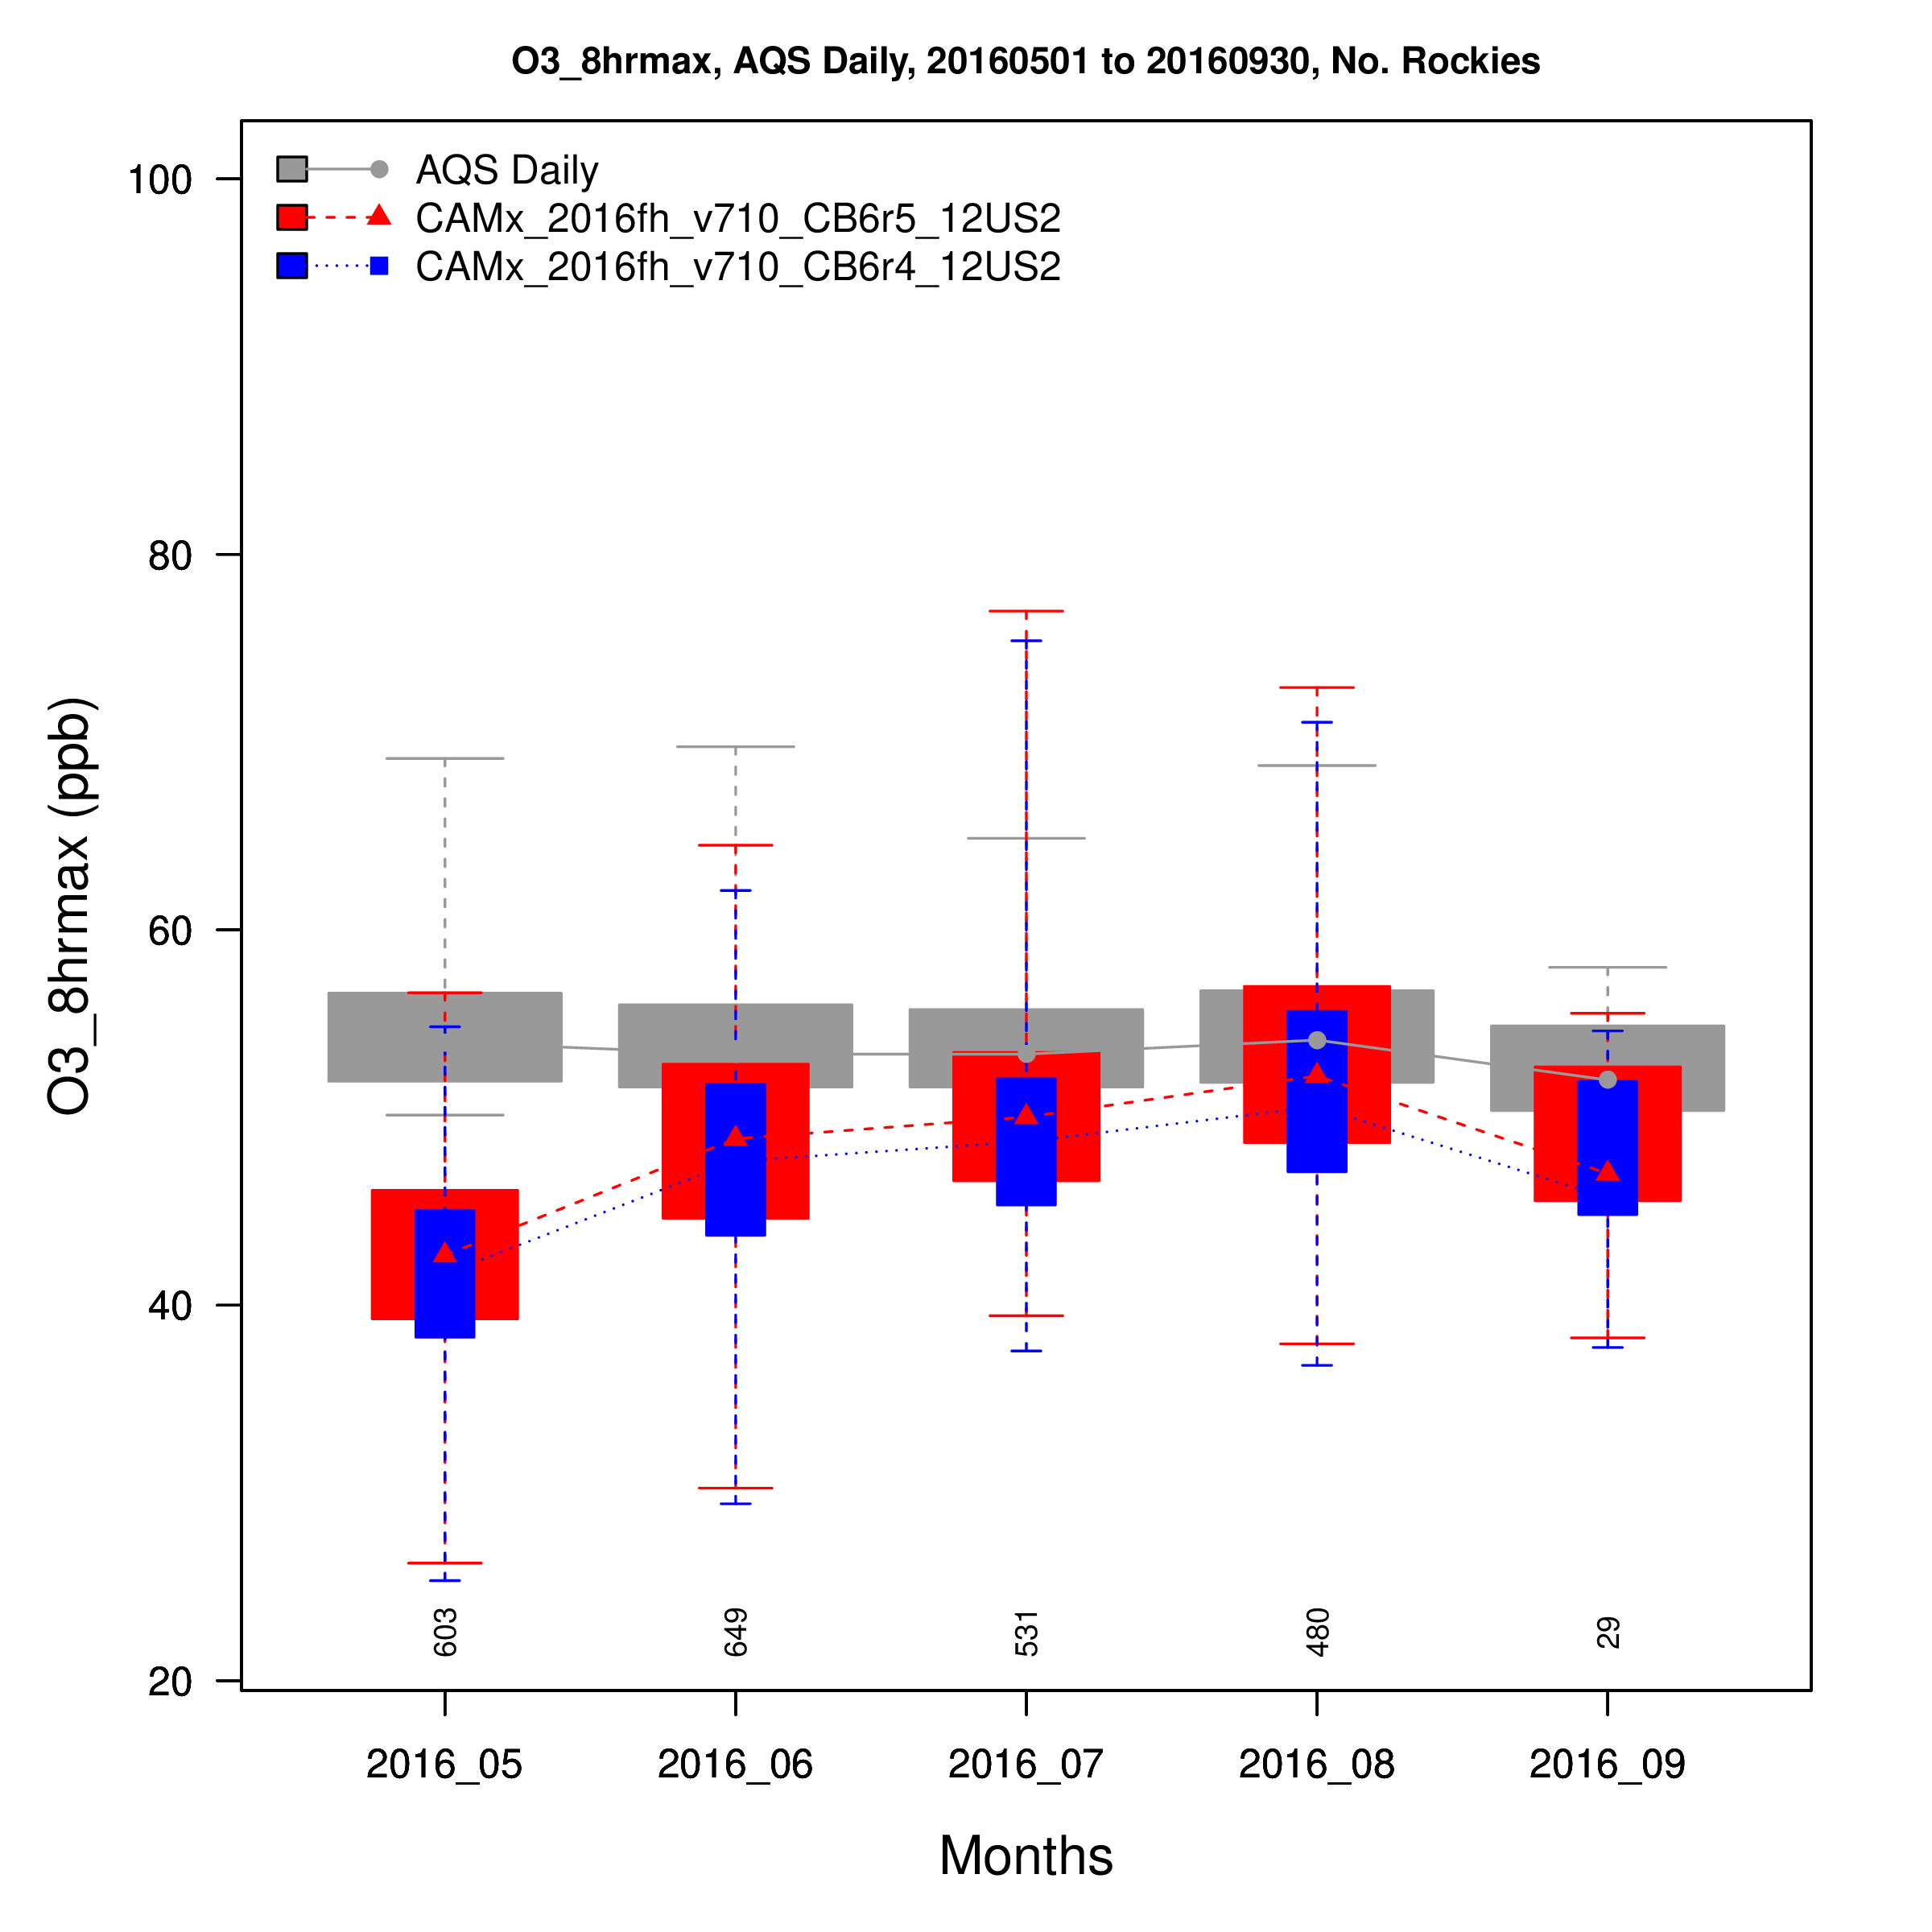
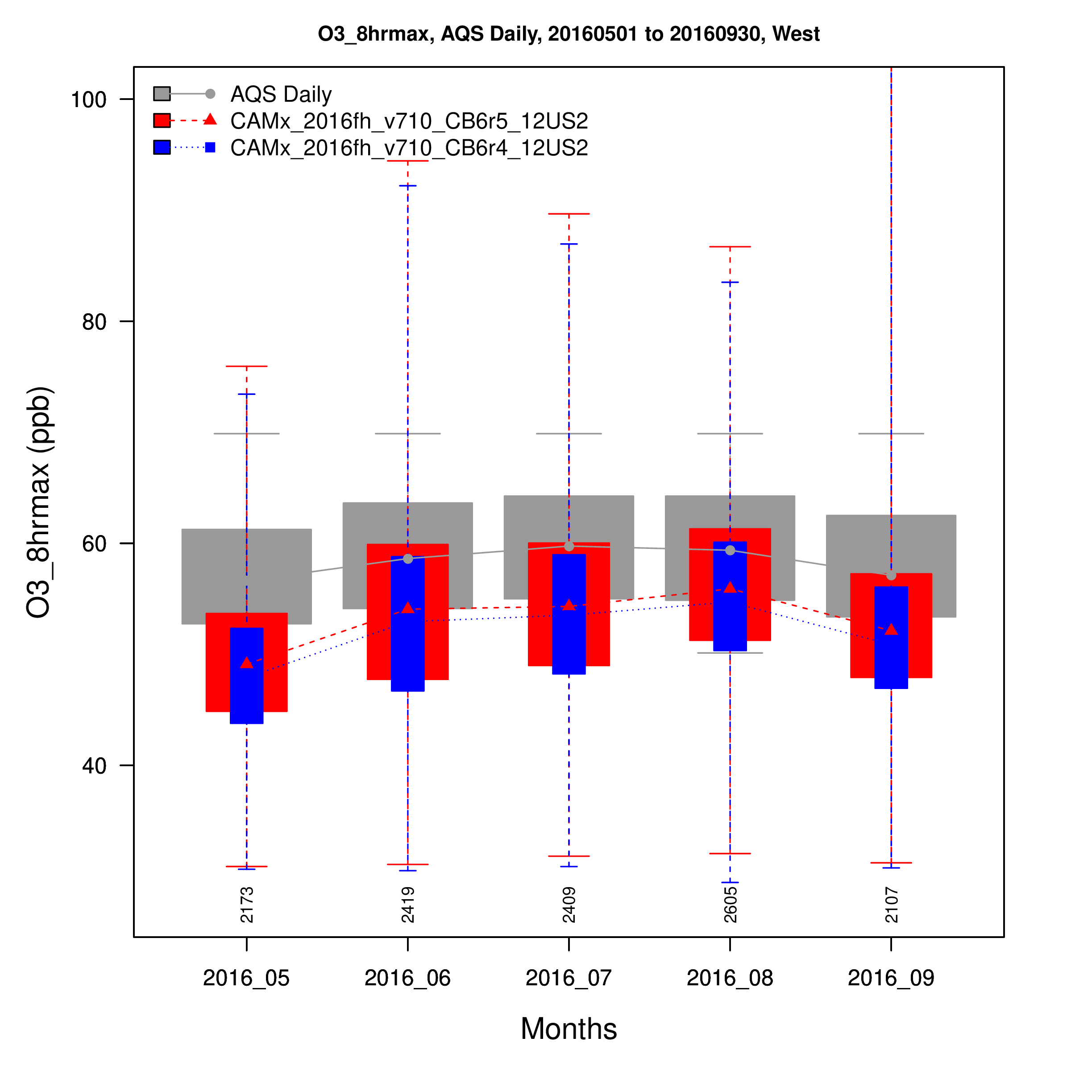
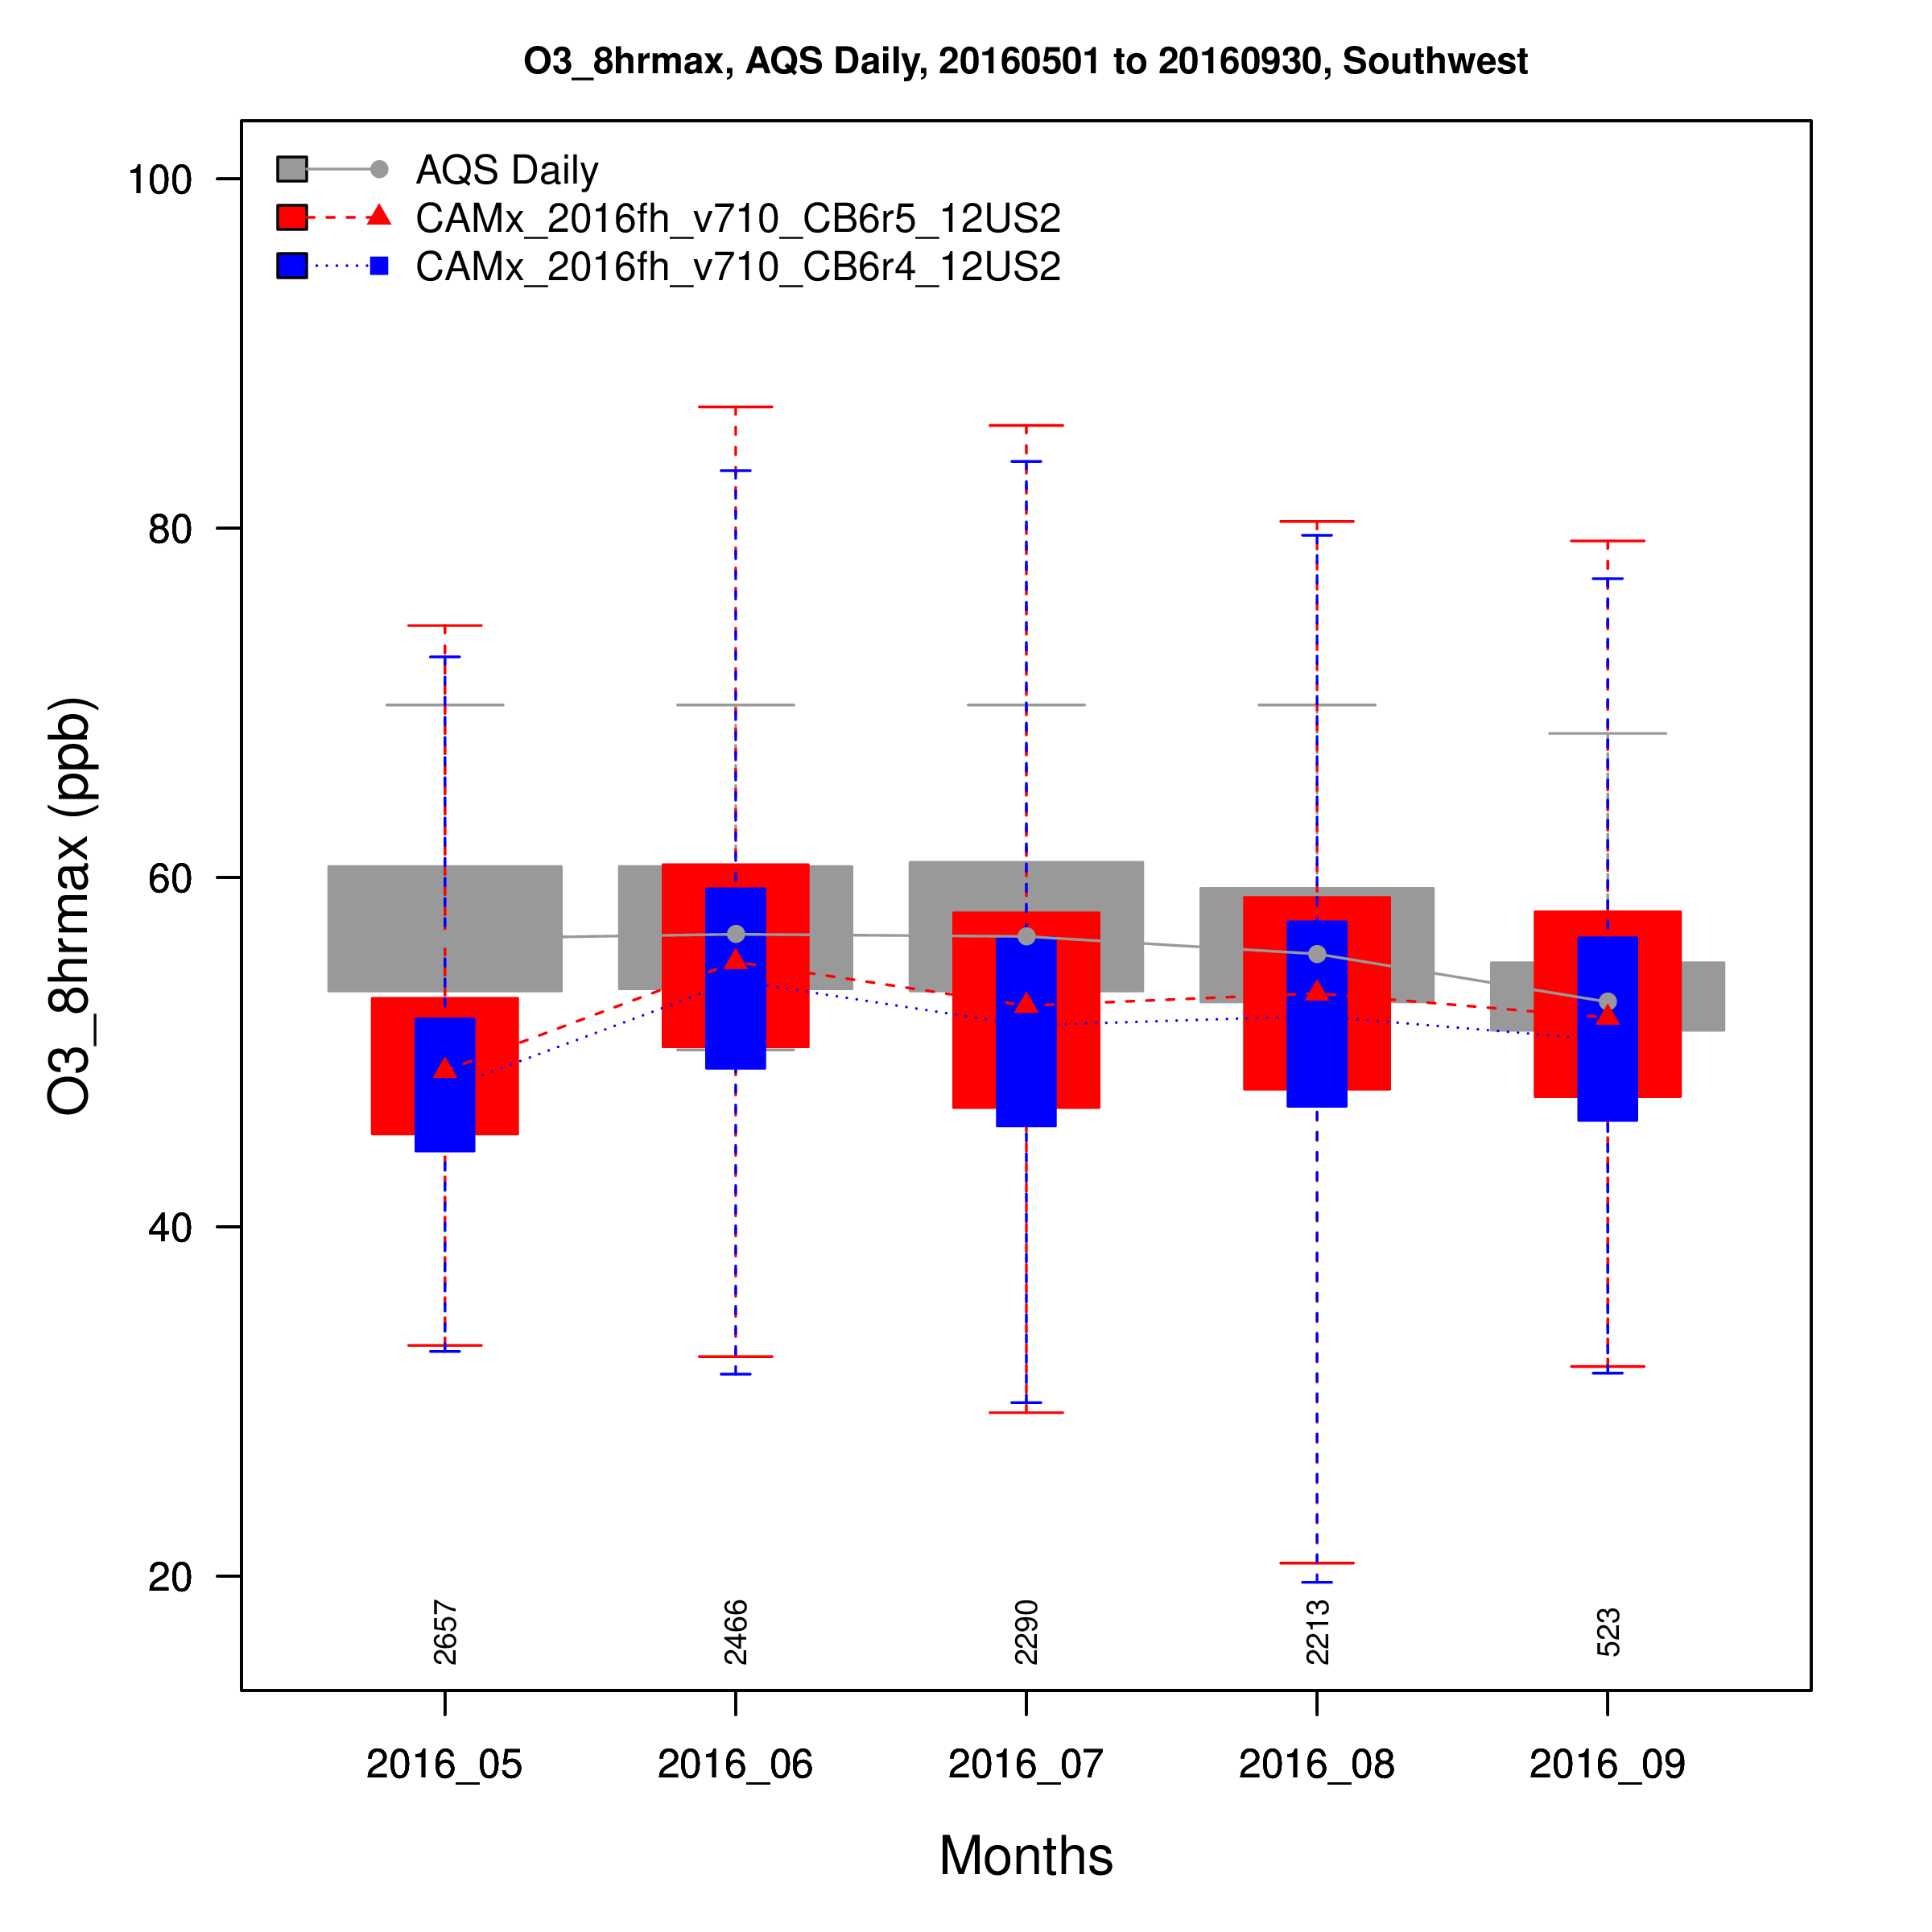
Northwest
No. Rockies
Distribution of MDA8 O3 by Month
Model performance issues found with CB6r4 in the West are also evident with CB6r5
West
Southwest

Slide 12
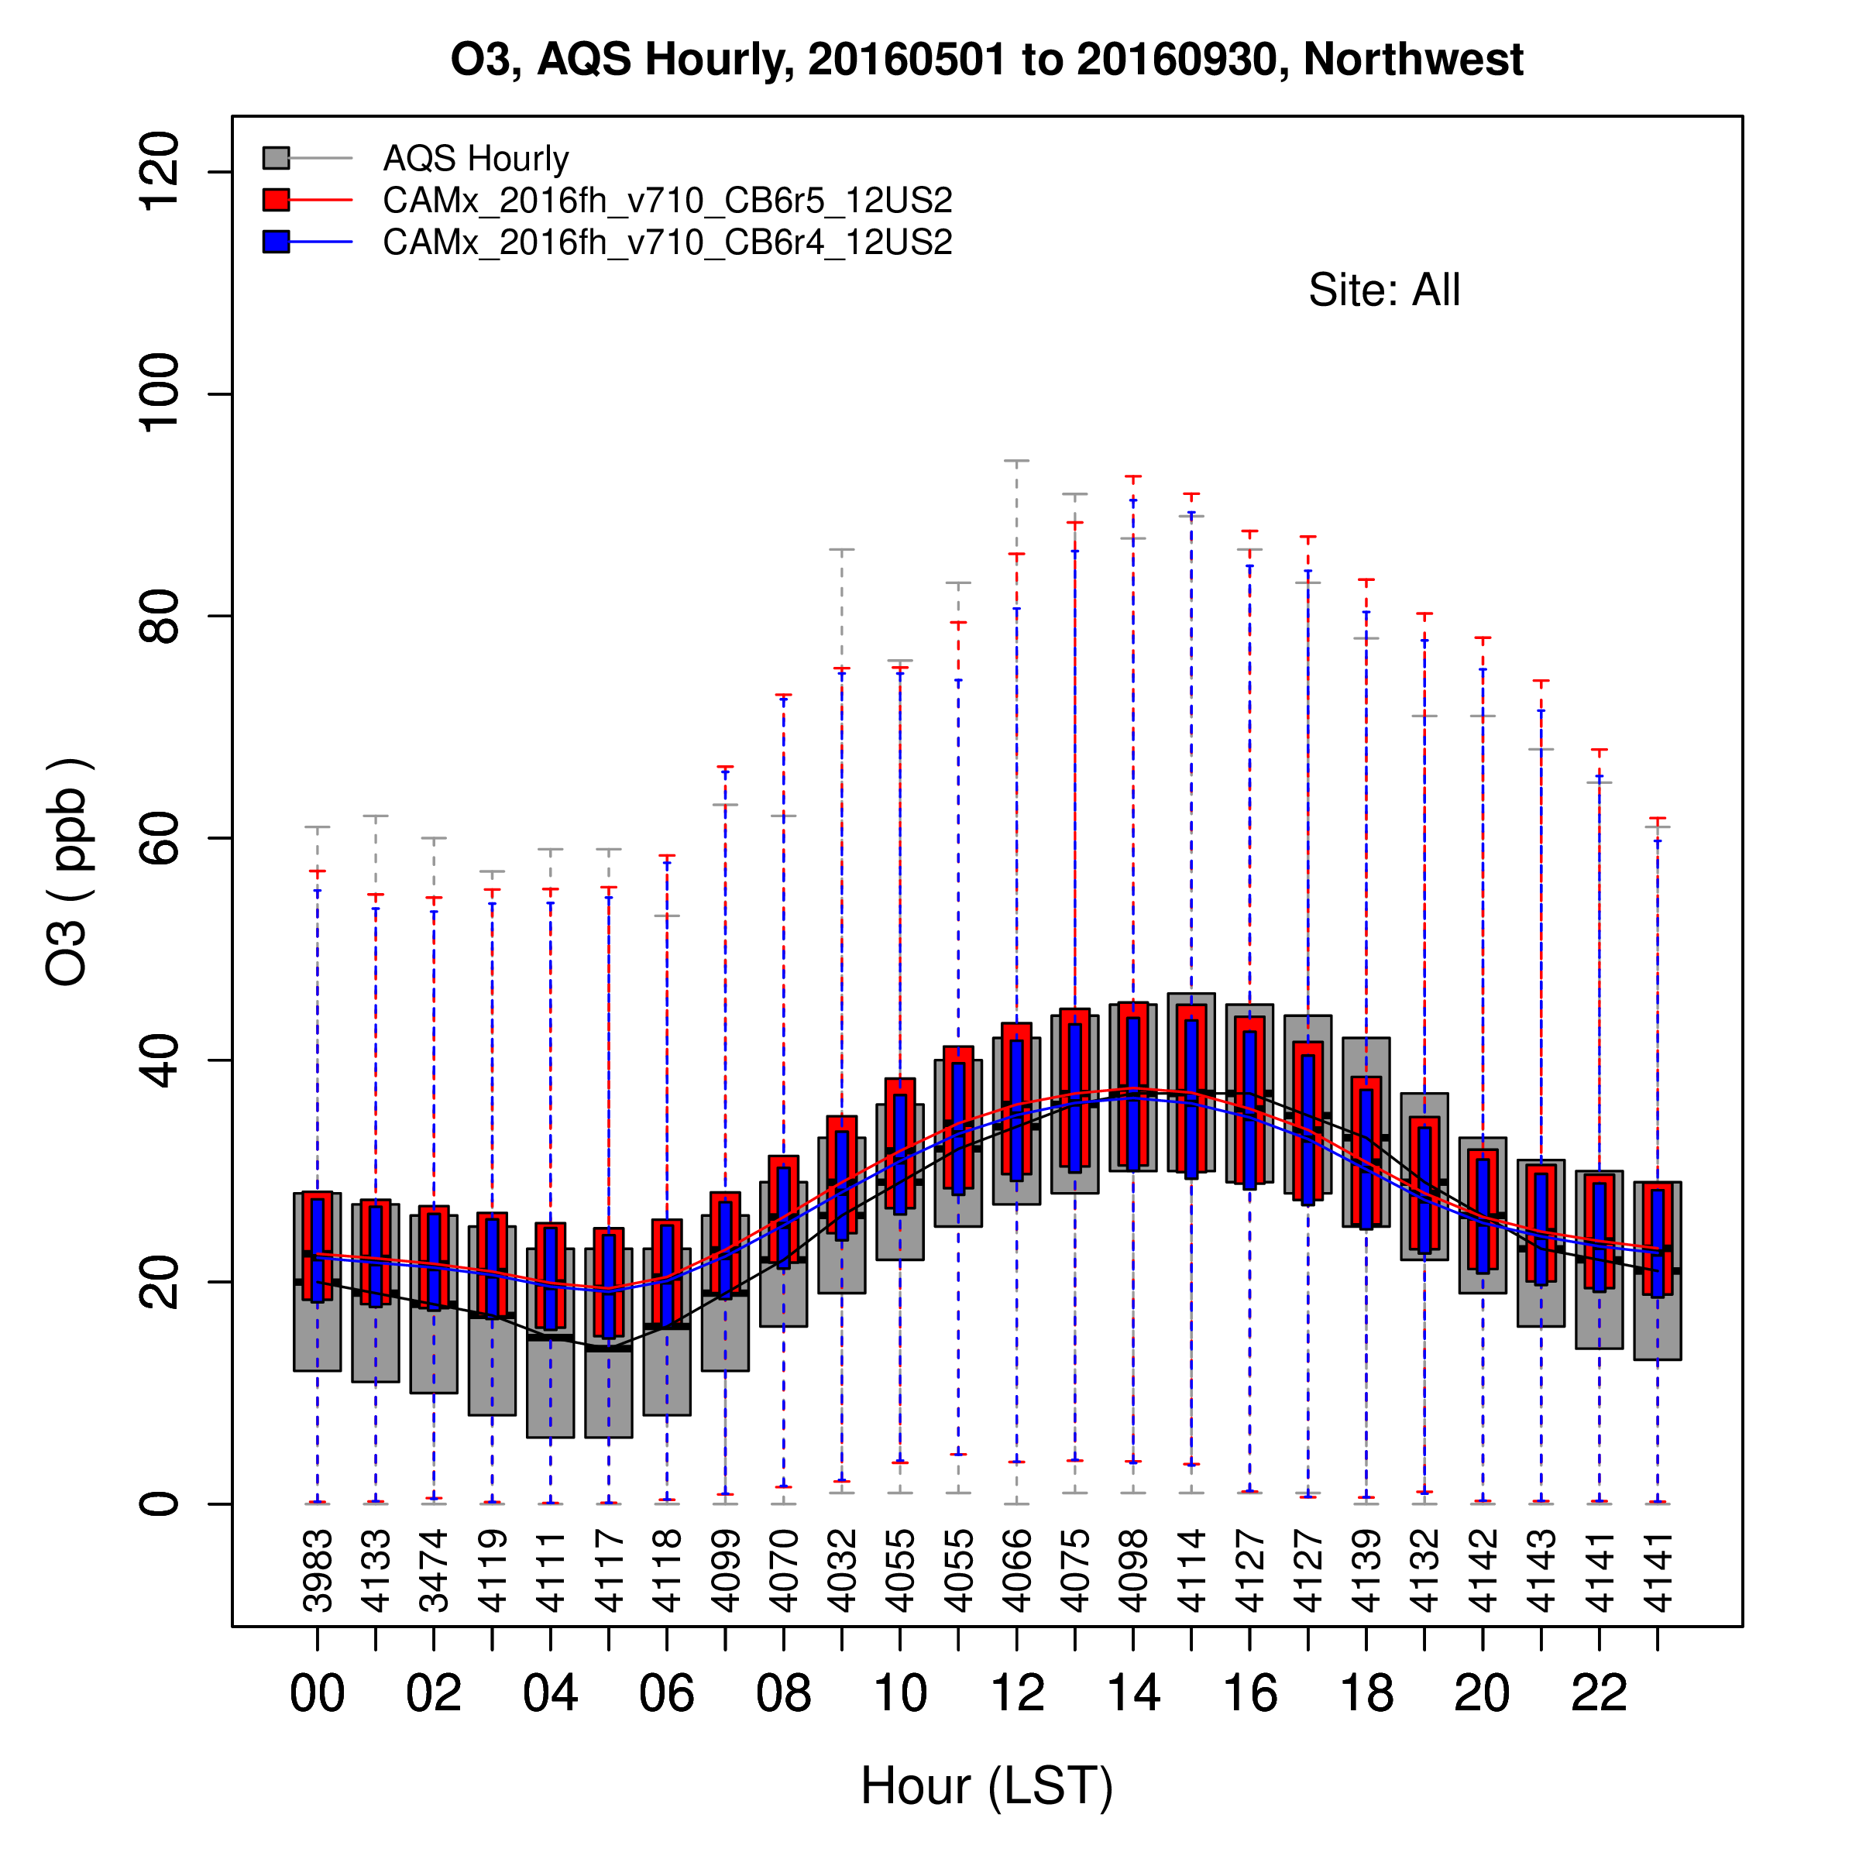
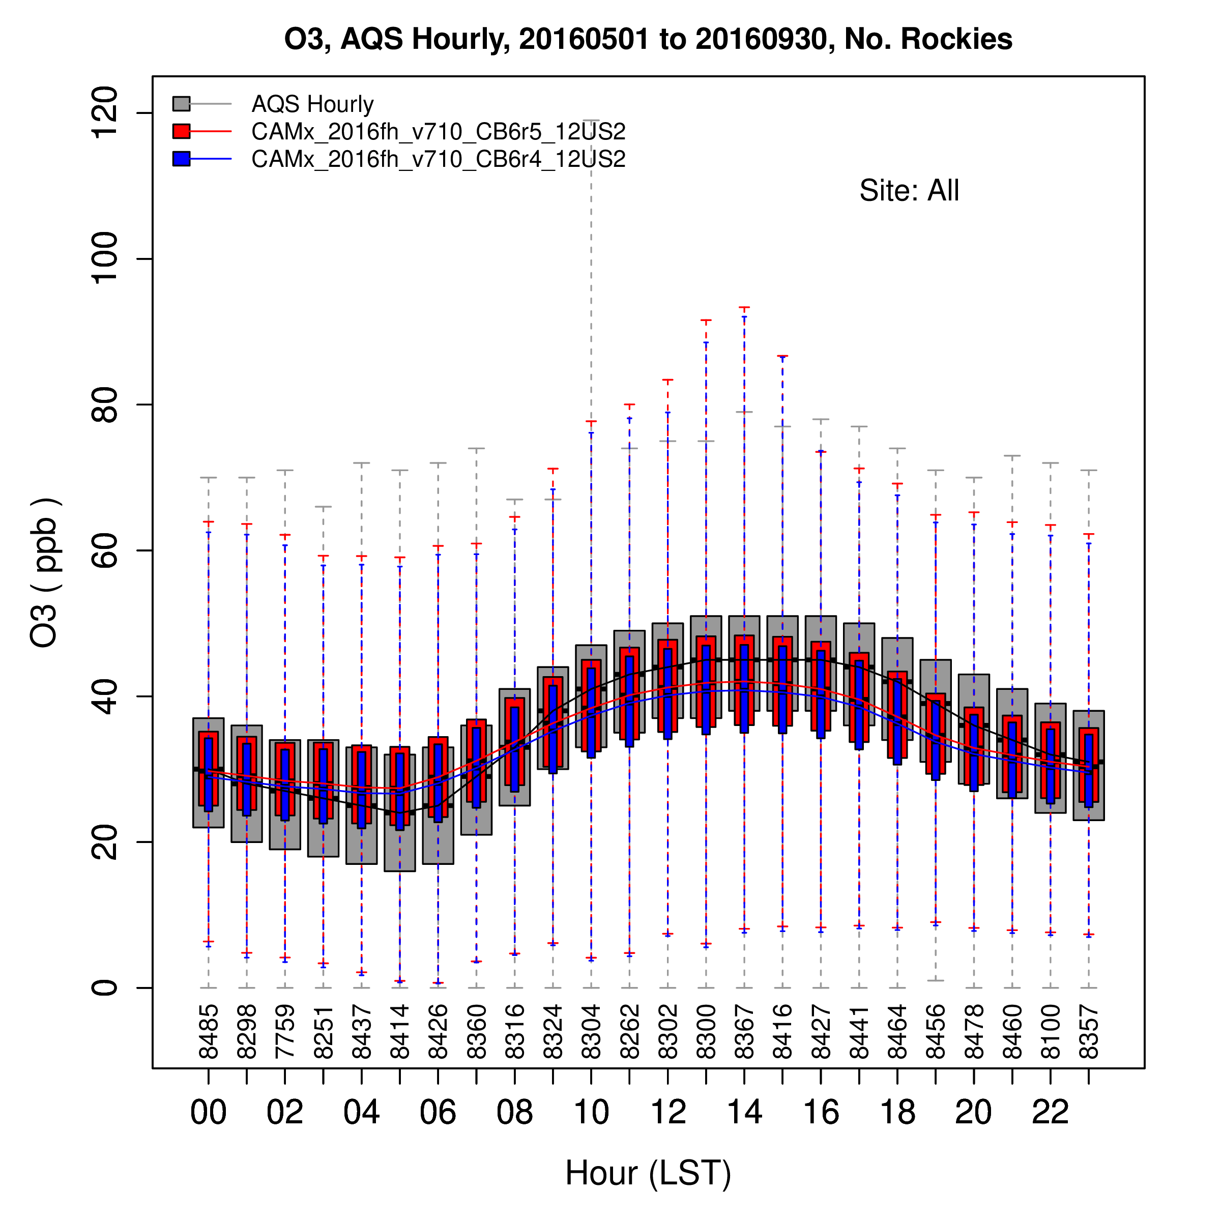
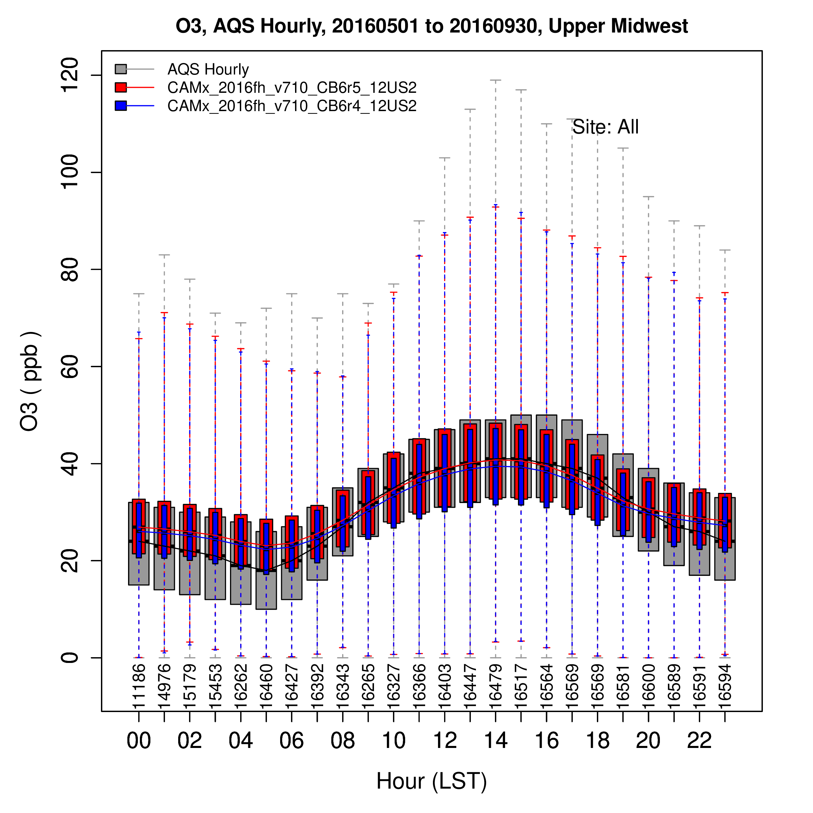
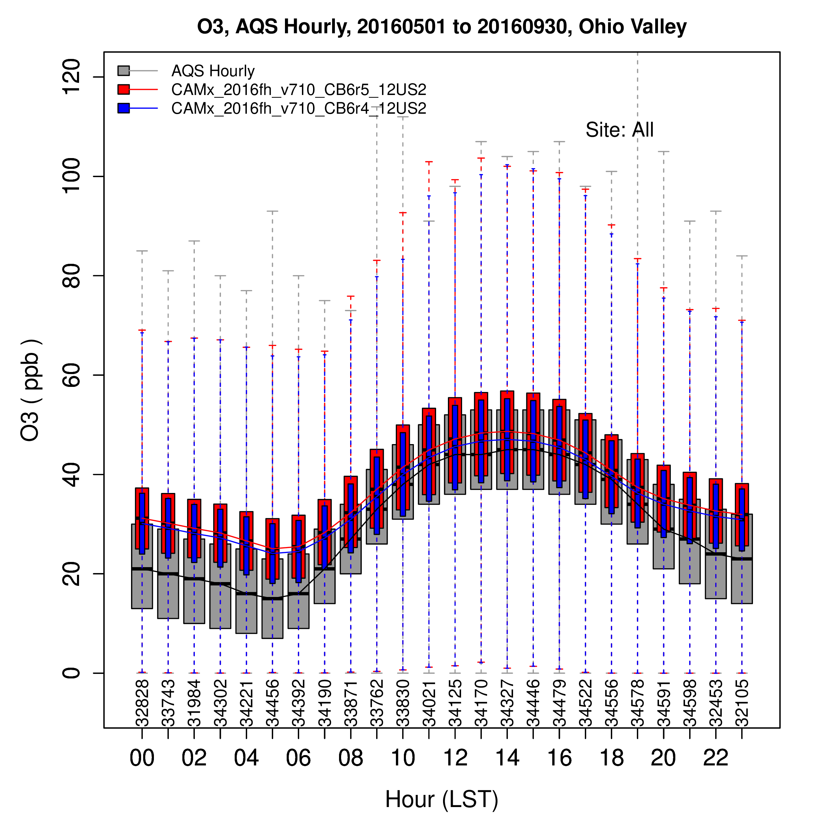
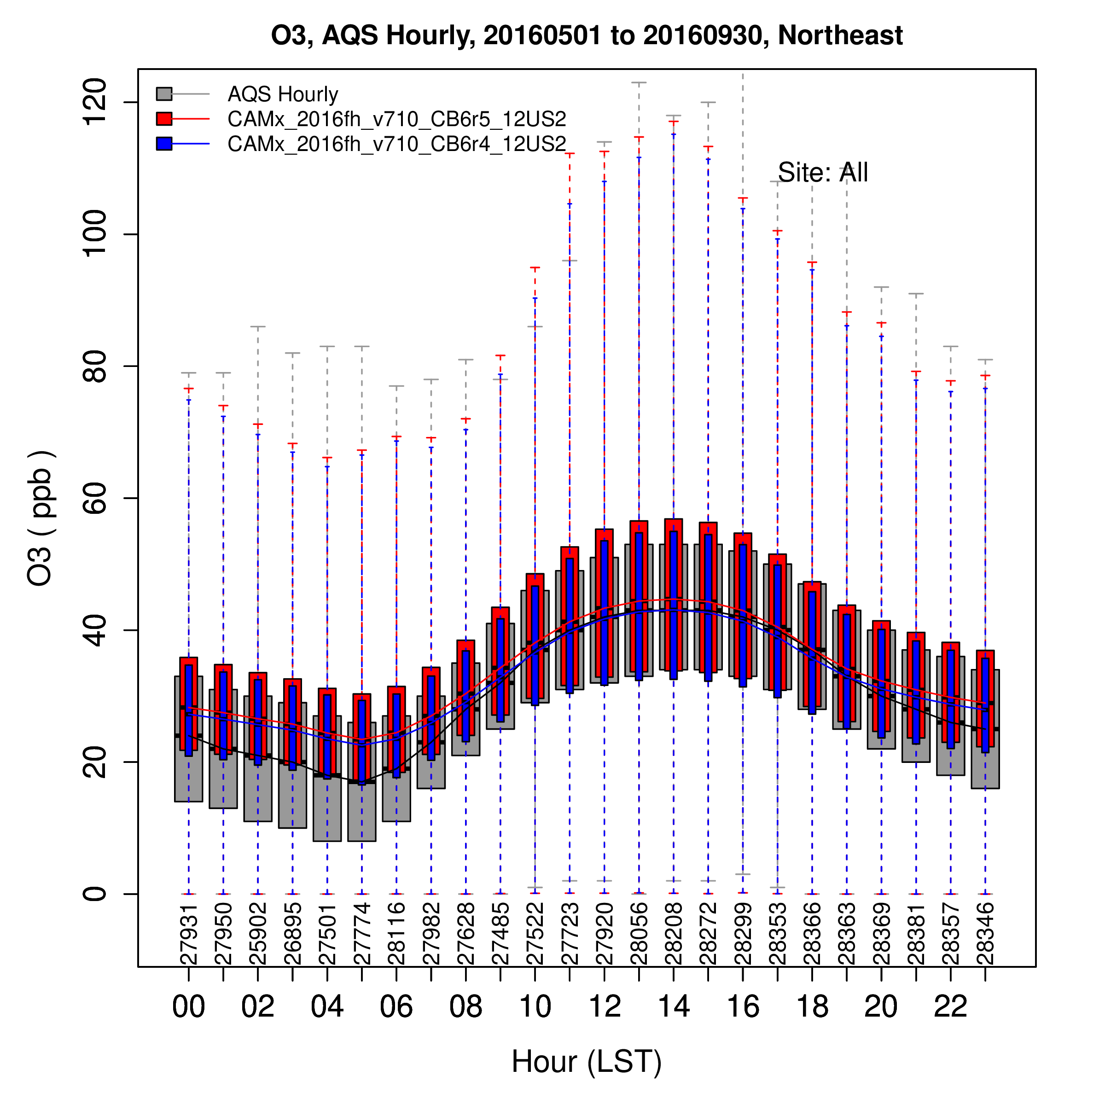
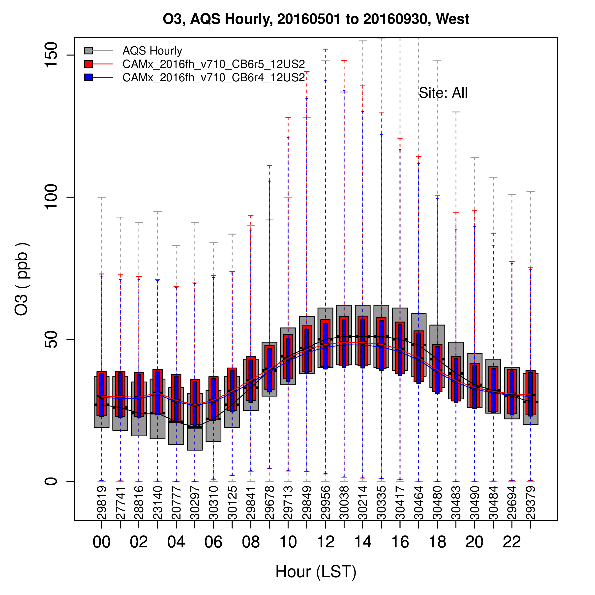
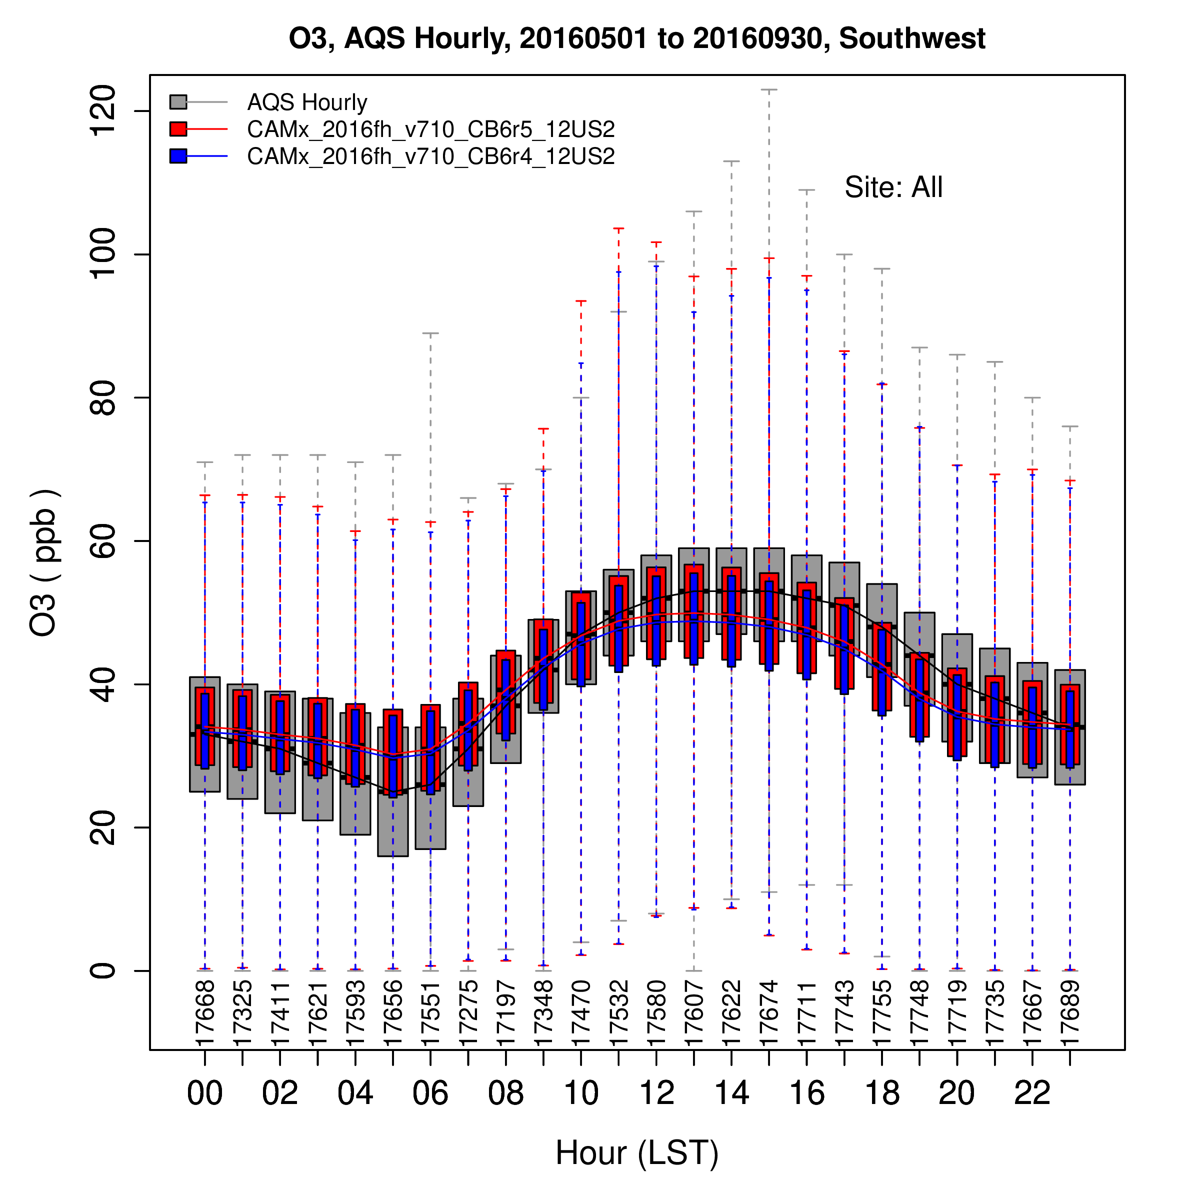
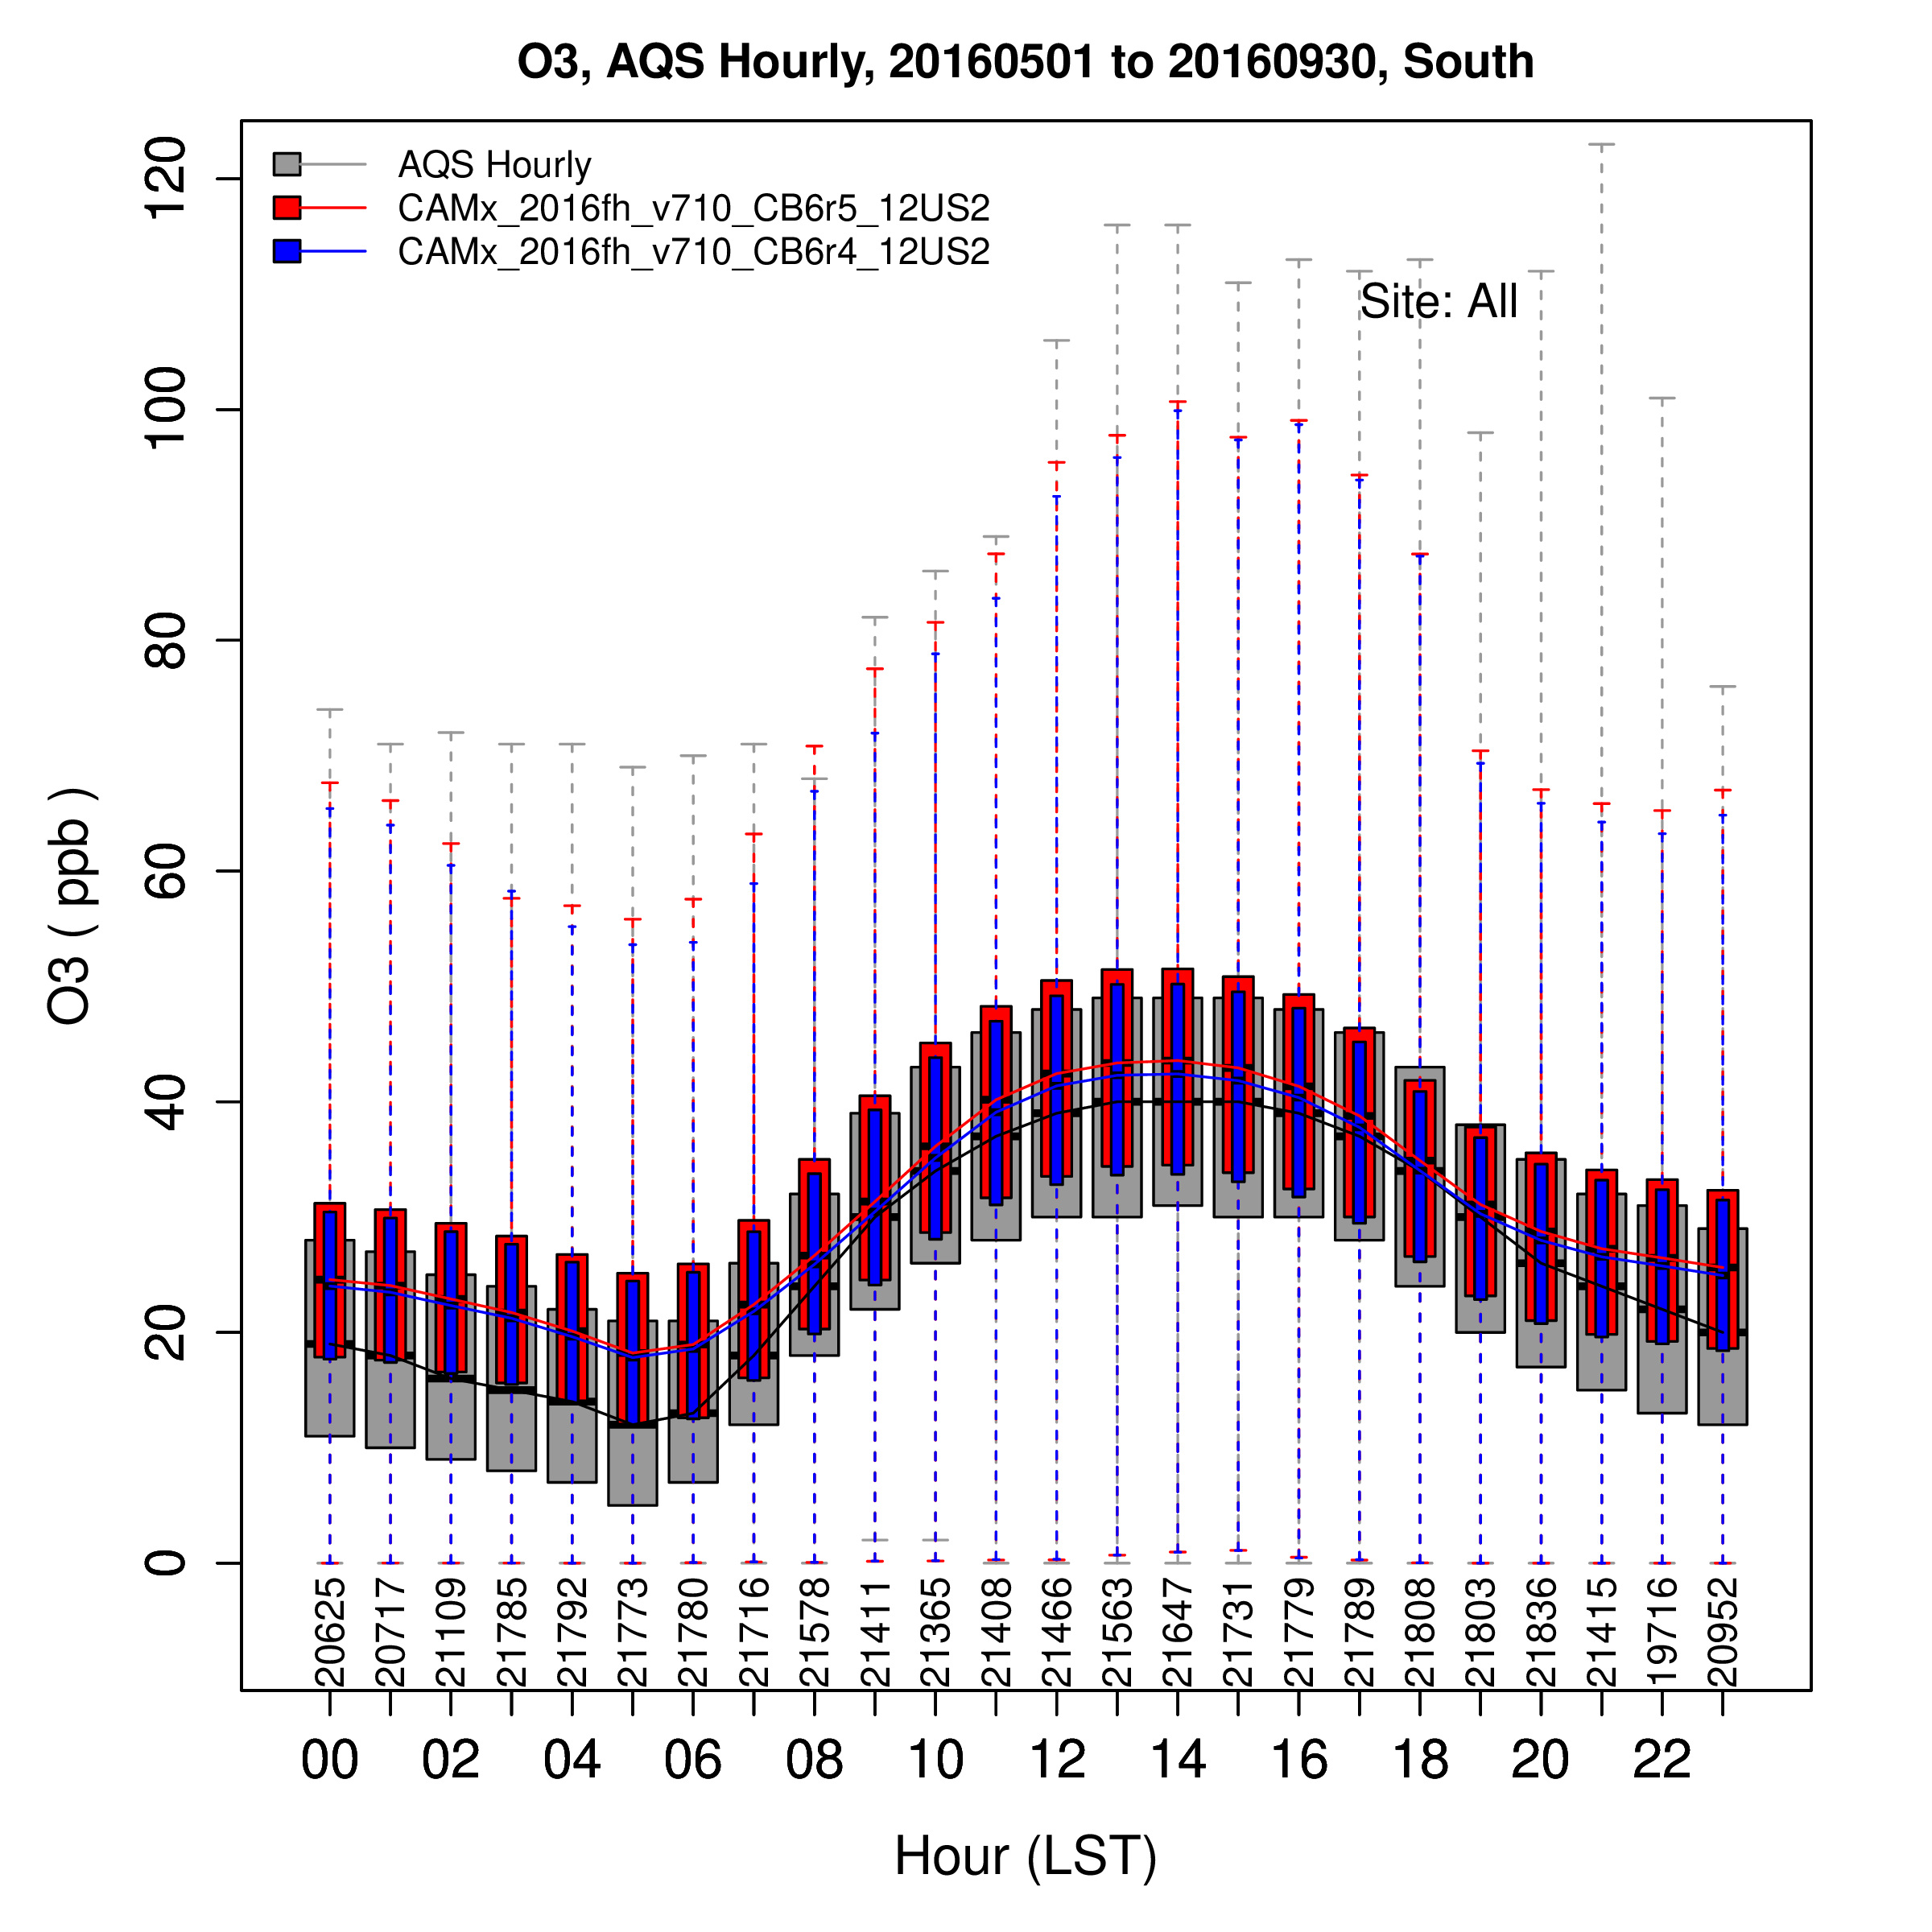
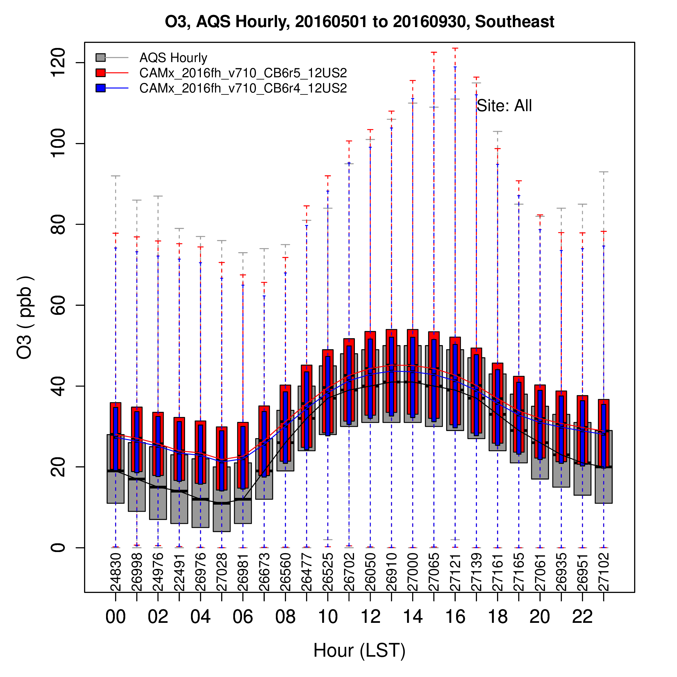
Northwest
No. Rockies
Midwest
Ohio Valley
Northeast
West
Southwest
South
Southeast
Overnight: Under prediction of high concentrations and over prediction of the interquartile range in all regions.
Morning to Noon: Rate of rise of O3 in model and obs are generally similar in all regions except for the No. Rockies
Early Afternoon: In the Midwest, South, Southwest, and West obs O3 continues to increase, whereas model O3 tends to flatten out. In the Ohio Valley, Northeast, and Southeast the model generally tracks the obs – during this time of the day.
Late Afternoon/Early Evening: Model largely under predicts obs in the Midwest (probably sites along Lake MI), South, Southwest, and West. Model O3 drops off earlier than obs in these four regions plus Ohio Valley and Northeast.

Slide 13
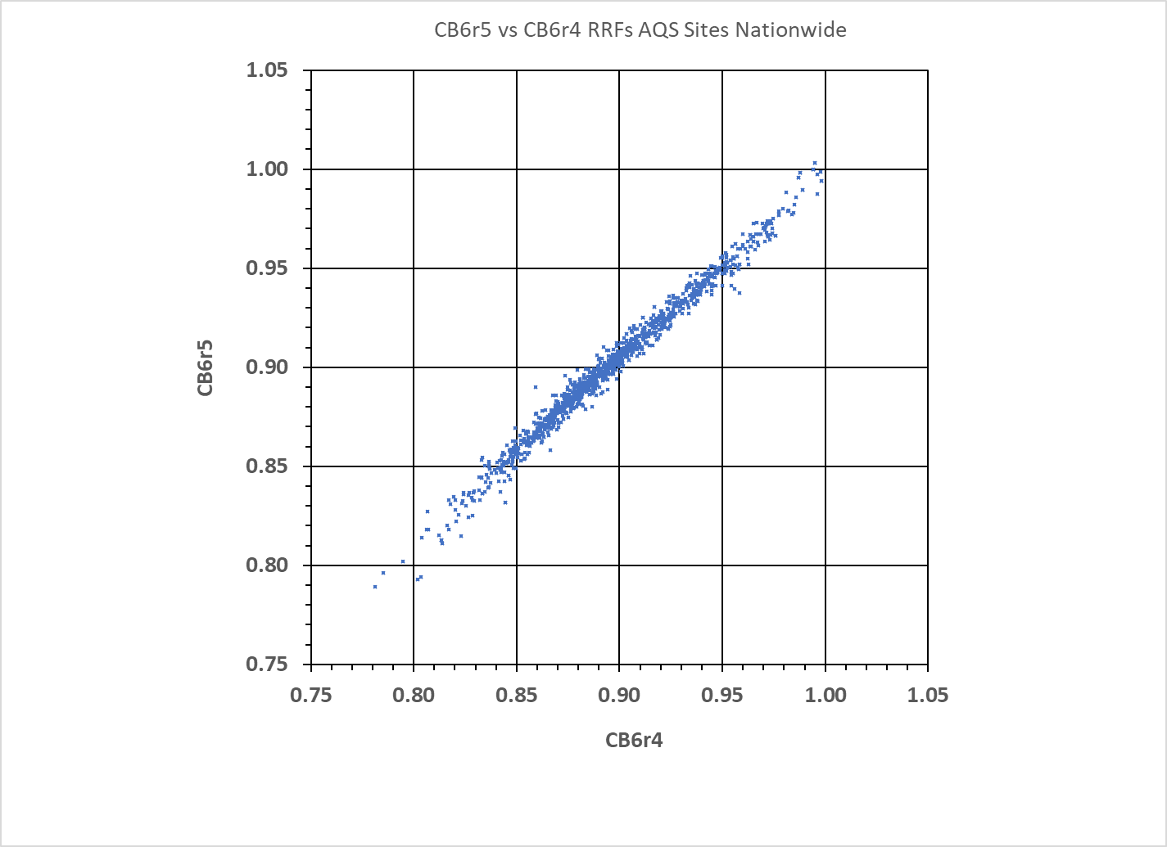
CB6r5 tends to be less responsive than r4 below .95

