Slide 1
Multi-Pollutant (MP) OAR Briefing
OAQPS’s Multi-Pollutant Team:
Beth Landis, Carey Jang, etc.
August 25, 2021

Slide 2
Outline
MP Background
MP Assessment Process
MP Projects
  South Carolina
  Louisville
NEXUS MP Tool
Next Steps

Slide 3
MP Background
Support a comprehensive, MP treatment of air quality problems to effectively improve air quality and make the most efficient use of available resources
  Primary Goal - identify & evaluate local control strategies targeting emissions of O₃ & PM_{2.5} and their precursors while at the same time reducing Air Toxics of concern for communities to maximize both health benefits and air quality improvements
MP planning has the potential to reduce the costs and increase benefits associated with air quality management (AQM)
Supports S/L/T air agencies in developing MP, risk-based AQM plans and implementing strategies that reduce air pollution emissions & improve public health
Success has been demonstrated in Detroit and SC; another project is currently underway in Louisville, KY
Tools needed to analyze MP data are either available currently or being developed in OAQPS (e.g., NEXUS)

Slide 4
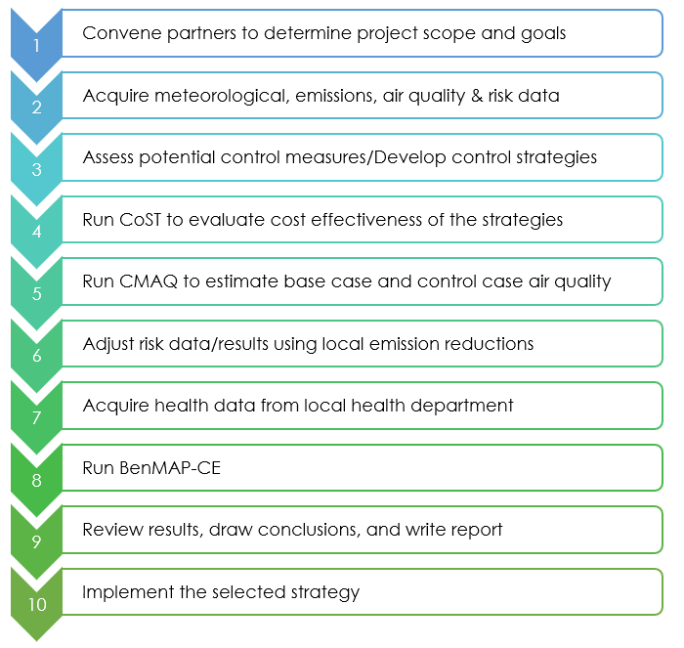
MP Assessment Process
Adapted from the SC Report (pages 23-24) - https://www.epa.gov/sites/production/files/2016-05/documents/usepa-south_carolina_final_report_may_26_16_2.pdf

Slide 5



SC - Background
Collaboration between EPA, SC, community leaders in ten upstate counties (Ten at the Top (TATT)) under the Advance program.
Goal: identify & evaluate a control strategy to reduce ozone and PM_{2.5} precursors and air toxic emissions of concern for communities to maximize health benefits & air quality improvements.
Control measures and their costs were identified including local measures that address multiple pollutants.
Air quality modeling was conducted to assess emission reduction effects on ozone, PM_{2.5}, and other pollutants.
Population risk exposure was assessed using the 2011 National Air Toxics Assessment (NATA) and Benefits Mapping and Analysis Program – Community Edition (BenMAP–CE).

Slide 6
SC – Status of Air Quality
(2010-2012)
PM_{2.5}:
  3 counties designated unclassifiable for 1997 PM_{2.5} NAAQS*
  Upstate attained the 2006 and 2012 standards for daily and annual PM_{2.5} - current annual NAAQS by a narrow margin
  2010-2012 design values for Greenville:
    Annual - 10.9 µg/m³
    24-Hour - 23 µg/m³
Ozone:
  Upstate attained 1997 (80 ppb) & 2008 (75 ppb) NAAQS
  2010-2012 DVs all in a range of concern
    Abbeville (64 ppb), Anderson (73 ppb), Greenville (69 ppb), Pickens (71 ppb), and Spartanburg (75 ppb)
  Advance for PM and Ozone
*70 FR 944, January 5, 2005

Slide 7
SC – Status of Air Quality
(2010-2012)
Projected Ozone & PM_{2.5}:
  Provided 2010-2012 DVs and projected 2020 DVs*
  Based on regulatory modeling, realized reductions in projected DVs due to anticipated Federal rules (e.g., mobile source rules & MATS final rule)
Air toxics:
  Based on 2011 NATA nearly 28,000 tons of air toxics emitted each year from the Upstate.
  Average cancer risk (CR) in the Upstate associated with inhalation of air toxics ~47 in a million.
    Majority of risk associated with formaldhyde (62 %), acetaldehyde (14 %) and benzene (8 %)
  NATA estimates ~ 3,000 people living in the area exposed to CRs > 60 in a million - highest risks in Greenville urban areas

Slide 8
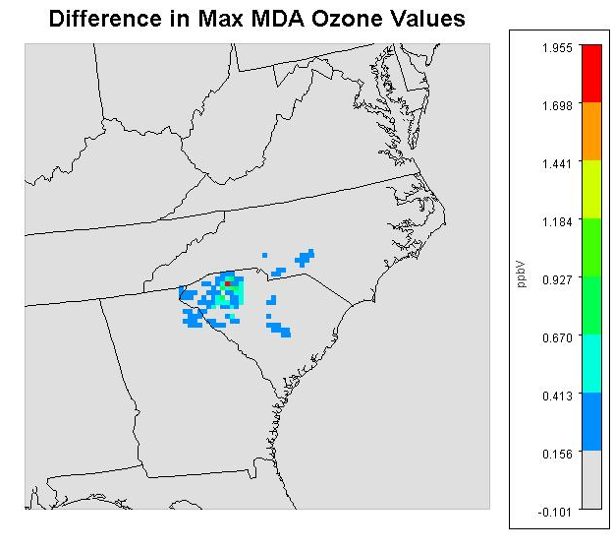
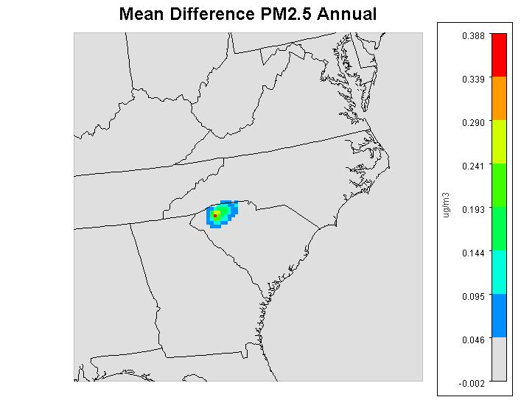
SC - Control Strategy Analysis Results
Max reduction in one cell of ~2 ppb
Most areas <1 ppb reduction (<1%)
Reductions 0.1 – 0.4 µg/m³ (~2%)

Slide 9
SC - Cost-Benefits Analysis
(Millions of 2010 Dollars)
Total Air Quality Benefits | PM_{2.5} | Ozone
Maximum Air Quality Change in any TATT County¹ | 0.251 µg m⁻³ | 0.106 ppb
Total Control Strategy Cost | $20
Total Benefits of Avoided Mortality and Morbidity (PM: Krewski-Lepeule; Ozone: Bell-Levy) | $92-210 | $3.2-4.4
Net Total Benefits | $75-280
Benefit-Cost Ratio | 3.8-14
¹The maximum change for PM_{2.5} is expected at Greenville County, SC;
the maximum change for ozone is expected at Spartanburg County, SC

Slide 10
SC - Lessons Learned
Local area perspective and expertise play a large role in successfully implementing any voluntary emissions reduction program.
Project allowed for knowledge transfer and feedback. TATT supports the development of tools and resources for local coalitions aimed at allowing them to easily understand the effect that certain activities will have on air quality and various pollutant levels. This analysis is helpful in determining whether programs (like Breathe Better at Schools) and their financial costs are supported by the likely outcomes.
When EPA and state partners work together closely, it’s possible to gather and use the detailed data needed for the benefits analysis.

Slide 11
SC - Overarching Conclusions
Implementing local control strategies in an area with a mix of sources is an important component of successful air quality management programs.
Improving air quality in areas already attaining the NAAQS can yield significant health benefits.
Control strategies that are implemented based on analyzing air quality and health data together result in a reduction of risk to certain populations in the area. As a result, there are cost savings and air quality improvement.
Reduction efforts to reduce precursors such as nitrogen oxides and other criteria pollutants will have a co-benefit in reducing risks from air toxics.
Mobile source reductions should be an area of focus for reduction strategies in the future.

Slide 12
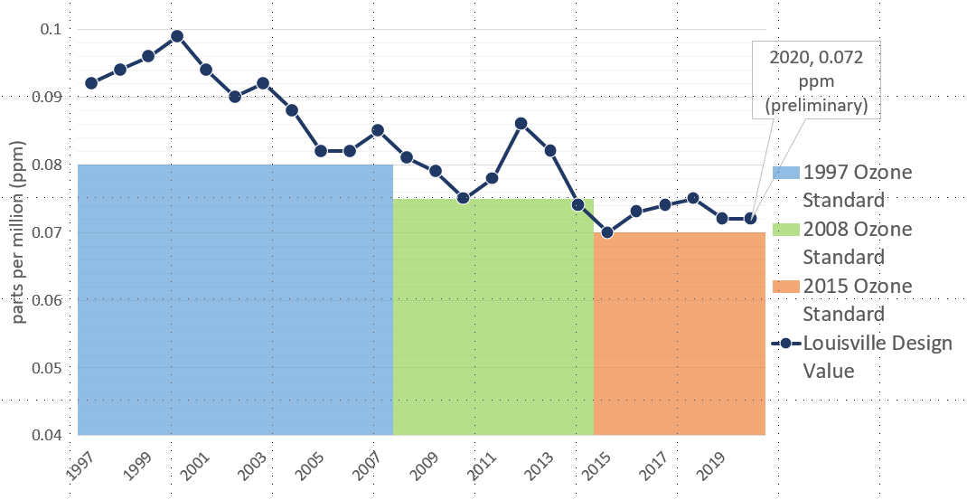
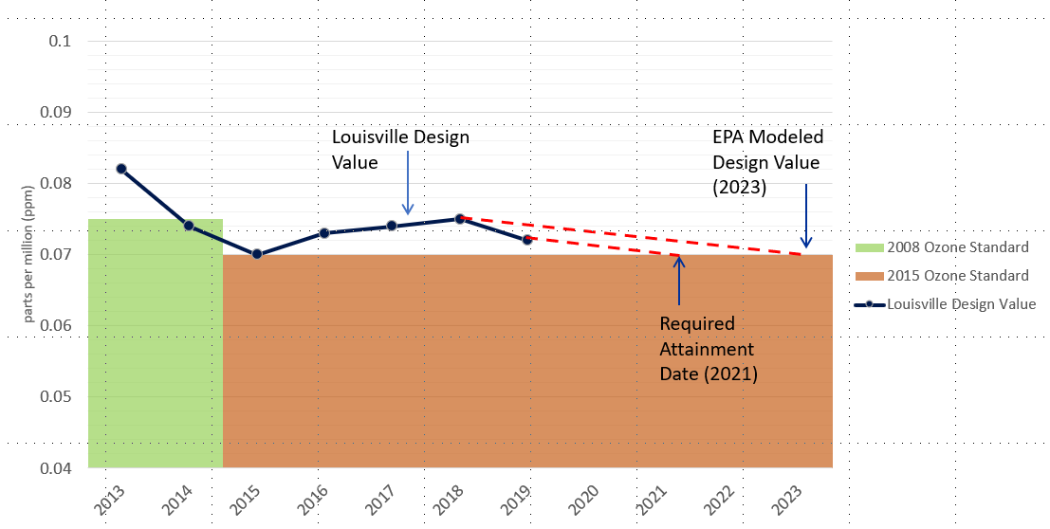
Louisville - Pollutant Concerns
Ozone
  Clean for 1997 NAAQS
  Advance for 2008 NAAQS
  Marginal nonattainment for 2015 NAAQS
    Attainment deadline August 3, 2021
Odors from VOCs
  Community complaints about odors in Rubbertown (industrial chemical area)
    EJ concerns as well
Graphics provided by LMAPCD

Slide 13
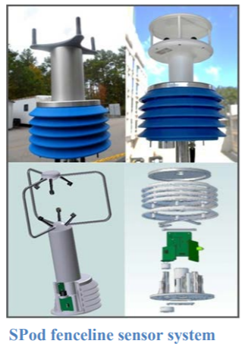
Louisville - ORD Projects
Rubbertown Next Generation Emission Measurement (NGEM) Demonstration Project¹
  R4 RARE Project
  SPod fenceline sensors evaluation
Citizen Science Regional Sustainability and Environmental Sciences (RECES) Project²
  Phone app for citizens to report odors
Regional State Innovation Projects³
  Odor VOC Emissions Tracker (oVET) combines fenceline VOC sensor, automated GC, & canister sampling to detect & locate fugitive odor causing air toxic VOC emission sources
¹ https://louisvilleky.gov/sites/default/files/air_pollution_control_district/documents/allother/2017/rubbertown_ngem_external_science_in_action_final_draft_090517.pdf
² https://louisvilleky.gov/sites/default/files/air_pollution_control_district/documents/allother/2018/community-leader-meeting-8-20-18-epa-citizen-science-project-odor-app.pdf
³ https://www.epa.gov/innovation/multi-component-voc-sensor-system-fugitive-emissions-and-odor-identification

Slide 14
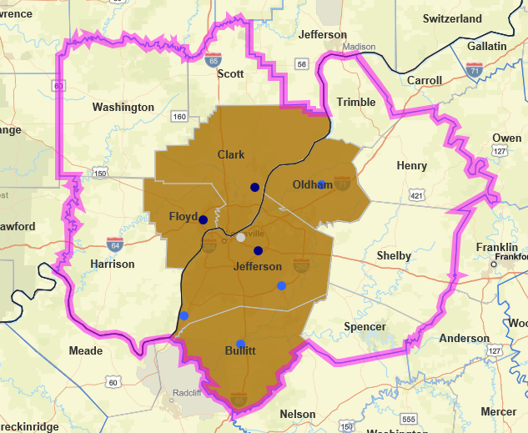
Louisville - O₃ Ambient Air Characterization
Graphic Created Using EPA NAAQS Dashboard
Multistate marginal O₃ NAA - KY/IN
12 county CBSA -- 5 counties marginal NAA for 2015 NAAQS
2015-2017 DVs:
  Jefferson, KY – 74 ppb
  Clark, IN – 71 ppb
  Floyd, IN – 71 ppb
2018 DV of 75 ppb
2019 DV of 72 ppb
2020 DV of 72 ppb (prelim)
Dark Blue – violating monitor
Light Blue – below NAAQS
White – no value
Adapted from Conceptual Model created by Gobeail McKinley

Slide 15
Louisville - Ozone Formation Study (OFS)
LMAPCD funded the OFS conducted by Ramboll
Goal: refine understanding of O₃ formation in Louisville / Jefferson Co. O₃ NAA to inform strategic policy decisions
Objectives:
  Develop comprehensive EI suitable for modeling O₃ formation
  Develop modeling tool useful for analyzing ozone formation processes
  Understand the sensitivity of Louisville O₃ to emissions precursors
Findings:
  Model-ready EI developed using data available to LMAPCD
  Model has acceptable performance for ozone
  When regional emissions reduced, Louisville/Jefferson County ozone is more NOx sensitive than VOC sensitive
    NOx emissions reductions decrease modeled ozone by 3.8 ppb in Jefferson County vs. 1.3 ppb for VOC emissions reductions¹
  On select days, ozone within Jefferson County has similar response to NOx and VOC emissions reductions
  ¹ Based on average of Top 10 days
  ² https://louisvilleky.gov/sites/default/files/air_pollution_control_district/documents/allother/2019/ramboll_mpsm_20191120_final.pdf

Slide 16
Louisville - BenMAP Results: Jefferson County, KY*
Retrospective Analysis
  Determined health benefits from PM_{2.5} reductions from 2014 to 2018
  1.67 µg/m³ change in Average Annual PM_{2.5} across Jefferson County
  73-165 avoided premature adult deaths/year (value of $635M - $1,440M, 2018$)
Rollback Analysis using Ramboll Results
  Total estimated health benefits from across-the-board reductions of VOCs and NOx by 25% (in 2018$)
    Sensitivity 1 NOx: $74 – 152 Million
      0.18 µg/m³ PM_{2.5} and 0.76 ppb O₃ reductions
    Sensitivity 2 VOC: $16 – 27 Million
      0.042 µg/m³ PM_{2.5} and 0.30 ppb O₃ reductions
Analysis completed by Ali Kamal / Chris Davis
*Additional details in Appendix Slides 25 - 27

Slide 17
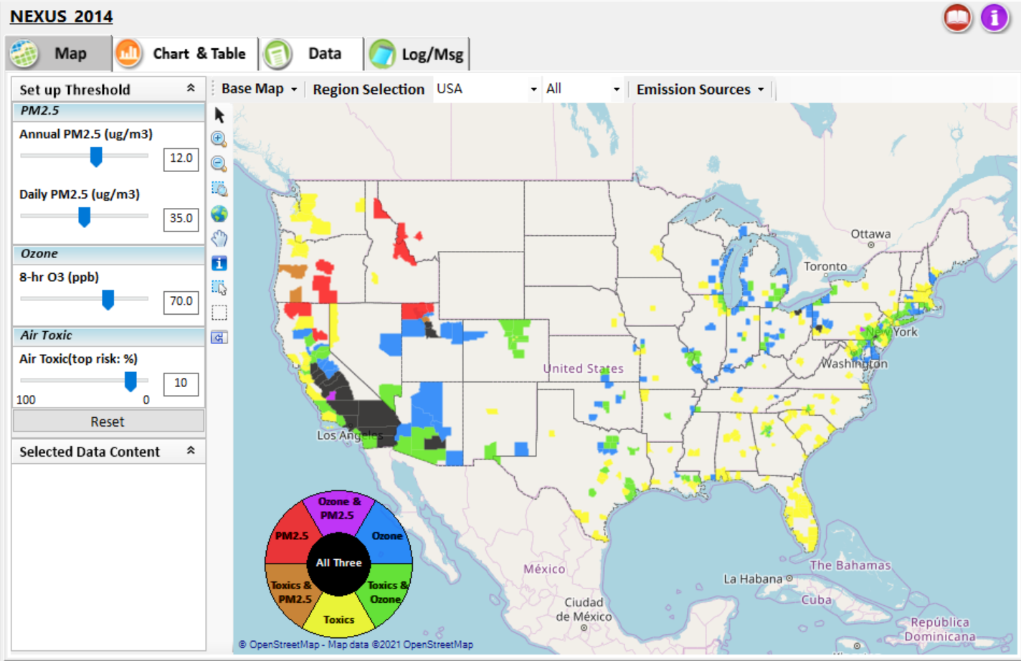
NEXUS - Tool Development
A new NEXUS Advanced Screening Tool is being developed to identify geographic areas where health risks related to O₃, PM_{2.5} and air toxics overlap and will be used to identify additional areas for MP collaboration

Slide 18
NEXUS - Expected Use
The NEXUS tool will allow users to do the following:
  National screening for areas with MP issues: Phase 1 development provides ability to quickly screen areas across nation that have combination of high air quality and/or risk levels for O₃, PM_{2.5} and Air Toxics.
  Area screening to understand nature of MP problem: Phase 2 development provides ability to ‘dial-into’ specific areas to determine extent to which common emissions sources are causing the MP issues.
We expect to use this tool to engage with Regions and identify areas that would potentially benefit most from MP approaches to reduce emissions (including current NA areas).
The NEXUS tool will essentially provide a ‘conceptual model’ of MP issues to facilitate engagement with state/local/tribal agencies and community stakeholder groups.
We also expect that it can have additional uses across the Office for Air Toxics, Environmental Justice and other programs.
18

Slide 19
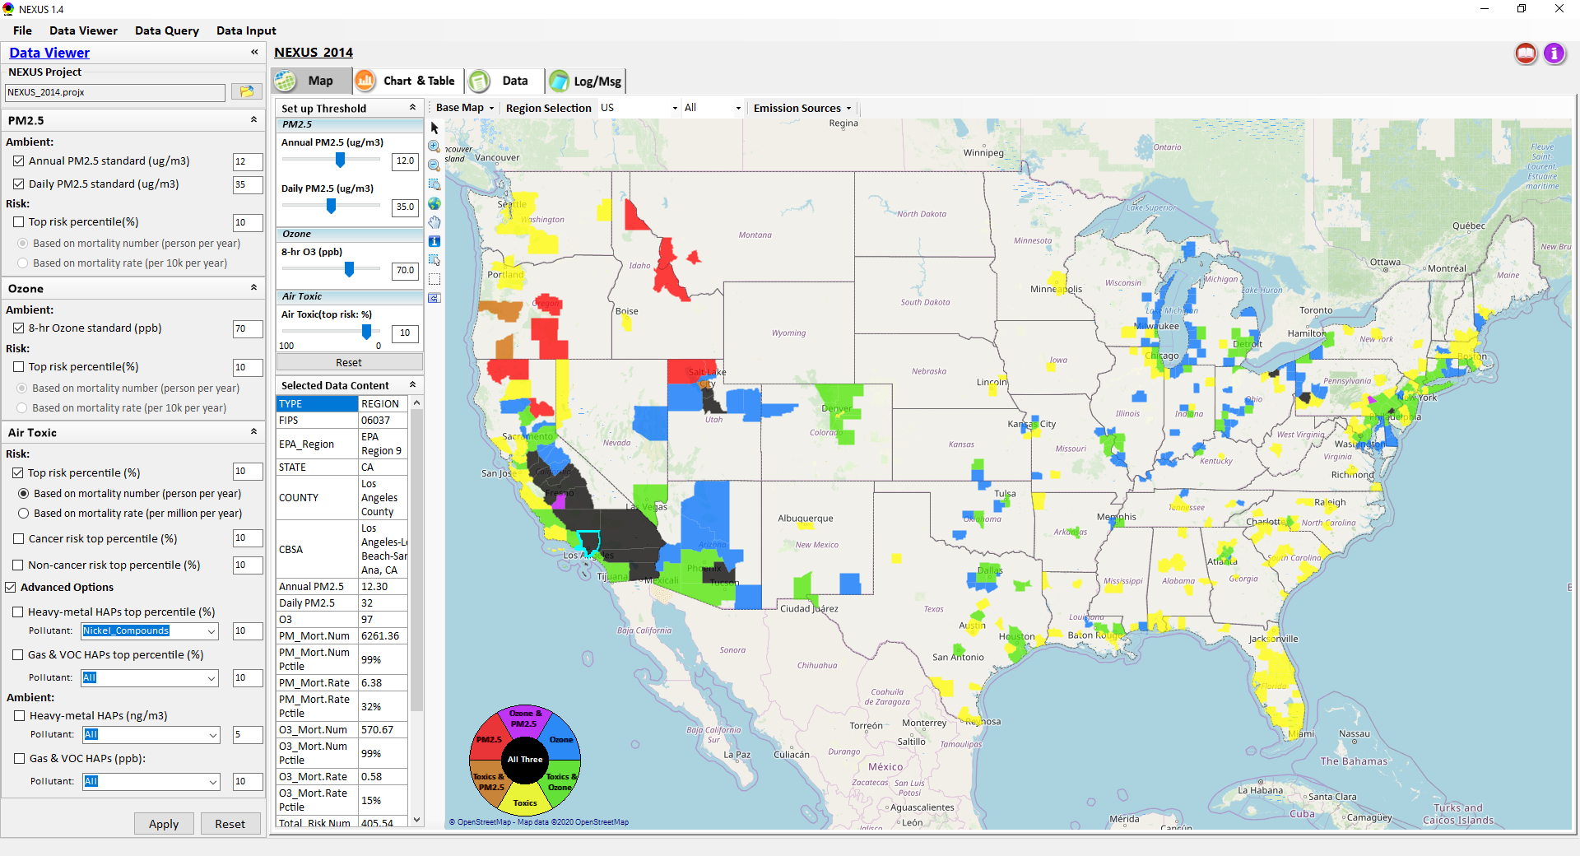
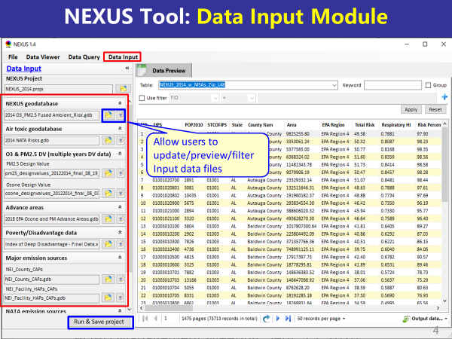
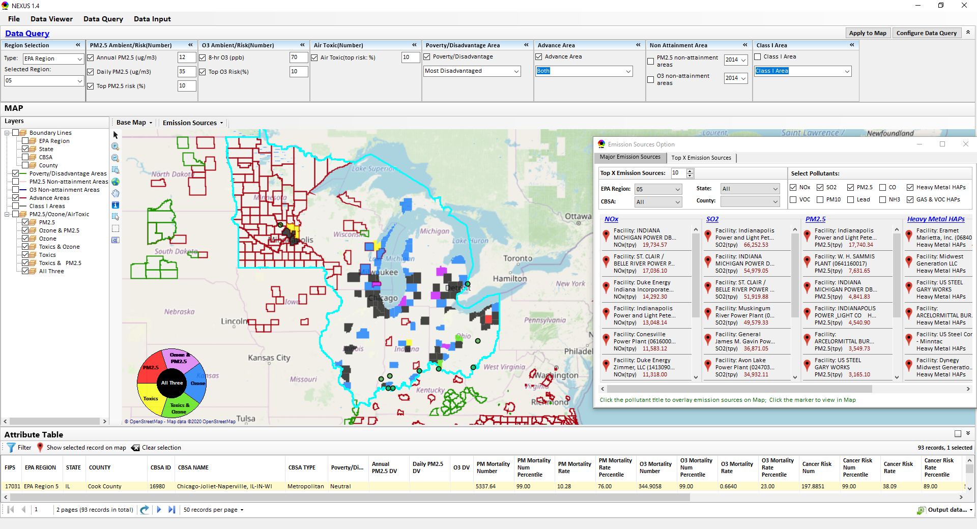
NEXUS - Three Key Modules
Data Viewer module
Data Input module
Data Query module
View and create interactive Map/Data/Chart/Table
Provide flexible selections & mapping of “Ambient” and/or “Risk” levels of PM_{2.5}, O₃ and Air Toxics
Provide regional analysis for “EPA region”, “States”, “CBSA”, and “County”
Link and display major emission sources locations & emitted pollutants info.
Expand data field selections and flexibility for exploratory/advanced users
Provide overlaying map and summary table for data query results
Current data query based on selected data fields: “Ambient/Risk, Advance area, Socio-demographic (EJ) area, NA Area, Class I area”
Allow to update & change input data files
Provide data preview and filter functions
Currently uses 10 publicly available input data files (~4GB)
Quick turnaround to run & save to a new “project” using new input data files
19

Slide 20
NEXUS - Examples
How can NEXUS be used to identify highest risk areas across O₃, PM_{2.5}, and Air Toxics, summarize the source(s) contributing to communities with possible EJ concerns, and review specific industrial sources for potential impacts?
  Example 1 → Detroit
How can NEXUS be used to identify the nature of multi-pollutant risks in Advance areas?
  Example 2 → Louisville
20

Slide 21
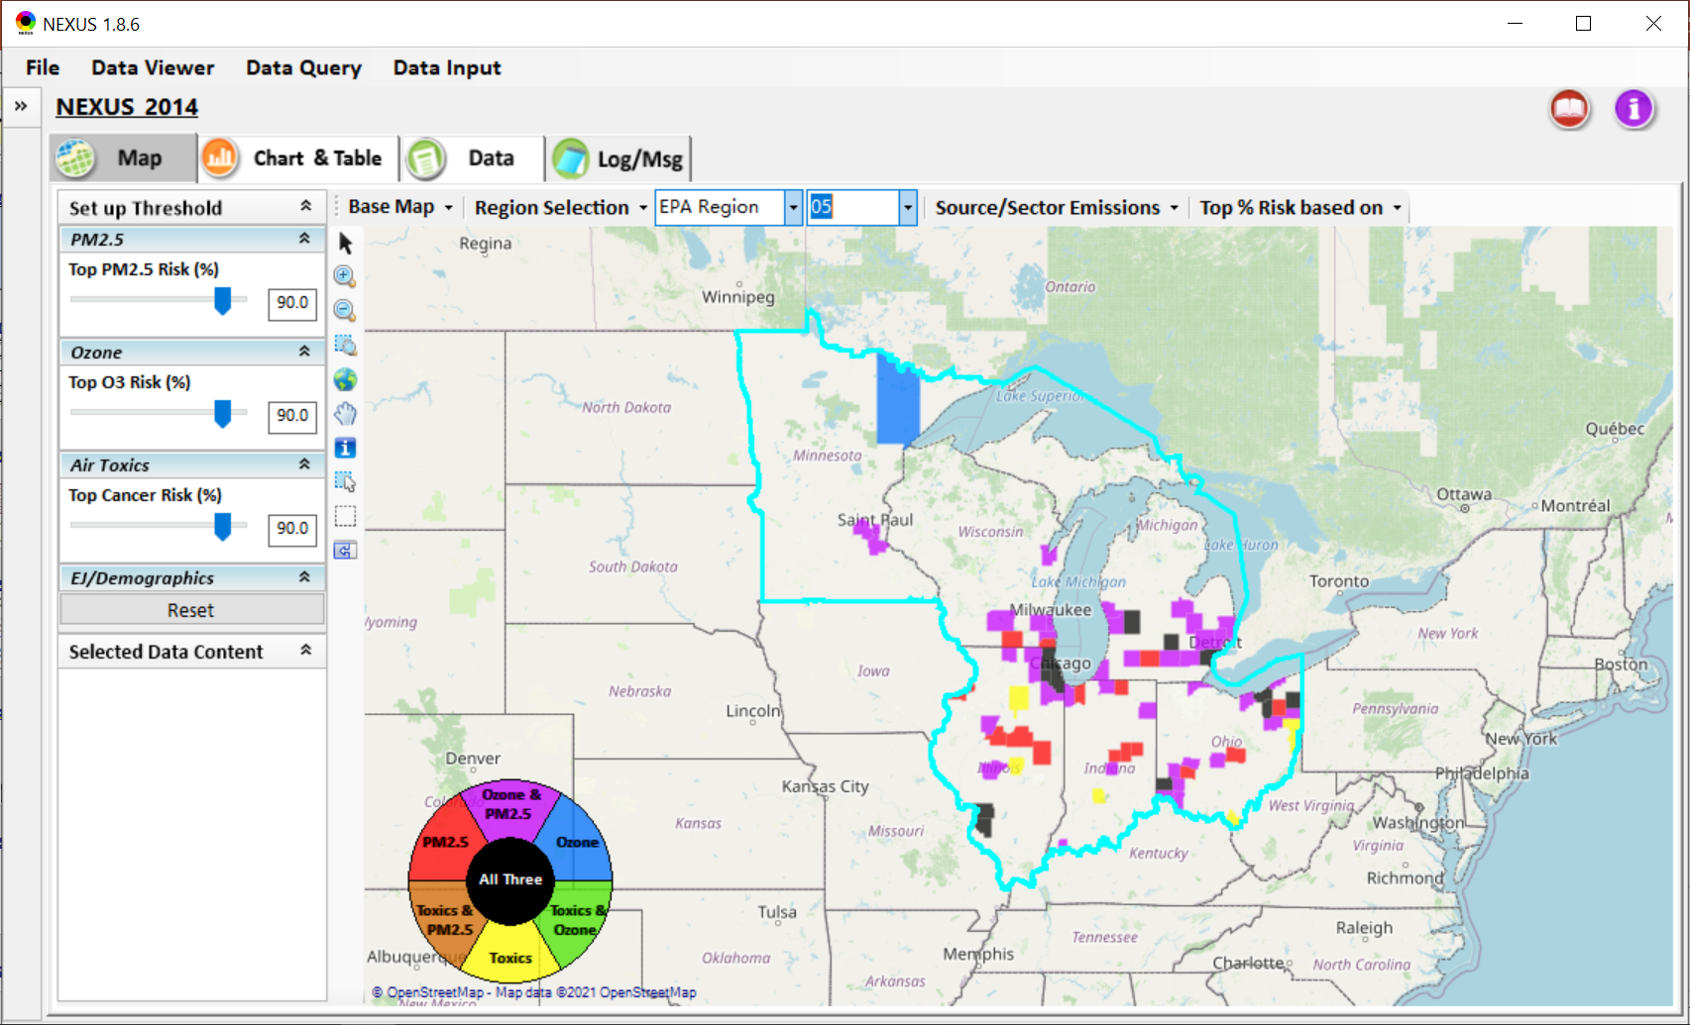
NEXUS – Detroit Example
NEXUS can be used to identify highest risk areas across O₃, PM_{2.5}, and Air Toxics.
Example map above is for Region 5

Slide 22
NEXUS - Highest MP Risk Areas in R5
(Data Query Module)
STATE | COUNTY | CBSA | Annual PM2.5 DV | Daily PM2.5 DV | O3 DV | PM Mortality Number% | O3 Mortality Number% | Cancer Risk Rate (max)%
IL | Cook County | Chicago-Naperville-Elgin, IL-IN-WI |  |  | 73 | 99.97 | 99.97 | 99.00
OH | Cuyahoga County | Cleveland-Elyria, OH | 11.7 | 25 | 70 | 99.78 | 99.53 | 97.00
IL | DuPage County | Chicago-Naperville-Elgin, IL-IN-WI |  |  | 70 | 98.73 | 97.70 | 99.00
MI | Wayne County | Detroit-Warren-Dearborn, MI | 11.2 | 28 | 73 | 99.91 | 99.84 | 95.00
MI | Kent County | Grand Rapids-Wyoming, MI | 9.1 | 25 | 68 | 97.92 | 96.71 | 99.00
IL | Lake County | Chicago-Naperville-Elgin, IL-IN-WI |  |  | 73 | 97.83 | 96.56 | 99.00
NEXUS can be used to identify highest risk areas across O₃, PM_{2.5}, and Air Toxics. Information above was generated in Data Query for Region 5 and exported into excel where rankings were applied.
Top CBSAs (using this approach) – Chicago, Cleveland, Detroit and Grand Rapids
Notes:
12 counties met criteria
Cook (Chicago)
Cuyahoga (Cleveland)
DuPage (Chicago)
Wayne (Detroit)
Kent (Grand Rapids)
Lake (Chicago)
Madison (St. Louis)
Summit (Akron)
Ingham (Lansing)
Butler (Cincinnati)
Trumbull (Youngstown)
St. Clair (St. Louis)

Slide 23
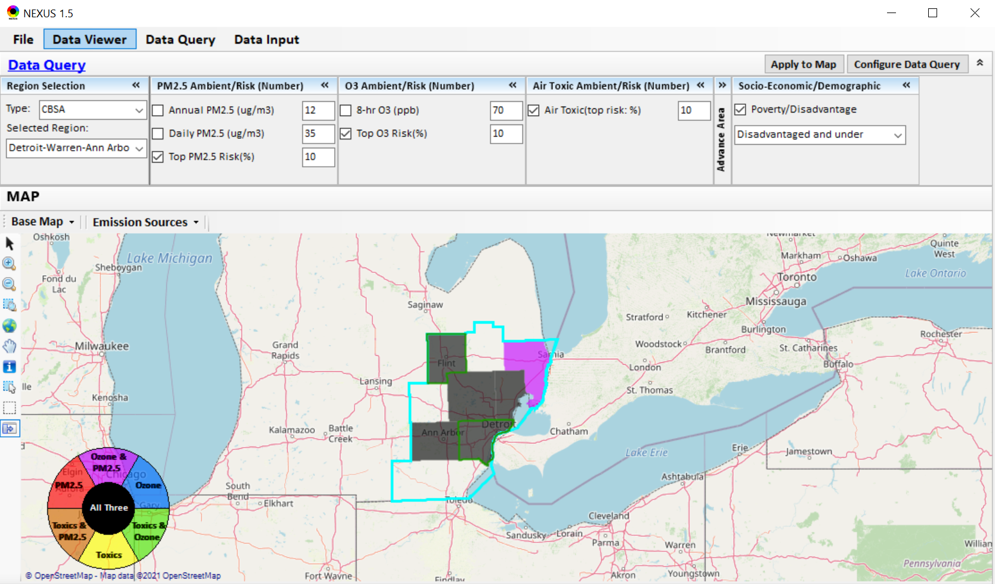
NEXUS - Detroit CBSA
NEXUS can be used to explore CBSAs with multi-pollutant concerns. This information was generated in Data Viewer for the Detroit CBSA. Two counties (Wayne & Genessee) are outlined in green, showing that they are “disadvantaged or under”. Let’s explore where the major sources are located in the CBSA…
23

Slide 24
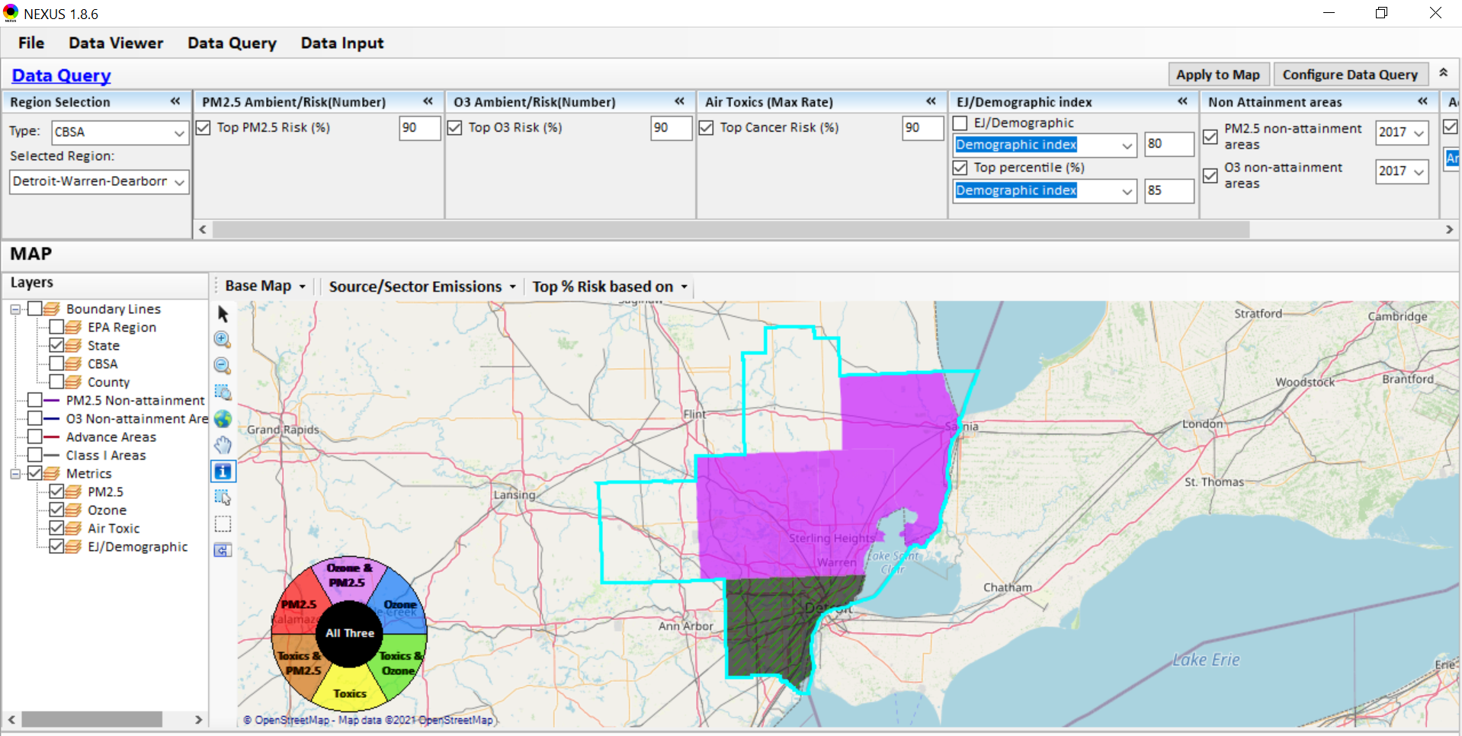
NEXUS - Detroit CBSA
NEXUS can be used to explore CBSAs with MP concerns. This information was generated in Data Query for the Detroit CBSA. Wayne County has dashed green lines, showing that the demographic index percentile is ≥ 85%. Let’s see where the major sources are located…

Slide 25
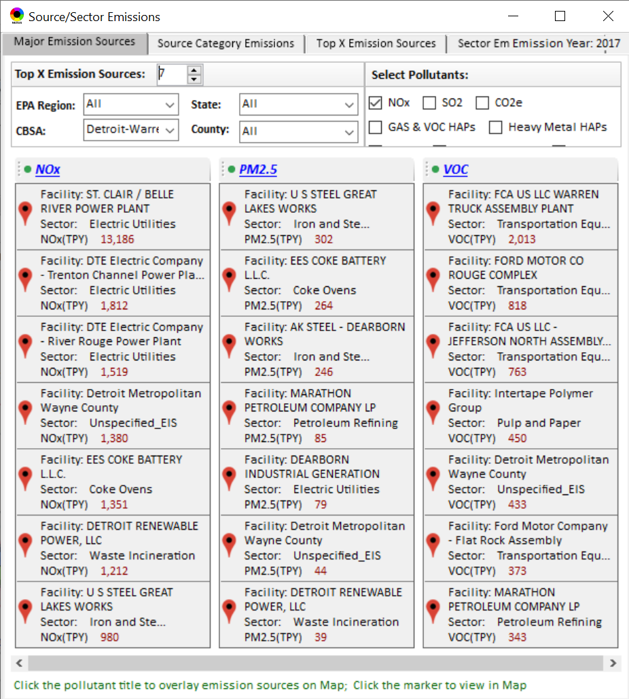
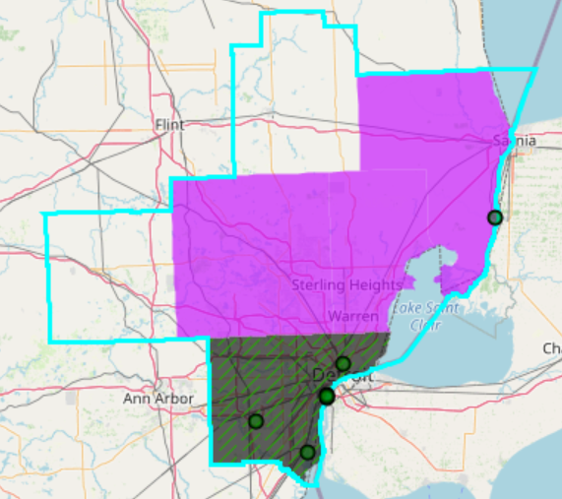
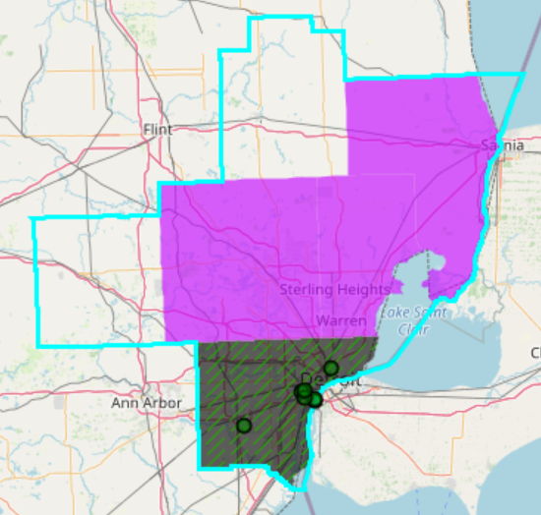
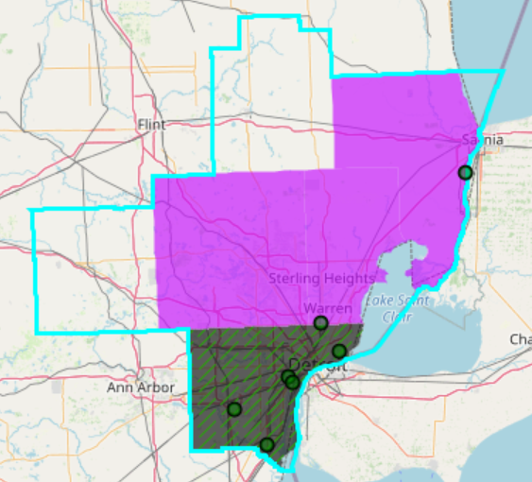
NEXUS - Emissions Sources in Detroit CBSA
Top NOx Emission Sources
Top PM_{2.5} Emission Sources
Top VOC Emission Sources
NEXUS can be used to identify top emission sources. The information above was generated in Data Query for the Detroit CBSA . We can quickly see that the majority of the NOx, PM_{2.5} and VOC & emission sources are located in Wayne County. Let’s explore the Wayne County sources further…

Slide 26
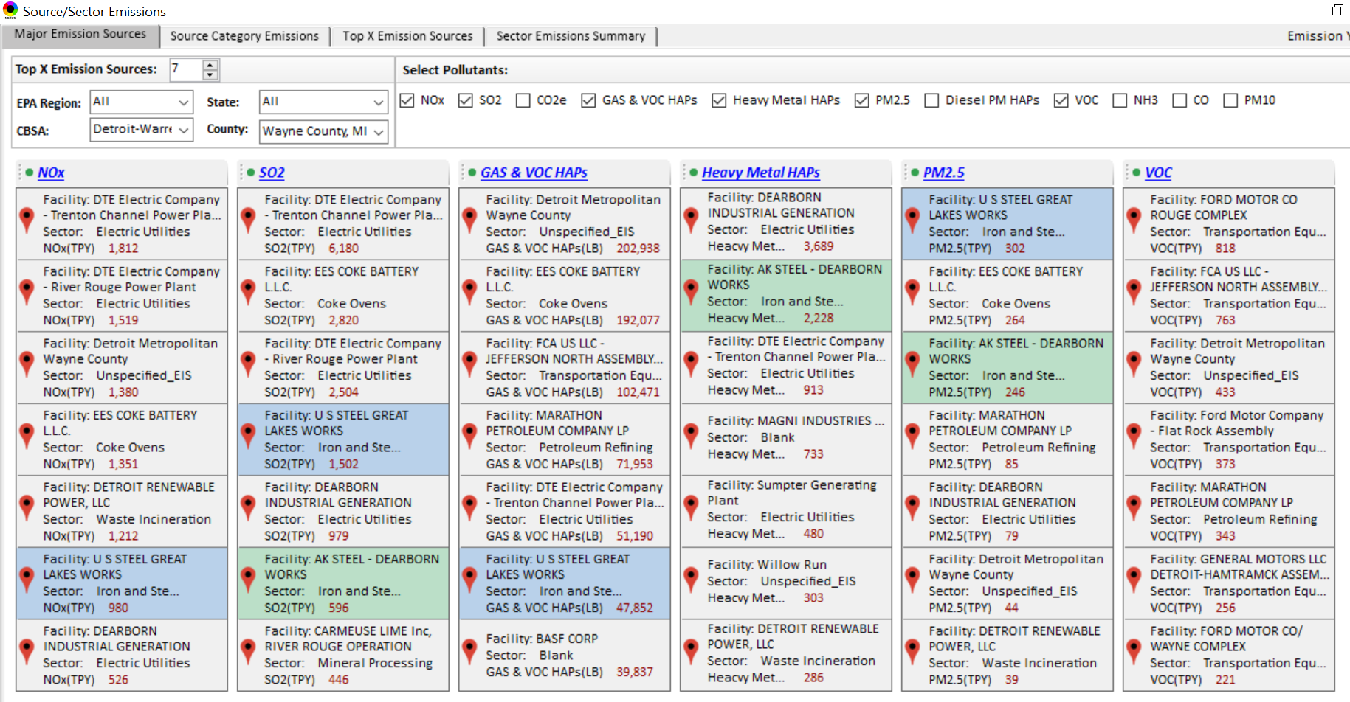
NEXUS Tool - Emissions Sources in Wayne County
NEXUS can be used to identify top emission sources. The information above was generated in Data Query for Wayne County, MI. This can help identify the potential co-benefits of controls. Let’s explore AK Steel and US Steel further...

Slide 27
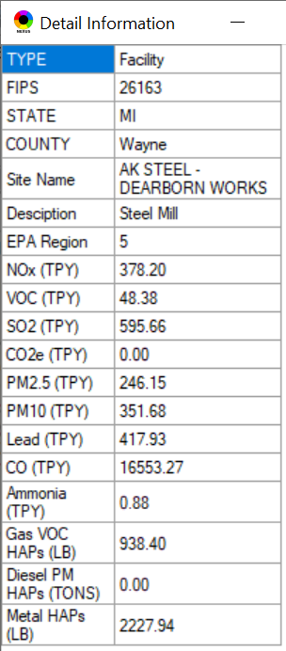
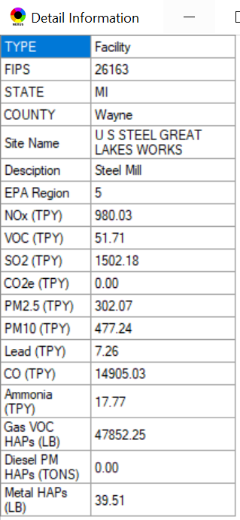
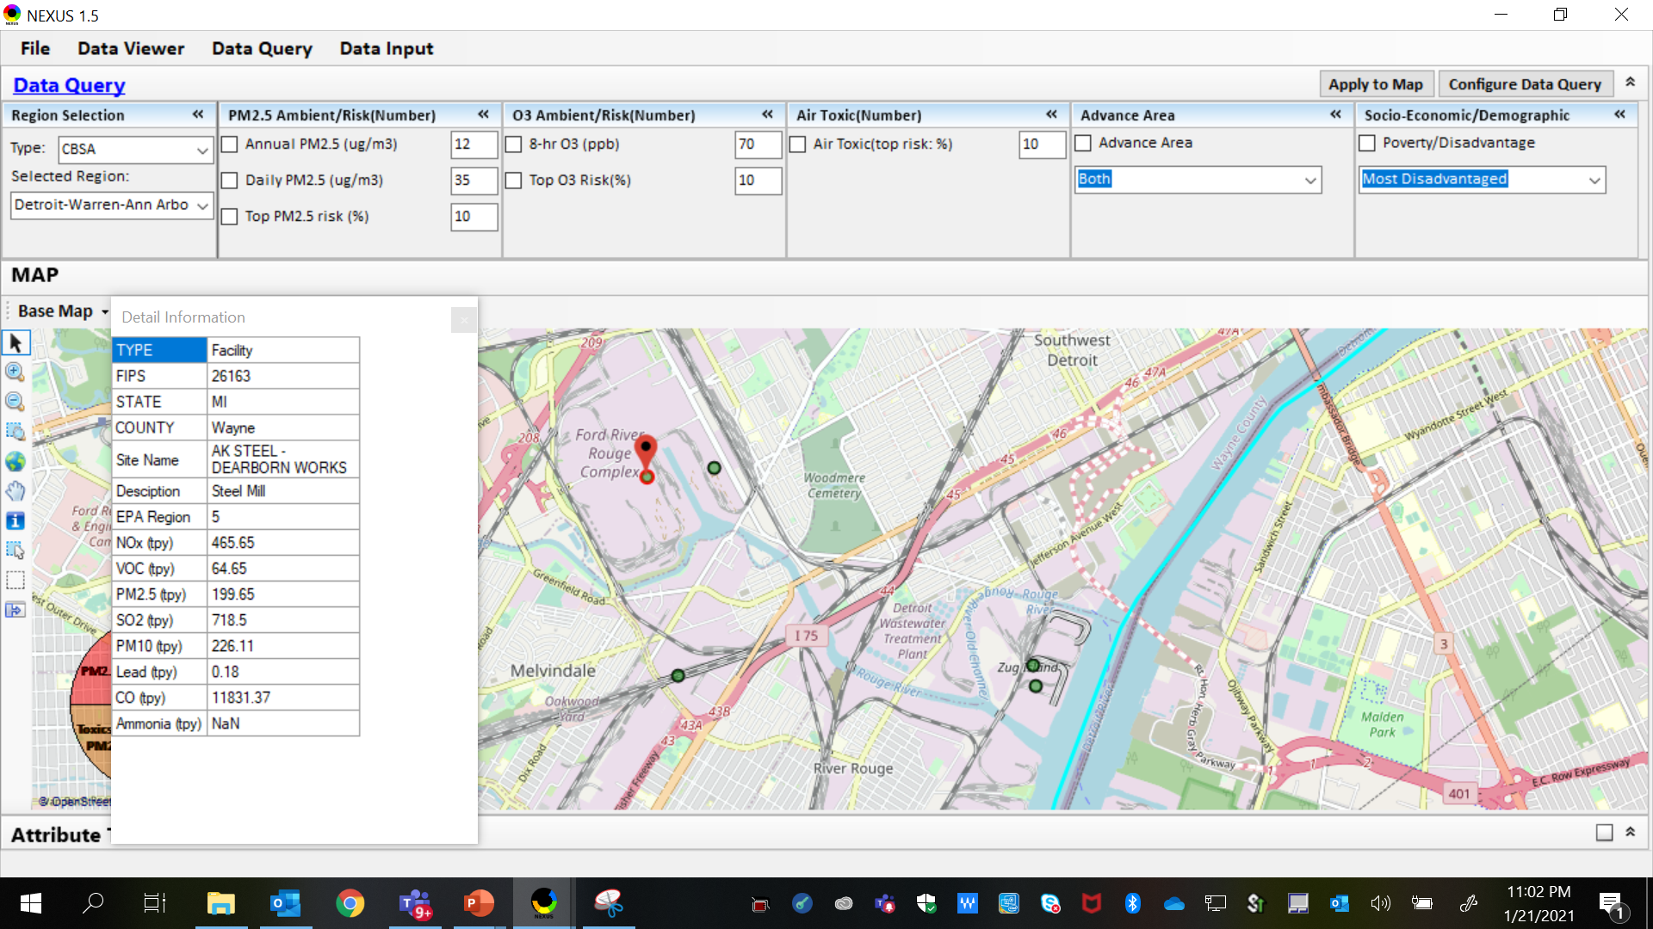
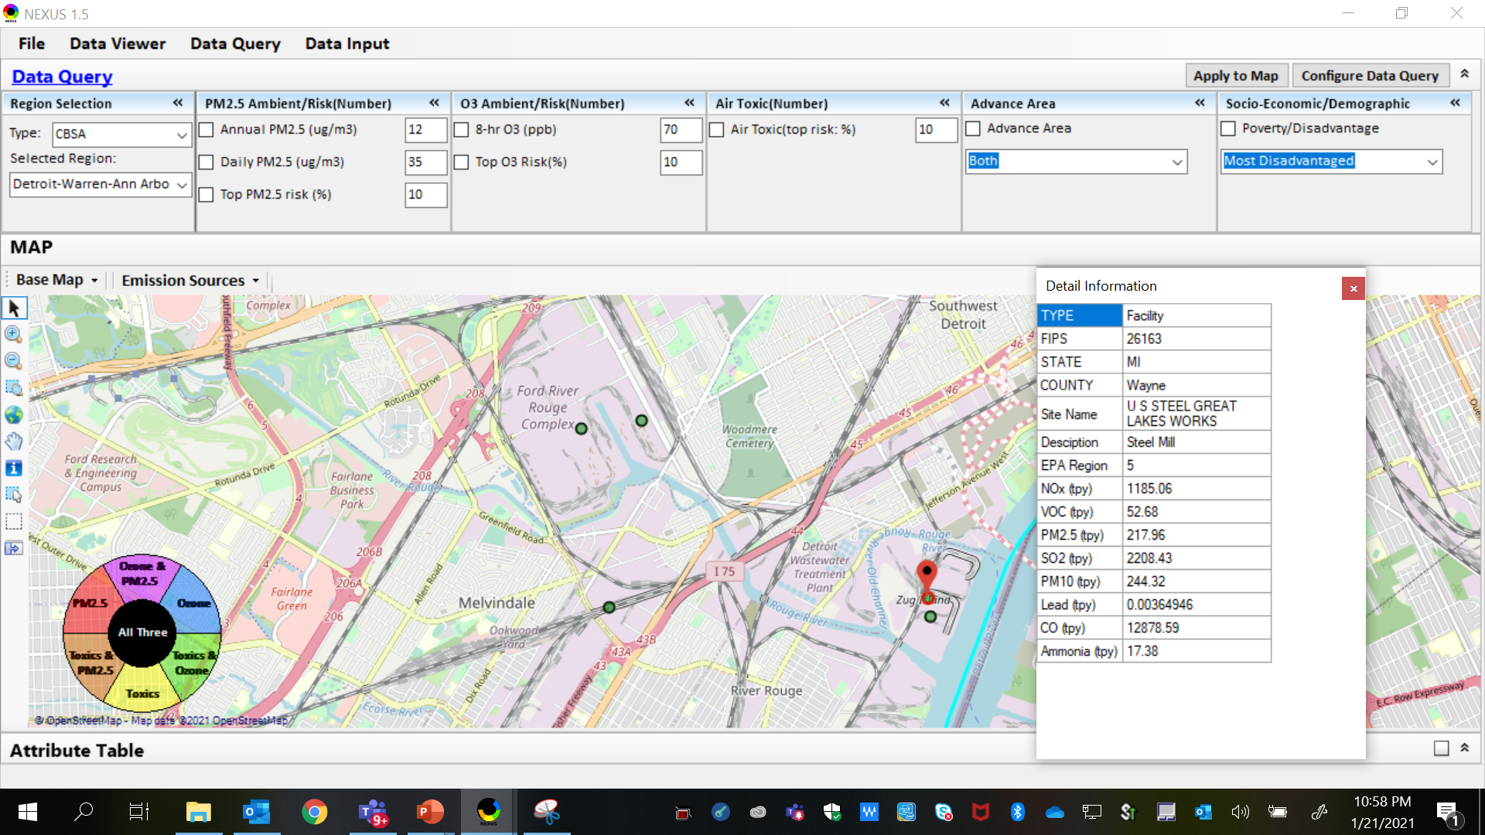
NEXUS Tool - Steel Mills in Wayne County
AK Steel & US Steel were identified as top emitters for NOx, SO₂, Gas and VOC HAPs, Heavy Metal HAPs and PM_{2.5}, highlighting the potential co-benefits of controls in these steel mills. The above map was generated in NEXUS Data Query. Let’s see the proximity of these steel mills to communities with potential EJ concerns…
AK Steel
US Steel
27

Slide 28
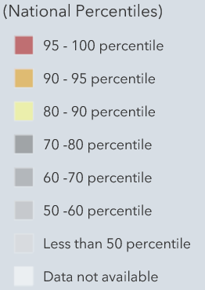
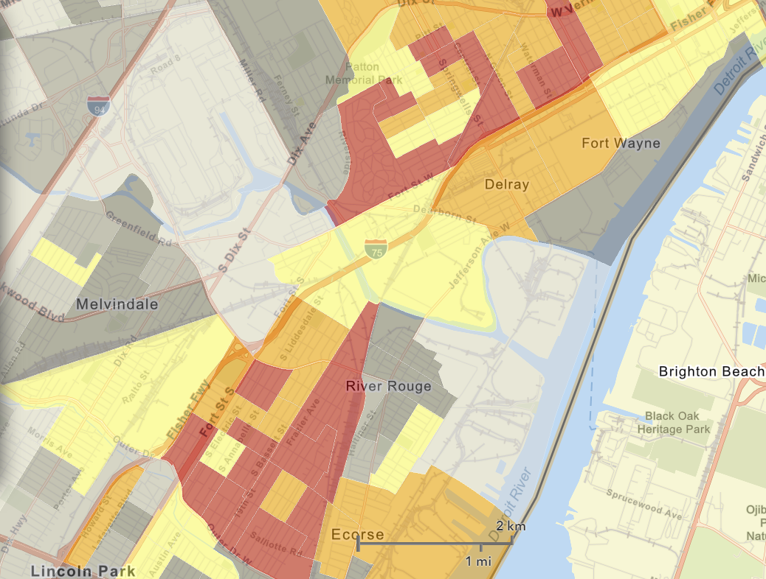
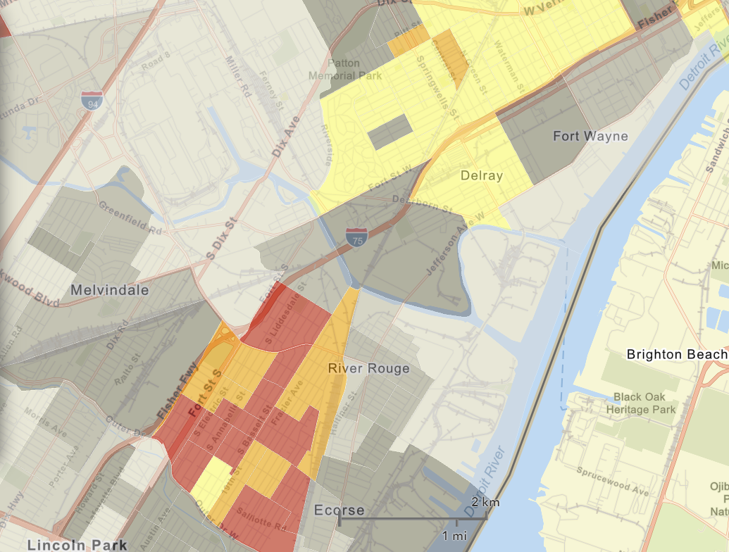
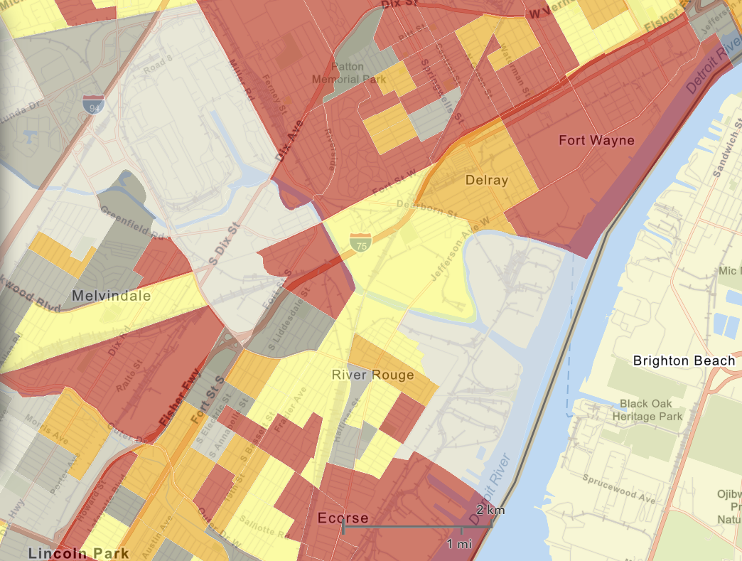

NEXUS Tool - EJ Indices in Wayne County
NEXUS Map
NEXUS can determine the presence or absence of environmental justice concerns in communities in areas with MP concerns. We are incorporating additional EJ metrics such as the data inputs below from EJSCREEN. These indices show the close proximity of AK Steel & US Steel to EJ communities.
AK Steel
US Steel
EJSCREEN Demographic Index
EJSCREEN People of Color Population
EJSCREEN Low Income Population
28

Slide 29
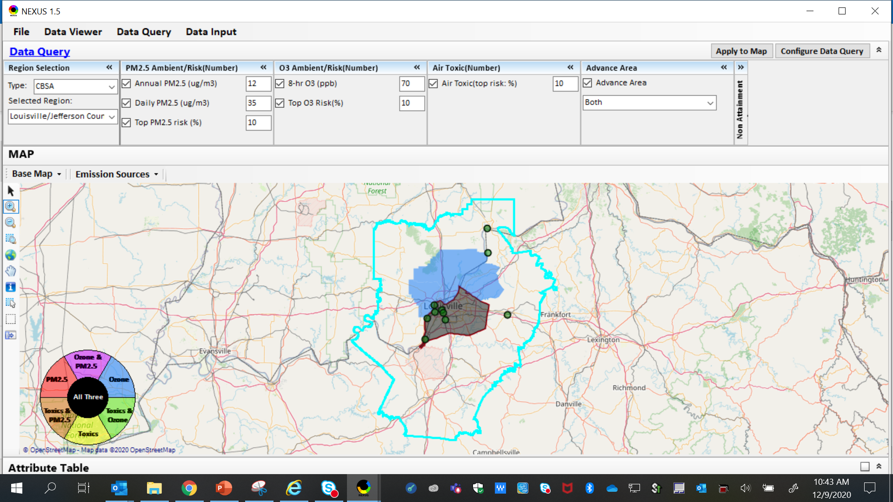
NEXUS Example - Louisville
The map above was generated for the Louisville/Jefferson County - Elizabethtown - Madison, KY-IN CBSA (2014 O₃ NAA), using the data query module. The top 10 Gas & VOC HAPS emission sources are identified.
29

Slide 30
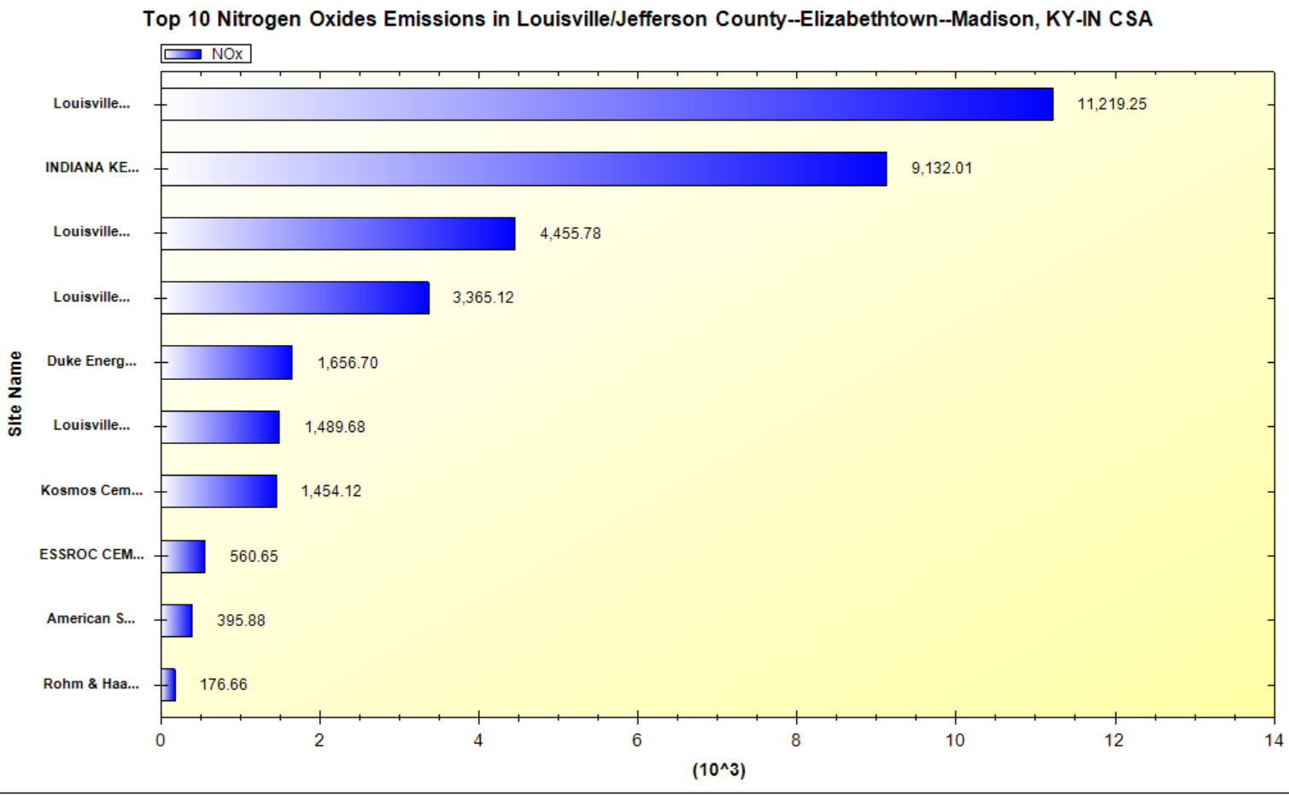
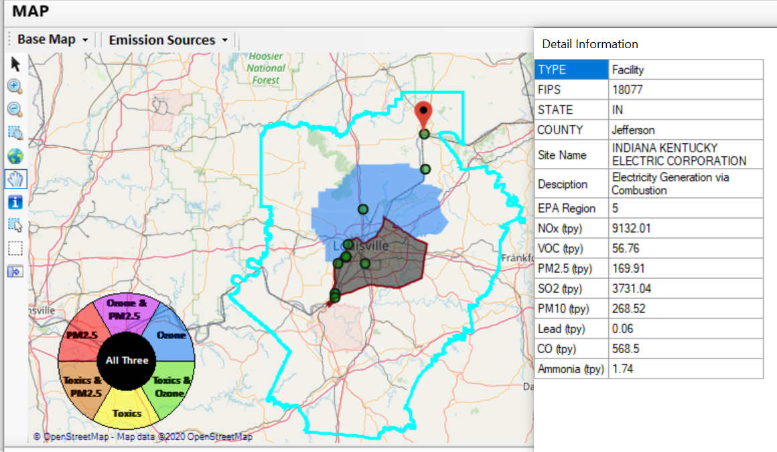
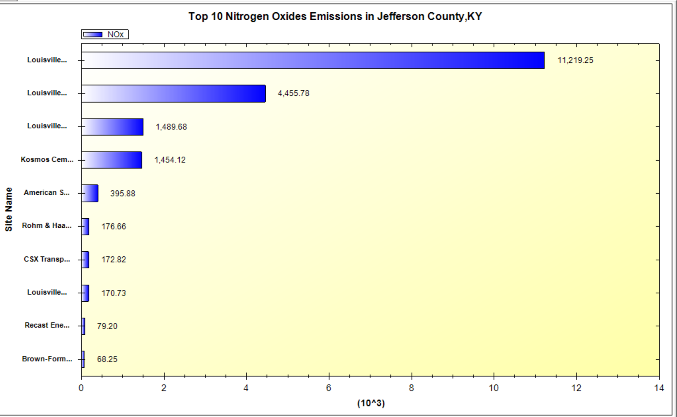
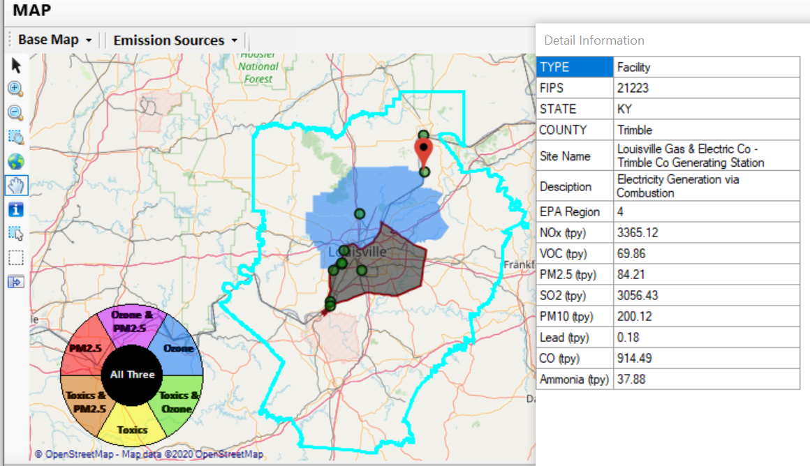
NEXUS Example - Louisville
2 of the top 4 NOx emission sources outside Jefferson County, KY (Jefferson County, IN & Tremble, KY)
30

Slide 31
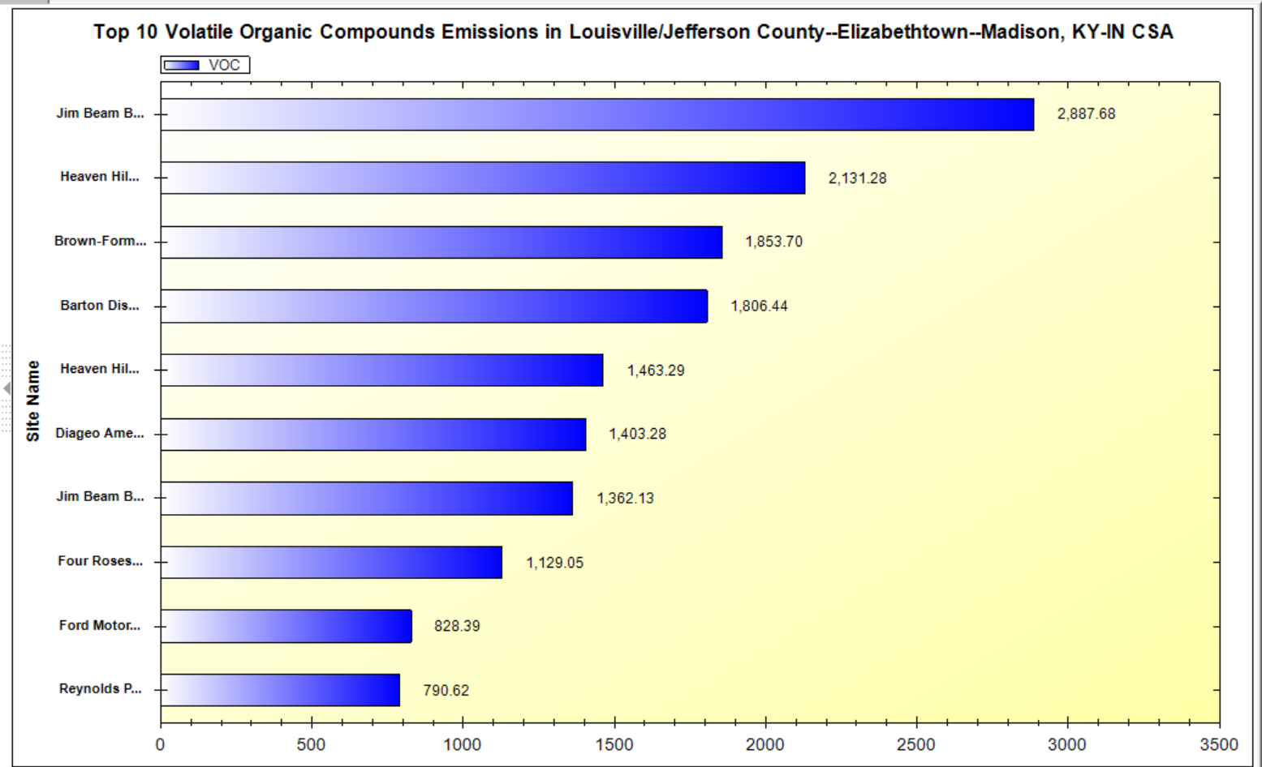
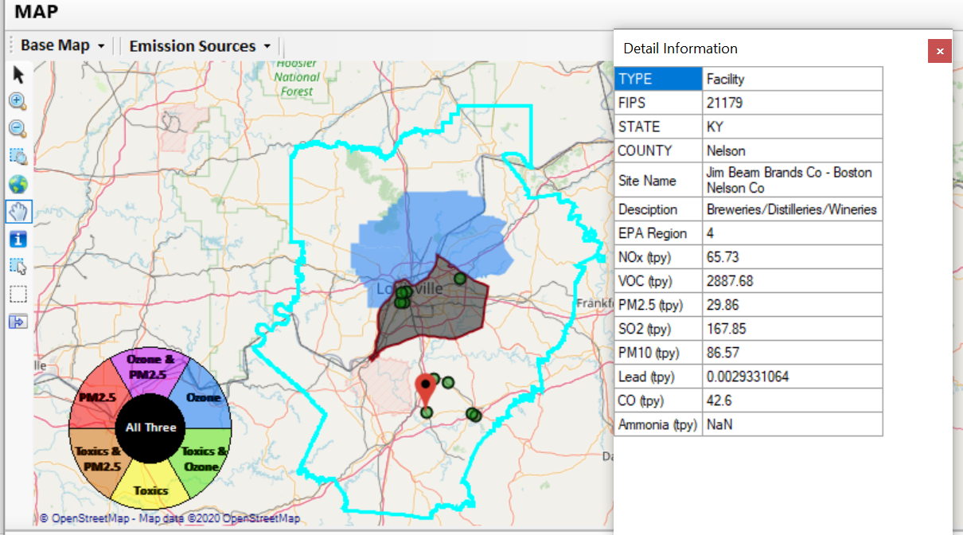
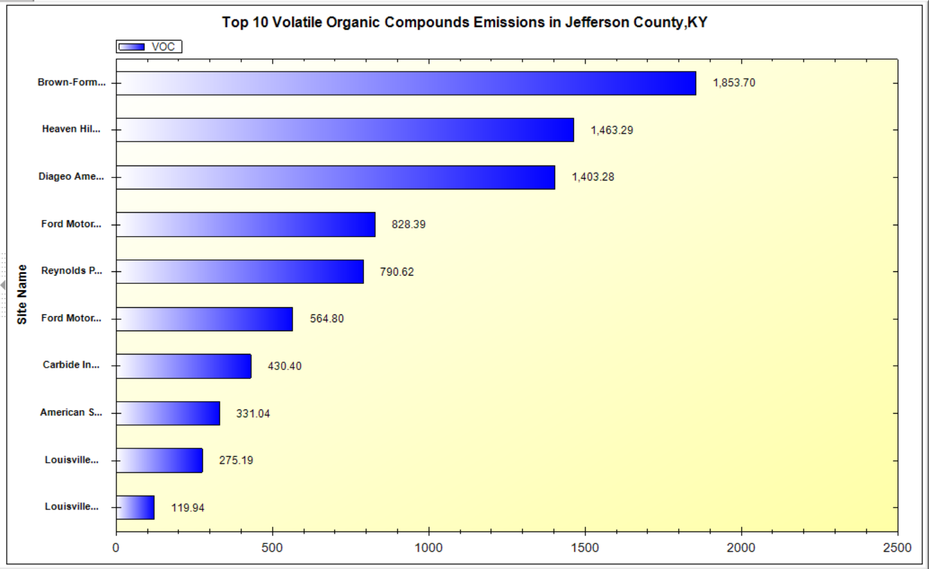
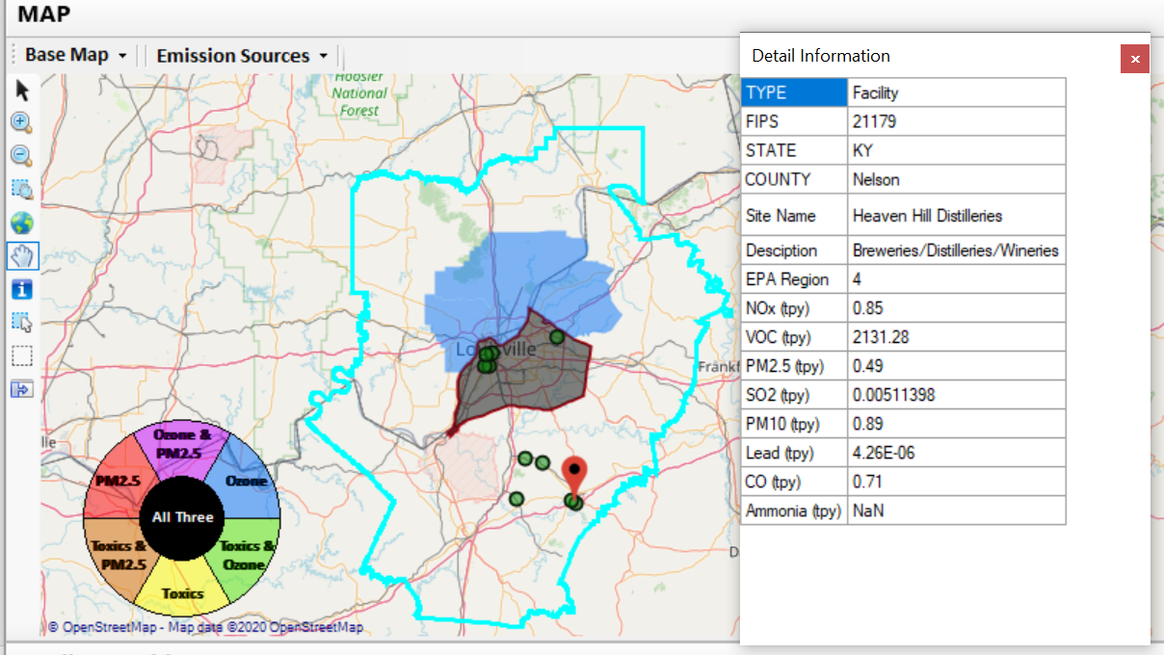
NEXUS Example - Louisville
Top 2 VOC emission sources are in Nelson County, KY
31

Slide 32
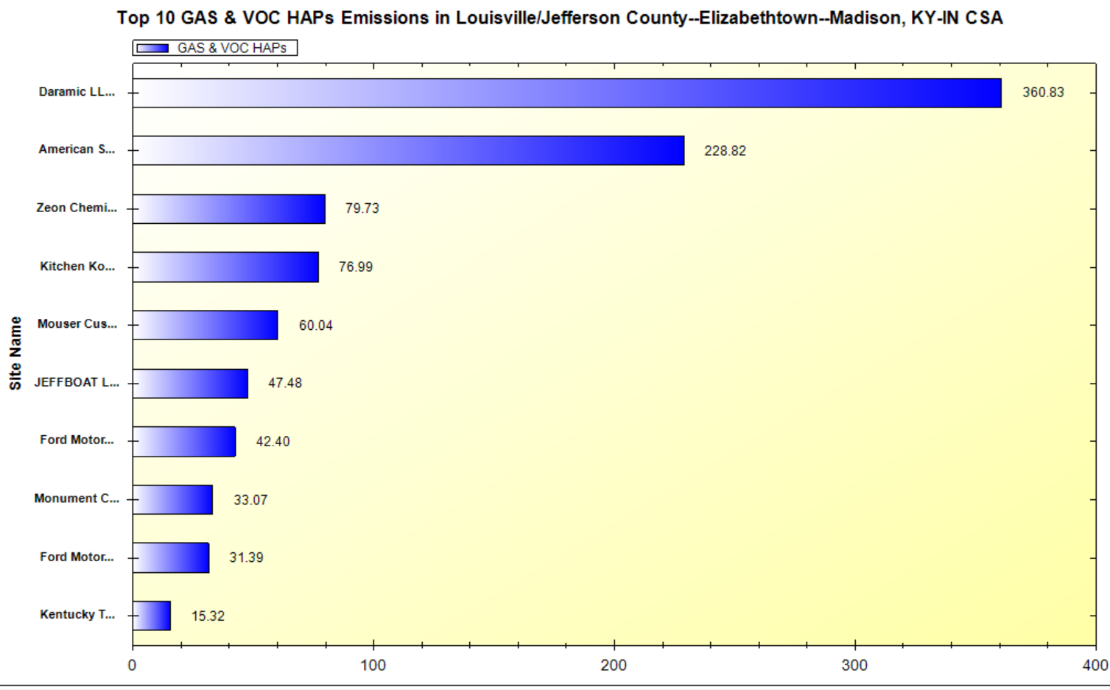
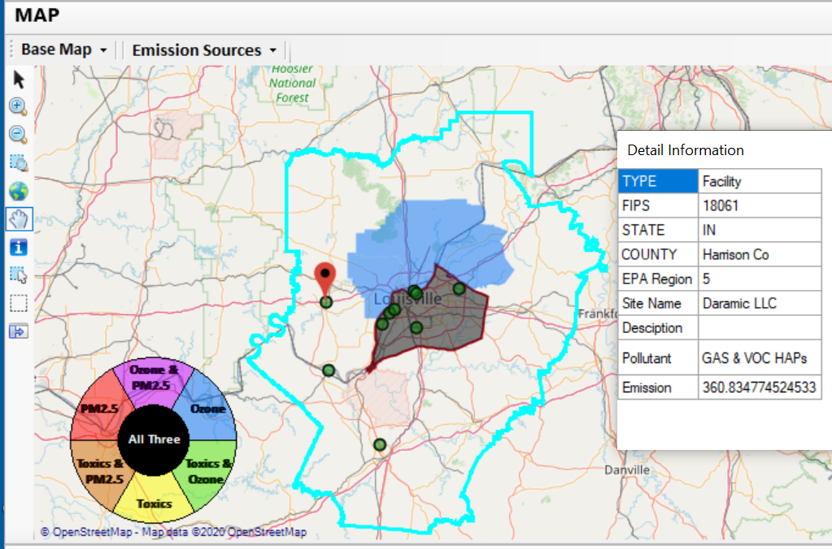
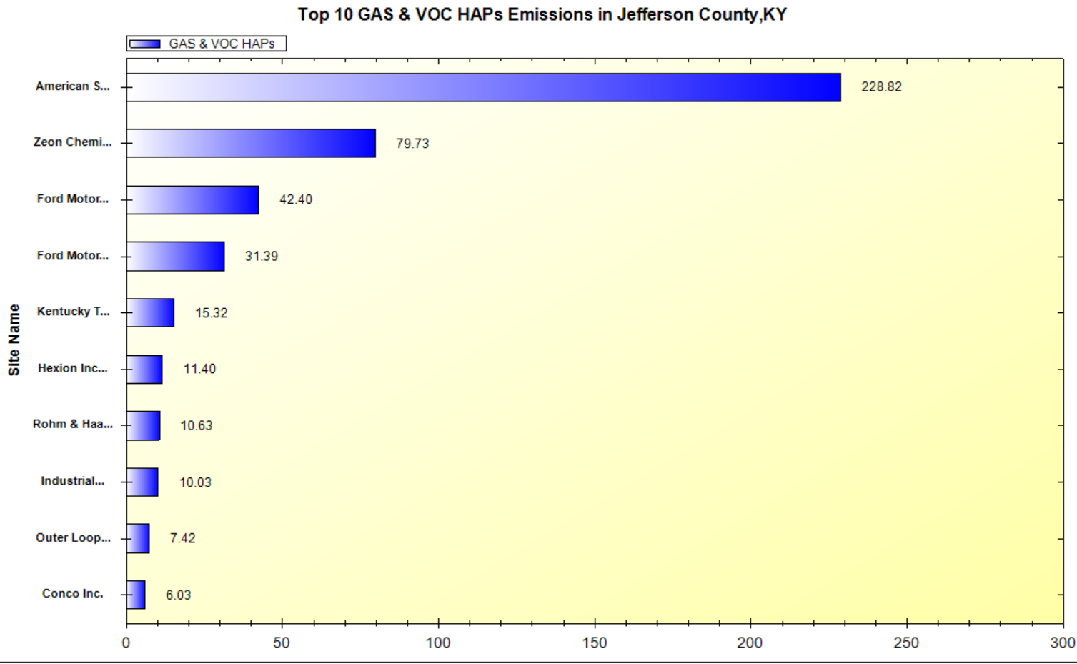
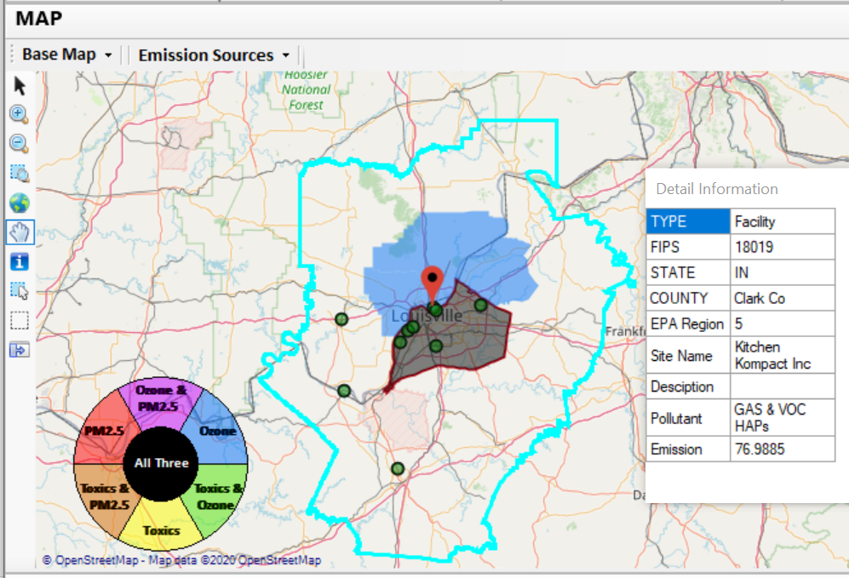
NEXUS Example - Louisville
2 of the top 4 gas & VOC HAPs emission sources in Indiana (Harrison & Clark County)
32

Slide 33
NEXUS & EJSCREEN
  EJ Layers
    Hazardous waste
    EJ Grants
    Water features
    Places
    Schools & Parks
    Transportation
    Boundaries
    Prisons
    Public Housing
    Subsidized Housing
    Climate
    Sites reporting to the EPA
    Superfund (NPL)
    RSEI
  Environmental Indicators
    Wastewater Discharge Indicator
    Hazardous Waste Proximity
    Superfund Proximity
    Lead Paint Indicator
    Traffic Proximity
    RMP Proximity
EJ Layers
Tribal Areas
Nonattainment Areas
  Environmental Indicators*
    NATA Respiratory HI
    NATA Cancer Risk
    NATA Diesel PM
    Ozone Model Concentrations
    PM_{2.5} Model Concentrations
Demographic Indicators
    People of Color Population
    Less Than HS Educated
    Low Income Population
    Linguistically Isolated
    Demographic Index
    Under Age 5
    Over Age 64
Ozone and PM_{2.5}
Emissions and source data
Risk data
Monitoring data
Air Toxics
Emissions and source data
Modeled concentration data
Risk data
Monitoring data
GHG emissions
*Provided to OEJ by OAQPS (AQAD & HEID)
33

Slide 34
NEXUS & EJSCREEN
NEXUS specifically designed for AQ planning: overlays publicly available air quality information to identify geographic areas where health risks related to O₃, PM_{2.5} and air toxics overlap
EJSCREEN specifically designed for EJ screening: combines environmental & demographic data to highlight areas where vulnerable populations may be disproportionately impacted by pollution
NEXUS contains air data not available in EJSCREEN: detailed emissions and source characterization, O₃ and PM_{2.5} risk data, NATA cancer and non-cancer risk by pollutant and source)
NEXUS relevance for OAQPS EJ screening and outreach efforts: By incorporating EJ indicators and data from EJSCREEN, it can highlight the nature of multi-pollutant AQ issues for communities with EJ concerns
Enhanced NEXUS screening capabilities: We plan to update NEXUS to incorporate proximity screening capabilities similar to EJSCREEN & the OAP/CAMD tool
34

Slide 35
NEXUS - Recent Upgrades & Improvements
NEXUS “1.5” → “1.8.6”
  New/revised Metrics (Air Toxics, PM_{2.5}, O₃ & EJ)
  New/updated data inputs and functions:
    EJ/Demographic data (from EJSCREEN)
    Tribal areas & Advance areas
    2017 emissions data (including GHG & sector mapping) (updated from 2014)
  “Source & Sector” emissions summary to support “Sector prioritization” effort
  “Source Category” emissions analysis (point, non-point, road, non-road, event)
  Complete EPA region “Table Generator”
  Upgrade “Data Query” module & “Data Input” module
35

Slide 36
Multi-Pollutant Team
Next Steps
Louisville
  Refine BenMAP analysis
  Determine control strategies
  Develop MP AQMP
NEXUS
  2017 fused PM_{2.5} & O₃ and risk data (Aug.) and 2017 fused air toxic and risk data (Nov/Dec)
  Include Monitoring sites/data (PM_{2.5} & O₃ first, then AT) (Sept/Oct)
  Develop prototype for “Proximity and spatial analysis for MP risks and EJ” module (TBD)
Based on Office wide engagements, use updated NEXUS tool to inform Multi-pollutant, Air Toxics, NAA/Advance controls, and EJ efforts as appropriate
Incorporate climate into MP process
Use NEXUS to develop packets for regions regarding MP areas of concern

Slide 37
Multi-Pollutant Team
MP Team Members
HEID
  Beth Landis / Kimber Scavo
  Robin Langdon / Darryl Weatherhead
  Matt Woody/ Kelly Rimer
  Sara Terry
  Carrie Wheeler
  Ben Gibson
  Rob Pinder
  Scott Voorhees
  Chris Davis
AQPD
  Rich Damberg / Megan Brachtl
AQAD
  Carey Jang / Tyler Fox
  Jim Kelly
  Joe Mangino
  Jeanette Reyes
OID
  Amanda Kaufman
  James Payne
SPPD
  Lisa Conner

