Slide 1
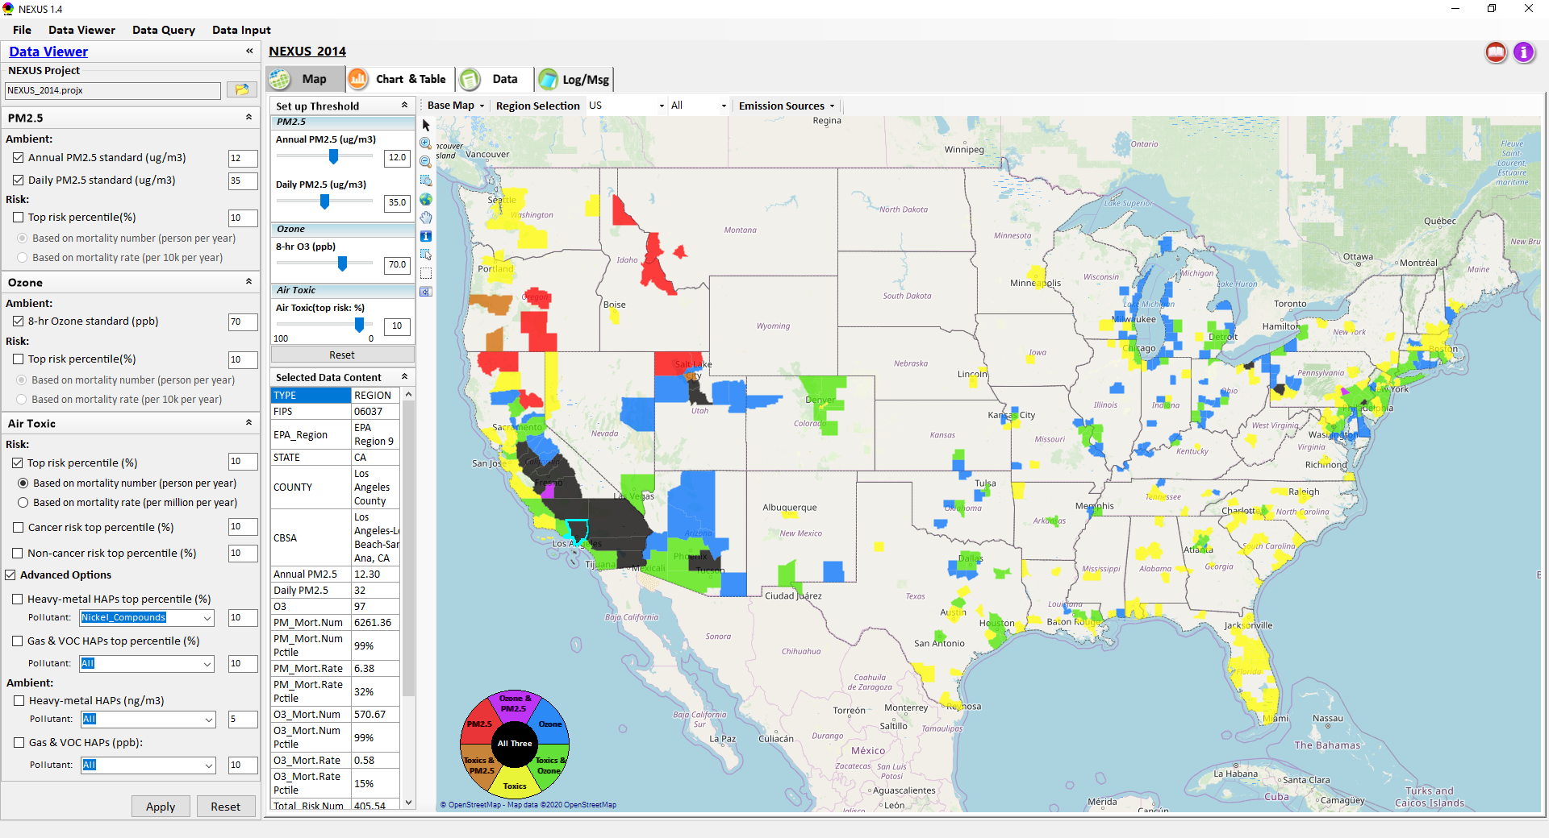
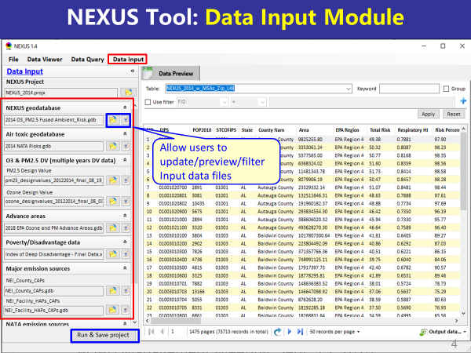
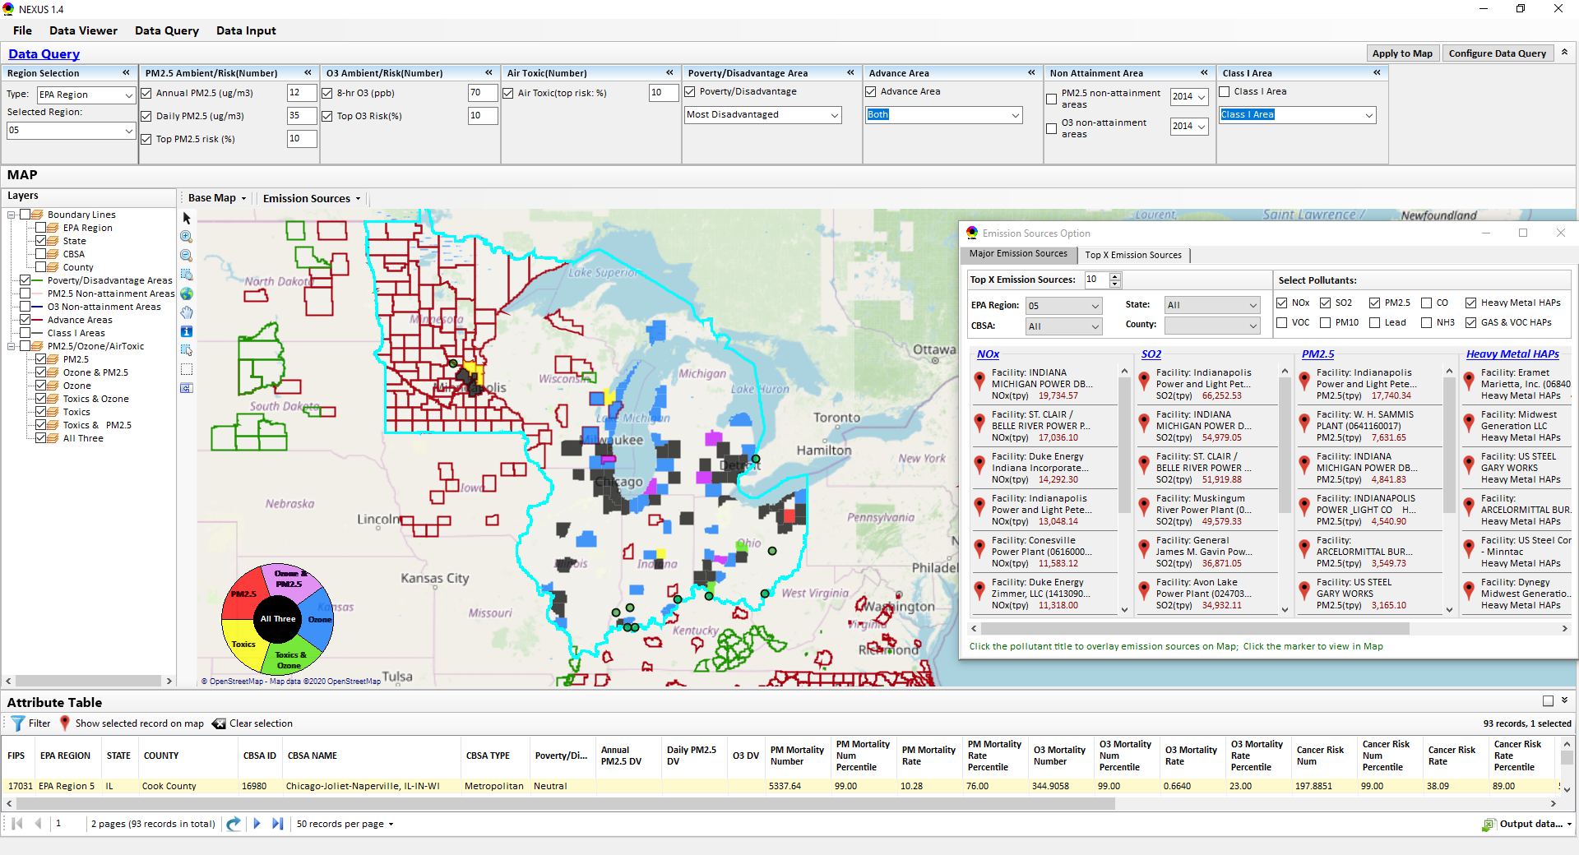
“NEXUS” Multi-Pollutant Analysis Tool
Development: Status Update
Data Viewer Module
Data Input Module
Data Query Module
“NEXUS 1.5” available on OAQPS’s Shared Drive at: “G:\SHARE\NEXUS\NEXUS 1.5\”
or at EPA’s new FTP site: ftp://newftp.epa.gov/aqmg/cjang/NEXUS/NEXUS 1.5/
HEID/AQAD Briefing
March 23, 2021
Carey Jang & Beth Landis

Slide 2
Overview
Feedback from OAQPS/SMT Briefing
NEXUS Updates
  Metrics (Toxics)
  2017 Data
  Proximity Based Module (Multi-pollutant)
National Sector Approach – NEXUS Application
Examples for Regions
  Chicago
  Pittsburgh
  Houston
Next Steps / Issues for Discussion
2

Slide 3
Feedback from OAQPS & SMT Briefing
National level screening capabilities for sectors in addition to current “area” orientation of tool
Improve the national screening metrics for air toxics to reduce possible ‘false-negatives’
Codify “proximity-based“ EJ screening analysis for sources/sectors across criteria and toxic pollutants
Provide information that can help prioritize SPPD rules
Incorporate Economic information?
3

Slide 4
Need to Improve Air Toxics Metrics
MP Team engaged with Air Toxics Team to improve upon current national screening metrics for air toxics
Current risk metrics were based on county-level population weighted averages (not appropriately accounting for local nature of risks) so false negatives could influence the areas ranking
ATAG provided input on improving these metrics
  New metrics now reflect more local risk (census-tracts) and expressed in “X in a million”
  Update use of percentiles based on risk value
4

Slide 5
NEXUS 1.7 (Under Development)
Near-term Priorities for 2021 NEXUS development:
Upgrade NEXUS (modules/metrics/EJ ) for beta release
  Revise air toxic (AT) metrics based on AT team’s suggestions
  Include EJ/demographic index & Tribal areas
2017 emissions data update (including GHG & Sector mapping)
(Note: used to support “Sector Prioritization” work)
2017 fused AQ (PM_{2.5}, O₃, AT) & risk data update (with need to discuss air toxics risk effort at DD and/or office level)
Draft design for new “Proximity-based risk & EJ analysis” module (census “block group”-level)
Ongoing
Planned
5

Slide 6
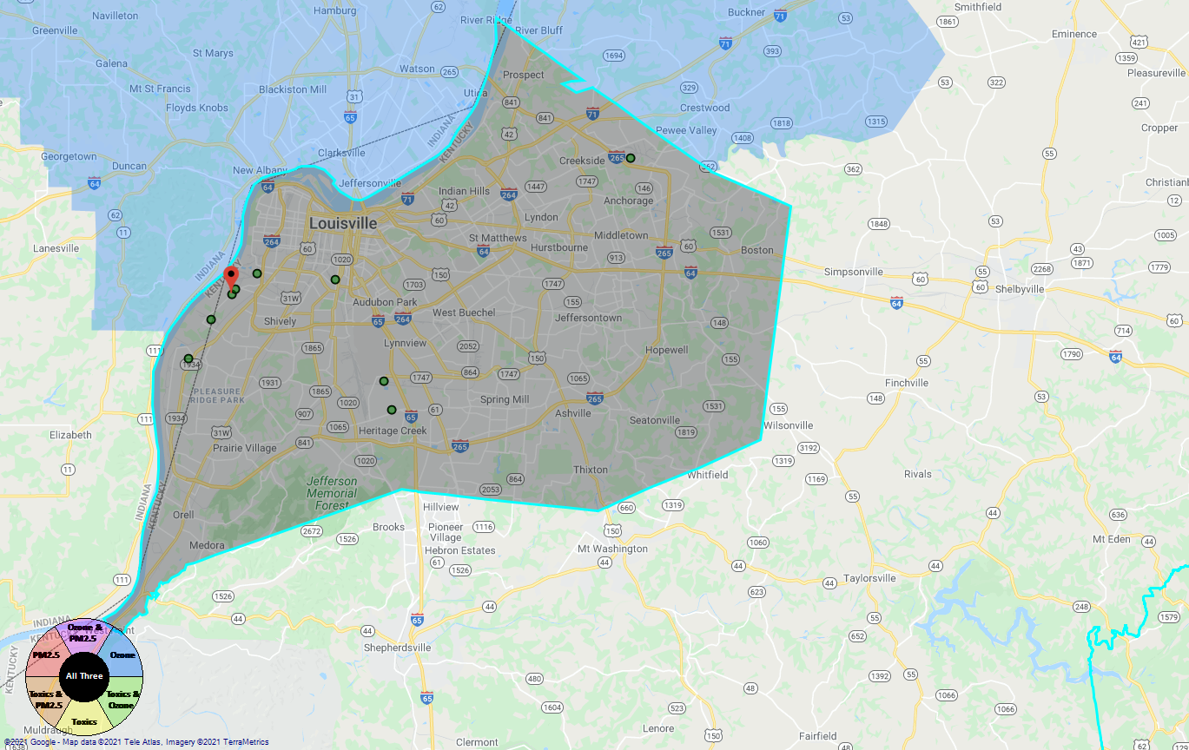
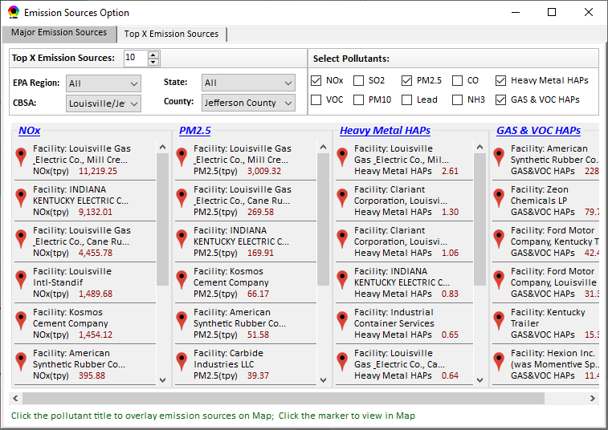
New “Proximity-based Risk & EJ Analysis Module”
Allow to set a flexible “Radius of Impact” for selected source/facility
Add “Tribal” for listing tribal areas (All & individual)
Proximity-based Source/Sector Multi-Pollutant Risk & EJ Analysis
Source/Sector Analysis
Spatial Analysis
Source: American Synthesis Rubber Co., KY Sector group: Polymers and Resins Production
[ x Display national map for Sector group
Radius of Impact
1
50km
Create Table
Create Plot
6

Slide 7
Screening Proximity Analysis in NEXUS:
Tabular Data Summary
Facility: American Synthesis Rubber Co., Louisville, KY Sector Group: Polymers and Resins Production Top Risk Drivers: ETO, Formaldehyde |  |  |  |  | Selected Options: Radius of Impact: 10km Number of CBSAs: 25 (top MP risk ranking) Air Toxics Risk threshold: 10 (“x”-in-a million)
 | Within Radius of Facility | County Avg. | State Avg. | EPA Region Avg. |  | Nation Avg. | Sector Group (within radius) National avg. | Sector Group (within radius) Top 25 CBSAs
Population total | x,xxx | xx,xxx | xxx,xxx | xxx,xxx |  | 317,xxx,xxx | xxx,xxx | xxx,xxx
PM2.5 risk (%tile) | x% | x% | x% | x% |  | x% | x% | x%
Ozone risk (%tile) | x% | x% | x% | x% |  | x% | x% | x%
Air Toxics risk: Cancer risk (%tile) | x% | x% | x% | x% |  | x% | x% | x%
Cancer risk value (“x”-in-a million)) | x.x | x.x | x.x | x.x |  | x.x | x.x | x.x
Cancer risk value above selected threshold (population %tile) | x% | x% | x% | x% |  | x% | x% | x%
Non-cancer risk (%tile) | x% | x% | x% | x% |  | x% | x% | x%
Non-cancer risk (Hazard Index) | x.x | x.x | x.x | x.x |  | x.x | x.x | x.x
Climate risks: Flood (%tile) | x% | x% | x% | x% |  | x% | x% | x%
Sea level rise (%tile) | x% | x% | x% | x% |  | x% | x% | x%
Fire (%tile) | x% | x% | x% | x% |  | x% | x% | x%
Disease (%tile) | x% | x% | x% | x% |  | x% | x% | x%
EJ/Demographics: Minority group (%tile) | x% | x% | x% | x% |  | x% | x% | x%
Low-income group (%tile) | x% | x% | x% | x% |  | x% | x% | x%
Demographic Index (%tile) | x% | x% | x% | x% |  | x% | x% | x%
Linguistic Isolation (%tile) | x% | x% | x% | x% |  | x% |  | x%
7

Slide 8
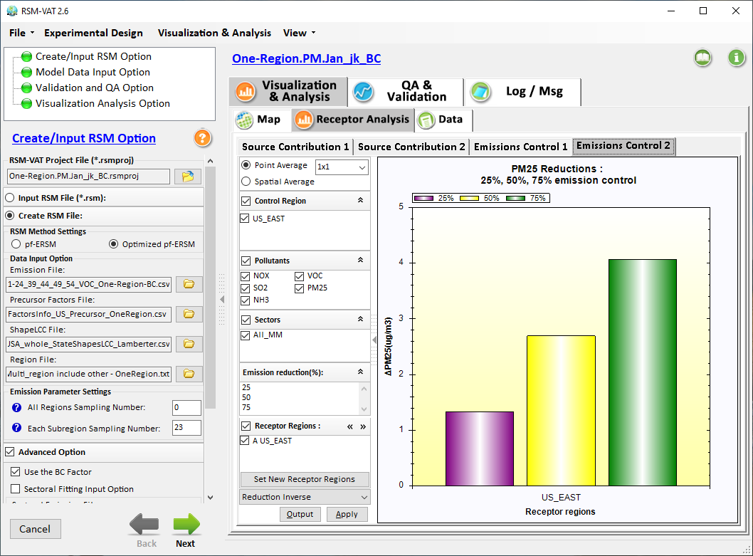
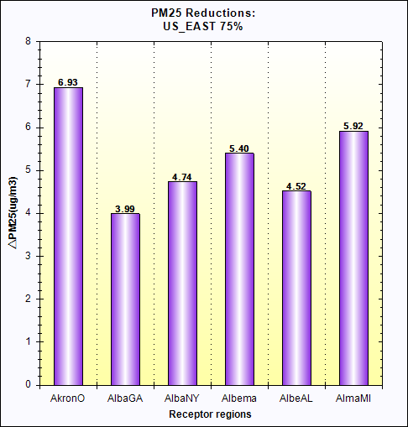
Screening Proximity Analysis in NEXUS:
Example Chart
Air Quality
Facility: American Synthesis Rubber Co., Louisville, KY
Sector Group: Polymers and Resins Production
PM2.5 risk
O3 risk
Air Toxics risk
Cancer risk
Non-Cancer risk
(%tile
EJ Indicators
Climate Risks
Population
Minority
Income
Education
Language
Flood
Fire
Sea Level Rise
Heat
Disease
Nation
avg. (%tile)
Climate Risks
Flood
Fire
Sea Level Rise
Heat
Disease
Within Radius County avg. State avg. EPA region avg. Nation avg. Sector Group avg.
of Facility (Within Radius)
8

Slide 9
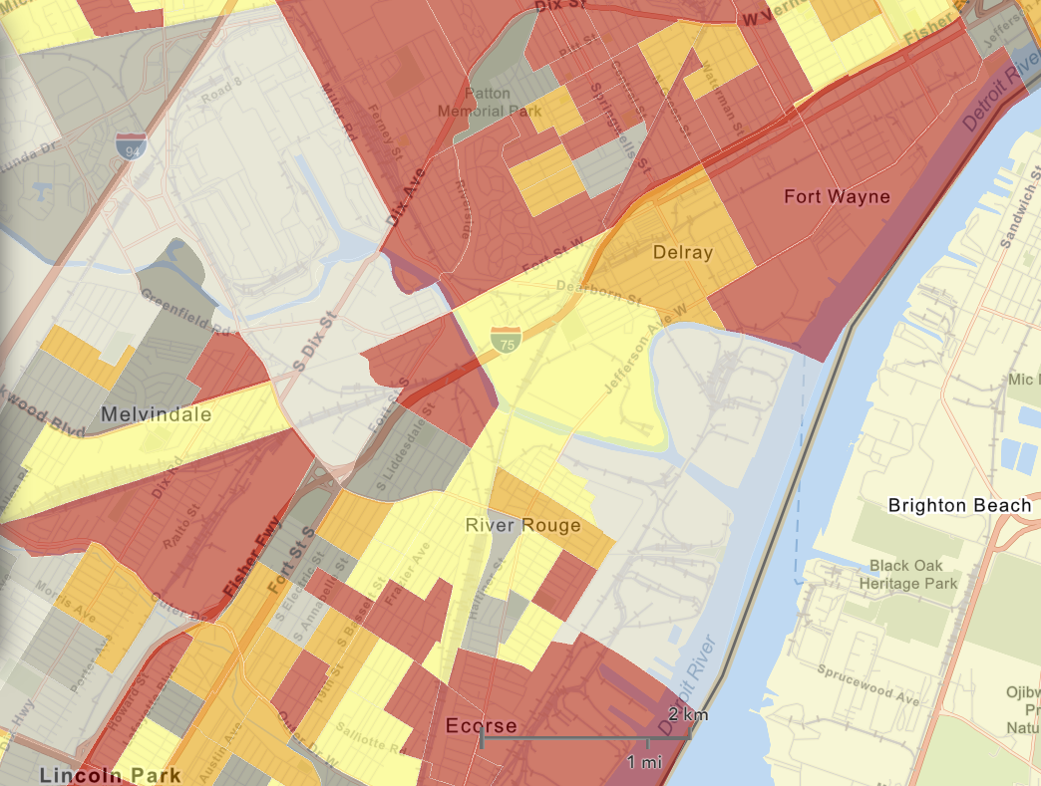
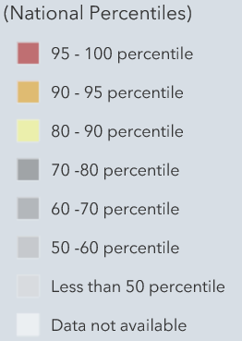

Proximity Analysis Module: Spatial Analysis
(census “block group”-level)
Air Quality
PM2.5 risk
O3 risk
Air Toxics risk
Cancer risk
Non-Cancer risk
EJ Indicators
Climate Risks
Population
Minority
Income
Education
Language
Flood
Fire
Sea Level Rise
Heat
Disease
Climate Risks
Flood
Fire
Sea Level Rise
Heat
Disease
Proximity-based Source/Sector Multi-Pollutant Risk & EJ Analysis
Source/Sector Analysis
Spatial Analysis
EJ
Indicators
Minority
Climate
Risk
Fire
9

Slide 10
Sector Emissions Prioritization Analysis over Major CBSAs using NEXUS
Products: Two Output Tables
  Table-1: Top “x” (x=20 in this case) “Facility” emissions (NOx, SO2, VOCs, Primary PM2.5, PM & metal HAPs, Gas & VOC HAPs) table for “x” (x=50) CBSAs with top ranked MP risk
  Table-2 (Summary): Total “Sector group” emissions summed up together over all top 50 CBSAs (Facilities combined into ~60 “Sector group” based on “Sector definition” spreadsheet created by Marc H. and SPPD) based on 2017 emissions data
10

Slide 11
Step #1 : CBSAs w/ Top-Ranked MP Risks
Method: Identify CBSAs with top MP risk ranking: Major CBSAs are selected.
 | EPA_REGION | STATE | CBSA_NAME | Overall Rank
1 | EPA Region 5 | IL-IN-WI | Chicago-Joliet-Naperville, IL-IN-WI | 1
2 | EPA Region 3 | PA | Pittsburgh, PA | 1
3 | EPA Region 6 | TX | Houston-Sugar Land-Baytown, TX | 1
4 | EPA Region 9 | CA | Los Angeles-Long Beach-Santa Ana, CA | 2
5 | EPA Region 6 | TX | Dallas-Fort Worth-Arlington, TX | 2
6 | EPA Region 4 | GA | Atlanta-Sandy Springs-Marietta, GA | 3
7 | EPA Region 4 | FL | Tampa-St. Petersburg-Clearwater, FL | 3
8 | EPA Region 4 | AL | Birmingham-Hoover, AL | 3
9 | EPA Region 9 | AZ | Phoenix-Mesa-Glendale, AZ | 3
10 | EPA Region 9 | CA | Fresno, CA | 3
11 | EPA Region 2 | NY-NJ-PA | New York-Northern New Jersey-Long Island, NY-NJ-PA | 3
12 | EPA Region 5 | OH | Cleveland-Elyria-Mentor, OH | 3
13 | EPA Region 9 | CA | Sacramento--Arden-Arcade--Roseville, CA | 4
14 | EPA Region 9 | NV | Las Vegas-Paradise, NV | 4
15 | EPA Region 4 | NC-SC | Charlotte-Gastonia-Rock Hill, NC-SC | 5
16 | EPA Region 9 | CA | San Diego-Carlsbad-San Marcos, CA | 5
17 | EPA Region 5 | MI | Detroit-Warren-Livonia, MI | 5
18 | EPA Regions 5 & 7 | MO-IL | St. Louis, MO-IL | 5
19 | EPA Region 5 | MI | Grand Rapids-Wyoming, MI | 6
20 | EPA Region 4 | TN | Nashville-Davidson--Murfreesboro--Franklin, TN | 6
21 | EPA Region 9 | CA | Bakersfield-Delano, CA | 6
22 | EPA Regions 2 & 3 | PA-NJ-DE-MD | Philadelphia-Camden-Wilmington, PA-NJ-DE-MD | 6
23 | EPA Region 9 | CA | Riverside-San Bernardino-Ontario, CA | 6
24 | EPA Region 4 | FL | Miami-Fort Lauderdale-Pompano Beach, FL | 6
25 | EPA Region 6 | LA | Baton Rouge, LA | 7
26 | EPA Region 6 | TX | El Paso, TX | 7
27 | EPA Region 10 | WA | Seattle-Tacoma-Bellevue, WA | 7
28 | EPA Region 4 & 5 | KY-IN | Louisville-Jefferson County, KY-IN | 7
 | EPA_REGION | STATE | CBSA_NAME | Overall Rank
29 | EPA Region 8 | CO | Denver-Aurora-Broomfield, CO | 8
30 | EPA Region 3 | PA | Reading, PA | 8
31 | EPA Region 9 | CA | Visalia-Porterville, CA | 8
32 | EPA Region 1 | CT | Bridgeport-Stamford-Norwalk, CT | 8
33 | EPA Region 4 & 6 | TN-MS-AR | Memphis, TN-MS-AR | 8
34 | EPA Regions 2 & 3 | PA-NJ | Allentown-Bethlehem-Easton, PA-NJ | 9
35 | EPA Region 6 | LA | New Orleans-Metairie-Kenner, LA | 9
36 | EPA Region 4 | NC | Greensboro-High Point, NC | 10
37 | EPA Region 4 | AL | Mobile, AL | 10
38 | EPA Region 4 | TN-GA | Chattanooga, TN-GA | 11
39 | EPA Region 4 | TN | Knoxville, TN | 11
40 | EPA Region 3 | DC-VA-MD-WV | Washington-Arlington-Alexandria, DC-VA-MD-WV | 11
41 | EPA Region 6 | OK | Tulsa, OK | 11
42 | EPA Region 9 | AZ | Tucson, AZ | 11
43 | EPA Region 4 | SC | Charleston-North Charleston-Summerville, SC | 12
44 | EPA Region 4 | SC | Greenville-Mauldin-Easley, SC | 12
45 | EPA Region 3 | WV | Charleston, WV | 13
46 | EPA Region 4 | SC | Spartanburg, SC | 13
47 | EPA Region 4 | NC | Winston-Salem, NC | 13
48 | EPA Region 4 | FL | Lakeland-Winter Haven, FL | 13
49 | EPA Region 5 | OH | Akron, OH | 13
50 | EPA Region 6 | TX | Beaumont-Port Arthur, TX | 14
51 | EPA Region 5 | MI | Lansing-East Lansing, MI | 14
52 | EPA Region 4 | FL | Orlando-Kissimmee-Sanford, FL | 14
53 | EPA Region 10 | OR | Eugene-Springfield, OR | 14
54 | EPA Region 9 | NV | Reno-Sparks, NV | 14
55 | EPA Regions 4 & 5 | OH-KY-IN | Cincinnati-Middletown, OH-KY-IN | 14
56 | EPA Region 3 | PA | Lancaster, PA | 14
11

Slide 12
Step #2 : Create Top Facilities “Table-1”
(for each CBSA)
Method: Output a table with “Top 20 facility emissions” (NOx, SO₂, VOCs, primary PM_{2.5}, HAPs, CO2e, etc.) for each CBSA (total 50 sub-tables)
CBSA Name: Chicago-Joliet-Naperville, IL-IN-WI. Population: 9452622
Facility Info | NOx (TON) | Facility Info | SO2 (TON) | Facility Info | Gas_ VOC_ HAPs (LB) | Facility Info | CO2e (TON)
Facility name: ArcelorMittal Burns Harbor LLC County/City/State: Porter/Burns Harbor/IN EIS_ID: 7376511 Sector Group: Coke Ovens NAICS code: 331110 NAICS description: Iron and Steel Mills and Ferroalloy Manufacturing | 9001 | Facility name: ArcelorMittal Burns Harbor LLC County/City/State: Porter/Burns Harbor/IN EIS_ID: 7376511 Sector Group: Coke Ovens NAICS code: 331110 NAICS description: Iron and Steel Mills and Ferroalloy Manufacturing | 12959 | Facility name: Chicago OHare International Airport County/City/State: Cook/Chicago/IL EIS_ID: 2681611 Sector Group: Air Transportation NAICS code: 488119 NAICS description: Other Airport Operations | 930152 | Facility name: ArcelorMittal USA LLC County/City/State: Lake/East Chicago/IN EIS_ID: 3986611 Sector Group: Iron and Steel Production NAICS code: 331110 NAICS description: Iron and Steel Mills and Ferroalloy Manufacturing | 12849804
Facility name: Northern Indiana Public Service Company LLC - RM Schahfer Generating Station County/City/State: Jasper/Wheatfield/IN EIS_ID: 7957011 Sector Group: Electric Utilities NAICS code: 221112 NAICS description: Fossil Fuel Electric Power Generation | 4925 | Facility name: US STEEL GARY WORKS County/City/State: Lake/Gary/IN EIS_ID: 8192011 Sector Group: Petroleum Refining NAICS code: 324199 NAICS description: All Other Petroleum and Coal Products Manufacturing | 5681 | Facility name: ARCELORMITTAL USA LLC County/City/State: Lake/East Chicago/IN EIS_ID: 3986511 Sector Group: Iron and Steel Production NAICS code: 331110 NAICS description: Iron and Steel Mills and Ferroalloy Manufacturing | 502521 | Facility name: ArcelorMittal Burns Harbor LLC County/City/State: Porter/Burns Harbor/IN EIS_ID: 7376511 Sector Group: Coke Ovens NAICS code: 331110 NAICS description: Iron and Steel Mills and Ferroalloy Manufacturing | 11170969
Facility name: Chicago OHare International Airport County/City/State: Cook/Chicago/IL EIS_ID: 2681611 Sector Group: Air Transportation NAICS code: 488119 NAICS description: Other Airport Operations | 3797 | Facility name: ARCELORMITTAL USA LLC County/City/State: Lake/East Chicago/IN EIS_ID: 3986511 Sector Group: Iron and Steel Production NAICS code: 331110 NAICS description: Iron and Steel Mills and Ferroalloy Manufacturing | 3030 | Facility name: BP Products North America Inc Whiting R County/City/State: Lake/Whiting/IN EIS_ID: 7247711 Sector Group: Petroleum Refining NAICS code: 32411 NAICS description: Petroleum Refineries | 337592 | Facility name: US STEEL GARY WORKS County/City/State: Lake/Gary/IN EIS_ID: 8192011 Sector Group: Petroleum Refining NAICS code: 324199 NAICS description: All Other Petroleum and Coal Products Manufacturing | 10261468
12

Slide 13
Step #3 : Create “Table-2” (Sector Group Summary)
Method: Output summary “Table-2” w/ all top 20 facility emissions combined into “Sector group” for all top ranked 50 CBSAs (Note: Facilities are grouped into ~60 sectors based on “Sector definition” spreadsheet created by Marc H. & SPPD) based on 2017 data
“Sector group” emissions combined for all 50 CBSAs (based on top 20 facility emissions in each CBSA); Total Population: 134,940,816
Sector Group | SO2 (TON) | NOx (TON) | PM2.5 (TON) | Gas_VOC_HAPs (LB) | Heavy_Metal_HAPs (LB) | CO2e (TON) | SO2 Score (freq. & rank)
Electric Utilities | 276526 | 195865 | 25828 | 6432707 | 127030 | 485754073 | 2014
Petroleum Refining | 52943 | 40169 | 12438 | 10295621 | 99736 | 95097998 | 574
Coke Ovens | 22405 | 15473 | 5158 | 1787622 | 29716 | 14570119 | 132
Pesticides and Agricultural Chemical Manufacturing | 17644 | 5861 | 1292 | 1627958 | 1788 | 18233480 | 153
Inorganic Chemical Manufacturing | 14522 | 7273 | 1405 | 1073205 | 48966 | 5231826 | 190
Mineral Processing | 13714 | 12628 | 1659 | 886251 | 33740 | 8364046 | 256
Iron and Steel Production | 10679 | 13345 | 5691 | 858984 | 110757 | 33030868 | 375
Cement Manufacturing | 10566 | 44083 | 5007 | 1472498 | 25010 | 27859268 | 444
Air Transportation | 8127 | 63035 | 2685 | 10417526 | 122777 | 18485627 | 1380
Pulp and Paper Industry | 7413 | 9791 | 2779 | 7227413 | 23704 | 10517197 | 251
Organic Chemical Manufacturing | 6240 | 38070 | 6254 | 10280694 | 20059 | 82521408 | 299
Landfills | 2952 | 9872 | 2356 | 2799470 | 1880 | 28651639 | 563
Consumer Products (Cleaning, Photographic, etc.) | 2815 | 1980 | 486 | 1363144 | 1724 | 1389978 | 66
Oil and Gas Production and Distribution | 2717 | 28271 | 2259 | 4467061 | 1804 | 12342771 | 466
Food Products Manufacturing | 2705 | 6197 | 3085 | 4110212 | 2496 | 3408089 | 327
Non-Ferrous Metals Production | 2694 | 3511 | 1695 | 3663067 | 91643 | 2165692 | 212
Glass Manufacturing | 2355 | 5832 | 953 | 92289 | 9990 | 1174855 | 210
Clay Products Manufacturing | 1349 | 685 | 602 | 650323 | 1631 | 200293 | 311
Waste Incineration | 1024 | 11872 | 483 | 679918 | 1801 | 9825913 | 189
13

Slide 14
SO₂ & NOx: Sector Group emissions
Summed up top 20 facility emissions over 50 major CBSAs
over
14

Slide 15
SO₂ & NOx: Sector Group “Score”
(Score = Frequency & Rank)
SO2 & NOx: Score of Top Sector Groups
15

Slide 16
Primary PM_{2.5}: Sector Group emissions
Summed up top 20 facility emissions over 50 major CBSAs
Primary PM2.5 emissions (ton/yr) from top Sector groups
over
16

Slide 17
Primary PM_{2.5} : Sector Group “Score”
(Score = Frequency & Rank)
Primary PM2.5: Score of Top Sector Groups
17

Slide 18
Gas & VOC HAPs: Sector Group emissions
Summed up top 20 facility emissions over 50 major CBSAs
Gas & VOC HAPs emissions (lb/yr) from top Sector groups
18

Slide 19
Gas & VOC HAPs: Sector Group “Score”
(Score = Frequency & Rank)
Gas & VOC HAPs: Score of Top Sector Groups
19

Slide 20
Heavy Metal HAPs: Sector Group emissions
Summed up top 20 facility emissions over 50 major CBSAs
Heavy HAPs emissions (lb/yr) from top Sector groups
20

Slide 21
Heavy Metal HAPs: Sector Group “Score”
(Score = Frequency & Rank)
Heavy Metal HAPs: Score of Top Sector Groups
21

Slide 22
CO2e: Sector Group emissions
Summed up top 20 facility emissions over 50 major CBSAs
over
22

Slide 23
CO2e: Sector Group “Score”
(Score = Frequency & Rank)
CO2e: Score of Top Sector Groups
23

Slide 24
Examples for Regional Engagement: Highest MP Risk Areas
 | EPA_REGION | STATE | CBSA_NAME | Overall Rank
1 | EPA Region 5 | IL-IN-WI | Chicago-Joliet-Naperville, IL-IN-WI | 1
2 | EPA Region 3 | PA | Pittsburgh, PA | 1
3 | EPA Region 6 | TX | Houston-Sugar Land-Baytown, TX | 1
4 | EPA Region 9 | CA | Los Angeles-Long Beach-Santa Ana, CA | 2
5 | EPA Region 6 | TX | Dallas-Fort Worth-Arlington, TX | 2
6 | EPA Region 4 | GA | Atlanta-Sandy Springs-Marietta, GA | 3
7 | EPA Region 4 | FL | Tampa-St. Petersburg-Clearwater, FL | 3
8 | EPA Region 4 | AL | Birmingham-Hoover, AL | 3
9 | EPA Region 9 | AZ | Phoenix-Mesa-Glendale, AZ | 3
10 | EPA Region 9 | CA | Fresno, CA | 3
11 | EPA Region 2 | NY-NJ-PA | New York-Northern New Jersey-Long Island, NY-NJ-PA | 3
12 | EPA Region 5 | OH | Cleveland-Elyria-Mentor, OH | 3
13 | EPA Region 9 | CA | Sacramento--Arden-Arcade--Roseville, CA | 4
14 | EPA Region 9 | NV | Las Vegas-Paradise, NV | 4
15 | EPA Region 4 | NC-SC | Charlotte-Gastonia-Rock Hill, NC-SC | 5
16 | EPA Region 9 | CA | San Diego-Carlsbad-San Marcos, CA | 5
17 | EPA Region 5 | MI | Detroit-Warren-Livonia, MI | 5
18 | EPA Regions 5 & 7 | MO-IL | St. Louis, MO-IL | 5
 | EPA_REGION | STATE | CBSA_NAME | Overall Rank
19 | EPA Region 5 | MI | Grand Rapids-Wyoming, MI | 6
20 | EPA Region 4 | TN | Nashville-Davidson--Murfreesboro--Franklin, TN | 6
21 | EPA Region 9 | CA | Bakersfield-Delano, CA | 6
22 | EPA Regions 2 & 3 | PA-NJ-DE-MD | Philadelphia-Camden-Wilmington, PA-NJ-DE-MD | 6
23 | EPA Region 9 | CA | Riverside-San Bernardino-Ontario, CA | 6
24 | EPA Region 4 | FL | Miami-Fort Lauderdale-Pompano Beach, FL | 6
25 | EPA Region 6 | LA | Baton Rouge, LA | 7
26 | EPA Region 6 | TX | El Paso, TX | 7
27 | EPA Region 10 | WA | Seattle-Tacoma-Bellevue, WA | 7
28 | EPA Region 4 & 5 | KY-IN | Louisville-Jefferson County, KY-IN | 7
29 | EPA Region 8 | CO | Denver-Aurora-Broomfield, CO | 8
30 | EPA Region 3 | PA | Reading, PA | 8
31 | EPA Region 9 | CA | Visalia-Porterville, CA | 8
32 | EPA Region 1 | CT | Bridgeport-Stamford-Norwalk, CT | 8
33 | EPA Region 4 & 6 | TN-MS-AR | Memphis, TN-MS-AR | 8
34 | EPA Regions 2 & 3 | PA-NJ | Allentown-Bethlehem-Easton, PA-NJ | 9
35 | EPA Region 6 | LA | New Orleans-Metairie-Kenner, LA | 9
NEXUS can be used to identify highest risk areas across O₃, PM_{2.5}, and Air Toxics. OAQPS could provide area profile packets to Regions to discuss nature of MP issues and possible avenues to address or conduct more refined analyses.
The information above was generated in NEXUS & exported into Excel where rankings were applied.
These CBSAs include at least one county that meets ALL the following criteria:
PM Mortality Number Percentile >= 90
O₃ Mortality Number Percentile >= 90
Cancer Risk Rate Max Percentile >= 90 (max census tract-level in a county)
24

Slide 25
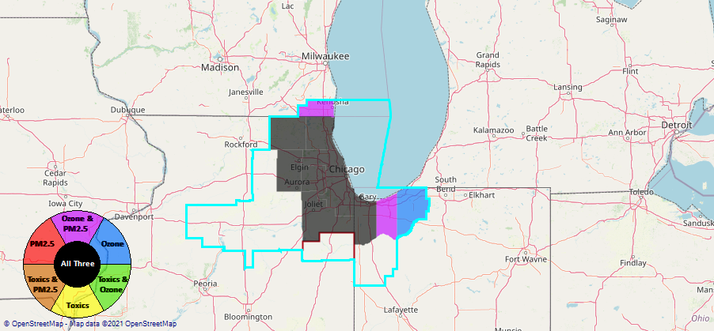
Example 1 - Chicago CBSA
Generated in NEXUS
25

Slide 26
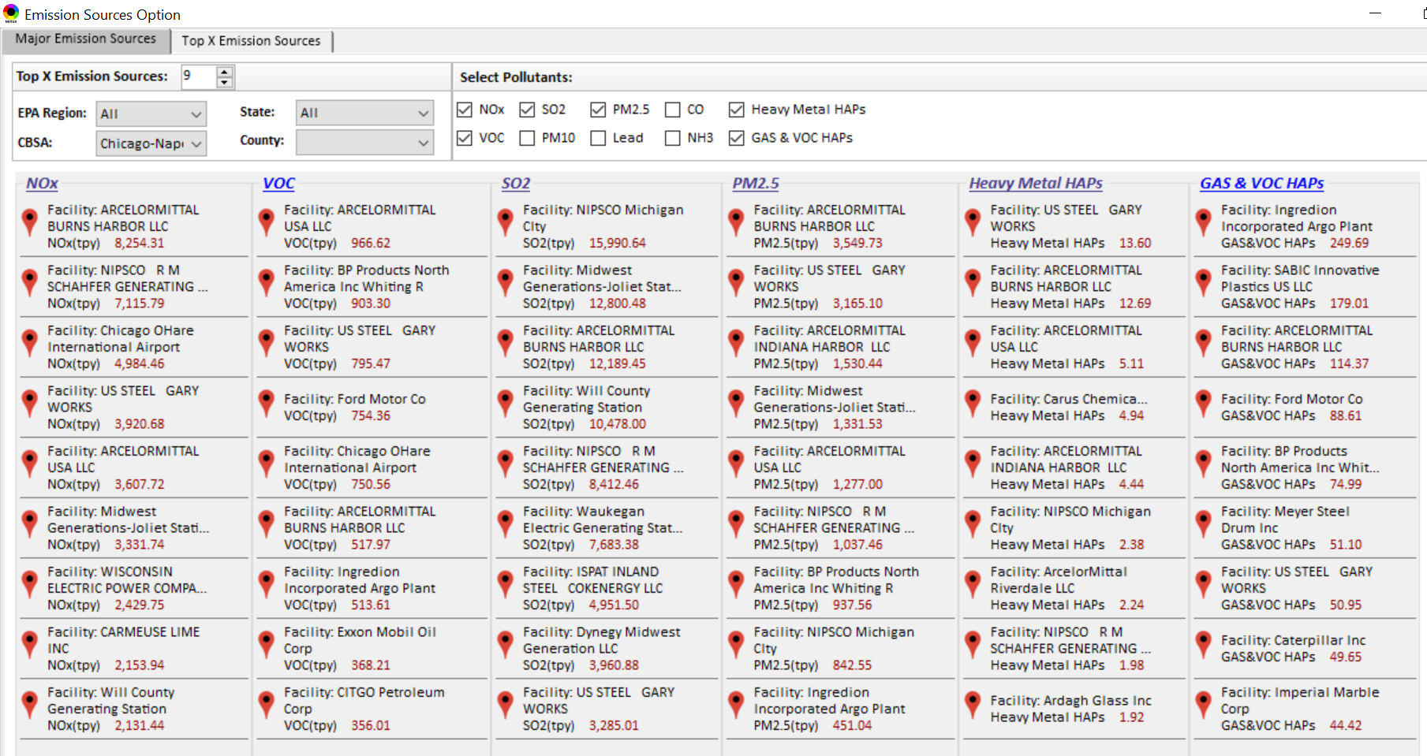
Example 1 - Chicago CBSA – Top Emission Sources
Generated in NEXUS
26

Slide 27
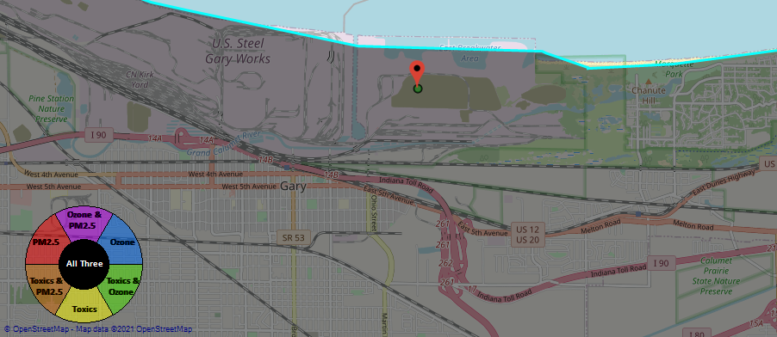
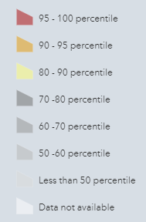
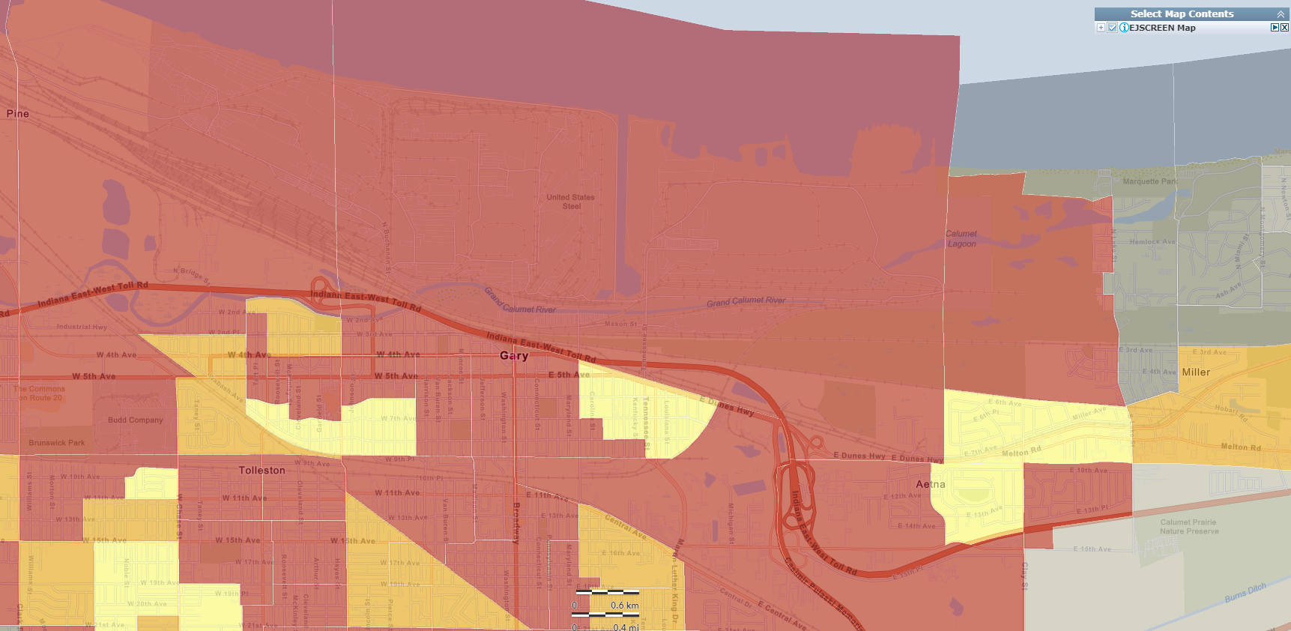
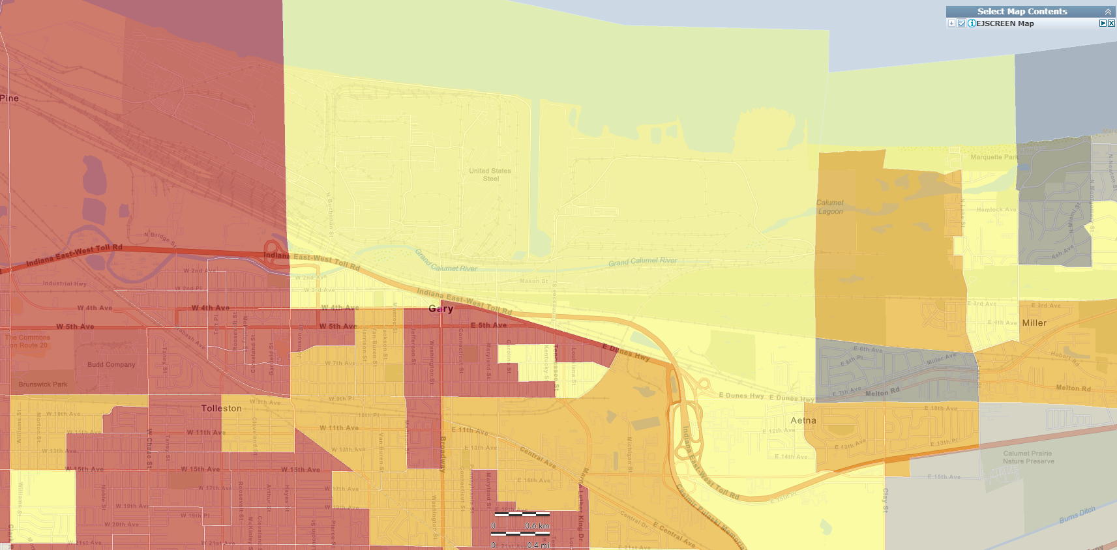
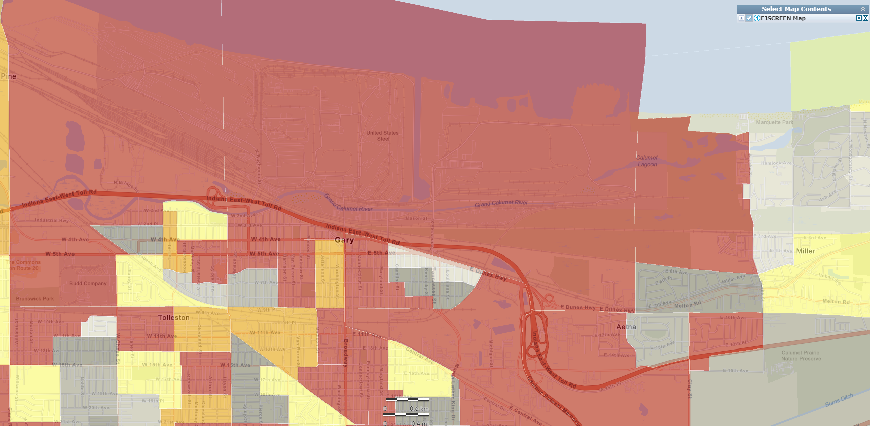
Example 1 - Chicago CBSA – US Steel Gary Works
Generated in NEXUS
National Percentiles
Generated in EJSCREEN
Generated in EJSCREEN
Generated in EJSCREEN
Demographic Index
People of Color Population
27
Low Income

Slide 28
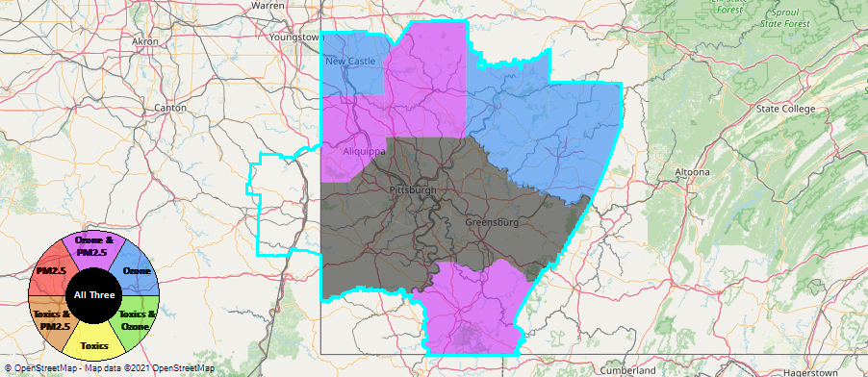
Example 2 - Pittsburgh CBSA
Generated in NEXUS
28

Slide 29
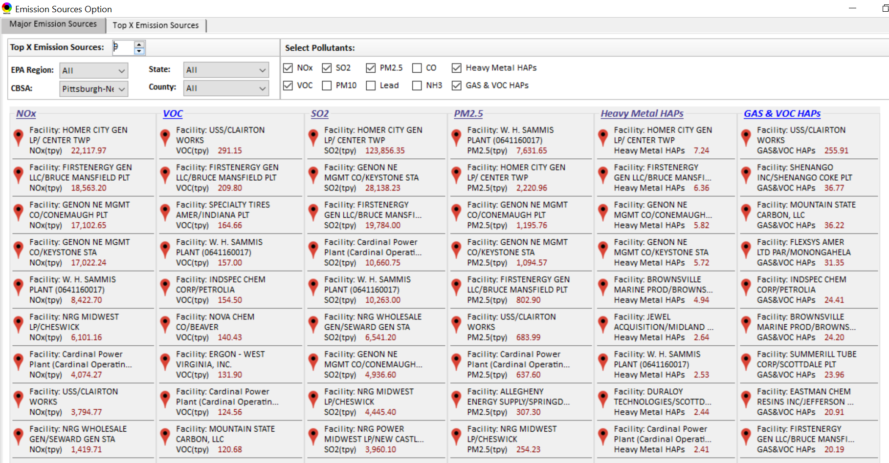
Example 2 - Pittsburgh CBSA – Top Emission Sources
Generated in NEXUS
EGUs
29

Slide 30
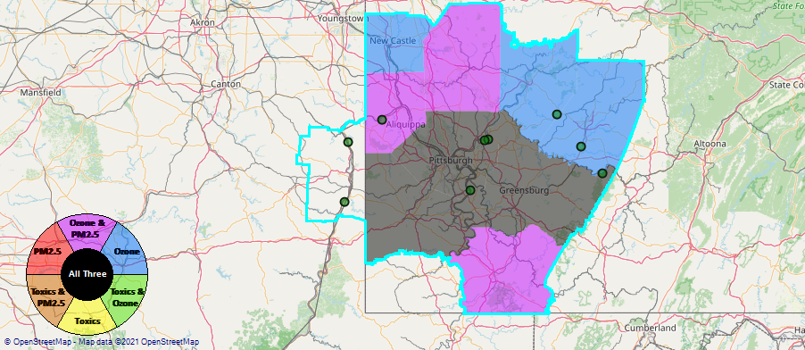
Example 2 - Pittsburgh CBSA – Dominated by EGUs
Generated in NEXUS
30

Slide 31
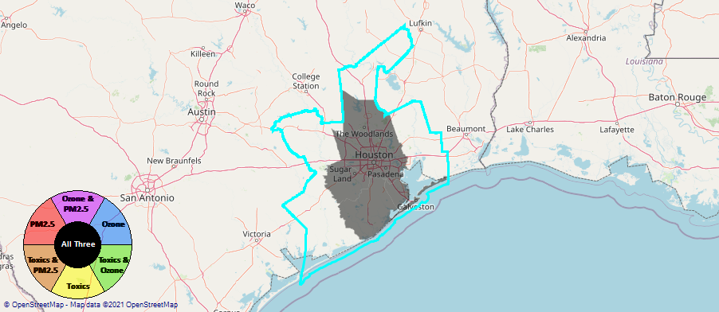
Example 3 - Houston CBSA
Generated in NEXUS
31

Slide 32
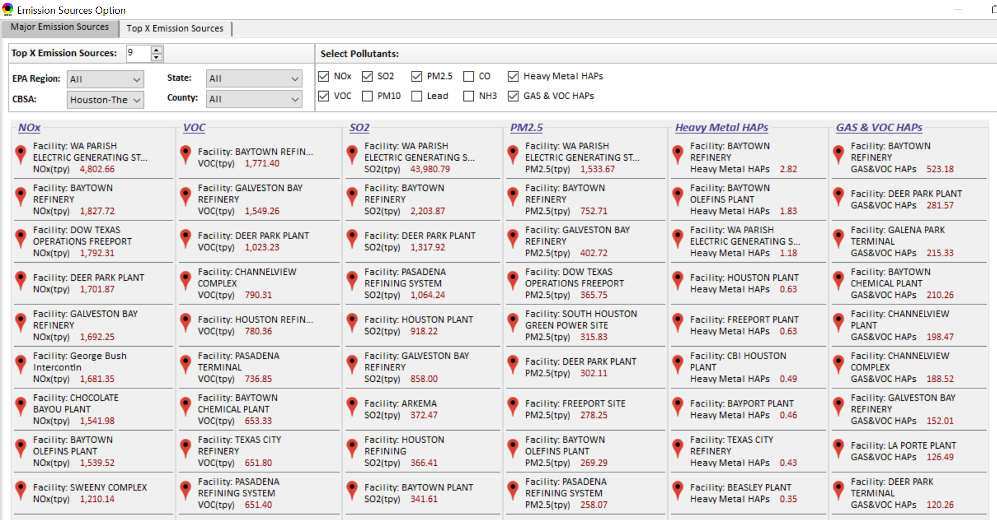
Example 3 - Houston CBSA – Top Emission Sources
Generated in NEXUS
32

Slide 33
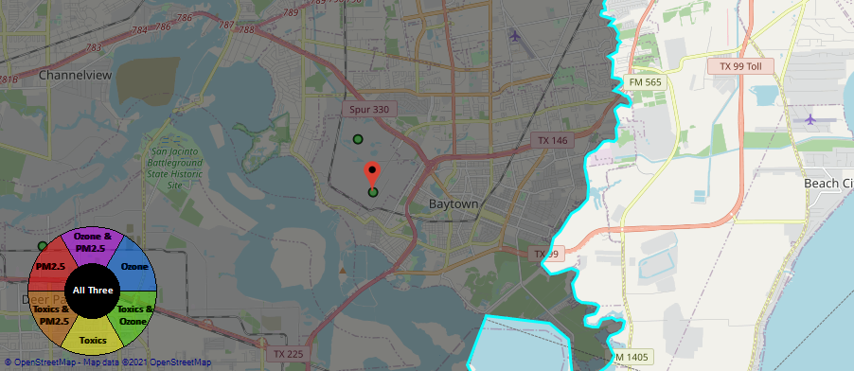
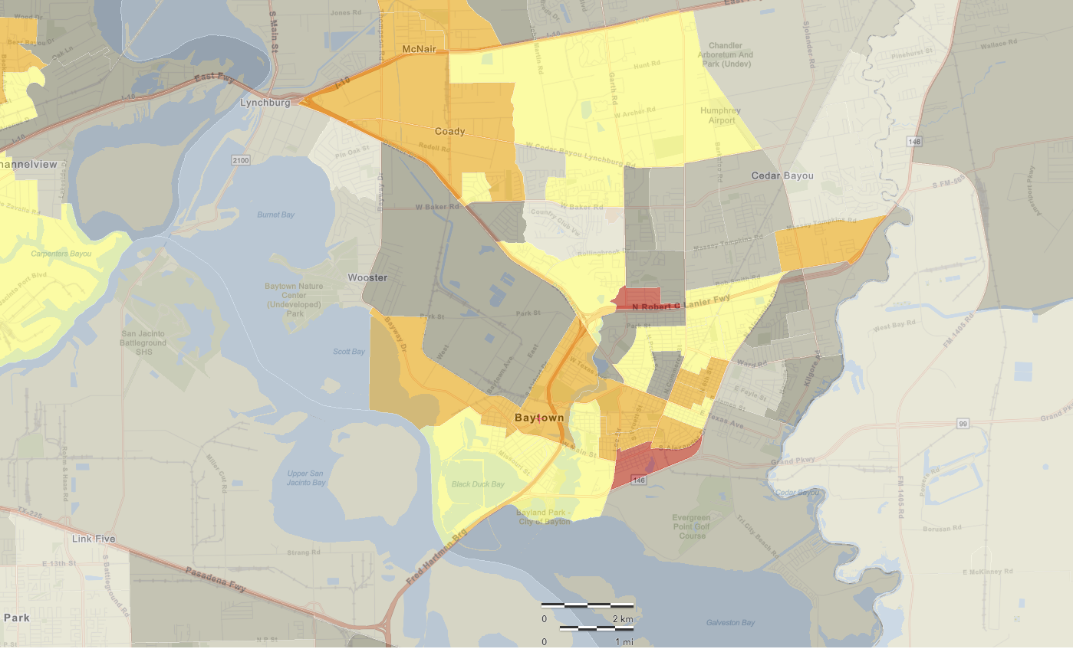
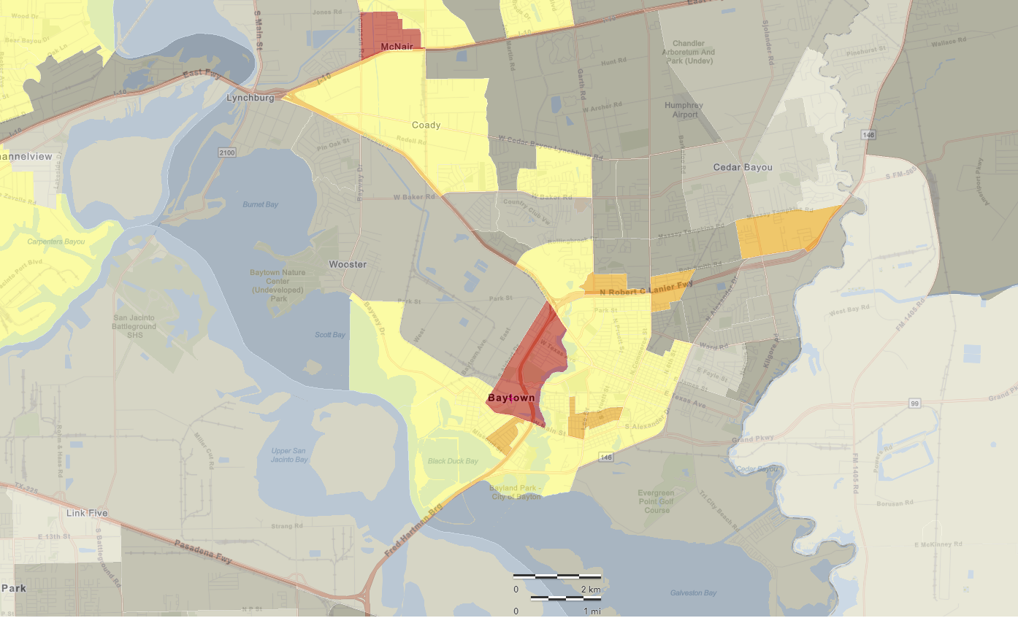
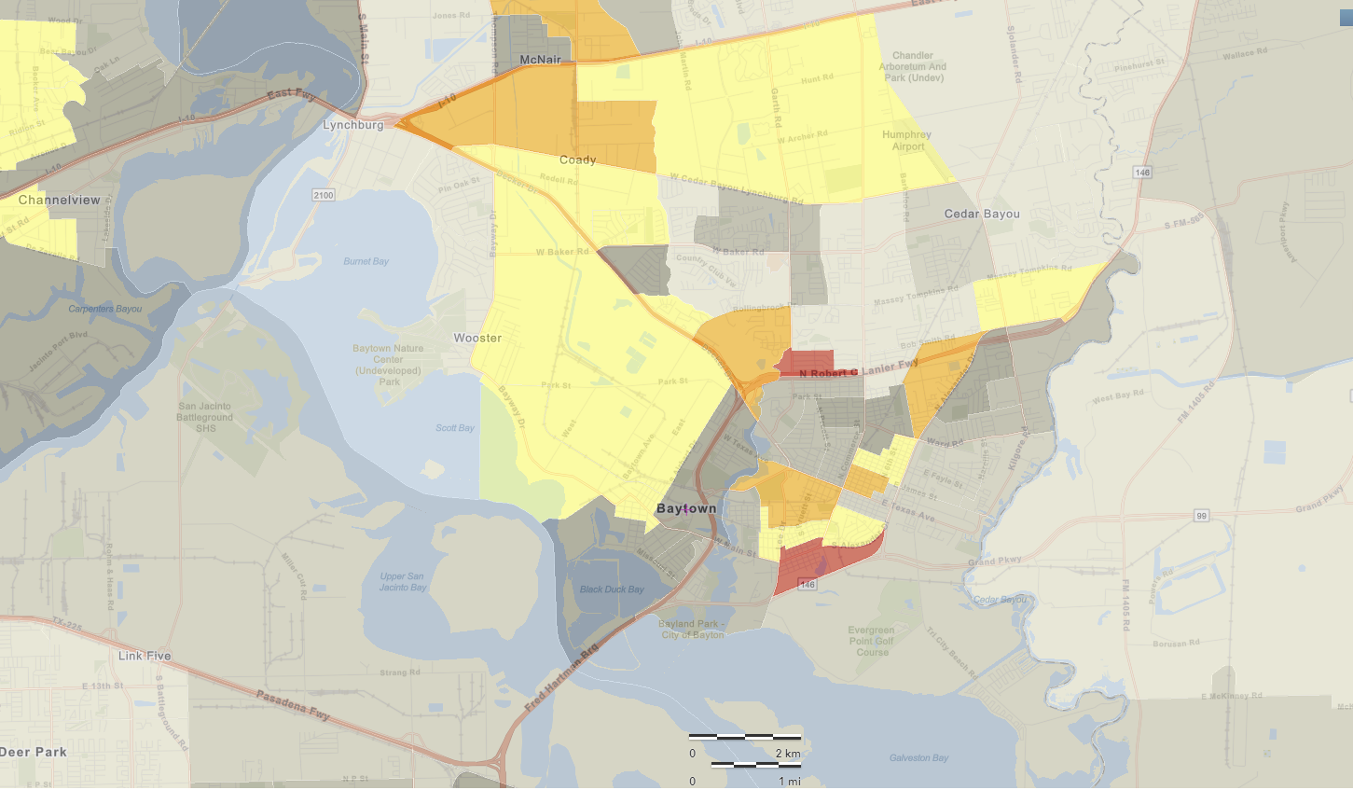
Example 3 - Houston CBSA – Baytown
Generated in NEXUS
National Percentiles
Baytown Olefins Plant (Chemical Plant)
Baytown Refinery (Petroleum)
Generated in EJSCREEN
Generated in EJSCREEN
Generated in EJSCREEN
Demographic Index
People of Color Population
33
Low Income

Slide 34
Next Steps / Issues for Discussion
Next Steps
  Follow up with additional EJ discussions/connection with EJSCREEN
  Updating existing data to 2017
    Emissions, O₃/PM_{2.5}/Toxics concentration, O₃ and PM_{2.5} risk
  Add new information
    Tribal areas, Advance areas, GHG emissions, monitoring data
  Develop proximity analysis module for MP risk, EJ & climate
  Meeting with economics group
Issues for Discussion
  2017 Air Toxics Risk Data
  OAQPS review/prioritization of analytical tools
  Funding mechanism
34

Slide 35
Questions?
35

Slide 36
Appendix A
Consideration of Climate Indicators
36

Slide 37
Climate Vulnerability
“Vulnerability is the susceptibility to the adverse effects of climate change, including both climate variability and extremes. Vulnerability measures the intersection of exposure, sensitivity to harm, and capacity to adapt to change. “ - NRDC Report; Turner et al 2003
1. What populations are particularly vulnerable to the projected effects of climate change?
2. Where is climate change vulnerability likely to increase baseline susceptibility to air pollution?
3. How might these vulnerabilities intersect with vulnerabilities relevant for EJ issues?
How can we identify/consider compounding vulnerabilities in communities likely to simultaneously experience air pollution, Environmental Justice, and climate issues?
37

Slide 38
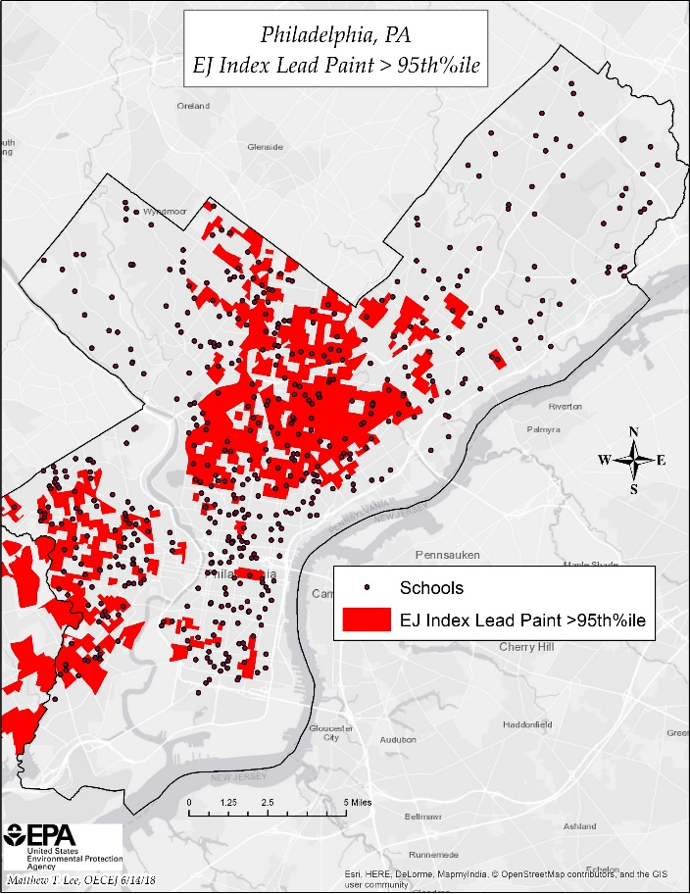
Data Driven Screening Tools
Data driven EJ screening tools either exist (i.e., EJ Screen/OEJ) or are in development (i.e., NEXUS, C. Jang/AQMG)
  Biden EO specifies “the development of a Climate and Environmental Justice Screening Tool, building off EPA’s EJSCREEN, to identify disadvantaged communities, support the Justice40 Initiative, and inform equitable decision making across the federal government”
OAQPS can assist in the effort to enhance these tools to reflect climate vulnerability thereby allowing for development of strategies and programs seeking to protect public and environmental health in areas with elevated risk for climate change impacts by identifying compounding vulnerabilities across the Climate-EJ space
  Addition of policy-relevant data layers / new indices
  Enhanced proximity analysis capabilities
Geographically explicit screening tools also help connect across scales, e.g., characterizing impacts of national climate strategies at the local/community level
EJ Screen (OEJ)
NEXUS Tool
(slide from C. Jang)
38

Slide 39
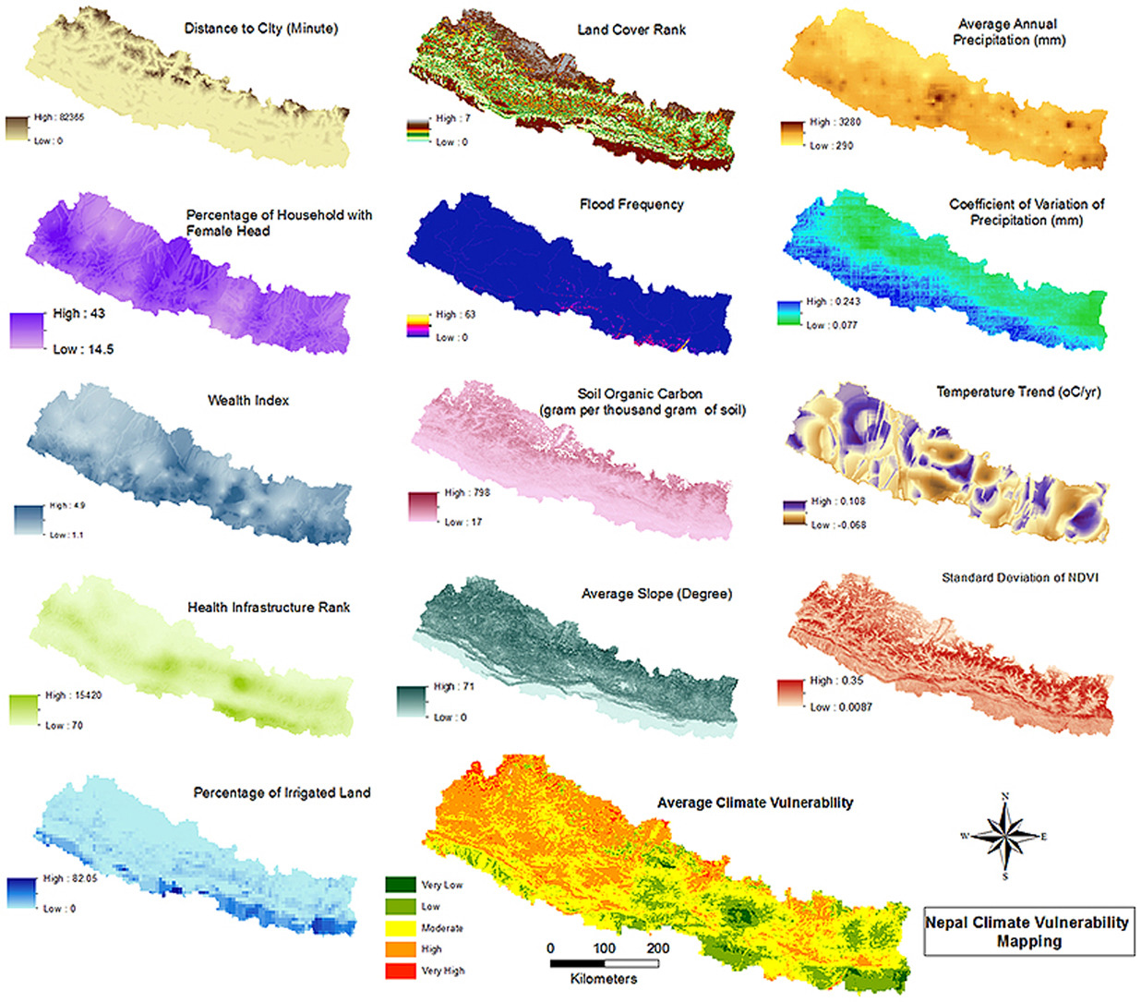
Elements of Climate Vulnerability
Components of climate vulnerability include environmental, physical, social, and economic factors (United Nations 2004 Report)
We can begin to characterize environmental and physical vulnerability with existing data sets and modeling tools
Many components contributing to underlying vulnerability are not explicitly tied to specific areas or environmental factors, but rather are intrinsic to broader socio-economic systems (e.g. food security, income and education, etc)
Opportunities for collaboration with HEID, ORD, OAP, and other partners with expertise in identifying and incorporating these elements of climate vulnerability
Potential overlap with EJ vulnerabilities
Mainali and Pricope 2017
39

Slide 40
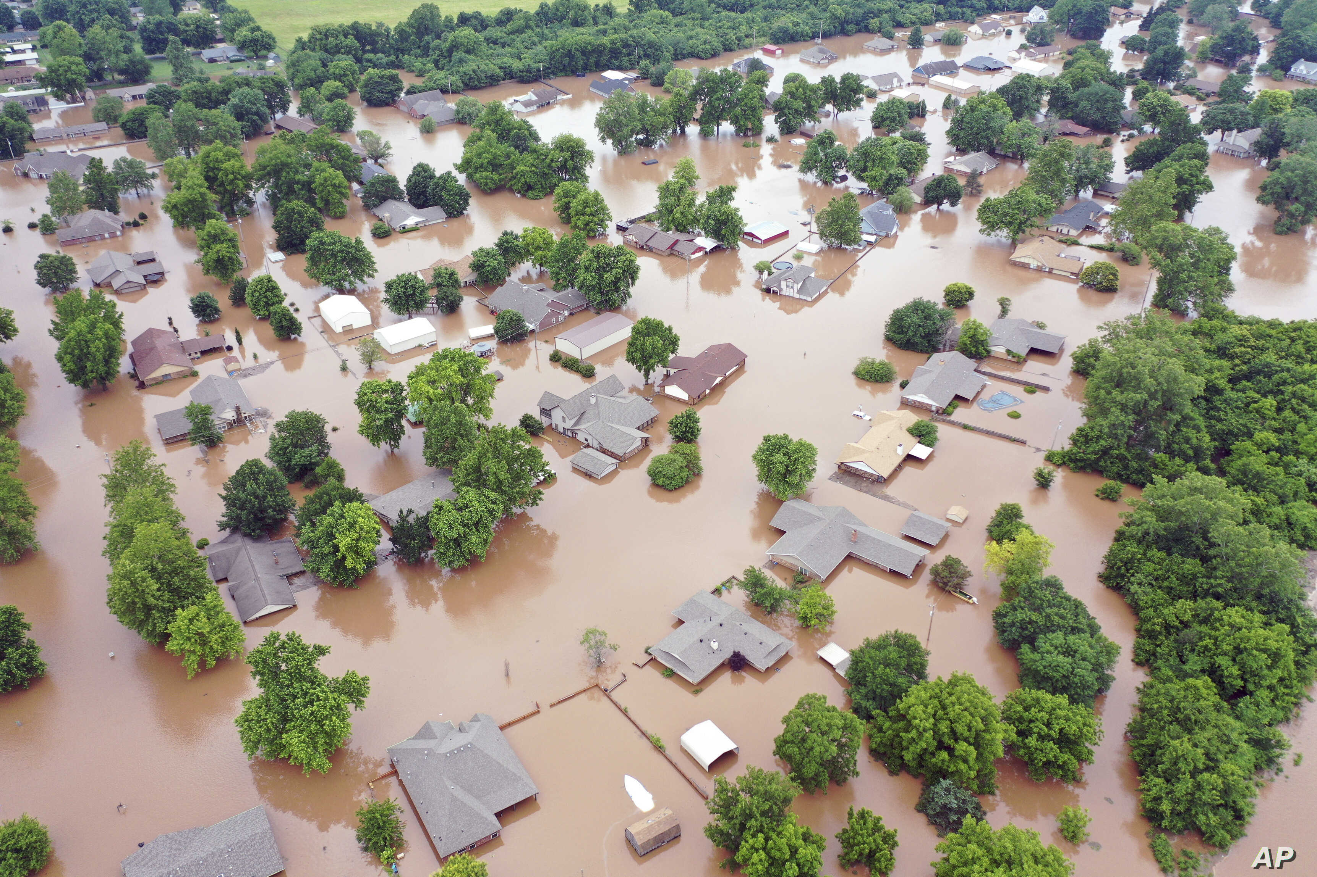

Geospatial Components of Climate Vulnerability
Geographic/Demographic Indicators
Low-lying/coastal
High elevation
Dense Urban
Extremely rural
Environmental Indicators*
Wildfire smoke prevalence
Precipitation (high and low)
Temperature stress (hot and cold)
Changes in meteorology (T, Precip, etc)
* These types of layers can be difficult to quantify directly without additional tools, e.g. meteorological or air quality models
Image credit: Associated Press
Image credit: cdc.gov
References: IPCC, NCA4
40

Slide 41
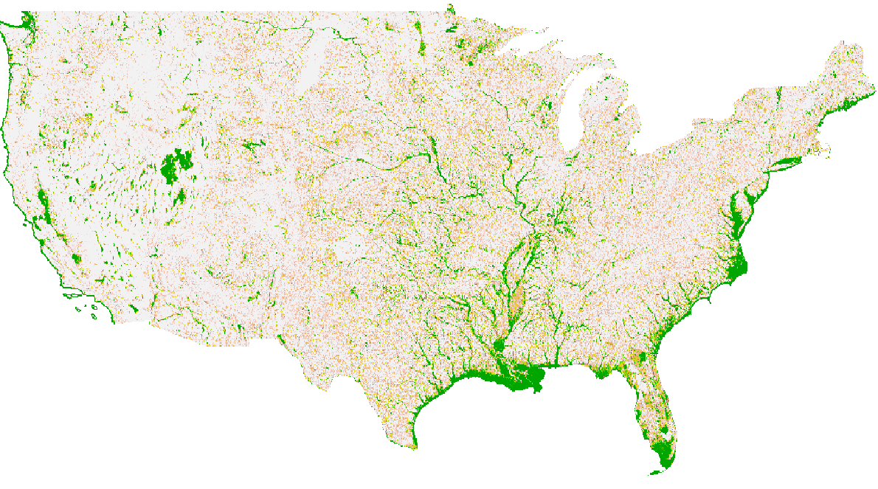
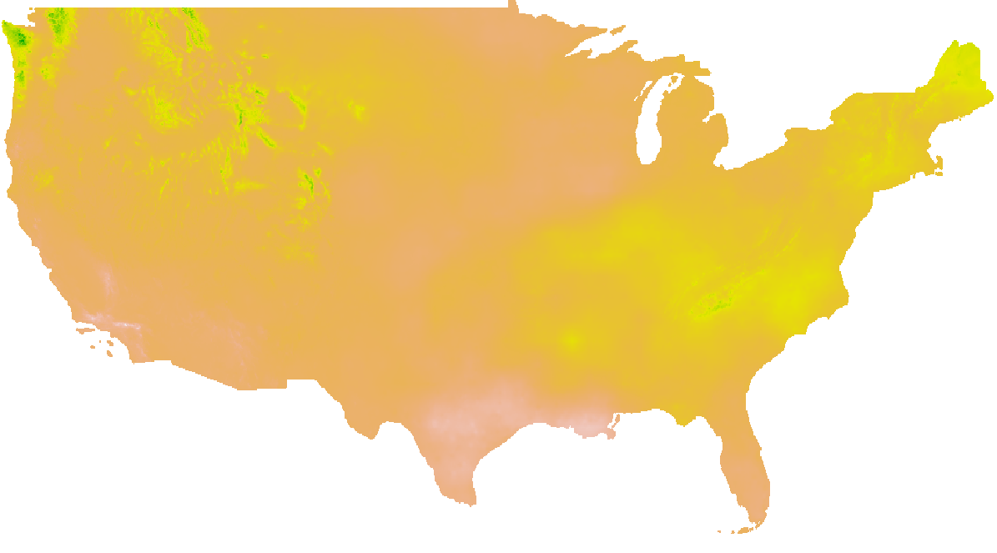
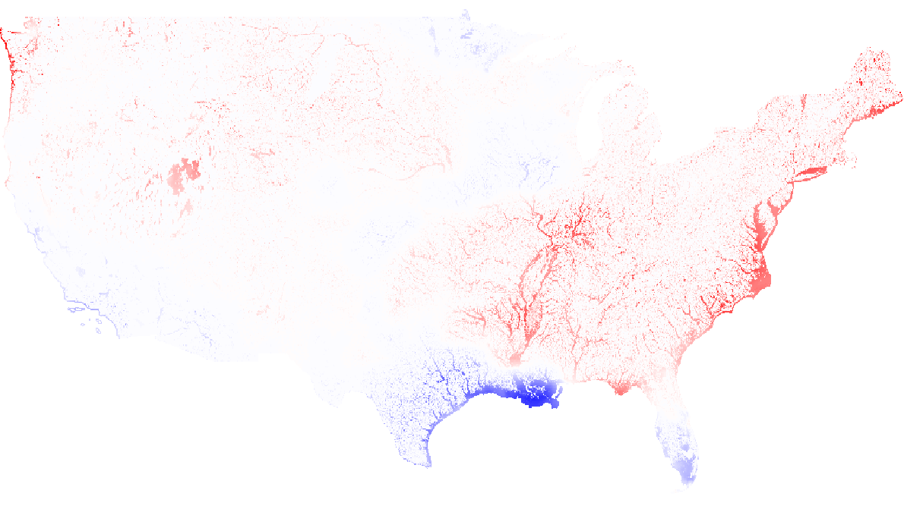
Addition of Policy-Relevant Data Layers / Indices
Floodplain
Projected Change in Precipitation by 2050
EnviroAtlas
NASA/NEX project
Combined Climate Indicators
41

Slide 42
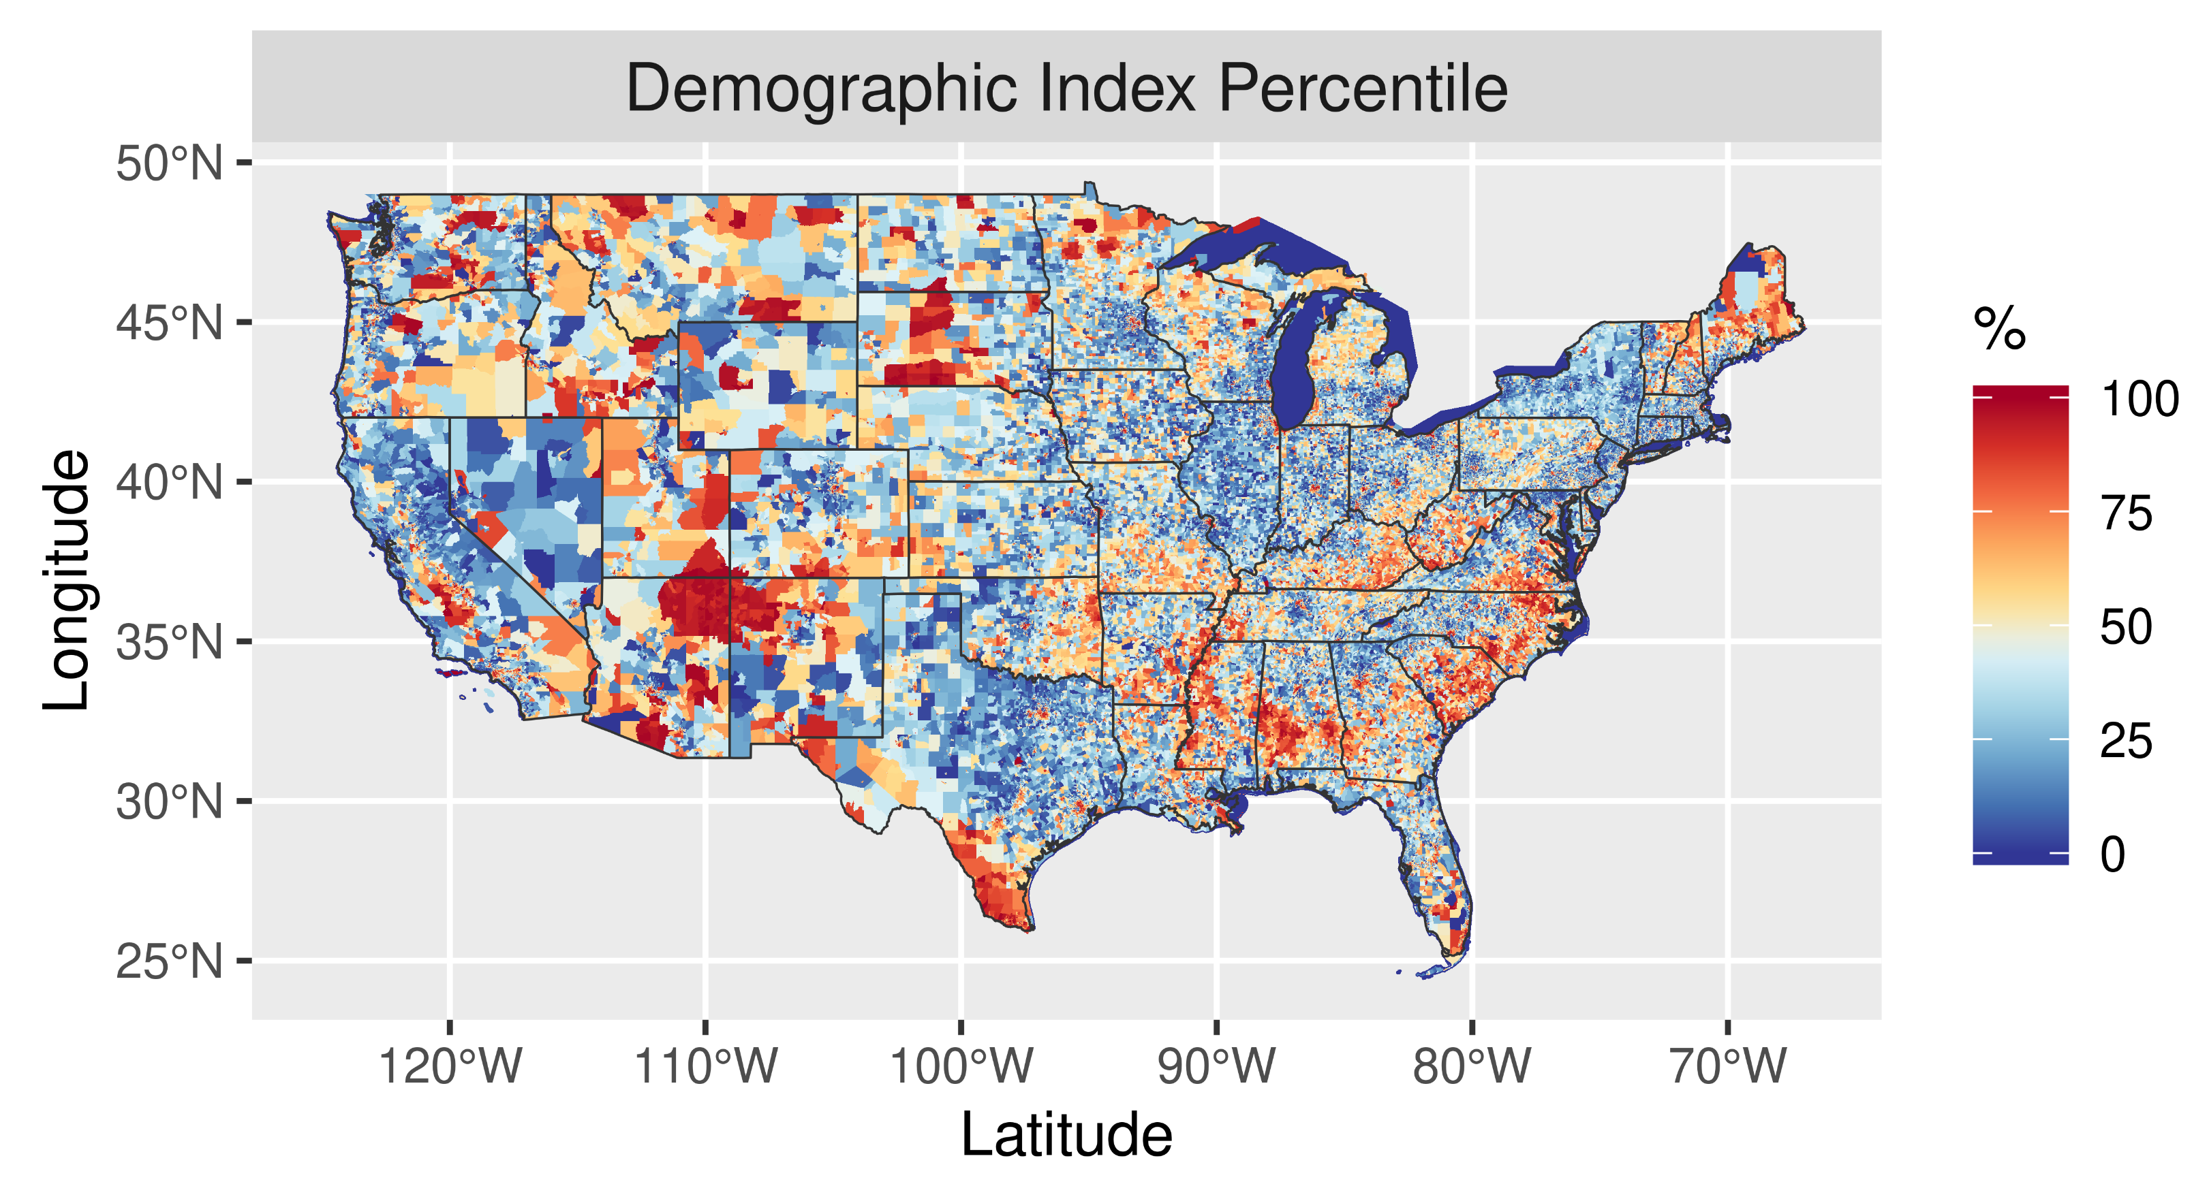
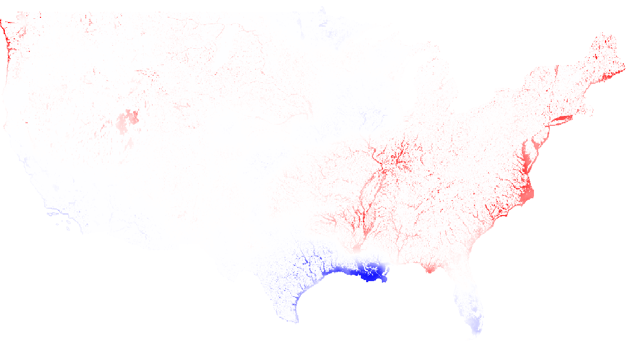
Addition of Policy-Relevant Data Layers / Indices
Combined Climate Indicators
Figure courtesy of J. Kelly
42

Slide 43
Addition of Policy-Relevant Data Layers / Indices
Combined Climate Indicators
Figure courtesy of J. Kelly
43

Slide 44
Appendix B
New Air Toxics Metrics
44

Slide 45
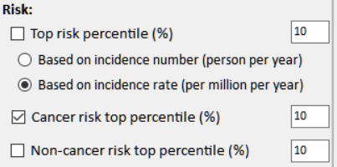
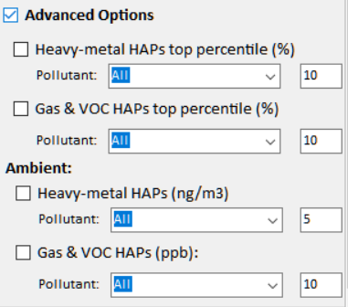
NEXUS Updates: New Air Toxics Metrics
Current
New
Risk:
□ Cancer Risk (max tract-level risk in the county): (default checked)
o Top risk Percentile (higher than x%) 90 (Note: default checked)
o Risk value (x-in-1 million) ? (Note: use 90 %tile risk value)
□ Non-cancer Hazard (max tract-level HI in the county):
o Top risk Percentile (higher than x%) 90 (default if above box checked)
o Hazard Index (HI) ? (Note: use 90 %tile value, find a reasonable range)
(Note: Add up all “HI” in “NATA_2014_Tract_HIs_FINAL” file.
“HI” > 1 means likely adverse non-cancer hazard; <1 means unlikely
Cancer Risk (max tract-level risk in the county):
□ PM & Metal HAPs
Pollutant: All
○ Top risk percentile (higher > %) 90
○ Risk value (x-in-1 million) ?
□ Gas & VOC HAPs
Pollutant: All
○ Top risk Percentile (higher > %) 90
○ Risk value (x-in-1 million) ?
[ ] Advanced Options:
45

Slide 46
Appendix C
Continuation of Slide 12
46

Slide 47
CBSA Name: Chicago-Joliet-Naperville, IL-IN-WI. Population: 9452622
Facility name: US STEEL GARY WORKS County/City/State: Lake/Gary/IN EIS_ID: 8192011 Sector Group: Petroleum Refining NAICS code: 324199 NAICS description: All Other Petroleum and Coal Products Manufacturing | 3089 | Facility name: ArcelorMittal USA LLC County/City/State: Lake/East Chicago/IN EIS_ID: 3986611 Sector Group: Iron and Steel Production NAICS code: 331110 NAICS description: Iron and Steel Mills and Ferroalloy Manufacturing | 2274 | Facility name: Ford Motor Co County/City/State: Cook/Chicago/IL EIS_ID: 7317011 Sector Group: Transportation Equipment Auto and Light Duty Truck NAICS code: 336111 NAICS description: Automobile Manufacturing | 297409 | Facility name: WISCONSIN ELECTRIC POWER COMPANY D/B/A WE ENERGIES-PLEASANT PRAIRIE POWER PLANT County/City/State: Kenosha/Pleasant Prairie/WI EIS_ID: 7509411 Sector Group: Electric Utilities NAICS code: 221112 NAICS description: Fossil Fuel Electric Power Generation | 6703669.7
Facility name: ARCELORMITTAL USA LLC County/City/State: Lake/East Chicago/IN EIS_ID: 3986511 Sector Group: Iron and Steel Production NAICS code: 331110 NAICS description: Iron and Steel Mills and Ferroalloy Manufacturing | 2868 | Facility name: Northern Indiana Public Service Company LLC - RM Schahfer Generating Station County/City/State: Jasper/Wheatfield/IN EIS_ID: 7957011 Sector Group: Electric Utilities NAICS code: 221112 NAICS description: Fossil Fuel Electric Power Generation | 1706 | Facility name: Ingredion Inc County/City/State: Cook/Bedford Park/IL EIS_ID: 946411 Sector Group: Food Products Manufacturing NAICS code: 311221 NAICS description: Wet Corn Milling | 225917 | Facility name: Northern Indiana Public Service Company LLC - RM Schahfer Generating Station County/City/State: Jasper/Wheatfield/IN EIS_ID: 7957011 Sector Group: Electric Utilities NAICS code: 221112 NAICS description: Fossil Fuel Electric Power Generation | 6492832.9
Facility name: WISCONSIN ELECTRIC POWER COMPANY D/B/A WE ENERGIES-PLEASANT PRAIRIE POWER PLANT County/City/State: Kenosha/Pleasant Prairie/WI EIS_ID: 7509411 Sector Group: Electric Utilities NAICS code: 221112 NAICS description: Fossil Fuel Electric Power Generation | 2128 | Facility name: BP Products North America Inc Whiting R County/City/State: Lake/Whiting/IN EIS_ID: 7247711 Sector Group: Petroleum Refining NAICS code: 32411 NAICS description: Petroleum Refineries | 1619 | Facility name: ArcelorMittal Burns Harbor LLC County/City/State: Porter/Burns Harbor/IN EIS_ID: 7376511 Sector Group: Coke Ovens NAICS code: 331110 NAICS description: Iron and Steel Mills and Ferroalloy Manufacturing | 214217 | Facility name: Dynegy Kendall Energy LLC County/City/State: Kendall/Minooka/IL EIS_ID: 9692211 Sector Group: Electric Utilities NAICS code: 221112 NAICS description: Fossil Fuel Electric Power Generation | 2943248.8
Facility name: BP Products North America Inc Whiting R County/City/State: Lake/Whiting/IN EIS_ID: 7247711 Sector Group: Petroleum Refining NAICS code: 32411 NAICS description: Petroleum Refineries | 1440 | Facility name: Exxon Mobil Oil Corp County/City/State: Will/Channahon/IL EIS_ID: 7360711 Sector Group: Petroleum Refining NAICS code: 324110 NAICS description: Petroleum Refineries | 1570 | Facility name: Exxon Mobil Oil Corp County/City/State: Will/Channahon/IL EIS_ID: 7360711 Sector Group: Petroleum Refining NAICS code: 324110 NAICS description: Petroleum Refineries | 163903 | Facility name: Exxon Mobil Oil Corp County/City/State: Will/Channahon/IL EIS_ID: 7360711 Sector Group: Petroleum Refining NAICS code: 324110 NAICS description: Petroleum Refineries | 2663474.1
Facility name: Northern Indiana Public Service Company LLC - Bailly Generating Station County/City/State: Porter/Chesterton/IN EIS_ID: 7376611 Sector Group: Electric Utilities NAICS code: 221112 NAICS description: Fossil Fuel Electric Power Generation | 1169 | Facility name: Ingredion Inc County/City/State: Cook/Bedford Park/IL EIS_ID: 946411 Sector Group: Food Products Manufacturing NAICS code: 311221 NAICS description: Wet Corn Milling | 1463 | Facility name: Dart Container Corp of Illinois County/City/State: Kane/North Aurora/IL EIS_ID: 2603711 Sector Group: Foam Manufacturing NAICS code: 326140 NAICS description: Polystyrene Foam Product Manufacturing | 134077 | Facility name: Waukegan Electric Generating Station County/City/State: Lake/Waukegan/IL EIS_ID: 7792311 Sector Group: Electric Utilities NAICS code: 221112 NAICS description: Fossil Fuel Electric Power Generation | 2228899.2
Facility name: Exxon Mobil Oil Corp County/City/State: Will/Channahon/IL EIS_ID: 7360711 Sector Group: Petroleum Refining NAICS code: 324110 NAICS description: Petroleum Refineries | 1160 | Facility name: Waukegan Electric Generating Station County/City/State: Lake/Waukegan/IL EIS_ID: 7792311 Sector Group: Electric Utilities NAICS code: 221112 NAICS description: Fossil Fuel Electric Power Generation | 931 | Facility name: Equistar Chemicals LP County/City/State: Grundy/Morris/IL EIS_ID: 8209311 Sector Group: Consumer Products (Cleaning, Photographic, etc.) NAICS code: 325998 NAICS description: All Other Miscellaneous Chemical Product and Preparation Manufacturing | 132087 | Facility name: Northern Indiana Public Service Company LLC - Bailly Generating Station County/City/State: Porter/Chesterton/IN EIS_ID: 7376611 Sector Group: Electric Utilities NAICS code: 221112 NAICS description: Fossil Fuel Electric Power Generation | 2120968.6
47

Slide 48
Appendix D
Continuation of Slide 13
48

Slide 49
“Sector group” emissions combined for all 50 CBSAs (based on top 20 facility emissions in each CBSA); Total Population: 134,940,816
Sector Group | SO2 (TON) | NOx (TON) | PM2.5 (TON) | Gas_VOC_HAPs (LB) | Heavy_Metal_HAPs (LB) | CO2e (TON) | SO2 Score (freq. & rank)
Asphalt Products Manufacturing | 917 | 1211 | 929 | 479267 | 2470 | 359866 | 389
Mining Activities | 860 | 3247 | 2090 | 478466 | 3527 | 2184543 | 120
Waste Treatment and Disposal | 640 | 2452 | 579 | 663971 | 5997 | 1901478 | 235
Construction and Related Industries | 580 | 2640 | 303 | 192543 | 3476 | 5161735 | 85
Polymers and Resins Production | 504 | 6810 | 1506 | 7153761 | 2487 | 4612128 | 104
Commercial Sterilization | 434 | 2222 | 305 | 155006 | 1090 | 1260938 | 115
Business Activities | 382 | 5055 | 627 | 761149 | 7101 | 3506488 | 99
Fibrous Minerals Production | 295 | 332 | 856 | 356831 | 1963 | 426975 | 58
Metal Fabrication | 293 | 1715 | 596 | 1239127 | 26233 | 757296 | 50
Wholesale and Retail Trade | 179 | 1305 | 531 | 2136286 | 4275 | 475685 | 52
Textiles and Apparel Manufacturing | 149 | 359 | 190 | 335731 | 300 | 74258 | 30
Iron and Steel Foundries | 143 | 578 | 1480 | 211778 | 23234 | 553631 | 82
Government (non-Defense) | 90 | 1927 | 856 | 232383 | 3357 | 662687 | 70
Building Products Manufacturing | 80 | 747 | 449 | 349973 | 5188 | 455439 | 11
Transportation Equipment Aerospace Industry | 45 | 735 | 106 | 671151 | 6357 | 214916 | 1
Agriculture and Forest Products (Not Specified) | 44 | 55 | 55 | 8973 | 48 | 177 | 25
49

