Slide 1
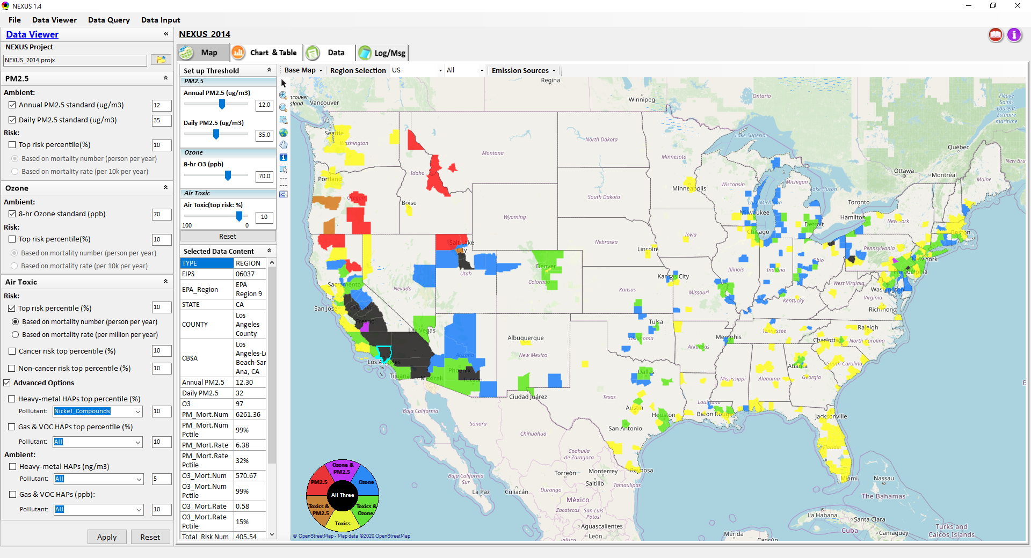
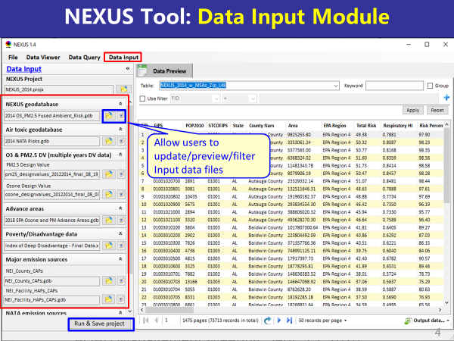
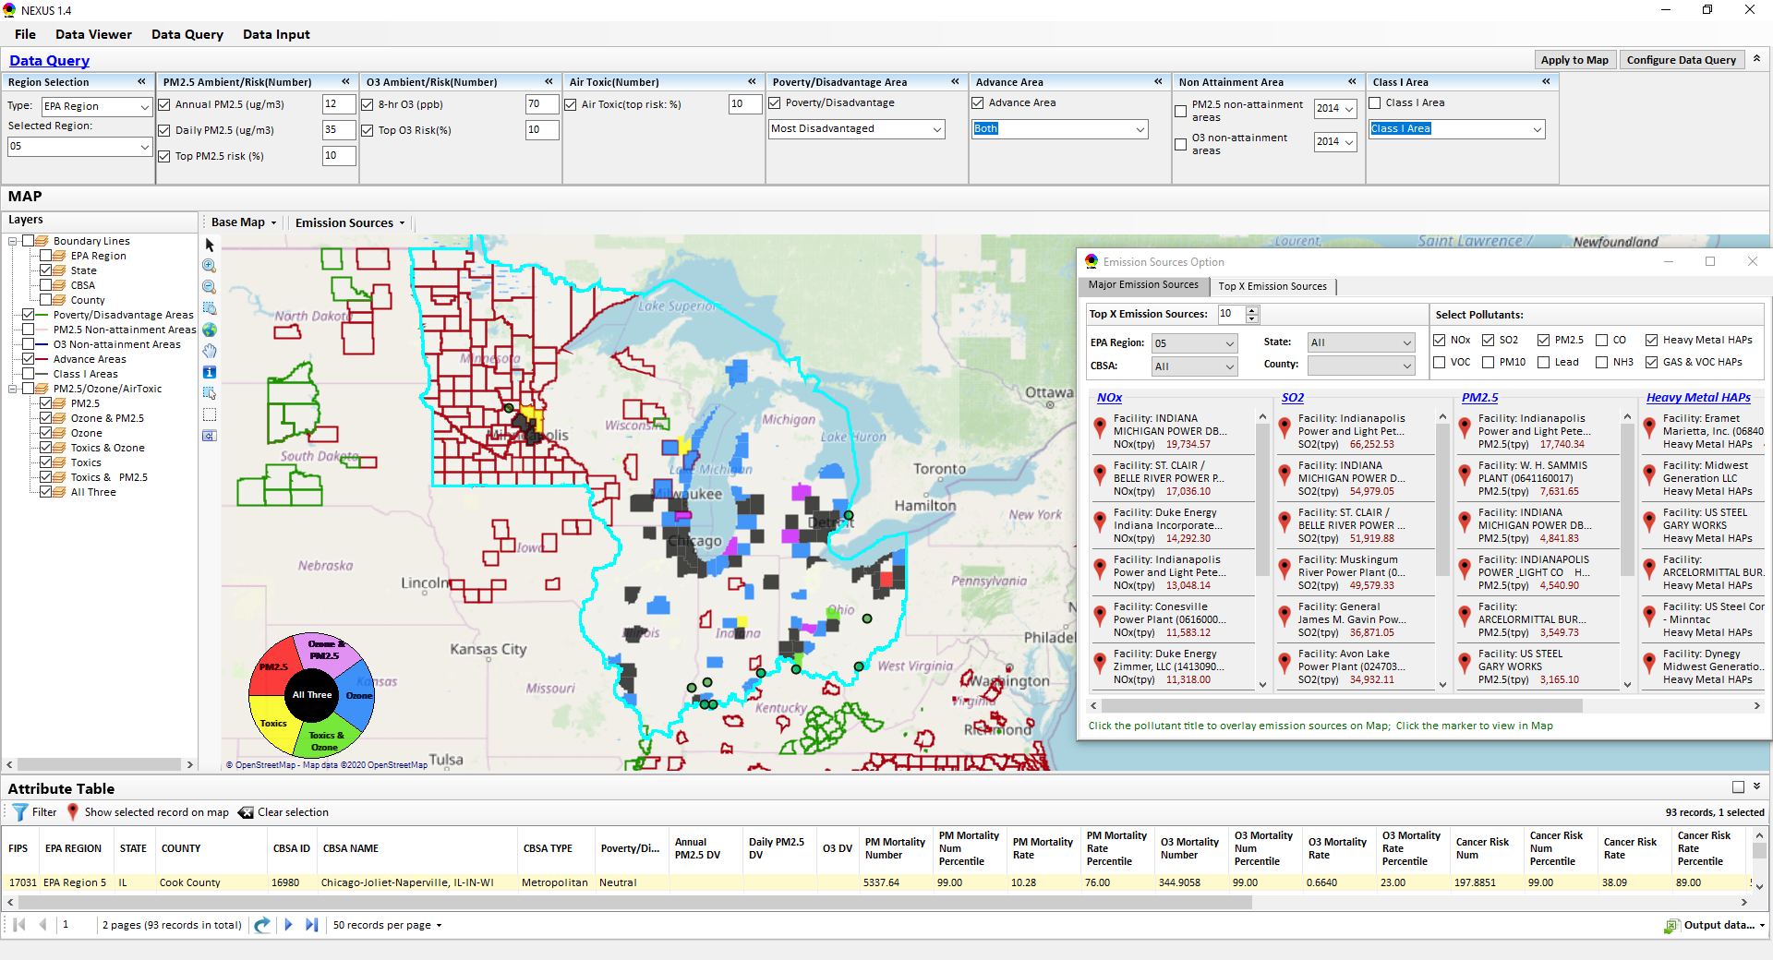
“NEXUS” Multi-Pollutant Analysis Tool
Development: Status Update
Data Viewer Module
Data Input Module
Data Query Module
“NEXUS 1.5” available on OAQPS’s Shared Drive at: “G:\SHARE\NEXUS\NEXUS 1.5\”
or at EPA’s new FTP site: ftp://newftp.epa.gov/aqmg/cjang/NEXUS/NEXUS 1.5/
HEID/AQAD Briefing
March 23, 2021
Carey Jang & Beth Landis

Slide 2
Overview
Feedback from OAQPS/SMT Briefing
NEXUS Updates
  Metrics (Toxics)
  2017 Data
  Multi-pollutant Proximity Based Module
National Sector Approach – NEXUS Application
Ranking of Highest Risk Areas
Examples for Regions
  Chicago
  Pittsburgh
  Houston
Next Steps / Issues for Discussion
2

Slide 3
Feedback from OAQPS & SMT Briefing
Improve the national screening metrics for air toxics to reduce possible ‘false-negatives’
Augment current “area” orientation of tool to provide national and areas screening capabilities for sectors in multi-pollutant context
Within high risk areas, provide multi-pollutant “proximity-based“ EJ screening analysis for sources/sectors so accounts for criteria and toxic pollutants
Provide information that can help prioritize SPPD rules
Incorporate Economic information?
3

Slide 4
NEXUS 1.7 (Under Development)
Near-term Priorities for 2021 NEXUS development:
Upgrade NEXUS (modules/metrics/EJ ) for beta release
  Revising air toxic (AT) metrics based on AT team’s suggestions
  Include EJ/demographic index & Tribal areas
2017 emissions data update (including GHG & Sector mapping)
(Supplemental information provided in “Sector Prioritization” context)
2017 AQ concentrations (PM_{2.5}, O₃, AT) & risk data update (note: separate discussion on air toxics risk effort with SMT)
Draft design for new Multi-pollutant based “Proximity analysis” module for EJ and related considerations (census tract and block level)
Ongoing
Planned
4

Slide 5
Need to Improve Air Toxics Metrics
MP Team engaged with Air Toxics Team to improve upon current national screening metrics for air toxics
Current risk metrics were based on county-level population weighted averages (not appropriately accounting for local nature of risks) so false negatives could influence the areas ranking
ATAG provided input on improving these metrics
  New metrics now reflect more local risk (at census-tract level) and expressed in “X in a million”
  Update use of percentiles based on risk value
5

Slide 6
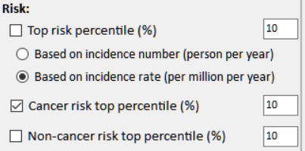
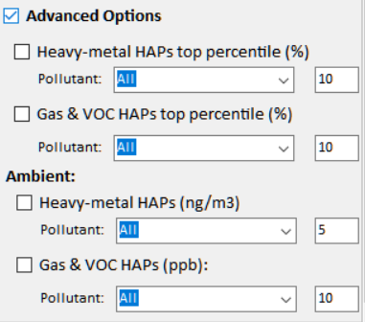
NEXUS Updates: New Air Toxics Metrics
Current
New
Risk:
□ Cancer Risk (max tract-level risk in the county): (default checked)
o Top risk Percentile (higher than x%) 90 (Note: default checked)
o Risk value (x-in-1 million) ? (Note: use 90 %tile risk value)
□ Non-cancer Hazard (max tract-level HI in the county):
o Top risk Percentile (higher than x%) 90 (default if above box checked)
o Hazard Index (HI) ? (Note: use 90 %tile value, find a reasonable range)
(Note: Add up all “HI” in “NATA_2014_Tract_HIs_FINAL” file.
“HI” > 1 means likely adverse non-cancer hazard; <1 means unlikely
Cancer Risk (max tract-level risk in the county):
□ PM & Metal HAPs
Pollutant: All
○ Top risk percentile (higher > %) 90
○ Risk value (x-in-1 million) ?
□ Gas & VOC HAPs
Pollutant: All
○ Top risk Percentile (higher > %) 90
○ Risk value (x-in-1 million) ?
[ ] Advanced Options:
6

Slide 7
Regional Engagement: Highest MP Risk Areas
 | EPA_REGION | STATE | CBSA_NAME | Overall Rank
1 | EPA Region 5 | IL-IN-WI | Chicago-Joliet-Naperville, IL-IN-WI | 1
2 | EPA Region 3 | PA | Pittsburgh, PA | 1
3 | EPA Region 6 | TX | Houston-Sugar Land-Baytown, TX | 1
4 | EPA Region 9 | CA | Los Angeles-Long Beach-Santa Ana, CA | 2
5 | EPA Region 6 | TX | Dallas-Fort Worth-Arlington, TX | 2
6 | EPA Region 4 | GA | Atlanta-Sandy Springs-Marietta, GA | 3
7 | EPA Region 4 | FL | Tampa-St. Petersburg-Clearwater, FL | 3
8 | EPA Region 4 | AL | Birmingham-Hoover, AL | 3
9 | EPA Region 9 | AZ | Phoenix-Mesa-Glendale, AZ | 3
10 | EPA Region 9 | CA | Fresno, CA | 3
11 | EPA Region 2 | NY-NJ-PA | New York-Northern New Jersey-Long Island, NY-NJ-PA | 3
12 | EPA Region 5 | OH | Cleveland-Elyria-Mentor, OH | 3
13 | EPA Region 9 | CA | Sacramento--Arden-Arcade--Roseville, CA | 4
14 | EPA Region 9 | NV | Las Vegas-Paradise, NV | 4
15 | EPA Region 4 | NC-SC | Charlotte-Gastonia-Rock Hill, NC-SC | 5
16 | EPA Region 9 | CA | San Diego-Carlsbad-San Marcos, CA | 5
17 | EPA Region 5 | MI | Detroit-Warren-Livonia, MI | 5
18 | EPA Regions 5 & 7 | MO-IL | St. Louis, MO-IL | 5
 | EPA_REGION | STATE | CBSA_NAME | Overall Rank
19 | EPA Region 5 | MI | Grand Rapids-Wyoming, MI | 6
20 | EPA Region 4 | TN | Nashville-Davidson--Murfreesboro--Franklin, TN | 6
21 | EPA Region 9 | CA | Bakersfield-Delano, CA | 6
22 | EPA Regions 2 & 3 | PA-NJ-DE-MD | Philadelphia-Camden-Wilmington, PA-NJ-DE-MD | 6
23 | EPA Region 9 | CA | Riverside-San Bernardino-Ontario, CA | 6
24 | EPA Region 4 | FL | Miami-Fort Lauderdale-Pompano Beach, FL | 6
25 | EPA Region 6 | LA | Baton Rouge, LA | 7
26 | EPA Region 6 | TX | El Paso, TX | 7
27 | EPA Region 10 | WA | Seattle-Tacoma-Bellevue, WA | 7
28 | EPA Region 4 & 5 | KY-IN | Louisville-Jefferson County, KY-IN | 7
29 | EPA Region 8 | CO | Denver-Aurora-Broomfield, CO | 8
30 | EPA Region 3 | PA | Reading, PA | 8
31 | EPA Region 9 | CA | Visalia-Porterville, CA | 8
32 | EPA Region 1 | CT | Bridgeport-Stamford-Norwalk, CT | 8
33 | EPA Region 4 & 6 | TN-MS-AR | Memphis, TN-MS-AR | 8
34 | EPA Regions 2 & 3 | PA-NJ | Allentown-Bethlehem-Easton, PA-NJ | 9
35 | EPA Region 6 | LA | New Orleans-Metairie-Kenner, LA | 9
NEXUS can be used to identify highest risk areas across O₃, PM_{2.5}, and Air Toxics. OAQPS could provide area profile packets to Regions to discuss nature of MP issues and possible avenues to address or conduct more refined analyses.
The information above was generated in NEXUS & exported into Excel where rankings were applied.
These CBSAs include at least one county that meets ALL the following criteria:
PM Mortality Number Percentile >= 90
O₃ Mortality Number Percentile >= 90
Cancer Risk Rate Max Percentile >= 90 (max census tract-level in a county)
7

Slide 8
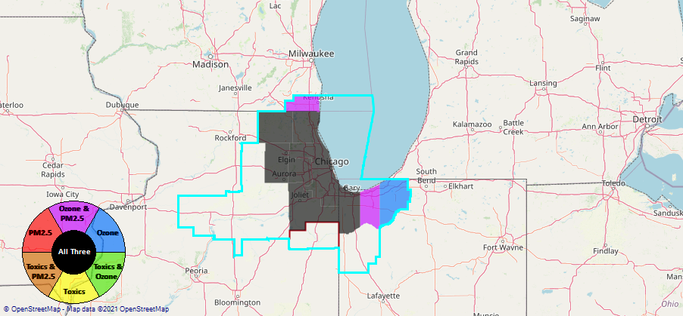
Region 5 Example—Chicago CBSA
Generated in NEXUS
8

Slide 9
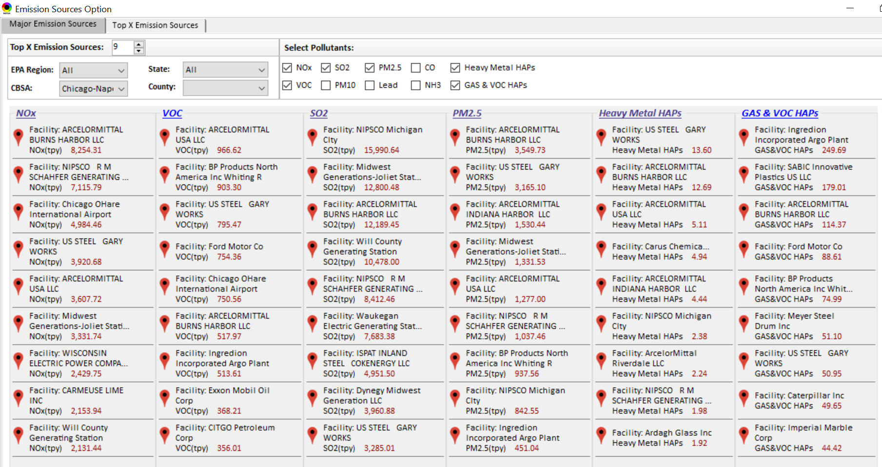
Chicago CBSA: Top Emission Sources
Generated in NEXUS
9

Slide 10
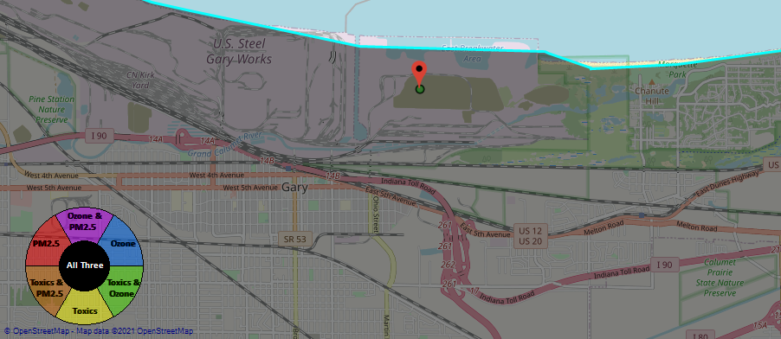
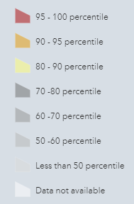
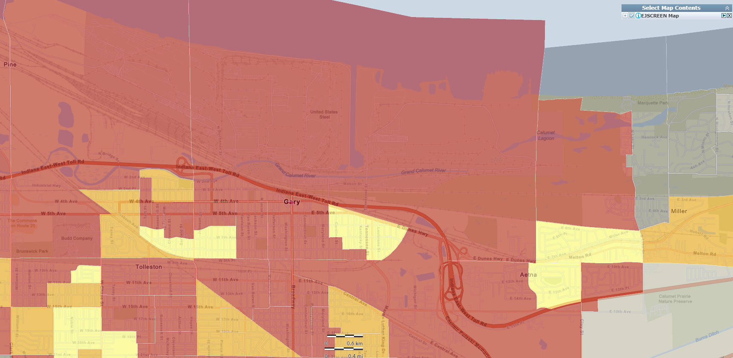
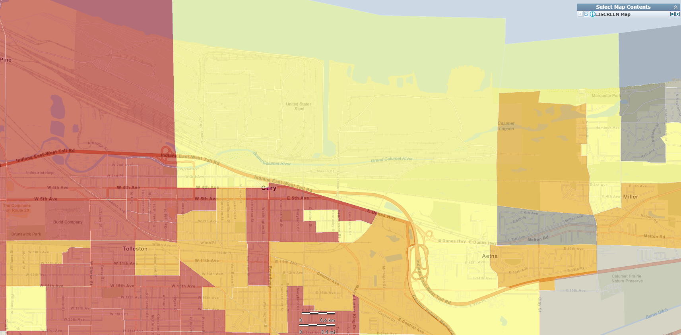
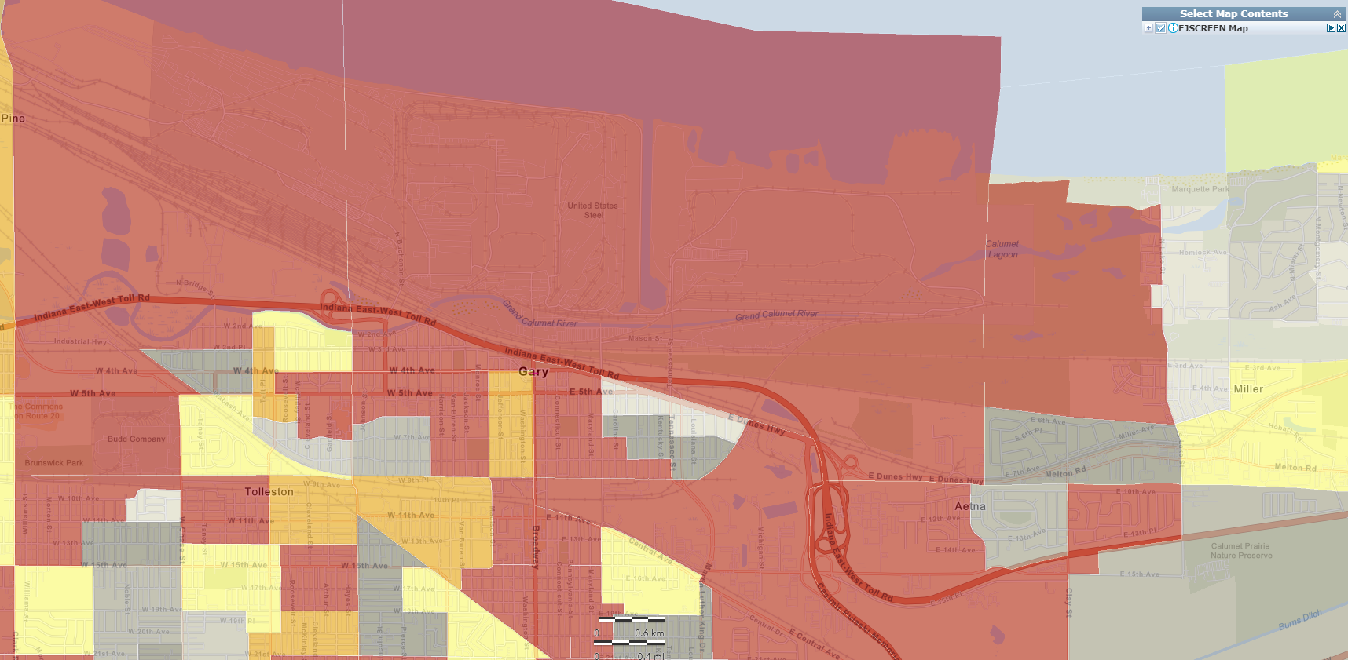
Chicago CBSA: US Steel Gary Works & EJ Screening
Generated in NEXUS
National Percentiles
Generated in EJSCREEN
Generated in EJSCREEN
Generated in EJSCREEN
Demographic Index
People of Color Population
10
Low Income

Slide 11
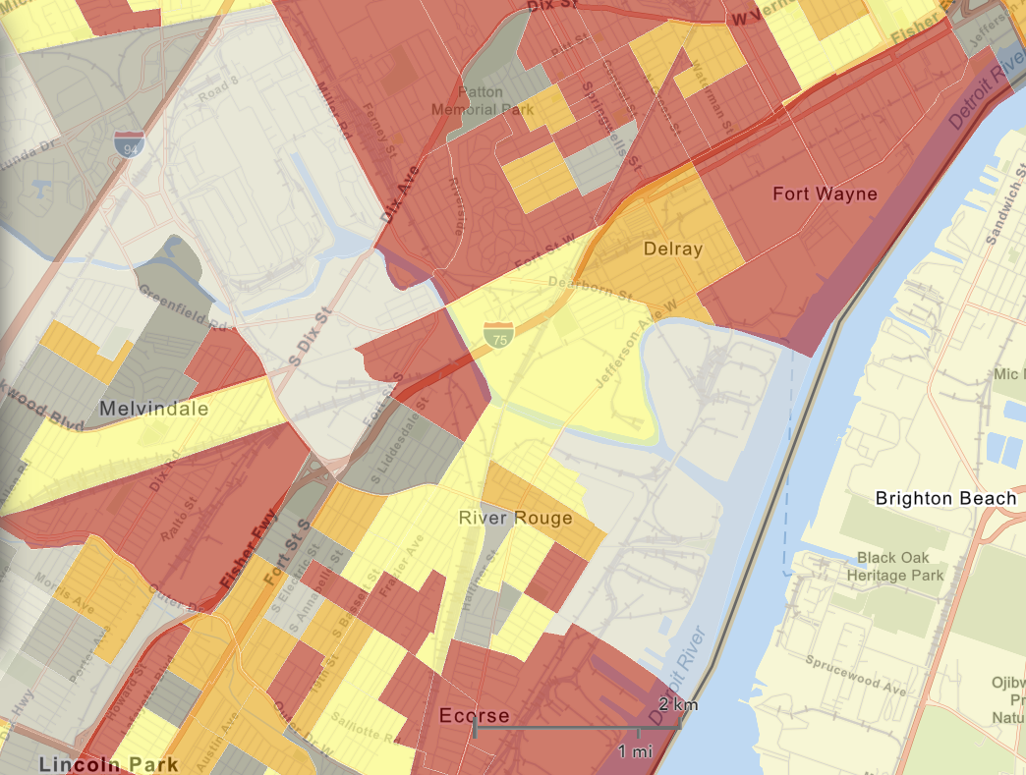
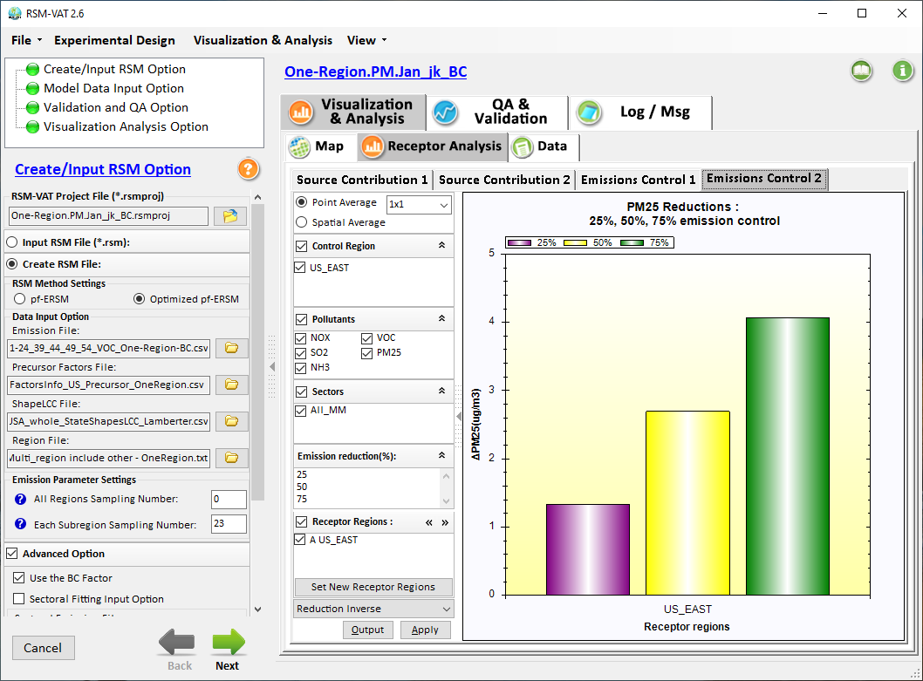
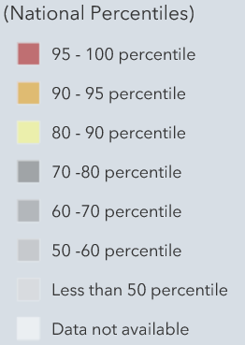

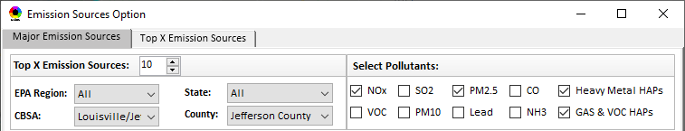
Example of Multi-Pollutant Proximity Analysis Module: Spatial Analysis
Air Quality
PM2.5 risk
O3 risk
Air Toxics risk
Cancer risk
Non-Cancer risk
EJ Indicators
Climate Risks
Population
Minority
Income
Education
Language
Flood
Fire
Sea Level Rise
Heat
Disease
Climate Risks
Flood
Fire
Sea Level Rise
Heat
Disease
Proximity-based Source/Sector Multi-Pollutant Risk & EJ Analysis
Source/Sector Analysis
Spatial Analysis
EJ
Indicators
Minority
Climate
Risk
Fire
11

Slide 12
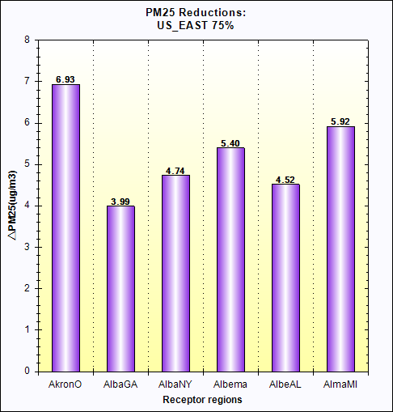
Multi-pollutant Screening Proximity Analysis in NEXUS:
Example Chart
Air Quality
Facility: American Synthesis Rubber Co., Louisville, KY
Sector Group: Polymers and Resins Production
PM2.5 risk
O3 risk
Air Toxics risk
Cancer risk
Non-Cancer risk
(%tile
EJ Indicators
Climate Risks
Population
Minority
Income
Education
Language
Flood
Fire
Sea Level Rise
Heat
Disease
Nation
avg. (%tile)
Climate Risks
Flood
Fire
Sea Level Rise
Heat
Disease
Within Radius County avg. State avg. EPA region avg. Nation avg. Sector Group avg.
of Facility (Within Radius)
12

Slide 13
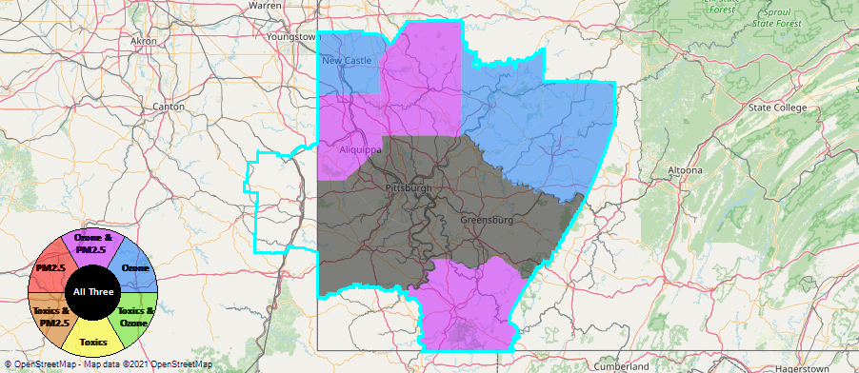
Region 3 Example—Pittsburgh CBSA
Generated in NEXUS
13

Slide 14
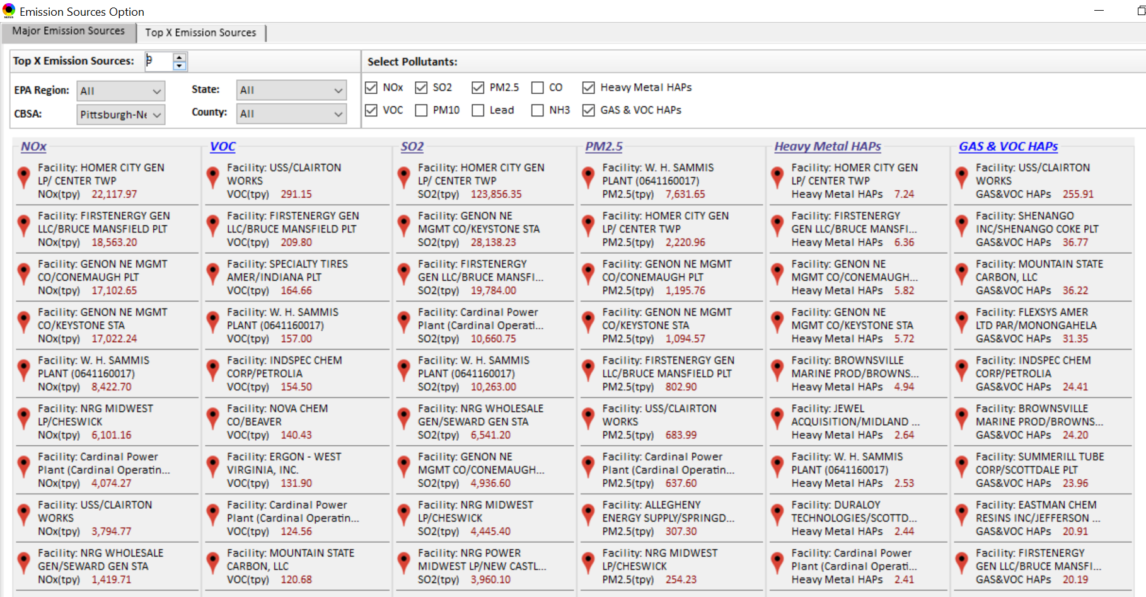
Pittsburgh CBSA: Top Emission Sources
Generated in NEXUS
EGUs
14

Slide 15
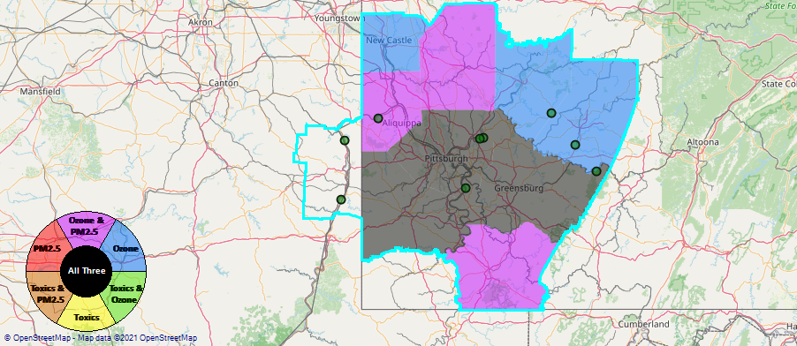
Pittsburgh CBSA – Dominated by EGUs
Generated in NEXUS
15

Slide 16
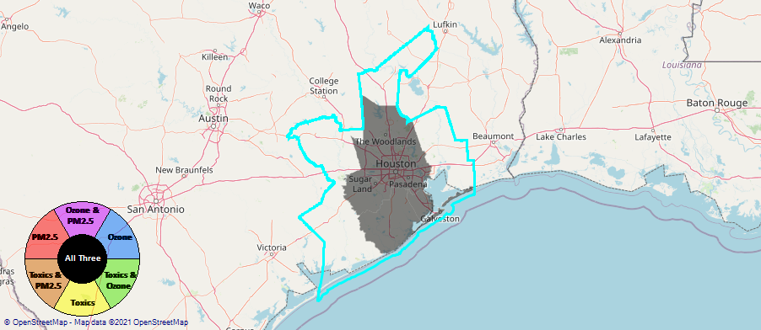
Region 6 Example–Houston CBSA
Generated in NEXUS
16

Slide 17
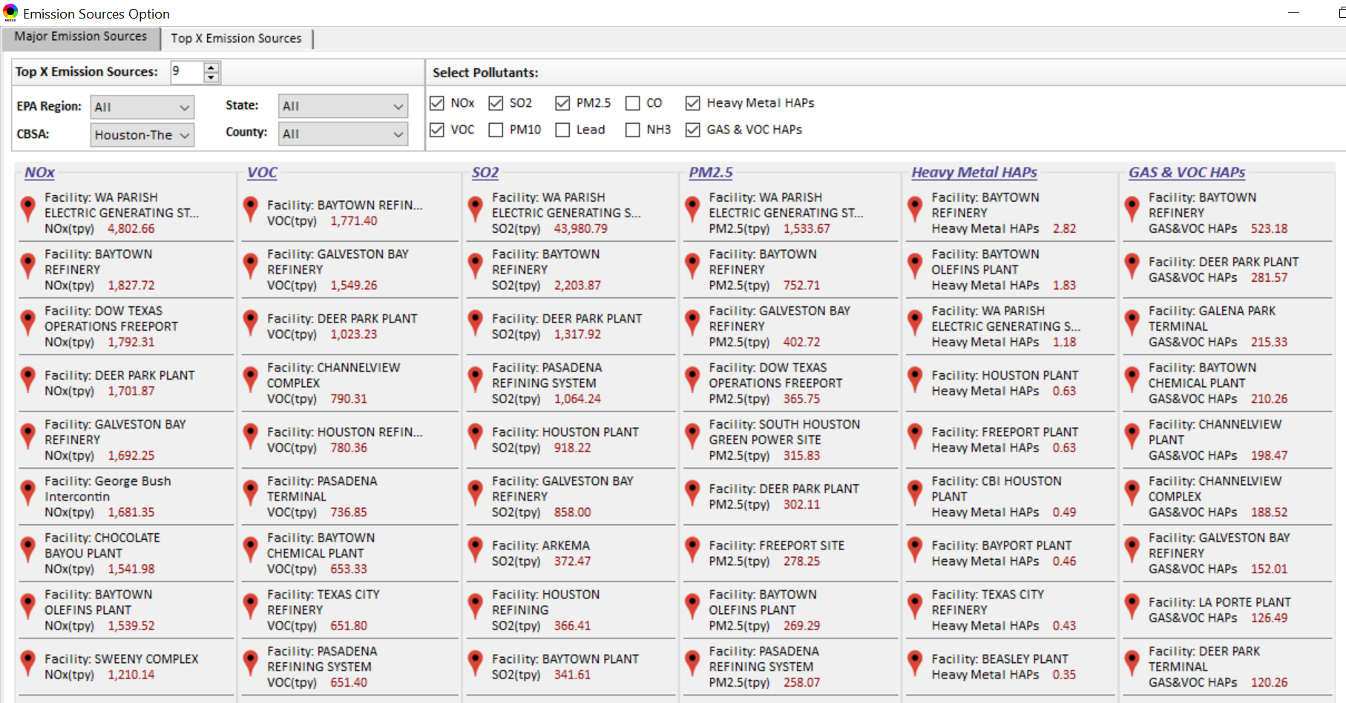
Houston CBSA: Top Emission Sources
Generated in NEXUS
17

Slide 18
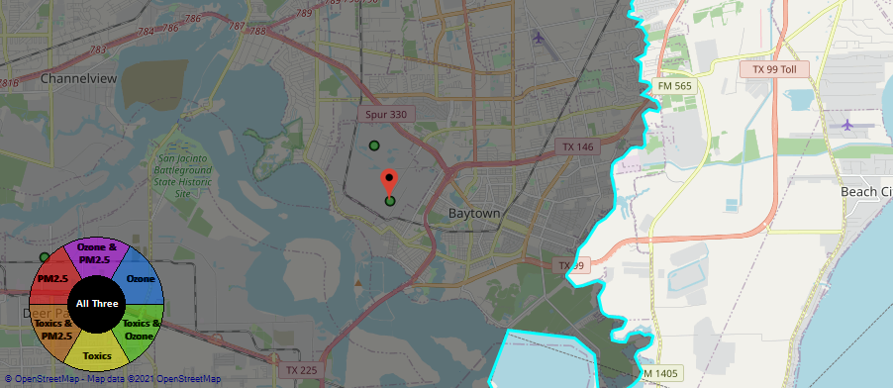
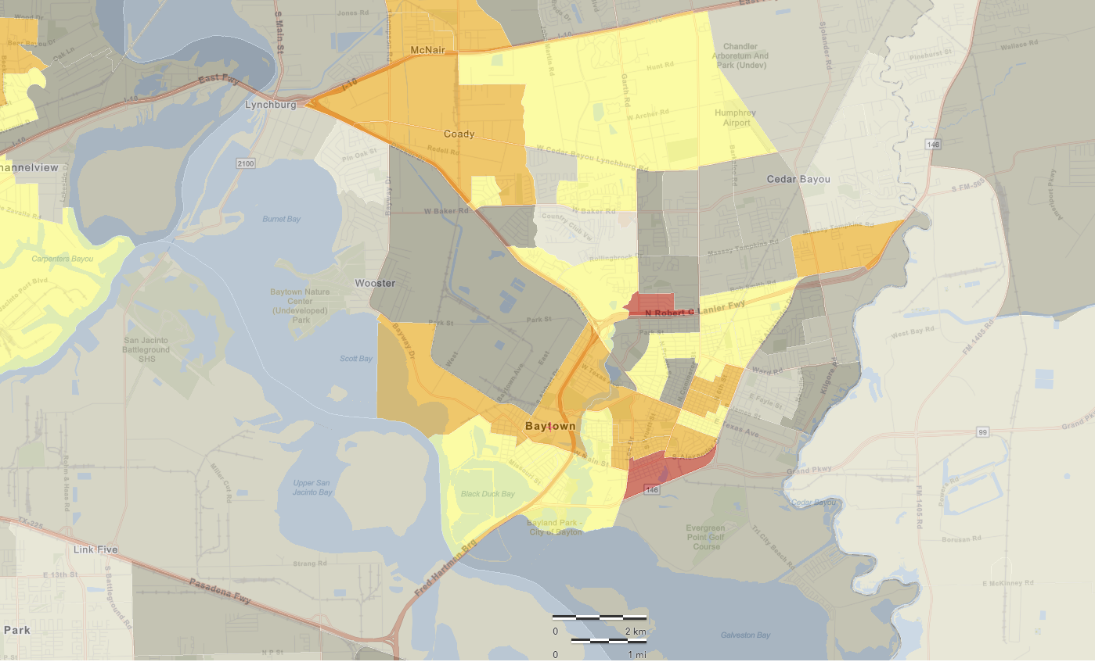
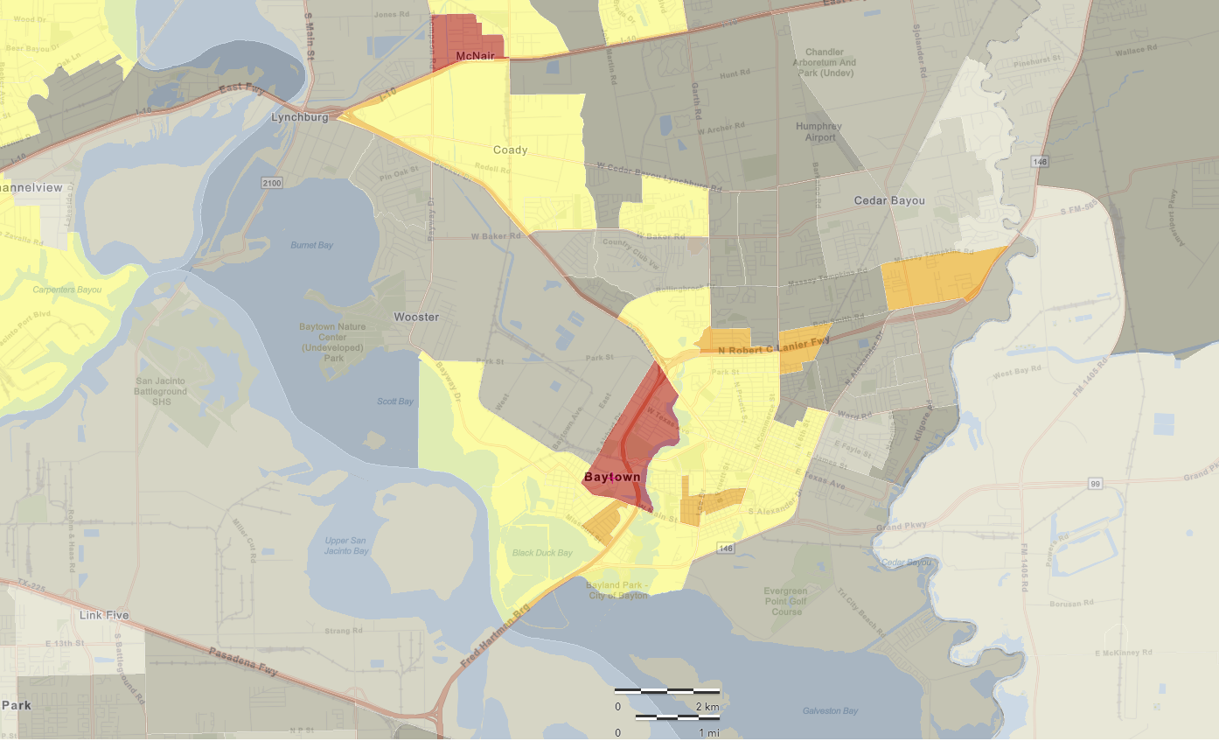
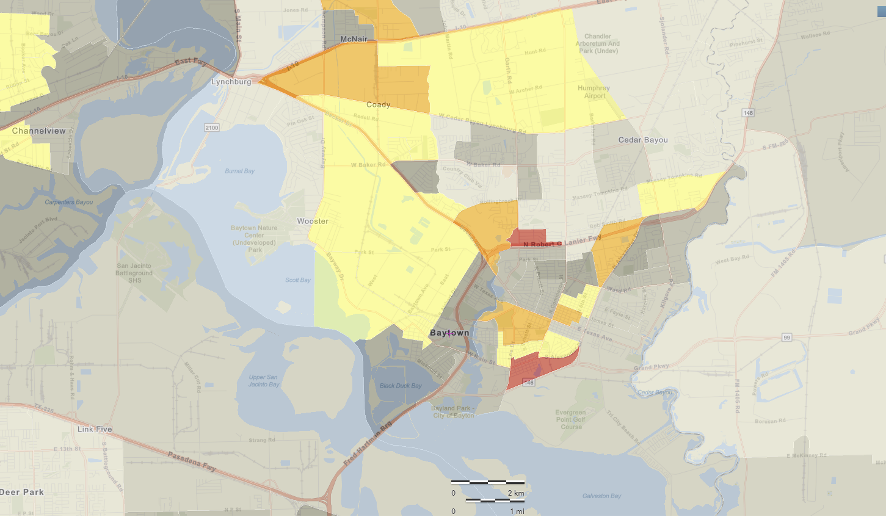
Houston CBSA: Baytown Chemical Plant & Refinery
Generated in NEXUS
National Percentiles
Baytown Olefins Plant (Chemical Plant)
Baytown Refinery (Petroleum)
Generated in EJSCREEN
Generated in EJSCREEN
Generated in EJSCREEN
Demographic Index
People of Color Population
18
Low Income

Slide 19
Next Steps / Issues for Discussion
Next Steps
  Follow up with additional EJ discussions/connection with EJSCREEN
  Updating existing data to 2017
    Emissions, O₃/PM_{2.5}/Toxics concentration, O₃ and PM_{2.5} risk
  Add new information
    Tribal areas, Advance areas, GHG emissions, monitoring data
  Develop MP proximity analysis module for areas
    MP risk in context of EJ (and can incorporate climate considerations)
  Meeting with economics group
Issues for Discussion
  2017 Air Toxics Risk Data
  OAQPS review/prioritization of analytical tools
  Funding mechanism
19

Slide 20
Questions?
20

Slide 21
Appendix A
NEXUS Sector Ranking within Highest Risk Areas
21

Slide 22
MP Ranking: CBSAs w/ Top-Ranked MP Risks
Method: Identify CBSAs with top MP risk ranking: Major CBSAs are selected.
 | EPA_REGION | STATE | CBSA_NAME | Overall Rank
1 | EPA Region 5 | IL-IN-WI | Chicago-Joliet-Naperville, IL-IN-WI | 1
2 | EPA Region 3 | PA | Pittsburgh, PA | 1
3 | EPA Region 6 | TX | Houston-Sugar Land-Baytown, TX | 1
4 | EPA Region 9 | CA | Los Angeles-Long Beach-Santa Ana, CA | 2
5 | EPA Region 6 | TX | Dallas-Fort Worth-Arlington, TX | 2
6 | EPA Region 4 | GA | Atlanta-Sandy Springs-Marietta, GA | 3
7 | EPA Region 4 | FL | Tampa-St. Petersburg-Clearwater, FL | 3
8 | EPA Region 4 | AL | Birmingham-Hoover, AL | 3
9 | EPA Region 9 | AZ | Phoenix-Mesa-Glendale, AZ | 3
10 | EPA Region 9 | CA | Fresno, CA | 3
11 | EPA Region 2 | NY-NJ-PA | New York-Northern New Jersey-Long Island, NY-NJ-PA | 3
12 | EPA Region 5 | OH | Cleveland-Elyria-Mentor, OH | 3
13 | EPA Region 9 | CA | Sacramento--Arden-Arcade--Roseville, CA | 4
14 | EPA Region 9 | NV | Las Vegas-Paradise, NV | 4
15 | EPA Region 4 | NC-SC | Charlotte-Gastonia-Rock Hill, NC-SC | 5
16 | EPA Region 9 | CA | San Diego-Carlsbad-San Marcos, CA | 5
17 | EPA Region 5 | MI | Detroit-Warren-Livonia, MI | 5
18 | EPA Regions 5 & 7 | MO-IL | St. Louis, MO-IL | 5
19 | EPA Region 5 | MI | Grand Rapids-Wyoming, MI | 6
20 | EPA Region 4 | TN | Nashville-Davidson--Murfreesboro--Franklin, TN | 6
21 | EPA Region 9 | CA | Bakersfield-Delano, CA | 6
22 | EPA Regions 2 & 3 | PA-NJ-DE-MD | Philadelphia-Camden-Wilmington, PA-NJ-DE-MD | 6
23 | EPA Region 9 | CA | Riverside-San Bernardino-Ontario, CA | 6
24 | EPA Region 4 | FL | Miami-Fort Lauderdale-Pompano Beach, FL | 6
25 | EPA Region 6 | LA | Baton Rouge, LA | 7
26 | EPA Region 6 | TX | El Paso, TX | 7
27 | EPA Region 10 | WA | Seattle-Tacoma-Bellevue, WA | 7
28 | EPA Region 4 & 5 | KY-IN | Louisville-Jefferson County, KY-IN | 7
 | EPA_REGION | STATE | CBSA_NAME | Overall Rank
29 | EPA Region 8 | CO | Denver-Aurora-Broomfield, CO | 8
30 | EPA Region 3 | PA | Reading, PA | 8
31 | EPA Region 9 | CA | Visalia-Porterville, CA | 8
32 | EPA Region 1 | CT | Bridgeport-Stamford-Norwalk, CT | 8
33 | EPA Region 4 & 6 | TN-MS-AR | Memphis, TN-MS-AR | 8
34 | EPA Regions 2 & 3 | PA-NJ | Allentown-Bethlehem-Easton, PA-NJ | 9
35 | EPA Region 6 | LA | New Orleans-Metairie-Kenner, LA | 9
36 | EPA Region 4 | NC | Greensboro-High Point, NC | 10
37 | EPA Region 4 | AL | Mobile, AL | 10
38 | EPA Region 4 | TN-GA | Chattanooga, TN-GA | 11
39 | EPA Region 4 | TN | Knoxville, TN | 11
40 | EPA Region 3 | DC-VA-MD-WV | Washington-Arlington-Alexandria, DC-VA-MD-WV | 11
41 | EPA Region 6 | OK | Tulsa, OK | 11
42 | EPA Region 9 | AZ | Tucson, AZ | 11
43 | EPA Region 4 | SC | Charleston-North Charleston-Summerville, SC | 12
44 | EPA Region 4 | SC | Greenville-Mauldin-Easley, SC | 12
45 | EPA Region 3 | WV | Charleston, WV | 13
46 | EPA Region 4 | SC | Spartanburg, SC | 13
47 | EPA Region 4 | NC | Winston-Salem, NC | 13
48 | EPA Region 4 | FL | Lakeland-Winter Haven, FL | 13
49 | EPA Region 5 | OH | Akron, OH | 13
50 | EPA Region 6 | TX | Beaumont-Port Arthur, TX | 14
51 | EPA Region 5 | MI | Lansing-East Lansing, MI | 14
52 | EPA Region 4 | FL | Orlando-Kissimmee-Sanford, FL | 14
53 | EPA Region 10 | OR | Eugene-Springfield, OR | 14
54 | EPA Region 9 | NV | Reno-Sparks, NV | 14
55 | EPA Regions 4 & 5 | OH-KY-IN | Cincinnati-Middletown, OH-KY-IN | 14
56 | EPA Region 3 | PA | Lancaster, PA | 14
22

Slide 23
Sectors Most Prevalent in Highest Risk Areas
Method: Highest emitting sectors within top ranked 50 CBSAs (Note: Facilities are grouped based on “Sector definition” spreadsheet created by Marc H. & SPPD)*
“Sector group” emissions combined for all 50 Highest Risk Ranked CBSAs Total Population: 134,940,816
Sector Group | SO2 (TON) | NOx (TON) | PM2.5 (TON) | Gas_VOC_HAPs (LB) | Heavy_Metal_HAPs (LB) | CO2e (TON) | SO2 Score (freq. & rank)
Electric Utilities | 276526 | 195865 | 25828 | 6432707 | 127030 | 485754073 | 2014
Petroleum Refining | 52943 | 40169 | 12438 | 10295621 | 99736 | 95097998 | 574
Coke Ovens | 22405 | 15473 | 5158 | 1787622 | 29716 | 14570119 | 132
Pesticides and Agricultural Chemical Manufacturing | 17644 | 5861 | 1292 | 1627958 | 1788 | 18233480 | 153
Inorganic Chemical Manufacturing | 14522 | 7273 | 1405 | 1073205 | 48966 | 5231826 | 190
Mineral Processing | 13714 | 12628 | 1659 | 886251 | 33740 | 8364046 | 256
Iron and Steel Production | 10679 | 13345 | 5691 | 858984 | 110757 | 33030868 | 375
Cement Manufacturing | 10566 | 44083 | 5007 | 1472498 | 25010 | 27859268 | 444
Air Transportation | 8127 | 63035 | 2685 | 10417526 | 122777 | 18485627 | 1380
Pulp and Paper Industry | 7413 | 9791 | 2779 | 7227413 | 23704 | 10517197 | 251
Organic Chemical Manufacturing | 6240 | 38070 | 6254 | 10280694 | 20059 | 82521408 | 299
Landfills | 2952 | 9872 | 2356 | 2799470 | 1880 | 28651639 | 563
Consumer Products (Cleaning, Photographic, etc.) | 2815 | 1980 | 486 | 1363144 | 1724 | 1389978 | 66
Oil and Gas Production and Distribution | 2717 | 28271 | 2259 | 4467061 | 1804 | 12342771 | 466
Food Products Manufacturing | 2705 | 6197 | 3085 | 4110212 | 2496 | 3408089 | 327
Non-Ferrous Metals Production | 2694 | 3511 | 1695 | 3663067 | 91643 | 2165692 | 212
Glass Manufacturing | 2355 | 5832 | 953 | 92289 | 9990 | 1174855 | 210
Clay Products Manufacturing | 1349 | 685 | 602 | 650323 | 1631 | 200293 | 311
Waste Incineration | 1024 | 11872 | 483 | 679918 | 1801 | 9825913 | 189
*Appendix contains graphics with sector ranking by pollutants
23

Slide 24
SO₂ & NOx: Sector Group emissions
Summed up top 20 facility emissions over 50 major CBSAs
over
24

Slide 25
SO₂ & NOx: Sector Group “Score”
(Score = Frequency & Rank)
SO2 & NOx: Score of Top Sector Groups
25

Slide 26
Primary PM_{2.5}: Sector Group emissions
Summed up top 20 facility emissions over 50 major CBSAs
Primary PM2.5 emissions (ton/yr) from top Sector groups
over
26

Slide 27
Primary PM_{2.5} : Sector Group “Score”
(Score = Frequency & Rank)
Primary PM2.5: Score of Top Sector Groups
27

Slide 28
Gas & VOC HAPs: Sector Group emissions
Summed up top 20 facility emissions over 50 major CBSAs
Gas & VOC HAPs emissions (lb/yr) from top Sector groups
28

Slide 29
Gas & VOC HAPs: Sector Group “Score”
(Score = Frequency & Rank)
Gas & VOC HAPs: Score of Top Sector Groups
29

Slide 30
Heavy Metal HAPs: Sector Group emissions
Summed up top 20 facility emissions over 50 major CBSAs
Heavy HAPs emissions (lb/yr) from top Sector groups
30

Slide 31
Heavy Metal HAPs: Sector Group “Score”
(Score = Frequency & Rank)
Heavy Metal HAPs: Score of Top Sector Groups
31

Slide 32
CO2e: Sector Group emissions
Summed up top 20 facility emissions over 50 major CBSAs
over
32

Slide 33
CO2e: Sector Group “Score”
(Score = Frequency & Rank)
CO2e: Score of Top Sector Groups
33

