Slide 1

EPA Evaluation and Development of Reduced Form Tools for Benefits Analyses and Related Policy Assessments
April 2021

Slide 2
Outline
Purpose: Review recent, ongoing, and planned OAQPS efforts related to Reduced Form Tools (RFT)
Background
EPA’s Benefit per Ton approach
Reduced Form Tool evaluation project
SAB review of EPA evaluation approach
Ongoing EPA tool development (FAST)
Programmatic needs supported by FAST
Next Steps

Slide 3
Background
Consistent with OMB guidance, EPA routinely estimates the anticipated impacts of regulatory actions. This includes:
Changes in emissions
Changes in air quality (change in pollutant concentrations across impacted domain)
Costs and benefits of changes, including the number and value of air pollution-attributable health impacts
Whenever possible, EPA strives to estimate these impacts using a state-of-the-science “full-form” approach:
Emissions: source-specific estimates from EPA’s National Emissions Inventory (NEI)
Air quality: photochemical air quality model (e.g., Community Multiscale Air Quality)
Health impacts: benefits tool (e.g., Environmental Benefits Mapping and Analysis Program)
Providing inputs, scenario development, and the actual photochemical model simulations as part of “full-form” approach can be time-consuming.
For nationwide domains, it may take months to a year to develop and evaluate a new platform and then weeks to months to simulate specific future emissions reduction scenarios using the platform
More recently EPA has been asked to provide multiple analysis years (e.g., OMB’s recent request for CSAPR)

Slide 4
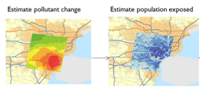
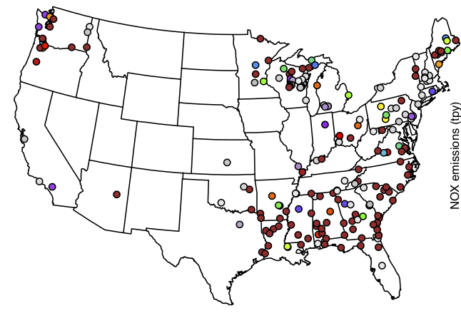
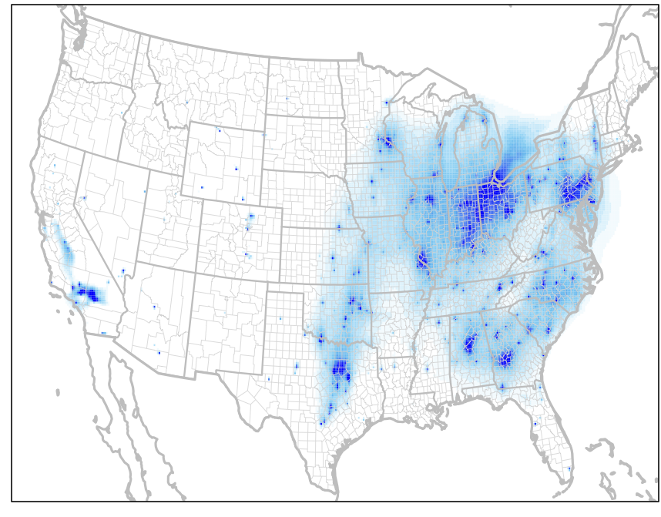
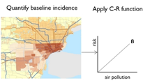
EPA routinely estimates AQ changes & health benefits for regulatory actions (Schematic of typical full form approach)
Base year & projected future year emissions scenarios are developed (pre- & post-control) based on the National Emissions Inventory and complex emissions models (e.g., IPM and MOVES)
Air quality model surfaces for each emissions scenario are generated with a photochemical grid model
Differences in air quality along with location-specific health incidence rates and population are used to estimate health impacts via BenMAP
Changes in emissions
Changes in air quality
Benefits

Slide 5
Background (continued)
In some cases EPA/OAR has used “reduced-form” (RF) approaches, which employ simpler methods to approximate the more complex analyses, when time or resources are constrained or the final scenarios to be modeled are not known until late in the regulatory process.
For example, the EPA’s Source Apportionment Benefit-per-Ton (SA-BPT) tool for national scale annual PM2.5 impacts was developed in 2012 through collaboration between HEID and AQAD
Continued advancements in air quality modeling and health benefits assessment necessitates updates in the methods used to support RIAs and other policy demonstrations
Recently, OAQPS developed a reduced form approach used in the ACE rule RIA (“ACE method”) that provides more flexibility and geographic specificity of source-receptor relationships than SA-BPT tool
OAQPS is currently working on developing a tool (i.e., Flexible Air quality Scenario Tool or FAST) that provides a formal framework to codify the ACE method and other similar reduced form applications that utilize source apportionment modeling to estimate air quality impacts for use in health benefits analyses

Slide 6
Reduced-form Approaches Can Expedite the RIA Benefits Assessment
Full-form tools assess emission changes (future base/control), model air quality, and estimate benefits
time
Emissions
Air Quality Modeling
Benefits
EPA’s Benefit-Per-Ton approach simplifies the steps using pre-derived emissions -> benefit relationships
Emissions
RFM

Slide 7
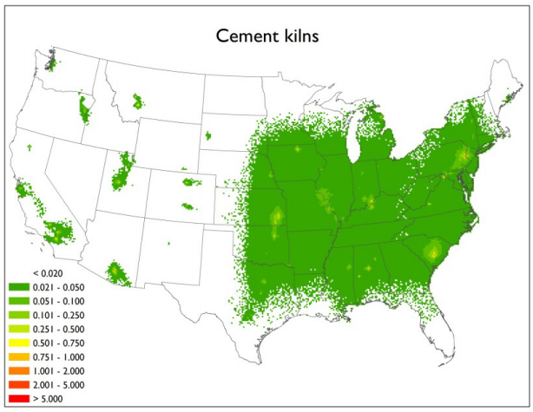

2005 Source Apportionment-based Benefit per Ton Approach (SA-BPT)
In 2012, EPA conducted national photochemical modeling using source apportionment and emissions based on the 2005 NEI to determine the relationship between emissions from specific source sectors and PM_{2.5} concentrations.
The annual PM_{2.5} contributions for each sector was used to estimate associated national benefits in BenMAP
Finally, these national benefits for each sector were divided by total sector emissions to derive a nationwide benefit-per-ton value ($/ton) for each of the 17 sectors for NOX, SO2, and primary PM2.5 emissions
Peer reviewed journal article—Fann et al, 2012:
“Characterizing the PM2.5 related health benefits of emissions reductions for 17 industrial, area, and mobile emissions sectors across the U.S.” Fann et al, 2012
Health Benefits ($/ton) = (Health benefits / Emissions)

Slide 8
2005 Source Apportionment-based Benefit per Ton Approach (SA-BPT): Sector Estimates

Slide 9
Application of EPA’s 2005 SA-BPT
EPA has used the 2005 NEI SA-BPT estimates for a variety of benefits analysis for rulemakings, in particular for co-benefits of PM2.5 impacts for air toxics focused actions
Adjustments have been made to the 2005 SA-BPT over time, in particular the numbers were adjusted to reflect updated population information and inflation
Technical Support Document Estimating the Benefit per Ton of Reducing PM2.5 Precursors from 17 Sectors (Feb 2018)
Limitations with the 2005 SA-BPT include:
Outdated vintage of the baseline data over time
Nature of sources and their emissions has changed across most sectors since 2005
Background levels of air pollution have drastically changed since 2005
Nationwide estimate does not provide geographic specific information about impacts associated with source specific emissions changes that vary by region/state

Slide 10
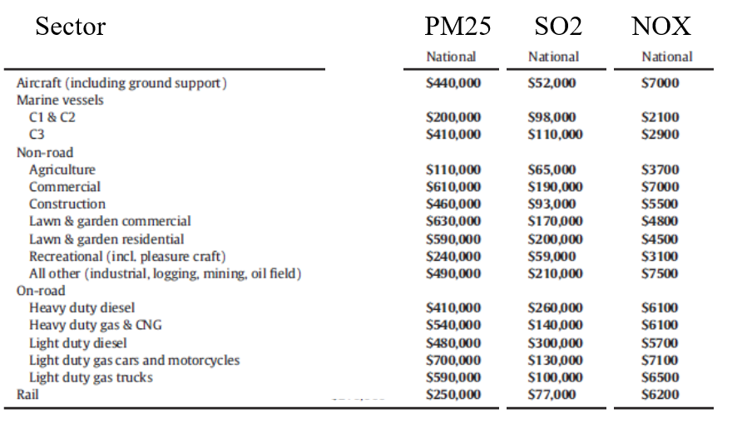
Mobile sector BPT update
Joint OTAQ/OAQPS effort similar to Fann et al, 2012
Mobile sector BPTs updated from 2005 NEI SA-BPT
BPTs estimated at national scale, eastern States, and western States separately
New annual PM2.5 BPTs generated based on 2011 NEI
Published in Wolfe et al, 2019

Slide 11
Reduced Form Tool (RFT) Evaluation Project
In October 2017, as part of the proposed rule to repeal the Clean Power Plan, EPA committed to systematically evaluating the uncertainty associated with reduced-form techniques, with the goal of better understanding the suitability of such approaches to estimating the health impacts of pollutant emissions changes.
EPA’s “benefit per ton” approach was specifically highlighted for evaluation
EPA committed to make the evaluation available for peer review
In October 2019, EPA released the contractor report: “Evaluating Reduced-Form Tools for Estimating Air Quality Benefits”.
https://www.epa.gov/benmap/reduced-form-evaluation-project-report
EPA has made public the modeling inputs and processing scripts to assist model developers and users in conducting similar evaluations. https://github.com/epa-kpc/RFMEVAL
EPA also authored a “Data in Brief” publication to document the github dataset: https://doi.org/10.1016/j.dib.2019.104886

Slide 12
Reduced Form Tool (RFT) Evaluation Project
EPA developed an evaluation framework that allowed for comparison of select reduced form tools to results provided by “full form” approach for a variety of policy scenarios.
Evaluation project used a mobile and EGU rule and 3 sector-based scenarios to compare multiple reduced form tools used to estimate annual PM2.5 monetized health impacts compared to photochemical model predicted impacts
The 3 industrial sector emissions scenarios included cement kilns, refineries, and pulp & paper
Reduced form tools included APEEP, InMAP, and EASIUR which were developed externally, in addition to EPA’s 2005 NEI SA-BPT
RFTs have varying degrees of fidelity compared to the photochemical model estimates of annual total monetized health benefits for the different policy scenarios
2005 NEI SA-BPT performed comparably to other RFMs
Project showed that the 2005 NEI SA-BPT needed a more recent representation of industrial sectors since they have changed since 2005
Project also showed the importance of differentiating primary and secondary pollutant impacts
Some pollutants can be primarily emitted and also formed through secondary chemical reactions and these need to be differentiated

Slide 13
SAB Review of RFT Evaluation Project
In May 2020, the EPA contractor report “Evaluating Reduced-Form Tools for Estimating Air Quality Benefits” was sent for external peer review by the Science Advisory Board (SAB)
SAB was charged with reviewing the evaluation approach used in this report
SAB was not charged with evaluating the tools used in the report or how EPA uses tools to support policy assessments
A draft version of their report was made available in late August 2020
Final version of the SAB peer review report expected by the end of 2020
EPA plans to integrate relevant suggestions from the final SAB report as part of the ongoing development of our tools particularly the need for geographic specificity of source-receptor relationships
Separately, EPA reached an agreement with OMB as part of the “Revisions to the Effluent Limitations Guidelines and Standards for the Steam Electric Power Generating Point Source Category” rule in August 2020 to update the 2005 NEI SA-BPT

Slide 14
Updating EPA’s SA-BPT Estimates to 2017
Updated group of sectors based on regulatory relevance and magnitude of PM and/or O3 precursor emissions
Focused effort on industrial sectors (20)
EGU rules would most likely rely on existing source apportionment modeling used for ACE rule (as has been case)
Mobile source BPT recently updated (2011 NEI based project)
2017 National Emissions Inventory (NEI) representation of those sectors
Sectors defined by NAICS and SCC groups (some overlap in sectors)
Estimating PM and O3 impacts as part of 2017 SA-BPT effort
Secondary PM2.5: NOX, SO2, and NH3 to annual PM2.5
Primary PM25: EC, OA, sulfate ion, and nitrate ion to annual PM2.5
NOX and VOC to average ozone season MDA8 O3
Source-receptor relationships
state specific contribution for 2 sectors (boilers and IC engines)
west/north/south differentiation for 18 sectors (top right)

Slide 15
EPA’s Reduced Form Approach for the Affordable Clean Energy (ACE) rule RIA, i.e., “the ACE method”
Timeline for this rule posed unique challenges
OAQPS made a commitment to base RIA cost-benefits analysis on photochemical modeling
Proposed and final rules on extremely compressed schedules with evolving control strategy for EGUs that did not allow for “full form” photochemical modeling
Developed and applied customized modeling solution to meet aggressive timeline
Used existing projected emissions case (i.e., 2023 from transport rule actions)
Conducted CAMx source apportionment simulations to track emissions from predefined groups of EGUs and associated air quality impacts
Provided needed source-receptor “ingredients”, i.e., relationship between groups of EGUs and gridded concentrations
Generate national air quality surfaces representing a given IPM run by adjusting the contributions from groups of EGUs proportional to changes in the precursor emissions provided by IPM
Allowed us to generate air quality surfaces that related state specific EGU emissions to gridded impacts that could be modulated to reflect different policy options provided by the IPM model
This methodology was later used to support other rulemakings related to the EGU sector: MATS coal refuse rule, Office of Water Effluent Limit Guidelines (ELG), and the Revised CSAPR Update proposal
Given the utility of this approach it formed the basis of EPA developing the FAST-CE tool that can incorporate additional sector source apportionment data so we can similarly inform rules related to other sectors

Slide 16
Source Apportionment Inputs to ACE method
For every grid-cell and PM component (or Ozone) source apportionment tagging attributes concentrations to each source apportionment “tag”
We set up source apportionment simulations to track EGU emissions from 43 states or state-groups split into coal EGUs, non-coal EGUs, and 2 tags to differentiate expected EGU retirements
Other US sources, Canada/Mexico, Fires, and Boundary conditions are also tracked so that we could attribute 100% of ozone and PM sources with a total of 91 tags.
Figure is illustrative only: contribution totals are not based on real data

Slide 17
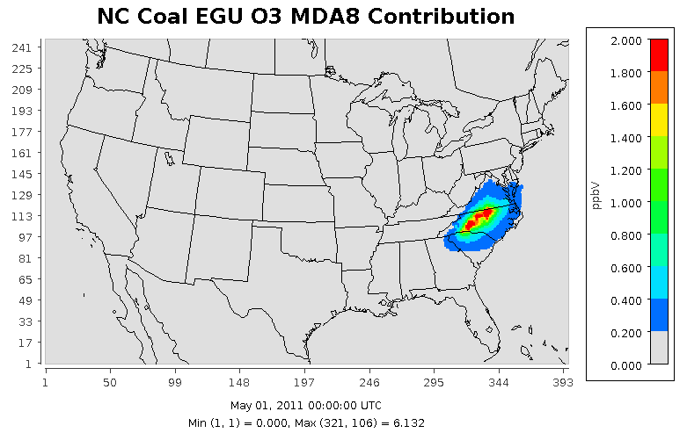
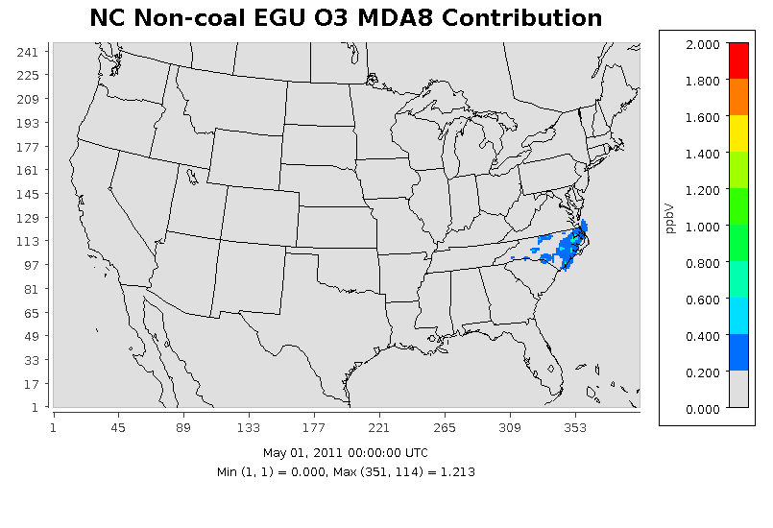
Example Source Apportionment Results
Allows for sector and geographic specific generation of source-receptor relationships to credibly estimate air
quality response to regulatory or policy emissions changes

Slide 18
EPA Reduced Form Model Development Effort
As part of “Phase 4” of the Reduced Form Tool evaluation project with OMB/HEID, the Air Quality Modeling Group is developing a reduced form tool that provides real-time and credible impacts of O3 and PM2.5 to emissions changes.
The Flexible Air quality Scenario Tool – Community Edition (FAST-CE) is a user-friendly tool that allows for timely application of source-receptor data to generate new air quality surfaces for input to BenMAP to support regulatory and policy assessments
The FAST-CE prototype was initially built based on the ACE rule methodology with source apportionment modeling of EGUs and being expanded and tested with additional source appt modeling of other sectors.
Thus, when “full form” modeling is not feasible, we can define scope of project in terms of sector/sub-sector and geographic scale to either use existing source receptor data within FAST or inform tool with results from new source apportionment modeling which could be conducted for a specific application.
FAST-CE provides an air quality distribution for the ACE and 2017 NEI SA-BPT databases do that EPA can describe the fraction of benefits at each ambient level

Slide 19
FAST-CE FRAMEWORK
Flexible Air quality Scenario Tool – Community Edition
Framework for using S-R information to generate O3 and PM2.5 concentration impacts of policy options
Key outputs for downstream programs to estimate monetized benefits assessment and attainment projections
Source-receptor relationships
Photochemical source apportionment modeling
BenMAP input files
Photochemical grid modeling w/ HDDM/DDM
FAST-CE tool
Response surface model based on photochemical grid modeling outputs
Validation/QA module: Comparison plots & Statistics for newly developed air quality surfaces and pre-made emissions scenarios based on comparable tags
Future development

Slide 20
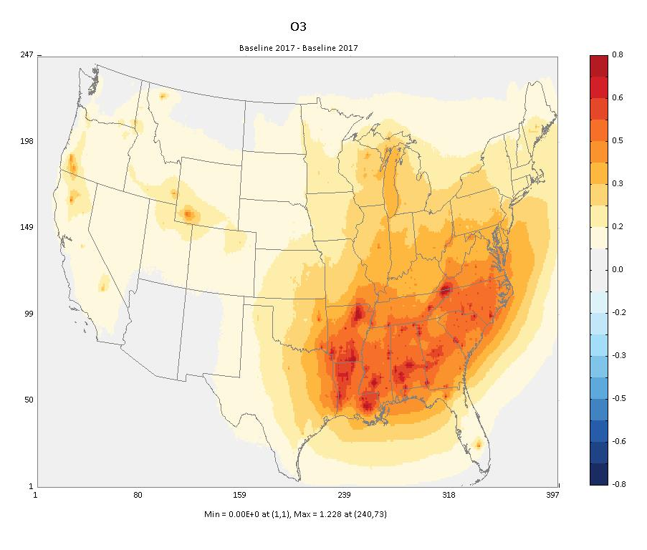
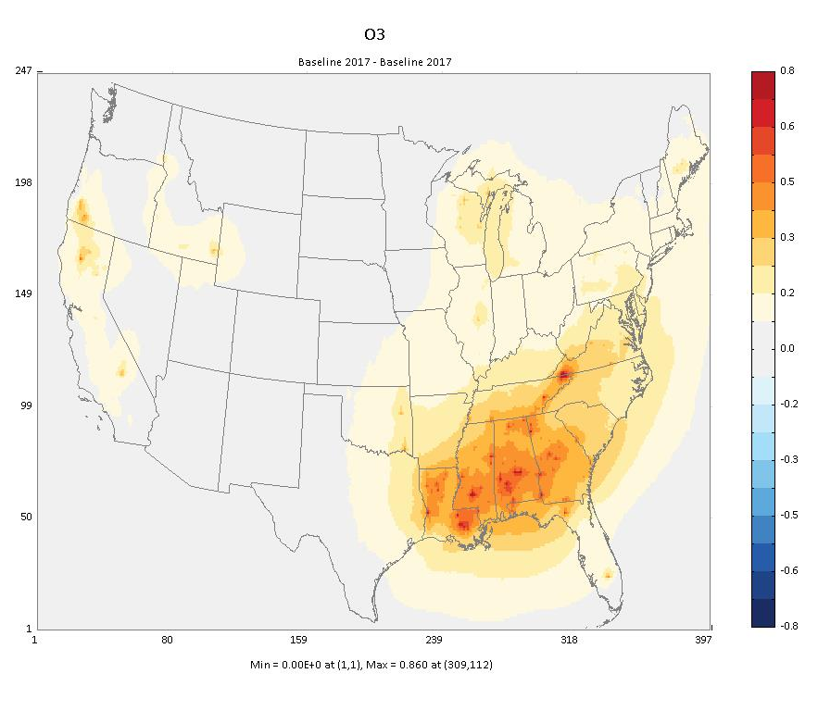
Illustrative example of developing a state/sector “policy” air quality surface with FAST-CE for industrial boilers
O3 impacts from entire industrial boiler sector
O3 impacts from a subset of the industrial boiler sector
States with industrial boilers subject to the proposed boiler MACT rule

Slide 21
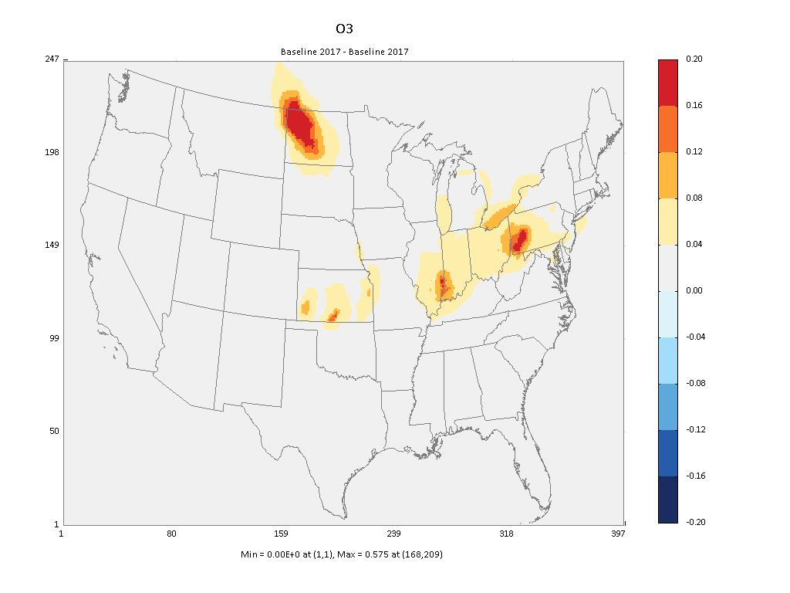
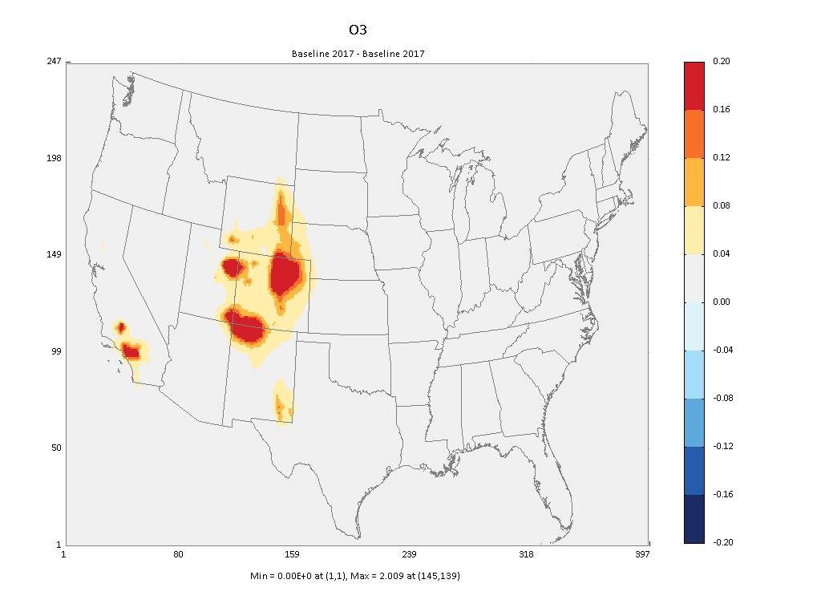
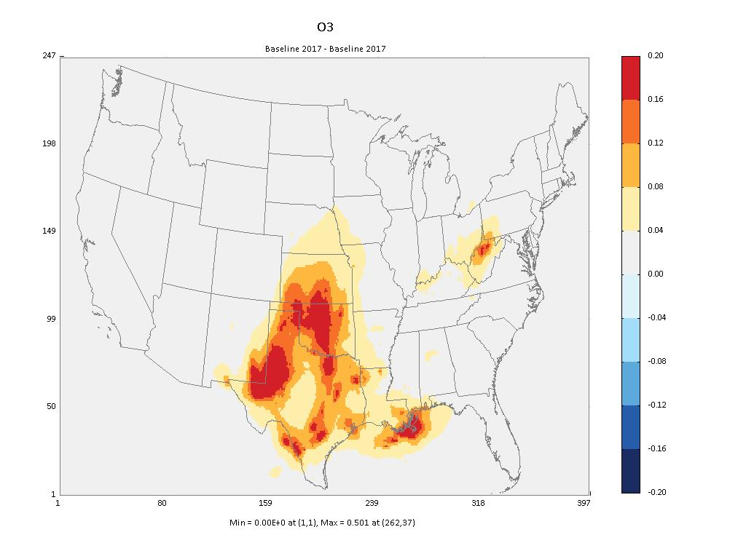
Air Quality Surfaces
Total VOC contribution to O3 season average MDA8 O3 for each source region
Similar surfaces for NOX to O3 but not shown

Slide 22
Modeling Approaches to meet benefits assessment needs
Photochemical modeling of final regulatory/policy scenario
Multi-source/region specificity for scenario development & benefits
Sector/source region specificity for scenario development & benefits
Sector/source region specificity for co-benefits analysis
Sector-relevant benefit per ton
Tier 3 final
NAAQS RIA
Modeling Approach
Needs in this space provided by the FAST-CE framework
ACE proposal
Industrial boiler RTR
Brick MACT
Simple Complex
Representation of Benefits

Slide 23
FAST-CE Can Inform Multiple Programmatic Needs
OAR (OAQPS, OAP, & OTAQ)
RIAs – cost and benefit analysis for rulemakings for which photochemical modeling of specific policy options are not feasible
OAP/Clean Air Markets Division
Internal application to inform IPM scenario development
ORD & OAP/Climate Change Division
Climate – tool could be used directly as a module in existing frameworks like GCAM to estimate air quality co-benefits or indirectly to provide source-receptor relationships to inform the system
OAQPS/HEID & OAP/Climate Protection Partnership Division
Energy Efficiency Savings Tool: use ACE modeling to develop BPT for EGUs by state for this new OAP tool
Used directly or indirectly to inform needed “transfer coefficients” (i.e., source receptor relationships) used in COBRA and optimization tools like CABOT

Slide 24
Example OAP Programmatic Needs
Energy Efficiency Savings Tool (EEST)
CO-Benefits Risk Assessment (COBRA) tool
COBRA uses county-level S-R matrix to estimate health benefits of energy efficiency programs so state level impacts from existing EGU modeling probably would not provide the necessary spatial scale so recommend conducting new modeling
Existing ACE source apportionment modeling for state-level EGUs (annual PM2.5 and MDA8 O3)
BenMAP simulations for each EGU/state
EGU/State specific Benefit per Ton estimates for use in EEST
New source apportionment photochemical modeling to inform O3 (and updated PM2.5) capability in COBRA for energy efficiency programs
Develop and input new S-R matrix at sector/county specificity to COBRA model to calculate associated health benefits

Slide 25
Next Steps
Ability to use FAST to develop surfaces for input to BenMAP allows seamless updates to BPT estimates and greater flexibility to inform benefits analyses with desired sector/geographic specificity
Continue work with OAP to use existing ACE modeling to inform EEST project by developing new EGU/state level BPT estimates
Continue development of source-receptor relationships used to support the FAST framework, i.e., conduct source appt modeling for sectors of interest/need for OAR programs (e.g., Major O3/PM2.5 rules, NAAQS RIAs, etc)
Continue coordination and engagement across OAR (OAQPS, OTAQ, OAP) to beta test and inform added development and/or use of the FAST framework in regulatory context
Potential for SAB Review prior to such use?
Longer term planning across OAR to develop S-R relationships needed to meet higher capacity needs (such as county level S-R relationships for potential use in COBRA or optimization models like CABOT)
AQMG will also continue over time to improve FAST inputs with advanced modeling approaches like HDDM/DDM instrumented model techniques and response surface modeling approaches.

