Slide 1
RoadMap for NEXUS Tool Demo (1)
National Screening (2017 Data)
Replicate “2008 MP Report” map with O₃/PM_{2.5} con. > NAAQS and air toxics risk* of top risk value & %tile
Note: (1) G.A., Name, Lead, Overview->Demo-show-more imp. what can do, Stop-Q/Help/Team effort
(2) St. page, GIS-based national map in County-level → 1st Q asked: Color, elaborate, imp. for demo/quiz
(3) Now NEXUS expert, start w/national screening, wear national Air Manger’s hat, 1st quiz
  What happens to areas at lower O₃/PM_{2.5} NAAQS levels?
  What happens to areas in nonattainment if we change HAP risk value & %tile?
Note: (1) 2nd Quiz: , as national man., what if “Risk-based” (Control panel, check risk/uncheck ambient) (2) Change risk value to 90th %tile,
(3) Next quiz: challenging, two kinds of AT, Co-control “PM + H.M.” & “O3 + VOC HAPs” (Bonus: ETOX) (4) Reset %tile, add EJ (Green dash area); Future add “5th metric; Climate risk indication” (5) Last quiz: CBSA ranking: MP risk + EJ
Provide NEXUS map on risk basis: O₃/PM_{2.5} BenMAP mortality risk and air toxics risk above top risk value & %tile
  What happens to MP areas if changes 90th %tile to 80th %tile or lower?
  What are the relationships between “Heavy Metal HAPs risk and PM_{2.5} risk” and between “Gas/VOC HAPs risk and O₃ risk” to identify potential co-pollutant issues?
  Determine the presence or absence of EJ concerns in communities with MP risk
  What is the ranking of MP risk and EJ index by CBSA or County?
1
*Note: Currently, air toxics risk data only available for “2014” but will be updated to “2017” by Dec. 2021

Slide 2
RoadMap for NEXUS Tool Demo (2)
Regional/State/CBSA/County Screening: Wear RSL manager’s hat
EPA Region (EPA R4 & R5) & State (KY) Examples
  Areas with MP risk in top 10% (90%^{th} tile) across O₃, PM_{2.5} and HAPs
CBSA Example:
Note:(1) Zoom-in Lv, What nature? --> Jefferson co. (Data Content) & Clark County – Black & Purple
(2) “Transparency to 30%”, What are “Major Emission Sources”? “Diminish Control pane”,
(3) Color for emissions ranking (red to blue); Click “NOx”, “SOx”, “HAPs” → Add CO2e (4) What common sources for co-control potential? Click “NOx first row”
(5) Many sources --> Zoom-in “Jefferson” → Google MAP
(6) Click NOx, 4th Amer. Synthetic → “Gas & VOC HAPs” → zoom-in Rubbertown (NGEM) -> Proximity
(7) What other emission (“non-point”) contribute to MP? → Source Category -> Visual (top X)
(8) What Monitor sites? → Display Monitor sites → color ranking -> click sites for AQ trend data
(9) Switch to Detroit CBSA an area of EJ concern? → Adjust EJ to 85%, O3 to 80% to (Wayne co. Black);
(10) H.M. HAPs All -> Manganese; Display “Major emissions” → Wayne co. (rolldown-> AK & US Steel)
  Louisville CBSA: General view and then dial into “Jefferson County”
    What is the nature of the area’s multi-pollutant air quality issues?
    What are the top emissions sources (facilities) in county by pollutant?
    What sources are common across pollutants that may indicate co-control potential?
    What are the monitoring sites & data available for PM_{2.5}, O₃ and air toxics?
    What communities are potentially impacted near these facilities and monitors?
2

Slide 3
RoadMap for NEXUS Tool Demo (3)
MP Risks and EJ/Demographic Screening
  Initial view of CBSA level information using the EJ/Demographic indicators to show overlay with MP areas
  Detroit (or Chicago) Example: General view and then dial into Wayne County (or Cook Country)
    What is the nature of the area’s multi-pollutant air quality issues?
    What are the top emissions sources (facilities) in county by pollutant?
    What sources are common across pollutants that may indicate co-control potential?
    What are the monitoring sites & data available for PM_{2.5}, O₃ and air toxics?
    What communities are potentially impacted near these facilities and monitors?
3

Slide 4
“NEXUS” Multi-Pollutant Analysis Tool
OAR Briefing and Live Demo
OAQPS’s Multi-Pollutant Team
September 22, 2021

Slide 5
Overview
NEXUS Background
  Tool Development
  Expected Use
  Key Modules
  Data Inputs
Recent Updates/Improvements
Planned Upgrades
“NEXUS 2.0”Live Demo
5

Slide 6
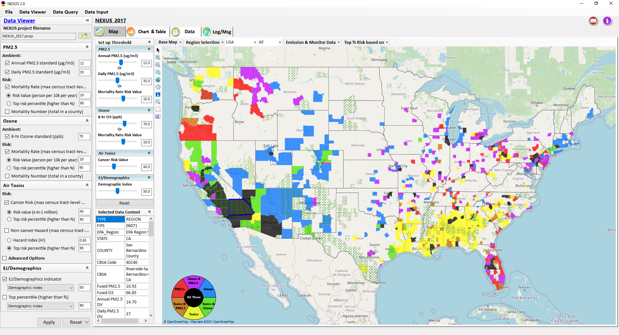
NEXUS: Tool Development
A new Multi-Pollutant (MP) Advanced Screening Tool (NEXUS) is being developed to identify geographic areas where health risks related to O₃, PM_{2.5} and air toxics overlap and will be used to identify additional areas for MP collaboration
6

Slide 7
NEXUS: Tool Development
Motivation: Develop a new multi-pollutant analysis tool to identify and assess areas with high ambient levels and/or health risks associated with PM_{2.5}, O₃, and air toxics
Phase-1: Develop a GIS-based NEXUS prototype with a user-friendly graphical interface to provide analysis and visualization functions of potential multi-pollutant AQ issues at the National level (March 2020)
Phase-2: Expand the NEXUS tool to allow users to dial into an EPA region, State, or Metropolitan area and provide V/A and data query functions for “AQ and emissions” information over the selected region of interest (August 2020)
7

Slide 8
NEXUS: Expected Use
The NEXUS tool will allow users to do the following:
  National screening to identify areas with MP issues: Phase 1 development provides ability to quickly screen areas across nation that have combination of high air quality and/or risk levels for O₃, PM_{2.5} and Air Toxics.
  Area screening to understand nature of MP problem: Phase 2 development provides ability to ‘dial-into’ specific areas to determine extent to which common emissions sources are causing the MP issues.
We expect to use this tool in conjunction with Regions and identify areas that would potentially benefit most from MP approaches to reduce emissions (including current NA areas).
The NEXUS tool will essentially provide a ‘conceptual model’ of an area’s MP issues to facilitate engagement with state/local/tribal agencies and community stakeholder groups.
We also expect that it can have additional value-added uses across the Office for Air Toxics, Environmental Justice and other programs.
8

Slide 9
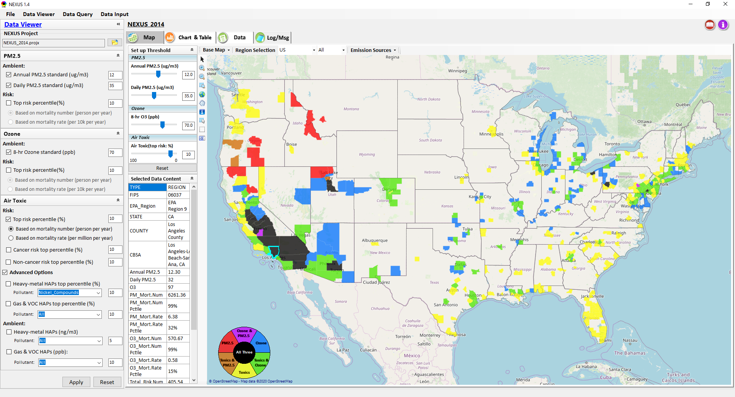
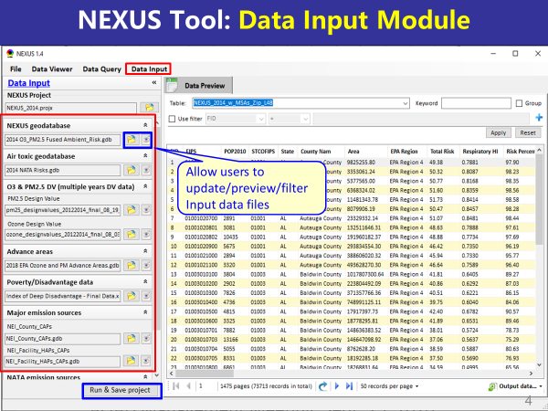
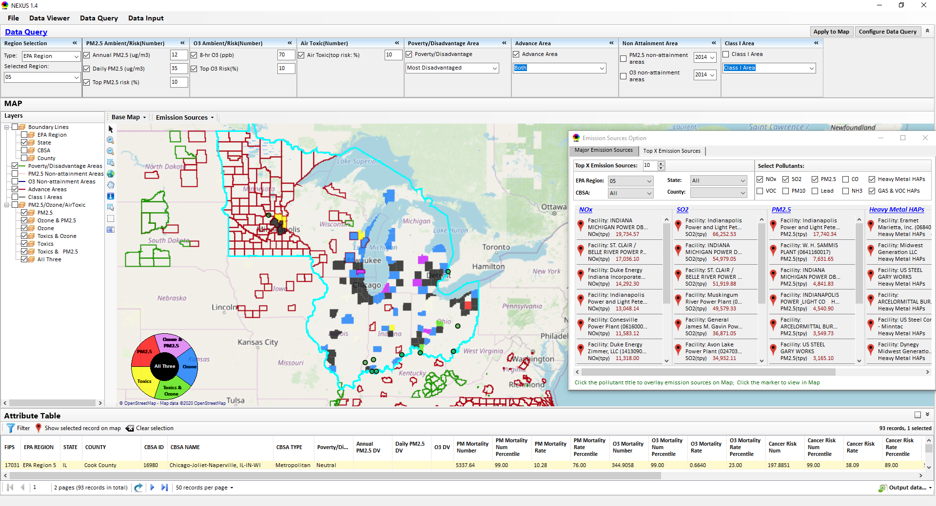
NEXUS: Three Key Modules
Data Viewer Module
Data Input Module
Data Query Module
View and create interactive Map/Data/Chart/Table
Provide flexible selections & mapping of “Ambient” and/or “Risk” levels of PM_{2.5}, O₃ and Air Toxics
Provide regional analysis for “EPA region”, “States”, “CBSA”, and “County”
Display major point emission locations and monitoring sites/data by pollutants
Integrate all MP data - emissions, monitoring, modeling, health risk, and EJ/demographic data into a single platform
Currently use10 publicly available input datasets
Provide data preview, search, filter and output functions
Allow to update/change input data files and then run/save to a new “project”
Expand data field selections and flexibility for exploratory & advanced users
Provide map overlaying and summary table for data query results
Current data query based on selected data fields: “Ambient & Risk for PM, O3 & Air toxics”, “EJ/demographic indicator”, “Advance area”, “NA Area”, “Tribal area”, Class I area”
9

Slide 10
NEXUS 2.0: Input Data Files and Sources
Input Data Files | Data Format | Data Description | Data Source | Data Period
“O₃ & PM_{2.5} Ambient and Risk” | Excel | O₃/PM_{2.5} fused ambient & risk data at county/census tract level | from OAQPS MP & BenMAP team | 2017
“Air Toxic Ambient and Risk” | Geodataset | Air toxics fused ambient & risk data at county/census tract level | from OAQPS MP & Air Toxic team | 2014*
“O₃ & PM_{2.5} Design Values” | Excel | O₃ & PM_{2.5} design values at county level | From EPA public website: https://www.epa.gov/air-trends/air-quality-design-values | 2012 to 2020
“NEI County Emissions” “NEI Facility Emissions” | Excel | County-level and facility source emissions of CAPs, HAPs & GHGs | From OAQPS public website: https://www.epa.gov/air-emissions-inventories/2017-national-emissions-inventory-nei-data | 2017
“O₃ & PM_{2.5} monitoring data | Excel | O₃ & PM_{2.5} monitoring data (DVs) | From OAQPS public website: https://gispub.epa.gov/arcgis/rest/services/OAR_OAQPS | 2002 to 2020
“Air Toxic monitoring data” | Excel | Air toxics monitoring data (22 HAPs) | From OAQPS public website: https://www.epa.gov/amtic/amtic-air-toxics-data-ambient-monitoring-archive | 2003 to 2018
EJ/Demographics data | Geodataset | Demographic indicators (7) from EJSCREEN | from EJSCREEN: https://www.epa.gov/ejscreen/download-ejscreen-data | 2020
“Advance areas“ | Geodataset | O₃ & PM_{2.5} Advance Areas | from OAQPS MP team | 2021
“Class 1_Areas” | Geodataset | EPA Class 1 Federal Areas | From EPA Class 1 Federal Areas Website: https://edg.epa.gov/data/public/OAR/OAQPS/Class1/Class1Areas.zip | 2016
“Tribal Areas” | Geodataset | EPA Tribal Areas | From EPA public website: https://edg.epa.gov/data/Public/OEI/OIAA/Tribes/EPAtribes.zip | 2018
* Will be updated to 2017 by end of 2021
10

Slide 11
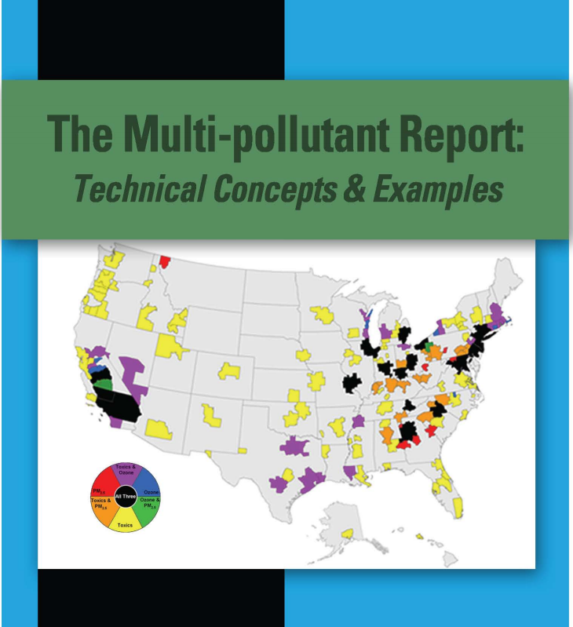
“NEXUS 2.0” Demo: 2017 NEXUS Case
Launching Page
2008
Roadmap for Demo:
(Use example cases)
National View: Use “NEXUS” across pollutants to provide an initial “SCREEN” at the national level by providing an indicator where there may be a common set of sources contributing to multi-pollutant issues.
Regional View: Dial into a region or area of interest to understand the pollutant/source connections, and potential for more effective and efficient multi-pollutant solution.
11

Slide 12
RoadMap for NEXUS Tool Demo (1)
National Screening (2017 Data)
Replicate “2008 MP Report” map with O₃/PM_{2.5} concentrations above NAAQS and air toxics risk* estimates of top risk value & percentile
  What happens to areas at lower O₃/PM_{2.5} NAAQS levels?
  What happens to areas in nonattainment if we change HAP risk value & %tile?
Provide NEXUS map on risk basis: O₃/PM_{2.5} BenMAP mortality risk and air toxics risk estimates above top risk value & %tile for all pollutants
  What happens to MP areas if changes 90th %tile to 80th %tile or lower?
  What are the relationships between “Heavy Metal HAPs risk and PM_{2.5} risk” and between “Gas/VOC HAPs risk and O₃ risk” to identify potential co-pollutant issues?
  Where are the areas of EJ concern overlapping with top MP risk areas?
  What is the ranking of MP risk and EJ index by CBSA or County?
*Note: Currently, air toxics risk data only available for “2014” but will be updated to “2017” by Dec. 2021
12

Slide 13
RoadMap for NEXUS Tool Demo (2)
Regional/State/CBSA/County Screening
EPA Region & State Examples
  Areas with MP risk in top 10% (90%^{th} tile) across O₃, PM_{2.5} and HAPs
CBSA Example
  Louisville CBSA: General view and then dial into “Jefferson County”
    What are the top emissions sources (facilities) in the county by pollutants?
    What sources are common across pollutants that may indicate co-control potential?
    What are other source categories’ emissions contribution (in addition to point sources)?
    What are the major sector groups’ emissions contribution by pollutants?
    What are the monitoring sites/data for PM_{2.5}, O₃ and air toxics?
    What are the historical trends of PM_{2.5}, O₃ and air toxics?
13

Slide 14
RoadMap for NEXUS Tool Demo (3)
MP Risks and EJ/Demographic Screening
  Initial view of CBSA level information using the EJ/Demographic indicators to show overlay with MP areas
  Detroit (or Chicago) Example: General view and then dial into Wayne County (or Cook Country)
    What are the top emissions sources (facilities) in the county by pollutants?
    What sources are common across pollutants that may indicate co-control potential?
    What are other source categories’ emissions contribution (in addition to point sources)?
    What are the major sector groups’ emissions contribution by pollutants?
    What are the monitoring sites/data for PM_{2.5}, O₃ and air toxics?
    What are the historical trends of PM_{2.5}, O₃ and air toxics?
14

Slide 15
NEXUS: Recent & Ongoing Development
NEXUS “1.5” (Jan. 2021) → NEXUS “2.0” (Sep. 2021)
  New/revised Metrics (PM_{2.5}, O₃, Air Toxics + EJ/Demographics as 4th metric)
  New/updated data inputs and functions:
    EJ/Demographic data (from EJSCREEN)
    Tribal areas, Advance areas, Attainment/DVs data, etc.
    2017 emissions data (including GHG & Sector mapping) (updated from 2014)
    “Sector Emissions Summary” module to support “Sector prioritization” effort
    “Source Category Emissions” module (point, non-point, on-road, non-road, event)
Near-term (Ongoing) Updates/Improvements
  Updating to 2017 fused PM_{2.5} & O₃ and health risk data (Sep.) and fused air toxics and risk data (Nov./Dec.) from current 2014 data
  Including monitoring sites/data (PM_{2.5}, O₃ and Air Toxics) (Sep./Oct.)
  Developing “Proximity analysis for MP risks and EJ” module (Dec.)
15

Slide 16
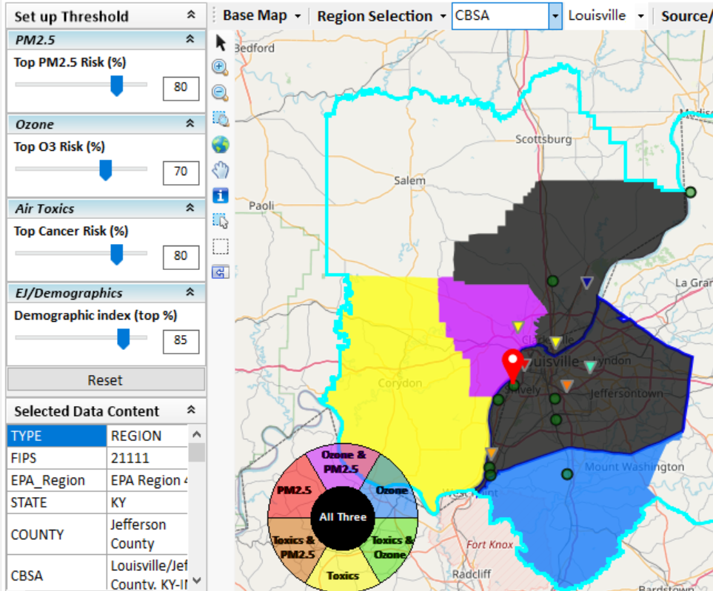
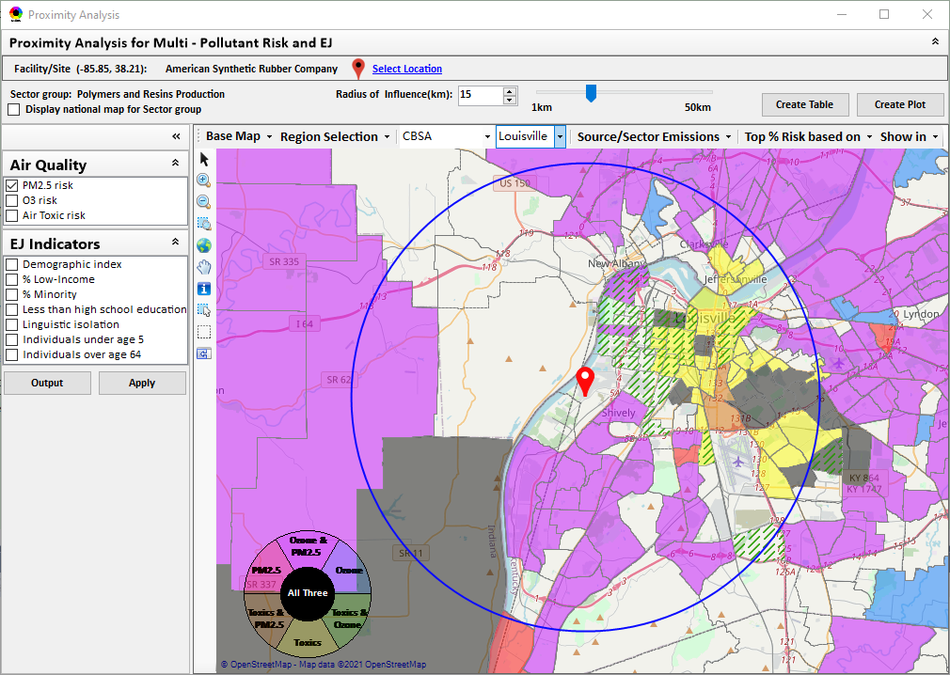
New “Proximity Analysis” Module (under development)
Currently in NEXUS
Proximity Analysis for MP Risks and EJ
County – level (current)
Community (Census Tract) - level
16

Slide 17
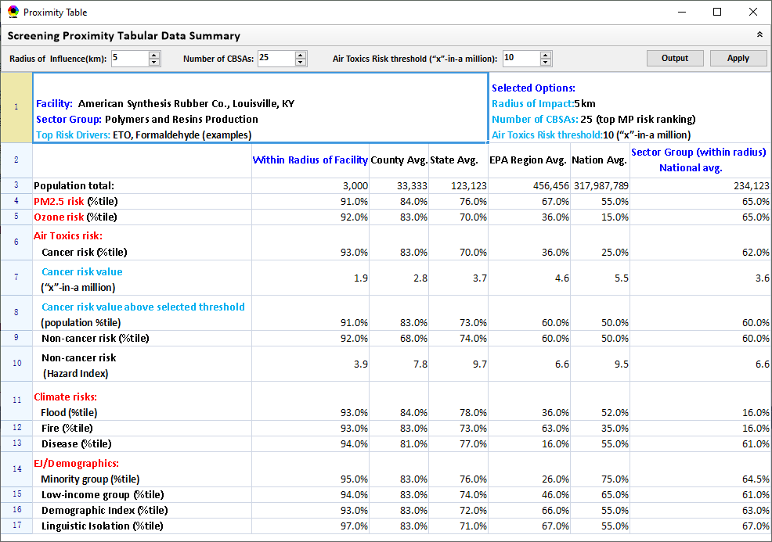
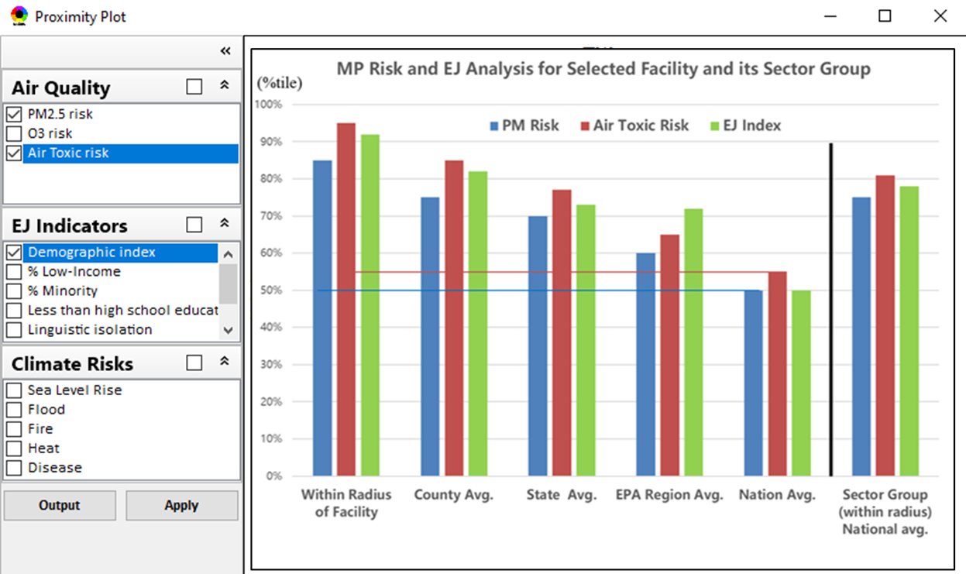
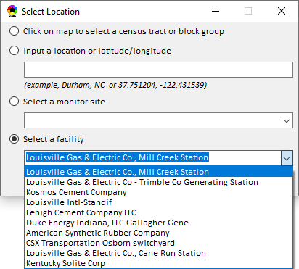
Proximity Analysis: Select “Location” & “Radius”
Select “Radius”
Choice of
Selecting a Location
17

Slide 18
NEXUS: Planned Development (2022)
Longer-term (Planned) Upgrades (2022)
  Include climate risk indicators (e.g., flood, fire, heat, disease, etc.)
  Explore “cloud-based” or “web-based” NEXUS platform to provide an “easy access” (easy or no installation) and “cross-platform” (not limited to Window-OS) version
  Develop screening-level source impact analysis capability for areas & communities of MP risk and EJ concern
18

Slide 19
“NEXUS 2.0”Demo
NEXUS 2.0 “Quick Tutorial” slides attached
Download “NEXUS” tool at: https://gaftp.epa.gov/aqmg/cjang/NEXUS/NEXUS 2.0/*
Carey Jang
OAR/OAQPS/AQAD/Air Quality Modeling Group, September 2021
19

Slide 20
NEXUS Demo: Example Cases
    Main GUI:
    Mimic 2008 MP report; County-based map
    Color/legend setup; Exceed “Ambient or risk” threshold defined in “Center panel”
    Click “county” to show “Data Content”
    Center panel & Left panel
    On-line User’s Manual & PPT Tutorial
    Nation View :
    “Ambient”: PM2.5: 12 -> 10 ug/m3; O3: 70 -> 65 ppb; “Risk”: Air Toxic 10% ->0%-> 20%
    All Risk only: O3:10%, PM:10%, AT: 10%
    Advanced: Heavy-metal HAPs, G&V:10%
      Co-PM risk: PM: 10%, H.M. HAPs: 10%
      Co- PM/NA: 12 ug/m3, H.M HAPs:10%
      Co-O3 risk: O3: 10%, G&V HAPs: 10%
      Co- O3/NA: 70 ppb, G&V HAPs:10%
    Advanced: H-M: Chromium & G-V: HCHO
    EPA Region/State/CBSA View:
    “dial-in” for regional (all risk: 10%)
    EPA Regions: R4/R5/R9 -> States: NC/CA -> CBSA: RDU
    “right-click” -> Major Emis. Sources
    Change color transparency/Google Map
    Major Emission Sources:
    CBSA: Louisville -> Jefferson Co. -> Facility (Louisville G&E)
    SO2/NOx/HAPs, Facility, Data Content;
    Top X Emission Sources: CAPs & HAPs
    Data Input module:
    Expand 1->10 inputs data files; Plan to update to 2017 (CDC & NATA)
    Data Query Module:
    Expand fields/flexibility: Exploratory users
    Configure DQ” window: Select Advance Area, EJ, 2017 DVs => Apply map
    Overlay Map & Detachable table summary
    Select “EPA Region 5” => “Advance + EJ”
    Change color transparency & Google Map
    CBSA: Minneapolis-> Major emis. sources
    Facility (Xcel Energy - Black Dog)
    Dakota Co. ->
      “PM2.5 + H.M.HAPs” (Xcel Energy)
      “VOC + NOx + G&V HAPs” (Flint Hills)
    Back to “EPA Region 5” -> EJ: Select “Disadvantage & under”
    CBSA: Detroit -> Wayne Co. ->
      “NOx + SOx” (DTE Elec.)
      “PM2.5 + H.M.HAPs” (AK Steel, US Steel)
    CBSA: Cincinnati -> Butler Co. (AK Steel) (Cincinnati News article)
20
Notes:
1. Thank Cen/Gao/Luo/Chen; 2. HZ more visits; 3. AP on HZ

