Slide 1
FAST-CE
Transport “Remand”
Case Results:
2021: O3-MDA8, O3-MDA1
2024: O3-MDA8, O3-MDA1 & PM2.5
1.“Less Stringent – Baseline”
2. “More Stringent – Baseline”

Slide 2
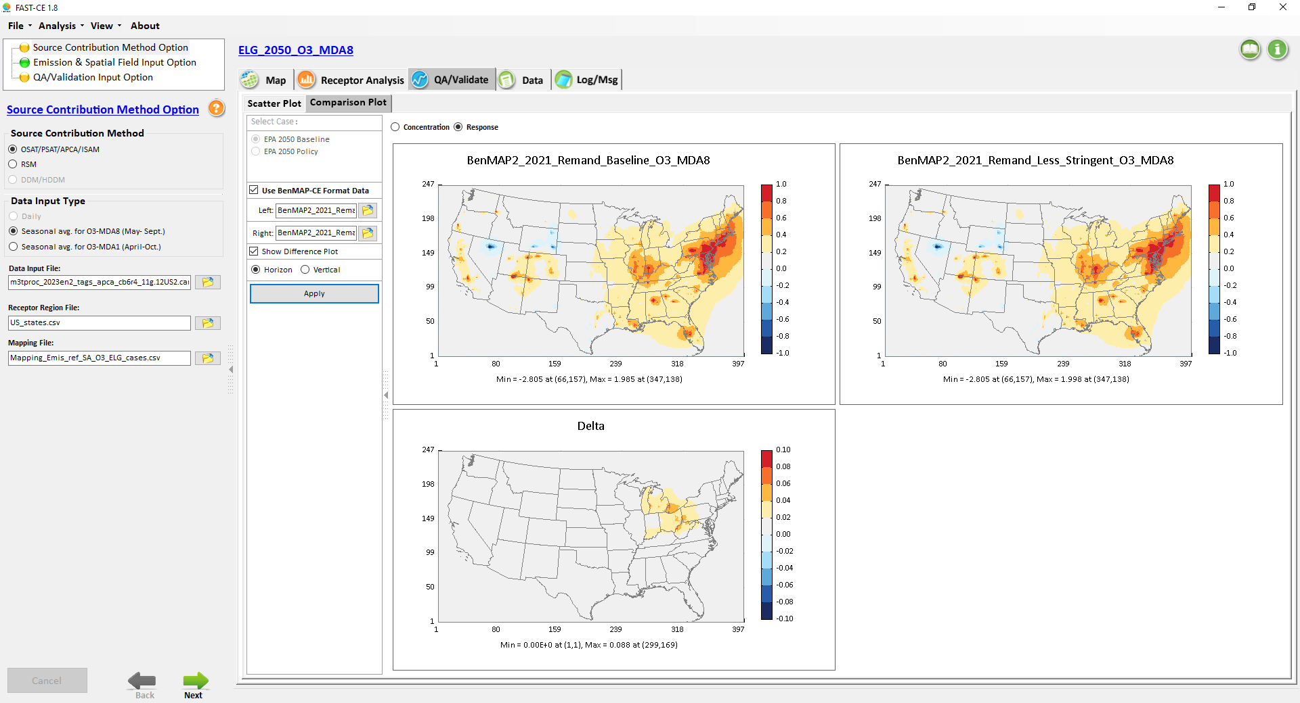
Remand_O3_MDA8_2021: “Less String – Baseline”
1
1
-1
-1
0.1
-0.1

Slide 3
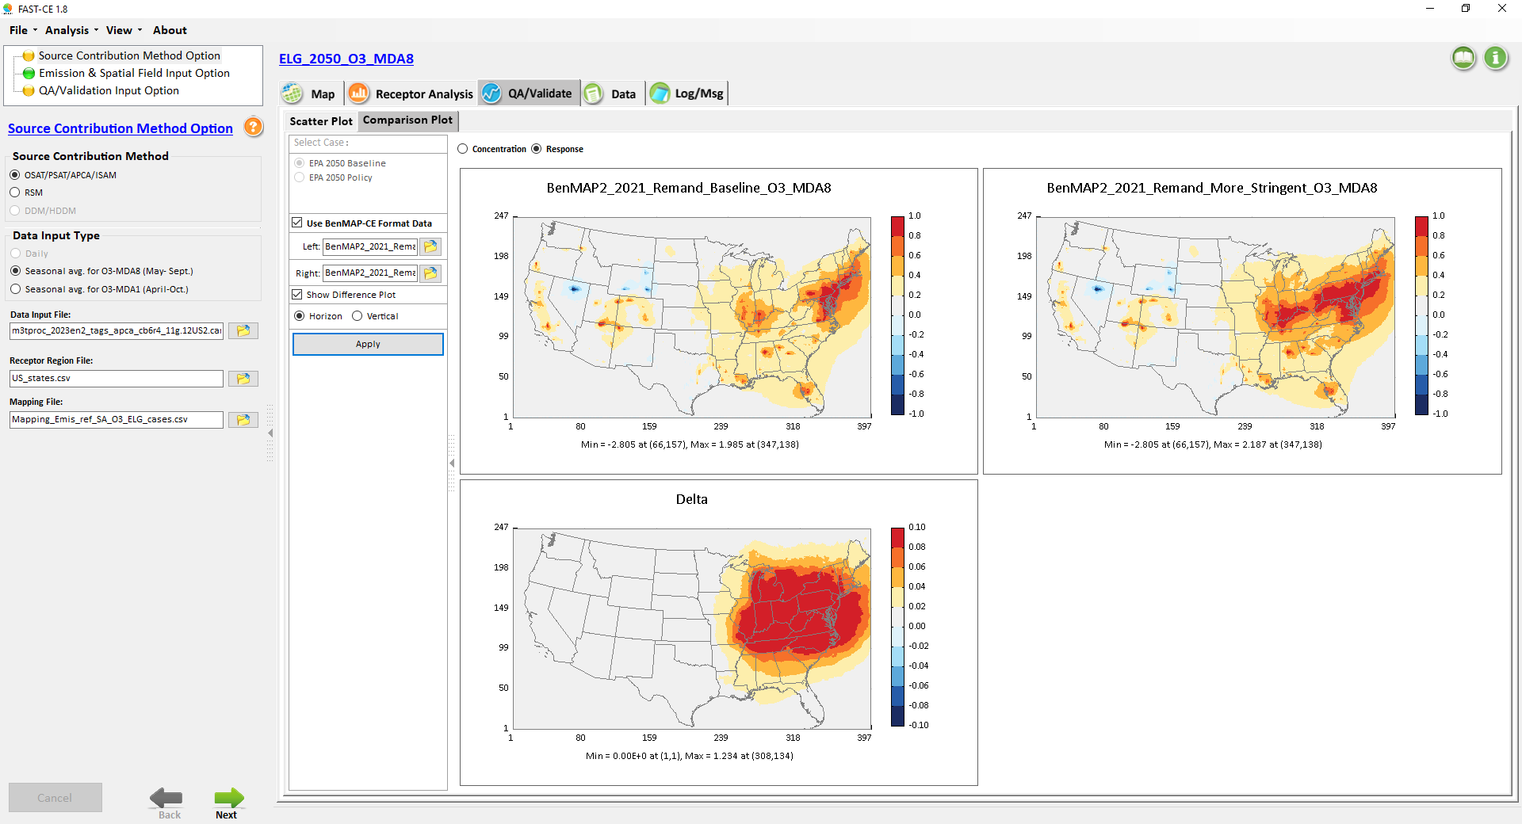
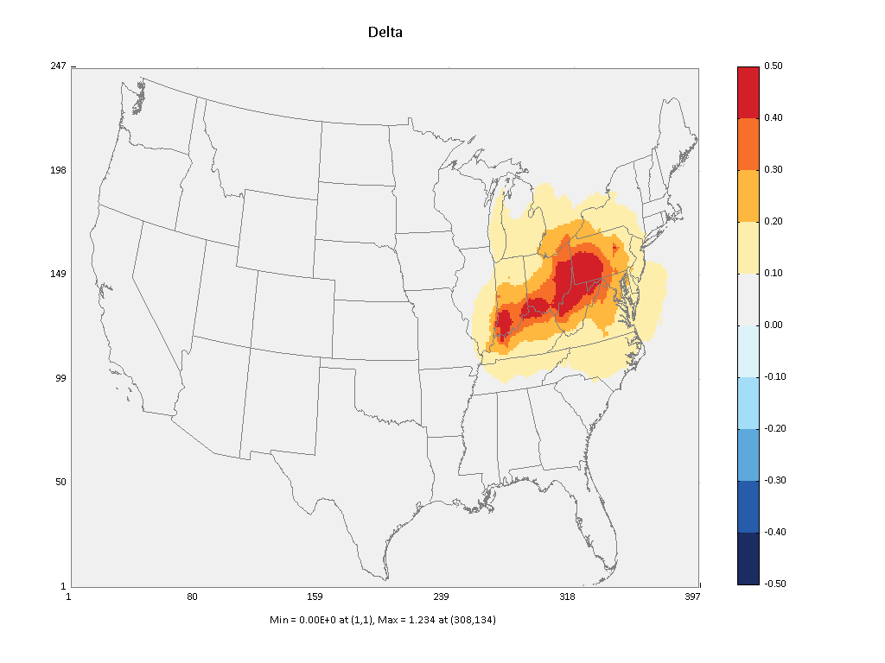
Remand_O3_MDA8_2021: “More String – Baseline”
1
1
-1
-1
0.1
0.5
-0.1
-0.5

Slide 4
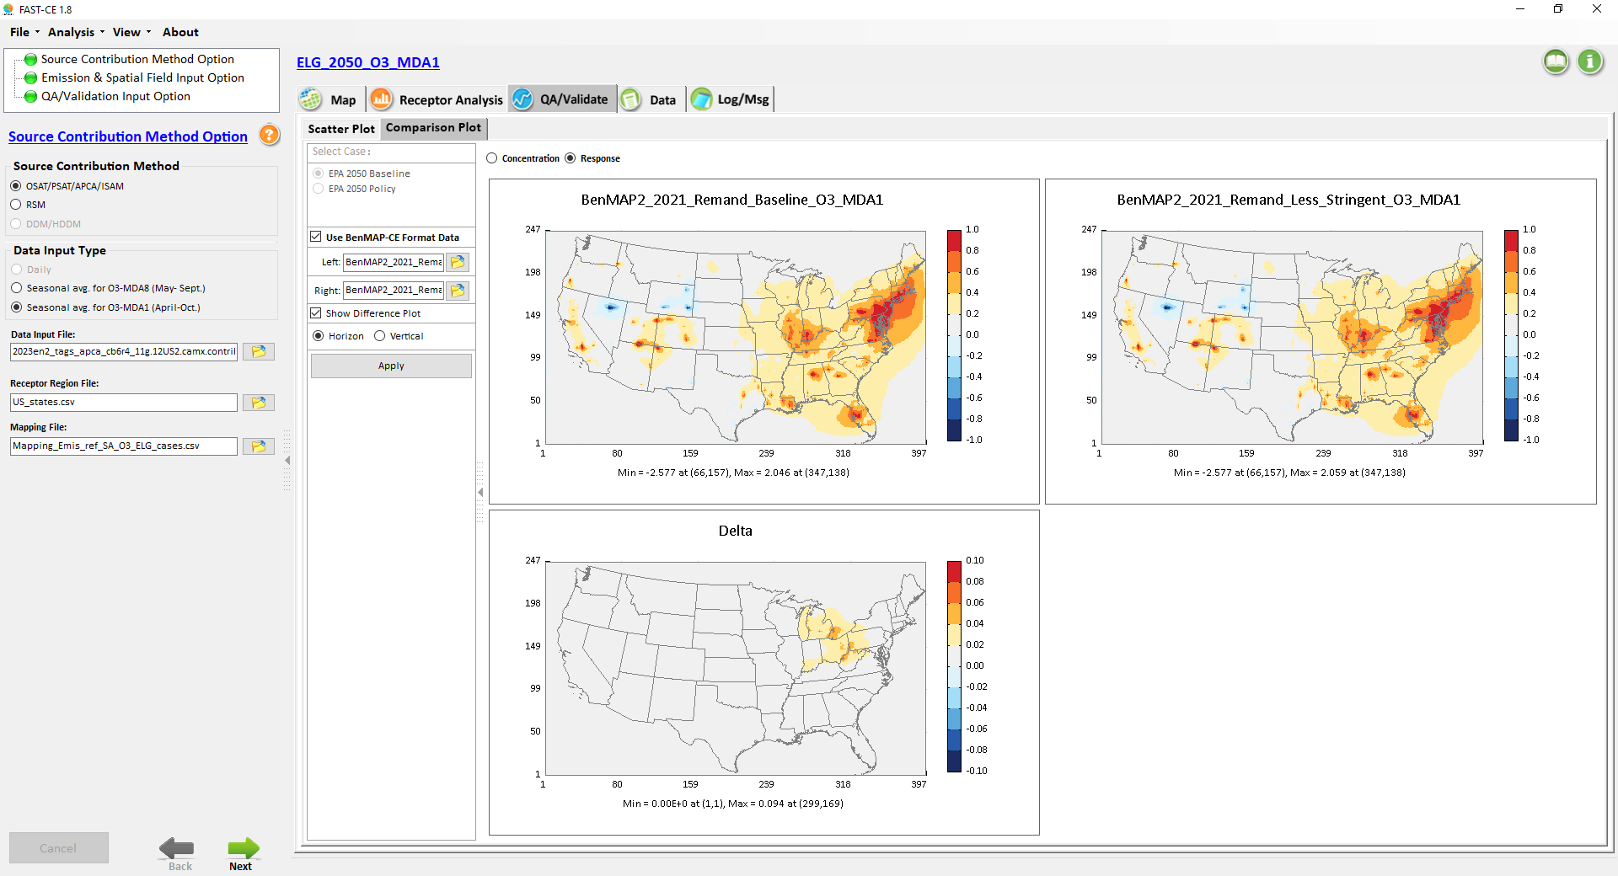
Remand_O3_MDA1_2021: “Less String – Baseline”
1
1
-1
-1
0.1
-0.1

Slide 5


Remand_O3_MDA1_2021: “More String – Baseline”
1
1
-1
-1
0.1
0.5
-0.1
-0.5

Slide 6
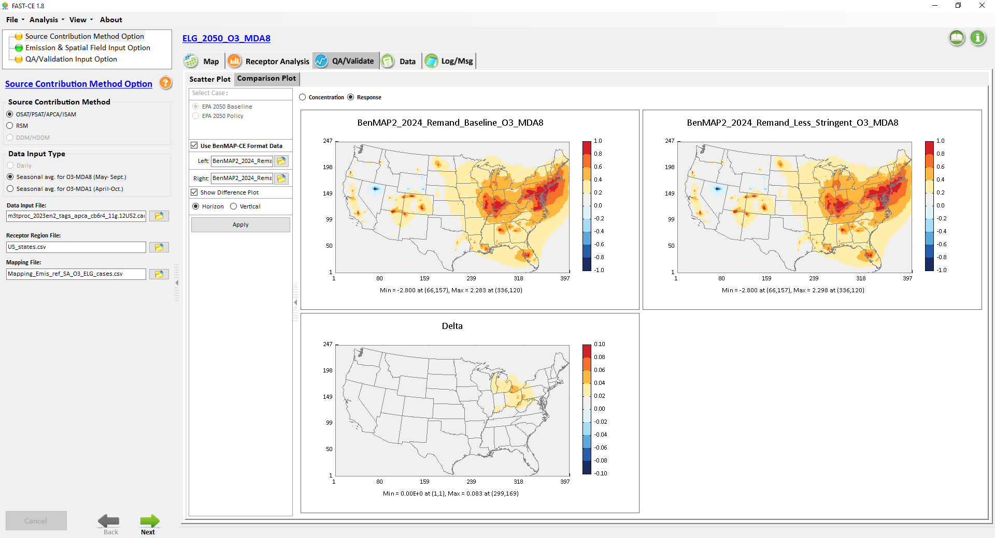
Remand_O3_MDA8_2024: “Less String – Baseline”
1
1
-1
-1
0.1
-0.1

Slide 7
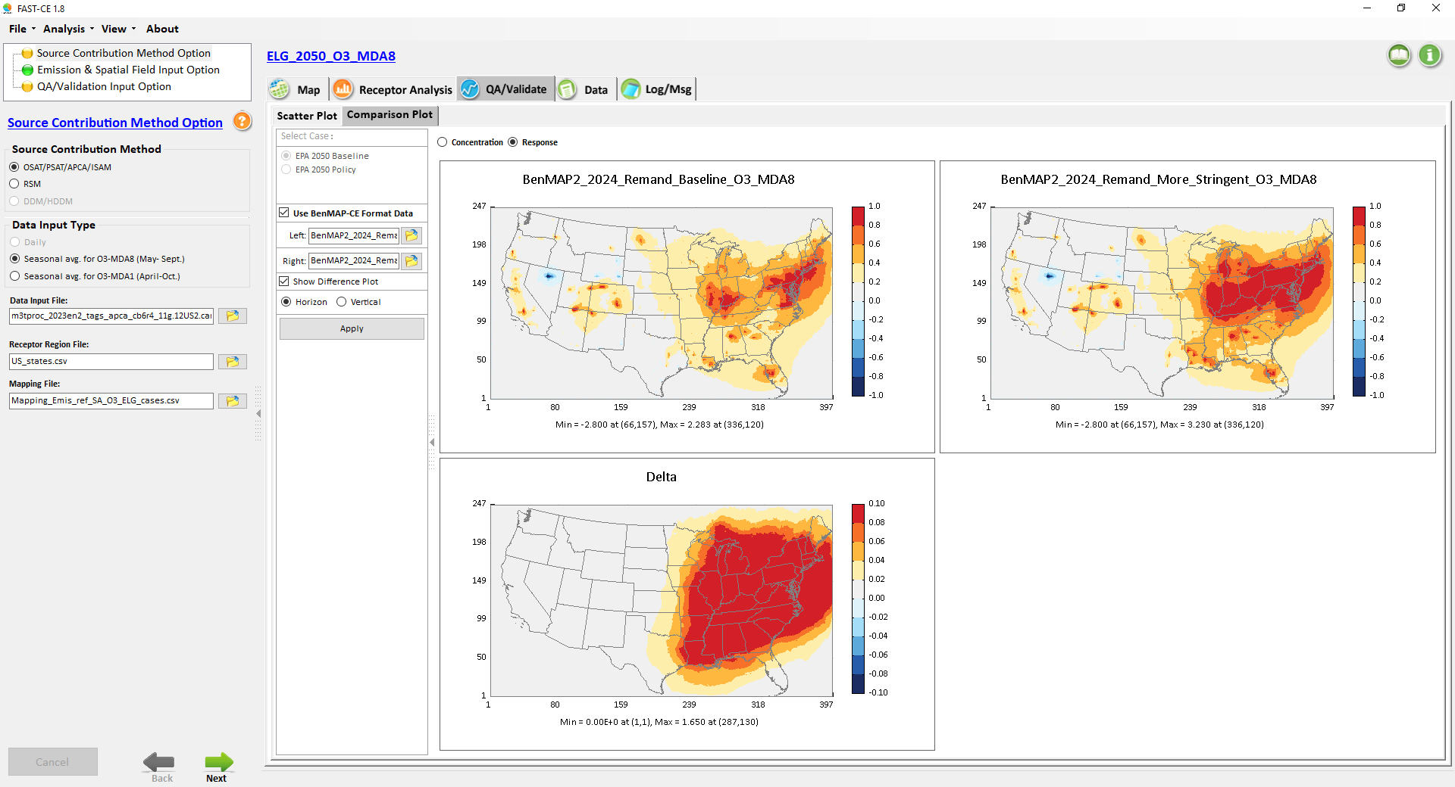
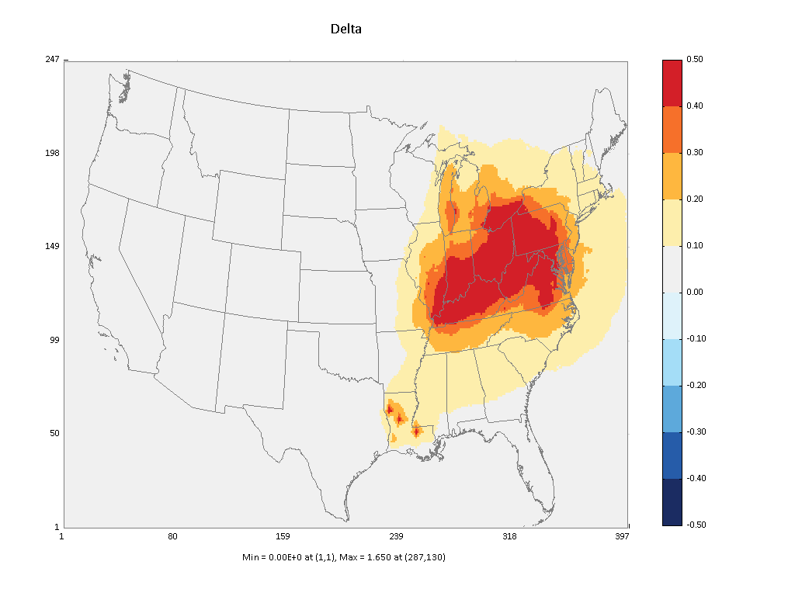
Remand_O3_MDA8_2024: “More String – Baseline”
1
1
-1
-1
0.1
0.5
-0.1
-0.5

Slide 8
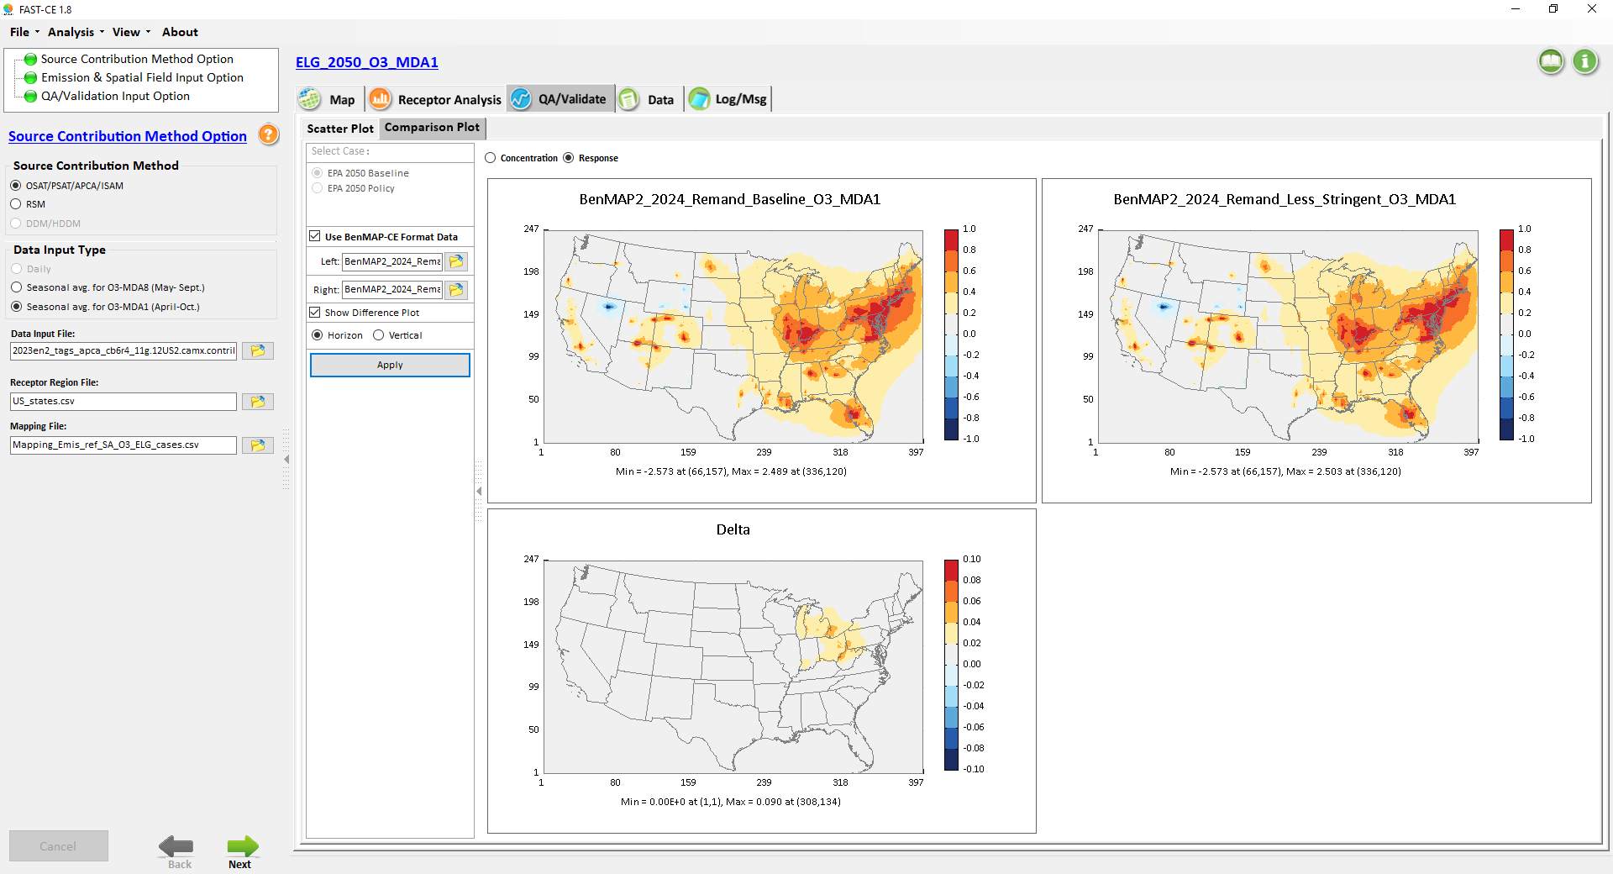
Remand_O3_MDA1_2024: “Less String – Baseline”
1
1
-1
-1
0.1
-0.1

Slide 9
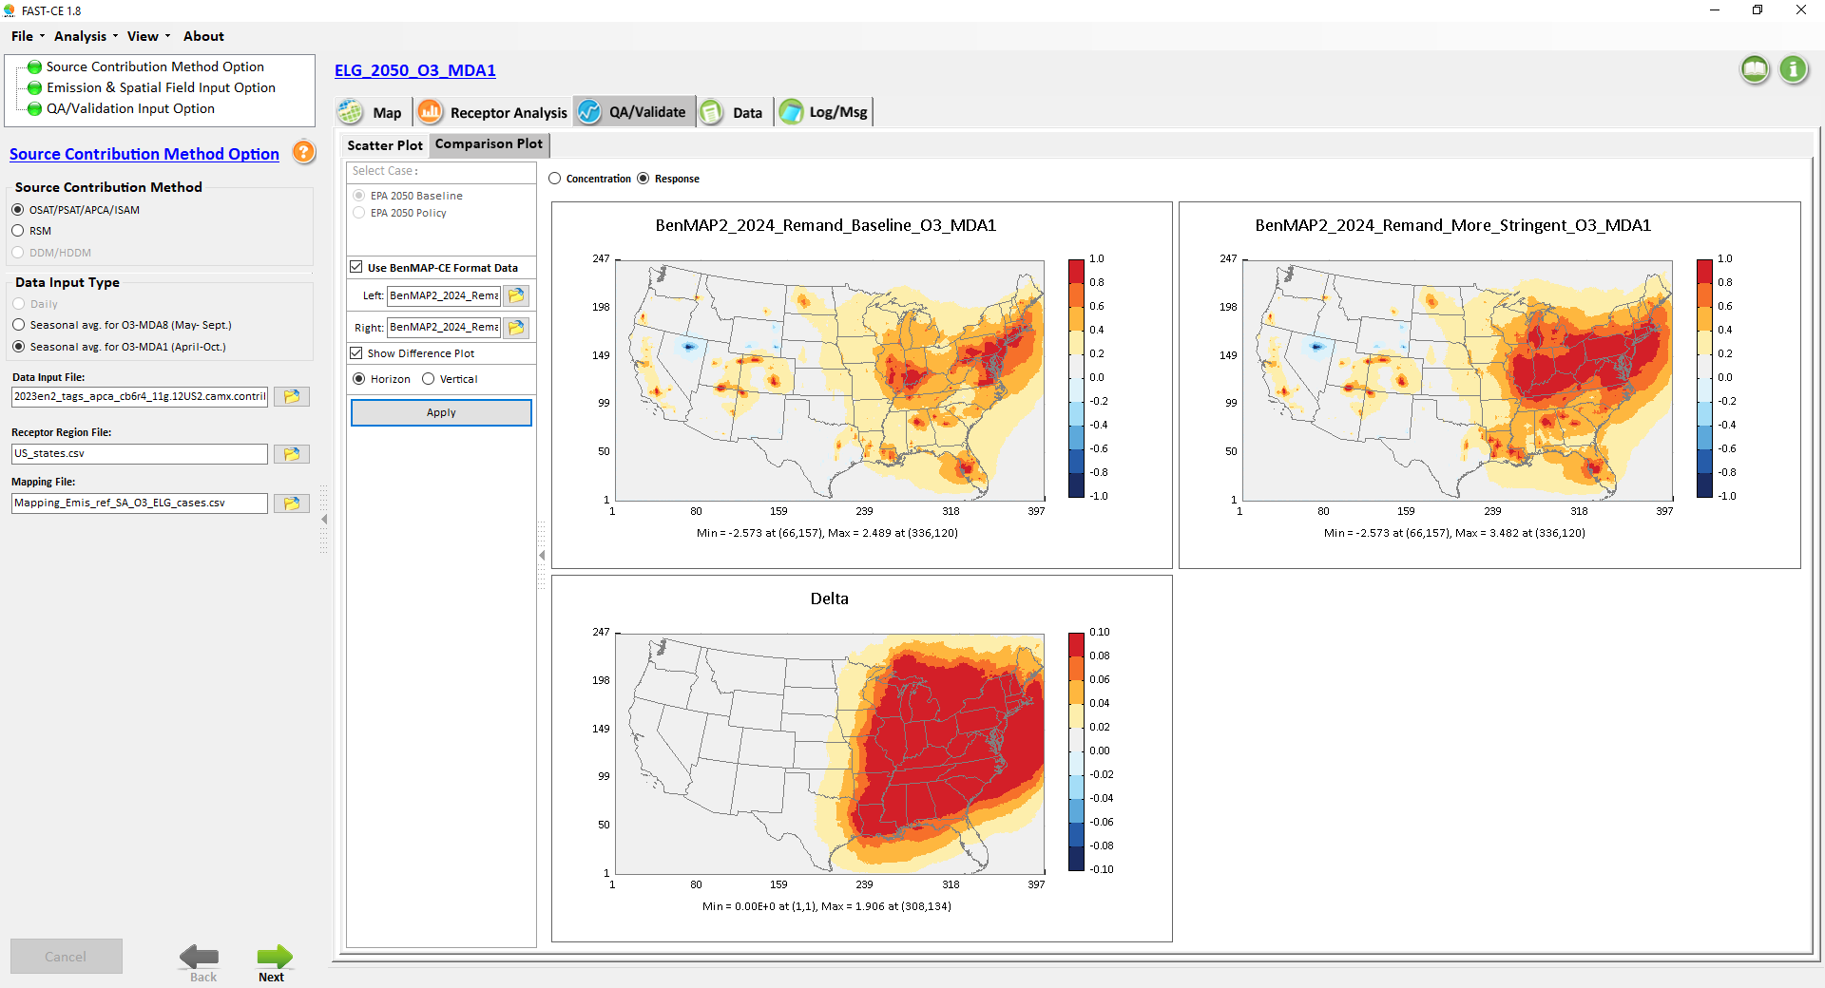

Remand_O3_MDA1_2024: “More String – Baseline”
1
1
-1
-1
0.1
0.5
-0.1
-0.5

Slide 10
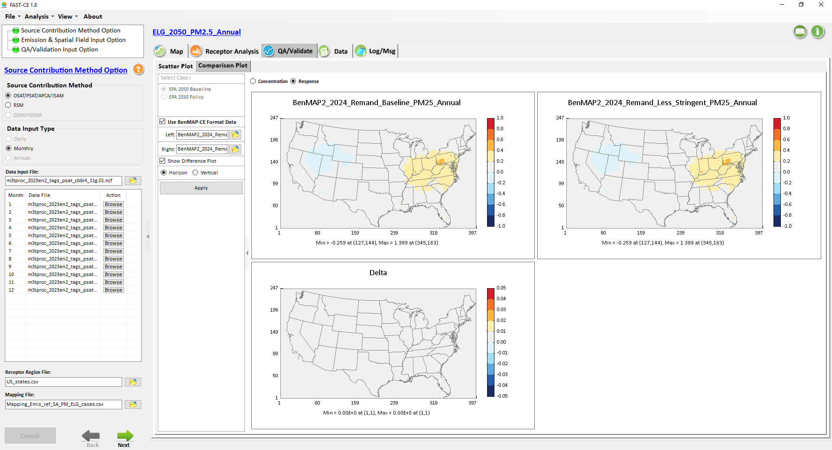
Remand_ PM2.5_Ann_2024 : “Less String – Baseline”
1
1
-1
-1
0.05
-0.05

Slide 11
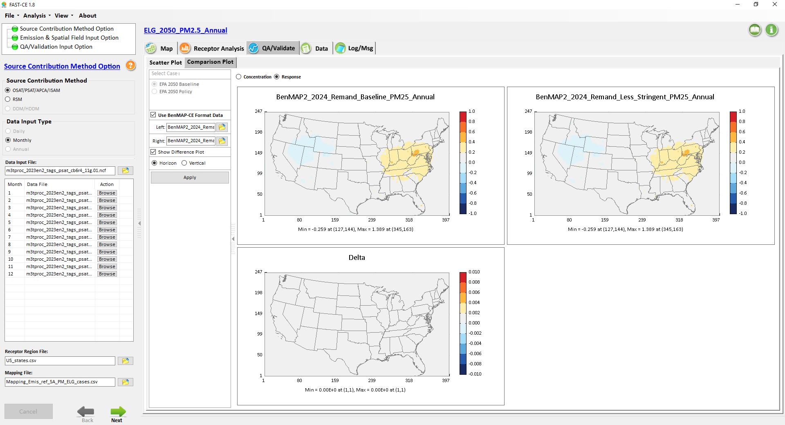
Remand_ PM2.5_Ann_2024 : “Less String – Baseline” (2)
1
1
-1
-1
0.01
-0.01

Slide 12

Remand_ PM2.5_Ann_2024 : “More String – Baseline”
1
1
-1
-1
0.05
-0.05

Slide 13

Remand_ PM2.5_Ann_2024 : “More String – Baseline” (2)
1
1
-1
-1
0.01
-0.01

Slide 14
FAST-CE
Transport “Remand”
Case Results:
2021: O3-MDA8, O3-MDA1
2024: O3-MDA8, O3-MDA1 & PM2.5
1.“Proposal – Baseline”
2. “More Stringent – Less Stringent”

Slide 15
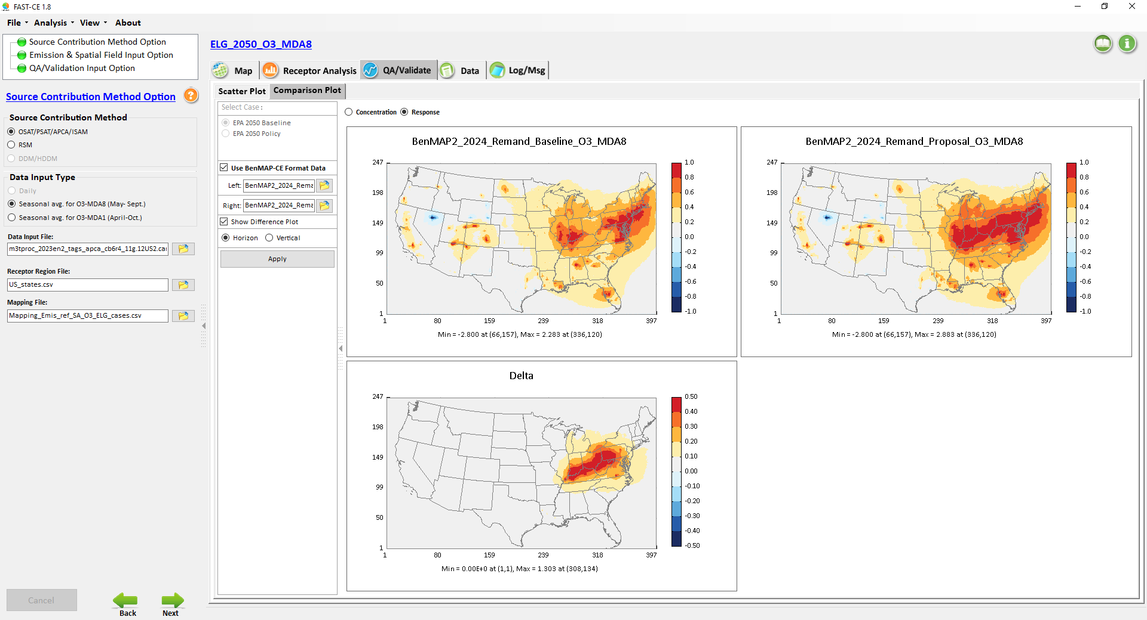
Remand_O3_MDA8_2024: “Proposal – Baseline”

Slide 16
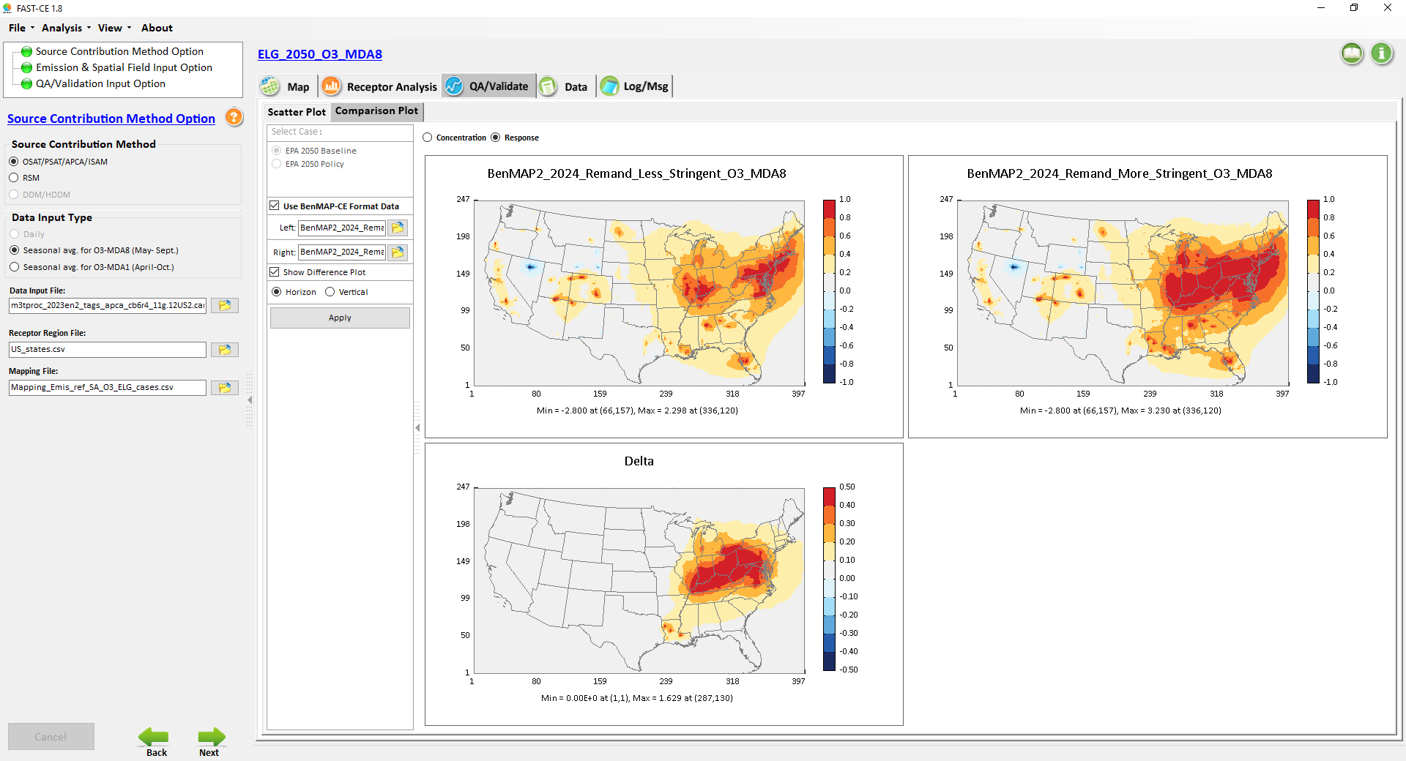
Remand_O3_MDA8_2024: “More Stringent – Less Stringent”

Slide 17
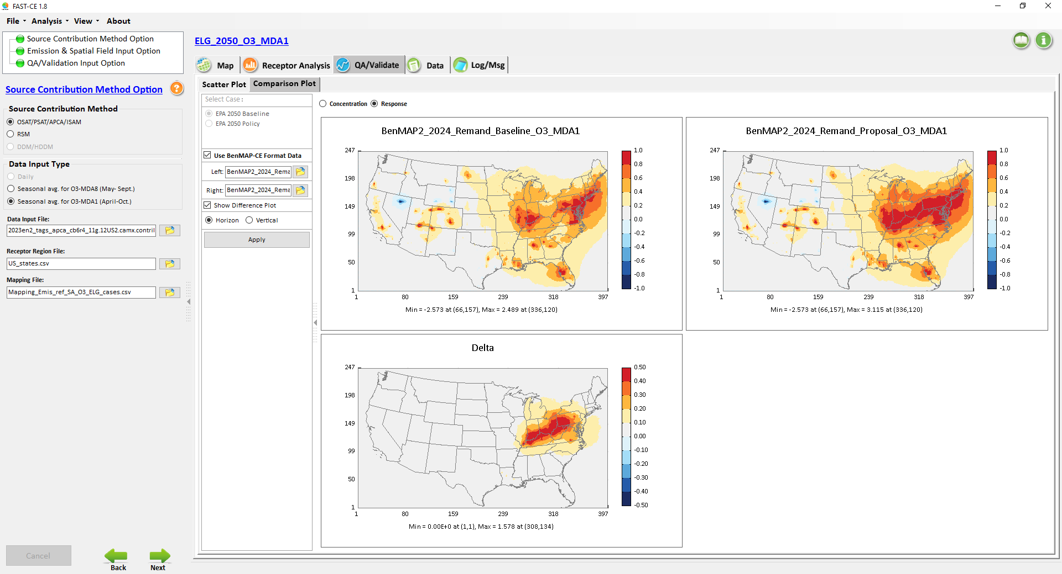
Remand_O3_MDA1_2024: “Proposal – Baseline”

Slide 18
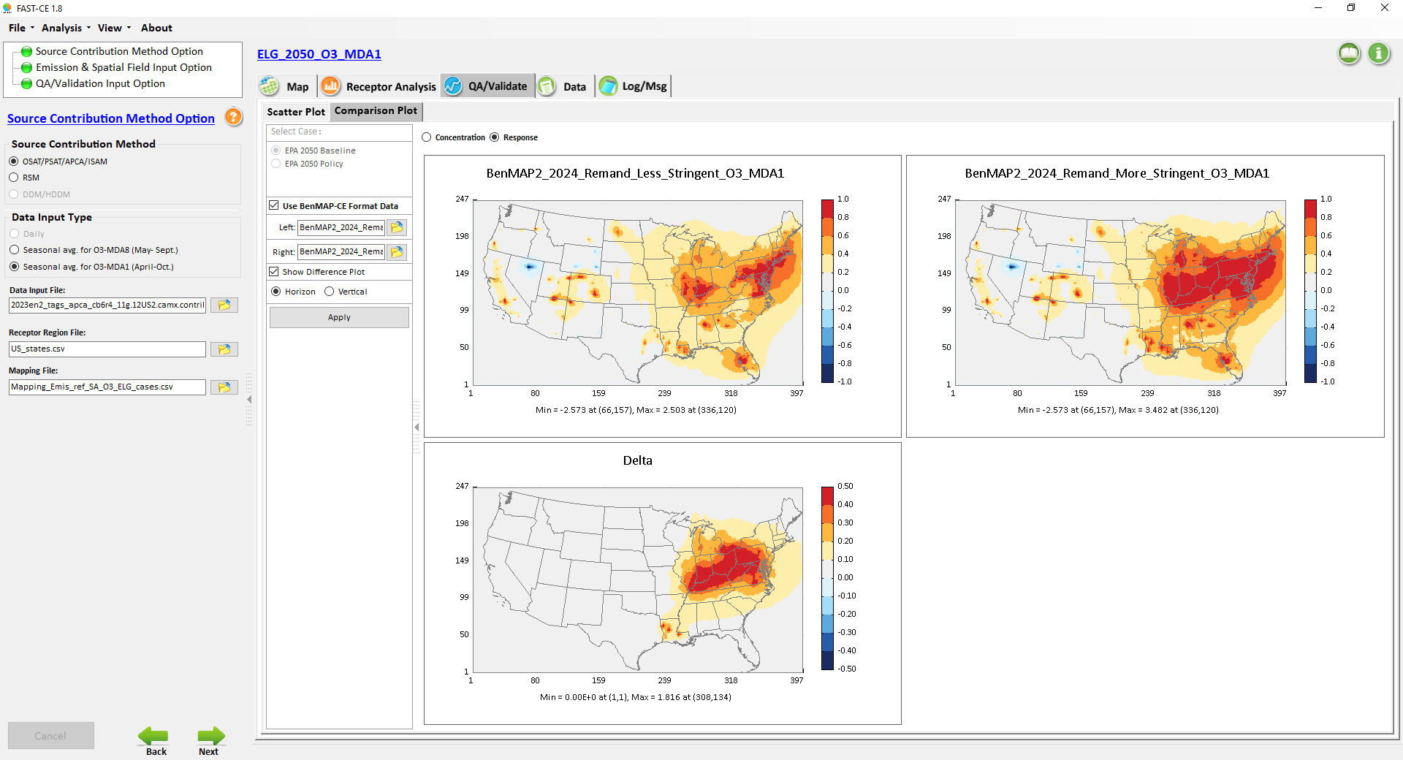
Remand_O3_MDA1_2024: “More Stringent – Less Stringent”

Slide 19
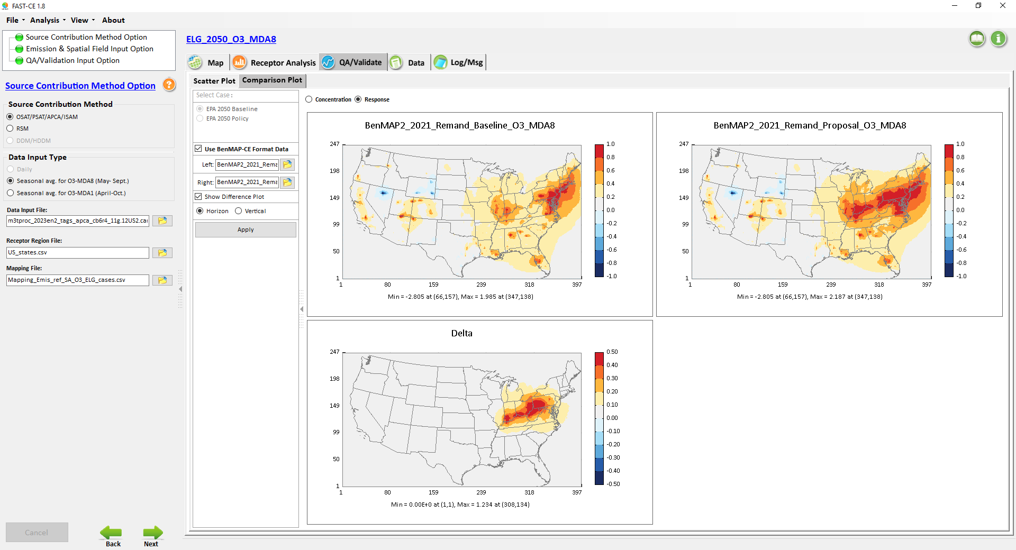
Remand_O3_MDA8_2021: “Proposal – Baseline”

Slide 20

Remand_O3_MDA8_2021: “More Stringent – Less Stringent”

Slide 21

Remand_O3_MDA1_2021: “Proposal – Baseline”

Slide 22

Remand_O3_MDA1_2021: “More Stringent – Less Stringent”

Slide 23
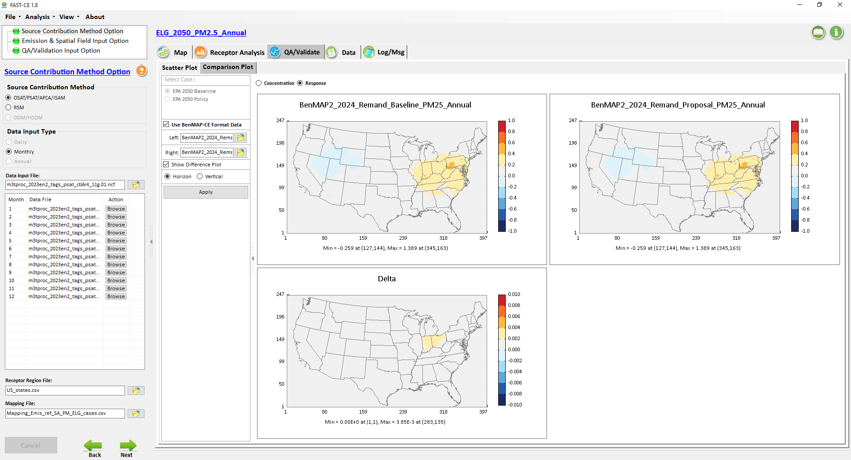
Remand_PM2.5_Ann_2024: “Baseline – Proposal”

Slide 24
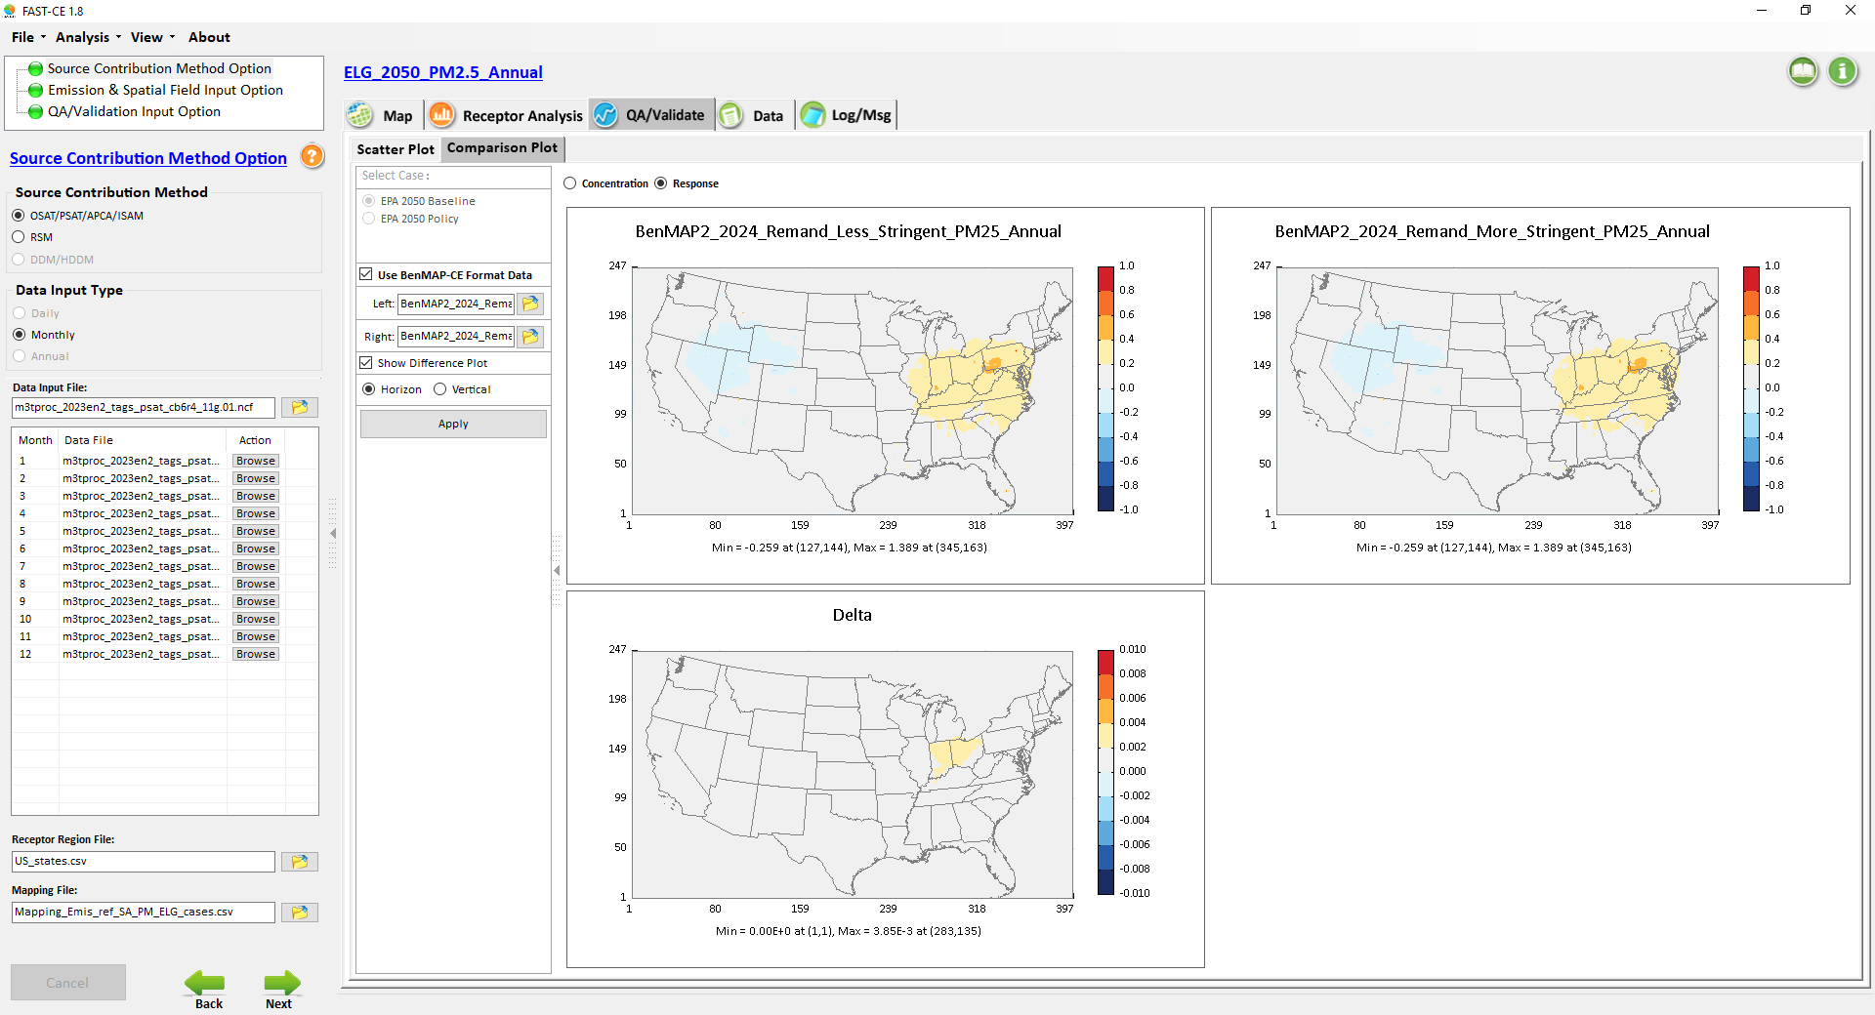
Remand_PM2.5_Ann_2024: “More Stringent – Less Stringent”

Slide 25
FAST-CE
Transport “Remand”
Case Results:
2021: O3-MDA8, O3-MDA1
2024: O3-MDA8, O3-MDA1 & PM2.5

Slide 26
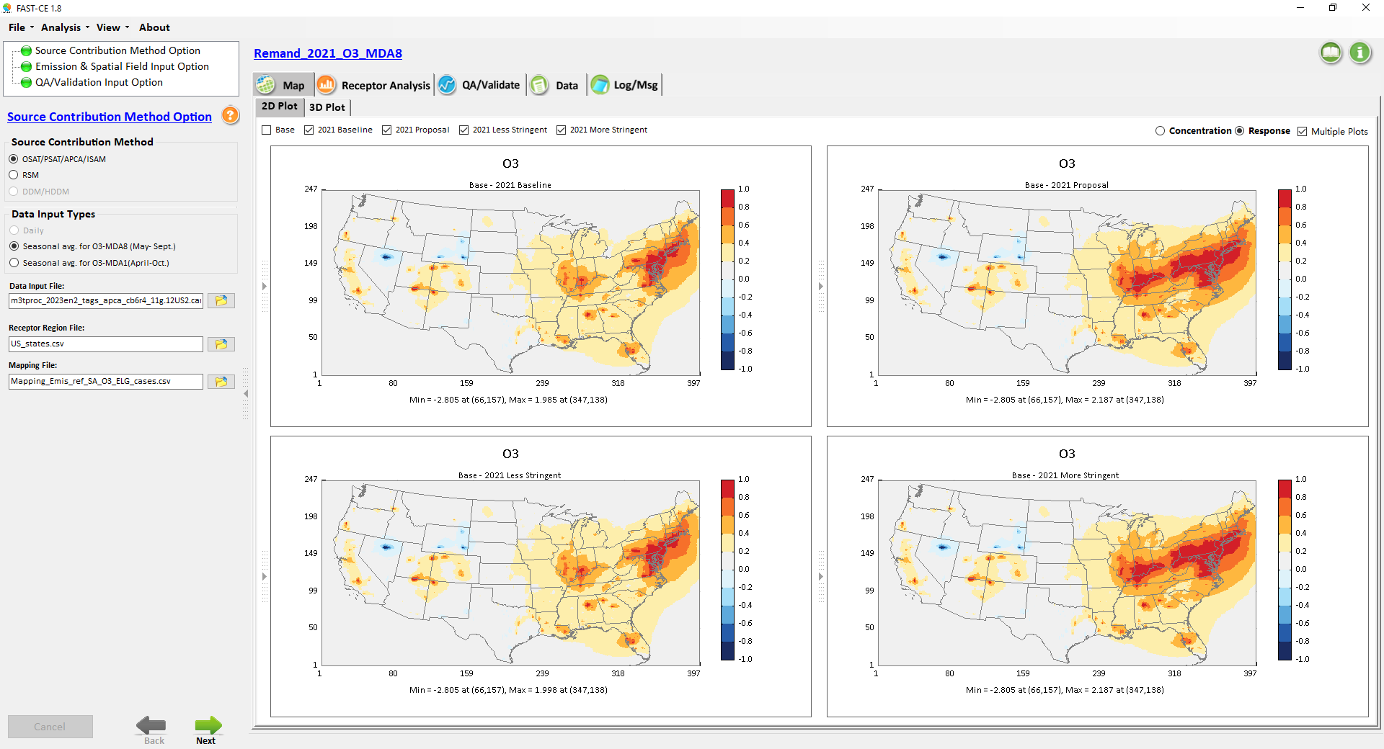
Remand_O3_MDA8 (Ozone Season)：2021 Responses

Slide 27
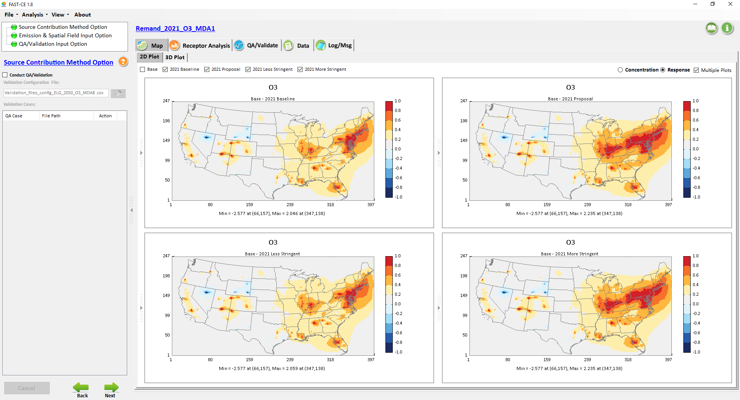
Remand_O3_MDA1 (Ozone Season)：2021 Responses

Slide 28
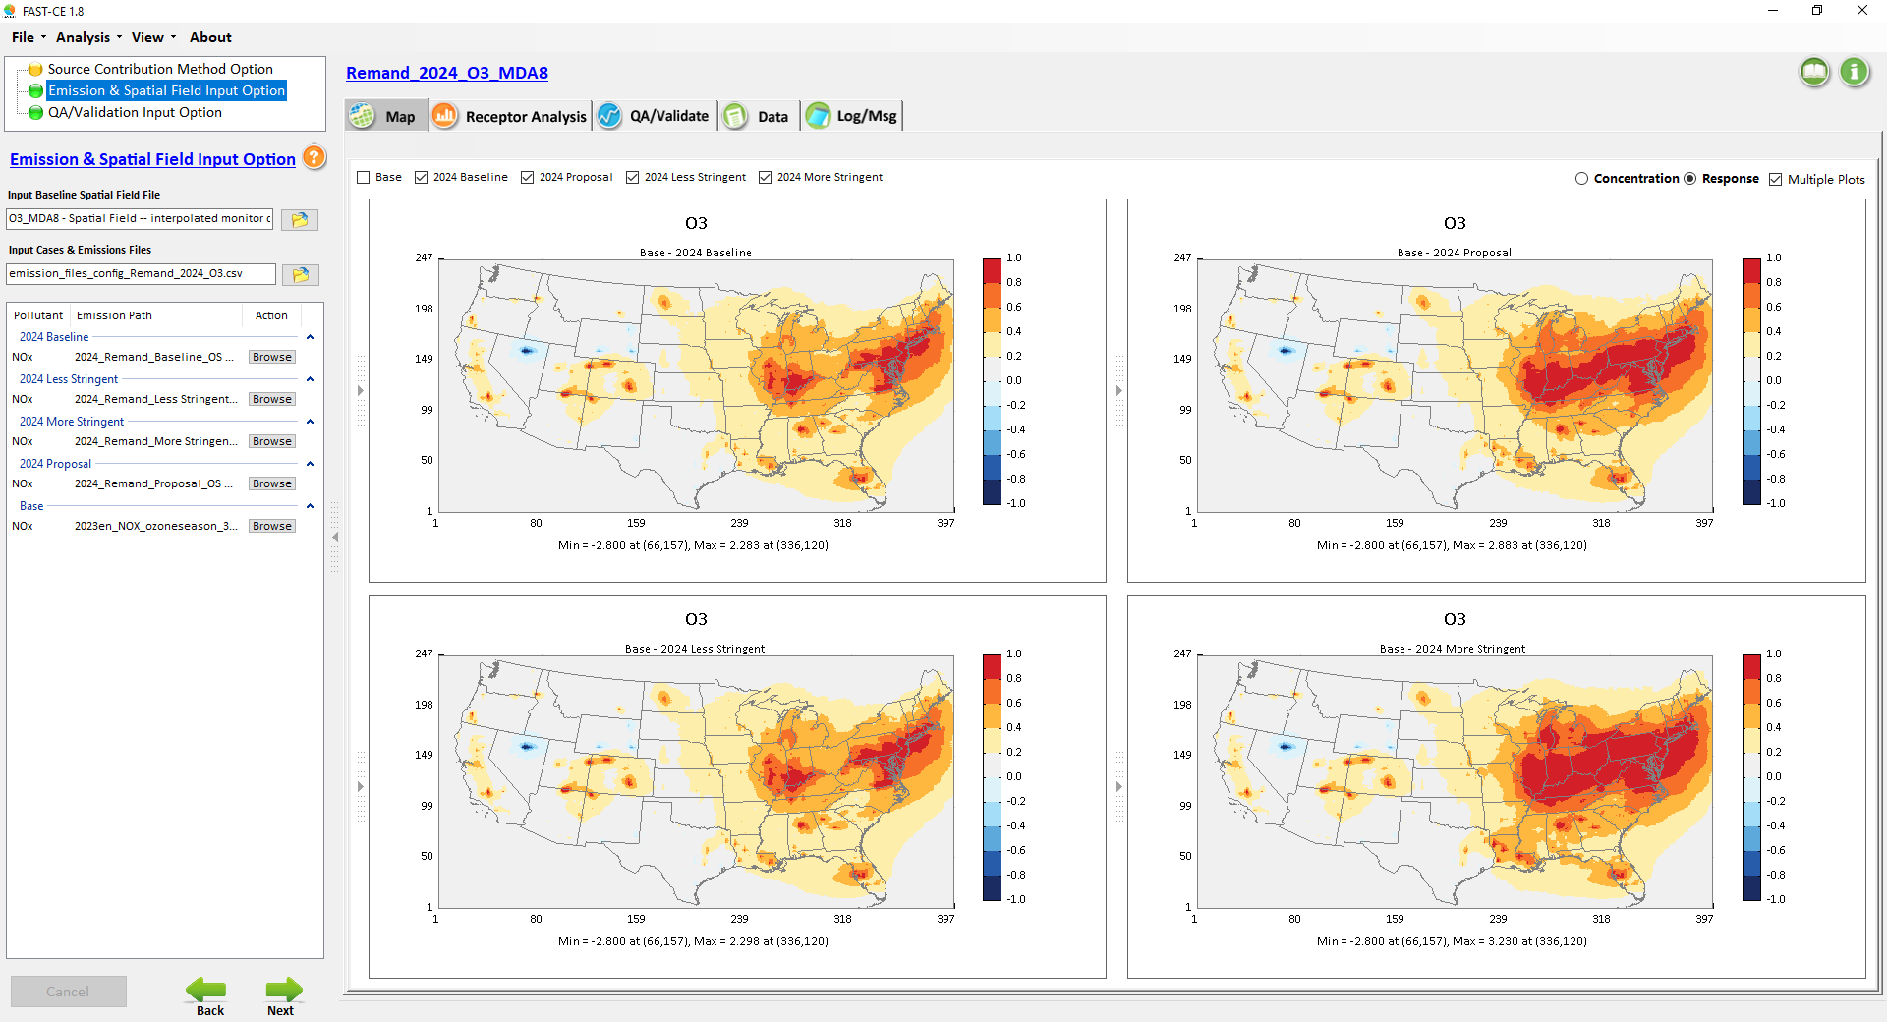
Remand_O3_MDA8 (Ozone Season)：2024 Responses

Slide 29
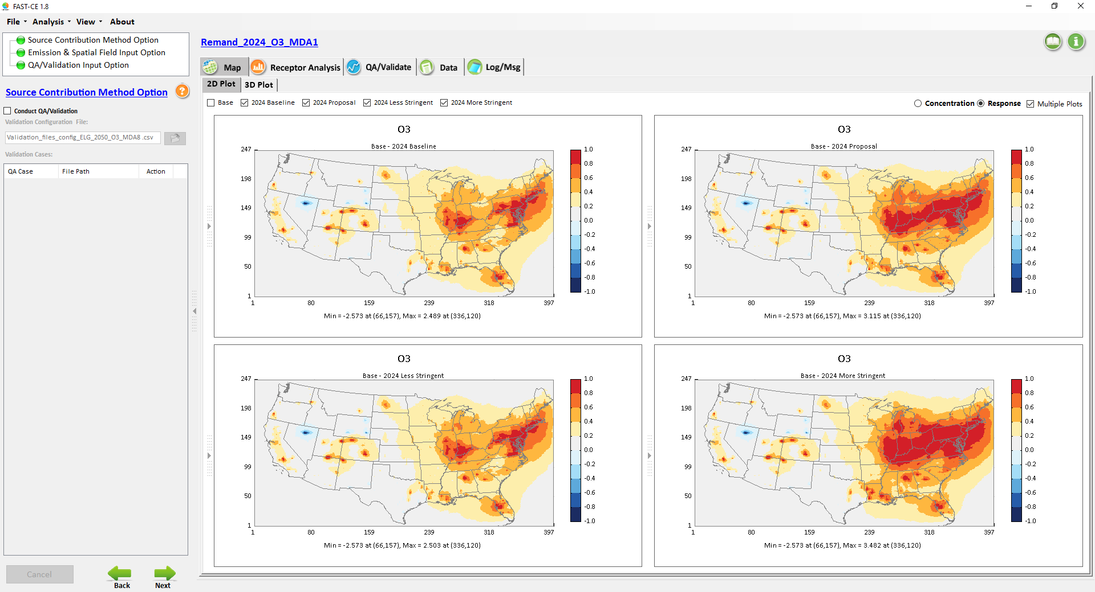
Remand_O3_MDA1 (Ozone Season)：2024 Responses

Slide 30
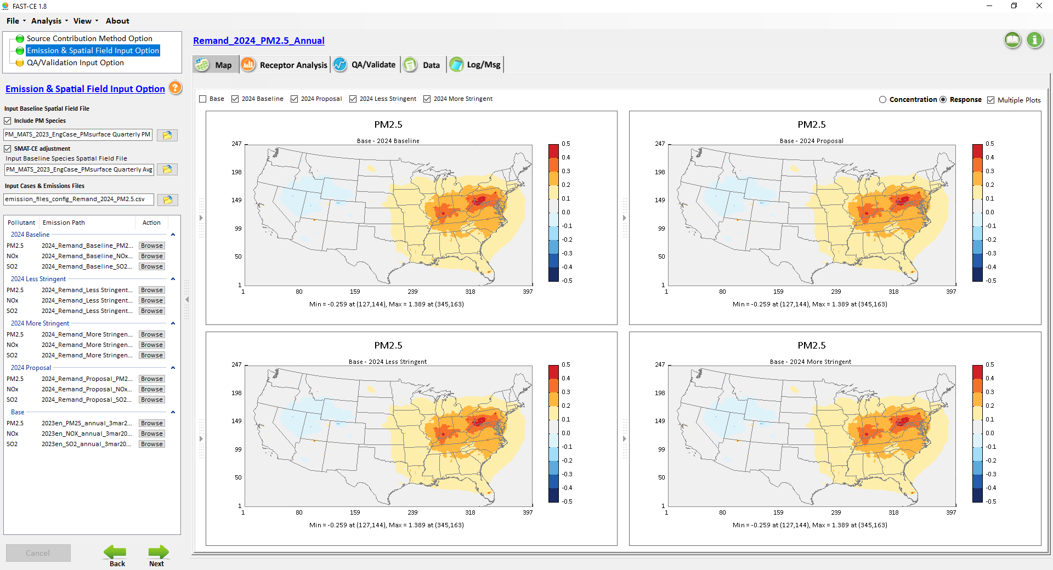
Remand_PM2.5_Annual：2024 Responses

Slide 31
FAST-CE
“OW_ELG” Case
QA Results:
2030,2040,2050
O3 MDA8 & PM2.5

Slide 32
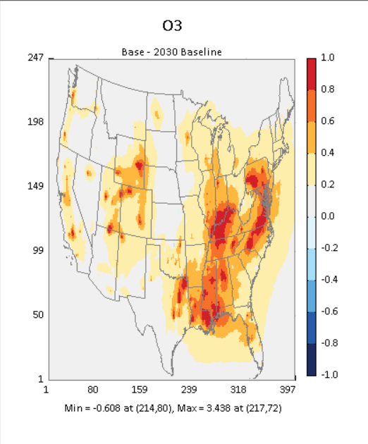
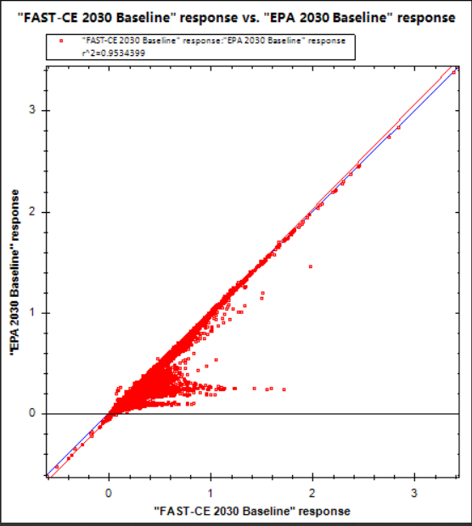
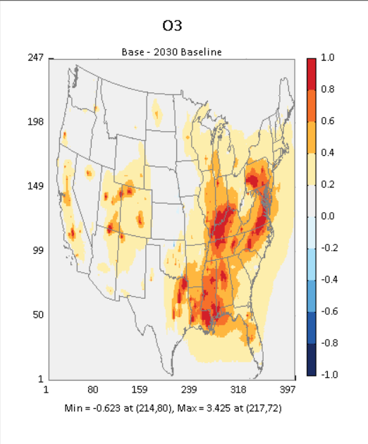
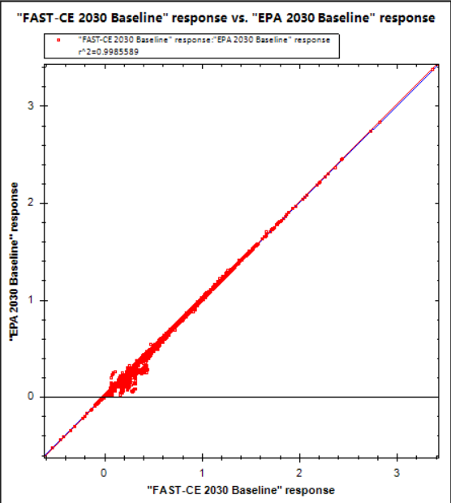
ELG_2030_O3_MDA8 QA results with/without “RET2030”
R^2=0.9534399
RET2030 =0
R^2=0.9985589
RET2030 =1

Slide 33
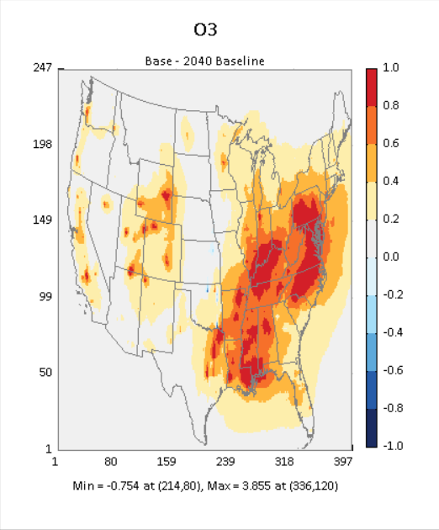
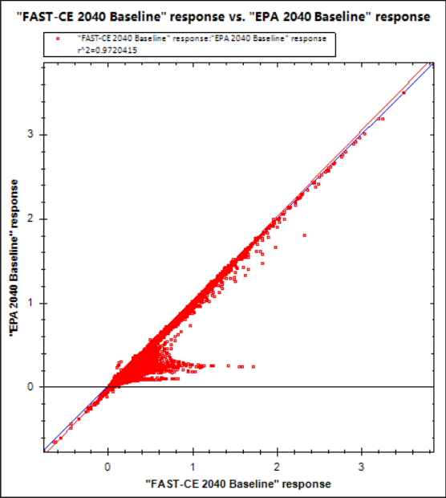
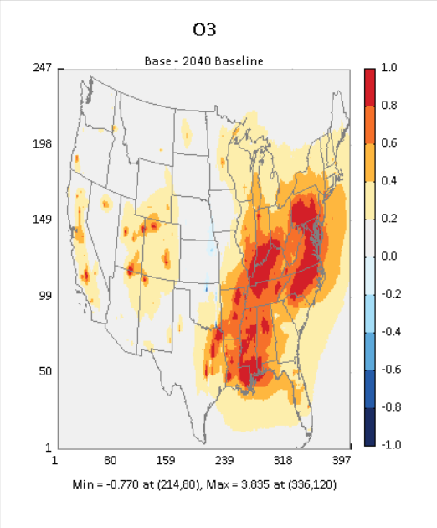
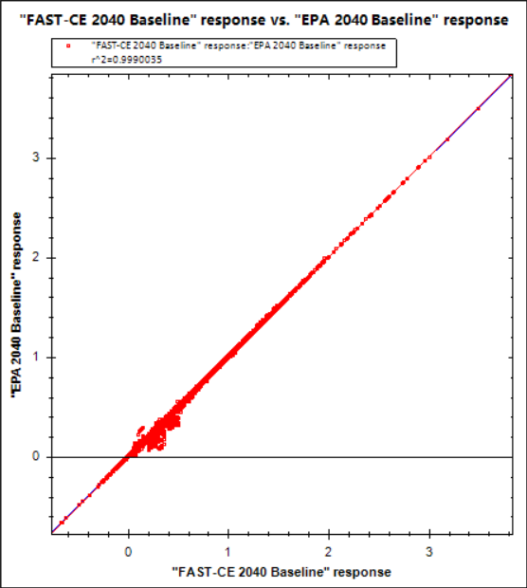
ELG_2040_O3_MDA8 QA results with/without “RET2030”
R^2=0.9720415
RET2030 =0
R^2=0.9990035
RET2030 =1

Slide 34
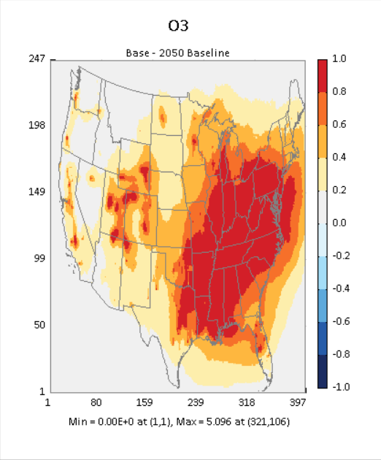
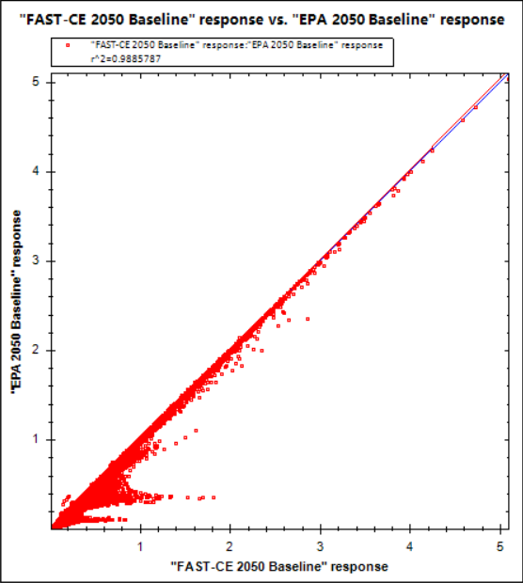
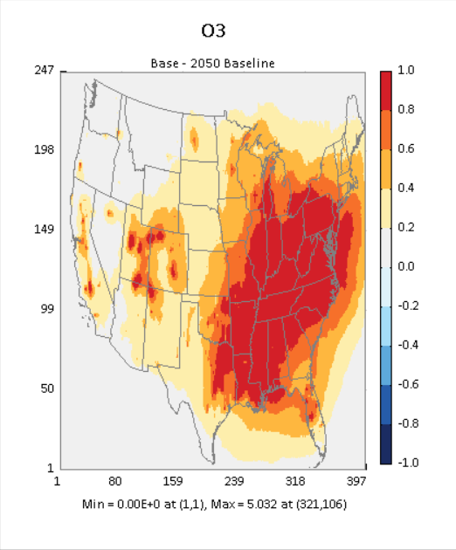
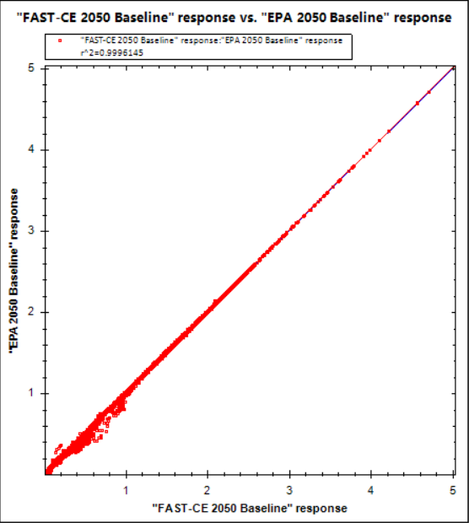
ELG_2050_O3_MDA8 QA results with/without “RET2030”
R^2=0.9885787
RET2030 =0
R^2=0.9996145
RET2030 =1

Slide 35
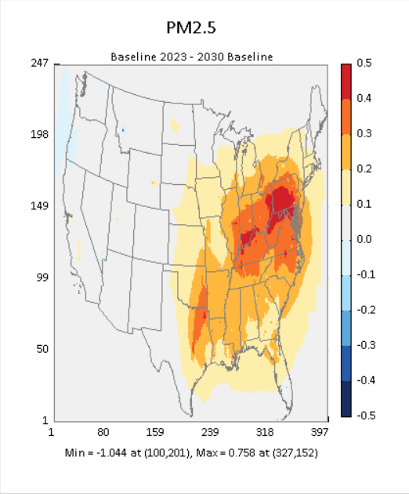
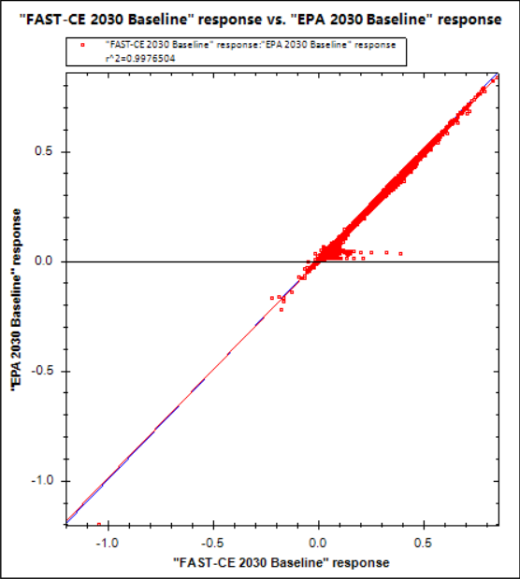
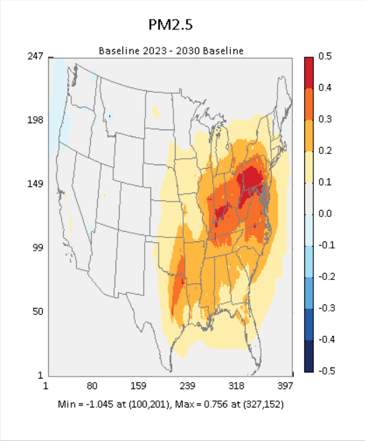
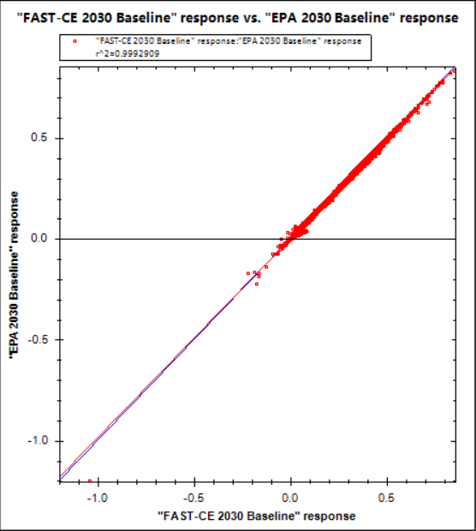
ELG_2030_PM2.5 QA results with/without “RET2030”
R^2=0.9976504
RET2030 =0
R^2=0.9992909
RET2030 =1

Slide 36
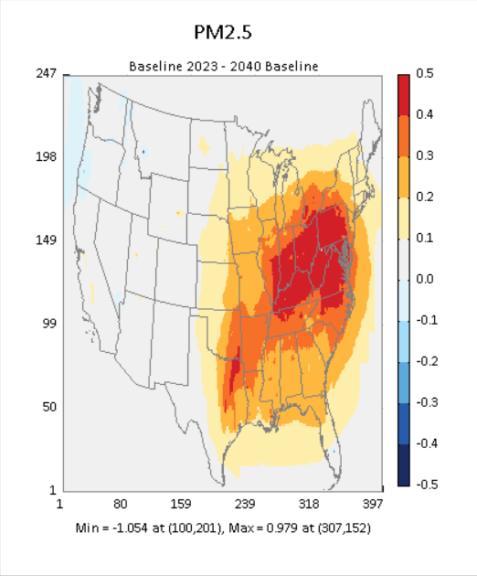
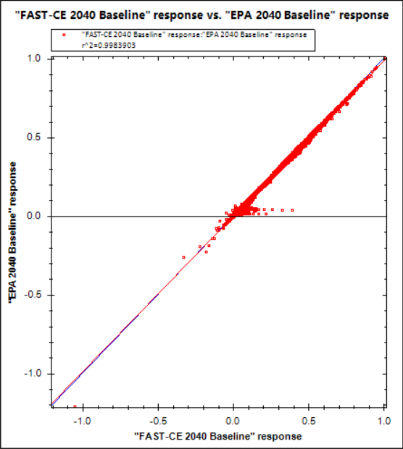

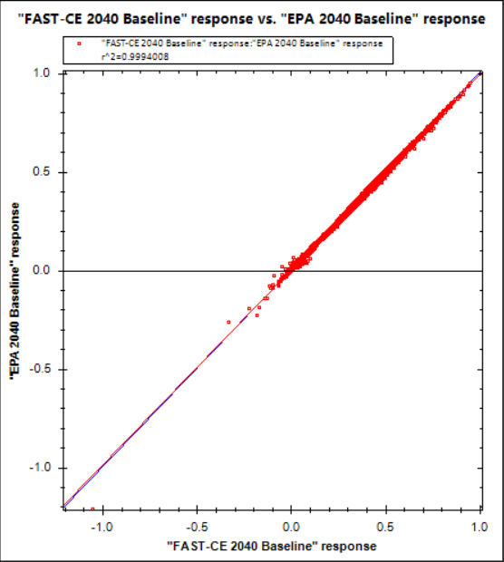
ELG_2040_PM2.5 QA results with/without “RET2030”
R^2=0.9983903
RET2030 =0
R^2=0.9994008
RET2030 =1

Slide 37
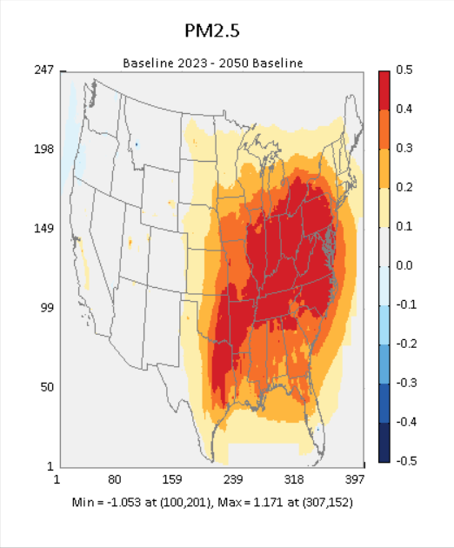
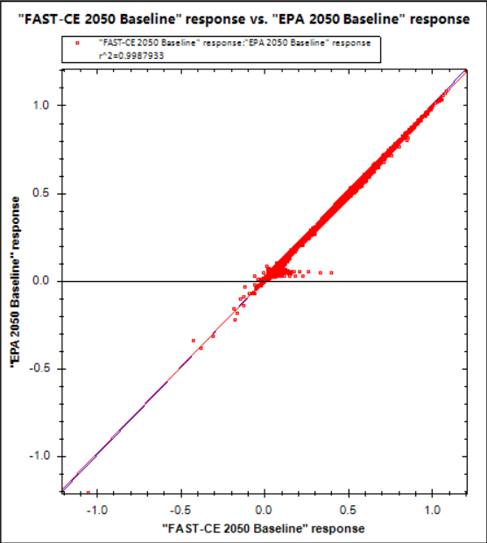
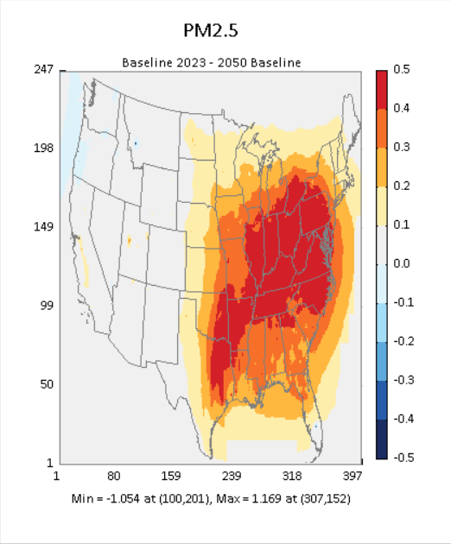

ELG_2050_PM2.5_Annual QA results with/without “RET2030”
R^2=0.9987933
RET2030 =0
R^2=0.9994101
RET2030 =1

Slide 38
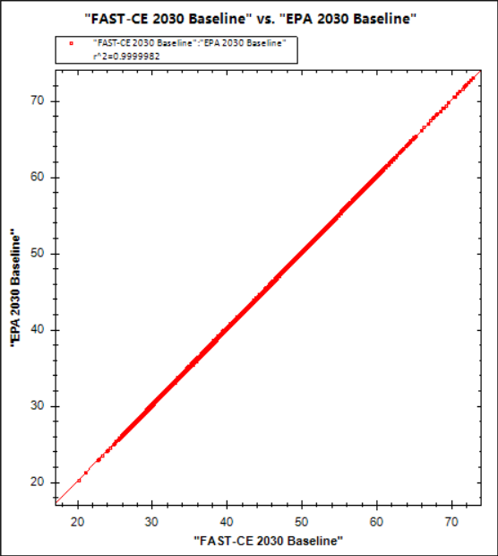
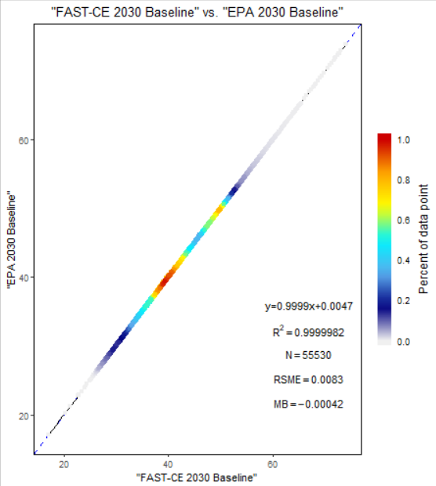
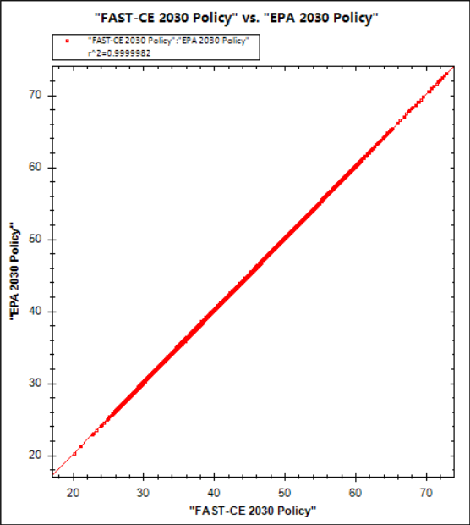
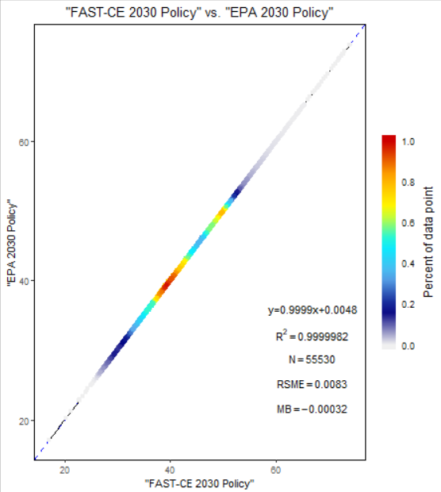

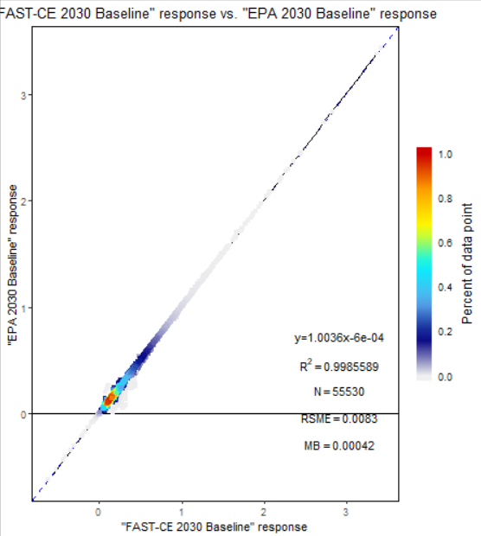


ELG_2030_O3_MDA8 with RET2030
2030 Baseline
2030 Policy
R^2=0.9999982
R^2=0.9999982
Conc.
R^2=0.9985589
R^2=0.9985452
Response

Slide 39








ELG_2040_O3_MDA8 with RET2030
2040 Baseline
2040 Policy
R^2=0.999998
R^2=0.999998
Conc.
R^2=0.9990035
R^2=0.9990076
Response

Slide 40








ELG_2050_O3_MDA8 with RET2030
2050 Baseline
2050 Policy
R^2=0.9999981
R^2=0.9999981
Conc.
R^2=0.9996145
R^2=0.9996138
Response

Slide 41








ELG_2030_PM2.5_Annual with RET2030
2030 Baseline
2030 Policy
R^2=0.9999957
R^2=0.9999958
Conc.
R^2=0.9992909
R^2=0.9992954
Response

Slide 42








ELG_2040_PM2.5_Annual with RET2030
2040 Baseline
2040 Policy
R^2=0.999994
R^2=0.999994
Conc.
R^2=0.9994008
R^2=0.9994015
Response

Slide 43








ELG_2050_PM2.5_Annual with RET2030
2050 Baseline
2050 Policy
R^2=0.9999906
R^2=0.9999905
Conc.
R^2=0.9994101
R^2=0.9994182
Response

