Slide 1
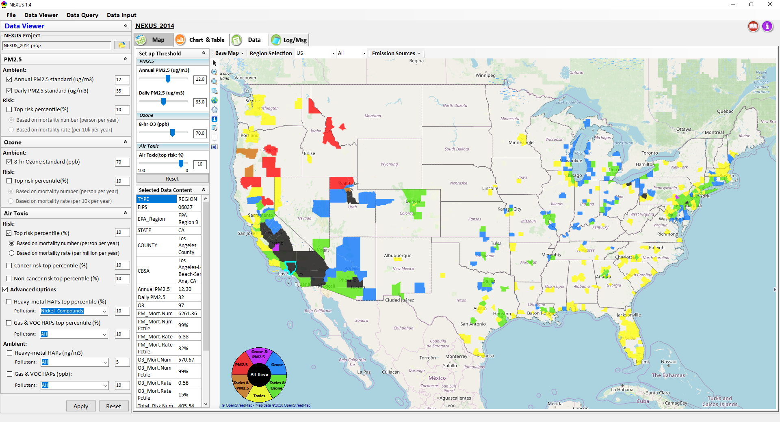
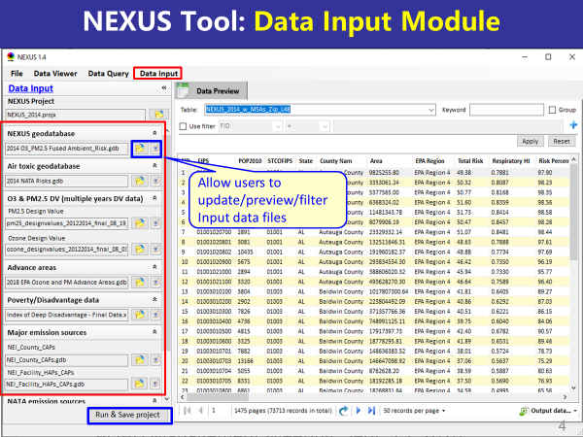
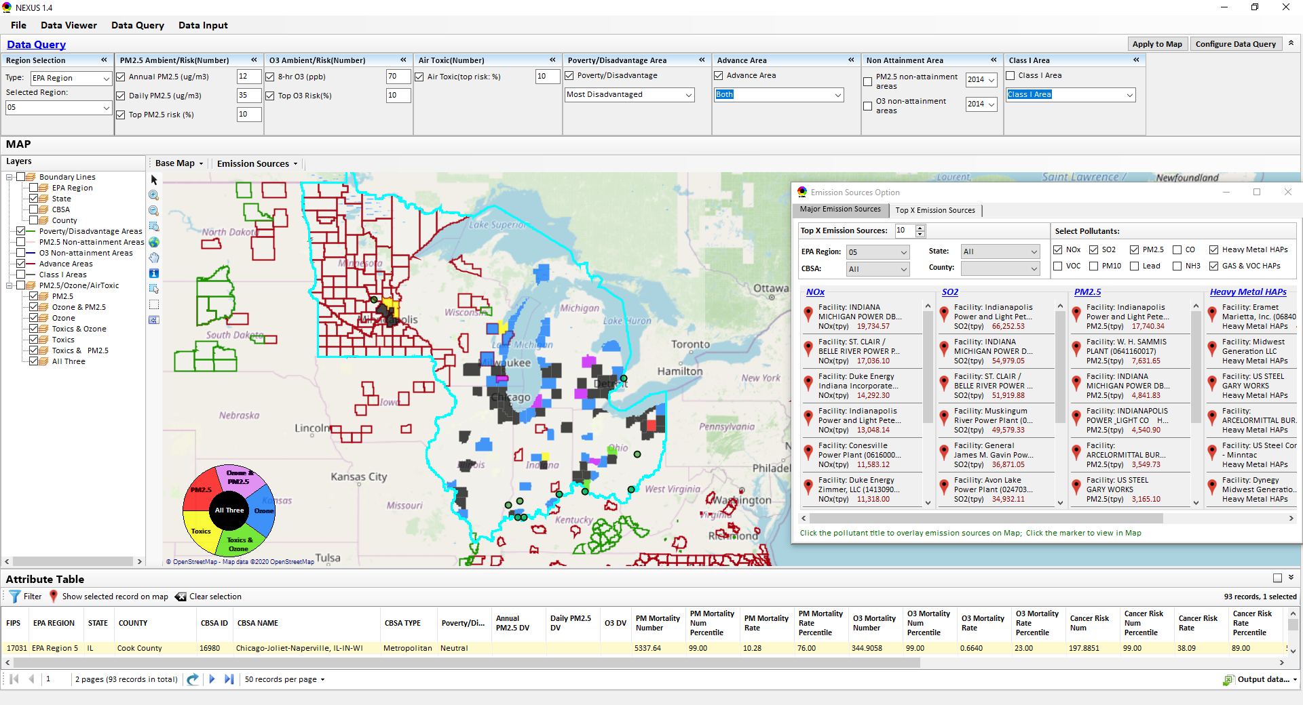
“NEXUS” Multi-Pollutant Analysis Tool Development: Status and Progress
Data Viewer Module
Data Input Module
Data Query Module
“NEXUS 1.5” available on OAQPS’s Shared Drive at: “G:\SHARE\NEXUS\NEXUS 1.5\”
OAQPS/AQAD/Air Quality Modeling Group
AQAD Management Team Meeting, Sept. 25, 2020

Slide 2
NEXUS Tool Development
Motivation: Develop a new multi-pollutant analysis tool to identify and assess areas with high ambient levels and/or health risks associated with PM2.5, O3, and air toxics
Phase-1: Develop a GIS-based NEXUS prototype with a user-friendly graphical interface to provide analysis and visualization functions of potential multi-pollutant AQ issues at national level (continental US)
Phase-2: Expand the NEXUS tool to allow users to dail into an EPA region, State, or metropolitan area and provide data query and V/A functions for “AQ and emissions” information over the selected region of interest
2

Slide 3
Expected Use of NEXUS Tool
The NEXUS tool will allow users to do the following:
National screening for areas with MP issues: Phase 1 development will provide ability to quickly screen areas across nation that have combination of high air quality and/or risk levels for O3, PM2.5 and air toxics.
Area screening to understand nature of MP problem: Phase 2 development will provide ability to ‘dial-into’ specific areas to determine extent to which common emissions sources are causing the MP issues.
OAQPS expects to use this tool to engage with Regions and identify areas that would potentially benefit most from MP approaches to reduce emissions (including current NAs and Advance areas).
The NEXUS tool will essentially provide a ‘conceptual model’ of MP issues within an area to facilitate engagement with state/local/tribal agencies and community stakeholder groups.
3

Slide 4
NEXUS Tool : Schedule & Installation
Work Plan | Date
Developed NEXUS tool prototype and Phase-1 functions | Dec. 2019 ~ April 2020
Developed Phase-2 functions and deliver first working (interim) NEXUS tool | May ~ July 2020
Developing a fully functional NEXUS tool for beta-testing and on-line User’s Manual | Aug. ~ Oct. 2020
Download “NEXUS” tool: The “NEXUS 1.5” package (“NEXUS v1.5 setup.exe” & “NEXUS 1.5 Data.exe”: run both to install) is available at OAQPS’s Shared Drive at: G:\SHARE\NEXUS\NEXUS 1.5\
Or Google Drive link below (or EPA’s ScienceFTP2 site upon request):
https://drive.google.com/open?id=1Xl3VqtlRXeBt_FrfHpuCZYumxjqMR9hL
(Note: Require software installation privilege to install “NEXUS tool” at EPA’s PCs; Older EPA PCs may be less efficient in running “NEXUS tool”)
4

Slide 5
NEXUS Tool: Three Key Modules
Data Viewer module
Data Input module
Data Query module
View and create interactive Map/Data/Chart/Table
Provide flexible selections & mapping of “Ambient” and/or “Risk” levels of PM2.5, O3 and air toxics
Provide regional analysis for “EPA region”, “States”. CBSA”, and “County”
Link and display major emission sources locations & emitted pollutants info.
Allow to update & change input data files
Provide data preview and filter functions
Extend to use 10 input data files now (publicly available, ~4 GB)
Quick turnaround to run & save to a new “project” using new input data files
Expand data field selections and flexibility for exploratory/advanced users
Provide overlaying map and summary table for data query results
Current data query based on selected data fields: “Ambient/Risk, Advance area, Socio-demographic (EJ) area, NA Area, Class I area”

Slide 6
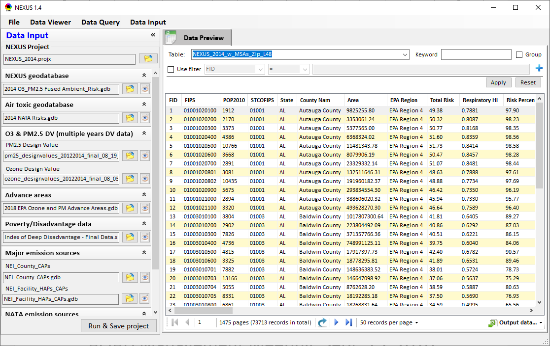
NEXUS Tool: Data Input Module
Allow users to update/preview/filter Input data files
Currently, there are 10 input data files used (publicly available)
Total files size ~4 GB
Run and Save to a new project after loading new input data files
6

Slide 7
Data Input File Names | Data Format | Data Description | Data Source | Data Period
“2014 O3 & PM2.5 fused Ambient & Risk” | Geodataset | O3/PM2.5 ambient & risk data at county/census tract level | from OAQPS MP team | 2014
“2014 NATA Risk” | Geodataset | Air toxics ambient & risk data at county/census tract level | from OAQPS MP team | 2014
“O3_DV_2009_2018” | Excel | O3 design values at county level | From EPA public website: https://www.epa.gov/air-trends/air-quality-design-values | 2009 to 2018
“PM_DV_2009_2018” | Excel | PM2.5 design values at county level | From EPA public website: https://www.epa.gov/air-trends/air-quality-design-values | 2009 to 2018
“Advance areas O3_PM” | Geodataset | O3 & PM2.5 Advance Areas | from OAQPS MP team | 2018
“Index of Poverty_ Disadvantage” | Excel | Index of poverty/disadvantage at county level | from Univ. of Michigan website: https://poverty.umich.edu/projects/understanding-communities-of-deep-disadvantage/ | 2017
“NEI_County_CAPs” “NEI_Facility_HAPs_ CAPs” | Geodataset | Major emission sources and facility info. of CAPs & HAPs at county level | From OAQPS public website: ftp://newftp.epa.gov/EPADataCommons/OAR/OAQPS/NEI/NEI_Facility_HAPs_CAPs.zip ftp://newftp.epa.gov/EPADataCommons/OAR/OAQPS/NEI/NEI_County_CAP.zip | 2008, 2011, 2014
“2014 NEI_NATA Emissions” | Access Database (*. accdb) | NATA emissions data from 2014 NEI database, including various source groups | From EPA public website: https://www.epa.gov/national-air-toxics-assessment/2014-nata-assessment-results#emissions | 2014
“Class1_FederalAreas” | Geodataset | Mandatory Class 1 Federal Areas | From Mandatory Class 1 Federal Areas Web Service: https://edg.epa.gov/data/public/OAR/OAQPS/Class1/Class1Areas.zip | —
Data Input Module: Input Files & Attributes
7

Slide 8
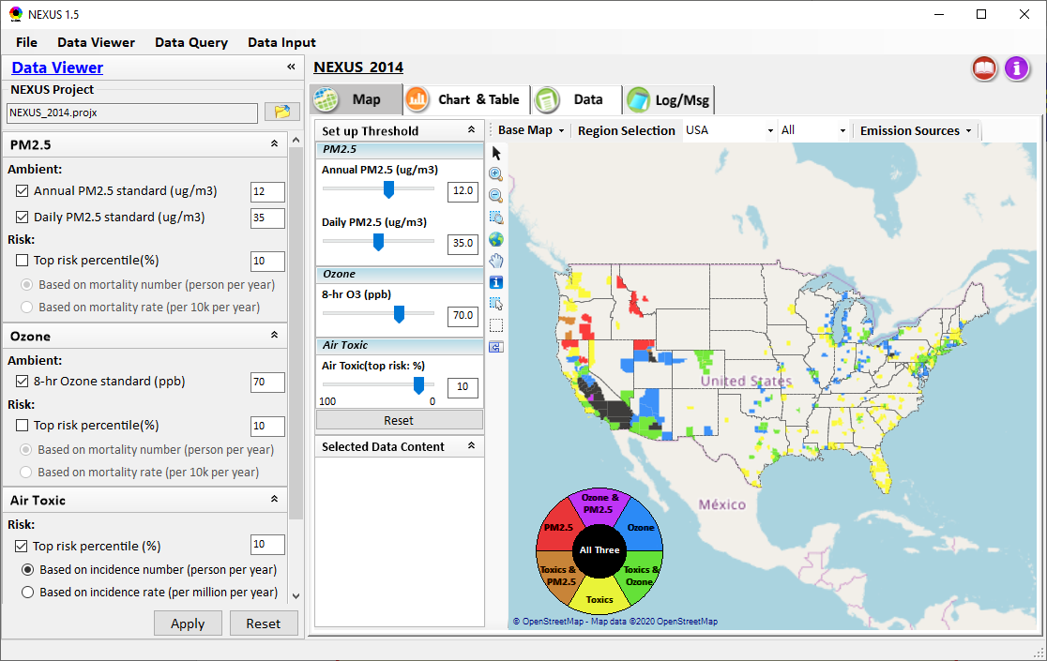
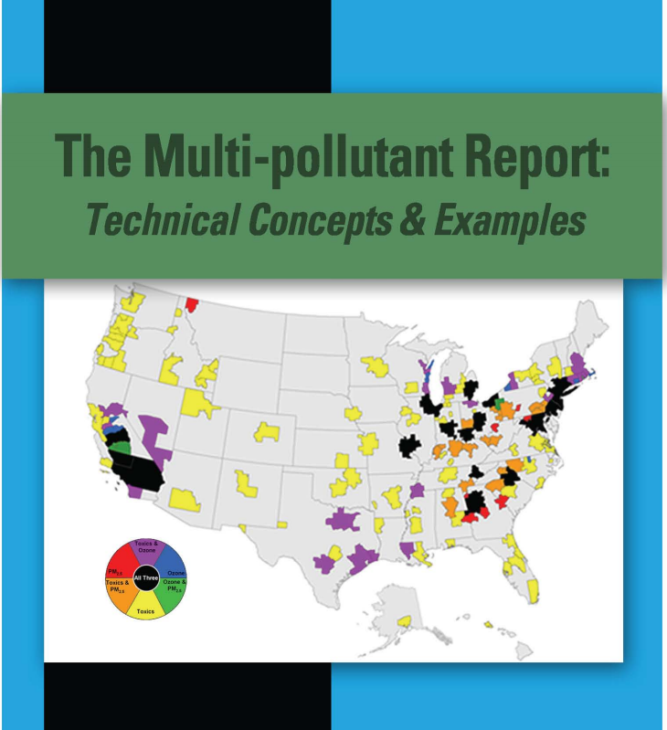
NEXUS Tool Demo: 2014 NEXUS Case
Launching Page
Roadmap for Demo:
(Use example cases)
National View: Use “NEXUS” across pollutants to provide an initial “SCREEN” at the national level by providing an indicator where there may be a common set of sources contributing to Multi-pollutant issues.
Regional View: Dial into a region or area of interest to understand the pollutant/source connections, and potential for more effective and efficient multi-pollutant solution.
2008
8

Slide 9
RoadMap for NEXUS Tool Demo (1)
National Screening (2014 Data)
Replicate 2008 NEXUS map with O3/PM2.5 concentrations above NAAQS and NATA risk estimates above selected percentile of top 10%
What happens to areas at lower O3/PM2.5 NAAQS levels?
What happens to areas current over O3/PM2.5 NAAQS if change HAP risk percentile?
Provide NEXUS map on risk basis: O3/PM2.5 BenMAP mortality risk based on fused surfaces and NATA risk estimates above selected percentile of top 10% for all pollutants
What happens to MP areas as one changes percentile to top 20% or others?
What is relationship between Heavy Metal HAPs risk (top 10%) and PM2.5 risk to identify potential co-pollutant issues?
What is relationship between Gas/VOC HAPs risk (top 10%) and O3 risk to identify potential co-pollutant issues?
9

Slide 10
RoadMap for NEXUS Tool Demo (2)
Regional/State/CBSA/County Screening
EPA Region 4 Example
Areas with MP risk in top 10% across O3, PM2.5 and HAPs
Louisville CBSA: General view and then dial into “Jefferson County” with transparent map color
What are the top 10 emissions sources in county by pollutant?
What specific sources are common across pollutants that may indicate co-control potential?
Can view these sources on the map with summary data available.
10

Slide 11
RoadMap for NEXUS Tool Demo (3)
Data Query: State/CBSA/County Views
Advance Areas
Initial view of national level information using the Advance Area definition to show overlay with MP areas
Region 5 => Minneapolis Example: General view and then dial into “Dakota County” with transparent map color
What are the top 10 emissions sources in county by pollutant?
What specific sources are common across pollutants that may indicate co-control potential?
Can view these sources on the map with summary data available.
11

Slide 12
RoadMap for NEXUS Tool Demo (4)
Data Query: State/CBSA/County Views
Socio-Economic/Demographic (EJ) Areas
Initial view of national level information using the Poverty/Disadvantaged indicator to show overlay with MP areas
Region 5 => Detroit Example: General view and then dial into “Wayne County” with transparent map color
What are the top 10 emissions sources in county by pollutant?
What specific sources are common across pollutants that may indicate co-control potential?
Can view these sources on the map with summary data available.
12

Slide 13
Discussion and Next Steps
Short-term:
Develop a fully functional version and continue to improve NEXUS based on MP team’s suggestions
Develop NEXUS User’s Manual
Long-term:
Upgrade and prepare NEXUS for Beta test with EPA Regions followed by public release & training
Update with 2017 fused AQ & air toxic data; Consider addition of screening-level analysis & assessment capabilities (e.g., EJ indicators) based on ours & user needs
Support OAQPS’s Air Toxic Strategy programs
Potential Issue:
UNC EMAQ contract ends in Sept., currently no funding to support NEXUS under new GSA contract starting Oct. 1st
13

Slide 14
“NEXUS 1.5”: Tutorial
Carey Jang, 9/25/2020
Download “NEXUS” tool: The “NEXUS 1.5” package (“NEXUS v1.5 setup.exe” & “NEXUS 1.5 Data.exe”: run both to install) is available at OAQPS’s Shared Drive at: G:\SHARE\NEXUS\NEXUS 1.5\
Or Google Drive link below (or EPA’s ScienceFTP2 site upon request):
https://drive.google.com/open?id=1Xl3VqtlRXeBt_FrfHpuCZYumxjqMR9hL
(Note: Require software installation privilege to install “NEXUS tool” at EPA’s PCs; Older EPA PCs may be less efficient in running “NEXUS tool”)
14

Slide 15

NEXUS Tool: On-line User’s Manual
Click “book” icon to launch “User’s manual”
Hot link to User’s manual’s “Data Viewer” chapter (same for “Data Input” & “Data Query”
15

Slide 16
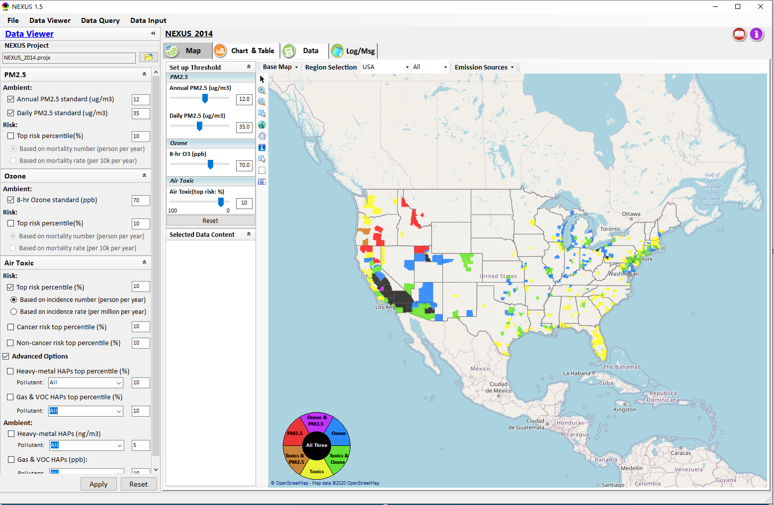

NEXUS Tool: Data Viewer Module
Click “File” to open or save a project
Switch between 3 key modules
Loaded NEXUS project file name
Select & adjust “Ambient” & “Risk” levels
“Advanced Option”: provide HAPs & species selections
16

Slide 17
Data Viewer Module: Selections & Map Display
Select & adjust “Ambient” & “Risk” threshold levels for color map display
“Apply” new selections to “Radio button” panel
17

Slide 18
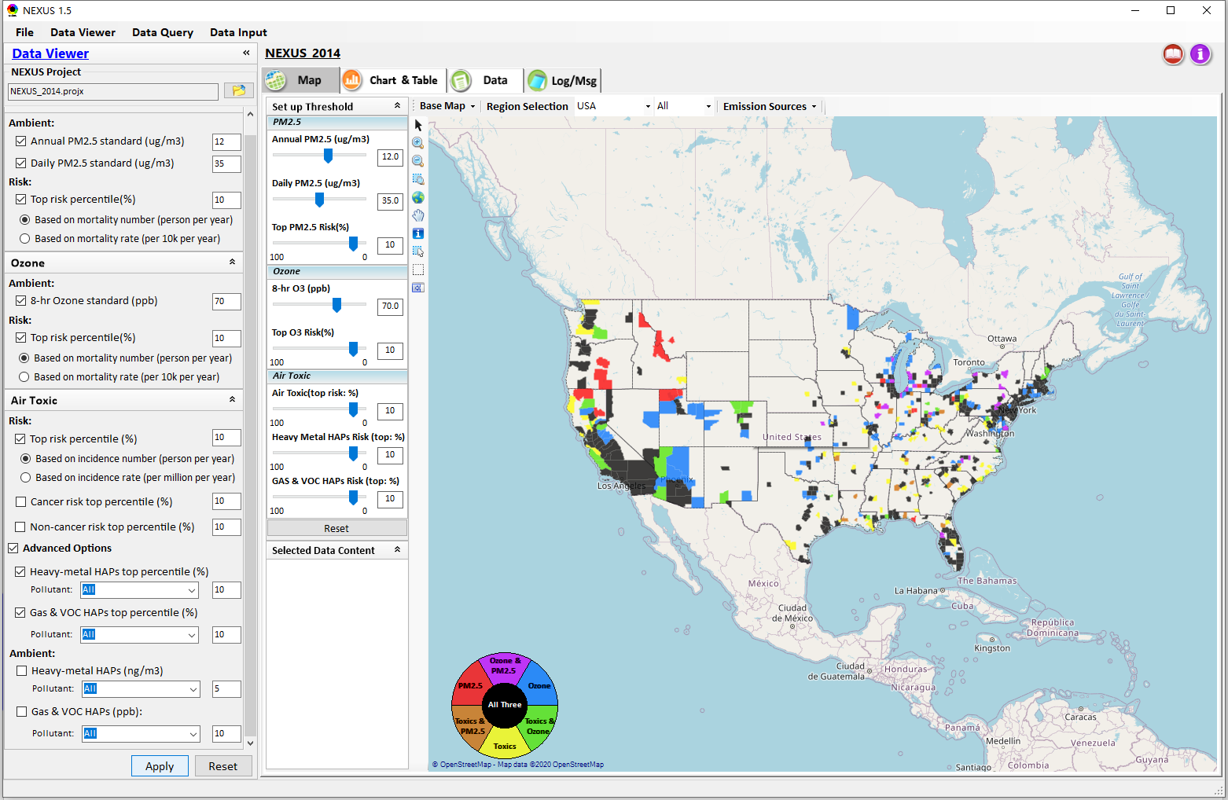
Data Viewer: “Apply” New Selections
“Check” new selections
New selections will appear on-the-fly in “radio button” panel and map display
“Apply” new selections
18

Slide 19
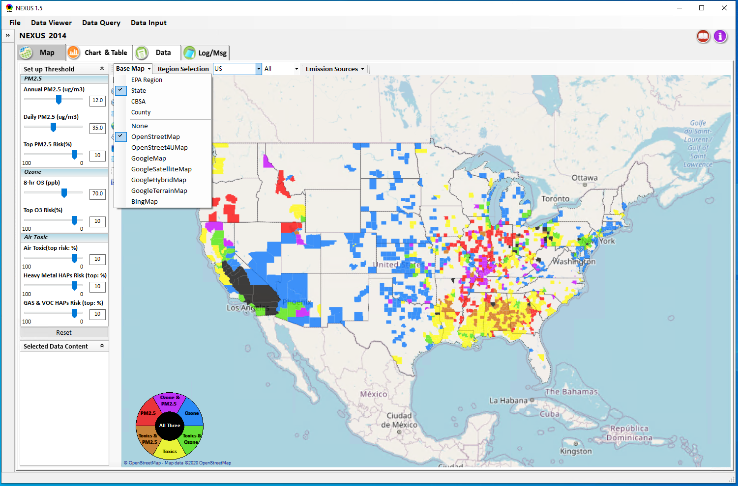
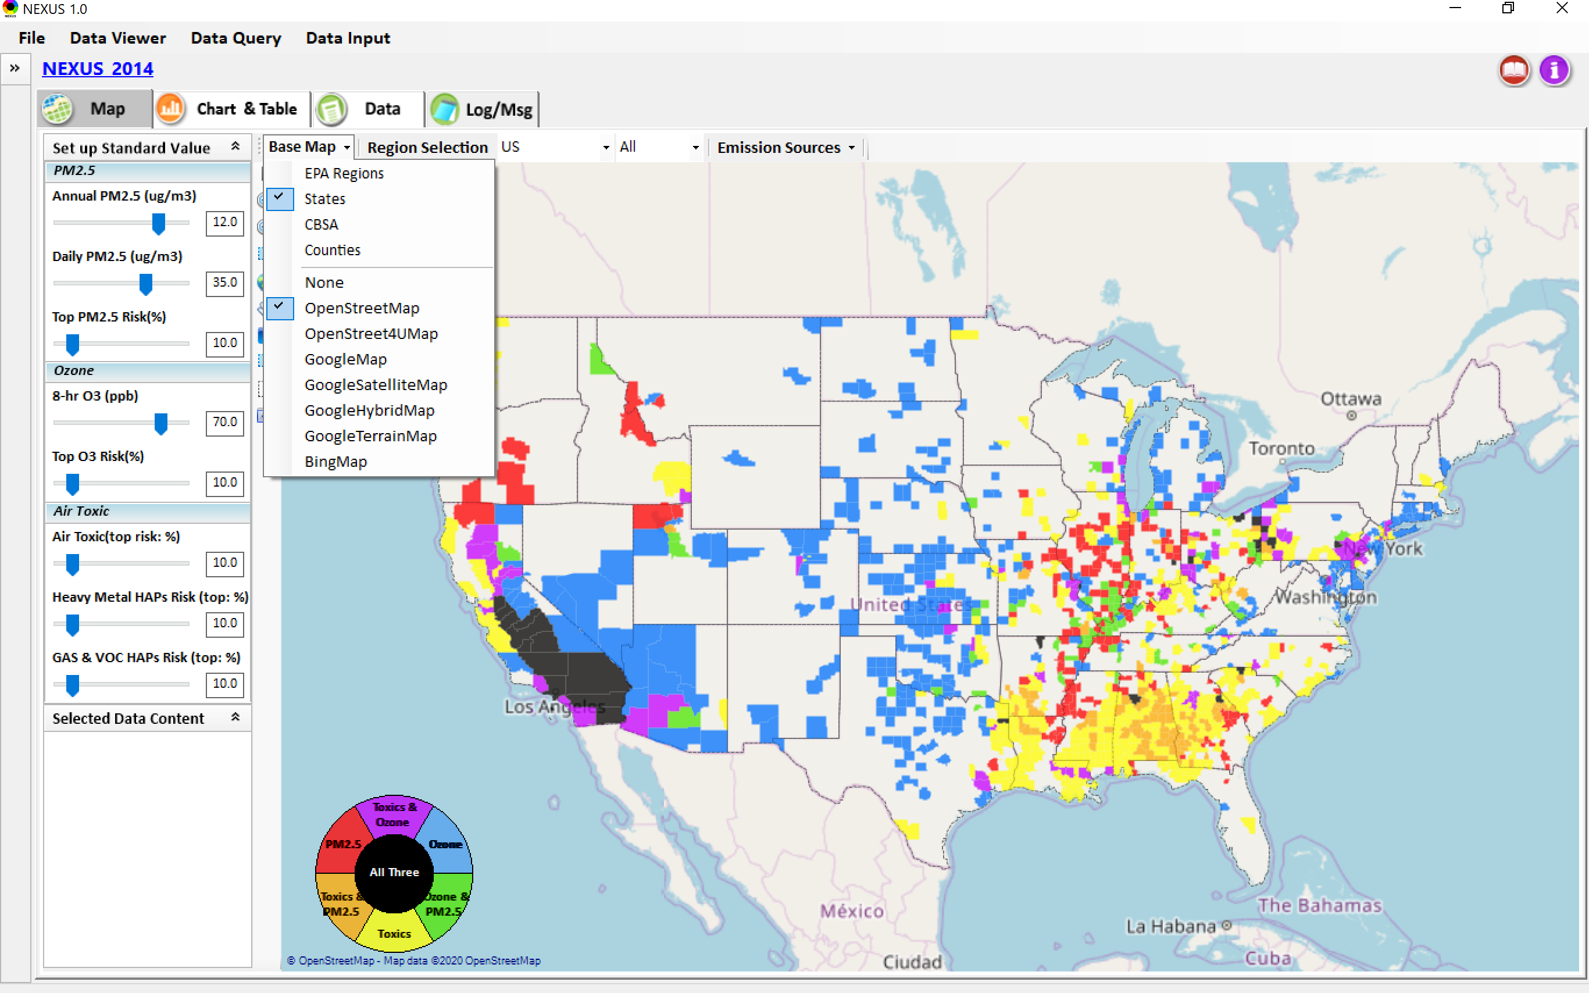
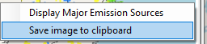
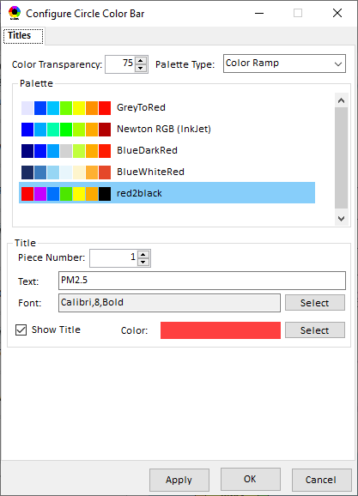
Data Viewer Module: Base Map & Color
“Base Map”: Change boundary lines and background map
“Right-click” map to save image
Click to change color & transparency
19

Slide 20
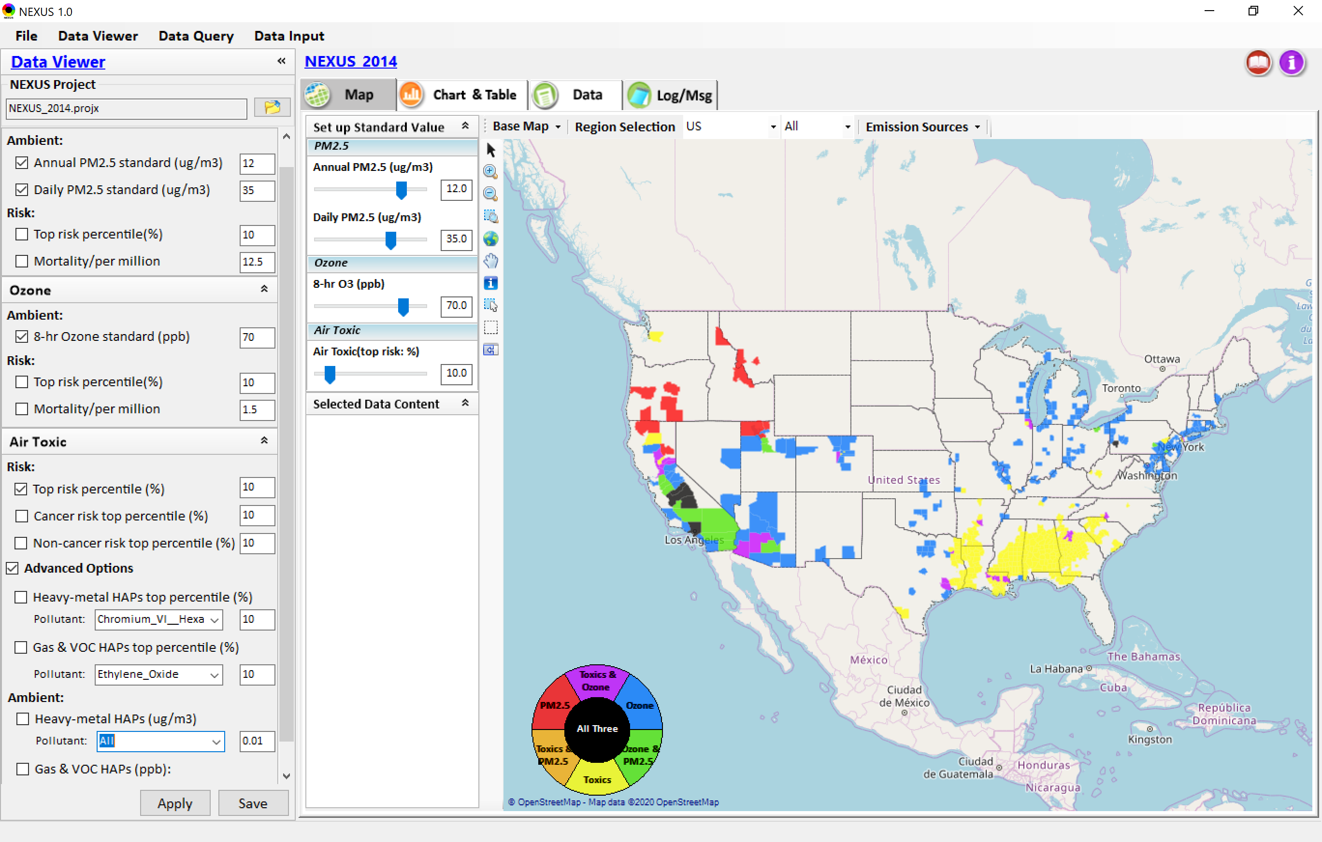

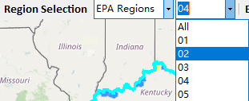
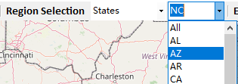
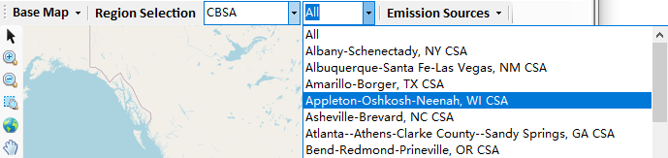
Data Viewer: “Region Selection”
Allow to select “EPA regions”, “States”, or “CBSA”
20

Slide 21
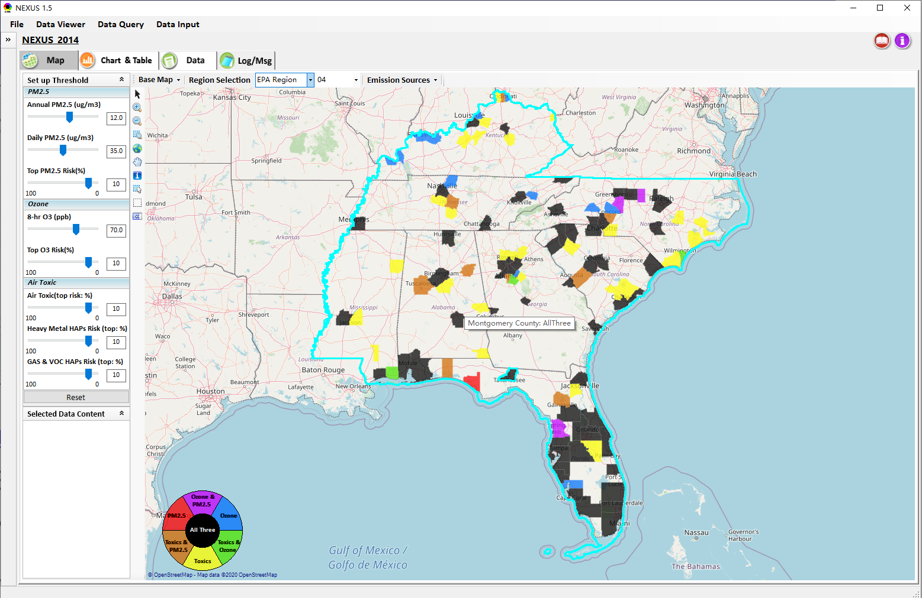
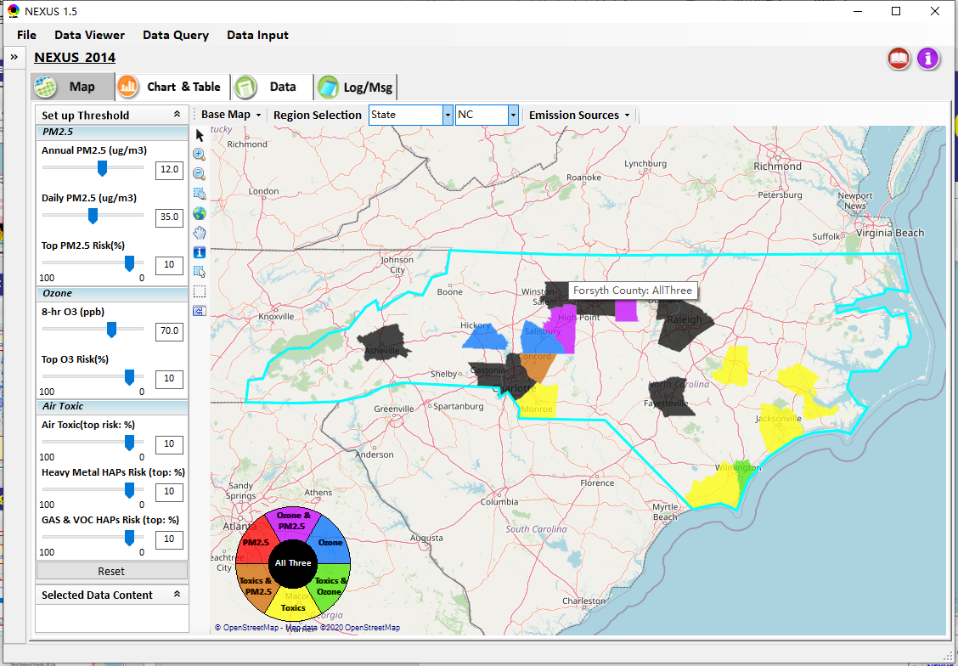
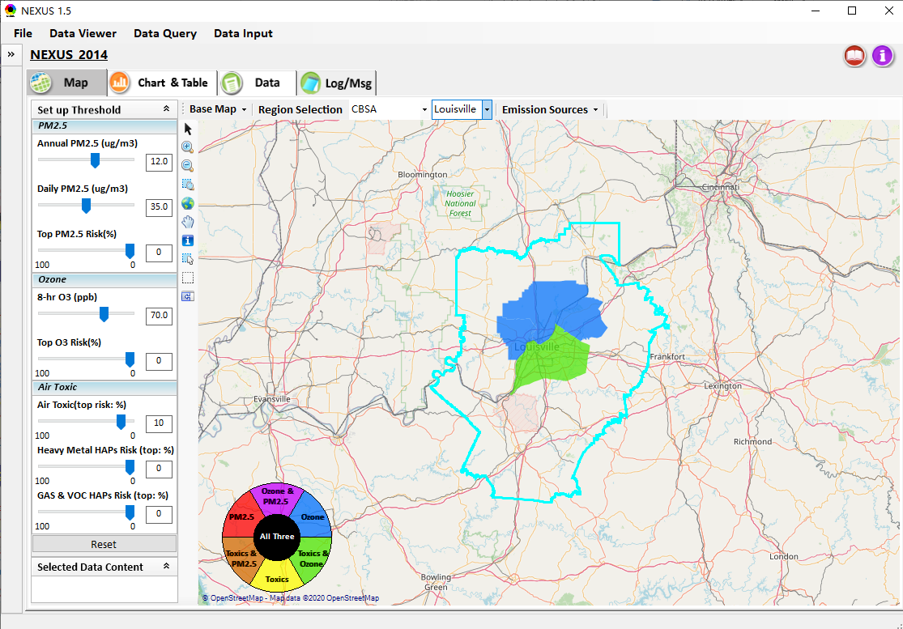
Data Viewer: Select EPA Region/State/CBSA
Examples:
EPA Region 4
NC
Louisville CBSA
21

Slide 22
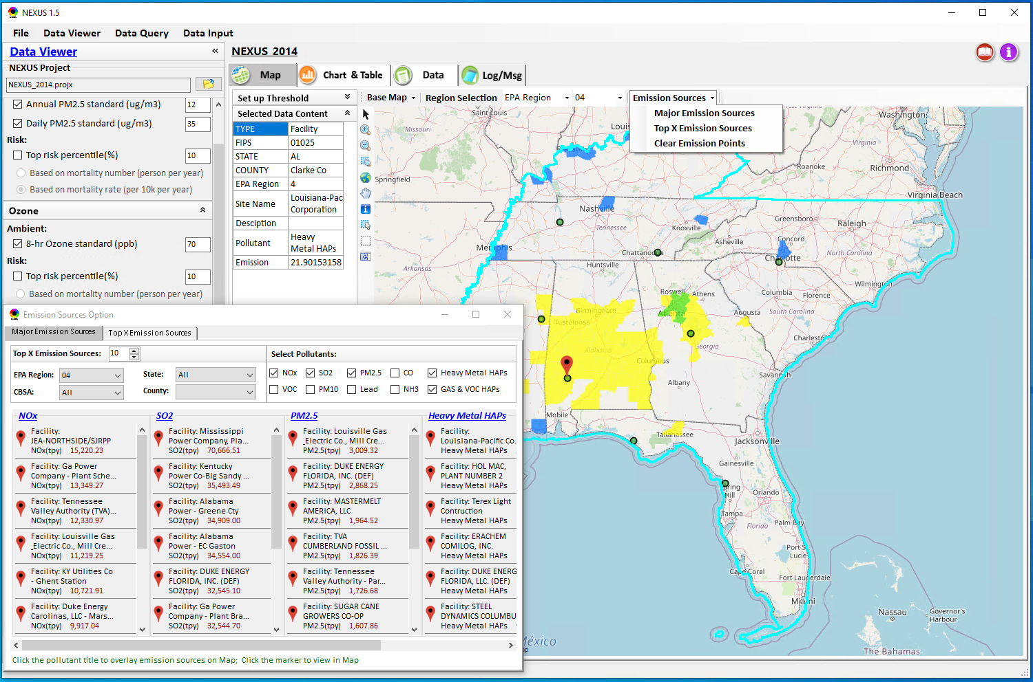
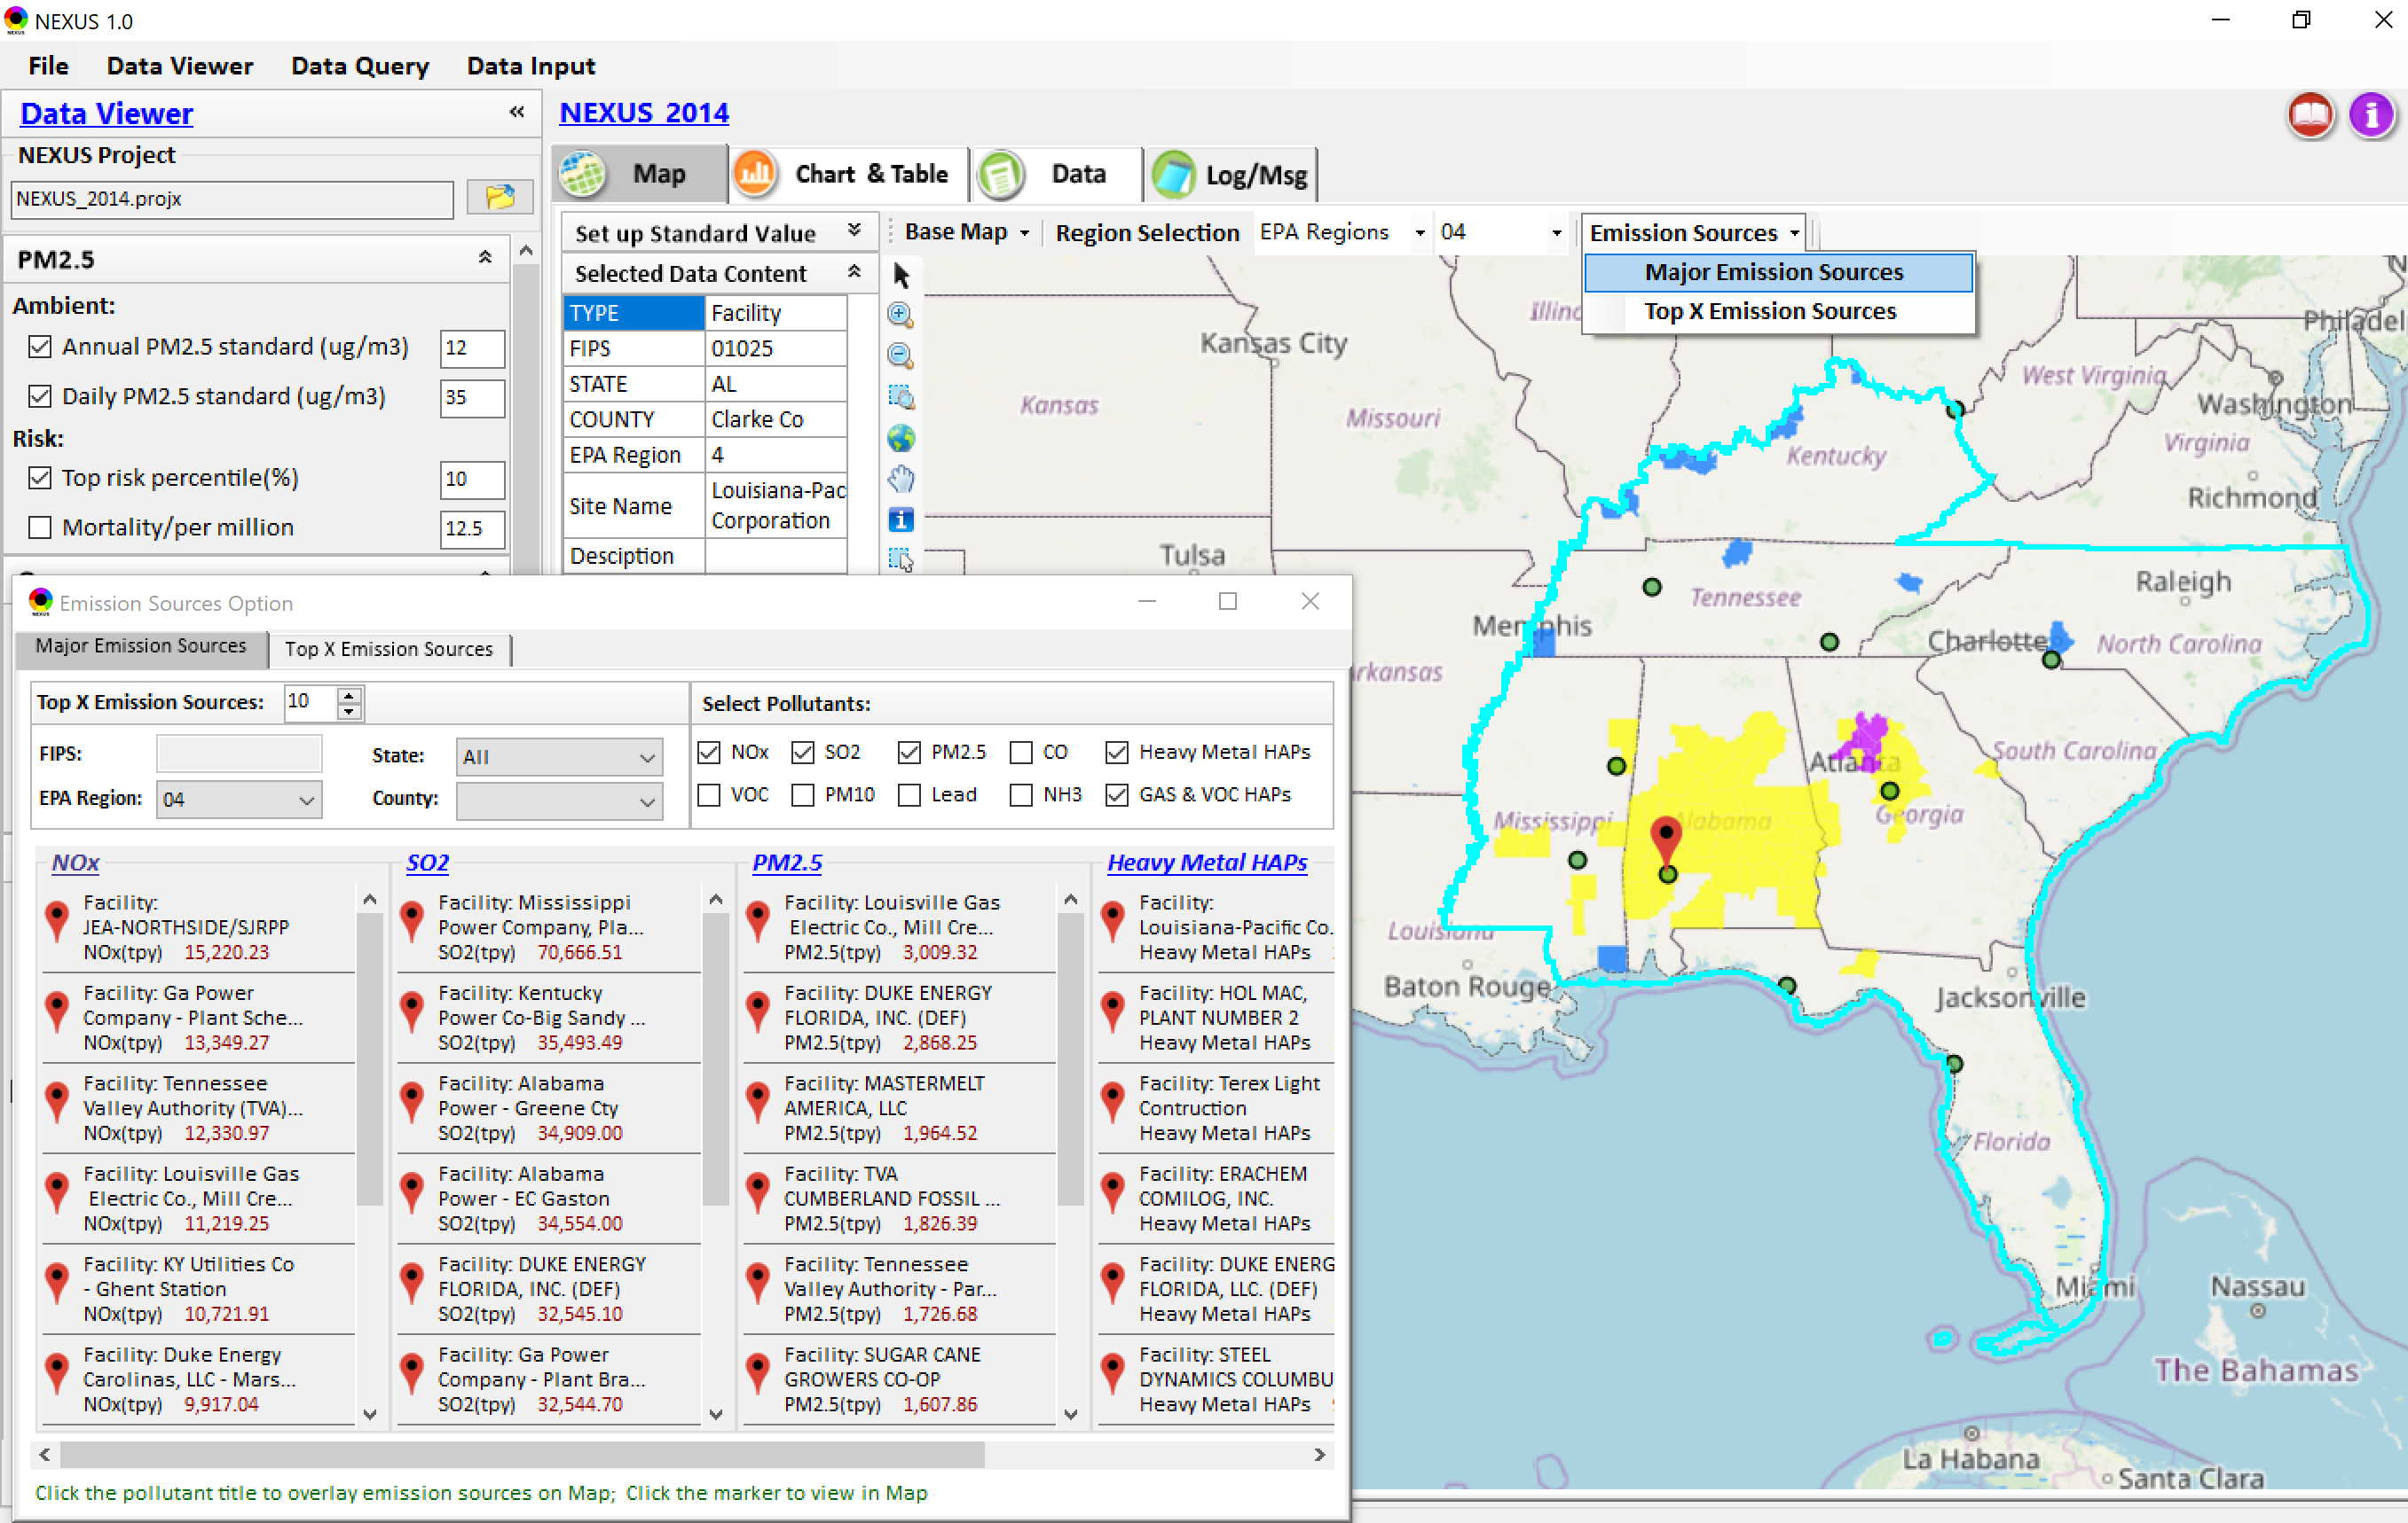
Data Viewer: Major Emission Sources
Click “Emission Sources” tab to display emission sources (green dots) and launch new window
Click any “facility” to link & display source location and emission information
22

Slide 23
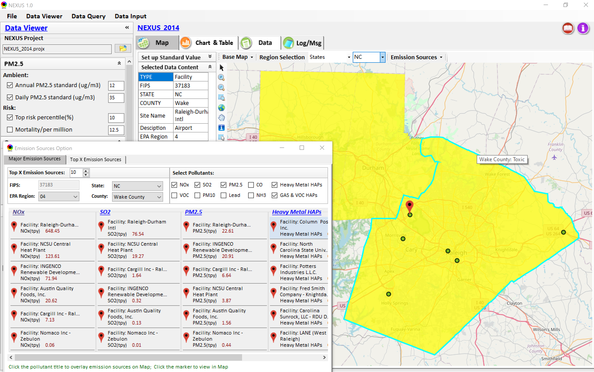
Data Viewer: Major Emission Sources
Allow to scroll down to county-level (e.g., Wake County, NC)
Wake county, NC
23

Slide 24
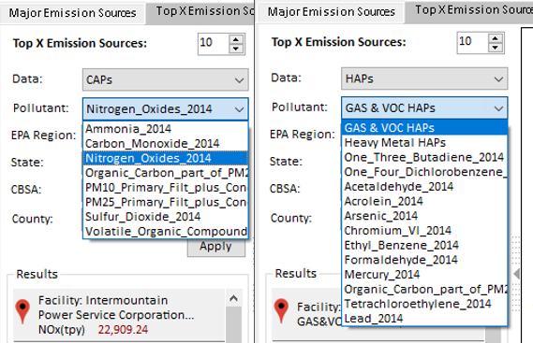
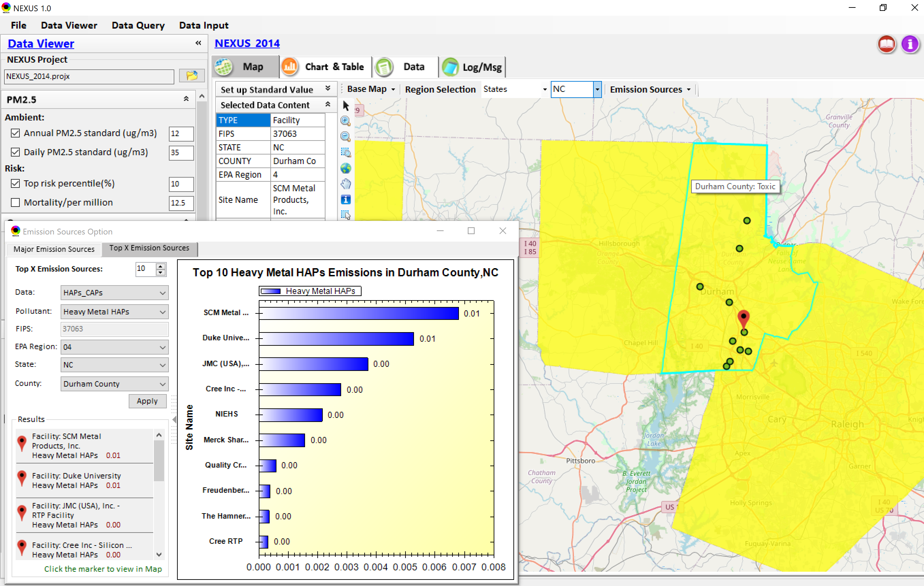
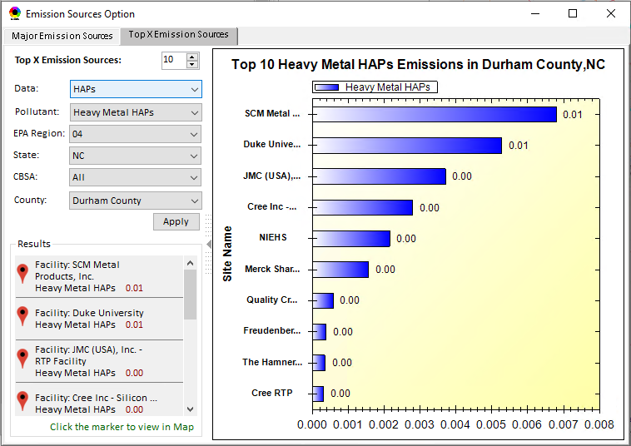
Data Viewer: Top “x” Emission Sources
Provide selection of CAPs precursors & HAPs species
Durham county, NC
24

Slide 25
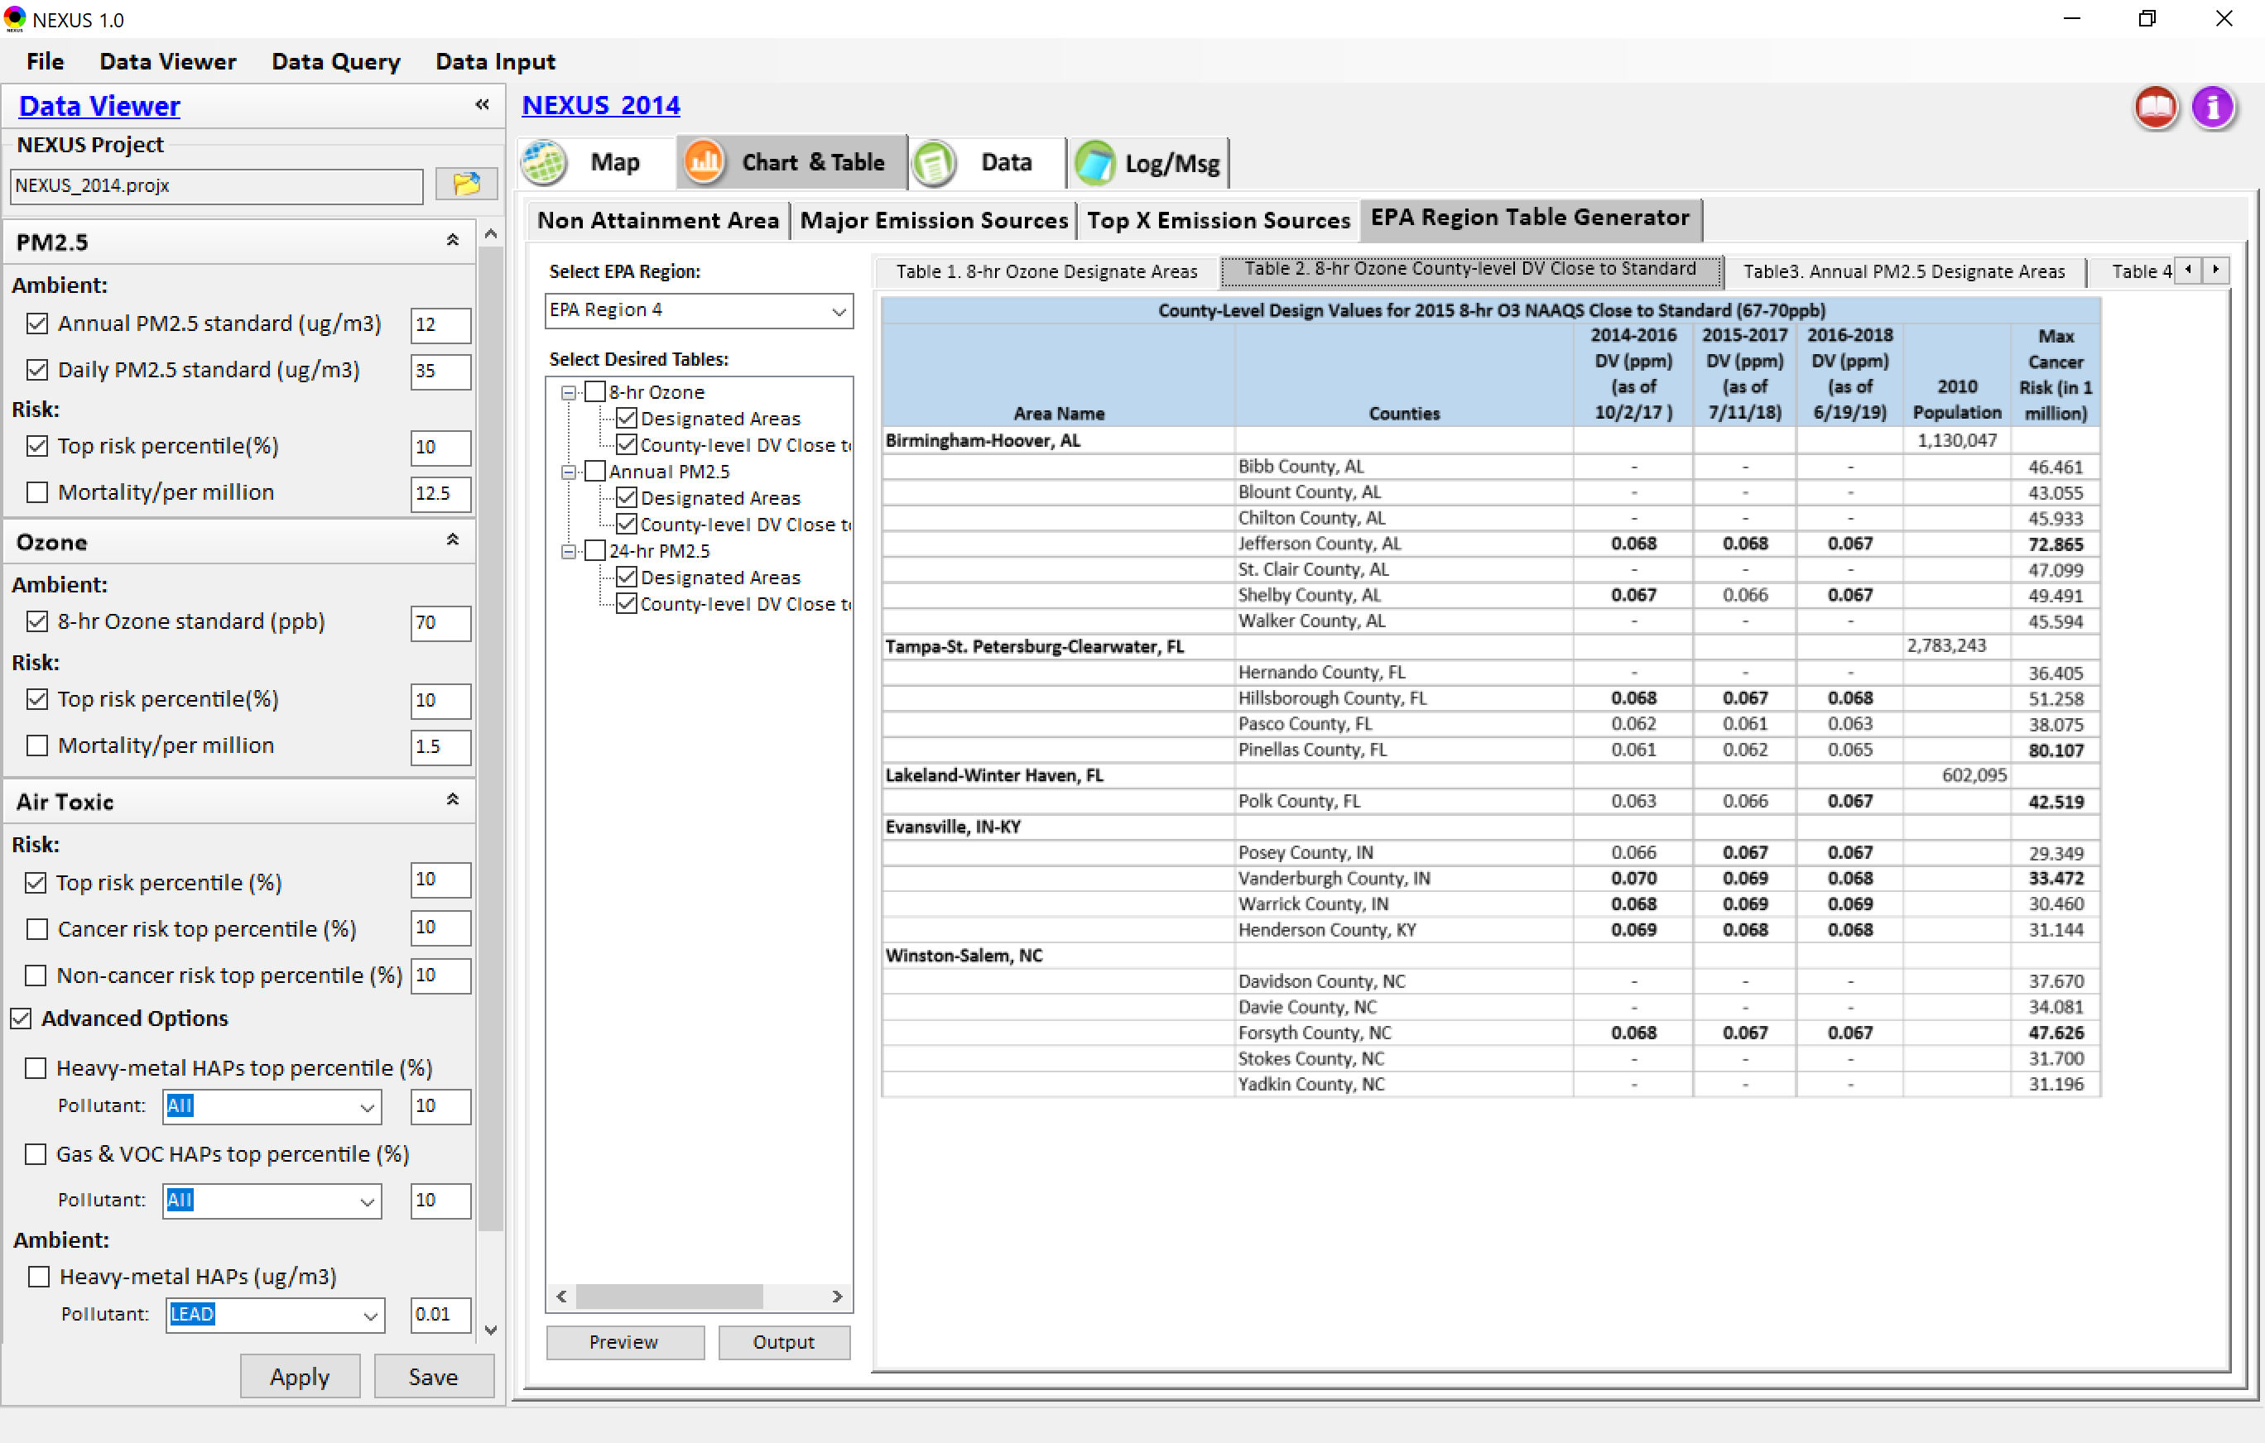
Data Viewer: EPA Region Table Generator
“EPA Region Table Generator” is still under development, but a preview of example “EPA Region 4” tables can be provided
25

Slide 26
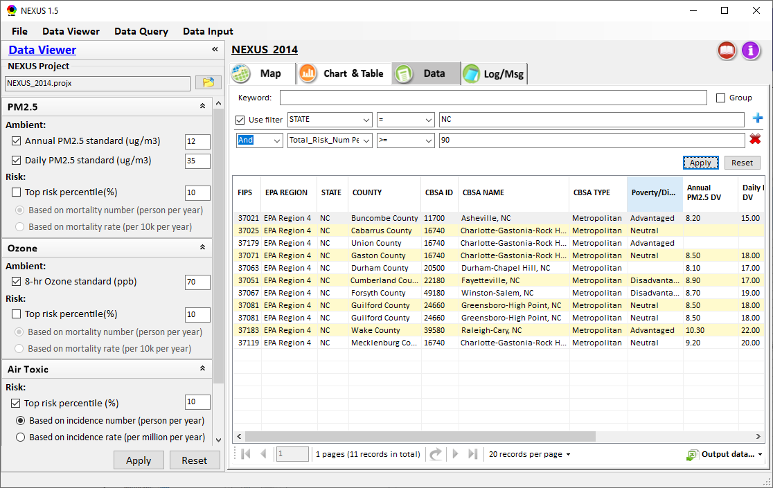
Data Viewer: Data Search & Filter
Click “+” to add filters; Click “x” to remove current filter;
Show specified records per page.
Click “Output data…” to output current page records or all records

Slide 27
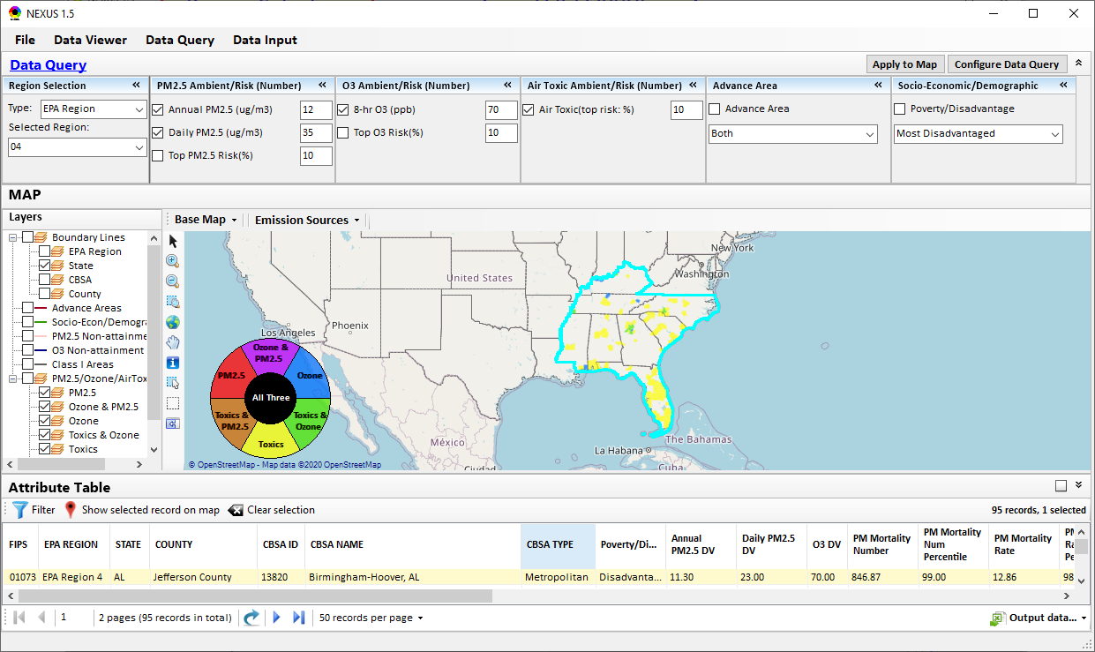
Data Query Module: Main Page
Region Selection
Data Query qualifier selection
Data Query Configuration
Map Overlaying selection
Detachable “Attribute Table”
11111111
27

Slide 28
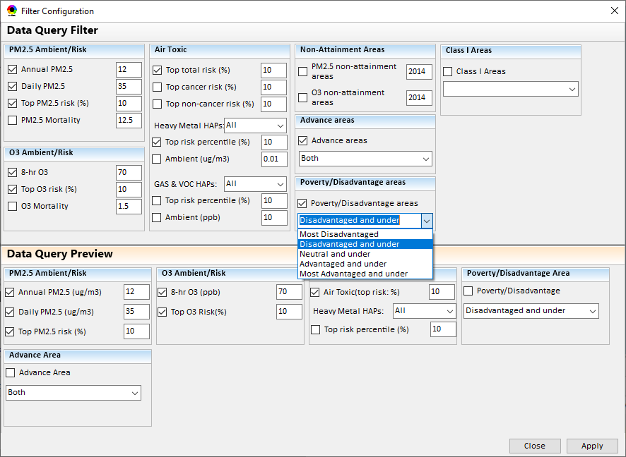
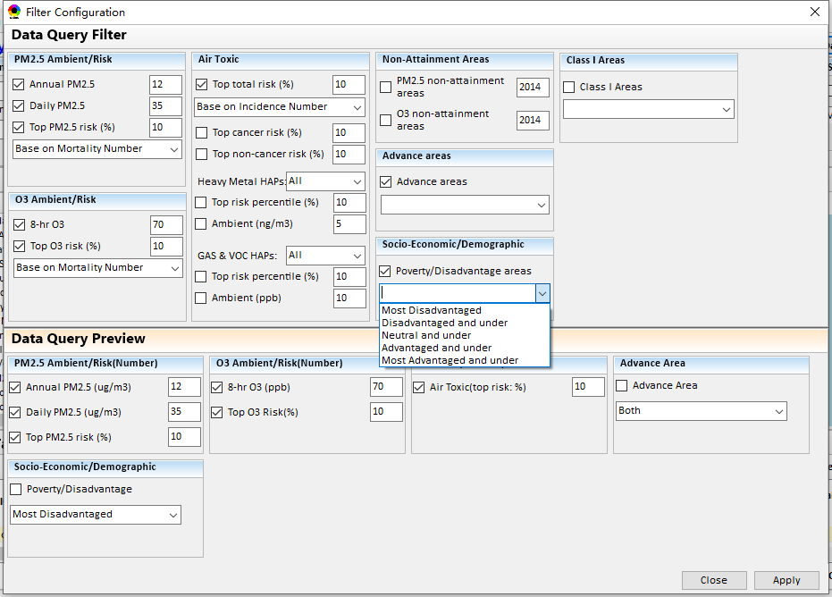
Data Query Module: Configure Data Query
“Data Query Filter” allows to select “qualifiers” for query
“Data Query Preview” displays the selected “qualifiers” at the same time
28

Slide 29
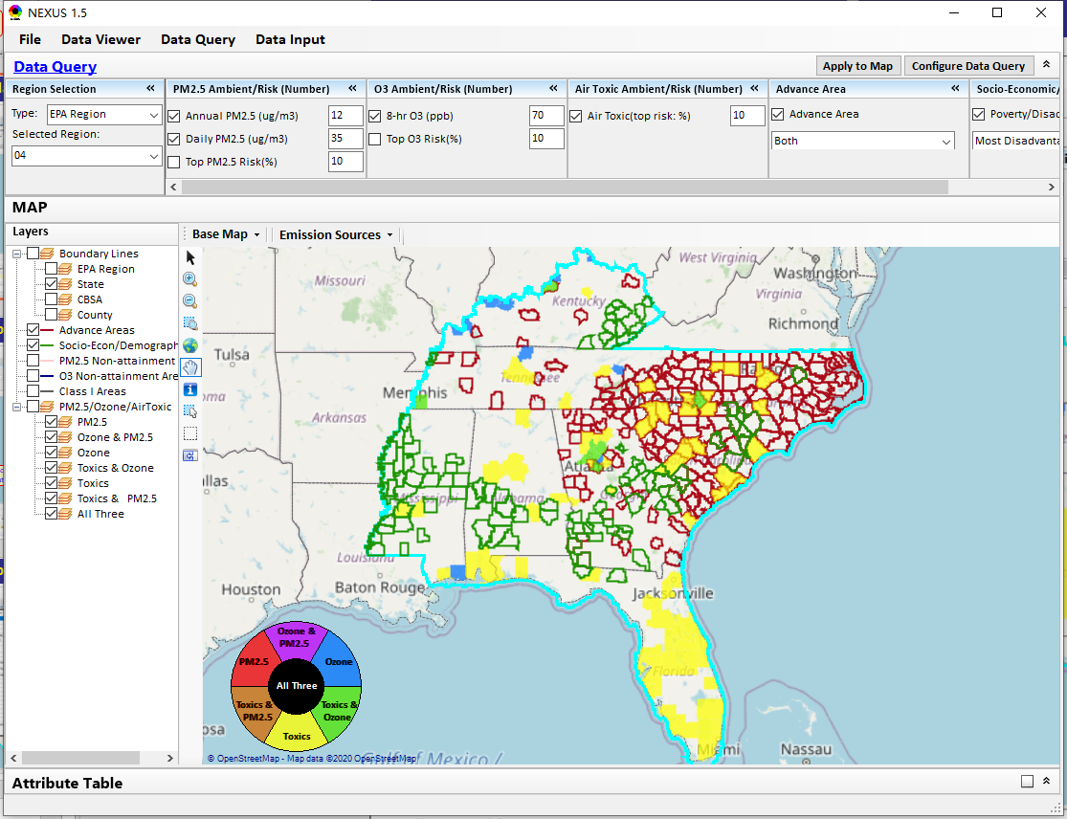
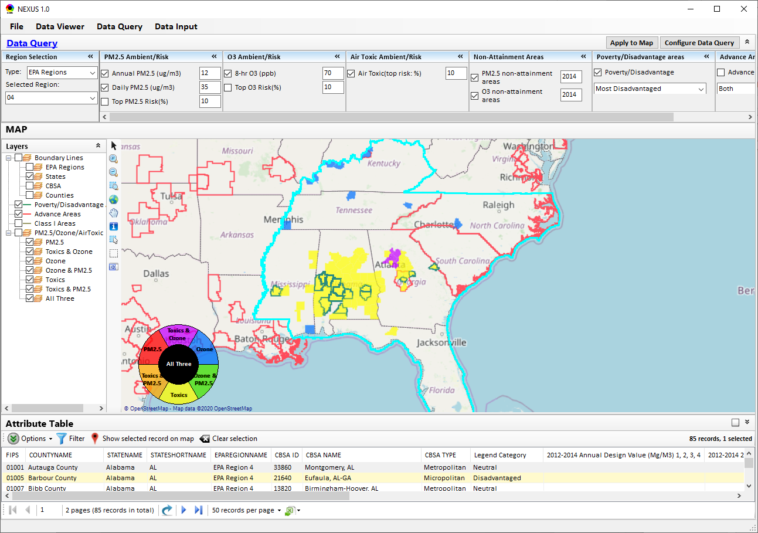
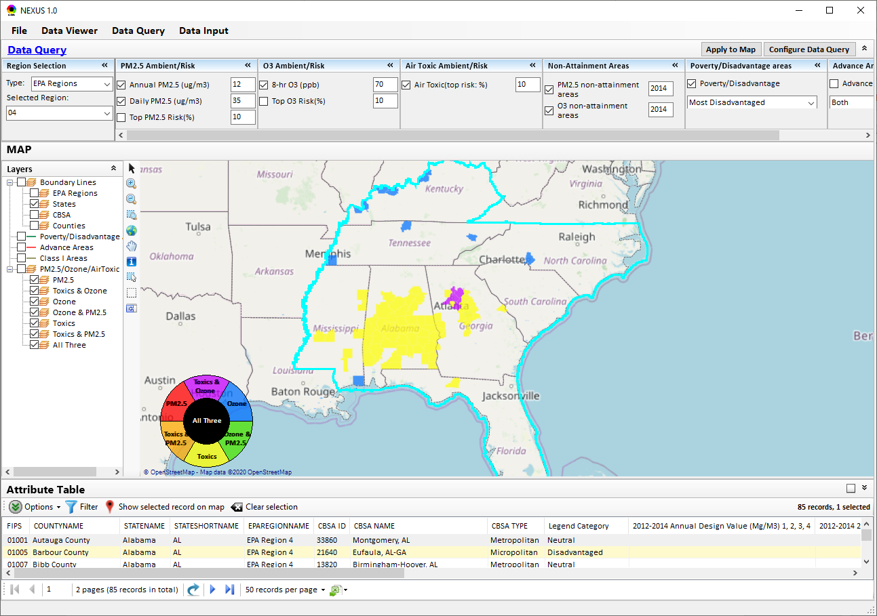
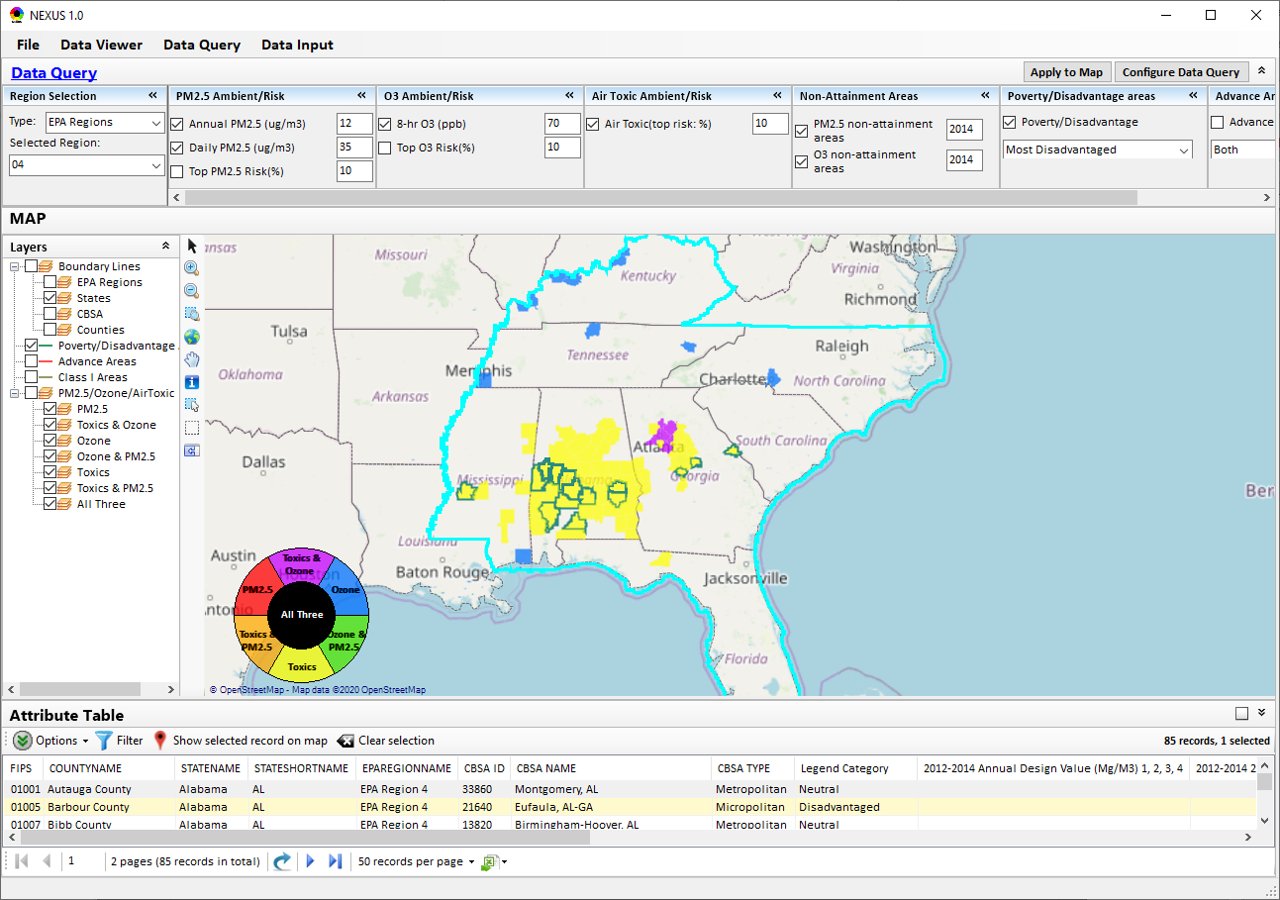
Data Query Module: Overlaying Map
Overlaying Map selection
29

Slide 30
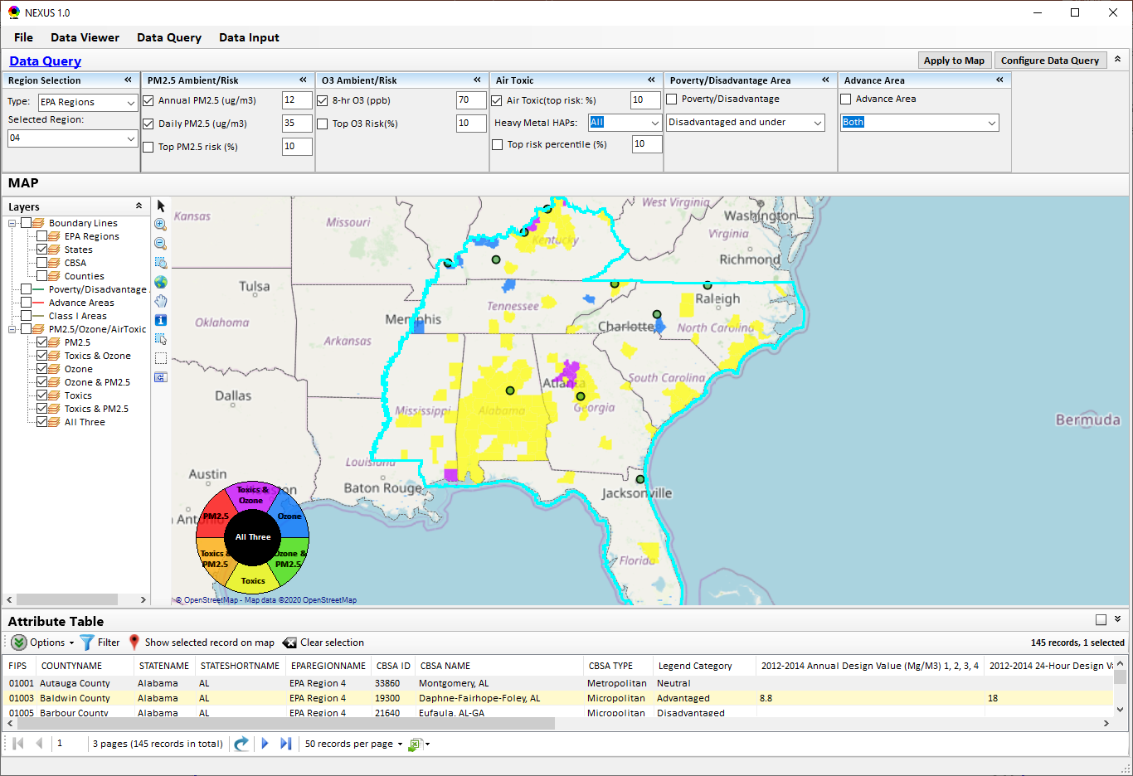
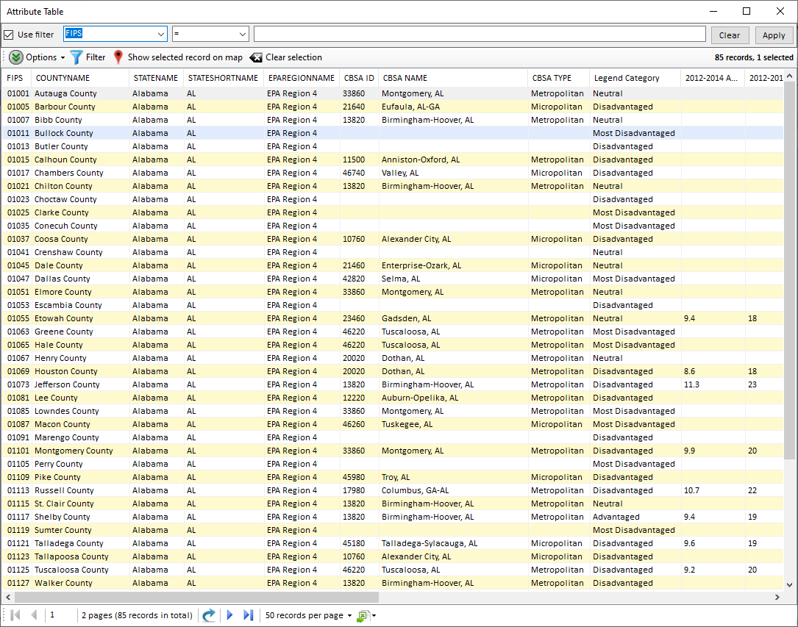
Data Query Module: Attribute Table
Filter/link/export functions (to be completed)
Detachable “Attribute Table”
30

Slide 31
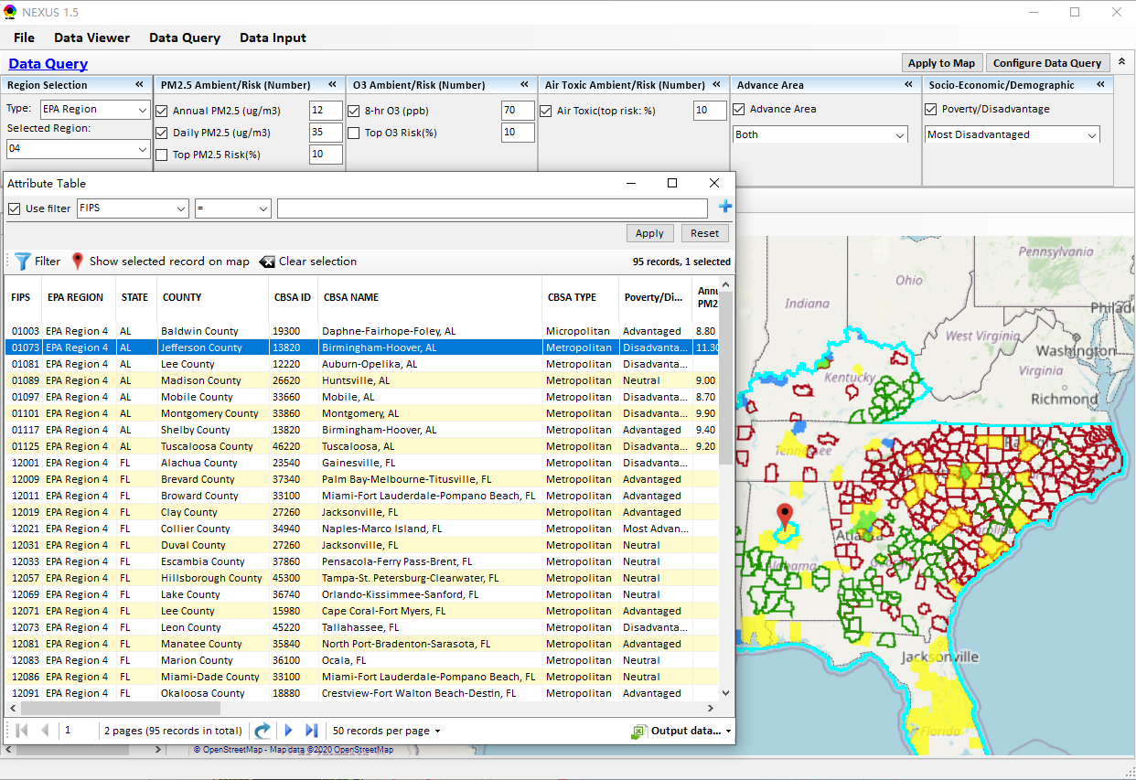
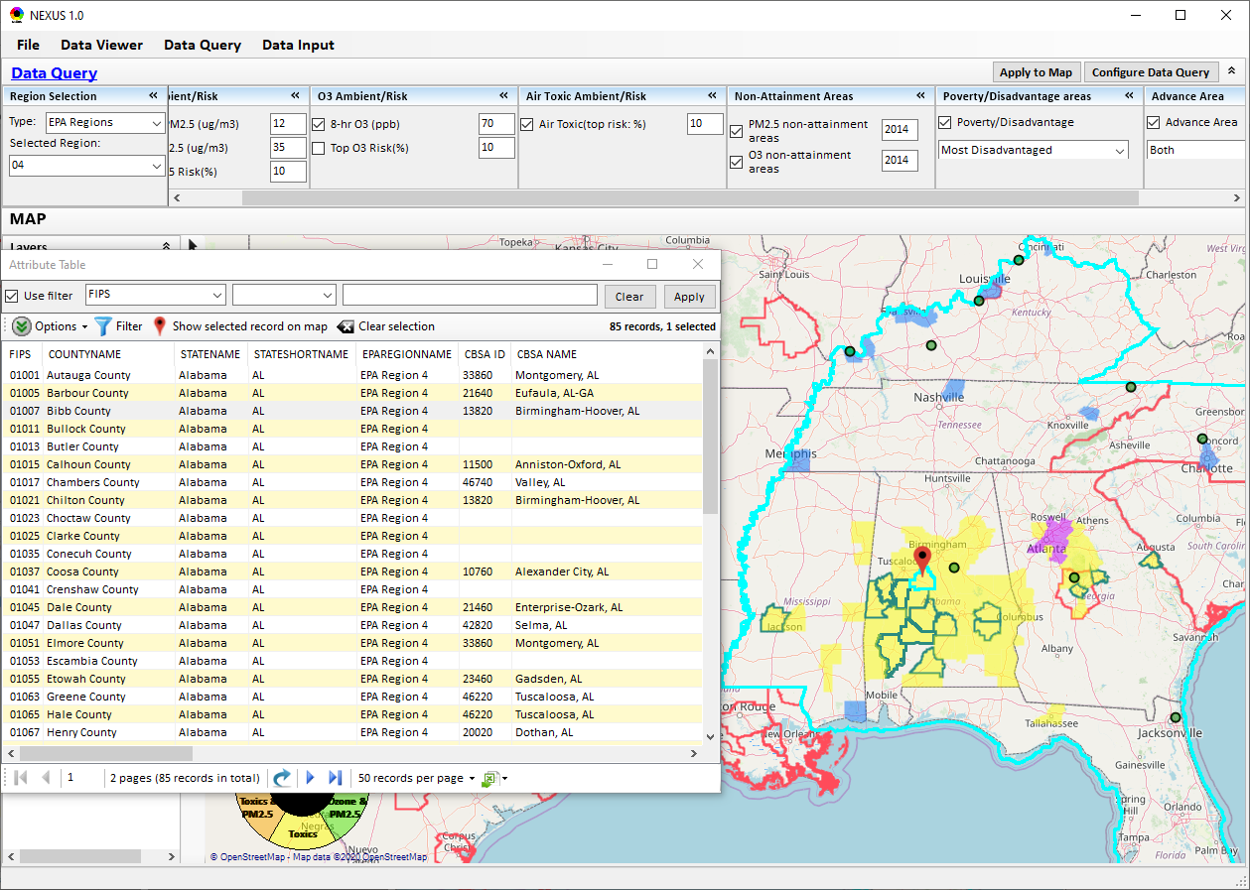
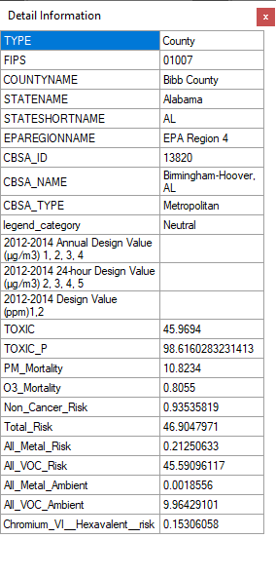
Data Query Module: Attribute Table
Click a “record” to link and display its location & info.
31

Slide 32
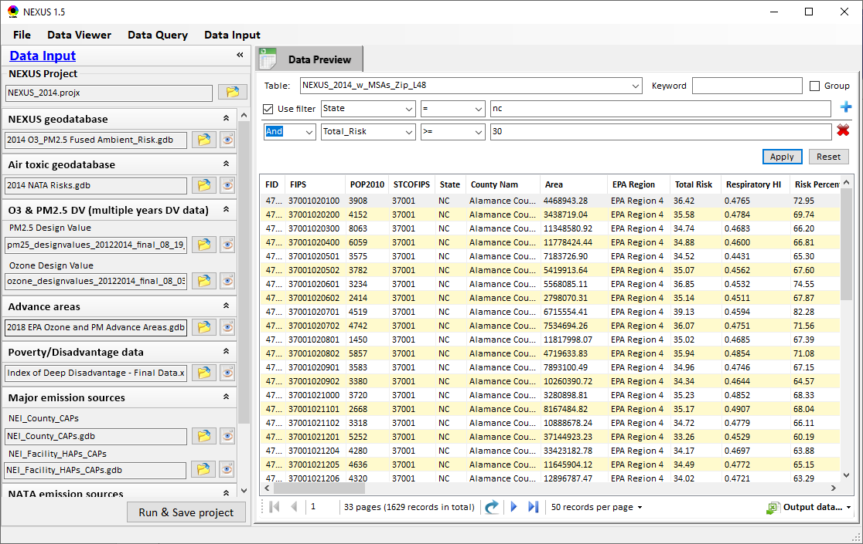
Data Input Module: Data Preview
Click to view data
Click to change input data file
Click to view data
Select a table to view if there are multiple tables in the selected data source file
Check to use filter to query data
Click to run & save project

Slide 33
End
33

Slide 34
NEXUS Demo: Example Cases
Main GUI:
Mimic 2008 MP report; County-based map
Color/legend setup; Exceed “Ambient or risk” threshold defined in “Center panel”
Click “county” to show “Data Content”
Center panel & Left panel
On-line User’s Manual & PPT Tutorial
Nation View :
“Ambient”: PM2.5: 12 -> 10 ug/m3; O3: 70 -> 65 ppb; “Risk”: Air Toxic 10% ->0%-> 20%
All Risk only: O3:10%, PM:10%, AT: 10%
Advanced: Heavy-metal HAPs, G&V:10%
Co-PM risk: PM: 10%, H.M. HAPs: 10%
Co- PM/NA: 12 ug/m3, H.M HAPs:10%
Co-O3 risk: O3: 10%, G&V HAPs: 10%
Co- O3/NA: 70 ppb, G&V HAPs:10%
Advanced: H-M: Chromium & G-V: HCHO
EPA Region/State/CBSA View:
“dial-in” for regional (all risk: 10%)
EPA Regions: R4/R5/R9 -> States: NC/CA -> CBSA: RDU
“right-click” -> Major Emis. Sources
Change color transparency/Google Map
Major Emission Sources:
CBSA: Louisville -> Jefferson Co. -> Facility (Louisville G&E)
SO2/NOx/HAPs, Facility, Data Content;
Top X Emission Sources: CAPs & HAPs
Data Input module:
Expand 1->10 inputs data files; Plan to update to 2017 (CDC & NATA)
Data Query Module:
Expand fields/flexibility: Exploratory users
Configure DQ” window: Select Advance Area, EJ, 2017 DVs => Apply map
Overlay Map & Detachable table summary
Select “EPA Region 5” => “Advance + EJ”
Change color transparency & Google Map
CBSA: Minneapolis-> Major emis. sources
Facility (Xcel Energy - Black Dog)
Dakota Co. ->
“PM2.5 + H.M.HAPs” (Xcel Energy)
“VOC + NOx + G&V HAPs” (Flint Hills)
Back to “EPA Region 5” -> EJ: Select “Disadvantage & under”
CBSA: Detroit -> Wayne Co. ->
“NOx + SOx” (DTE Elec.)
“PM2.5 + H.M.HAPs” (AK Steel, US Steel)
CBSA: Cincinnati -> Butler Co. (AK Steel) (Cincinnati News article)
34
Notes:
1. Thank Cen/Gao/Luo/Chen; 2. HZ more visits; 3. AP on HZ

Slide 35
One may like to know “xxx”: Example Cases
Just some initial thoughts on the sequence of examples:
Data Viewer module: -> “Map” menu:
Mimic the initial NEXUS map per 2008 AQAD report: O3 and PM2.5 DVs above the NAAQS (concentrations) with 2014 NATA HAP cancer risk (%-ile threshold)
- SHOW HOW THE AREAS MAY CHANGE WITH LOWER NAAQS LEVELS—10 UG/M FOR ANNUAL PM2.5, AND SEPARATELY 65 PPB O3, AND THEN TOGETHER
Update the NEXUS map to be on risk-risk basis across pollutants (based on spatial fusion of O3 and PM2.5): O3 mortality risk, PM2.5 mortality risk, with 2014 NATA HAP cancer risk (%-ile threshold)
SHOW HOW THE AREAS MAY CHANGE WITH DIFFERENT RISK THRESHOLD FOR NATA RISK (check beforehand what different thresholds make difference and codify those)
MAIN QUESTION: The “NEXUS” across pollutants allows for an initial “SCREEN” at the national level by providing an indicator where there may be MP issue wherein a common set of sources contribute to multiple pollutant issues, e.g., NOx for O3 and PM2.5, Metal HAPs and PM2.5, VOC HAPs and O3.
- Try to bring in the VOC and Metal HAP information to show these overlaps.
“Region Analysis” menu:
DAIL INTO A PARTICULAR REGION OR AREA TO BETTER UNDERSTAND THE POLLUTANT/SOURCE CONNECTIONS AND, THUS, POTENTIAL FOR MULTIPOLLUTANT SOLUTIONS THAT ARE MORE EFFECTIVE AND EFFICIENT AT ADDRESSING THESE AIR QUALITY ISSUES.
“Major Emission Sources” menu:
Select a Region, such as Region 4 or 9, to illustrate that we can show these areas for a particular Region to engage with them and dive into the details—emissions, sources, etc.
Select a particular area, such as Louisville, to illustrate how one can use the tool to learn more about the potential for common pollutants and sources to inform possible MP solutions.
Data Query module
NOTE: HERE THAT WE COULD OVERLAY SOME THINGS ON THE RISK-RISK MAP—NONATTAINMENT BOUNDARIES FOR O3 AND PM2.5, EPA ADVANCE AREAS, EJ METRIC, OTHERS
Data Input module
Where are these input data coming from? How can we update new input data and save project case?
35
Notes:
1. Thank Cen/Gao/Luo/Chen; 2. HZ more visits; 3. AP on HZ

Slide 36
We may like to know “xxx”
Data Inputs:
-We will need to add a general category for “Socio-Economic/Demographic”
-the Poverty/Disadvantaged indicator would be part of this category
-pull in demographic information on race, ethnicity, gender, etc
Provide Slide that outlines the Demo
-National screening (2014 data):
-Replicate 2008 NEXUS map with O3/PM2.5 concentrations above NAAQS and NATA risk estimates (above selected percentile of top 10%)
-What happens to areas under a lower O3/PM2.5 NAAQS level?
-What happens to areas current over O3/PM2.5 NAAQS if change HAP risk percentile?
-Provide NEXUS map on risk basis: O3/PM2.5 BenMAP mortality risk based on fused surfaces and NATA risk estimates (above selected percentile of top 10% for O3, PM2.5 and HAPs)
-Can see expansion of MP areas as one changes percentile to top 20% or others.
-Focus on Heavy Metal HAPs risk (top 10%) and relate to PM2.5 risk for potential co-pollutant issues.
-Focus on Gas/VOC HAPs risk (top 10%) and relate to O3 risk for potential co-pollutant issues.
-Regional, State, CBSA and County level view
-Region 4 example
-Large number of areas with MP risk in top 10% across O3, PM2.5 and HAPs so lets look into a few of them:
Louisville example: General and then dial into Jefferson Co. with transparent map color
+Show the source emissions in the map but also 2014 data and their ranking across pollutants illustrating co-control potential
Identify the sources you want to highlight
-Data Query module: State, CBSA and County level
Advance areas example
-Show national level information using the Advance Area definition to show overlay with MP areas
Go to Region 5
Minneapolis example: General and then dial into county level information
+Show the source emissions in the map but also 2014 data and their ranking across pollutants illustrating co-control potential
Identify the sources you want to highlight
-Go back to Region 5 focus
EJ Considerations example (income focused indicator from UMich)
-Show national level information using the Poverty/Disadvantaged indicator to show overlay with MP areas
Detroit example: General and then dial into county level information (Disadvantaged and under category)
+Show the source emissions in the map but also 2014 data and their ranking across pollutants illustrating co-control potential
Identify the sources you want to highlight
36
Notes:
1. Thank Cen/Gao/Luo/Chen; 2. HZ more visits; 3. AP on HZ

Slide 37
MP Team suggestions
Some overarching set-up comments
-Since uses fairly large amount of computer memory, suggest to users in advance of install/usage to make sure they have sufficient RAM to run (for example, runs pretty slow on my laptop, and I need to close down some things like Teams, etc. to clear up RAM in order to run). Just something to alert users to.
-Alert users that initial install time takes some time (for example, on my laptop it took over an hour at least to get all files loaded and installed). Its just good for users to be aware so they don’t think it’s a quick install.
-In future updates, you may want to think about how users can output graphics from this tool---some of these could really help in developing presentations or quick information sheets on a given area. Outside of using snip-it add-on tools, I don’t readily see how to extract graphical items.
Some functionality comments:
-Pop-up info box not showing when putting mouse over area (see Section 4.1 of User Guide—Fig. 14 example—“when mousing over an area, a tip box containing…”
-Confusing as to where to set filters---box on left has settings and then there is also the box to right of that for “set up standard value”---which one should be used, or both, and in which order? Does one override the other? When do you need to push “Apply”? sometimes, you don’t need to hit ‘apply’, and changes occur in the Map.
-It does not seem that you can export “table of major emissions sources” or ‘table of top ten sources”----there are options for output of .csv file for other items in the tool, but not for these chart/table items, which would be very useful to have for export along with the nonattainment/risk table info.
-Emissions sources info not shown as option in “Data” menu tab (where there is an export option—related to item above)
-When you select area in Map tab, and then go to “Chart and Table” table, you would expect to see data for that area---but you don’t. You need to then go in and identify an area---it would be improvement that when you map the area on “Map” tab, and then go to Chart/Table table and see data for that area.
-So, if you do select an area under ‘Map’ tab, and then identify a state, you can go to the “emission sources’ subtab to see top ten or major emission sources for that selected area---however, you can not go to ‘county’ level even though you change the base map to include counties.
-In ‘Chart and Table” tab, select county level for a state, then use subtab “Top X emission sources” and you get histogram along with results list of top X facilities for that pollutant you chose. You can then click on the facility on the list, and you get pop-up info box for that facility plotted on the map with marker. The pop up box only lists criteria pollutants, and does not include the pollutant you selected for the histogram.
-Is there a way to simply ‘reset’ and clear all your filters without having to de-select and apply everything you have set for the current exercise (as opposed to closing the tool and re-opening it again)?
Units
-Under ‘Chart and Table” table, you can select button under “Set up Standard Value” for ‘air toxic’, and then set risk%. When doing so, you get histogram for your area of interest title “Top 10% of air Toxic” risk…..but no unit values are show for data---should it be assumed it is cancer risk/million? Regardless, should have units available.
-Under ‘Chart and Table’ you can define a geographic area, and select ‘major emission sources”, but you can’t output the resulting table---which would be very useful (similar to comment above)
-Under “Chart and Table” when you select “major emission sources’ or “top X emission sources” , there are no units indicated for the HAP emissions…assume tpy? For criteria pollutant choice, units are shown (tpy). For a number of individual HAP pollutant selections, there is also no indication of units.
37
Notes:
1. Thank Cen/Gao/Luo/Chen; 2. HZ more visits; 3. AP on HZ

Slide 38
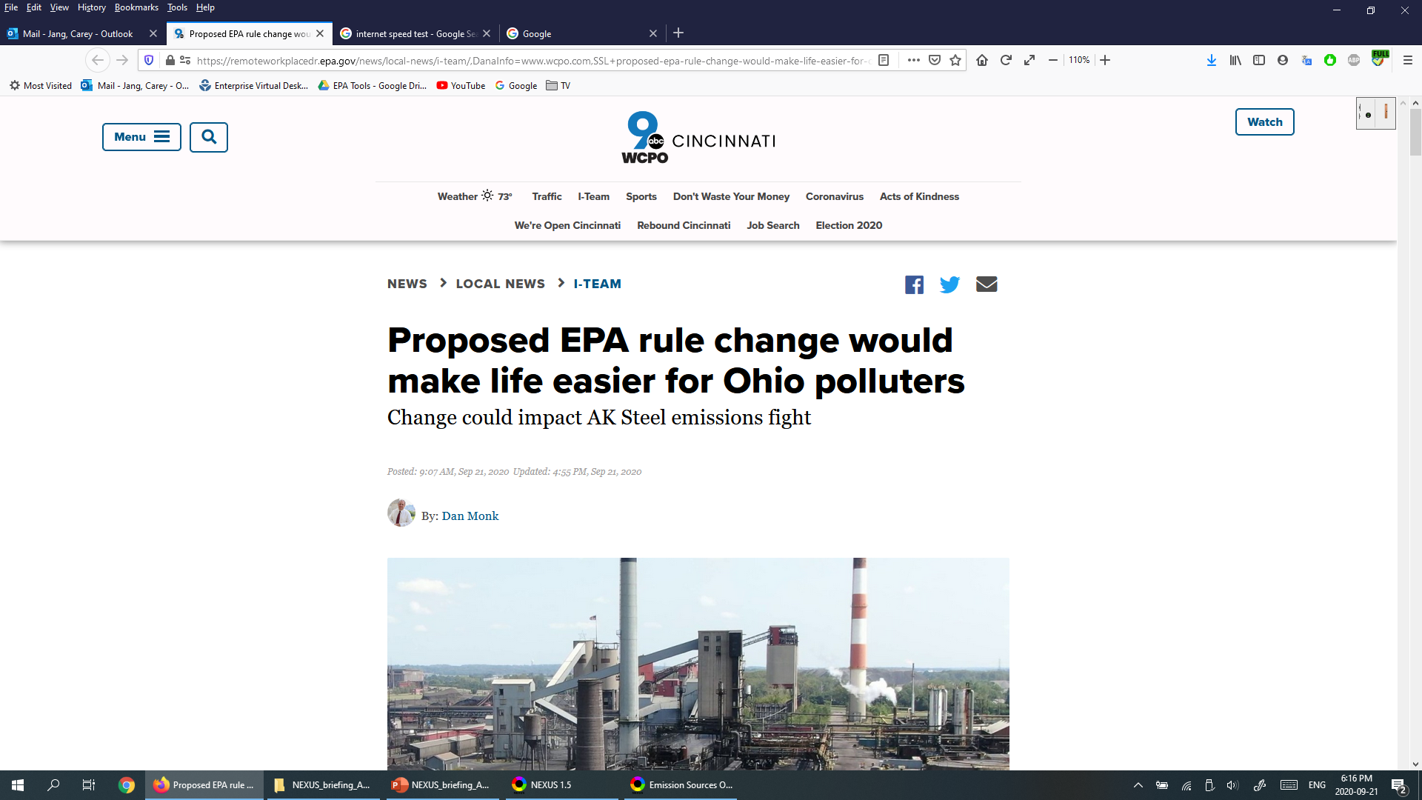
“AK Steel” News in Cincinnati, Butler County, OH
https://www.wcpo.com/news/local-news/i-team/proposed-epa-rule-change-would-make-life-easier-for-ohio-polluters , 9/21/2020
38

Slide 39
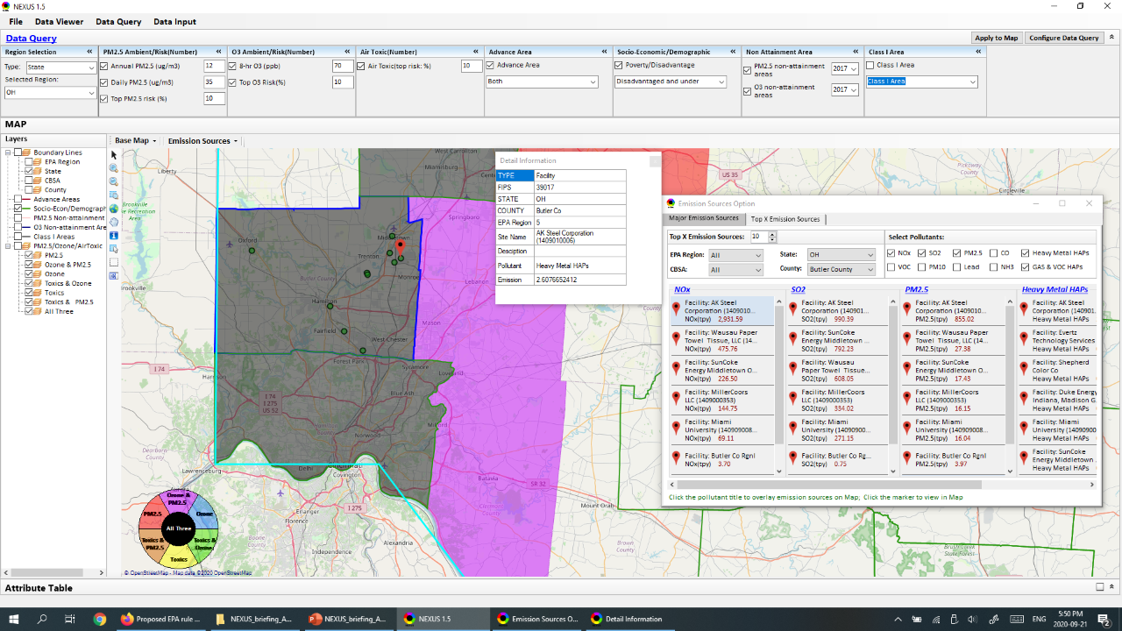
“AK Steel” in Butler County, OH
39

Slide 40
We may like to know “xxx”
Just some initial thoughts on the sequence of examples:
Data Viewer module: -> “Map” menu:
Mimic the initial NEXUS map per 2008 AQAD report: O3 and PM2.5 DVs above the NAAQS (concentrations) with 2014 NATA HAP cancer risk (%-ile threshold)
- SHOW HOW THE AREAS MAY CHANGE WITH LOWER NAAQS LEVELS—10 UG/M FOR ANNUAL PM2.5, AND SEPARATELY 65 PPB O3, AND THEN TOGETHER
Update the NEXUS map to be on risk-risk basis across pollutants (based on spatial fusion of O3 and PM2.5): O3 mortality risk, PM2.5 mortality risk, with 2014 NATA HAP cancer risk (%-ile threshold)
SHOW HOW THE AREAS MAY CHANGE WITH DIFFERENT RISK THRESHOLD FOR NATA RISK (check beforehand what different thresholds make difference and codify those)
MAIN QUESTION: The “NEXUS” across pollutants allows for an initial “SCREEN” at the national level by providing an indicator where there may be MP issue wherein a common set of sources contribute to multiple pollutant issues, e.g., NOx for O3 and PM2.5, Metal HAPs and PM2.5, VOC HAPs and O3.
- Try to bring in the VOC and Metal HAP information to show these overlaps.
“Region Analysis” menu:
DAIL INTO A PARTICULAR REGION OR AREA TO BETTER UNDERSTAND THE POLLUTANT/SOURCE CONNECTIONS AND, THUS, POTENTIAL FOR MULTIPOLLUTANT SOLUTIONS THAT ARE MORE EFFECTIVE AND EFFICIENT AT ADDRESSING THESE AIR QUALITY ISSUES.
“Major Emission Sources” menu:
Select a Region, such as Region 4 or 9, to illustrate that we can show these areas for a particular Region to engage with them and dive into the details—emissions, sources, etc.
Select a particular area, such as Louisville, to illustrate how one can use the tool to learn more about the potential for common pollutants and sources to inform possible MP solutions.
Data Query module
NOTE: HERE THAT WE COULD OVERLAY SOME THINGS ON THE RISK-RISK MAP—NONATTAINMENT BOUNDARIES FOR O3 AND PM2.5, EPA ADVANCE AREAS, EJ METRIC, OTHERS
Data Input module
Where are these input data coming from? How can we update new input data and save project case?
40
Notes:
1. Thank Cen/Gao/Luo/Chen; 2. HZ more visits; 3. AP on HZ

Slide 41
We may like to know “xxx“: Demo cases
Main GUI:
Color/legend setup & County-based map
Left panel & center panel
Help & On-line User’s Manual
Nation View :
PM2.5: 12 -> 10 ug/m3; O3: 70 -> 65 ppb
County info.: Selected data content
Air Toxic: 10% -> 0% -> 20%
Risk only: O3:10%, PM:10%, AT: 10%
Risk only: AT Cancer, Non-Cancer
Advanced: Heavy-metal HAPs, G & V
Advanced: H-M: Chromium & G-V: HCHO
EPA Region/State/CBSA View:
Allow “dial-in” for regional stakeholders
EPA Regions: R4/R5/R9
States: NC/NY/OH/CA
RDU/Louisville
Open/Google Map & County lines
Major Emission Sources:
R4 -> NC -> RDU -> Wake
SO2/NOx/HAPs, Facility, Data Content
Top X Emission Sources – CAPs & HAPs
Data Input module:
Where all these data coming from?
10 inputs data
Data Query Module:
“USA” & “EPA Region” selection
“Data query configuration” window: Select Advance Area, EJ, 2017 DVs
“Qualifier” -> Risk: 10%
Advance area: Minneapolis -> Emission sources/facility -> NOx, PM, Heavy metal
Disadvantage & under: Detroit Emission sources/facility -> NOx, PM, Heavy metal
“DQ Filter” and “DQ Preview”
41
Notes:
1. Thank Cen/Gao/Luo/Chen; 2. HZ more visits; 3. AP on HZ

Slide 42
Discussion and Next Steps
Short-term:
Develop a fully functional version and continue to improve NEXUS based on MP team’s suggestions
Develop draft NEXUS User’s Guide
Long-term:
Upgrade and prepare NEXUS for Beta test with EPA Regions followed by public release & training
Consider addition of screening-level analysis and assessment capabilities based on ours and user needs
Support OAQPS’s Air Toxic Strategy Initiative
Potential Issue:
UNC EMAQ contract ends in Sept., currently no funding to support NEXUS under new GSA contract starting Oct. 1st
42

Slide 43
Roadmap of NEXUS Demo:
National View:
The“NEXUS” across pollutants allows for an initial “SCREEN” at the national level by providing an indicator where there may be MP issue wherein a common set of sources contribute to multiple pollutant issues, e.g., NOx for O3 and PM2.5, Metal HAPs and PM2.5, VOC HAPs and O3.
Regional View:
DAIL INTO A PARTICULAR REGION OR AREA TO BETTER UNDERSTAND THE POLLUTANT/SOURCE CONNECTIONS AND, THUS, POTENTIAL FOR MULTIPOLLUTANT SOLUTIONS THAT ARE MORE EFFECTIVE AND EFFICIENT AT ADDRESSING THESE AIR QUALITY ISSUES.
43

Slide 44
“NEXUS” Tool Demo
GUI:
Launch page:
File & 3 key modules
Pre-loaded project name – open & save
Data Viewer Module:
Move/expand map & color/Transparency
“Radio Button” panel
Ambient & Risk
Top Risk % & mortality/million
Advance Options – Air toxic species
Apply to new selections: “Radio button”
Base map & boundary lines
“Region Selection”: EPA Region/State
CBSA: Louisville – PM & O3 risk; Gas & VOC HAPs
Heavy-metal HAPs
Emission Sources (back to EPA Region 4):
Major Emission Sources: NOX, SO2, PM, HAPs
R4 → NC → Wake Country
Top X emission sources: CAPs & HAPs
EPA Region Table Generator
Chart, Data & Log/msg
Data Input Module:
10 inputs data files, public EPA
Open/load new data & data preview
Run and save to a new project (1~4 min, ~4 GB)
Data Query Module:
“EPA Region” selection
“Qualifier” selection -> 10%, “Apply to Map”
“Map Overlaying” (Poverty & Adv.) – too busy, remove “PM & O3” layers
“Data query configuration” window
“DQ Filter” and “DQ Preview”
Add H-M & G-V HAPs, O3 & PM 10% risks
Focus on AT: too busy, remove PM/O3 layers
“Detachable Table”: “Click a record”, Filter, link to emission location, display emis. chart
Next Steps & Work Plan
44
Notes:
1. Thank Cen/Gao/Luo/Chen; 2. HZ more visits; 3. AP on HZ

Slide 45
End
45

