Slide 1
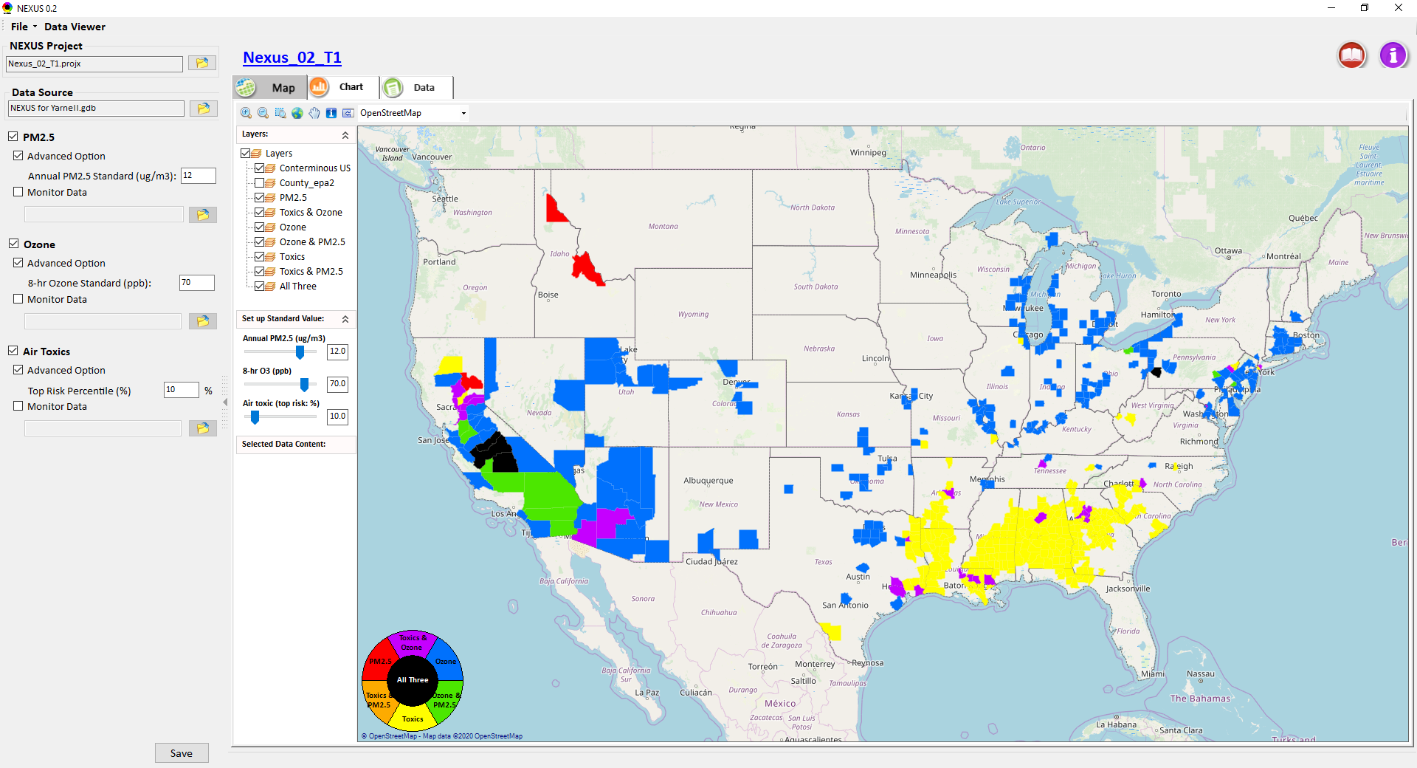
NEXUS Multi-Pollutant Analysis Tool Development: Status Update & Work Plan
Carey Jang and Tyler Fox ,
AQAD/Air Quality Modeling Group, March 02, 2020

Slide 2
NEXUS Tool Development
Motivation: Develop a multi-pollutant risk-based analysis tool to identify and evaluate overlapping areas of high health risks associated with PM2.5, O3, and air toxics
Phase-1: Develop a GIS-based tool prototype with a user-friendly GUI to provide visualization and analysis functions of potential multi-pollutant AQ issues for PM2.5, O3, and air toxics over a national level
Phase-2: Expand NEXUS to allow users to select a region or metropolitan area and provide data query and visualization functions of air quality and emissions information over the selected (or combined) region or metropolitan area of interest
NEXUS Prototype download: I:\SHARE\NEXUS_Tool\NEXUS 0.2\*

Slide 3
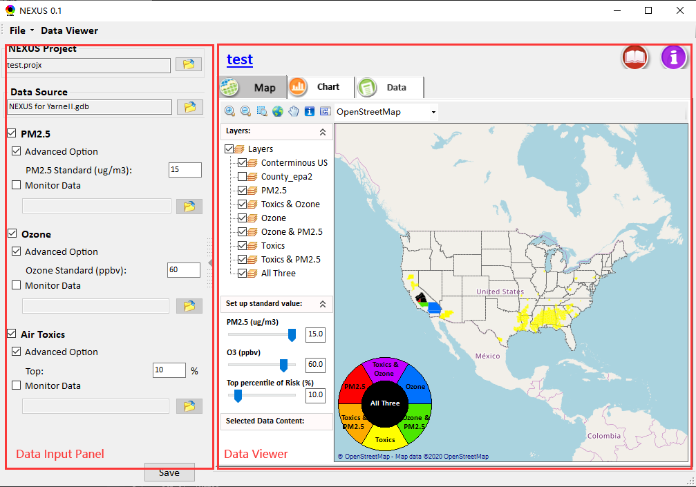
NEXUS prototype: Phase-1
Develop a NEXUS multi-pollutant analysis tool prototype with user-friendly GUI to provide visualization and analysis functions of potential multi-pollutant air quality issues for PM_{2.5}, O₃, and air toxics over a national level (based on 2014 Geodatabase “NEXUS for Yanell.gdb”)
Under Data input panel:
  Allow users to input the data source in geodatabase format (*.gdb), and then check interested pollutant (e.g., PM_{2.5}, Ozone and Air toxics) and set the attainment standard or risk percentages for selected pollutant.
Under Data viewer panel:
  Provides GIS map, graphics and data tables that identify area design values with toxic pollutant data to highlight air quality pollutant concentrations and risk percentages.

Slide 4
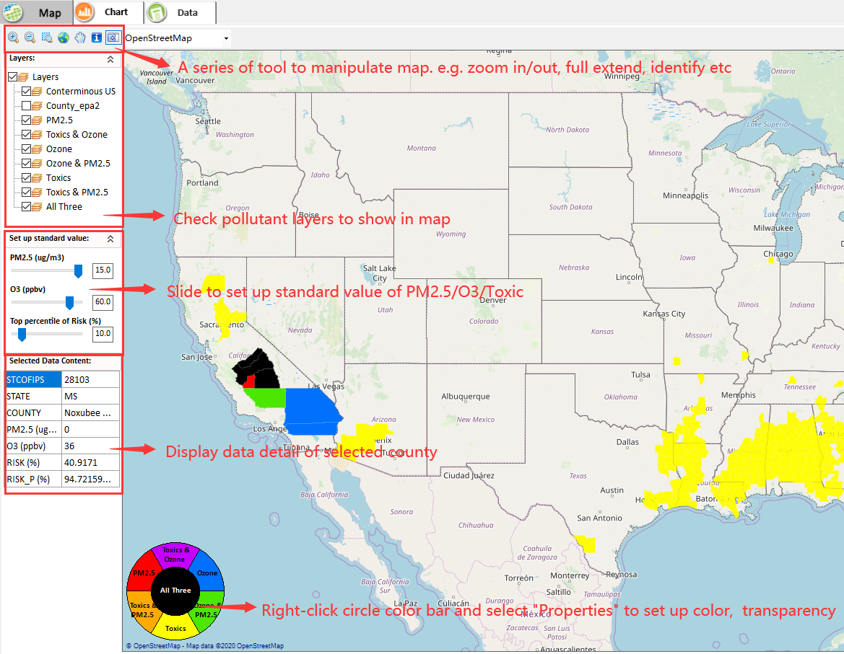
NEXUS prototype: Phase-1
Under GIS map:
Provide a series of functions to support map operations, e.g., Zoom in/out or Zoom to full extent and identify the detailed information for selected region, and multiple online base maps for users (e.g., open street map, google map and Bing Map, etc.)
Allow to check different pollutant layers and show those areas with O₃ and/or PM_{2.5} concentrations above the air quality standards in GIS map;
Support to set the layer transparency/color.
Support to set up standard value flexibly.
Support to display data details of selected county.

Slide 5
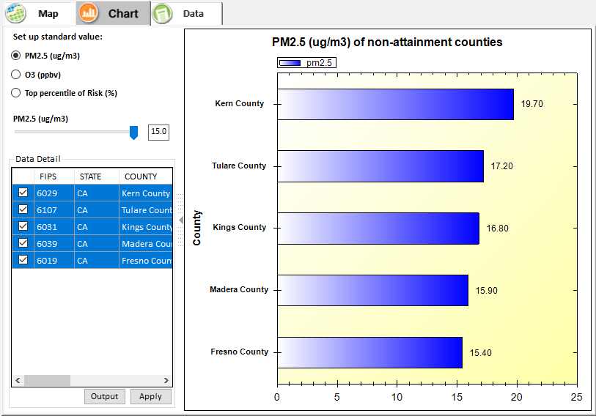
NEXUS prototype: Phase-1
Under Chart page:
Show those areas with O₃ or PM_{2.5} concentrations above user-defined air quality standards or modeled county-level cancer risk estimated from NATA in user-defined top percent in descending order

Slide 6
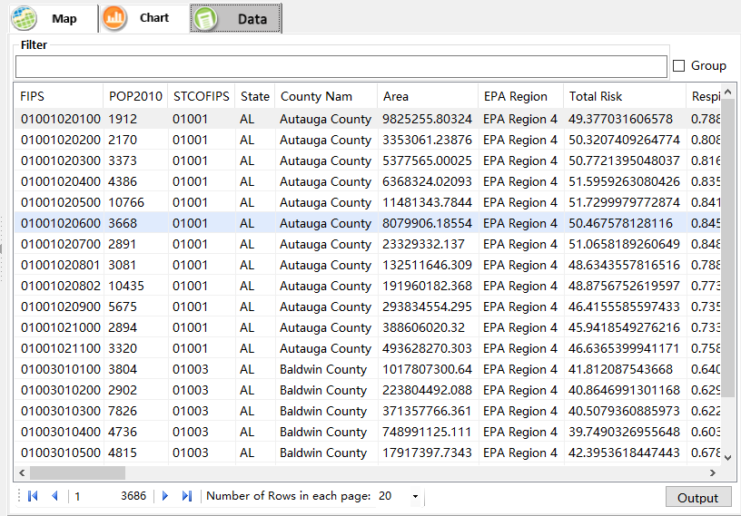
NEXUS prototype: Phase-1
Under Data tab page:
List those data elements used for ranking areas from input geodatabase (based on 2014 Geodatabase “NEXUS for Yanell.gdb”)
Support to sort, group and output these data for further study

Slide 7
List of Tasks under Development
Enhance/Improve “Data” module:
  Add “Advanced Filter” to customize the expression to filter data；
  Show “Statistics” for selected item；
Include ambient/emission and other dataset & display in GIS
  Design values
  Design value trends - 10 year lookback
  Projections
  Emissions NEI – county level by data category
  Emissions NEI – individual source
  Nonattainment area boundaries
  Ozone and PM advance area boundaries
Phase 2：Expand NEXUS tool
  Allow to select pollutants of interest and then show the corresponding sorting results of pollutant sources (e.g., Top 10 pollutant sources)
Develop draft on-line User’s Manual and Quick Start Guide for the NEXUS tool

Slide 8
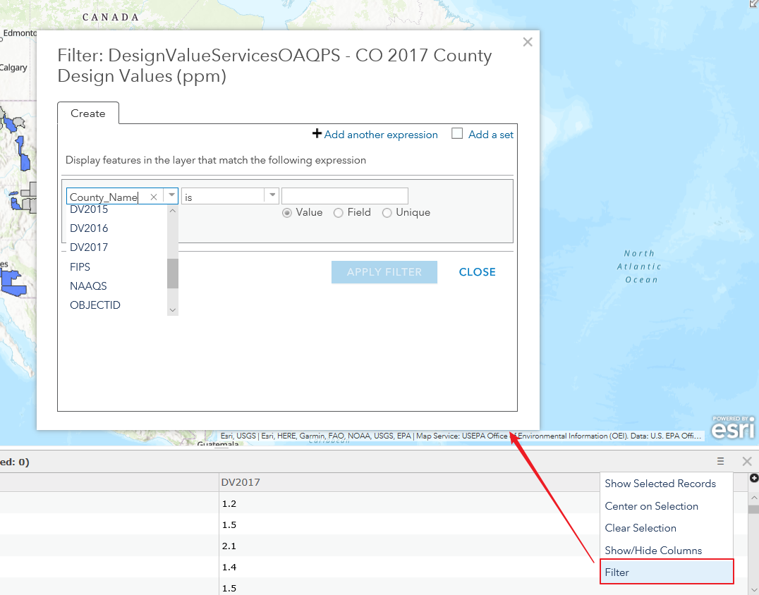
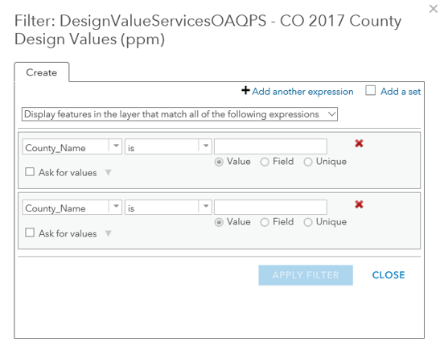
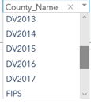

List of Tasks under Development
Enhance/Improve “Data” module:
Add “Advanced Filter”to custom the expression to filter data

Slide 9
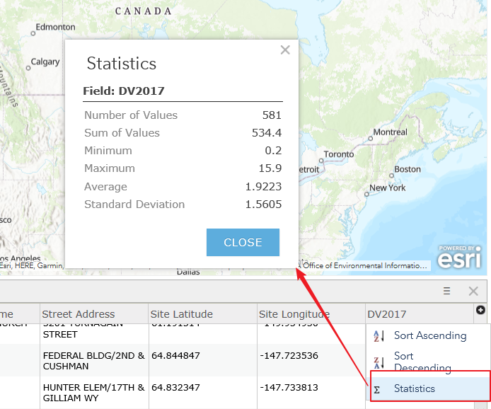
List of Tasks under Development
Enhance/Improve “Data” module:
Show “Statistics” for selected item

Slide 10
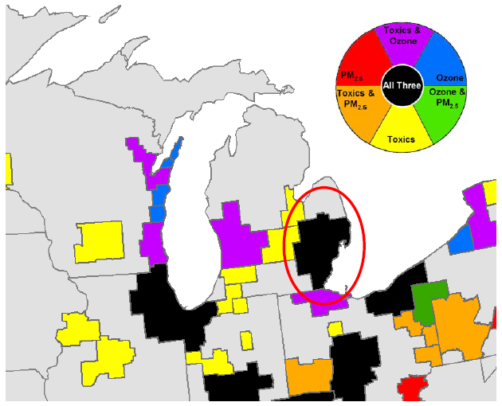
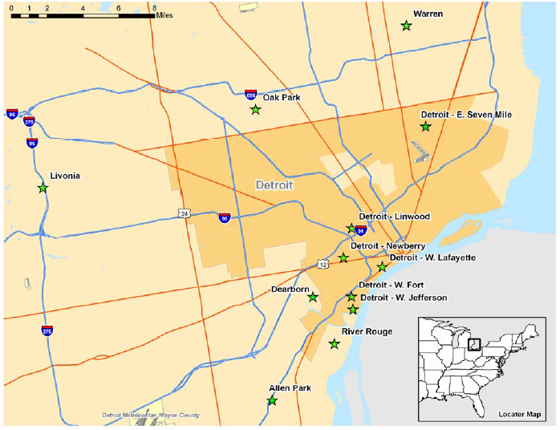
Phase-2 Extended NEXUS tool
Future Tasks: Phase 2
Expand the NEXUS tool functions to allow user to select a region or metropolitan area and provide analysis and visualization functions of air quality and emissions information over the selected (or combined) region or metropolitan area of interest
Multi-pollutant nexus of air quality issues for selected regions/areas
Air sampling network and traffic volumes network for selected regions/areas

Slide 11
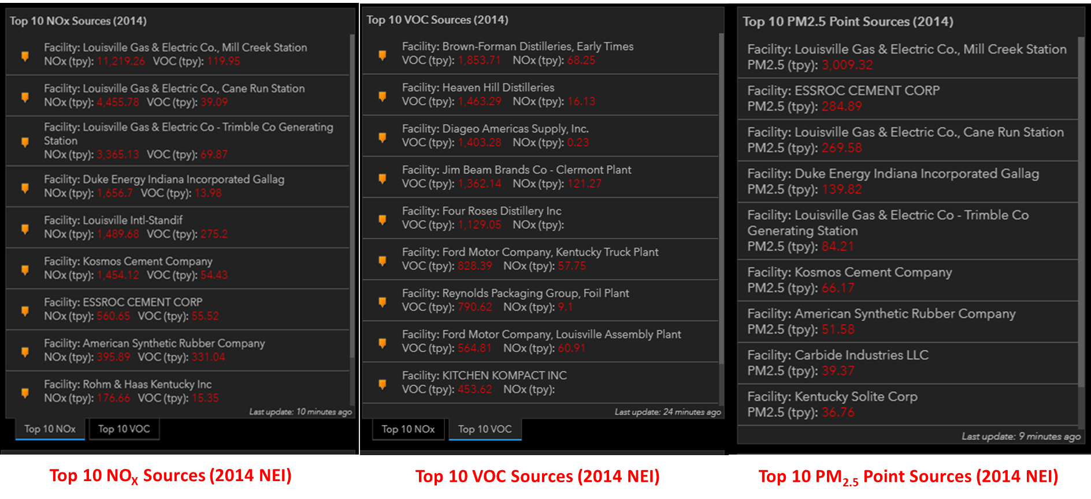
Phase-2 NEXUS tool: Extended functions
Future Tasks: Phase 2
Expand NEXUS funcitons to select pollutants of interest and then show the corresponding sorting results of pollutant sources (e.g., Top 10 pollutant sources)
Example sorting results of pollutant sources

Slide 12
NEXUS Tool Development: Schedule
Work Plan | Date
Develop Phase-1 NEXUS tool prototype and functions | Dec. 2019 ~ March 2020
Expand Phase-2 NEXUS tool and functions | June 2020
Deliver a fully functional NEXUS tool and draft on-line User’s Manual | July 2020
NEXUS Prototype download: I:\SHARE\NEXUS_Tool\NEXUS 0.2\*

