Slide 1
“NEXUS 2.3”: Quick Tutorial
Download “NEXUS” tool: The “NEXUS 2.3” package (“NEXUS 2.3 Setup.exe” & “NEXUS 2.3 Data.exe”: run both “*.exe” files to install) can be downloaded at EPA’s new FTP site:
https://gaftp.epa.gov/aqmg/cjang/NEXUS/MP_Team/NEXUS 2.3/*
Note: Require software installation privilege or “Power Broker” (limited elevated privilege) to install “NEXUS tool” at EPA’s PC; Check “This PC\Documents\My NEXUS files\data\* (\tool\*, \result\*)” to see if NEXUS program & input dataset are installed successfully
1

Slide 2
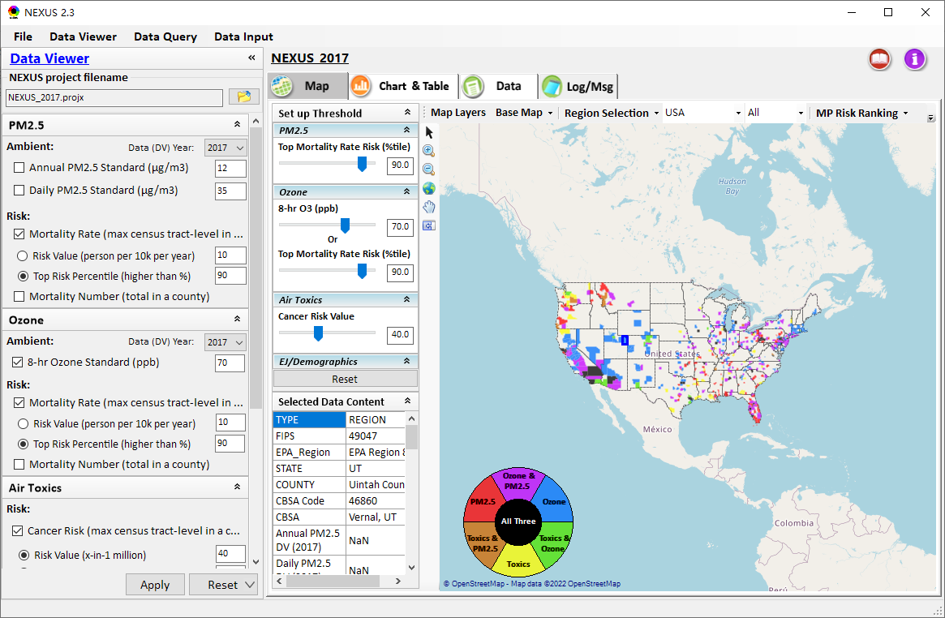
NEXUS Tool: On-line User’s Manual
Click “book” icon to launch “User’s manual”
Hot link to User’s manual’s “Data Viewer” chapter (same for “Data Input” module & “Data Query” model)
2

Slide 3
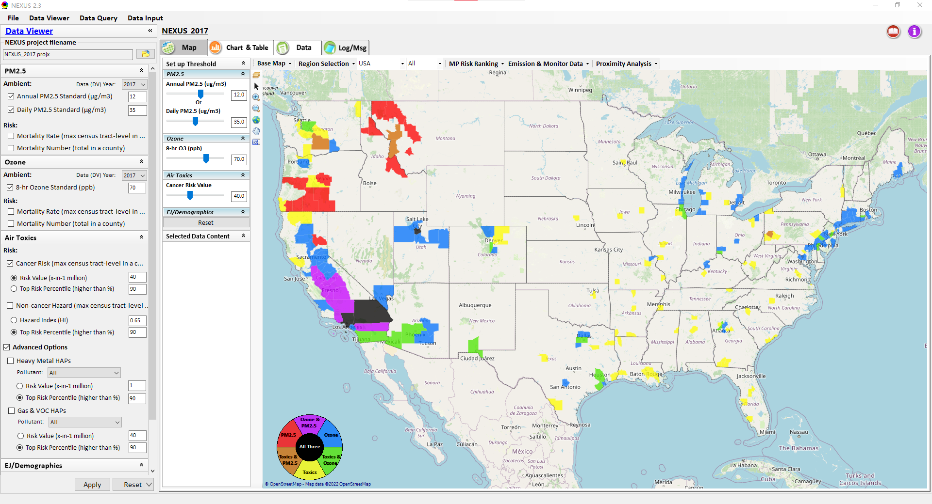
NEXUS Tool: Data Viewer Module
Click “File” to open or save a project
Switch between 3 key modules
NEXUS project file name
Select desired ambient data (DV) year (2013-2020)
Select & adjust “Ambient” or “Risk” levels
“Advanced Option”: provide HAPs & species selections
3

Slide 4
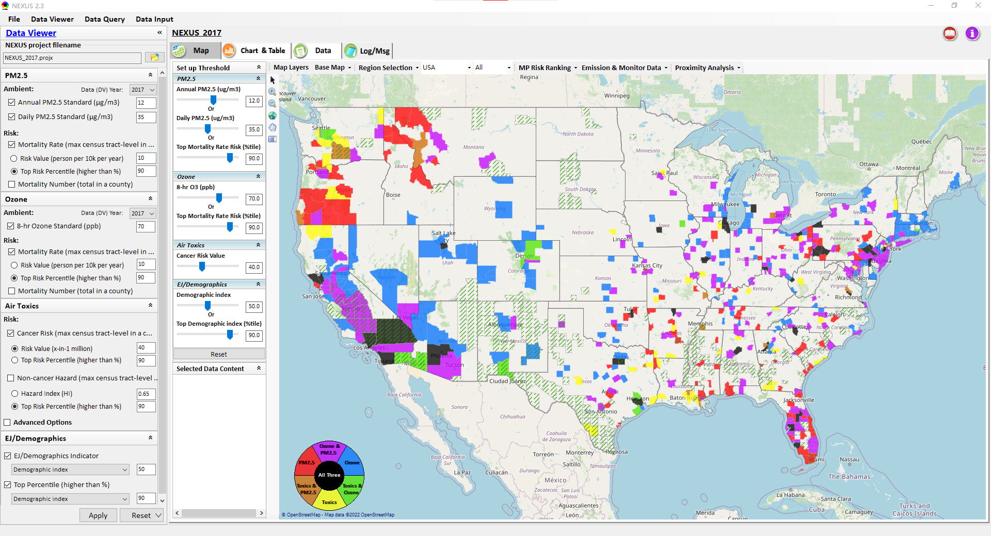
Data Viewer: “Apply” New Selections
“Check” boxes to add/remove selections
New selections will appear in “Slider bars” panel and map display
“Slider bars” allow to select & adjust “Ambient” and/or “Risk” threshold levels to display corresponding color map
“Apply” new selections
4

Slide 5

NEXUS Update: New EJ Metric and Data
New EJ/Demographic metric is displayed with “green dash” for counties exceeding selected threshold
5

Slide 6
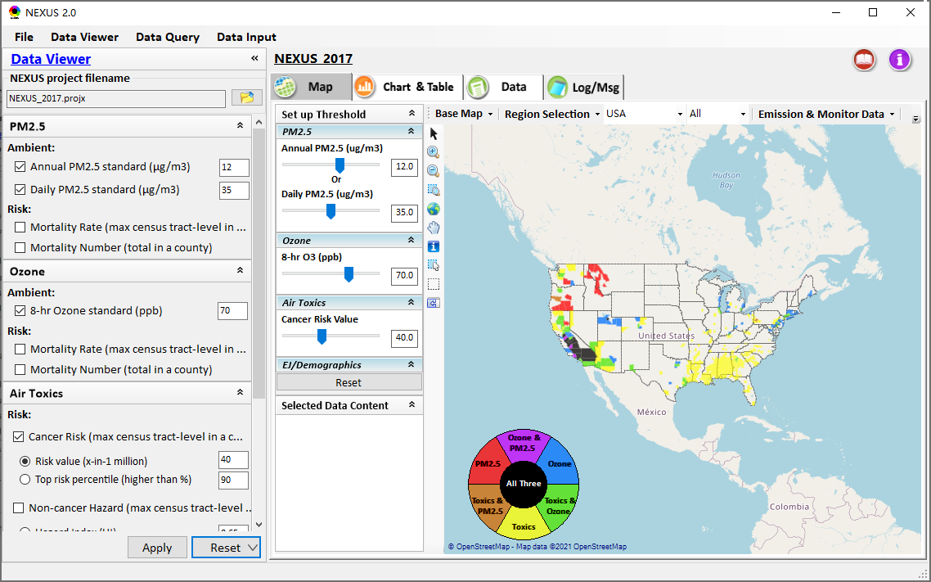
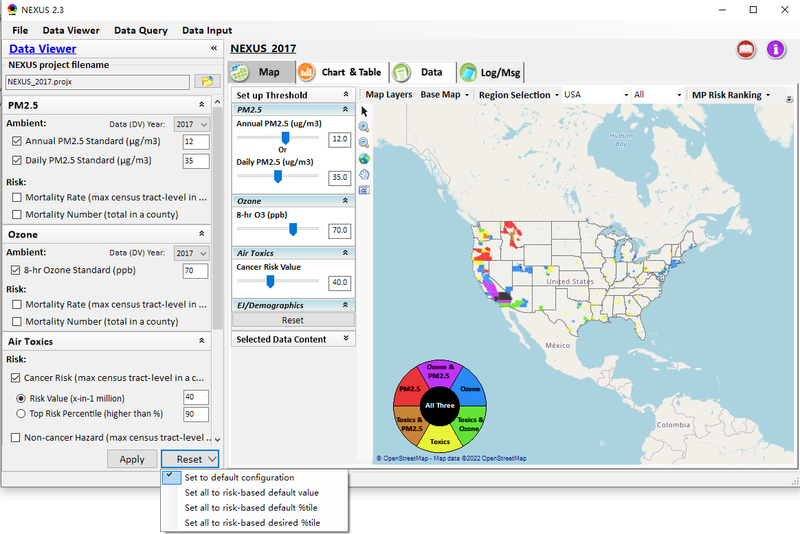
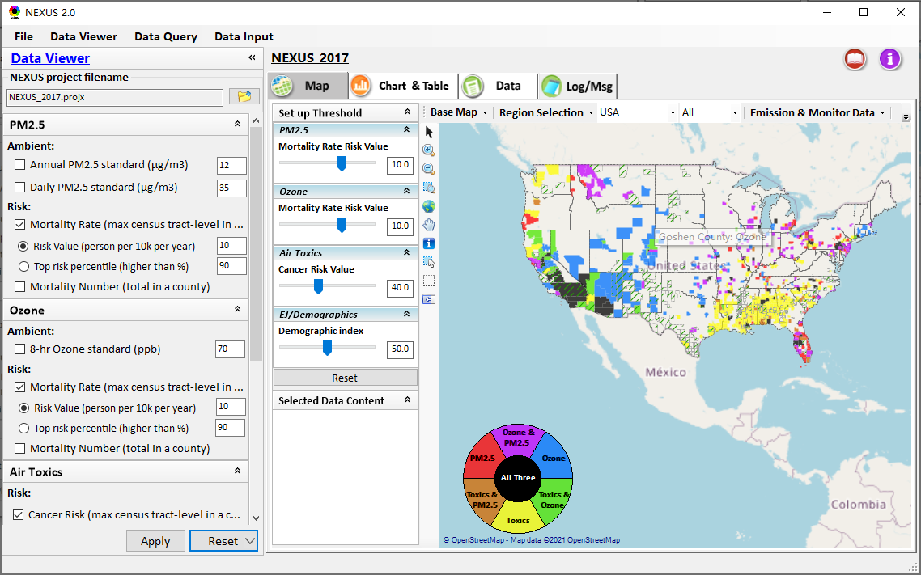
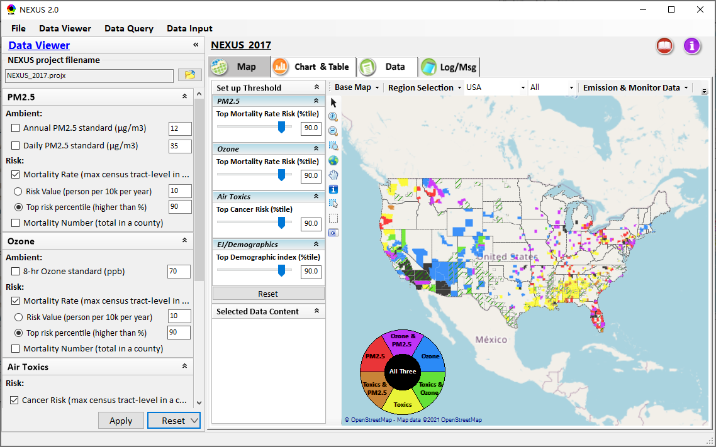
Data Viewer: “Reset” New Selections
default configuration
risk-based
“Reset” new selections
risk-based in %tile
6

Slide 7
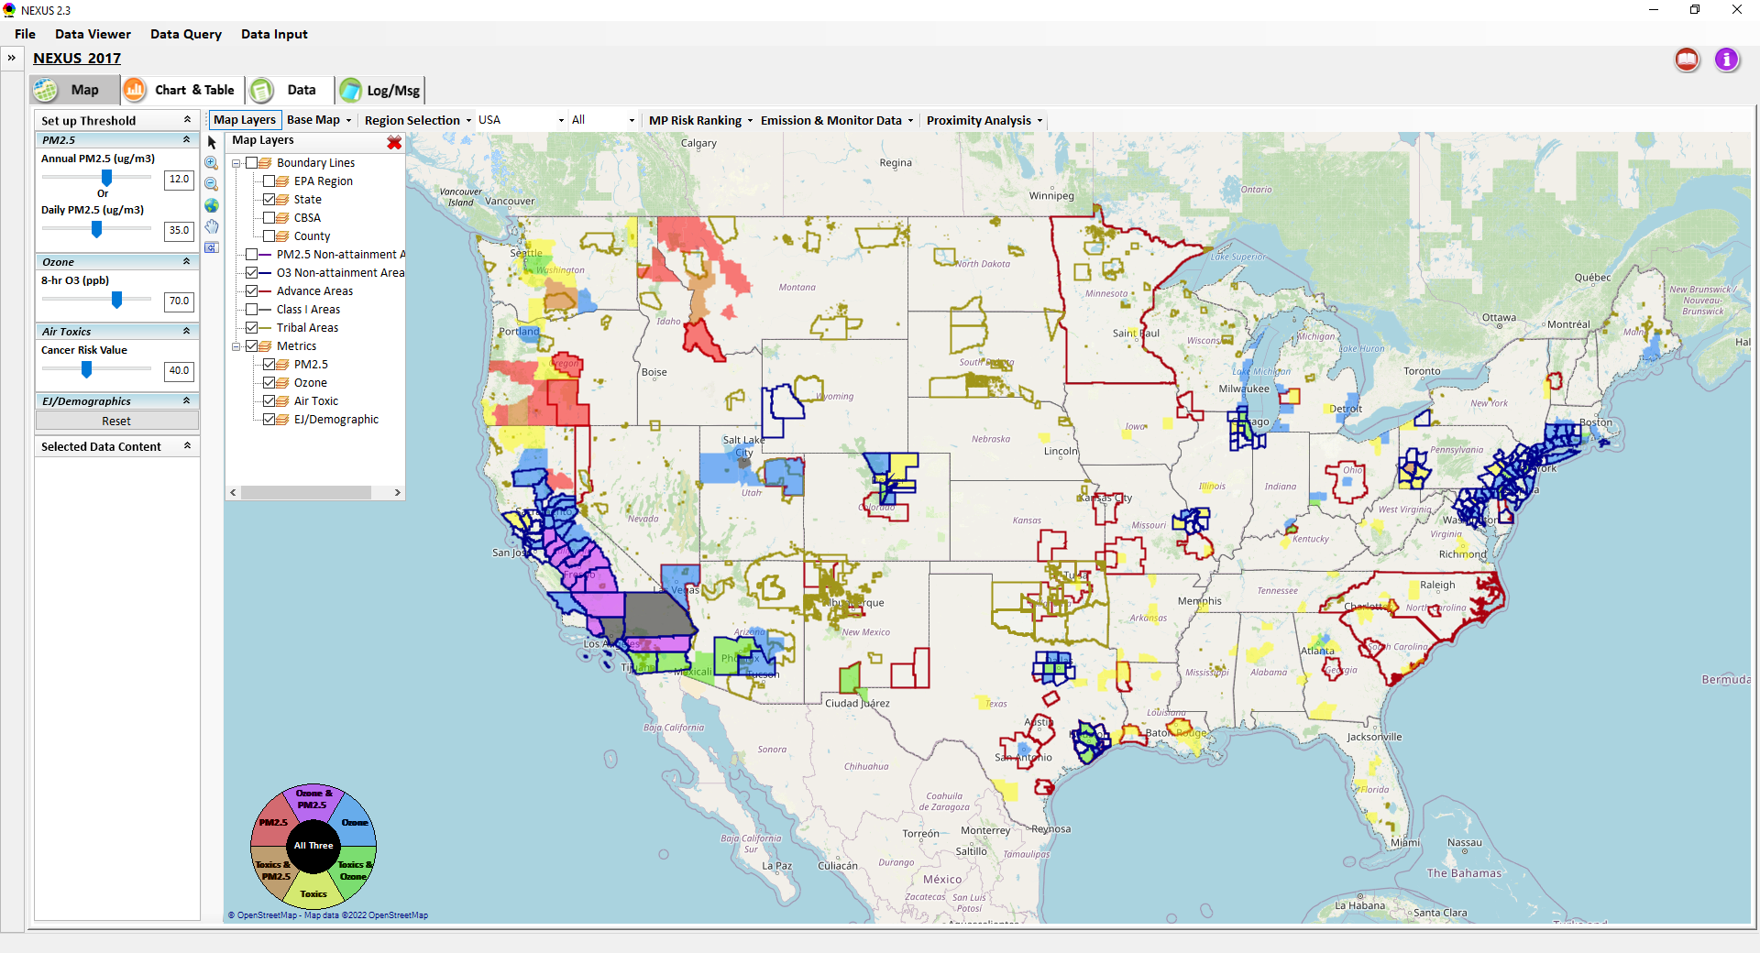
Data Viewer Module: Map Layers menu
Click “X” to close “Map Layers” menu
“Map Layers” menu: Provide (show/hide) map overlaps of various areas, AQ metrics and boundary lines
7

Slide 8
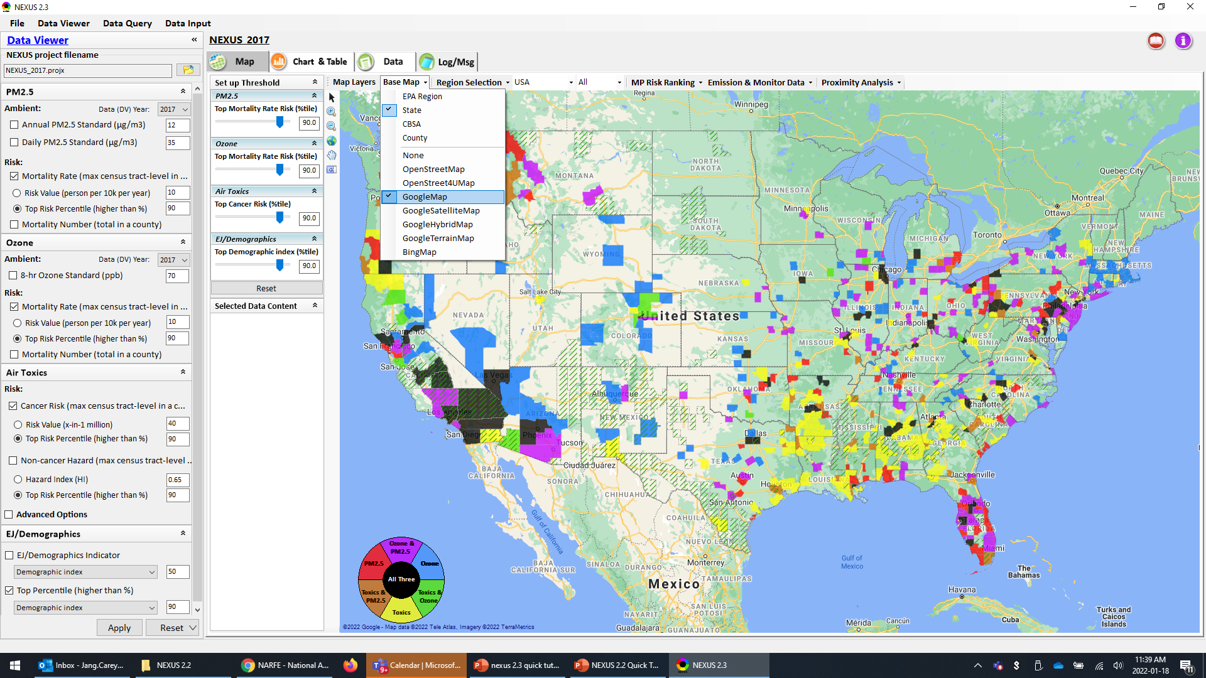
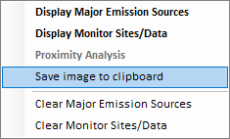
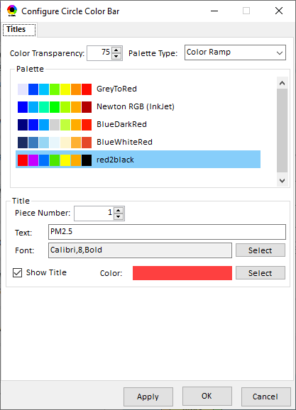
Data Viewer Module: Configure Base Map & Color
“Base Map” menu: Change boundary lines and background map (e.g., “Google Map”)
“Right-click” map to save map image
Click “color map” to change color & transparency
8

Slide 9
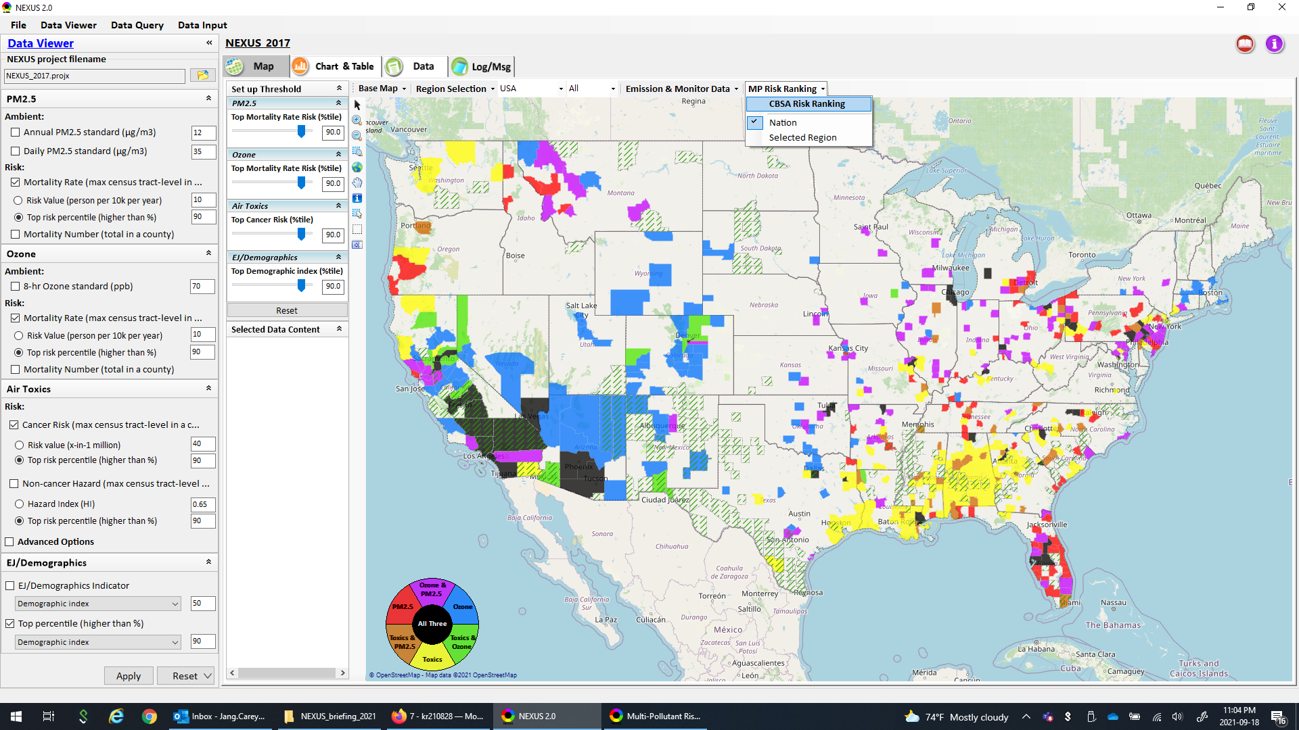
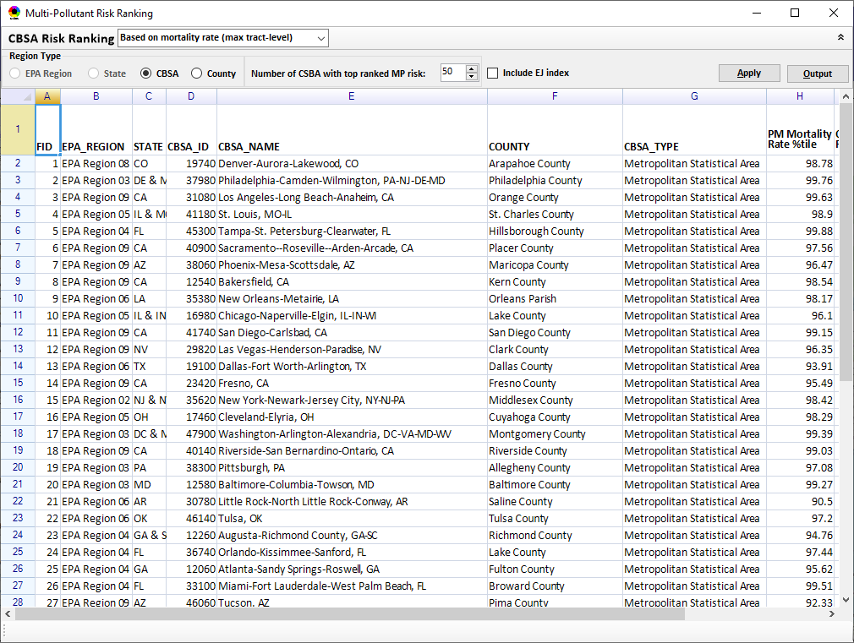
Data Viewer Module: MP Risk Ranking
“CBSA Risk Ranking”: provide MP risk ranking by CBSA or County
9

Slide 10
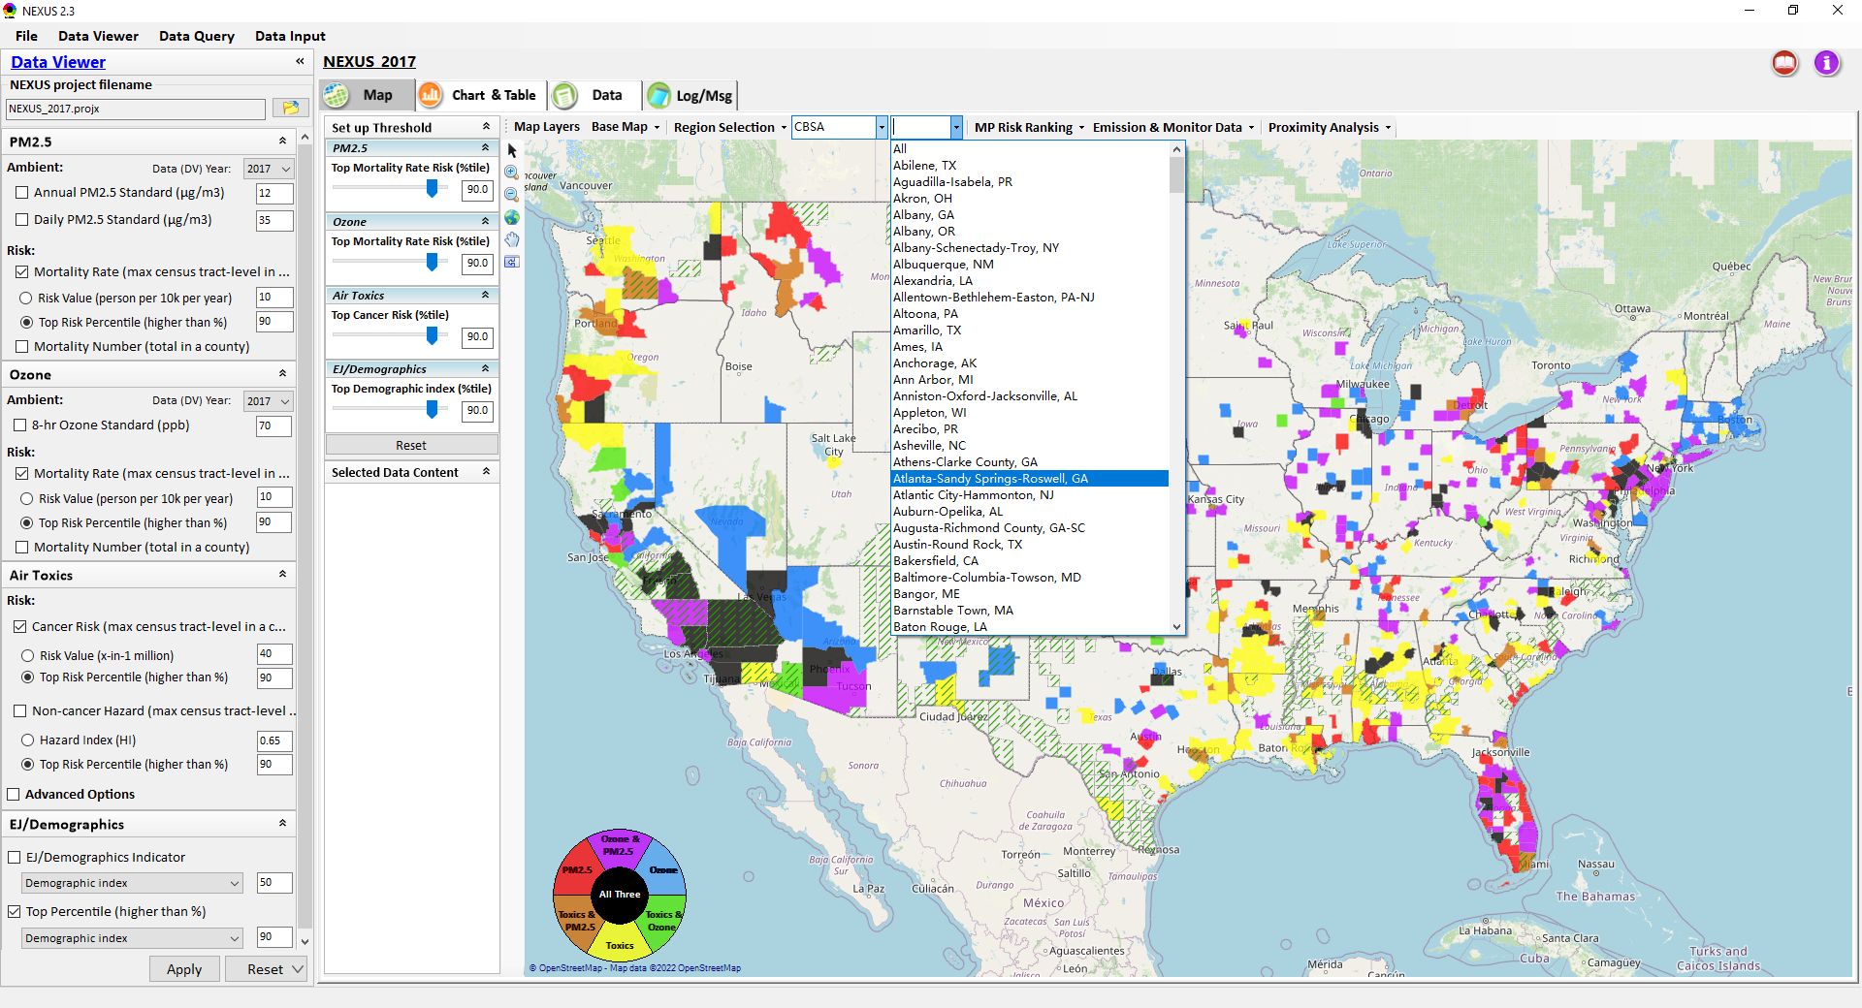
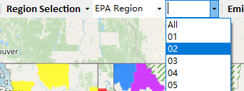
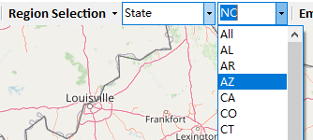
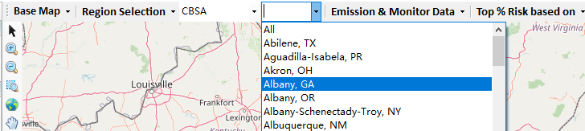
Data Viewer: “Region Selection”
Allow to select “EPA regions”, “States”, or “CBSA”
10

Slide 11
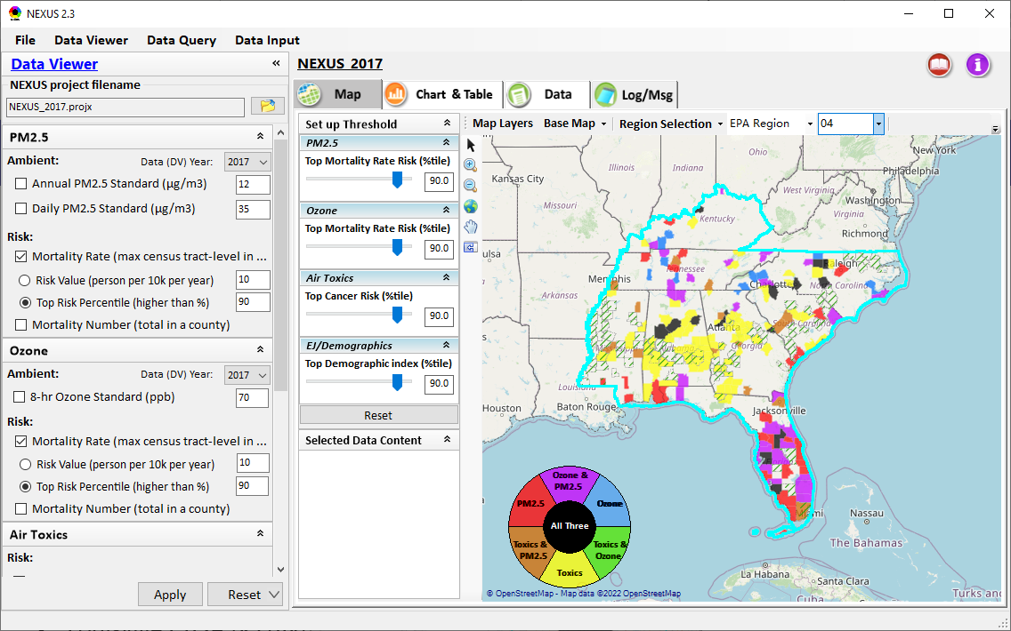
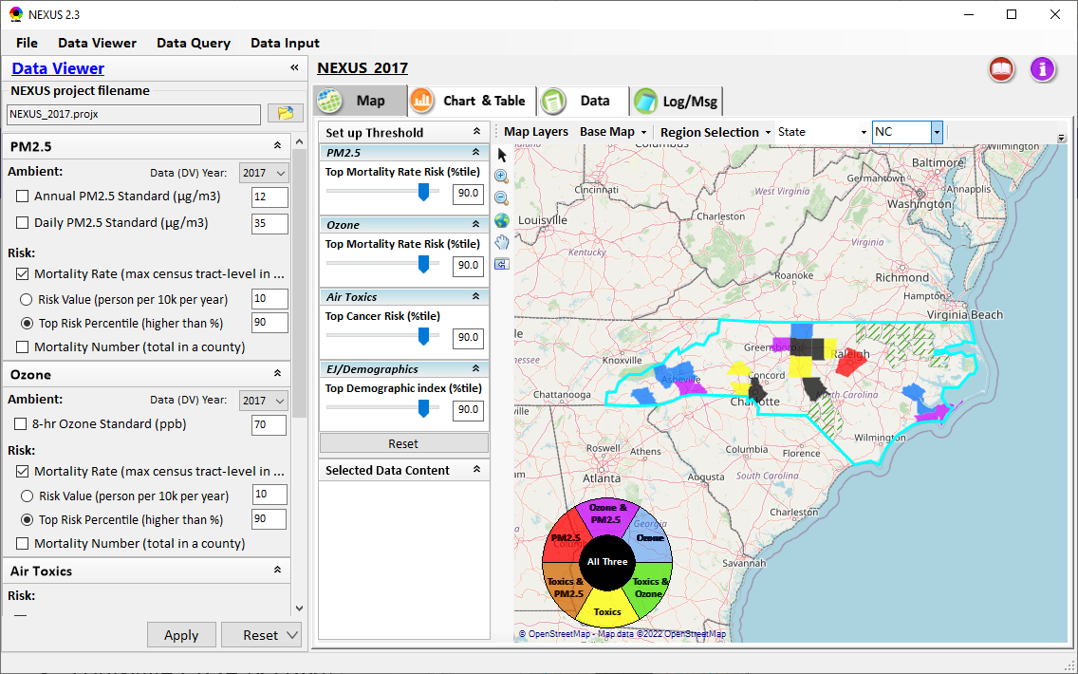
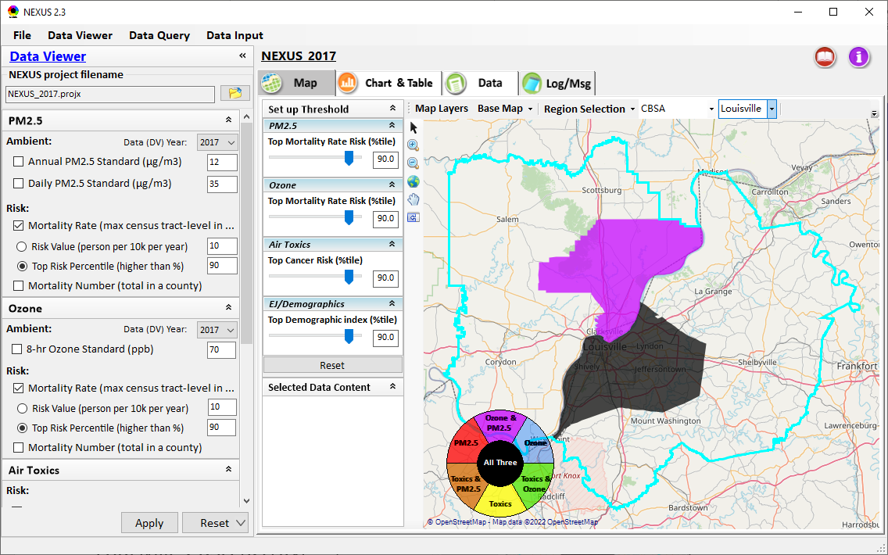
Data Viewer: Select EPA Region/State/CBSA
Examples:
EPA Region 4
State: NC
Louisville CBSA (KY/IN)
11

Slide 12
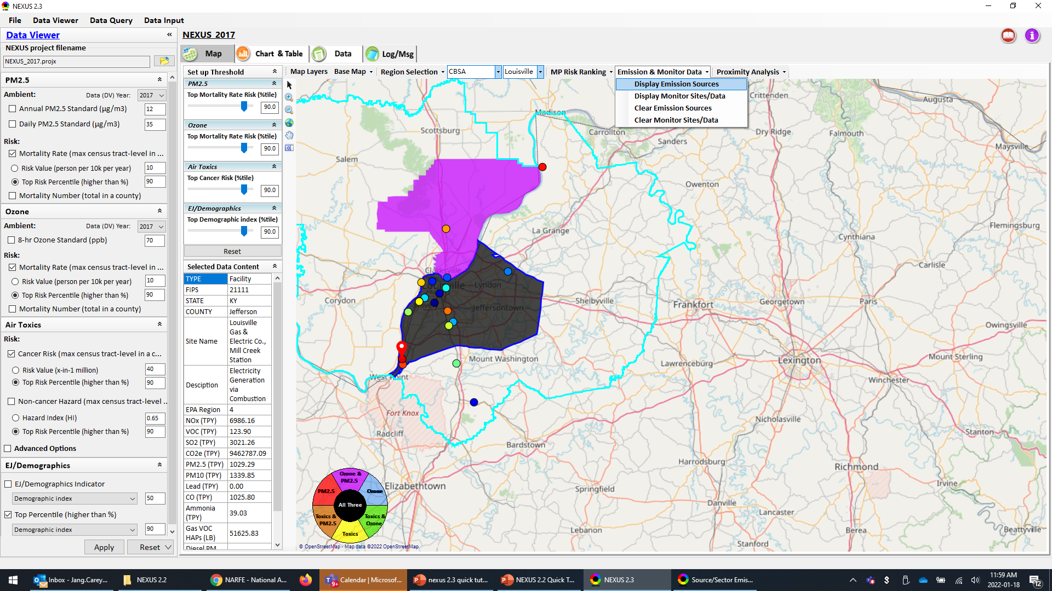
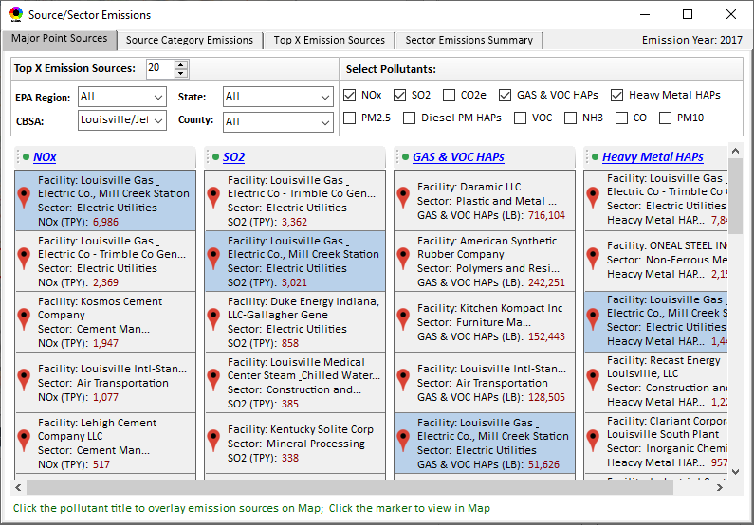
Data Viewer: Major Emission Sources
Click “Display Emission Sources” tab (or right-click) to display emission sources and launch new window
Click any “facility” to link & display source location and emitted pollutants information. Same facility emitting various pollutants can be identified with the same highlighted color.

Slide 13
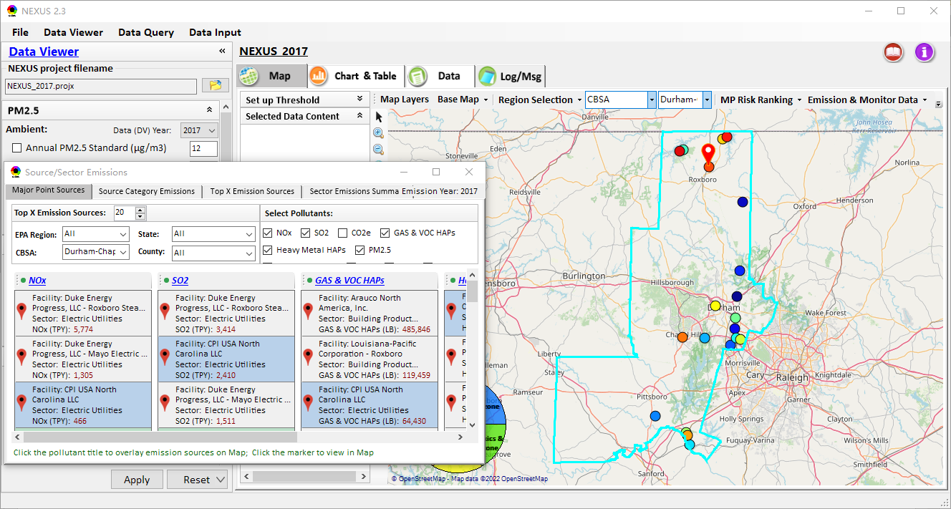
Data Viewer: Major Emission Sources
Allow to scroll down to CBSA-level (e.g., Durham CH CBSA ) or County-level
Durham CH CBSA
Emissions ranking by “color” of circles from red (higher) to blue (lower)
13

Slide 14
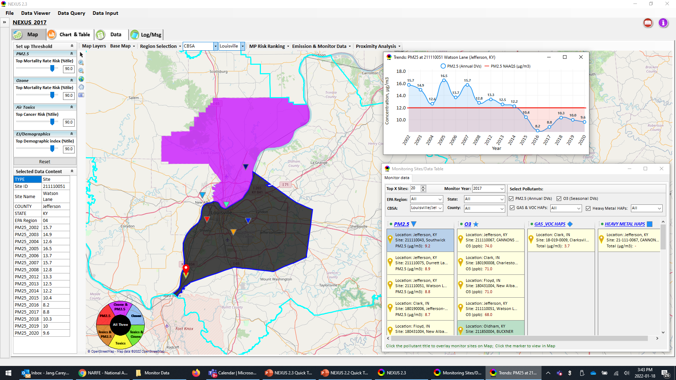
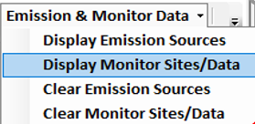
NEXUS: “Monitoring Data/Site” Module
Click menu (or right-click) to display “Monitor Sites/Data”
AQ trend
Monitor Site/Data
Click to display
AQ trend at monitor site
Use different symbol to display each pollutant’s “monitoring sites” e.g., PM_{2.5} (triangle), O₃ (star), etc.
Click to select monitor site & pollutant
14

Slide 15
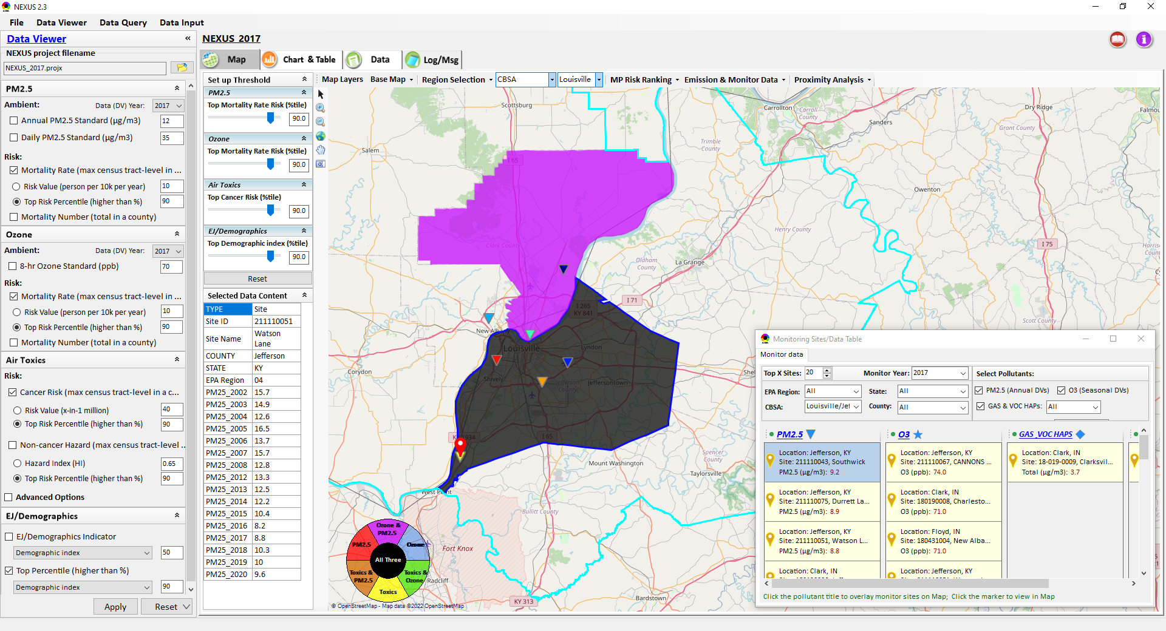
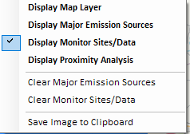
Two ways navigate to Proximity Analysis Module
Click menu (or right-click) to display “Proximity Analysis” module
Or click any facility, monitor site or a county, and then right-click on map and select “Display Proximity Analysis”.

Slide 16
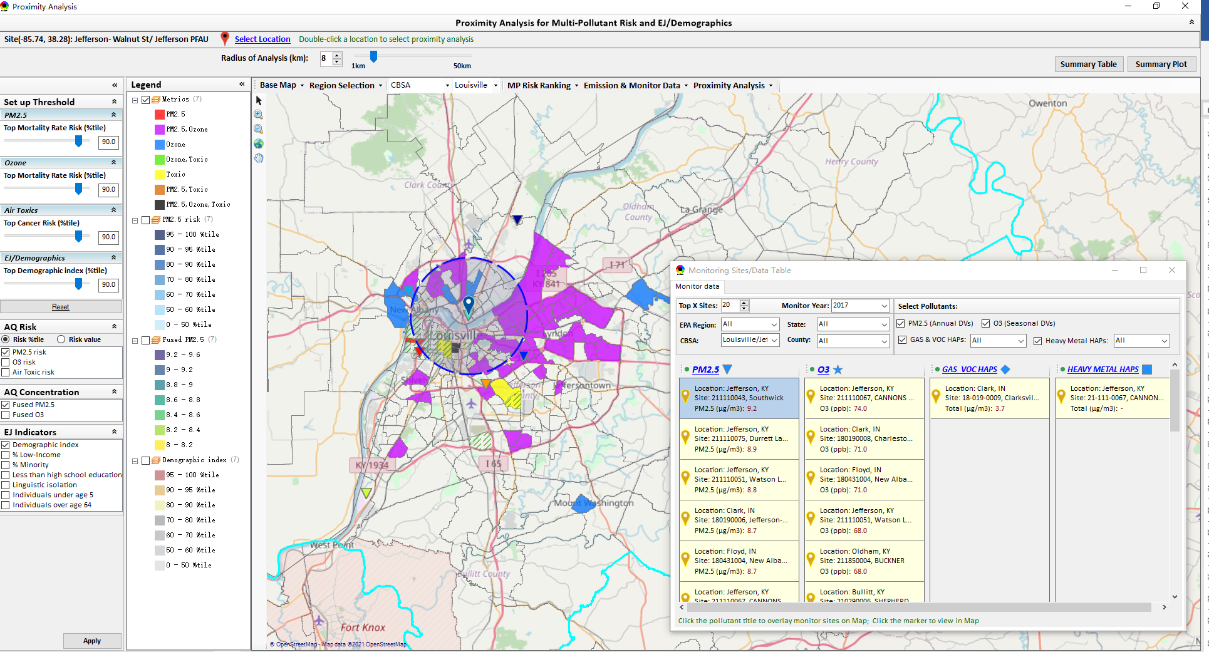
Proximity Analysis Module: Overlaying Map
“Set up Threshold” panel (similar to Data Viewer module) allows to identity those geographic areas exceeding the selected thresholds.
Check (Uncheck) to show (hide) an overlaying map
The AQ Risk/Concentration and EJ indicators configurations provide metric selections to overlay the MP and/or EJ analysis map.

Slide 17
Proximity Analysis Module: Overlaying Map
Click “Reset” button to reset all values to default (or to a specified %tile if all indicators are selected in %tile)
Provide a “toggle” choice to select “Risk %tile” or “Risk value”

Slide 18
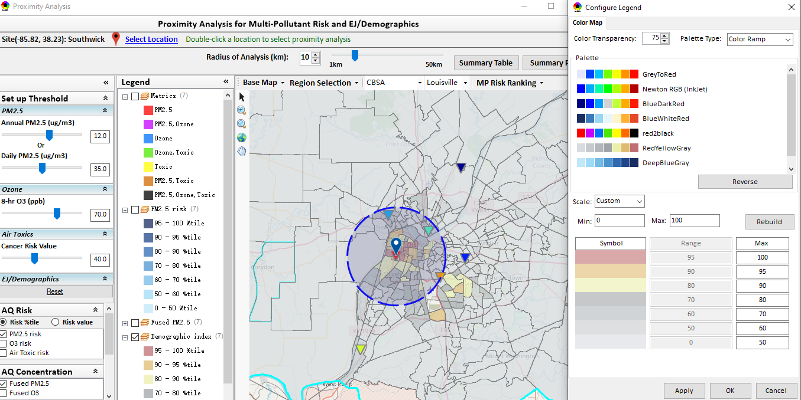
Proximity Analysis Module: Legend Configure
Click nay color tile to to config the legend color & transparency

Slide 19
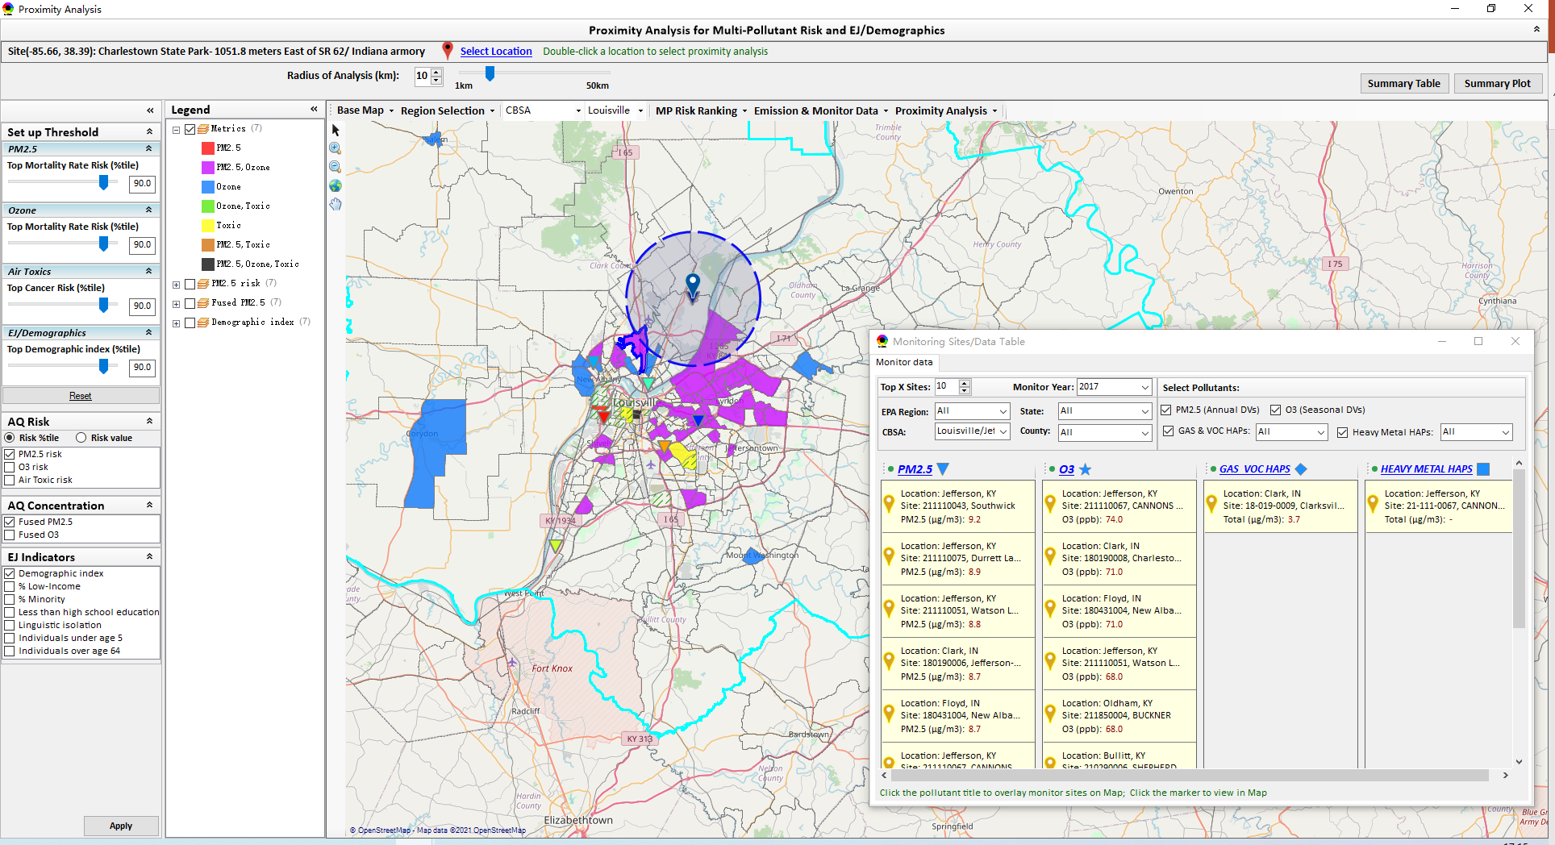

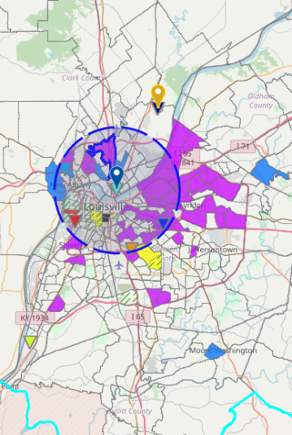
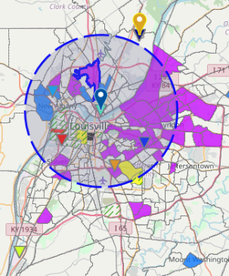
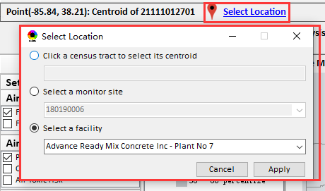
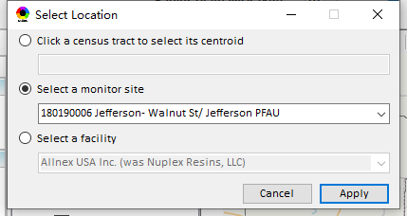
Proximity Analysis Module: Set the “Radius of Analysis”
Adjust the analysis radius
Click the “Select Location” and select a census tract, a monitor site or a facility in “Select Location” dialog
(b) Or Double-click a facility or monitoring site or a census tract to select proximity analysis center point

Slide 20
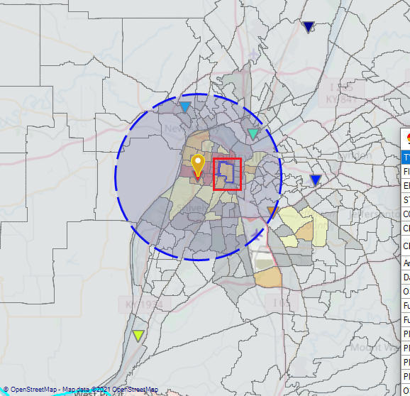
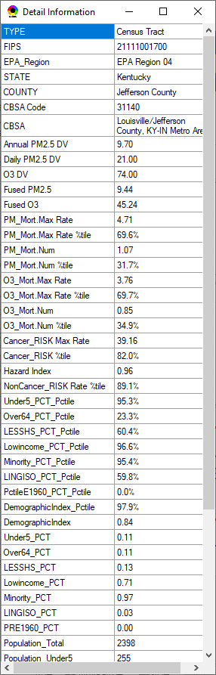
Proximity Analysis Module: Show Detail information
Click a facility or monitoring site or a census tract to show the detail information

Slide 21
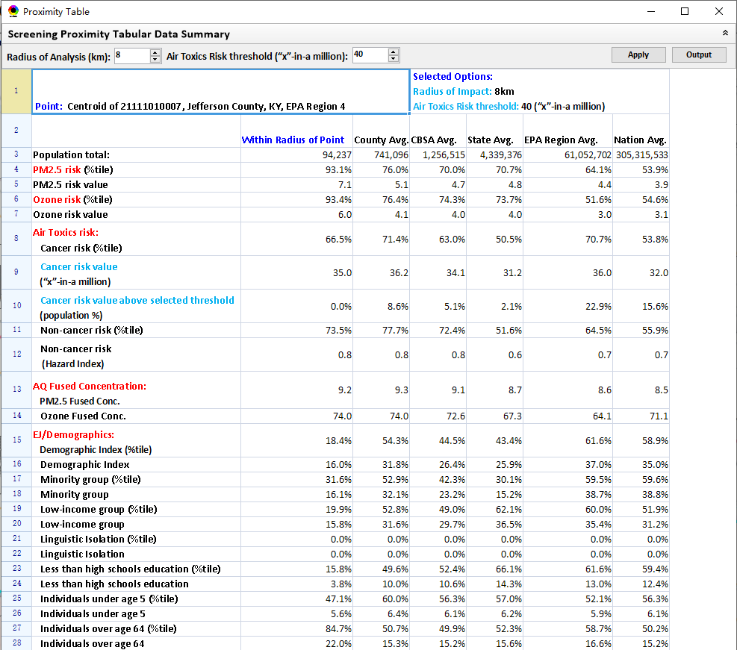
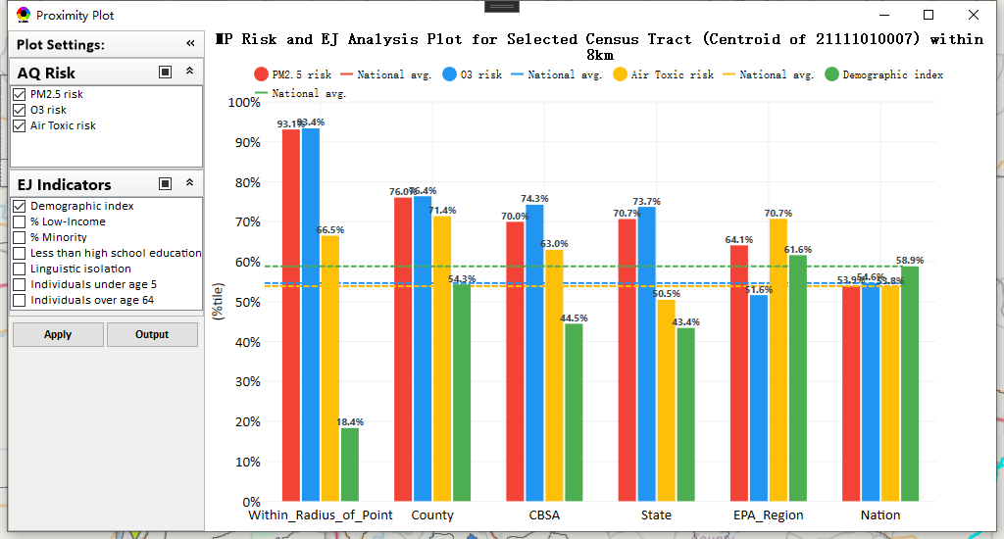
Proximity Analysis Module: Summary Table/Plot
Summary table
Summary plot
Set the radius of analysis and the threshold of air toxics to show the summary results for selected point within radius
Emissions
Support to output the summary table as excel file (*.xlsx)
Select one or more indicators to plot the summary results for selected point within radius, county/CBSA/State/EPA Region and Nation avg.

Slide 22
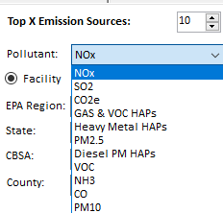
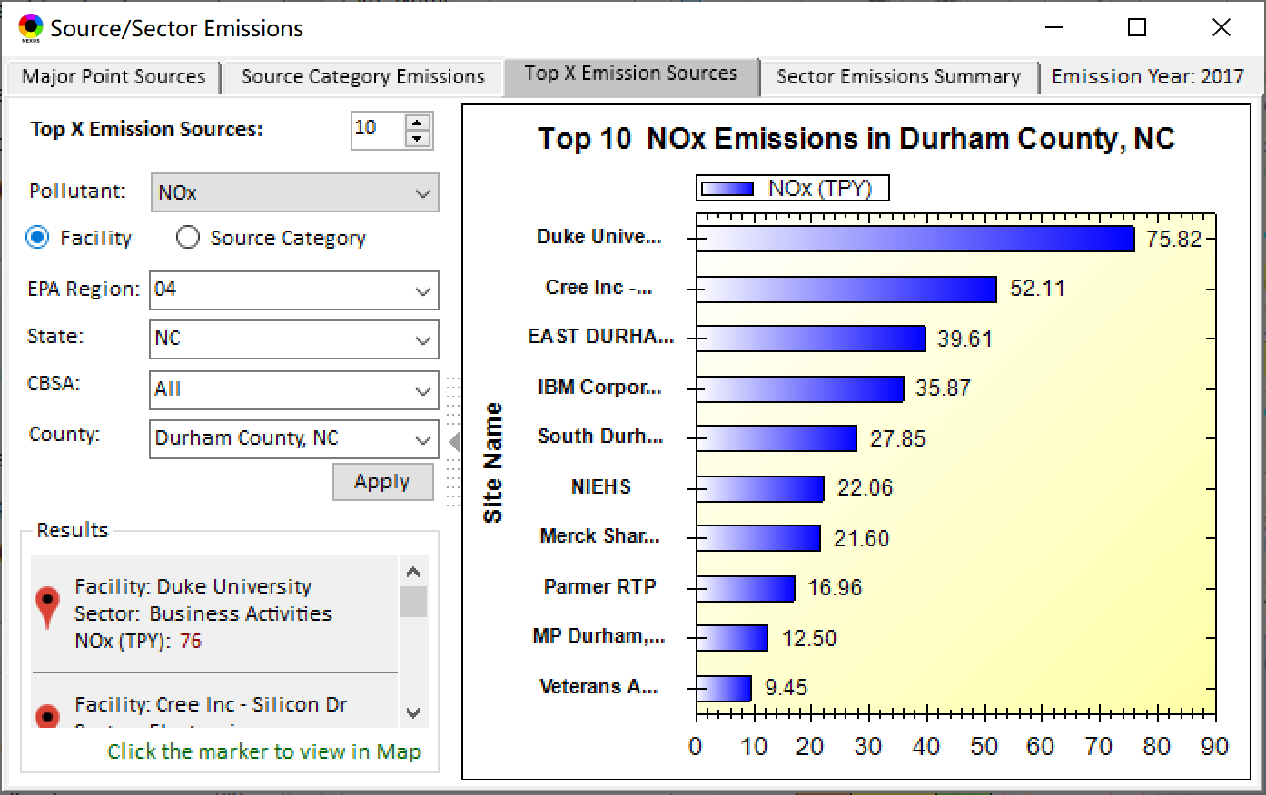
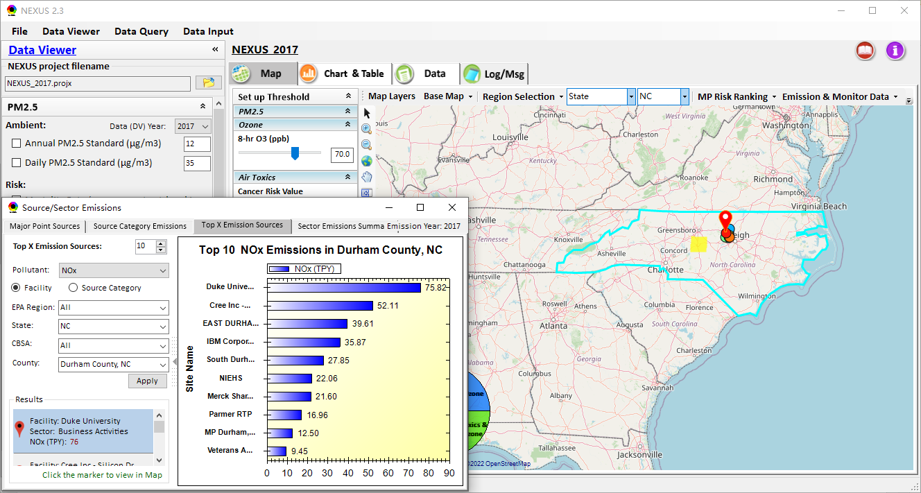
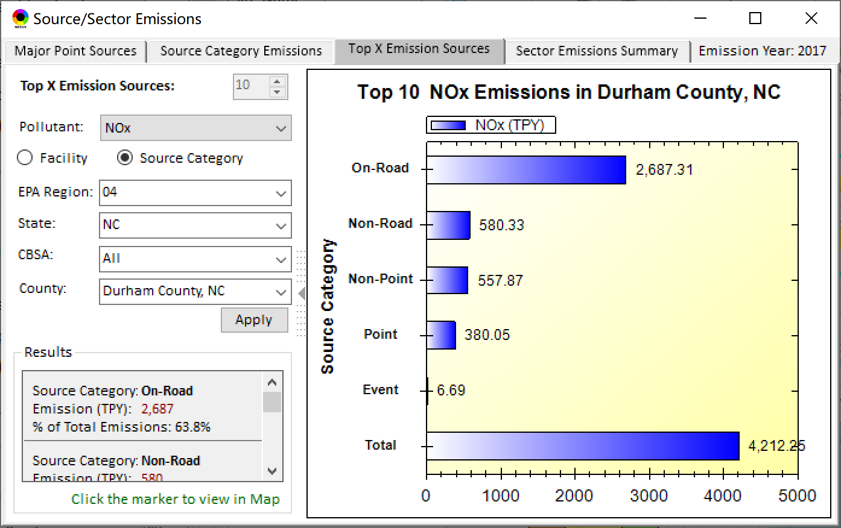
Data Viewer: Top “x” Emission Sources
Provide selection of Facility & Source Category
Provide selection of Facility or Source Category
Durham county, NC
22

Slide 23
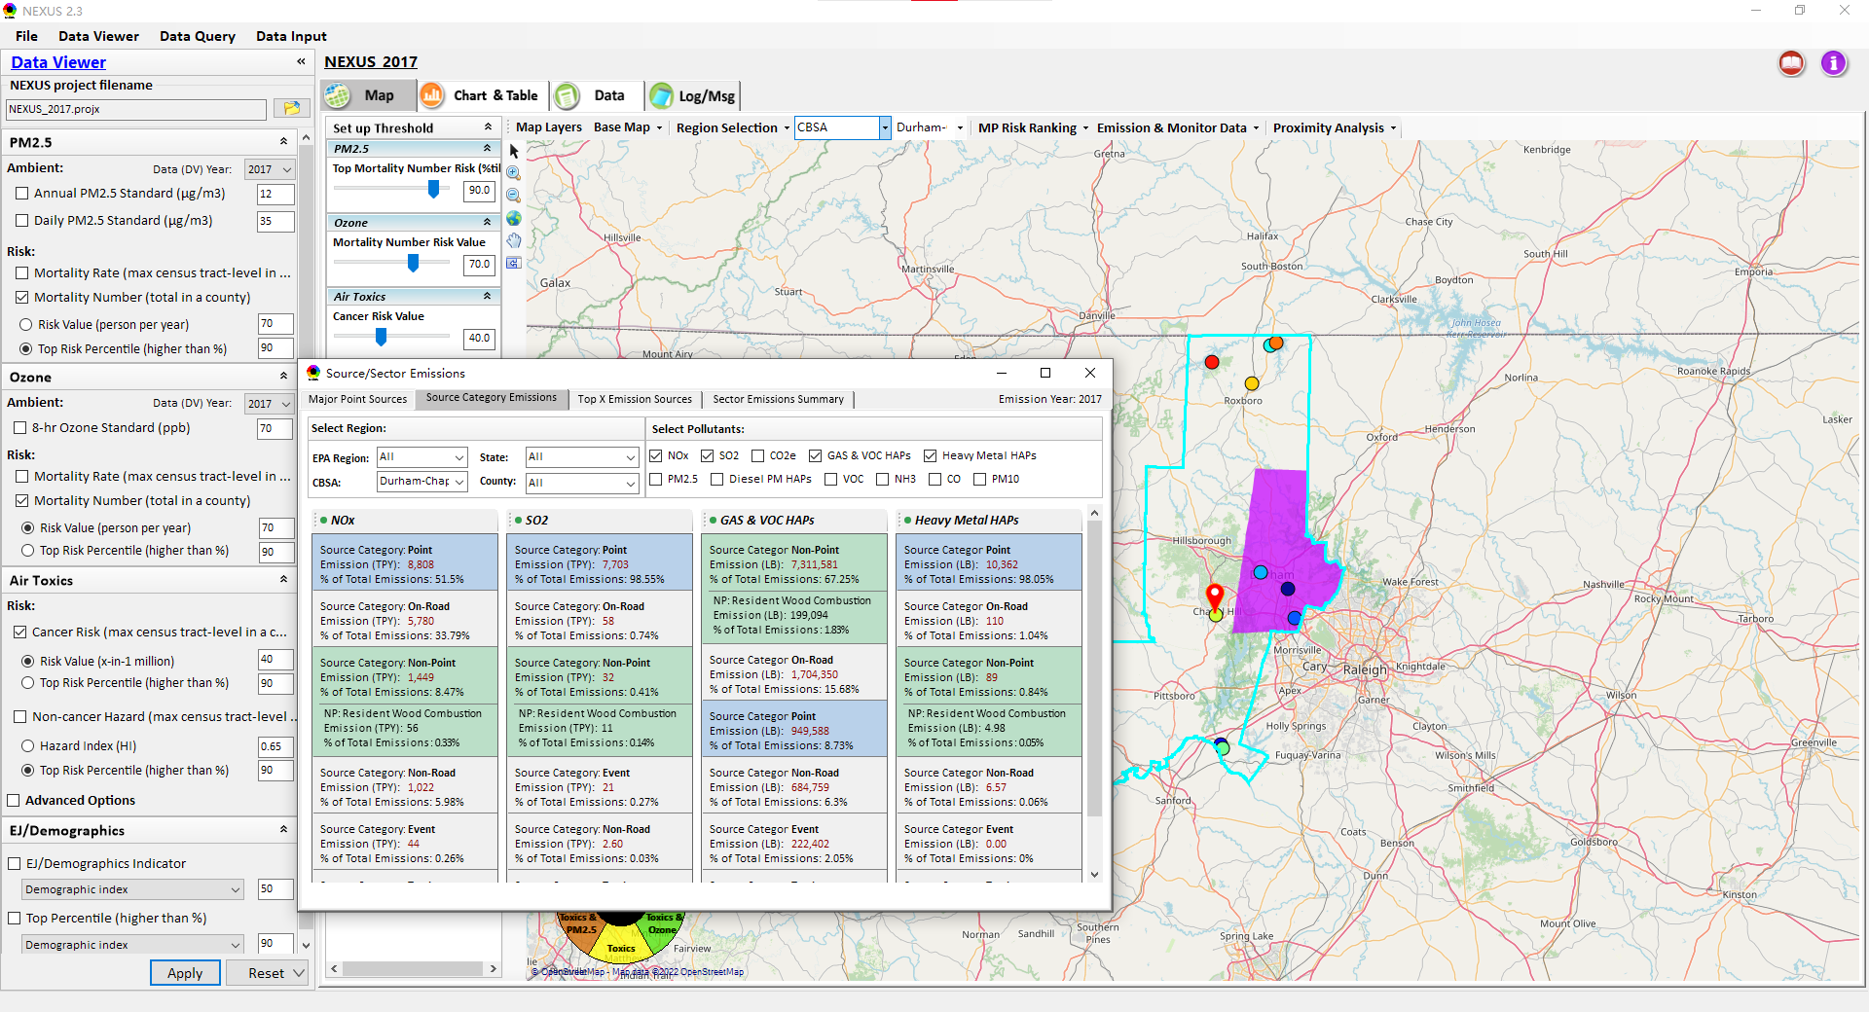
NEXUS Update: “Source Category Emissions”
“Source Category Emissions” module provide five source categories, including “Point”, “Non-Point”, “On-Road”, “Non-Eoad”, and “Wvent” emissions for the selected region, CBSA, or county.
For “Non-Point”, including Resident Wood Combustion emissions.
23

Slide 24
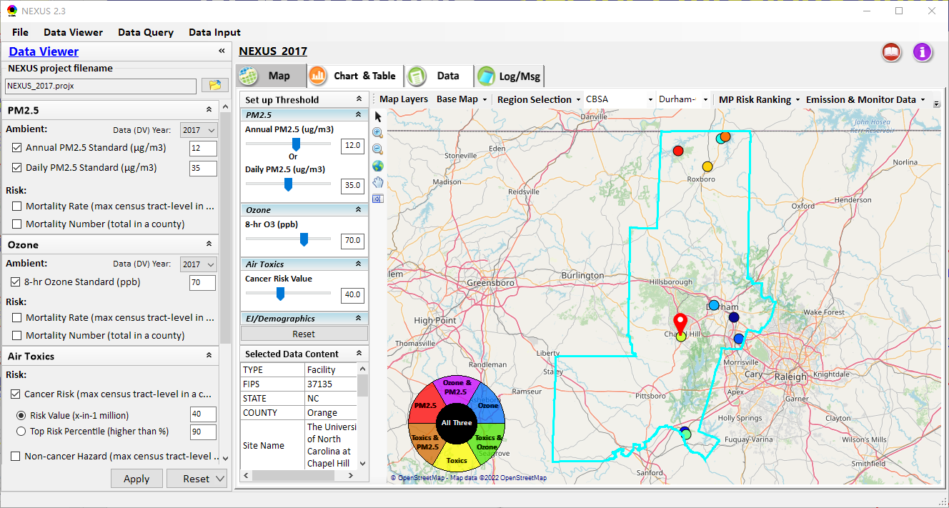
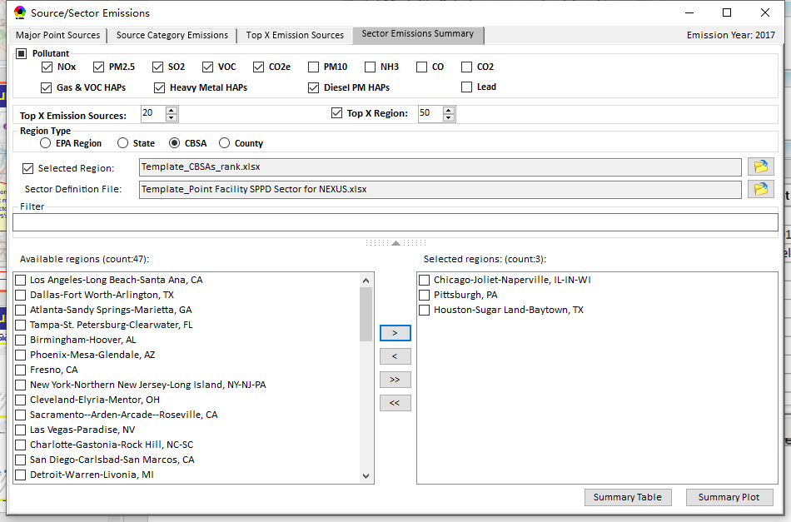
NEXUS Update: “Sector Emissions Summary”
“Sector Emission Summary” function allow to select major CBSAs and provides source and sector emissions summary to support “Sector Prioritization” effort
24

Slide 25
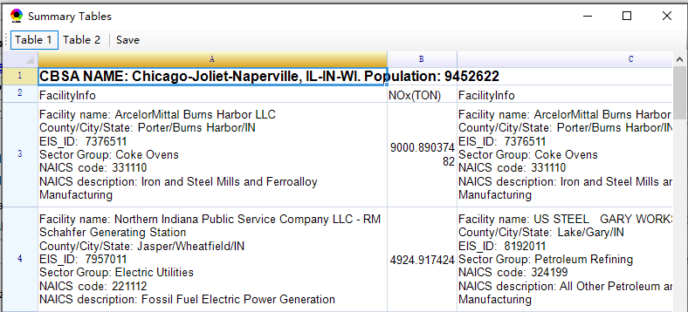
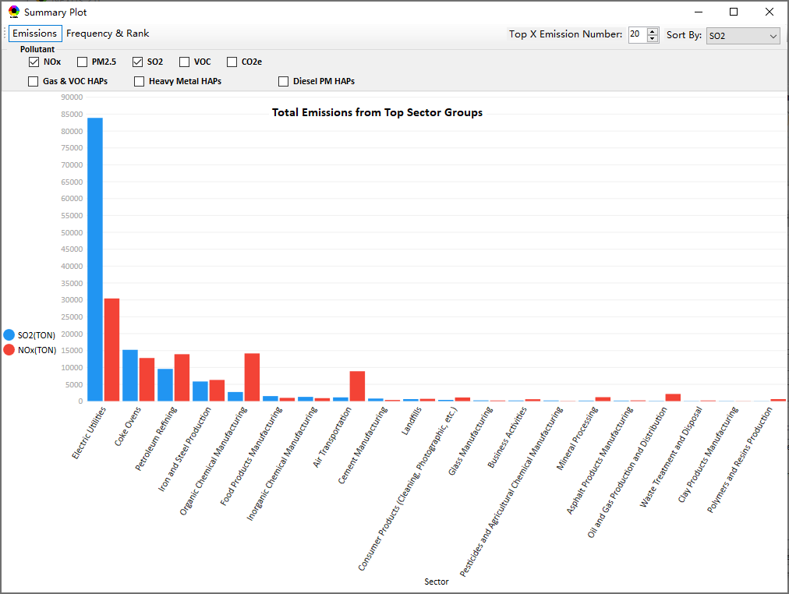
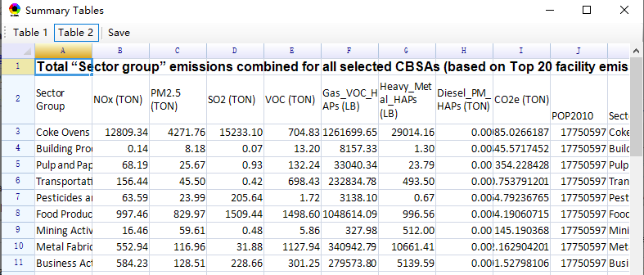
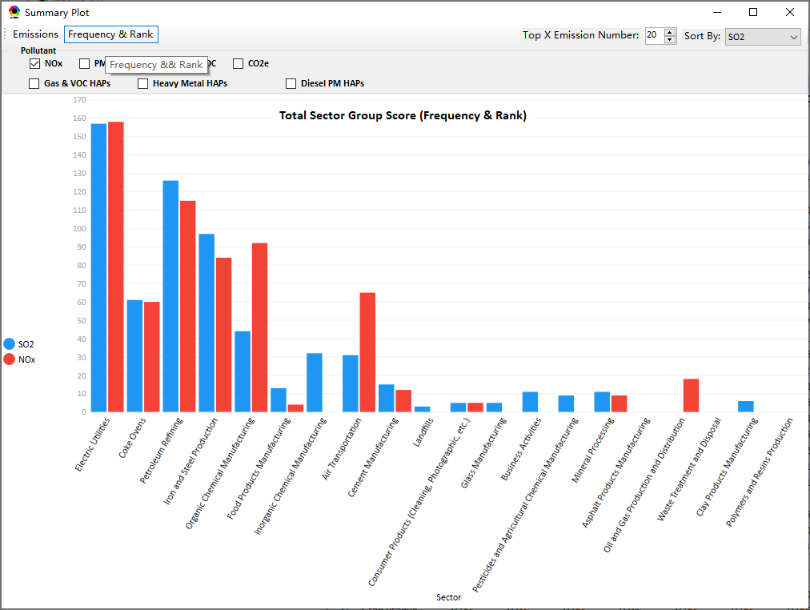
NEXUS Update: “Sector Emissions Summary”
Summary table
Summary plot
Emissions
Frequency & Rank
25

Slide 26
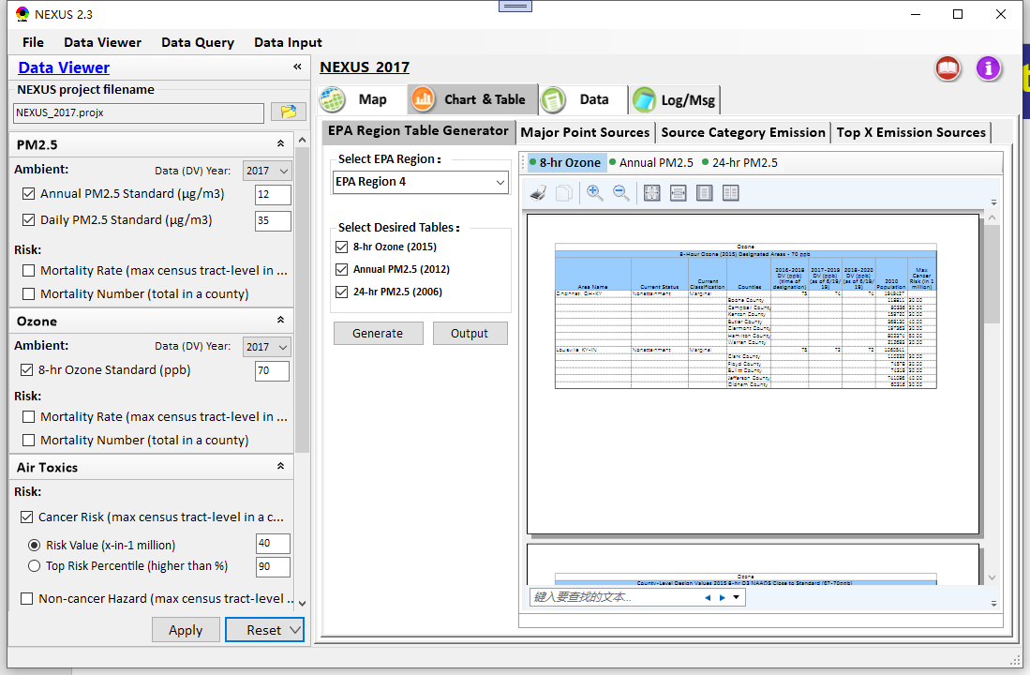
Data Viewer: EPA Region Table Generator
“EPA Region Table Generator” provides attainment status of O3 and PM2.5 and their DVs; also allows to select any EPA region based on data updated to 2020.
26

Slide 27

Data Viewer: Data Search & Filter
Click “+” to add filters; Click “x” to remove current filter;
Show specified records per page.
Click “Output data…” to output current page records or all records
27

Slide 28

Data Input Module: Data Preview
“Transparency” & “Open-Source”:
All NEXUS input/output data files are available under:
“This PC\Documents\My NEXUS files\Data (\Result)”
Check to use filter to query data
Select a table to view if there are multiple tables in the selected data source file
Click to change input data file
Click to view data
Click to run & save project
28

Slide 29

Data Query Module: Overlaying Map
Region Selection
Data Query Configuration
Data Query qualifier selection
Overlaying Map selection
29

Slide 30

Data Query Module: Configure Data Query
“Data Query Filter” allows to select “qualifiers” for query
“Data Query Preview” displays the selected “qualifiers” at the same time
30

Slide 31


Data Query Module: Attribute Table
Filter/search/export functions
Detachable “Attribute Table”
31

Slide 32


Data Query Module: Attribute Table
Click a “record” to link and display its location & info.
32

Slide 33
End
33

