Slide 1

“NEXUS 3.6”Beta Release Version:
Quick Tutorial
Download “NEXUS” tool: The “NEXUS 3.6” package (“NEXUS 3.6 Setup.exe” & “NEXUS 3.6 Data.exe”: run both “*.exe” files to install) can be downloaded at EPA’s internal shared drive:
“ctrl-click” to follow right link to download:
Note: Require software installation privilege or “Power Broker” (limited installation privilege) to install “NEXUS tool” at EPA’s PCs; Please check “This PC\Documents\My NEXUS files\data\* (\tool\*, \result\*, etc.)” to see if NEXUS tool & input dataset have been installed successfully. If feasible, please un-install previous version first to ensure a successful installation.
NEXUS 3.6
OAQPS NEXUS team, 3/02/2023
1

Slide 2
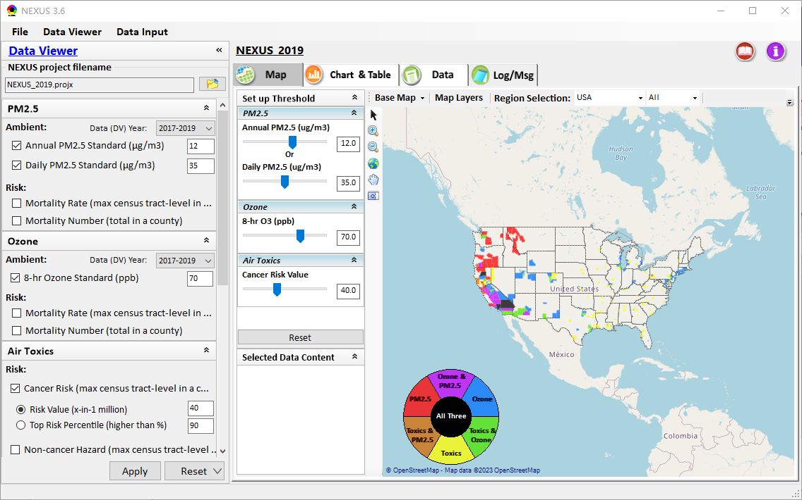
NEXUS Tool: On-line User’s Manual
NEXUS project file name.
The project year represents the risk (mortality/morbidity) and “PM2.5/O3 Nonattainment Areas” data together with the “DV Year” (3-year span) are from the specified year, e.g., 2019. Note that other data are provided with the latest year available (e.g., NEI emissions 2017)
Click “book” icon to launch “User’s manual”
Hot link to User’s manual’s “Data Viewer” chapter (same for “Data Input” module)
2

Slide 3
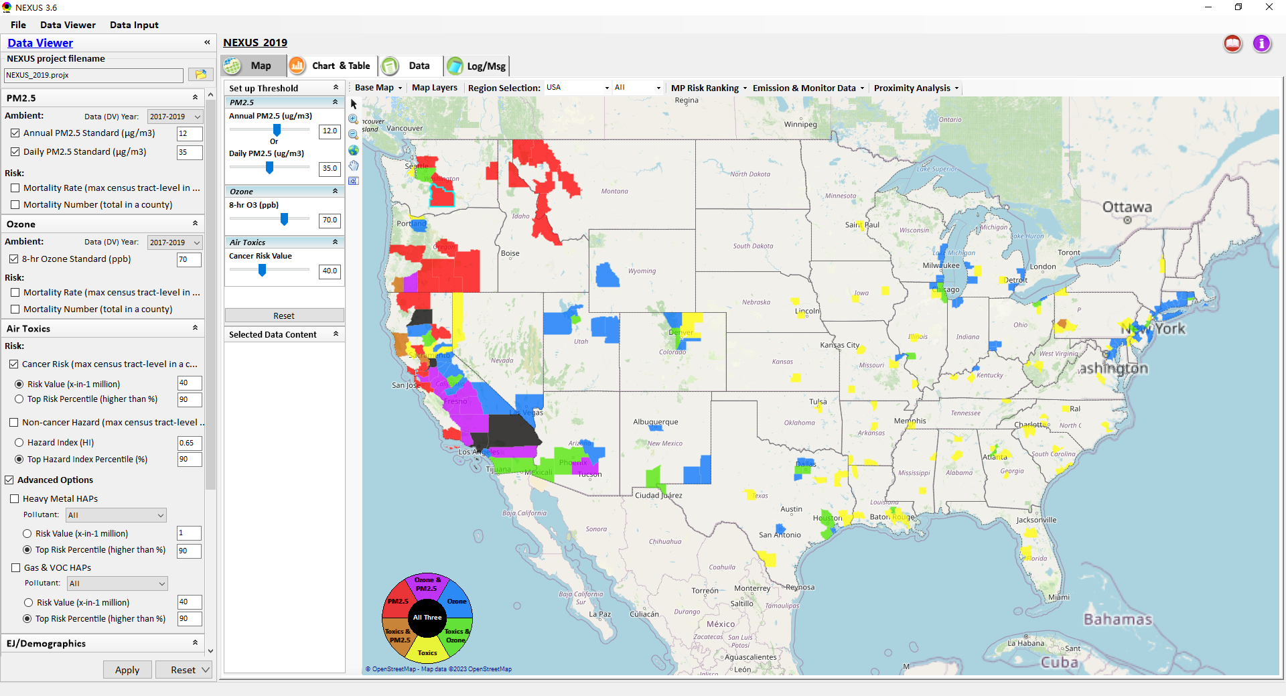
NEXUS Tool: Data Viewer Module
Click “File” to open or save a project
Switch between 2 key modules
Select desired ambient data (DV) year (2013 to 2020 in “3-year” period)
Select & adjust “Ambient” or “Risk” levels
“Advanced Option”: provide HAPs & species selections
3

Slide 4
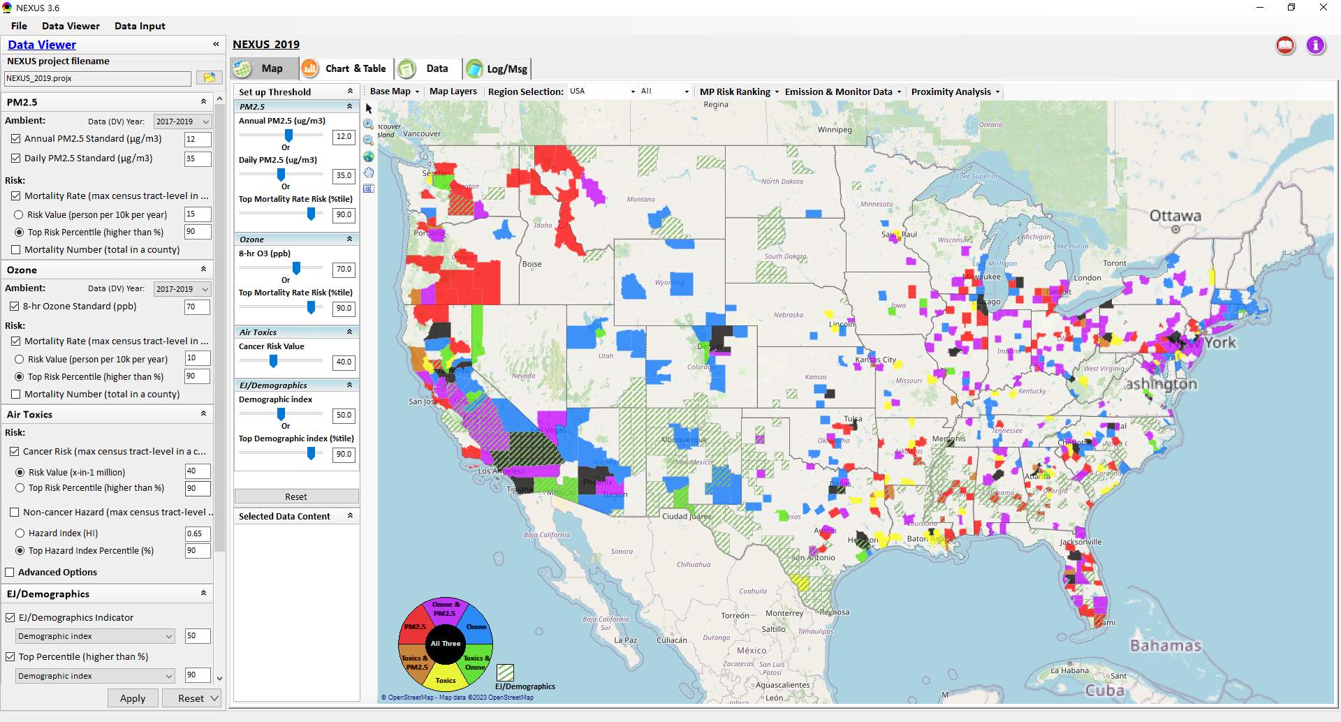
Data Viewer: “Apply” New Selections
“Check” boxes to add or remove “Ambient” and/or “Risk” selections
New selections will appear in “Slider bars” panel and map display
“Slider bars” allow to select & adjust “Ambient” and/or “Risk” threshold levels to display corresponding color map
“Apply” new selections
4

Slide 5

Data Viewer : EJ/Demographics Metric and Data
EJ/Demographic metric is displayed with “green dash” for counties exceeding selected threshold
5

Slide 6
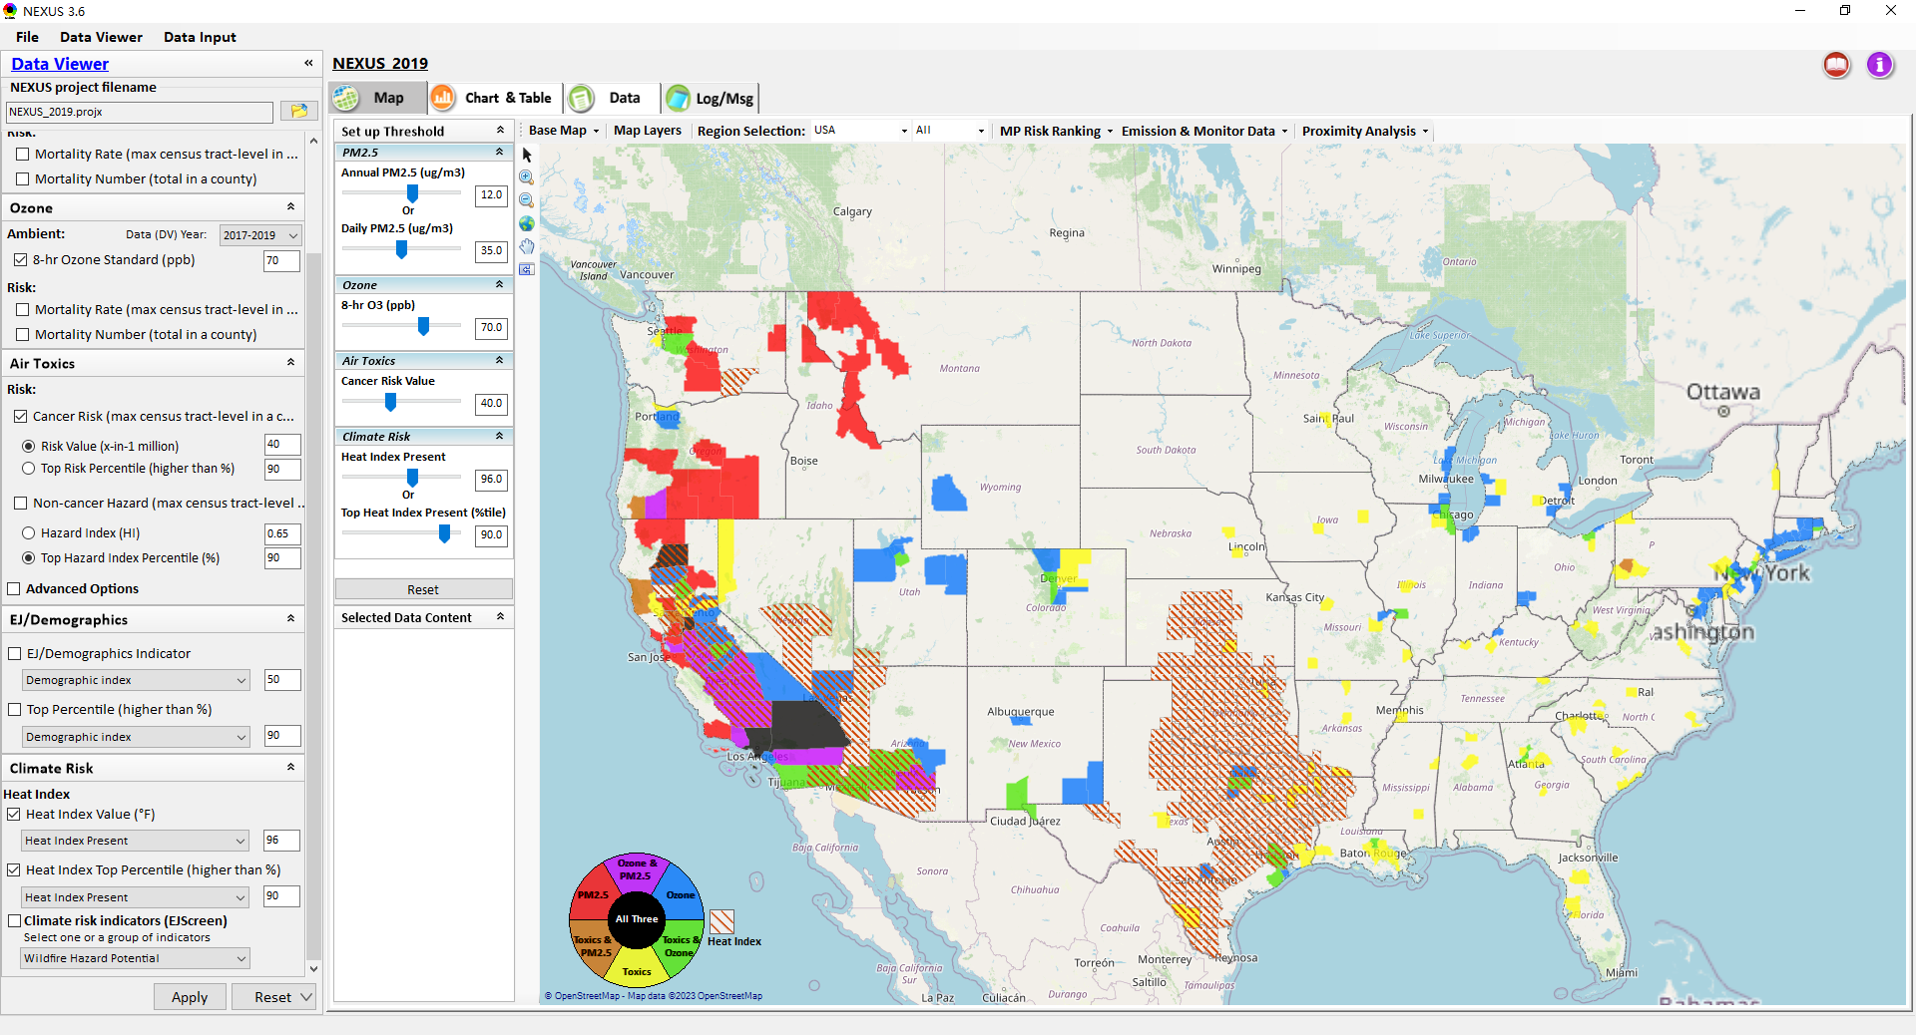
NEXUS Update: Climate Risk Metric and Data
Heat Index metric is displayed with “red dash” for counties exceeding selected threshold
6

Slide 7
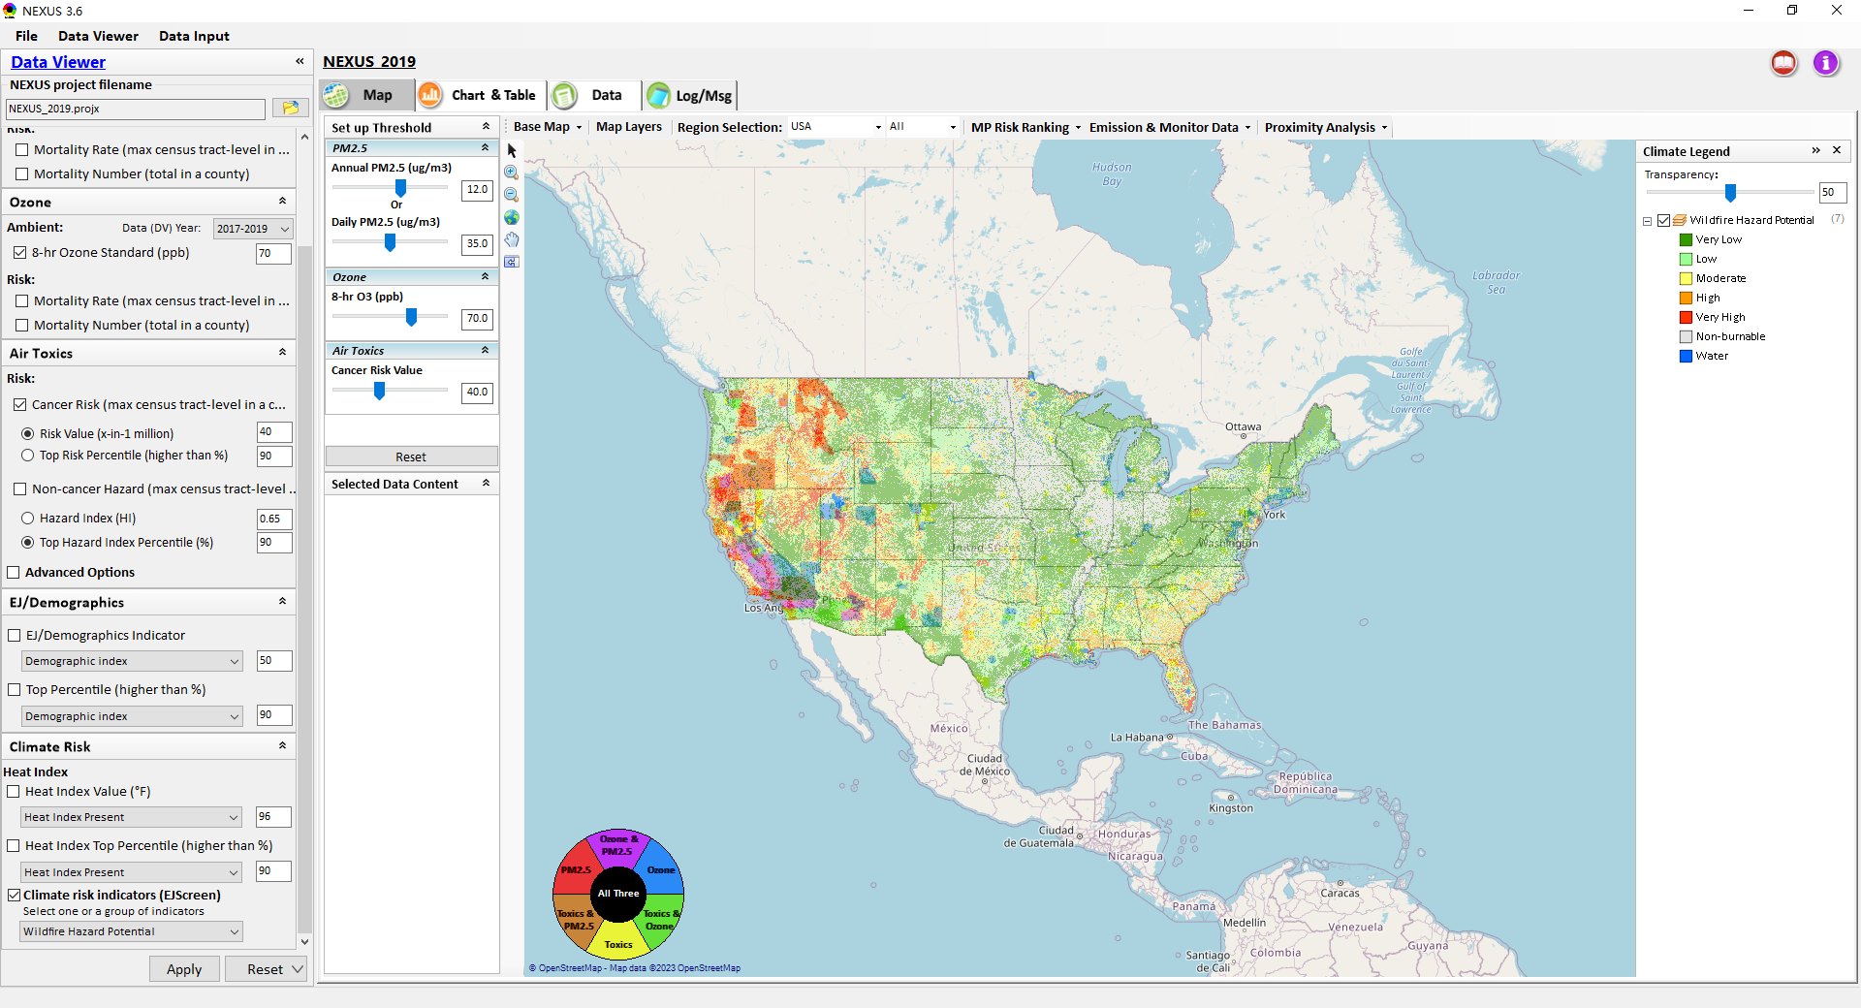
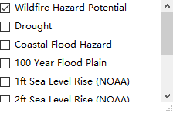
NEXUS Update: Climate risk indicators (EJScreen)
Move the Slider to set the transparency for the selected “Climate risk indicators”
The legend of “Climate risk indicators (EJScreen)” will be displayed in the panel
1. Check the “Climate risk indicators”
2. Select one or a group of indicators
7

Slide 8
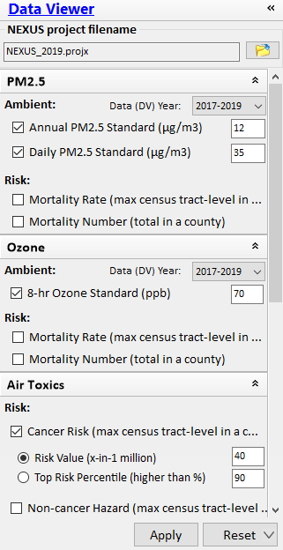
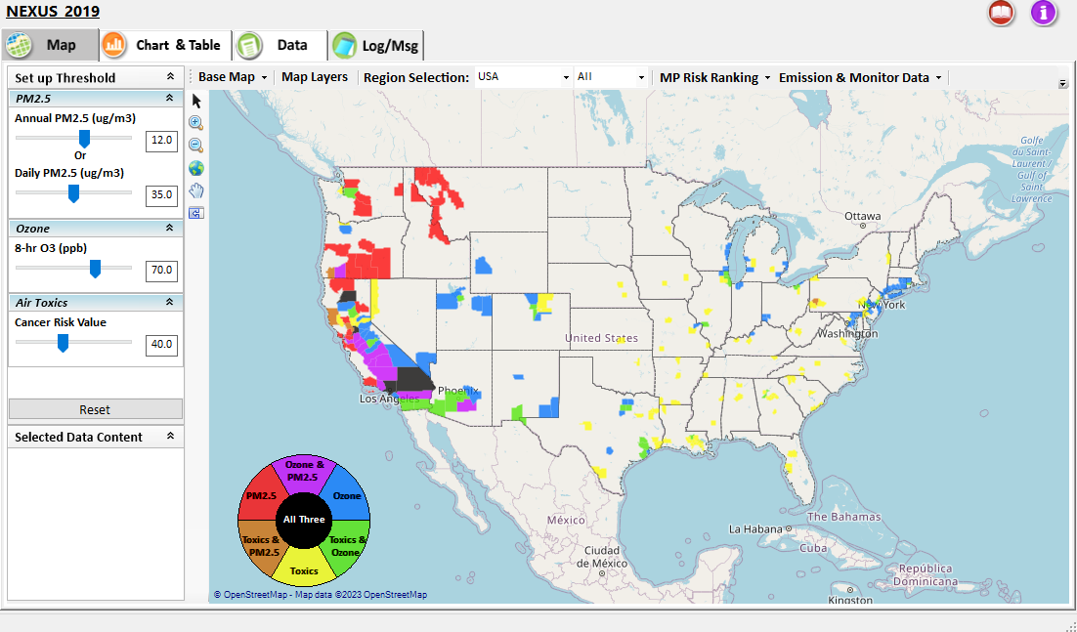
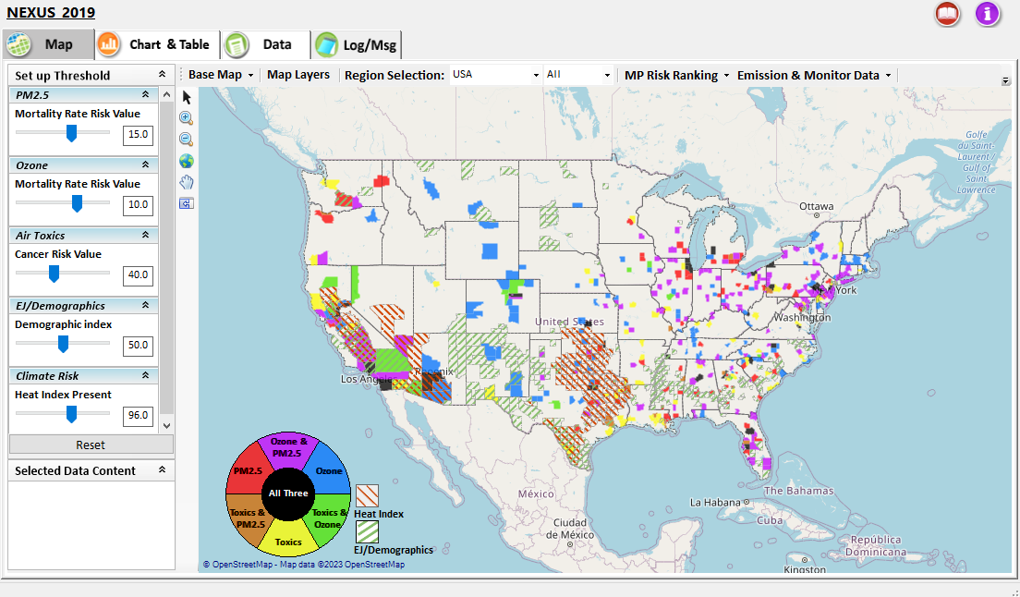
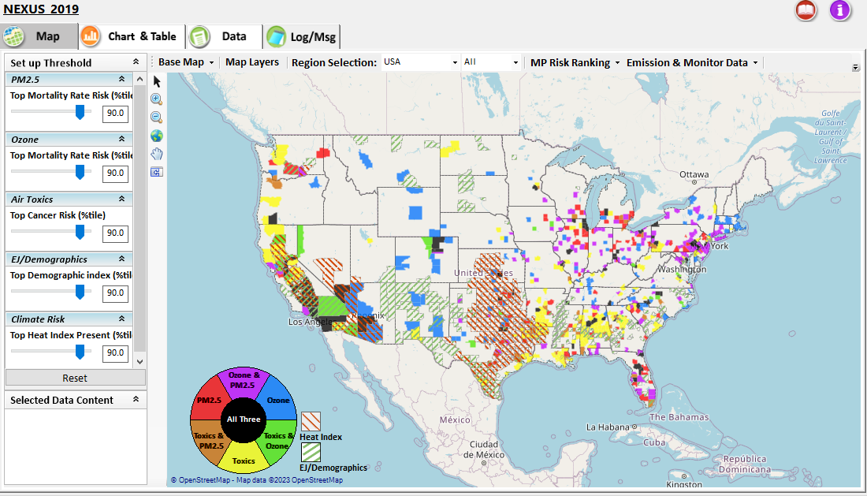
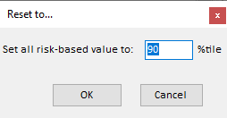

Data Viewer: “Reset” New Selections
default configuration
risk-based value
risk-based in %tile
“Reset” new selections
risk-based in desired %tile
8

Slide 9
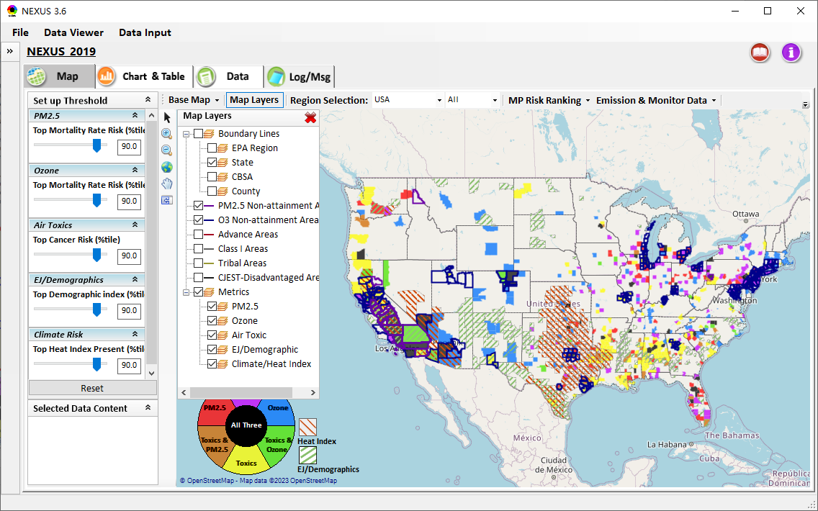
Data Viewer Module: Map Layers menu
Click “X” to close “Map Layers” menu
“Map Layers” menu: Provide (show/hide) map overlaps of various areas, AQ metrics and boundary lines
9

Slide 10
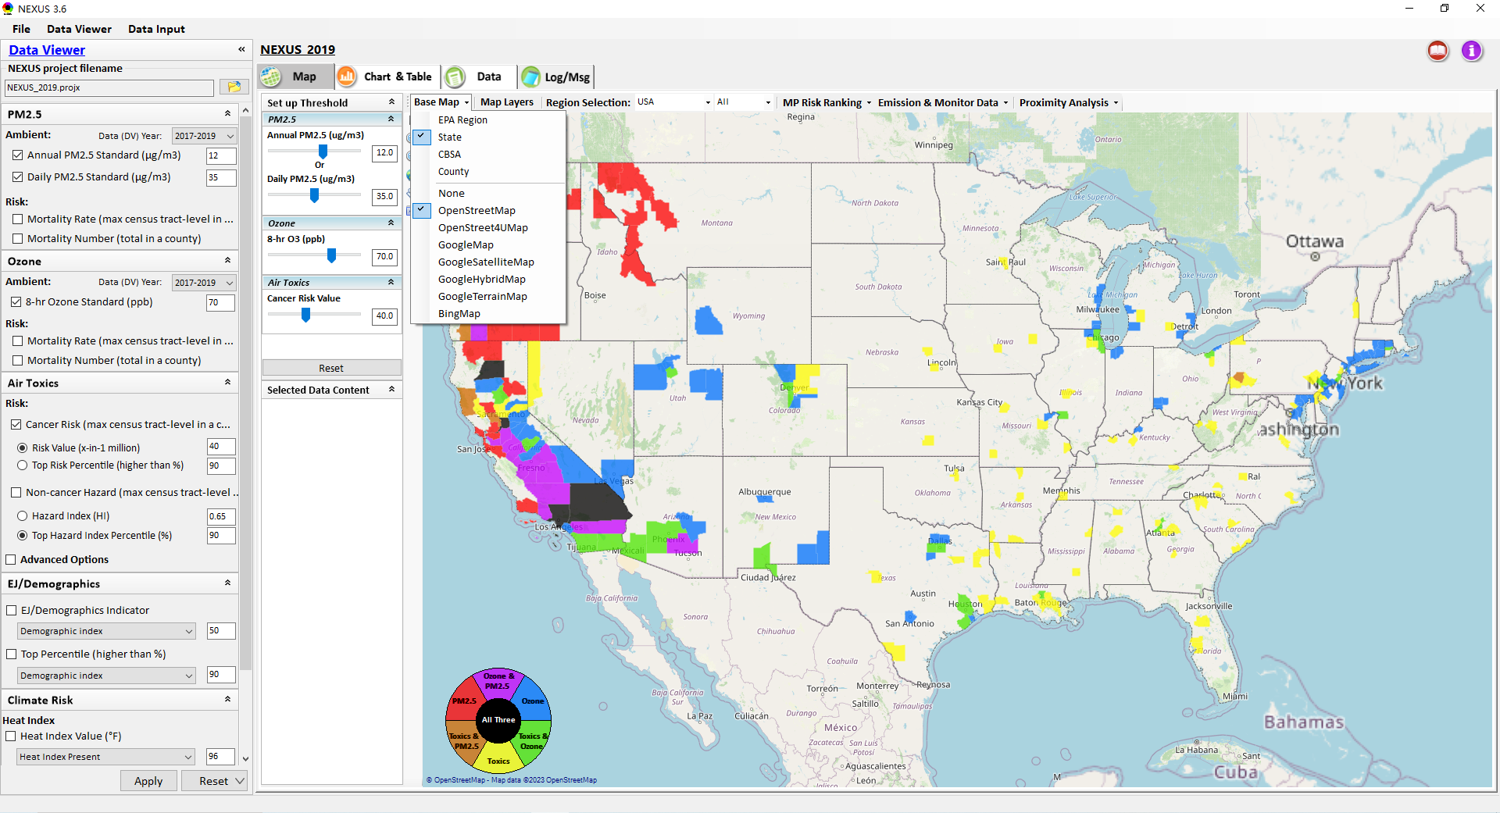
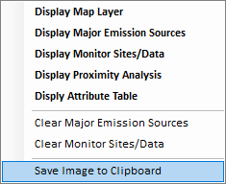
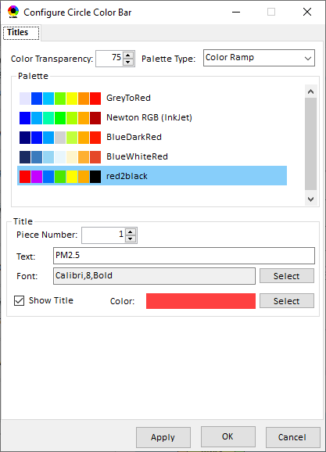
Data Viewer Module: Configure Base Map & Color
“Base Map” menu: Change boundary lines and background map (e.g., “Google Map”)
“Right-click” map to save map image
Click “color map” to change color & transparency
10

Slide 11
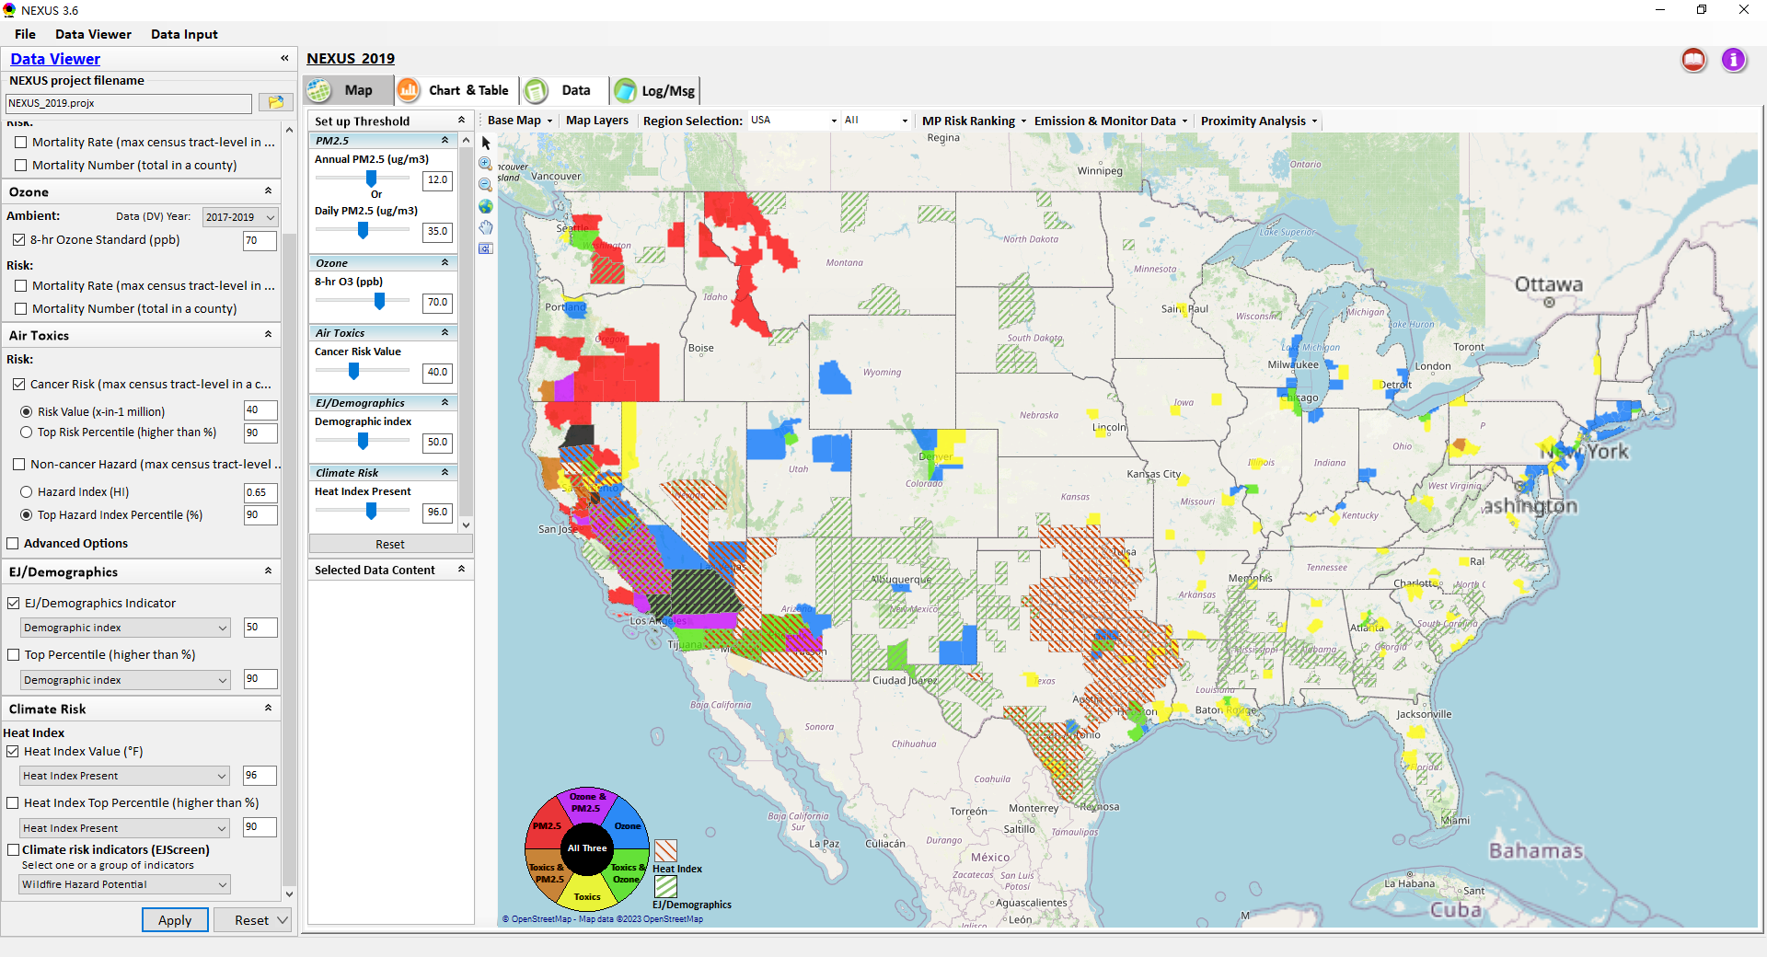
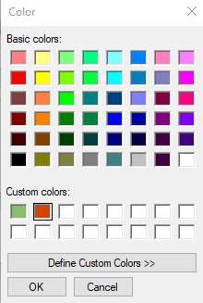
NEXUS Update: Configure Base Map & Color
2. Choose the color for the legend, and then click the “OK” button
1. Click “Heat Index” or “EJ/Demographics” to change the color of legend
11

Slide 12
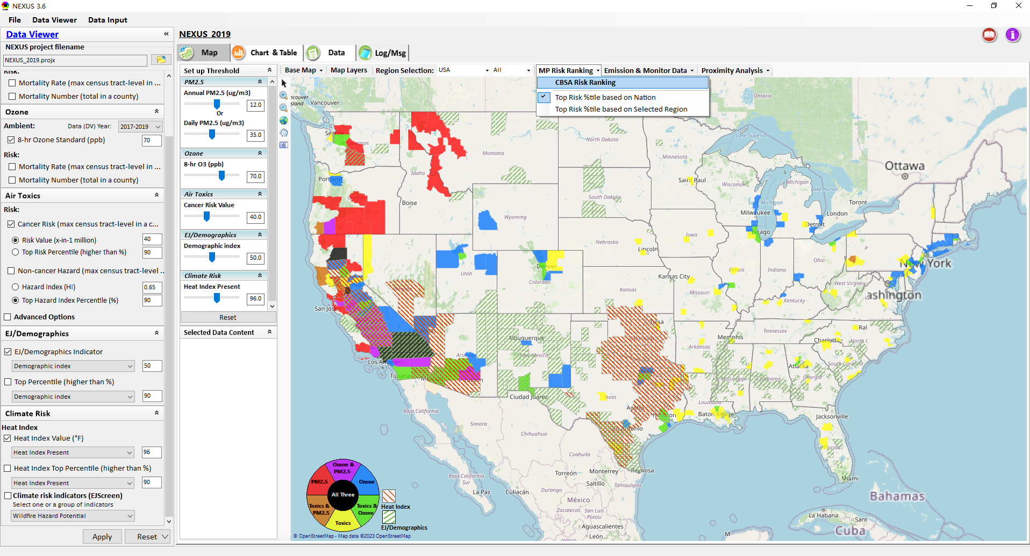
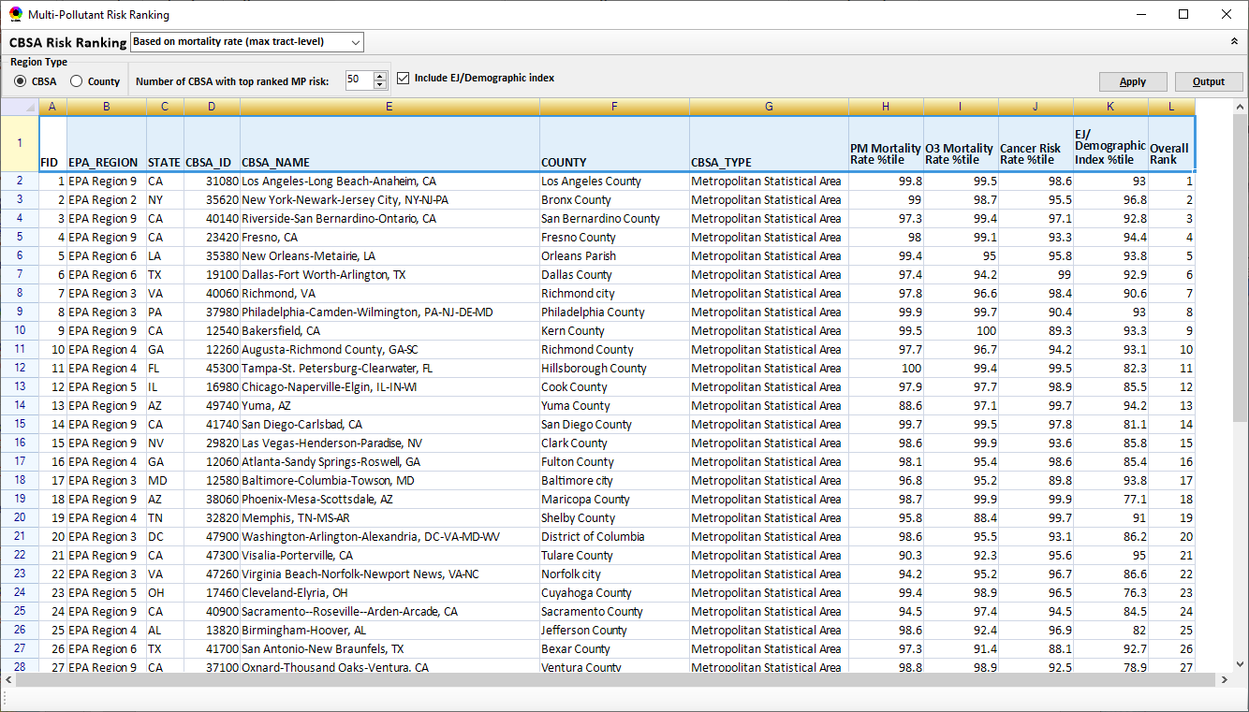
Data Viewer Module: MP Risk Ranking
Check box to include EJ/demographic index as part of CBSA ranking
Click “CBSA Risk Ranking” to provide MP risk ranking by CBSA or County
12

Slide 13
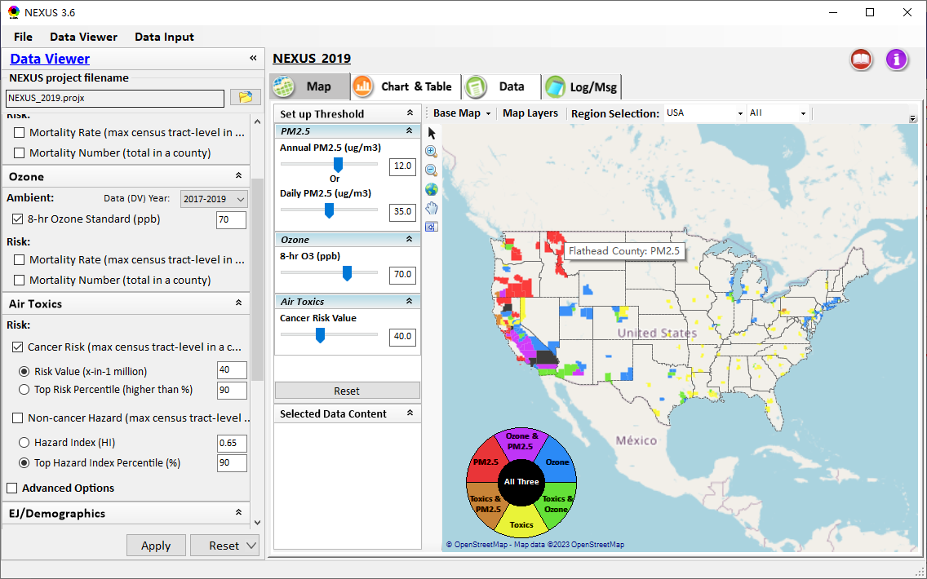
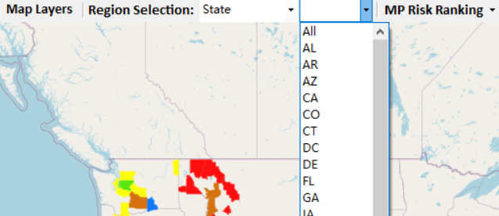
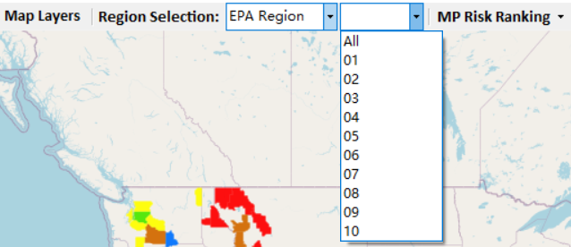
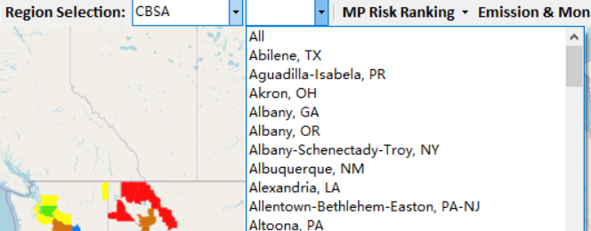
Data Viewer: “Region Selection”
Allow to select “EPA regions”, “States”, or “CBSA”
13

Slide 14
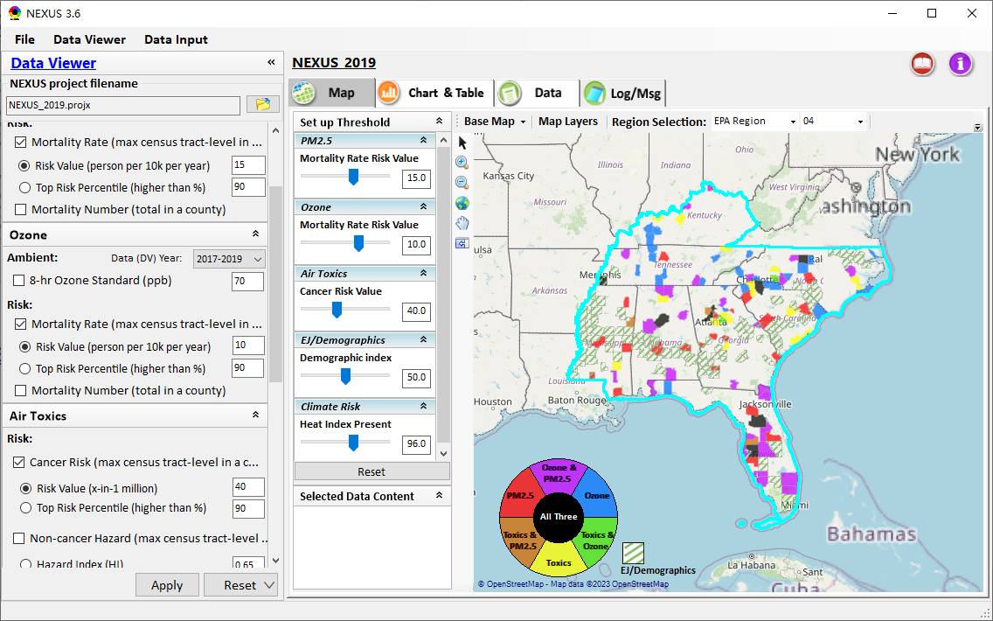
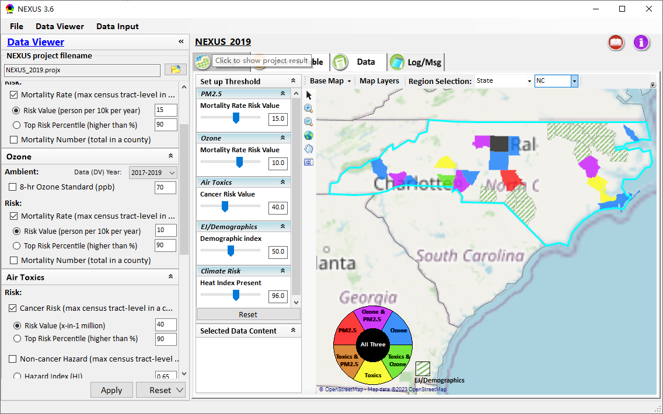
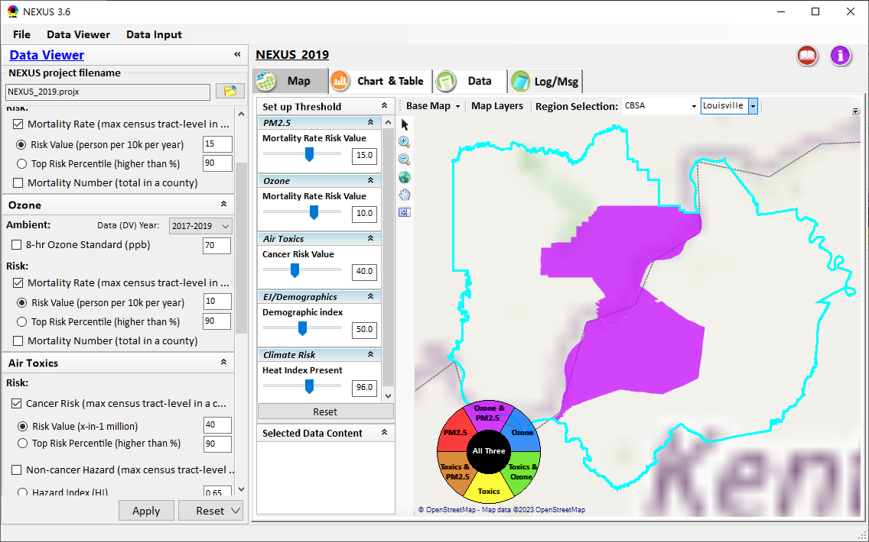
Data Viewer: Select EPA Region/State/CBSA
Examples:
EPA Region 4
State: NC
Louisville CBSA (KY/IN)
14

Slide 15
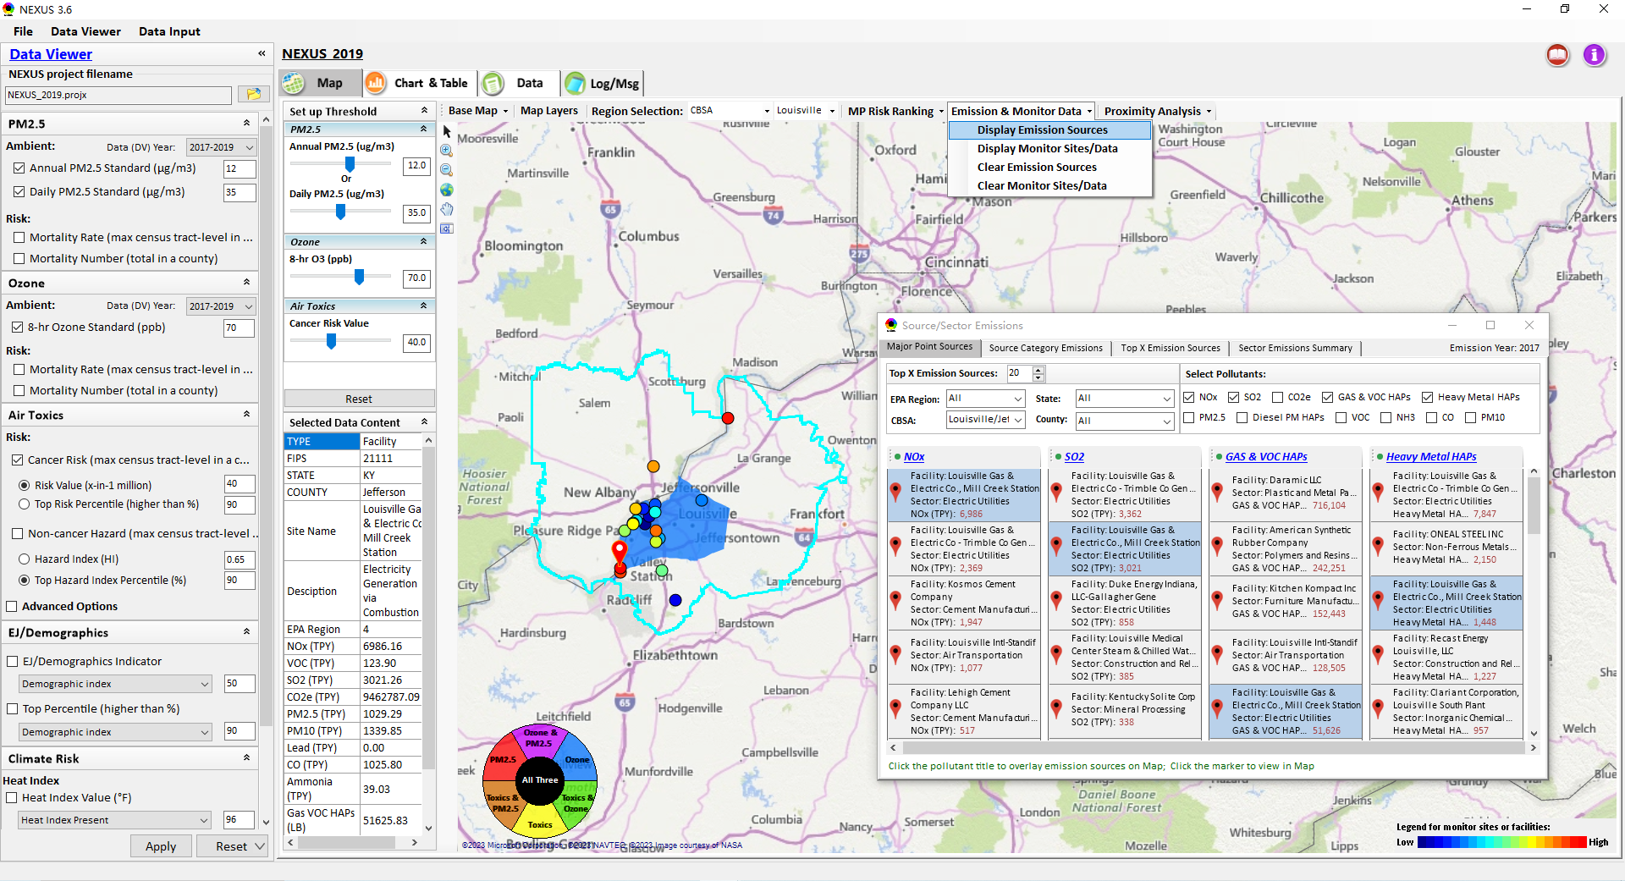
Data Viewer: Major Emission Sources
Click “Display Emission Sources” tab (or “right-click”) to display emission sources and launch new window
Click any “facility” to link & display source location and emitted pollutants information. Same facility emitting various pollutants can be identified with the same highlighted color.
15

Slide 16
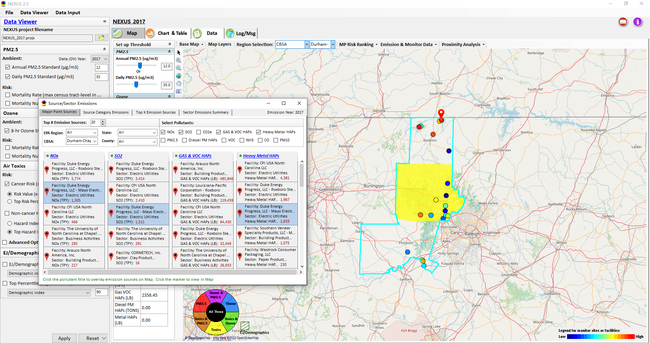
Data Viewer: Major Emission Sources
Allow to scroll down to CBSA-level (e.g., Durham CH CBSA ) or County-level
Durham CH CBSA
Emissions ranking by “color” of circles from red (higher) to blue (lower)
Color Legend for facilities emissions
16

Slide 17
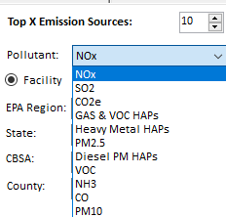
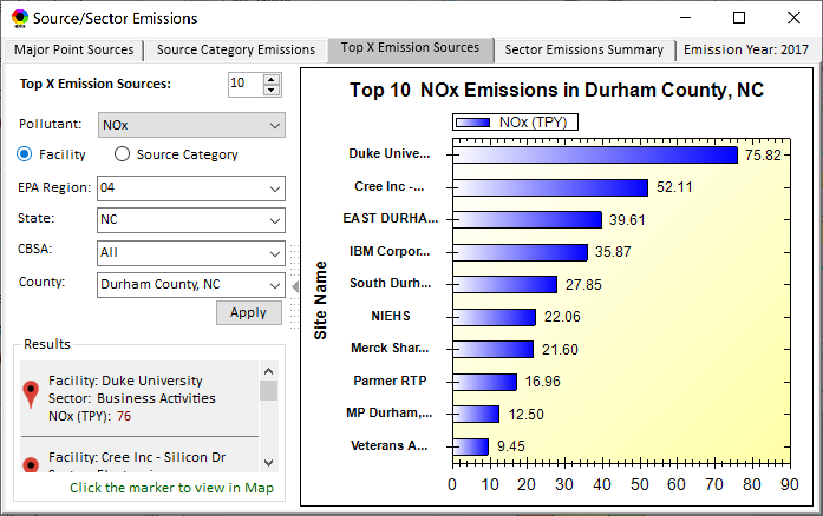
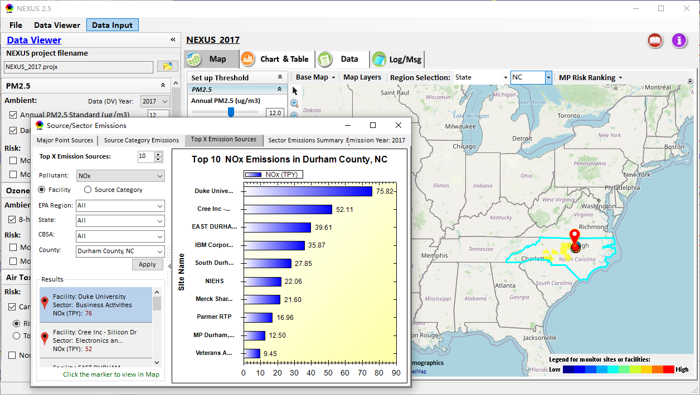
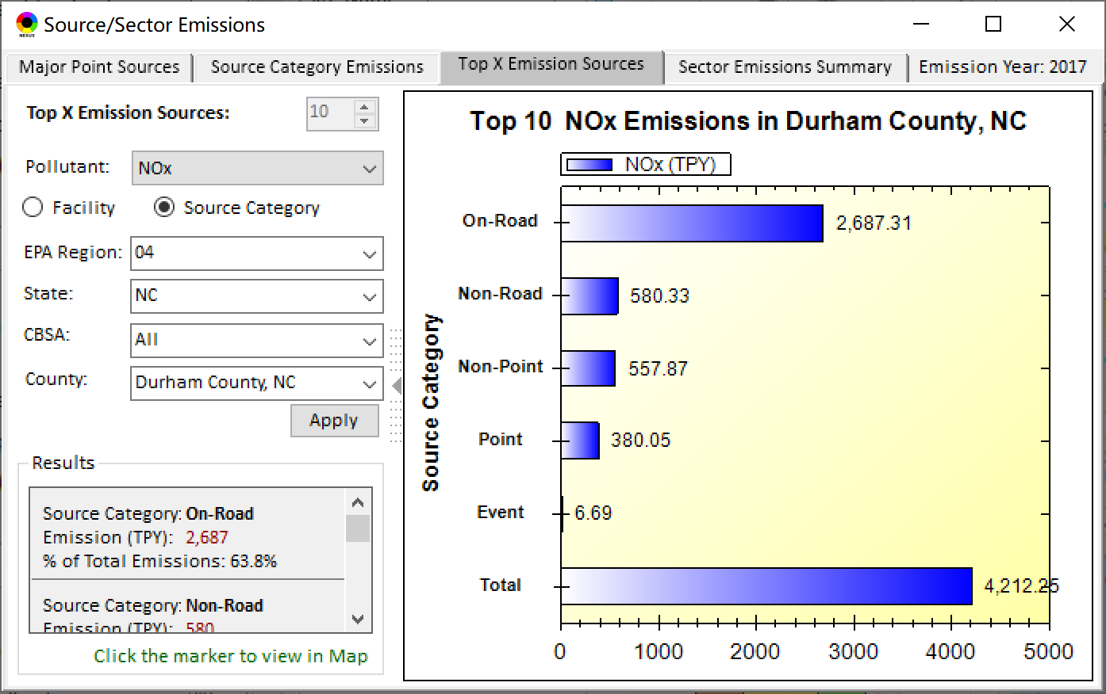
Data Viewer: Top “x” Emission Sources
Provide selection of Facility & Source Category
Provide selection of Facility or Source Category
Durham county, NC
17

Slide 18
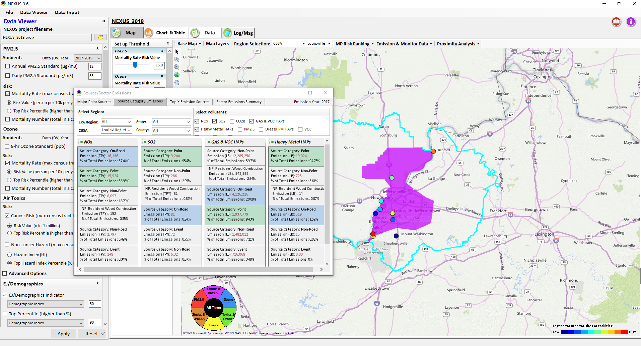
Data Viewer: “Source Category Emissions”
“Source Category Emissions” module provide five source categories, including “Point”, “Non-Point”, “On-Road”, “Non-Road”, and “Event” emissions for the selected region, CBSA, or county.
For “Non-Point”, including Resident Wood Combustion (RWC) emissions.
18

Slide 19
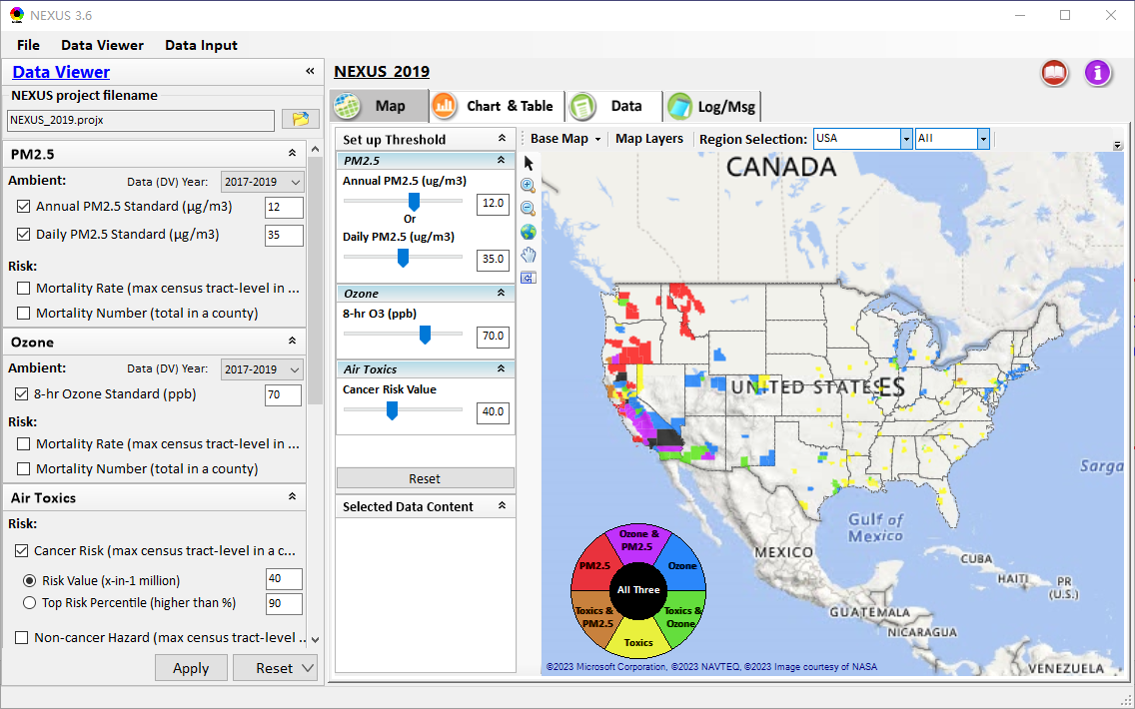
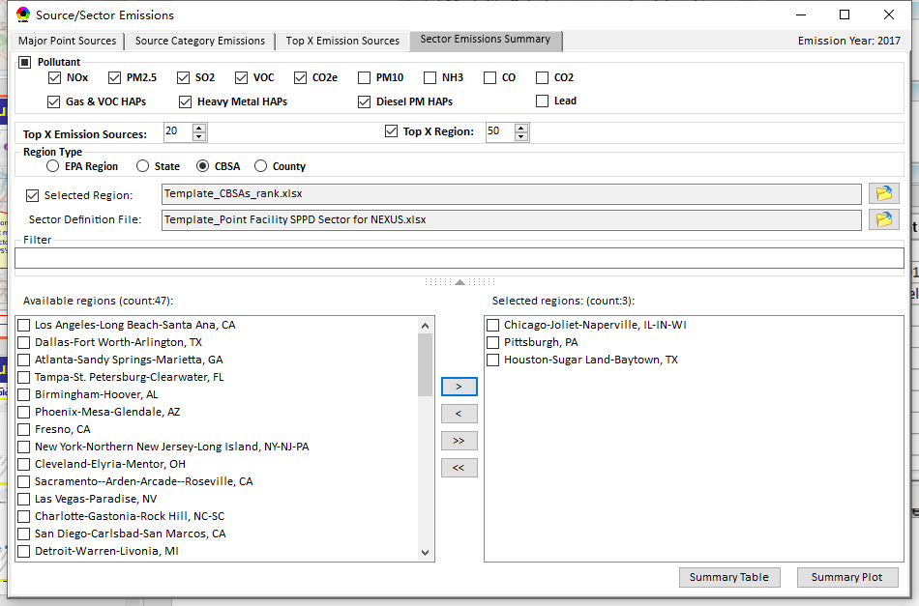
Data Viewer: “Sector Emissions Summary”
“Sector Emission Summary” function allow to select major CBSAs and provides source and sector emissions summary to support “Sector Prioritization” effort
19

Slide 20
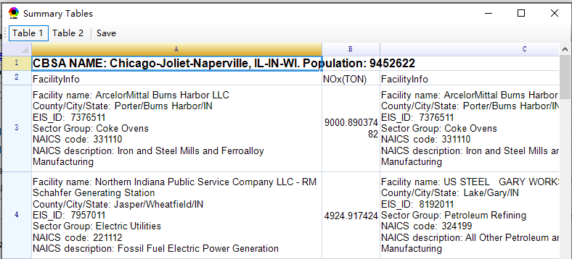
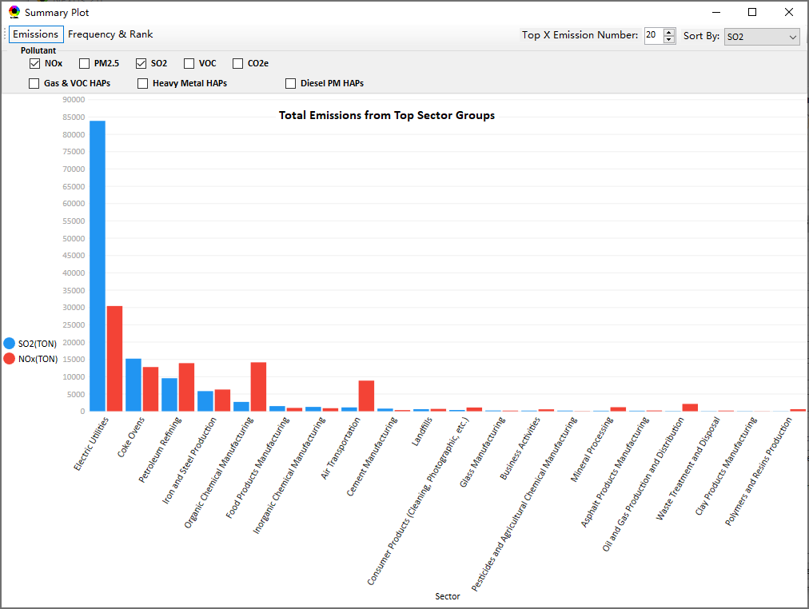
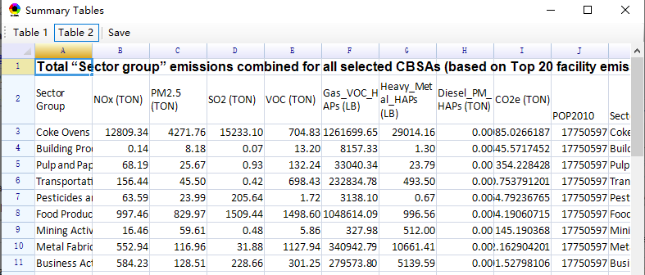
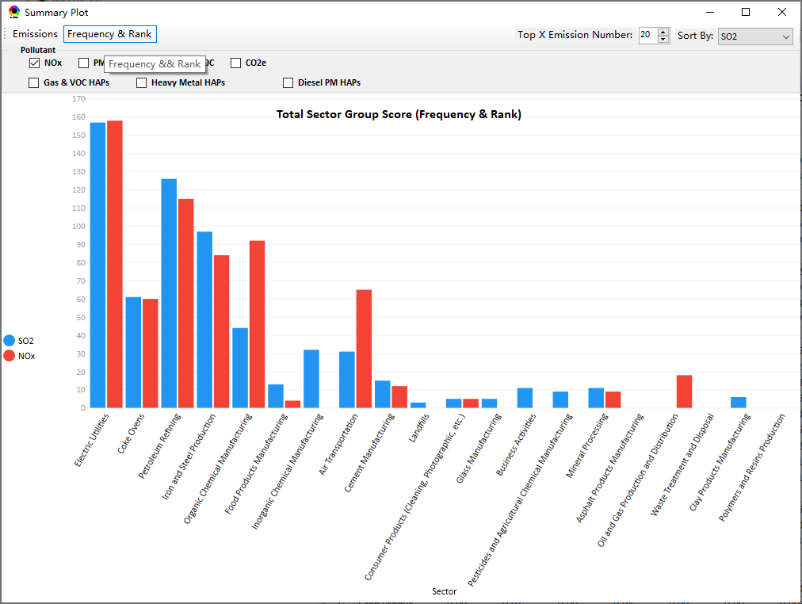
Data Viewer: “Sector Emissions Summary”
Summary table
Summary plot
Emissions
Frequency & Rank
20

Slide 21
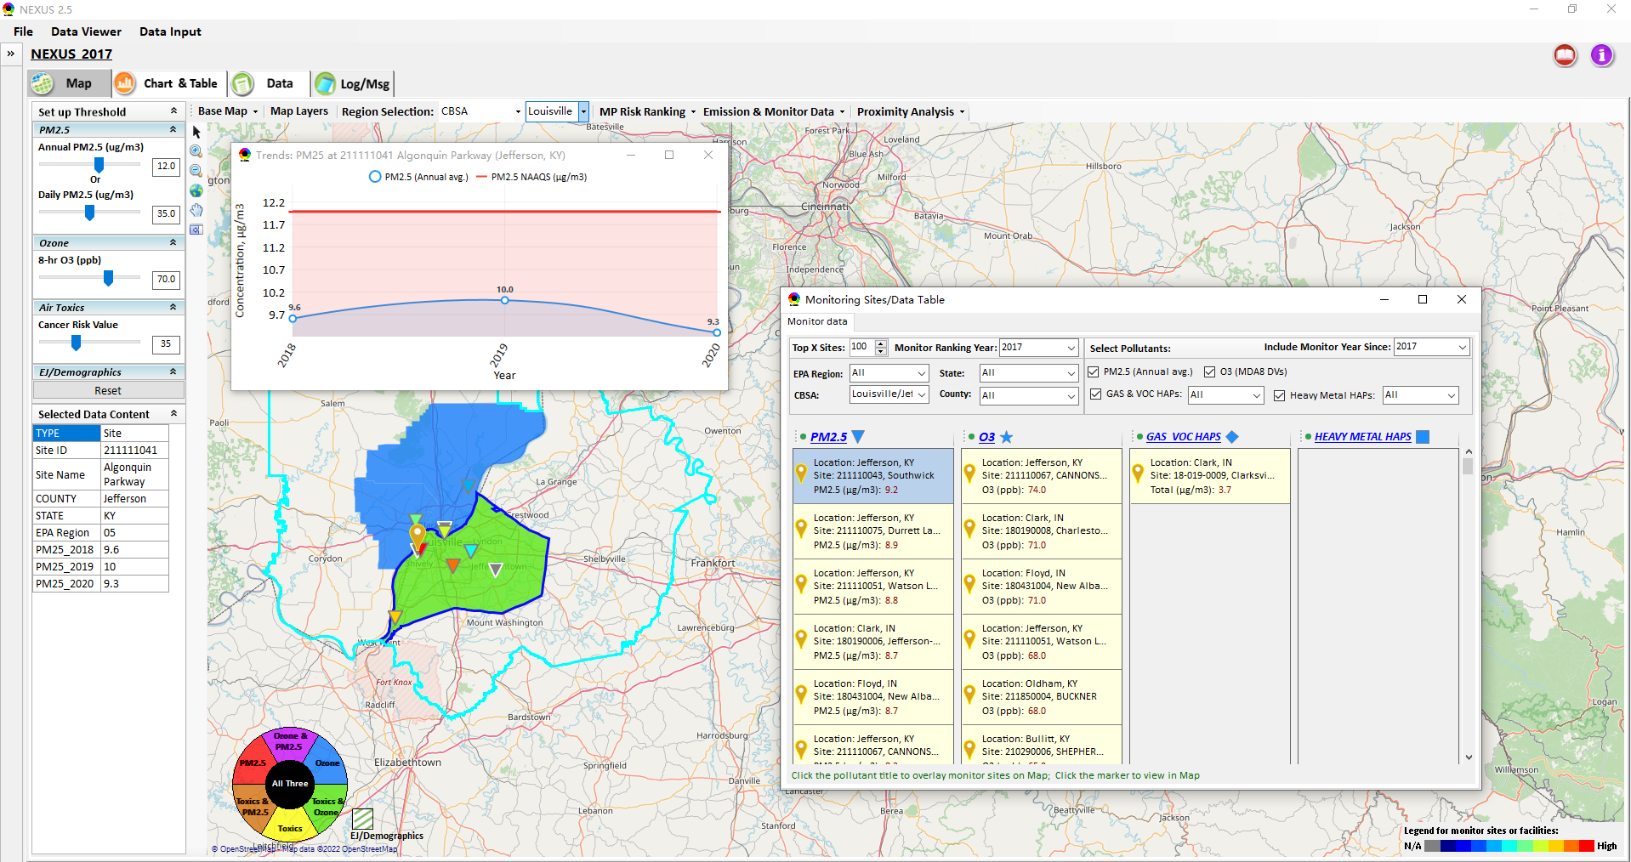
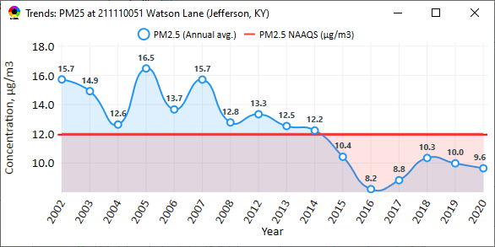
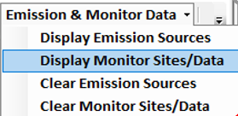
Data Viewer : “Monitoring Data/Sites”
Click menu (or right-click) to display “Monitor Sites/Data”
List the monitor sites by ranking the data based on selected year
AQ trend
Include only those monitor sites with data since selected year
Monitor Site/Data
Click to display
AQ trend at monitor site
Use different symbol to display each pollutant’s “monitoring sites” e.g., PM_{2.5} (triangle), O₃ (star), etc.
Click to select monitor site & pollutant
Color Legend for monitor sites
21

Slide 22
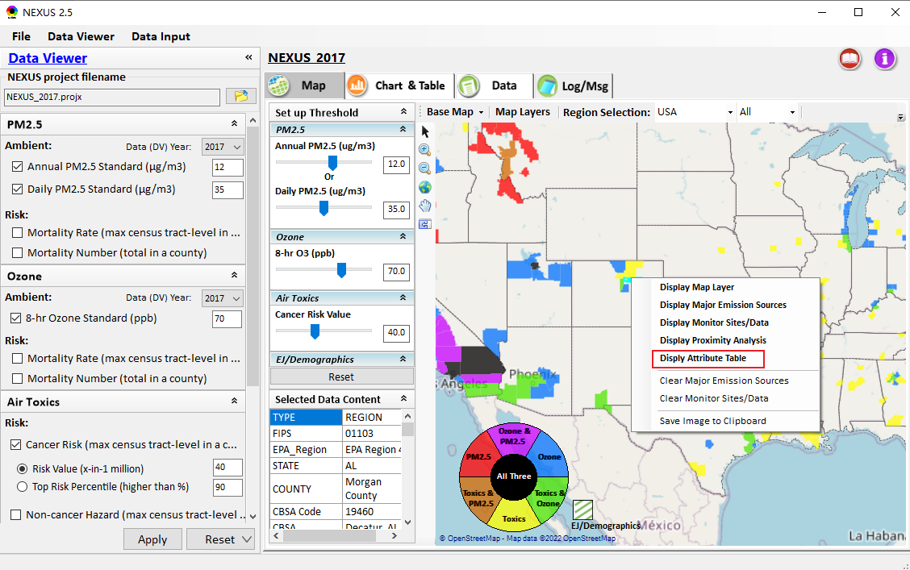
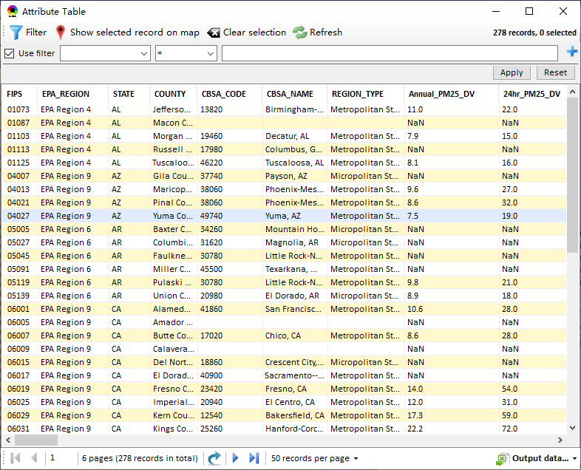
Data Viewer : “Attribute Table” (1)
“Attribute Table” provides information of “counties” displayed. This table will display “census tract” information under “Proximity analysis” module.
“Right-click” map to select “Display Attribute Table ” to launch “Attribute Table”
22

Slide 23
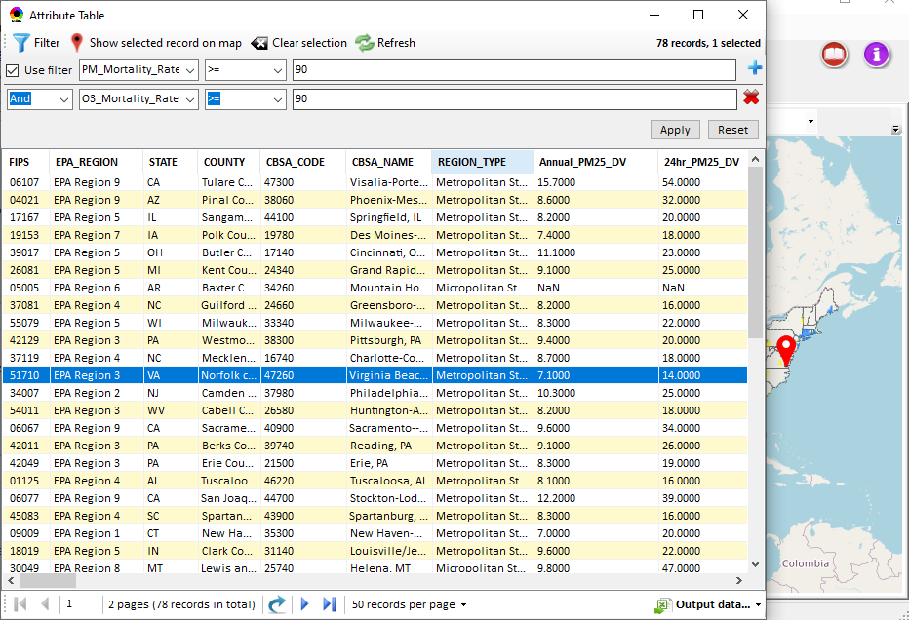
Data Viewer : “Attribute Table” (2)
Provide “filter/search/export functions
Click “+” to add filters; Click “x” to remove current filter;
Click to show/hide Filter settings
Click to show selected record on map
Click a “record” to link and display its location & info.
Click “Reset” to clear all filter criterias
Show specified records per page.
Click to output data as Excel file
23

Slide 24
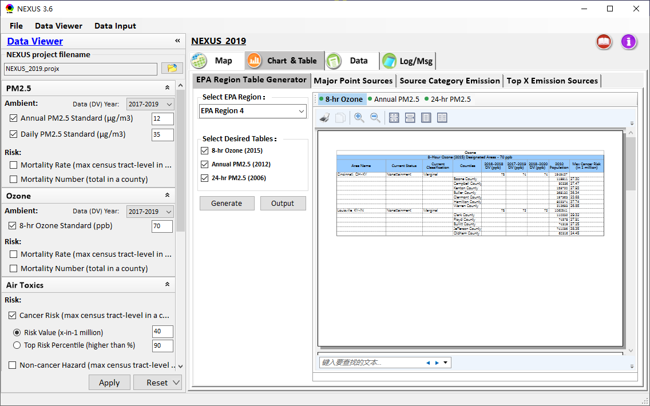
Data Viewer: EPA Region Table Generator
“EPA Region Table Generator” provides attainment status of O3 and PM2.5 and their DVs; also allows to select any EPA region based on data updated to 2020.
24

Slide 25
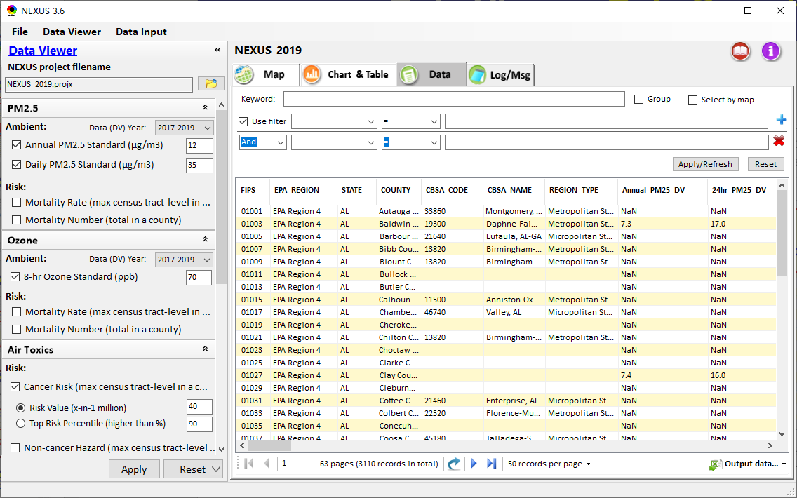
Data Viewer: Data Search & Filter
Click “+” to add filters; Click “x” to remove current filter;
Click the “Select by map” to get the information of counties which are displayed on “Map” module
Show specified records per page.
Click “Output data…” to output current page records or all records
25

Slide 26
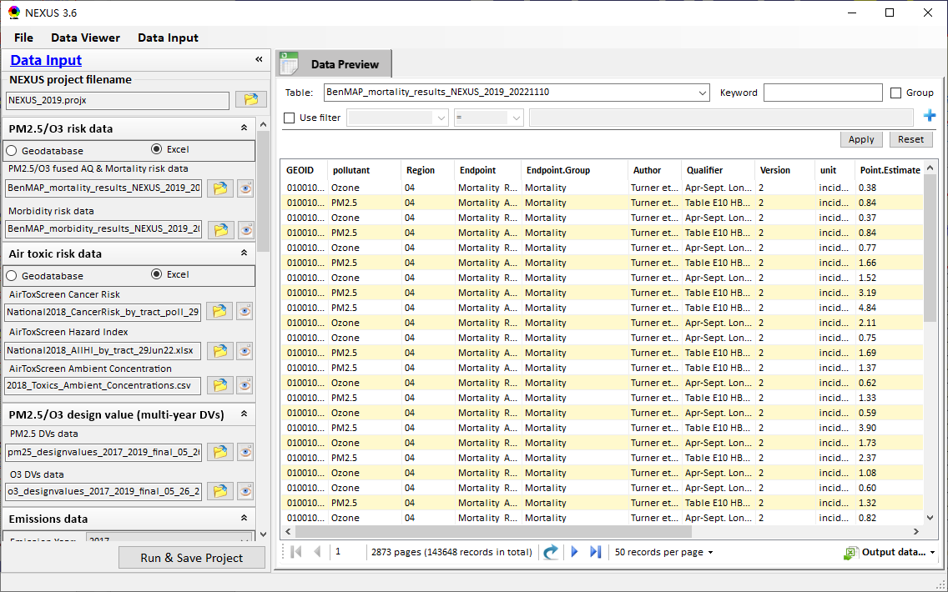
Data Input Module: Data Preview
“Transparency” & “Open-Source”:
All NEXUS input/output data files are available under:
“This PC\Documents\My NEXUS files\Data (\Result)”
Check to use filter to query data
Select a table to view if there are multiple tables in the selected data source file
Click to change input data file
Click to view data
Click to run & save project
26

Slide 27
Proximity Analysis
Module
(Census tract-level)
27

Slide 28
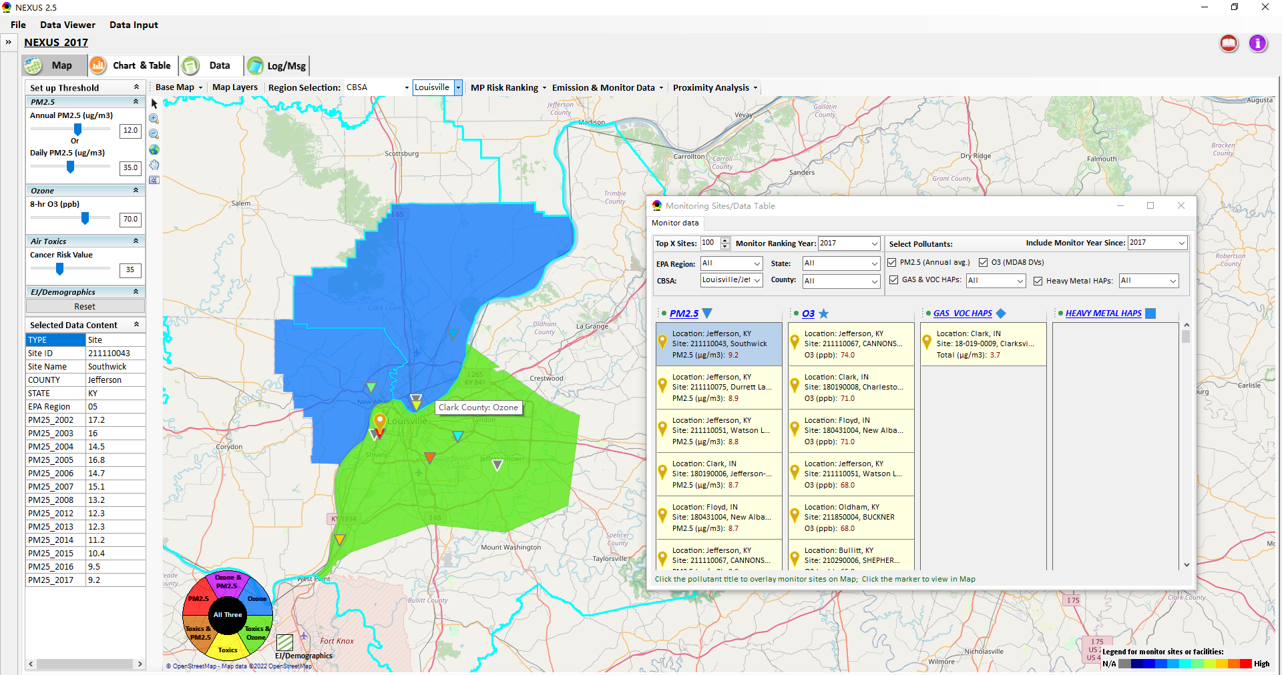
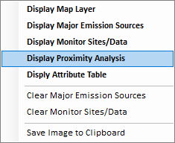
Two ways navigate to Proximity Analysis Module
Click any monitor site, facility or county, and then “right-click” to select “Display Proximity Analysis”.
Or double click any monitor site or facility to launch “Proximity Analysis” module.
28

Slide 29

Proximity Analysis Module: Overlaying Map
“Set up Threshold” panel (similar to Data Viewer module) allows to identity those geographic areas exceeding the selected thresholds.
Check/un-check to display/hide overlaying map of selected metrics
Allow to select AQ mortality or morbidity risks, AQ concentration and EJ/demographic indicators and display overlaying map.
29

Slide 30
Proximity Analysis Module: Overlaying Map
Click “Reset” button to reset all values to default (or to a specified %tile if all indicators are selected in %tile)
Provide a “toggle” choice to select “Risk %tile” or “Risk value”
30

Slide 31

NEXUS Update: Overlaying Climate Risk Map
Move the Slider to set the transparency of the selected “Climate risk indicators”, or input the value of interest in the textbox
Support to click any node to set the transparency of climate risk layer
Select one or a group of indicators
31

Slide 32


Proximity Analysis Module: Configure Color & Transparency
Move “Slider bar” to select desired “Radius of analysis”
Click any “color tile” to configure color legend & transparency
32

Slide 33

NEXUS Update: Map Layers menu
Click “X” to close “Map Layers” menu
“Map Layers” menu: Provide (show/hide) map overlaps of “CJEST-Disadvantaged Areas”, “PM2.5 Non-attainment Areas”, etc.
33

Slide 34


Proximity Analysis Module: Summary Plot & Summary Table (1)
Create “Summary Plot” and “Summary Table” for a selected census tract, monitor site or emitting facility
Summary Plot
Summary Table
34

Slide 35


Proximity Analysis Module: Summary Plot & Summary Table (2)
Summary table
Summary plot
Set “Radius of analysis” and threshold of air toxics to show summary results for selected site(s) within radius
Click to select the desired scale of highlighted numbers
Click “Output” button to export summary table to an Excel file (*.xlsx)
List top 6 risk drivers within radius of sites
Select one or more indicators to plot summary results for selected site(s) within radius, county/CBSA/State/EPA Region and Nation avg.
35

Slide 36






NEXUS Update: “Select Sites” Functions (1)
Click “Select Sites” to select one or a group of monitor sites, facilities, CJEST-Disadvantaged communities ,census tracts, or user-defined locations under “Select Sites” pop-up window
36

Slide 37




Proximity Analysis Module: “Select Sites” Functions (2)
Click the “Output” button to export to an Excel file.
Include only census tracts falling within the area of specified radius, with an area ratio larger than x% (10% by default)
Select all
Click the “Create individual Sites” or “Create National Sites Table” to provide proximity analysis for individual sites
National & State avg. table
National table for all selected individual sites
37

Slide 38


Proximity Analysis Module: “Select Sites” Functions (3)
Configure
color legend:
1. Click to select the desired scale of highlighted numbers
2. Set max. & min. values and then click the “Rebuild” button to rebuild the color legend
3. Customize the numerical range for each color legend
Check/uncheck to display/ hide highlighted colors
4. Click “Apply” or “OK” button to apply new setting
38

Slide 39




Proximity Analysis Module: “Group” Summary Plot & Table
Summary plot & table for a group of census tracts, monitor sites, facilities or locations (latitude/longitude)
Summary table
①Click “Select Sites”
④Click “Summary Table” or “Summary Plot”
Select sites
② Select a group of sites
③Click “Apply”
Summary Plot
39

Slide 40


Proximity Analysis Module: Display Site information
Click a facility or monitoring site or a census tract to show the detail information
40

Slide 41
NEXUS 3.6
Quick Tutorial Slides
End
41

