Slide 1
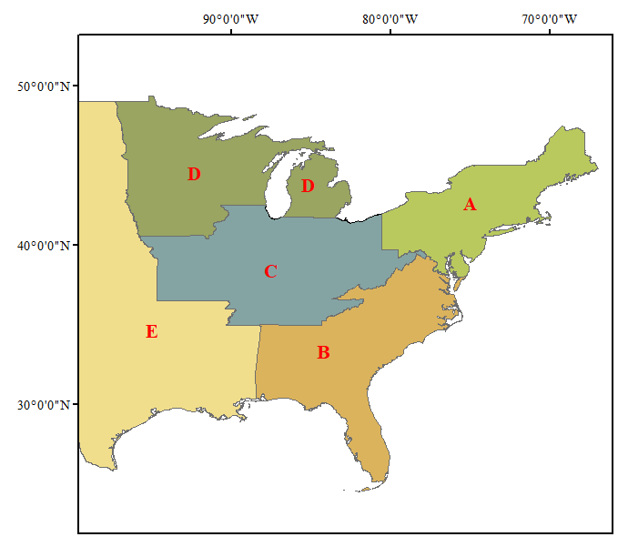
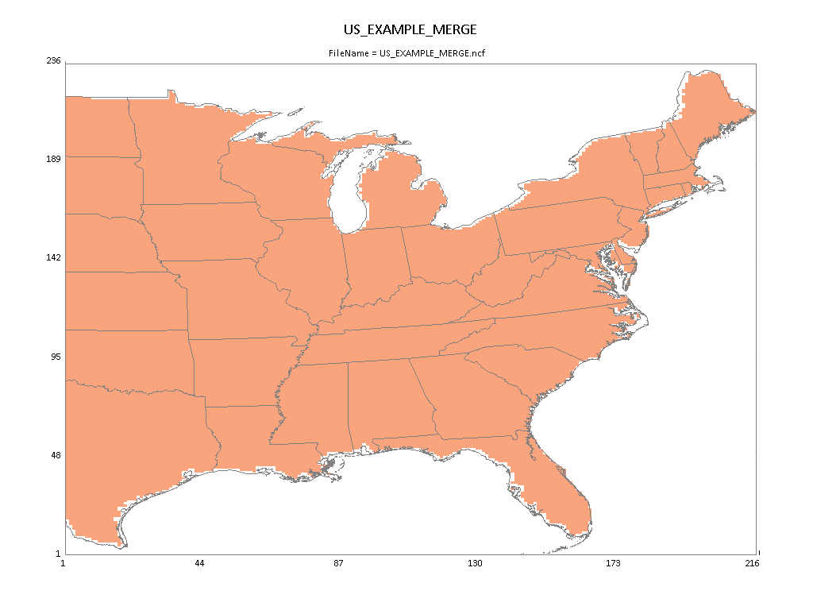
RSM/CMAQ “One-Region” Case and “Five-Region” Case: Preliminary Results
Five-Region RSM/CMAQ
One-Region RSM/CMAQ
“RSM 2.5” installation package at: “G:\SHARE\RSM-VAT\RSM 2.5\”
AQAD/Air Quality Modeling Group
Nov. 10, 2020

Slide 2
Experimental Design: CMAQ EUS “One-Region” Case
1 regions (Eastern USA)
All Eastern USA
5 Pollutants
4 non-linear pollutant (NOx, NH₃, SO₂, VOCs) factors + 1 Primary PM factor
1 Sector
All manmade (All_MM)
6 factors = 5 Pollutants * 1 region *1 Sector + 1 BC
24 total CMAQ simulations (12-km, January & July) used for RSM creation
1 base case
20 cases for non-linear factors = 20 cases * (all region), created by Hammersley quasi-random Sequence Sample (HSS) method (0 ~ 1.2)
2 cases for linear Primary PM factors = 1 regions * 2 (0 and 0.5)
1 Clean Boundary Conditions
10 (out-of-sample) + 15 (NOx, NH3, & SO2 emission cuts: 20/40/60/80/100%) cases for validation (QA for pf-RSM)
2

Slide 3
Experimental Design: CMAQ EUS “Five-Region” Case
5 regions (CR: climate region)
A: Northeast (NE_CR); B: Southeast (SE_CR); C: Central (CEN_CR); D: Upper Midwest (UPMW_CR); E: Other
5 Pollutants
4 non-linear pollutant (NOx, NH₃, SO₂, VOCs) factors + 1 Primary PM factor
1 Sector
All manmade (All_MM)
26 factors = 5 Pollutants * 5 regions *1 Sector + 1 BC
132 total CMAQ simulations (12-km, January & July) used for RSM creation
1 base case
120 cases for non-linear factors = 20 cases * (all region + 5 regions), created by Hammersley quasi-random Sequence Sample (HSS) method (0 ~ 1.2)
10 cases for linear Primary PM factors = 5 regions * 2 (0 and 0.5)
1 Clean Boundary Conditions
15 cases for “out-of-sample” validation (QA for pf-RSM)
3

Slide 4
QA for RSM CMAQ EUS “Five-Region” Case:
pf-RSM “Out-of-Sample” Validation
O3 July 8-hr avg.
PM2.5 July monthly avg.
PM2.5 Jan. monthly avg.
PM_SO4 Jan. monthly avg.
PM_NO3 Jan. monthly avg.
4

Slide 5
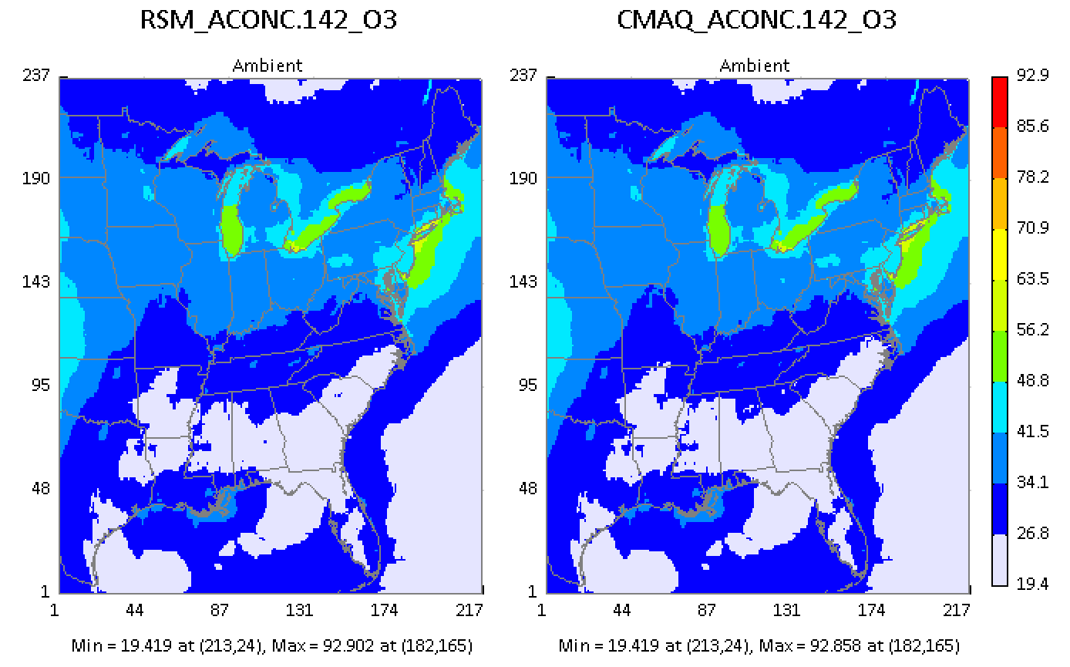
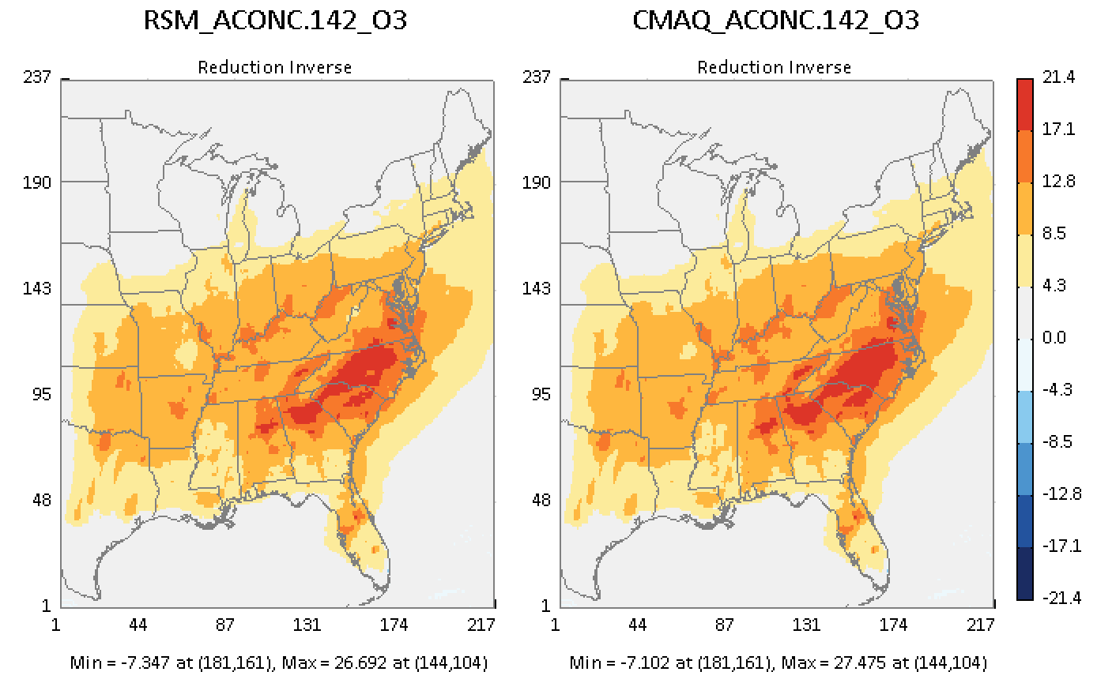
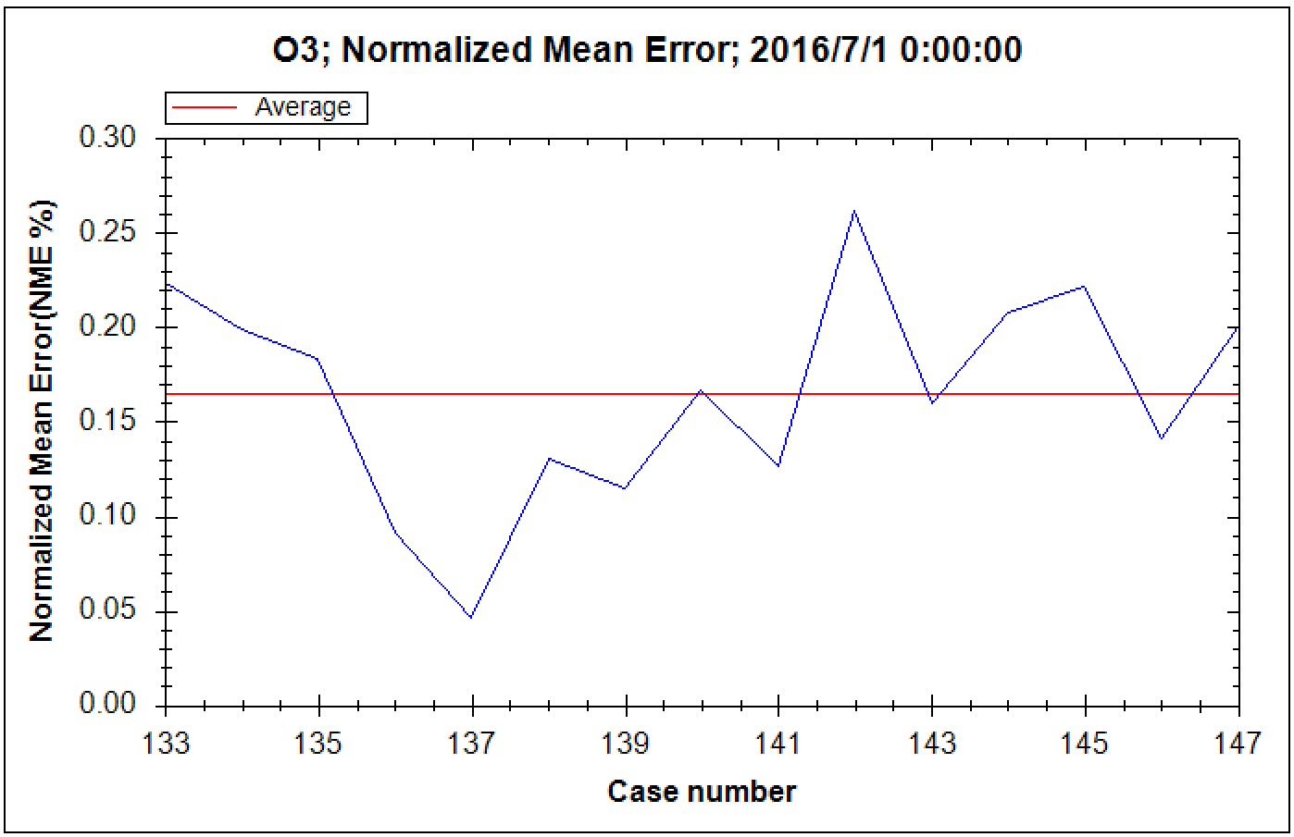
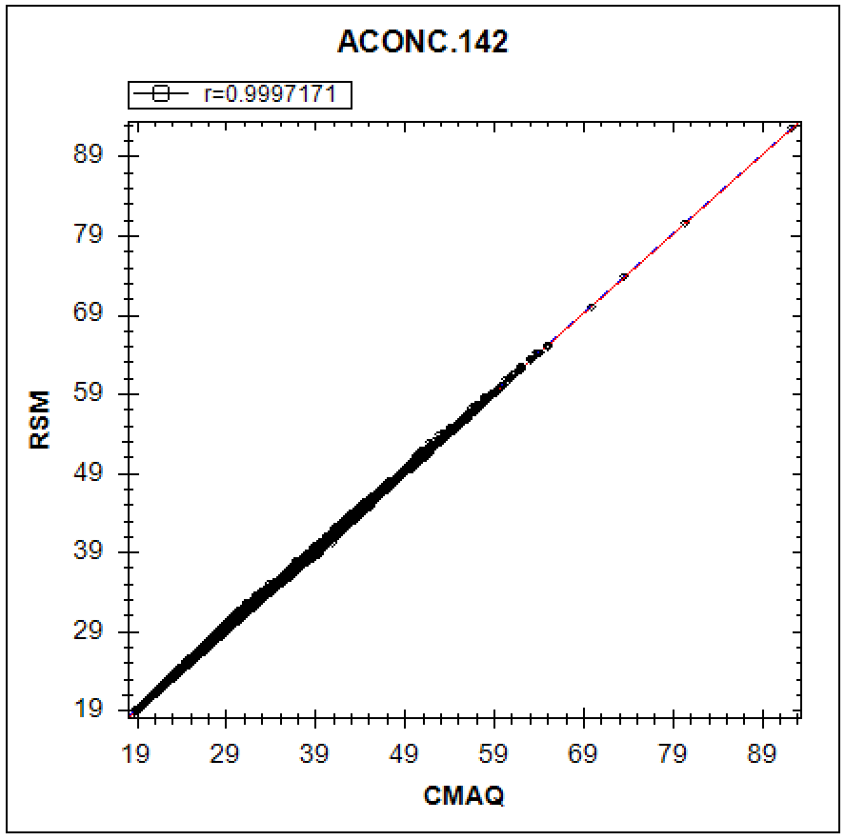
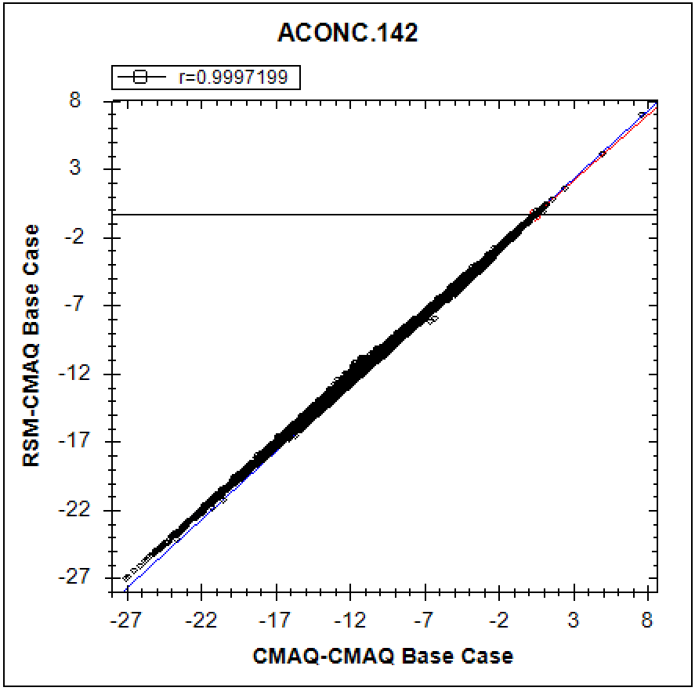
(July, O₃-8hr avg.): Worst #1
“Out-of-Sample” Validation: O₃ Conc. & Response
5

Slide 6
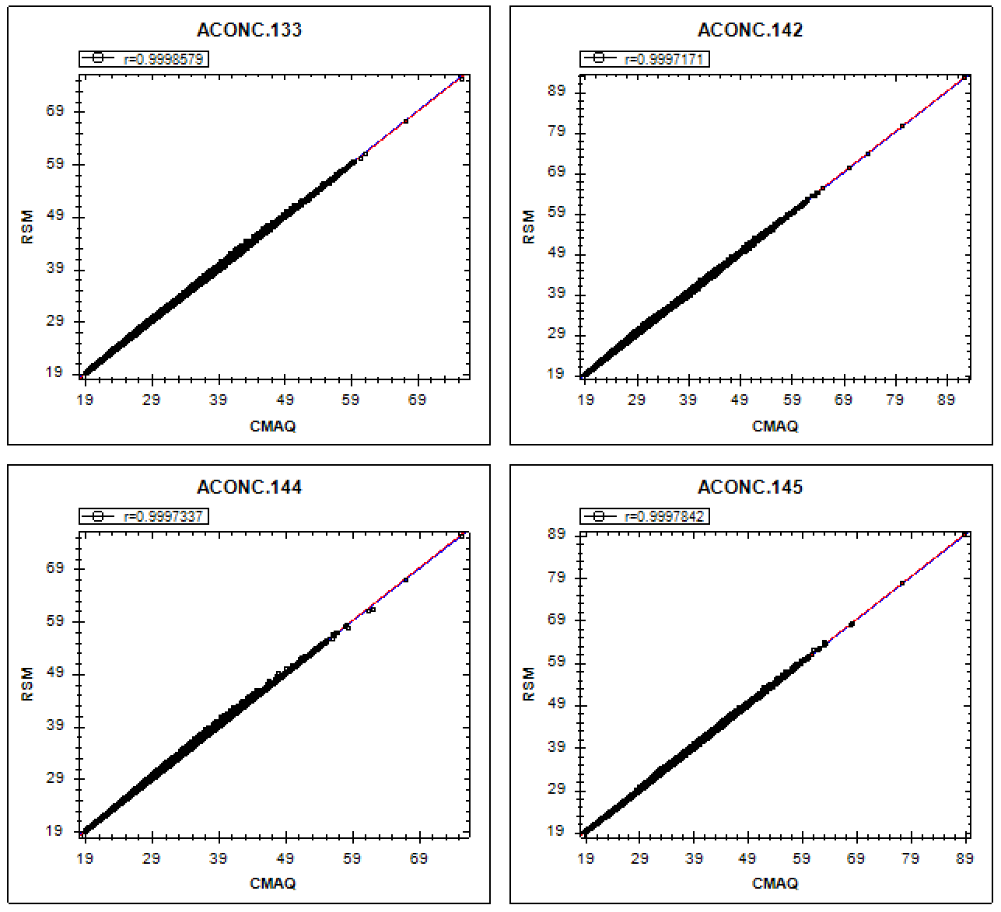
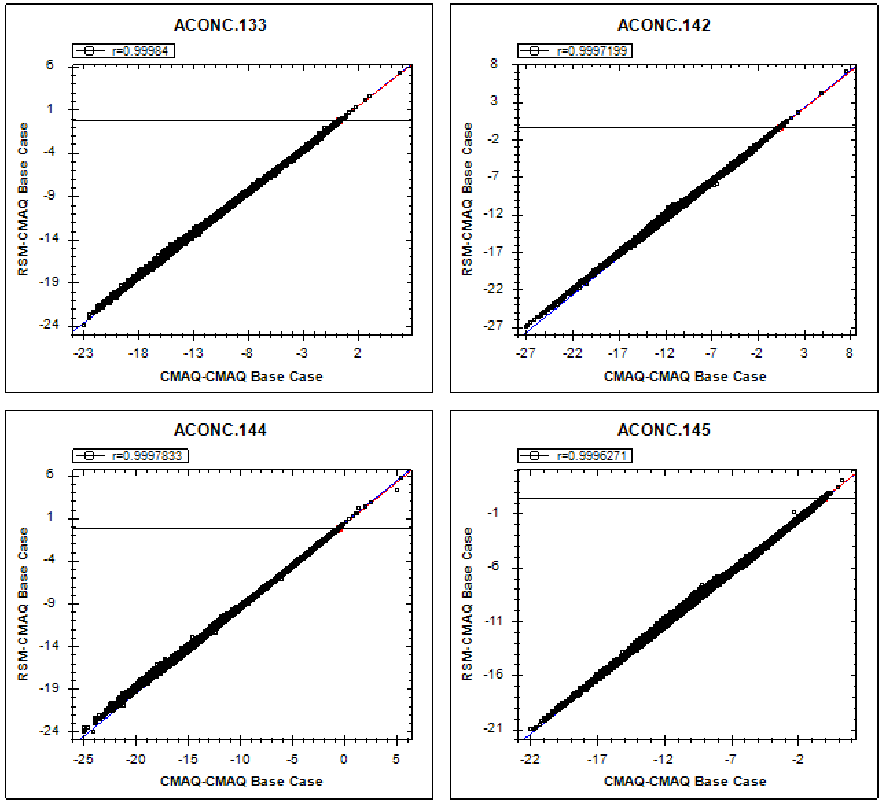
“Out-of-Sample” Validation: O₃ Conc. & Response
(July, O₃-8hr avg. , US): Worst 4 cases
6

Slide 7
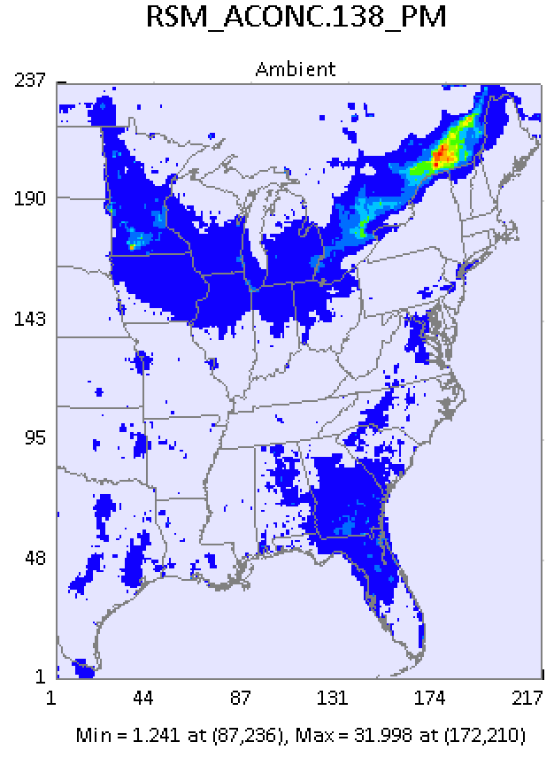
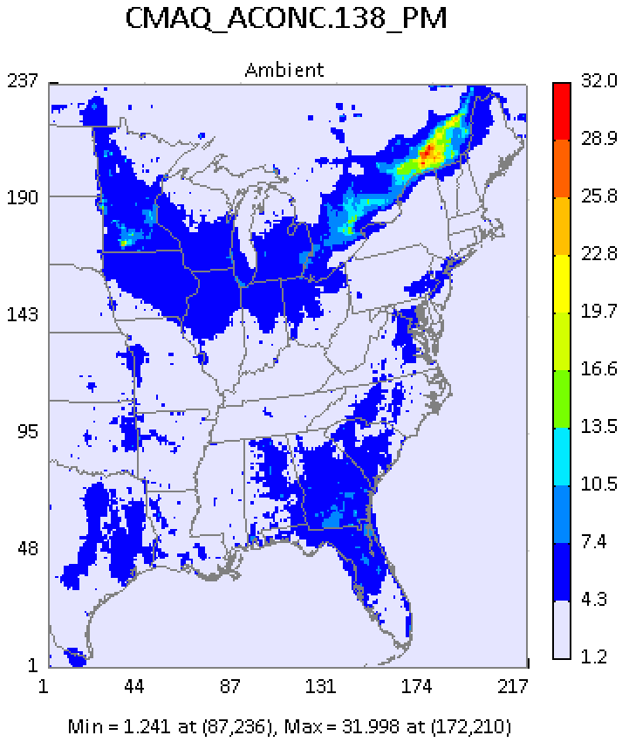
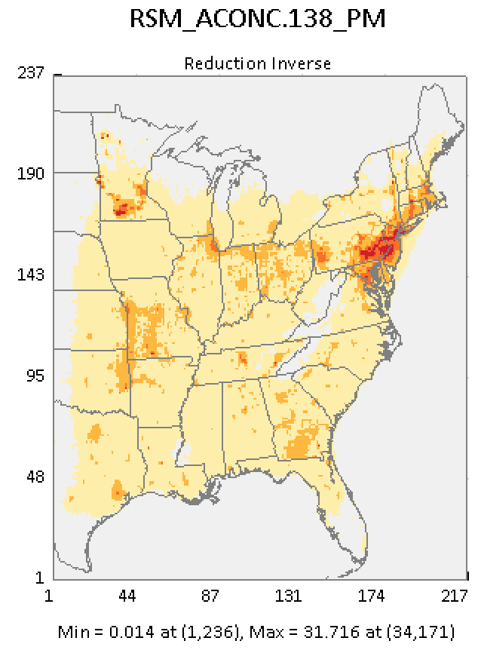
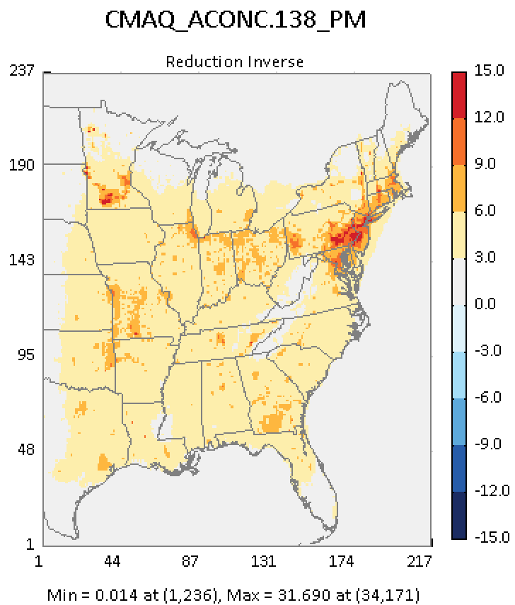
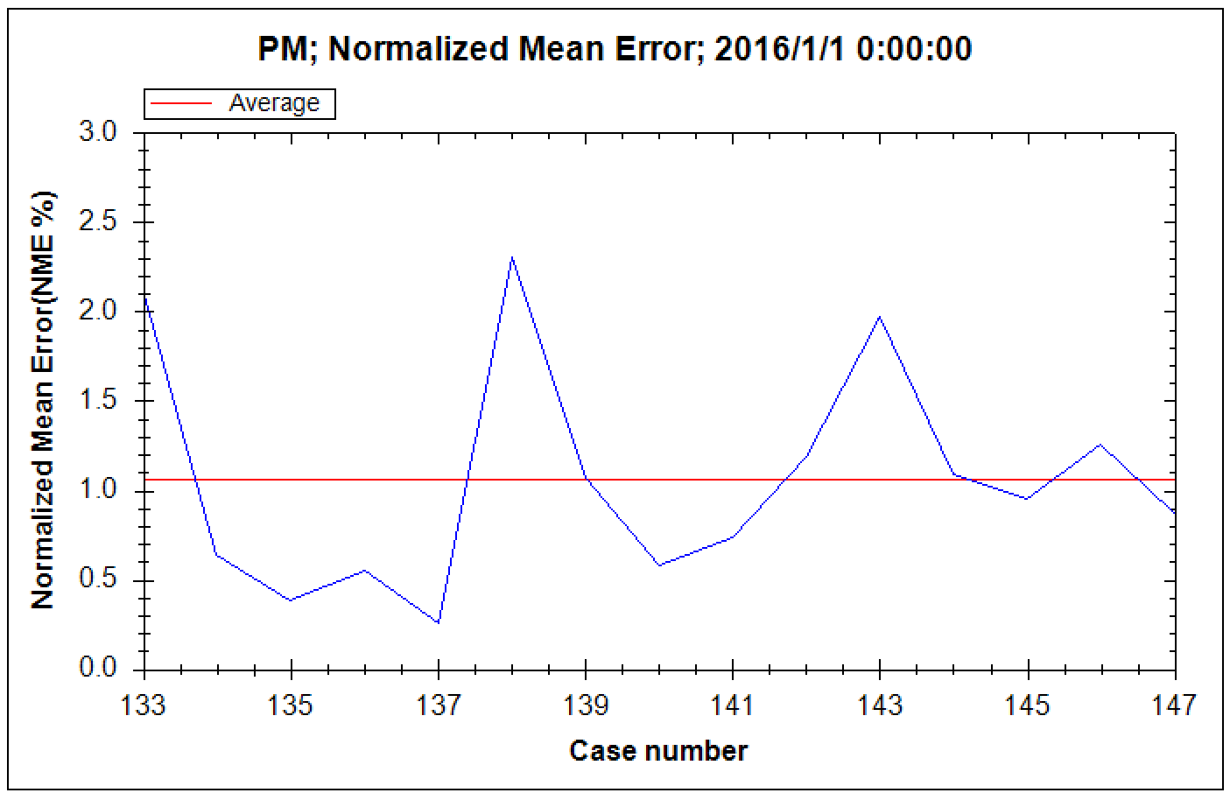
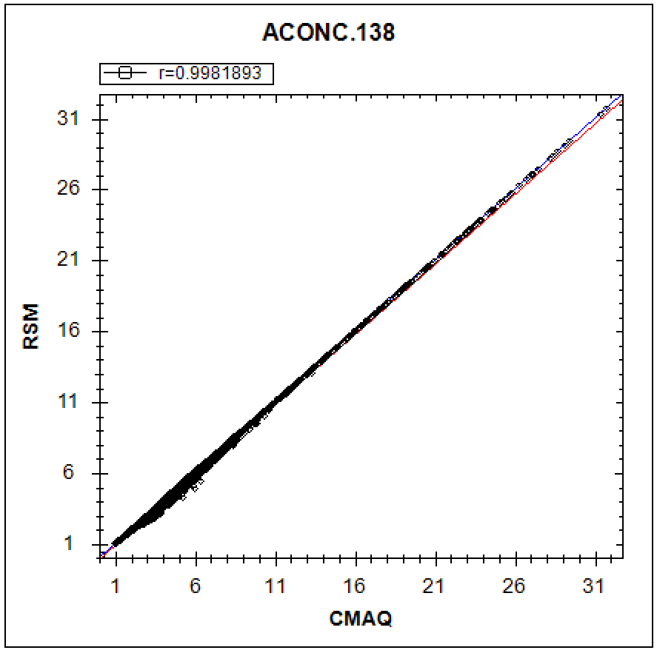
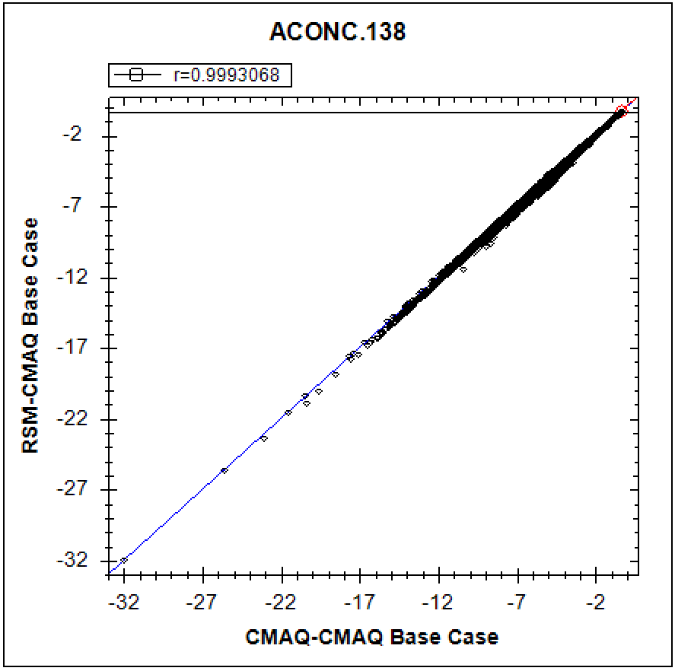
(Jan., PM_{2.5} monthly avg.): Worst Case #1
“Out-of-Sample” Validation: PM_{2.5} Conc. & Response
7

Slide 8
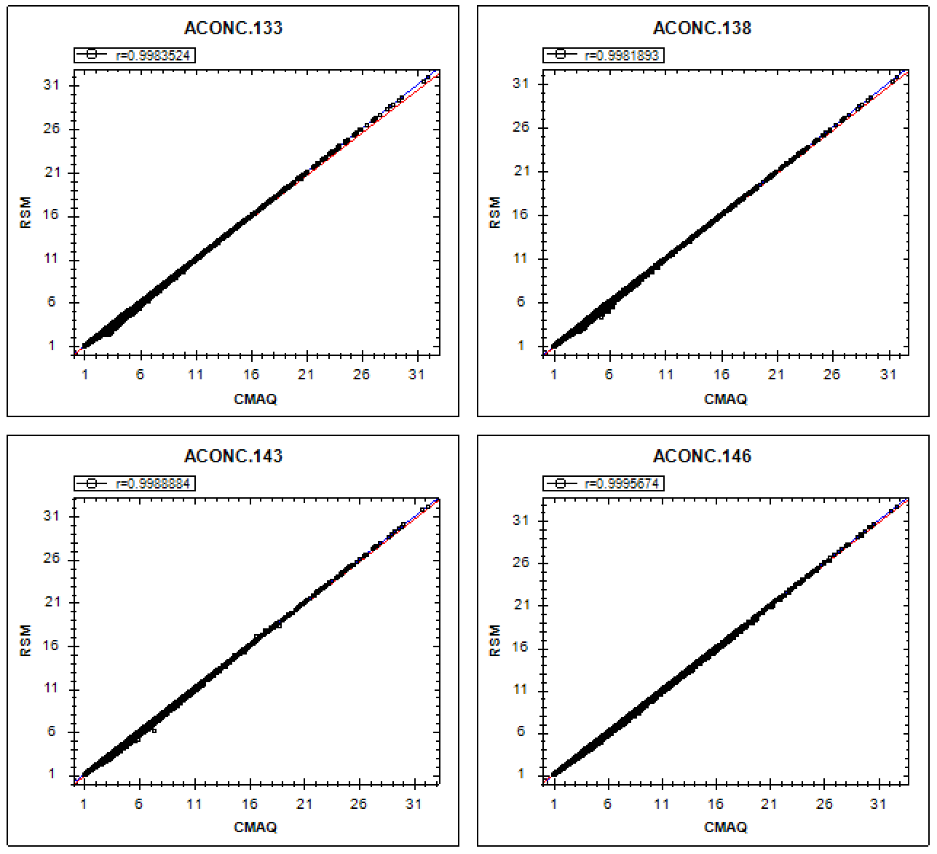
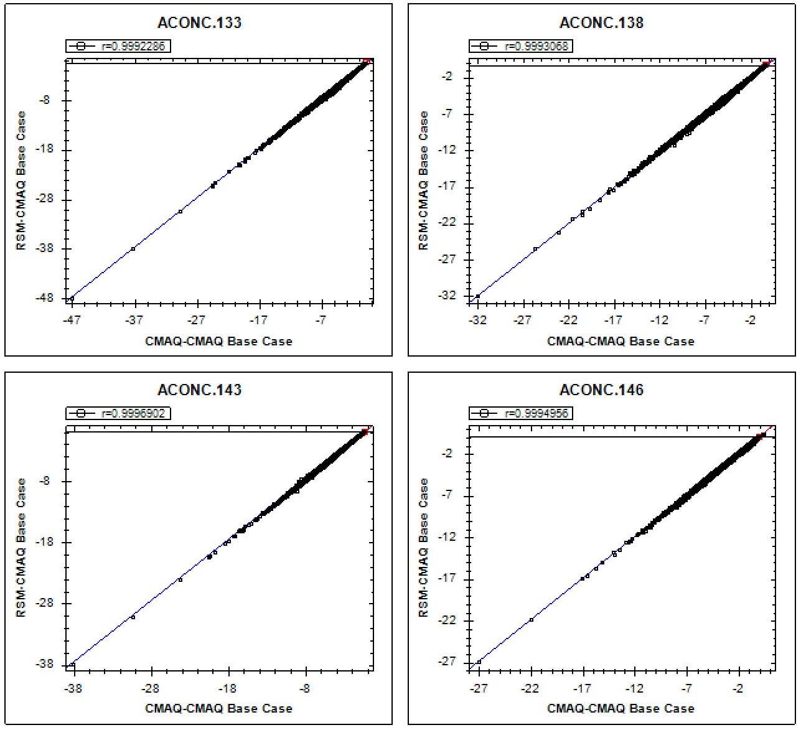
“Out-of-Sample” Validation: PM2.5 Conc. & Response
(Jan., PM_{2.5} monthly avg., US): Worst 4 cases
8

Slide 9
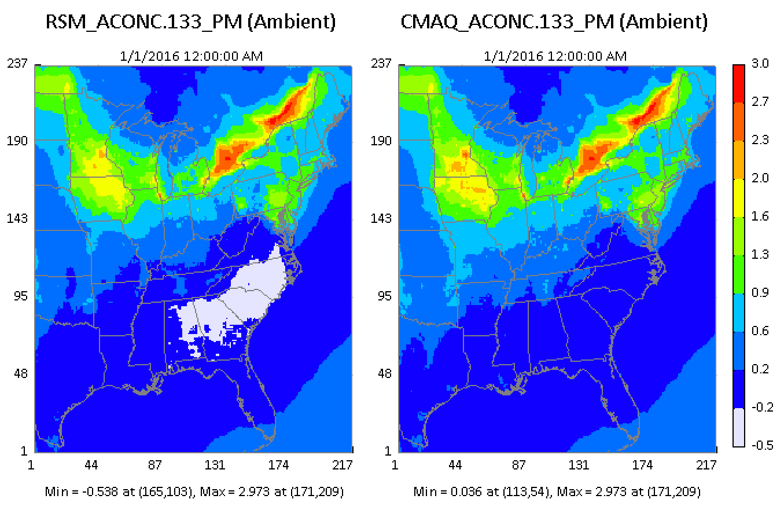
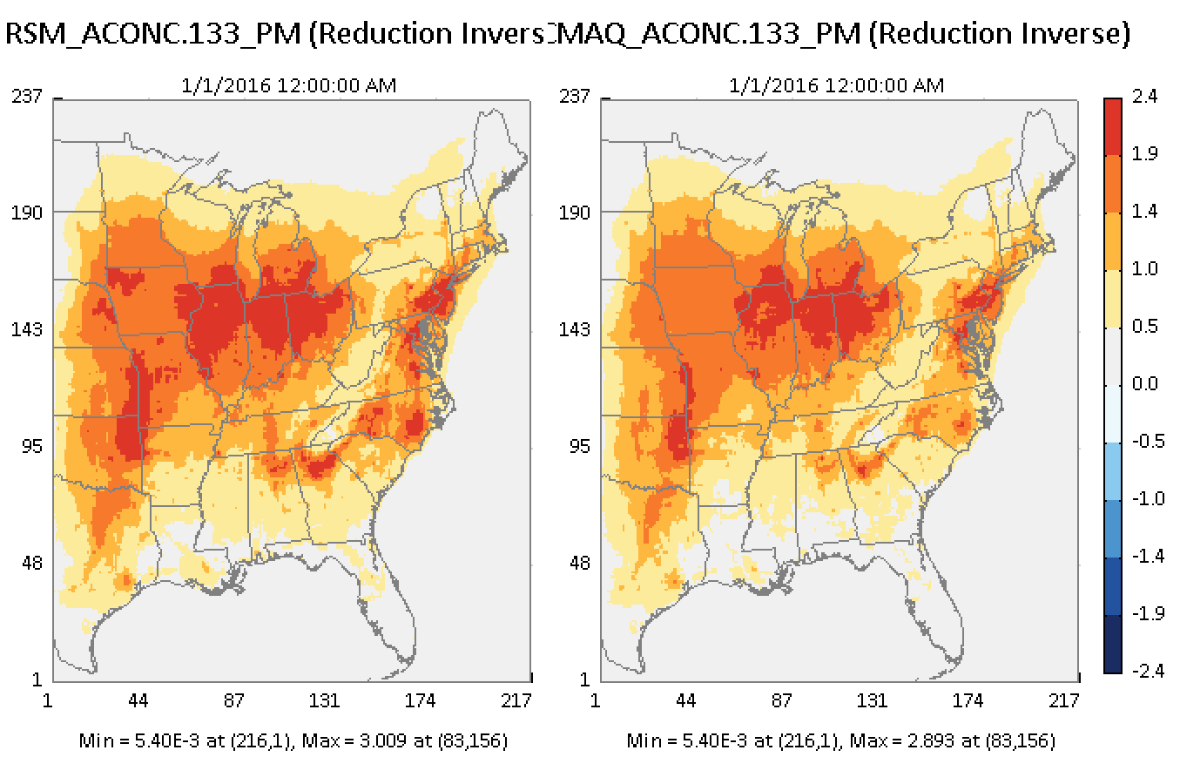
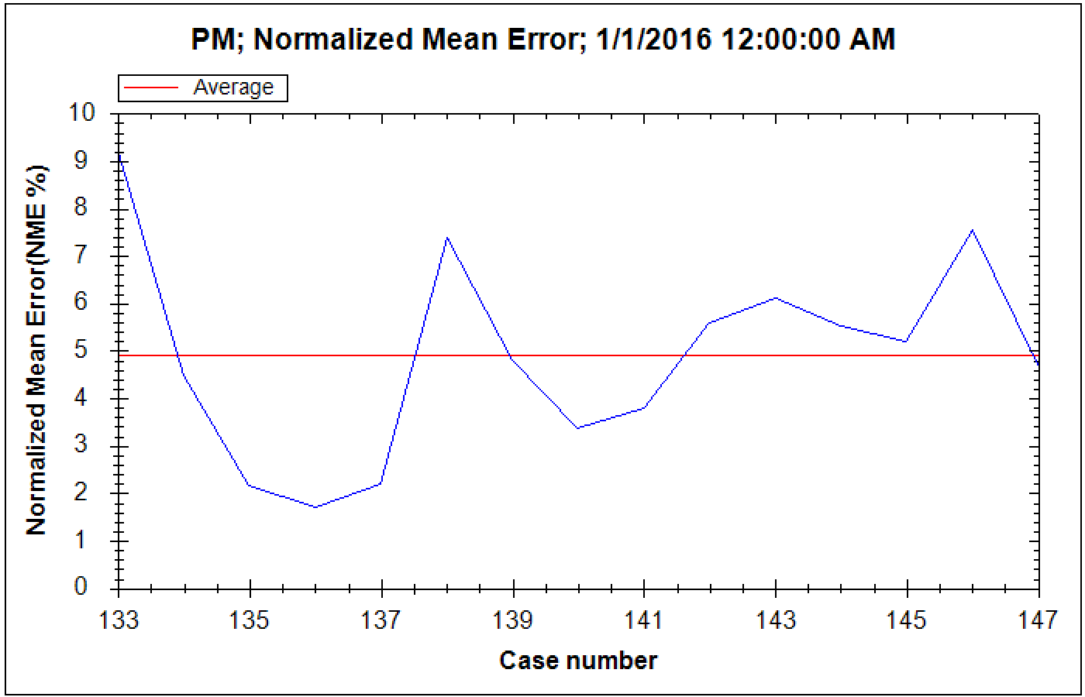
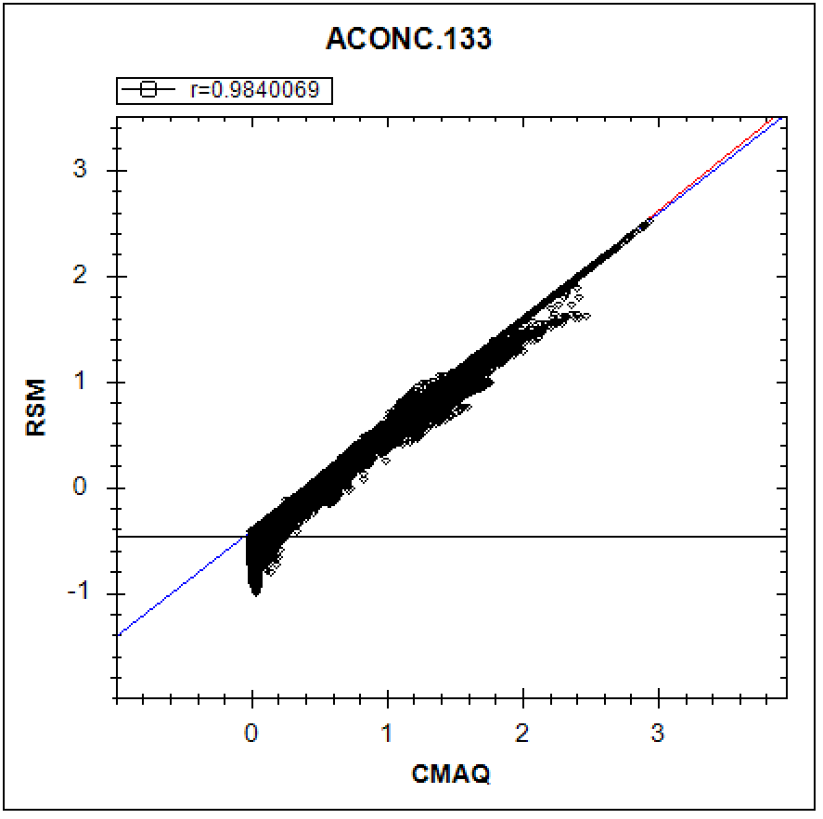
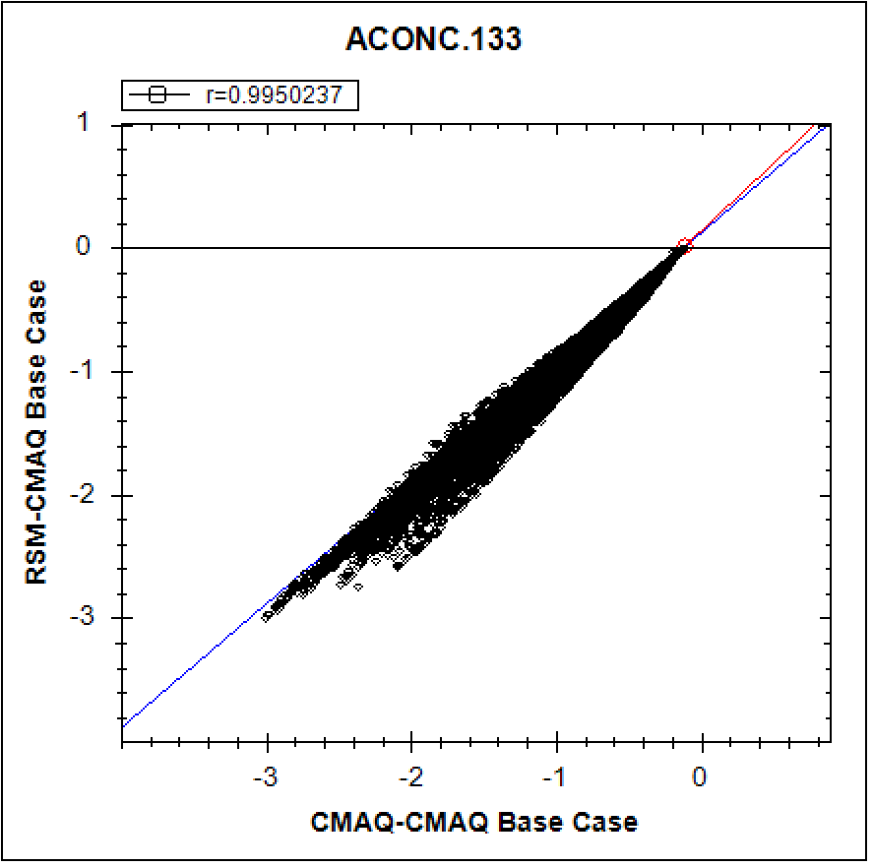
(Jan., PM_NO₃ monthly avg., US): Worst #1
“Out-of-Sample Validation”: PM_NO₃ Conc. & Responses
9

Slide 10

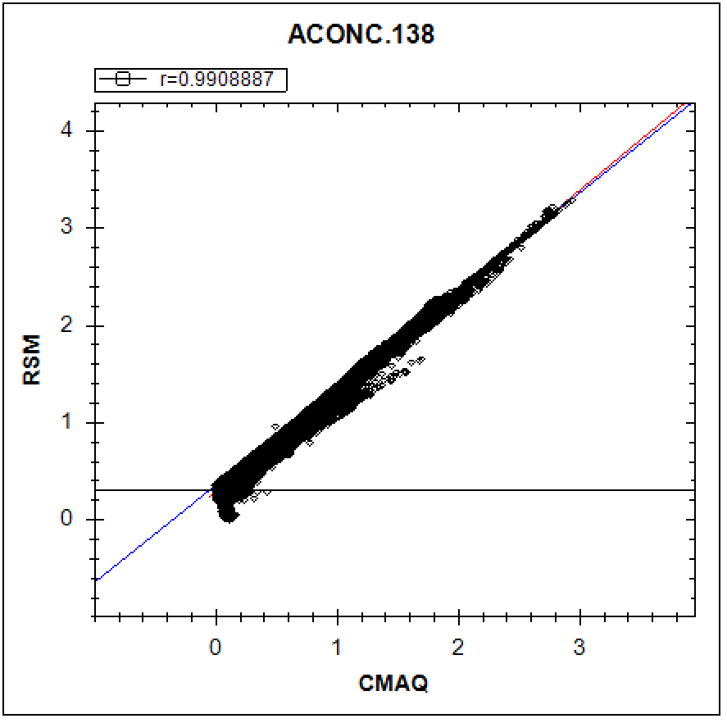
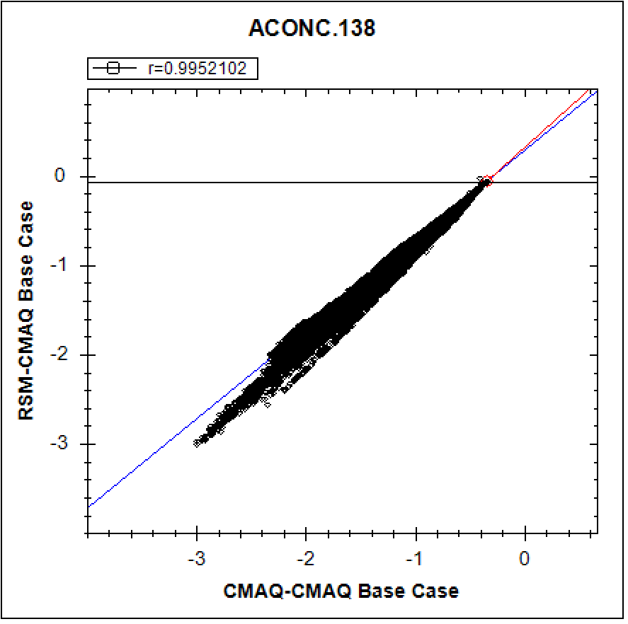
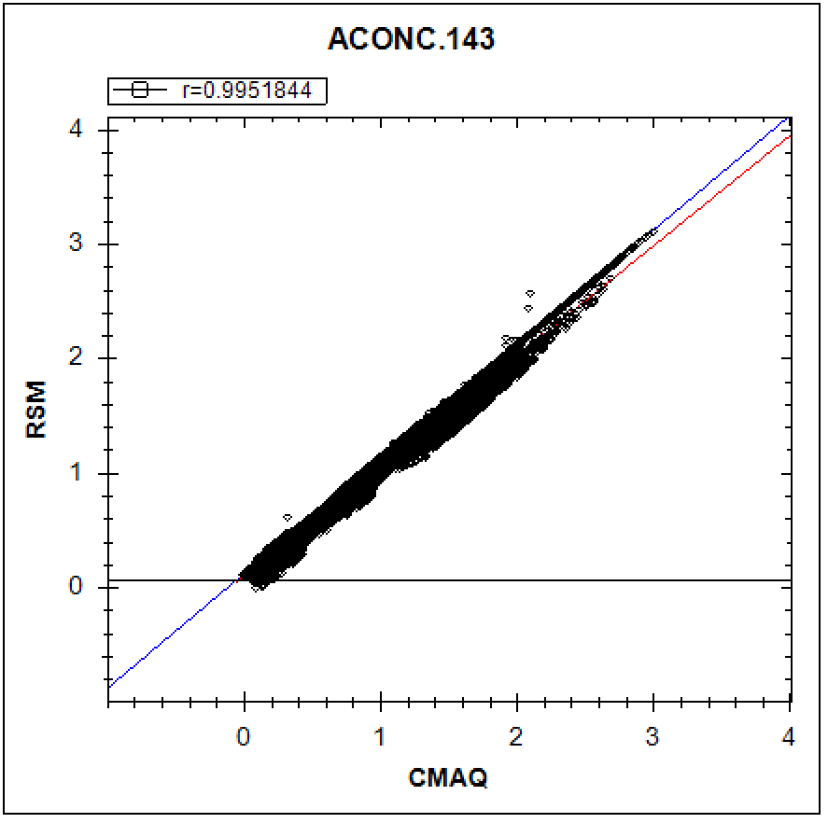
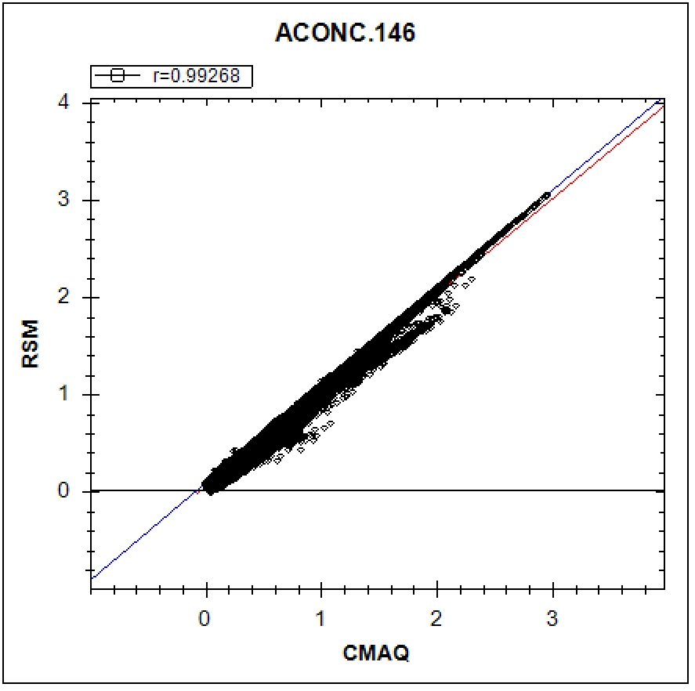
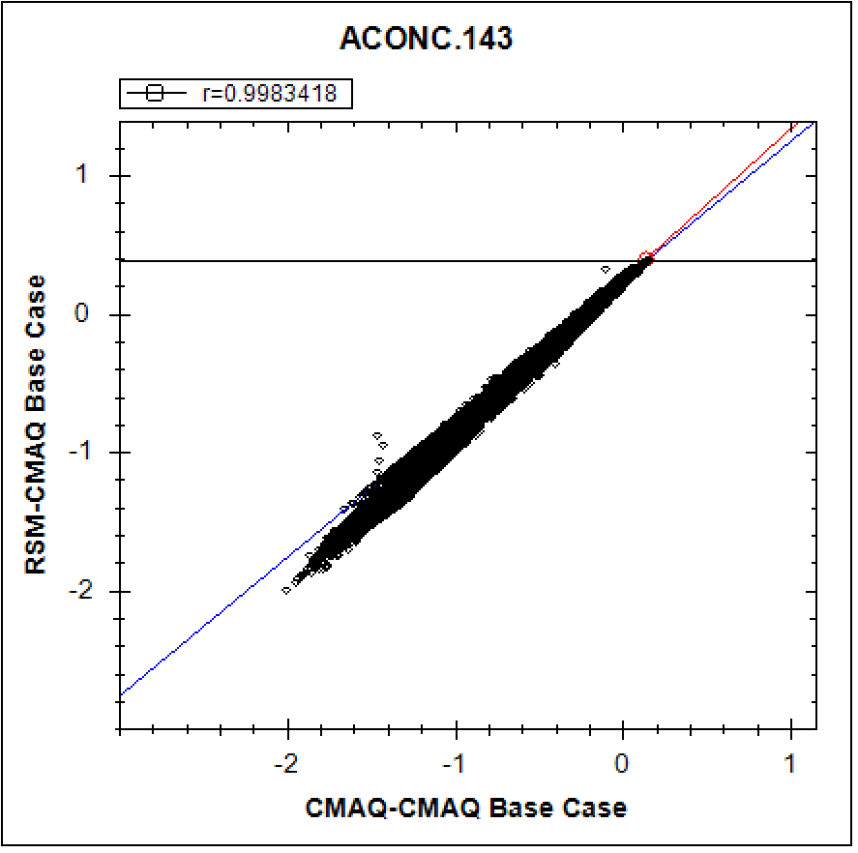
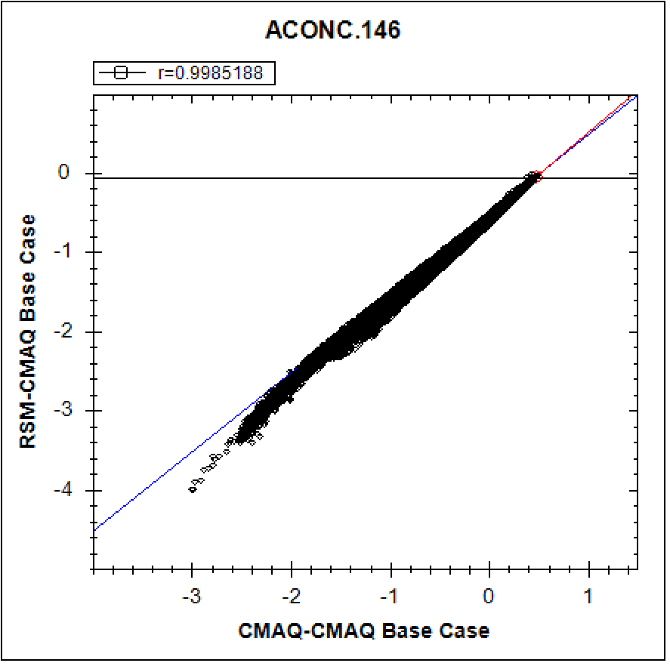
“Out-of-Sample” Validation: PM_NO₃ Concentration & Response
(Jan., PM_NO₃ monthly avg.): Worst 4 cases
10

Slide 11
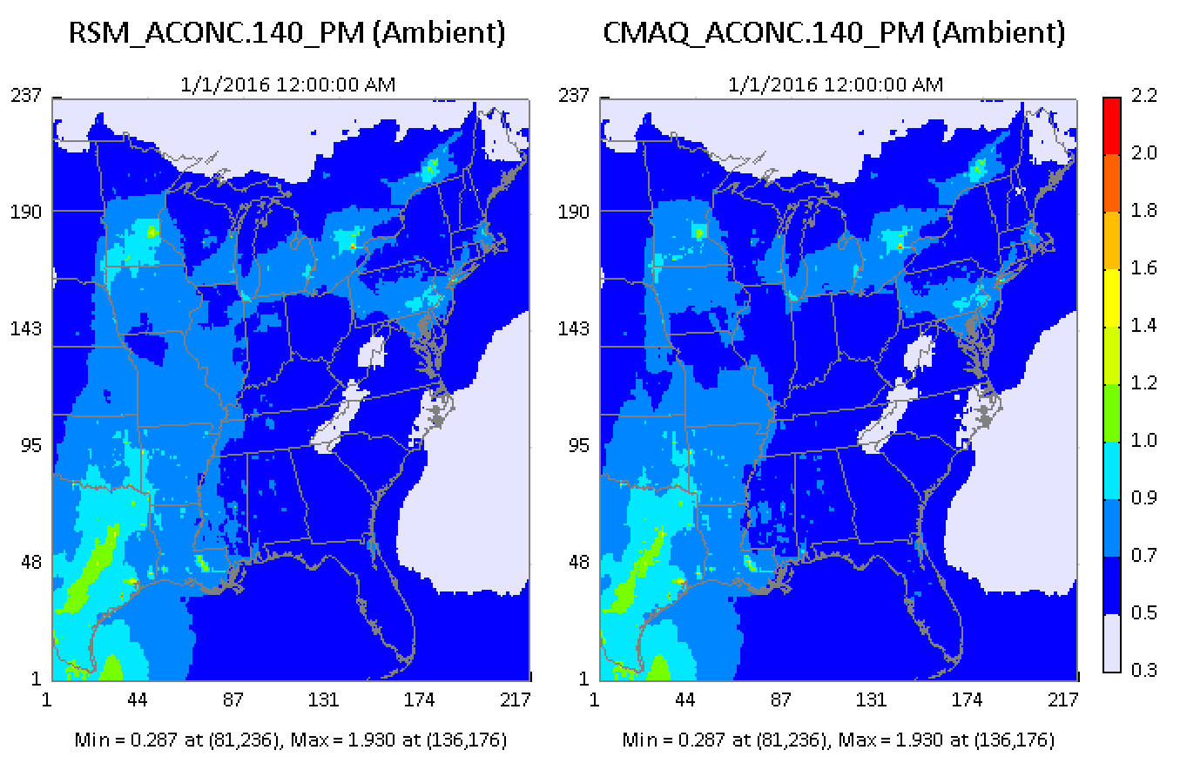
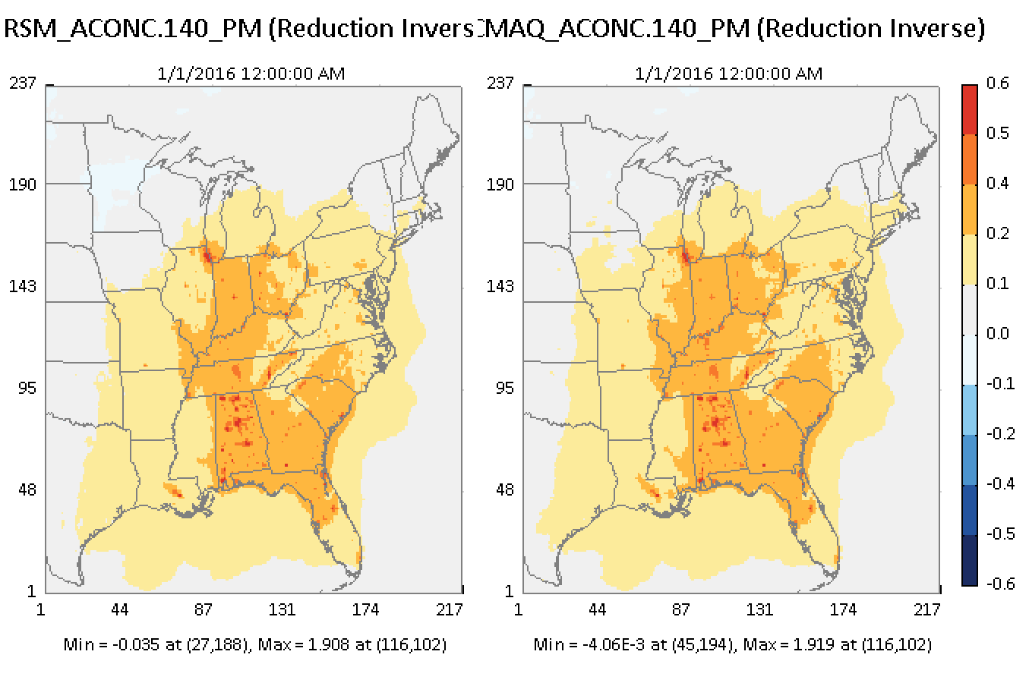
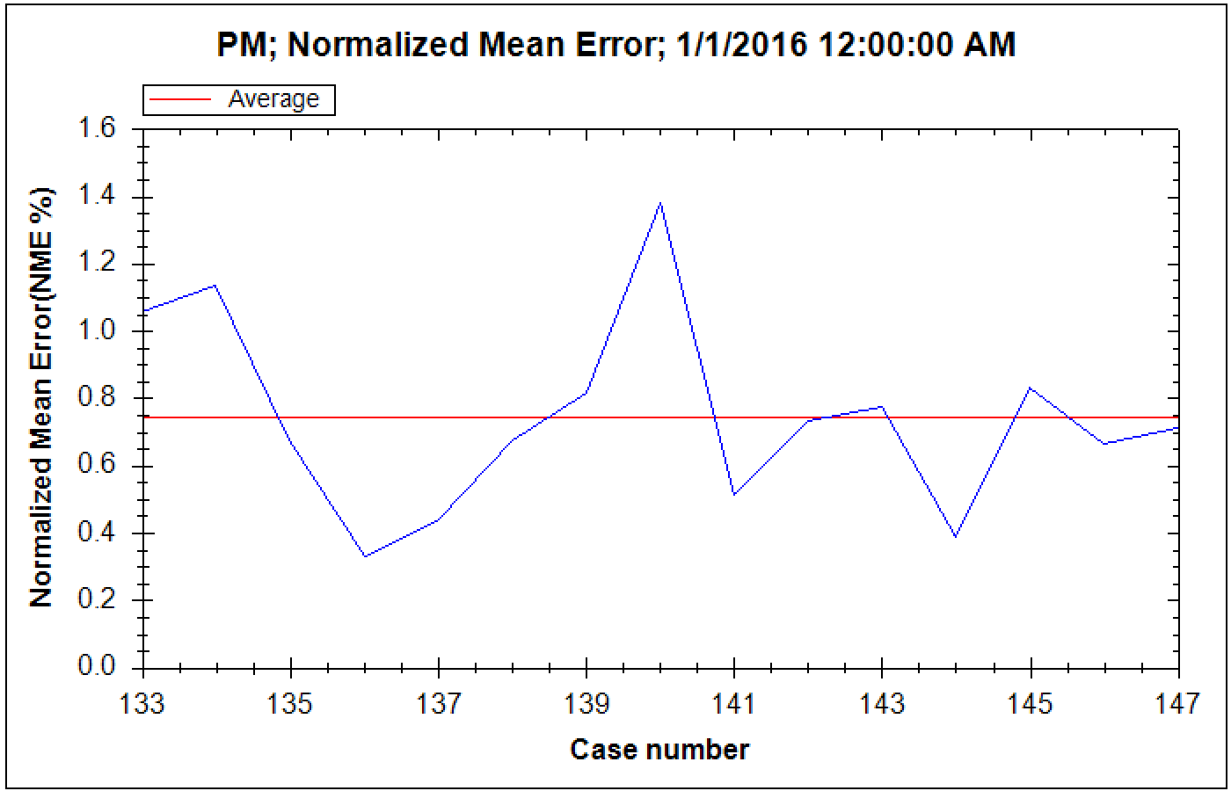
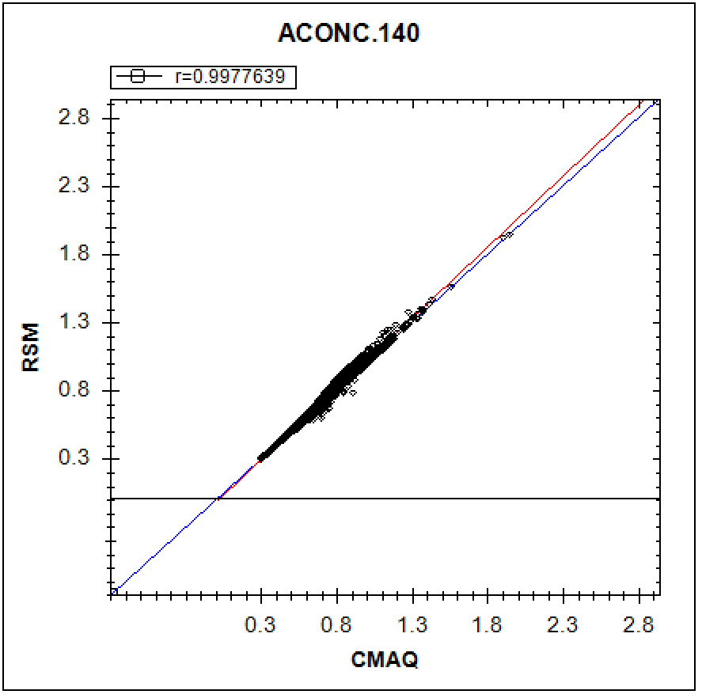
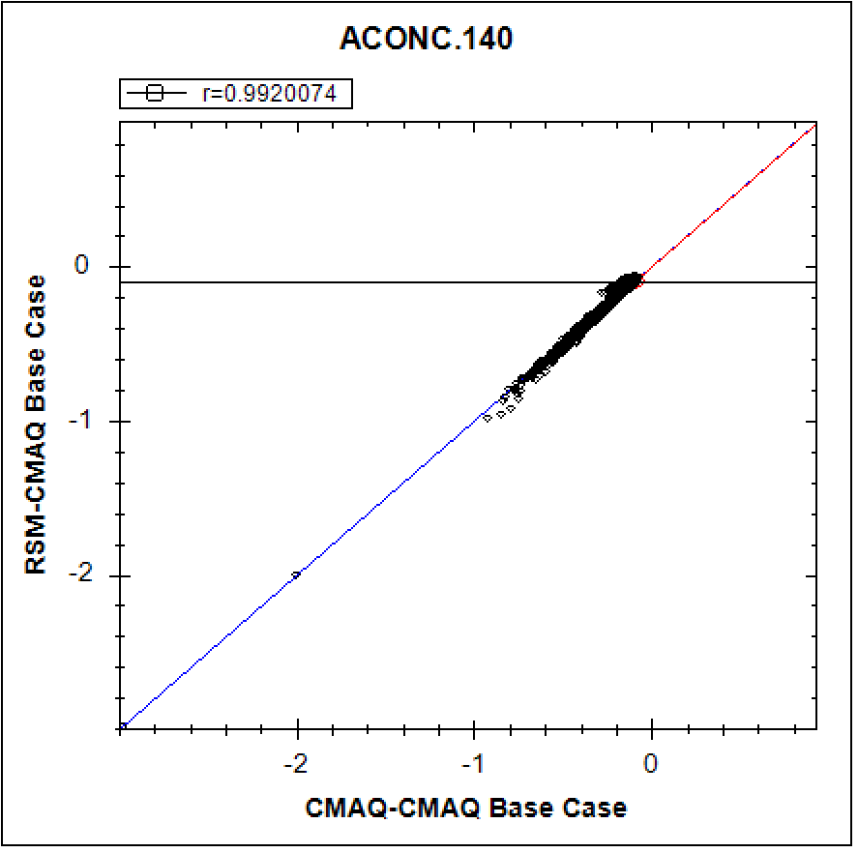
(Jan., PM_SO₄ monthly avg., US): Worst #1
“Out-of-Sample” Validation: PM_SO₄ Conc. & Responses
11

Slide 12
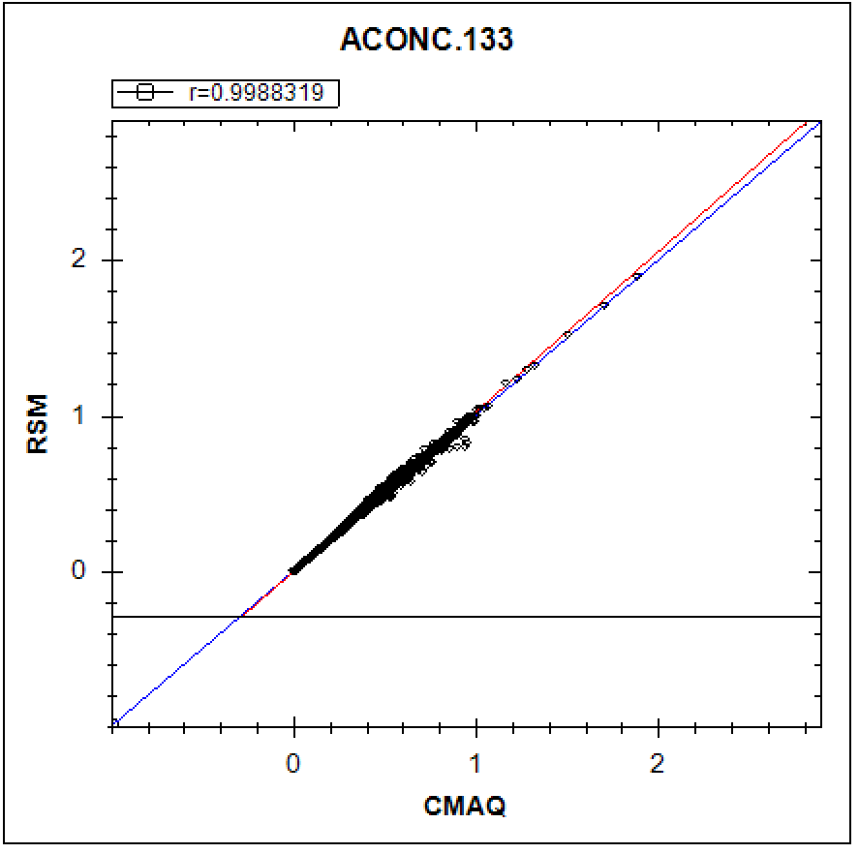
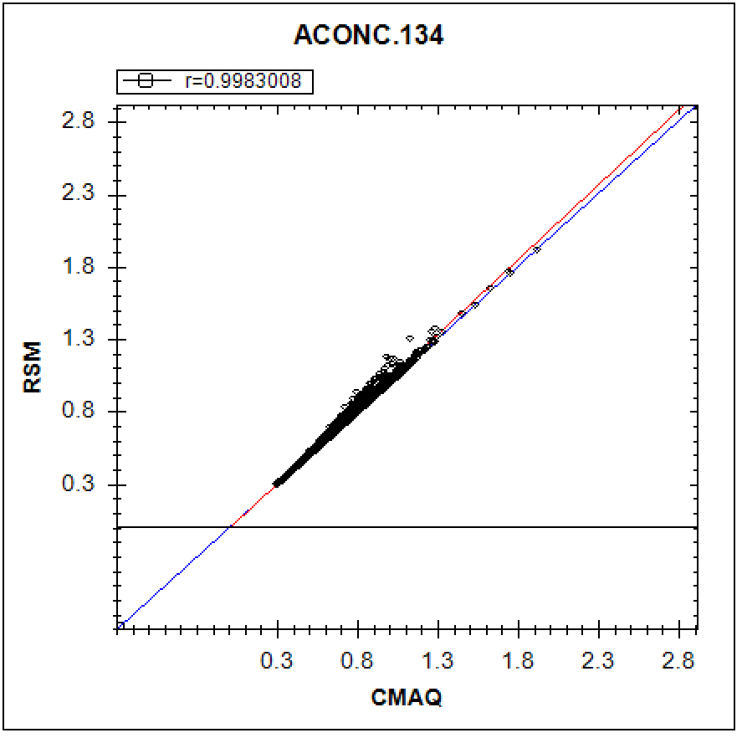
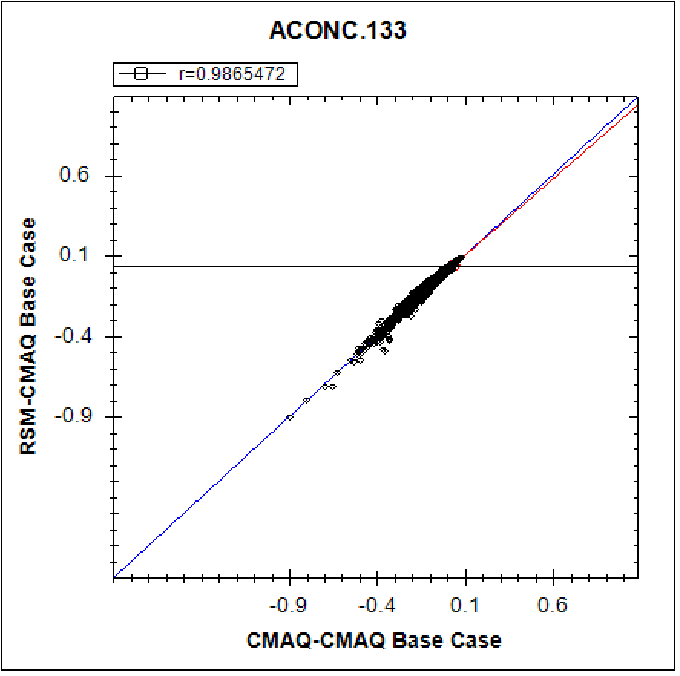
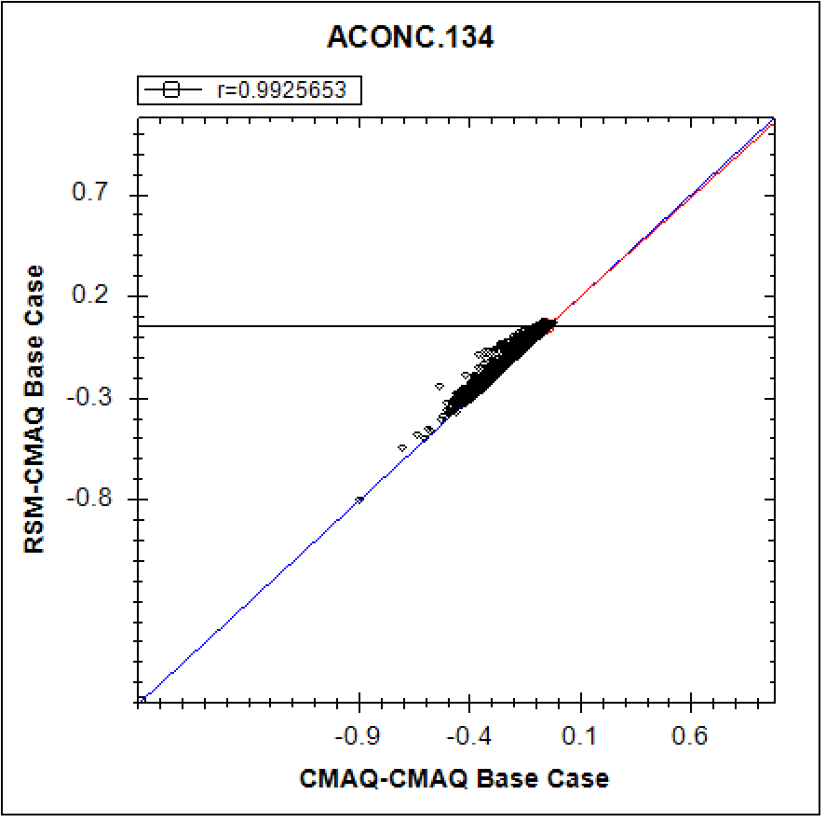

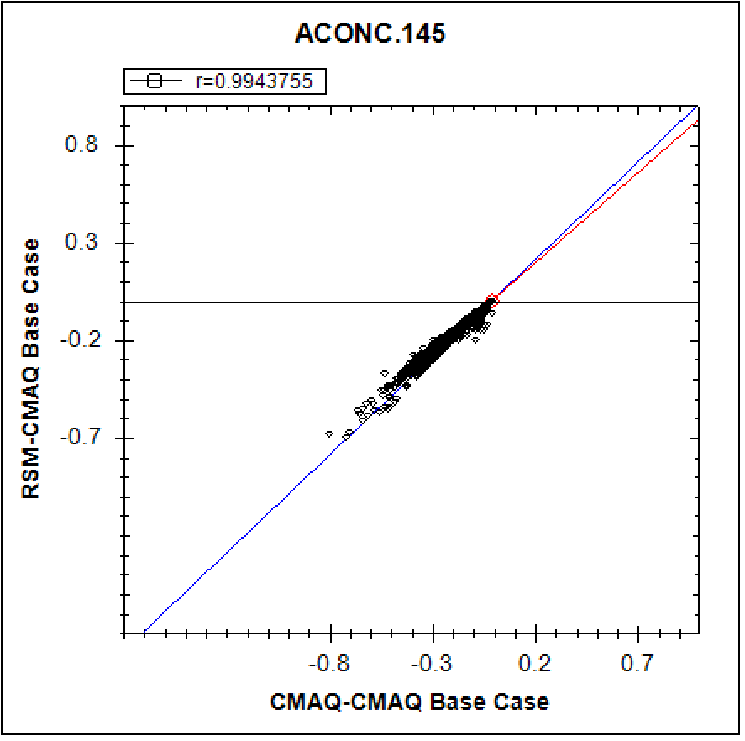
“Out-of-Sample” Validation: PM_SO₄ Concentration & Response
(Jan., PM_SO₄ monthly avg.): Worst 4 cases
12

Slide 13
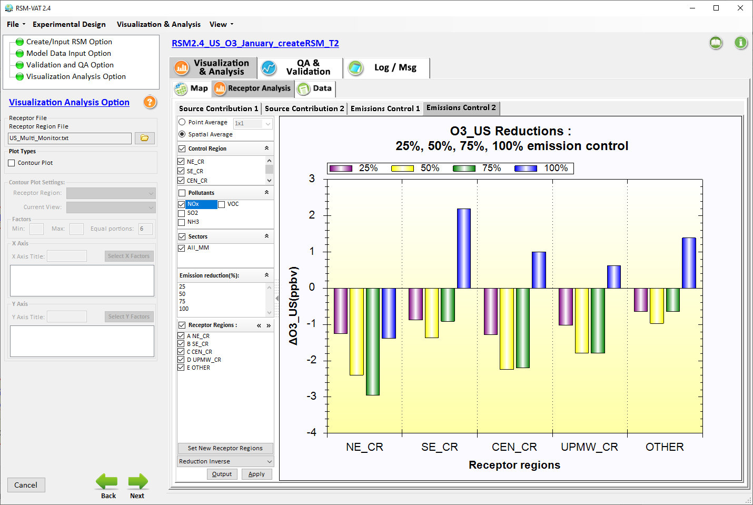
RSM example: “O3” & “PM_SO4” non-linear chemistry
Jan. O3 responses to NOx Emissions cut %
NOx Emissions cut only
100%
benefit
25%
75%
50%
Select 25%, 50%, 75%, 100% NOx Emissions cut only (corresponding CMAQ results provided in Appendix)
disbenefit
13

Slide 14
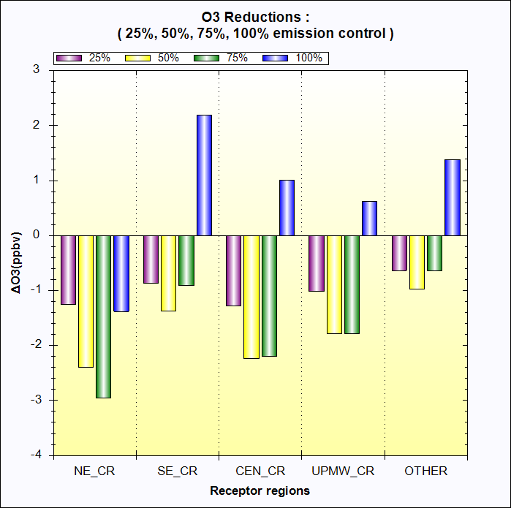
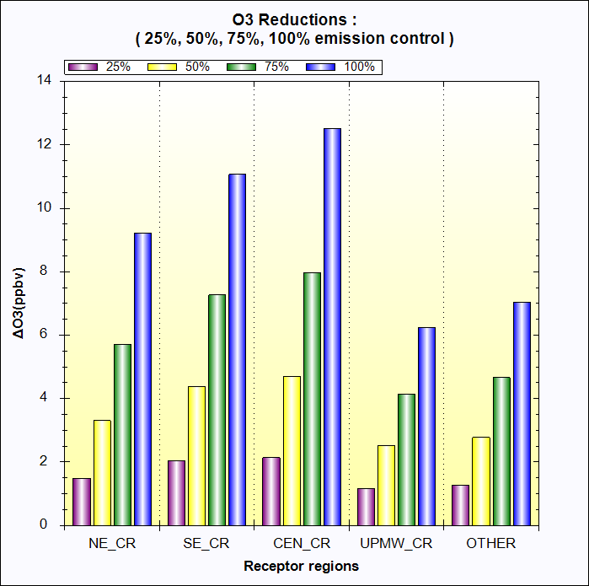
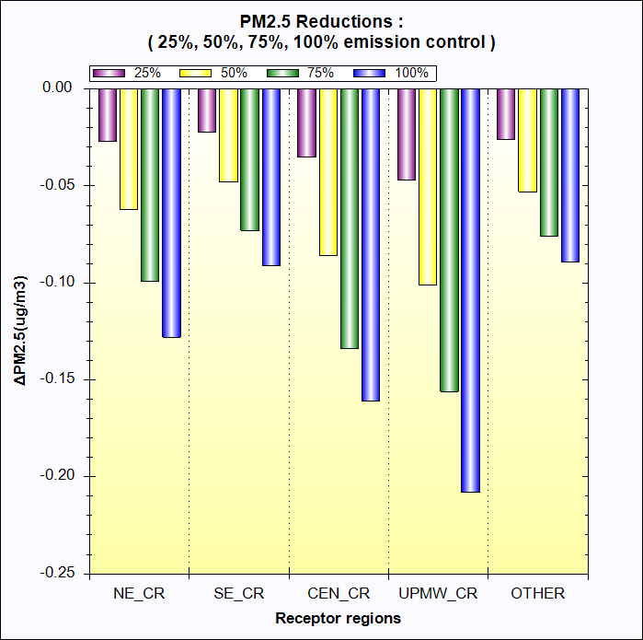
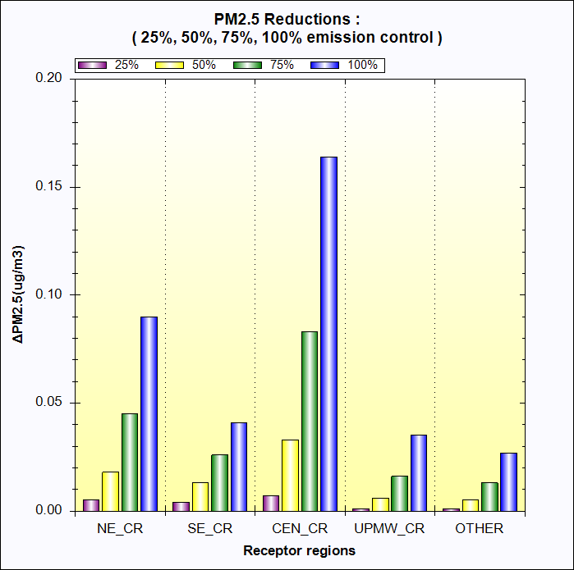
Jan. O3 responses to NOx cut
July O3 responses to NOx cut
benefit
benefit
disbenefit
Jan. PM_SO4 responses to NOx cut
July PM_SO4 responses to NOx cut
benefit
disbenefit
Notes:
1. Thank Cen/Gao/Luo/Chen; 2. HZ more visits; 3. AP on HZ

Slide 15
Experimental Design: CMAQ EUS “One-Region” Case
1 regions (Eastern USA)
All Eastern USA
5 Pollutants
4 non-linear pollutant (NOx, NH₃, SO₂, VOCs) factors + 1 Primary PM factor
1 Sector
All manmade (All_MM)
6 factors = 5 Pollutants * 1 region *1 Sector + 1 BC
24 total CMAQ simulations (12-km, January & July) used for RSM creation
1 base case
20 cases for non-linear factors = 20 cases * (all region), created by Hammersley quasi-random Sequence Sample (HSS) method (0 ~ 1.2)
2 cases for linear Primary PM factors = 1 regions * 2 (0 and 0.5)
1 Clean Boundary Conditions
10 (out-of-sample) + 15 (NOx, NH3, & SO2 emission cuts: 20/40/60/80/100%) cases for validation (QA for pf-RSM)
15

Slide 16
QA for RSM CMAQ EUS “One-Region” Case:
pf-RSM “Out-of-Sample” Validation
O3 July 8-hr avg.
PM2.5 July monthly avg.
PM2.5 Jan. monthly avg.
PM_SO4 Jan. monthly avg.
PM_NO3 Jan. monthly avg.
16

Slide 17
July, O₃-8hr avg. , US
17

Slide 18
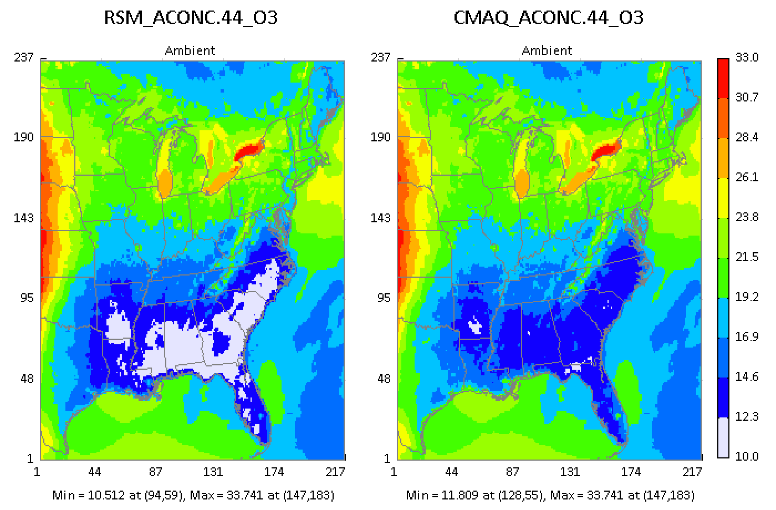
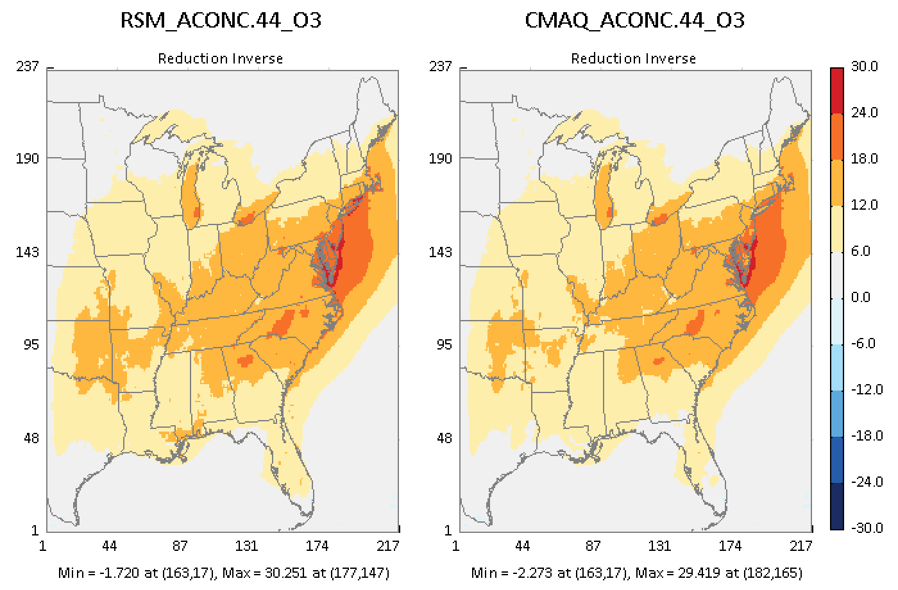
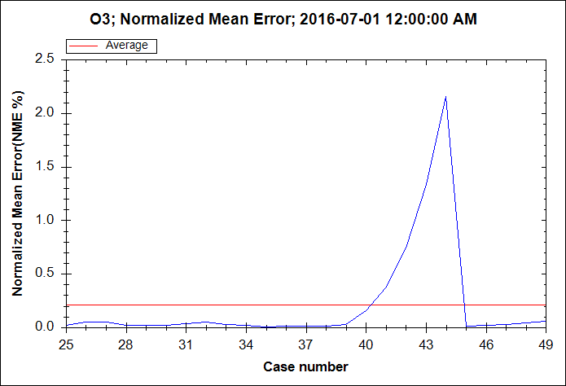
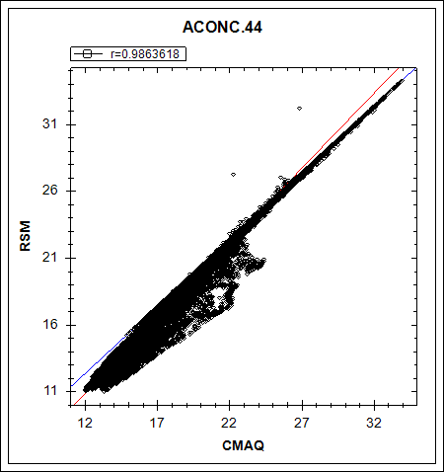
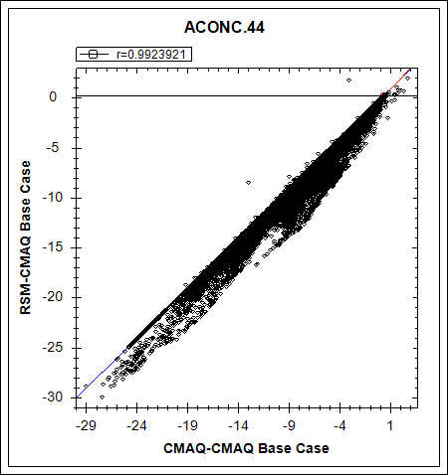
(July, O₃ monthly avg. , US) Worst 1
Out-of-Sample Validation: Predicted O₃ Concentrations & Responses
18

Slide 19
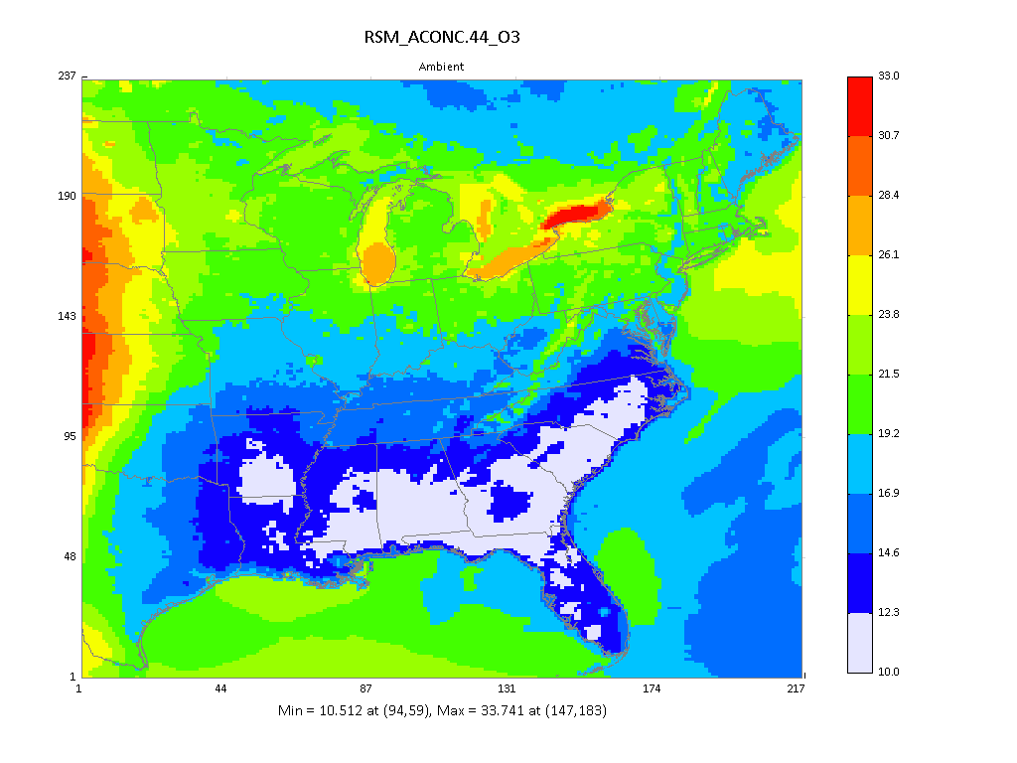







Out-of-Sample Validation: Predicted Concentrations
(July, O₃ monthly avg. , US) Worst 1
19

Slide 20


Out-of-Sample Validation: Concentration Comparison
(July, O₃ monthly avg. , US) Worst 4
20

Slide 21
July, PM_{2.5} monthly avg., US
21

Slide 22





(July, PM_{2.5} monthly avg. , US) Worst 1
Out-of-Sample Validation: Predicted PM_{2.5} Concentrations & Responses
22

Slide 23








Out-of-Sample Validation: Predicted Concentrations
(July, PM_{2.5} monthly avg. , US) Worst 1
23

Slide 24


Out-of-Sample Validation: Concentration Comparison
(July, PM_{2.5} monthly avg. , US) Worst 4
24

Slide 25
Jan., PM_{2.5} monthly avg., US
25

Slide 26





(Jan., PM_{2.5} monthly avg. , US) Worst 1
Out-of-Sample Validation: Predicted PM_{2.5} Concentrations & Responses
26

Slide 27








Out-of-Sample Validation: Predicted Concentrations
(Jan., PM_{2.5} monthly avg. , US) Worst 1
27

Slide 28


Out-of-Sample Validation: Concentration Comparison
(Jan., PM_{2.5} monthly avg. , US) Worst 4
28

Slide 29
Jan., PM_NO₃ monthly avg., US

Slide 30







(Jan., PM_NO₃ monthly avg., US): Worst #1
“Out-of-Sample Validation”: PM_NO₃ Conc. & Responses
30

Slide 31

Out-of-Sample Validation: Predicted Concentrations
(Jan., PM_NO₃ monthly avg., US) Worst 1
31

Slide 32


“Out-of-Sample” Validation: PM_NO₃ Concentration & Response
(Jan., PM_NO₃ monthly avg.): Worst 4 cases
32

Slide 33
Jan., PM_SO₄ monthly avg., US

Slide 34







(Jan., PM_SO₄ monthly avg., US): Worst #1
“Out-of-Sample” Validation: PM_SO₄ Conc. & Responses
0.4
34

Slide 35

Out-of-Sample Validation: Predicted Concentrations
(Jan., PM_SO₄ monthly avg., US) Worst 1
0.2
35

Slide 36


“Out-of-Sample” Validation: PM_SO₄ Concentration & Response
(Jan., PM_SO₄ monthly avg.): Worst 4 cases
36

Slide 37


Five-Region RSM
One-Region RSM
Jan. O3 responses to NOx cut
Jan. O3 responses to NOx cut
benefit
benefit
disbenefit
disbenefit
Jan. PM_SO4 responses to NOx cut
Jan. PM_SO4 responses to NOx cut
disbenefit
disbenefit
disbenefit
Notes:
1. Thank Cen/Gao/Luo/Chen; 2. HZ more visits; 3. AP on HZ

Slide 38
End
Carey Jang, U.S. EPA, Jang.carey@epa.gov
38

Slide 39






w/o
&
w/
BC
(100%
NOx
SOx
NH3
Inc.
in
RSM
Create)
39

