Slide 1
RSM-VAT 2.8 quick tutorial for DeepRSM module
1

Slide 2
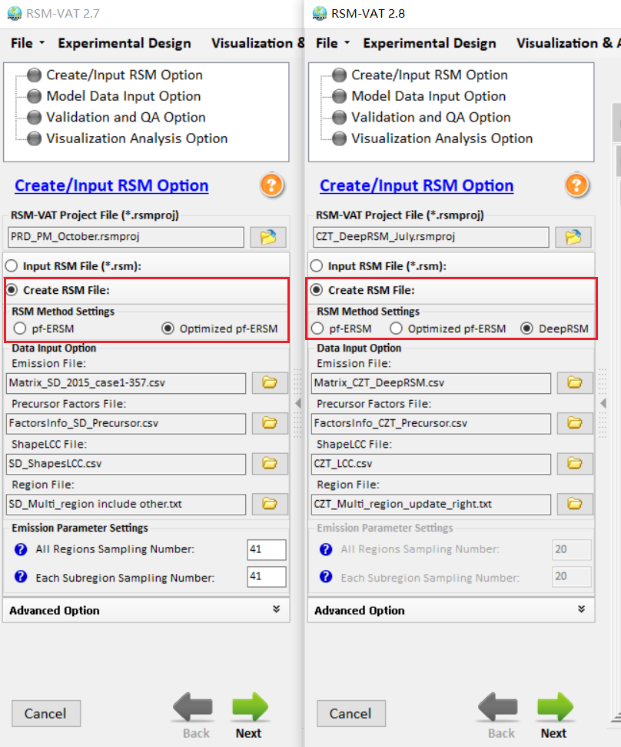
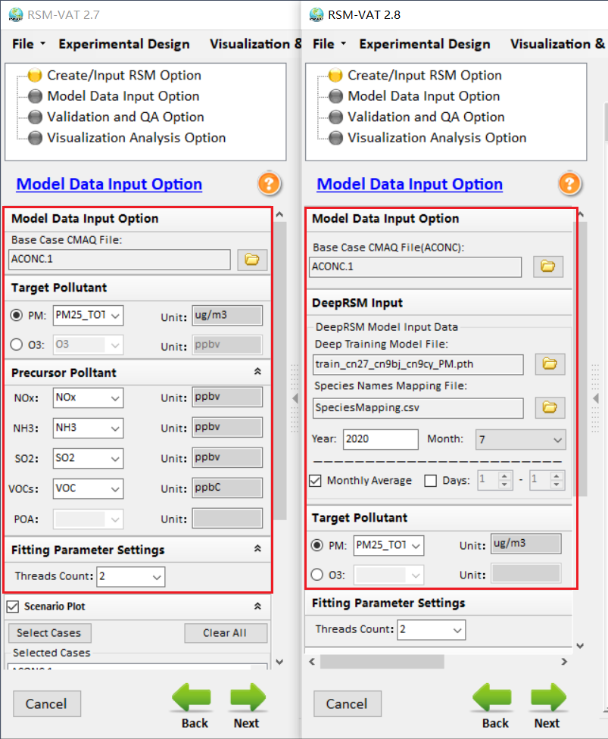
RSM-VAT Update: GUI comparison with RSM-VAT 2.7
Create/Input RSM Option
Model Data Input Option
RSM-VAT 2.7
RSM-VAT 2.8
RSM-VAT 2.7
RSM-VAT 2.8
2

Slide 3
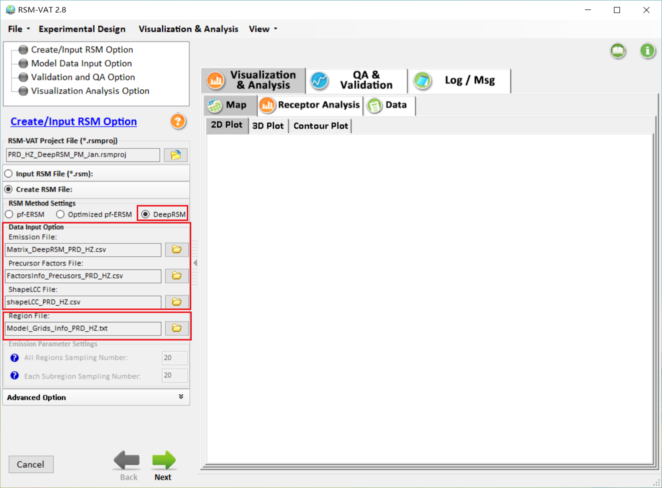
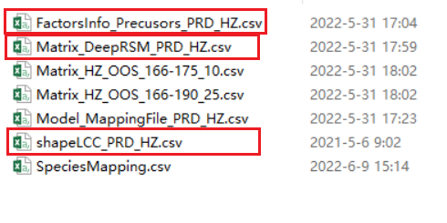
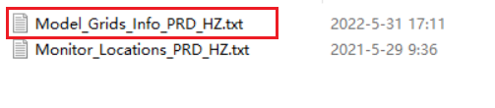
DeepRSM: Create RSM File
1.Choose “DeepRSM”
2. Select the corresponding file
3.Click “Next”
3

Slide 4
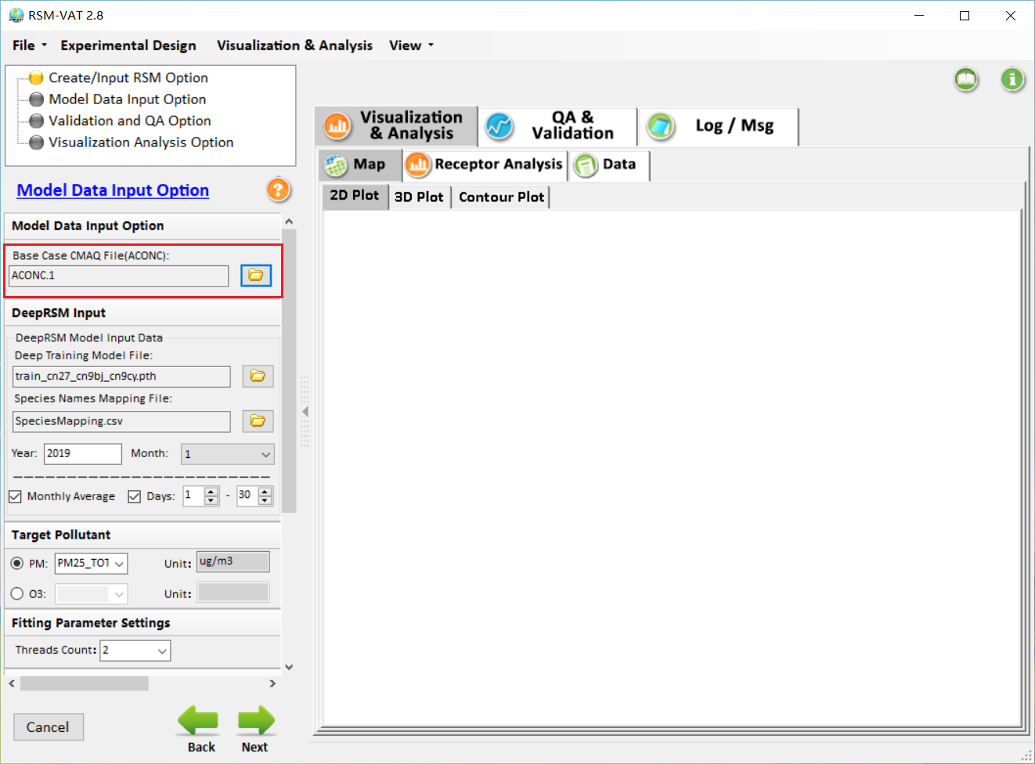
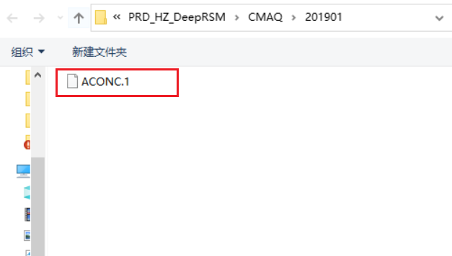
DeepRSM: Model Data Input Option
4.Choose Base Case CMAQ File (e.g., ACONC.1)
4

Slide 5
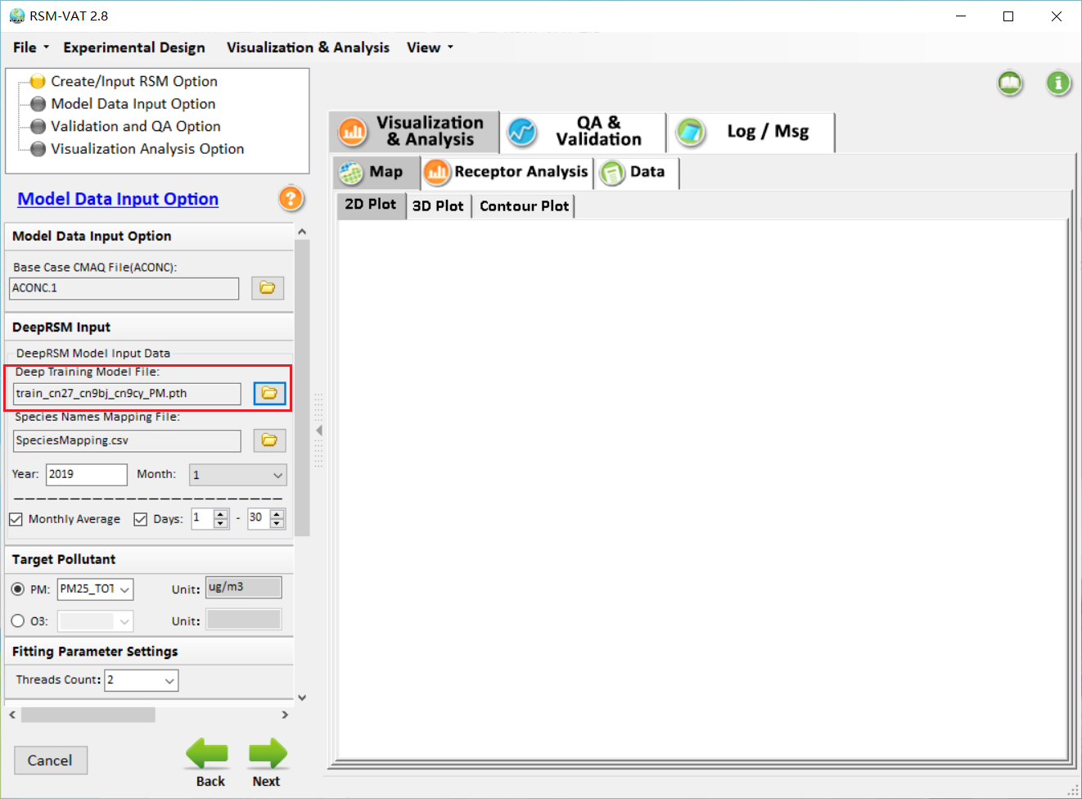
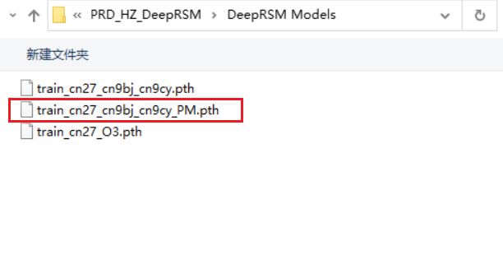
DeepRSM: Model Data Input Option
5.Choose Deep Training Model File, e.g., “train_cn27_cn9bj_cn9cy_PM.pth”
5

Slide 6
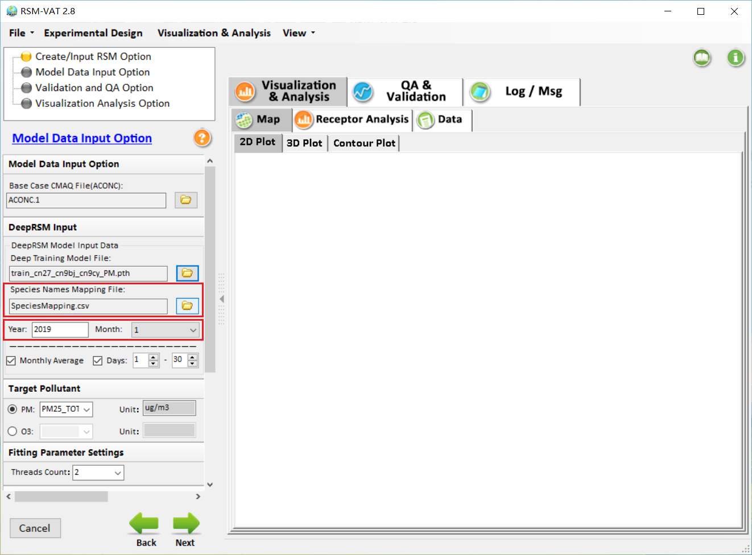
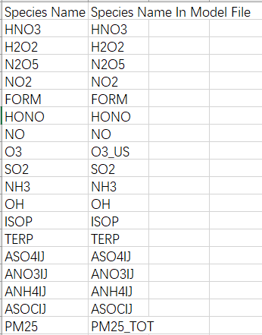
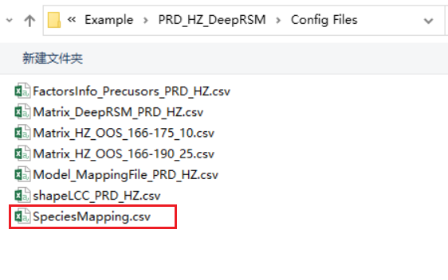
DeepRSM: Model Data Input Option
6.Choose Species Names Mapping File, e.g., “SpeciesMapping.csv”
The time can be read automatically according to the base file(Base Case CMAQ File)
6

Slide 7
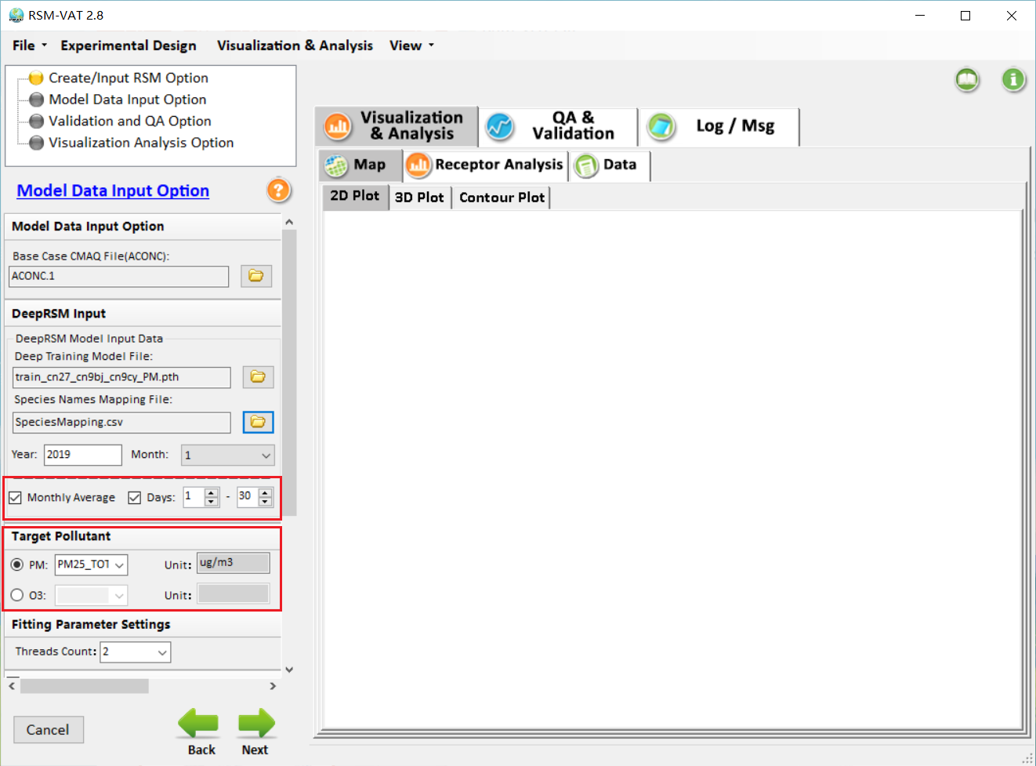
DeepRSM: Model Data Input Option
7. Users can choose monthly or daily calculation according to the provided base file. Multi-days data can be calculated simultaneously. Here select monthly average and Days “1-30” as example.
8. Select target pollutant as needed.
9.Click “Next”
7

Slide 8
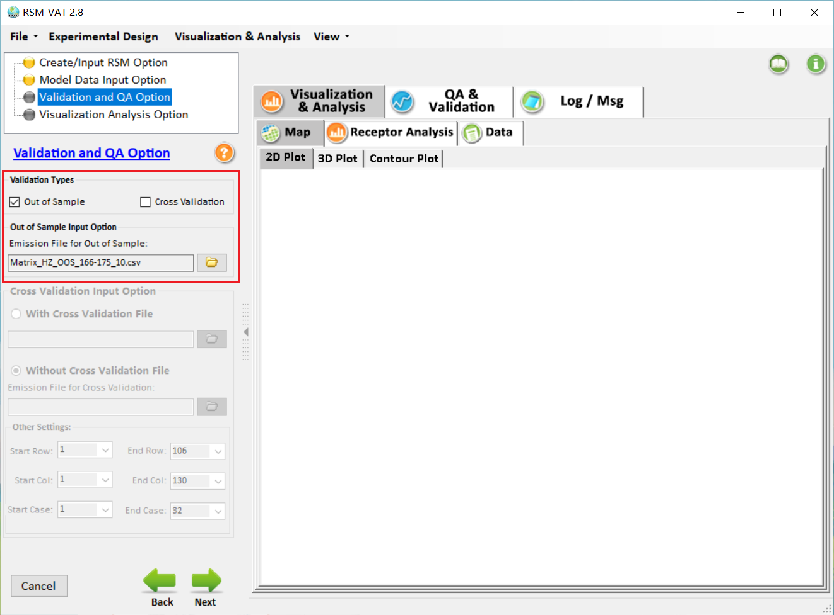
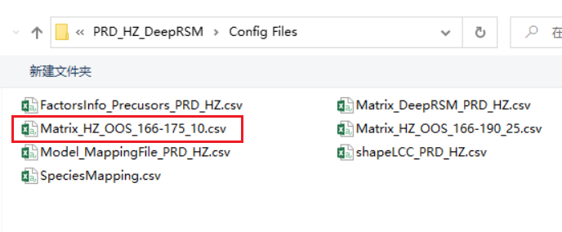
DeepRSM: Validation and QA Option
10. Select OOS validation emission control matrix file, e.g., ” Matrix_HZ_OOS_166-175_10.csv”
11.Click “Next”
8

Slide 9
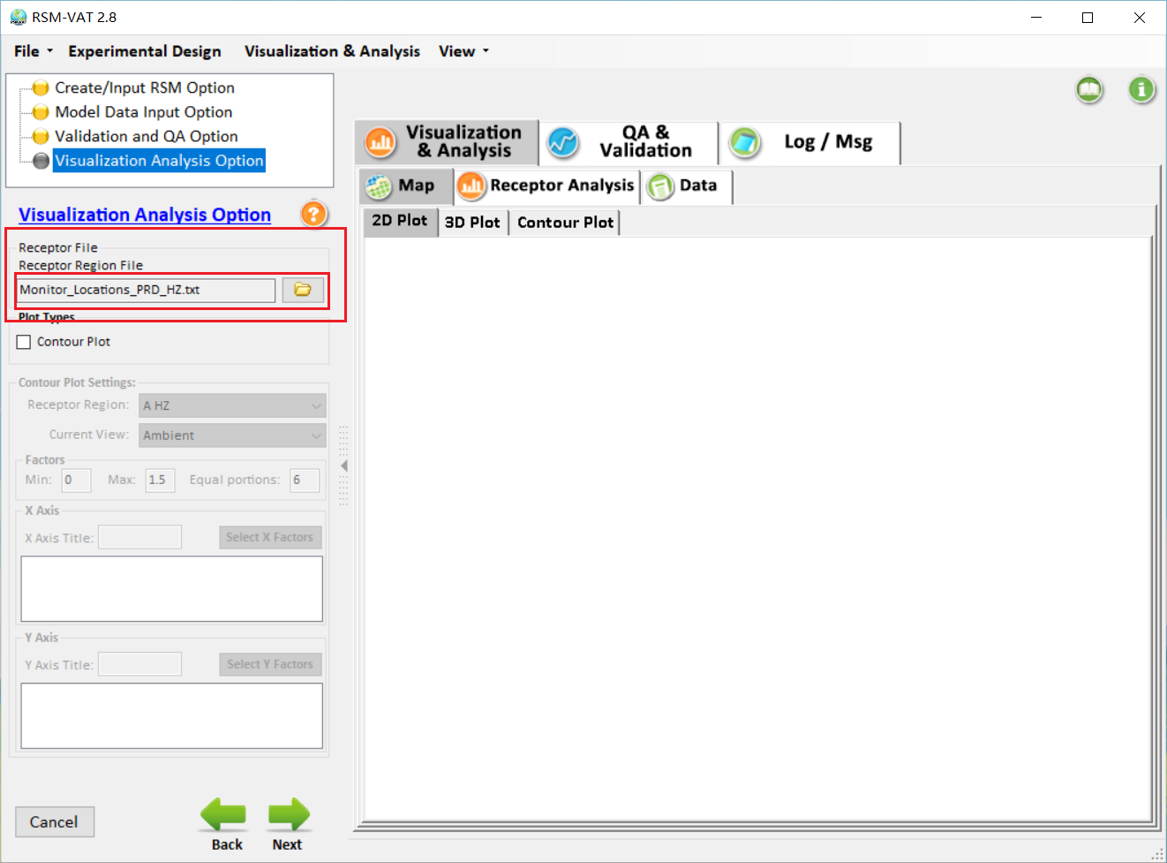
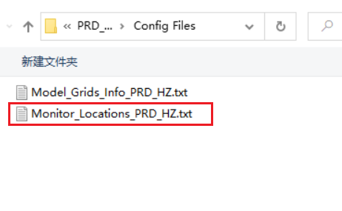
DeepRSM: Validation and QA Option
12.Choose receptor file, e.g., “Monitor_Locations_PRD_HZ.txt”
13.Click “Next”
9

Slide 10
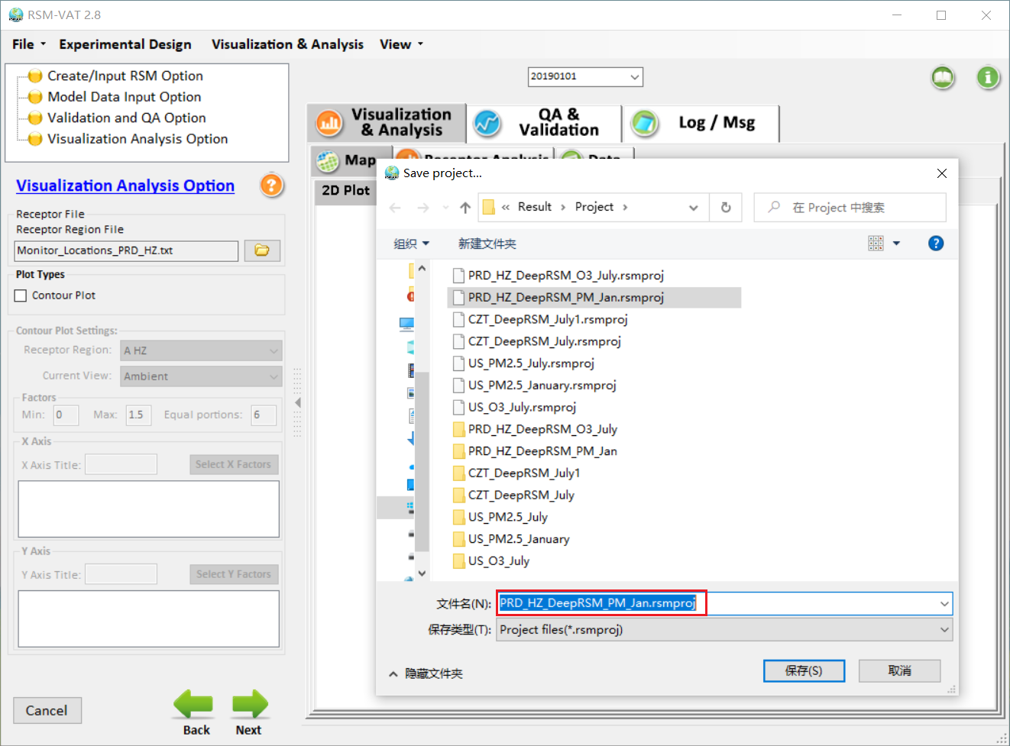
DeepRSM: Save and Running
14.Save and running
10

Slide 11
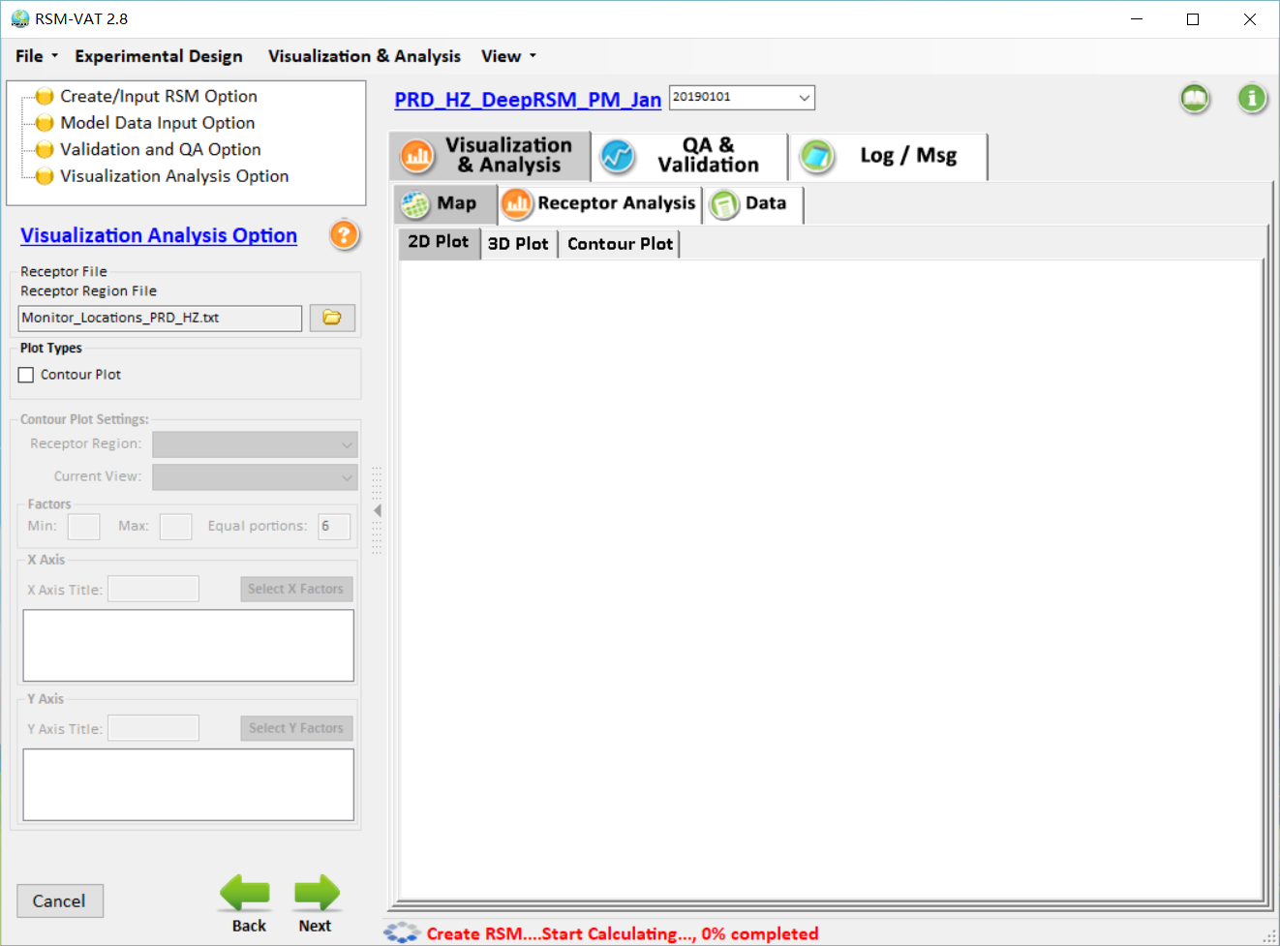
DeepRSM: Running
11

Slide 12
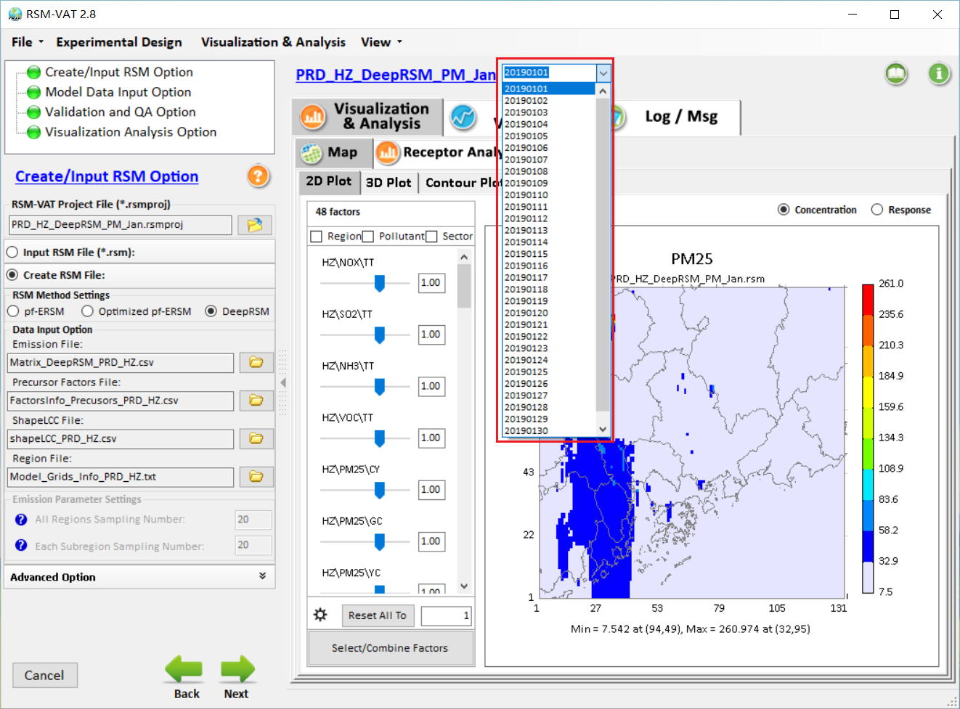
DeepRSM: Results
If daily data calculation is also selected, you can select here to view other results. This selection ends with “32”, which means that results are showing in monthly average. Otherwise, it shows results for selected day.
12

Slide 13
RSM-VAT (DeepRSM)
Quick Tutorial Slides
End
13

