Slide 1
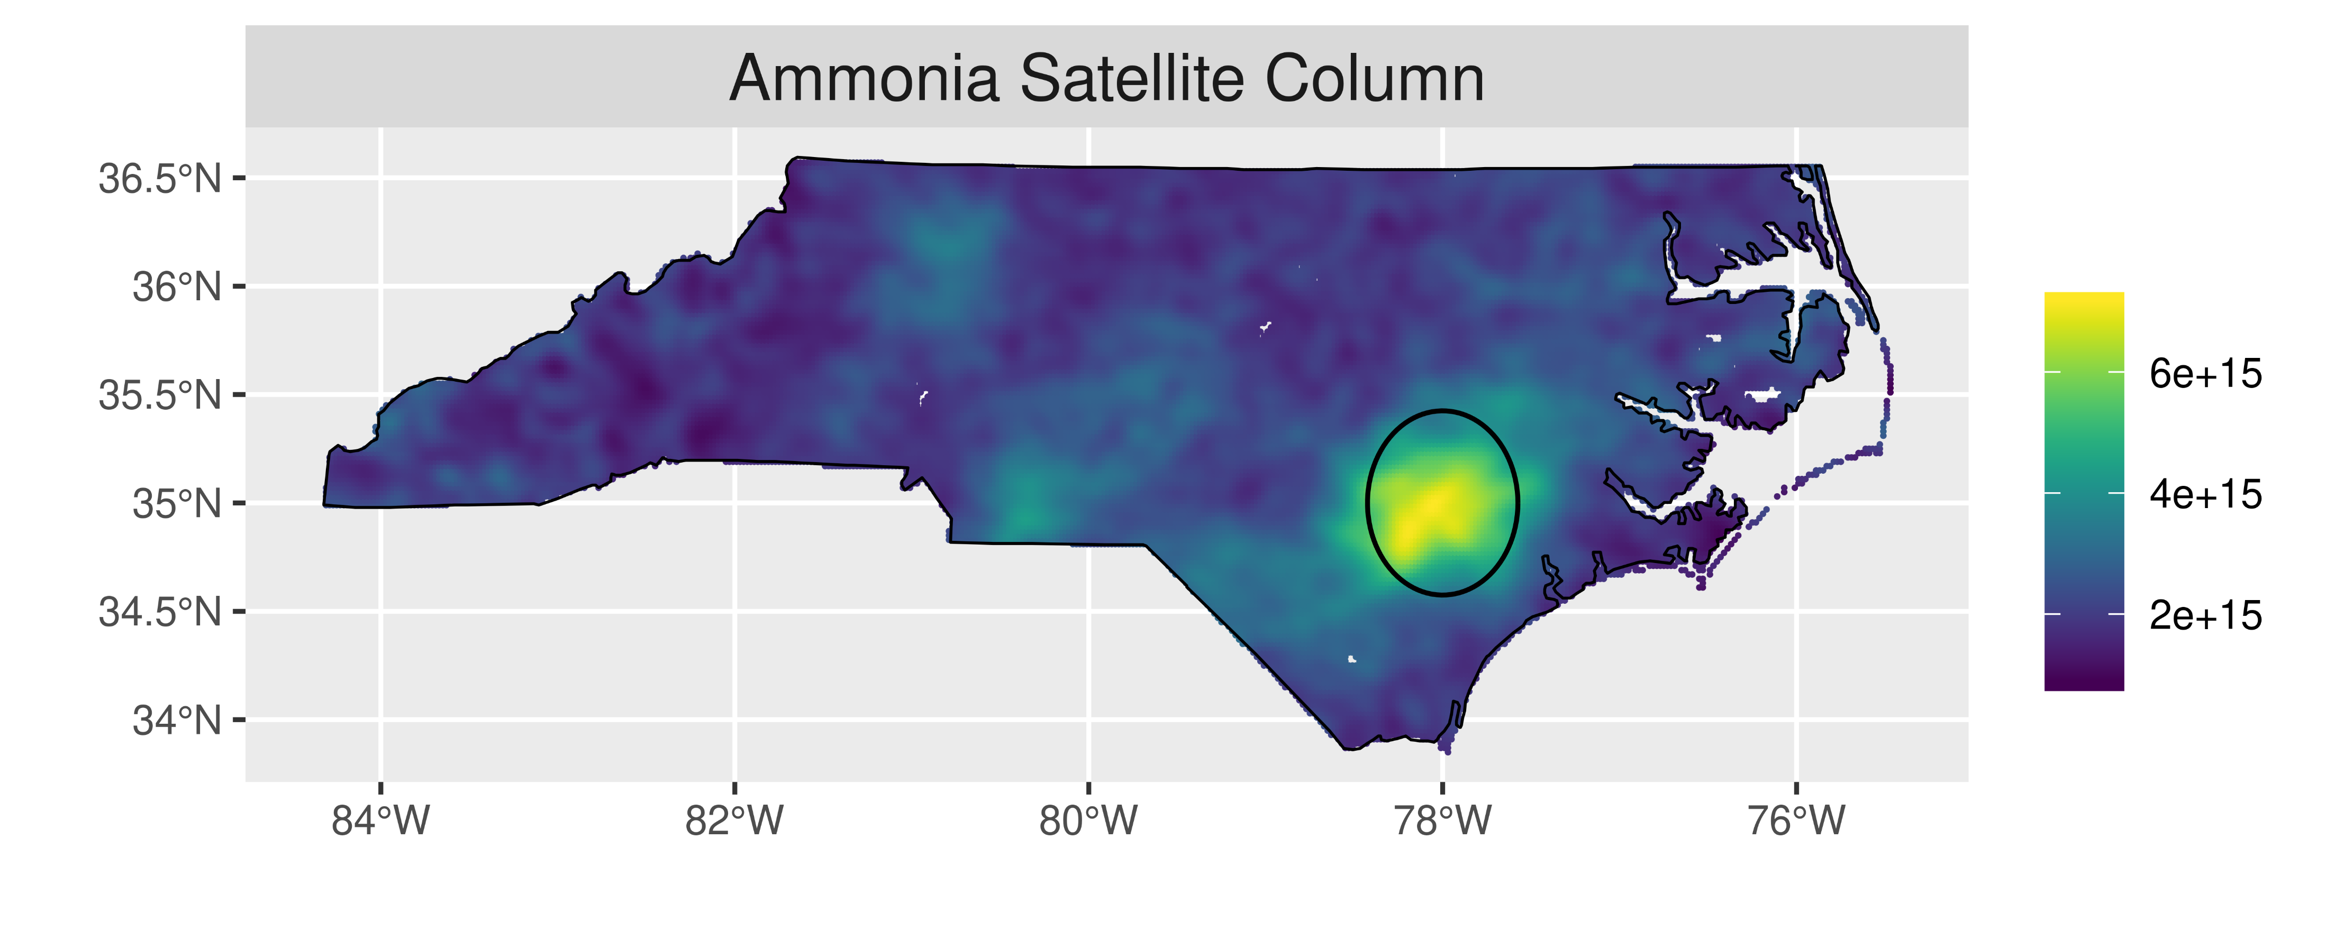
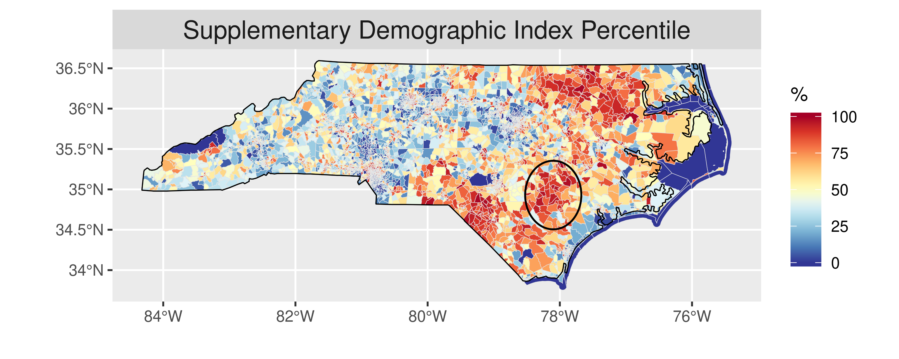
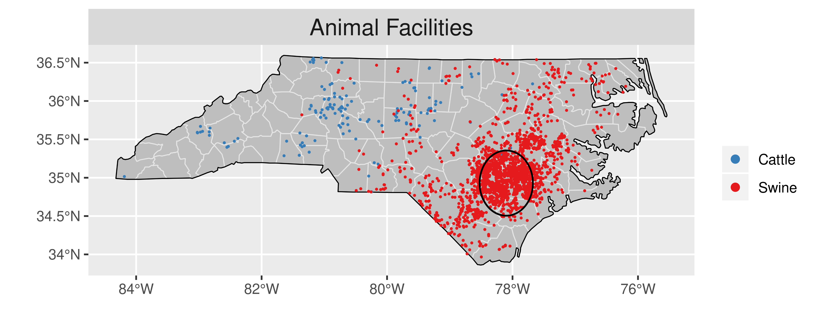
Ammonia in North Carolina
In eastern NC, ammonia is elevated near hog farms where Demographic Index Percentile* is elevated
*Suppl. Dem. Index Percentile: The percentile (% of the US population lives in a block group with a lower value) of the Supplementary Demographic Index (the average of percent minority, percent low income, percent less than high school education, percent linguistically isolated, percent kids, and percent elderly in the block group)

Slide 2
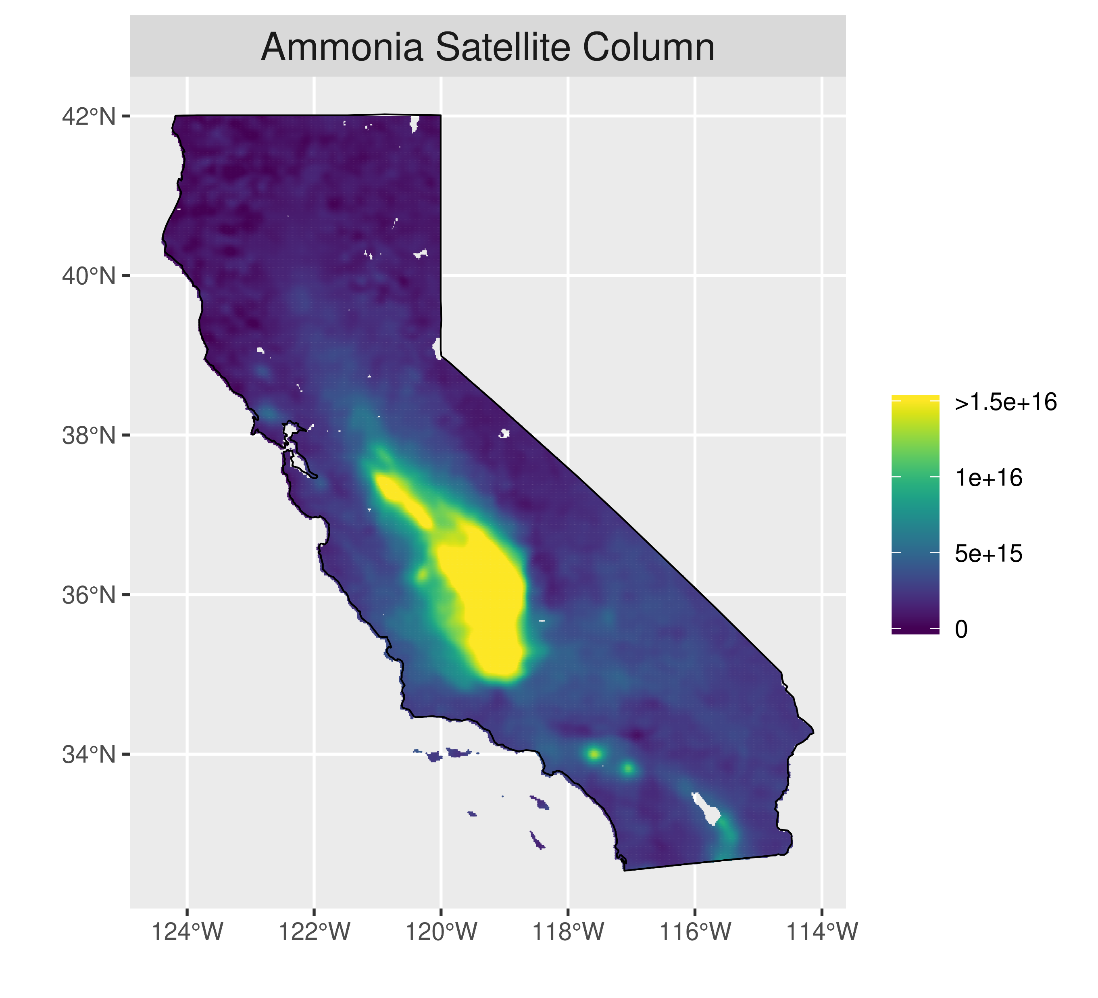
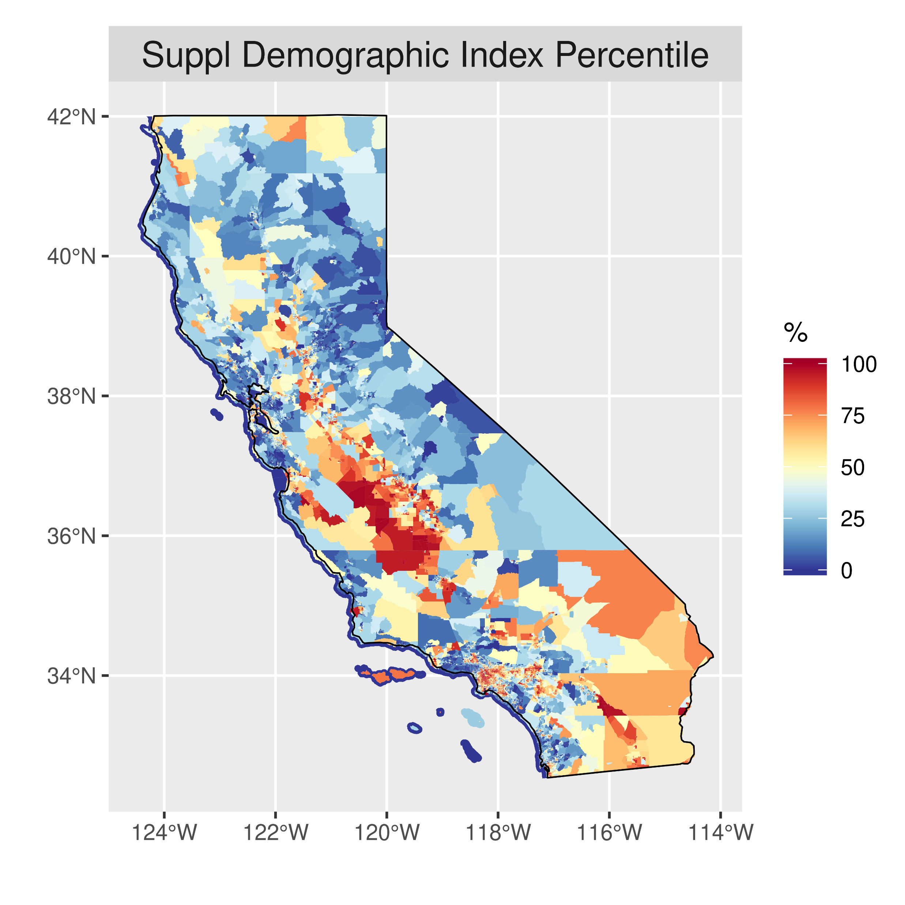
Ammonia in California
In San Joaquin Valley, ammonia is elevated near dairy farms and agricultural activity where Demographic Index Percentile* is elevated
Statewide, ammonia exposure is 30% higher for Hispanic than NH-White based on satellite columns
*Suppl. Dem. Index Percentile: The percentile (% of the US population lives in a block group with a lower value) of the Supplementary Demographic Index (the average of percent minority, percent low income, percent less than high school education, percent linguistically isolated, percent kids, and percent elderly in the block group)
Notes:
Hispanic: 5.29e15
NH-White:4.01e15

Slide 3
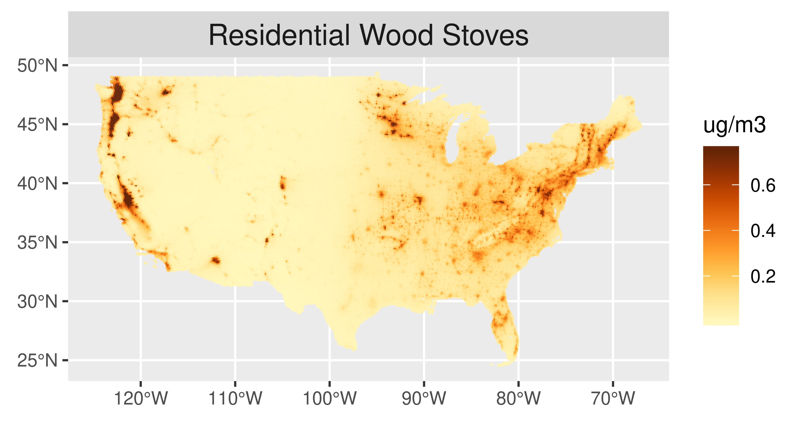
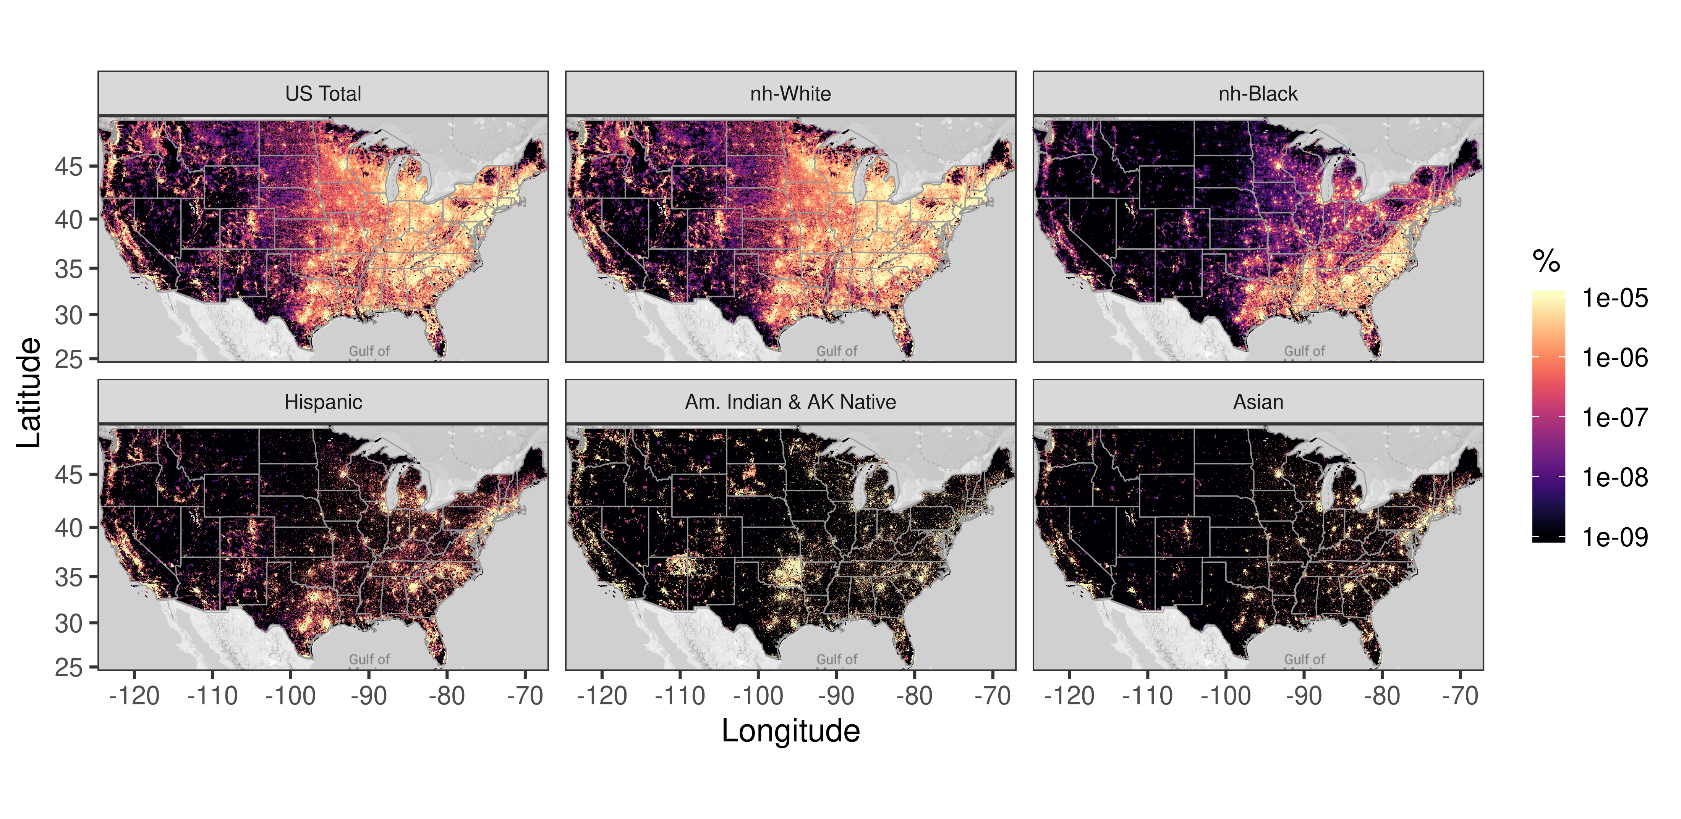
Preliminary Consideration of 2017 Sector Modeling
2017 Sector Modeling from Kirk Baker
Nationally, exposure to PM_{2.5} from residential wood stoves is 30% higher for Asian than NH-White based on 2017 CAMx sector modeling
Future work will examine sector contributions to exposure in more detail
Notes:
Asian: 0.404
NH-White: 0.312

