Slide 1
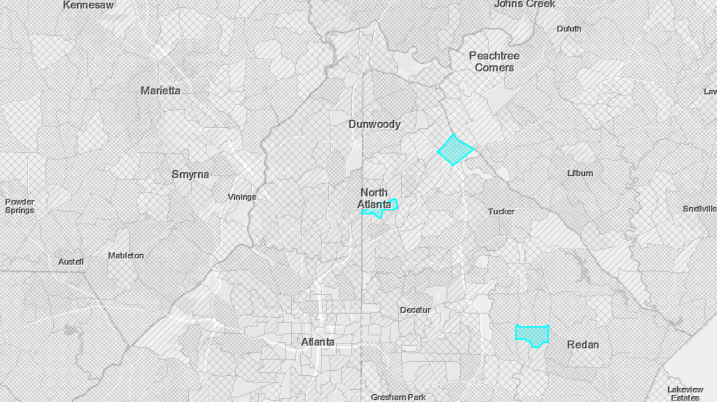

The Nexus Project: Developing a Multipollutant GIS Data Tool
CIMG Briefing
Mark Morris & Ali Kamal
June 7, 2018
Notes:
Angie Shadis (MP website lead)

Slide 2
Overview
Introduction
Goal and Background
Nexus GIS Approach
Nexus Applications
Next Steps
2

Slide 3

Goal
Introduction
Identify geographic areas where high health risks related to ozone, PM_{2.5}, and air toxics overlap.
3

Slide 4
Why do we need a multipollutant approach?
Background
“We breathe on an integrated basis, so we should plan and regulate on an integrated basis.” --- The Regulatory Assistance Project Lead to economic, resource, and health benefits
Air agencies and others continue to express interest and have implemented multipollutant planning. Strategic and holistic approach to emission reductions
Data intensive projects are a challenge (e.g., fused data layers, BenMAP). Federal assistance is a plus.
This tool will allow us to engage with interested areas on multipollutant planning. “Cooperative Federalism”
Allows areas to focus on issues of concern: pollutants, source sectors, co-control, environmental justice. Biggest bang for the buck
4

Slide 5
Previous Proof-of-Concept Work
Background
Wesson et al. Manuscript and AQAD Multi-pollutant Report
Detroit Multipollutant Study Results
 | “Status Quo” | “Multi-pollutant, Risk-Based”
Total Benefits (M 2006$) | $1,127 | $2,385
Avoided Deaths (age >30) | 59-150 | 130-320
Total Costs (M 2006$) | $56 | $66
Cost per µg/m³ PM₂₅ reduced | $0.50 | $0.32
Cost per ppb O₃ reduced | $2.6 | $0.58
Net Benefits (M 2006$) | $1 071 | $2 319
Benefit-Cost Ratio | 20.1 | 36.1
*Identified areas in Detroit where 75th percentile levels overlapped
5

Slide 6
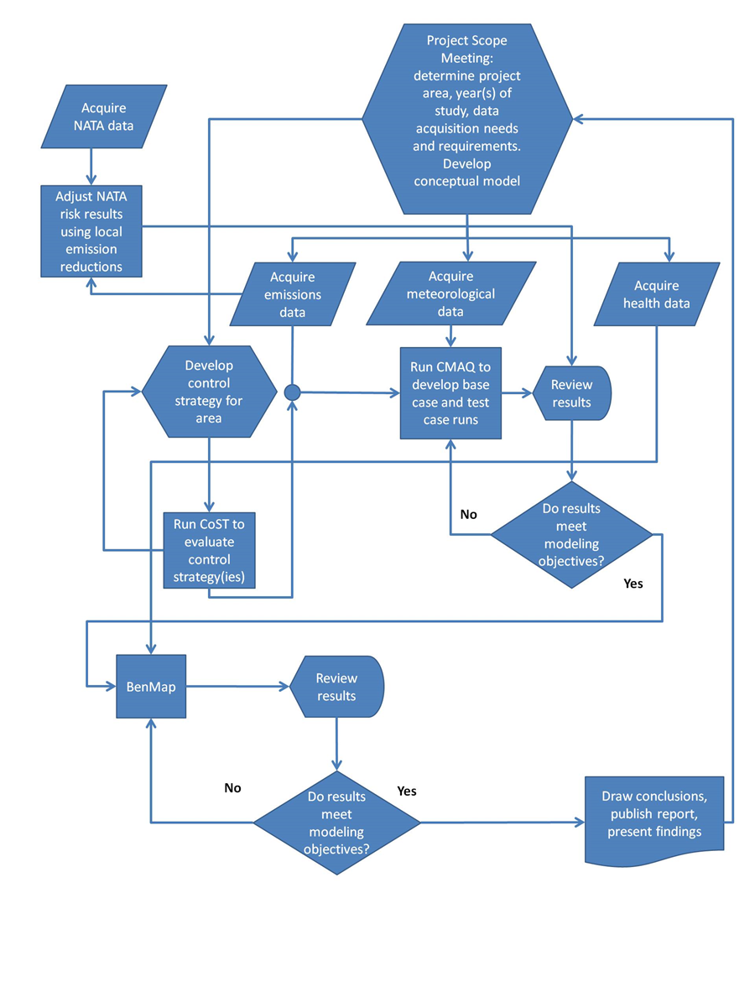
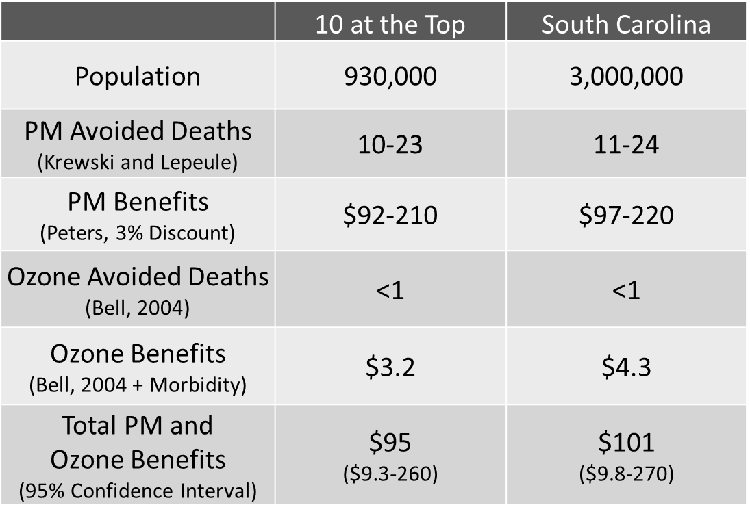
Previous proof-of-concept work
Background
South Carolina Project
Worked Directly with the SC Dept of Health
CMAQ Modeling Performed by SC Staff
Non-Regulatory, Voluntary Control Strategies
Scavo et al. 2017
6

Slide 7
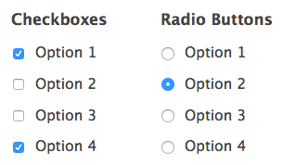

Nexus Current Capabilities
Background
Identify geographic areas with multipollutant air quality issues (ozone, PM_{2.5} and air toxics) and highlight/characterize the health risks associated with the select multipollutant areas
Provide screening information on the nature of the multipollutant issue:
Nature of the pollutant exposure
Degree to which a susceptible population may be exposed
Degree to which common precursors and emission sources contribute to the risk
Interactive map with user-defined inputs and scaling functions (percentiles) to optimize the query
7
Notes:
Similar in design to NATA app – developed in-house
Visualize data and identify nexus areas
User can specify any combination of criteria, including values and/or percentiles, to identify nexus areas
Advantages – straightforward, easily updated with new data, interactive, user-defined parameters
SA would help, beyond screening – 2016NEI model performance (A. Eyth) set emissions up and input into the model “If” you ever want to do a SA model (Various (~20) base case runs – to get good estimates) Mobile S; IPM (EGUs) ; CSN and IMPROVE (filters) – 17 sectors ; CAMx SA modeling - 2016 Model Performance comparisons; Tier3 (mobile source) CAMx was used;

Slide 8
AQAD and HEID Collaboration
Nexus Current Data
Background
Ozone and PM
Emissions Data
Health-Related
2011 Ozone and PM_{2.5} Concentrations (Fused data fields based on modeling and ambient data)
2011 Ozone and PM_{2.5} Design values
2008, 2011, 2014 National Emissions Inventory - Air toxics emissions data summary by pollutant and sector (Point, Non-point, Onroad, Nonroad)
2010 Census Tract Population Data
Air Toxics Risk Estimates (Cancer Risk and Non-Cancer Respiratory Hazard Index)
BenMAP-CE health endpoint estimates based on epidemiological studies: Mortality, Hospital Admissions, ER Visits
Data Presented in Absolute
Values and by Percentage
8

Slide 9
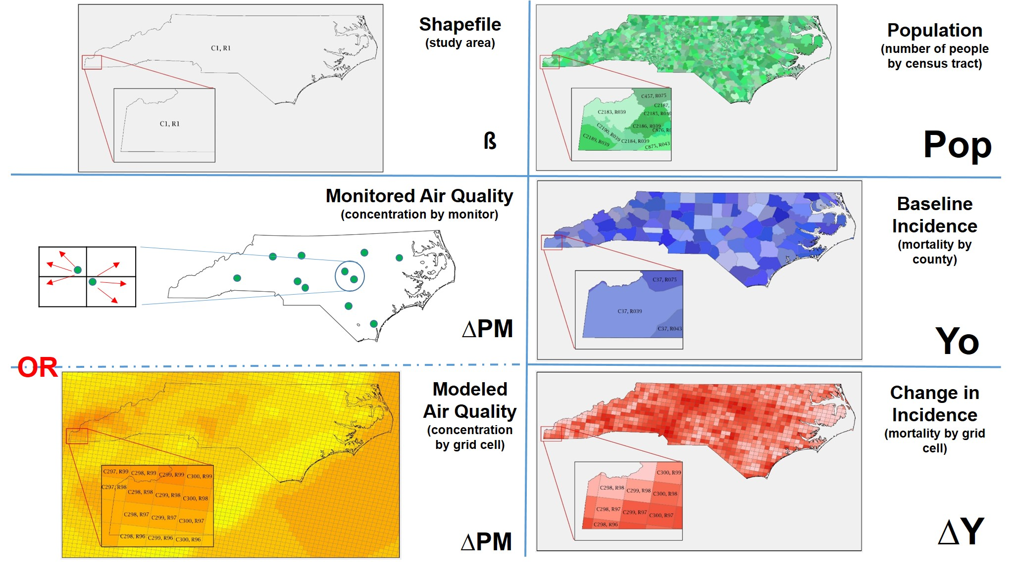
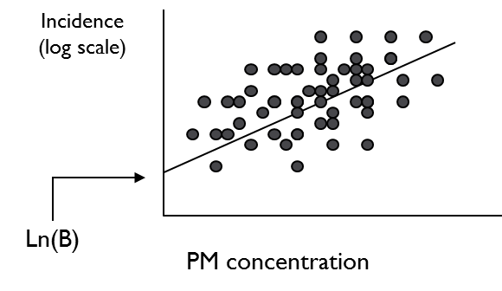
BenMAP-CE Background
Underlying Data Layers
∆ Y = Yo (1-e ^{-ß∆ PM}) * Pop
Background
^{β}
9

Slide 10
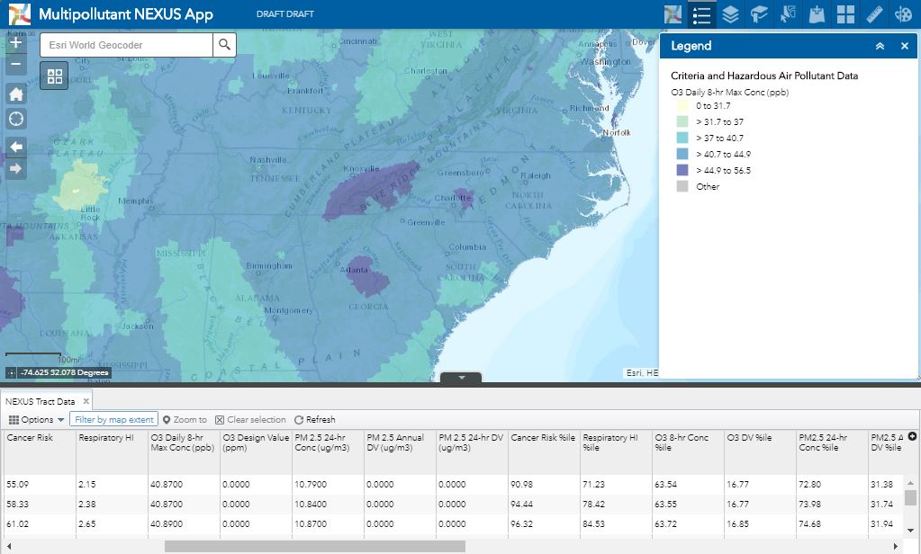
Nexus Data Layer – Pollutant Data Layer
GIS Approach
Ozone daily 8-hour max concentration (ppb)
10

Slide 11
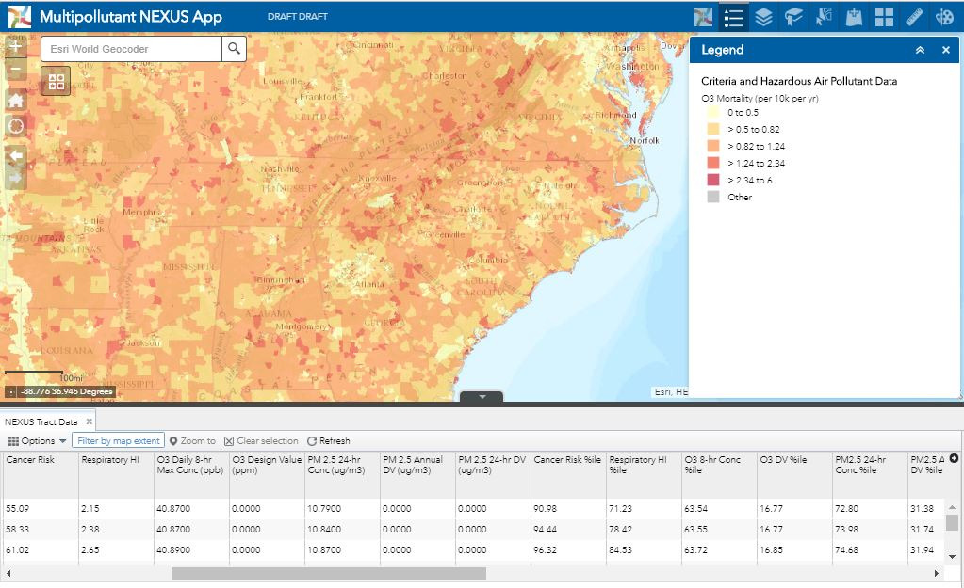
Visualizing BenMAP-CE Results (Total Burden Analysis)
GIS Approach
Ozone mortality (per 10k per year)
11

Slide 12
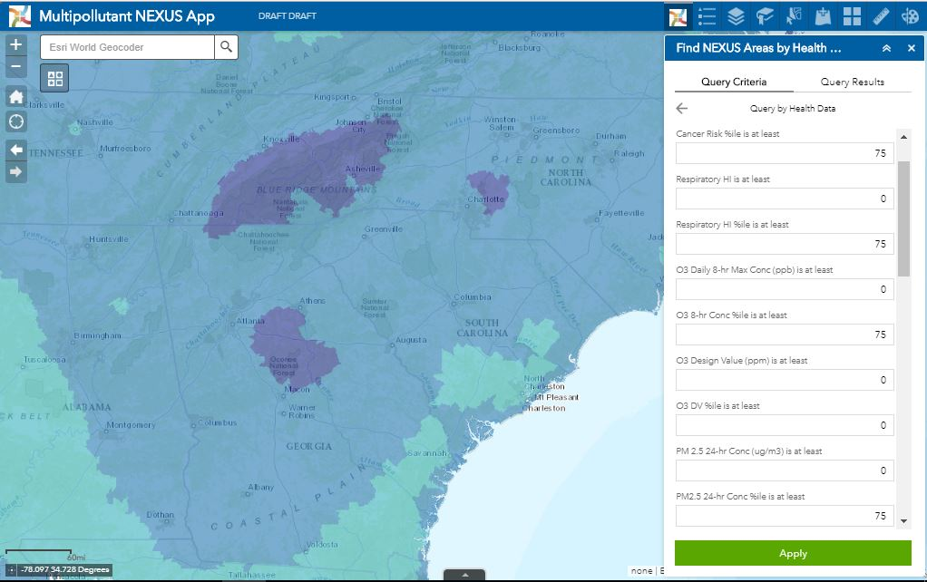
Performing a Query with the Search “Widget”
GIS Approach
≥ 75 percentile of Ozone and PM_{2.5} concentration, Cancer Risk, and Respiratory HI
12

Slide 13
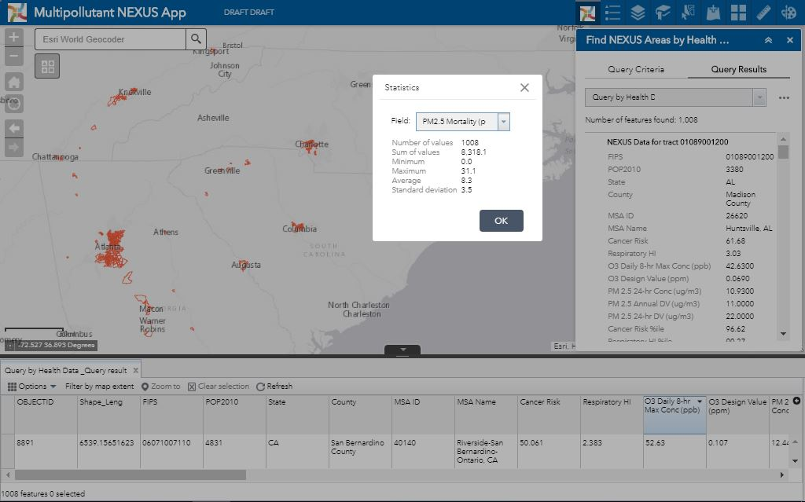
Evaluating the Query Results in the Attribute Table
GIS Approach
13

Slide 14
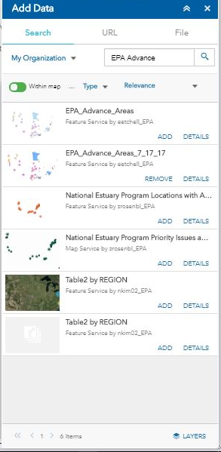
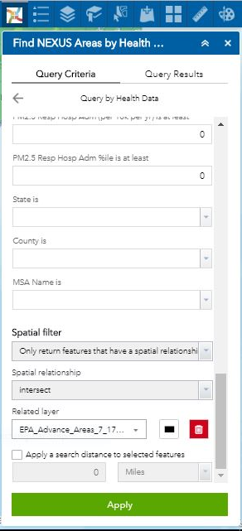
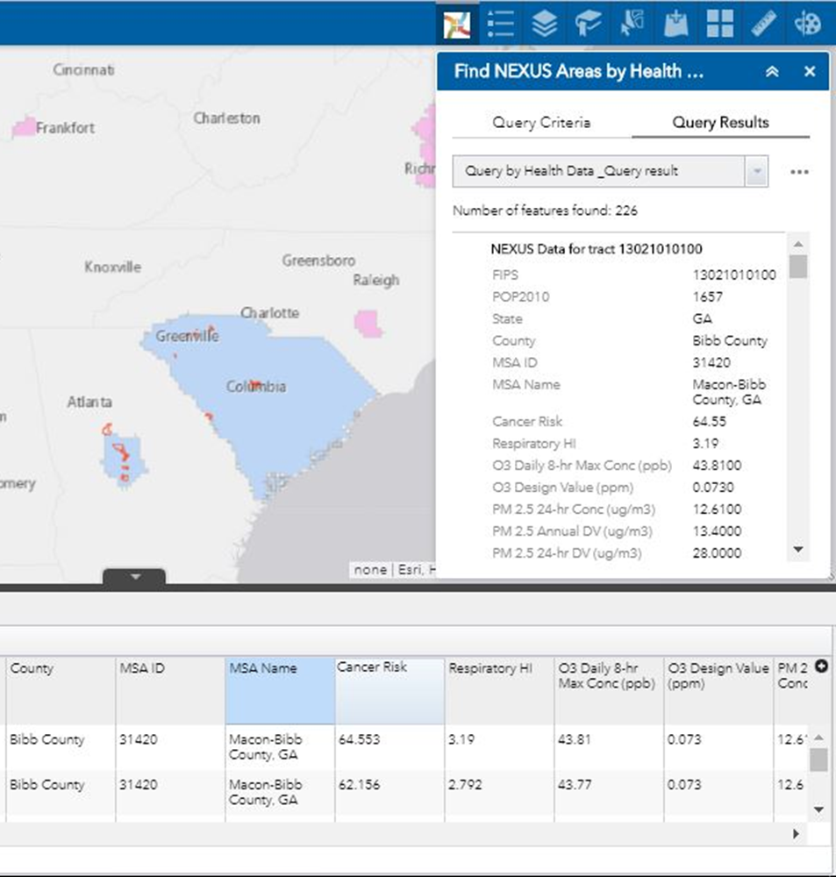
Where the Query Intersects Advance Areas
GIS Approach
14

Slide 15
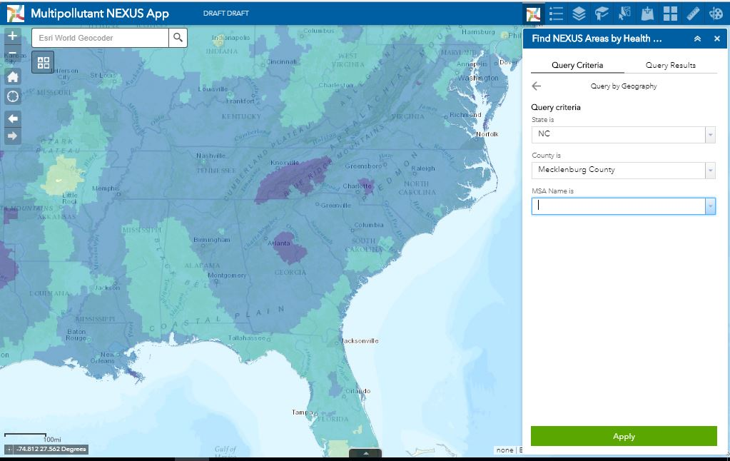
NEXUS App – Query by Geography - County
GIS Approach
15

Slide 16
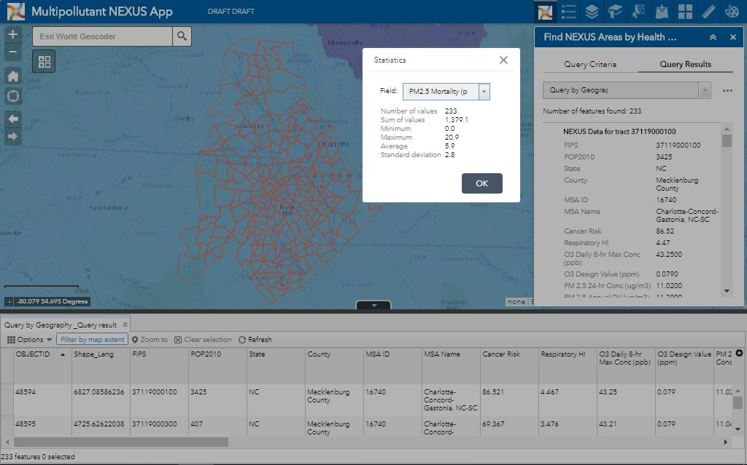
Query by Geographic Area
GIS Approach
16

Slide 17
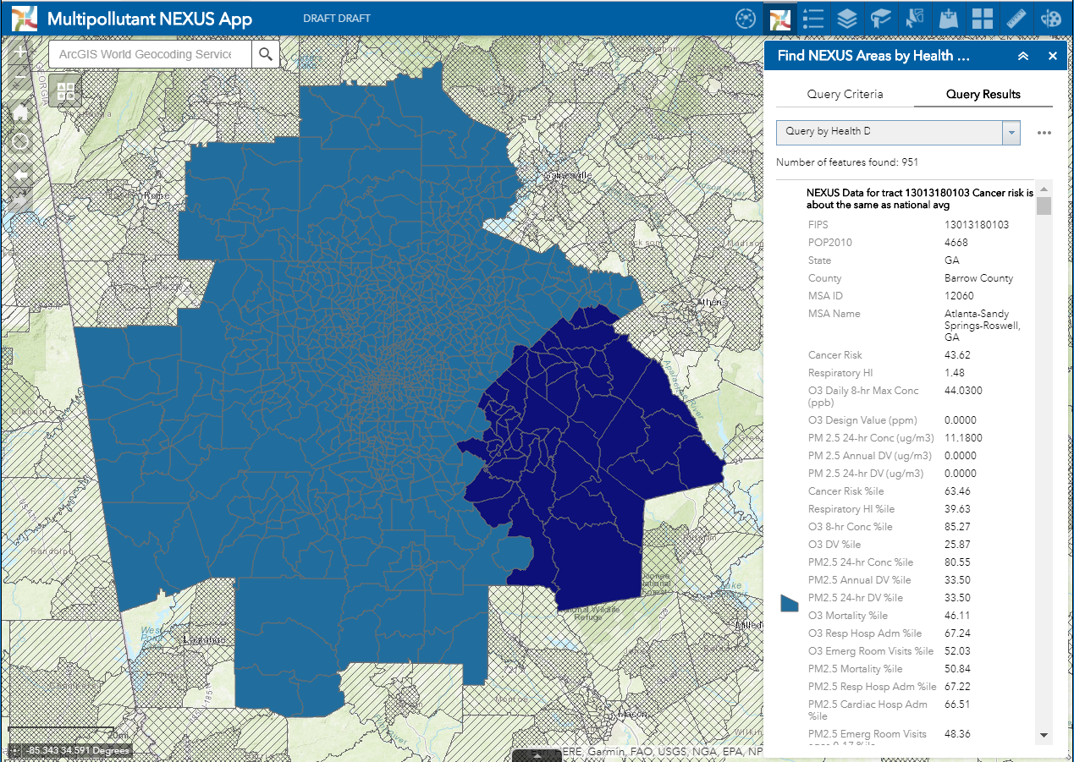
Query by Geography – Atlanta Metropolitan Area Ozone 8-Hour Max
Application
17

Slide 18
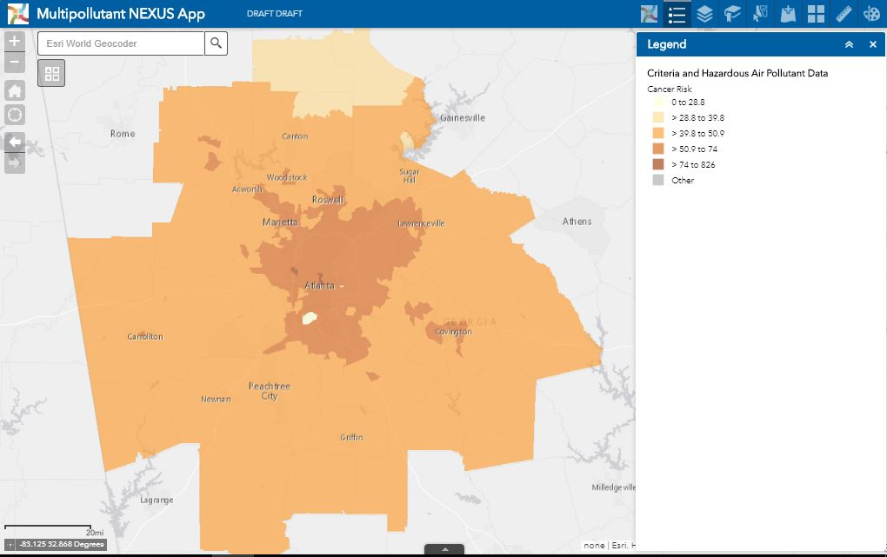
Total Cancer Risk Cases per Million
Application
18

Slide 19
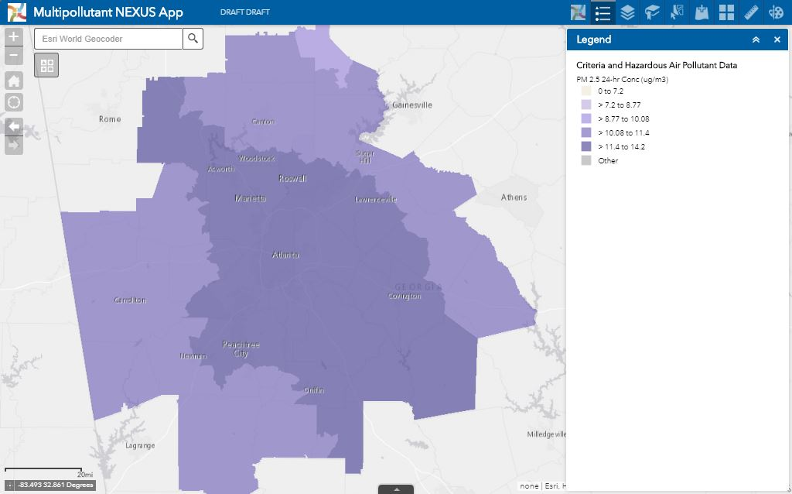
2011 PM_{2.5} Annual Mean Census Tract Fused Surface Concentrations
Application
19

Slide 20
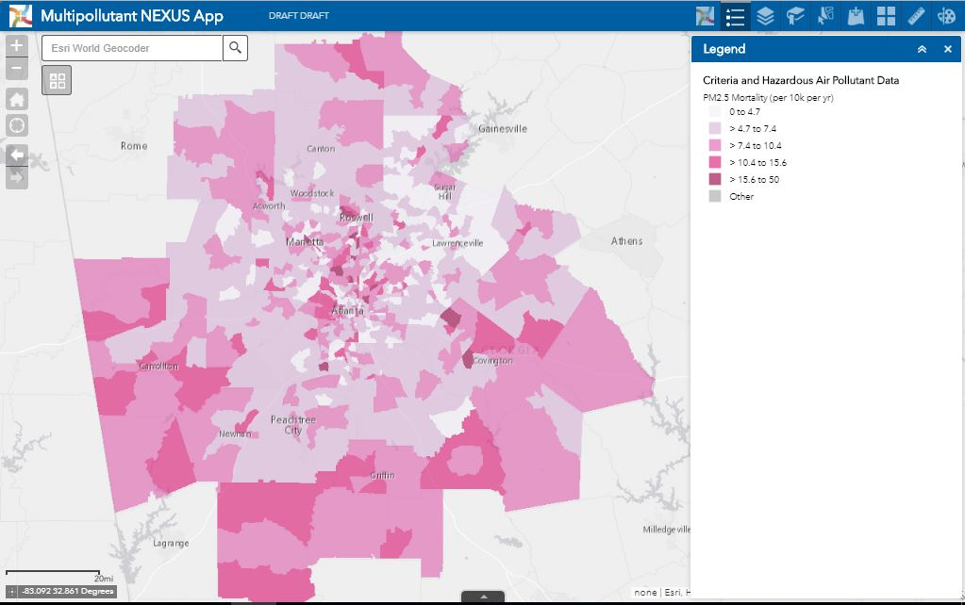
PM_{2.5} Attributed Mortality Deaths per 10,000 per Year
Application
20

Slide 21
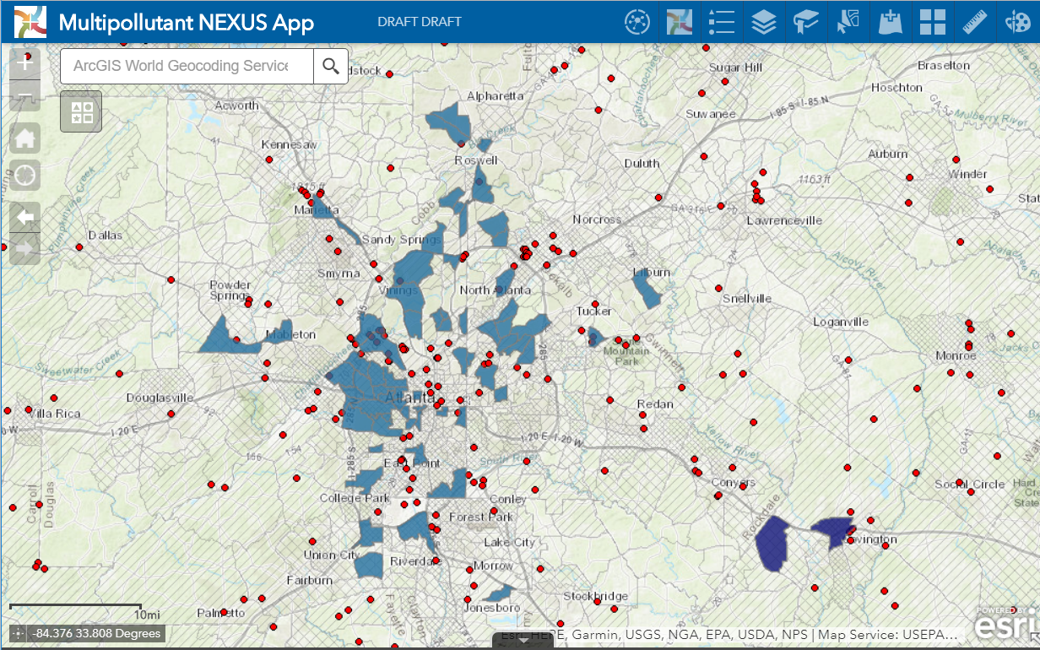
The “Nexus” Results
Application
Query: Cancer Risk ≥ 50, PM_{2.5} Conc ≥ 10; PM_{2.5} Mortality ≥ 10
21

Slide 22
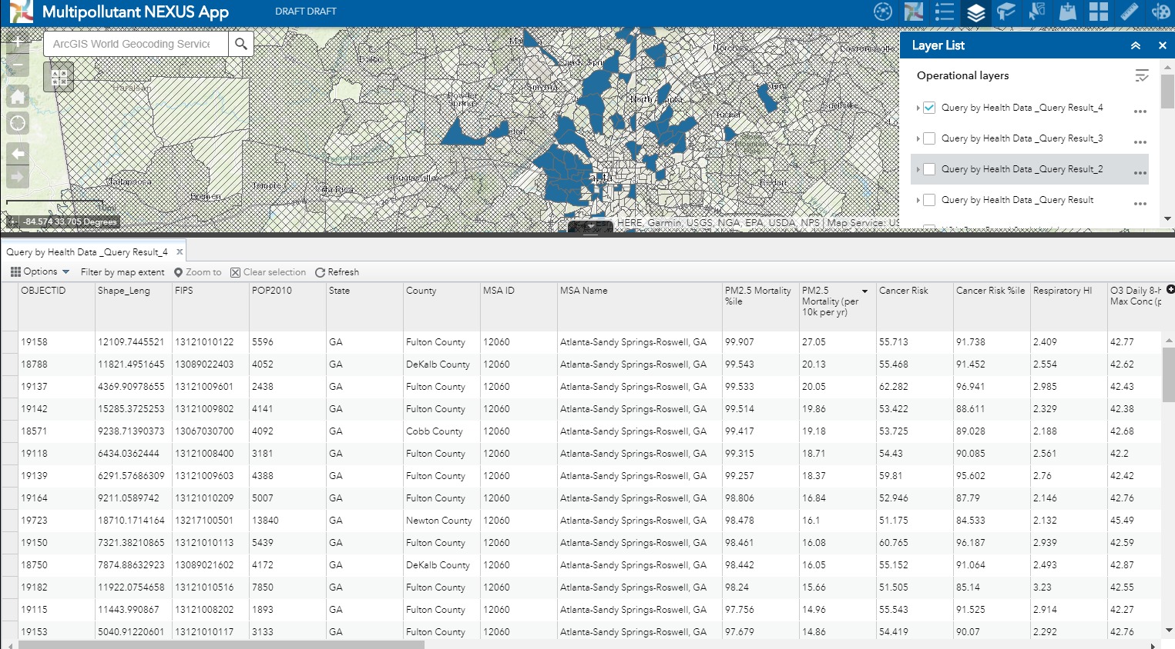
The “Nexus” Results
Application
Query: Cancer Risk ≥ 50, PM_{2.5} Conc ≥ 10; PM_{2.5} Mortality ≥ 10
22

Slide 23
Future Nexus Capabilities
Next Steps
Provide Management with a list of areas (summary reports) in attainment with violating monitors where a multipollutant approach would be effective
Add the 2014 Fused Surface Data and Reanalyze Benefits Results and Compare the Findings with 2011 Results
Collaborate with AQAD to investigate source apportionment in high interest Nexus areas – find the greatest benefits
Provide screening data for potential emission reductions that could reduce health risks (provide health benefits) and the appropriate controls: COST
23

Slide 24
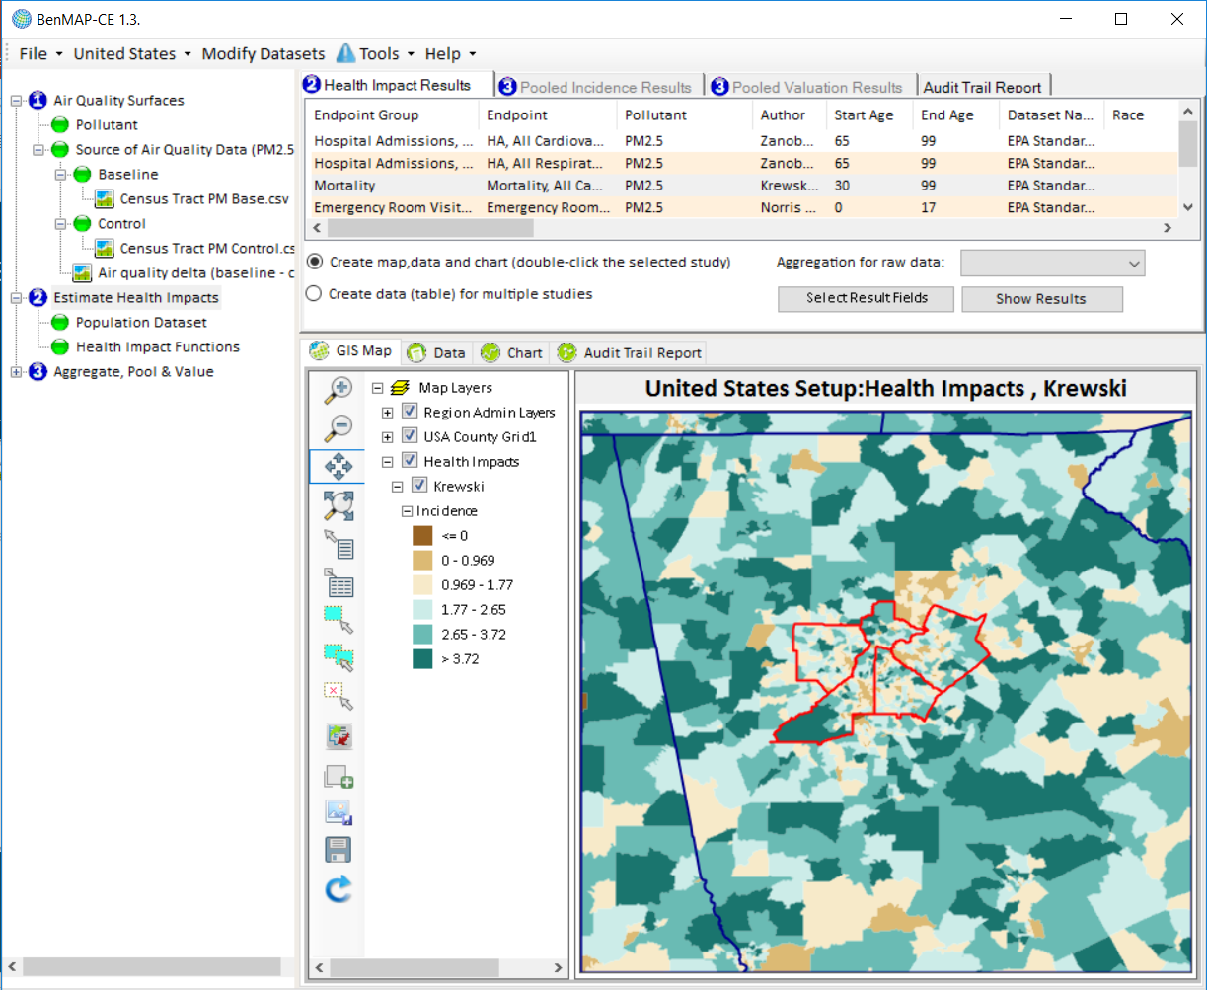
BenMAP-CE “Rollback” Scenario
Next Steps
Nexus Data: 361 Deaths
PM2.5 Rollback: 324 Deaths
Avoided Deaths: 35
PM2.5 by 10% in all Census Tracts in Fulton County
Limitations: Impacts are all within a single county, PM2.5 reductions cannot be interpolated across neighboring counties without the help of air quality modeling
24

Slide 25
Parting Thoughts on the Nexus Tool
Next Steps
Flexible, interactive map used to screen geographic areas for their multipollutant air quality issues is what makes this tool accessible
Census tract level health benefits analysis (BenMAP-CE) based on the multipollutant risks is what sets this tool apart
Other map services (demographics, climate factors, can easily be added to the query and newer data (NEI, NATA, Design Values) can be added when published
Our goal is to work collaboratively with state and local groups on their multipollutant air quality management plan, giving them targeted reductions that maximize the health benefits
25

Slide 26
Questions?
Next Steps
Notes:
My Questions: How can this be applied in an international setting? We see international users dire for this information. Currently BMp now has the GBD dataset in BenMAP – We are fortunate we have so many high resolution underlying data. This can be a launching pad for others to do quick analysis
Another Question: There are so many other tools out there: CHVI EJScreen

