Slide 1
WO 2-18 Task 2 Webinar: Multipollutant GIS Data Analysis
Bryan Penfold, Mike McCarthy, Ashley Graham, and Hilary Hafner
Sonoma Technology, Inc.
October 13th, 2016

Slide 2
Schedule
Task 1: Work plan
Task 2: GIS nexus estimates
Webinar presentation
Technical memo (draft, comments, and final)
Data layers and methodology
Task 3: Nexus suitability
Task 4: Final deliverables

Slide 3
Goal of Task 2
Identify and visualize geographic areas where high health risks related to ozone, PM_{2.5}, and air toxics overlap (nexus areas).
CONUS only
Develop a GIS spatial database for which individual map layers can be overlaid to assess the spatial nexus of air quality issues.

Slide 4
Data Collection
Air toxics risk estimates (cancer and non-cancer neurological and reproductive indices), emissions, and concentration data from the 2011 National Air Toxics Assessment (NATA)
2011 ozone and PM2.5 concentrations (fused data fields based on modeling and ambient data)
Designated nonattainment areas and design values for ozone and PM2.5
Emissions data summary by source sector and pollutant from the 2011 National Emissions Inventory (NEI)
U.S. population data from the 2010 census, including demographic attributes
Latitude and longitude of federal reference method monitors for ozone and PM2.5
BenMAP estimates of county-level morbidity and mortality estimates based on 2011 ozone and PM2.5 concentrations
Baseline prevalence and incidence estimates for morbidity and mortality endpoints

Slide 5
Nexus (Hot Spot) Analysis
Data included…
Toxics
Cancer risk (census tract)
Respiratory hazard (census tract)
Ozone and PM2.5
Fused concentrations (census tract)
Monitor-based design values (aggregated to county level, then assigned to corresponding census tracts)

Slide 6
Nexus Data Layer Scenarios
Layer normalization – Additive approach
Layer normalization – Multiplication approach
Layer ranking – Additive approach
Layer ranking – Multiplication approach

Slide 7
Normalization vs Rank Ordered
Normalization - Values are normalized on a scale of 0 to 100, with the highest concentrations ranked highest
Rank ordered – Values are rank ordered on a scale 1 to ~72000 census tracts. Ties are given the same value. Low ranks = high values.

Slide 8
Current Weighting Schemes
Each pollutant category (ozone, PM_{2.5}, toxics) is averaged individually for all of its own data layers.
Additive schemes –(ozone + PM_{2.5} + toxics)/3
Multiplication schemes – (ozone X PM_{2.5} X toxics)^0.333

Slide 9
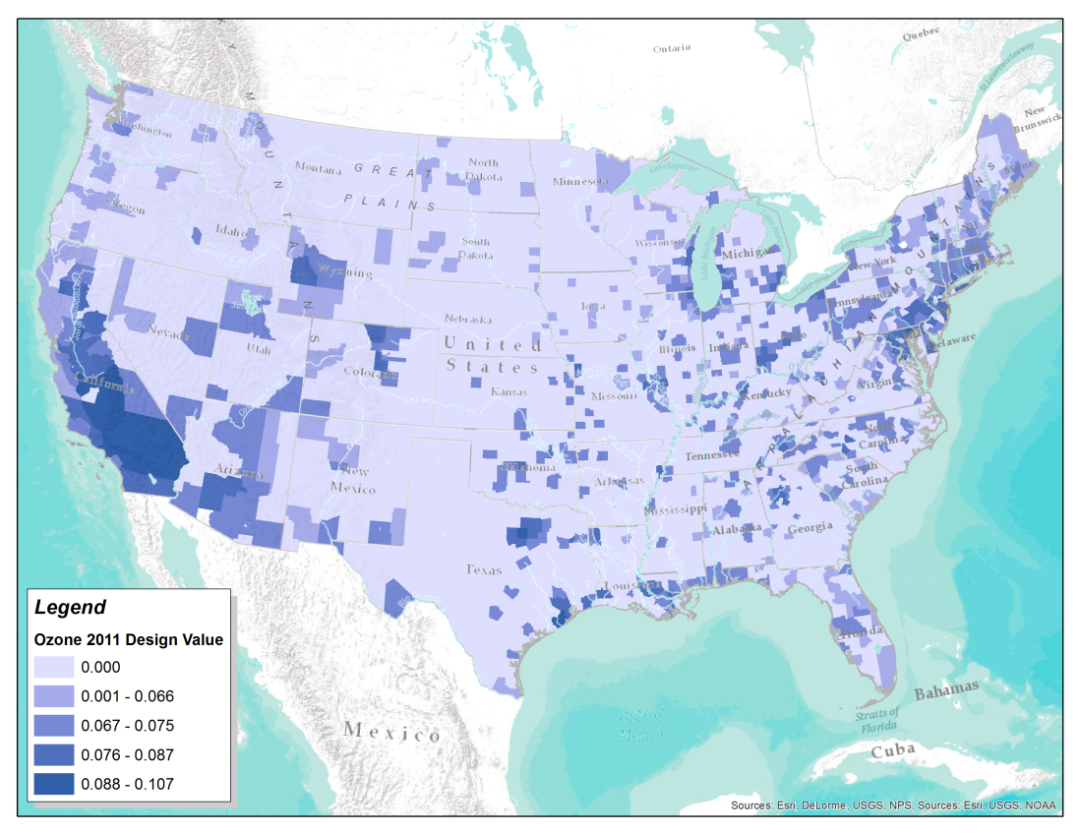
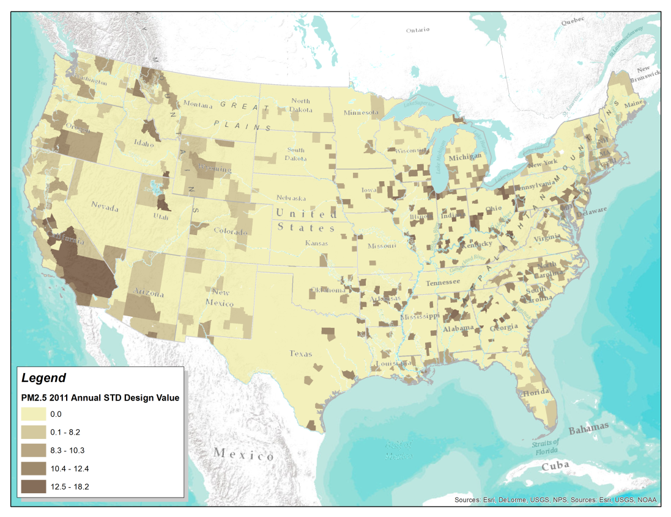
Data Layer Maps
2011 Monitor-based Design Values

Slide 10
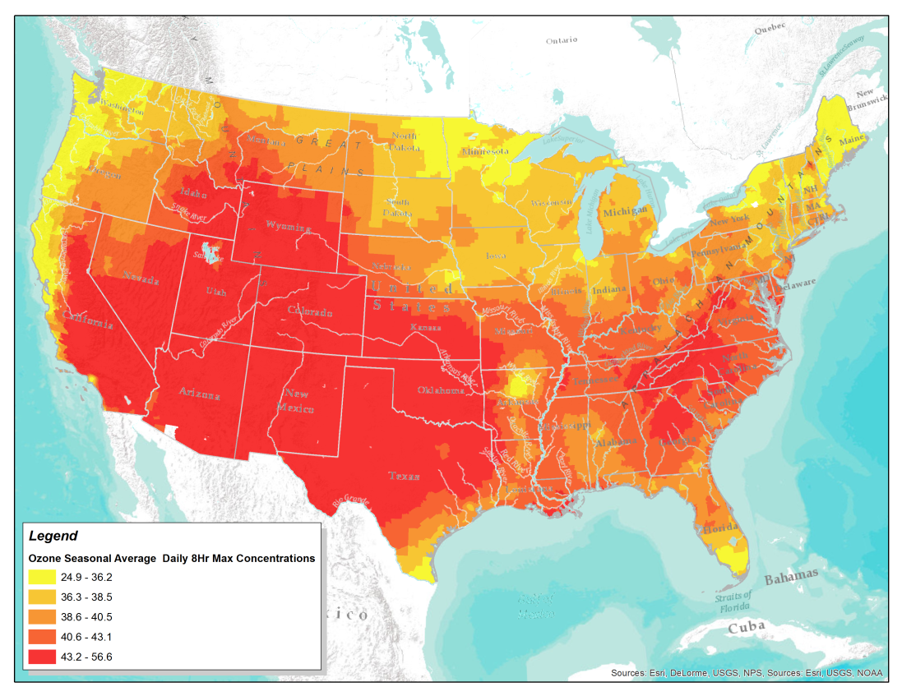
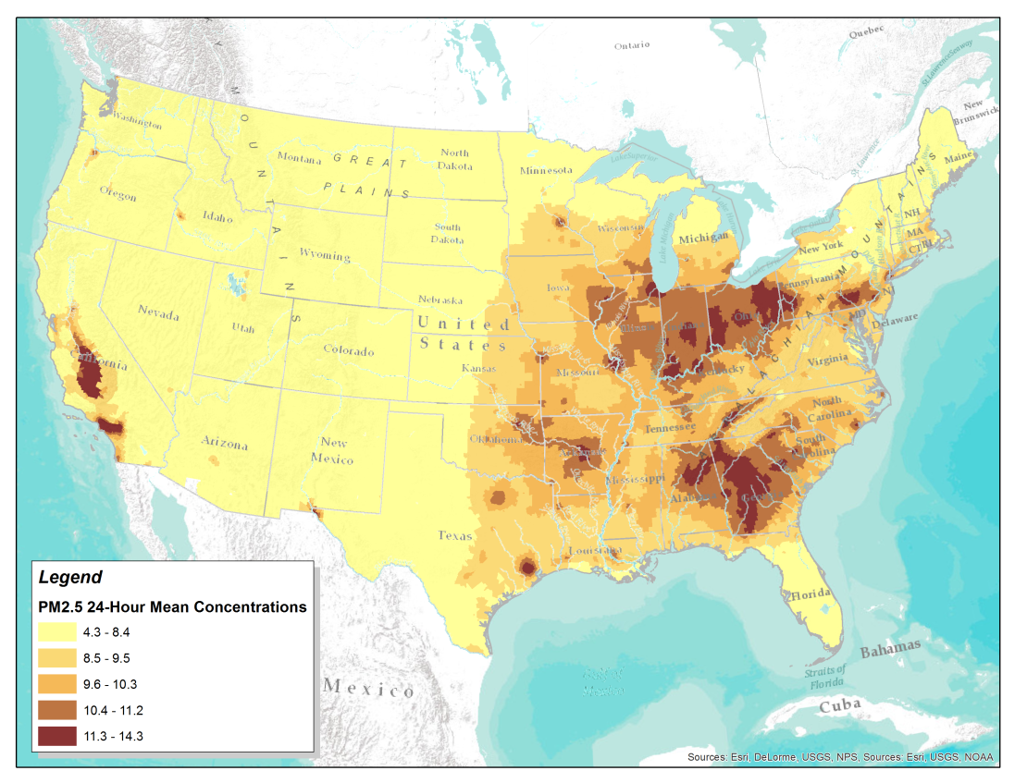
Data Layer Maps
2011 Fused concentration data

Slide 11
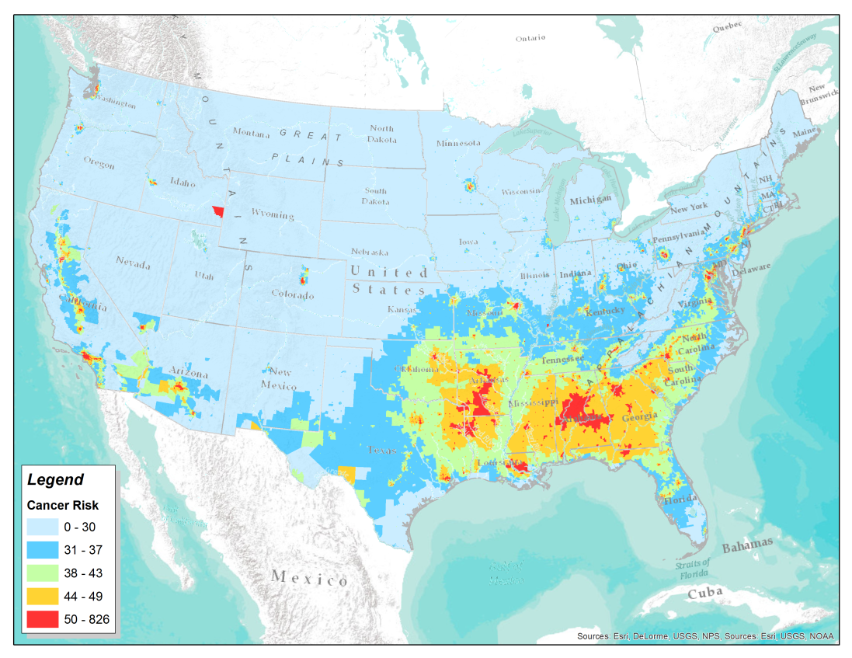
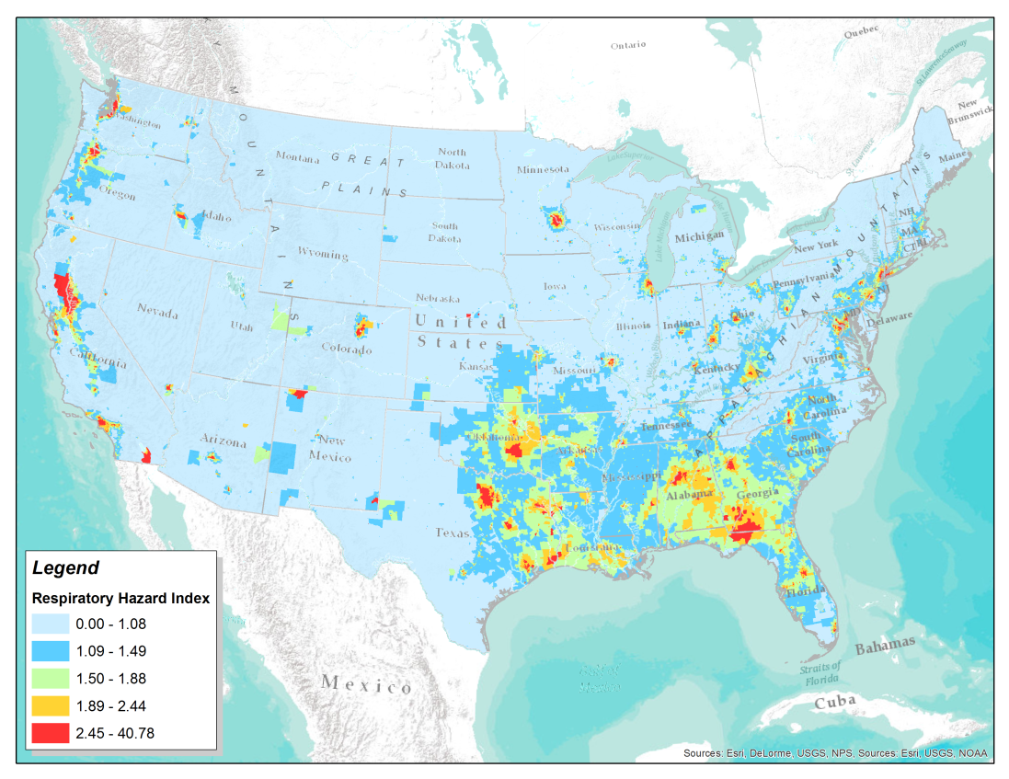
Data Layer Maps
2011 NATA toxics data

Slide 12
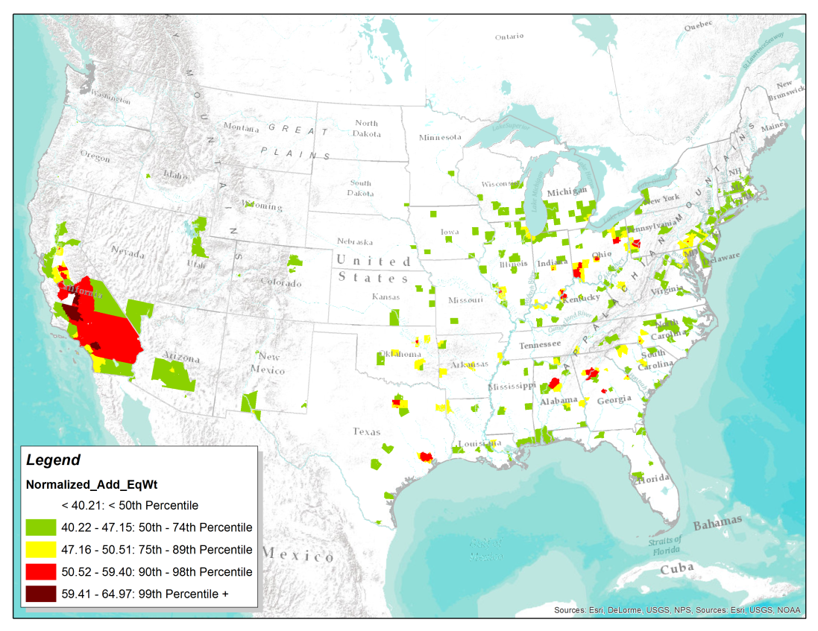
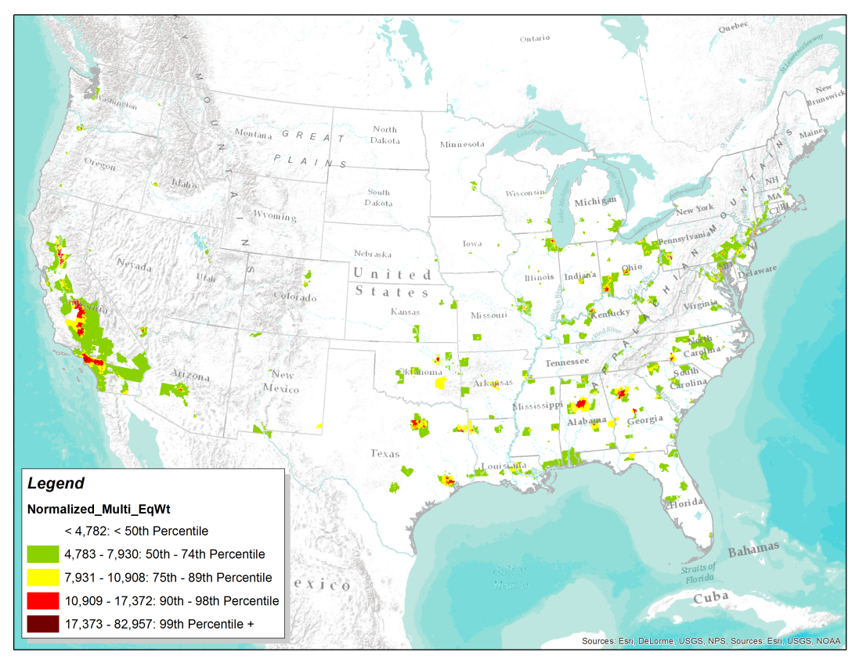
Data Layer Nexus Weighting Scenarios
Normalization of data inputs

Slide 13
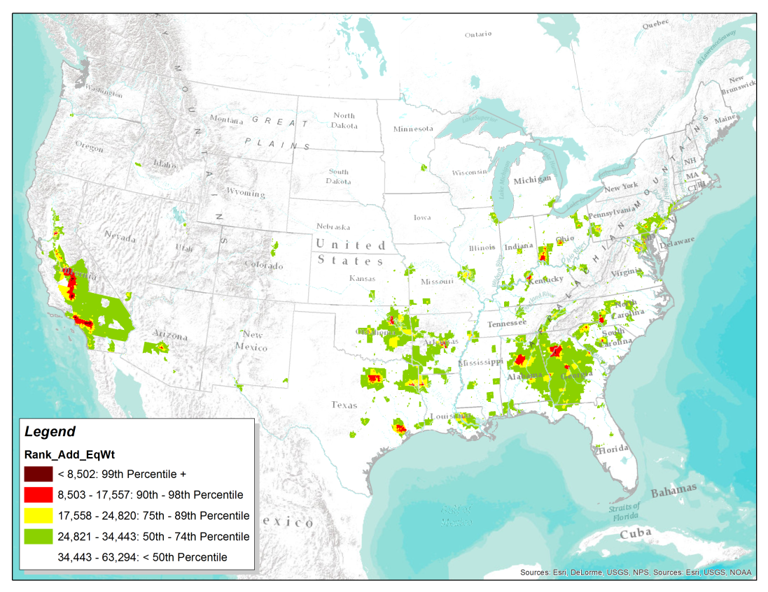
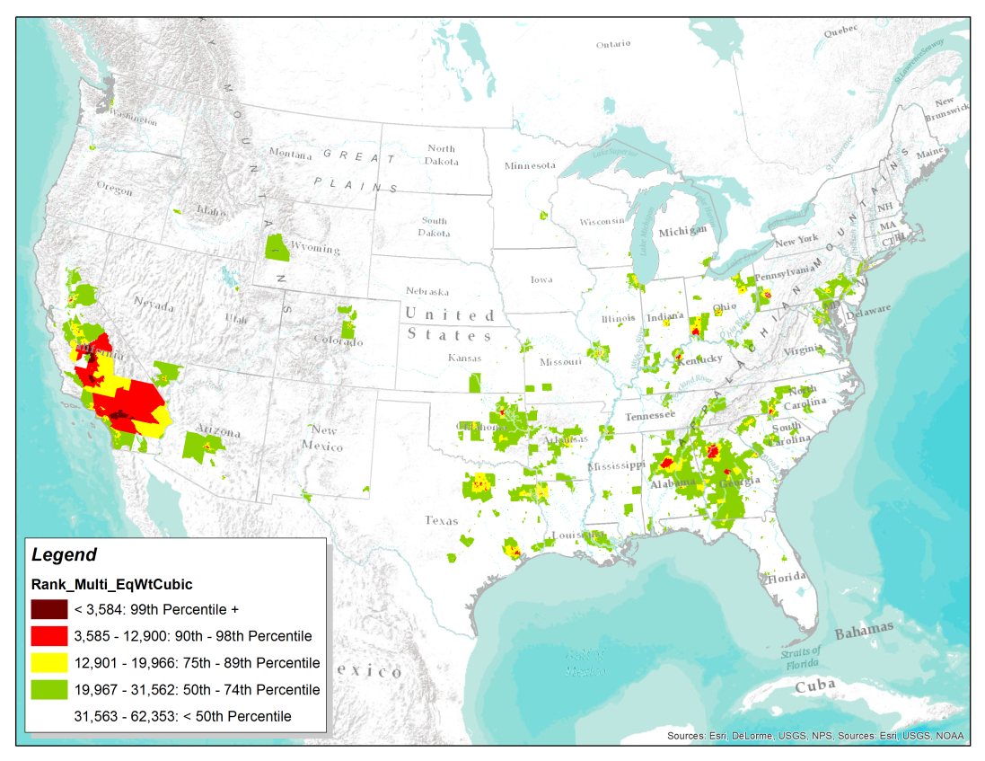
Data Layer Nexus Weighting Scenarios
Rank of data inputs

Slide 14
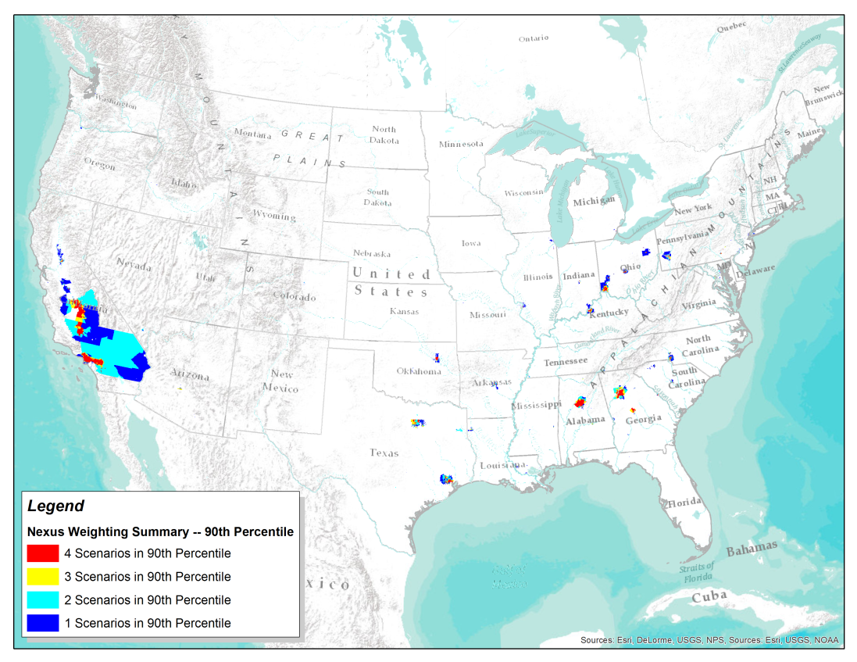
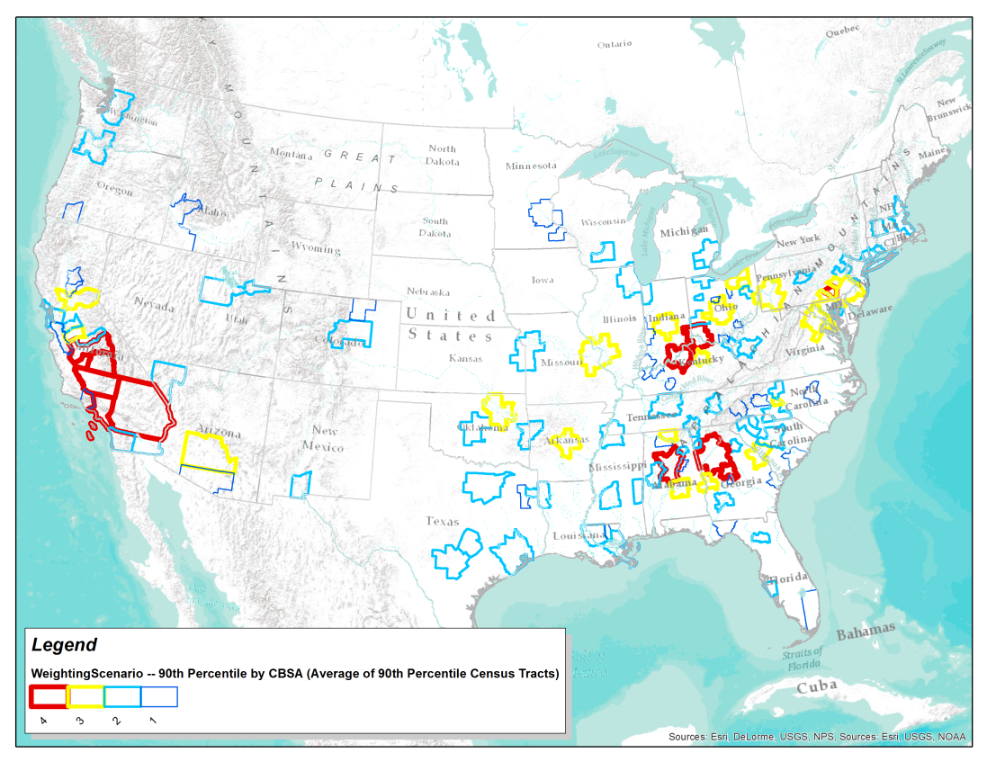
Data Layer Nexus Weighting Scenario Summary
Summary results from all 4 weighting scenarios at the 90th percentile

Slide 15
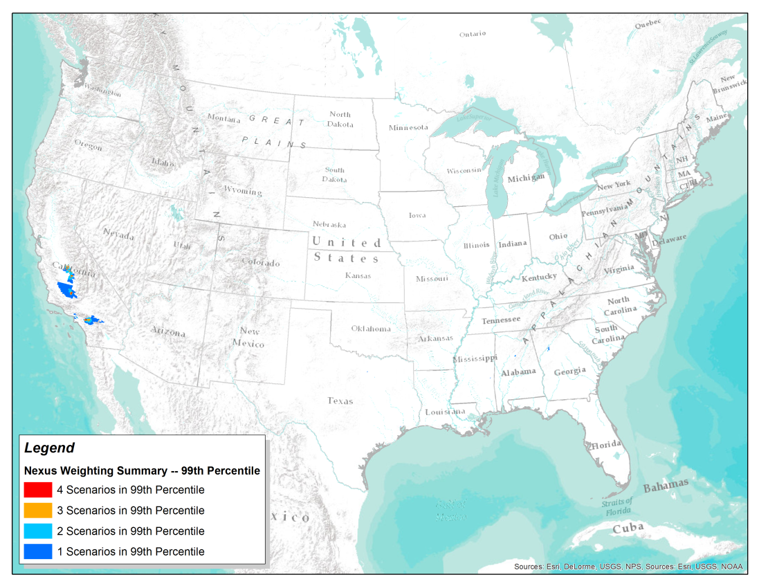
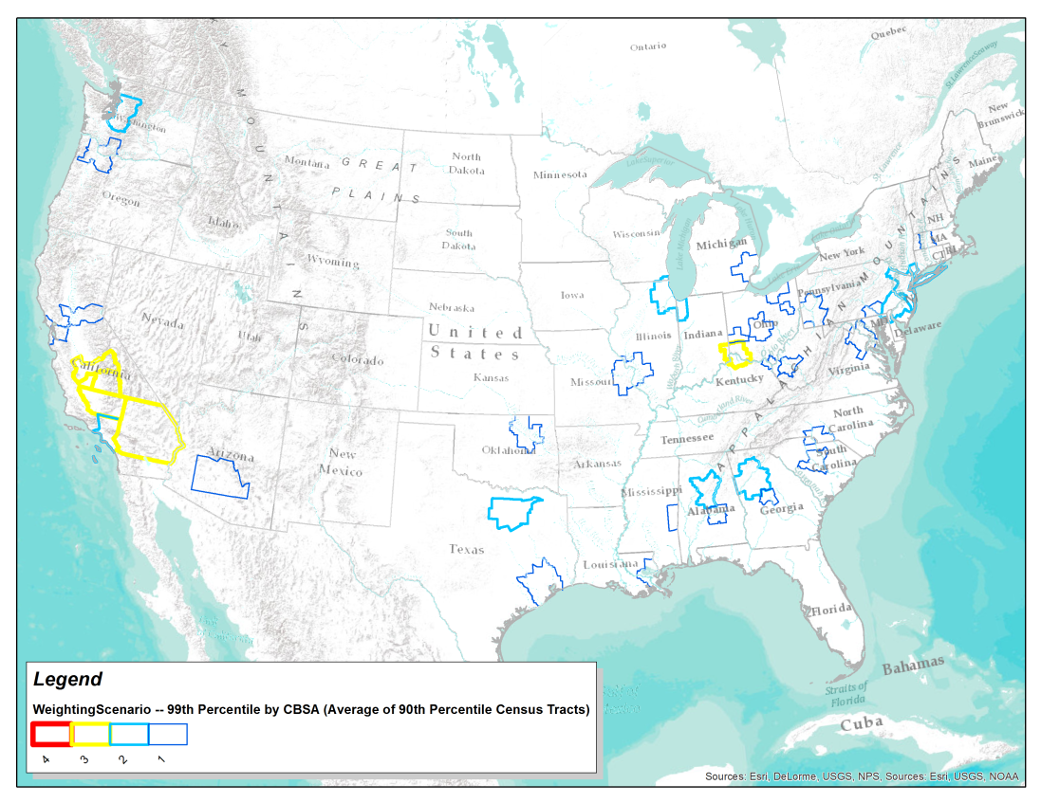
Data Layer Nexus Weighting Scenario Summary
Summary results from all 4 weighting scenarios at the 99th percentile

Slide 16
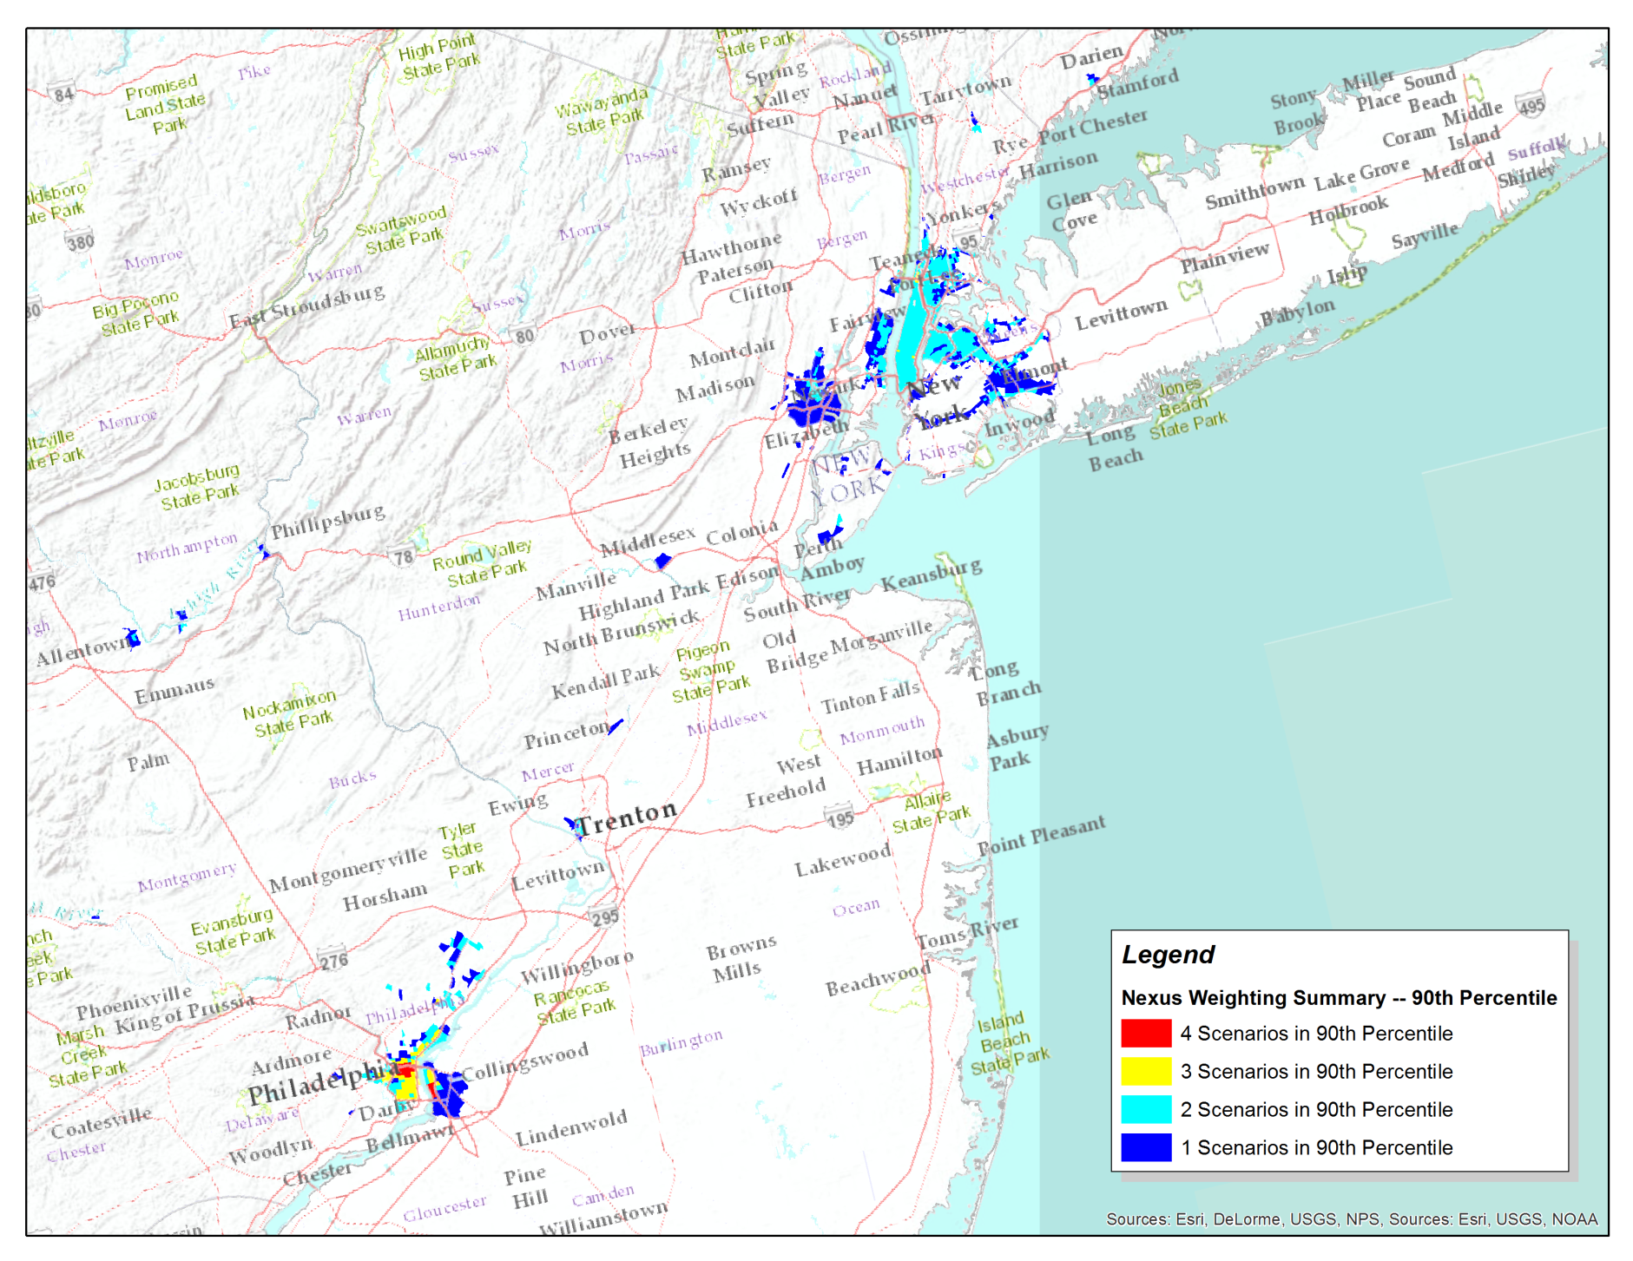
Data Layer Nexus Weighting Scenario Example
Investigating results from the New York area
-only 2 scenarios showing nexus in 90th percentile

Slide 17
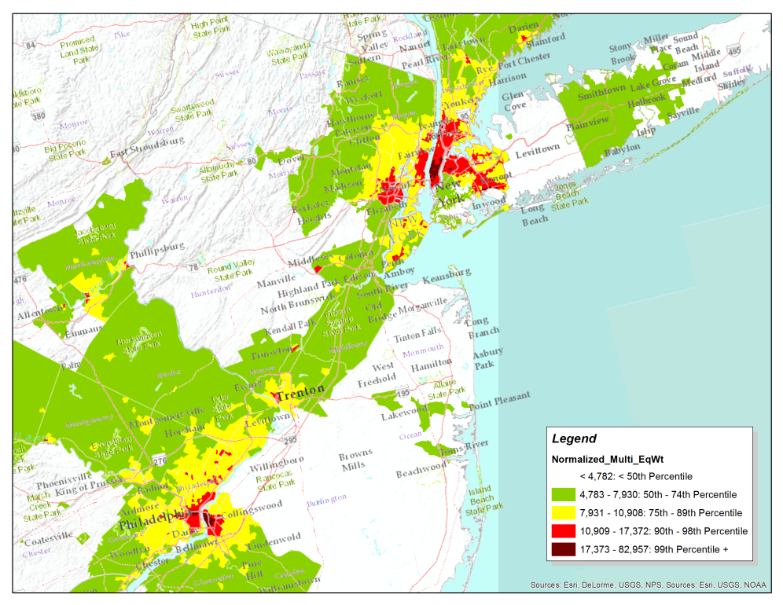
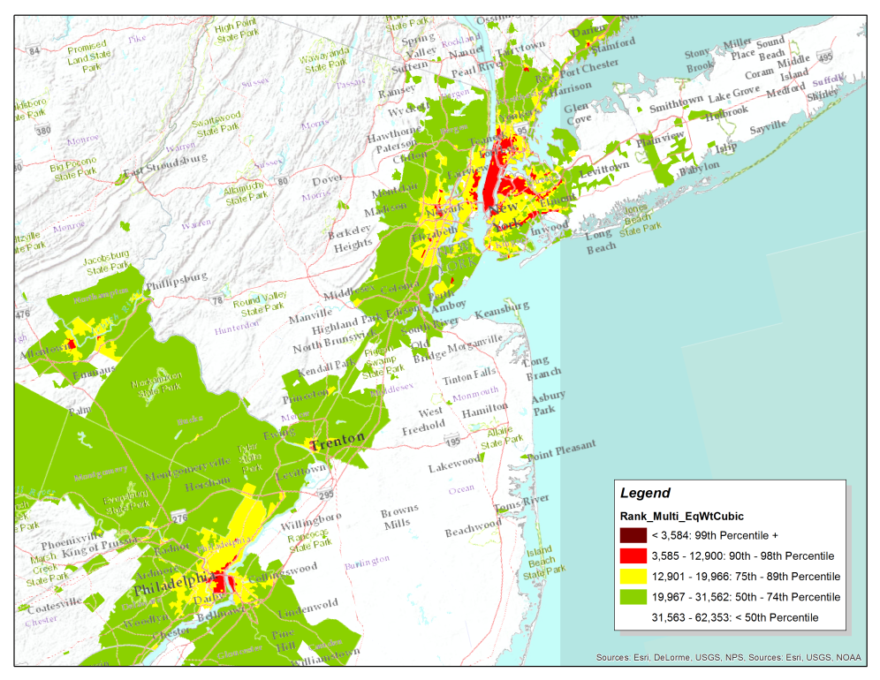
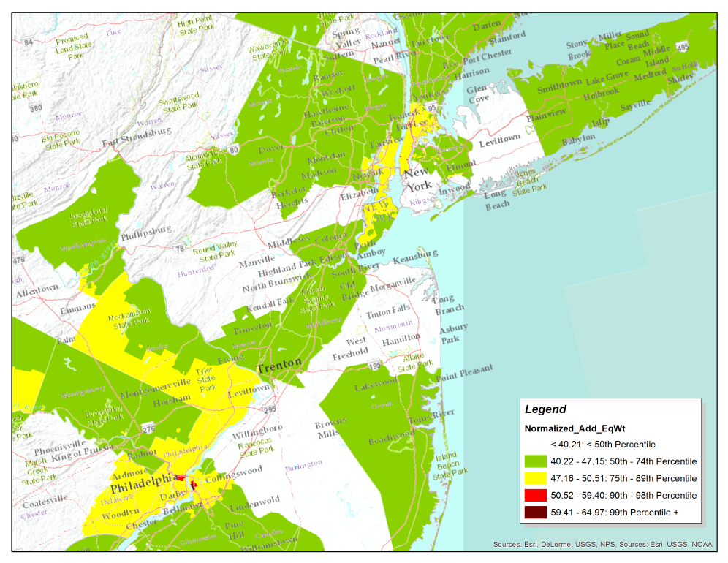
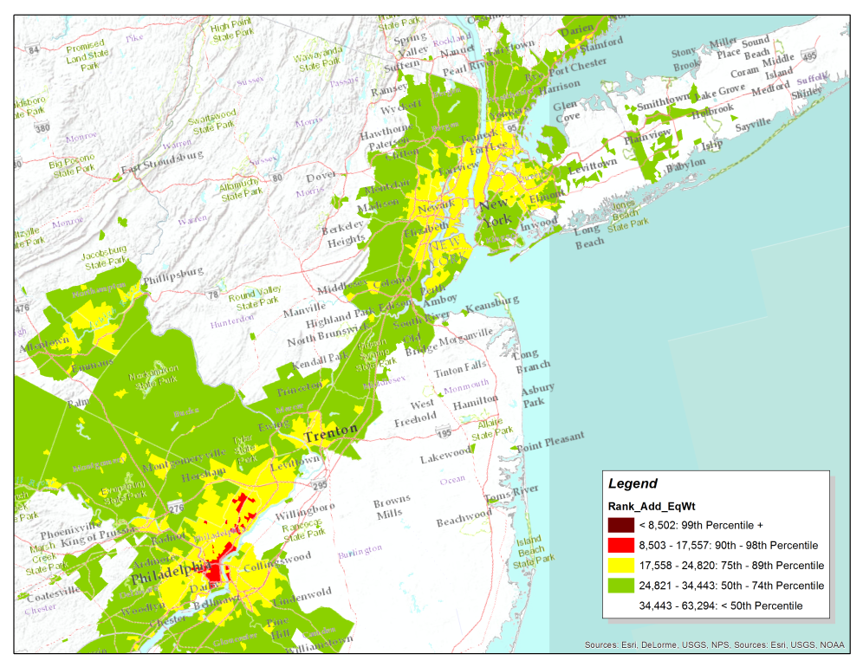
Data Layer Nexus Weighting Scenario Example
Multiplication approach shows 90th percentile results

Slide 18
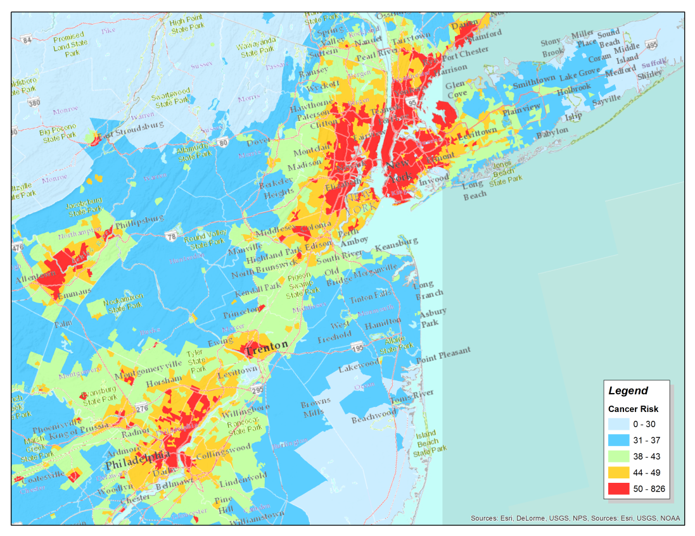
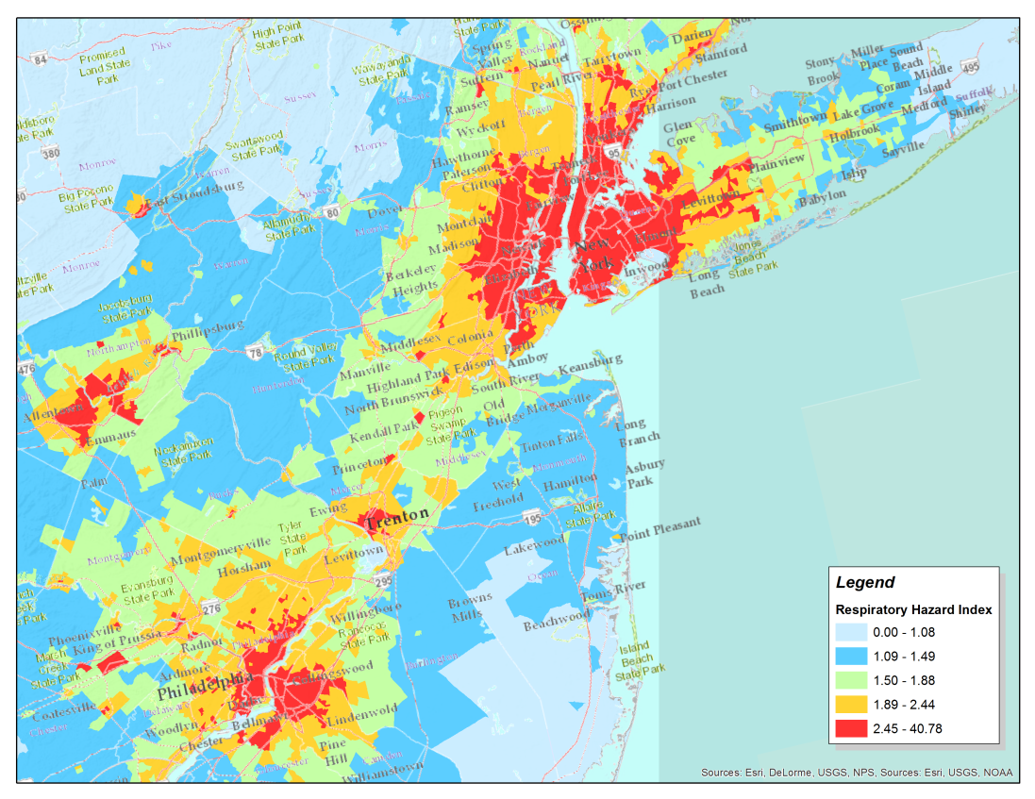
Data Layer Nexus Weighting Scenario Example
Both Cancer Risk and Respiratory Hazard Index are high

Slide 19
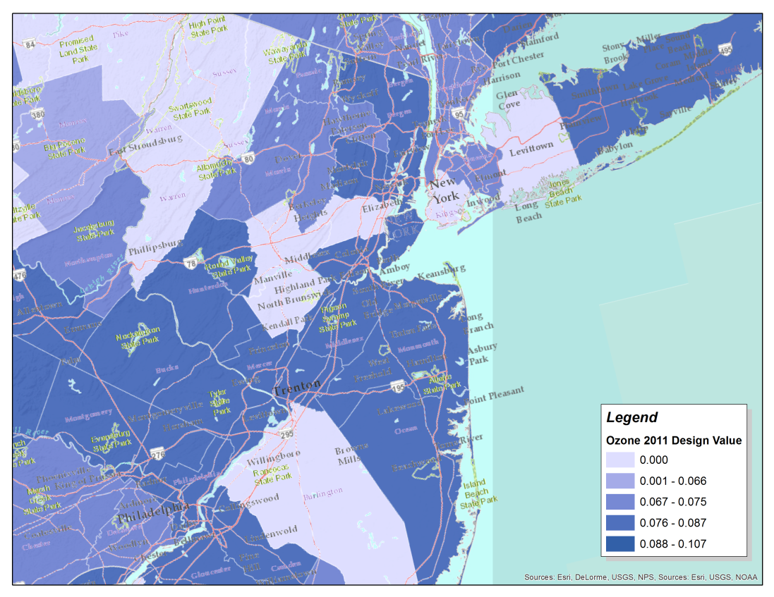
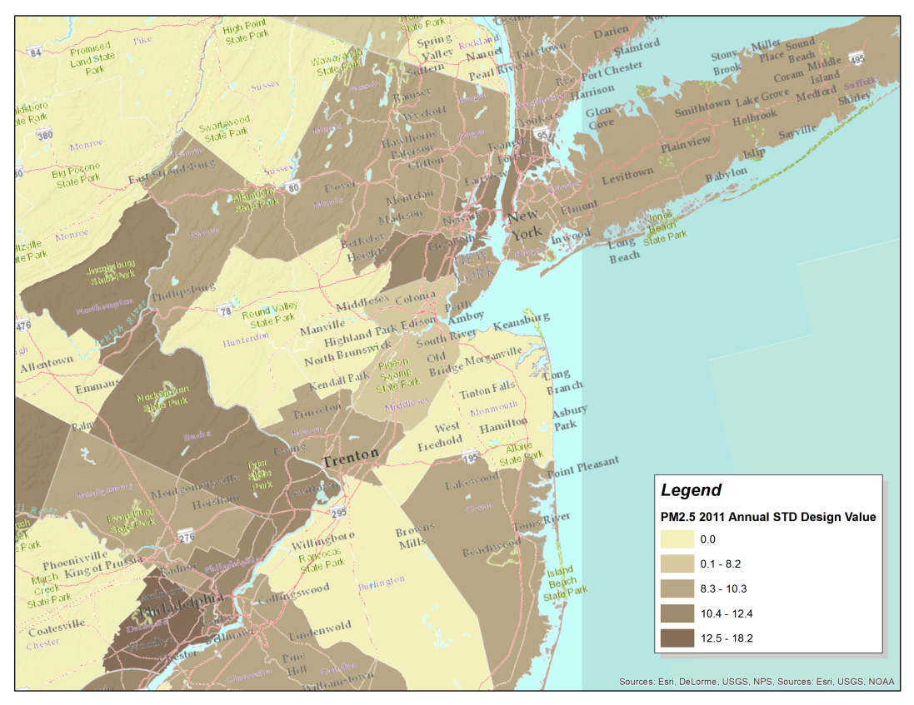
Data Layer Nexus Weighting Scenario Example
Design values for both PM2.5 and Ozone are moderate to high

Slide 20
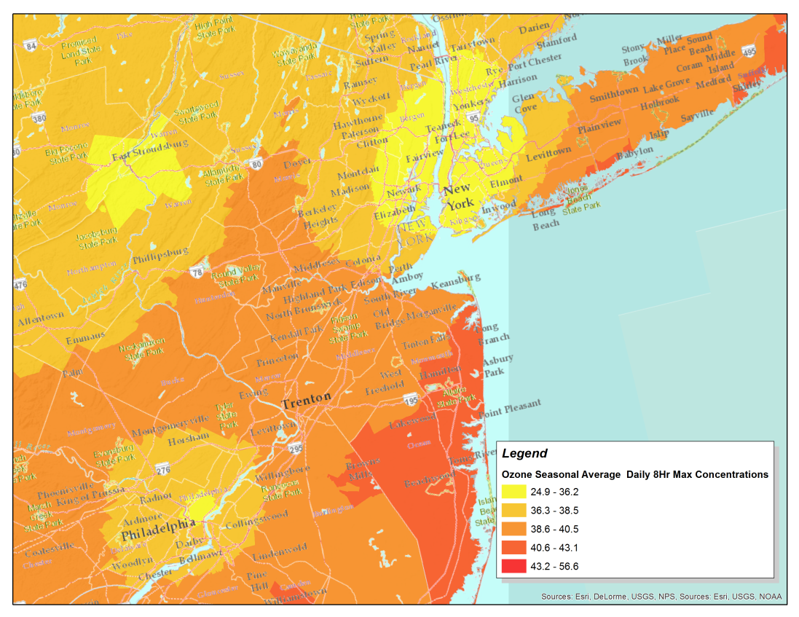
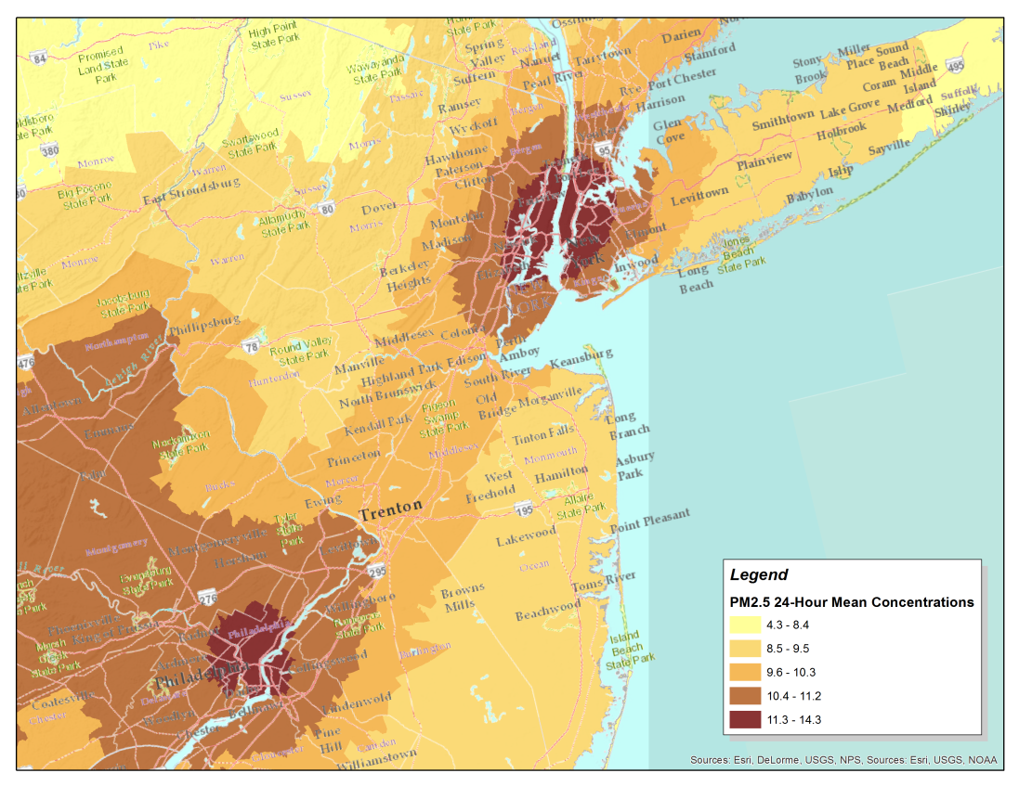
Data Layer Nexus Weighting Scenario Example
PM2.5 concentrations are high, however Ozone concentrations are low

