Slide 1
NEXUS EJ Considerations
March 2021

Slide 2
Illustrative EJ Analytical framework* used to provide context for the use and value of NEXUS tool
Contextual data & analysis based on emissions, monitoring, and modeling to understand exposure to air pollution by EJ communities
Initial Screening of EPA Actions
EJSCREEN and prior experience used to identify potential low, med, high EJ impacts of actions to inform need for early engagement
Screening Analysis of Action
Qualitative/narrative and proximity analyses based on demographics, risk, and other factors to inform outreach and reg/policy development
NEXUS TOOL
Refined Analysis of Action
Apply refined tools/models to estimate impacts and consider options to address disparate impacts, if necessary
yes
Action has broad disparate impact?
*Adapted from OID EJ Concept diagram (per Wood 2/17 e-mail) and OAQPS team discussions

Slide 3
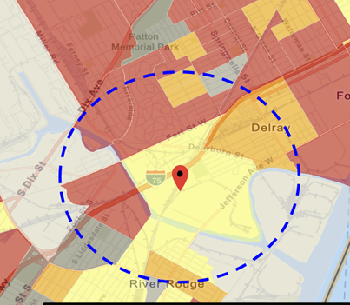
Current Practice for EJ Screening
“Proximity analysis” is the primary EJ screening approach because close proximity to air pollutant sources, such as industrial plants and major highways, is correlated with exposure and adverse health risks.
  Involves comparison of demographic distributions near source(s) (e.g., within 5, 10, 50 km) to those for the state, region, and nation
Types of Proximity Analysis
  Demographic analysis
  Risk-based demographic analysis
  Can consider other factors for use (next slide)
Current Tools Used
  EJSCREEN by OID for initial screening and rules (with added GIS scripting)
  Project specific efforts for criteria and toxic rules (in-house or contractor)

Slide 4
How to Improve EJ Screening:
(1) Identifying and Characterizing EJ Concerns
Consider use of NEXUS tool to codify and augment proximity analyses for outreach and regulatory/policy use
  Incorporate EJSCREEN data layers into NEXUS to be consistent with past practice and codify an approach for OAQPS EJ purposes
    Ease of use, transparency of data, efficiently and consistently apply across programs
  Codify and expand demographic proximity analyses to include emissions density, pop-weighted concentrations, and risk across all pollutants
    improved screening approach as it better reflects air pollutant exposure by source/sector
  Account for multi-pollutant exposure/risk to EJ communities rather than single pollutant to better measure harm from air pollution exposures
  Consistency in data, approach, tool for use in screening for our outreach efforts and in regulatory/policy context

Slide 5
NEXUS Multipollutant Screening Tool
PC-based software that enables visualization and querying of spatial data on emissions, air quality, and risk for criteria and toxic pollutants.
Developed to inform screening analyses to identify areas that could benefit from multipollutant air quality management strategies
Adaptable to OAQPS needs -- based on recent feedback, is being expanded to facilitate screening analyses relevant for EJ and climate applications (e.g., demographic/risk proximity for criteria & air toxics, GHG emissions, climate vulnerability)
Informs other EPA needs – OAQPS currently provides data layers to EJSCREEN and we can consider providing the expanded data/metrics used in NEXUS to OEJ?
EJ relevance:
  Enables rapid identification of areas with elevated ozone, PM_{2.5}, and toxics risk (also working on sector capabilities per Peter request in previous briefing)
  Enables identification of air quality levels and top emitting sources/sectors near disadvantaged communities to inform efforts to prioritize sectors and areas for our programs and outreach
  Proximity analyses can be codified in NEXUS for ease of use, transparency, and access to more recent and relevant data/metrics for comparisons

Slide 6
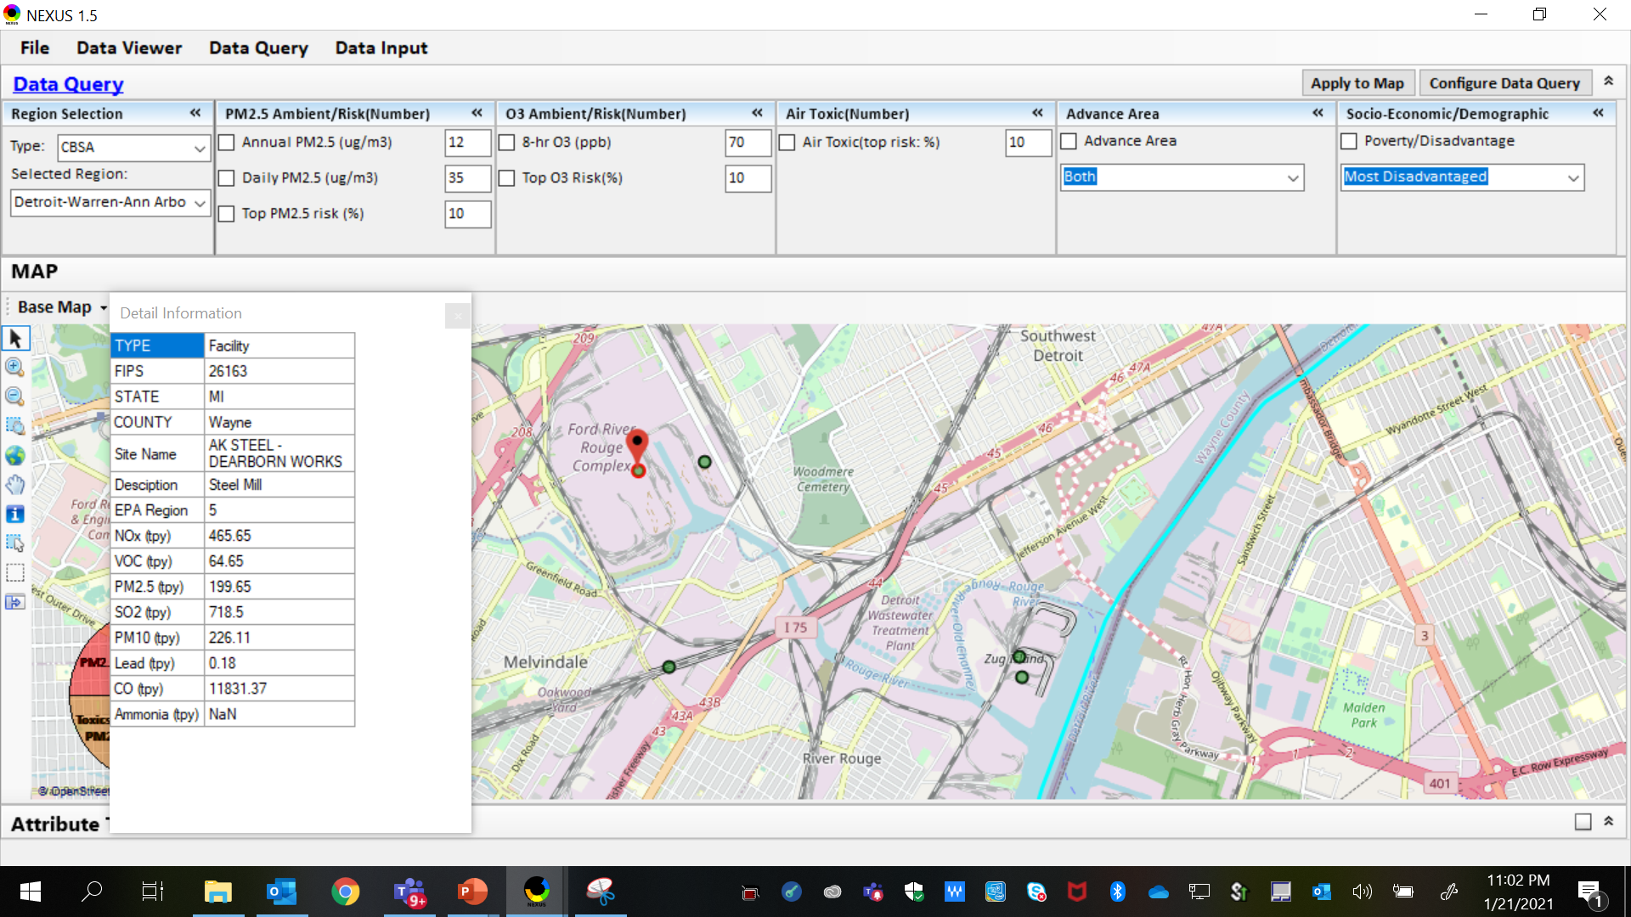
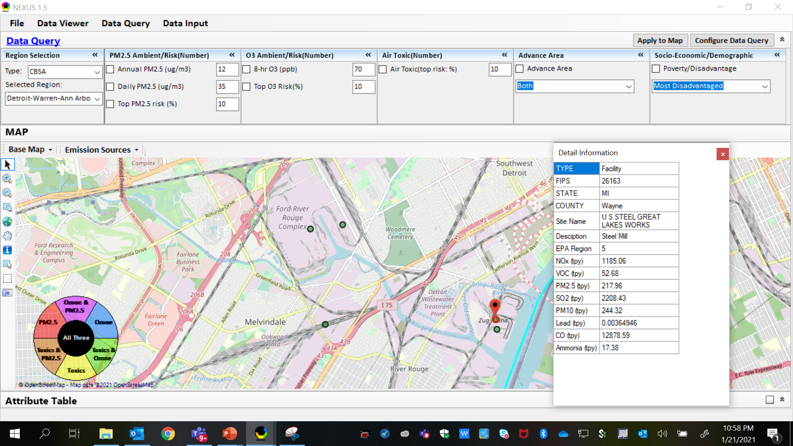
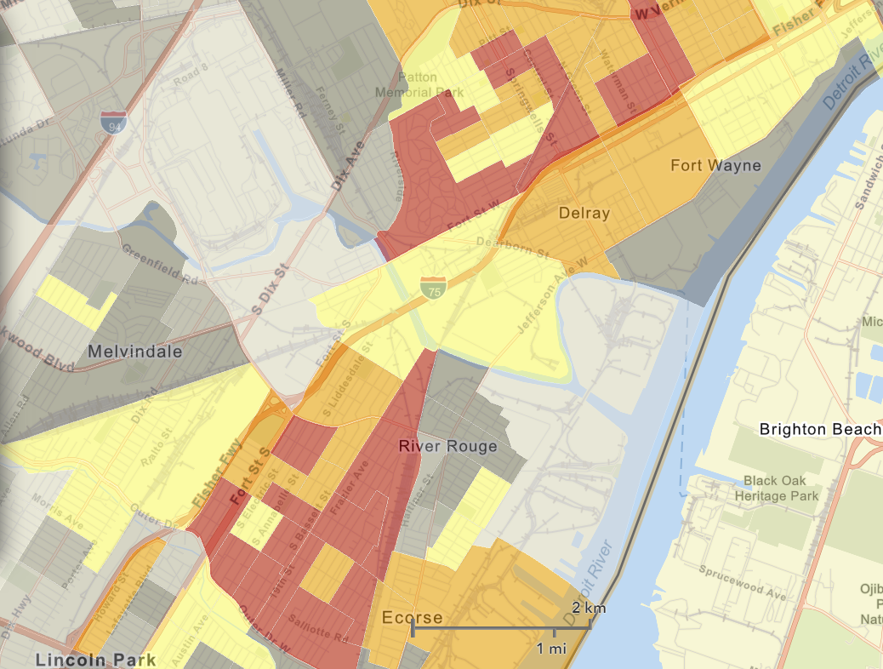
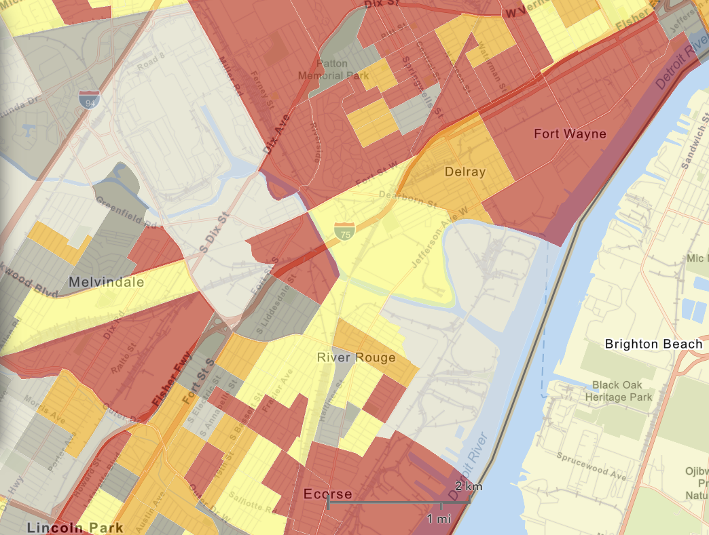
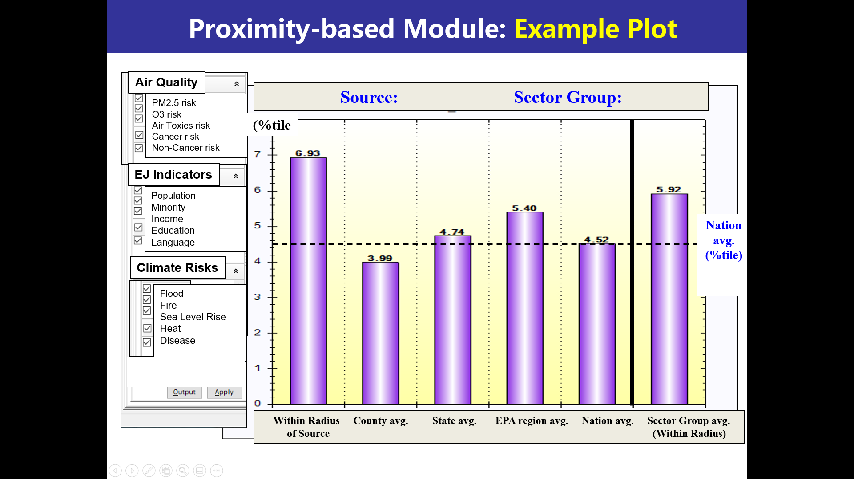

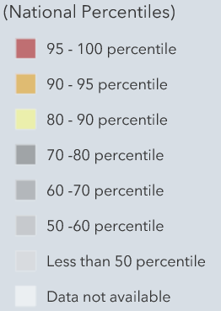
NEXUS Illustrative Example
AK Steel
US Steel
AK Steel
NEXUS is used to quickly identify top emitters of NOx, SO₂, PM_{2.5}, and heavy-metal HAPs near elevated demographic index and has developing proximity capability
US Steel
EJSCREEN Demographic Index
EJSCREEN Low Income Population
Source: Beth Landis and Carey Jang

Slide 7
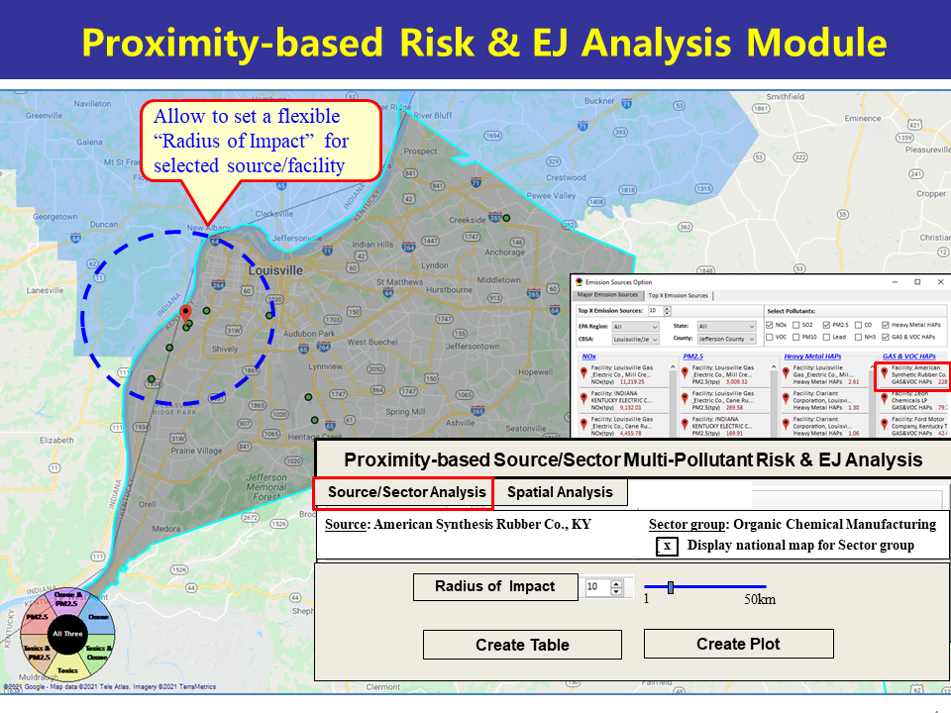
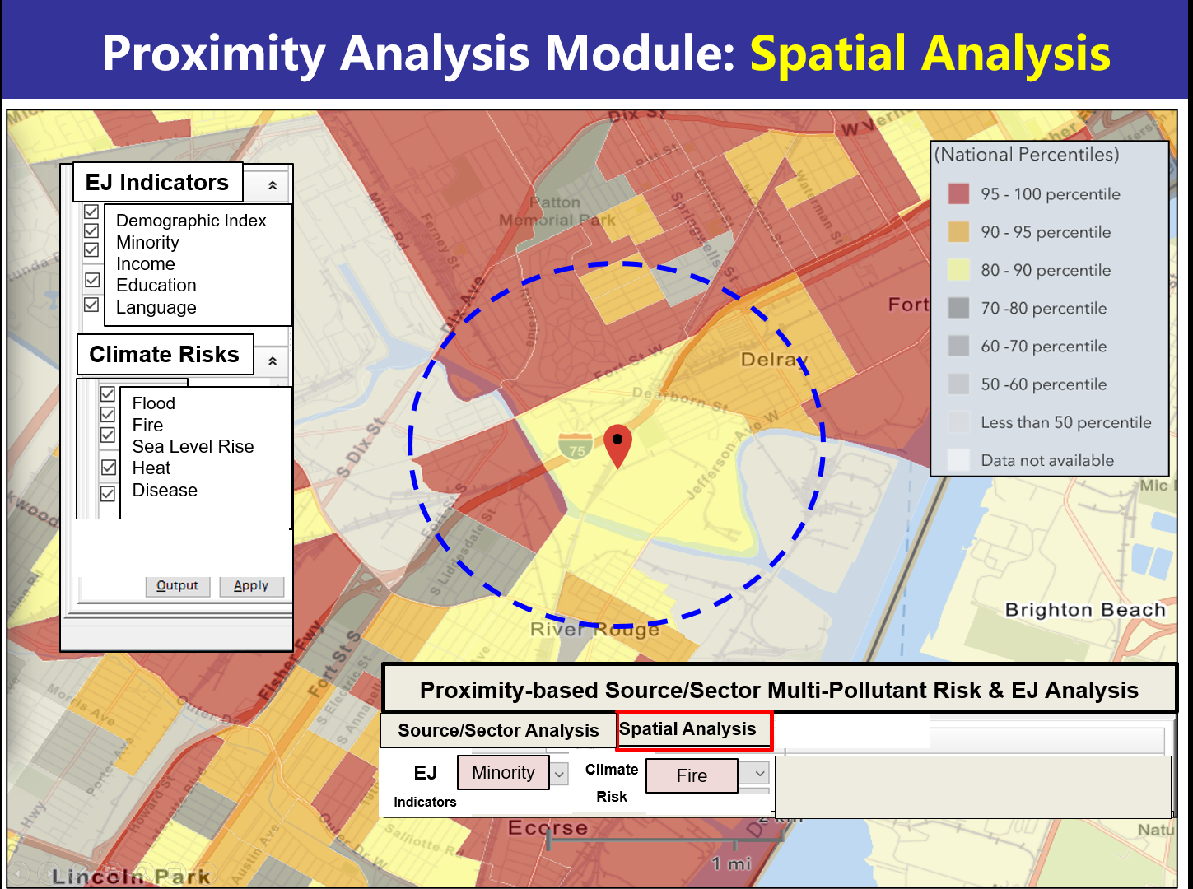
Codifying Screening Proximity Analysis in NEXUS: Future Direction

Slide 8
Screening Proximity Analysis in NEXUS: Tabular Data Summary
 | Source Name: American Synthesis Rubber Co., Louisville, KY Sector Group Name: Organic Chemical Manufacturing
 |  | Within Radius of Source | County Avg. | State Avg. | EPA Region Avg. | Nation Avg. | Sector Group (within radius) National avg. | Sector Group (within radius) Top 25 MSAs
Population total |  | x,xxx | xx,xxx | xxx,xxx | xxx,xxx | 317,xxx,xxx | xxx,xxx | xxx,xxx
PM2.5 risk |  | x% | x% | x% | x% | x% | x% | x%
Ozone risk |  | x% | x% | x% | x% | x% | x% | x%
Air Toxics: Cancer risk |  | x% | x% | x% | x% | x% | x% | x%
Climate risks: Flood |  | x% | x% | x% | x% | x% | x% | x%
Sea level rise |  | x% | x% | x% | x% | x% | x% | x%
Fire |  | x% | x% | x% | x% | x% | x% | x%
Disease |  | x% | x% | x% | x% | x% | x% | x%
EJ: Minority group (%tile) |  | x% | x% | x% | x% | x% | x% | x%
Low-income group (%tile) |  | x% | x% | x% | x% | x% | x% | x%
Demographic Index (%tile) |  | x% | x% | x% | x% | x% | x% | x%
Linguistic Isolation (%tile) |  | x% | x% | x% | x% | x% |  | x%

