Slide 1
Development Progress of NEXUS

Slide 2
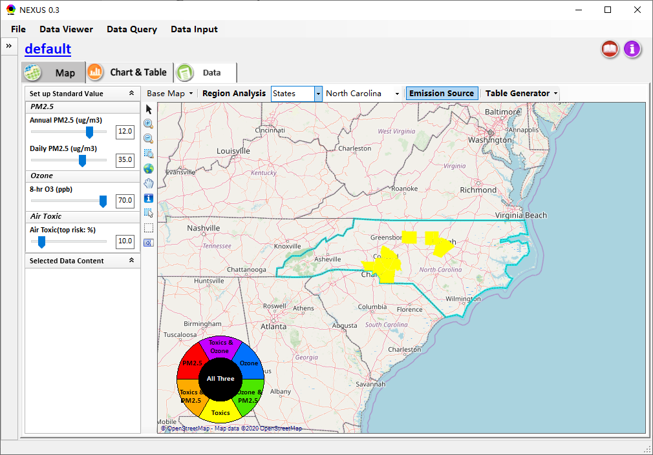
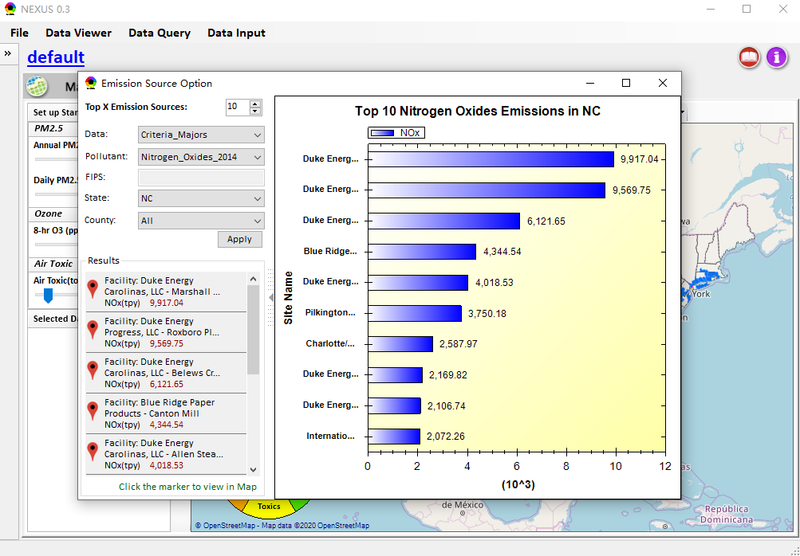
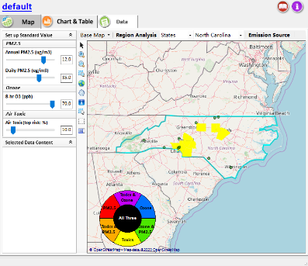
Data Viewer
Under Data Viewer:
Change the “Map Provider” to “Base Map”.
Change “Chart” to “Chart & Table”.
Slow the “speed” of zoom in/out using mouse wheel
Click the Emission Source, a pop-up window of “Top X emissions” options will show up, and the emissions will overlay on map
Notes:
地图服务只保留了Open Street Map， Open Street 4U Map, Google Map, Google Satellite Map， Google Hybrid Map， Google Terrain Map和Bing Map
现在的PM2.5 和 O3 非达标区域的结果，已经用 源数据（Excel）查验过了，应该是没问题的
Region Analysis 模块目前只支持 “EPA Region” or “State”.

Slide 3
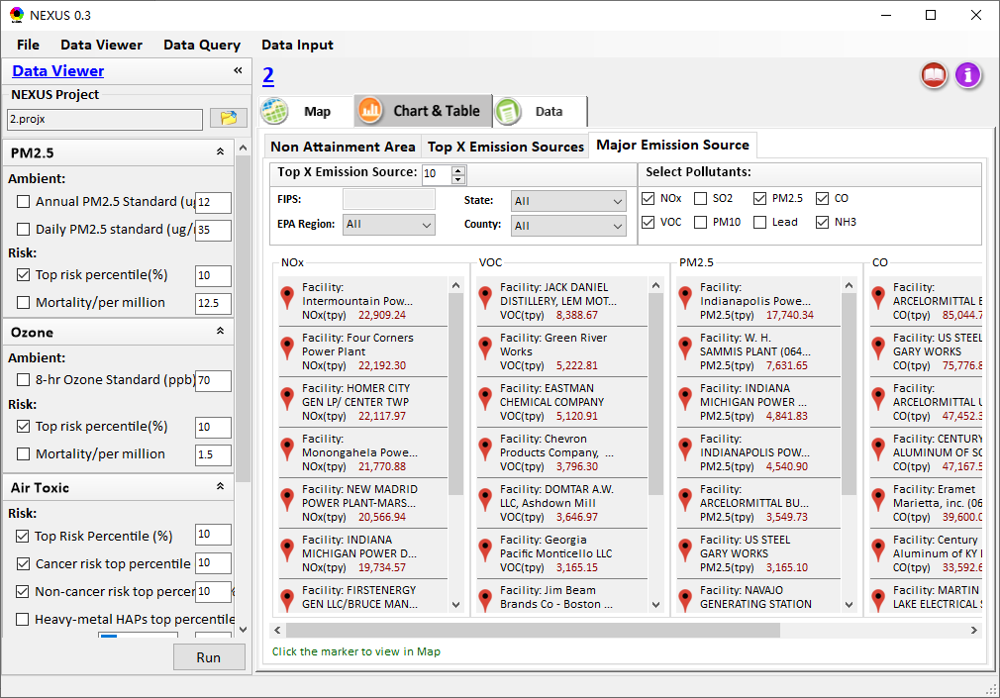
Data Viewer
Add “Major Emission Source” Module under Chart & Table

Slide 4
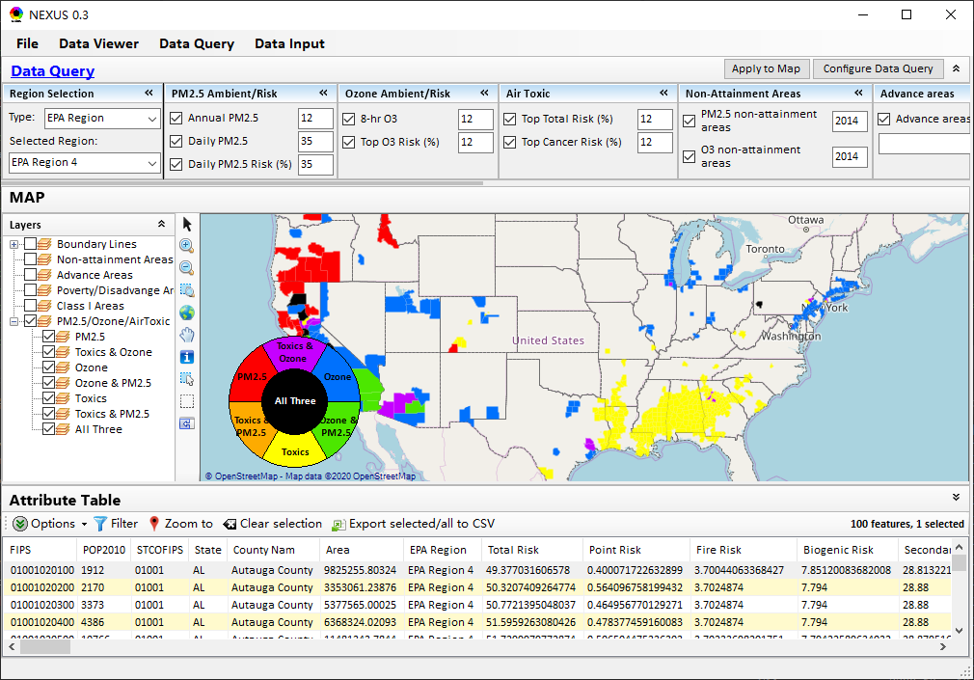
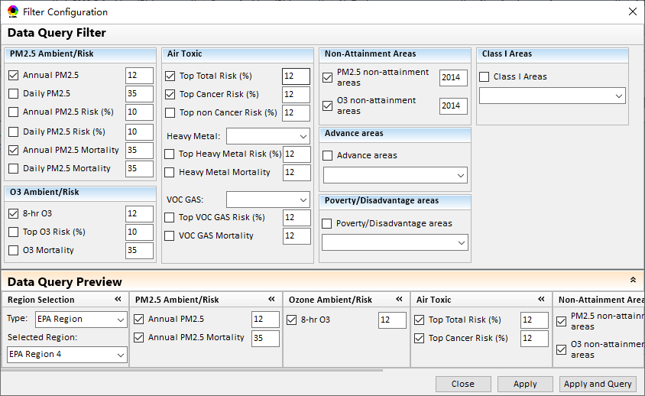
Data Query
Update GUI design:
Change the caption color to “blue-white” for all filters.
Add a “splitter” between “Region Selection” and “PM2.5 Ambient/Risk”
Change “Configure Filter Panels” to “Configure Data Query”
Change the panel labels of the “Filter Configuration”
Notes:
目前Data Query模块只能展示默认的数据结果

