Slide 1
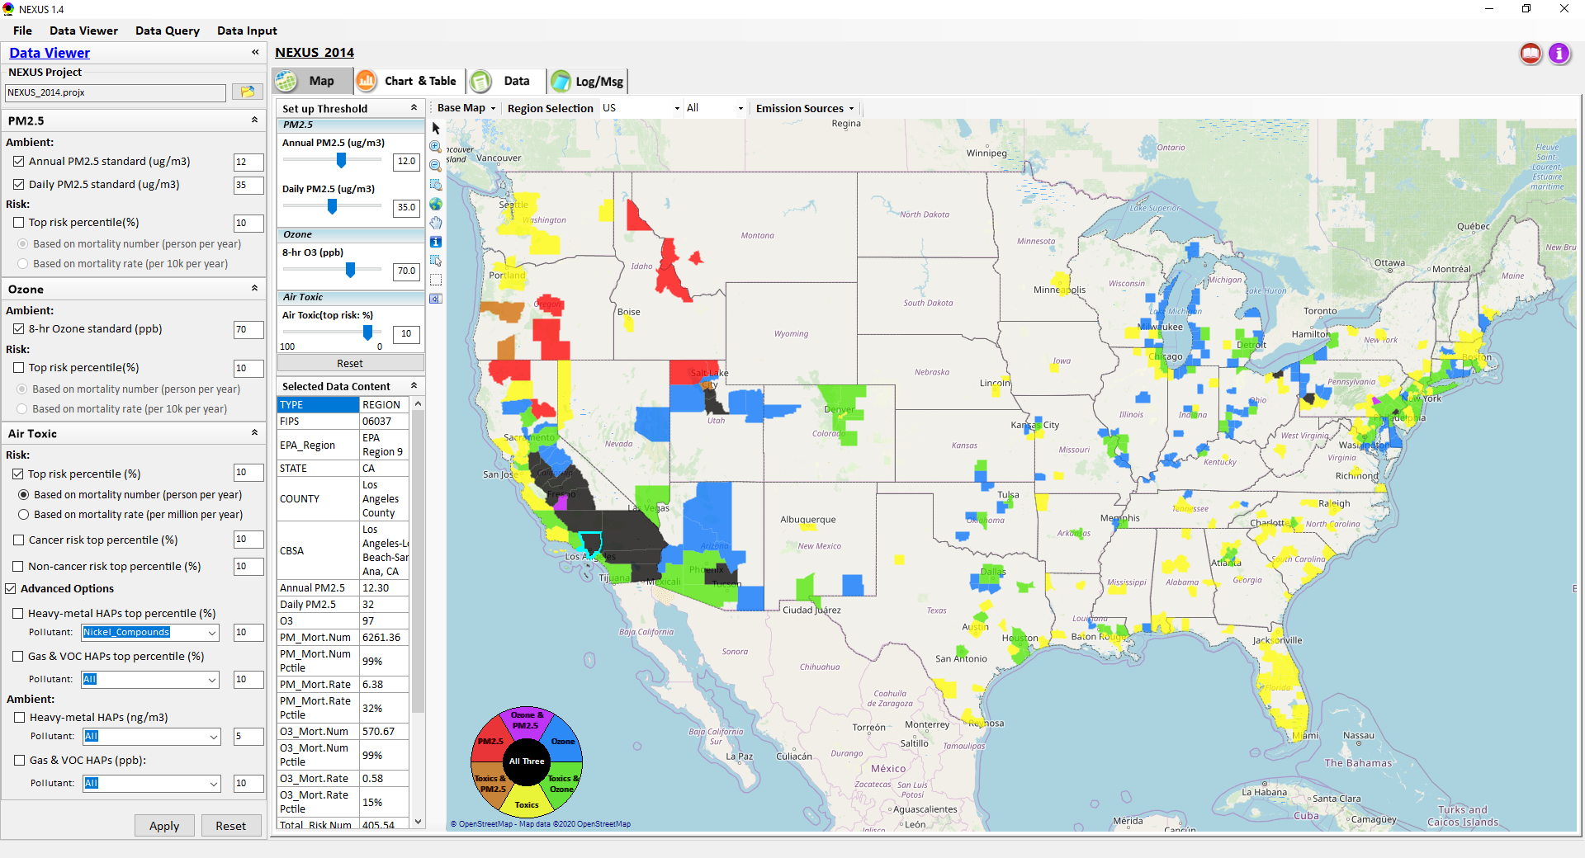
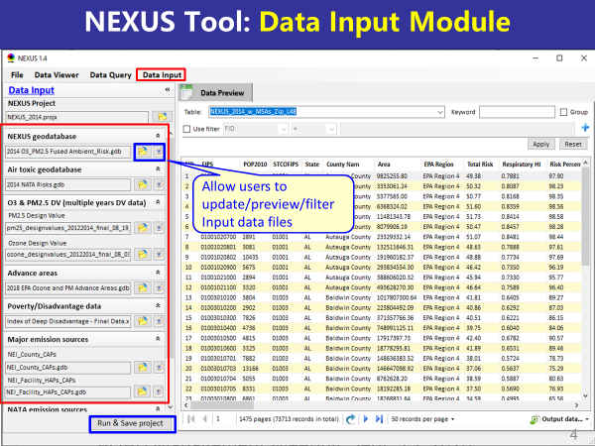
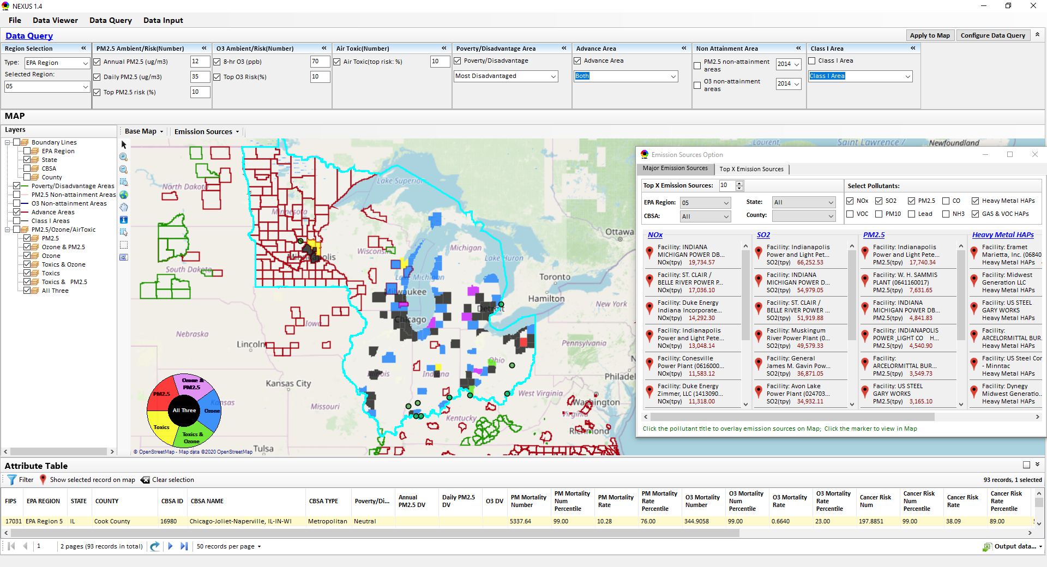
“NEXUS” Multi-Pollutant Analysis Tool
Development: Status Update
Data Viewer Module
Data Input Module
Data Query Module
“NEXUS 1.5” available on OAQPS’s Shared Drive at: “G:\SHARE\NEXUS\NEXUS 1.5\”
or at EPA’s new FTP site: ftp://newftp.epa.gov/aqmg/cjang/NEXUS/NEXUS 1.5/
HEID/AQAD Briefing
March 23, 2021
Carey Jang & Beth Landis

Slide 2
Overview
Feedback from OAQPS/SMT Briefing
NEXUS Updates
  Metrics (Toxics)
  2017 Data
  Proximity Based Module
National Sector Approach – NEXUS Application
Examples for Regions
  Chicago
  Pittsburgh
  Houston
Next Steps / Issues for Discussion
2

Slide 3
Feedback from OAQPS/SMT Briefing
National level comparison to sector group
New“Proximity-based source & sector risk and EJ analysis” module
Information that can help prioritize SPPD rules
Economic information
3

Slide 4
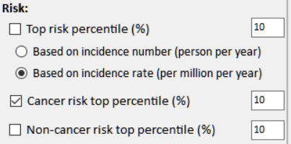
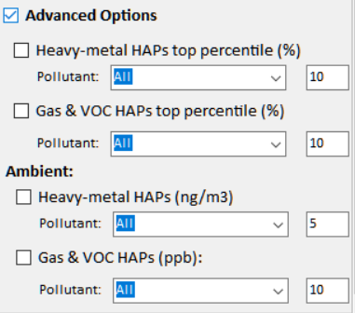
NEXUS 1.6 (with New Air Toxics Metrics)
(Updated version used to support “Sector Prioritization” work)
Current
New
Risk:
□ Cancer Risk (max tract-level risk in the county): (default checked)
o Top risk Percentile (higher than x%) 90 (Note: default checked)
o Risk value (x-in-1 million) ? (Note: use 90 %tile risk value)
□ Non-cancer Hazard (max tract-level HI in the county):
o Top risk Percentile (higher than x%) 90 (default if above box checked)
o Hazard Index (HI) ? (Note: use 90 %tile value, find a reasonable range)
(Note: Add up all “HI” in “NATA_2014_Tract_HIs_FINAL” file.
“HI” > 1 means likely adverse non-cancer hazard; <1 means unlikely
Cancer Risk (max tract-level risk in the county):
□ PM & Metal HAPs
Pollutant: All
○ Top risk percentile (higher > %) 90
○ Risk value (x-in-1 million) ?
□ Gas & VOC HAPs
Pollutant: All
○ Top risk Percentile (higher > %) 90
○ Risk value (x-in-1 million) ?
[ ] Advanced Options:
4

Slide 5
NEXUS 1.7 (Under Development)
Near-term Priorities for 2021 NEXUS development:
Upgrade NEXUS (modules & MP metrics/EJ) for beta release
2017 emissions data update (including GHG & Sector) (Note: used to support “Sector Prioritization” work)
2017 fused AQ (PM_{2.5}, O₃ & Air Toxics) & risk data update
Draft development plan for “Proximity-based risk & EJ analysis” module (census block group level)
5

Slide 6
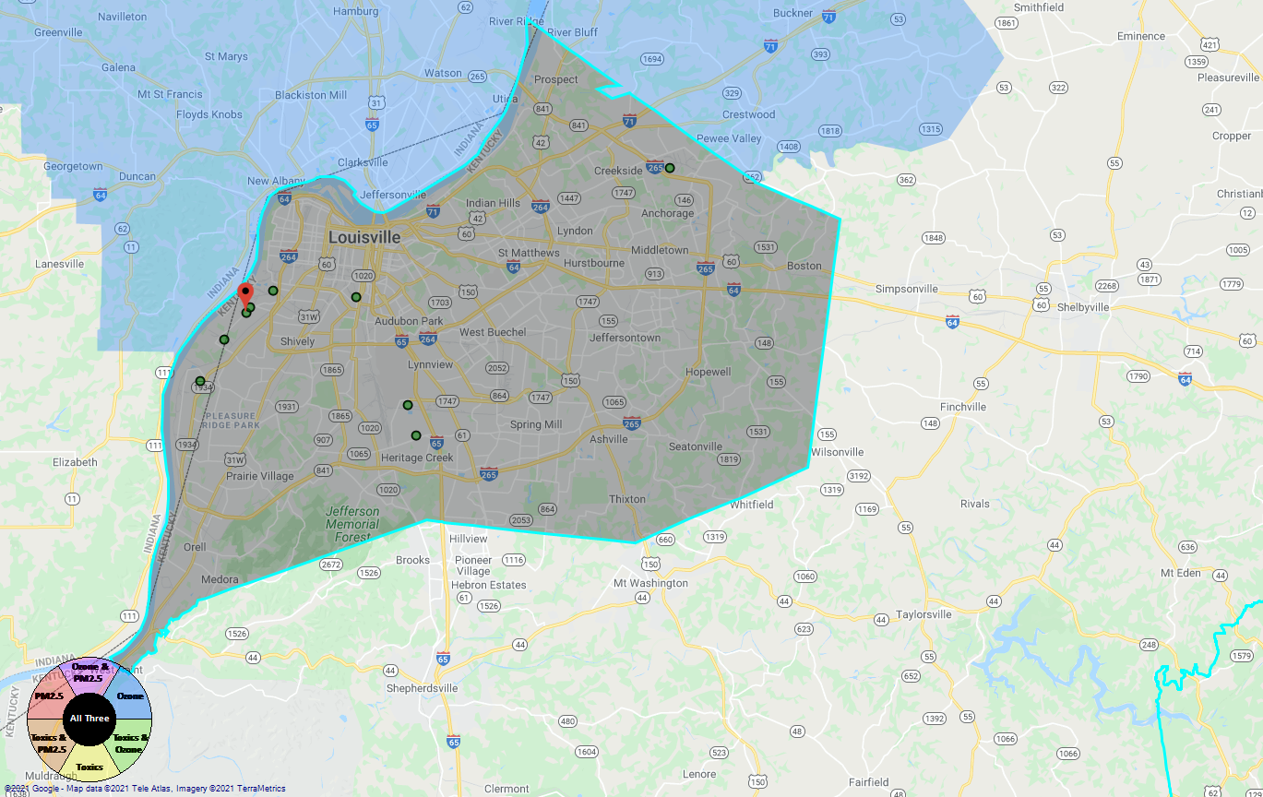
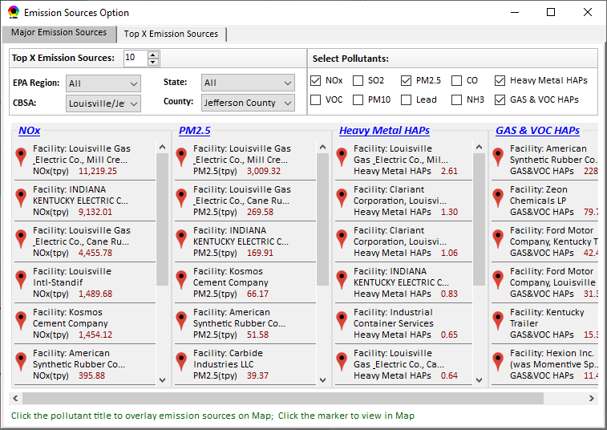
Proximity-based Risk & EJ Analysis Module
Allow to set a flexible “Radius of Impact” for selected source/facility
Add “Tribal” for listing tribal areas (All & individual)
Proximity-based Source/Sector Multi-Pollutant Risk & EJ Analysis
Source/Sector Analysis
Spatial Analysis
Source: American Synthesis Rubber Co., KY Sector group: Organic Chemical Manufacturing
[ x Display national map for Sector group
Radius of Impact
1
50km
Create Table
Create Plot
6
6

Slide 7
Proximity-based Module: Example Table
Source Name: American Synthesis Rubber Co., Louisville, KY Sector Group Name: Organic Chemical Manufacturing
 | Within Radius of Source | County Avg. | State Avg. | EPA Region Avg. | Nation Avg. | Sector Group (within radius) National avg.
Population total | x,xxx | xx,xxx | xxx,xxx | xxx,xxx | 317,xxx,xxx | xxx,xxx
PM2.5 risk (%tile) | x% | x% | x% | x% | x% | x%
Ozone risk (%tile) | x% | x% | x% | x% | x% | x%
Air Toxics risk: Cancer risk (%tile) | x% | x% | x% | x% | x% | x%
Cancer risk value (x in-million lifetime) | x.x | x.x | x.x | x.x | x.x | x.x
Non-cancer risk (%tile) | x% | x% | x% | x% | x% | x%
Non-cancer risk (Hazard Index) | x.x | x.x | x.x | x.x | x.x | x.x
Climate risk: Flood (%tile) | x% | x% | x% | x% | x% | x%
Sea level rise (%tile) | x% | x% | x% | x% | x% | x%
Fire (%tile) | x% | x% | x% | x% | x% | x%
Disease (%tile) | x% | x% | x% | x% | x% | x%
EJ Indicators: Minority group (%tile) | x% | x% | x% | x% | x% | x%
Low-income group (%tile) | x% | x% | x% | x% | x% | x%
Demographic Index (%tile) | x% | x% | x% | x% | x% | x%
Linguistic Isolation (%tile) | x% | x% | x% | x% | x% | x%
7

Slide 8
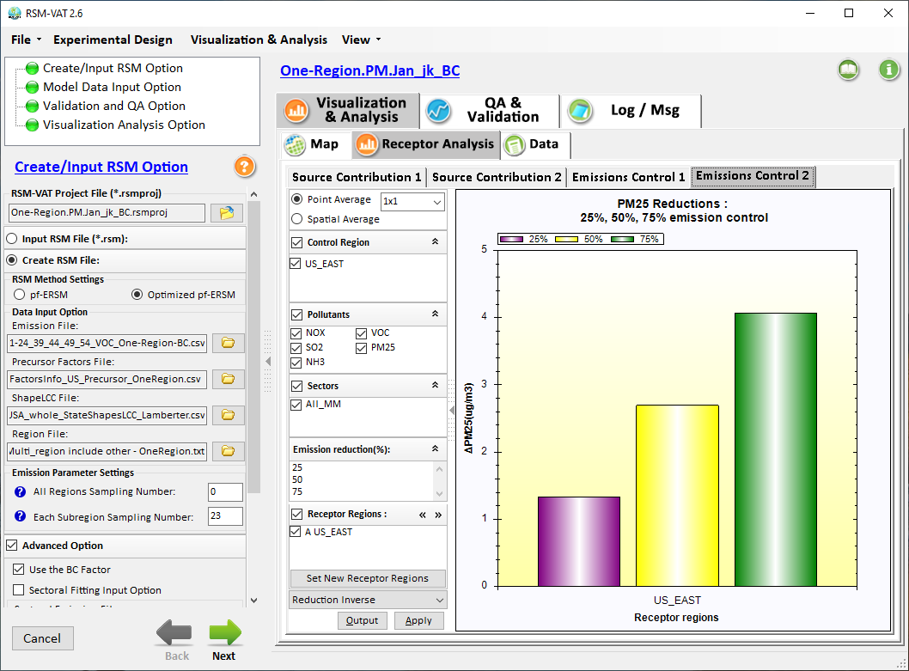
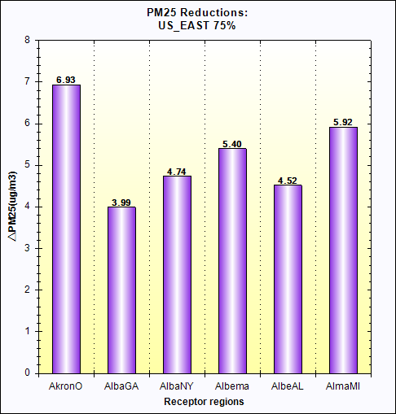
Proximity-based Module: Example Chart
Air Quality
Source: Sector Group:
PM2.5 risk
O3 risk
Air Toxics risk
Cancer risk
Non-Cancer risk
(%tile
EJ Indicators
Climate Risks
Population
Minority
Income
Education
Language
Flood
Fire
Sea Level Rise
Heat
Disease
Nation
avg. (%tile)
Climate Risks
Flood
Fire
Sea Level Rise
Heat
Disease
Within Radius County avg. State avg. EPA region avg. Nation avg. Sector Group avg.
of Source (Within Radius)
8

Slide 9
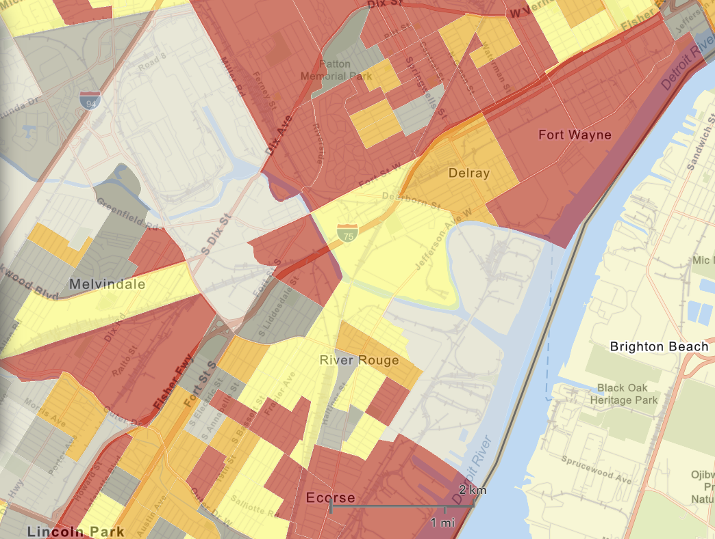
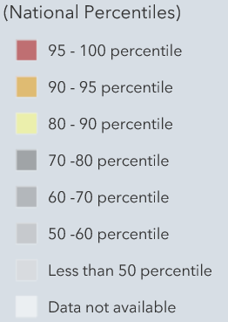

Proximity Analysis Module: Spatial Analysis
EJ Indicators
Demographic Index
Minority
Income
Education
Language
Climate Risks
Flood
Fire
Sea Level Rise
Heat
Disease
Proximity-based Source/Sector Multi-Pollutant Risk & EJ Analysis
Source/Sector Analysis
Spatial Analysis
EJ
Indicators
Minority
Climate
Risk
Fire
9
9

Slide 10
National Sector Approach – NEXUS Application
Placeholder – Carey will add in slides after incorporating new information received from Mark H.
10

Slide 11
Examples for Regions: Highest MP Risk Areas
 | EPA_REGION | STATE | CBSA_NAME | Overall Rank
1 | EPA Region 5 | IL-IN-WI | Chicago-Joliet-Naperville, IL-IN-WI | 1
2 | EPA Region 3 | PA | Pittsburgh, PA | 1
3 | EPA Region 6 | TX | Houston-Sugar Land-Baytown, TX | 1
4 | EPA Region 9 | CA | Los Angeles-Long Beach-Santa Ana, CA | 2
5 | EPA Region 6 | TX | Dallas-Fort Worth-Arlington, TX | 2
6 | EPA Region 4 | GA | Atlanta-Sandy Springs-Marietta, GA | 3
7 | EPA Region 4 | FL | Tampa-St. Petersburg-Clearwater, FL | 3
8 | EPA Region 4 | AL | Birmingham-Hoover, AL | 3
9 | EPA Region 9 | AZ | Phoenix-Mesa-Glendale, AZ | 3
10 | EPA Region 9 | CA | Fresno, CA | 3
11 | EPA Region 2 | NY-NJ-PA | New York-Northern New Jersey-Long Island, NY-NJ-PA | 3
12 | EPA Region 5 | OH | Cleveland-Elyria-Mentor, OH | 3
13 | EPA Region 9 | CA | Sacramento--Arden-Arcade--Roseville, CA | 4
14 | EPA Region 9 | NV | Las Vegas-Paradise, NV | 4
15 | EPA Region 4 | NC-SC | Charlotte-Gastonia-Rock Hill, NC-SC | 5
16 | EPA Region 9 | CA | San Diego-Carlsbad-San Marcos, CA | 5
17 | EPA Region 5 | MI | Detroit-Warren-Livonia, MI | 5
18 | EPA Regions 5 & 7 | MO-IL | St. Louis, MO-IL | 5
 | EPA_REGION | STATE | CBSA_NAME | Overall Rank
19 | EPA Region 5 | MI | Grand Rapids-Wyoming, MI | 6
20 | EPA Region 4 | TN | Nashville-Davidson--Murfreesboro--Franklin, TN | 6
21 | EPA Region 9 | CA | Bakersfield-Delano, CA | 6
22 | EPA Regions 2 & 3 | PA-NJ-DE-MD | Philadelphia-Camden-Wilmington, PA-NJ-DE-MD | 6
23 | EPA Region 9 | CA | Riverside-San Bernardino-Ontario, CA | 6
24 | EPA Region 4 | FL | Miami-Fort Lauderdale-Pompano Beach, FL | 6
25 | EPA Region 6 | LA | Baton Rouge, LA | 7
26 | EPA Region 6 | TX | El Paso, TX | 7
27 | EPA Region 10 | WA | Seattle-Tacoma-Bellevue, WA | 7
28 | EPA Region 4 & 5 | KY-IN | Louisville-Jefferson County, KY-IN | 7
29 | EPA Region 8 | CO | Denver-Aurora-Broomfield, CO | 8
30 | EPA Region 3 | PA | Reading, PA | 8
31 | EPA Region 9 | CA | Visalia-Porterville, CA | 8
32 | EPA Region 1 | CT | Bridgeport-Stamford-Norwalk, CT | 8
33 | EPA Region 4 & 6 | TN-MS-AR | Memphis, TN-MS-AR | 8
34 | EPA Regions 2 & 3 | PA-NJ | Allentown-Bethlehem-Easton, PA-NJ | 9
35 | EPA Region 6 | LA | New Orleans-Metairie-Kenner, LA | 9
NEXUS can be used to identify highest risk areas across O₃, PM_{2.5}, and Air Toxics.
The information above was generated in NEXUS & exported into Excel where rankings were applied.
These CBSAs include at least one county that meets ALL the following criteria:
PM Mortality Number Percentile >= 90
O₃ Mortality Number Percentile >= 90
Cancer Risk Rate Max Percentile >= 90 (max census tract-level in a county)
11

Slide 12
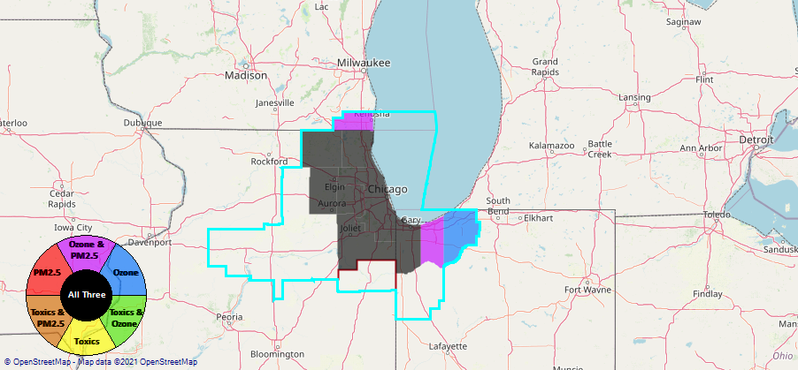
Example 1 - Chicago CBSA
Generated in NEXUS
12

Slide 13
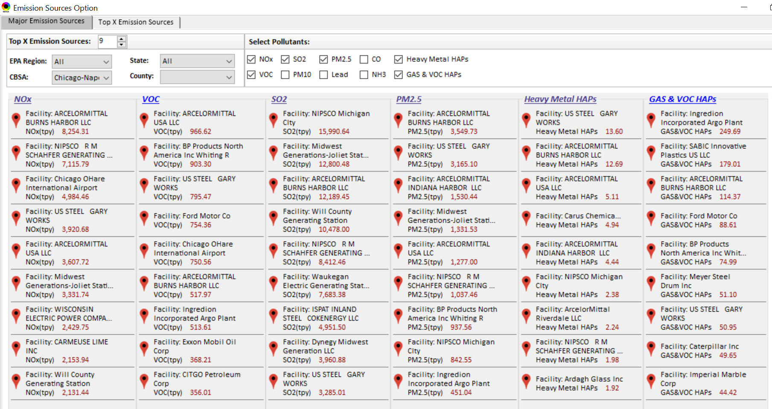
Example 1 - Chicago CBSA – Top Emission Sources
Generated in NEXUS
13

Slide 14
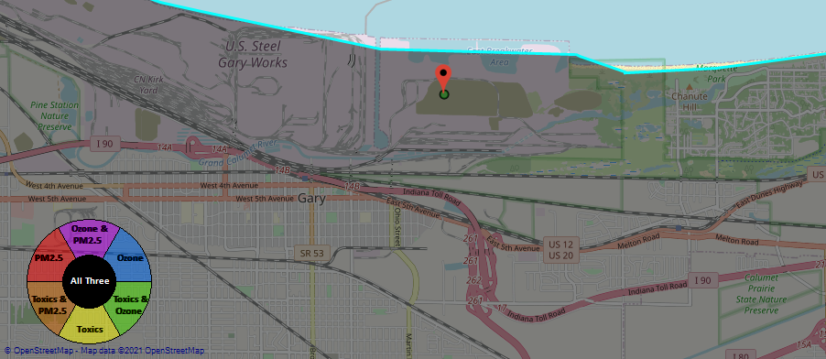
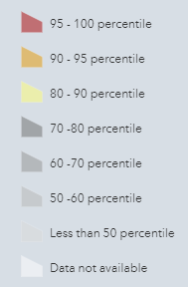
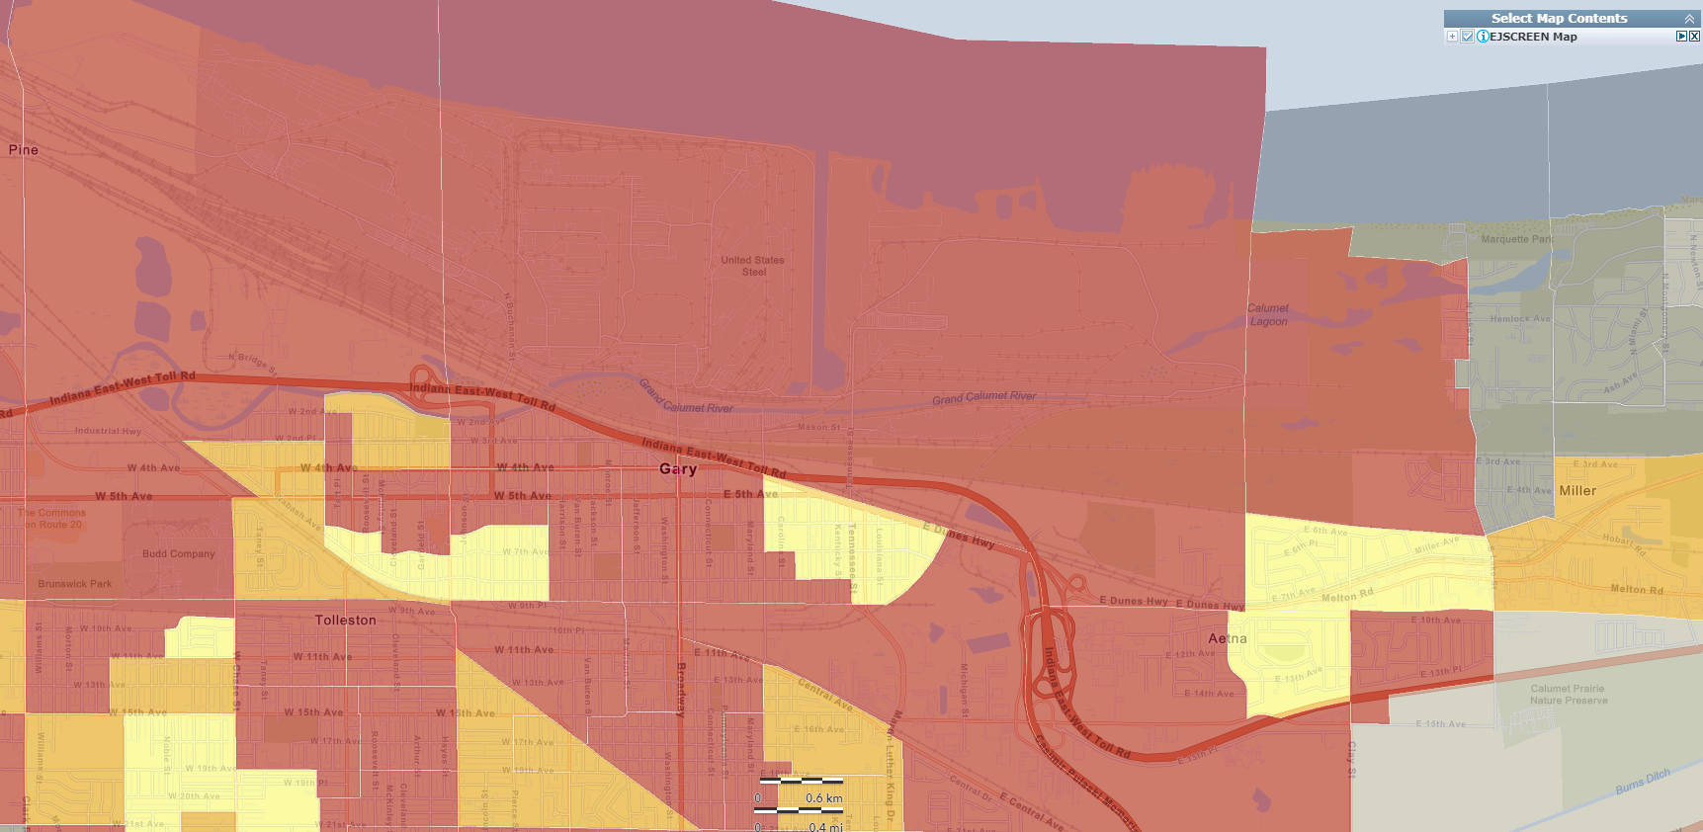
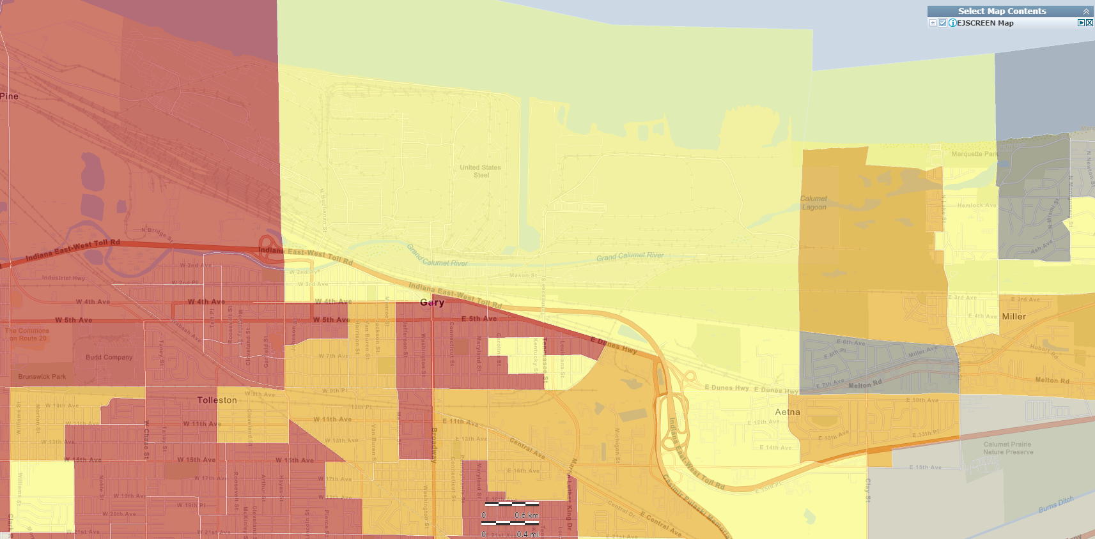
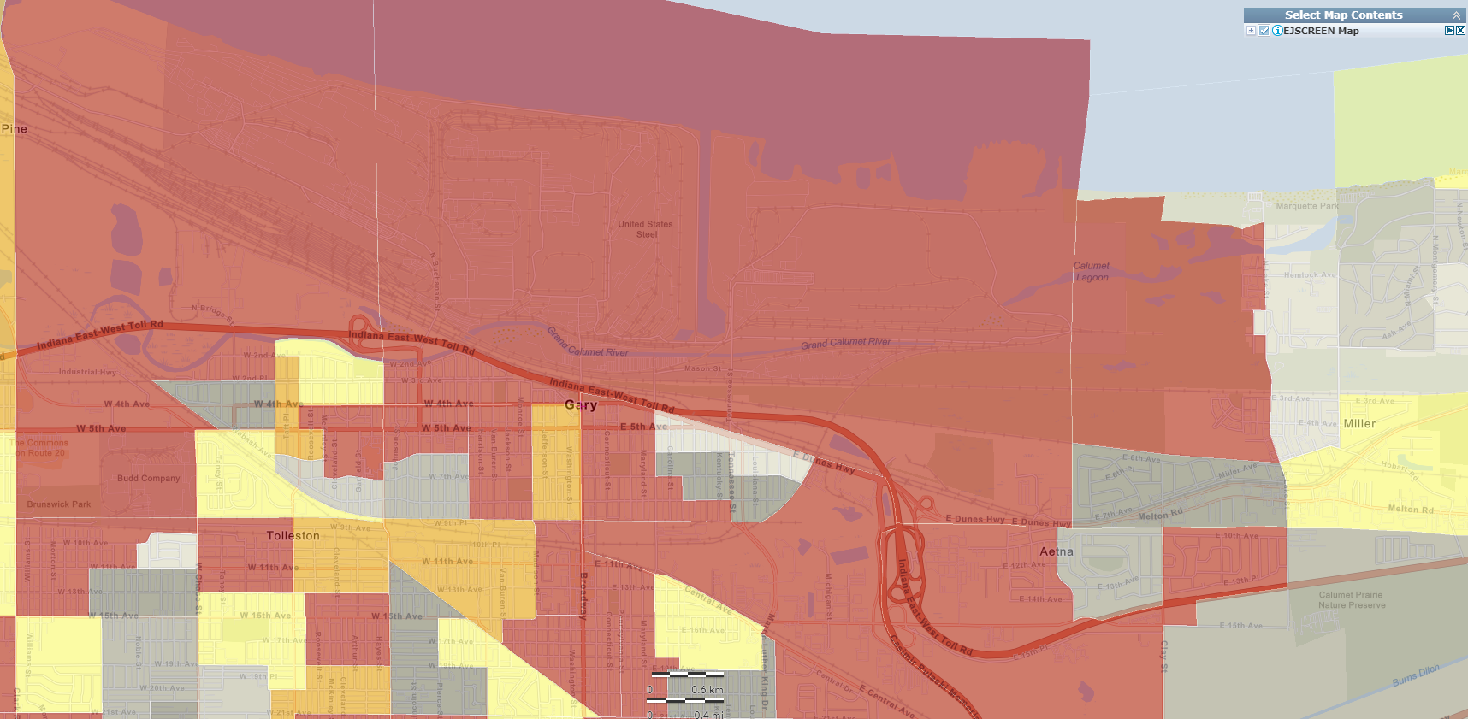
Example 1 - Chicago CBSA – US Steel Gary Works
Generated in NEXUS
National Percentiles
Generated in EJSCREEN
Generated in EJSCREEN
Generated in EJSCREEN
Demographic Index
People of Color Population
14
Low Income

Slide 15
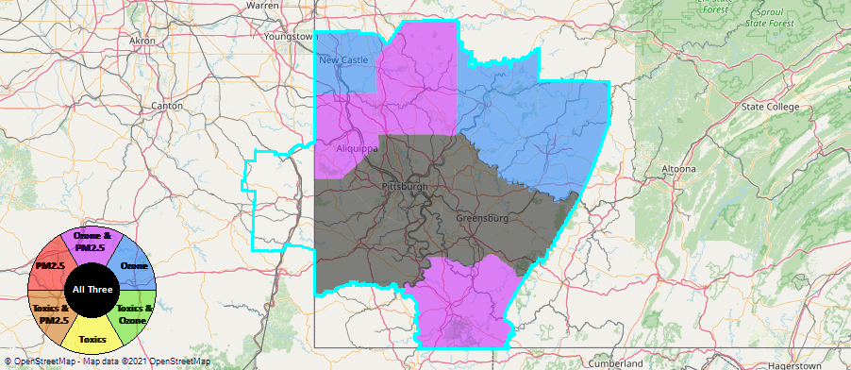
Example 2 - Pittsburgh CBSA
Generated in NEXUS
15

Slide 16
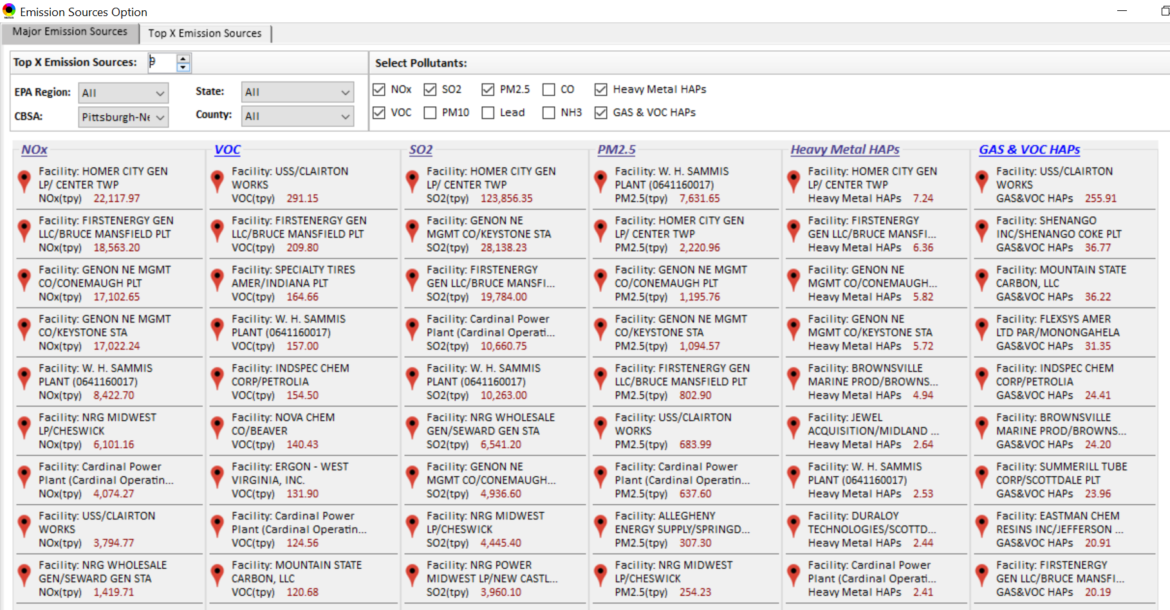
Example 2 - Pittsburgh CBSA – Top Emission Sources
Generated in NEXUS
EGUs
16

Slide 17
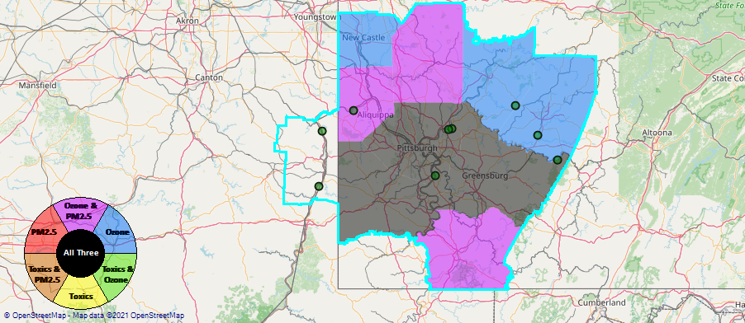
Example 2 - Pittsburgh CBSA – Dominated by EGUs
Generated in NEXUS
17

Slide 18
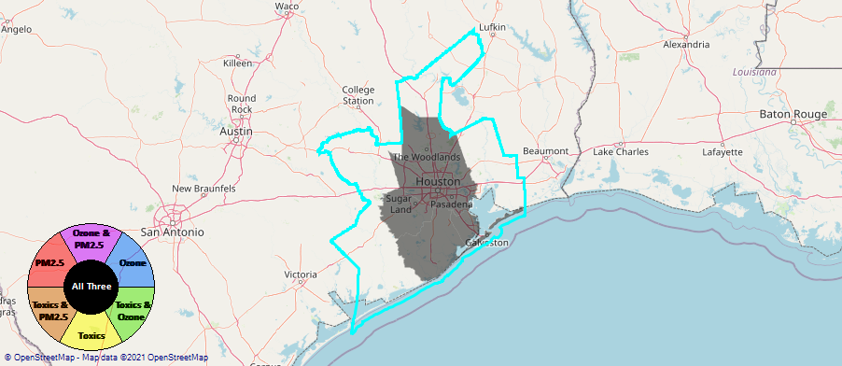
Example 3 - Houston CBSA
Generated in NEXUS
18

Slide 19
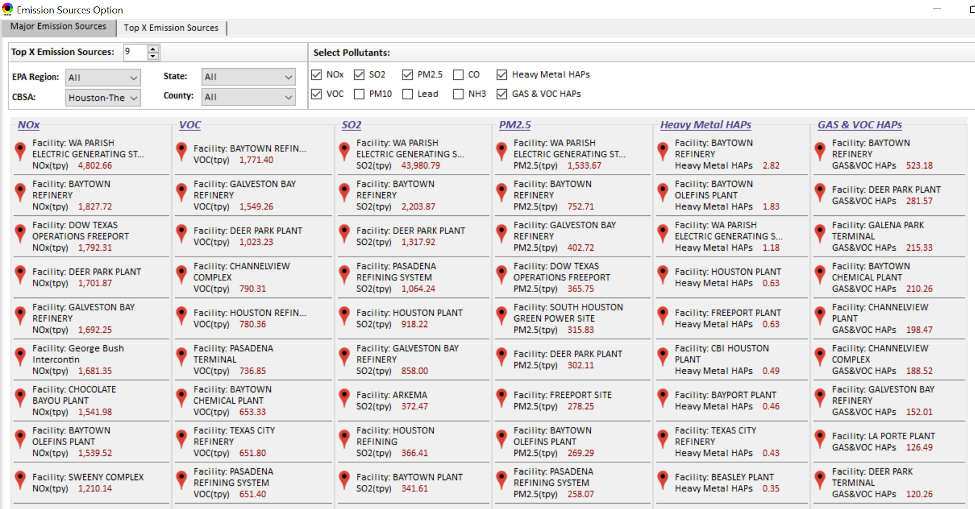
Example 3 - Houston CBSA – Top Emission Sources
Generated in NEXUS
19

Slide 20
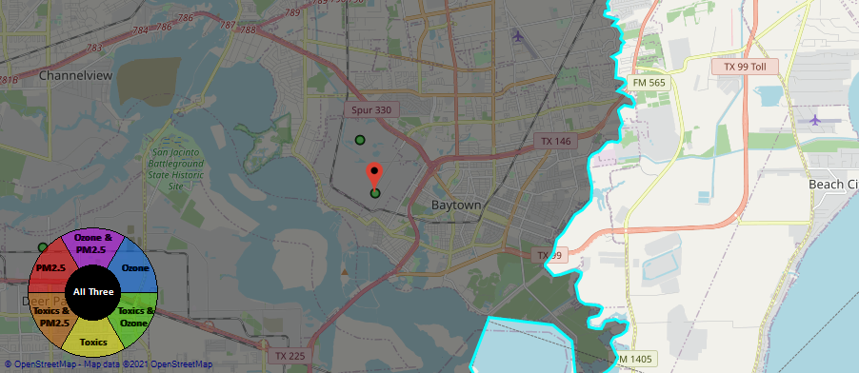
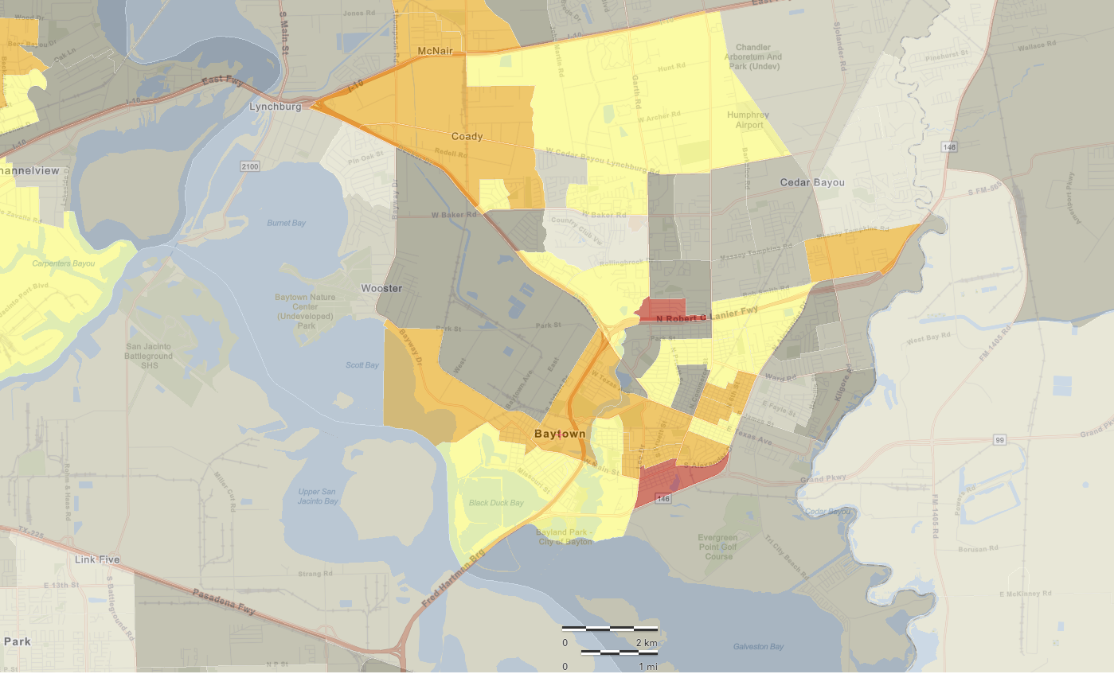
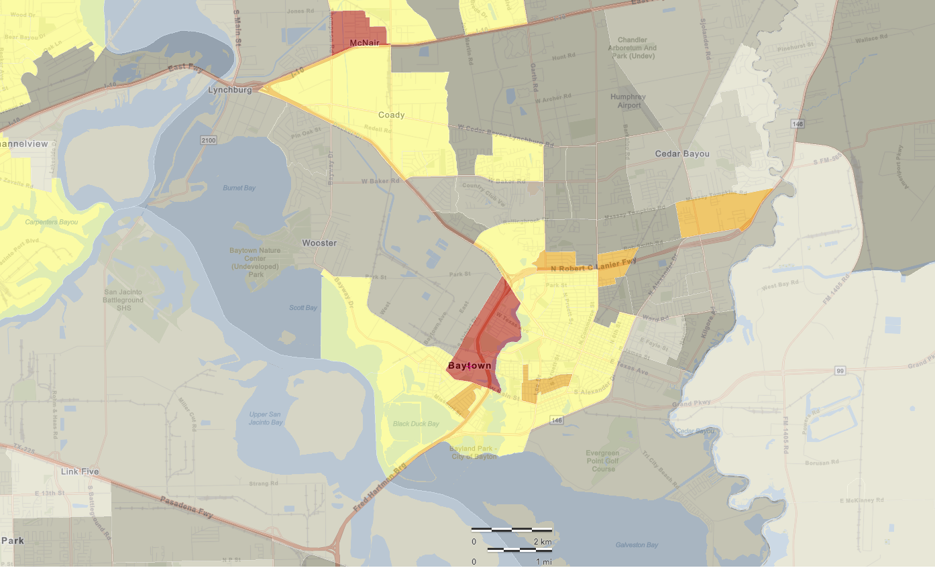
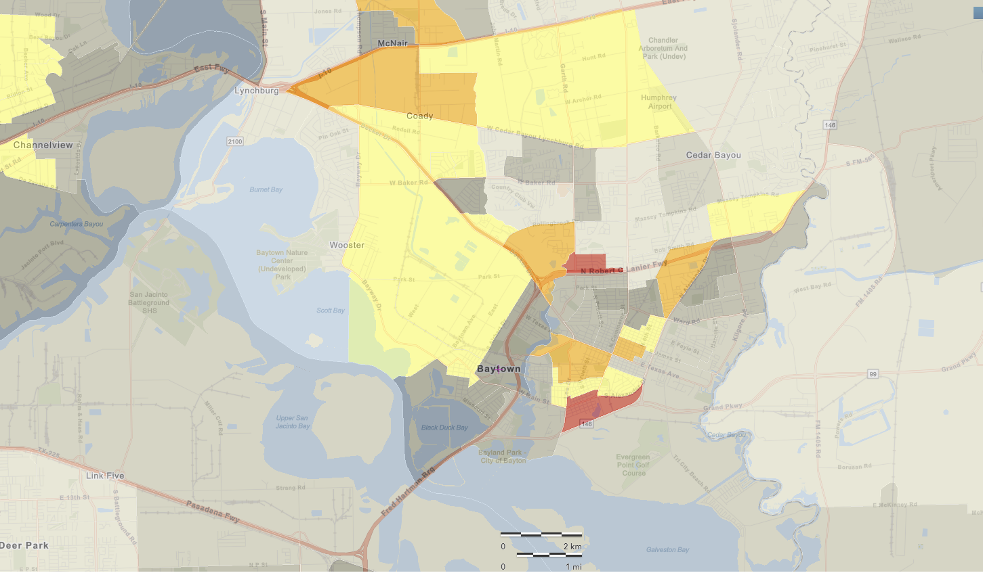
Example 3 - Houston CBSA – Baytown
Generated in NEXUS
National Percentiles
Baytown Olefins Plant (Chemical Plant)
Baytown Refinery (Petroleum)
Generated in EJSCREEN
Generated in EJSCREEN
Generated in EJSCREEN
Demographic Index
People of Color Population
20
Low Income

Slide 21
Next Steps / Issues for Discussion
Next Steps
  Meeting with economics group
  Meeting with EJSCREEN
  Updating existing data to 2017
    Emissions, concentration, risk
  Add new 2017 data
    EJ, GHGs, monitoring
  Revise or add to current set of metrics/indicators
    Risk estimates, EJ metrics/indicators
Issues for Discussion
  2017 Air Toxics Risk Data
  Larger office prioritization of analytical tools
  Funding
21

