Slide 1
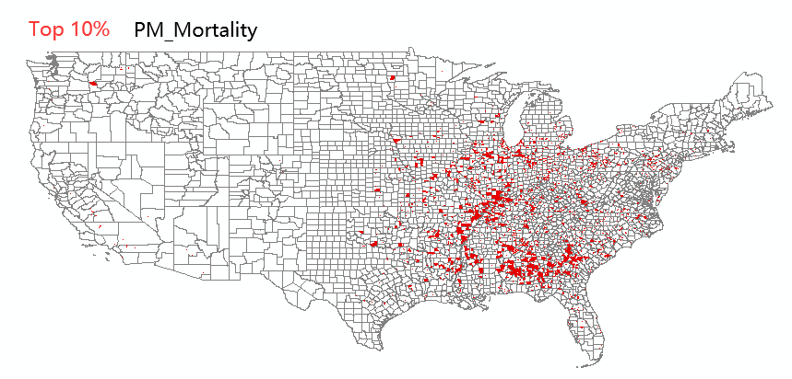
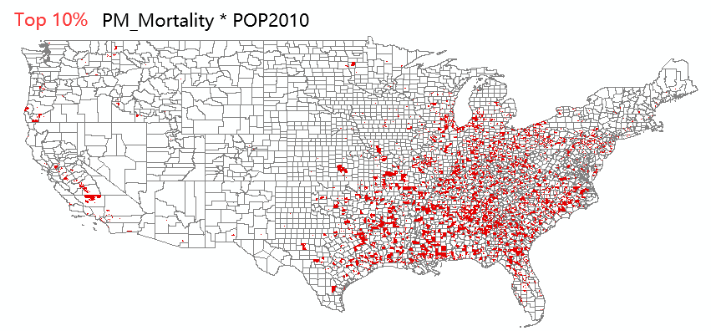
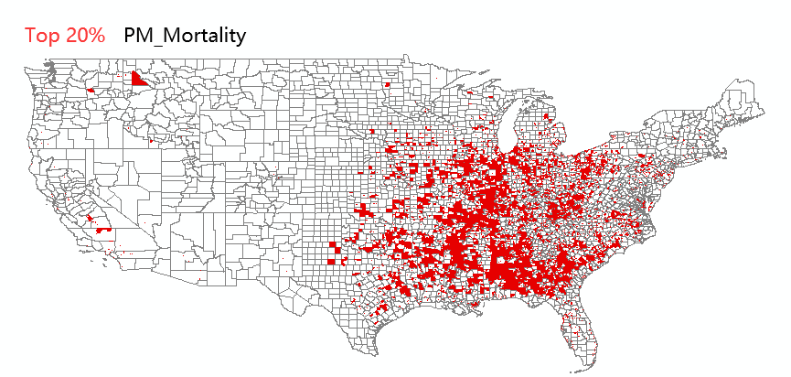
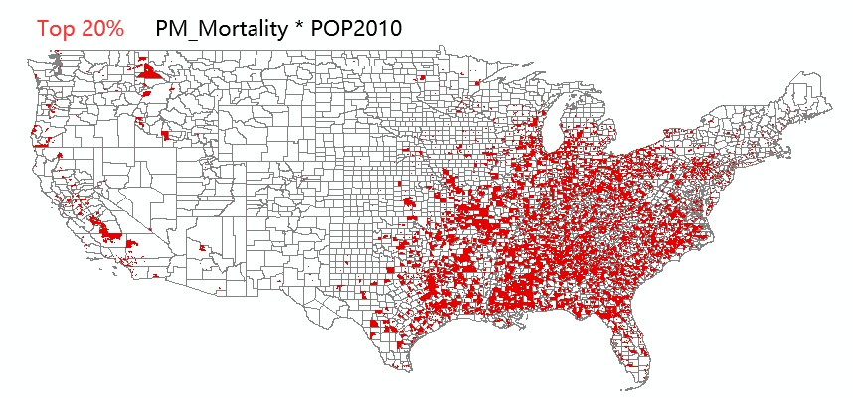






“TRACT – Level”
PM2.5_Risk from “2014 NEXUS for Yarnell.gdb” (in “Census Tract” level)
$$\text{PM}\text{_}Mor\text{tality}\text{ (\#/10}\text{k} \text{per} \text{year}\text{)}$$
$$\text{PM}\text{_}Mor\text{tality} \text{×} POP2010$$
$Top 1$0%
(mortality rate: “per 10k per year”)
$Top 1$0%
(mortality number: “people per year”)
$Top$20%
$Top$20%

Slide 2
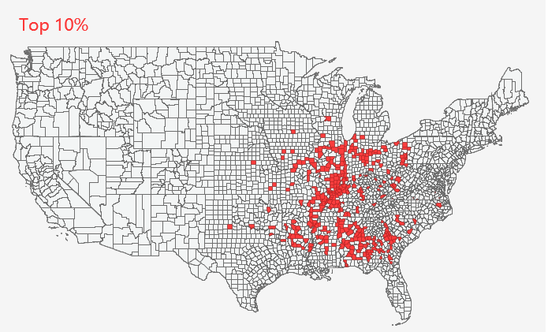
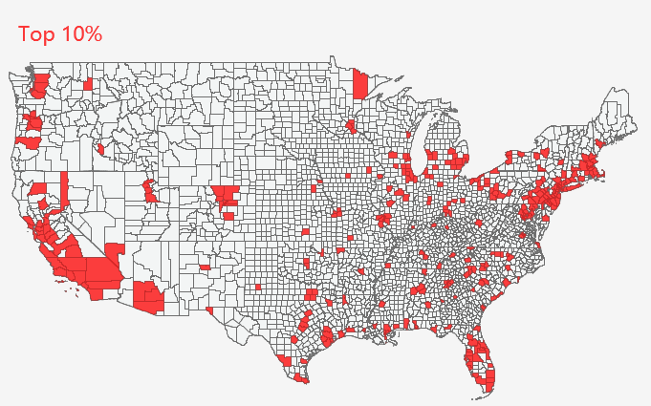
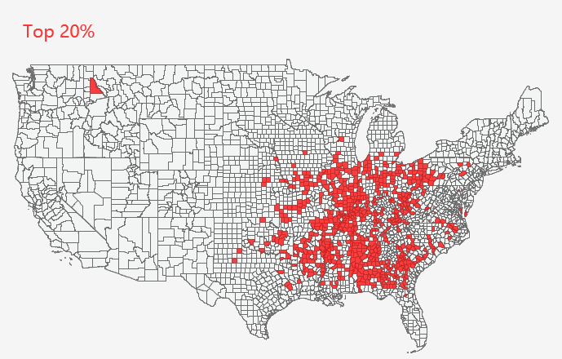
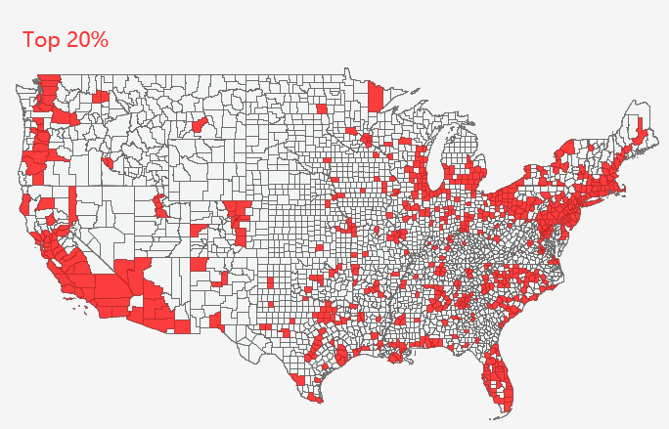
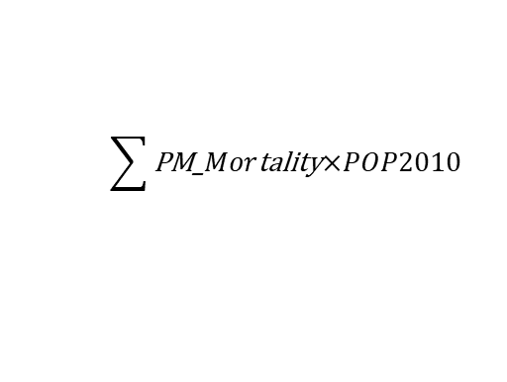
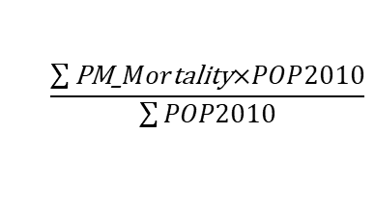
“County – Level”
PM2.5 Risk (aggregated from “Census Tract” to “County” level)
$$\frac{\sum{\text{PM}\text{_}Mor\text{tality}\text{×}POP2010}}{\sum{POP2010}}$$
$$\sum{\text{PM}\text{_}Mor\text{tality}\text{×}POP2010}$$
(mortality rate: “per 10k per year”)
(mortality number: “people per year”)

Slide 3
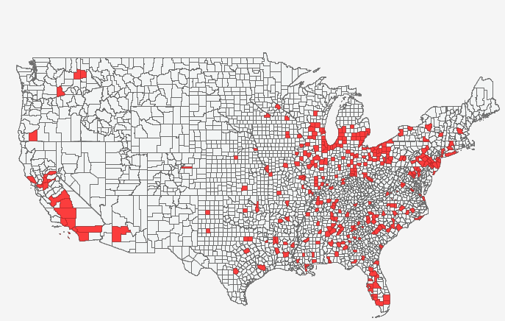
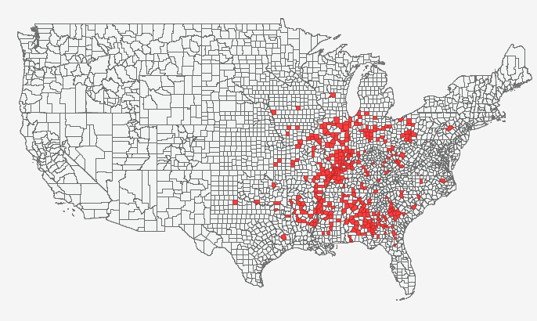
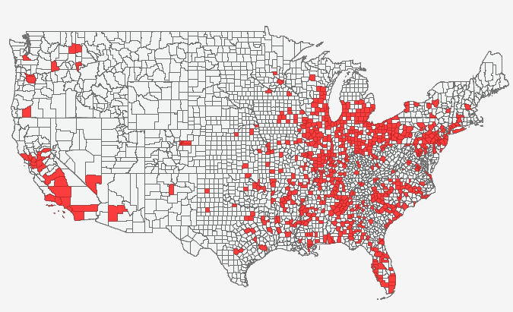
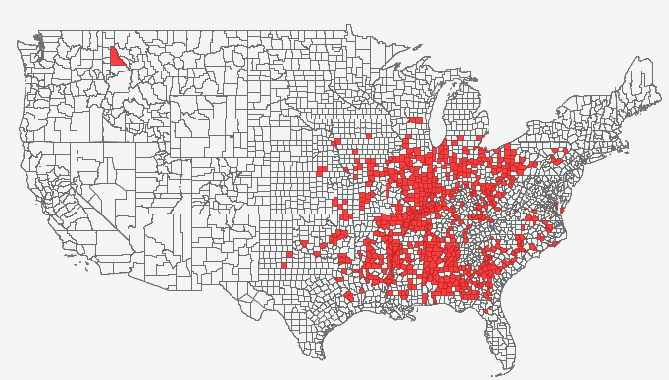






“County – Level”
$\text{Max}\text{(}\text{PM}\text{_}Mor\text{tality}\text{)}$
$Top 1$0%
$Top 1$0%
$\text{AVG}\text{(}\text{PM}\text{_}Mor\text{tality}\text{)}$
$Top 2$0%
$Top 2$0%

Slide 4
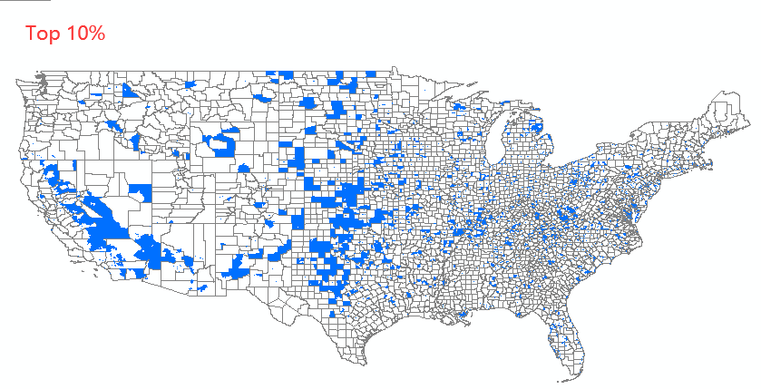
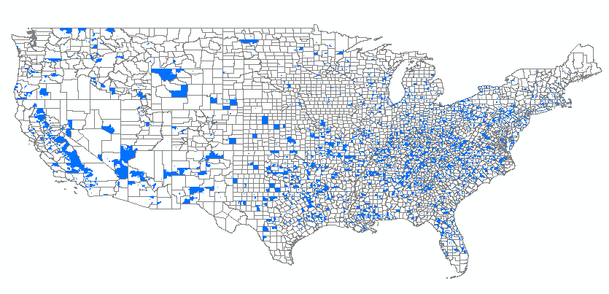
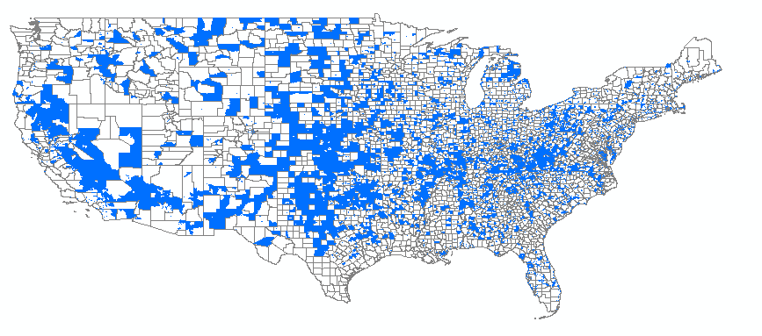
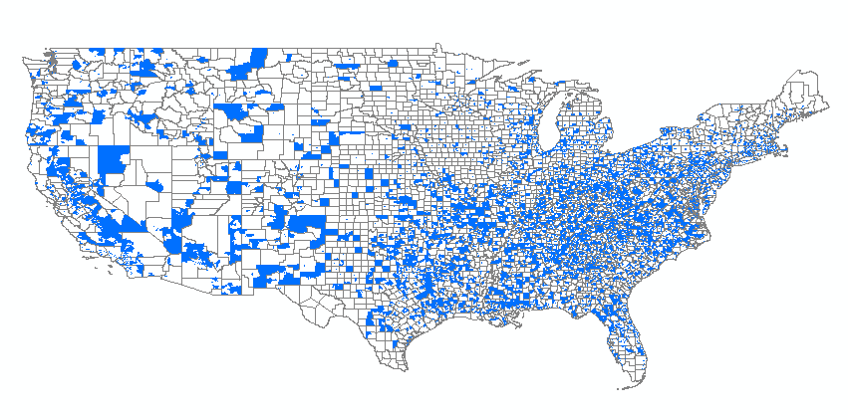






“TRACT – Level”
O3_Risk from “2014 NEXUS for Yarnell.gdb” (in “Census Tract” level)
$$O_{3}\text{_}Mor\text{tality}$$
$$O_{3}\text{_}Mor\text{tality} \text{×} POP2010$$
$Top 1$0%
(mortality rate: “per 10k per year”)
(mortality number: “people per year”)
$Top 1$0%
$Top 2$0%
$Top 2$0%

Slide 5
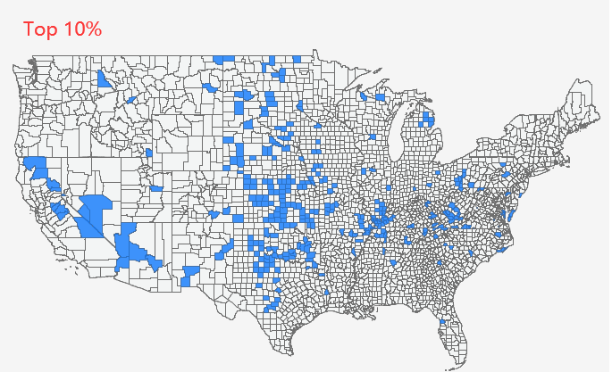
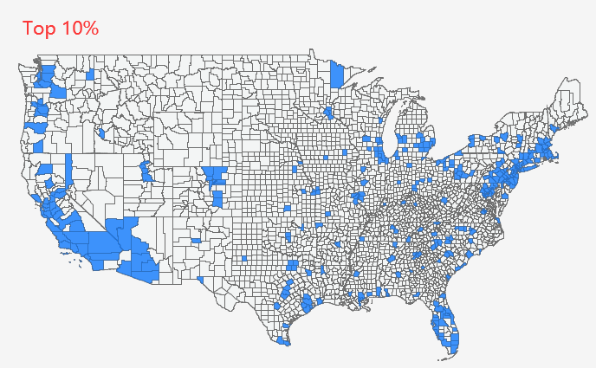
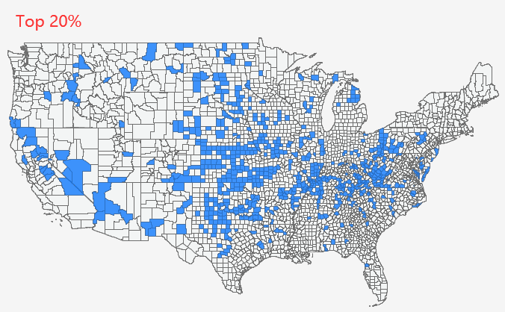
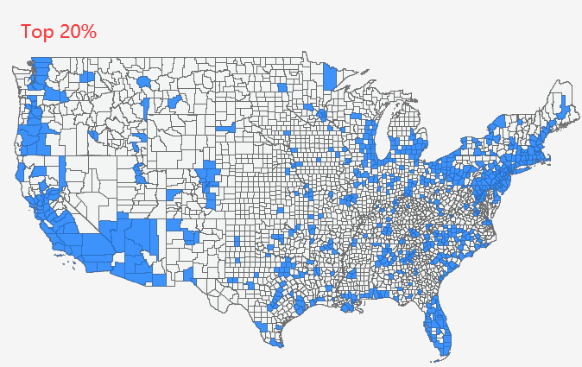
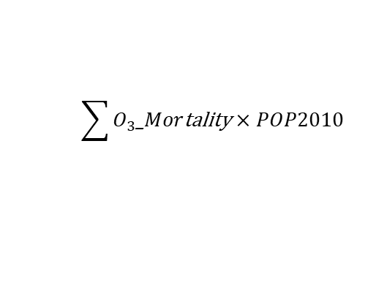
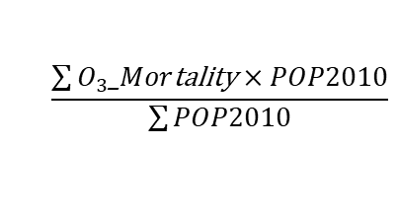
“County – Level”
O3 Risk (aggregated from “Census Tract” to “County” level)
$$\frac{\sum{O_{3}\text{_}Mor\text{tality} \text{×} POP2010}}{\sum{POP2010}}$$
$$\sum{O_{3}\text{_}Mor\text{tality} \text{×} POP2010}$$
(mortality rate: “per 10k per year”)
(mortality number: “people per year”)

