Slide 1
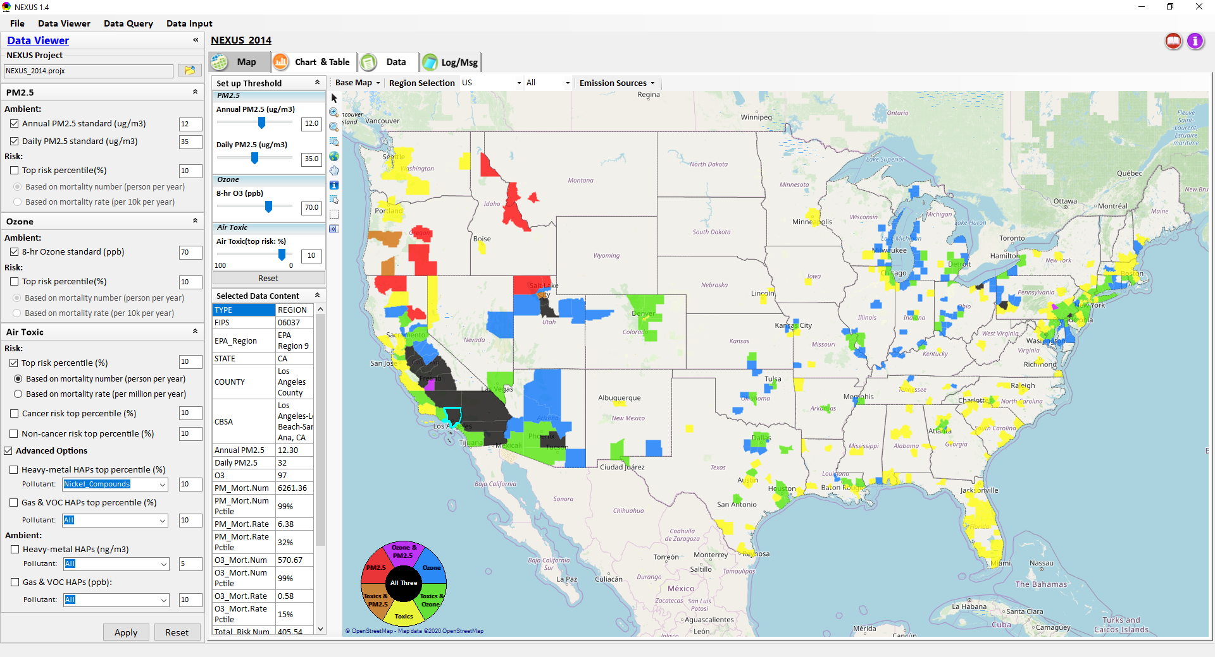
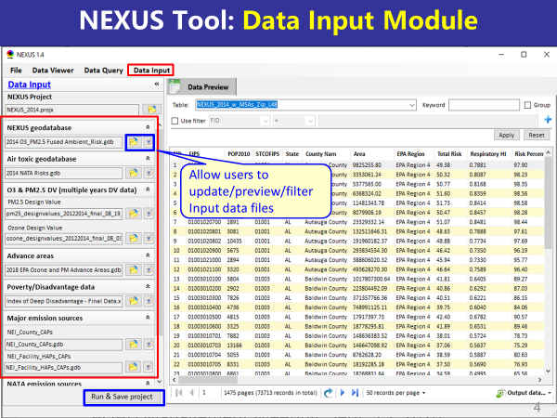
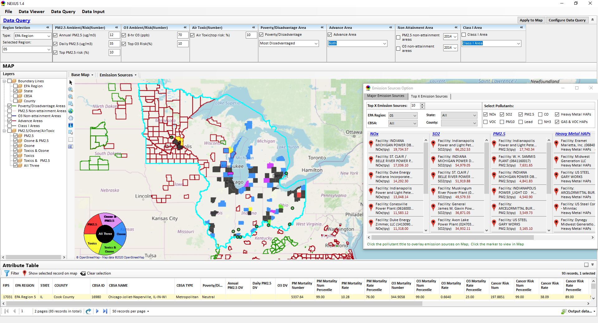
“NEXUS” Multi-Pollutant Analysis Tool
Development: Status and Progress
Data Viewer Module
Data Input Module
Data Query Module
“NEXUS 1.5” available on OAQPS’s Shared Drive at: “G:\SHARE\NEXUS\NEXUS 1.5\”
or at EPA’s new FTP site: ftp://newftp.epa.gov/aqmg/cjang/NEXUS/NEXUS 1.5/
OAQPS Briefing
February 1, 2021
Carey Jang & Beth Landis
1

Slide 2
Overview
Multi-Pollutant Background
NEXUS Advanced Screening Tool Development
  Expected Use
  Engagement Across Office
Key Modules
Questions NEXUS Can Answer & Examples
Discussion & Next Steps
Live Demo
2

Slide 3
Multi-Pollutant (MP) Background
Support a comprehensive, MP treatment of air quality problems to effectively improve air quality and make the most efficient use of available resources
  Primary Goal - identify & evaluate local control strategies targeting emissions of O₃ & PM_{2.5} and their precursors while at the same time reducing Air Toxics of concern for communities to maximize both health benefits and air quality improvements
MP planning has the potential to reduce the costs and increase benefits associated with air quality management (AQM)
Supports S/L/T air agencies in developing MP, risk-based AQM plans and implementing strategies that reduce air pollution emissions & improve public health
Success has been demonstrated in Detroit and SC; another project is currently underway in Louisville, KY (briefed in May 2020)
Tools needed to analyze MP data are either available currently or being developed in OAQPS (e.g., NEXUS)
3

Slide 4
NEXUS Tool Development
Motivation: Develop a new multi-pollutant analysis tool to identify and assess areas with high ambient levels and/or health risks associated with PM_{2.5}, O₃ and Air Toxics
Phase-1: Develop a GIS-based NEXUS prototype with a user-friendly graphical interface to provide analysis and visualization functions of potential multi-pollutant AQ issues at national level (continental US)
Phase-2: Expand the NEXUS tool to allow users to dial into an EPA region, State, or metropolitan area and provide data query and visualization functions for “emissions and air quality” information over the selected region of interest
4

Slide 5
Expected Use of NEXUS Tool
The NEXUS tool will allow users to do the following:
  National screening for areas with MP issues: Phase 1 development provides ability to quickly screen areas across nation that have combination of high air quality and/or risk levels for O₃, PM_{2.5} and Air Toxics.
  Area screening to understand nature of MP problem: Phase 2 development provides ability to ‘dial-into’ specific areas to determine extent to which common emissions sources are causing the MP issues.
We expect to use this tool to engage with Regions and identify areas that would potentially benefit most from MP approaches to reduce emissions (including current NA areas).
The NEXUS tool will essentially provide a ‘conceptual model’ of MP issues to facilitate engagement with state/local/tribal agencies and community stakeholder groups.
We also believe that it has additional uses across the Office for Air Toxics, Environmental Justice and other programs.
5

Slide 6
NEXUS Tool: Engagement Across OAQPS
Audience | Date
AQAD & HEID – DD & Management Team | Sept. 25, 2020
Air Toxics Team | Nov. 3, 2020
AQPD – DD & Management Team | Dec. 10, 2020
OID – DD & Management Team | Jan. 25, 2021
SPPD – DD & Management Team | Jan 28, 2021
OAQPS – Office Director | Feb 1, 2021
6

Slide 7
Planned Use of NEXUS: AQAD
Assemble technical information for accessibility and transparency to facilitate understanding of multi-pollutant air quality issues across the U.S.
Provide information on O₃, PM_{2.5}, and Air Toxics (and GHGs in future) to inform and connect our program efforts:
  Multi-pollutant considerations w/ HEID & EPA Regions
  NAA, Advance areas w/ AQPD
  Tribal areas and EJ strategy w/ OID
  Sector assessments w/ SPPD

Slide 8
Planned Use of NEXUS: HEID
Multi-pollutant Team
  Identify highest risk areas across O₃, PM_{2.5}, and Air Toxics to promote MP considerations across the office
  Engage with EPA Regions in these areas to consider MP control strategies and outreach purposes
  Identify the nature of multi-pollutant risks across EJ communities to identify sources/sectors/areas of focus for our programs

Slide 9
Potential Use of NEXUS: AQPD
Non-attainment areas/Advance program
  Understand multi-pollutant risks to consider more effective multi-pollutant control strategies
  Overlay high MP risk areas with NAAs and Advance areas:
    What are the top emissions sources by pollutant?
    What specific sources are common across pollutants that may indicate co-control potential?
    Engage with EPA regions, S/L/T air agencies, & community stakeholders to consider MP control strategies as part of SIP or voluntary programs and address other pollutant concerns such as within EJ communities

Slide 10
Potential Use of NEXUS: OID
Tribal Program
  Identify high risk areas for O₃, PM_{2.5}, & Air Toxics
  Engage with EPA regions and tribal air agencies to consider MP control strategies as part of TIPs or voluntary programs
EJ Strategy and Outreach
  Assist in understanding the nature of multi-pollutant risks for EJ communities as part of upcoming OAQPS EJ Strategy including identifying sources/sectors/areas of focus
  Use formally as a screening tool under OAQPS EJ strategy (in complimentary manner w/ EJSCREEN)

Slide 11
Potential Use of NEXUS: SPPD
Inform prioritization of sources/sectors that significantly contribute to highest nationwide risk across O₃, PM_{2.5}, and Air Toxics
Identify facilities and/or sectors with potential co-benefits of control in areas with highest multi-pollutant risks
  For example, help GHG rules/policies focus on sectors that have highest local air quality health benefits
Identify sources/sectors that significantly contribute to toxics and criteria pollutant risks within EJ communities

Slide 12
NEXUS Tool: Three Key Modules
Data Viewer module
Data Input module
Data Query module
View and create interactive Map/Data/Chart/Table
Provide flexible selections & mapping of “Ambient” and/or “Risk” levels of PM_{2.5}, O₃ and Air Toxics
Provide regional analysis for “EPA region”, “States”, “CBSA”, and “County”
Link and display major emission sources locations & emitted pollutants info.
Allow to update & change input data files
Provide data preview and filter functions
Currently uses 10 publicly available input data files (~4GB)
Quick turnaround to run & save to a new “project” using new input data files
Expand data field selections and flexibility for exploratory/advanced users
Provide overlaying map and summary table for data query results
Current data query based on selected data fields: “Ambient/Risk, Advance area, Socio-demographic (EJ) area, NA Area, Class I area”
12

Slide 13
NEXUS Tool: Examples
How can NEXUS be used to identify highest risk areas across O₃, PM_{2.5}, and Air Toxics, the sector(s) contributing and EJ communities impacted?
  Example 1 → Region 5 → Detroit
How can NEXUS be used to identify how best to address multi-pollutant risks in nonattainment areas?
  Example 2 → Region 4 → Atlanta
How can NEXUS be used to review industrial sources and potential impacts on EJ communities?
  Example 3 → Region 4 → Birmingham
13

Slide 14
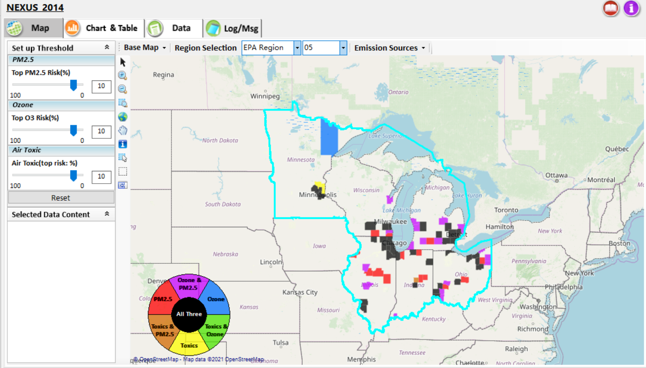
NEXUS Tool: Example 1 - ID High MP Risk Areas, Contributing Sector(s) & EJ Areas
NEXUS can be used to identify highest risk areas across O₃, PM_{2.5}, and Air Toxics.
Example map above is for Region 5
14

Slide 15
NEXUS Tool: R5 Rankings from Data Query Module
STATE | COUNTY | CBSA NAME | PM Mortality Num % | O3 Mortality Num % | Total Risk Num % | Overall Rank | Poverty / Disadvantage | Advance Area Type
IL | Cook County | Chicago-Joliet-Naperville, IL-IN-WI | 99 | 99 | 99 | 1 | Neutral
MI | Wayne County | Detroit-Warren-Livonia, MI | 99 | 99 | 99 | 1 | Disadvantaged
MI | Oakland County | Detroit-Warren-Livonia, MI | 99 | 99 | 98 | 2 | Advantaged
OH | Cuyahoga County | Cleveland-Elyria-Mentor, OH | 99 | 99 | 98 | 2 | Disadvantaged
OH | Franklin County | Columbus, OH | 99 | 99 | 98 | 2 | Neutral
IN | Marion County | Indianapolis-Carmel, IN | 99 | 98 | 98 | 3 | Disadvantaged
OH | Hamilton County | Cincinnati-Middletown, OH-KY-IN | 99 | 98 | 97 | 4 | Disadvantaged
WI | Milwaukee County | Milwaukee-Waukesha-West Allis, WI | 99 | 98 | 97 | 4 | Disadvantaged | PM
MN | Hennepin County | Minneapolis-St. Paul-Bloomington, MN-WI | 98 | 98 | 98 | 4 | Advantaged | Both
IL | DuPage County | Chicago-Joliet-Naperville, IL-IN-WI | 98 | 97 | 98 | 5 | Most Advantaged
MI | Macomb County | Detroit-Warren-Livonia, MI | 98 | 98 | 97 | 5 | Advantaged
OH | Montgomery County | Dayton, OH | 98 | 98 | 95 | 6 | Disadvantaged
IN | Lake County | Chicago-Joliet-Naperville, IL-IN-WI | 98 | 97 | 95 | 7 | Neutral
OH | Summit County | Akron, OH | 98 | 97 | 95 | 7 | Neutral
IL | Lake County | Chicago-Joliet-Naperville, IL-IN-WI | 97 | 96 | 97 | 7 | Advantaged
NEXUS can be used to identify highest risk areas across O₃, PM_{2.5}, and Air Toxics. Information above was generated in Data Query for Region 5 and exported into excel where rankings were applied.
Top CBSAs (using this approach) – Chicago, Detroit, Cleveland, Columbus, Indianapolis, Cincinnati, Milwaukee, Minneapolis, Dayton & Akron
15

Slide 16
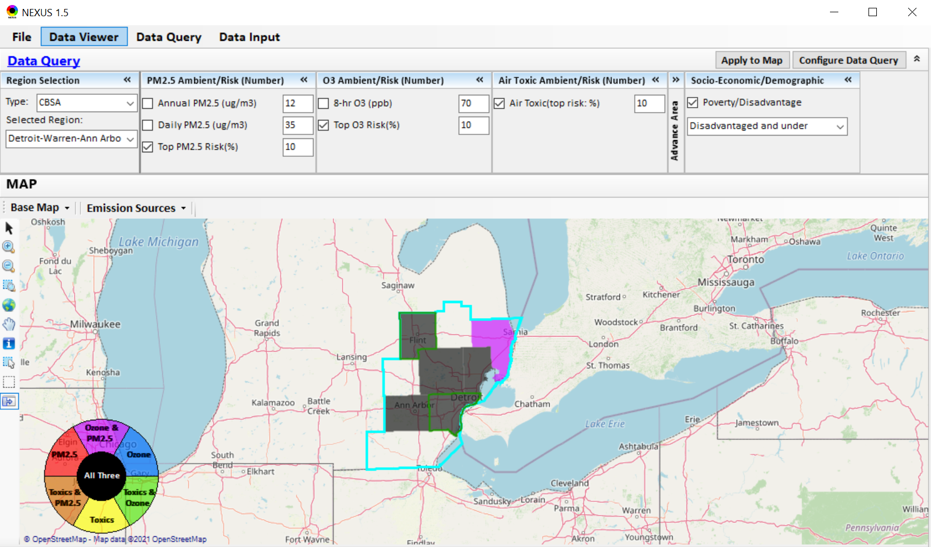
NEXUS Tool: Detroit CBSA
NEXUS can be used to explore CBSAs with multi-pollutant concerns. This information was generated in Data Viewer for the Detroit CBSA. Two counties (Wayne & Genessee) are outlined in green, showing that they are “disadvantaged or under”. Let’s explore where the major sources are located in the CBSA…
16

Slide 17
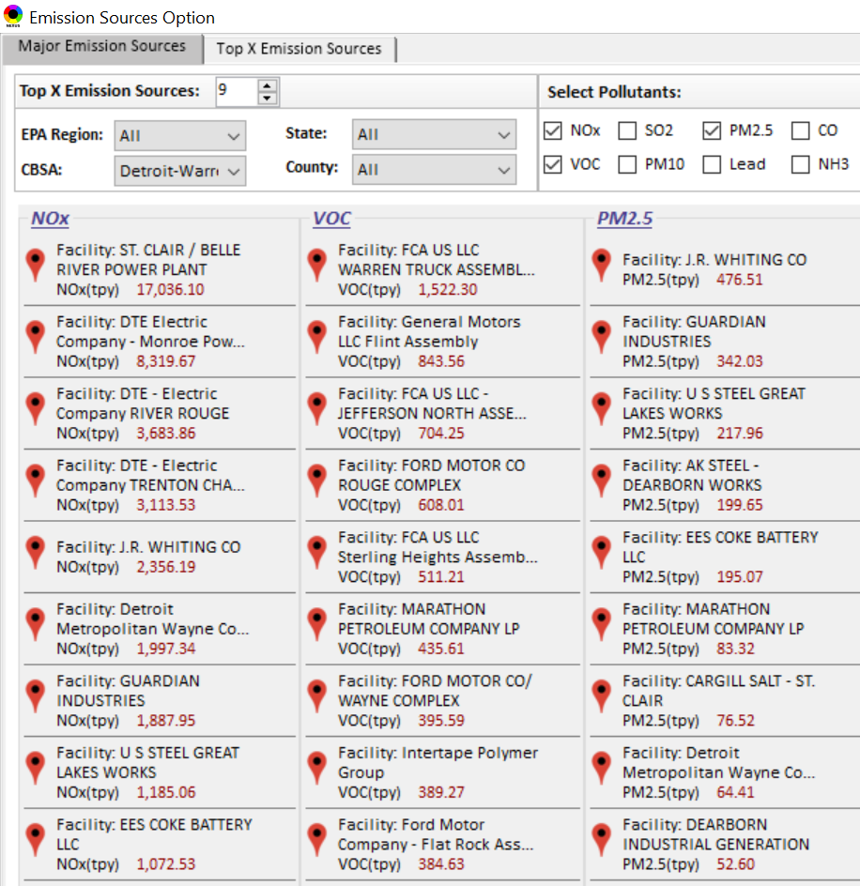
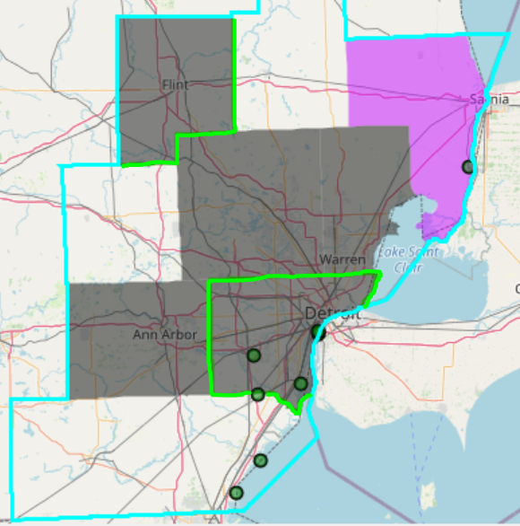

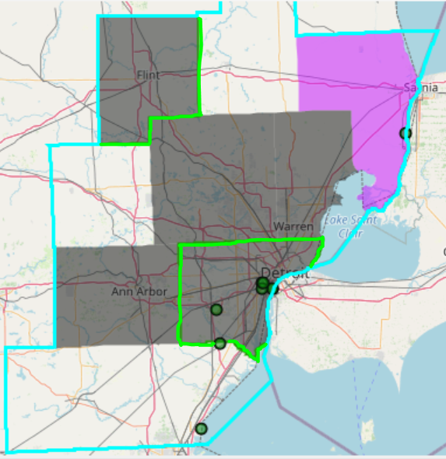
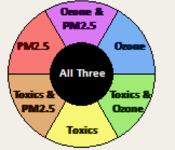
NEXUS Tool: Emissions Sources in Detroit CBSA
G
S
G
S
Ma
Ma
S
Ma
M
W
W
M
G
M
M
M
W
W
W
Top NOx Emission Sources
Top VOC Emission Sources
W
W
W
M
Ma
W
G
S
W
W
W
Ma
M
W
S
W
W
S
W
W
W
W
M
G = Genessee Co., Ma= Macomb Co., M= Monroe Co., S = St. Clair Co., W = Wayne Co.
Top PM_{2.5} Emission Sources
NEXUS can be used to identify top emission sources. The information above was generated in Data Query for the Detroit CBSA . We can quickly see that the majority of the NOx, VOC & PM_{2.5} emission sources are located in Wayne County. Let’s explore the Wayne County sources further…
17

Slide 18
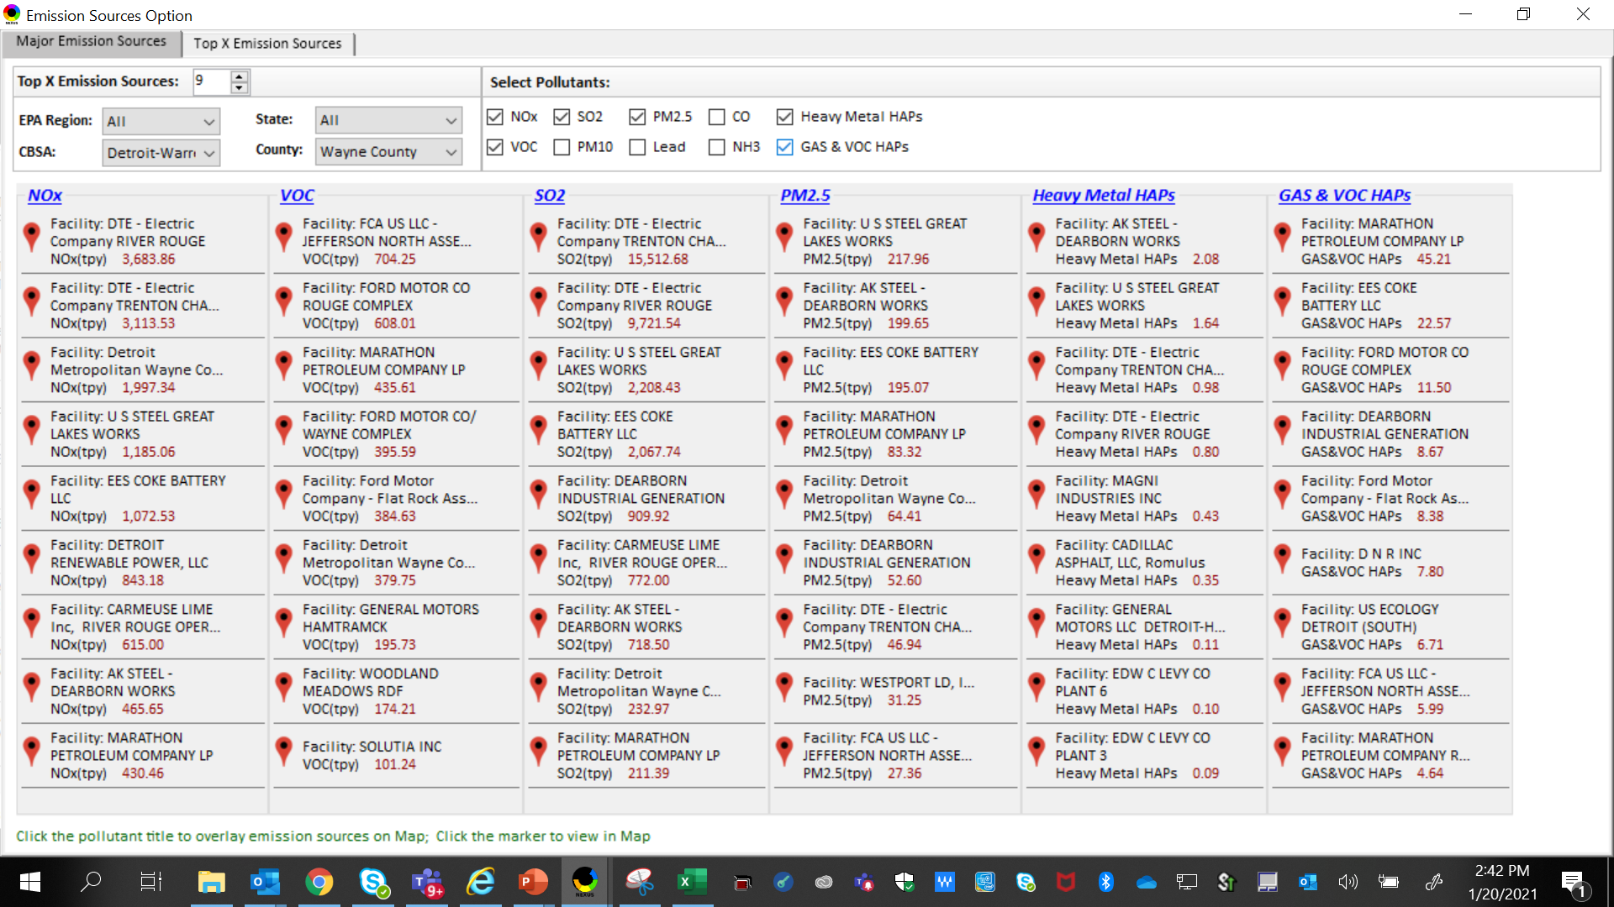
NEXUS Tool: Emissions Sources in Wayne County
NEXUS can be used to identify top emission sources. The information above was generated in Data Query for Wayne County, MI. This can help identify the potential co-benefits of controls. Let’s explore AK Steel and US Steel further...
18

Slide 19
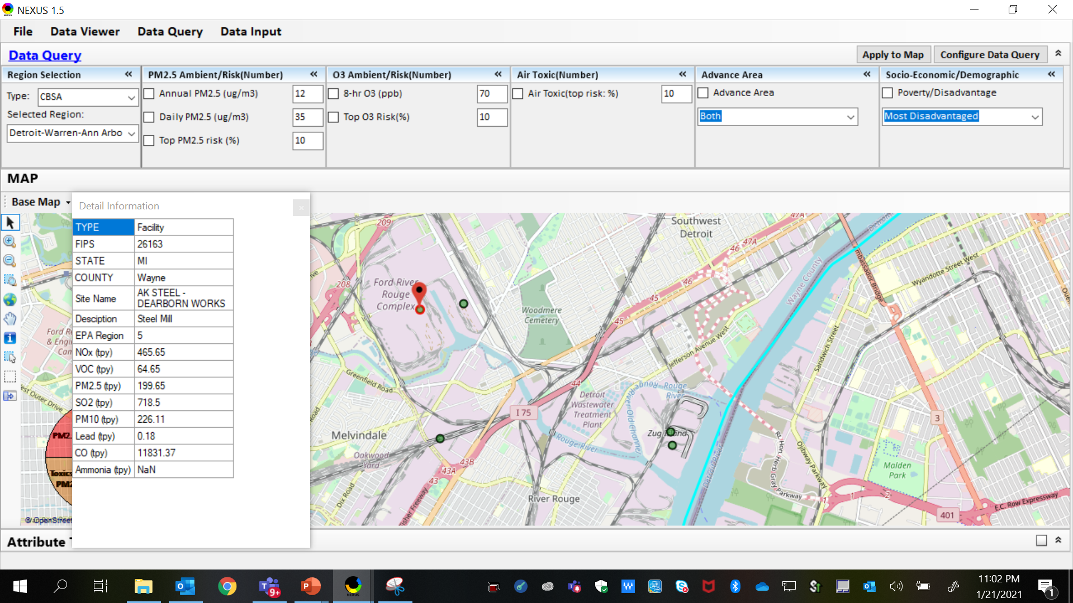
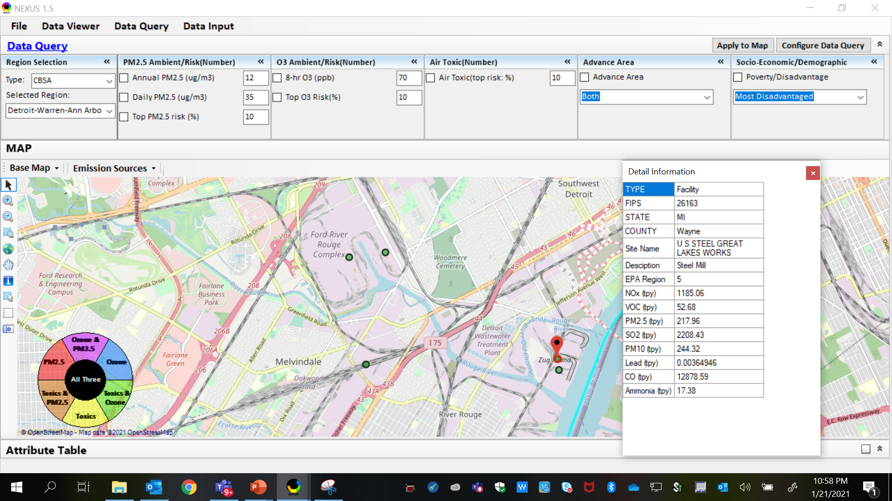
NEXUS Tool: Steel Mills in Wayne County
AK Steel
US Steel
AK Steel & US Steel were both identified as top emitters for NOx, SO₂, PM_{2.5} and Heavy Metal HAPs, highlighting the potential co-benefits of controls in these steel mills. The above map was generated in NEXUS Data Query. Let’s see the proximity of these steel mills to EJ communities…
19

Slide 20
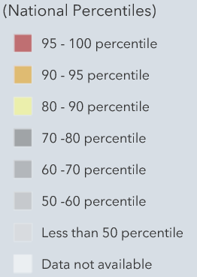
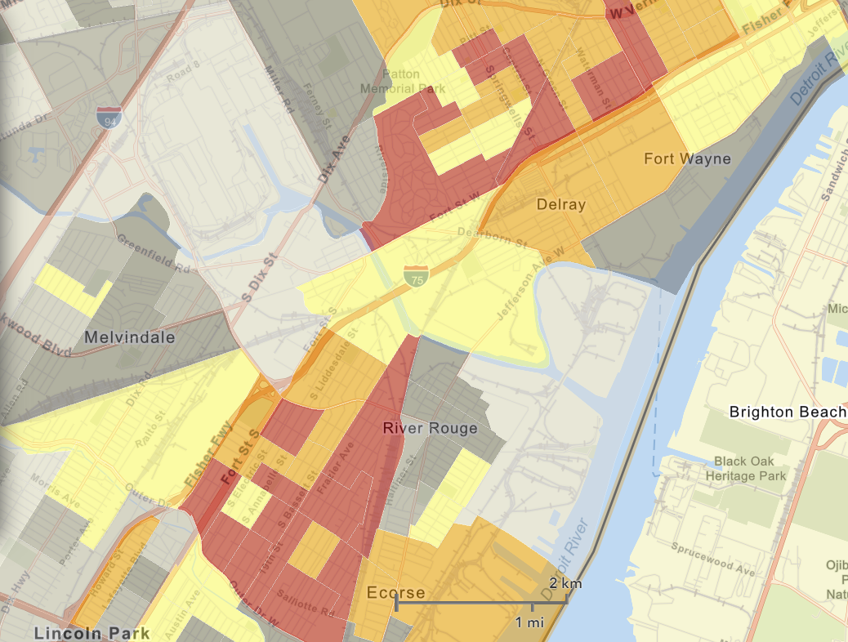
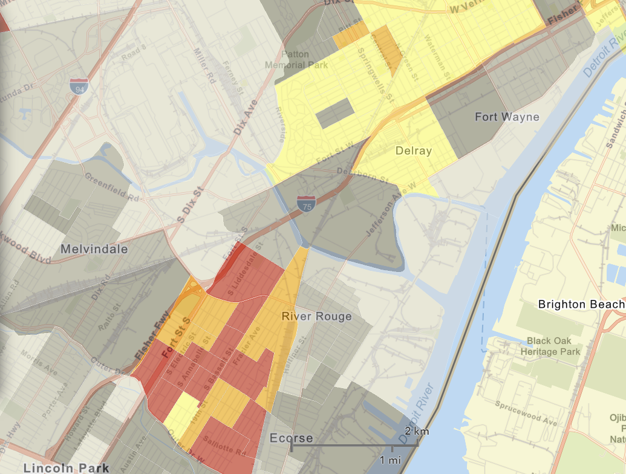
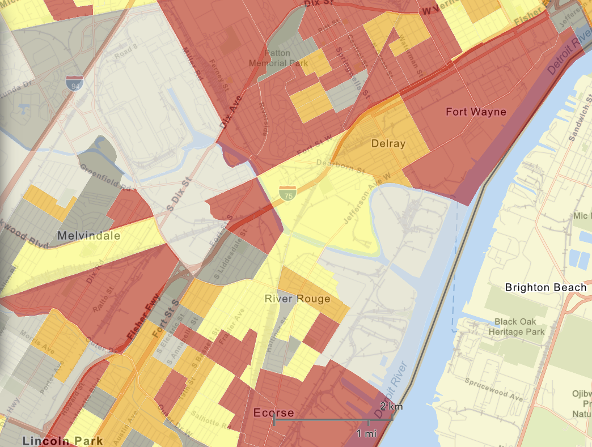

NEXUS Tool: EJ Indices in Wayne County
NEXUS Map
NEXUS can be used to determine EJ communities in areas with MP concerns. NEXUS currently includes a poverty/disadvantage index, and we plan to incorporate additional EJ metrics such as the data inputs below from EJSCREEN. These indices show the close proximity of AK Steel & US Steel to EJ communities.
AK Steel
US Steel
EJSCREEN Demographic Index
EJSCREEN Minority Population
EJSCREEN Low Income Population
20

Slide 21
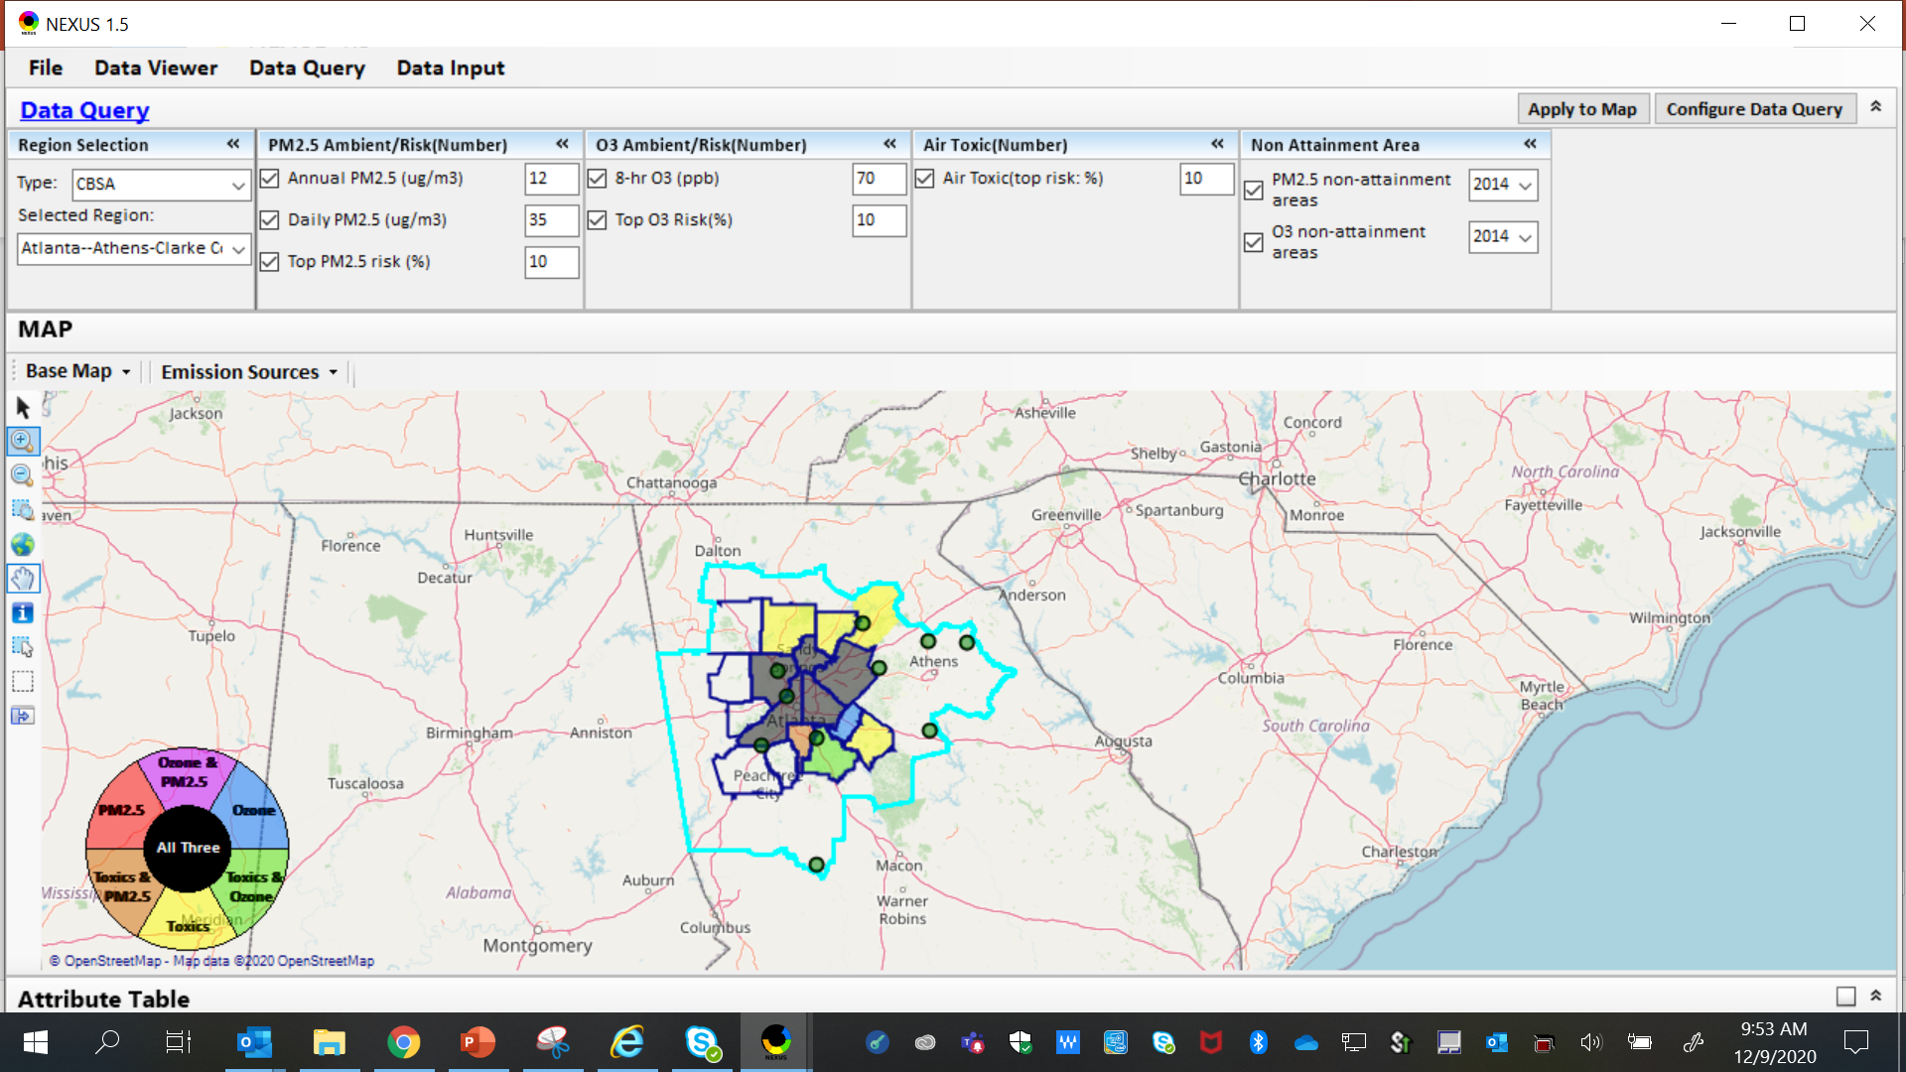
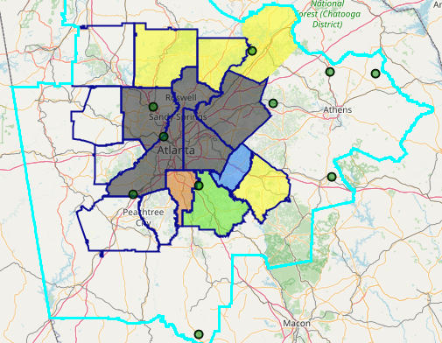
NEXUS Tool: Example 2 – MP Risk in NAAs
The maps above were generated for the Atlanta CBSA (2015 O₃ NAA), using the data query module. The top 10 Gas & VOC HAPS emission sources are plotted.
21

Slide 22
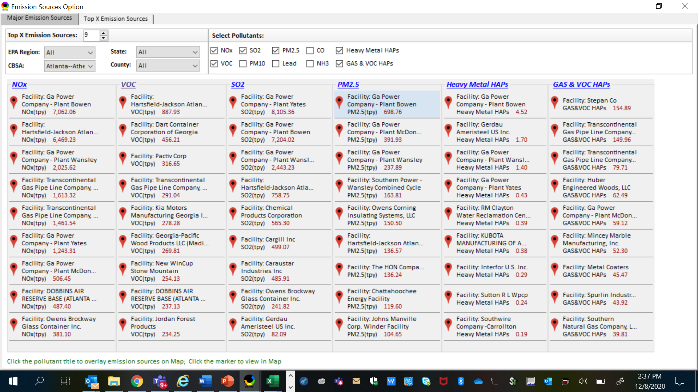
NEXUS Tool: Identifying MP Co-Controls
NEXUS can be used to identify top emission sources. Information above was generated in Data Query for the Atlanta CBSA. This can help identify the potential co-benefits of controls, e.g., Transcontinental Gas Pipeline Co.
22

Slide 23
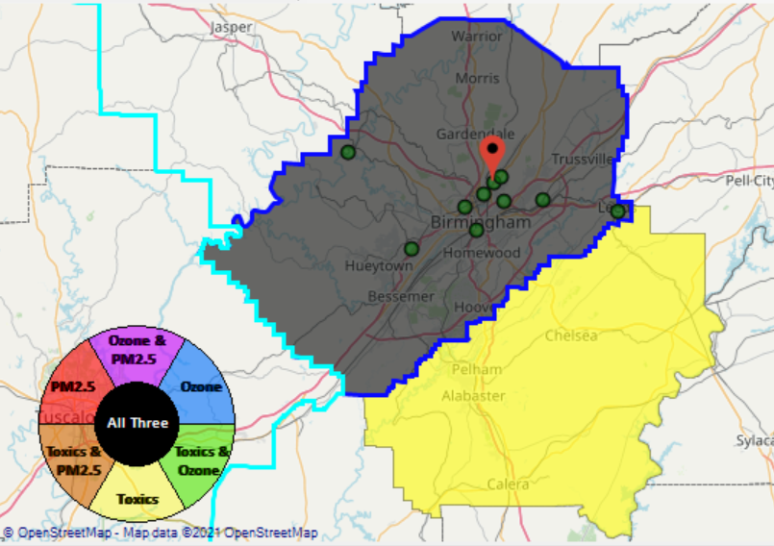
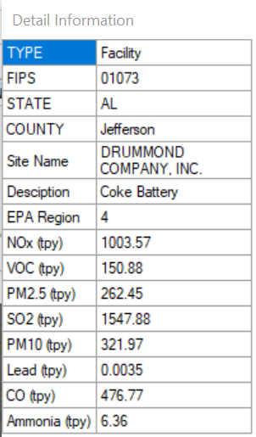
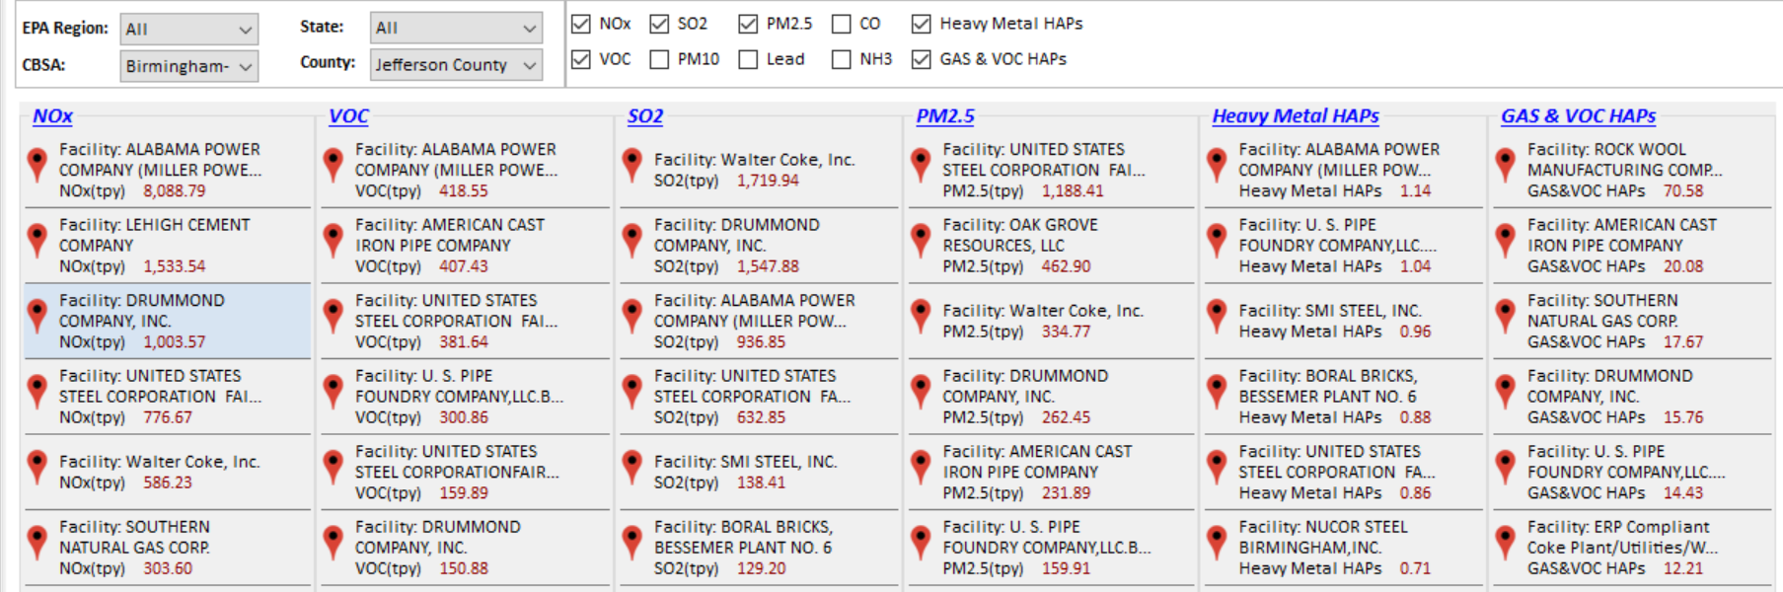
NEXUS Tool: Example 3 – Reviewing an Industrial Source
Drummond’s ABC Coke facility in Tarrant, AL, just outside the Birmingham city limits in Jefferson County, recently paid fines under settlement agreement for emitting 10x more benzene than reporting, along with other violations. We can use NEXUS to take a look at the facility.
23

Slide 24
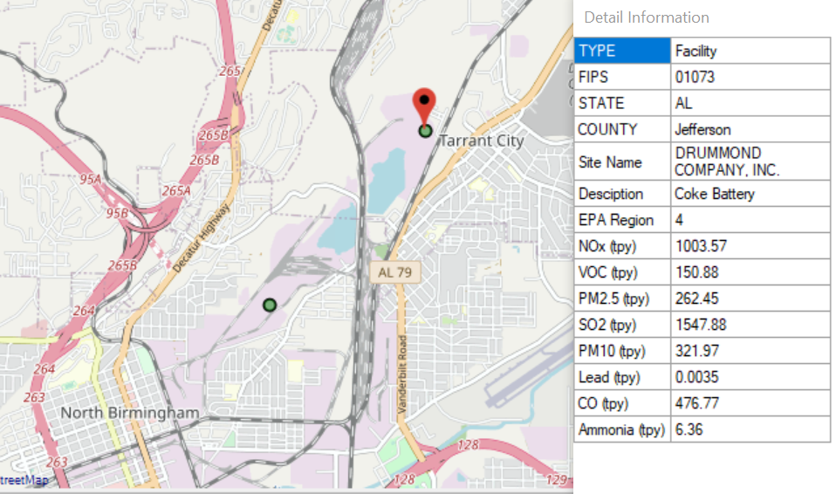
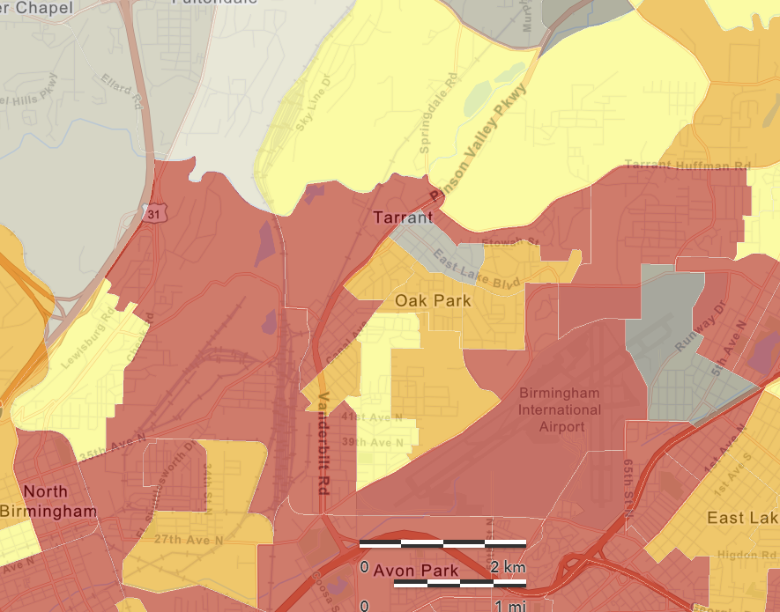
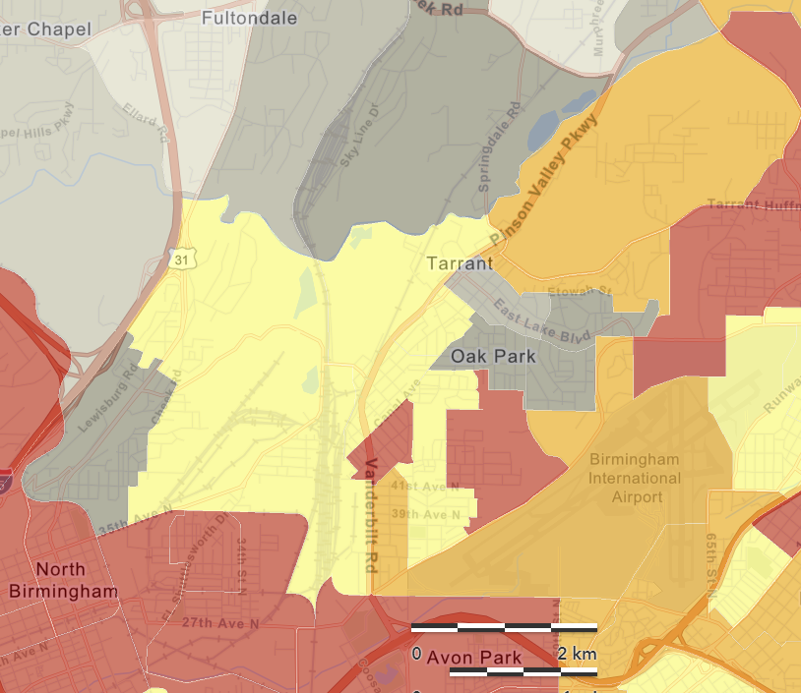
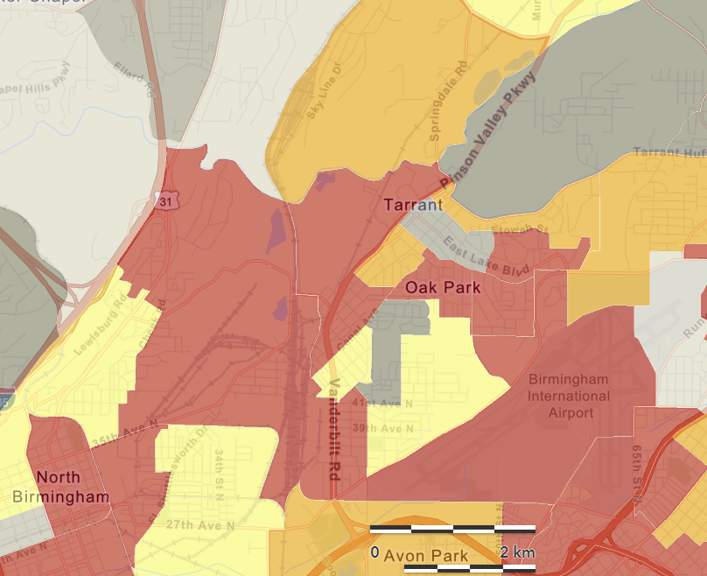
NEXUS Tool: Reviewing an Industrial Source near EJ Areas
NEXUS Map
Adding EJ metrics, such as those shown below in EJSCREEN, can be used in NEXUS to determine the proximity of industrial sources to EJ communities in areas with MP concerns.
EJSCREEN Demographic Index
EJSCREEN Minority Population
EJSCREEN Low Income Population
24

Slide 25
NEXUS Tool: Potential EJ Capability Additions
NEXUS is complimentary to EJSCREEN: in providing functionality specific to OAQPS needs, it can access EJSCREEN data layers and also provide data for use in EJSCREEN (e.g., updated emissions, modeling and risk estimates)
A source/sector module could allow for Multi-pollutant ‘proximity-based assessment’ for EJ communities
  Define an area around a source/sector and calculate % distribution of demographics (race, ethnicity, etc.)
  Compare % distribution to the state, region, or national level averages
  Expand demographic comparisons to include O₃, PM_{2.5} and Air Toxics risks or other metrics of interest (e.g., emissions density, pop-weighted air quality concentrations, etc.)
Incorporate EJ analysis similar to what is currently used for Risk and Technology Review (RTR) and other actions
  NEXUS could provide a transparent and accessible way to complete screening analyses and share across the office and programs (criteria and toxics).
  Additional discussion planned about improving the tool’s ability to more accurately screen for toxics with more highly resolved data and/or ability to incorporate more refined emissions and modeling data.
25

Slide 26
NEXUS Tool: Next Steps (1)
    Short-term:
    GOAL: Upgrade/improve NEXUS tool to reflect latest data & information and MP team’s feedbacks
    Currently expect FY21 funding to support NEXUS -- perhaps $50k from AQAD
      Update NEXUS data to 2017
        2017 data for O₃, PM_{2.5} & Air Toxics risk/ambient/emissions
        Tribal boundaries & socioeconomic/demographic data for EJ
      Add O₃, PM_{2.5}, and Air Toxics monitoring data
      Update metrics/indicators (e.g., risk metrics, EJ indicators)
    Engage across Office to determine how this tool may best inform or be used for OAQPS’s Air Toxics Strategy programs
      Consider addition of screening-level analysis & assessment capabilities (e.g., proximity-based EJ analysis)
26

Slide 27
NEXUS Tool: Next Steps (2)
    Long-term:
    Conduct Beta testing of NEXUS tool within OAQPS and with EPA Regions
    Based on Office wide engagements, use updated NEXUS tool to inform Multi-pollutant, Air Toxics, NAA/Advance controls, and EJ efforts as appropriate
    Develop plan for routine updates and maintenance of the NEXUS tool to best support OAR/OAQPS programs and determine appropriate extensions as need and resources provide.
    Collaborate with OID on NEXUS Training Materials
27

Slide 28
NEXUS Tool: Discussion
Are there particular areas where you/SMT need additional information?
Do you agree with the current areas of focus of the tool across the office?
Are there other needs or items we should consider?

Slide 29
Live Demo
Carey Jang
29

Slide 30
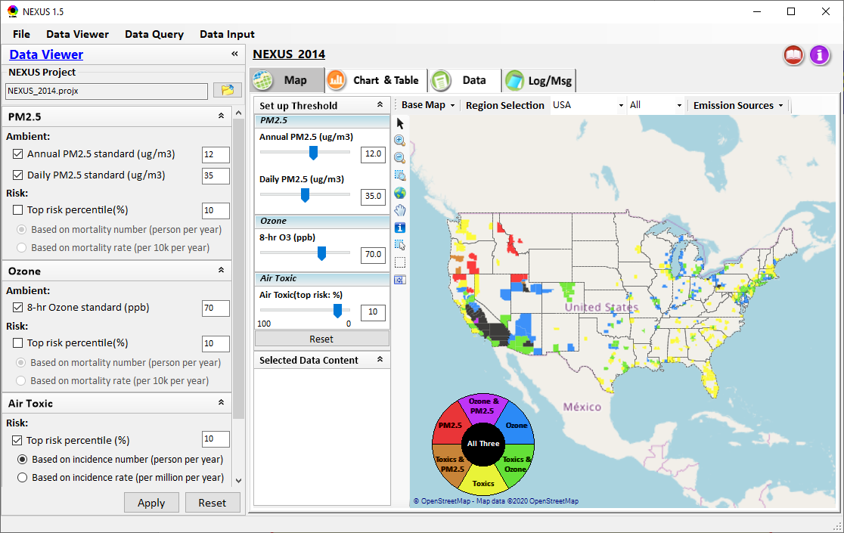
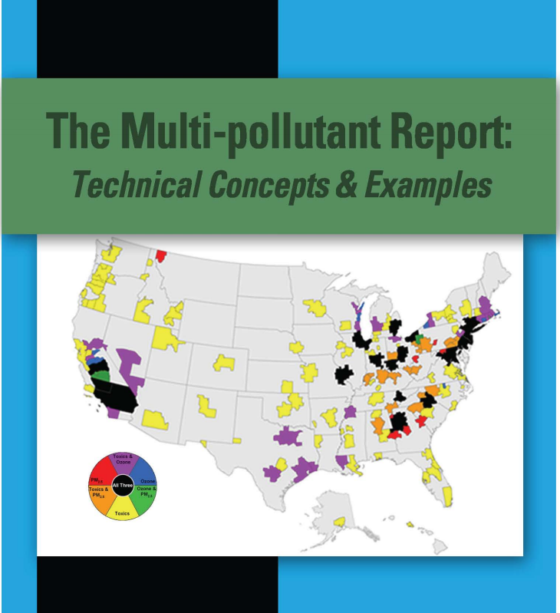
NEXUS Tool Demo: 2014 NEXUS Case
Launching Page
Roadmap for Demo:
(Use example cases)
National View: Use “NEXUS” across pollutants to provide an initial “SCREEN” at the national level by providing an indicator where there may be a common set of sources contributing to Multi-pollutant issues.
Regional View: Dial into a region or area of interest to understand the pollutant/source connections, and potential for more effective and efficient multi-pollutant solution.
2008
30

Slide 31
RoadMap for NEXUS Tool Demo (1)
National Screening (2014 Data)
Replicate 2008 NEXUS map with O₃/PM_{2.5} concentrations above NAAQS and NATA risk estimates above selected percentile of top 10%
  What happens to areas at lower O₃/PM_{2.5} NAAQS levels?
  What happens to areas current over O₃/PM_{2.5} NAAQS if change HAP risk percentile?
Provide NEXUS map on risk basis: O₃/PM_{2.5} BenMAP mortality risk based on fused surfaces and NATA risk estimates above selected percentile of top 10% for all pollutants
  What happens to MP areas as one changes percentile to top 20% or others?
  What is relationship between Heavy Metal HAPs risk (top 10%) and PM_{2.5} risk to identify potential co-pollutant issues?
  What is relationship between Gas/VOC HAPs risk (top 10%) and O₃ risk to identify potential co-pollutant issues?
31

Slide 32
RoadMap for NEXUS Tool Demo (2)
Regional/State/CBSA/County Screening
EPA Region 4 Example
  Areas with MP risk in top 10% across O3, PM2.5 and HAPs
  Louisville CBSA: General view and then dial into “Jefferson County” with transparent map color
    What are the top 10 emissions sources in county by pollutant?
    What specific sources are common across pollutants that may indicate co-control potential?
    Can view these sources on the map with summary data available.
32

Slide 33
Appendix
Slides
33

Slide 34
NEXUS Tool : Schedule & Installation
Work Plan | Date
Developed NEXUS tool prototype and Phase-1 functions | April 2020
Developed Phase-2 functions and deliver first working (interim) NEXUS tool | August 2020
Developed a fully functional NEXUS tool and on-line User’s Manual | Dec. 2020
Upgrading NEXUS tool for Beta testing and broader OAQPS and Regional office use | Jan. ~ July 2021
Download “NEXUS” tool: The “NEXUS 1.5” package (“NEXUS v1.5 setup.exe” & “NEXUS 1.5 Data.exe”: run both to install) is available at OAQPS’s Shared Drive a:t G:\SHARE\NEXUS\NEXUS 1.5\ or at EPA’s new FTP site: ftp://newftp.epa.gov/aqmg/cjang/NEXUS/NEXUS 1.5/
(Note: Require software installation privilege to install “NEXUS tool” on EPA’s PCs)
34

Slide 35
Data Input File Names | Data Format | Data Description | Data Source | Data Period
“2014 O₃ & PM_{2.5} fused Ambient & Risk” | Geodataset | O₃/PM_{2.5} ambient & risk data at county/census tract level | from OAQPS MP team | 2014
“2014 NATA Risk” | Geodataset | Air Toxics ambient & risk data at county/census tract level | from OAQPS MP team | 2014
“O₃_DV_2009_2018” | Excel | O₃ design values at county level | From EPA public website: https://www.epa.gov/air-trends/air-quality-design-values | 2009 to 2018
“PM_DV_2009_2018” | Excel | PM_{2.5} design values at county level | From EPA public website: https://www.epa.gov/air-trends/air-quality-design-values | 2009 to 2018
“Advance areas O₃_PM” | Geodataset | O₃ & PM_{2.5} Advance Areas | from OAQPS MP team | 2018
“Index of Poverty_ Disadvantage” | Excel | Index of poverty/disadvantage at county level | from Univ. of Michigan website: https://poverty.umich.edu/projects/understanding-communities-of-deep-disadvantage/ | 2017
“NEI_County_CAPs” “NEI_Facility_HAPs_ CAPs” | Geodataset | Major emission sources and facility info. of CAPs & HAPs at county level | From OAQPS public website: ftp://newftp.epa.gov/EPADataCommons/OAR/OAQPS/NEI/NEI_Facility_HAPs_CAPs.zip ftp://newftp.epa.gov/EPADataCommons/OAR/OAQPS/NEI/NEI_County_CAP.zip | 2008, 2011, 2014
“2014 NEI_NATA Emissions” | Access Database (*. accdb) | NATA emissions data from 2014 NEI database, including various source groups | From EPA public website: https://www.epa.gov/national-air-toxics-assessment/2014-nata-assessment-results#emissions | 2014
“Class1_FederalAreas” | Geodataset | Mandatory Class 1 Federal Areas | From Mandatory Class 1 Federal Areas Web Service: https://edg.epa.gov/data/public/OAR/OAQPS/Class1/Class1Areas.zip | —
Data Input Module: Input Files & Attributes
35

