Slide 1
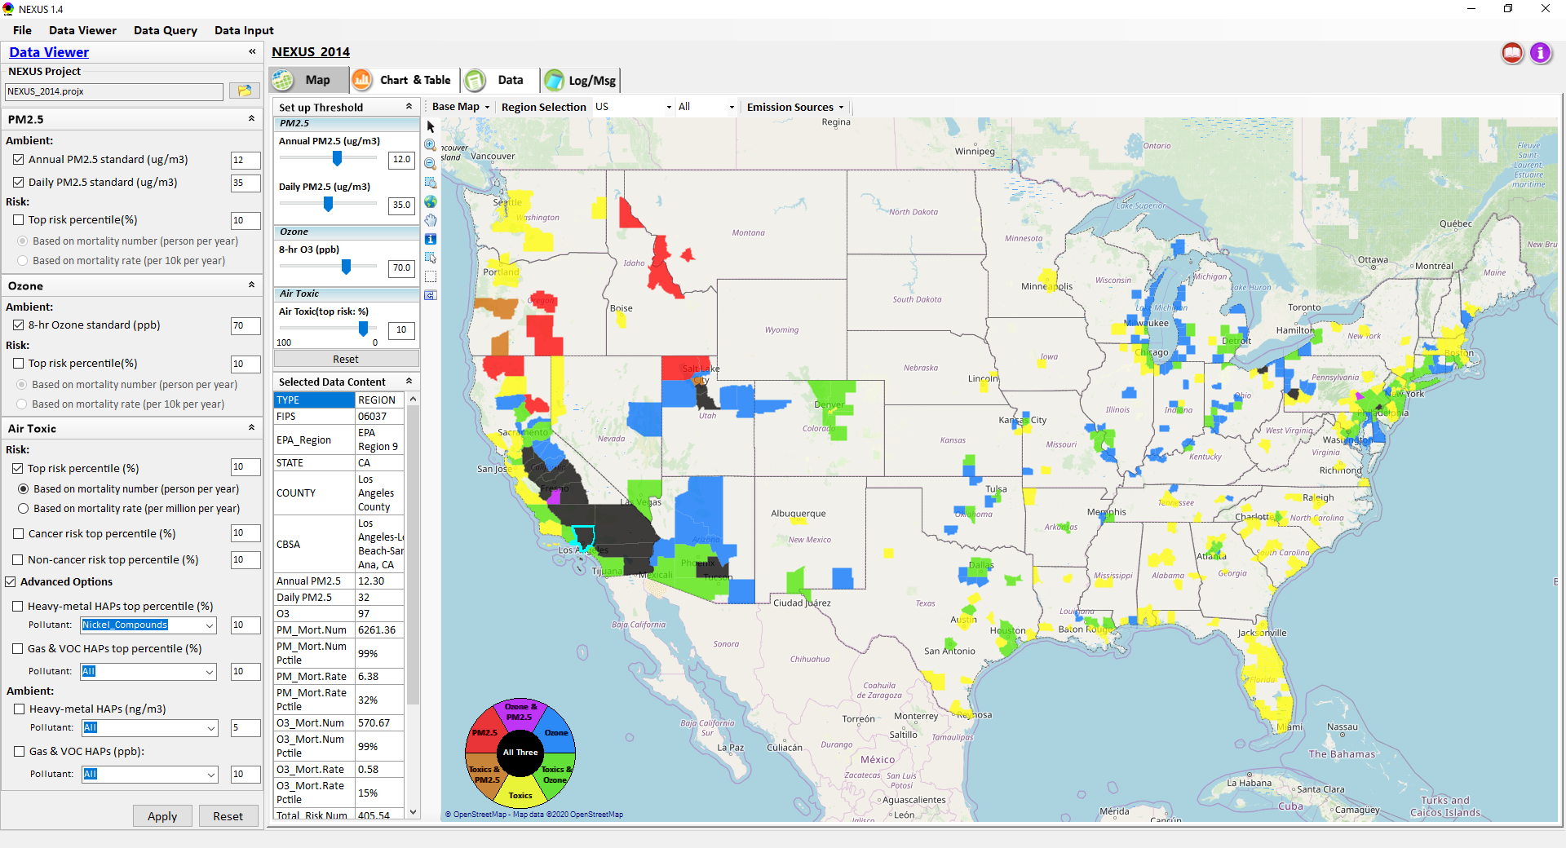
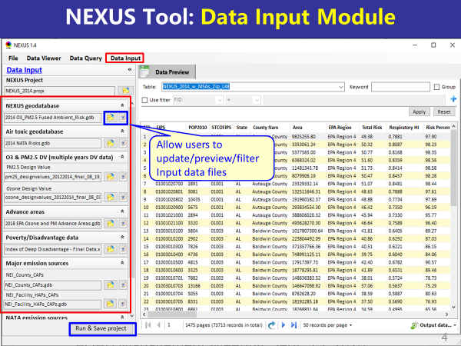
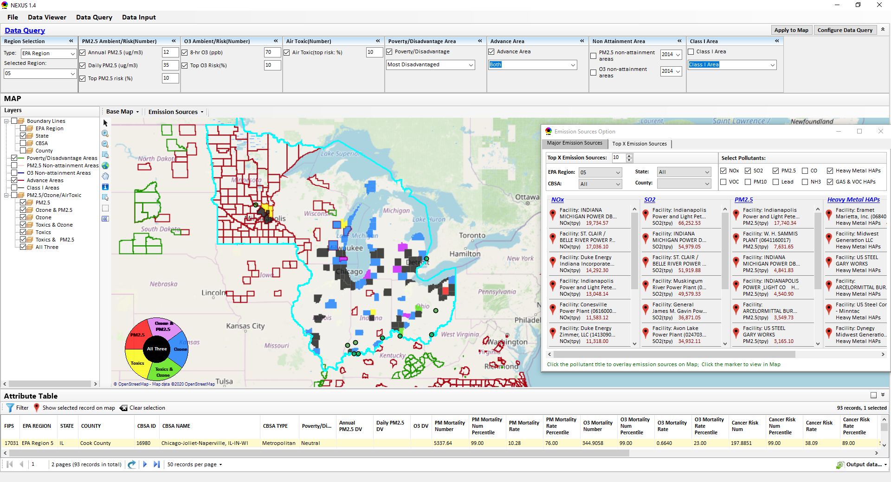
“NEXUS” Multi-Pollutant Analysis Tool
Development: Status and Progress
Data Viewer Module
Data Input Module
Data Query Module
“NEXUS 1.5” available on OAQPS’s Shared Drive at: “G:\SHARE\NEXUS\NEXUS 1.5\”
or at EPA’s new FTP site: ftp://newftp.epa.gov/aqmg/cjang/NEXUS/NEXUS 1.5/
OAQPS/OID Briefing
January 25, 2021
Carey Jang & Beth Landis
1

Slide 2
Overview
Multi-Pollutant Background
NEXUS Tool Development
  Expected Use
  Schedule
Key Modules
Questions NEXUS can Answer & Examples: OID focused
Discussion & Next Steps
Live Demo
2

Slide 3
Multi-Pollutant (MP) Background
Support a comprehensive, MP treatment of air quality problems to effectively improve air quality and make the most efficient use of available resources
  Primary Goal - identify & evaluate local control strategies targeting emissions of O₃ & PM_{2.5} and their precursors while at the same time reducing Air Toxics of concern for communities to maximize both health benefits and air quality improvements
MP planning has the potential to reduce the costs and increase benefits associated with air quality management (AQM)
Supports S/L/T air agencies in developing MP, risk-based AQM plans and implementing strategies that reduce air pollution emissions & improve public health
Success has been demonstrated in Detroit and SC; another project is currently underway in Louisville, KY
Tools needed to analyze MP data are either available currently or being developed in OAQPS (NEXUS)
3

Slide 4
NEXUS Tool Development
Motivation: Develop a new multi-pollutant analysis tool to identify and assess areas with high ambient levels and/or health risks associated with PM_{2.5}, O₃ and Air Toxics
Phase-1: Develop a GIS-based NEXUS prototype with a user-friendly graphical interface to provide analysis and visualization functions of potential multi-pollutant AQ issues at national level (continental US)
Phase-2: Expand the NEXUS tool to allow users to dial into an EPA region, State, or metropolitan area and provide data query and V/A functions for “AQ and emissions” information over the selected region of interest
4

Slide 5
Expected Use of NEXUS Tool
The NEXUS tool will allow users to do the following:
  National screening for areas with MP issues: Phase 1 development will provide ability to quickly screen areas across nation that have combination of high air quality and/or risk levels for O₃, PM_{2.5} and Air Toxics.
  Area screening to understand nature of MP problem: Phase 2 development will provide ability to ‘dial-into’ specific areas to determine extent to which common emissions sources are causing the MP issues.
We expect to use this tool to engage with Regions and identify areas that would potentially benefit most from MP approaches to reduce emissions (including current NA areas).
The NEXUS tool will essentially provide a ‘conceptual model’ of MP issues to facilitate engagement with state/local/tribal agencies and community stakeholder groups.
We also believe that it has additional uses across the Office for Air Toxics, Environmental Justice and other programs.
5

Slide 6
NEXUS Tool : Schedule & Installation
Work Plan | Date
Developed NEXUS tool prototype and Phase-1 functions | April 2020
Developed Phase-2 functions and deliver first working (interim) NEXUS tool | August 2020
Developed a fully functional NEXUS tool and on-line User’s Manual | Dec. 2020
Upgrading NEXUS tool for Beta testing and broader OAQPS and Regional office use | Jan. ~ July 2021
Download “NEXUS” tool: The “NEXUS 1.5” package (“NEXUS v1.5 setup.exe” & “NEXUS 1.5 Data.exe”: run both to install) is available at OAQPS’s Shared Drive a:t G:\SHARE\NEXUS\NEXUS 1.5\ or at EPA’s new FTP site: ftp://newftp.epa.gov/aqmg/cjang/NEXUS/NEXUS 1.5/
(Note: Require software installation privilege to install “NEXUS tool” on EPA’s PCs)
6

Slide 7
NEXUS Tool : Briefing Schedule
Audience | Date
AQAD & HEID – DD & Management Team | Sept. 25, 2020
Air Toxics Team | Nov. 3, 2020
AQPD – DD & Management Team | Dec. 10, 2020
OID – DD & Management Team | Jan. 25, 2021
SPPD – DD & Management Team | Jan 27, 2021
OAQPS – Office Director | Feb 1, 2021
7

Slide 8
NEXUS Tool: Three Key Modules
Data Viewer Module
Data Input Module
Data Query Module
Setting Pane - users can set standard values for several kinds of pollutant data for the data viewer
Viewer Pane - shows multi-pollutant data in maps, charts and tables.
Setting Pane – users can define data sources for NEXUS
Preview Pane – preview input files
Upper Pane - the query conditions setting pane
Middle Pane – map
Bottom Pane – attribute table
8

Slide 9
NEXUS Tool: DATA VIEWER
Data Viewer module
View and create interactive Map/Data/Chart/Table
Provide flexible selections & mapping of “Ambient” and/or “Risk” levels of PM_{2.5}, O₃ and Air Toxics
Provide regional analysis for “EPA region”, “States”. CBSA”, and “County”
Link and display major emission sources locations & emitted pollutants info.
9

Slide 10
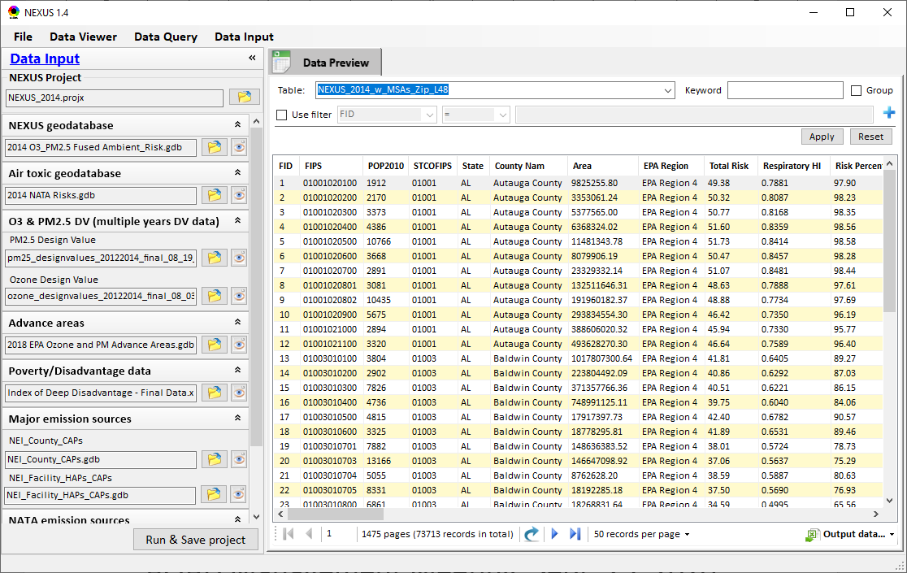
NEXUS Tool: DATA INPUT
Data Input module
Allow users to update/preview/filter Input data files
Currently, there are 10 input data files used (publicly available)
Run and Save to a new project after loading new input data files
Allow to update & change input data files
Provide data preview and filter functions
Current potential to use up to 10 publicly available input data files (~4GB)
Quick turnaround to run & save to a new “project” using new input data files
10

Slide 11
Data Input File Names | Data Format | Data Description | Data Source | Data Period
“2014 O₃ & PM_{2.5} fused Ambient & Risk” | Geodataset | O₃/PM_{2.5} ambient & risk data at county/census tract level | from OAQPS MP team | 2014
“2014 NATA Risk” | Geodataset | Air Toxics ambient & risk data at county/census tract level | from OAQPS MP team | 2014
“O₃_DV_2009_2018” | Excel | O₃ design values at county level | From EPA public website: https://www.epa.gov/air-trends/air-quality-design-values | 2009 to 2018
“PM_DV_2009_2018” | Excel | PM_{2.5} design values at county level | From EPA public website: https://www.epa.gov/air-trends/air-quality-design-values | 2009 to 2018
“Advance areas O₃_PM” | Geodataset | O₃ & PM_{2.5} Advance Areas | from OAQPS MP team | 2018
“Index of Poverty_ Disadvantage” | Excel | Index of poverty/disadvantage at county level | from Univ. of Michigan website: https://poverty.umich.edu/projects/understanding-communities-of-deep-disadvantage/ | 2017
“NEI_County_CAPs” “NEI_Facility_HAPs_ CAPs” | Geodataset | Major emission sources and facility info. of CAPs & HAPs at county level | From OAQPS public website: ftp://newftp.epa.gov/EPADataCommons/OAR/OAQPS/NEI/NEI_Facility_HAPs_CAPs.zip ftp://newftp.epa.gov/EPADataCommons/OAR/OAQPS/NEI/NEI_County_CAP.zip | 2008, 2011, 2014
“2014 NEI_NATA Emissions” | Access Database (*. accdb) | NATA emissions data from 2014 NEI database, including various source groups | From EPA public website: https://www.epa.gov/national-air-toxics-assessment/2014-nata-assessment-results#emissions | 2014
“Class1_FederalAreas” | Geodataset | Mandatory Class 1 Federal Areas | From Mandatory Class 1 Federal Areas Web Service: https://edg.epa.gov/data/public/OAR/OAQPS/Class1/Class1Areas.zip | —
Data Input Module: Input Files & Attributes
11

Slide 12
NEXUS Tool: DATA QUERY
Data Query module
Expand data field selections and flexibility for exploratory/advanced users
Provide overlaying map and summary table for data query results
Current data query based on selected data fields: “Ambient/Risk, Advance area, Socio-demographic (EJ) area, NA Area, Class I area”
12

Slide 13
OID Related Examples
How can NEXUS can be used to identify highest risk areas across O₃, PM_{2.5}, and Air Toxics?
  Example 1 → Miami CBSA
How can NEXUS be used to identify the nature of multi-pollutant risks affecting Tribes?
  Example 2 → Oklahoma City-Shawnee CBSA
How can NEXUS be used to identify the nature of multi-pollutant risks in areas with EJ concerns?
  Example 3 → Memphis CBSA
13

Slide 14
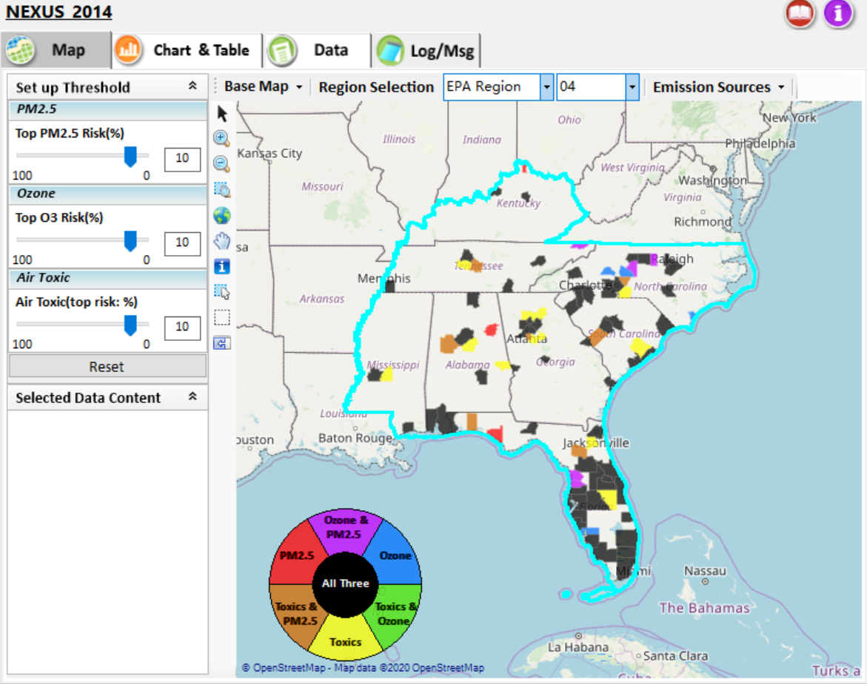
NEXUS Tool: Example 1 - ID High MP Risk Areas
NEXUS can be used to identify highest risk areas across O₃, PM_{2.5}, and Air Toxics. Example map above is for Region 4
14

Slide 15
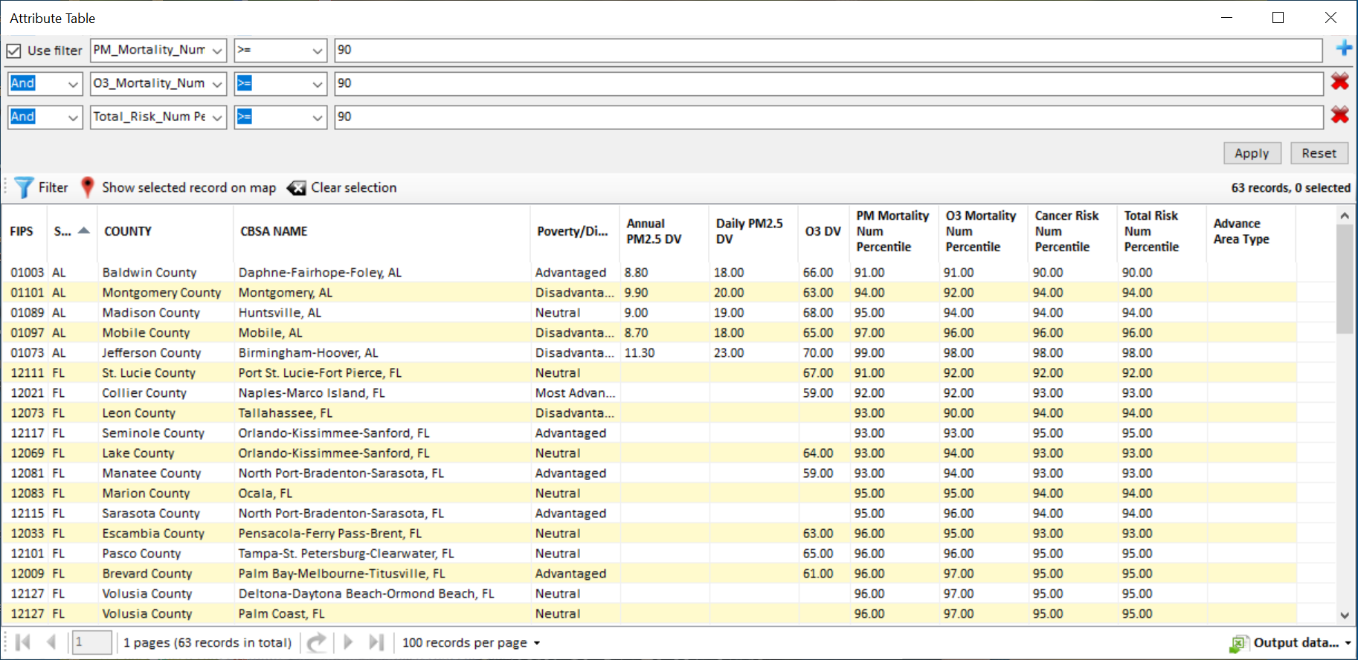
NEXUS Tool: Highest MP Risk Areas in R4
NEXUS can be used to identify highest risk areas across O₃, PM_{2.5}, and Air Toxics. Example table above was generated in Data Query for Region 4. Table Generator Module is planned for future development. Currently, data can be exported to Excel.
15

Slide 16
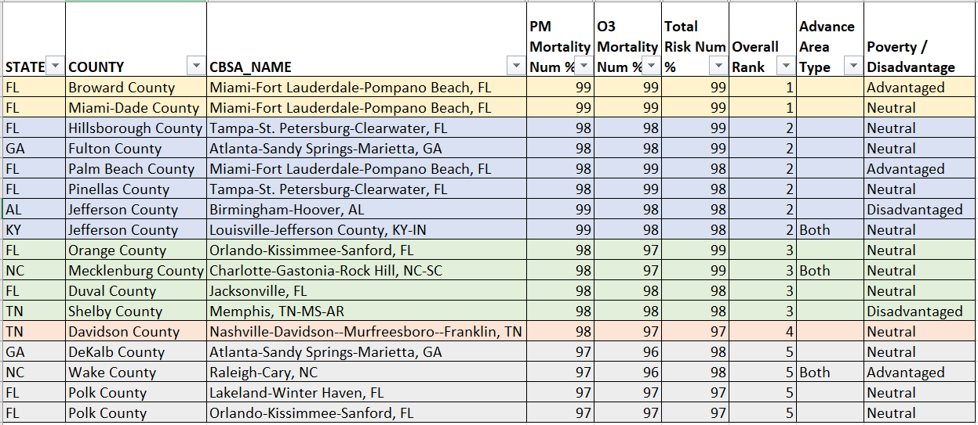
NEXUS Tool: Rankings from Data Query Module
NEXUS can be used to identify highest risk areas across O₃, PM_{2.5}, and Air Toxics. Information above was generated in Data Query for Region 4 and exported into excel where rankings were applied.
Top 5 CBSAs (using this approach) – Miami, Tampa, Atlanta, Birmingham, Louisville
16

Slide 17
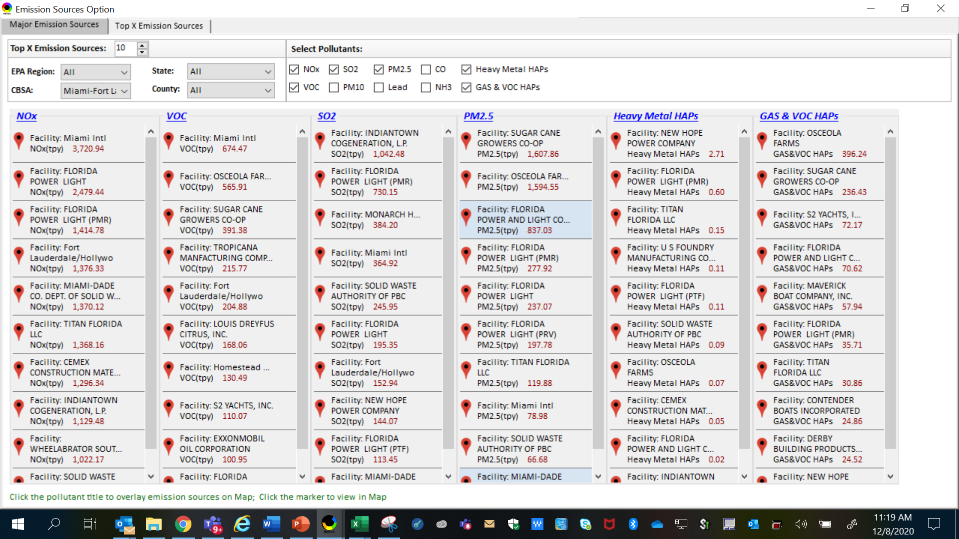
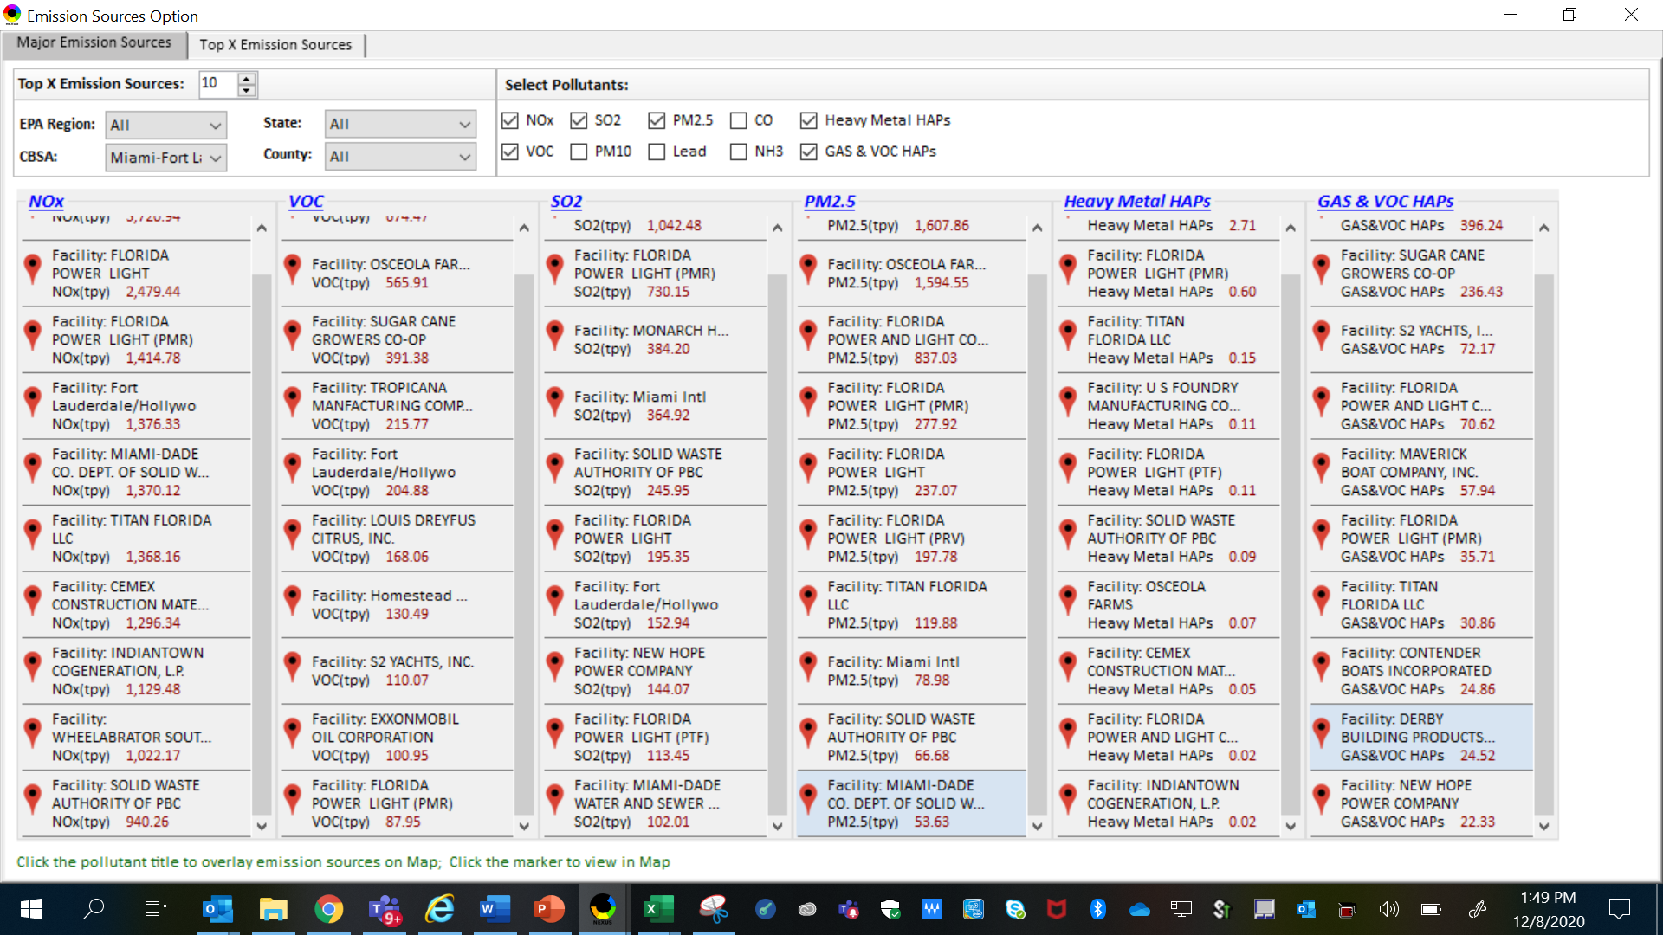
NEXUS Tool: Emissions Sources in Miami CBSA
NEXUS can be used to identify top emission sources. Information above was generated in Data Query for the Miami CBSA. This can help identify the potential co-benefits of controls.
17

Slide 18
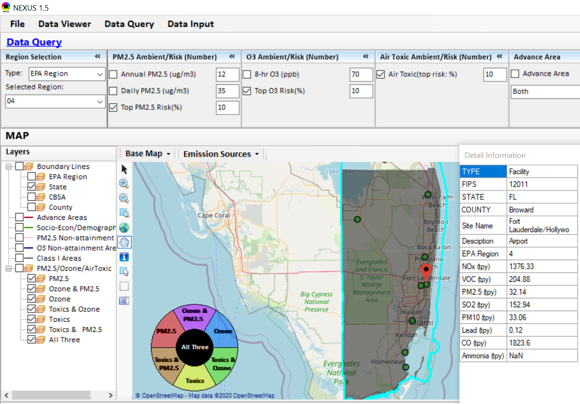
NEXUS Tool: Source Details in Miami CBSA
What is this and where is it located?
NEXUS can be used to identify top emission sources. Information above was generated in Data Query for the Miami CBSA.
18

Slide 19
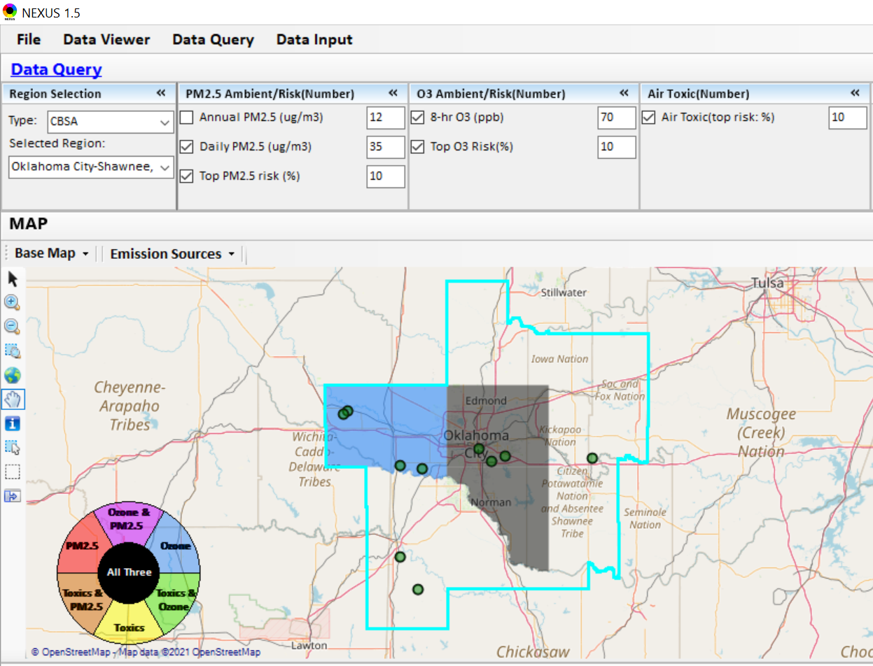
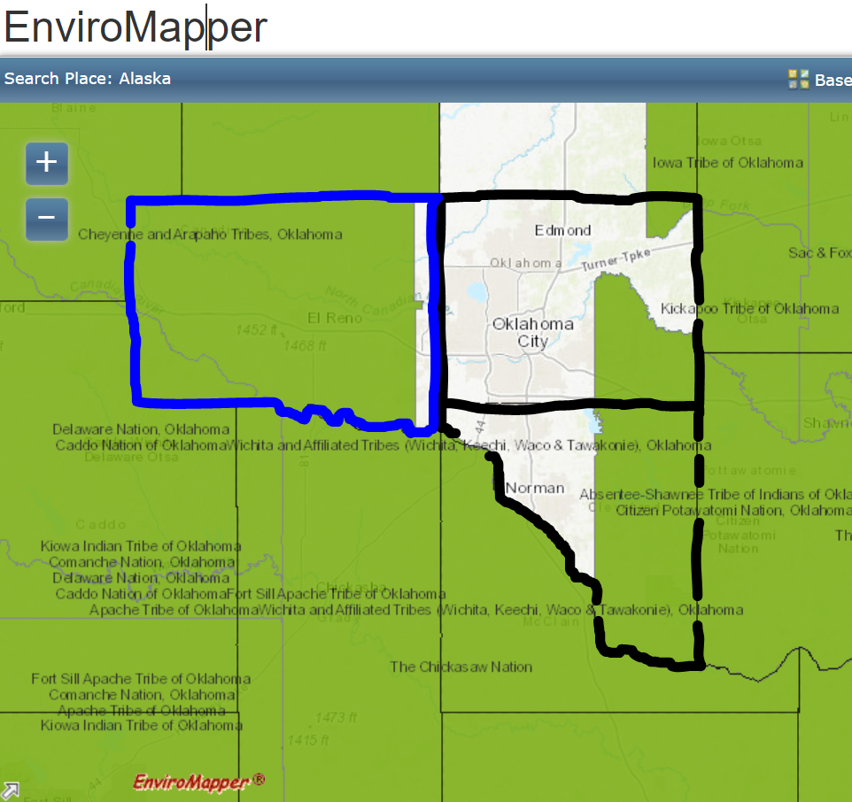
NEXUS Tool: Example 2—MP Sources in OKC-Shawnee CBSA
Cheyenne & Arapaho Tribes, OK
Iowa Tribe of OK
Kickapoo Tribe of OK
Citizen Potawatomi Nation, OK
The Chickasaw Nation
The maps above were generated for the Oklahoma City-Shawnee CBSA using the NEXUS data query module & EnviroMapper to demonstrate the benefit of adding a Tribal Boundary layer. The top 10 Gas & VOC HAPs emission sources are plotted in NEXUS.
19

Slide 20
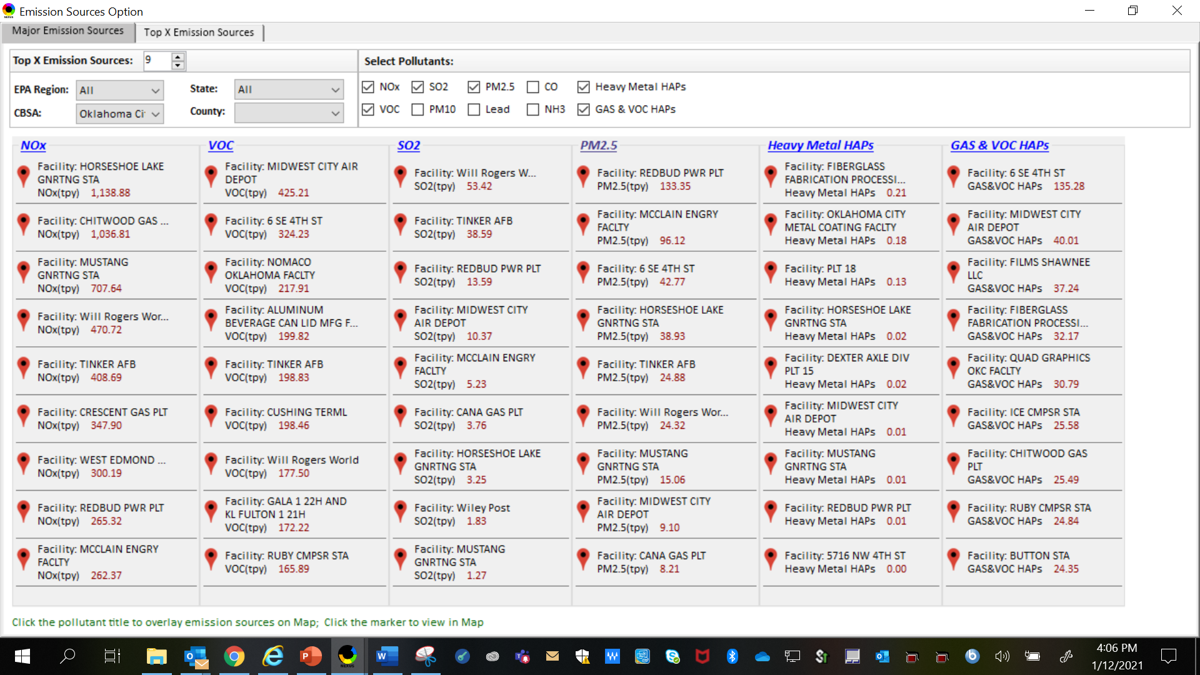
NEXUS Tool: Emissions Sources in OKC-Shawnee CBSA
NEXUS can be used to identify top emission sources. The information above was generated in Data Query for the Oklahoma City-Shawnee CBSA . This can help identify the potential co-benefits of controls. Let’s explore the Horseshoe Lake Generating Station further…
20

Slide 21
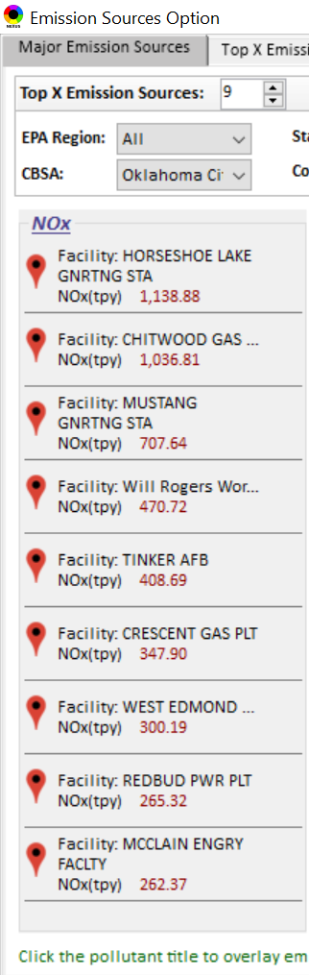
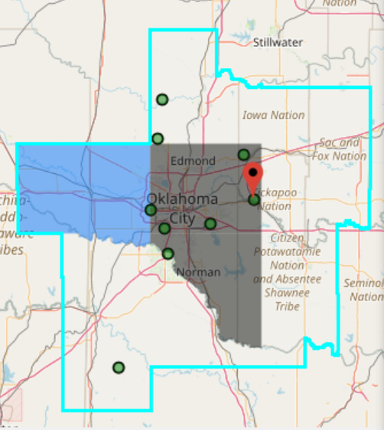
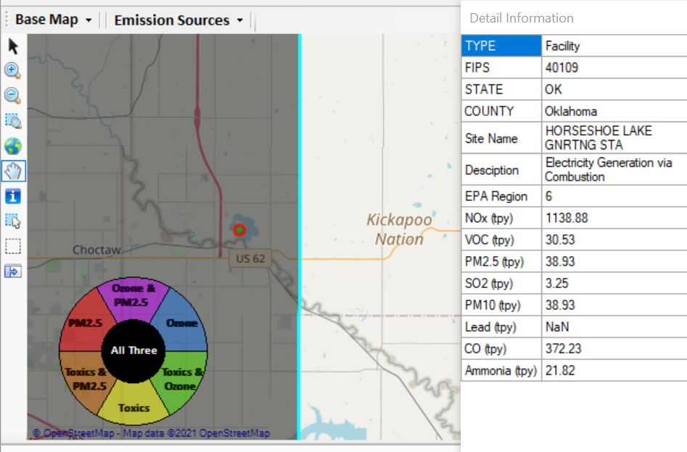
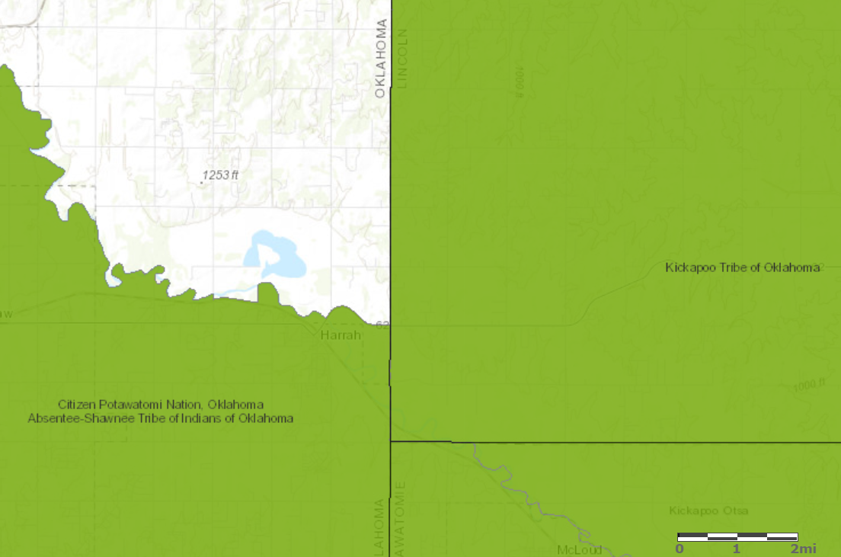

NEXUS Tool: Source Details in OKC-Shawnee CBSA
These maps were generated for the Oklahoma City-Shawnee CBSA using the NEXUS data query module & EnviroMapper to demonstrate the benefit of adding a Tribal Boundary layer. The #1 NOx Source for the CBSA (Horseshoe Lake Generating Station), also a top emitter for SO₂ and heavy metal HAPs, is located in very close proximity to two Tribes. There are potential co-benefits of controlling this source that would likely result in benefits to these Tribes.
Kickapoo Tribe of OK
Citizen Potawatomi Nation, OK
21

Slide 22
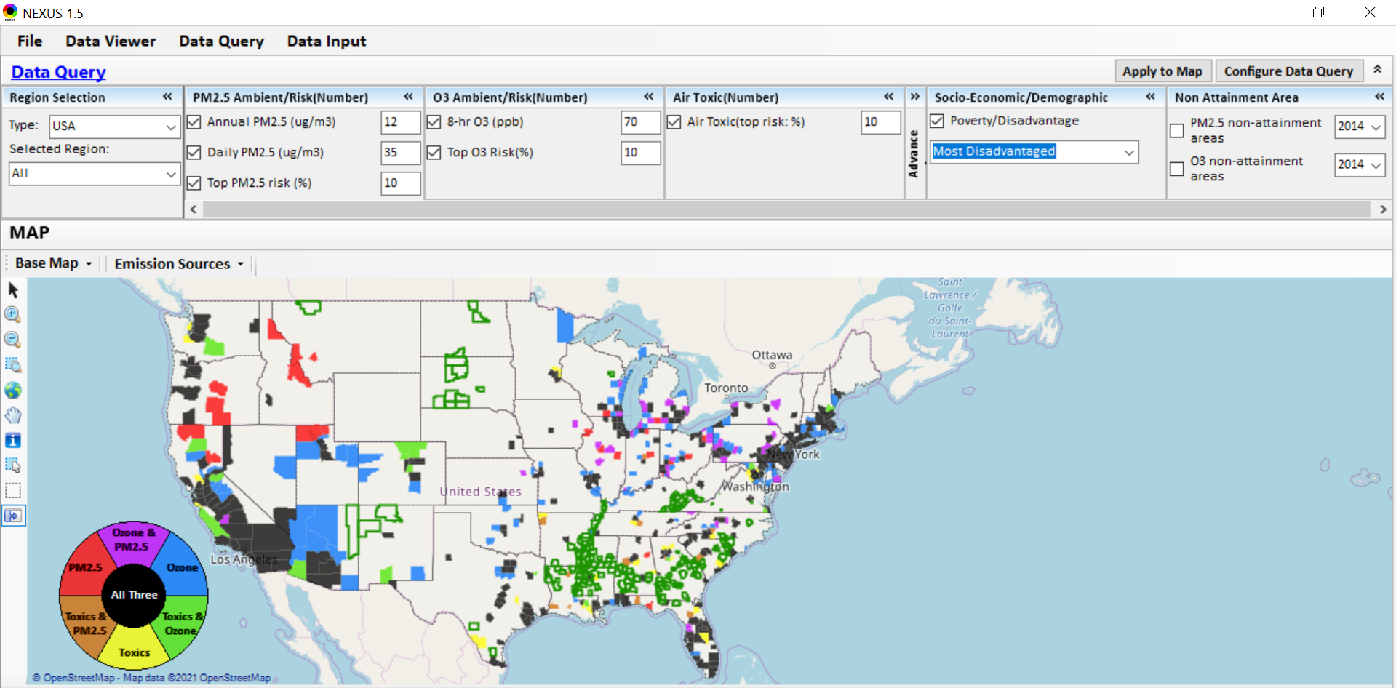
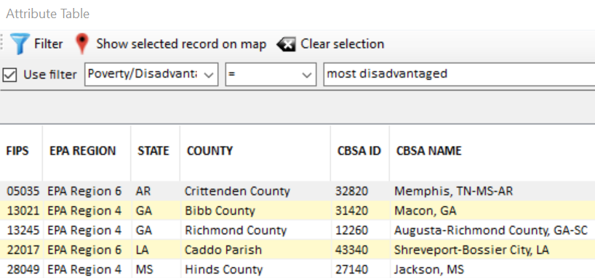
NEXUS Tool: Example 3 - MP Risks in EJ Communities
NEXUS can be used to determine EJ communities in areas with multi-pollutant concerns. The information above was generated in Data Query. NEXUS currently includes a poverty/disadvantage index, and we plan to incorporate additional EJ metrics. Let’s explore the Memphis CBSA further…
22

Slide 23
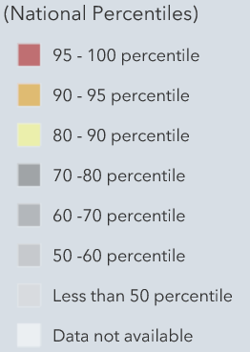
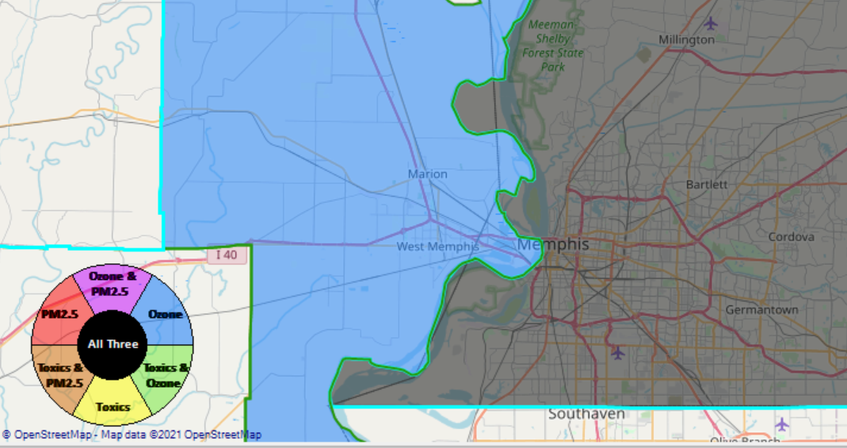
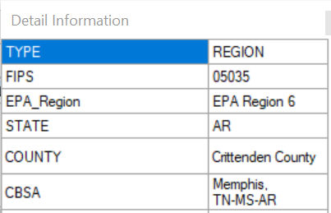

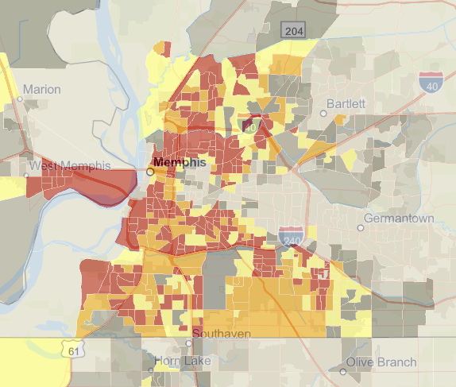
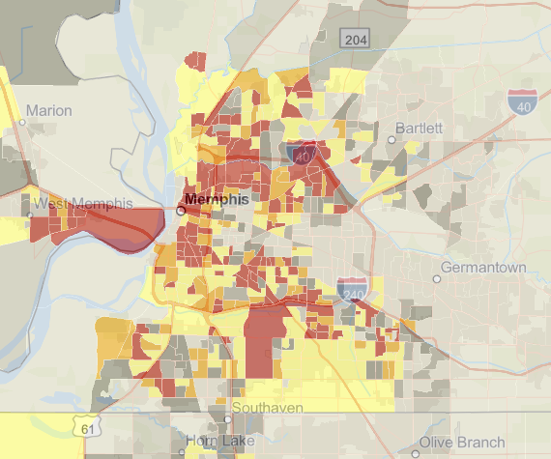
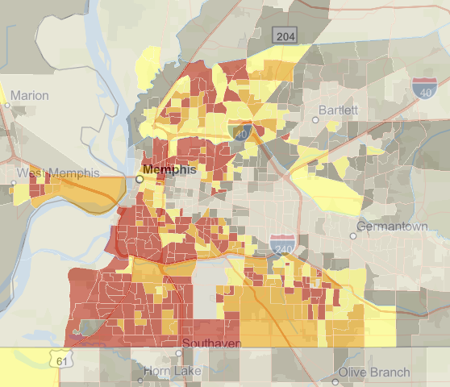
NEXUS Tool: Screening with Data Query Module
Memphis CBSA using the NEXUS data query module
EJSCREEN Demographic Index
EJSCREEN Low Income Population
EJSCREEN Minority Population
NEXUS can be used to determine EJ communities in areas with multi-pollutant concerns. NEXUS currently includes a poverty/disadvantage index, and we plan to incorporate additional EJ metrics such as the data inputs above from EJSCREEN.
23

Slide 24
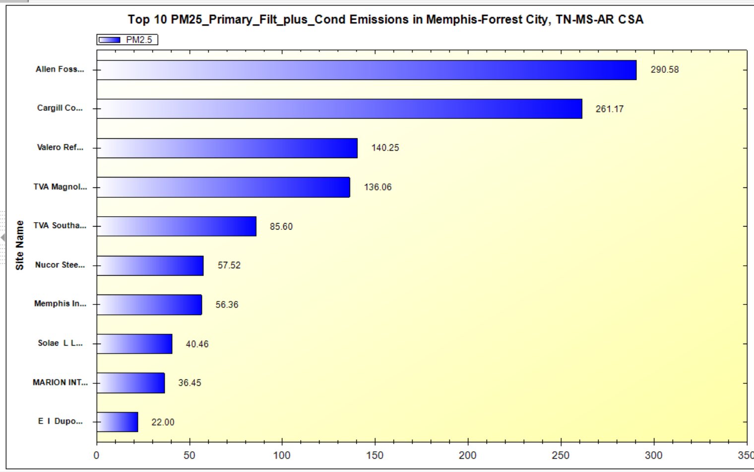
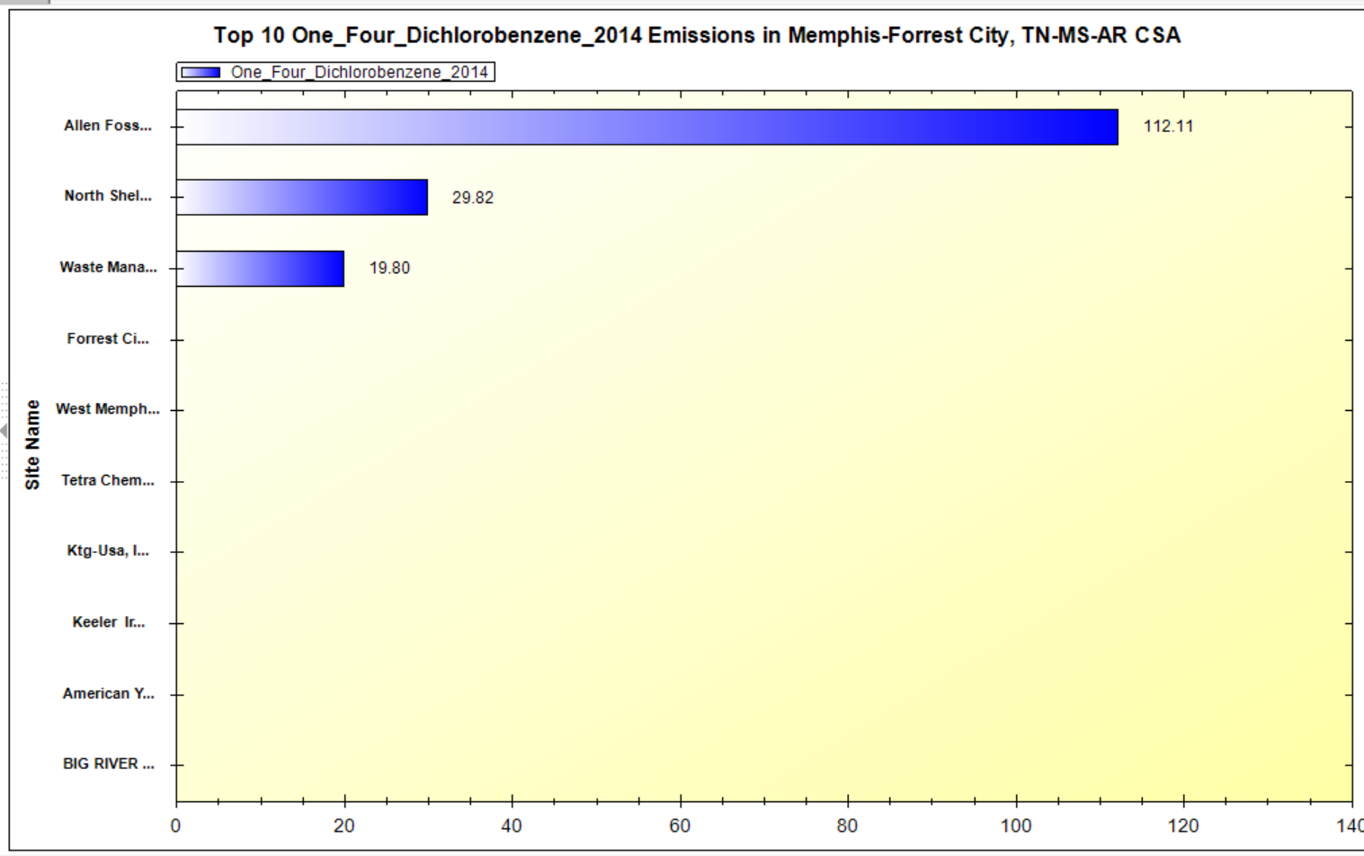
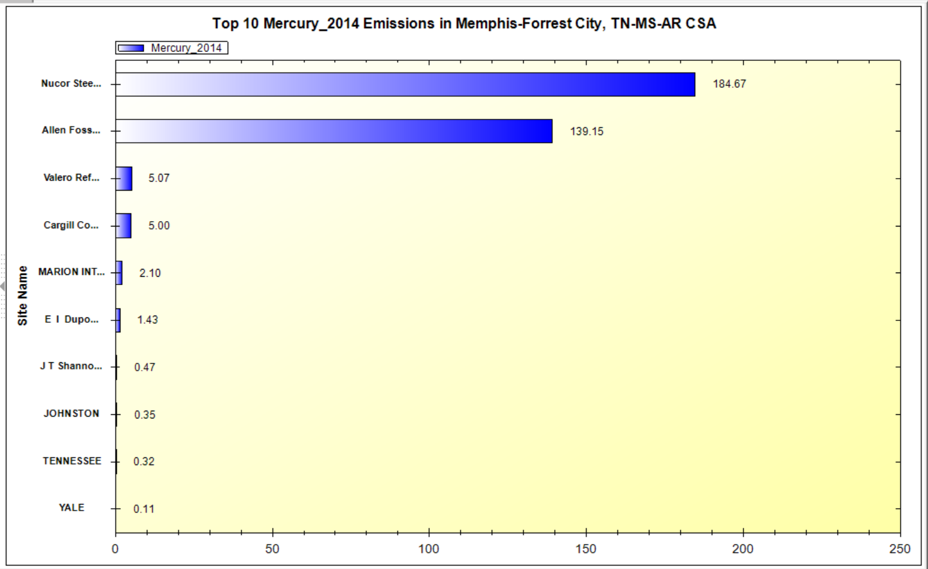
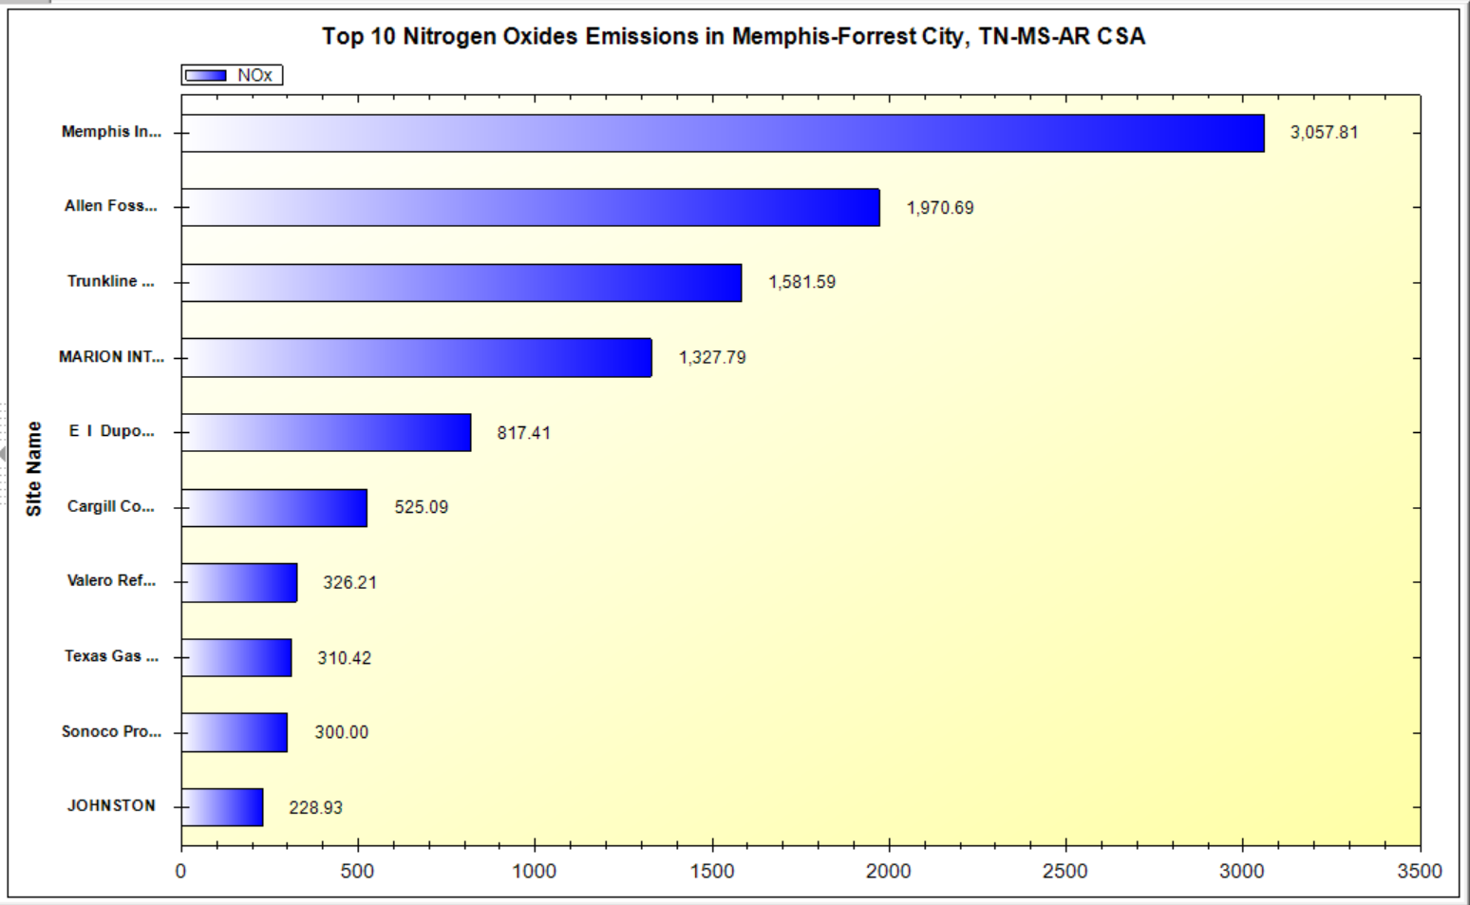
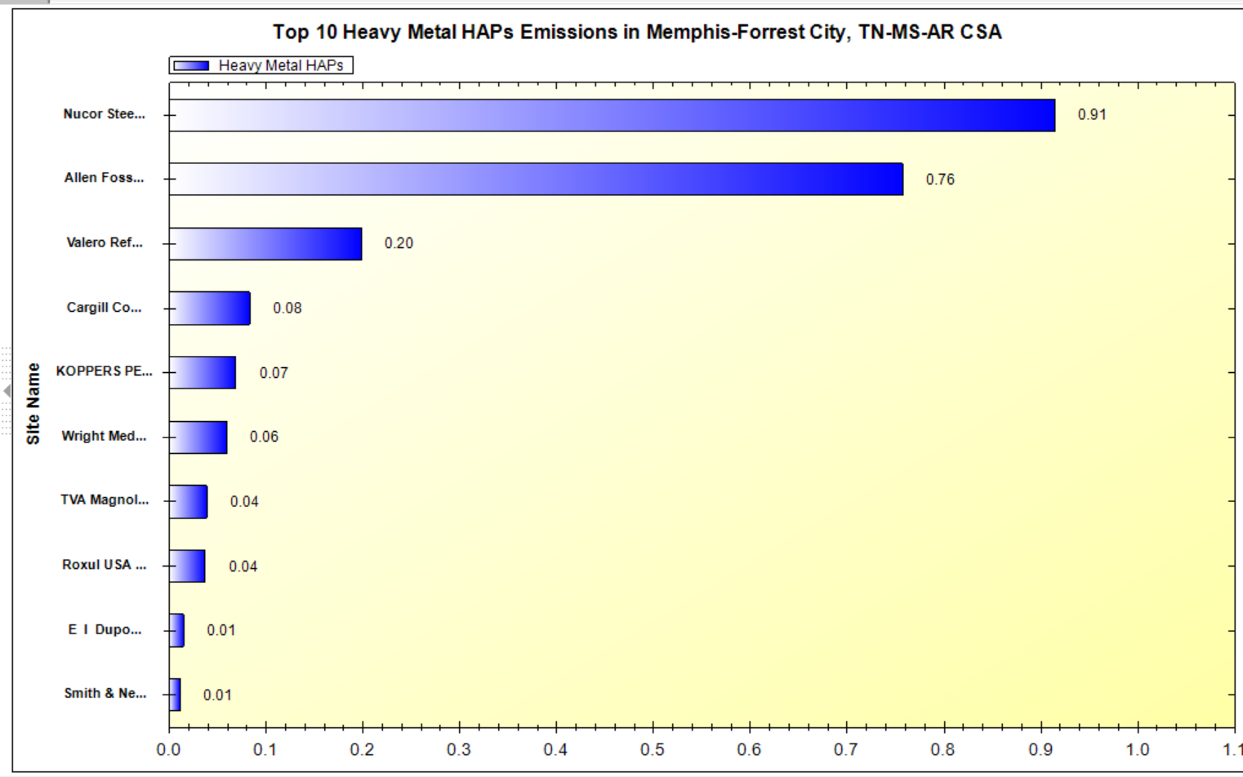
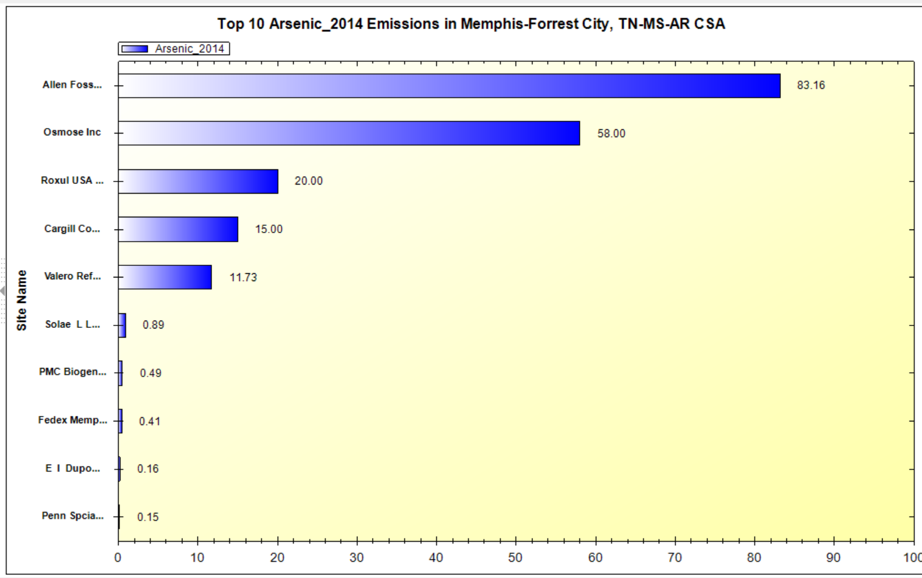
NEXUS Tool: Major Emissions Sources in Memphis
PM_{2.5}
Mercury
1,4-Dichlorobenzene
NOx
Heavy Metal HAPs
Arsenic
NEXUS can create bar charts of major emission sources. The bar charts above show the Allen Fossil Plant as a top 2 emitter for PM_{2.5}, NOx, 1,4-Dichlorobenzene, Heavy Metal HAPS, Mercury & Arsenic, demonstrating the potential co-benefits of controls at this facility.
24

Slide 25
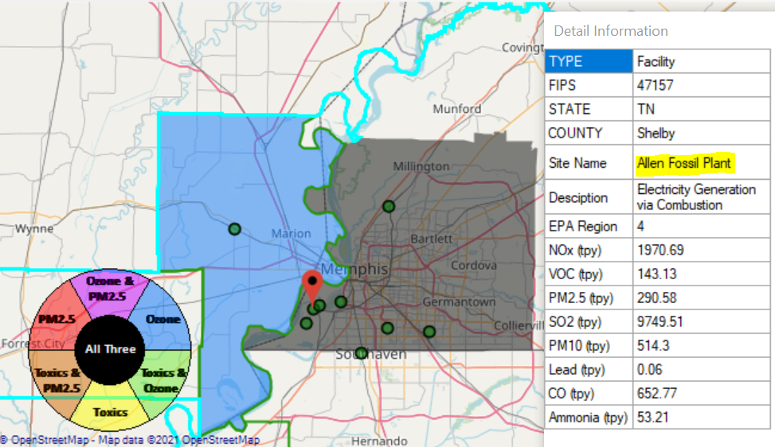
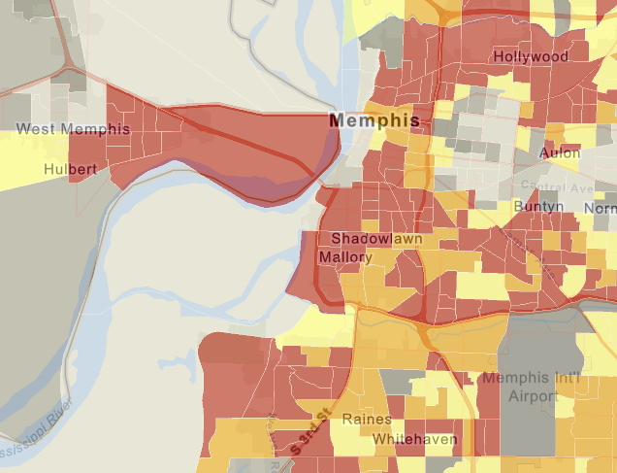
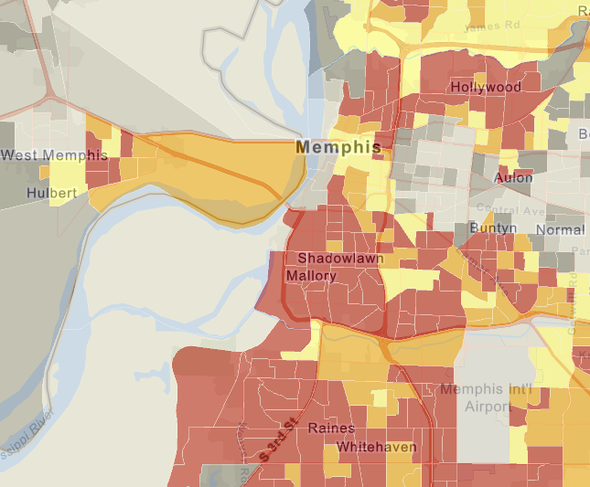
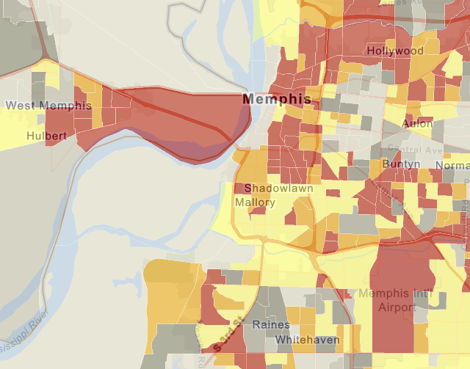

NEXUS Tool: EJ Screening in Memphis
Map Generated in NEXUS
Adding additional indices to NEXUS would allow us determine when facilities, such as Allen Fossil Plant, are near EJ communities
EJSCREEN Demographic Index
EJSCREEN Minority Population
25
EJSCREEN Low Income Population

Slide 26
Potential Environmental Justice Indices
Currently in EJSCREEN…
  Environmental Indicators
    PM_{2.5}
    Ozone
    NATA Cancer Risk
    NATA Respiratory HI
    NATA Diesel PM
    Traffic Proximity
    Lead Paint Indicator
    Superfund Proximity
    RMP Proximity
    Hazardous Waste Proximity
    Wastewater Discharge Indicator
  Demographic Indicators
    Demographic Index
    Minority Population
    Low Income Population
    Linguistically Isolated
    Less Than HS Educated
    Under Age 5
    Over Age 64
  Additional EJ Layers
    Nonattainment area
    Hazardous waste
    EJ Grants
    Water features
    Places
    Schools
    Parks
    Transportation
    EPA Tribal Areas Boundaries
    Prisons
    Public Housing
    Subsidized Housing
    Sites reporting to the EPA
Already in NEXUS -– Would Like to Add to NEXUS
Additional Ideas:
Walkability, asthma rates, proximity to parks/green spaces, high VMT/day within ¼-½ mile buffer, hospitalizations, proximity to sources & disadvantaged areas
26

Slide 27
Potential EJ Capability Additions
A source/sector module could allow for Multi-pollutant ‘proximity-based assessment’ for EJ communities
  Define an area around a source/sector and calculate % distribution of demographics (race, ethnicity, etc.)
  Compare % distribution to the state, region, or national level averages
  Expand demographic comparisons to include O₃, PM_{2.5} and Air Toxics risks or other metrics of interest
Incorporate analysis similar to what is currently used for Risk and Technology Review (RTR) and other actions
  NEXUS could provide a more transparent and accessible way to complete screening analyses and share across the office and programs (criteria and toxics). However, the ability to accurately screen for toxics is limited at this time
27

Slide 28
Discussion and Next Steps (1)
    Short-term:
    GOAL: Upgrade/improve NEXUS tool to reflect latest data & information and MP team’s feedbacks
    Currently expect FY21 funding to support NEXUS -- perhaps $50k from AQAD
      Update NEXUS data to 2017
        2017 data for O₃, PM_{2.5} & Air Toxics risk/ambient/emissions
        Tribal boundaries & socioeconomic/demographic data for EJ
      Add O₃, PM_{2.5}, and Air Toxics monitoring data
      Update metrics/indicators (e.g., risk metrics, EJ indicators)
    Engage across Office to determine how this tool may best inform or be used for OAQPS’s Air Toxics Strategy programs
      Consider addition of screening-level analysis & assessment capabilities (e.g., proximity-based EJ analysis)
28

Slide 29
Discussion and Next Steps (2)
    Long-term:
    Upgrade and prepare NEXUS for Beta test within OAQPS and with EPA Regions
    Based on Office wide engagements, use updated NEXUS tool with 2017 data to inform Multi-pollutant, Air Toxics, Advance, and EJ efforts as appropriate
    Develop plan for routine updates and maintenance of the NEXUS tool to best support OAR/OAQPS programs and determine appropriate extensions as need and resources provide.
    Collaborate with OID on NEXUS Training Materials
29

Slide 30
Live Demo
Carey Jang
30

Slide 31
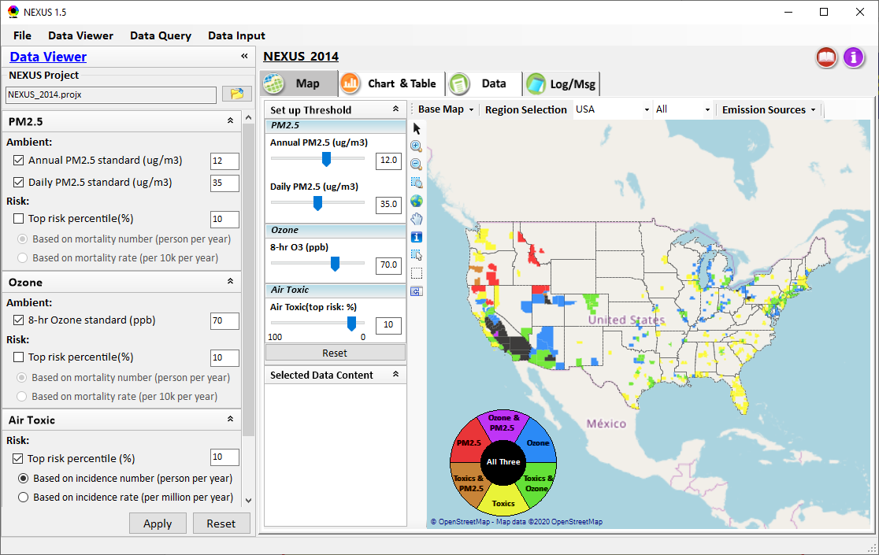
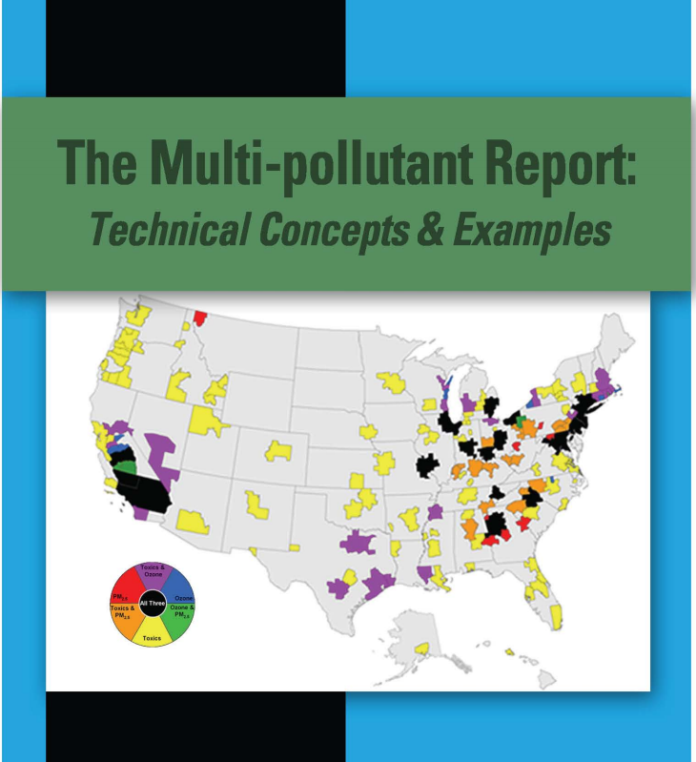
NEXUS Tool Demo: 2014 NEXUS Case
Launching Page
Roadmap for Demo:
(Use example cases)
National View: Use “NEXUS” across pollutants to provide an initial “SCREEN” at the national level by providing an indicator where there may be a common set of sources contributing to Multi-pollutant issues.
Regional View: Dial into a region or area of interest to understand the pollutant/source connections, and potential for more effective and efficient multi-pollutant solution.
2008
31

Slide 32
“NEXUS 1.5”:
Quick Tutorial
Carey Jang
Download “NEXUS” tool: The “NEXUS 1.5” package (“NEXUS v1.5 setup.exe” & “NEXUS 1.5 Data.exe”: run both to install) is available at OAQPS’s Shared Drive at: G:\SHARE\NEXUS\NEXUS 1.5\
or at EPA’s new FTP site:
ftp://newftp.epa.gov/aqmg/cjang/NEXUS/NEXUS 1.5/
(Note: Require software installation privilege to install “NEXUS tool” on EPA’s PC)
32

Slide 33

NEXUS Tool: On-line User’s Manual
Click “book” icon to launch “User’s manual”
Hot link to User’s manual’s “Data Viewer” chapter (same for “Data Input” & “Data Query”
33

Slide 34
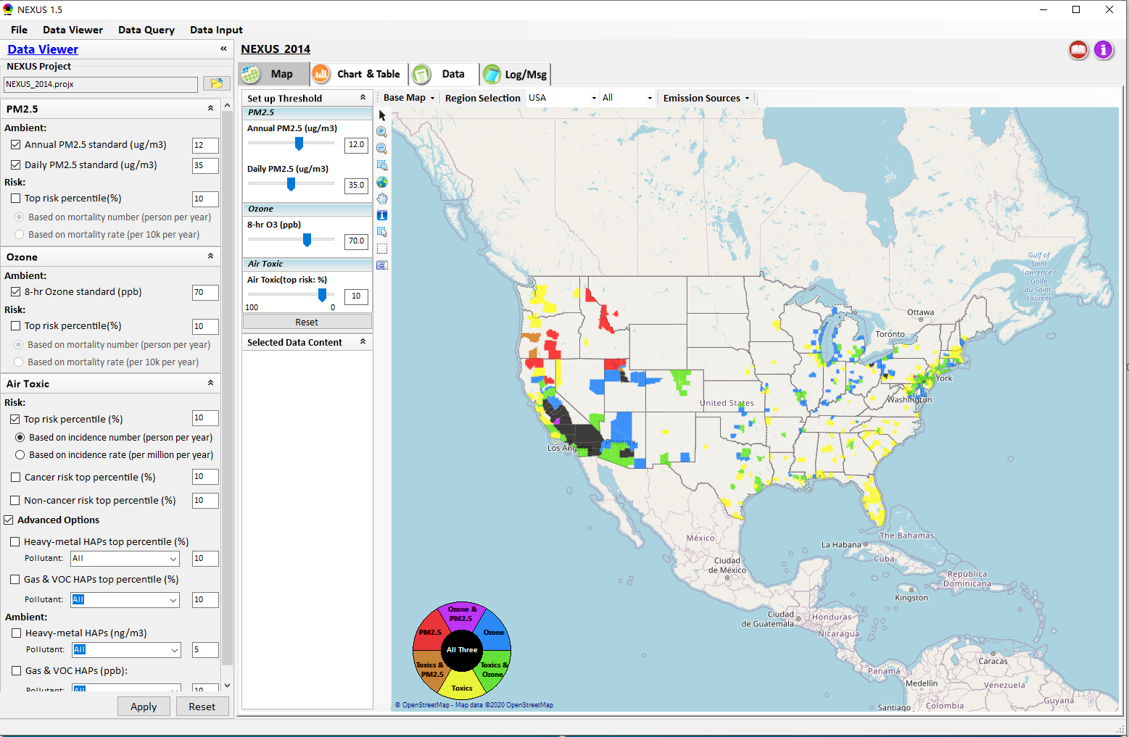

NEXUS Tool: Data Viewer Module
Click “File” to open or save a project
Switch between 3 key modules
Loaded NEXUS project file name
Select & adjust “Ambient” & “Risk” levels
“Advanced Option”: provide HAPs & species selections
34

Slide 35
Data Viewer Module: Selections & Map Display
Select & adjust “Ambient” & “Risk” threshold levels for color map display
“Apply” new selections to “Radio button” panel
35

Slide 36
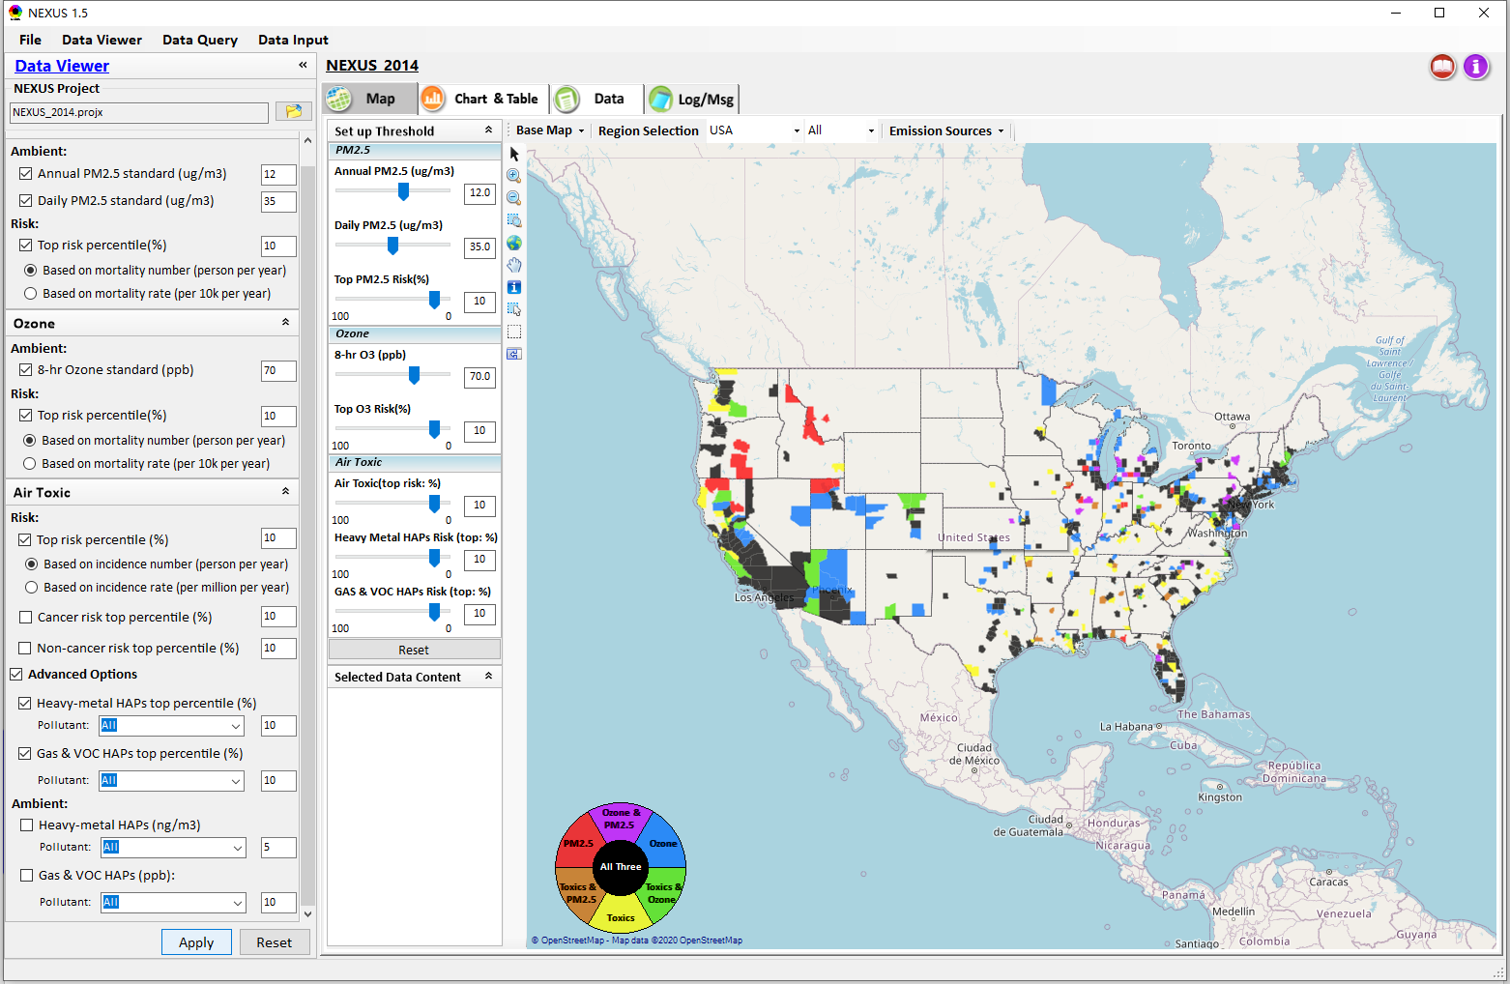
Data Viewer: “Apply” New Selections
“Check” new selections
New selections will appear on-the-fly in “radio button” panel and map display
“Apply” new selections
36

Slide 37
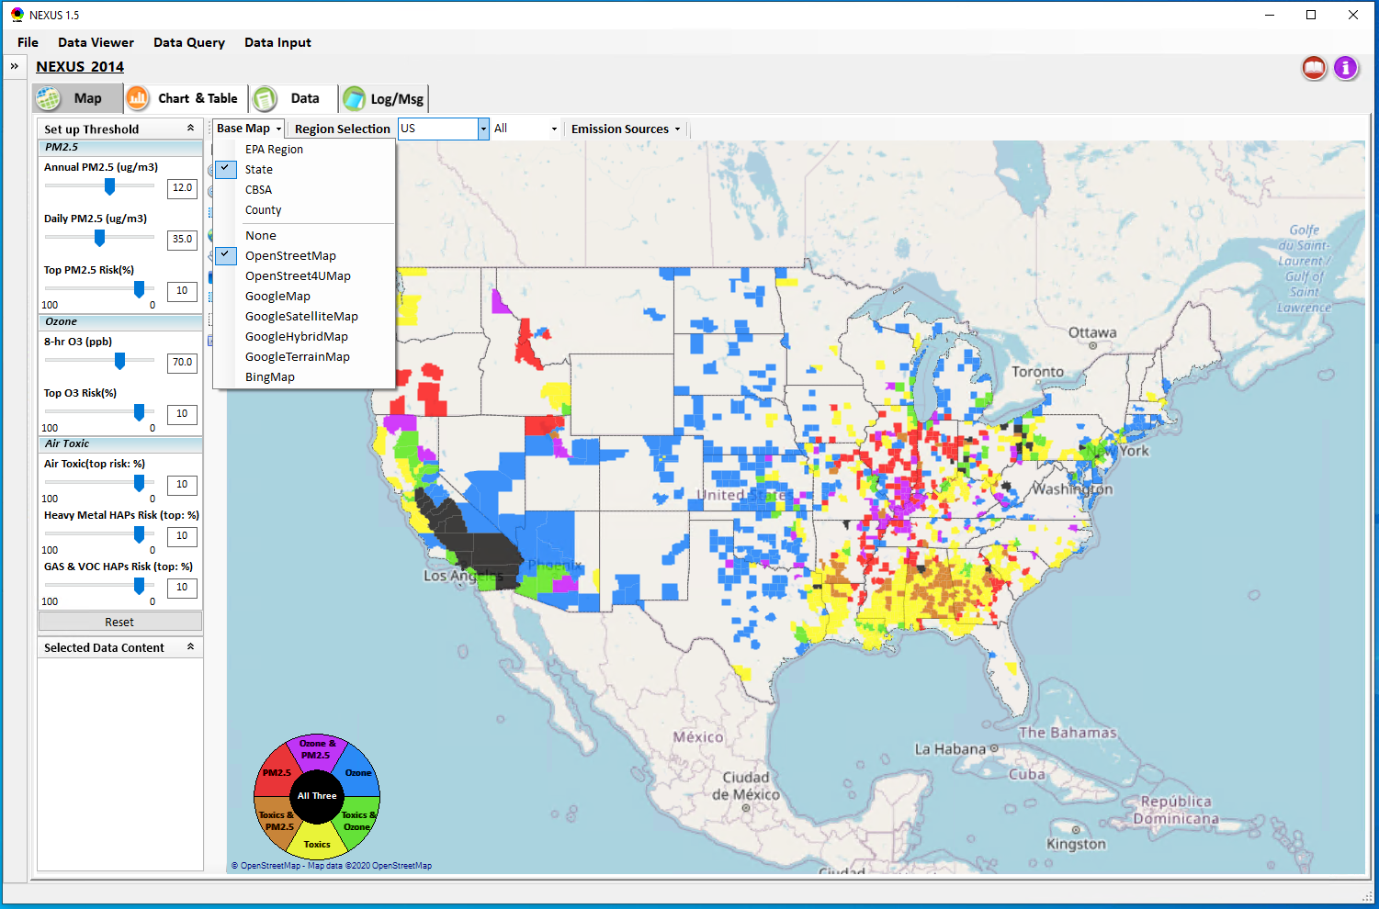
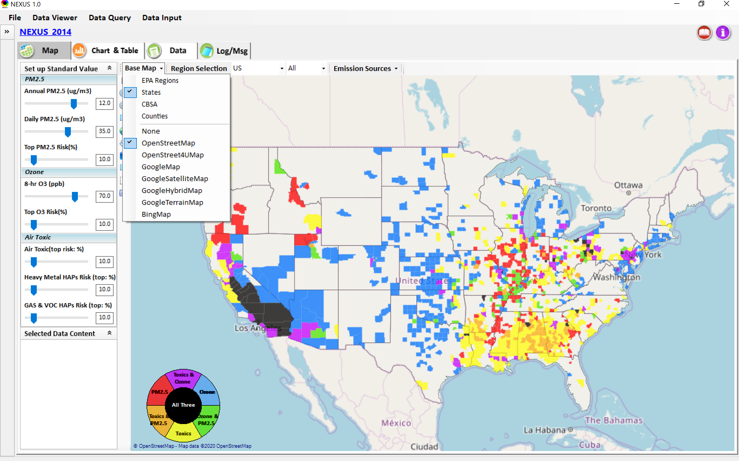
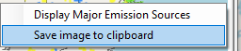
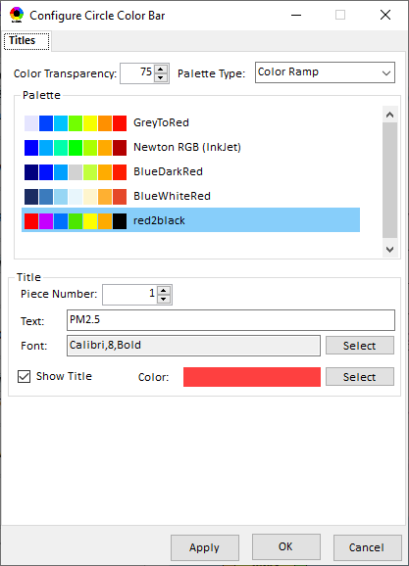
Data Viewer Module: Base Map & Color
“Base Map”: Change boundary lines and background map
“Right-click” map to save image
Click to change color & transparency
37

Slide 38
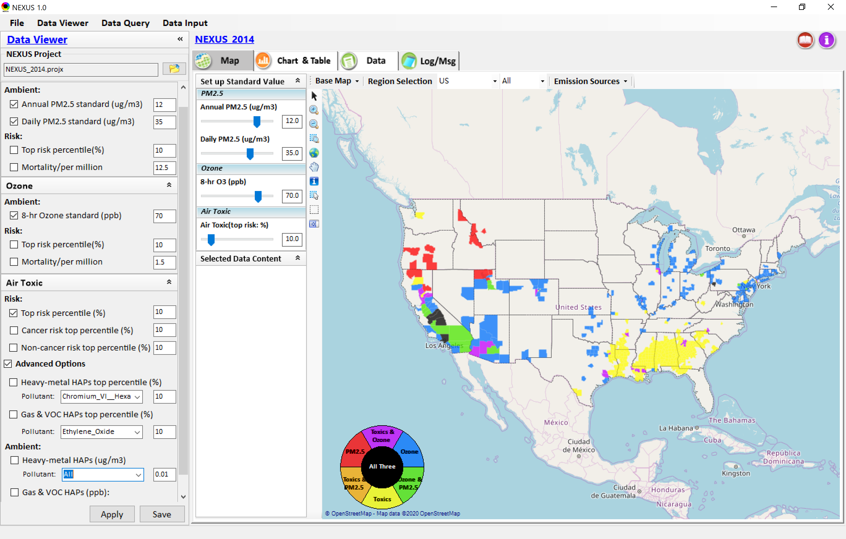

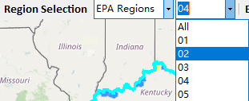
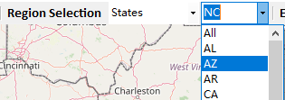
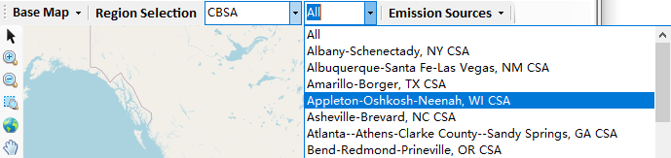
Data Viewer: “Region Selection”
Allow to select “EPA regions”, “States”, or “CBSA”
38

Slide 39
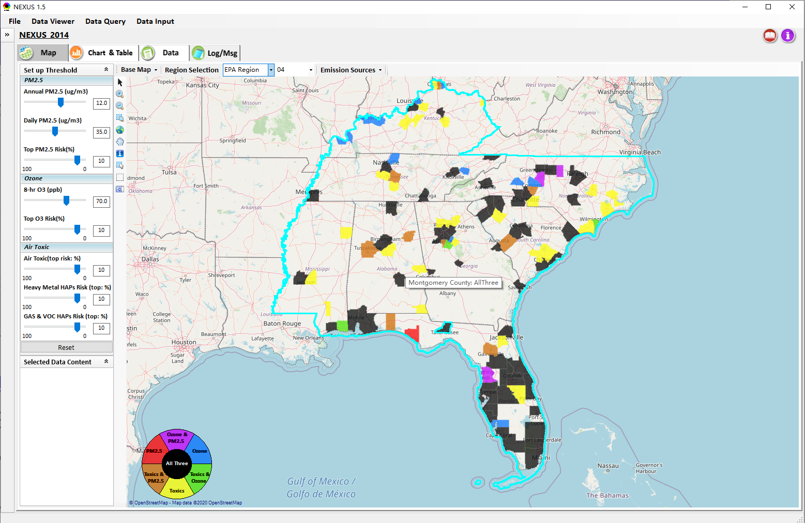
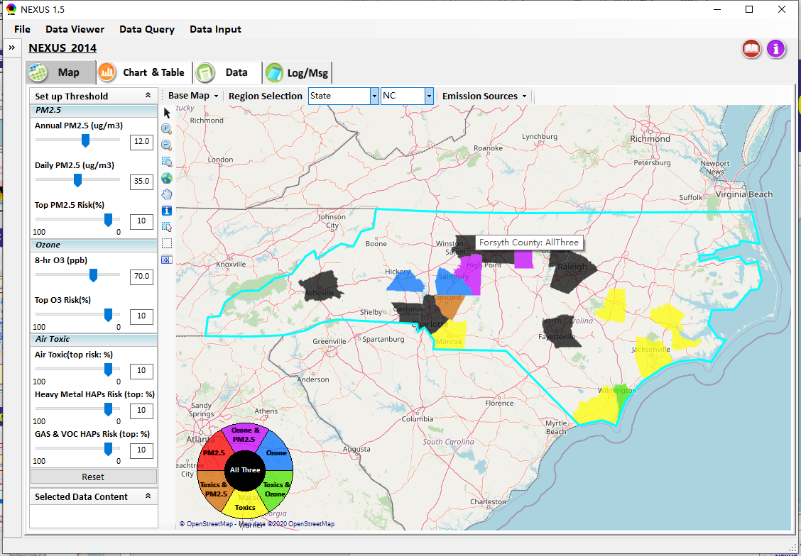
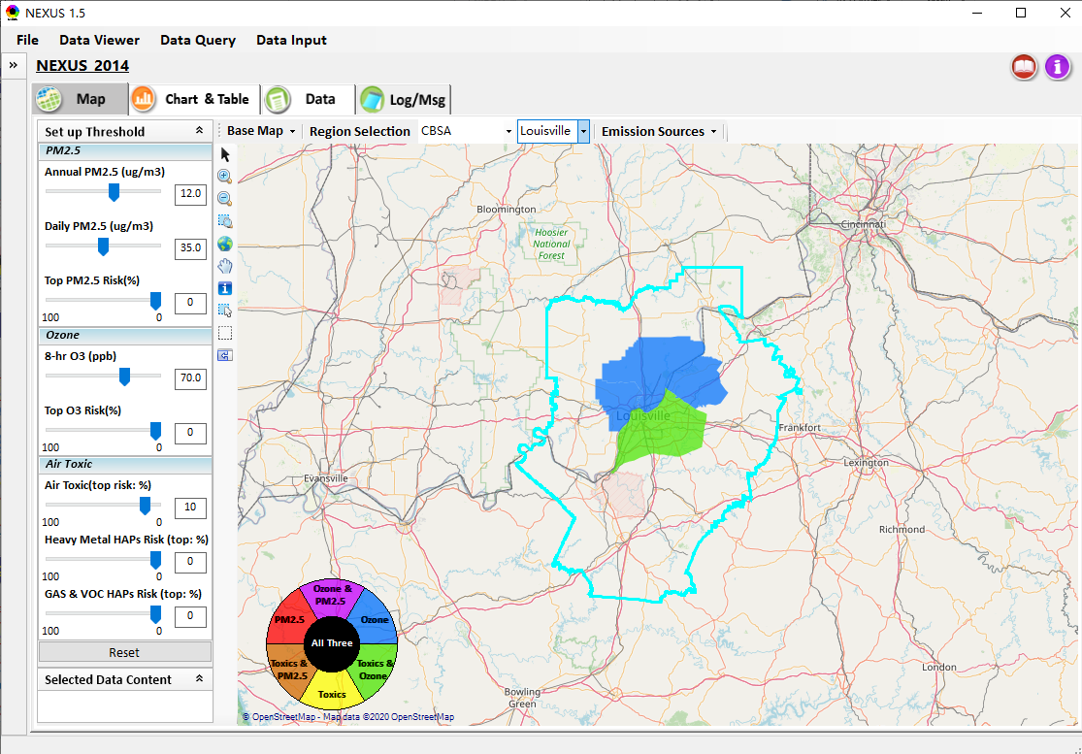
Data Viewer: Select EPA Region/State/CBSA
Examples:
EPA Region 4
NC
Louisville CBSA
39

Slide 40


Data Viewer: Major Emission Sources
Click “Emission Sources” tab to display emission sources (green dots) and launch new window
Click any “facility” to link & display source location and emission information
40

Slide 41

Data Viewer: Major Emission Sources
Allow to scroll down to county-level (e.g., Wake County, NC)
Wake county, NC
41

Slide 42



Data Viewer: Top “x” Emission Sources
Provide selection of CAPs precursors & HAPs species
Durham county, NC
42

Slide 43

Data Viewer: EPA Region Table Generator
“EPA Region Table Generator” is still under development, but a preview of example “EPA Region 4” tables can be provided
43

Slide 44

Data Viewer: Data Search & Filter
Click “+” to add filters; Click “x” to remove current filter;
Show specified records per page.
Click “Output data…” to output current page records or all records
44

Slide 45

Data Query Module: Main Page
Region Selection
Data Query qualifier selection
Data Query Configuration
Map Overlaying selection
Detachable “Attribute Table”
11111111
45

Slide 46


Data Query Module: Configure Data Query
“Data Query Filter” allows to select “qualifiers” for query
“Data Query Preview” displays the selected “qualifiers” at the same time
46

Slide 47




Data Query Module: Overlaying Map
Overlaying Map selection
47
47

Slide 48


Data Query Module: Attribute Table
Filter/link/export functions (to be completed)
Detachable “Attribute Table”
48

Slide 49



Data Query Module: Attribute Table
Click a “record” to link and display its location & info.
49

Slide 50

Data Input Module: Data Preview
Click to change input data file
Click to view data
Select a table to view if there are multiple tables in the selected data source file
Check to use filter to query data
Click to run & save project
50

Slide 51
RoadMap for NEXUS Tool Demo (1)
National Screening (2014 Data)
Replicate 2008 NEXUS map with O₃/PM_{2.5} concentrations above NAAQS and NATA risk estimates above selected percentile of top 10%
  What happens to areas at lower O₃/PM_{2.5} NAAQS levels?
  What happens to areas current over O₃/PM_{2.5} NAAQS if change HAP risk percentile?
Provide NEXUS map on risk basis: O₃/PM_{2.5} BenMAP mortality risk based on fused surfaces and NATA risk estimates above selected percentile of top 10% for all pollutants
  What happens to MP areas as one changes percentile to top 20% or others?
  What is relationship between Heavy Metal HAPs risk (top 10%) and PM_{2.5} risk to identify potential co-pollutant issues?
  What is relationship between Gas/VOC HAPs risk (top 10%) and O₃ risk to identify potential co-pollutant issues?
51

Slide 52
RoadMap for NEXUS Tool Demo (2)
Regional/State/CBSA/County Screening
EPA Region 4 Example
  Areas with MP risk in top 10% across O3, PM2.5 and HAPs
  Louisville CBSA: General view and then dial into “Jefferson County” with transparent map color
    What are the top 10 emissions sources in county by pollutant?
    What specific sources are common across pollutants that may indicate co-control potential?
    Can view these sources on the map with summary data available.
52

Slide 53
RoadMap for NEXUS Tool Demo (3)
Data Query: State/CBSA/County Views
Advance Areas
  Initial view of national level information using the Advance Area definition to show overlay with MP areas
  Region 5 => Minneapolis Example: General view and then dial into “Dakota County” with transparent map color
    What are the top 10 emissions sources in county by pollutant?
    What specific sources are common across pollutants that may indicate co-control potential?
    Can view these sources on the map with summary data available.
53

Slide 54
RoadMap for NEXUS Tool Demo (4)
Data Query: State/CBSA/County Views
Socio-Economic/Demographic (EJ) Areas
  Initial view of national level information using the Poverty/Disadvantaged indicator to show overlay with MP areas
  Region 5 => Detroit Example: General view and then dial into “Wayne County” with transparent map color
    What are the top 10 emissions sources in county by pollutant?
    What specific sources are common across pollutants that may indicate co-control potential?
    Can view these sources on the map with summary data available.
54

Slide 55
End
55

