Slide 1
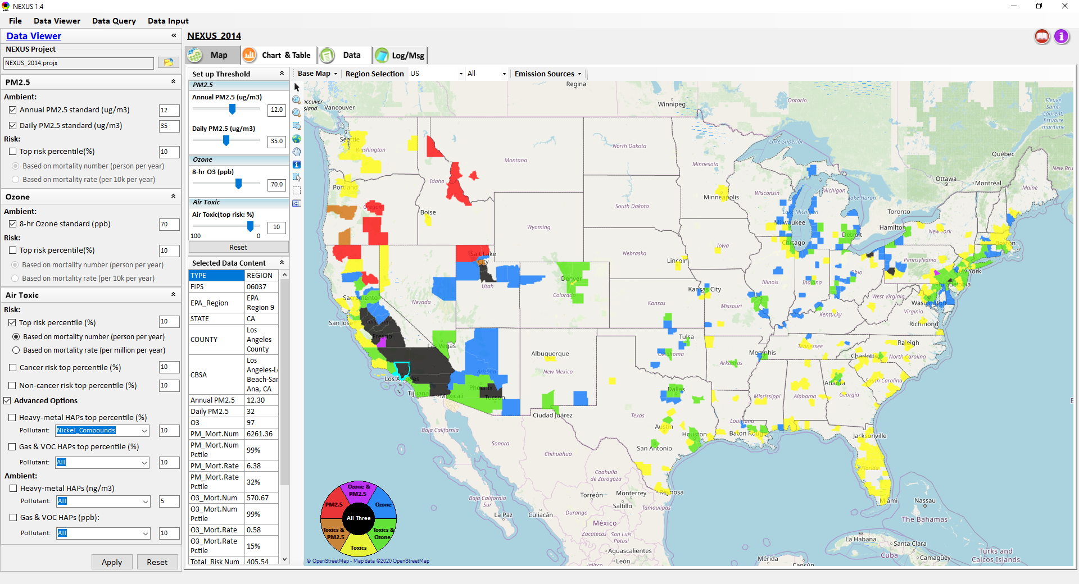
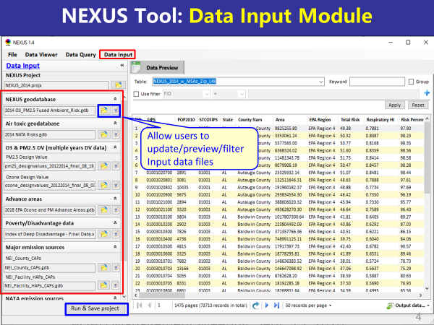
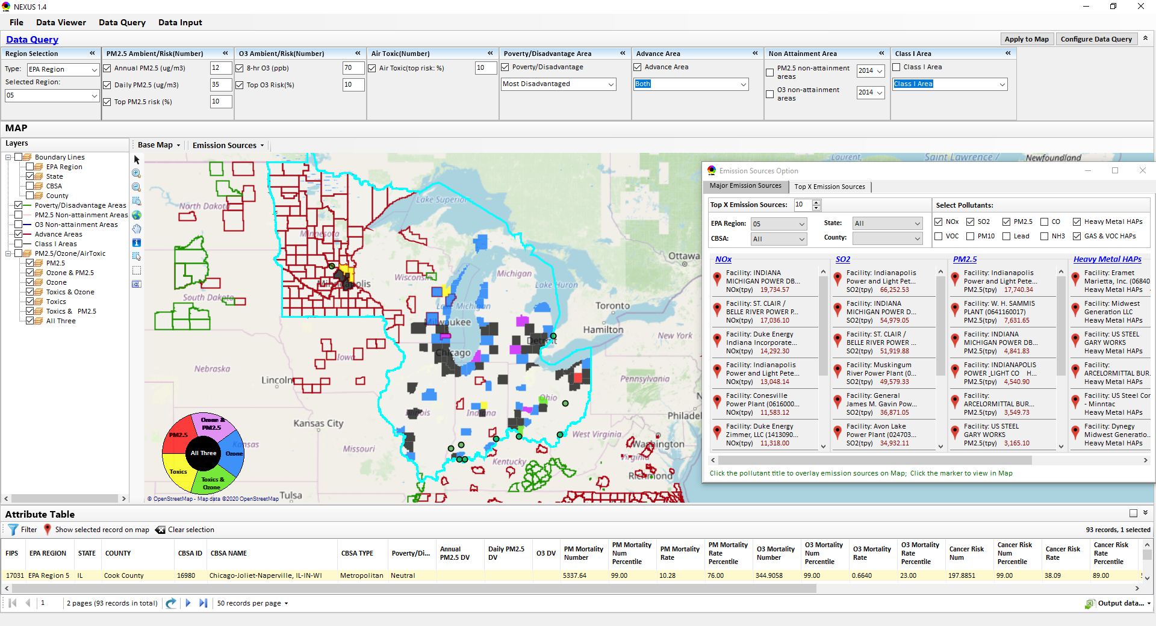
“NEXUS” Multi-Pollutant Analysis Tool Development: Status and Progress
Data Viewer Module
Data Input Module
Data Query Module
“NEXUS 1.5” available on OAQPS’s Shared Drive at: “G:\SHARE\NEXUS\NEXUS 1.5\”
or at EPA’s new FTP site: ftp://newftp.epa.gov/aqmg/cjang/NEXUS/NEXUS 1.5/
OAQPS/SPPD Briefing
January 28, 2021
Carey Jang & Beth Landis
1

Slide 2
Overview
Multi-Pollutant Background
NEXUS Tool Development
Expected Use
Schedule
Key Modules in NEXUS
Questions NEXUS can Answer & Examples: SPPD focused
Discussion & Next Steps
Live Demo
2

Slide 3
Multi-Pollutant (MP) Background
Support a comprehensive, MP treatment of air quality problems to effectively improve air quality and make the most efficient use of available resources
Primary Goal - identify & evaluate local control strategies targeting emissions of O₃ & PM_{2.5} and their precursors while at the same time reducing Air Toxics of concern for communities to maximize both health benefits and air quality improvements
MP planning has the potential to reduce the costs and increase benefits associated with air quality management (AQM)
Supports S/L/T air agencies in developing MP, risk-based AQM plans and implementing strategies that reduce air pollution emissions & improve public health
Success has been demonstrated in Detroit and SC; another project is currently underway in Louisville, KY
Tools needed to analyze MP data are either available currently or being developed in OAQPS (NEXUS)
3

Slide 4
NEXUS Tool Development
Motivation: Develop a new multi-pollutant analysis tool to identify and assess areas with high ambient levels and/or health risks associated with PM_{2.5}, O₃ and Air Toxics
Phase-1: Develop a GIS-based NEXUS prototype with a user-friendly graphical interface to provide analysis and visualization functions of potential multi-pollutant AQ issues at national level (continental US)
Phase-2: Expand the NEXUS tool to allow users to dial into an EPA region, State, or metropolitan area and provide data query and V/A functions for “AQ and emissions” information over the selected region of interest
4

Slide 5
Expected Use of NEXUS Tool
The NEXUS tool will allow users to do the following:
National screening for areas with MP issues: Phase 1 development will provide ability to quickly screen areas across nation that have combination of high air quality and/or risk levels for O₃, PM_{2.5} and Air Toxics.
Area screening to understand nature of MP problem: Phase 2 development will provide ability to ‘dial-into’ specific areas to determine extent to which common emissions sources are causing the MP issues.
We expect to use this tool to engage with Regions and identify areas that would potentially benefit most from MP approaches to reduce emissions (including current NA areas).
The NEXUS tool will essentially provide a ‘conceptual model’ of MP issues to facilitate engagement with state/local/tribal agencies and community stakeholder groups.
We also believe that it has additional uses across the Office for Air Toxics, Environmental Justice and other programs.
5

Slide 6
NEXUS Tool : Schedule & Installation
Work Plan | Date
Developed NEXUS tool prototype and Phase-1 functions | April 2020
Developed Phase-2 functions and deliver first working (interim) NEXUS tool | August 2020
Developed a fully functional NEXUS tool and on-line User’s Manual | Dec. 2020
Upgrading NEXUS tool for Beta testing and broader OAQPS and Regional office use | Jan. ~ July 2021
Download “NEXUS” tool: The “NEXUS 1.5” package (“NEXUS v1.5 setup.exe” & “NEXUS 1.5 Data.exe”: run both to install) is available at OAQPS’s Shared Drive at G:\SHARE\NEXUS\NEXUS 1.5\ or at EPA’s new FTP site: ftp://newftp.epa.gov/aqmg/cjang/NEXUS/NEXUS 1.5/
(Note: Require software installation privilege to install “NEXUS tool” on EPA’s PCs)
6

Slide 7
NEXUS Tool: Briefing Schedule
Audience | Date
AQAD & HEID – DD & Management Team | Sept. 25, 2020
Air Toxics Team | Nov. 3, 2020
AQPD – DD & Management Team | Dec. 10, 2020
OID – DD & Management Team | Jan. 25, 2021
SPPD – DD & Management Team | Jan 28, 2021
OAQPS – Office Director | Feb 1, 2021
7

Slide 8
NEXUS Tool: Three Key Modules
Data Viewer module
Data Input module
Data Query module
View and create interactive Map/Data/Chart/Table
Provide flexible selections & mapping of “Ambient” and/or “Risk” levels of PM_{2.5}, O₃ and air toxics
Provide regional analysis for “EPA region”, “States”, “CBSA”, and “County”
Link and display major emission sources locations & emitted pollutants info.
Allow to update & change input data files
Provide data preview and filter functions
Currently uses 10 publicly available input data files (~4 GB)
Quick turnaround to run & save to a new “project” using new input data files
Expand data field selections and flexibility for exploratory/advanced users
Provide overlaying map and summary table for data query results
Current data query based on selected data fields: “Ambient/Risk, Advance area, Socio-demographic (EJ) area, NA Area, Class I area”

Slide 9
Data Input File Names | Data Format | Data Description | Data Source | Data Period
“2014 O₃ & PM_{2.5} fused Ambient & Risk” | Geodataset | O₃/PM_{2.5} ambient & risk data at county/census tract level | from OAQPS MP team | 2014
“2014 NATA Risk” | Geodataset | Air Toxics ambient & risk data at county/census tract level | from OAQPS MP team | 2014
“O₃_DV_2009_2018” | Excel | O₃ design values at county level | From EPA public website: https://www.epa.gov/air-trends/air-quality-design-values | 2009 to 2018
“PM_DV_2009_2018” | Excel | PM_{2.5} design values at county level | From EPA public website: https://www.epa.gov/air-trends/air-quality-design-values | 2009 to 2018
“Advance areas O₃_PM” | Geodataset | O₃ & PM_{2.5} Advance Areas | from OAQPS MP team | 2018
“Index of Poverty_ Disadvantage” | Excel | Index of poverty/disadvantage at county level | from Univ. of Michigan website: https://poverty.umich.edu/projects/understanding-communities-of-deep-disadvantage/ | 2017
“NEI_County_CAPs” “NEI_Facility_HAPs_ CAPs” | Geodataset | Major emission sources and facility info. of CAPs & HAPs at county level | From OAQPS public website: ftp://newftp.epa.gov/EPADataCommons/OAR/OAQPS/NEI/NEI_Facility_HAPs_CAPs.zip ftp://newftp.epa.gov/EPADataCommons/OAR/OAQPS/NEI/NEI_County_CAP.zip | 2008, 2011, 2014
“2014 NEI_NATA Emissions” | Access Database (*. accdb) | NATA emissions data from 2014 NEI database, including various source groups | From EPA public website: https://www.epa.gov/national-air-toxics-assessment/2014-nata-assessment-results#emissions | 2014
“Class1_FederalAreas” | Geodataset | Mandatory Class 1 Federal Areas | From Mandatory Class 1 Federal Areas Web Service: https://edg.epa.gov/data/public/OAR/OAQPS/Class1/Class1Areas.zip | —
Data Input Module: Input Files & Attributes
9

Slide 10
NEXUS Tool: SPPD Related Examples
How can NEXUS be used to identify highest risk areas across O₃, PM_{2.5}, and Air Toxics and the sector(s) contributing?
Example 1 → Region 5 → Detroit
How can NEXUS be used to identify facilities with potential co-benefits of controls in areas with highest risk across O₃, PM_{2.5}, and Air Toxics?
Example 2 → Region 5 → Cincinnati → AK Steel
How can NEXUS be used to identify how best to address multi-pollutant risks?
Example 3 → Region 4 → Louisville
How can NEXUS be used to review industrial sources?
Example 4 → Region 4 → Birmingham
10

Slide 11
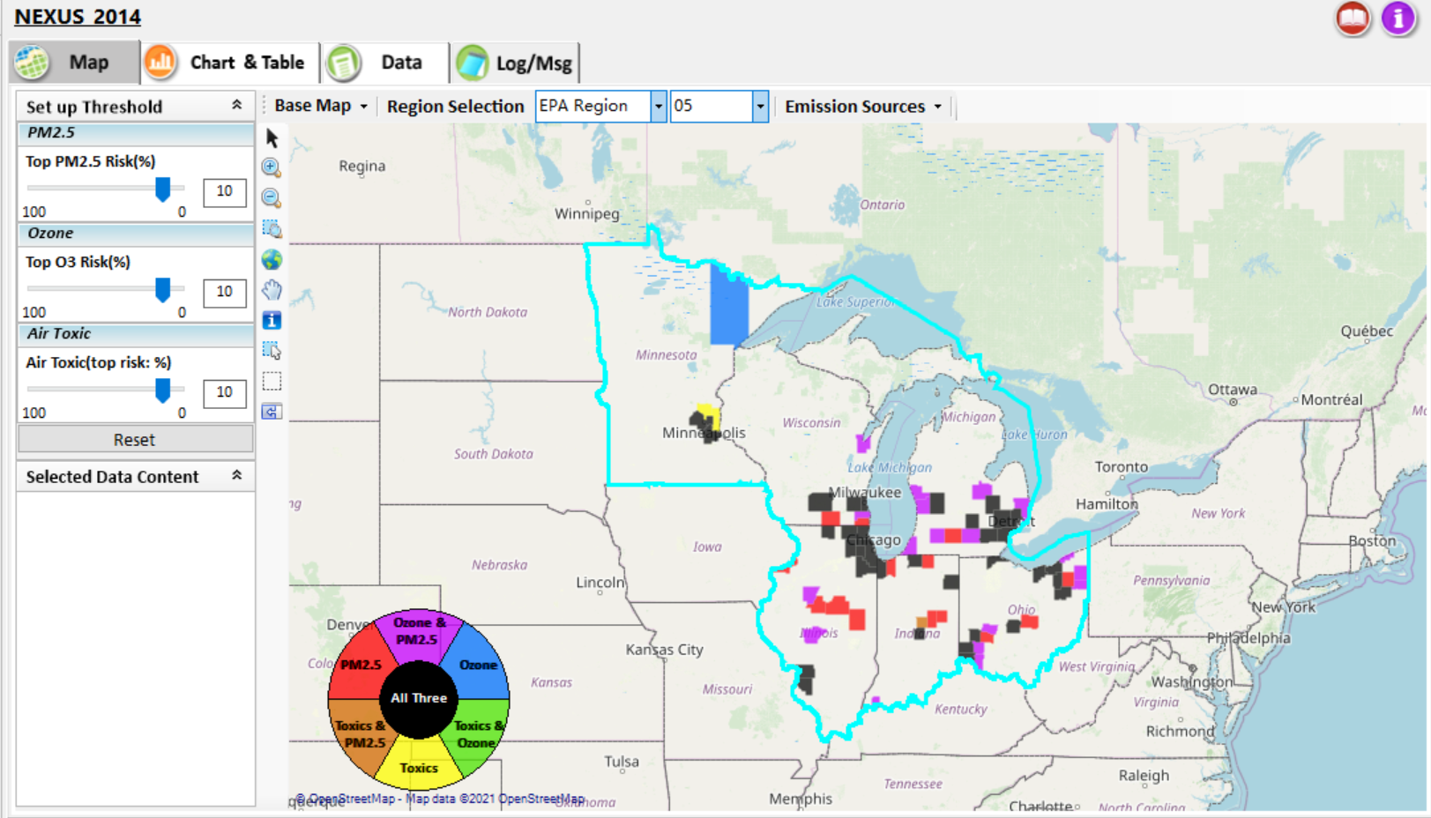
NEXUS Tool: Example 1 - ID High MP Risk Areas & Contributing Sector(s)
NEXUS can be used to identify highest risk areas across O₃, PM_{2.5}, and Air Toxics.
Example map above is for Region 5
11

Slide 12
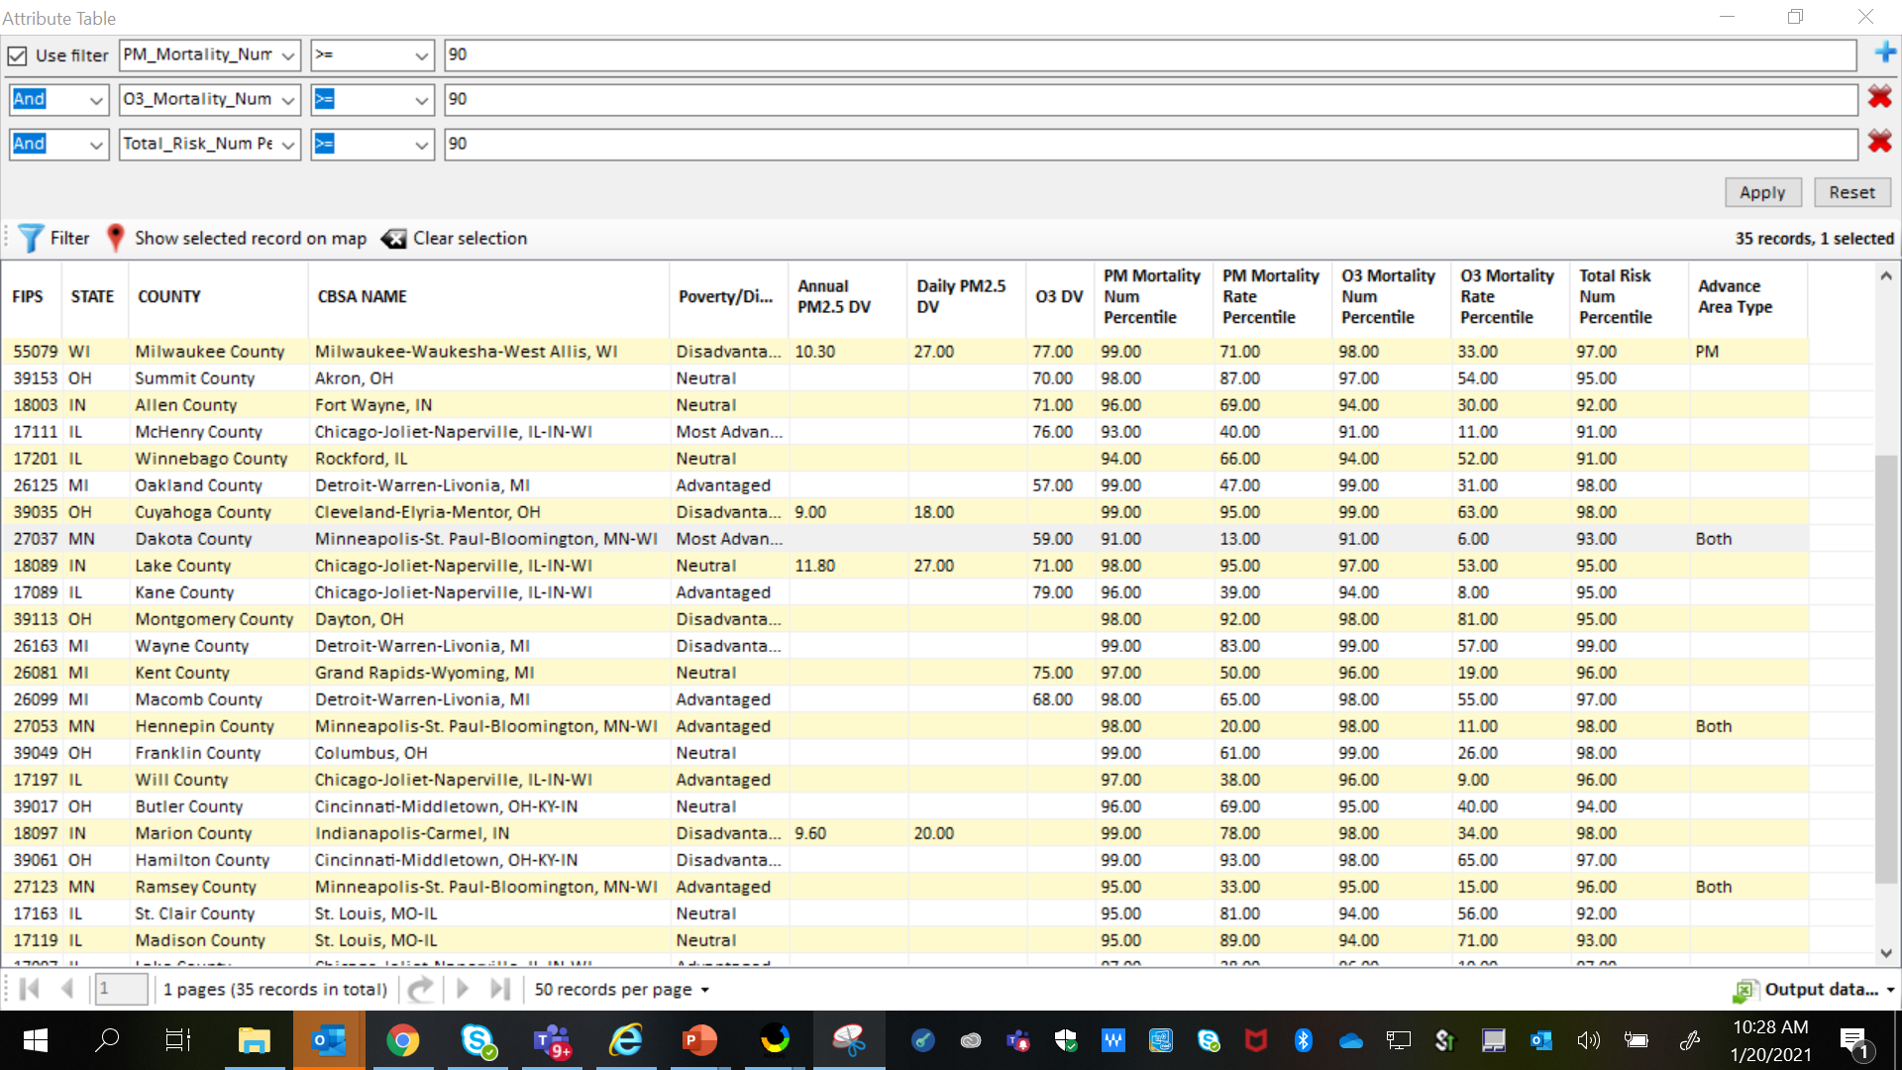
NEXUS Tool: Highest MP Risk Areas in R5
NEXUS can be used to identify highest risk areas across O₃, PM_{2.5}, and Air Toxics. Example table above was generated in Data Query for Region 5. Table Generator Module is planned for future development. Currently, data can be exported to Excel.
12

Slide 13
NEXUS Tool: R5 Rankings from Data Query Module
STATE | COUNTY | CBSA NAME | PM Mortality Num % | O3 Mortality Num % | Total Risk Num % | Overall Rank | Poverty / Disadvantage | Advance Area Type
IL | Cook County | Chicago-Joliet-Naperville, IL-IN-WI | 99 | 99 | 99 | 1 | Neutral
MI | Wayne County | Detroit-Warren-Livonia, MI | 99 | 99 | 99 | 1 | Disadvantaged
MI | Oakland County | Detroit-Warren-Livonia, MI | 99 | 99 | 98 | 2 | Advantaged
OH | Cuyahoga County | Cleveland-Elyria-Mentor, OH | 99 | 99 | 98 | 2 | Disadvantaged
OH | Franklin County | Columbus, OH | 99 | 99 | 98 | 2 | Neutral
IN | Marion County | Indianapolis-Carmel, IN | 99 | 98 | 98 | 3 | Disadvantaged
OH | Hamilton County | Cincinnati-Middletown, OH-KY-IN | 99 | 98 | 97 | 4 | Disadvantaged
WI | Milwaukee County | Milwaukee-Waukesha-West Allis, WI | 99 | 98 | 97 | 4 | Disadvantaged | PM
MN | Hennepin County | Minneapolis-St. Paul-Bloomington, MN-WI | 98 | 98 | 98 | 4 | Advantaged | Both
IL | DuPage County | Chicago-Joliet-Naperville, IL-IN-WI | 98 | 97 | 98 | 5 | Most Advantaged
MI | Macomb County | Detroit-Warren-Livonia, MI | 98 | 98 | 97 | 5 | Advantaged
OH | Montgomery County | Dayton, OH | 98 | 98 | 95 | 6 | Disadvantaged
IN | Lake County | Chicago-Joliet-Naperville, IL-IN-WI | 98 | 97 | 95 | 7 | Neutral
OH | Summit County | Akron, OH | 98 | 97 | 95 | 7 | Neutral
IL | Lake County | Chicago-Joliet-Naperville, IL-IN-WI | 97 | 96 | 97 | 7 | Advantaged
NEXUS can be used to identify highest risk areas across O₃, PM_{2.5}, and Air Toxics. Information above was generated in Data Query for Region 5 and exported into excel where rankings were applied.
Top CBSAs (using this approach) – Chicago, Detroit, Cleveland, Columbus, Indianapolis, Cincinnati, Milwaukee, Minneapolis, Dayton & Akron
13

Slide 14
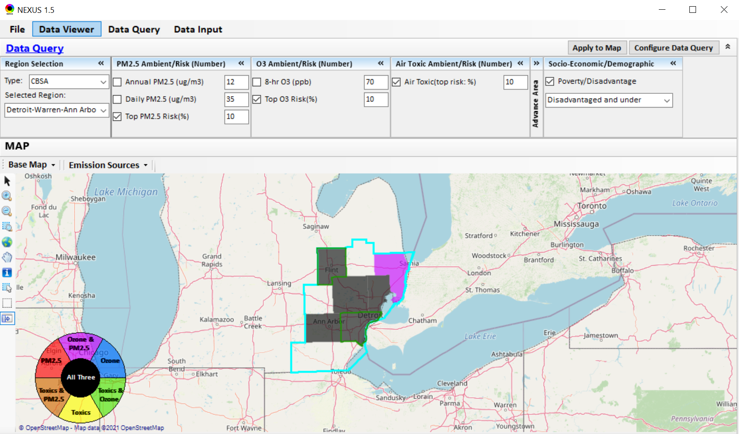
NEXUS Tool: Detroit CBSA
NEXUS can be used to explore CBSAs with multi-pollutant concerns. This information was generated in Data Viewer for the Detroit CBSA. Two counties (Wayne & Genessee) are outlined in green, showing that they are “disadvantaged or under”. Let’s explore where the major sources are located in the CBSA…
14

Slide 15
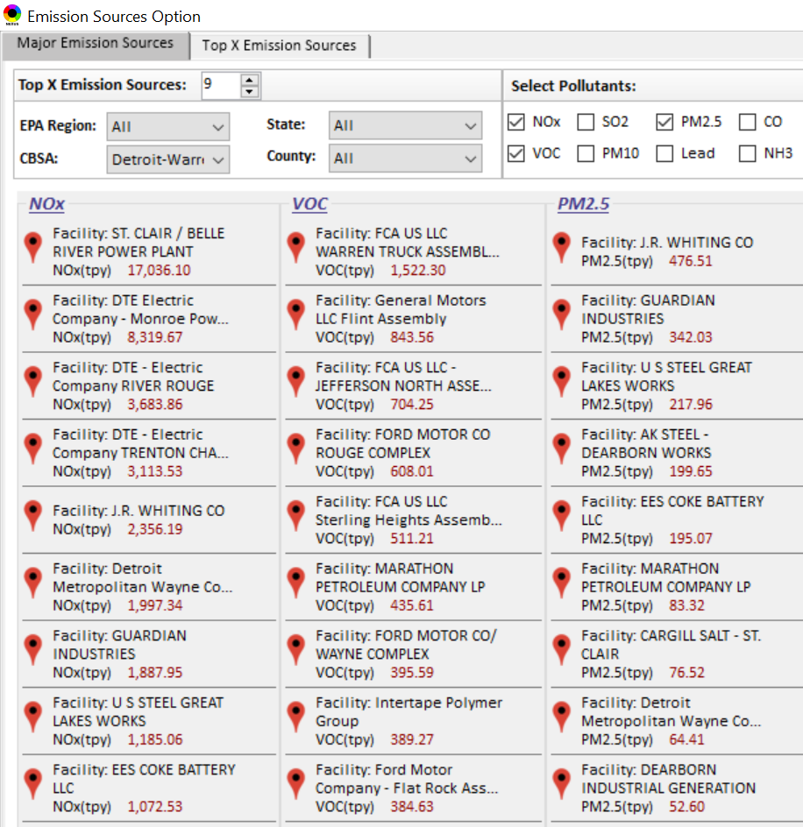
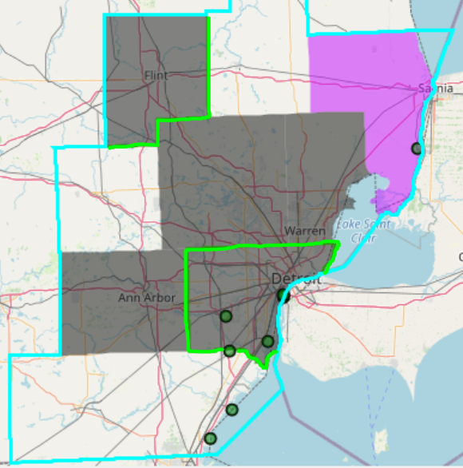

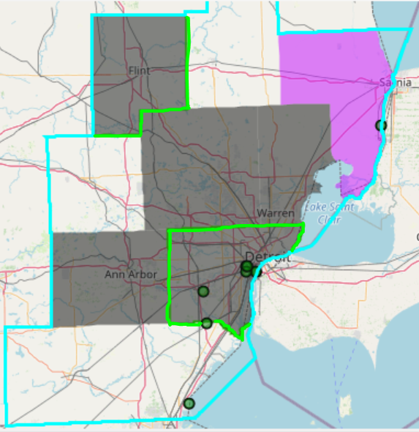
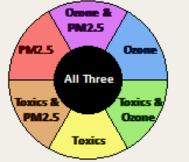
NEXUS Tool: Emissions Sources in Detroit CBSA
G
S
G
S
Ma
Ma
S
Ma
M
W
W
M
G
M
M
M
W
W
W
Top NOx Emission Sources
Top VOC Emission Sources
W
W
W
M
Ma
W
G
S
W
W
W
Ma
M
W
S
W
W
S
W
W
W
W
M
G = Genessee Co., Ma= Macomb Co., M= Monroe Co., S = St. Clair Co., W = Wayne Co.
Top PM_{2.5} Emission Sources
NEXUS can be used to identify top emission sources. The information above was generated in Data Query for the Detroit CBSA . We can quickly see that the majority of the NOx, VOC & PM_{2.5} emission sources are located in Wayne County. Let’s explore the Wayne County sources further…
15

Slide 16
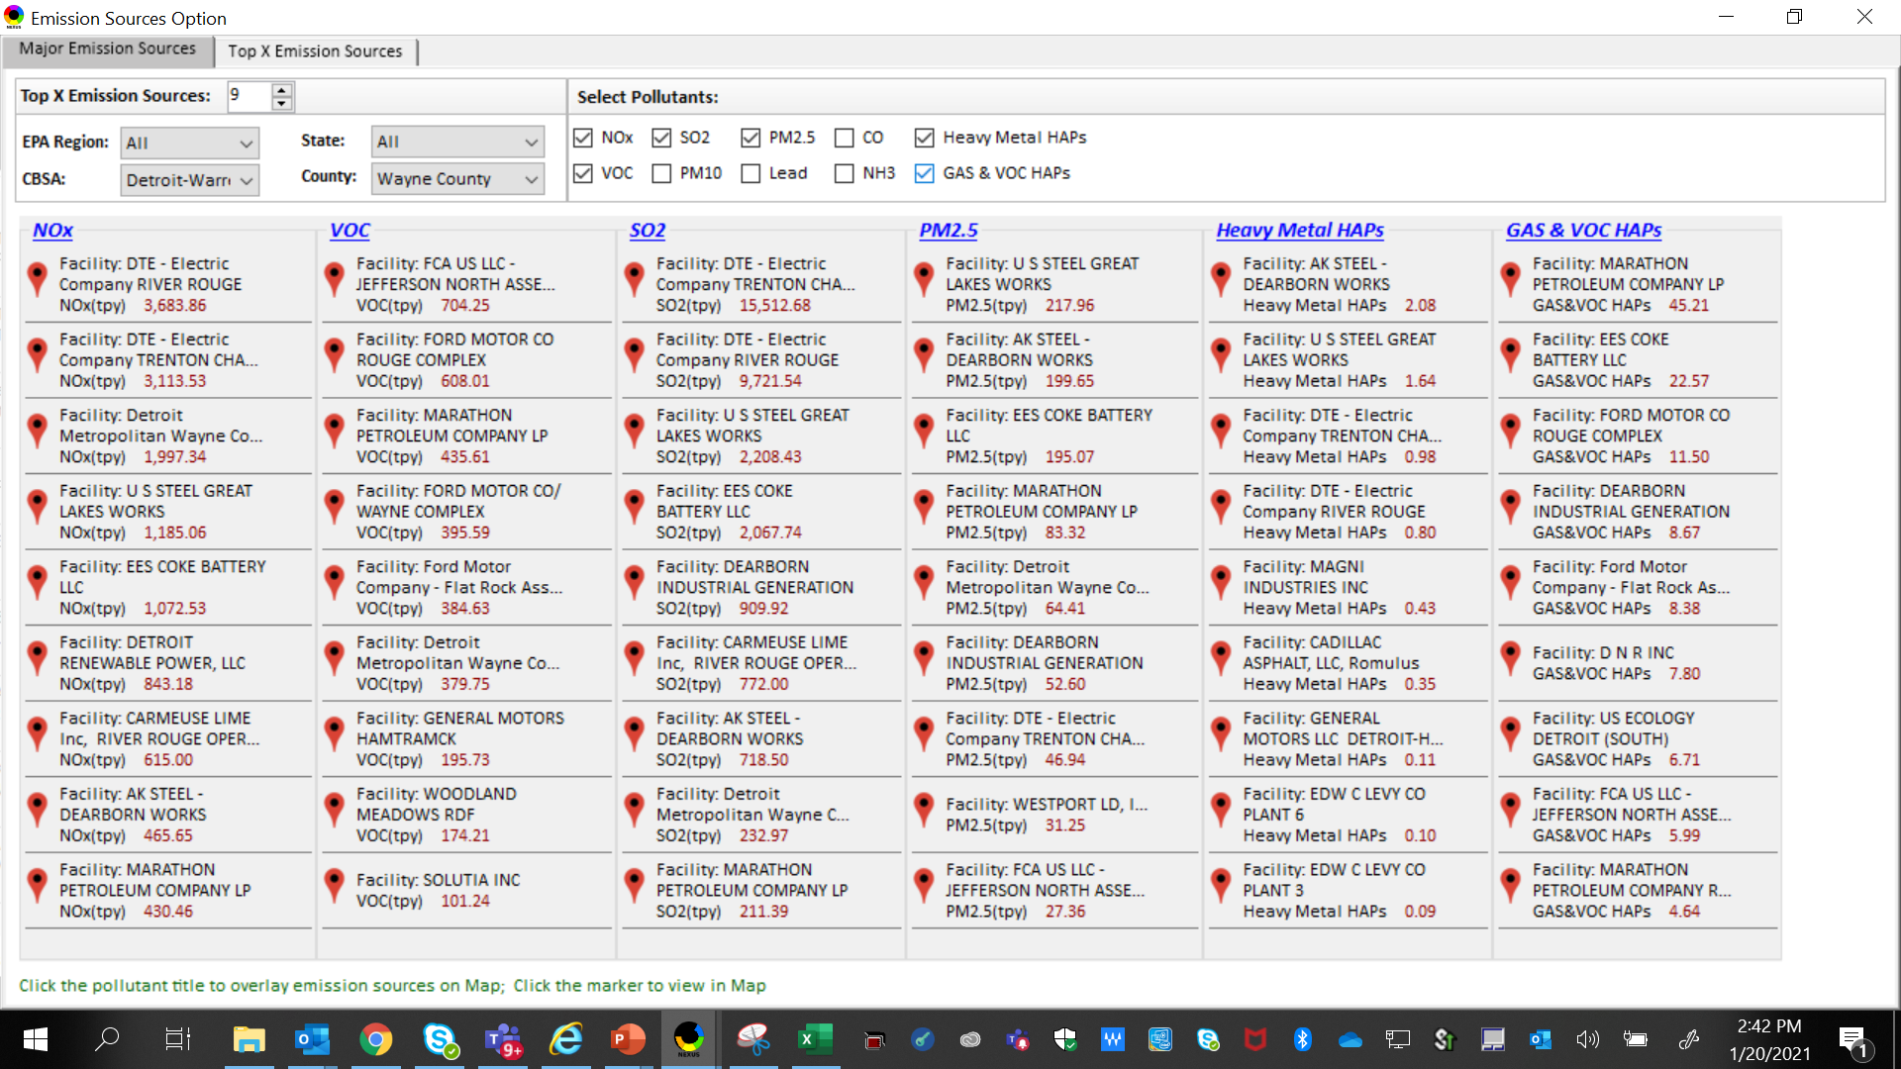
NEXUS Tool: Emissions Sources in Wayne County
NEXUS can be used to identify top emission sources. The information above was generated in Data Query for Wayne County, MI. This can help identify the potential co-benefits of controls. Let’s explore AK Steel and US Steel further...
16

Slide 17
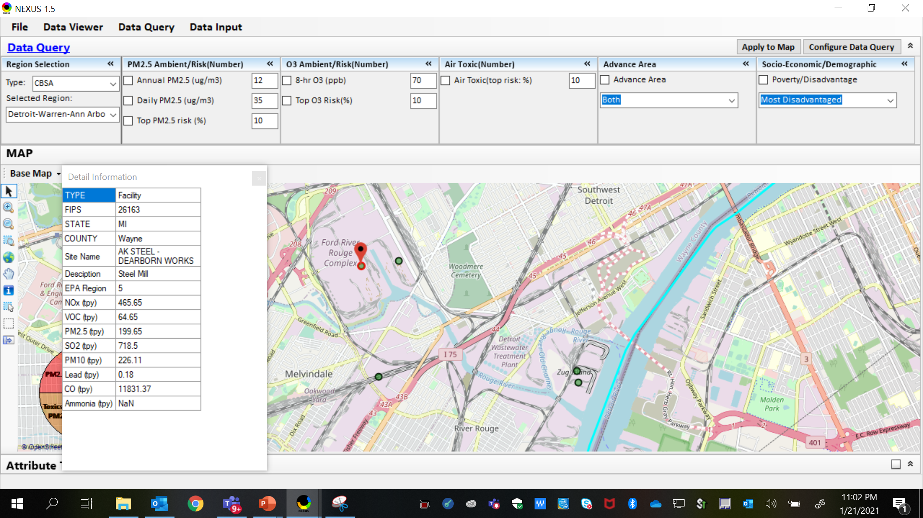
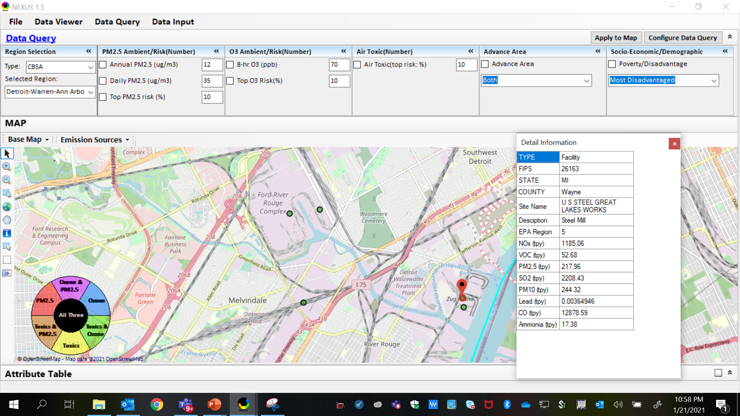
NEXUS Tool: Steel Mills in Wayne County
AK Steel
US Steel
AK Steel & US Steel were both identified as top emitters for NOx, SO₂, PM_{2.5} and Heavy Metal HAPs, highlighting the potential co-benefits of controls in these steel mills. The above map was generated in NEXUS Data Query. Let’s see the proximity of these steel mills to EJ communities…
17

Slide 18
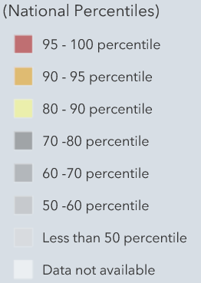
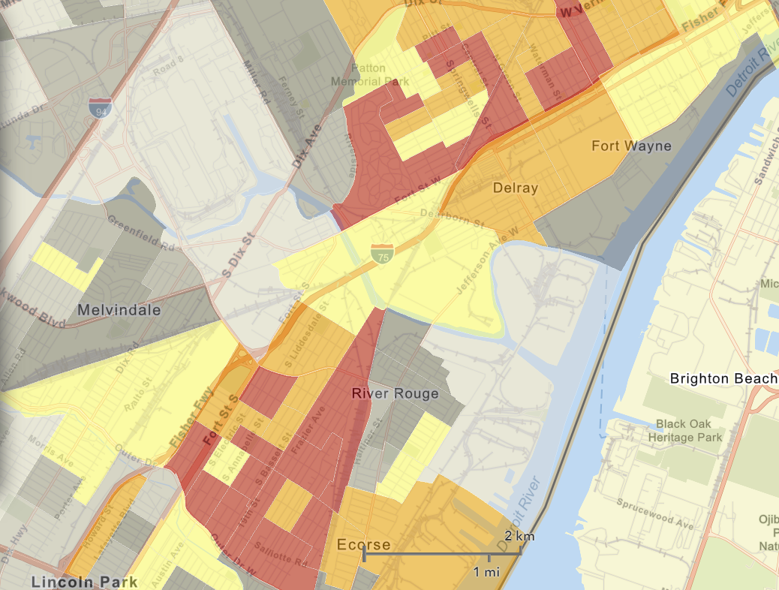
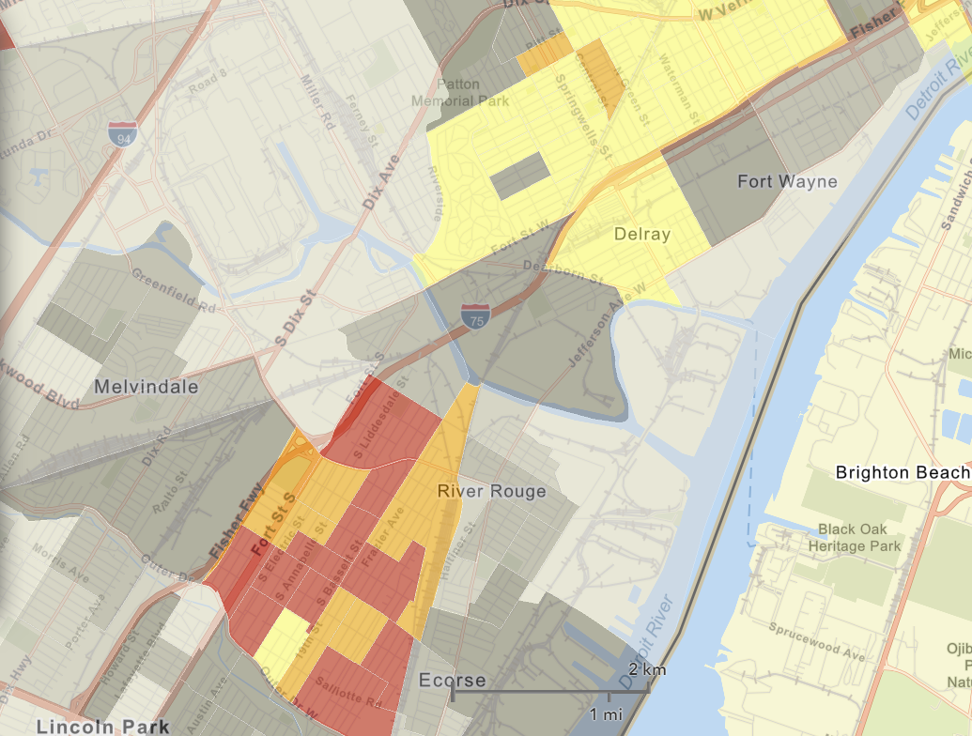
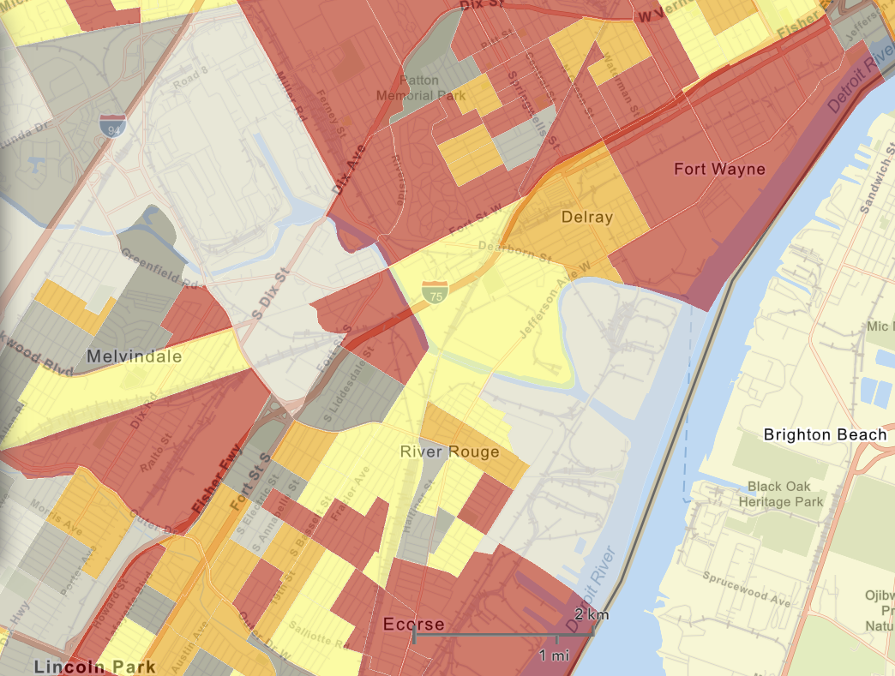

NEXUS Tool: EJ Indices in Wayne County
NEXUS Map
NEXUS can be used to determine EJ communities in areas with MP concerns. NEXUS currently includes a poverty/disadvantage index, and we plan to incorporate additional EJ metrics such as the data inputs below from EJSCREEN. These indices show the close proximity of AK Steel & US Steel to EJ communities.
AK Steel
US Steel
EJSCREEN Demographic Index
EJSCREEN Minority Population
EJSCREEN Low Income Population
18

Slide 19
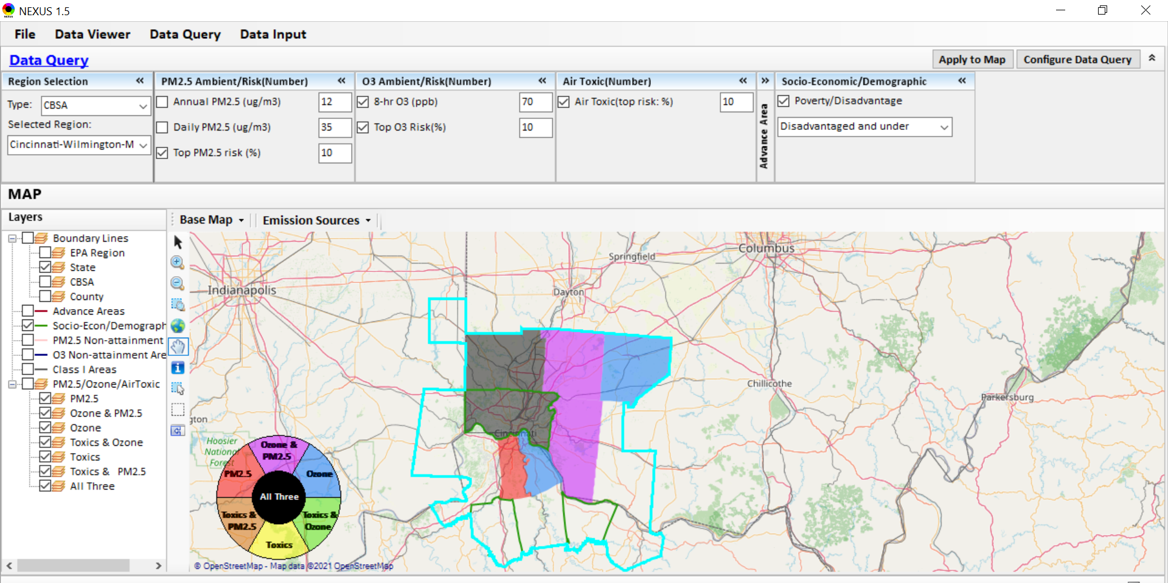
NEXUS Tool: Example 2 - ID Facilities with Potential Co-Benefits of Controls in MP Areas
NEXUS can be used to explore CBSAs with multi-pollutant concerns. This information was generated in Data Query for the Cincinnati CBSA. Two counties (Butler and Hamilton) are high risk areas across PM_{2.5}, O₃ & toxics. Let’s explore where the major sources are located in the CBSA…
19

Slide 20
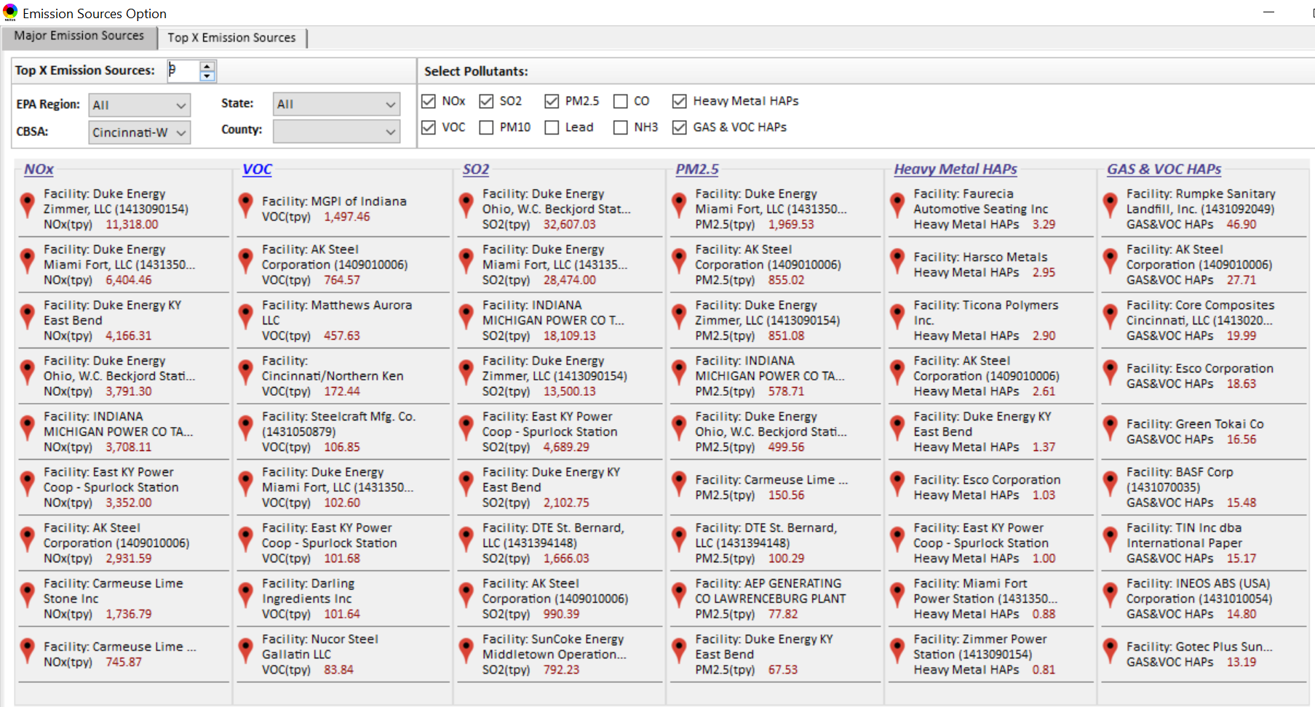
NEXUS Tool: Emission Sources in Cincinnati CBSA
NEXUS can be used to identify top emission sources. The information above was generated in Data Query for the Cincinnati CBSA. This can help identify the potential co-benefits of controls. Notice that AK Steel is a top emitter in every category. Let’s explore this further…
20

Slide 21
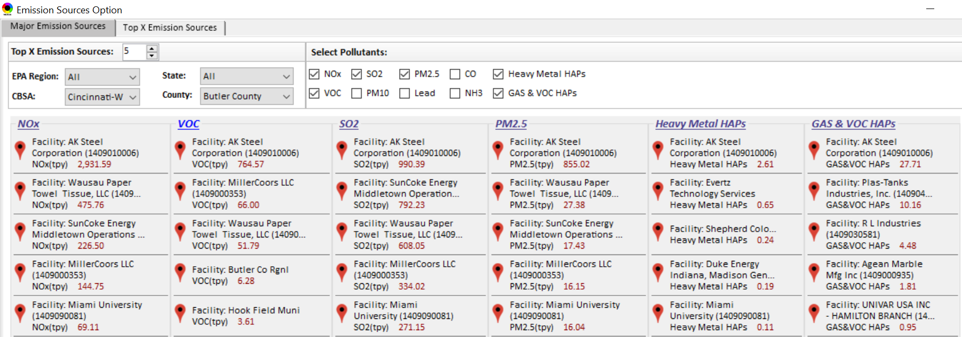
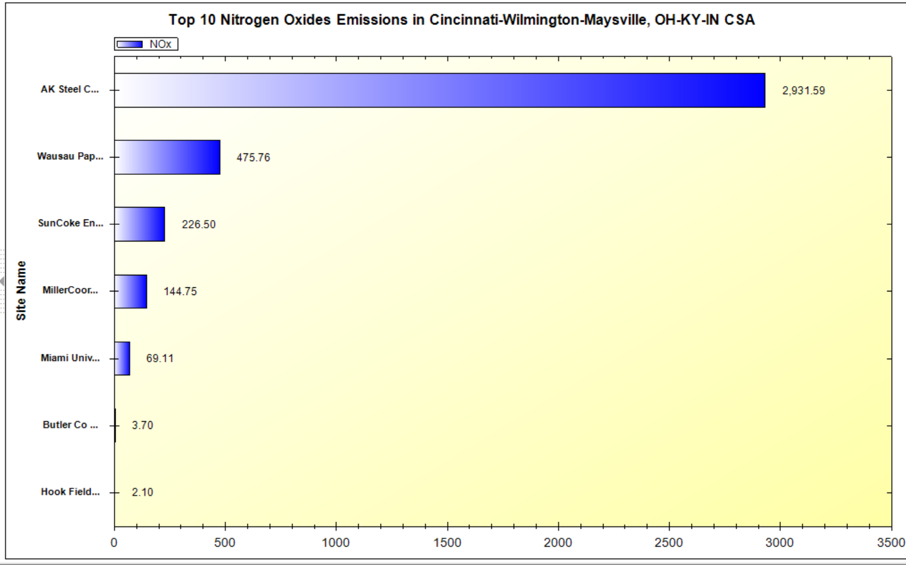
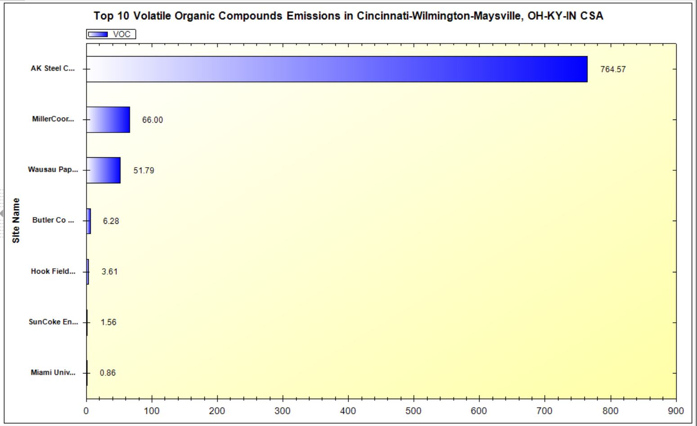
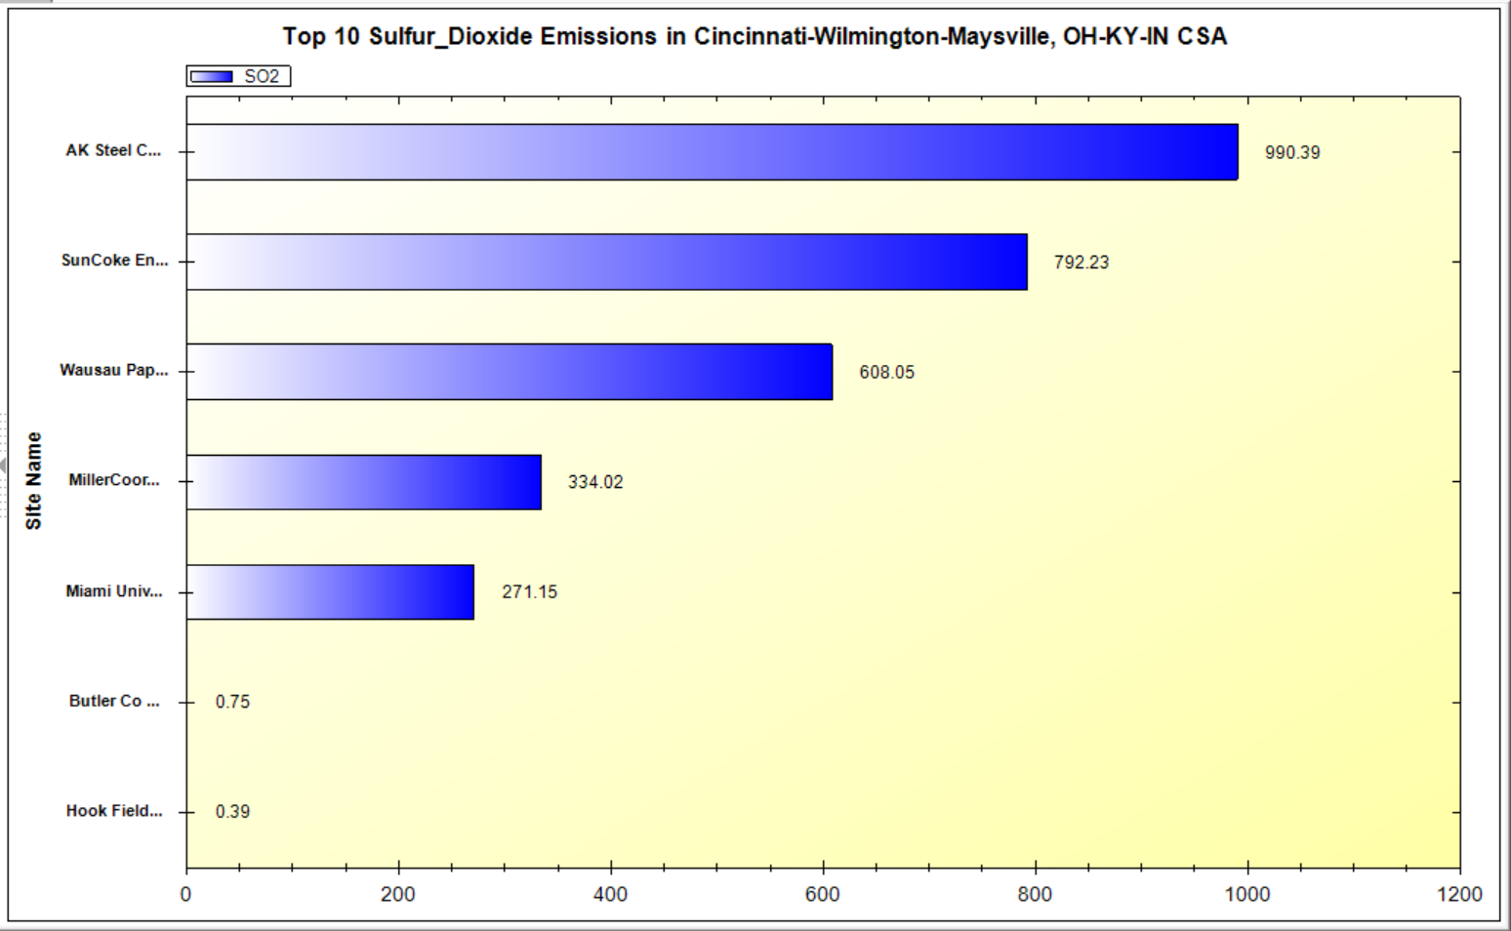
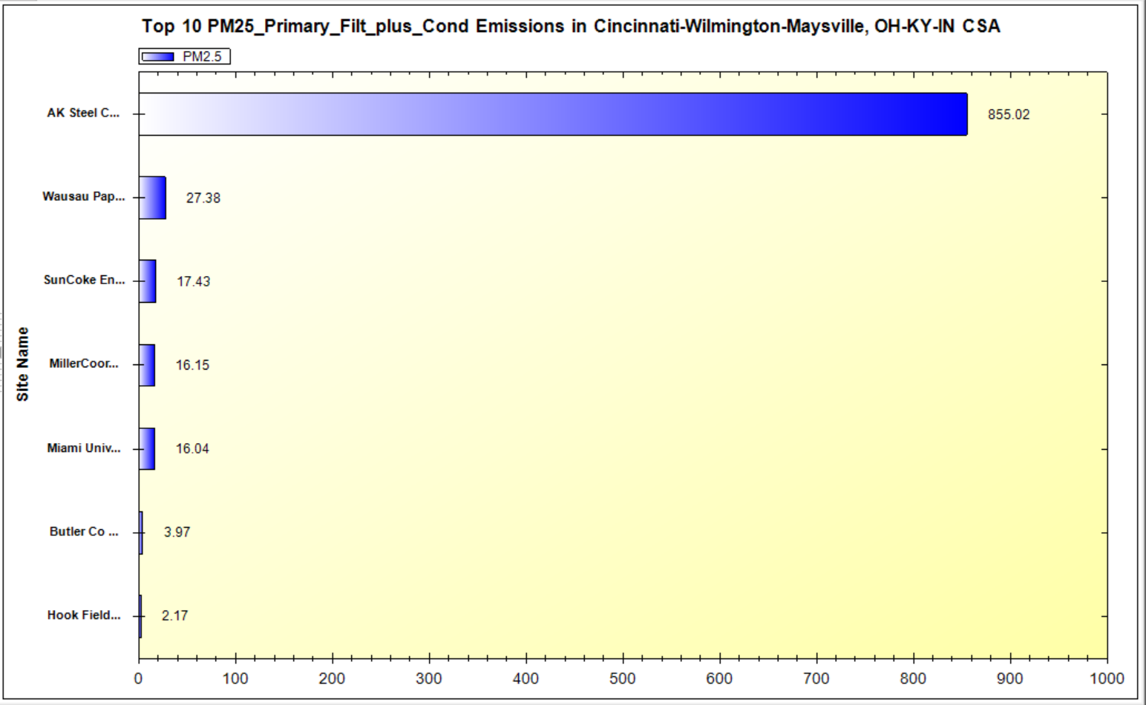
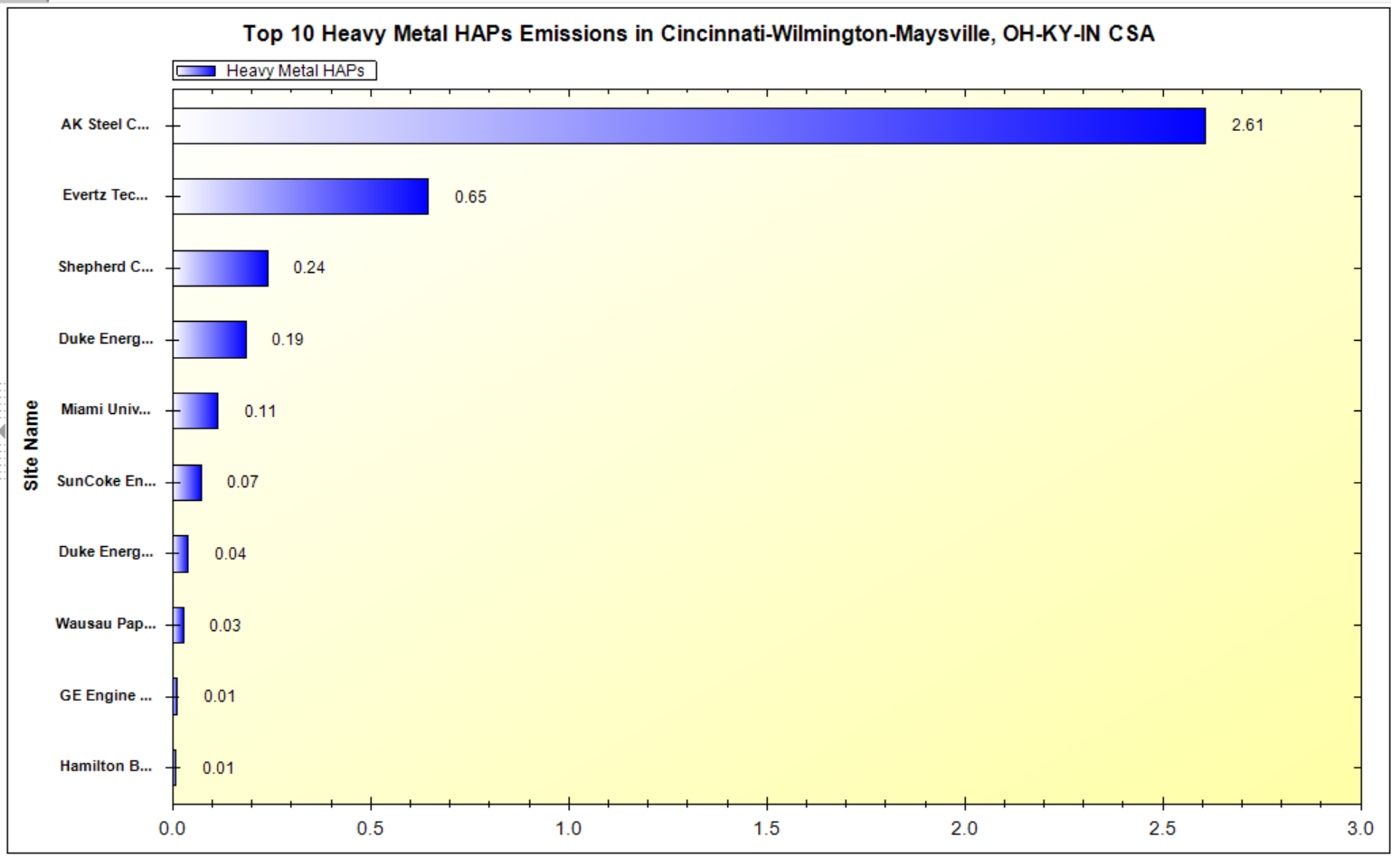
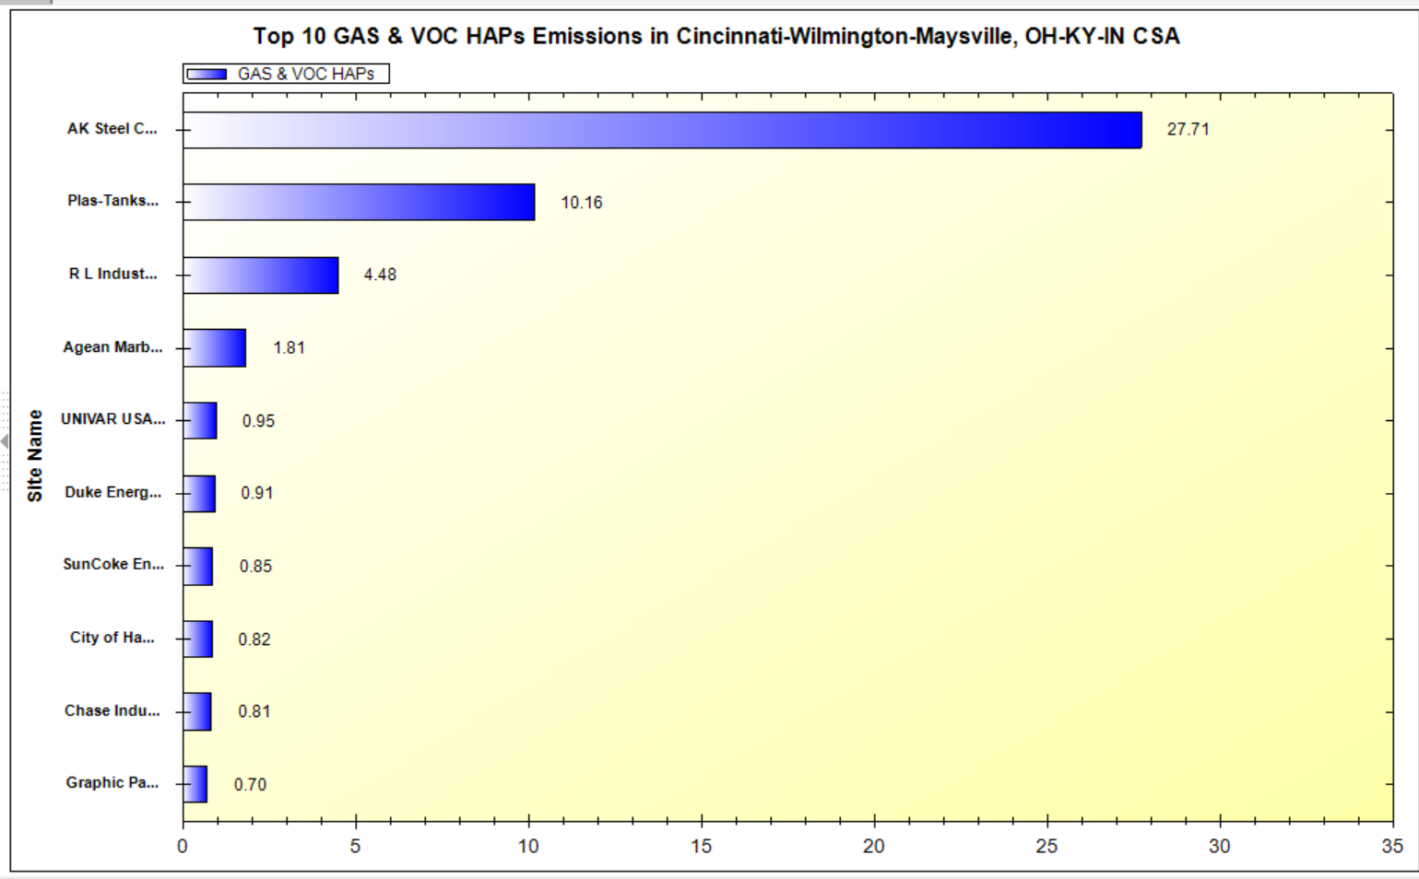
NEXUS Tool: Emission Sources in Butler County
NEXUS can be used to identify top emission sources. The above table and bar charts were generated in Data Query for Butler County. AK Steel is the top emitter in every category, and the bar charts quickly show how its emissions compare to other sources in the county.
21

Slide 22
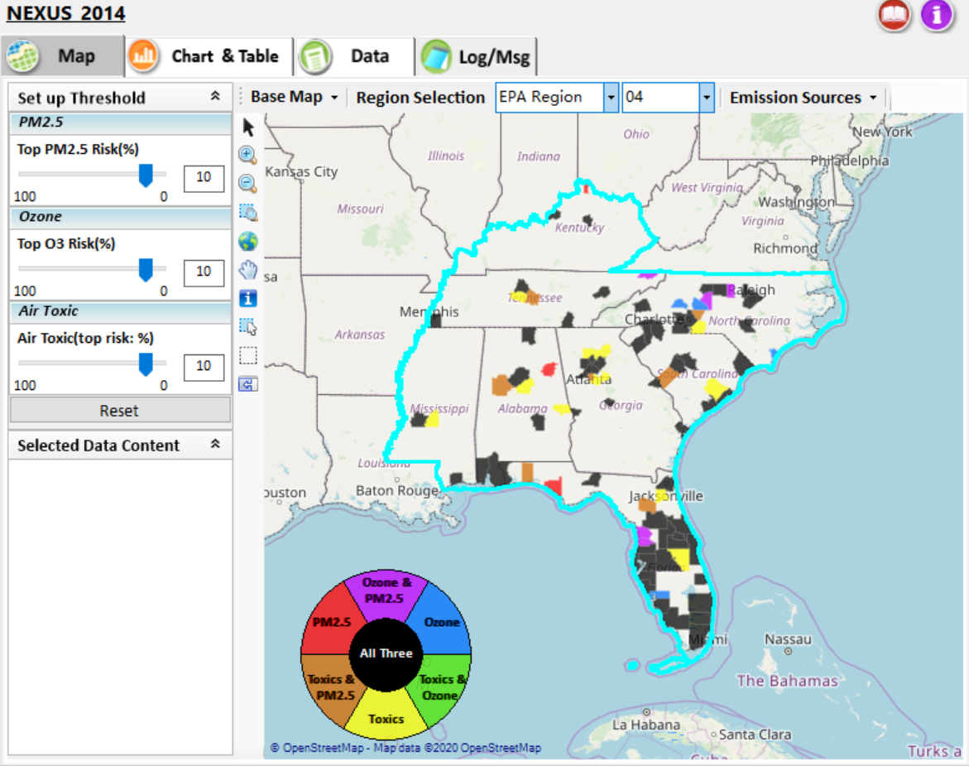
NEXUS Tool: Example 3 – Addressing MP Concerns
NEXUS can be used to identify highest risk areas across O₃, PM_{2.5}, and Air Toxics. Example map above is for Region 4
22

Slide 23
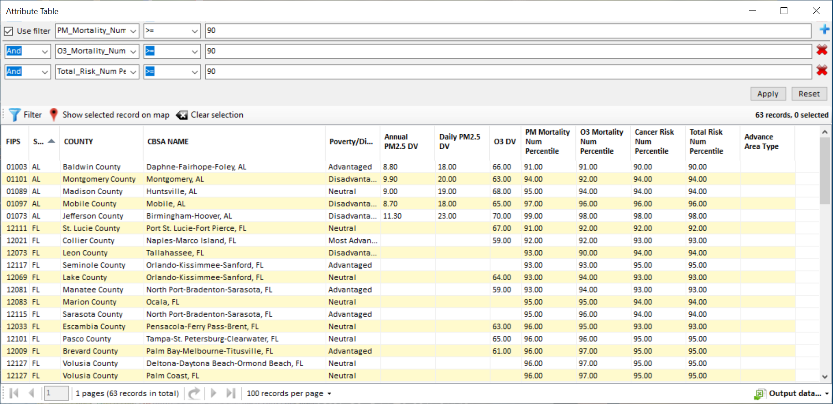
NEXUS Tool: Highest MP Risk Areas in R4
NEXUS can be used to identify highest risk areas across O₃, PM_{2.5}, and Air Toxics. Example table above was generated in Data Query for Region 4. Table Generator Module is planned for future development. Currently, data can be exported to Excel.
23

Slide 24
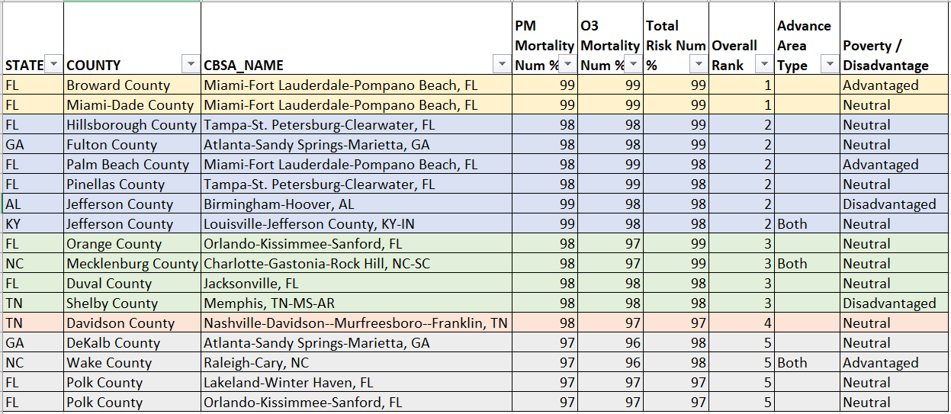
NEXUS Tool: R4 Rankings from Data Query Module
NEXUS can be used to identify highest risk areas across O₃, PM_{2.5}, and Air Toxics. Information above was generated in Data Query for Region 4 and exported into excel where rankings were applied.
Top 5 CBSAs (using this approach) – Miami, Tampa, Atlanta, Birmingham, Louisville
24

Slide 25
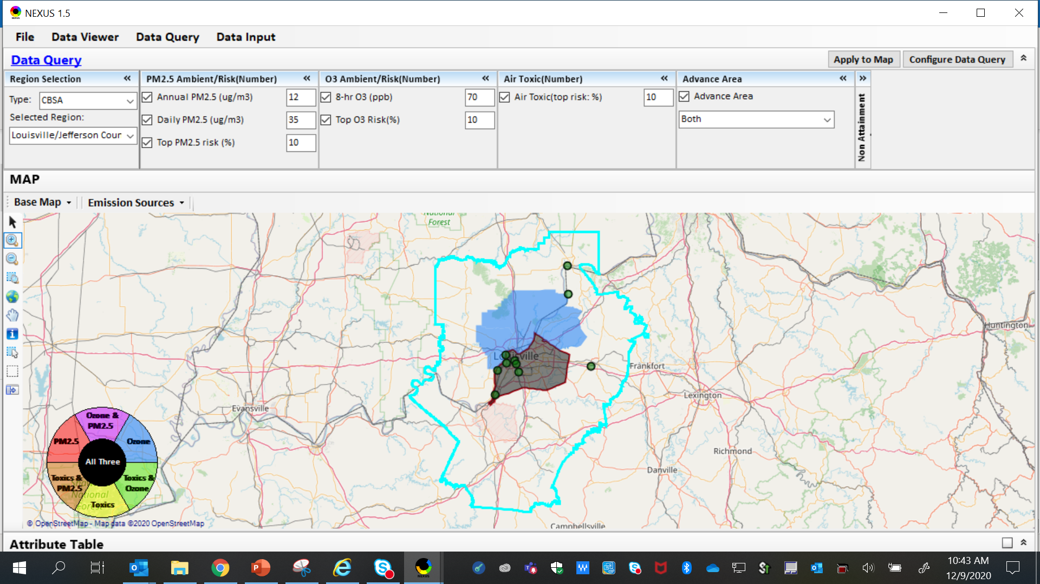
NEXUS Tool: Louisville CBSA
The map above was generated for the Louisville/Jefferson County - Elizabethtown - Madison, KY-IN CBSA (2015 marginal O₃ NAA & 2008 Advance Area), using the data query module. The top 10 Gas & VOC HAPS emission sources are identified.
25

Slide 26
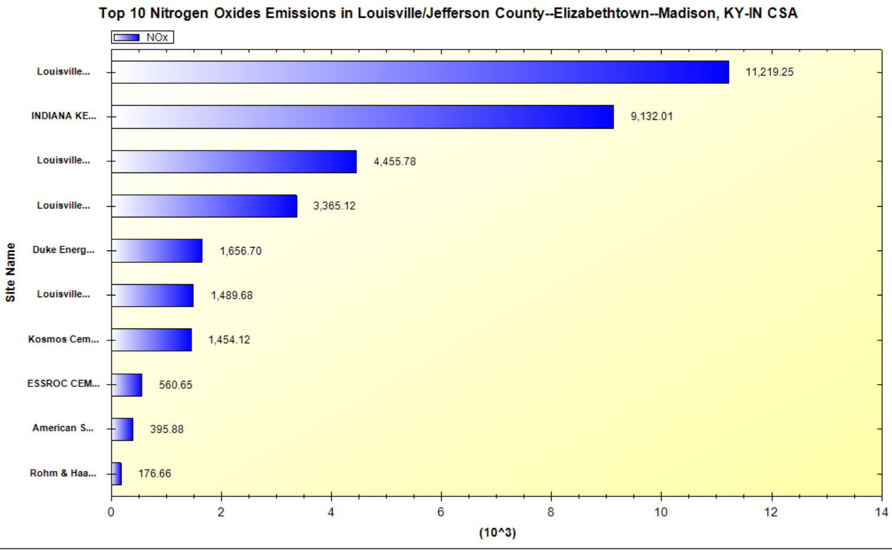
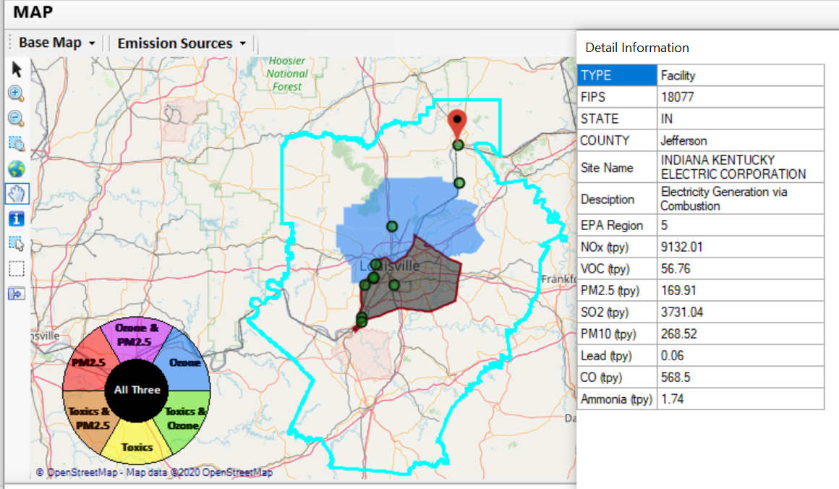
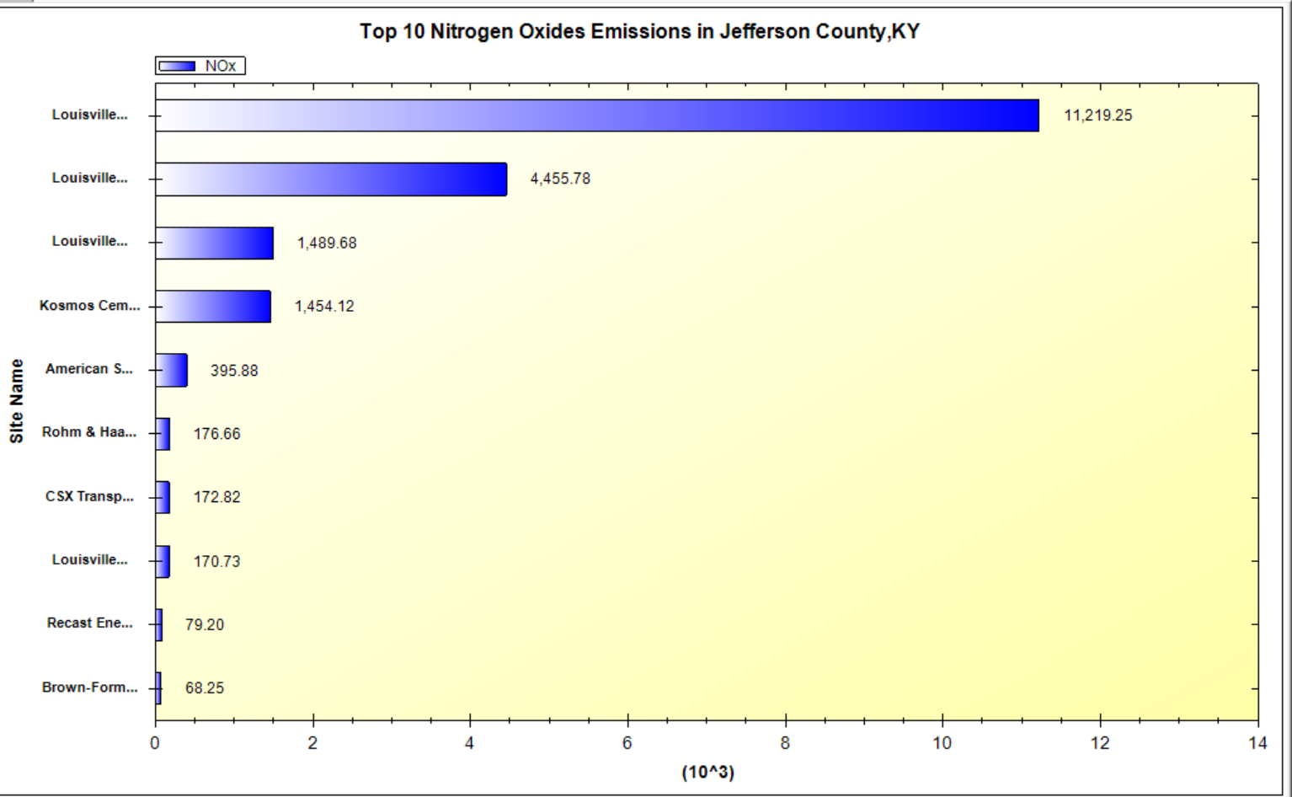
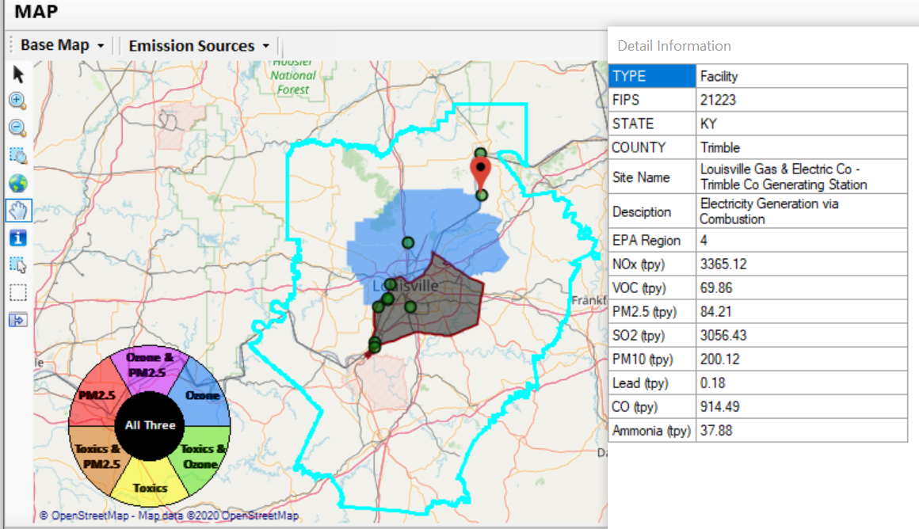
NEXUS Tool: NOx Emission Sources in Louisville CBSA
Indiana Kentucky Electric Corp.
Louisville G&E Co. – Trimble Co.
2 of the top 4 NOx emission sources (EGUs) are outside Jefferson Co., KY (Jefferson Co., IN & Tremble, KY)
26

Slide 27
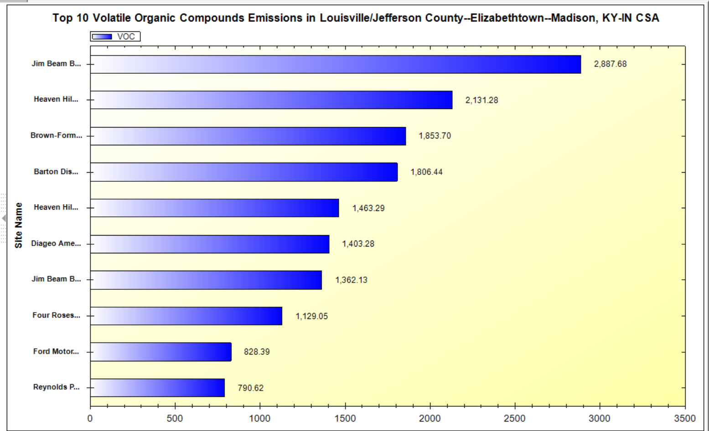
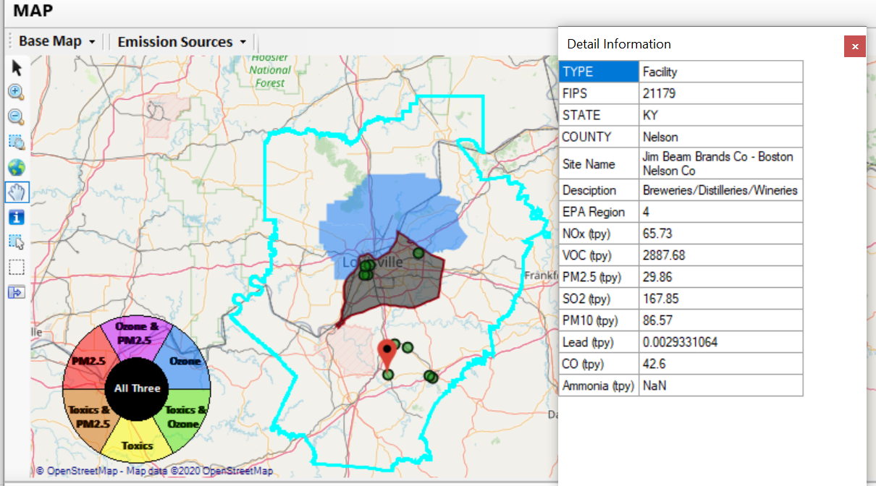
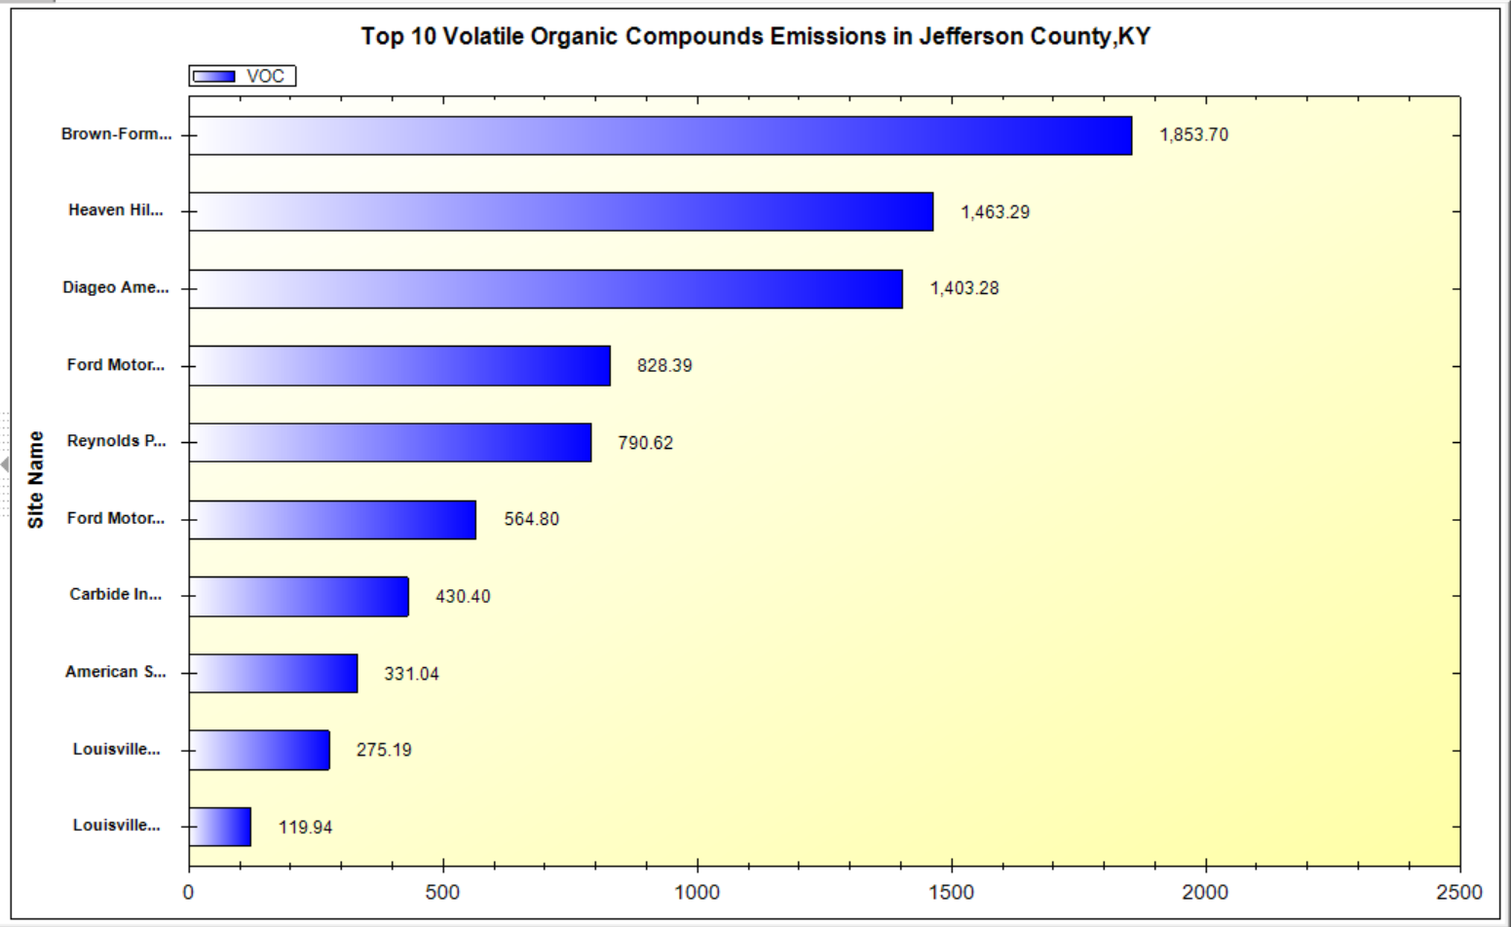
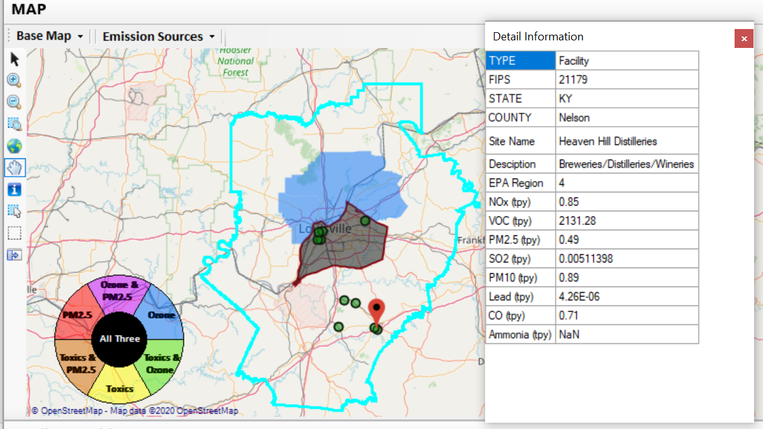
NEXUS Tool: VOC Emission Sources in Louisville CBSA
Top 2 VOC emission sources (distilleries) are in Nelson County, KY
27

Slide 28
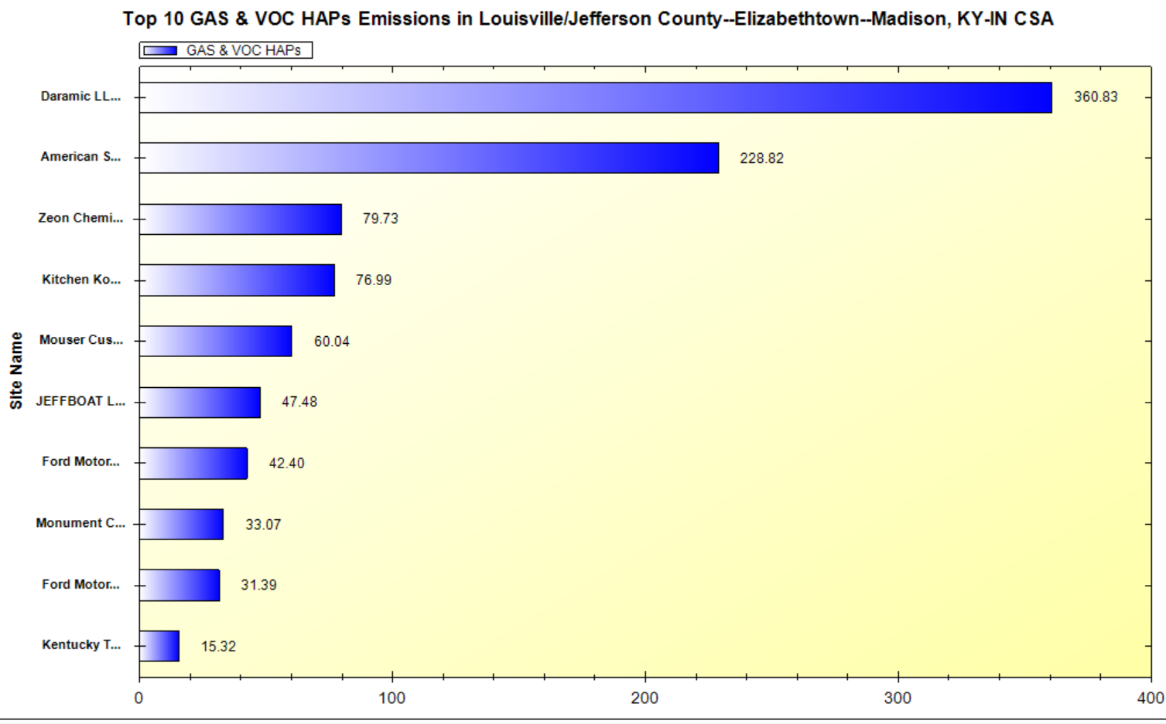
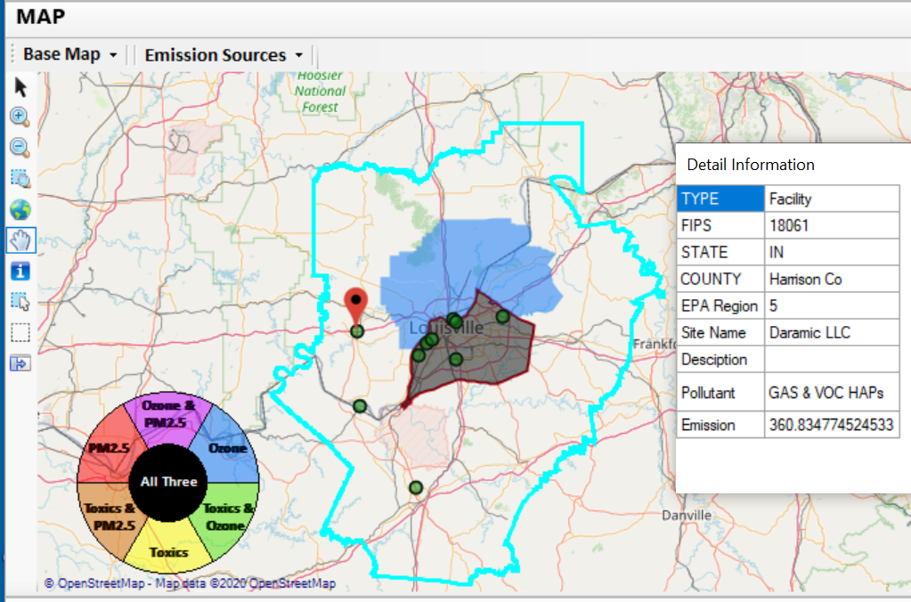
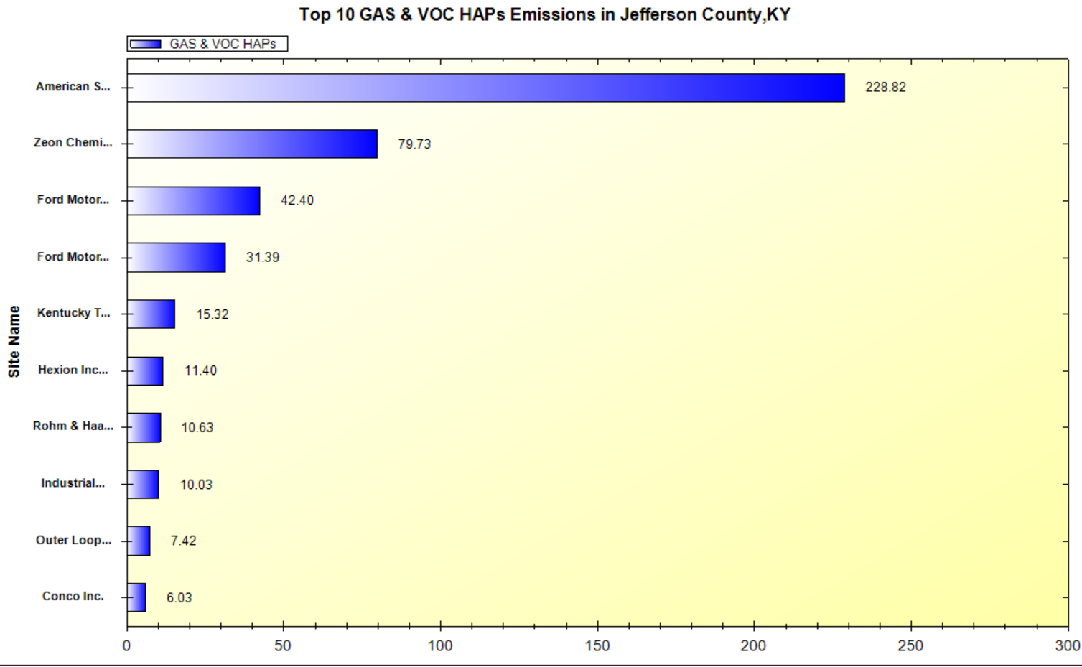
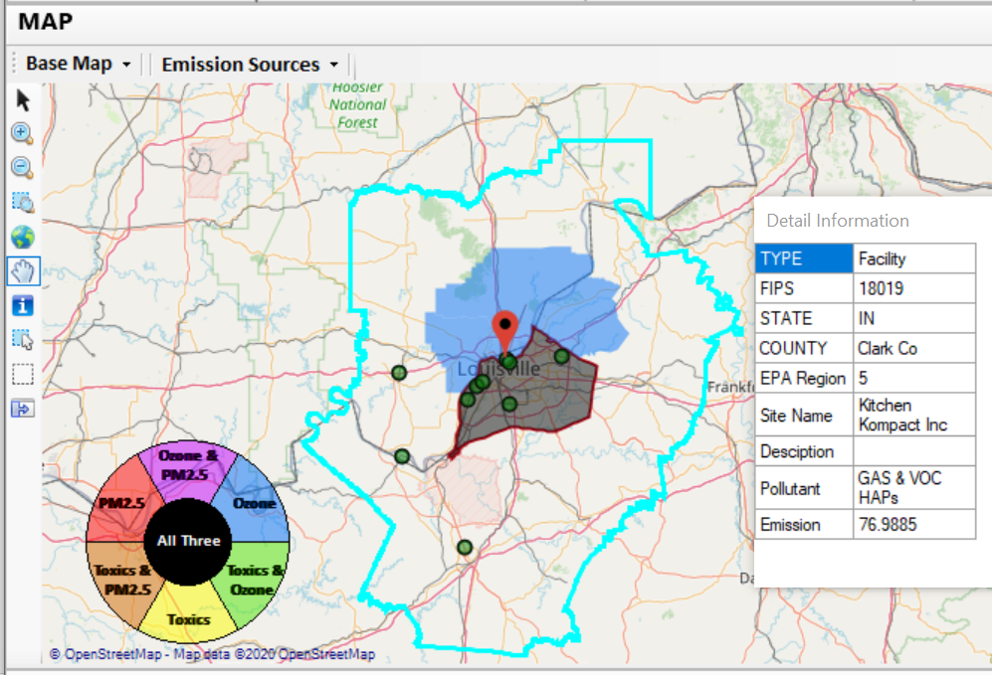
NEXUS Tool: Gas & VOC HAPs Emission Sources in Louisville CBSA
28
2 of the top 4 gas & VOC HAPs emission sources in Indiana (Harrison & Clark County)

Slide 29
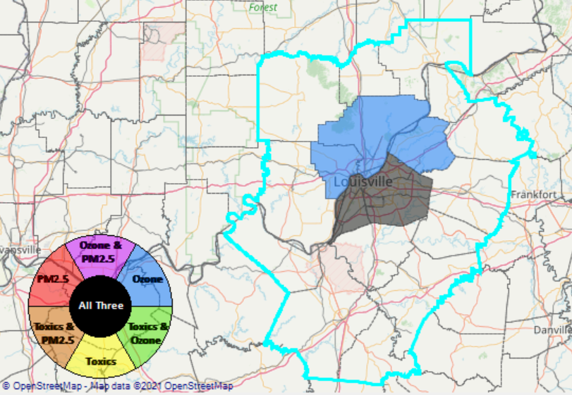
NEXUS Tool: Addressing MP Concerns
NEXUS can be used to quickly demonstrate to an area (Louisville) that coordination outside of their local jurisdiction (Jefferson County, KY) is necessary in order to see the reductions needed to come into attainment
Coordination is needed with the state of Kentucky, state of Indiana, EPA R4 & EPA R5
29

Slide 30
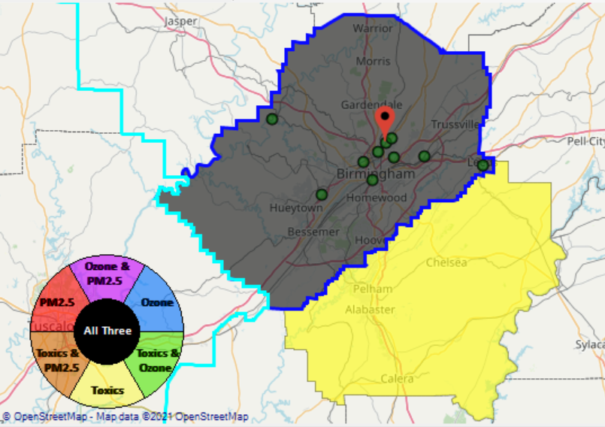
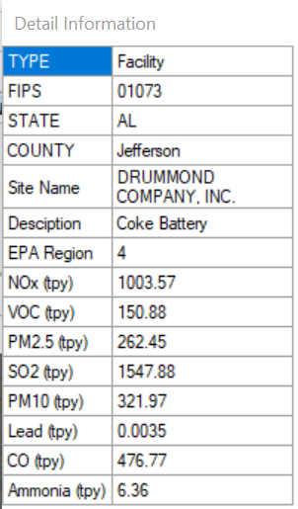
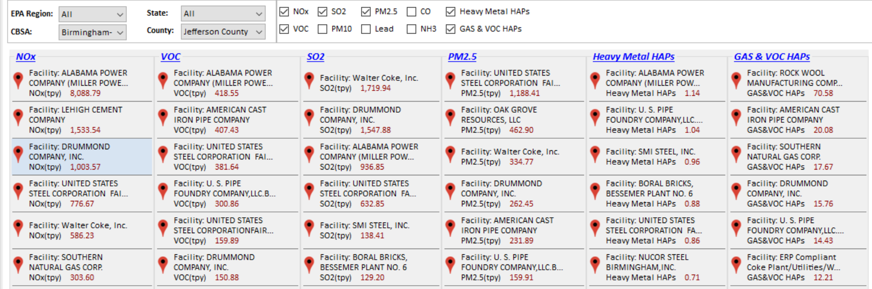
NEXUS Tool: Example 4 – Reviewing an Industrial Source
Drummond’s ABC Coke facility in Tarrant, AL, just outside the Birmingham city limits in Jefferson County, recently paid fines under settlement agreement for emitting 10x more benzene than reporting, along with other violations. We can use NEXUS to take a look at the facility.
30

Slide 31
Potential EJ Capability Additions
A source/sector module could allow for Multi-pollutant “proximity-based assessment” for EJ communities
Define an area around a source/sector and calculate % distribution of demographics (race, ethnicity, etc.)
Compare % distribution to the state, region, or national level averages
Expand demographic comparisons to include O₃, PM_{2.5} and Air Toxics risks or other metrics of interest (e.g., emissions density, pop-weighted air quality concentrations, etc.)
Incorporate analysis similar to what is currently used for Risk and Technology Review (RTR) and other actions
NEXUS could provide a more transparent and accessible way to complete screening analyses and share across the office and programs (criteria and toxics). However, the ability to accurately screen for toxics is limited at this time
31

Slide 32
Discussion and Next Steps (1)
Short-term:
GOAL: Upgrade/improve NEXUS tool to reflect latest data & information and MP team’s feedbacks
Currently expect FY21 funding to support NEXUS -- perhaps $50k from AQAD
Update NEXUS data to 2017
2017 data for O₃, PM_{2.5} & Air Toxics risk/ambient/emissions
Tribal boundaries & socio-demographic data for EJ
Add O₃, PM_{2.5}, and Air Toxics monitoring data
Update metrics/indicators (e.g., risk metrics, EJ indicators)
Engage across Office to determine how this tool may best inform or be used for OAQPS’s Air Toxics Strategy programs
Consider addition of screening-level analysis & assessment capabilities (e.g., proximity-based EJ analysis)
32

Slide 33
Discussion and Next Steps (2)
Long-term:
Upgrade and prepare NEXUS for Beta test within OAQPS and with EPA Regions
Based on Office wide engagements, use updated NEXUS tool with 2017 data to inform Multi-pollutant, Air Toxics, Advance, and EJ efforts as appropriate
Develop plan for routine updates and maintenance of the NEXUS tool to best support OAR/OAQPS programs and determine appropriate extensions as need and resources provide.
Collaborate with OID on NEXUS Training Materials
33

Slide 34
Live Demo
Carey Jang
34

Slide 35
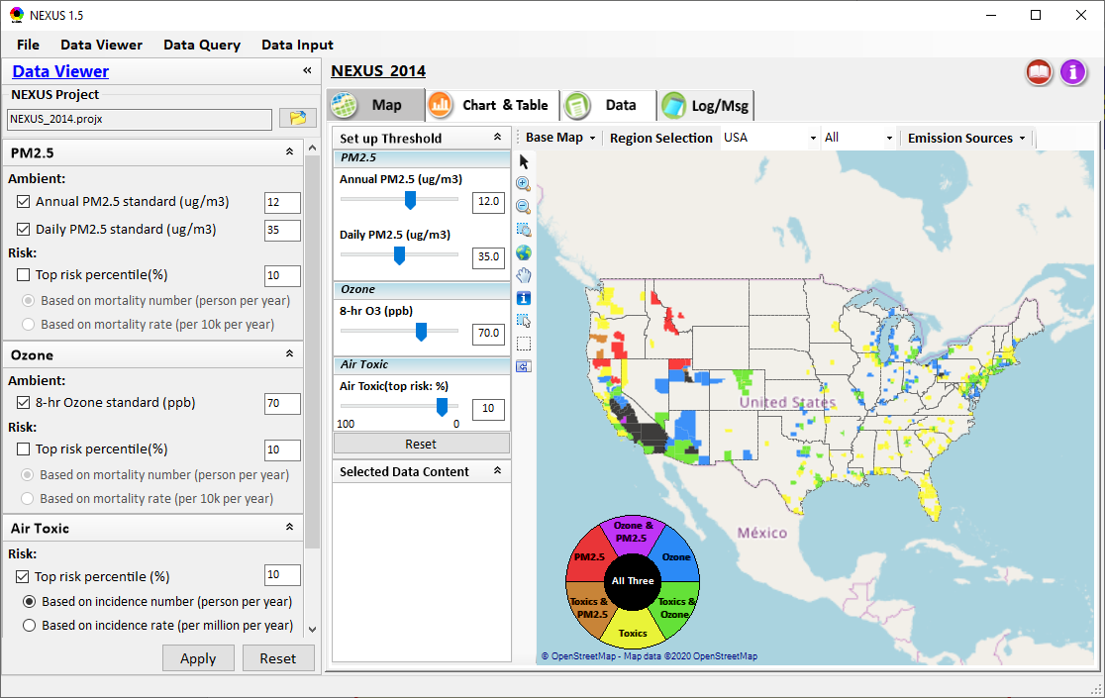
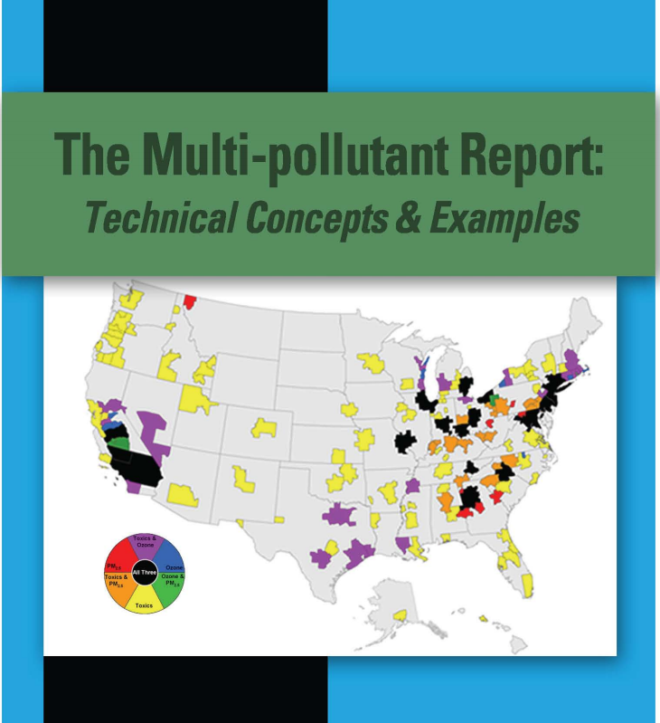
NEXUS Tool Demo: 2014 NEXUS Case
Launching Page
Roadmap for Demo:
(Use example cases)
National View: Use “NEXUS” across pollutants to provide an initial “SCREEN” at the national level by providing an indicator where there may be a common set of sources contributing to Multi-pollutant issues.
Regional View: Dial into a region or area of interest to understand the pollutant/source connections, and potential for more effective and efficient multi-pollutant solution.
2008
35

Slide 36
“NEXUS 1.5”: Quick Tutorial
Carey Jang
Download “NEXUS” tool: The “NEXUS 1.5” package (“NEXUS v1.5 setup.exe” & “NEXUS 1.5 Data.exe”: run both to install) is available at OAQPS’s Shared Drive at: G:\SHARE\NEXUS\NEXUS 1.5\
or at EPA’s new FTP site:
ftp://newftp.epa.gov/aqmg/cjang/NEXUS/NEXUS 1.5/
(Note: Require software installation privilege to install “NEXUS tool” on EPA’s PC)
36

Slide 37

NEXUS Tool: On-line User’s Manual
Click “book” icon to launch “User’s manual”
Hot link to User’s manual’s “Data Viewer” chapter (same for “Data Input” & “Data Query”
37

Slide 38
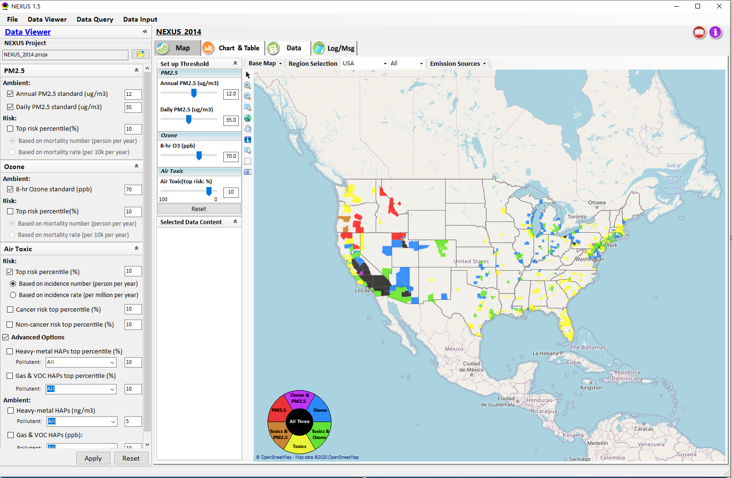

NEXUS Tool: Data Viewer Module
Click “File” to open or save a project
Switch between 3 key modules
Loaded NEXUS project file name
Select & adjust “Ambient” & “Risk” levels
“Advanced Option”: provide HAPs & species selections
38

Slide 39
Data Viewer Module: Selections & Map Display
Select & adjust “Ambient” & “Risk” threshold levels for color map display
“Apply” new selections to “Radio button” panel
39

Slide 40
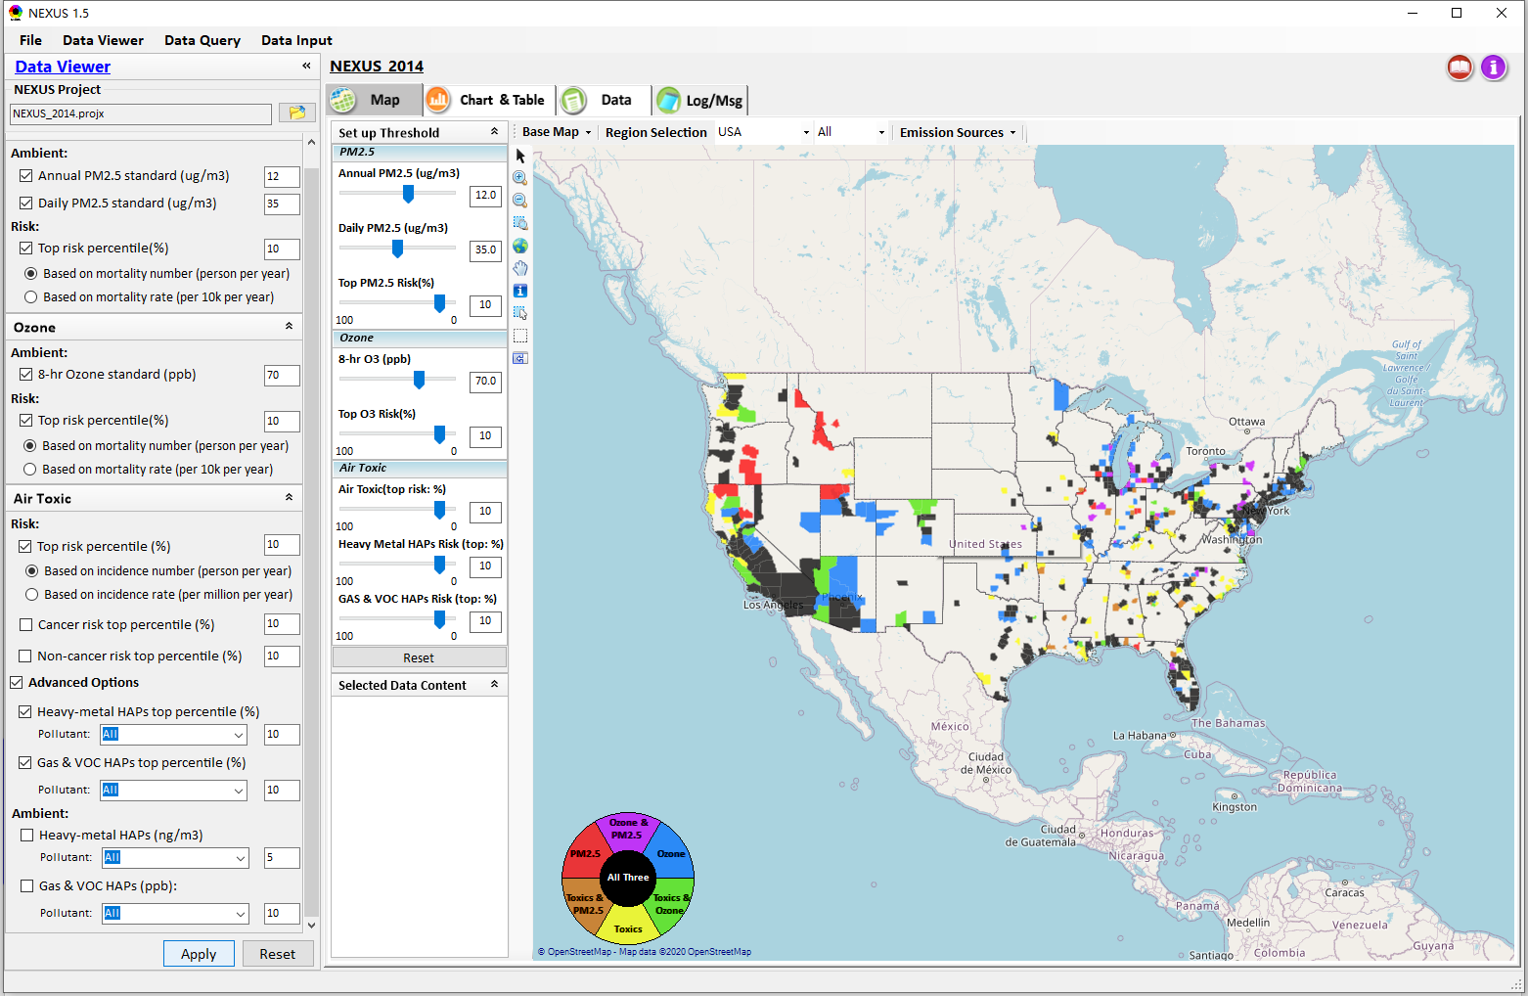
Data Viewer: “Apply” New Selections
“Check” new selections
New selections will appear on-the-fly in “radio button” panel and map display
“Apply” new selections
40

Slide 41




Data Viewer Module: Base Map & Color
“Base Map”: Change boundary lines and background map
“Right-click” map to save image
Click to change color & transparency
41

Slide 42





Data Viewer: “Region Selection”
Allow to select “EPA regions”, “States”, or “CBSA”
42

Slide 43



Data Viewer: Select EPA Region/State/CBSA
Examples:
EPA Region 4
NC
Louisville CBSA
43

Slide 44


Data Viewer: Major Emission Sources
Click “Emission Sources” tab to display emission sources (green dots) and launch new window
Click any “facility” to link & display source location and emission information
44

Slide 45

Data Viewer: Major Emission Sources
Allow to scroll down to county-level (e.g., Wake County, NC)
Wake county, NC
45

Slide 46



Data Viewer: Top “x” Emission Sources
Provide selection of CAPs precursors & HAPs species
Durham county, NC
46

Slide 47

Data Viewer: EPA Region Table Generator
“EPA Region Table Generator” is still under development, but a preview of example “EPA Region 4” tables can be provided
47

Slide 48

Data Viewer: Data Search & Filter
Click “+” to add filters; Click “x” to remove current filter;
Show specified records per page.
Click “Output data…” to output current page records or all records
48

Slide 49

Data Query Module: Main Page
Region Selection
Data Query qualifier selection
Data Query Configuration
Map Overlaying selection
Detachable “Attribute Table”
11111111
49

Slide 50


Data Query Module: Configure Data Query
“Data Query Filter” allows to select “qualifiers” for query
“Data Query Preview” displays the selected “qualifiers” at the same time
50

Slide 51




Data Query Module: Overlaying Map
Overlaying Map selection
51
51

Slide 52


Data Query Module: Attribute Table
Filter/link/export functions (to be completed)
Detachable “Attribute Table”
52

Slide 53



Data Query Module: Attribute Table
Click a “record” to link and display its location & info.
53

Slide 54

Data Input Module: Data Preview
Click to change input data file
Click to view data
Select a table to view if there are multiple tables in the selected data source file
Check to use filter to query data
Click to run & save project
54

Slide 55
RoadMap for NEXUS Tool Demo (1)
National Screening (2014 Data)
Replicate 2008 NEXUS map with O₃/PM_{2.5} concentrations above NAAQS and NATA risk estimates above selected percentile of top 10%
What happens to areas at lower O₃/PM_{2.5} NAAQS levels?
What happens to areas current over O₃/PM_{2.5} NAAQS if change HAP risk percentile?
Provide NEXUS map on risk basis: O₃/PM_{2.5} BenMAP mortality risk based on fused surfaces and NATA risk estimates above selected percentile of top 10% for all pollutants
What happens to MP areas as one changes percentile to top 20% or others?
What is relationship between Heavy Metal HAPs risk (top 10%) and PM_{2.5} risk to identify potential co-pollutant issues?
What is relationship between Gas/VOC HAPs risk (top 10%) and O₃ risk to identify potential co-pollutant issues?
55

Slide 56
RoadMap for NEXUS Tool Demo (2)
Regional/State/CBSA/County Screening
EPA Region 4 Example
Areas with MP risk in top 10% across O3, PM2.5 and HAPs
Louisville CBSA: General view and then dial into “Jefferson County” with transparent map color
What are the top 10 emissions sources in county by pollutant?
What specific sources are common across pollutants that may indicate co-control potential?
Can view these sources on the map with summary data available.
56

Slide 57
RoadMap for NEXUS Tool Demo (3)
Data Query: State/CBSA/County Views
Advance Areas
Initial view of national level information using the Advance Area definition to show overlay with MP areas
Region 5 => Minneapolis Example: General view and then dial into “Dakota County” with transparent map color
What are the top 10 emissions sources in county by pollutant?
What specific sources are common across pollutants that may indicate co-control potential?
Can view these sources on the map with summary data available.
57

Slide 58
RoadMap for NEXUS Tool Demo (4)
Data Query: State/CBSA/County Views
Socio-Economic/Demographic (EJ) Areas
Initial view of national level information using the Poverty/Disadvantaged indicator to show overlay with MP areas
Region 5 => Detroit Example: General view and then dial into “Wayne County” with transparent map color
What are the top 10 emissions sources in county by pollutant?
What specific sources are common across pollutants that may indicate co-control potential?
Can view these sources on the map with summary data available.
58

Slide 59
End
59

