Slide 1
Data Input Module: Input Files & Attributes
Data Input File Names | Data Format | Data Description | Data Source | Data Period
“2014 NATA for Yarnell” | Geodataset | O3/PM2.5 ambient & risk data on county/census tract level | from OAQPS MP team | 2014
“2014 NATA Risk” | Geodataset | Air toxics ambient & risk data on county/census tract level | from OAQPS MP team | 2014
“O3_DV_2009_2018” | Excel | O3 design values on county level | From EPA public website: https://www.epa.gov/air-trends/air-quality-design-values | 2009 to 2018
“PM_DV_2009_2018” | Excel | PM2.5 design values on county level | From EPA public website: https://www.epa.gov/air-trends/air-quality-design-values | 2009 to 2018
“Advance areas O3_PM” | Geodataset | O3 & PM2.5 Advance Areas | from OAQPS MP team | 2018
“Index of Poverty_Disadvantage” | Excel | Index of poverty/disadvantage on county level | from Univ. of Michigan website: https://poverty.umich.edu/projects/understanding-communities-of-deep-disadvantage/ | 2015-2017
NEI_Country_CAPs NEI_Facility_HAPs_CAPS | Geodataset | Major emission sources and facility info. of CAPs & HAPs on county level | From OAQPS public website: ftp://newftp.epa.gov/EPADataCommons/OAR/OAQPS/NEI/NEI_Facility_HAPs_CAPs.zip, ftp://newftp.epa.gov/EPADataCommons/OAR/OAQPS/NEI/NEI_County_CAP.zip | 2008, 2011, 2014
2014 NATA Emissions | Access Database (*. accdb) | NATA emissions data from the 2014 National Emissions Inventory (NEI) for many different source groups, such as point, nonpoint, onroad, and nonroad | From EPA public website: https://www.epa.gov/national-air-toxics-assessment/2014-nata-assessment-results#emissions | 2014
Class1_FederalAreas | Geodataset | Mandatory Class 1 Federal Areas in the United States | From Mandatory Class 1 Federal Areas Web Service:https://edg.epa.gov/data/public/OAR/OAQPS/Class1/Class1Areas.zip | —
Notes:
1. Thank Cen/Gao/Luo/Chen; 2. HZ more visits; 3. AP on HZ

Slide 2
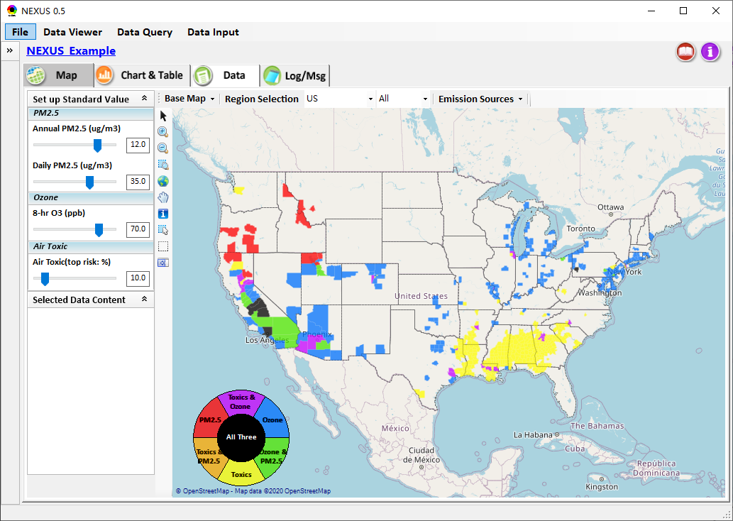
Data Viewer: Potential multi-pollutant issues
Adjust standard value for PM2.5/Ozone/Air Toxic

Slide 3
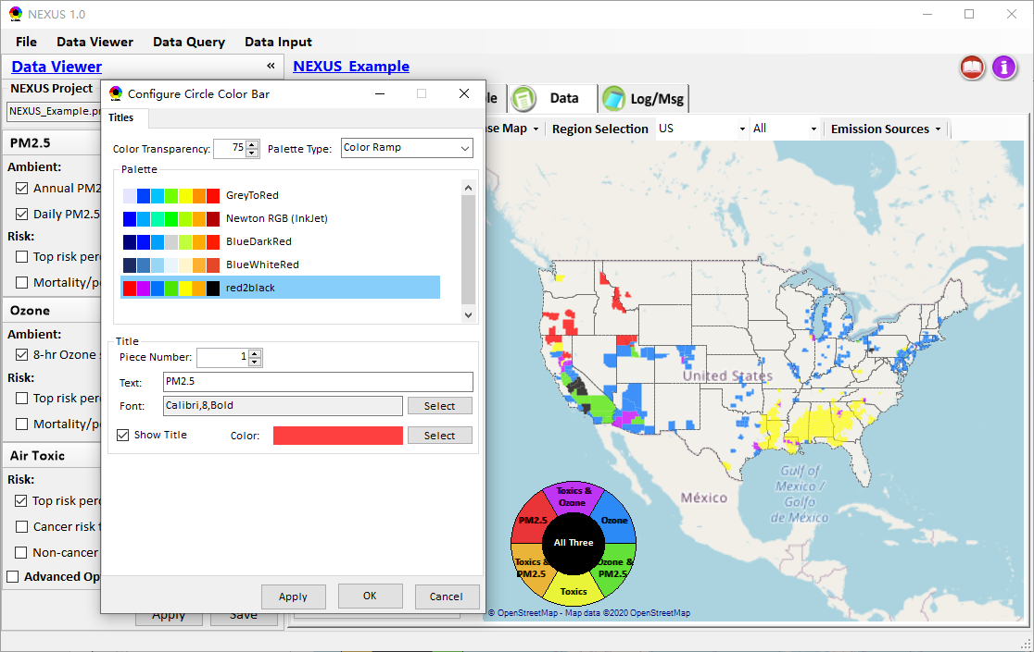
Data Viewer: Potential multi-pollutant issues
Set up color transparency
Single-click to configure “Circle Color Bar”

Slide 4
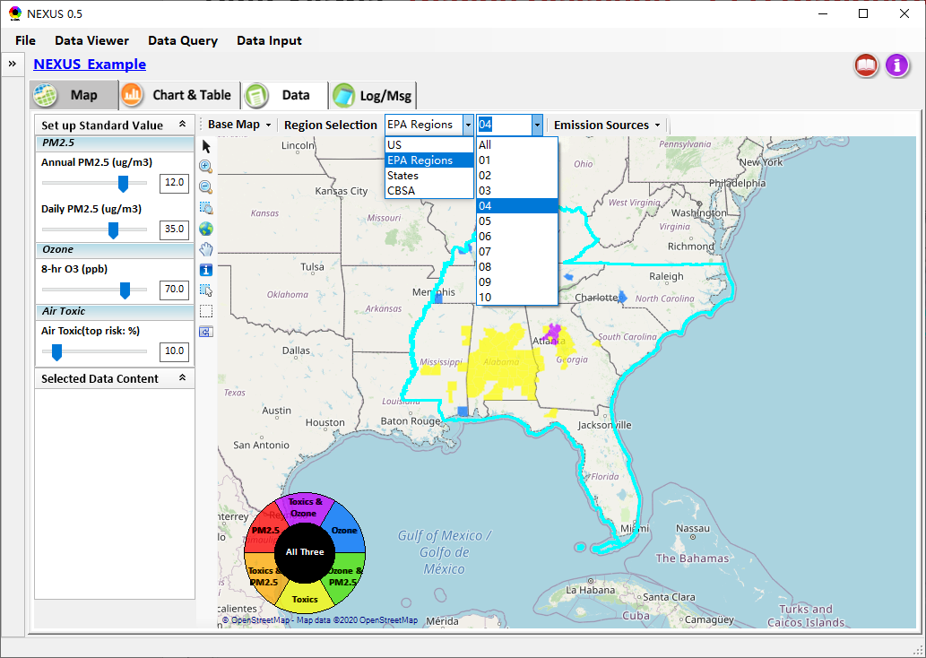
Data Viewer: Region Selection – EPA Region/States/CBSA
Select region type

Slide 5
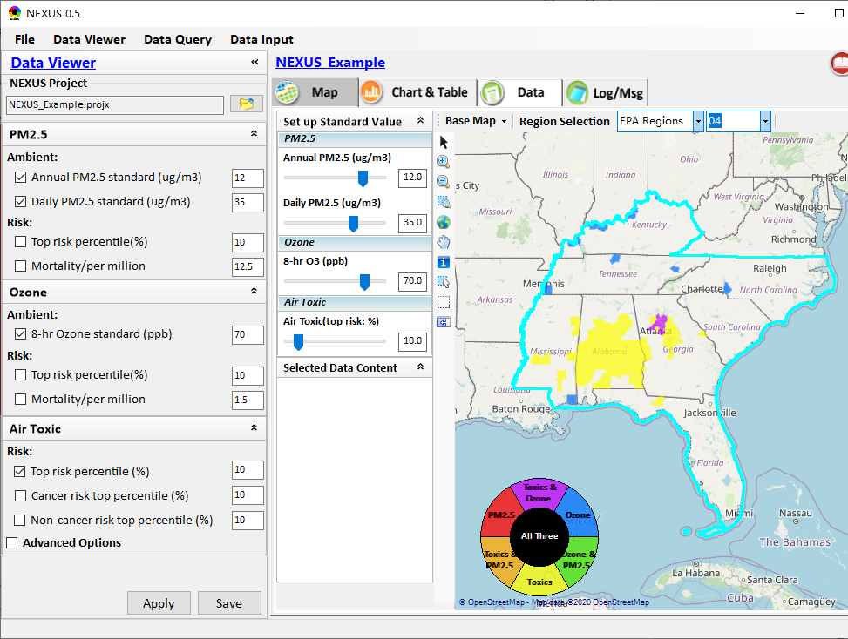
Data Viewer: Advanced options
Expand or hide the left panel

Slide 6
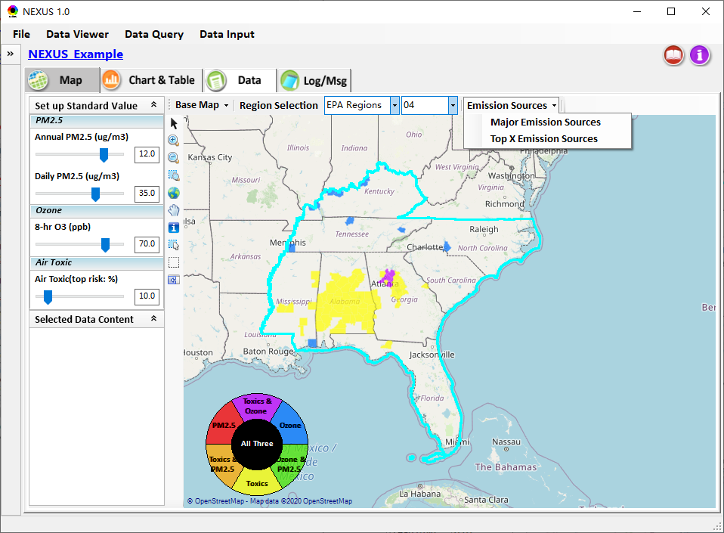
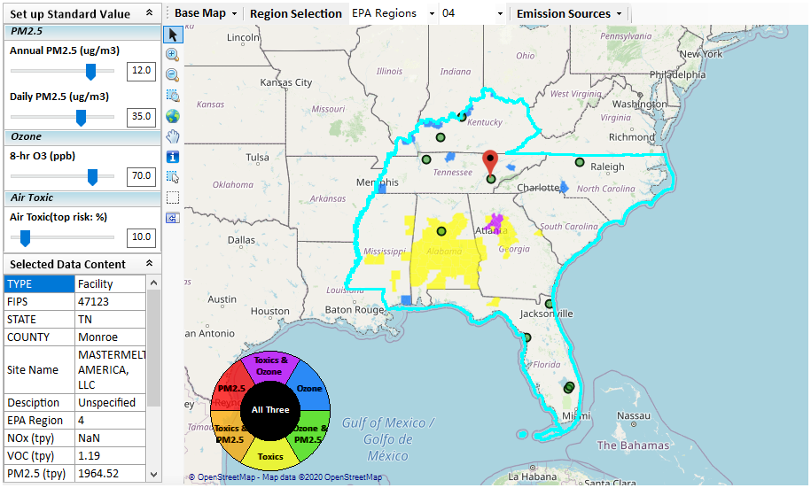
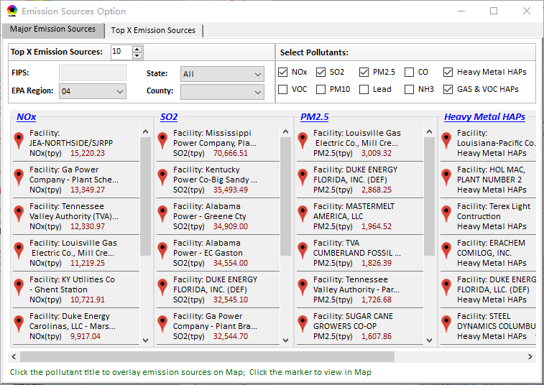
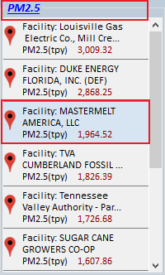
Data Viewer: Major Emission Sources
Select Region
Select Pollutants
Click to view emission sources in Map

Slide 7
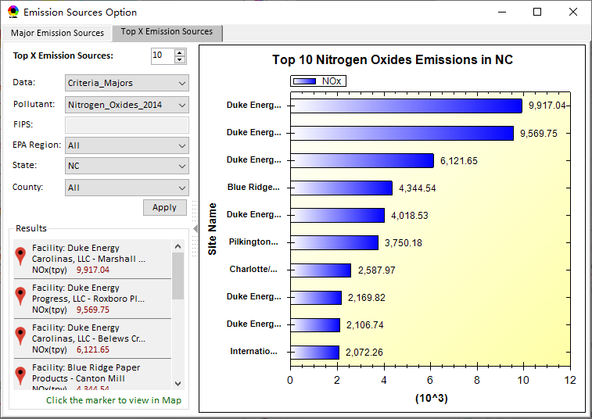

Data Viewer: Top X Emission Sources
Select Region, Pollutant
Click to view emission sources in Map

Slide 8
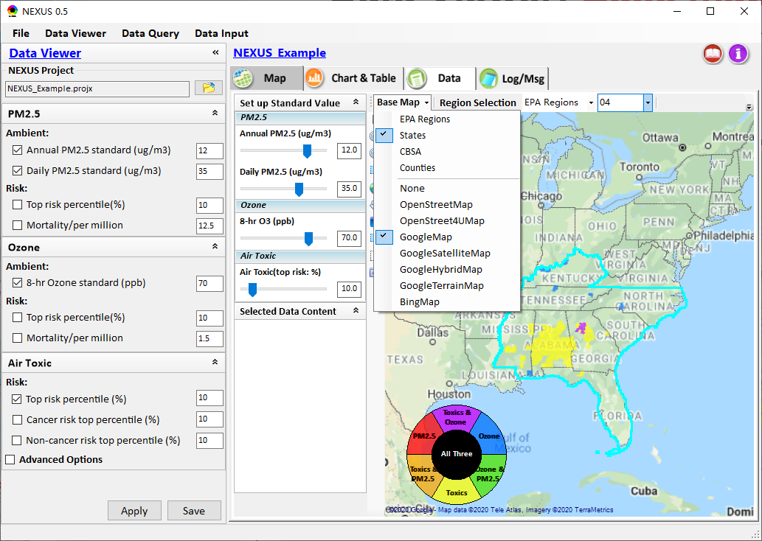
Data Viewer: Base map selection
Overlay selected boundary lines
Select to use “GoogleMap”

Slide 9
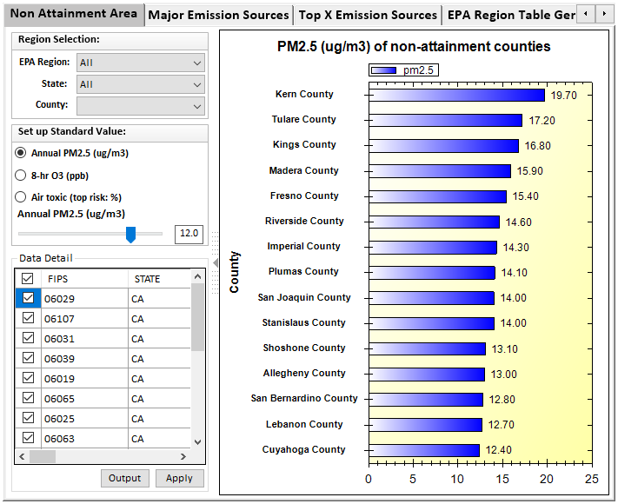
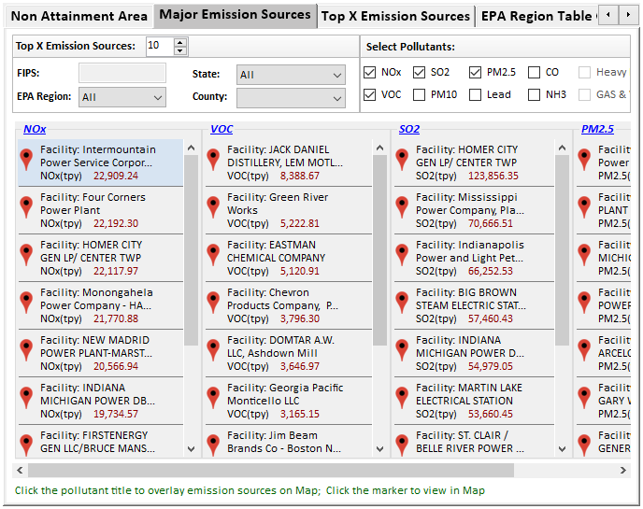
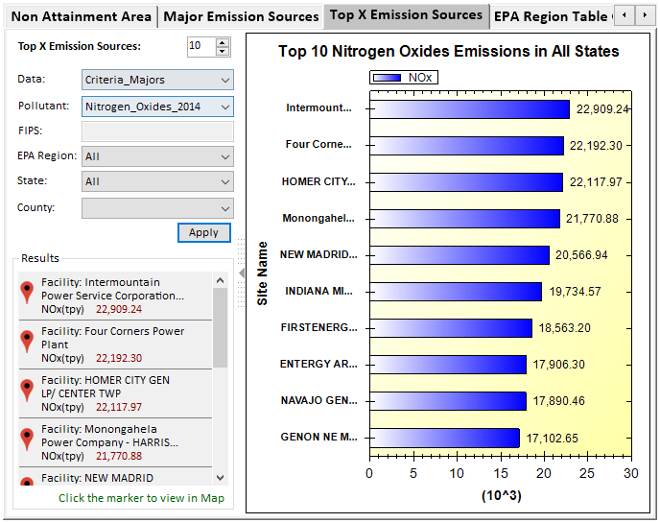
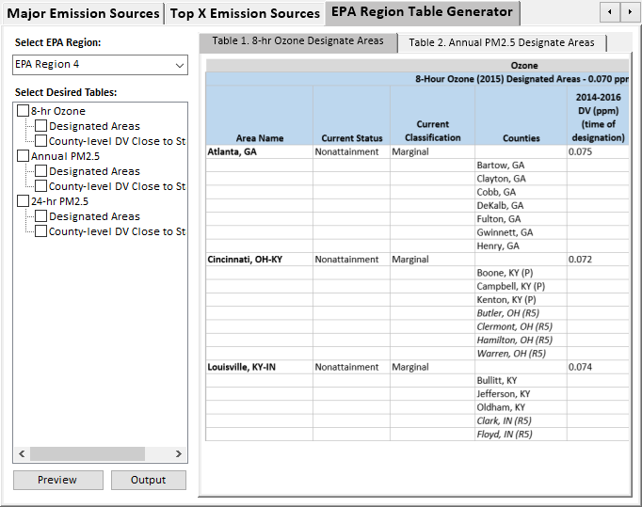
Data Viewer: Chart & Table

Slide 10
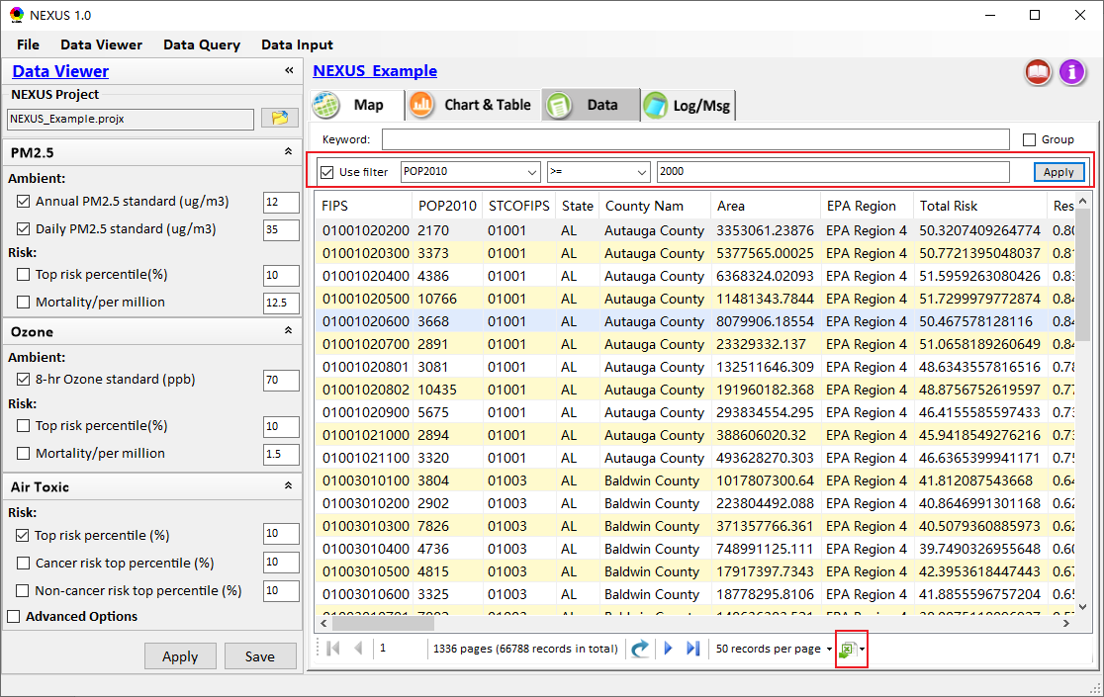
Data Viewer: Data table
Use filter
Extract data

Slide 11
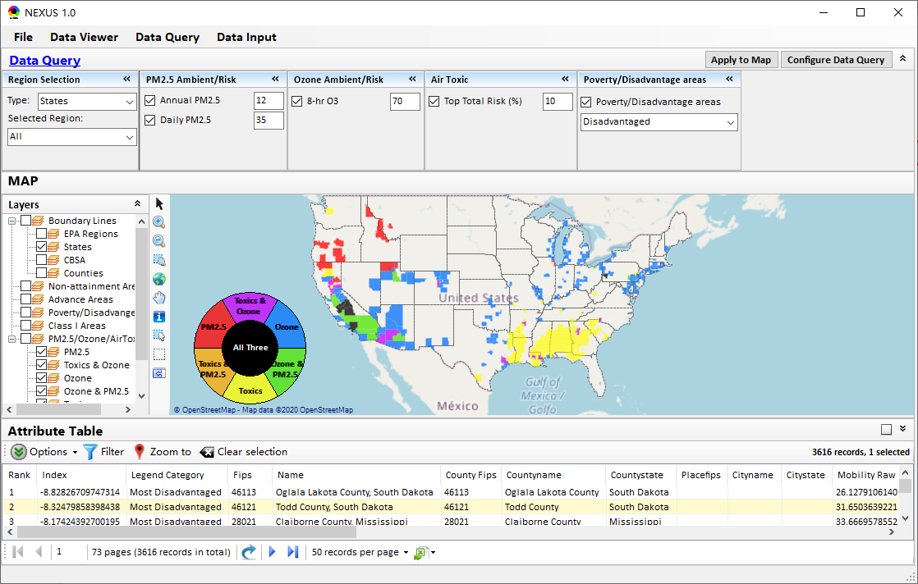
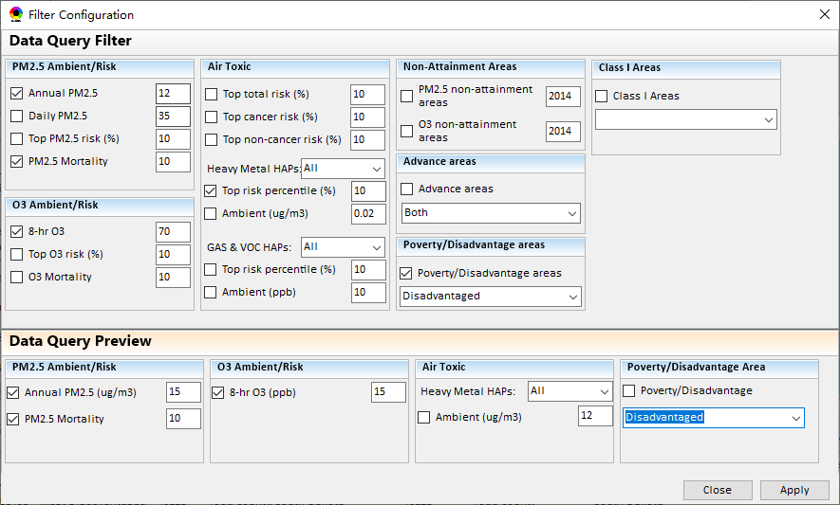
Data Query: Filter Configuration
Configuration to filter data
Check to add new filter

Slide 12
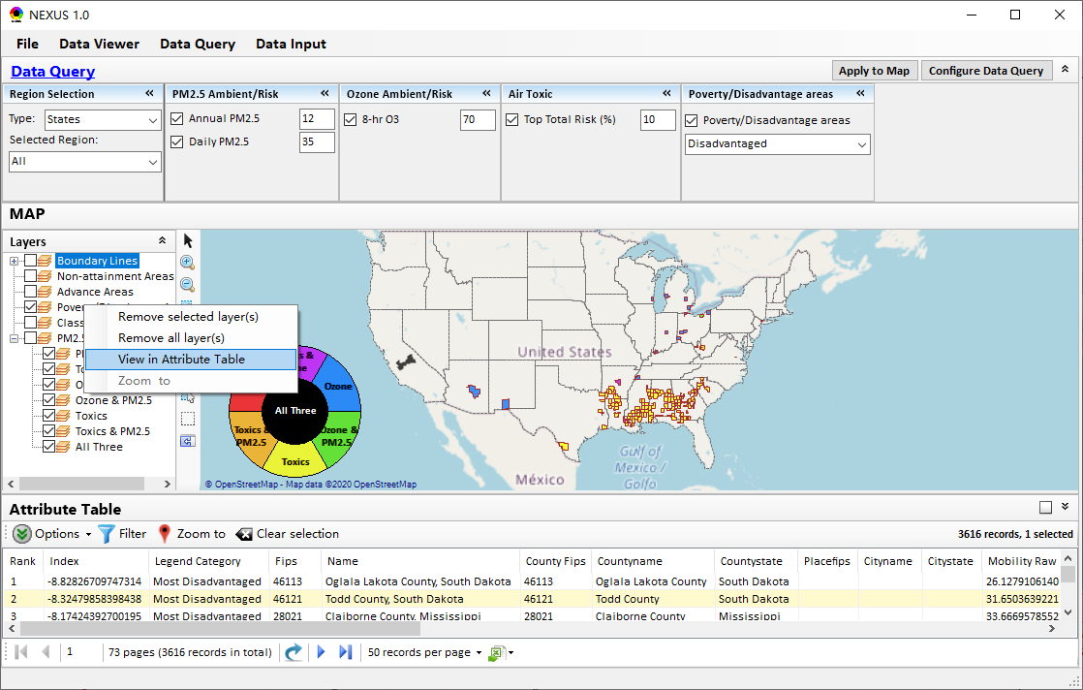
Data Query: Display in Map & Table
Query data and display results in Map

Slide 13
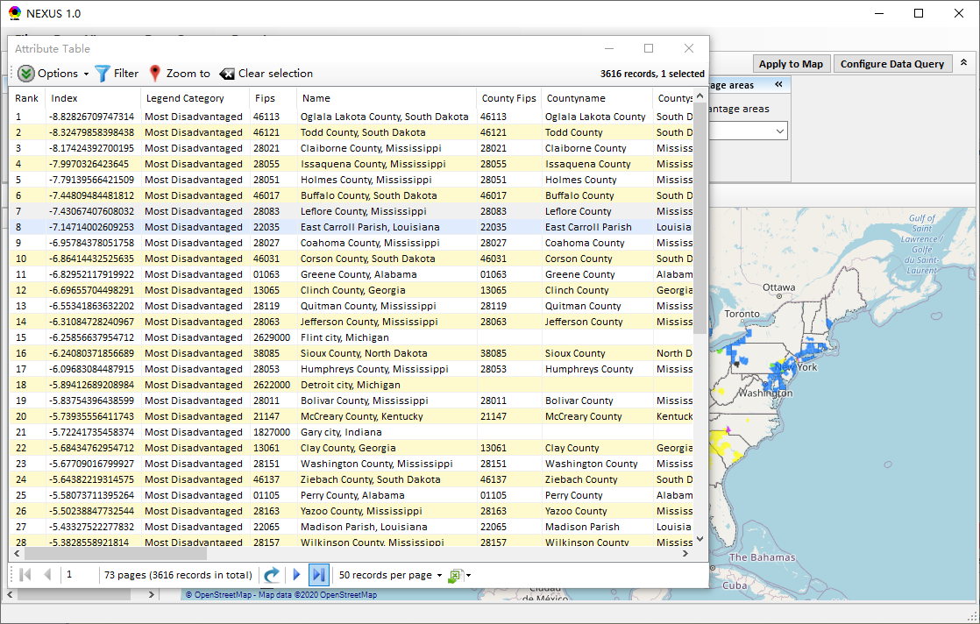
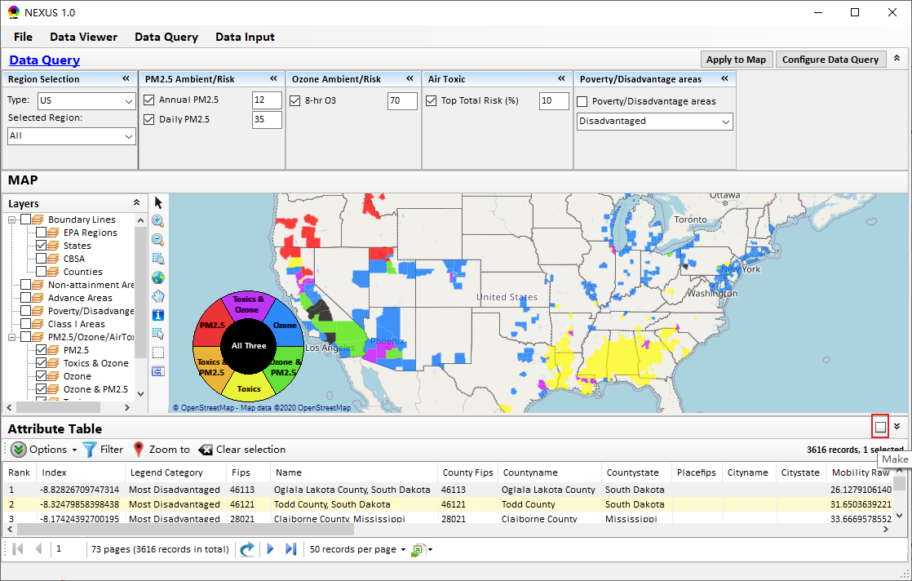
Data Query: Display in Map & Table
Make the table float

Slide 14
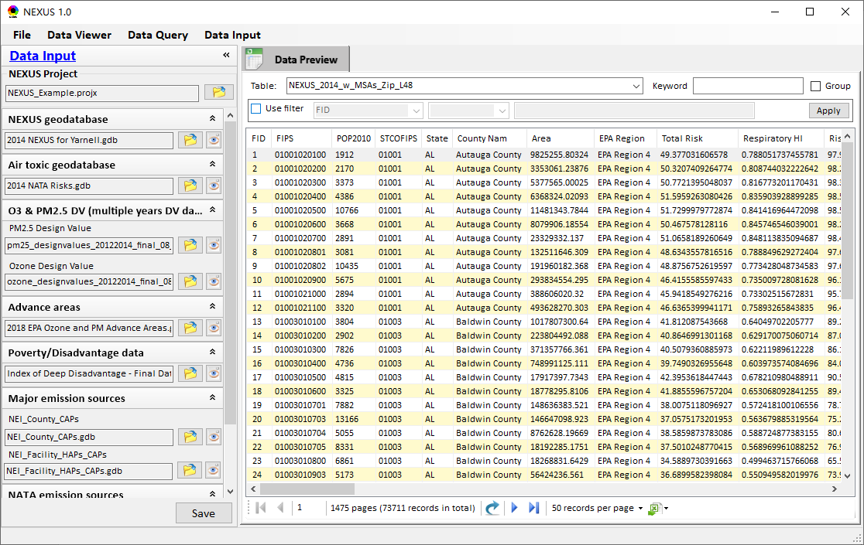
Data Input:
Use filter
Select and input data file
Preview data file
Output current data to *.csv file

Slide 15
End
Notes:
1. Thank Cen/Gao/Luo/Chen; 2. HZ more visits; 3. AP on HZ

