Slide 1
NEXUS 1.3:
List of Suggestions
Carey Jang, 9/11/2020
These suggestions are minor improvements. Please continue to finish the “to-do-list”
Send me an updated version by 9/18 if possible

Slide 2
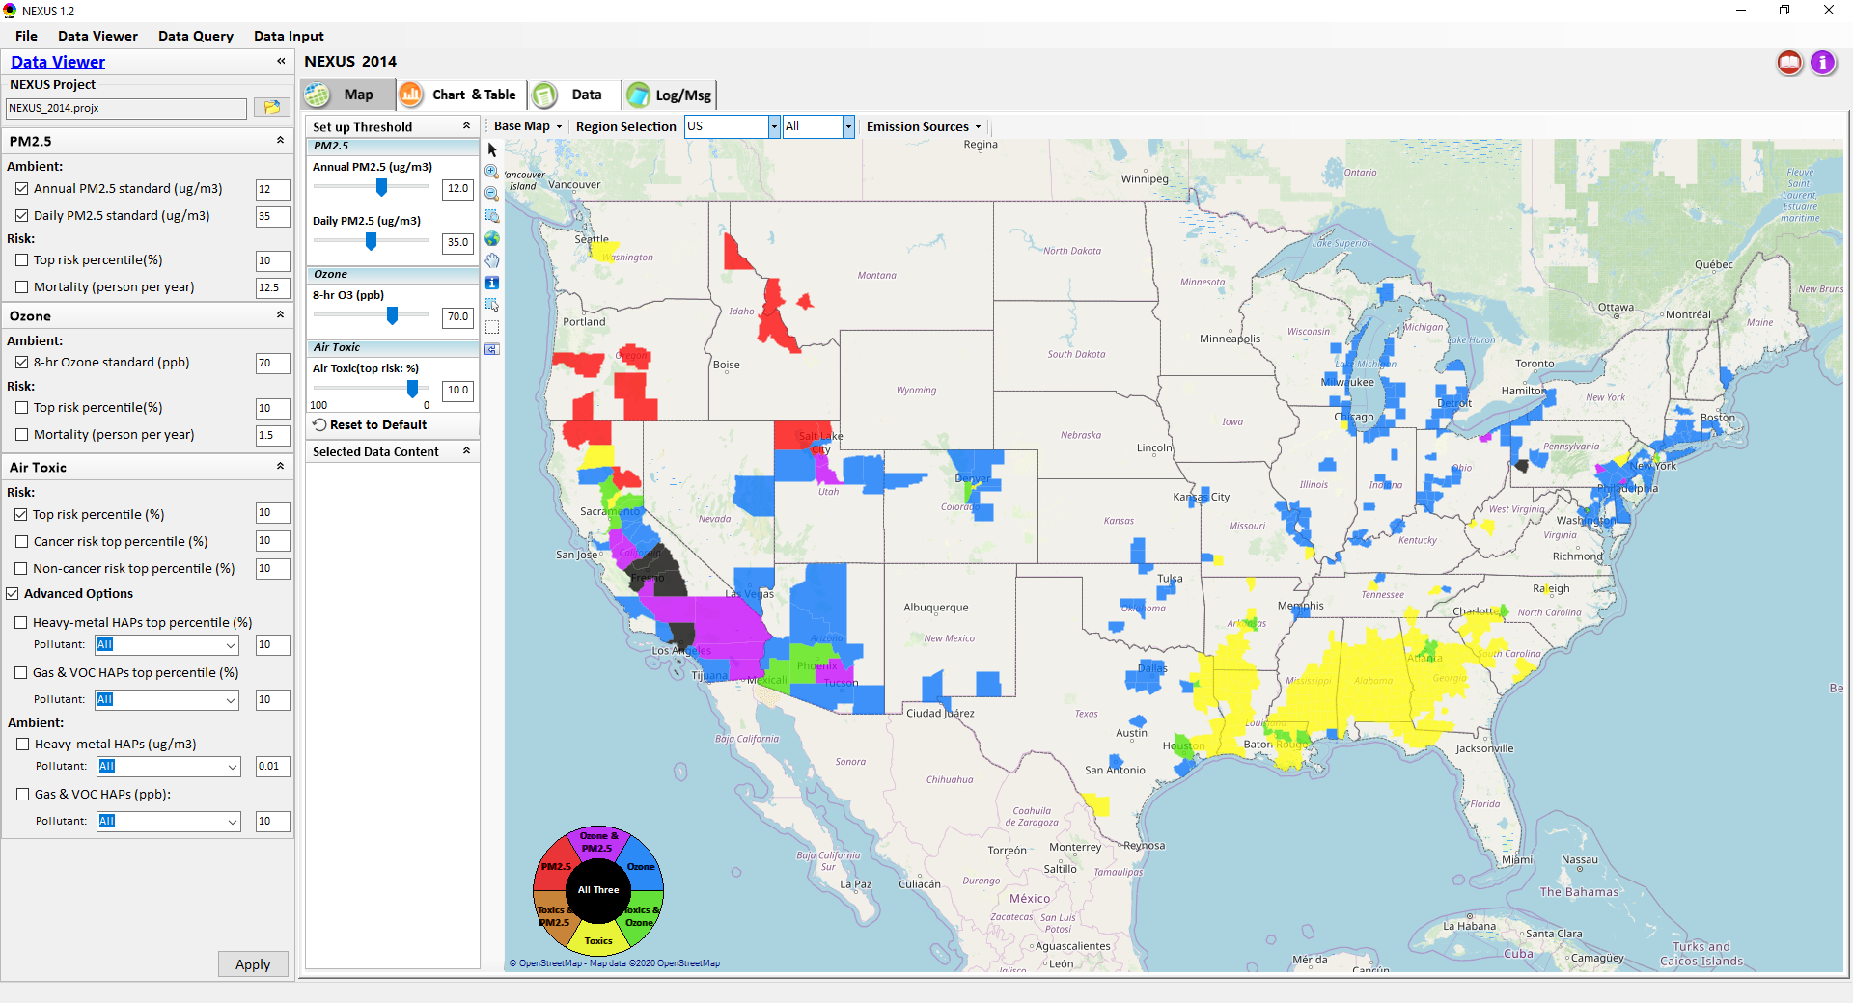
NEXUS Tool: Data Viewer Module
“Hot link” to “User’s manual’s “Data Viewer” chapter (same for “Data Input” & “Data Query”
Click to launch “User’s manual”
Reformat both “PM2.5 & O3 Risk” to:
[] Top risk percentile (%) [10]
O Based on mortality number (person per year)
O Based on mortality rate (per 10k per year)
(Note 1: “Toggle circle” option, default checked “mortality number)
(Note 2: Remove “Mortality (person per year)”; instead, add both mortality number & mortality rate in “Selected Data Content”)
Reformat both “Air Toxic Risk” to:
[] Top risk percentile (%) [10]
O Based on mortality number (person per year)
O Based on mortality rate (per million per year)
(Note 1: “Toggle circle” option, default checked “mortality number)
(Note 2: Insert “Toggle circle” above “[] Cancer risk….”, but apply the selection to all air toxic risk calculations below (include “Advanced”)
Change Heavy Metal HAPS range to “0 – 0.15” with default “0.01”
Change Gas & VOC HAPS range to “0 – 15” with default “5”
2

Slide 3
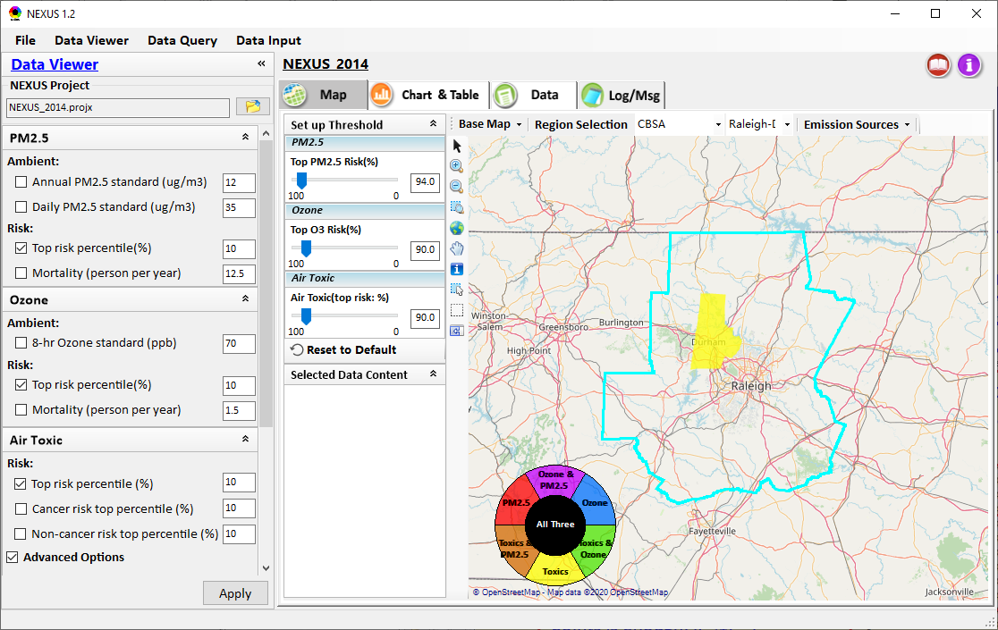
NEXUS Tool: Data Viewer Module
Bug:
All top risk bars are not working when “CBSA” selected; PM2.5 & O3 risk bars not working when “EPA Region” selected (very strange, but “USA” & “State” working)
Change “Reset to Default” to “Reset” (box icon) similar to “Apply” below)
Use “center justified” for “Toxics & PM2.5” to avoid “PM2.5” out of the color legend.
Also slightly shrink the “All Three” “black center circle” to avoid overlapping with any letters
3

Slide 4
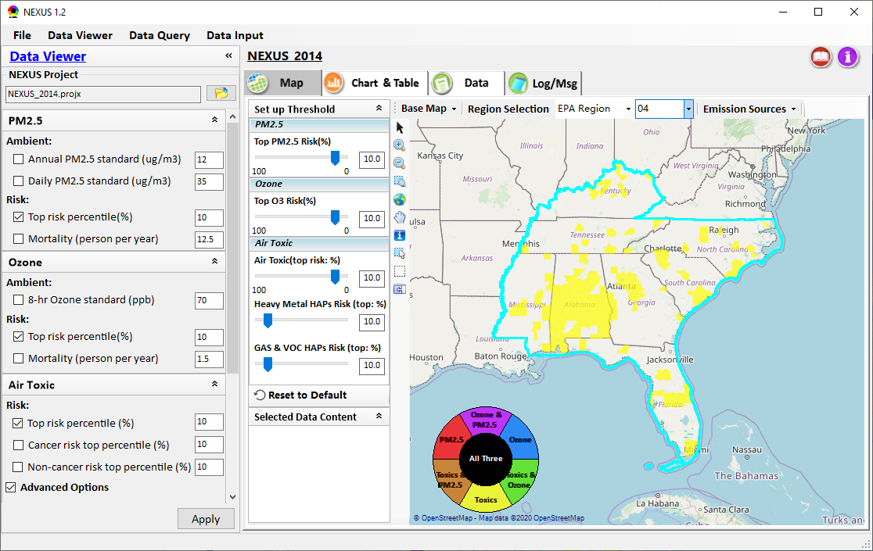
NEXUS Tool: Data Viewer Module
Top PM2.5 & O3 risk bars are not working when “EPA Region” selected
Use no decimal points for all risk bars (i.e., use “10” instead of “10.0)
“Heavy Metal Risk” & “Gas & VOC Risk” bars are not formatted “100 to 0”
4

Slide 5
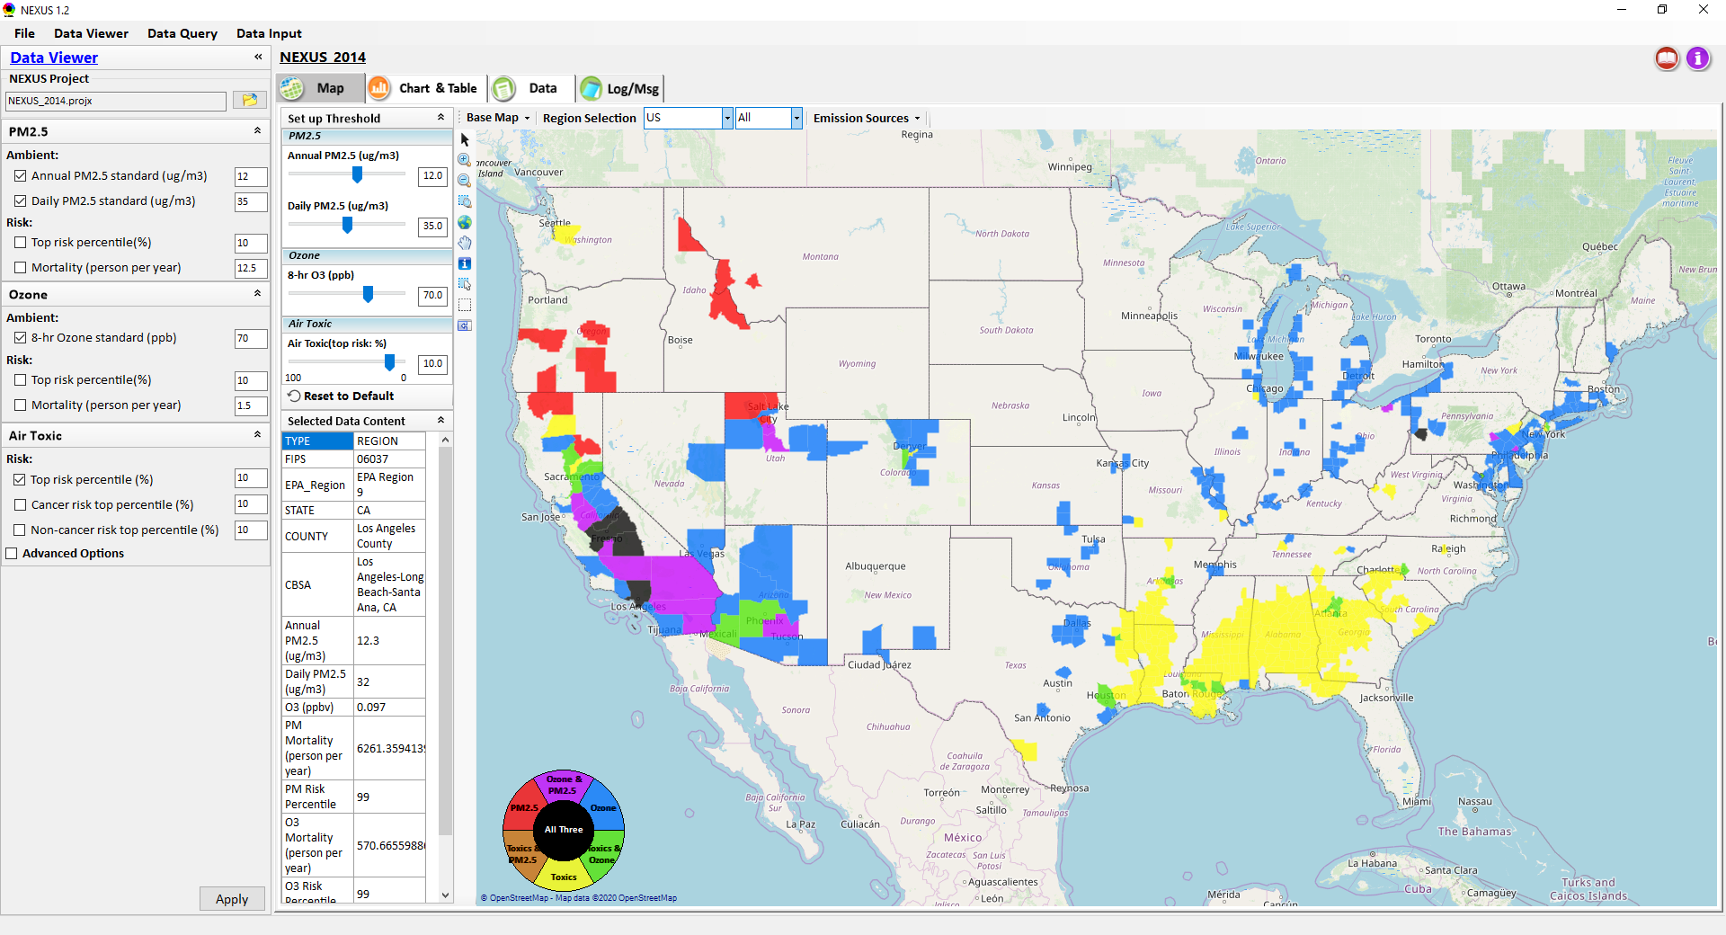
NEXUS Tool: Data Viewer Module
O3 conc. is not correct (x 1,000 if “ppb”)
Remove all “units” (given in left panel already)
Include new “Mortality number” and “Mortality Rate”; use only 2 decimal points
When “Apply” or “Reset” clicked, clear “Selected Data Content”
5

Slide 6
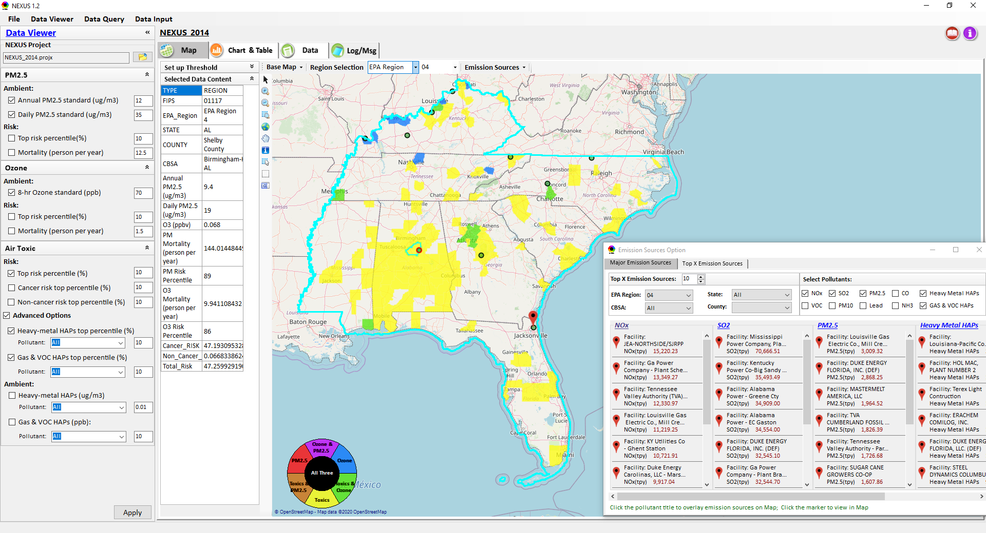
NEXUS Tool: Major Emission Sources
(1) Don’t let “Map” jump (or move), (2) don’t hide “Set up Threshold”, automatically every time when “Emission Sources” (Facility) or “Pollutants” are selected (allow users to control)
Under “Emission Sources” when click “green circle”, display “Emissions” data (instead of “County’s AQ data”; now “AQ data” seems to overwrite “Emission data”)
6

Slide 7
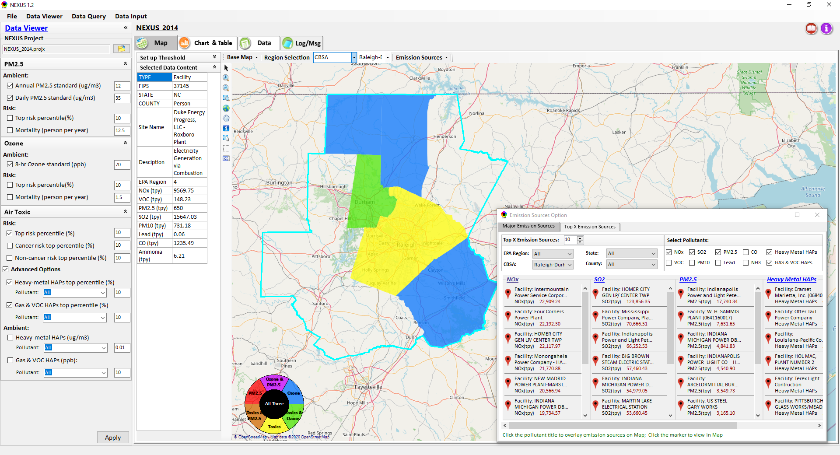
NEXUS Tool: Major Emission Sources
Bug :
(“CBSA” for “Emission Sources” unstable)
Under CBSA, when “Emission Sources” -> Major Emission Sources” clicked (or “right-click” “Display Major Emission Sources”) (or click “Facility” or “Pollutants”, it automatically jump to whole USA domain (even if both windows have “CBSA” selected already). Click “Facility” or “Pollutants” sometimes jump out of selected CBSA into USA domain or other region.
Same CBSA problem in “Top X Emission Sources”
7

Slide 8
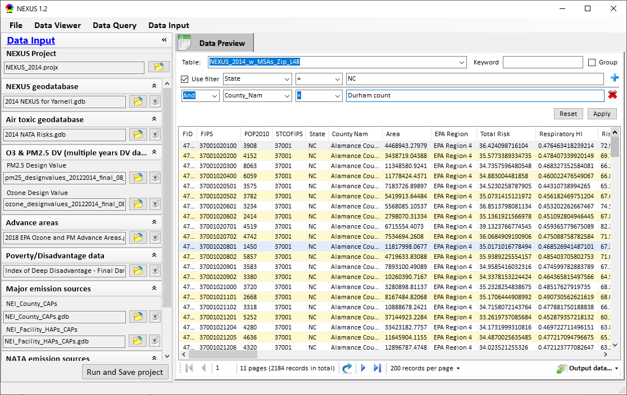
NEXUS Tool: Data Input Module
Note: Apply to all “Data” (including Data Viewer & Data Query)
Switch order (“Apply” first)
Change filename to “2014 O3_PM2.5 Fused Ambient_Risk.gdb”.
Bug: Only allow to input up to 12 letters, but need to fully match name (please allow partial match)
Reduce the data decimal points (for all fields) for display. If >1, ~2 decimal points is enough, if <1, ~4 decimal points
Change to “Run & Save Project”
8
8

Slide 9
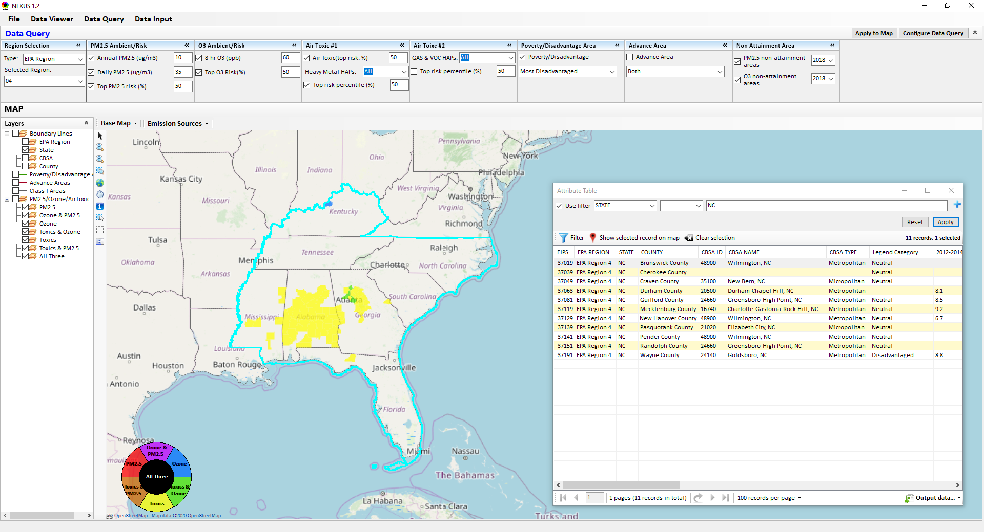
NEXUS Tool: Data Query Module
Critical bug:
“Apply to Map” not working
Default options “unchecked” for “Poverty/Disadvantage Area” & “Advance Area”
Refer to previous slide (Slide #8) for all the similar “Data” issues
9

Slide 10
NEXUS Tool: Data Viewer Module
To Do List:
Include an updated Online-User’s manual
Under Data Query Module, remove those layers which locate outside the selected region.
Complete the Table Generator module.
Under the Data Module, display the checked data only.
10

Slide 11
End
11

