Slide 1
Data Input Module: Input Files & Attributes
Data Input File Names | Data Format | Data Description | Data Source | Data Period
“NATA for Yarnell” | Geodataset | O3/PM2.5 ambient & risk data on county/census tract level | from OAQPS MP team | 2014
“2014 NATA Risk” | Geodataset | Air toxics ambient & risk data on county/census tract level | from OAQPS MP team | 2014
“O3_DV_2001_2018” | Excel | O3 design values on county level | From OAQPS public website (see note below) | 2001 to 2018 (?)
“PM_DV_2001_2018” | Excel | PM2.5 design values on county level | From OAQPS public website: (see note below) | 2001 to 2018 (?)
“Advance areas O3_PM” | Geodataset | O3 & PM2.5 Advance Areas | from OAQPS MP team | 2018
“Index of Poverty_Disadvantage” | Excel | Index of poverty/disadvantage on county level | from Univ. of Michigan Website “?” | 2019(?)
NEI_Country_CAPs NEI_Facility_HAPs_CAPS | Geodataset | Major emission sources and facility info. of CAPs & HAPs on county level | From OAQPS public website (see note below) | 2017(?)
(Use shorter file names like above, rename the existing ones)
Note: Download from OAQPS public website: “ ?“
Notes:
1. Thank Cen/Gao/Luo/Chen; 2. HZ more visits; 3. AP on HZ

Slide 2
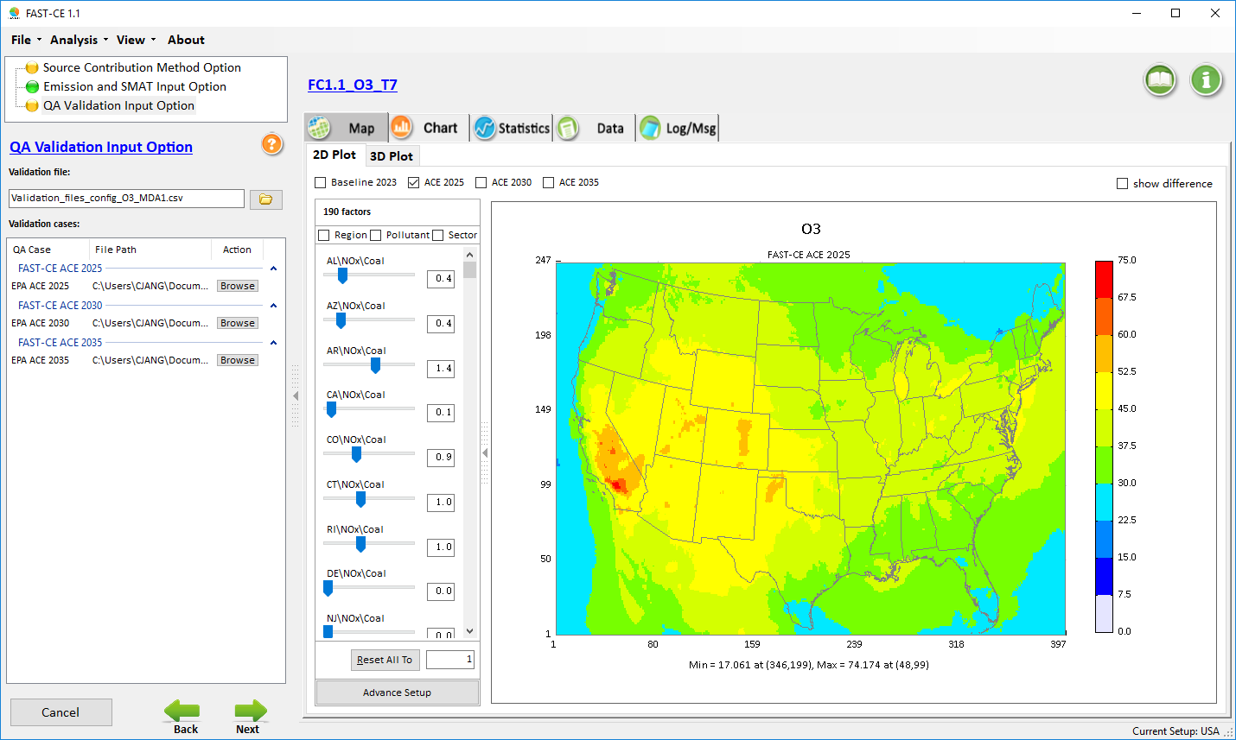
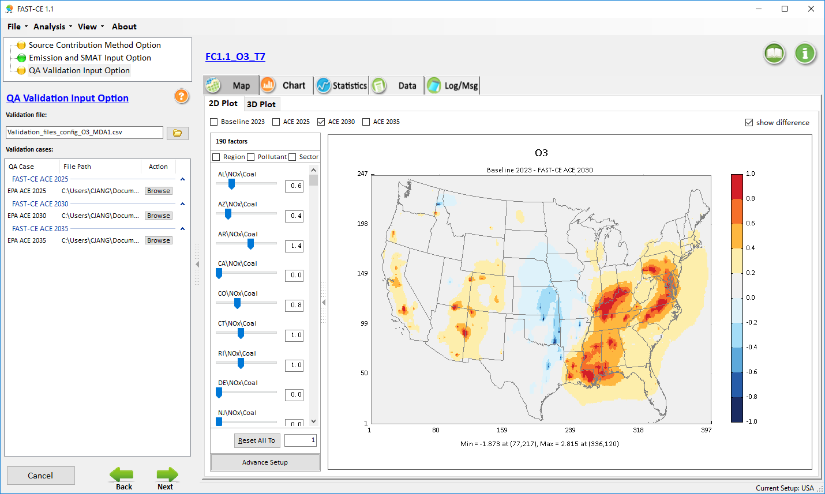
“FAST-CE” Prototype: Demo (FAST-CE: Flexible Air Quality Scenario Tool – Community Edition)
For Ozone and PM2.5
The FAST-CE 1.6 package (“FAST-CE 1.6.exe” & “FAST-CE 1.6 Data.exe”: run both to install) is available at the Google Drive (or EPA’s ScienceFTP2 site upon request) at:
https://drive.google.com/open?id=1Xl3VqtlRXeBt_FrfHpuCZYumxjqMR9hL
Concentration
Response
Carey Jang, OAQPS/AQAD/AQMG, 6/02/2020
Notes:
spatial field: A Spatial Field refers to air pollution estimates made at the center of each grid cell in a specified modeling domain. For example, MATS might calculate ozone design values for each grid cell in the modeling domain. Several types of Spatial Fields can be calculated for ozone and PM.
利用环境监测数据、模型数据（主要是CMAQ模拟的结果）作为模型输入，并利用优化的数理统计技术对大气复合污染状况进行模拟，实现对环境空气质量标准的达标评估。其中包括point estimate和spatial field estimate。

Slide 3
“FAST-CE”: Flexible Air Quality Scenario Tool – Community Edition)
Motivation:
As part of next phase “Reduced Form Modeling” (RFM) project with OMB/HEID, AQAD/AQMG is pursuing the development of a reduced form tool that provides real-time and credible impacts of O3 and PM2.5 to emissions changes.
“FAST-CE” is designed as an user-friendly tool to provide flexible and timely assessments of O3 and PM2.5 responses to any given emission scenarios.
The FAST-CE prototype was initially built based on the ACE rule methodology with source apportionment modeling of EGUs, and now is being expanded with additional Source Apportionment and Response Surface Model (RSM) cases.
Available cases and data for this FAST-CE demo:
ACE rule case for O3 and PM2.5: CAMx source apportionment (APCA) modeling results (dataset provided by Heather S., further details see Appendix)
RFM test case for O3 and PM2.5: CAMx SA (OSAT & PSAT) modeling results (dataset provided by Kirk B.)
RSM test case for O3 and PM2.5: Response Surface Modeling results (dataset provided by Carey J. and Jim K.)
Notes:
1. Thank Cen/Gao/Luo/Chen; 2. HZ more visits; 3. AP on HZ

Slide 4
Current/Planned Modeling Cases in FAST-CE
Projects | Modeling Year | SA Method | Pollutants of interest | Region/Sectorof interest | Lead
ACE Rule SA Modeling (2025/2030/2035) | 2011 CAMx | APCA | O3 PM2.5 | States w/ EGU Tags (National) | Heather
Reduced Form Modeling | 2011 CAMx | OSAT/PSAT | O3 PM2.5 | 3 Sectors (National) | Kirk
Response Surface Modeling | 2016 CMAQ | pf-RSM | O3 PM2.5 & Species | 5 Climate Regions (East US) | Carey & Jim
2016 Platform SA Modeling (not implemented yet) | 2016 CAMx | APCA | O3 PM2.5 | 41 Source Tags (National) | Norm
Notes:
1. Thank Cen/Gao/Luo/Chen; 2. HZ more visits; 3. AP on HZ

Slide 5
FAST-CE: “Flexible Air Quality Scenario Tool – Community Edition”(2020)
Emission control factors, etc.
Input parameters
Multiple tracer species
Emission Inventory
(regions, pollutants, sectors, etc.)
Photochemical model (CMAQ/CAMx)
Photochemical model (CAMx/CMAQ)
Sensitivity coefficients
Math. & Chemical approximation
Math. approximation
Chemical approximation
Response Surface Modeling
Source/Receptor Sensitivity Modeling
Source Apportionment Modeling
RSM
DDM
APCA/OSAT/PSAT & ISAM
Dynamic control
strategies
FAST-CE
Flexible & Real-time AQ Scenarios & Source Contribution Assessment
Assessment of health & economic benefit and attainment benefit
Attainment assessment tool (SMAT-CE)
Health benefit tool
(BenMAP-CE)
5

Slide 6
“FAST-CE” Development Plan
(FAST-CE: Flexible Air Quality Scenario Tool – Community Edition)
Develop “FAST-CE” prototype with user-friendly GUI to include source apportionment (SA) modeling techniques (APCA/PSAT/OSAT) used in the Affordable Clean Energy (ACE) rule (2023 baseline, 2025/2030/2035 scenarios): (July 2019 - Jan. 2020)
Expand FAST-CE to include other source apportionment modeling cases and techniques (RSM, DDM, etc.) and explore O3 non-linearity capability (Spring/Summer 2020)
Develop a common platform and QA/Validation module for evaluating SA, DDM, and RSM all together under a selected modeling case (e.g., Eastern U.S.): (Fall 2020)
Notes:
1. Thank Cen/Gao/Luo/Chen; 2. HZ more visits; 3. AP on HZ

Slide 7
“FAST-CE” Approach (Jan. 2020 Prototype)
“Quarterly/seasonal” Contribution
Fraction
From “Tag 1”
In each grid
0.2 | 0.1 | 0.3 | 0.2 | 0.1
0.2 | 0.1 | 0.3 | 0.2 | 0.1
2011 CAMx Base
(SMAT-CE & BenMAP-CE assessment)
-------------
Tag 1
Tag “N”
Method:
WIN-DOS
Pre-process CAMx APCA modeling inputs to create “quarterly/seasonal” gridded contribution fraction from each “Tag”
2023 CAMx APCA
modeling results
(“Tagged” States/Sectors/Pollutants)
Run SMAT-CE first to create 2023 SMAT-CE AQ surface
Create “quarterly/seasonal”
gridded SMAT-CE output
“FAST-CE” reads/processes
(1) gridded tag contribution fraction, (2) emission ratios of 2023/ACE cases (2025,2030,2035) or any other cases (user-defined)
(each grid’s “tag fraction” adjusted by static annual emissions ratio)
ACE Future “2025/2030/2035”
(Created via 2023 CAMx APCA modeling results)
Major advantages: “Flexible” & “Real-time”
SMAT-CE AQ scenarios surface created by “FAST-CE”
Validation/QA module: Comparison plots & Statistics for “ACE” vs. FAST-CE”
Create SMAT/BenMAP input files for 2023 vs. ACE (2025/2030/2035)
“FAST-CE” creates “SMAT-CE AQ surface”, and GUI allows to adjust any AQ scenario surface for
PM & O3 (1hr & 8hr)
Note:
PM: Quarterly & Annual
O3 MDA8: Seasonal (5-9)
O3 MDA1: Seasonal (4-10)
Notes:
1. Thank Cen/Gao/Luo/Chen; 2. HZ more visits; 3. AP on HZ

Slide 8
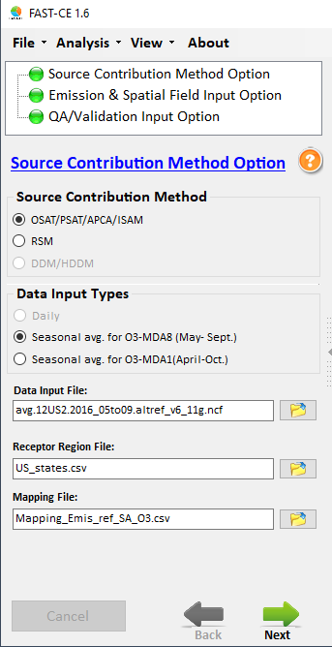
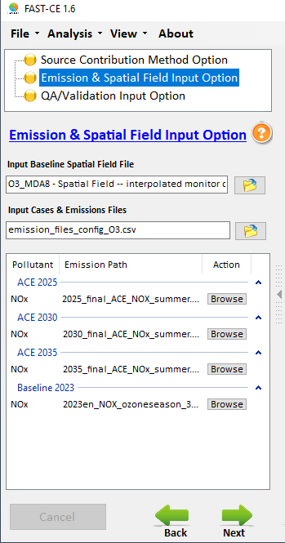
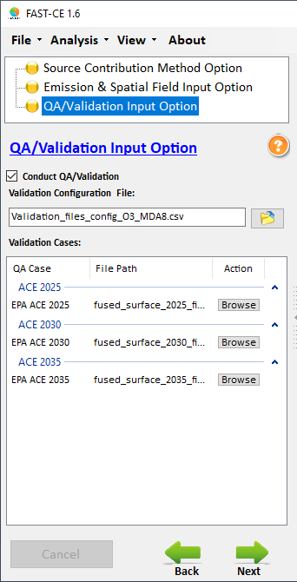
1. Source Contribution Method Module
2. Emissions & Spatial Field Input Module
3. Q/A and Validation Input Module
Three key modules in FAST-CE
8
Notes:
1. Thank Cen/Gao/Luo/Chen; 2. HZ more visits; 3. AP on HZ

Slide 9
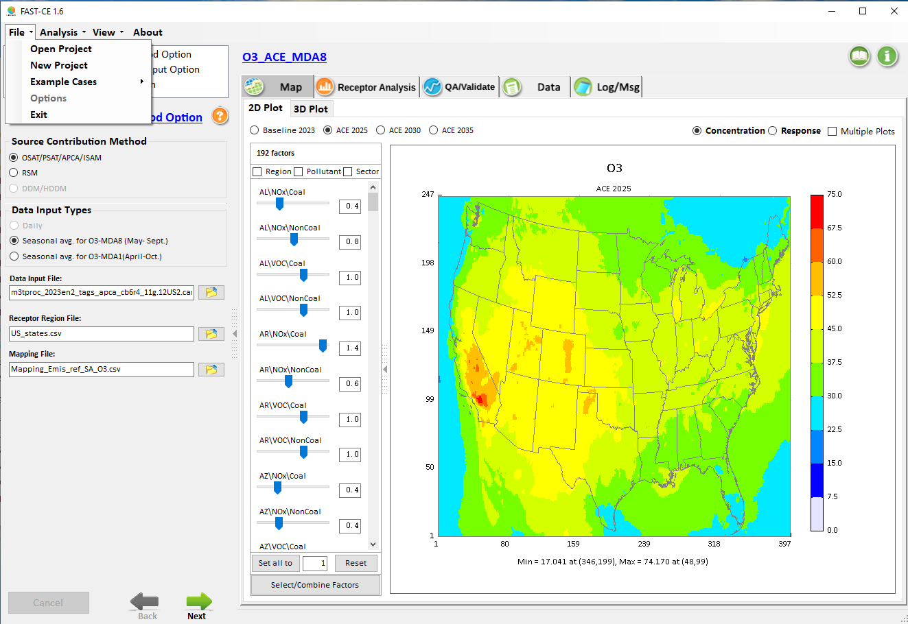
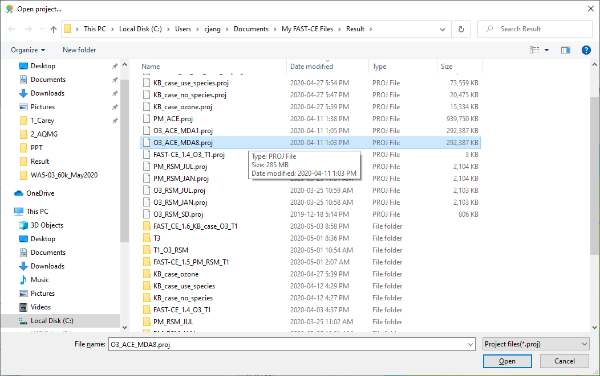
FAST-CE: “Open Project” (ACE O3 case)
Click “Open Project” to open the pre-run example case projects
ACE
KB_Case
RSM
9
Notes:
1. Thank Cen/Gao/Luo/Chen; 2. HZ more visits; 3. AP on HZ

Slide 10
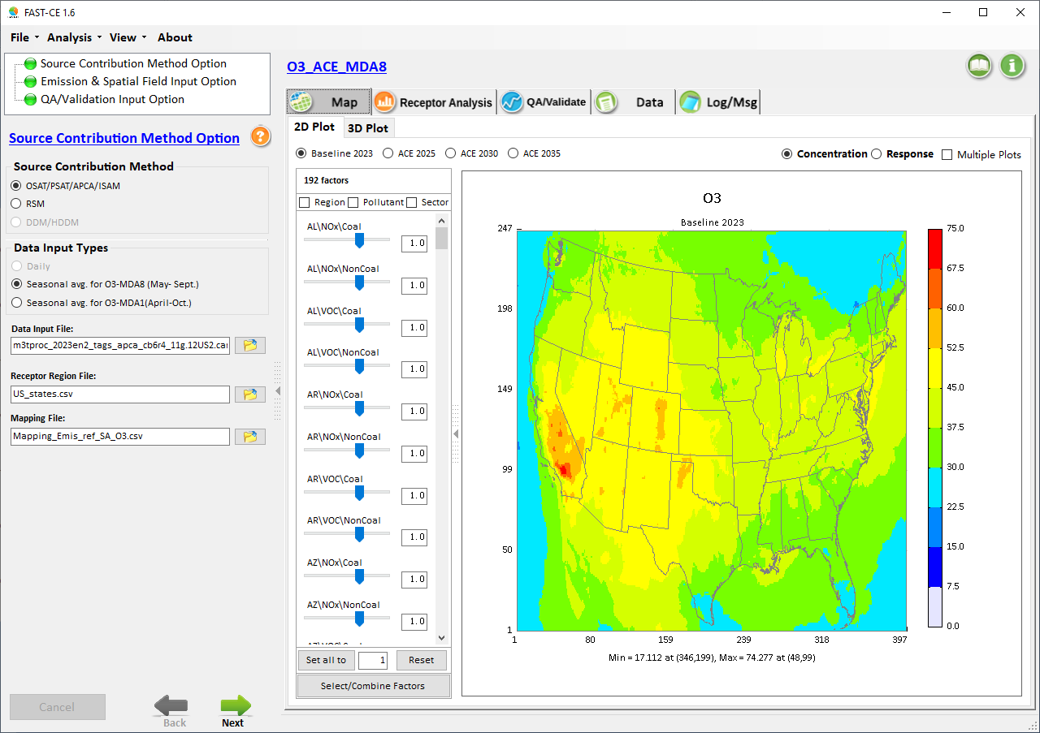
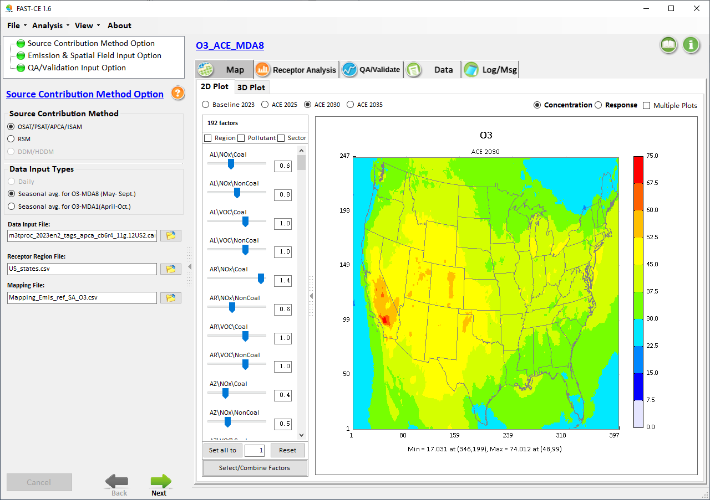
“Baseline” vs. “Scenarios”
Adjustable radio button
Notes:
1. Thank Cen/Gao/Luo/Chen; 2. HZ more visits; 3. AP on HZ

Slide 11

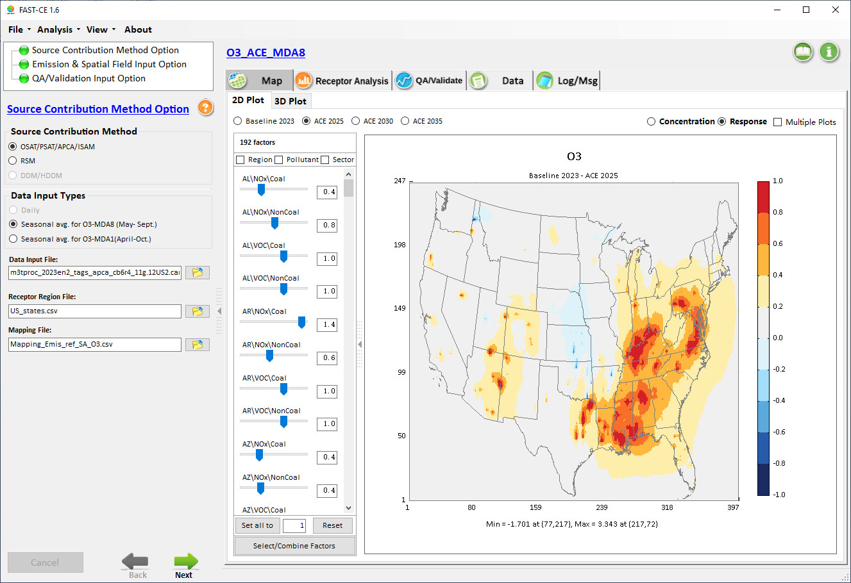
“Concentration” vs. “Response”
Notes:
1. Thank Cen/Gao/Luo/Chen; 2. HZ more visits; 3. AP on HZ

Slide 12
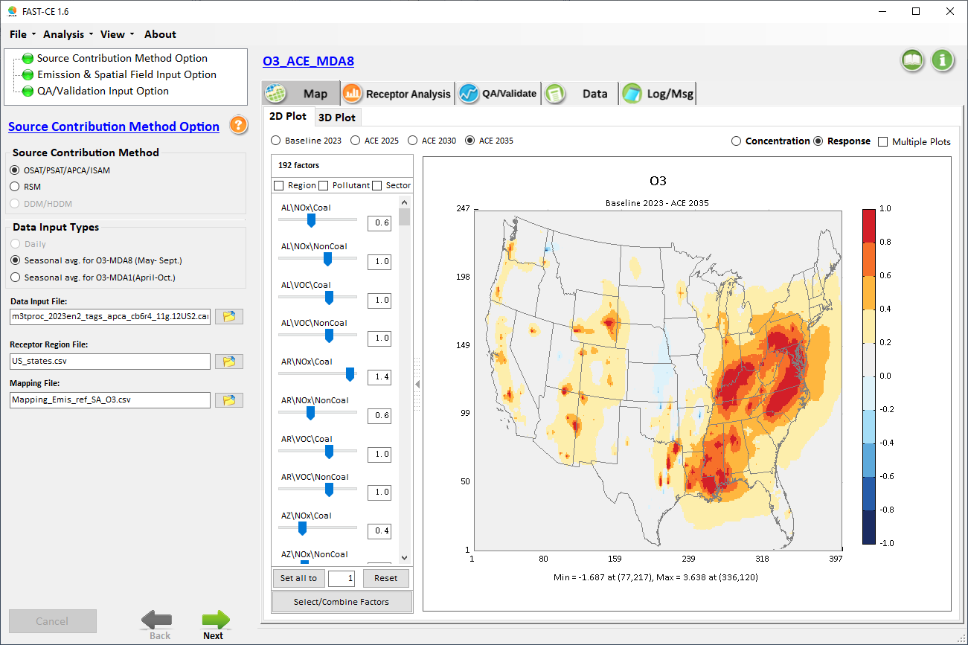
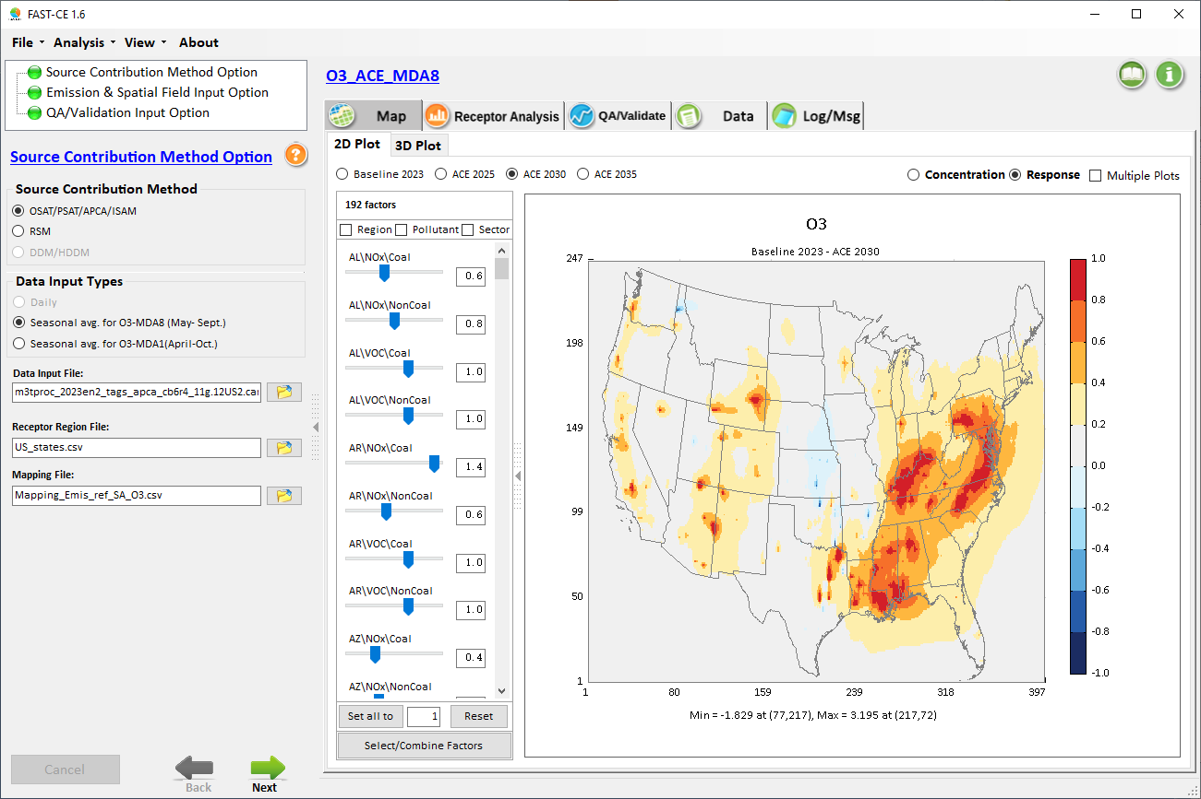
Real-time Scenario & Response
Notes:
1. Thank Cen/Gao/Luo/Chen; 2. HZ more visits; 3. AP on HZ

Slide 13
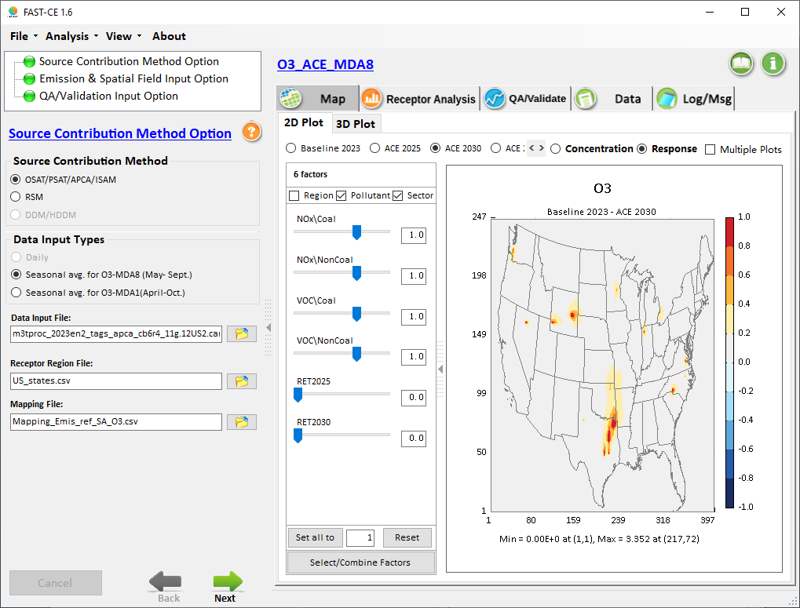
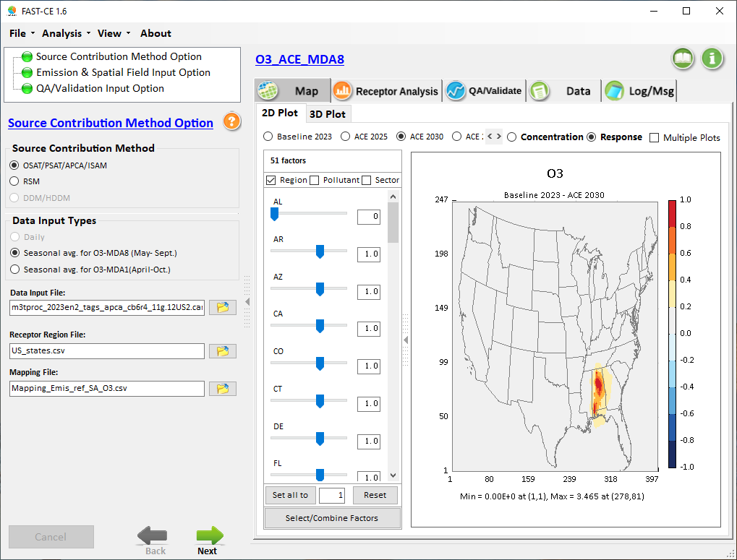
Factor Selection: “Region”/“Pollutant”/“Sector”
Notes:
1. Thank Cen/Gao/Luo/Chen; 2. HZ more visits; 3. AP on HZ

Slide 14
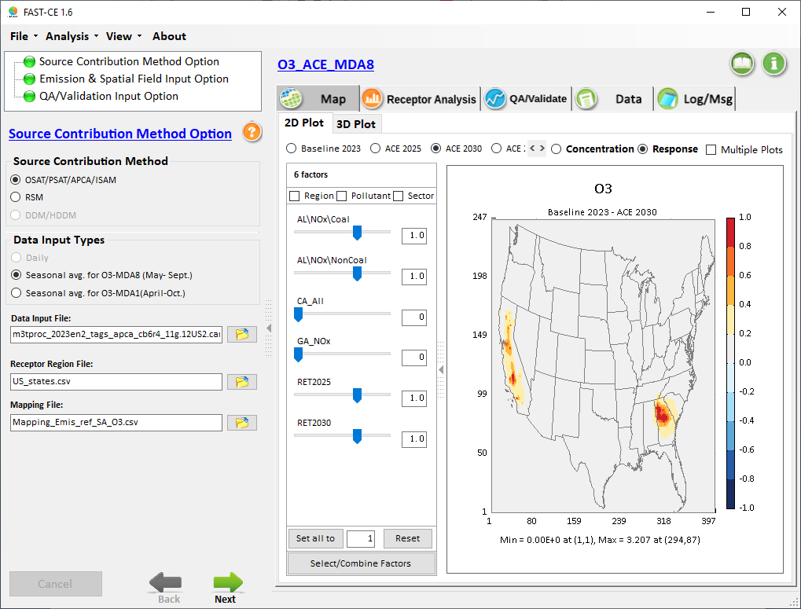
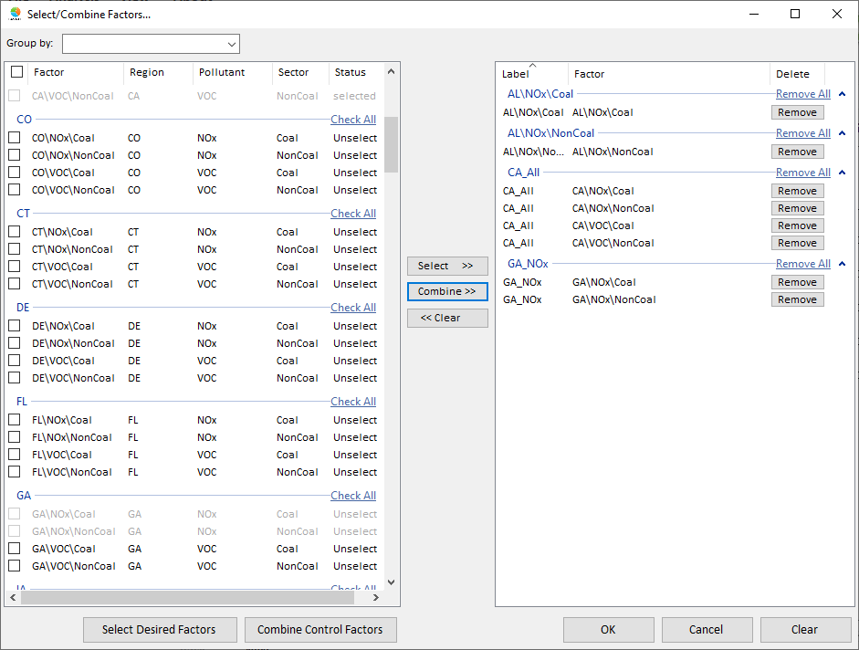
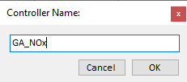
Customize “Region/Pollutant/Sector” Factors
Notes:
1. Thank Cen/Gao/Luo/Chen; 2. HZ more visits; 3. AP on HZ

Slide 15
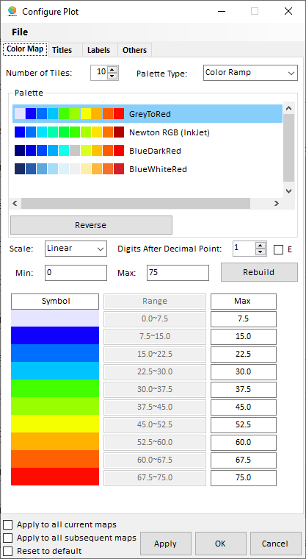
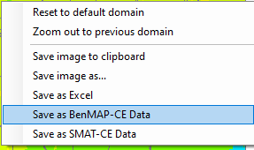
“Save to BenMAP/SMAT” & “Adjust Color/Scale”
A simple “click” to open “color/scale/legend” window
A simple “Right click” to
save image (copy & paste)
Save to BenMAP or SMAT format
Notes:
1. Thank Cen/Gao/Luo/Chen; 2. HZ more visits; 3. AP on HZ

Slide 16
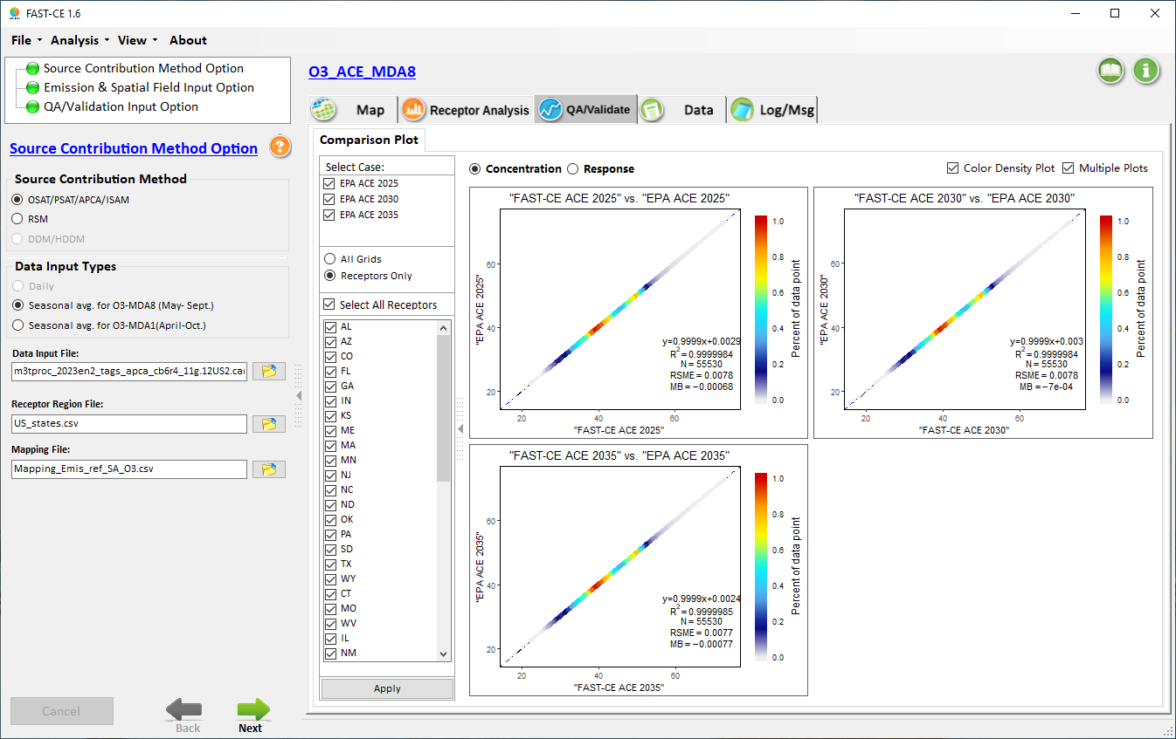
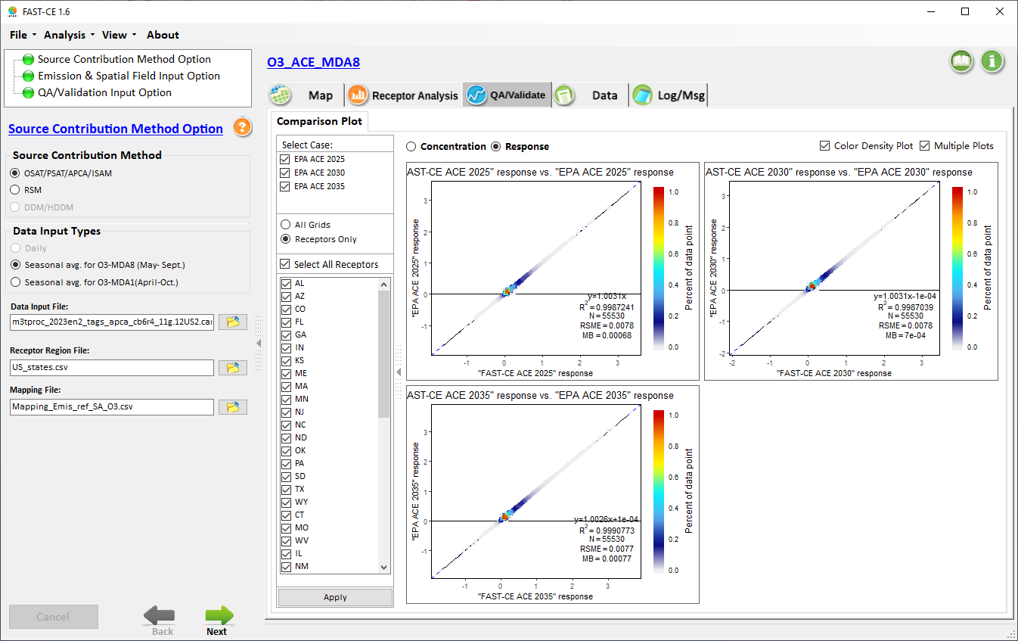
QA/Validation Module: ACE O3 Cases
ACE 2025
ACE 2030
FAST-CE 2025
FAST-CE 2030
ACE 2035
FAST-CE 2035
Notes:
1. Thank Cen/Gao/Luo/Chen; 2. HZ more visits; 3. AP on HZ

Slide 17
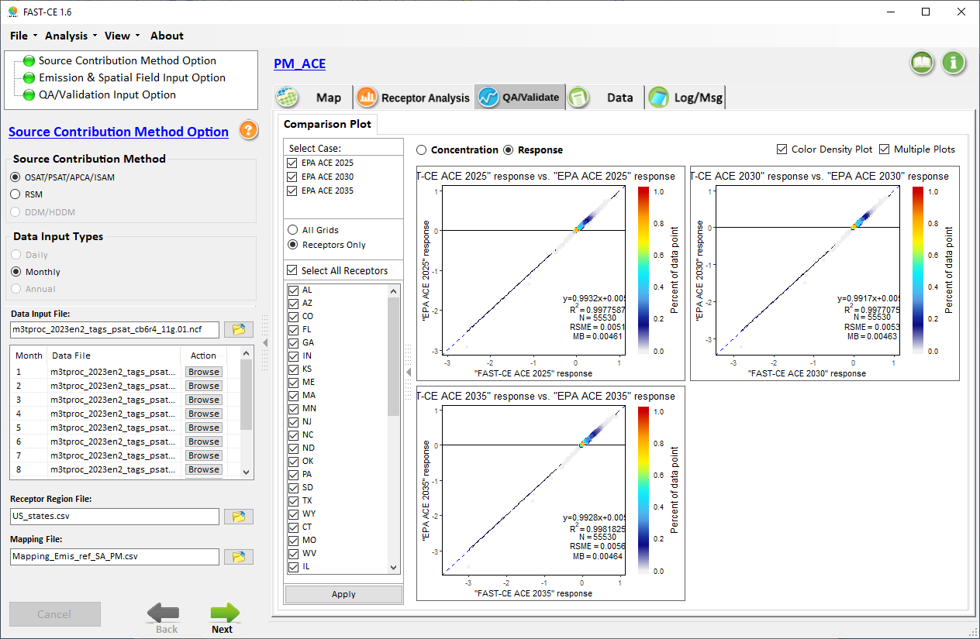
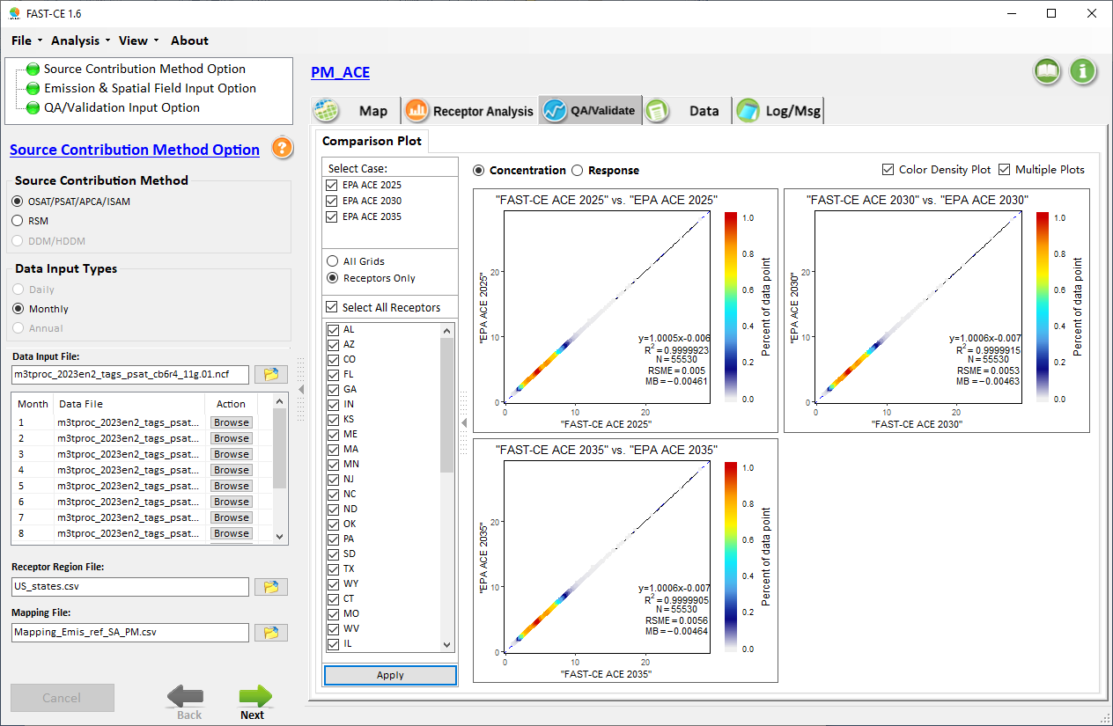
QA/Validation Module: ACE PM2.5 Cases
ACE 2025
ACE 2030
FAST-CE 2025
FAST-CE 2030
ACE 2035
FAST-CE 2035
Notes:
1. Thank Cen/Gao/Luo/Chen; 2. HZ more visits; 3. AP on HZ

Slide 18
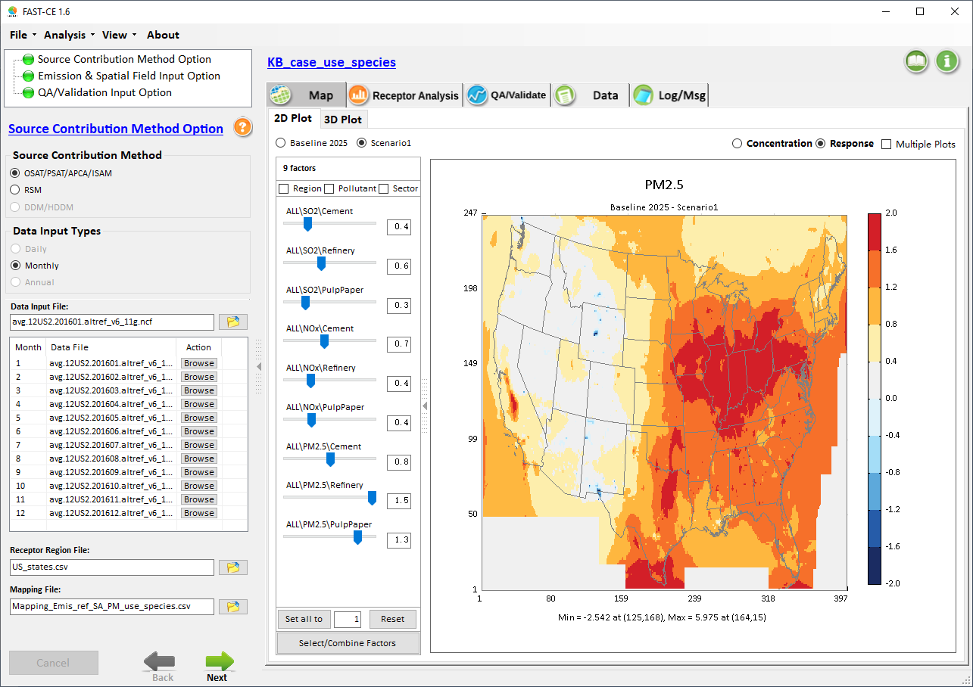
CAMx/PSAT PM2.5 example case: “KB_case_use_species.proj”
Three Sectors:
Cement
Pulp & paper
Refinery
Notes:
1. Thank Cen/Gao/Luo/Chen; 2. HZ more visits; 3. AP on HZ

Slide 19
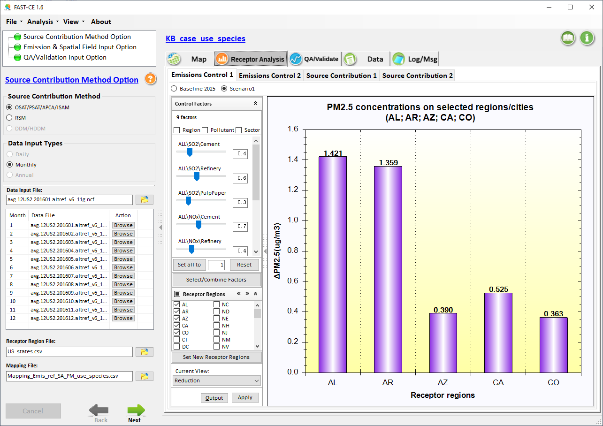
Receptor Analysis: Emission Control #1
Receptor Analysis: four types of display
Notes:
1. Thank Cen/Gao/Luo/Chen; 2. HZ more visits; 3. AP on HZ

Slide 20
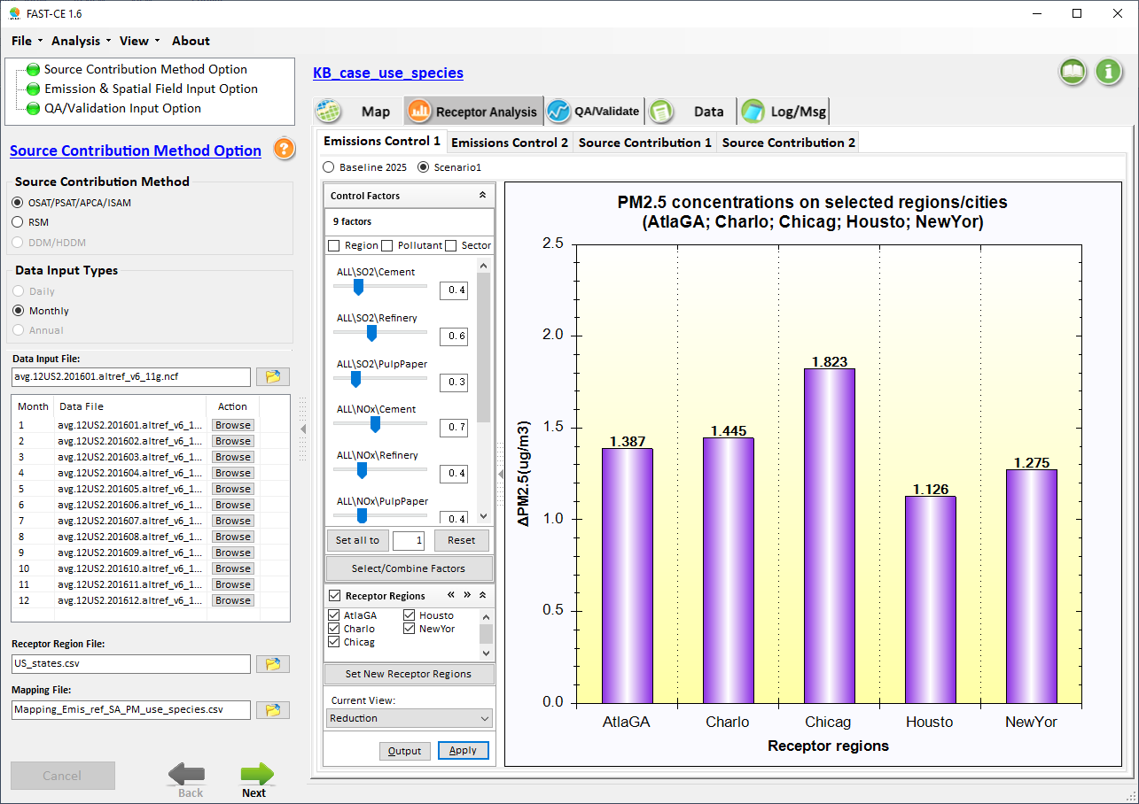
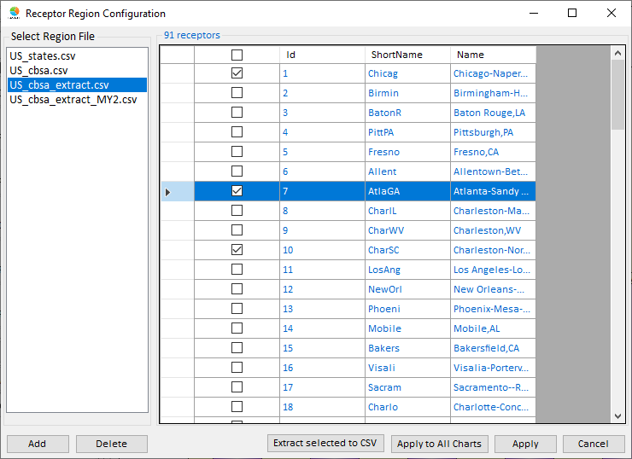
Customize Receptor Regions/Areas
Click here to customize the receptor regions
Notes:
1. Thank Cen/Gao/Luo/Chen; 2. HZ more visits; 3. AP on HZ

Slide 21
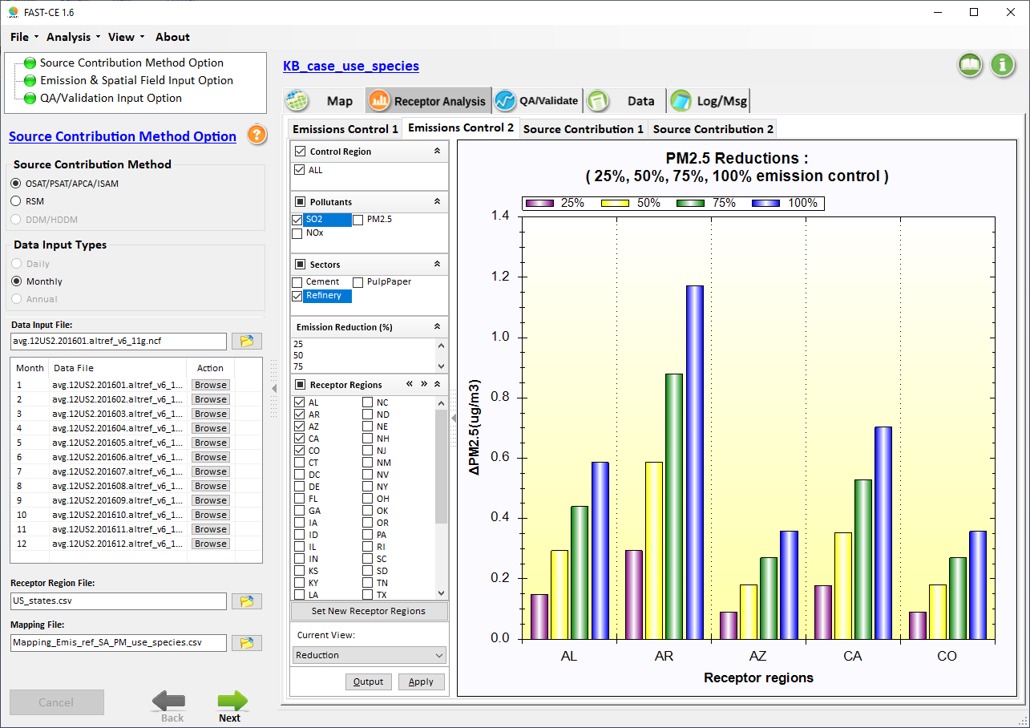
Receptor Analysis: Emission Control #2
PM2.5 responses to Emissions cut %
Select 25%, 50%, 75%, 100% SO2 Refinery Emissions cut
Notes:
1. Thank Cen/Gao/Luo/Chen; 2. HZ more visits; 3. AP on HZ

Slide 22
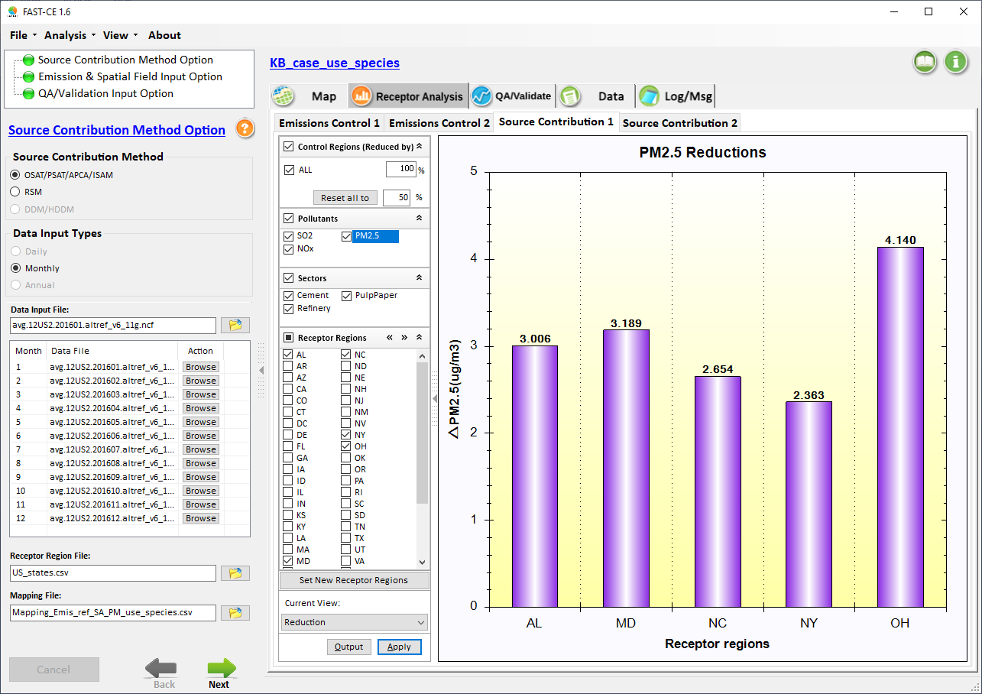
Receptor Analysis: Source Contribution #1
Total Contribution of emissions reduction
Notes:
1. Thank Cen/Gao/Luo/Chen; 2. HZ more visits; 3. AP on HZ

Slide 23
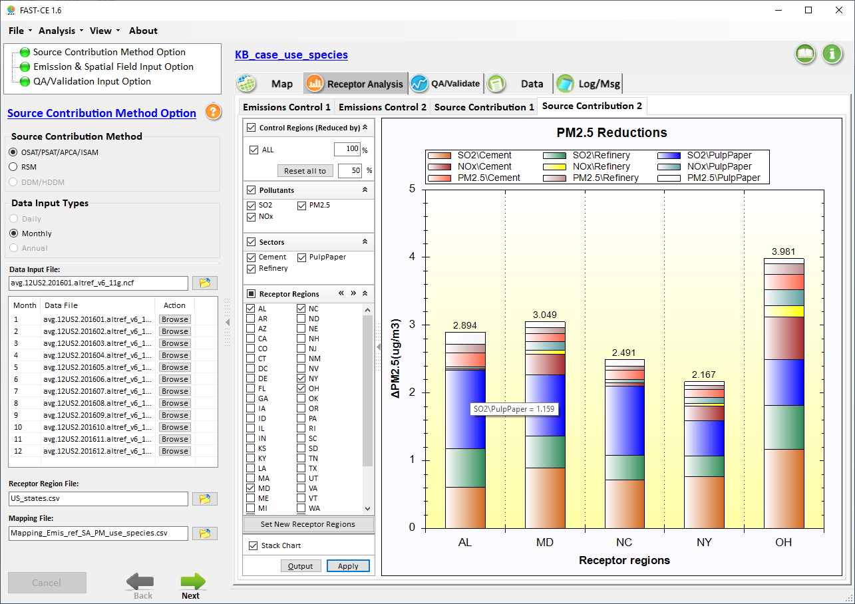
Receptor Analysis: Source Contribution #2
Individual Contributions of emissions reduction
Notes:
1. Thank Cen/Gao/Luo/Chen; 2. HZ more visits; 3. AP on HZ

Slide 24
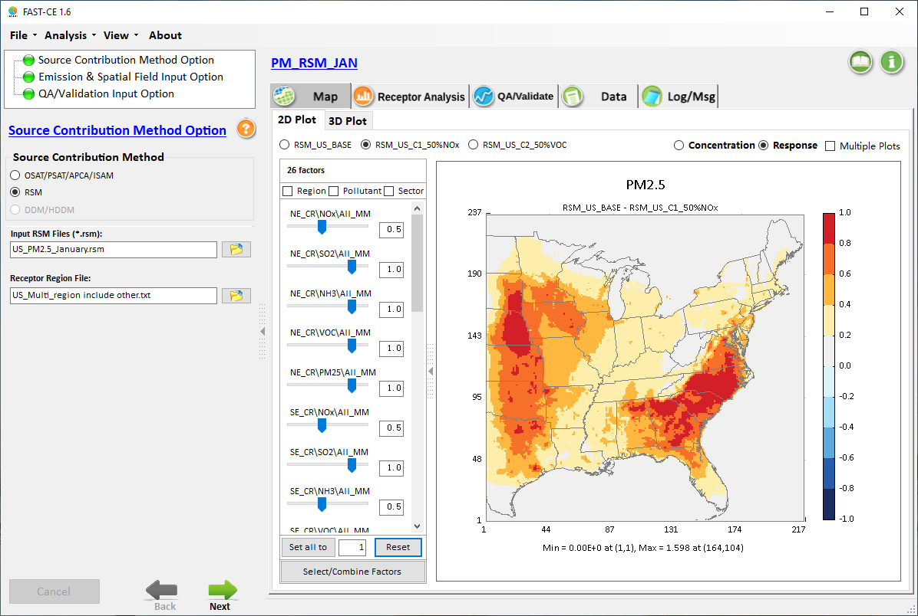
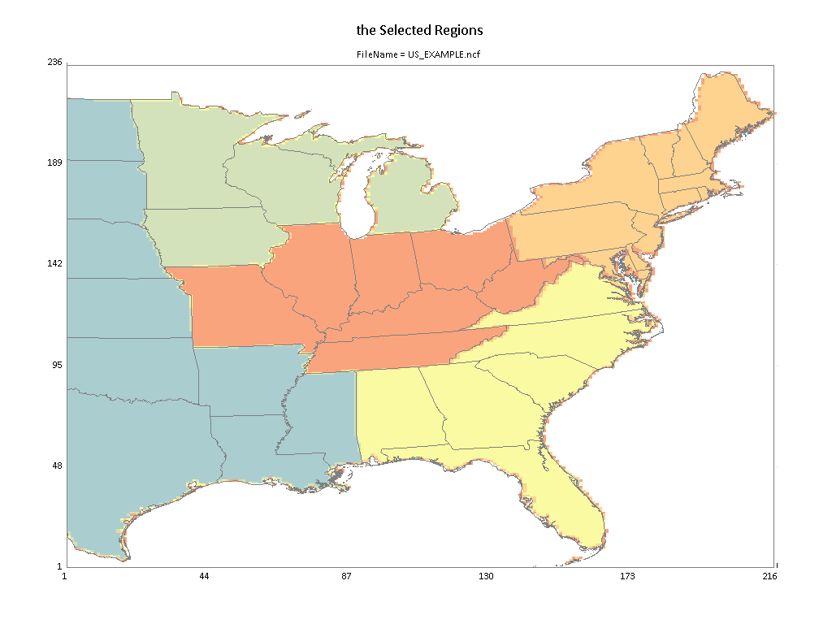
RSM EUS cases: “PM[O3]_RSM_Jan[Jul].proj”
Five Climate Regions:
NE
SE
Cen
Up_MW
Other
Notes:
1. Thank Cen/Gao/Luo/Chen; 2. HZ more visits; 3. AP on HZ

Slide 25
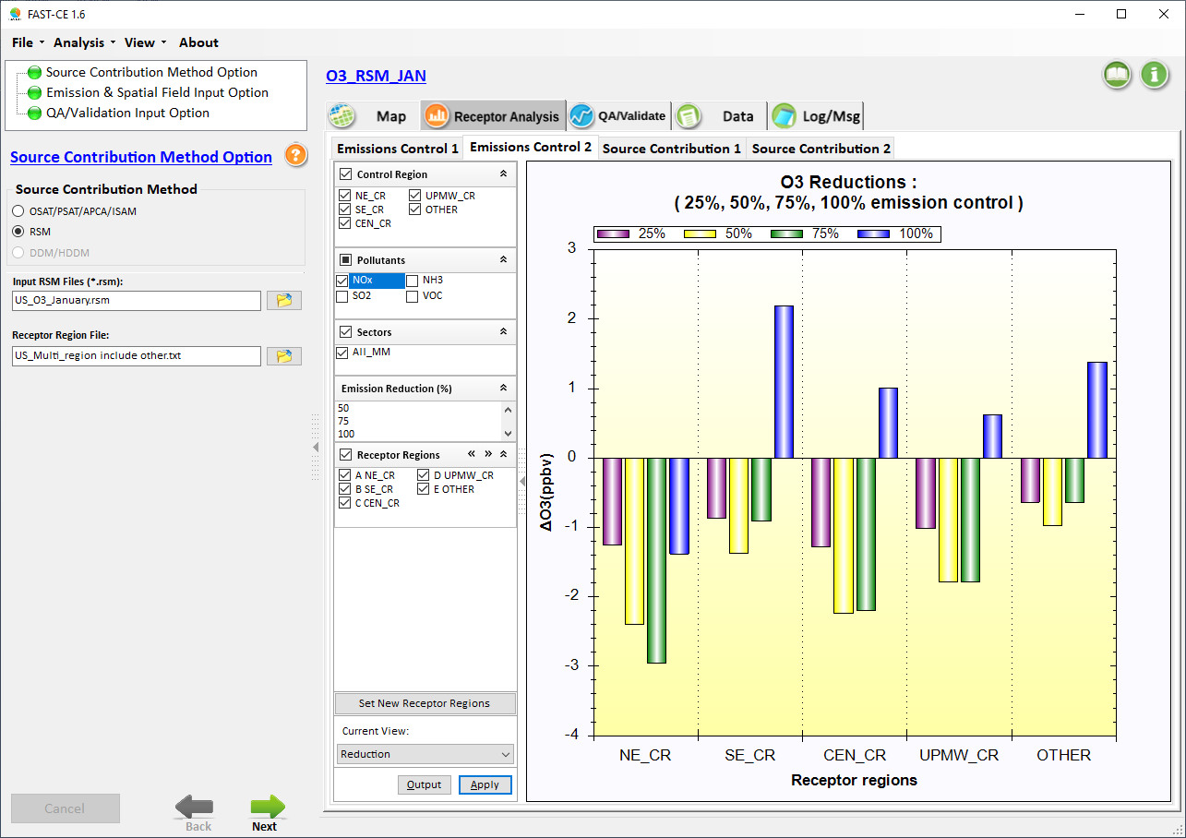
RSM example: O3 & PM_SO4 non-linear chemistry
benefit
Jan. O3 responses to NOx Emissions cut %
100%
NOx Emissions cut only
Select 25%, 50%, 75%, 100% NOx Emissions cut only (corresponding CMAQ results provided in Appendix)
25%
75%
50%
disbenefit
Notes:
1. Thank Cen/Gao/Luo/Chen; 2. HZ more visits; 3. AP on HZ

Slide 26
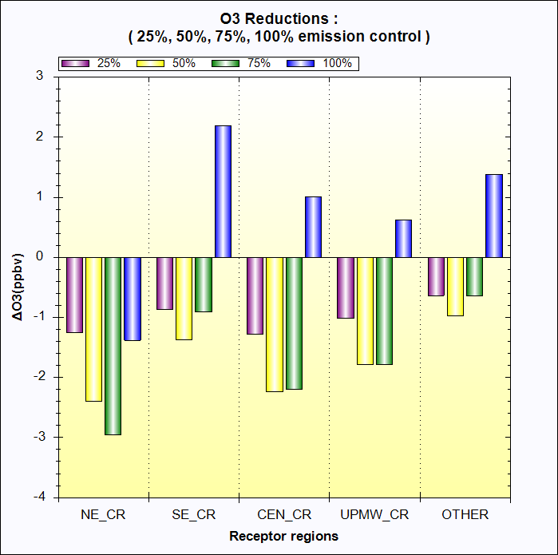
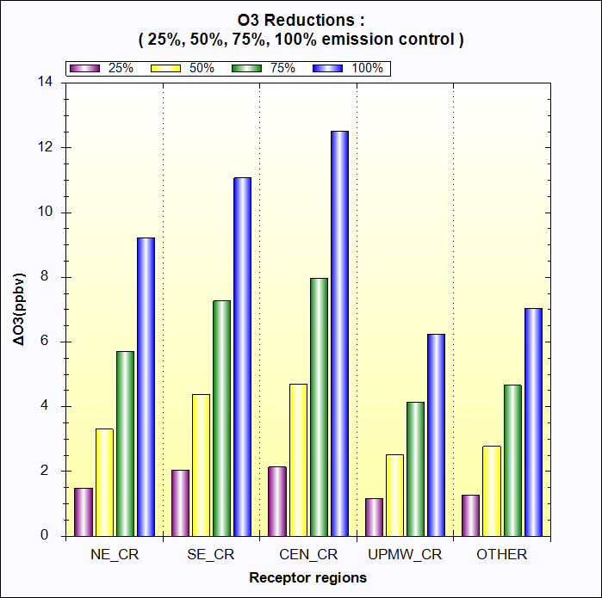
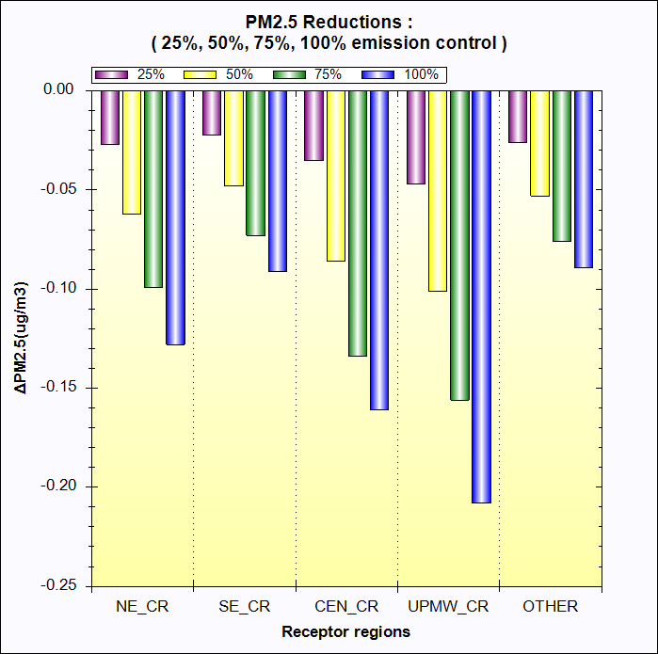
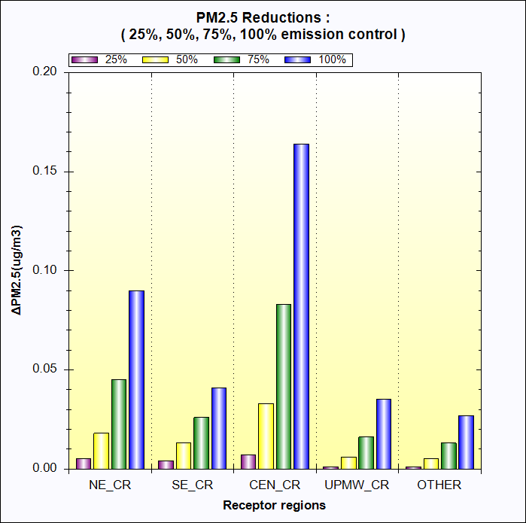
Jan. O3 responses to NOx cut
July O3 responses to NOx cut
Jan. PM_SO4 responses to NOx cut
July PM_SO4 responses to NOx cut
Notes:
1. Thank Cen/Gao/Luo/Chen; 2. HZ more visits; 3. AP on HZ

Slide 27
Appendix
Notes:
1. Thank Cen/Gao/Luo/Chen; 2. HZ more visits; 3. AP on HZ

Slide 28
ACE PM2.5/O3 Benefit Modeling (August 2018)
Note: ACE benefit modeling includes only: 1) EGU point sources split out by fuel type and state ; all other sectors lumped into a single tag
2) NOx, SO2 & primary PM, and no VOC emissions
~300 GB daily Input data
Linux platform
R scripts to calculate emissions ratios (ER): 2023/scenario
Species Definition files
Combine utility program
O3N tags multiplied by summer NO2 ER;
sulfate tags multiplied by SO2 ER;
nitrate tags multiplied by NO2 ER;
PM tag multiplied by PM ER
2023 CAMx APCA
IOAPI Modeling Results
(Tagged EGUs by State/Fuel/Pollutant)
Method:
2023 & 2025/2030/2035 Annual EGU Emissions (from IPM)
(Emis grouped by State/Fuel/Pollutant)
Base & ACE 2025/2030/2035 IOAPI Surfaces
Major issues: create only one AQ surface,
No flexibility, each case takes > one hour
2011 CAMx base year IOAPI Surfaces
WIN-OS
platform
BenMAP-CE input files for
base vs. ACE (2025/2030/2035)
Benefit Assessment
Run SMAT-CE for each ACE year (for each PM2.5, MDA8, MDA1)
(3 x 3 = 9 cases)
Notes:
1. Thank Cen/Gao/Luo/Chen; 2. HZ more visits; 3. AP on HZ

Slide 29
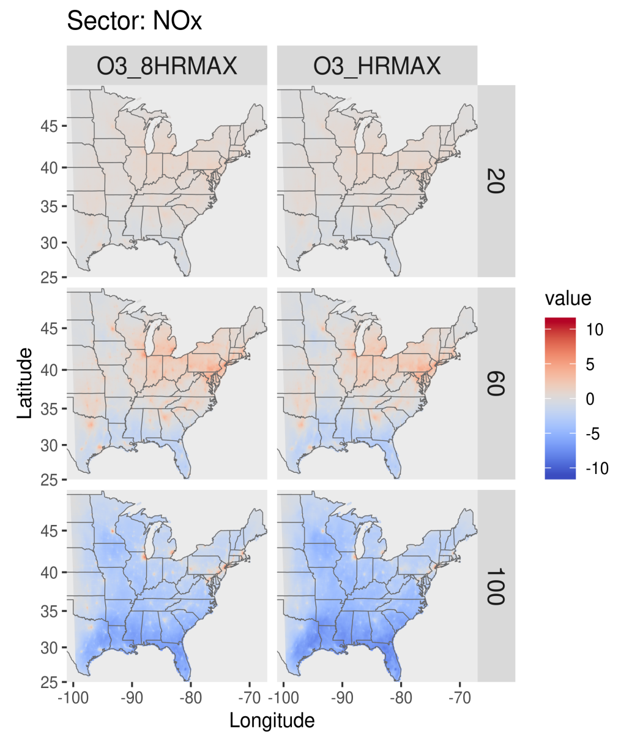
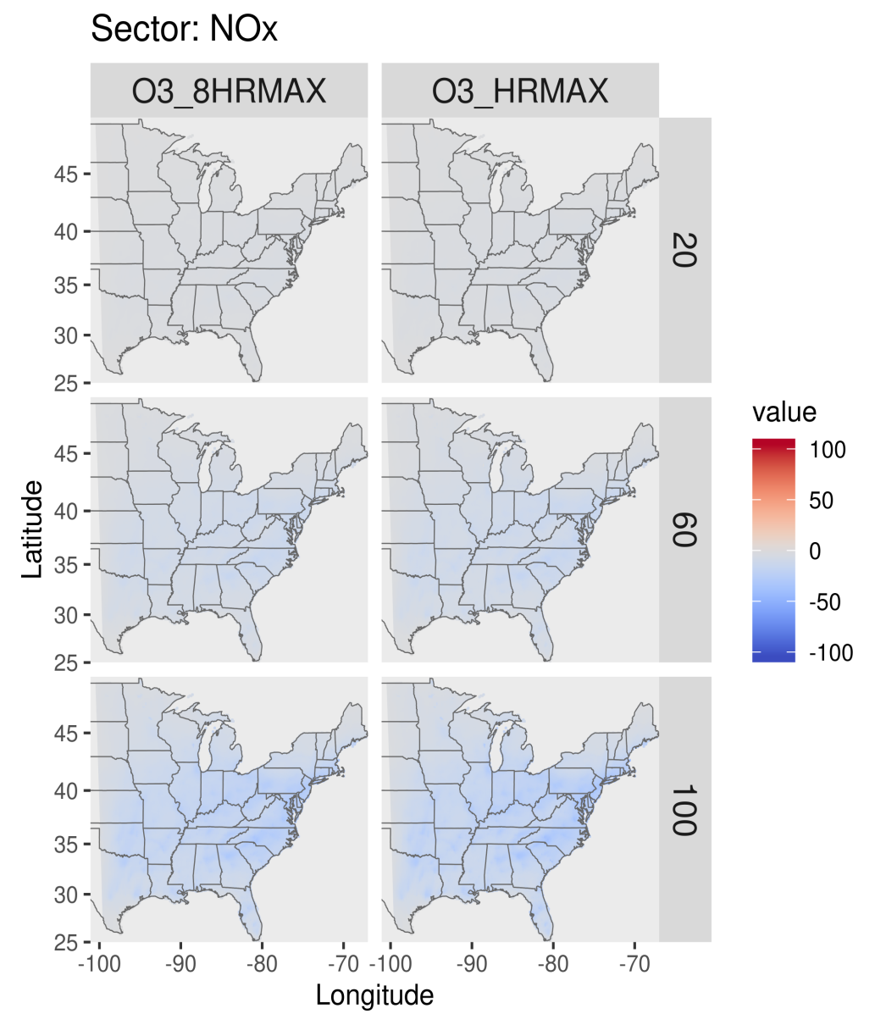
Delta O3 for 20-100 percent reductions in anthropogenic NOx emissions
January
July
By Jim Kelly

Slide 30
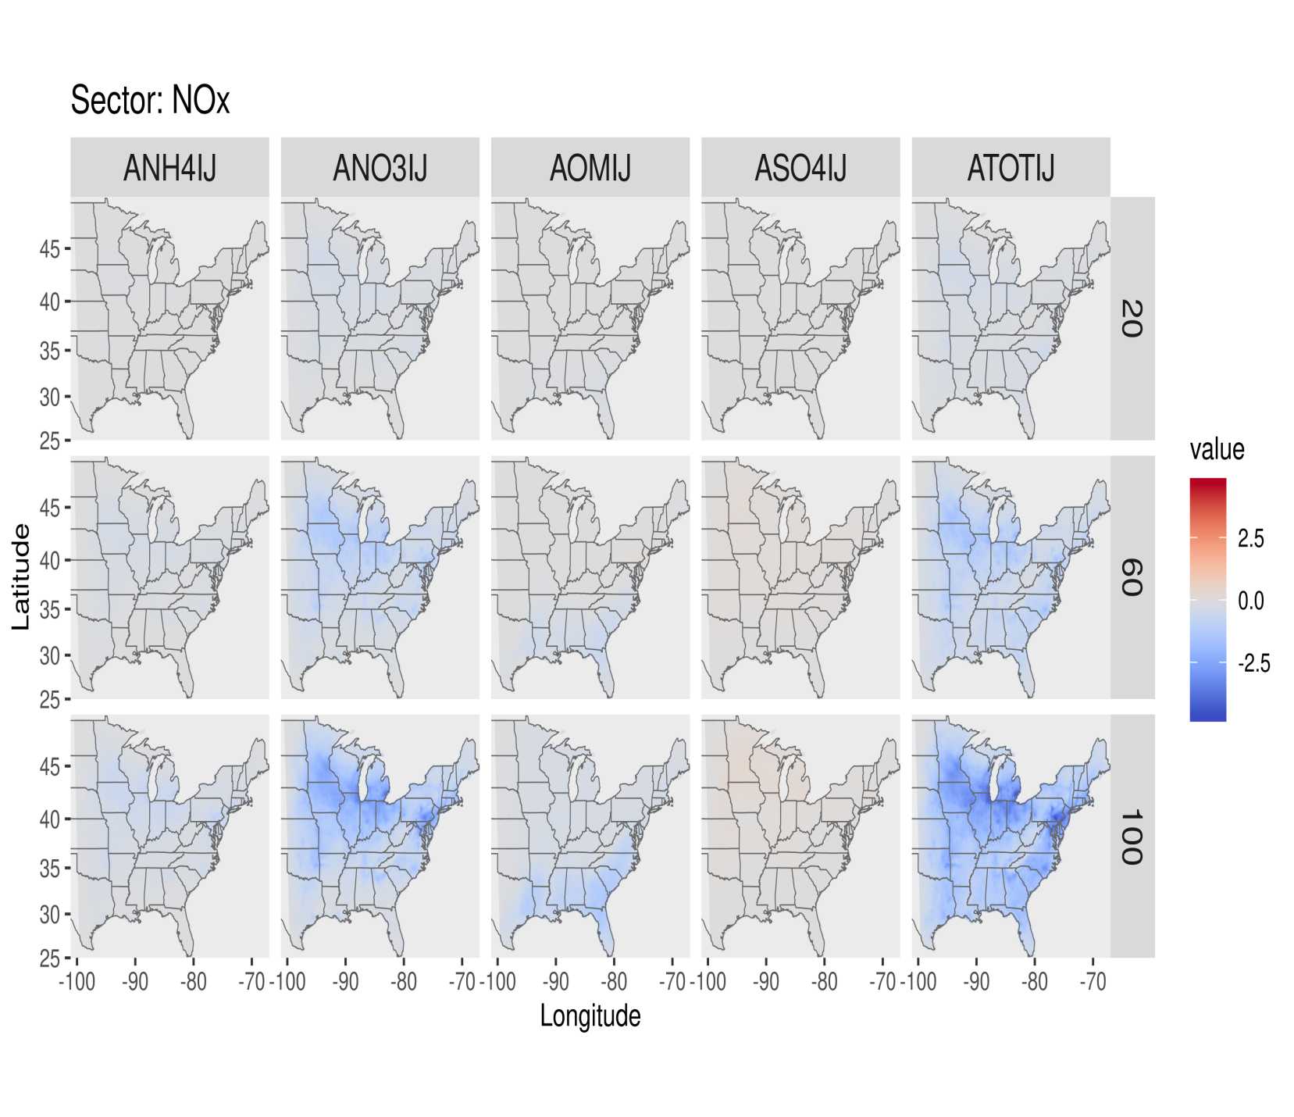
Delta PM for 20-100 percent reductions in anthropogenic NOx emissions
January
By Jim Kelly

Slide 31
“FAST-CE” Demo
GUI:
Run O3 case (load/show PM case next)
Go thru PPT slides
Main GUI -> File/Analysis/View
Menu: MAP/RA/QA/Log&Msg
Traffic Light: Each module & input files
MAP:
MAP -> each ACE case (use 2030)
Conc./Response toggle & Reset
Multiple plots & 3D
Output to SMAT/BenMAP/CSV & color legend
Radio button: Control %: Set & Reset
Region/Pollutant/Sector:
RETIRE & TB & IL/OH/PA
NOx/VOC & Coal/NonCoal
Select/Combine Factors ->
Receptor Analysis
Emissions Control 1& 2
1) Pollutant/Sector
1) Select receptor regions & Set New Receptor Regions
2) NOx: 20/40/60/80/100
Source Contribution 1 &2
QA/Validation:
Conc./Response toggle
Multiple plots
Color Density
PM Module:
Load PM project, longer
monthly PM
SMAT adjustment for PM species
MAP: Each ACE case & Conc./Response
Region/Pollutant/Sector:
SO2/NOx/PM & Coal/NonCoal
RETIRE & TB
Receptor Analysis
Source Contribution 2: NOx disbenfit
QA/Validate
Notes:
1. Thank Cen/Gao/Luo/Chen; 2. HZ more visits; 3. AP on HZ

Slide 32
End
Notes:
1. Thank Cen/Gao/Luo/Chen; 2. HZ more visits; 3. AP on HZ

