Slide 1
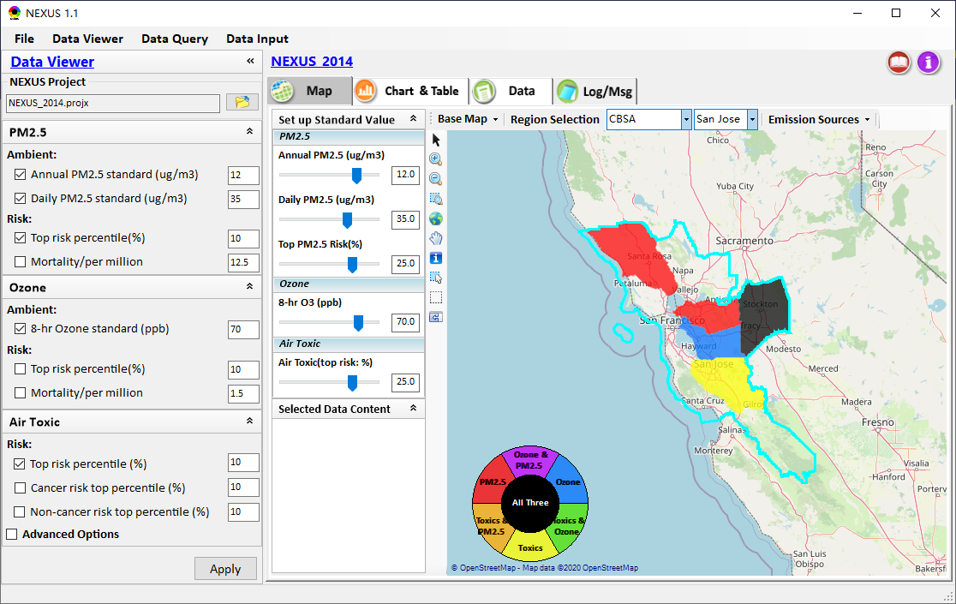

NEXUS Tool: Data Viewer Module
Add “Clear” under this menu
Develop and include the CBSA regional analysis function
Make all “Risk top %” inverse (from “100” to “0”, still default at 10%)
Remove “Save” under Data Vewer module
Fix the color position issue
8
1
Notes:
Need more data info about CBSAs and corresponding counties.

Slide 2
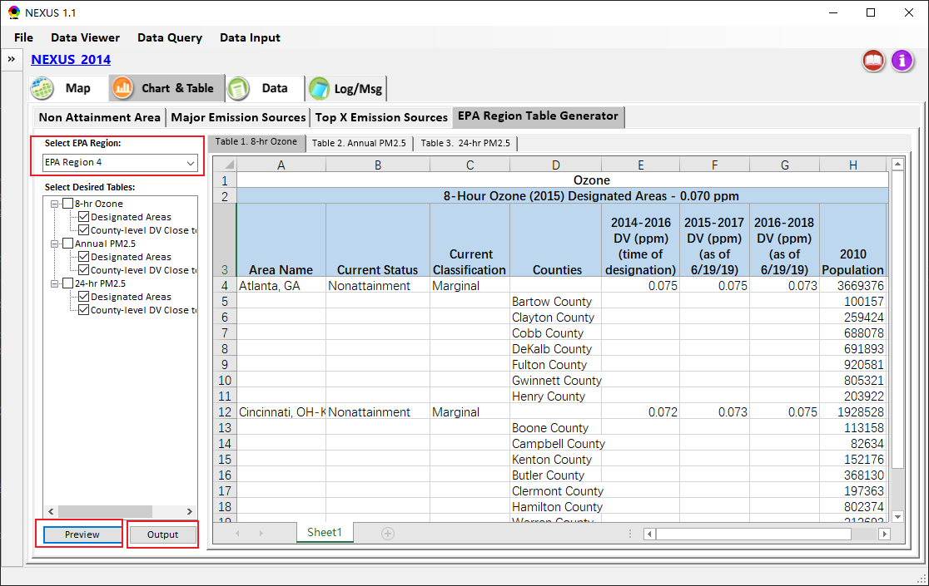
NEXUS Tool: Table Generator
Select EPA Region
Click to Preview
Save as excel file
Notes:
The preview function requires the system to install Office Excel first.

Slide 3
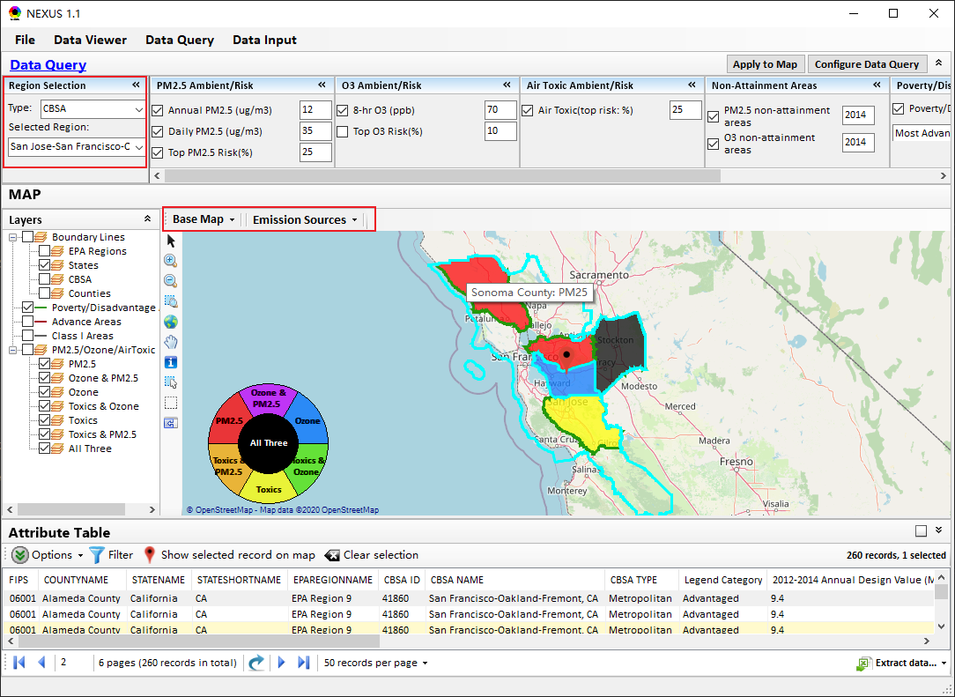
NEXUS Tool: Data Query
Include CBSA selection
Need further development to select DV years
Enable the Emission Sources function

Slide 4
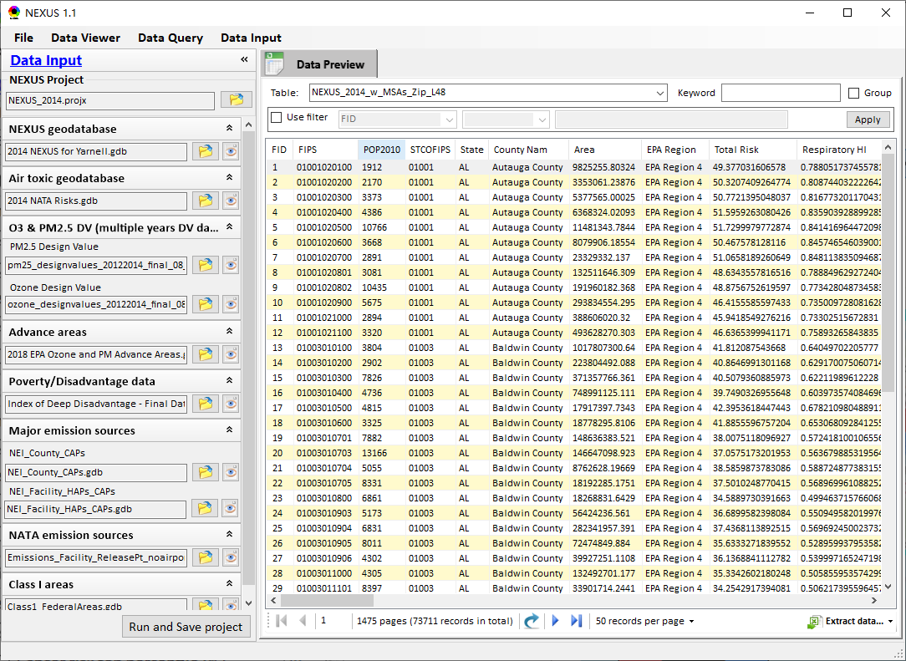
NEXUS Tool: Data Input
Need further development to enable more filter conditions.
Change to “Run and Save project”
Use bold font

Slide 5
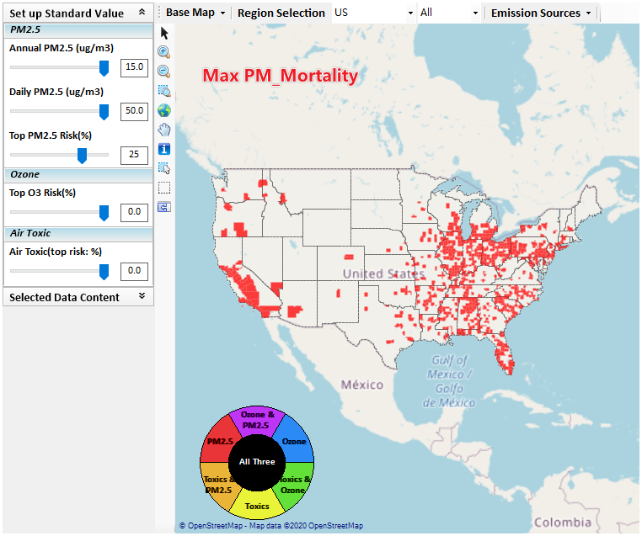
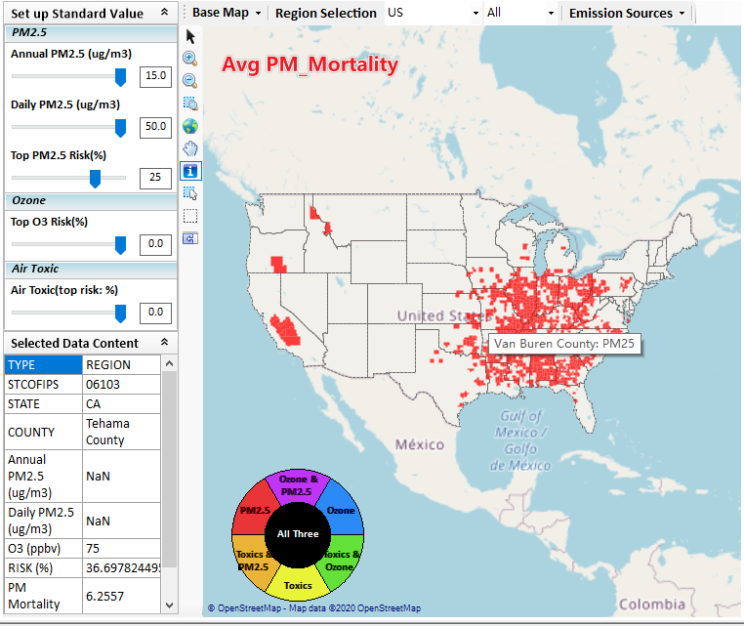
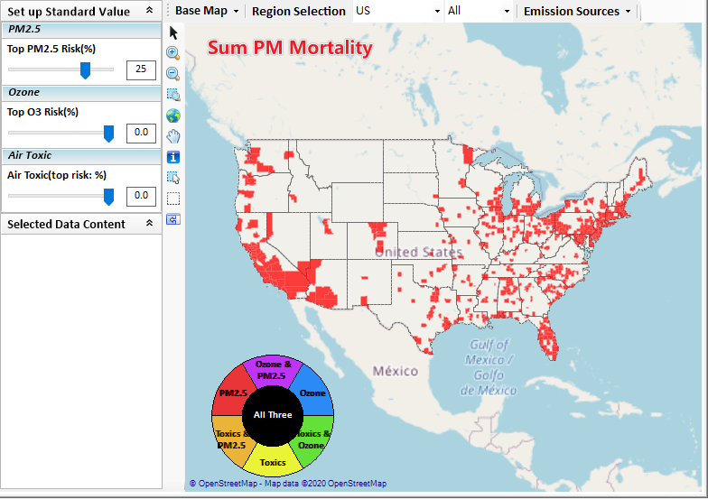
Issues discussion
PM2.5 risks (e.g., top 25%) do not show up in California. This is wrong (2014 NEXUS data has high CA PM2.5 risks)
The problem may caused by wrongly using “Average” to calculate the county-level of PM2.5/O3 Mortality and Air Toxic Risk.

Slide 6
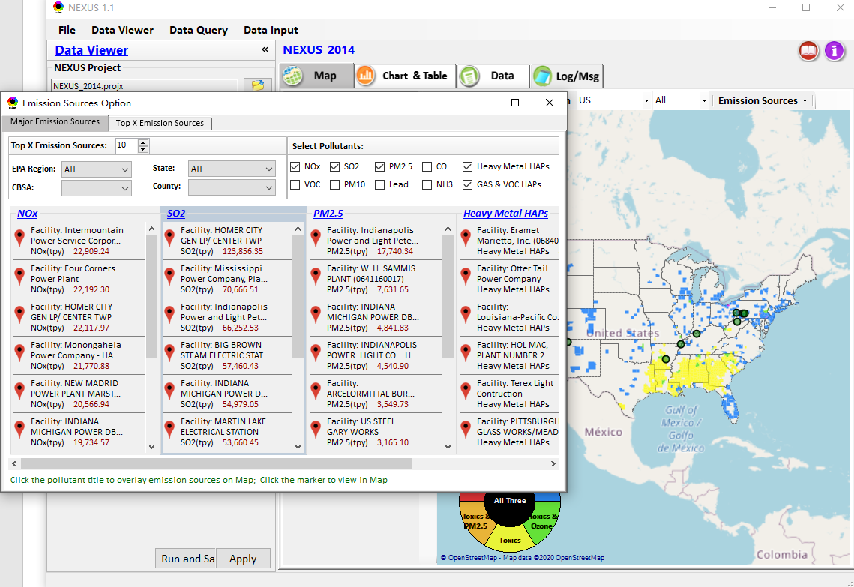
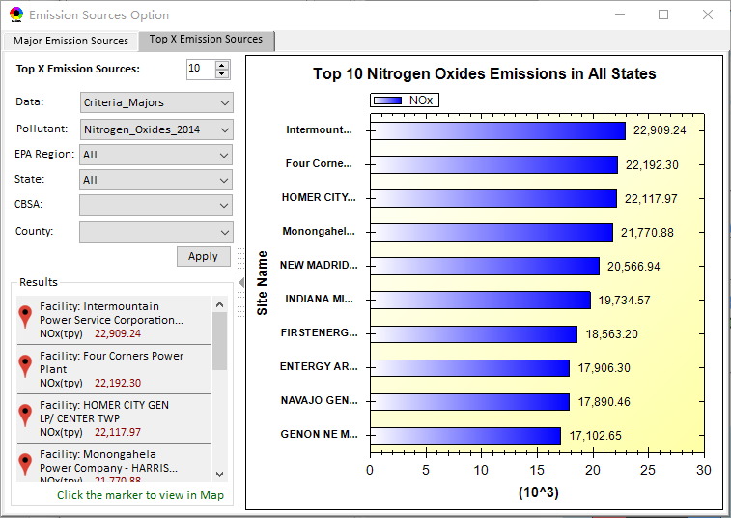
To do list
1. Include CBSA as part of “Emission Sources” selection (now EPA region, State, County only)
6
Notes:
Need more data info about CBSAs and corresponding counties

Slide 7
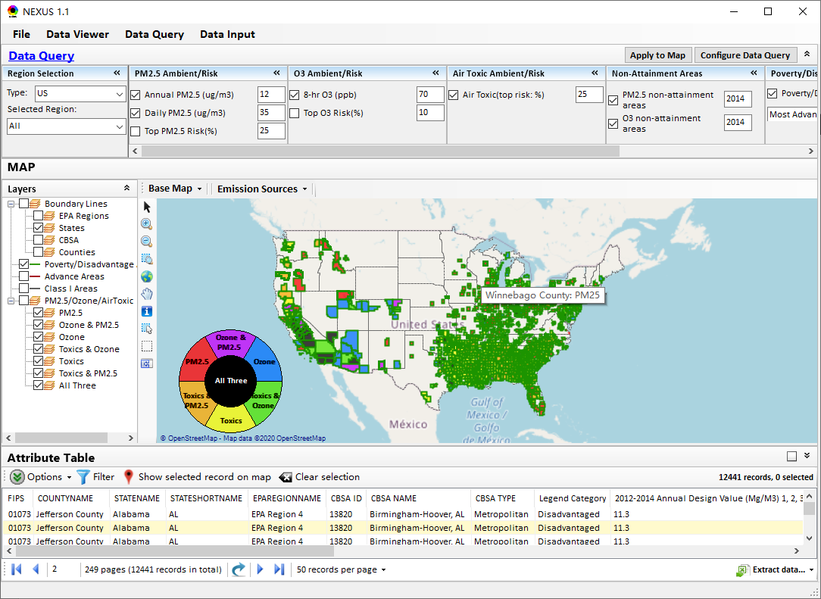
To do list
2. Enable to select different DV year (2013-2018) in Data Query Module
3. Enable to apply more filer conditions.
4. fix the Poverty/disadvantage issue
5. Check the memory problem
7
Notes:
Need more data info about CBSAs and corresponding counties

