Slide 1
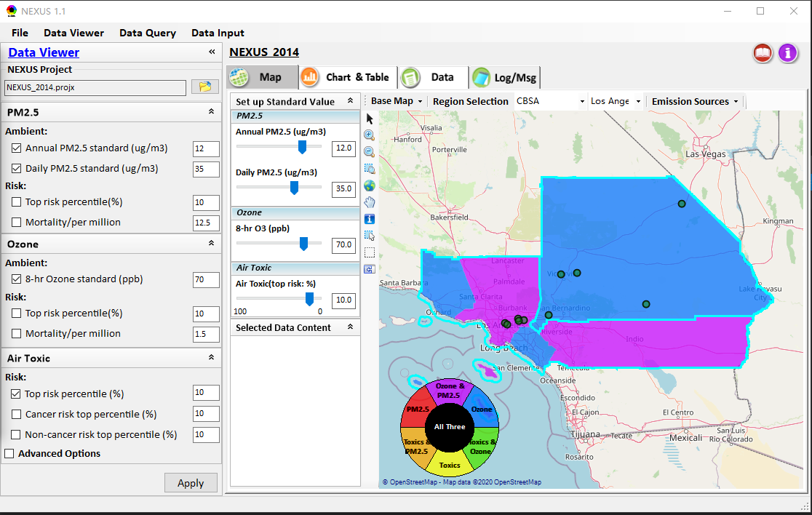
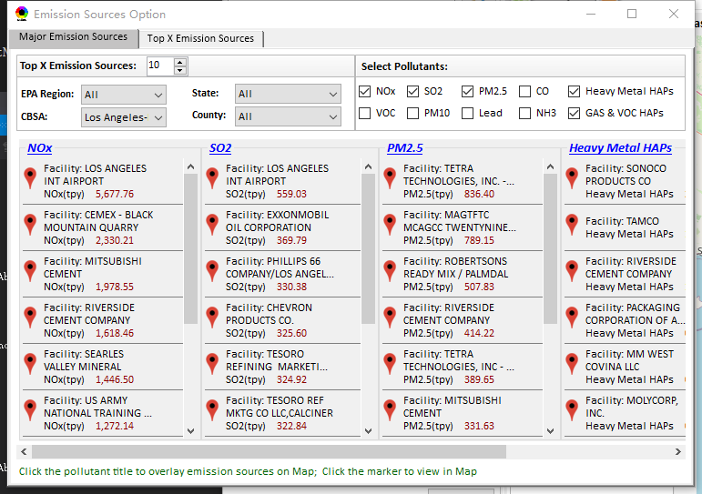
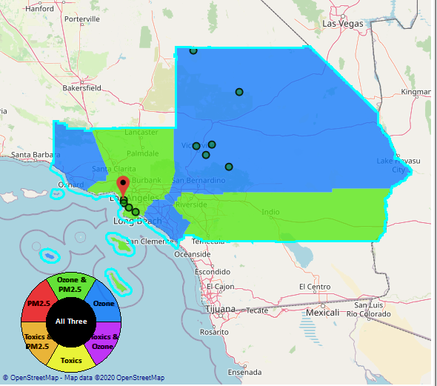
NEXUS Tool: Data Viewer
    1. Include CBSA as part of “Emission Sources” selection
Use black color
Enable the CBSA selection
Add the “100” and “0” label
Update the color
1
Notes:
Need more data info about CBSAs and corresponding counties

Slide 2
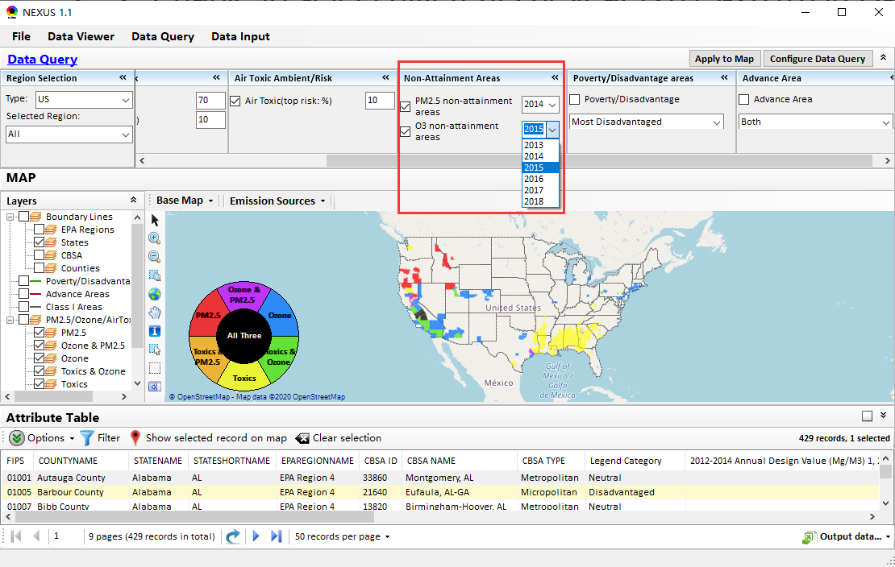
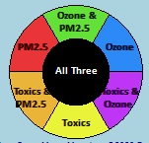
NEXUS Tool: Data Query
    2. Enable to select different DV year (2013-2018) in Data Query Module
Apply to Map
Select DV year
2
Notes:
Need more data info about CBSAs and corresponding counties

Slide 3
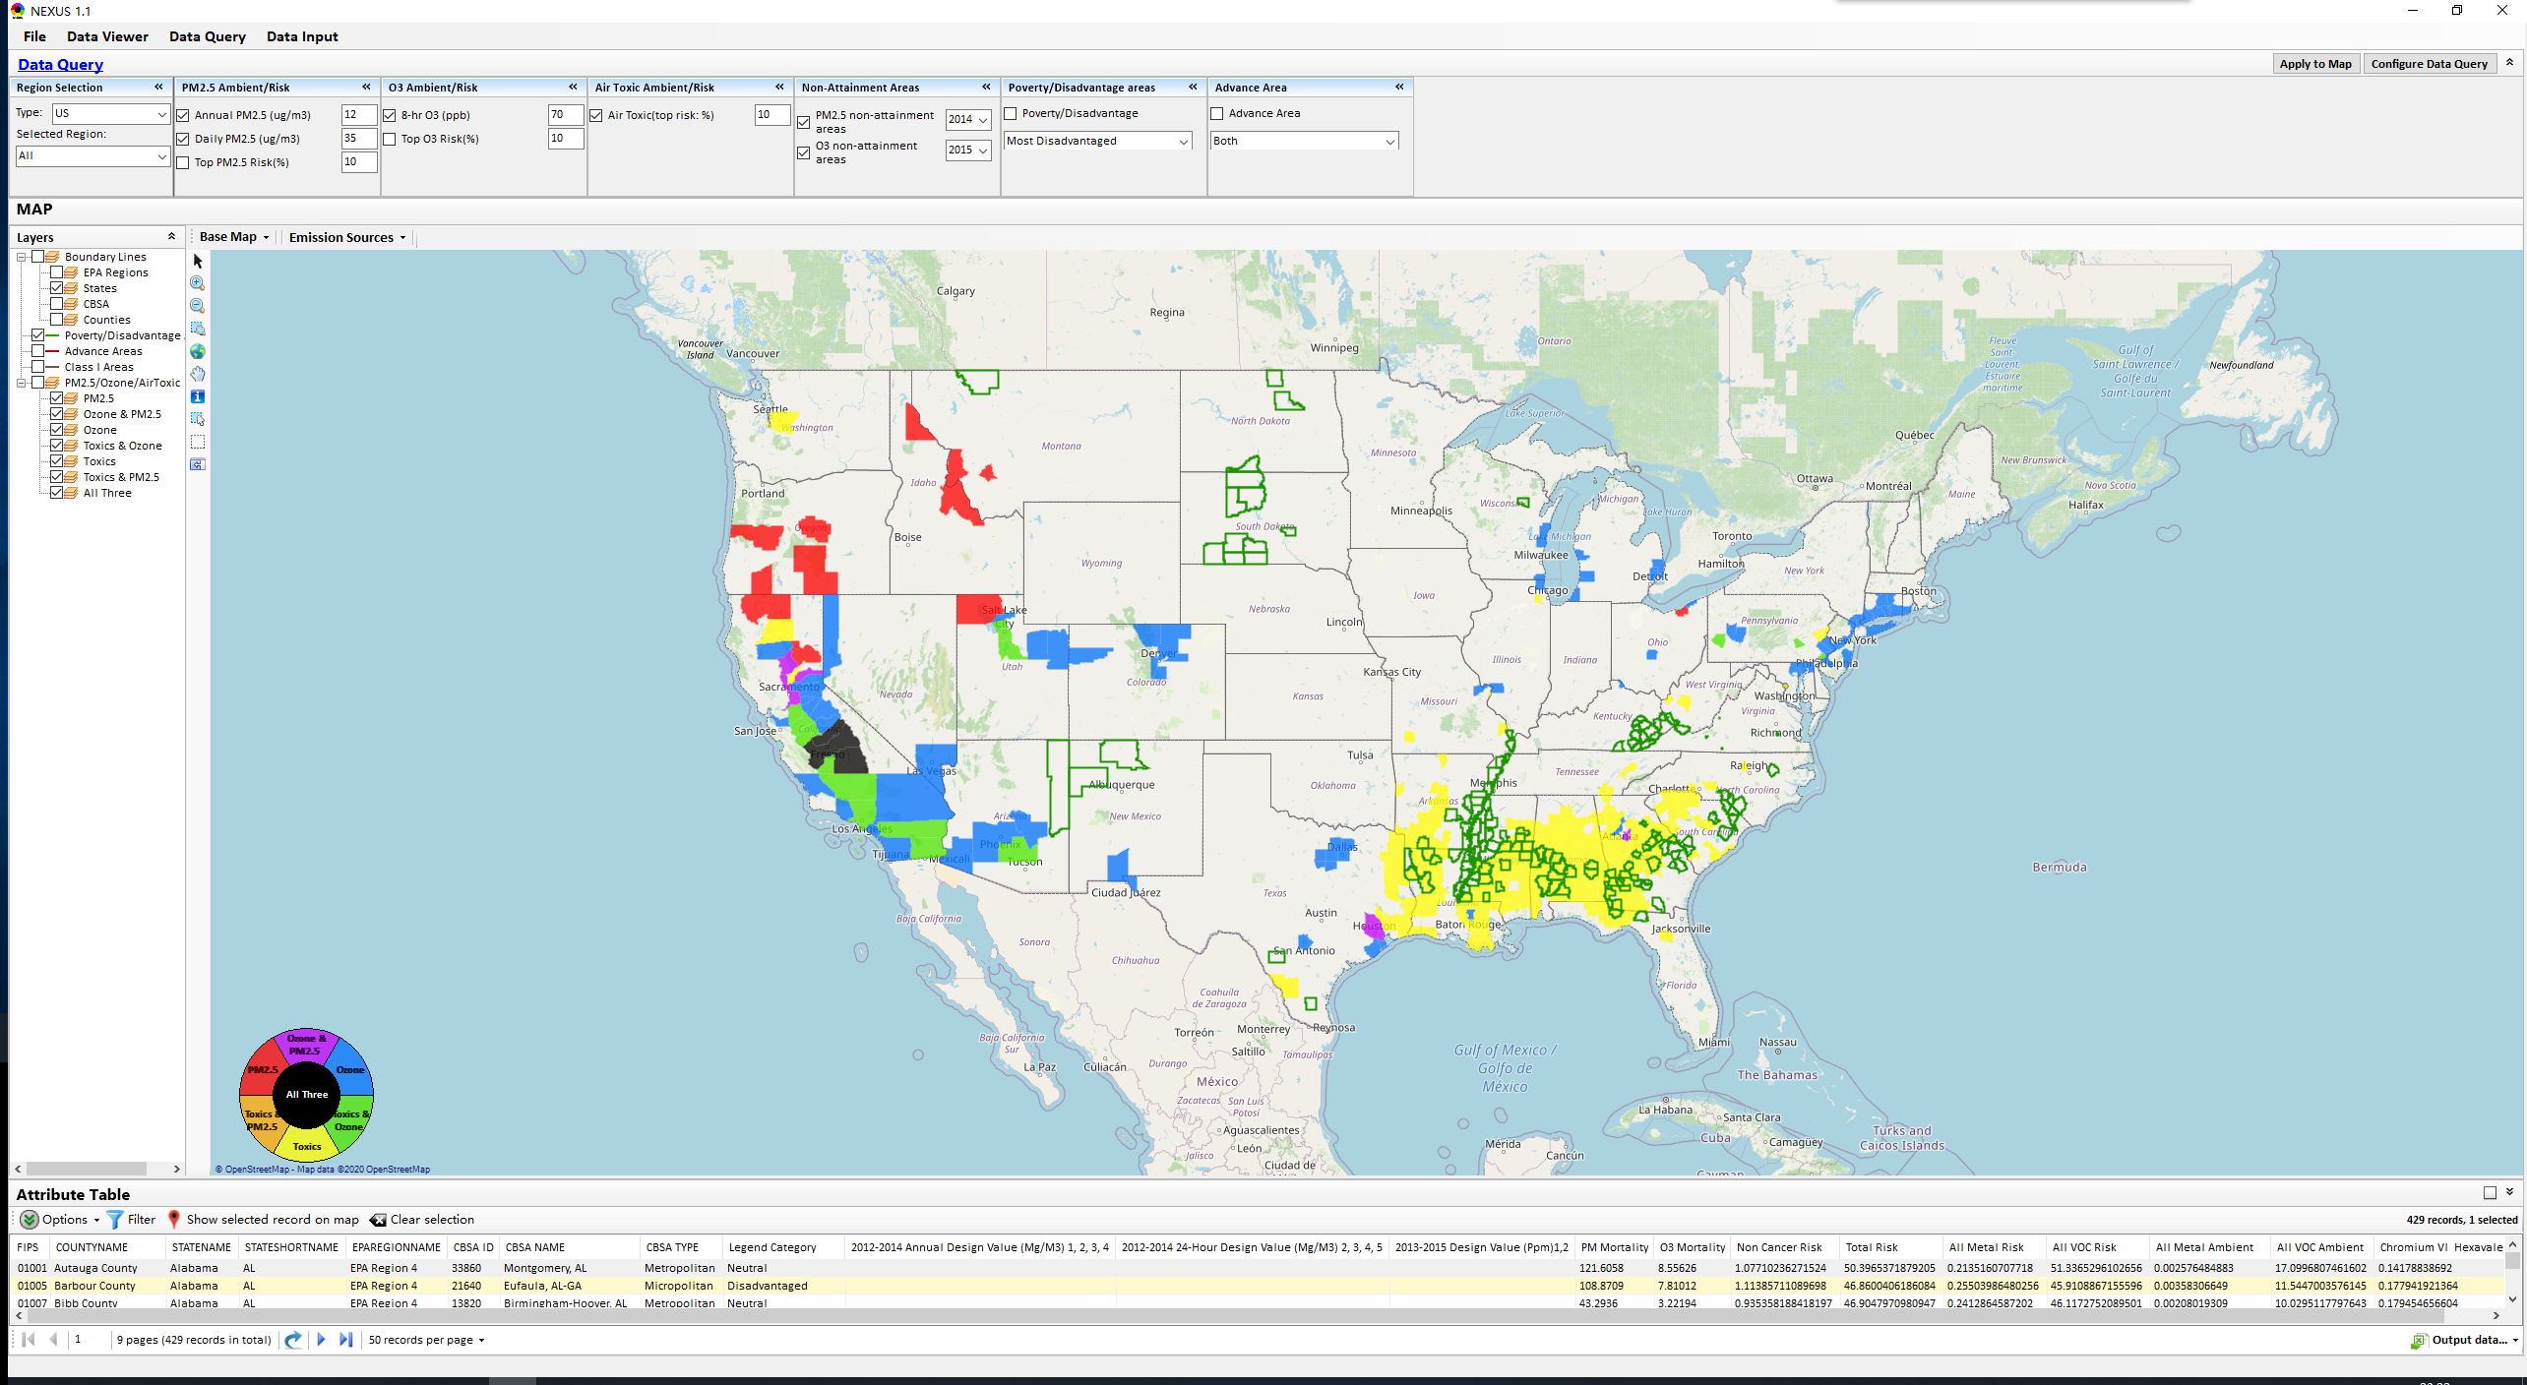
NEXUS Tool: Data Query
    3. Fix the Poverty/disadvantage issue
3
Notes:
Need more data info about CBSAs and corresponding counties

Slide 4
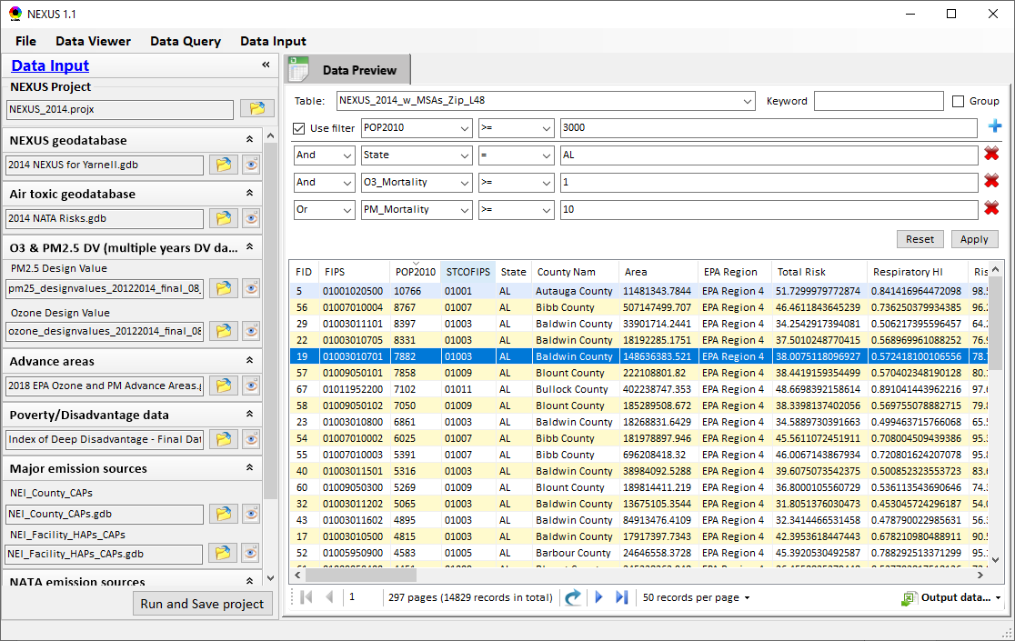
NEXUS Tool: DataTable
    4. Enable to apply more filer conditions.
Click to add one filter
Remove filter
“And” or “Or”
4
Notes:
Need more data info about CBSAs and corresponding counties

Slide 5
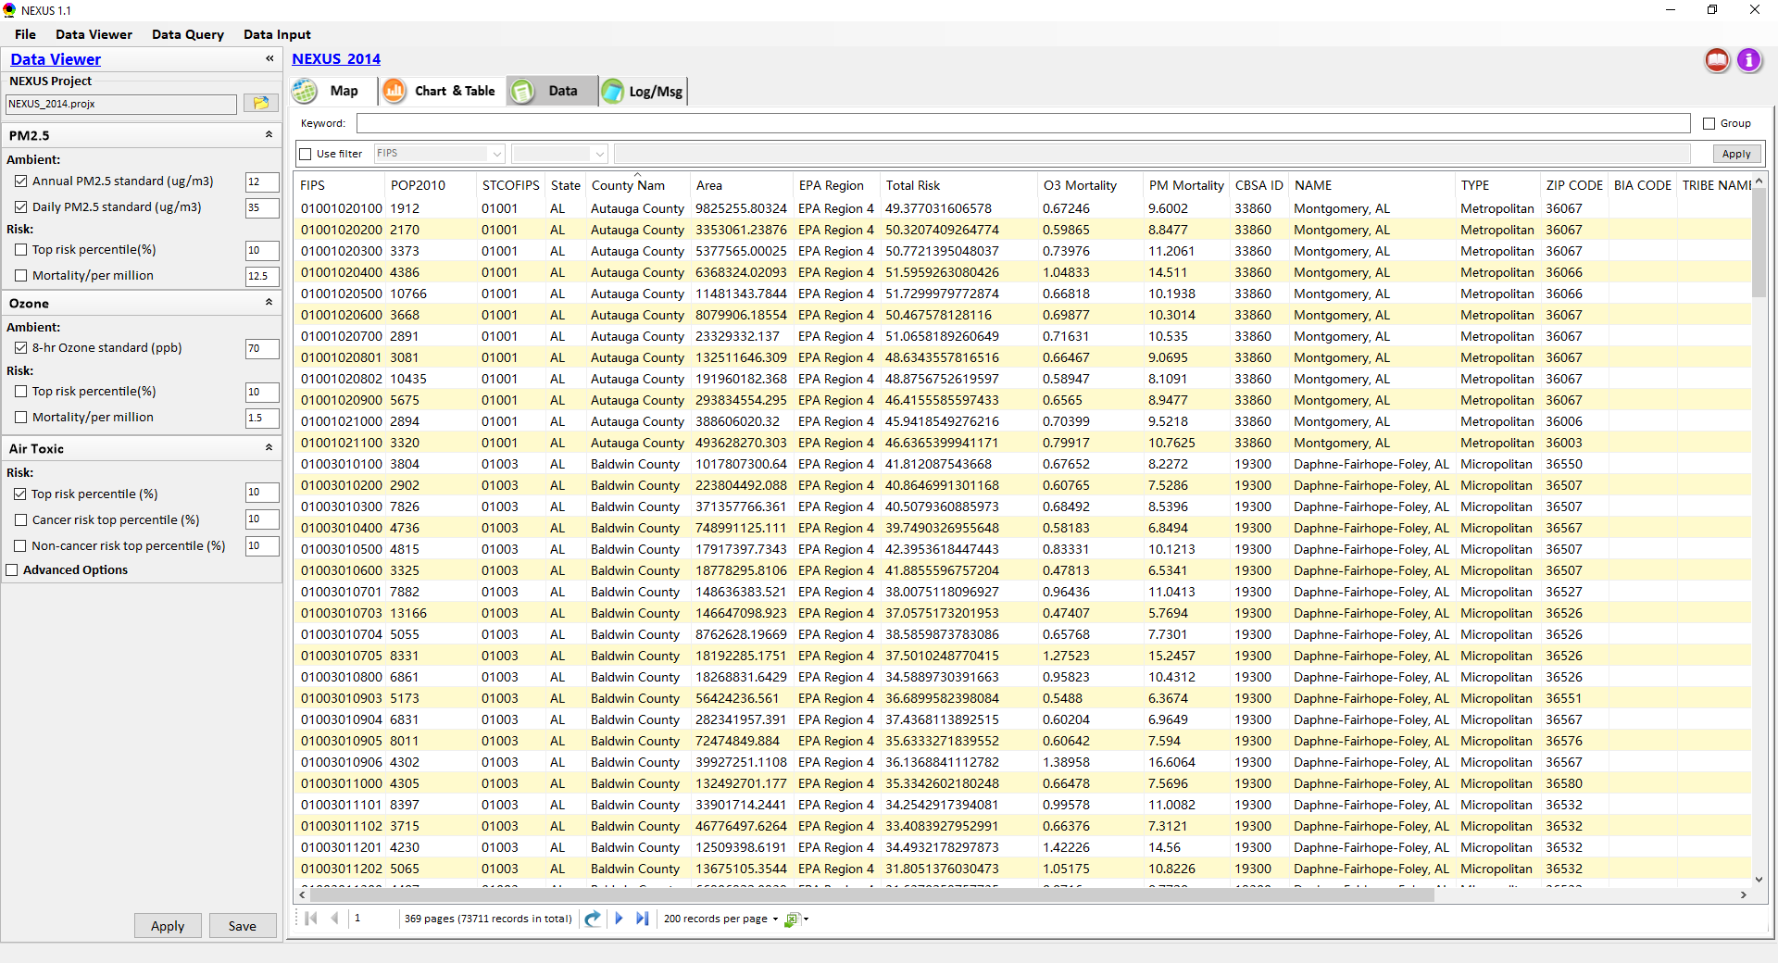
NEXUS Tool: Mortality Calculation
Q1: O3 & PM2.5 Mortality (unit in “pop/million”)?
Q2: How to calculate a county’s total mortality?
Population (2010)
FIPS code
ZIP code
5
Notes:
Need more data info about CBSAs and corresponding counties

Slide 6
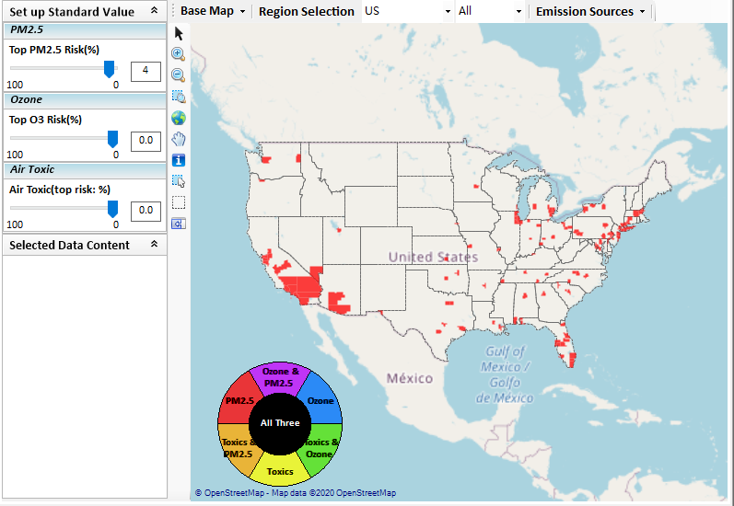
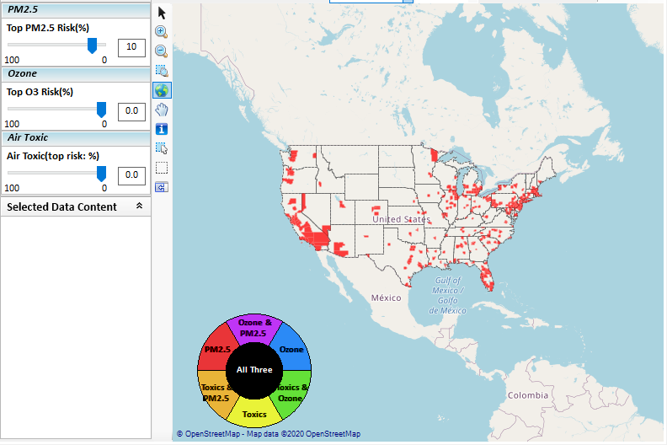
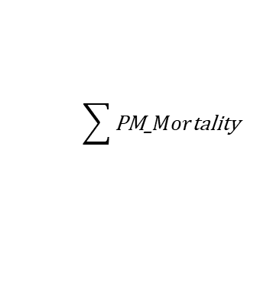
Issues discussion: PM2.5 Risk problem
$$\sum{\text{PM}\text{_}Mor\text{tality}}$$
Top 4% PM2.5 Risk: 16 counties in CA
Top 10% PM2.5 Risk: 24 counties in CA

Slide 7
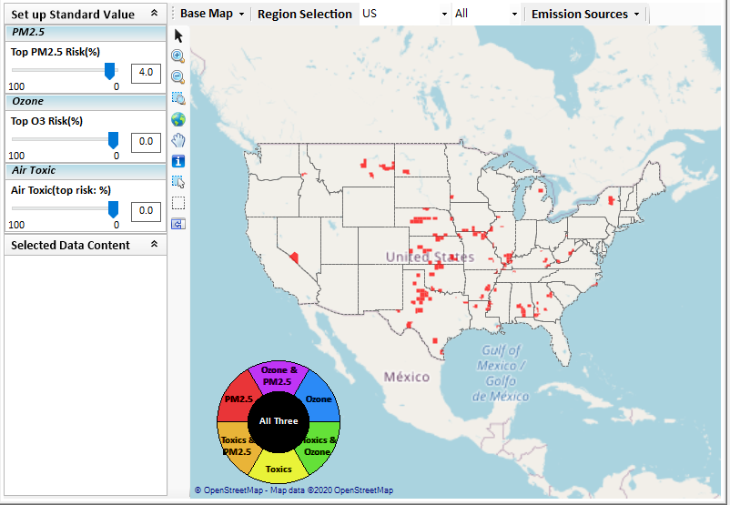
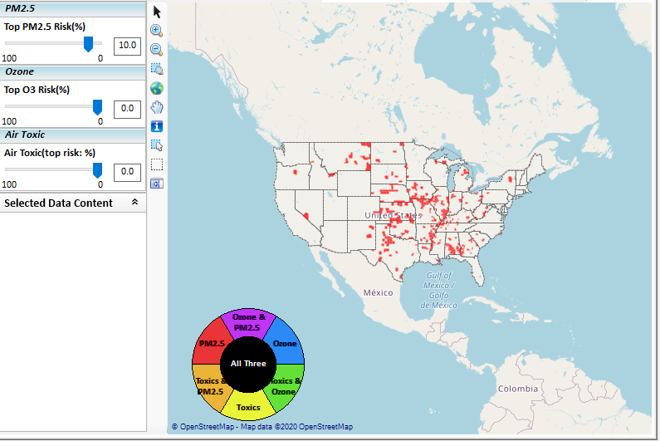
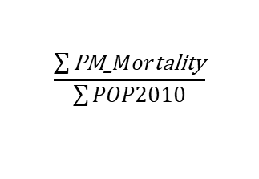
Issues discussion: PM2.5 Risk problem
$$\frac{\sum{\text{PM}\text{_}Mor\text{tality}}}{\sum{POP2010}}$$
Top 4% PM2.5 Risk: 0 counties in CA
Top 10% PM2.5 Risk: 0 counties in CA

Slide 8
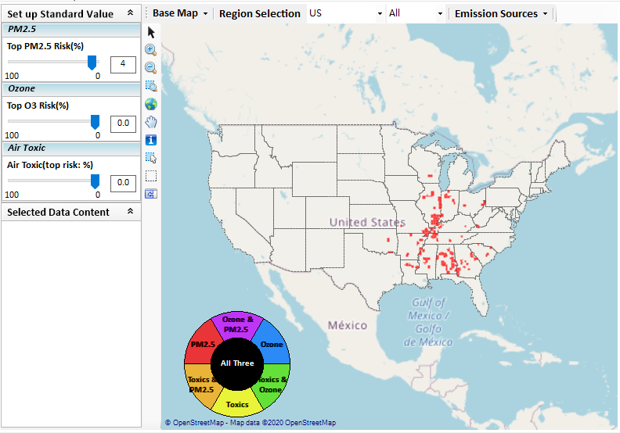
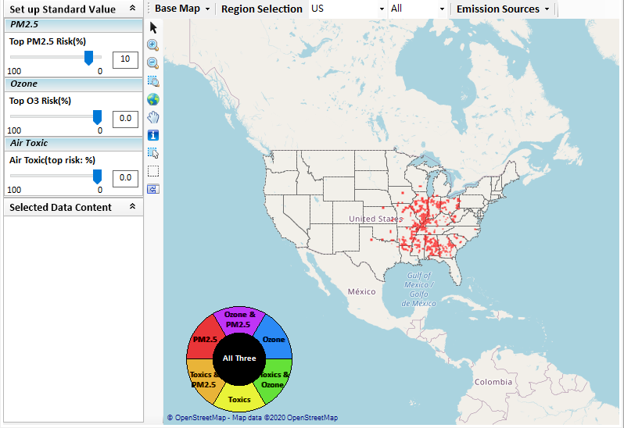
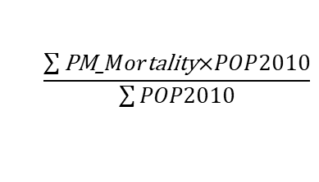
Issues discussion: PM2.5 Risk problem
$$\frac{\sum{\text{PM}\text{_}Mor\text{tality}\text{×}POP2010}}{\sum{POP2010}}$$
Top 4% PM2.5 Risk: 0 counties in CA
Top 10% PM2.5 Risk: 0 counties in CA

