Slide 1
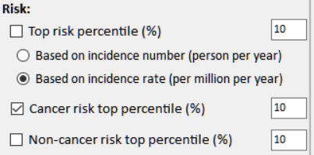
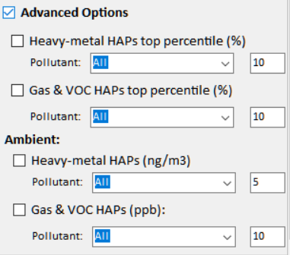
NEXUS 1.6 : Air Toxics
Current
New
Risk:
□ Cancer Risk (max tract-level risk in the county): (default checked)
o Top risk Percentile (higher than x%) 90 (Note: default checked)
o Risk value (x-in-1 million) ? (Note: use 90 %tile risk value)
□ Non-cancer Hazard (max tract-level HI in the county):
o Top risk Percentile (higher than x%) 90 (default if above box checked)
o Hazard Index (HI) ? (Note: use 90 %tile value, find a reasonable range)
(Note: Add up all “HI” in “NATA_2014_Tract_HIs_FINAL” file.
“HI” > 1 means likely adverse non-cancer hazard; <1 means unlikely
Cancer Risk (max tract-level risk in the county):
□ PM & Metal HAPs
Pollutant: All
○ Top risk percentile (higher > %) 90
○ Risk value (x-in-1 million) ?
□ Gas & VOC HAPs
Pollutant: All
○ Top risk Percentile (higher > %) 90
○ Risk value (x-in-1 million) ?
[ ] Advanced Options:
1

Slide 2
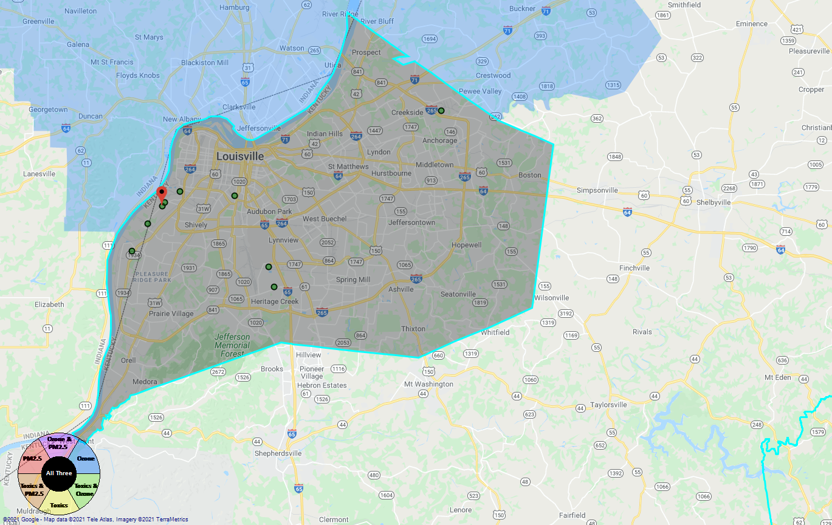
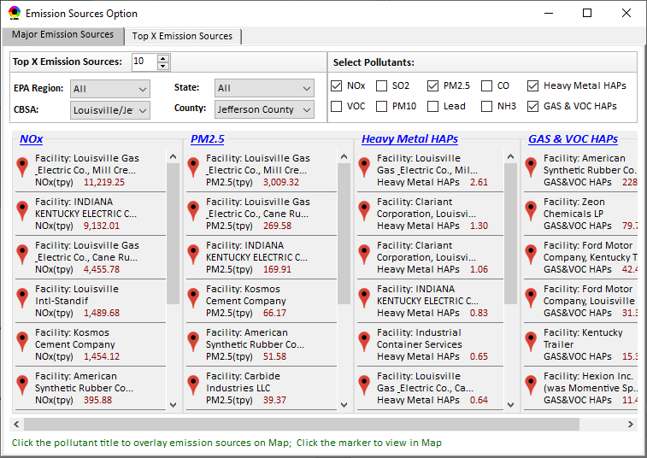
Proximity-based Risk & EJ Analysis Module
Allow to set a flexible “Radius of Impact” for selected source/facility
Add “Tribal” for listing tribal areas (All & individual)
Proximity-based Source/Sector Multi-Pollutant Risk & EJ Analysis
Source/Sector Analysis
Spatial Analysis
Source: American Synthesis Rubber Co., KY Sector group: Organic Chemical Manufacturing
[ x Display national map for Sector group
Radius of Impact
1
50km
Create Table
Create Plot
2

Slide 3
Proximity-based Module: Example Table
Source Name: American Synthesis Rubber Co., Louisville, KY Sector Group Name: Organic Chemical Manufacturing
 | Within Radius of Source | County Avg. | State Avg. | EPA Region Avg. | Nation Avg. | Sector Group (within radius) National avg.
Population total | x,xxx | xx,xxx | xxx,xxx | xxx,xxx | 317,xxx,xxx | xxx,xxx
PM2.5 risk (%tile) | x% | x% | x% | x% | x% | x%
Ozone risk (%tile) | x% | x% | x% | x% | x% | x%
Air Toxics risk: Cancer risk (%tile) | x% | x% | x% | x% | x% | x%
Cancer risk value (x in-million lifetime) | x.x | x.x | x.x | x.x | x.x | x.x
Non-cancer risk (%tile) | x% | x% | x% | x% | x% | x%
Non-cancer risk (Hazard Index) | x.x | x.x | x.x | x.x | x.x | x.x
Climate risk: Flood (%tile) | x% | x% | x% | x% | x% | x%
Sea level rise (%tile) | x% | x% | x% | x% | x% | x%
Fire (%tile) | x% | x% | x% | x% | x% | x%
Disease (%tile) | x% | x% | x% | x% | x% | x%
EJ Indicators: Minority group (%tile) | x% | x% | x% | x% | x% | x%
Low-income group (%tile) | x% | x% | x% | x% | x% | x%
Demographic Index (%tile) | x% | x% | x% | x% | x% | x%
Linguistic Isolation (%tile) | x% | x% | x% | x% | x% | x%
3

Slide 4
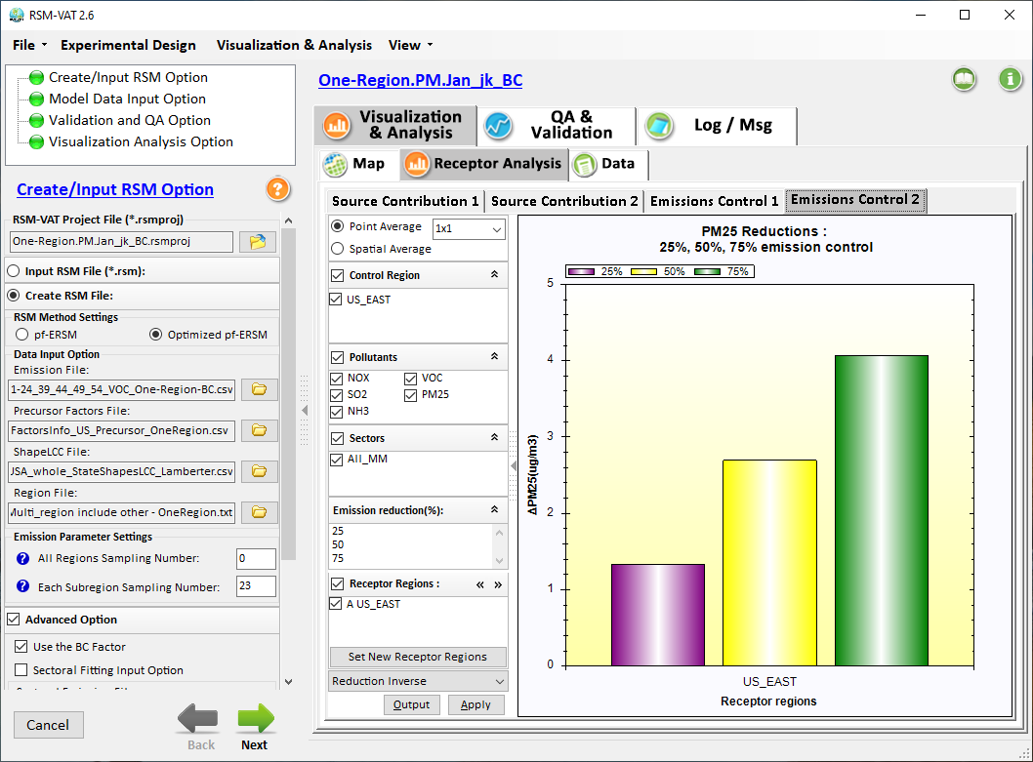
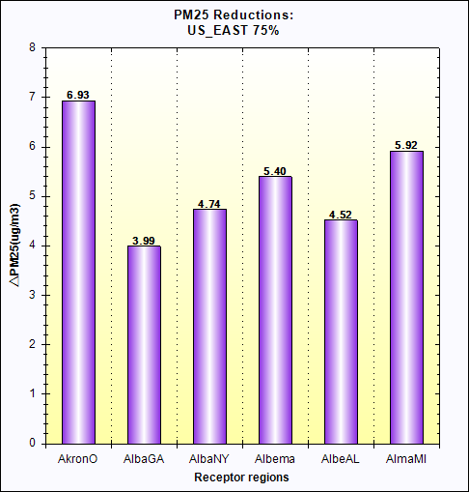
Proximity-based Module: Example Chart
Air Quality
Source: Sector Group:
PM2.5 risk
O3 risk
Air Toxics risk
Cancer risk
Non-Cancer risk
(%tile
EJ Indicators
Climate Risks
Population
Minority
Income
Education
Language
Flood
Fire
Sea Level Rise
Heat
Disease
Nation
avg. (%tile)
Climate Risks
Flood
Fire
Sea Level Rise
Heat
Disease
Within Radius County avg. State avg. EPA region avg. Nation avg. Sector Group avg.
of Source (Within Radius)
4

Slide 5
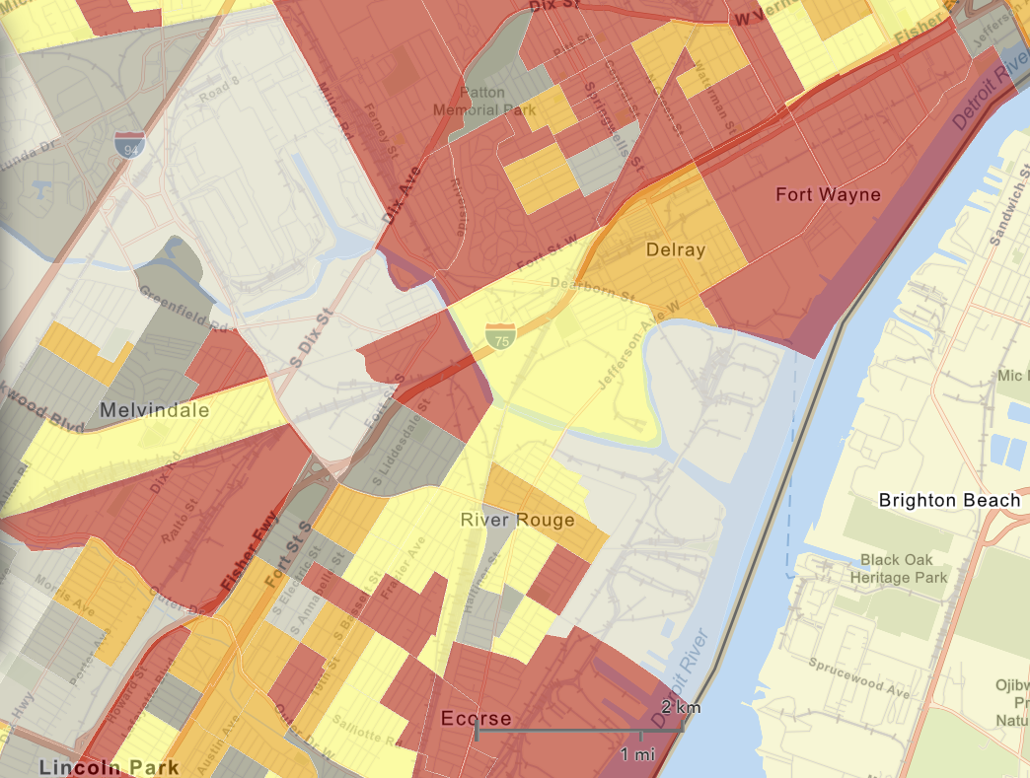
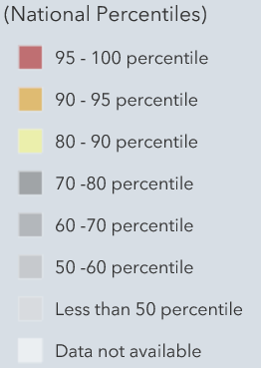

Proximity Analysis Module: Spatial Analysis
EJ Indicators
Demographic Index
Minority
Income
Education
Language
Climate Risks
Flood
Fire
Sea Level Rise
Heat
Disease
Proximity-based Source/Sector Multi-Pollutant Risk & EJ Analysis
Source/Sector Analysis
Spatial Analysis
EJ
Indicators
Minority
Climate
Risk
Fire
5

