Slide 1
NEXUS Tool Use for Sector Prioritization
NEXUS tool is currently oriented towards areas to identify sources/sectors contributing to multi-pollutant (O3, PM2.5, toxics) air quality issues
We can exercise the current version to identify sources/sectors that are most prevalent in the top 50 multi-p risk areas.
Working with the MP Team (HEID & AQPD) to use NEXUS and generate the sector data to supplement the current spreadsheet screening and allow more information to confirm or qualify its sector rankings.

Slide 2
NEXUS Tool: Complete National Rankings of Areas from Data Query Module: R5 Example
STATE | COUNTY | CBSA NAME | PM Mortality Num % | O3 Mortality Num % | Total Risk Num % | Overall Rank | Poverty / Disadvantage | Advance Area Type
IL | Cook County | Chicago-Joliet-Naperville, IL-IN-WI | 99 | 99 | 99 | 1 | Neutral
MI | Wayne County | Detroit-Warren-Livonia, MI | 99 | 99 | 99 | 1 | Disadvantaged
MI | Oakland County | Detroit-Warren-Livonia, MI | 99 | 99 | 98 | 2 | Advantaged
OH | Cuyahoga County | Cleveland-Elyria-Mentor, OH | 99 | 99 | 98 | 2 | Disadvantaged
OH | Franklin County | Columbus, OH | 99 | 99 | 98 | 2 | Neutral
IN | Marion County | Indianapolis-Carmel, IN | 99 | 98 | 98 | 3 | Disadvantaged
OH | Hamilton County | Cincinnati-Middletown, OH-KY-IN | 99 | 98 | 97 | 4 | Disadvantaged
WI | Milwaukee County | Milwaukee-Waukesha-West Allis, WI | 99 | 98 | 97 | 4 | Disadvantaged | PM
MN | Hennepin County | Minneapolis-St. Paul-Bloomington, MN-WI | 98 | 98 | 98 | 4 | Advantaged | Both
IL | DuPage County | Chicago-Joliet-Naperville, IL-IN-WI | 98 | 97 | 98 | 5 | Most Advantaged
MI | Macomb County | Detroit-Warren-Livonia, MI | 98 | 98 | 97 | 5 | Advantaged
OH | Montgomery County | Dayton, OH | 98 | 98 | 95 | 6 | Disadvantaged
IN | Lake County | Chicago-Joliet-Naperville, IL-IN-WI | 98 | 97 | 95 | 7 | Neutral
OH | Summit County | Akron, OH | 98 | 97 | 95 | 7 | Neutral
IL | Lake County | Chicago-Joliet-Naperville, IL-IN-WI | 97 | 96 | 97 | 7 | Advantaged
NEXUS can be used to identify highest risk areas across O₃, PM_{2.5}, and Air Toxics. Information above was generated in Data Query for Region 5 and exported into excel where rankings were applied.
Top CBSAs (using this approach) – Chicago, Detroit, Cleveland, Columbus, Indianapolis, Cincinnati, Milwaukee, Minneapolis, Dayton & Akron
2

Slide 3
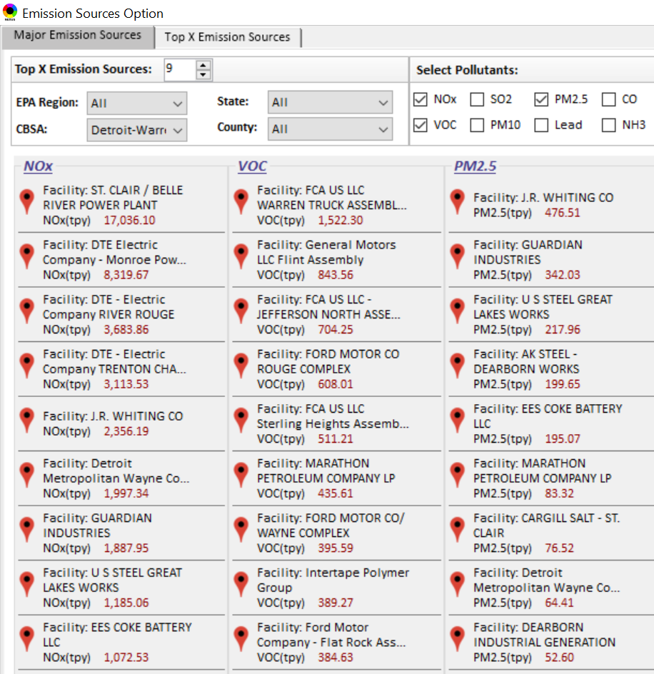
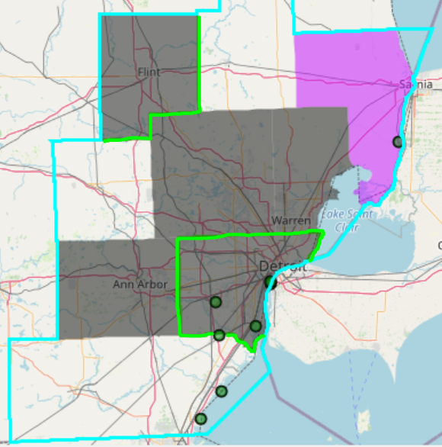

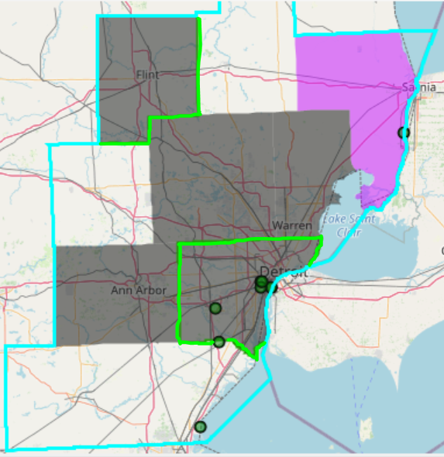
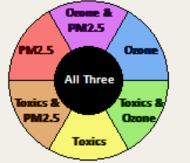
NEXUS Tool: Identify Emissions Sources in CBSAs: Detroit CBSA Example
G
S
G
S
Ma
Ma
S
Ma
M
W
W
M
G
M
M
M
W
W
W
Top NOx Emission Sources
Top VOC Emission Sources
W
W
W
M
Ma
W
G
S
W
W
W
Ma
M
W
S
W
W
S
W
W
W
W
M
G = Genessee Co., Ma= Macomb Co., M= Monroe Co., S = St. Clair Co., W = Wayne Co.
Top PM_{2.5} Emission Sources
NEXUS can be used to identify top emission sources. The information above was generated in Data Query for the Detroit CBSA . We can quickly see that the majority of the NOx, VOC & PM_{2.5} emission sources are located in Wayne County. Let’s explore the Wayne County sources further…
3

Slide 4
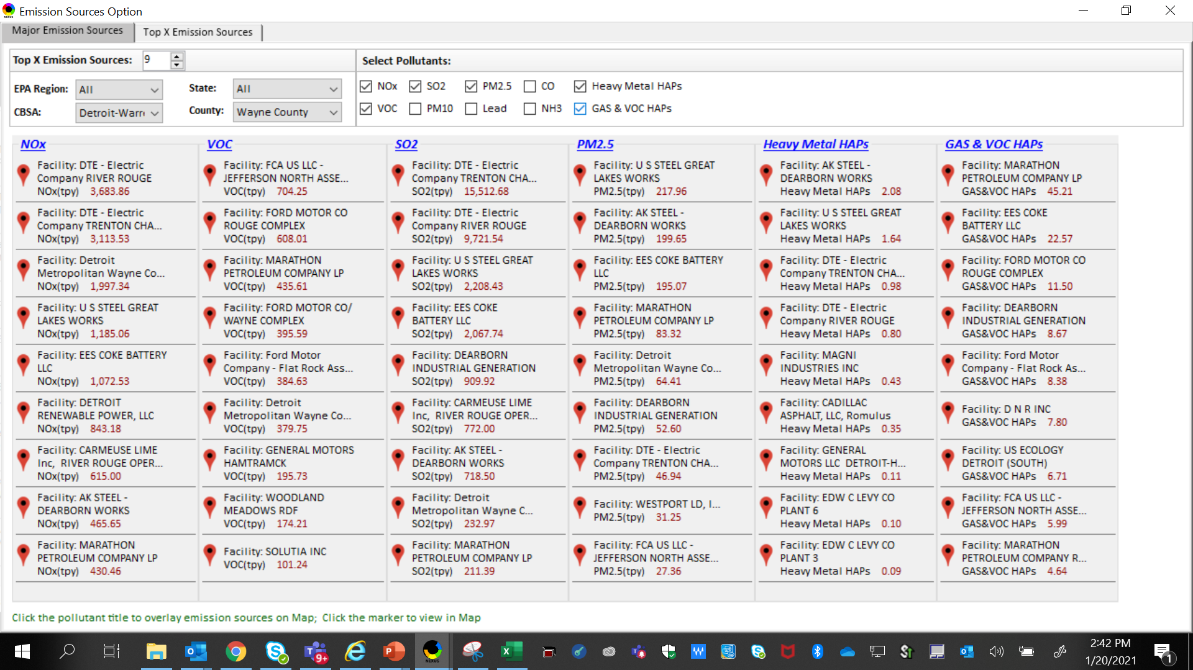
NEXUS Tool: Identify Top Emitting Sources: Wayne County Example
NEXUS can be used to identify top emission sources. The information above was generated in Data Query for Wayne County, MI. This data can then be summarized by sector and pollutant in a separate spreadsheet across all areas for generating additional insights on sector rankings.
4

Slide 5
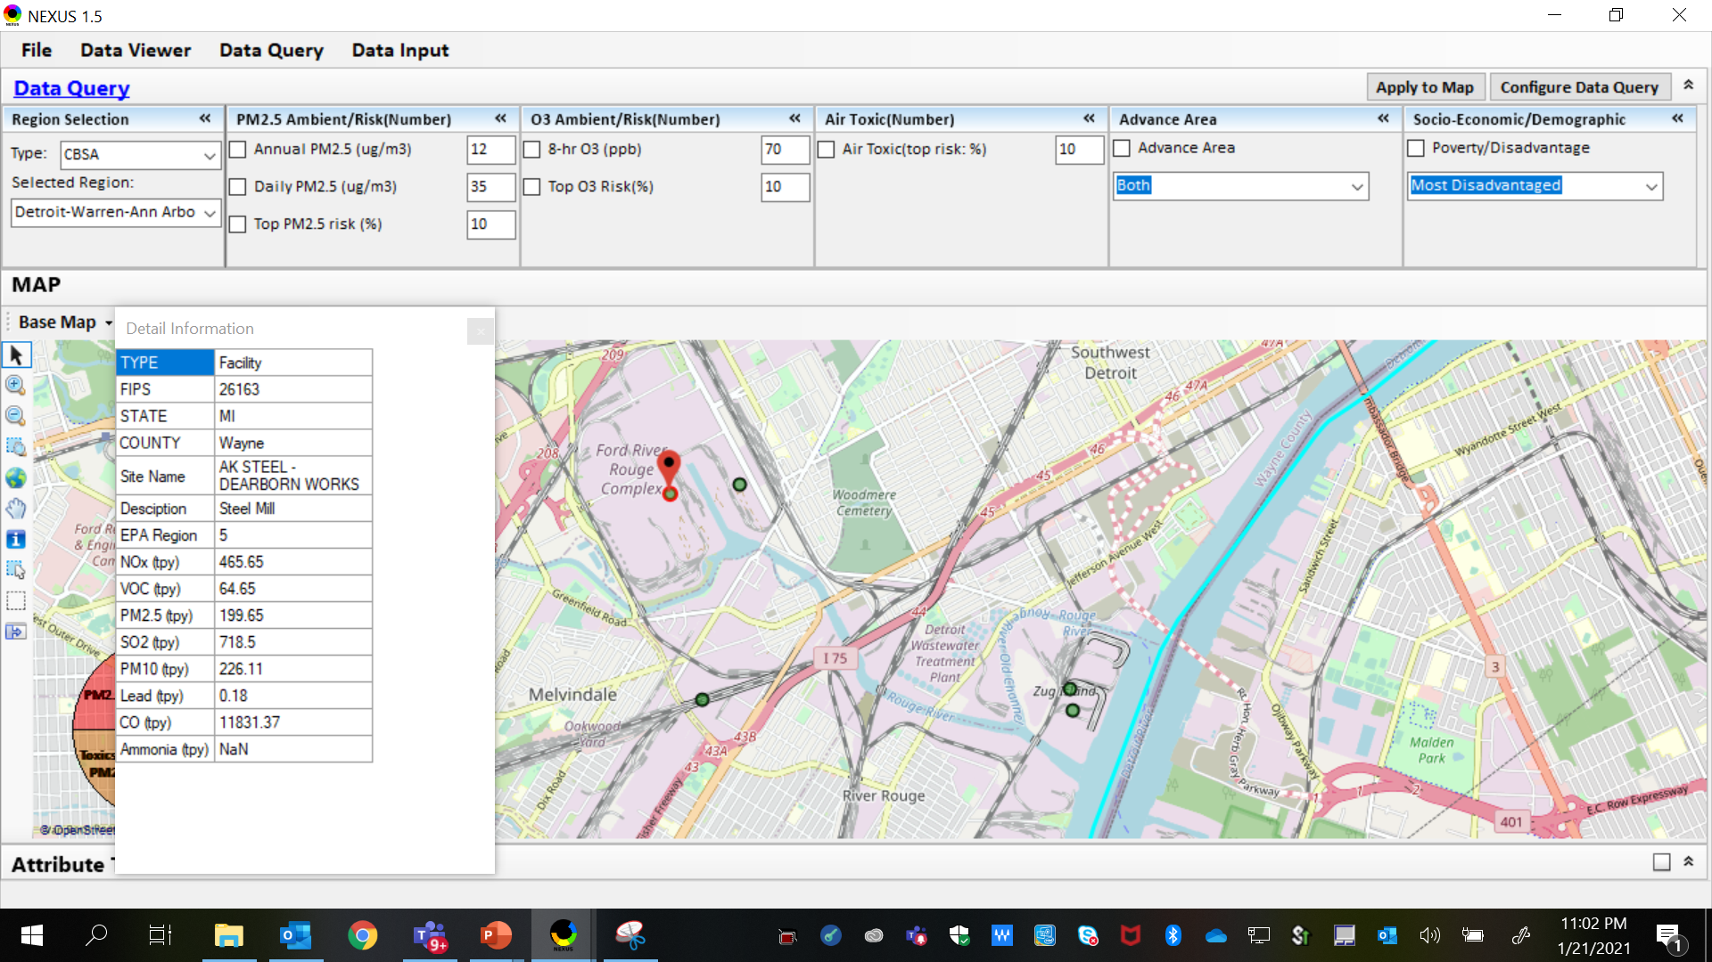
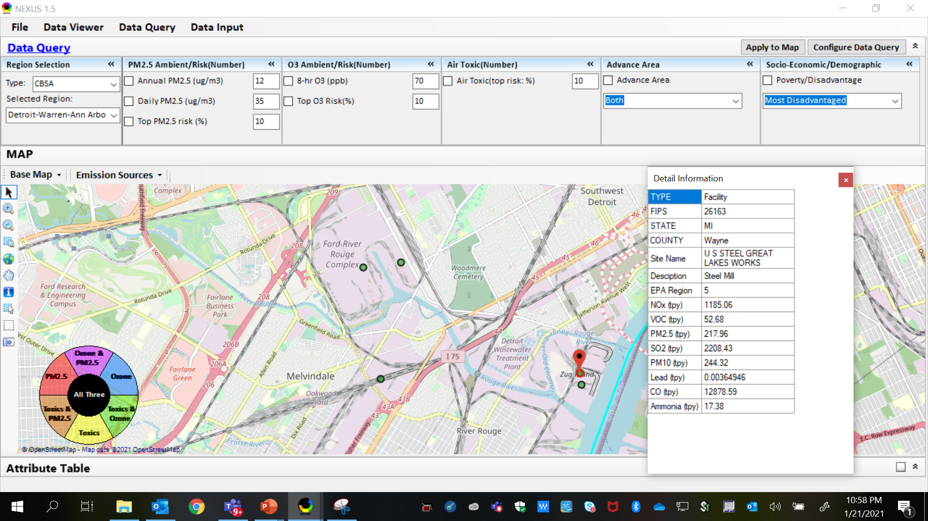
NEXUS Tool: Sector Screening for EJ Purposes: Steel Mills in Wayne County
AK Steel
US Steel
AK Steel & US Steel were both identified as top emitters for NOx, SO₂, PM_{2.5} and Heavy Metal HAPs, highlighting the potential co-benefits of controls for steel mill sector. The above map was generated in NEXUS Data Query. Let’s see the proximity of these steel mills to EJ communities…
5

Slide 6
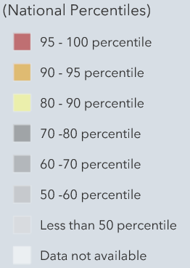
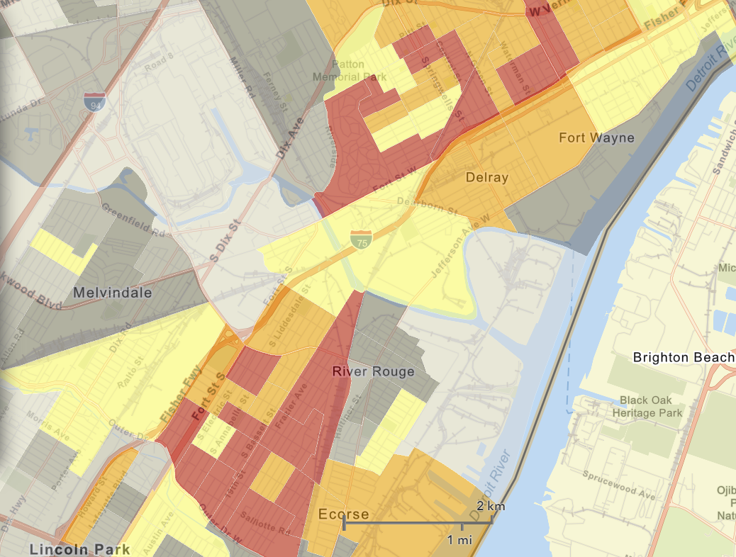
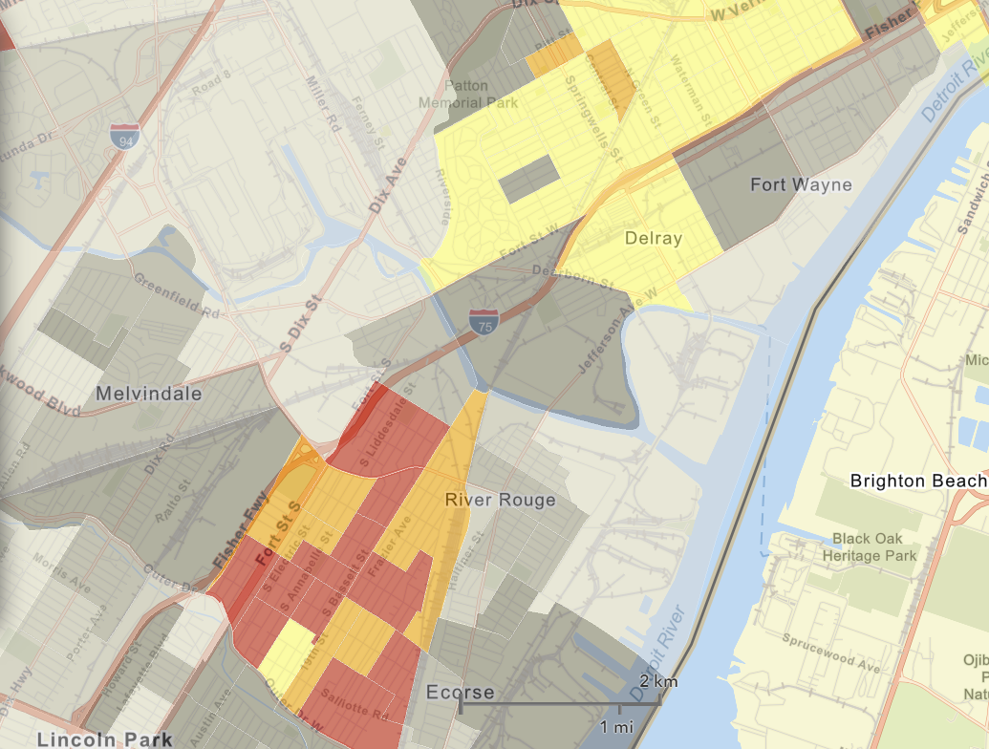
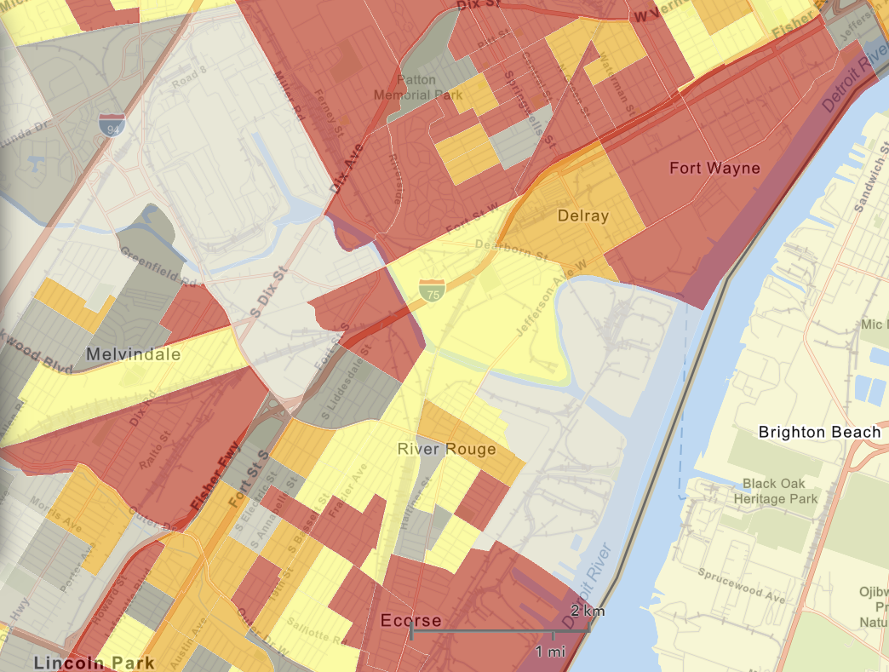

NEXUS Tool: EJ Screening Information: Indices in Wayne County
NEXUS Map
NEXUS can be used to determine EJ communities in areas with MP concerns. NEXUS currently includes a poverty/disadvantage index, and we plan to incorporate additional EJ metrics such as the data inputs below from EJSCREEN. These indices show the close proximity of AK Steel & US Steel to EJ communities.
AK Steel
US Steel
EJSCREEN Demographic Index
EJSCREEN Minority Population
EJSCREEN Low Income Population
6

