Slide 1
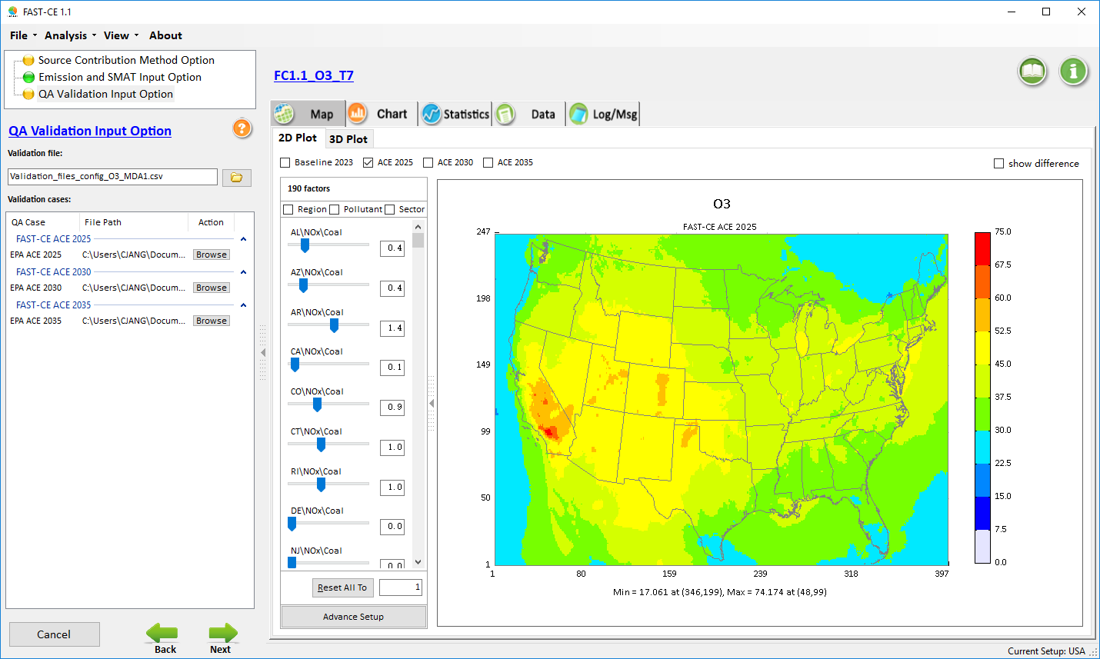
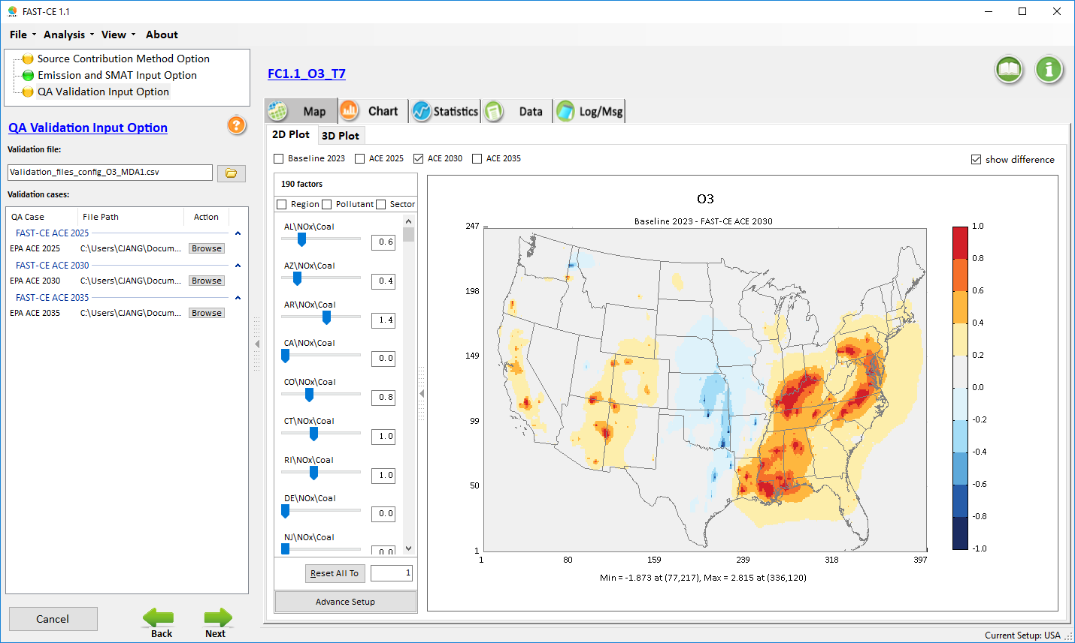
“FAST-CE”
(FAST-CE: Flexible Air Quality Scenario Tool – Community Edition)
For Ozone and PM2.5
The FAST-CE 2.3 package (“FAST-CE 2.3.exe” & “FAST-CE 2.3 Data.exe”: run both to install) is available at EPA’s NewFTP site under:
ftp://newftp.epa.gov/aqmg/cjang/FAST-CE/FAST-CE 2.3/
Concentration
Response
Carey Jang, OAQPS/AQAD/AQMG
Notes:
spatial field: A Spatial Field refers to air pollution estimates made at the center of each grid cell in a specified modeling domain. For example, MATS might calculate ozone design values for each grid cell in the modeling domain. Several types of Spatial Fields can be calculated for ozone and PM.
利用环境监测数据、模型数据（主要是CMAQ模拟的结果）作为模型输入，并利用优化的数理统计技术对大气复合污染状况进行模拟，实现对环境空气质量标准的达标评估。其中包括point estimate和spatial field estimate。

Slide 2
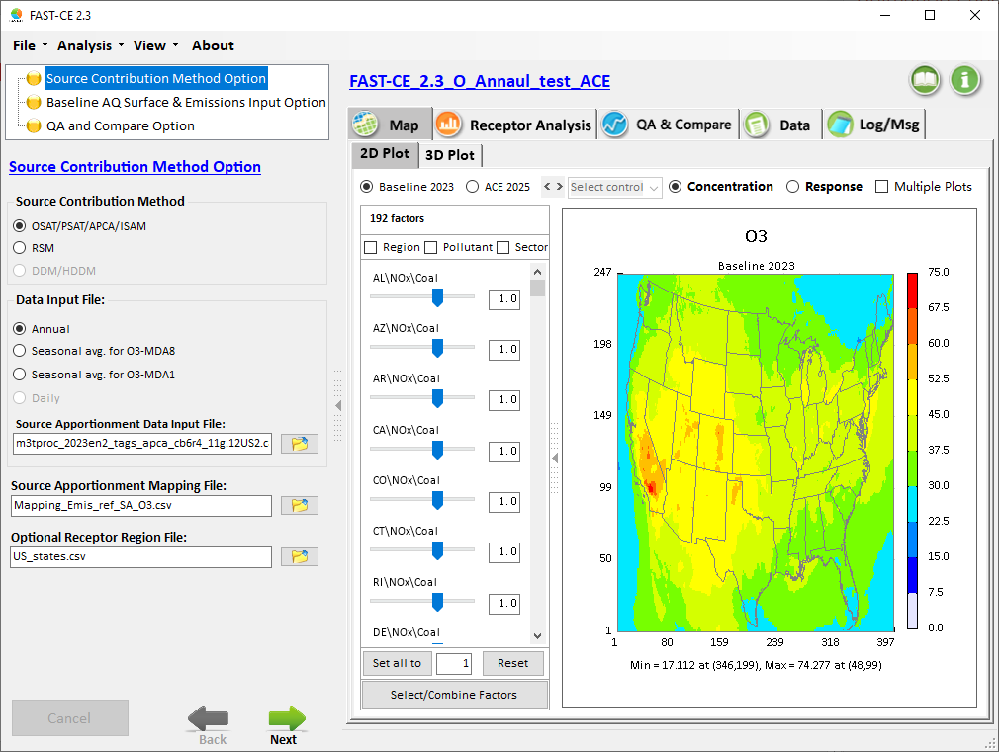
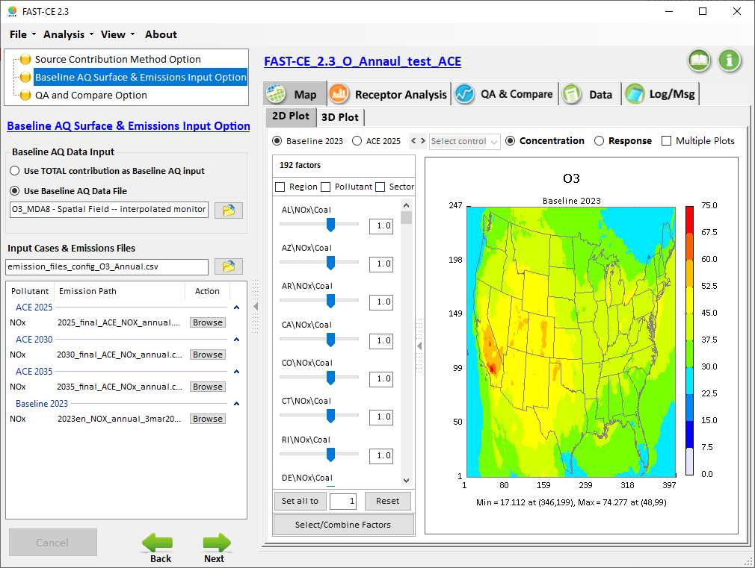
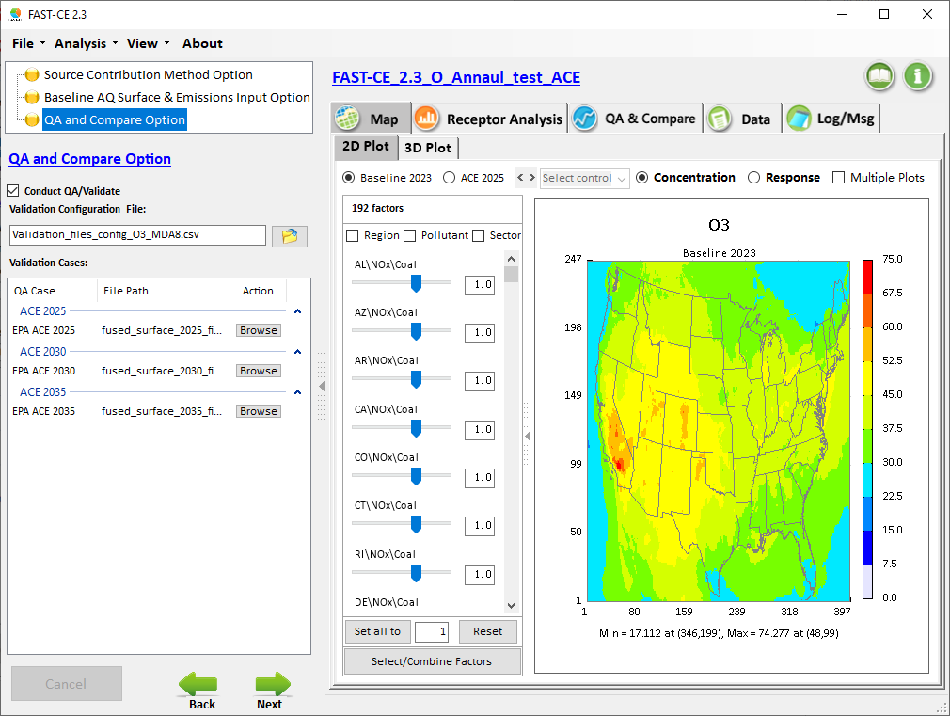
Source Contribution Method Module
Baseline AQ Surface & Emissions Input Module
Q/A and Compare Module
2
Notes:
1. Thank Cen/Gao/Luo/Chen; 2. HZ more visits; 3. AP on HZ

Slide 3
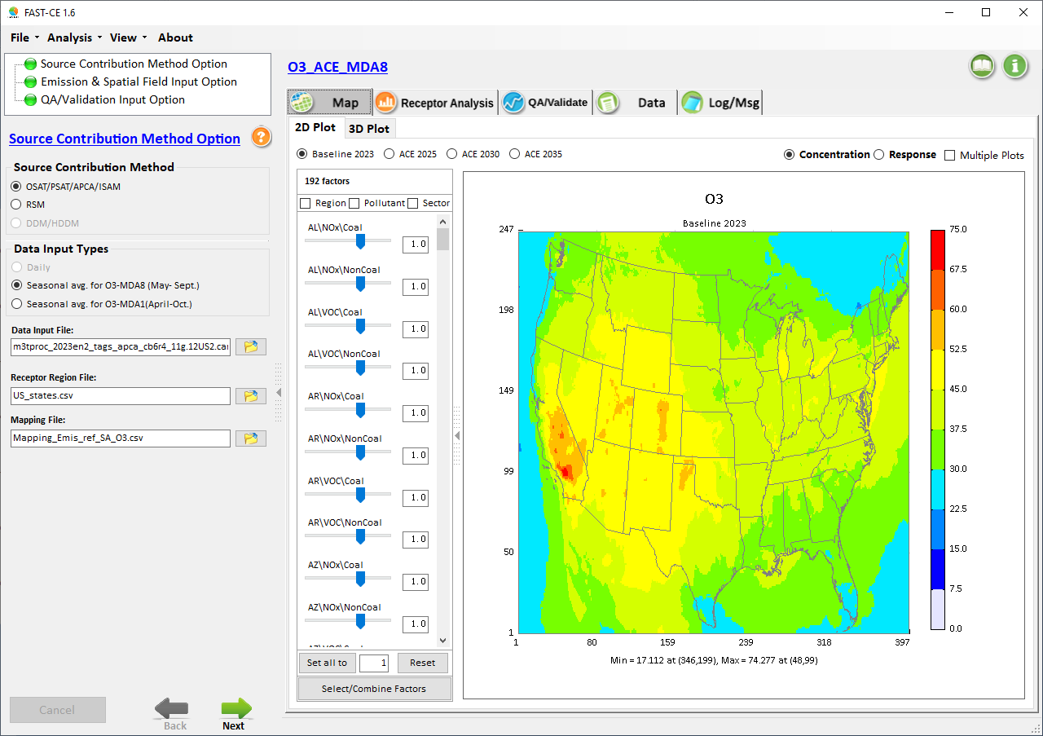
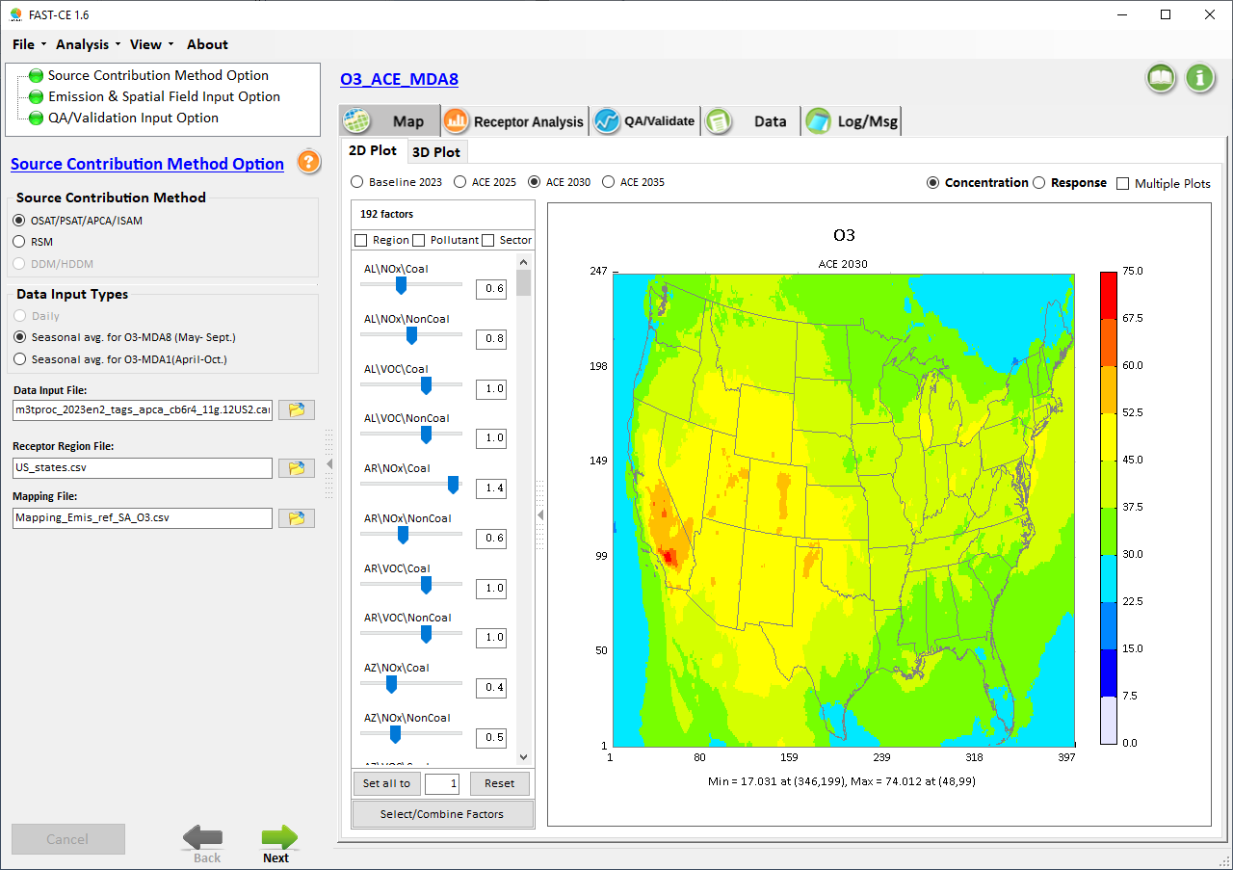
“Baseline” vs. “Scenarios”
Adjustable radio button
Notes:
1. Thank Cen/Gao/Luo/Chen; 2. HZ more visits; 3. AP on HZ

Slide 4

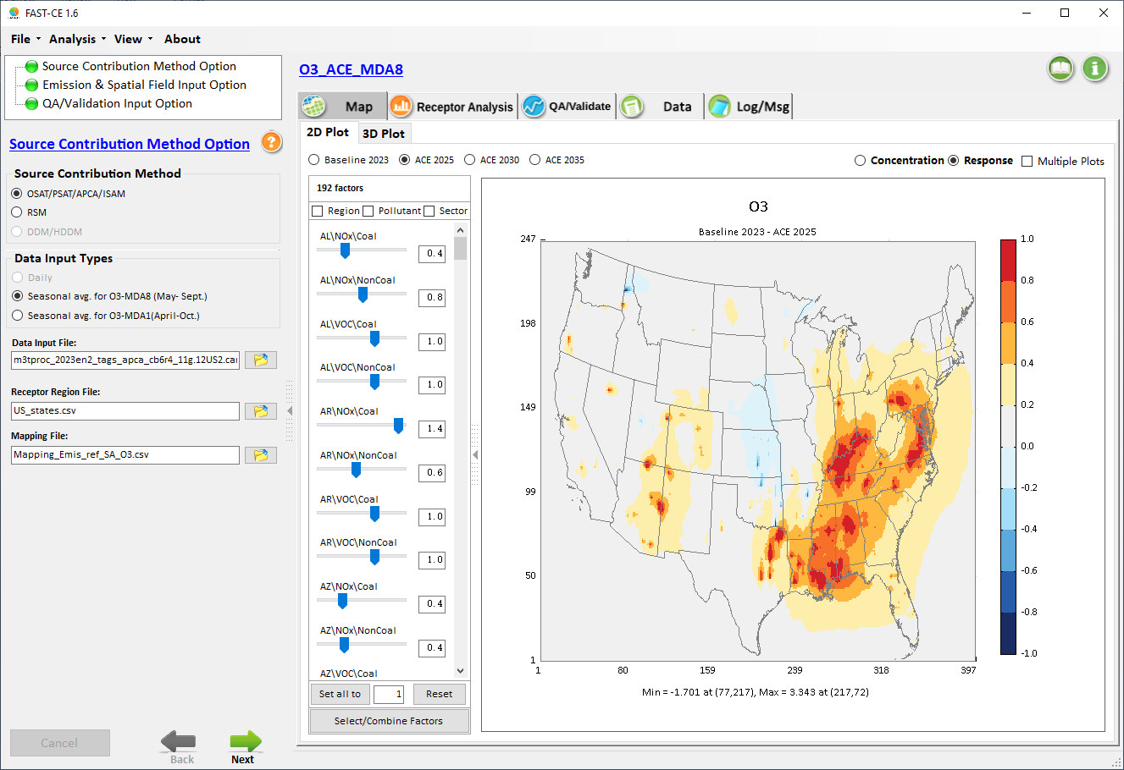
“Concentration” vs. “Response”
Notes:
1. Thank Cen/Gao/Luo/Chen; 2. HZ more visits; 3. AP on HZ

Slide 5
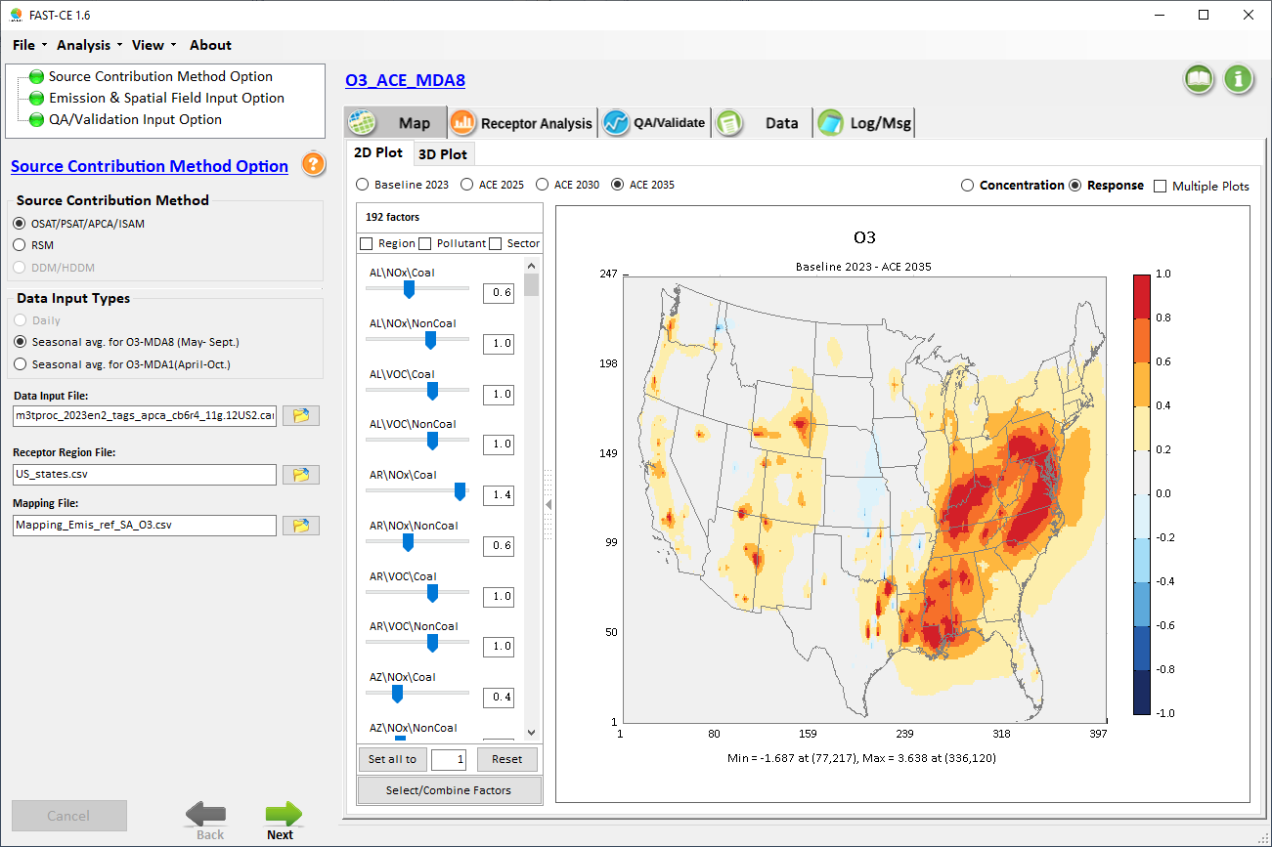
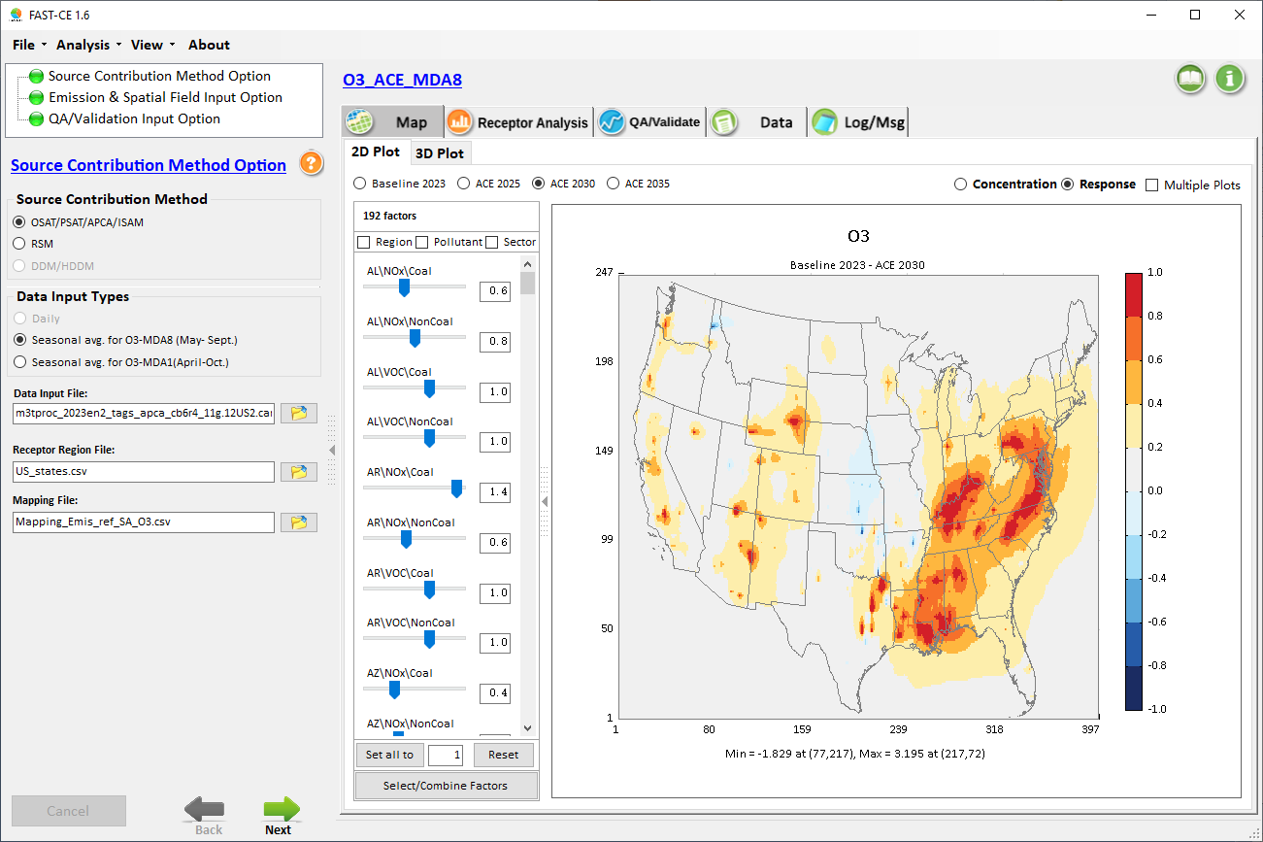
Real-time Scenario & Response
Notes:
1. Thank Cen/Gao/Luo/Chen; 2. HZ more visits; 3. AP on HZ

Slide 6
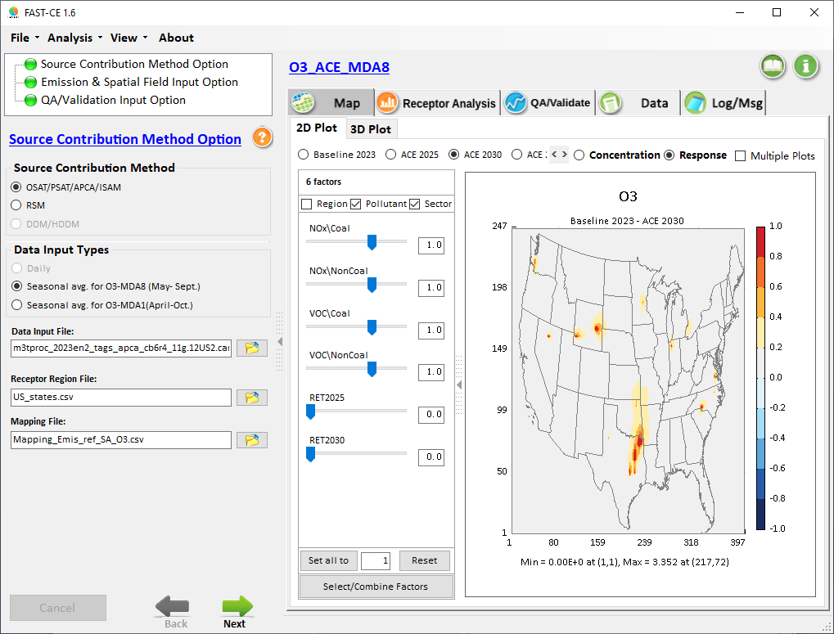
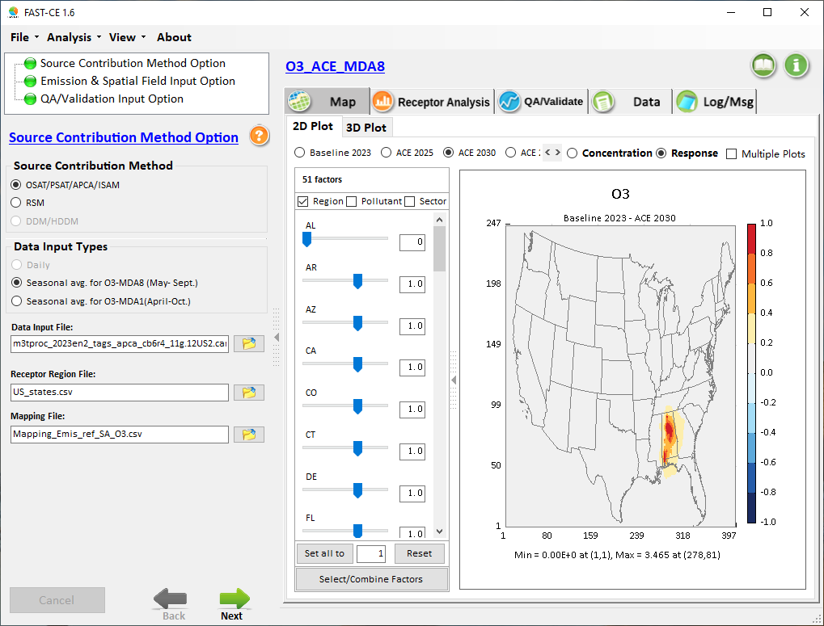
Factor Selection: “Region”/“Pollutant”/“Sector”
Notes:
1. Thank Cen/Gao/Luo/Chen; 2. HZ more visits; 3. AP on HZ

Slide 7
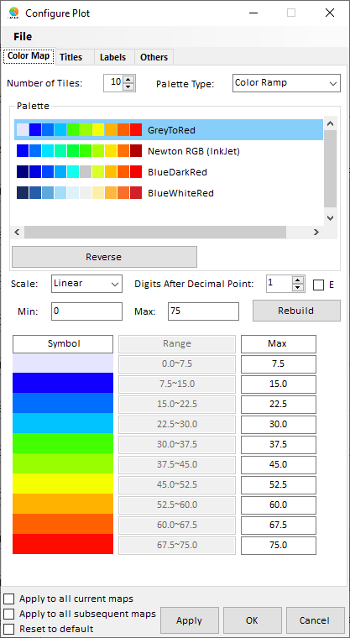
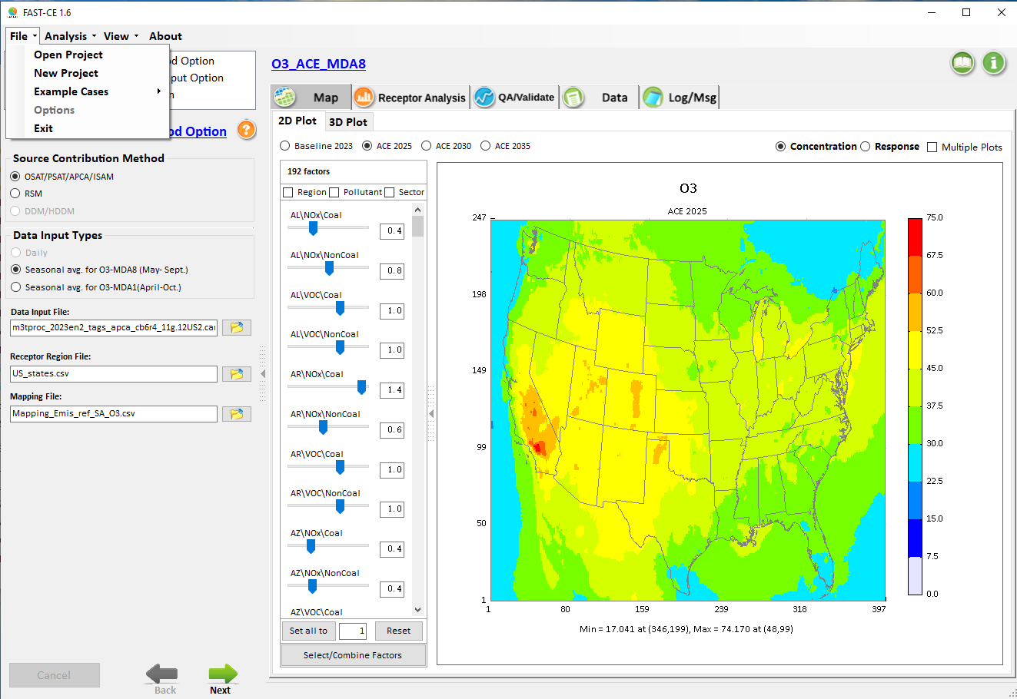
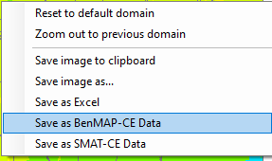
“Save to BenMAP/SMAT” & “Adjust Color/Scale”
A simple “click” to open “color/scale/legend” window
“Right click” to
save image (copy & paste)
Save to BenMAP or SMAT format
Notes:
1. Thank Cen/Gao/Luo/Chen; 2. HZ more visits; 3. AP on HZ

Slide 8
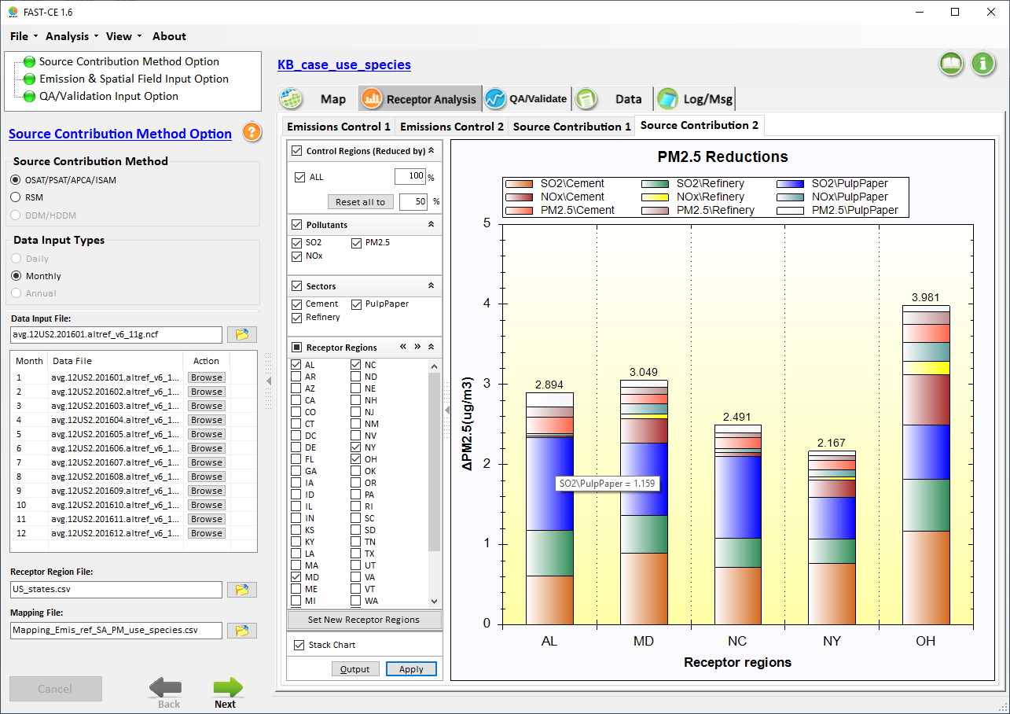
Receptor Analysis: Source Contribution #2
Individual Contributions of emissions reduction
Notes:
1. Thank Cen/Gao/Luo/Chen; 2. HZ more visits; 3. AP on HZ

Slide 9
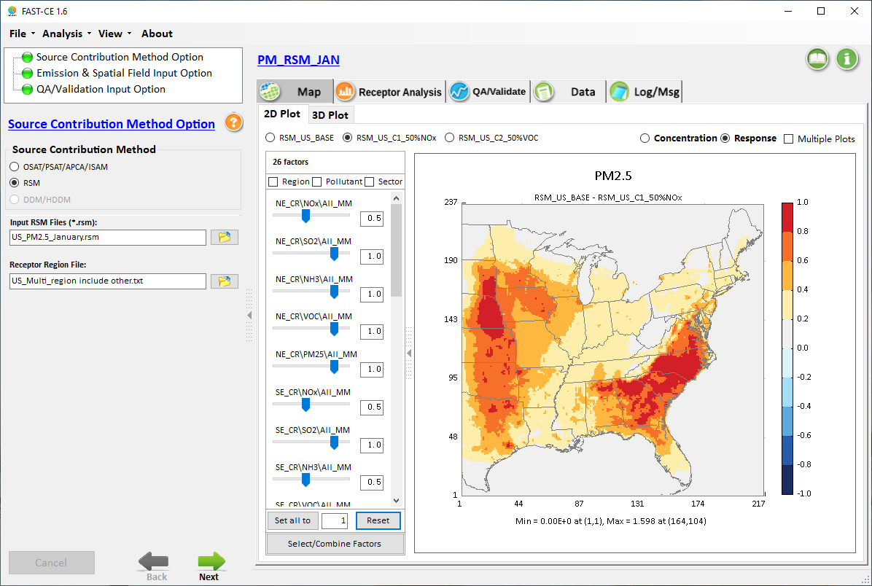
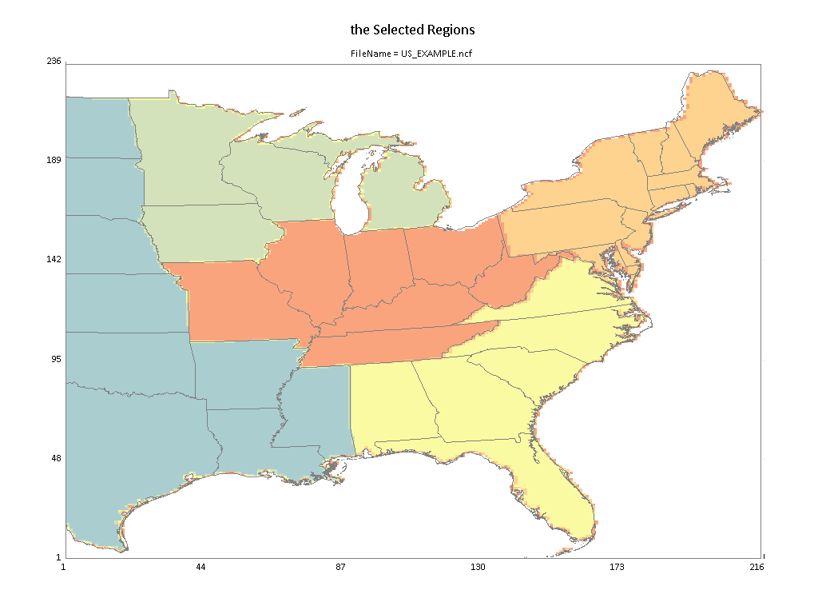
RSM EUS cases: “PM[O3]_RSM_Jan[Jul].proj”
Five Climate Regions:
NE
SE
Cen
Up_MW
Other
Notes:
1. Thank Cen/Gao/Luo/Chen; 2. HZ more visits; 3. AP on HZ

Slide 10
FAST-CE: “Flexible Air Quality Scenario Tool – Community Edition”
Emission control factors, etc.
Input parameters
Multiple tracer species
Emission Inventory
(regions, pollutants, sectors, etc.)
Photochemical model (CMAQ/CAMx)
Photochemical model (CAMx/CMAQ)
Sensitivity coefficients
Math. & Chemical approximation
Math. approximation
Chemical approximation
Response Surface Modeling
Source/Receptor Sensitivity Modeling
Source Apportionment Modeling
RSM
DDM
APCA/OSAT/PSAT & ISAM
Dynamic control
strategies
FAST-CE
Flexible & Real-time AQ Scenarios & Source Contribution Assessment
Assessment of health & economic benefit and attainment benefit
Cost estimate tool
Attainment assessment tool (SMAT-CE)
Health benefit tool
(BenMAP-CE)
Least cost strategies (LE-CO)
10
Optimized Cost/Benefit Control Strategy

Slide 11
ACE PM2.5/O3 Benefit Modeling (August 2018)
Note: ACE benefit modeling includes only: 1) EGU point sources split out by fuel type and state ; all other sectors lumped into a single tag
2) NOx, SO2 & primary PM, and no VOC emissions
~300 GB daily Input data
Linux platform
R scripts to calculate emissions ratios (ER): 2023/scenario
Species Definition files
Combine utility program
O3N tags multiplied by summer NO2 ER;
sulfate tags multiplied by SO2 ER;
nitrate tags multiplied by NO2 ER;
PM tag multiplied by PM ER
2023 CAMx APCA
IOAPI Modeling Results
(Tagged EGUs by State/Fuel/Pollutant)
Method:
2023 & 2025/2030/2035 Annual EGU Emissions (from IPM)
(Emis grouped by State/Fuel/Pollutant)
Base & ACE 2025/2030/2035 IOAPI Surfaces
Major issues: create only one AQ surface,
No flexibility, each case takes > one hour
2011 CAMx base year IOAPI Surfaces
WIN-OS
platform
BenMAP-CE input files for
base vs. ACE (2025/2030/2035)
Benefit Assessment
Run SMAT-CE for each ACE year (for each PM2.5, MDA8, MDA1)
(3 x 3 = 9 cases)
Notes:
1. Thank Cen/Gao/Luo/Chen; 2. HZ more visits; 3. AP on HZ

Slide 12
“FAST-CE” Approach (Jan. 2020 Prototype)
“Quarterly/seasonal” Contribution
Fraction
From “Tag 1”
In each grid
0.2 | 0.1 | 0.3 | 0.2 | 0.1
0.2 | 0.1 | 0.3 | 0.2 | 0.1
2011 CAMx Base
(SMAT-CE & BenMAP-CE assessment)
-------------
Tag 1
Tag “N”
New Method:
WIN-DOS
Pre-process CAMx APCA modeling inputs to create “quarterly/seasonal” gridded contribution fraction from each “Tag”
2023 CAMx APCA
modeling results
(“Tagged” States/Sectors/Pollutants)
Run SMAT-CE first to create 2023 SMAT-CE AQ surface
Create “quarterly/seasonal”
gridded SMAT-CE output
“FAST-CE” reads/processes
(1) gridded tag contribution fraction, (2) emission ratios of 2023/ACE cases (2025,2030,2035) or any other cases (user-defined)
(each grid’s “tag fraction” adjusted by static annual emissions ratio)
ACE Future “2025/2030/2035”
(Created via 2023 CAMx APCA modeling results)
Major advantages: “Flexible” & “Real-time”
SMAT-CE AQ scenarios surface created by “FAST-CE”
Validation/QA module: Comparison plots & Statistics for “ACE” vs. FAST-CE”
Create SMAT/BenMAP input files for 2023 vs. ACE (2025/2030/2035)
“FAST-CE” creates “SMAT-CE AQ surface”, and GUI allows to adjust any AQ scenario surface for
PM & O3 (1hr & 8hr)
Note:
PM: Quarterly & Annual
O3 MDA8: Seasonal (5-9)
O3 MDA1: Seasonal (4-10)
Notes:
1. Thank Cen/Gao/Luo/Chen; 2. HZ more visits; 3. AP on HZ

