Slide 1
GUI Design of Show monitor data & Proximity Analysis
Revised by Carey Jang, 8/04/2021
1

Slide 2

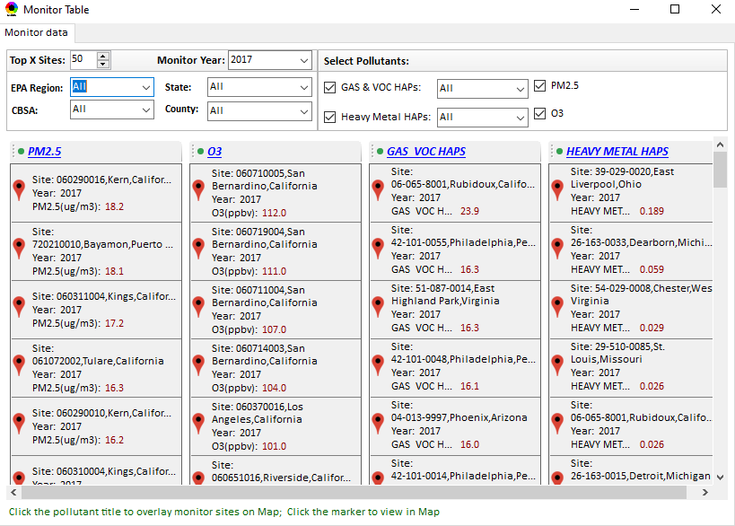
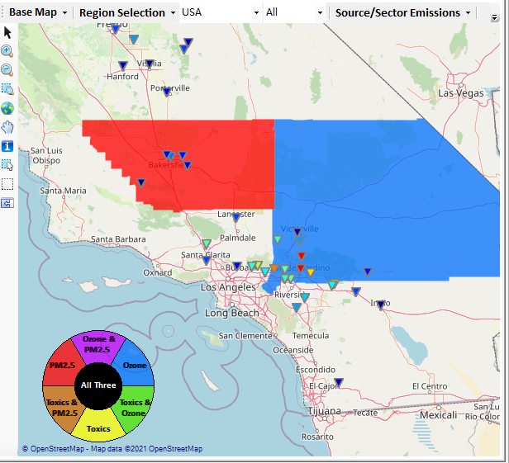
Show Monitor Data
Right-click on map, and then click “Display Monitor Sites/Data”, a Monitor table window (similar to “Major Point Sources”) will pop up, and the top X sites (the colors of sites are according to the concentration of selected pollutant) will be overlaid on map, too.
Change to:
PM2.5 & O3 first, then HAPs
PM2.5 (annual DVs)
O3 (seasonal DVs)
Display
Monitor Year: 2020
EPA Region: Region 9
State: CA
Change to:
Location:
Site ID:
Gas & VOC HAPs:
(Note: (1) spell out HAPs,
(2) No need for year, already given above)

Slide 3
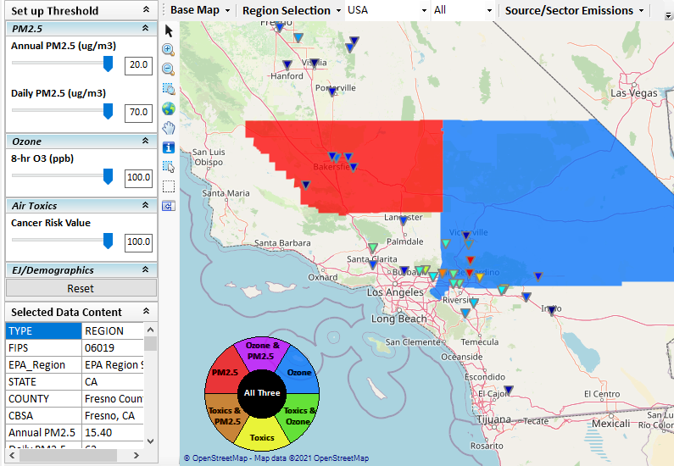
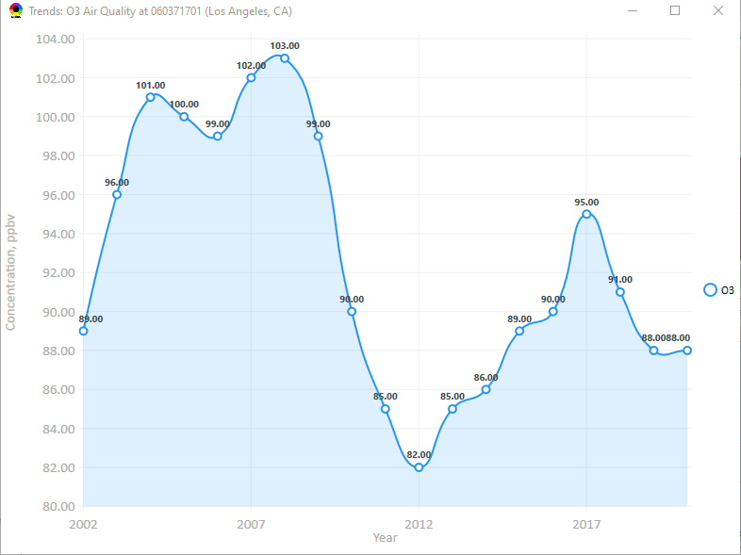
Show the air quality trend for selected site
Click a site icon, and the air quality trend of current site will pop up.
Possible to display a “Target” sign above here when selected, similar to “Major point sources” ?

Slide 4
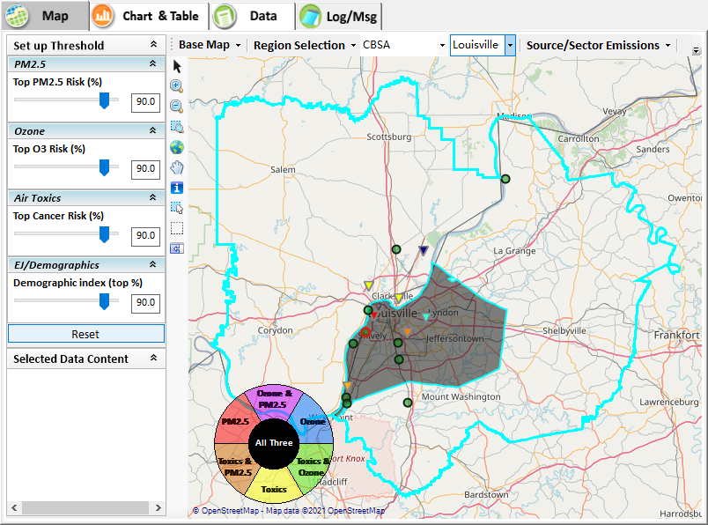
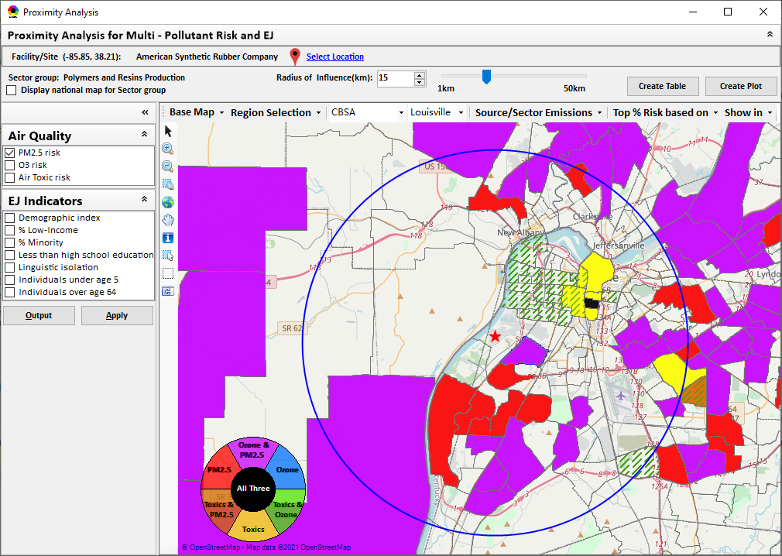
Proximity Analysis module
Display a “Target” sign here;
Display the same “Target” sign at the right map too
Double-click a facility or monitor site to show Proximity Analysis module

Slide 5
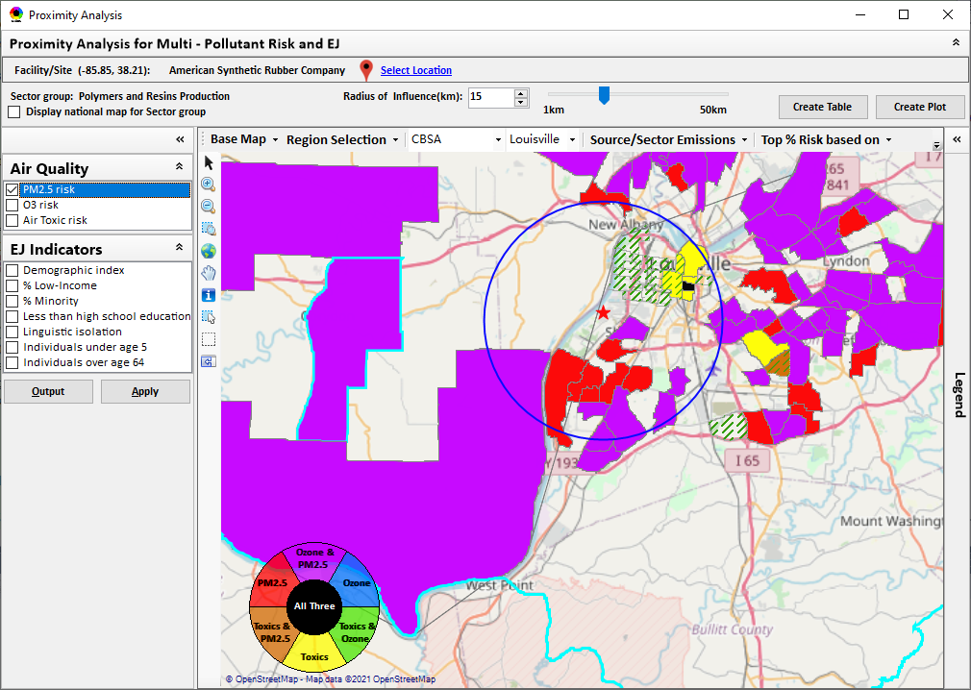
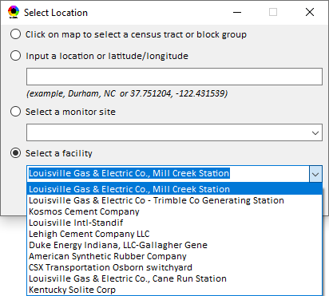
GUI for “Select Location”

Slide 6
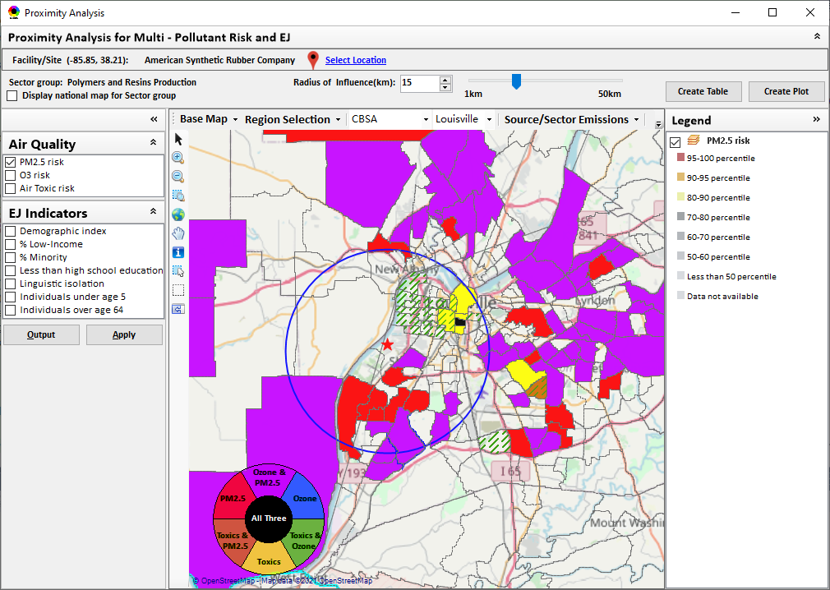
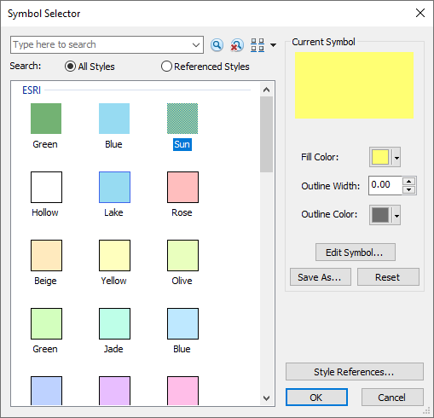
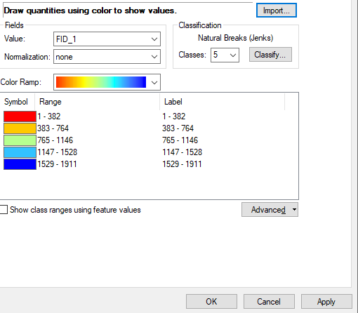
GUI Design for Legend
Double click the legend title to configure the legend

Slide 7
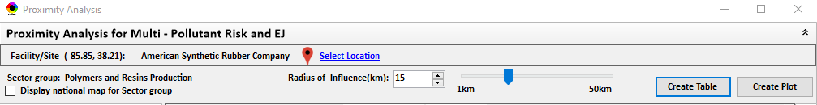
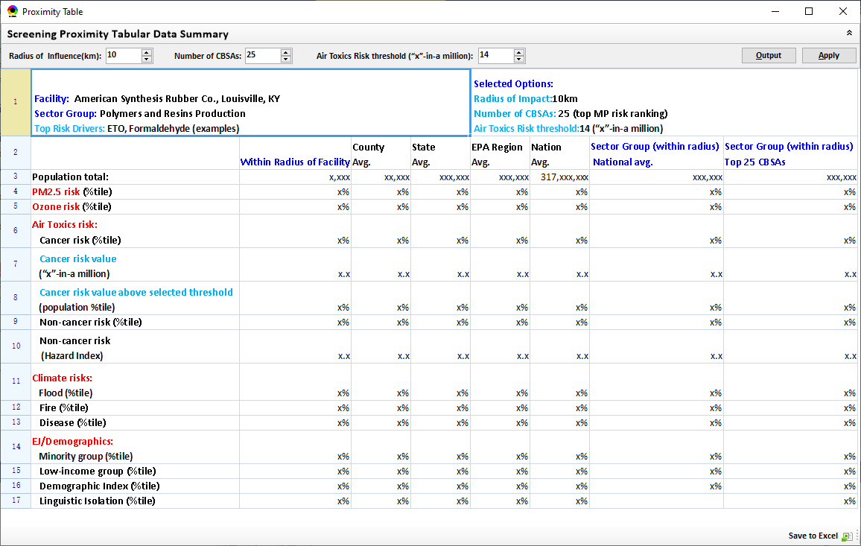
GUI Design of Proximity Analysis summary table
Remove this column now:
“Top 25 CBSAs”
Center justified the Data columns in this Table (alignment looks strange)

Slide 8
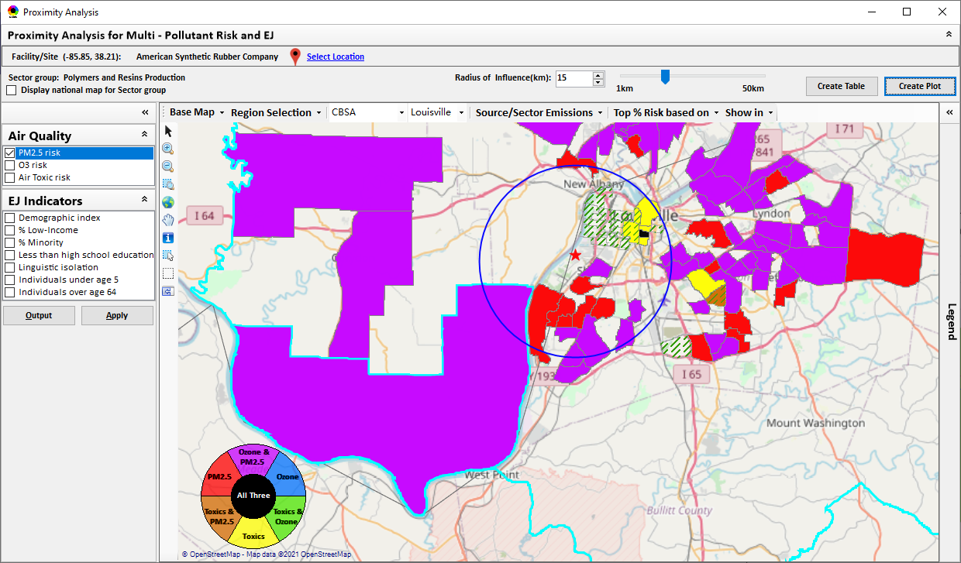
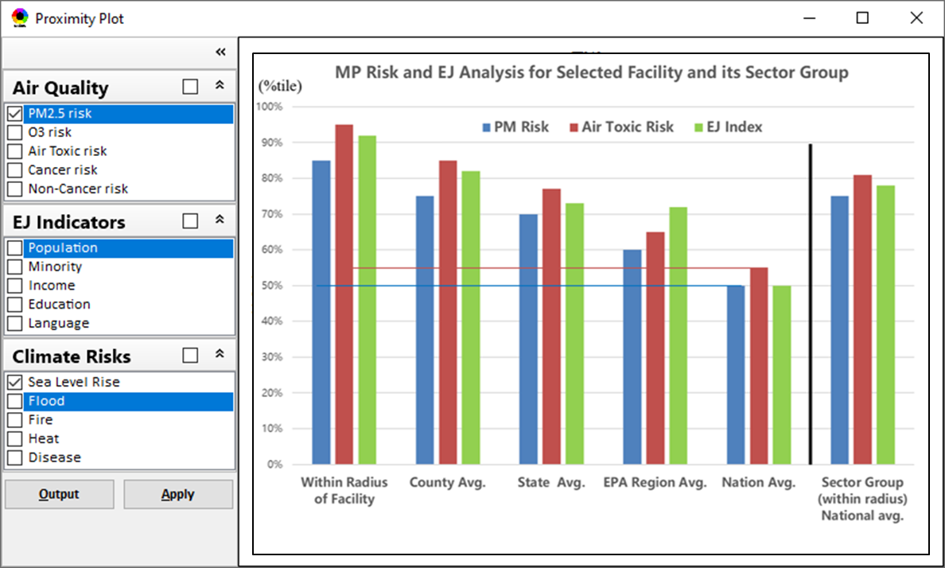
GUI Design of Proximity Analysis Plot
Change “Population” to “Demographic index”,
Check box only to: (1) PM2.5 risk, (2) Air Toxic risk, (3) “Demographic index”

Slide 9
Quick Fixes for NEXUS 1.8.8 (from NEXUS 1.8.7)
Suggested by Carey Jang, 8/04/2021
9

Slide 10
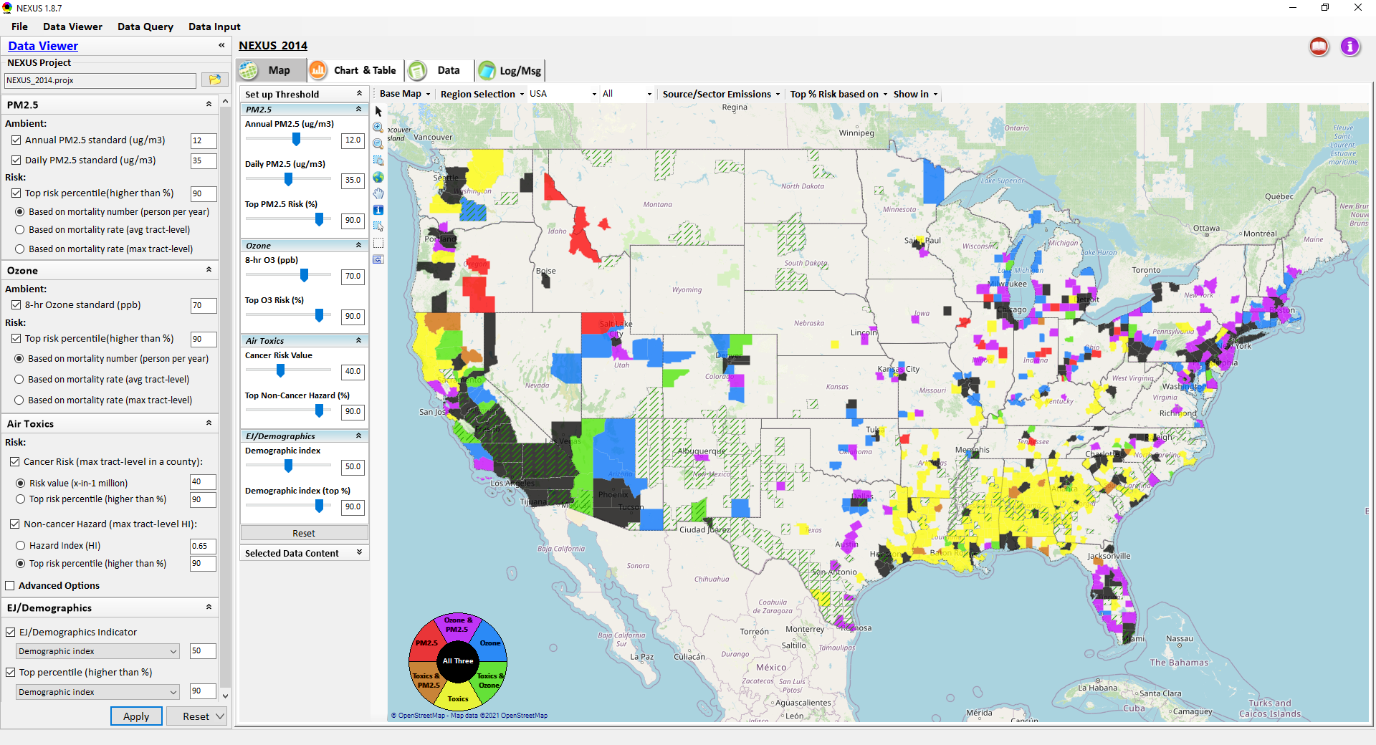
NEXUS 1.8.8: Quick fixes
or
or
Turn this off (remove) for now. Too slow in displaying “census tract” (Note: may not be working, I have to close NEXUS when trying this).
or
Insert “or” here if more than one selected for each metric
or
or

Slide 11
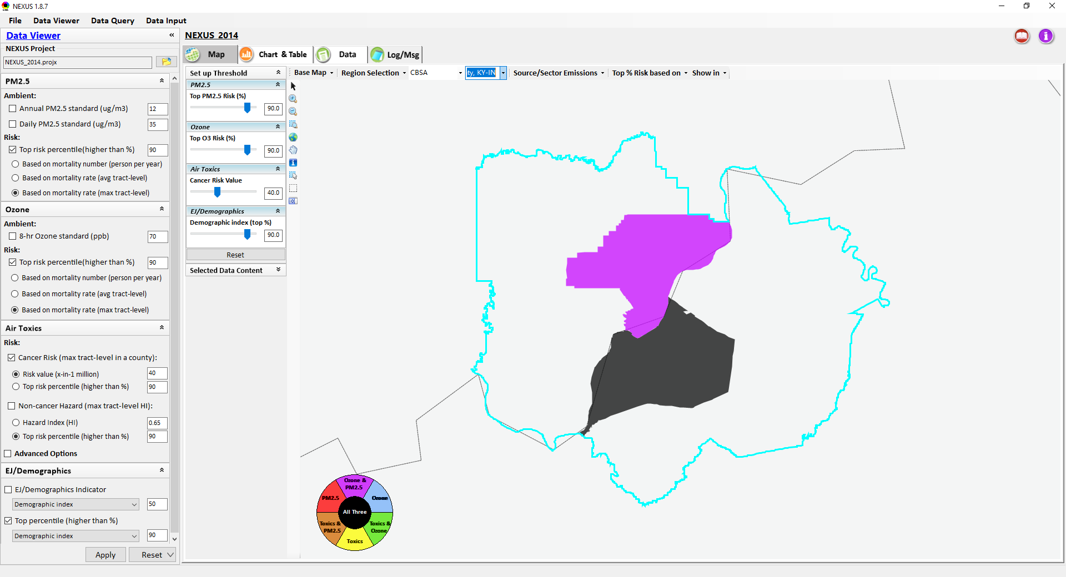
NEXUS 1.8.8: Quick fixes
Display “left justified” (e.g., can not see the selected “Louisville” CBSA)
Question: Is it possible to find a map option to display a cleaner map with only City names and geographic boundaries? (e.g, this map with State & City names only)
(Note: not a priority, can wait for later version)

Slide 12
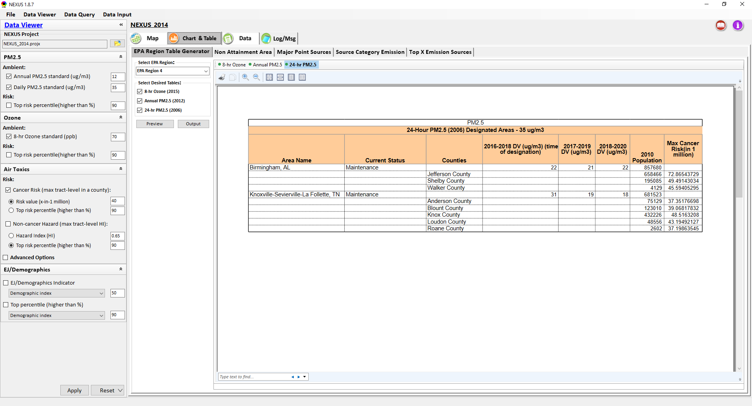
NEXUS 1.8.8: Quick fixes
Region 4: problem in 24-hr PM2.5. Why display when they are <35 ug/m3?
Region 9: similar and more problems for 24-hr PM2.5 (Note: not a priority, can wait for later version)
Change “Preview” to “Generate”
Make all fonts to larger fonts
Remove (hide) this “Non-Attainment Area” for now (many issues in this function)
Add “Sector Emissions Summary” in the end (Note: not a priority, can wait for later version)
Use only two decimal points for all tables

Slide 13
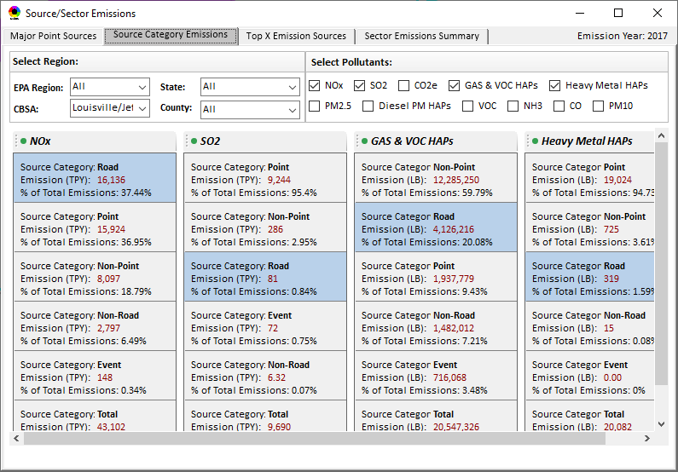
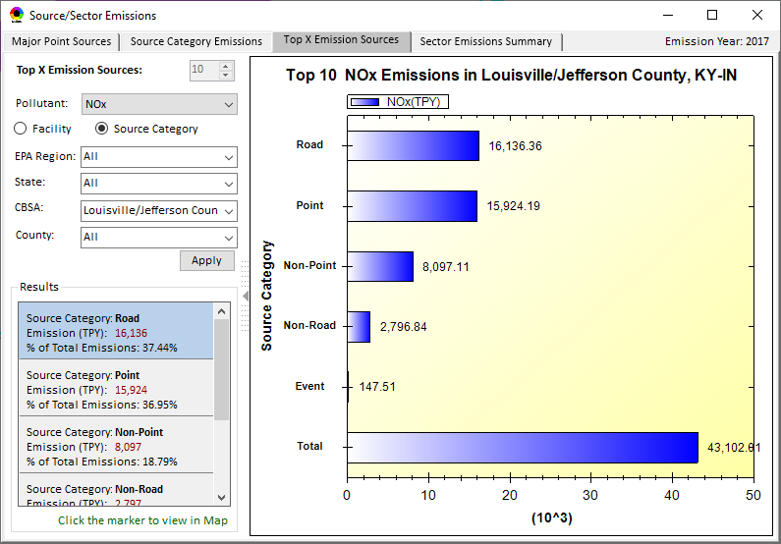
NEXUS 1.8.8: Quick fixes
Change all “Road” to “On-Road” in both tables

Slide 14
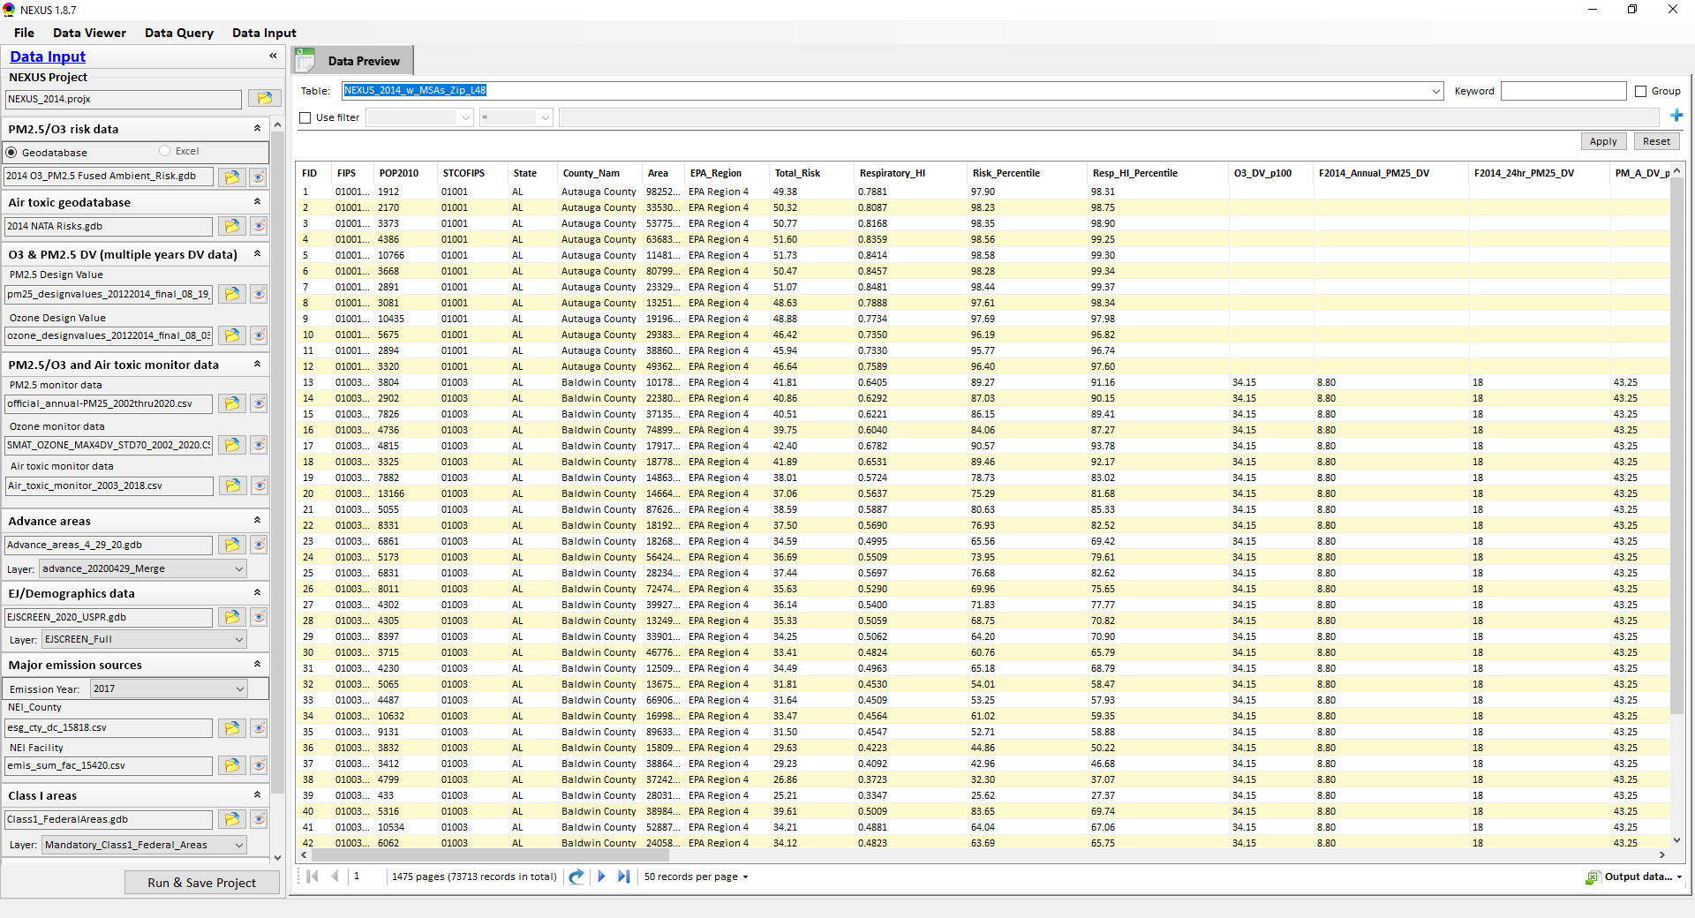
NEXUS 1.8.8: Quick fixes
Change “Air toxic geodatabase” to
“Air toxic risk data”
Change to
“PM2.5/O3 design value (multi-year DVs)”
Change to “PM2.5 DVs data” and “O3 DVs data”
Update to “Advance_areas_20210318.mpk” (see attached, also under https://gaftp.epa.gov/Air/aqmg/cjang/NEXUS/2017_Update/Advance_Area_2021/

