Slide 1

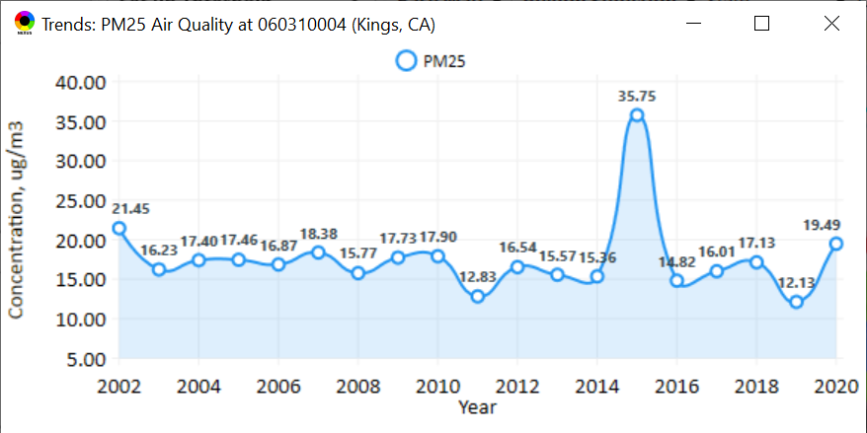
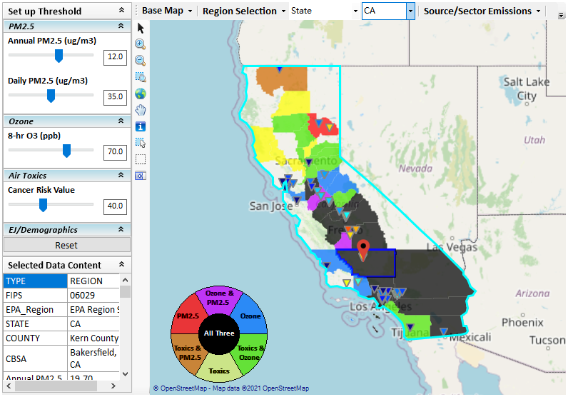
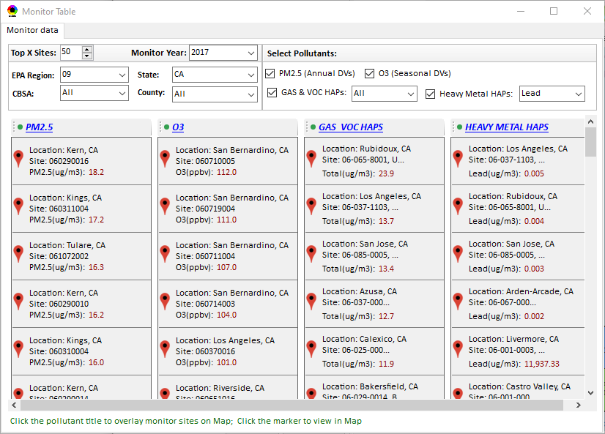
New “Monitoring Data/Site” Module (under development)
Right-click to invoke
AQ trend
Click to display
AQ trend at monitor site
Monitor Site/Data
Click to select monitor site
& pollutant

Slide 2
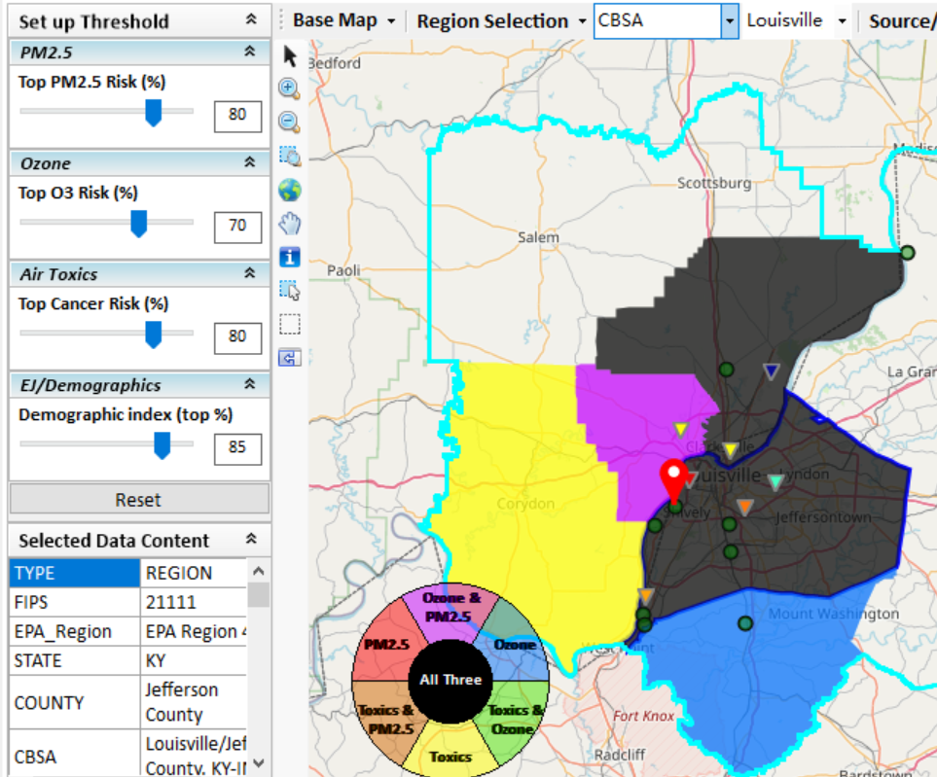
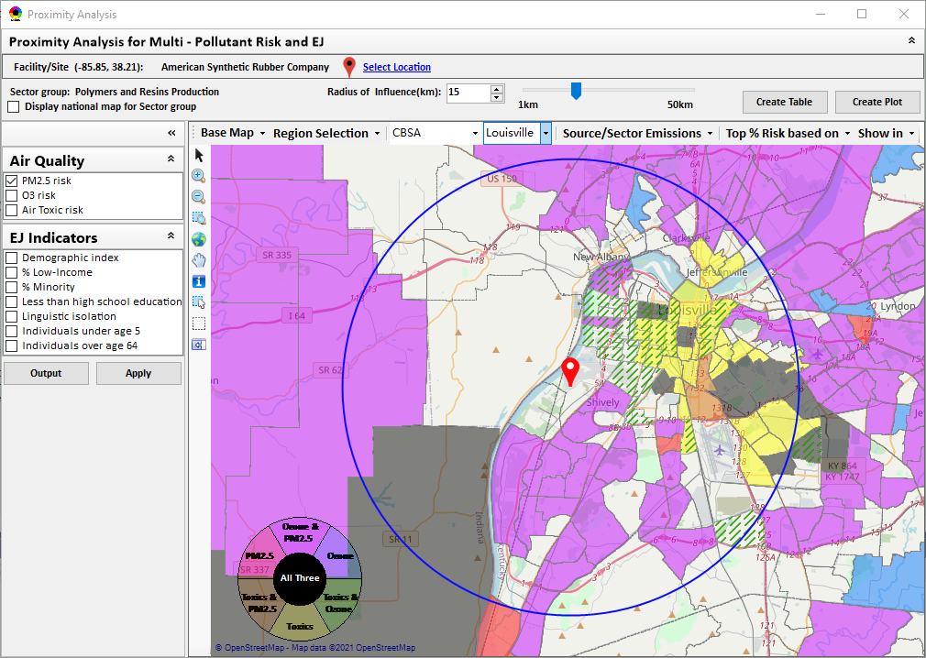
New “Proximity Analysis” Module (under development)
Proximity Analysis for MP Risks and EJ
Right-click to invoke
County - level
Census Tract - level

Slide 3
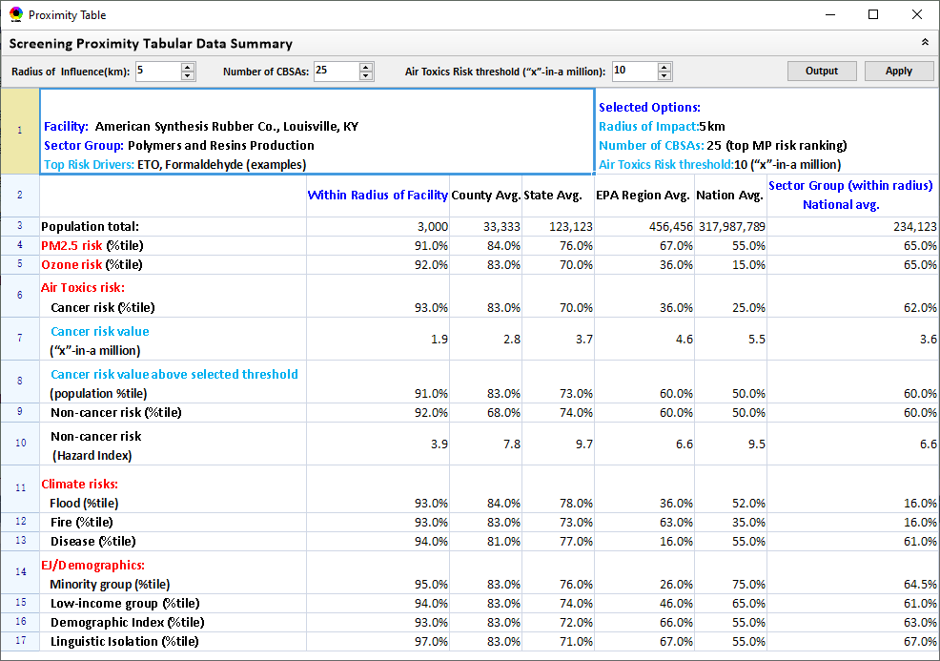
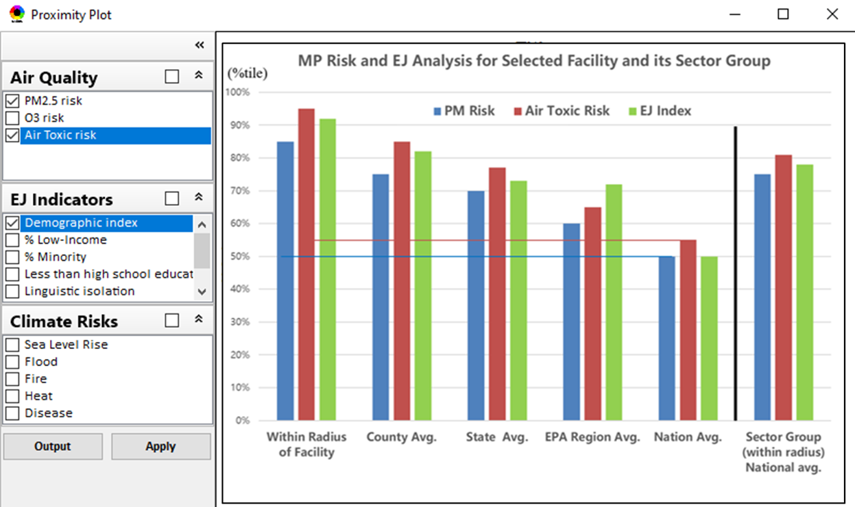
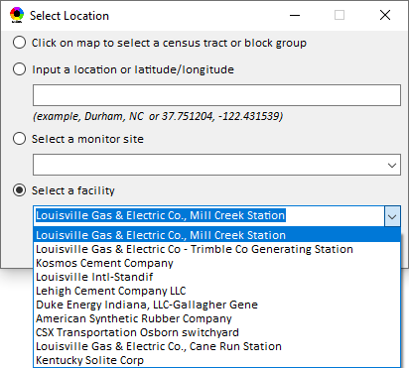
Proximity Analysis: Select “Location” & “Radius”
Select “Radius”
Choice of
Selecting a Location

Slide 4
GUI Design of Show monitor data & Proximity Analysis
8/05/2021
4

Slide 5

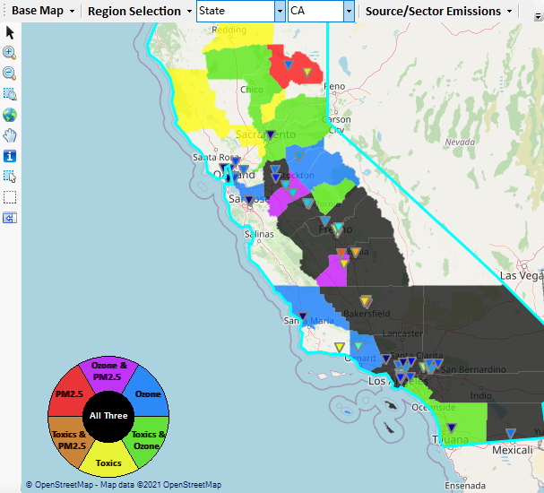
Show Monitor Data
Right-click on map, and then click “Display Monitor Sites/Data”, a Monitor table window (similar to “Major Point Sources”) will pop up, and the top X sites (the colors of sites are according to the concentration of selected pollutant) will be overlaid on map, too.
Show full information when mouse moving over the panel

Slide 6
Show the air quality trend for selected site
Click a site icon, and the air quality trend of current site will pop up.

Slide 7
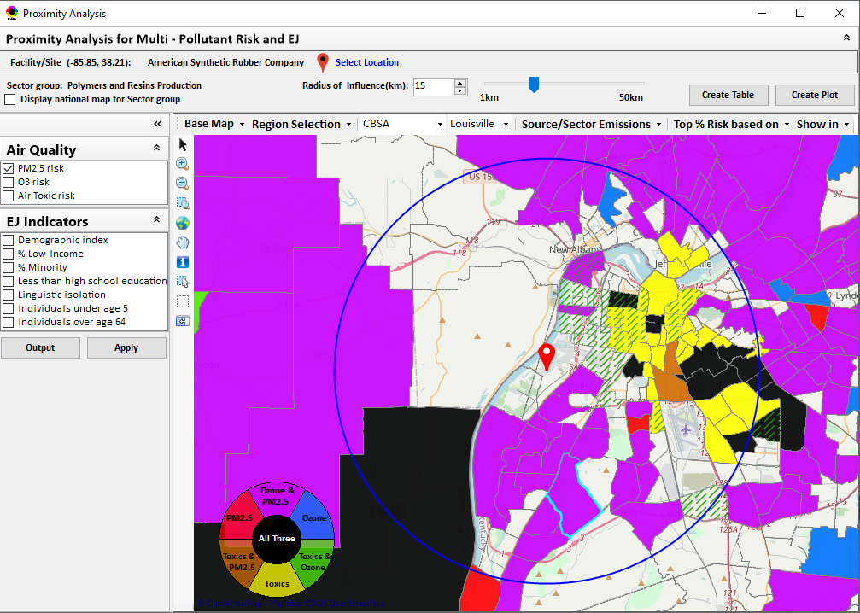
Proximity Analysis module
Double-click a facility or monitor site to show Proximity Analysis module

Slide 8
GUI for “Select Location”

Slide 9
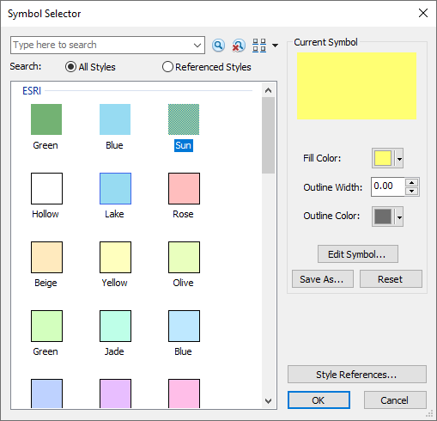
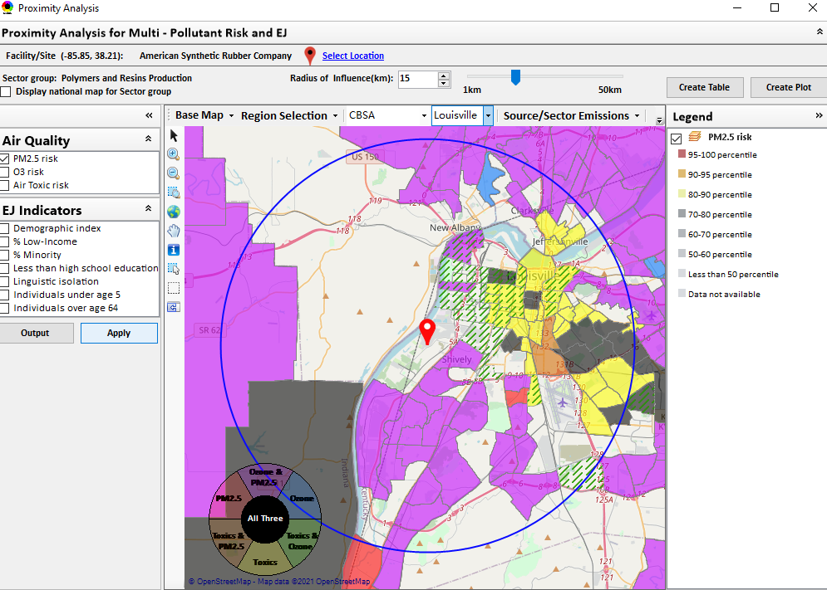
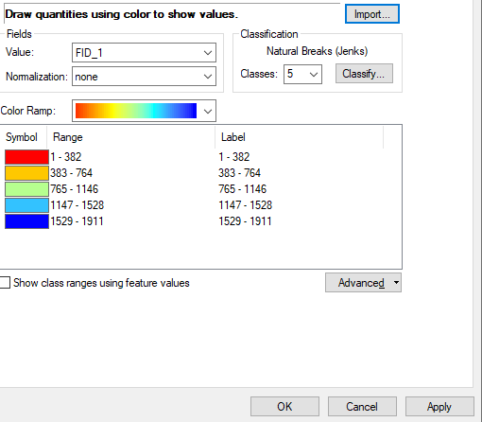
GUI Design for Legend
Double click the legend title to configure the legend

Slide 10
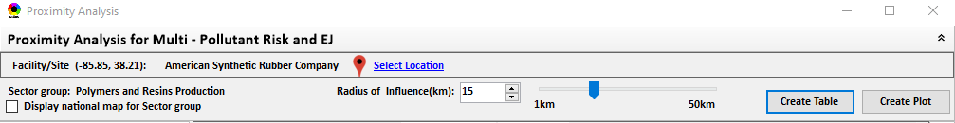
GUI Design of Proximity Analysis summary table

Slide 11
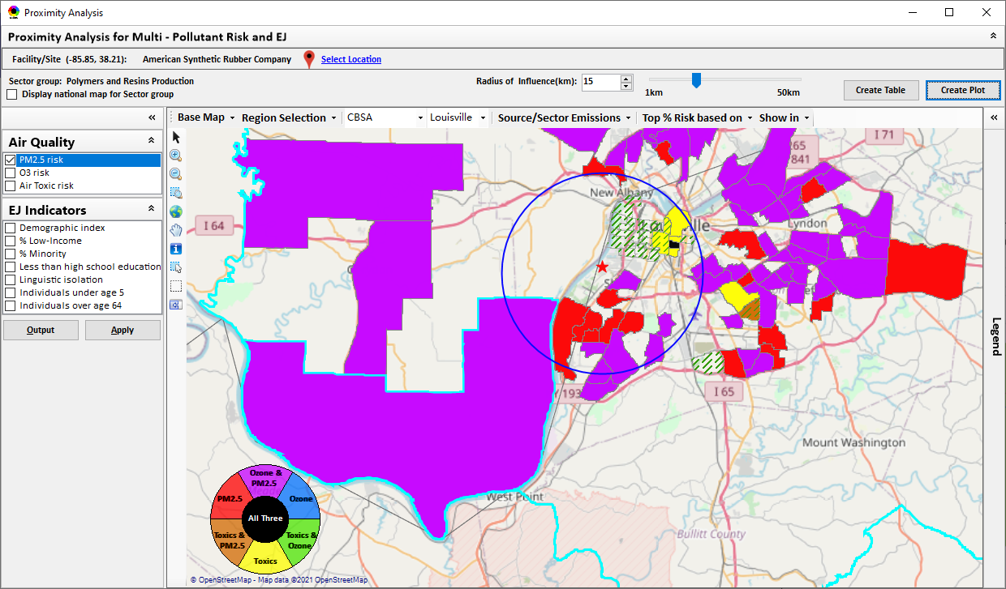
GUI Design of Proximity Analysis Plot

