Slide 1
NEXUS - Recent Improvements & Planned Upgrades
NEXUS “1.5” (Winter/2020) → NEXUS “1.8.6” (Summer/2021)
New/revised Metrics (PM_{2.5}, O₃, Air Toxics & EJ)
New/updated data inputs and functions:
EJ/Demographic data (from EJSCREEN)
Tribal areas & Advance areas
2017 emissions data (including GHG & sector mapping) (updated from 2014)
“Source & Sector emissions” module to support “Sector prioritization” effort
“Source Category emissions” module (point, non-point, on-road, non-road, event)
On-going Updates and Upgrades
Update to 2017 fused PM_{2.5} & O₃ and health risk data (Sept.) and air toxic and risk data (Nov./Dec.) from current 2014 data
Include & display monitoring sites/data (PM_{2.5}, O₃ & Air toxics) (Sept./Oct.)
Develop prototype for “Proximity and spatial analysis for MP risks and EJ” module (Nov./Dec.)
1

Slide 2

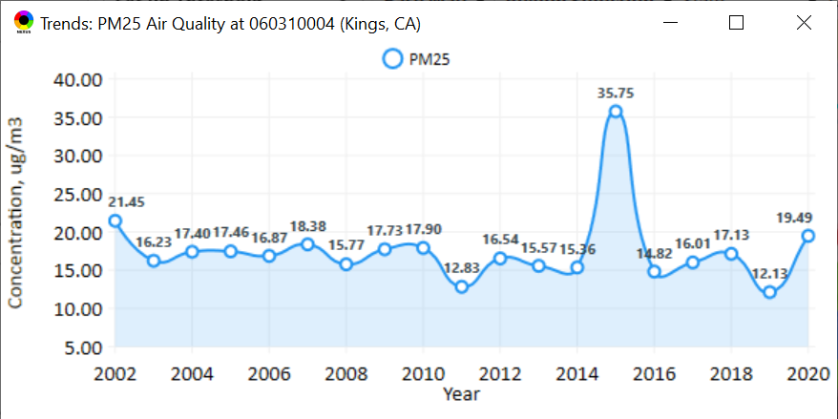
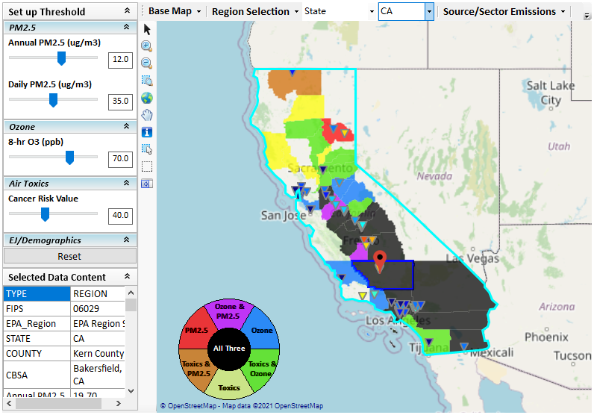
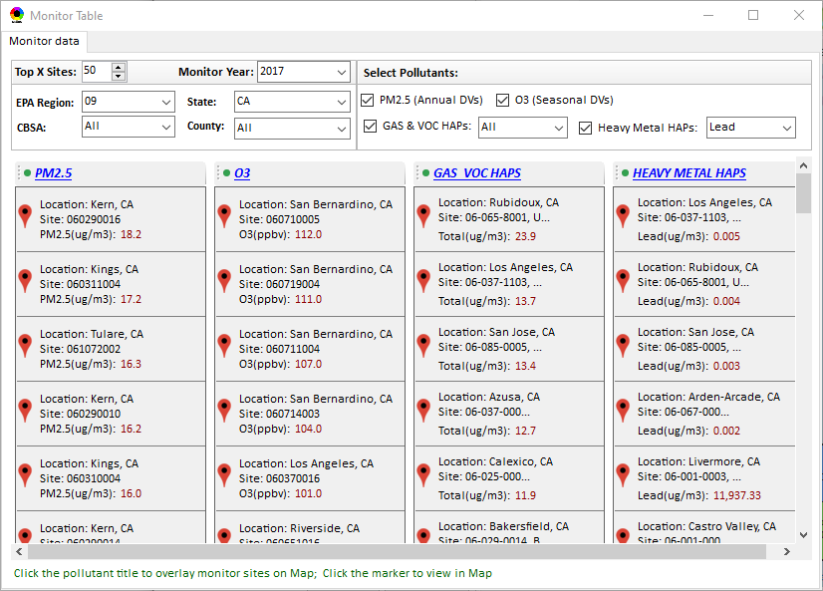
New “Monitoring Data/Site” Module (under development)
Right-click to invoke
AQ trend
Click to display
AQ trend at monitor site
Monitor Site/Data
Click to select monitor site
& pollutant
2

Slide 3
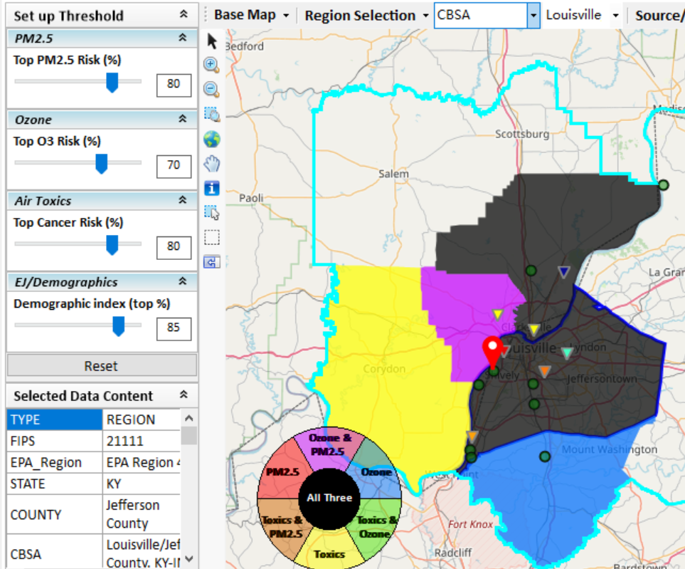
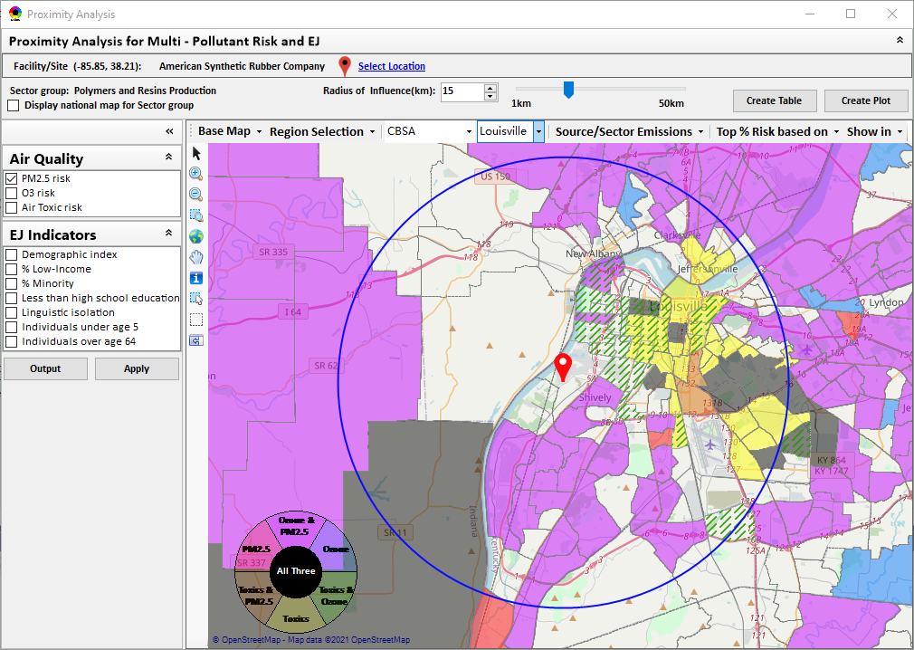
New “Proximity Analysis” Module (under development)
Proximity Analysis for MP Risks and EJ
Right-click to invoke
County – level (current)
Census Tract - level
3

Slide 4
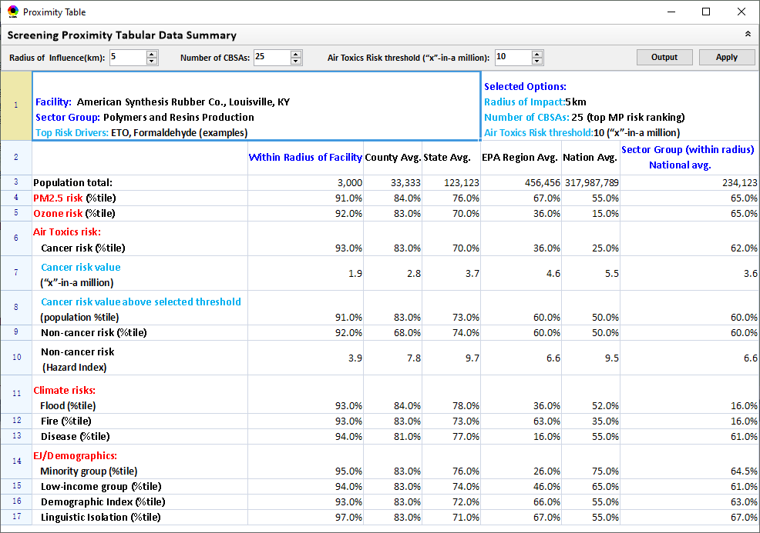
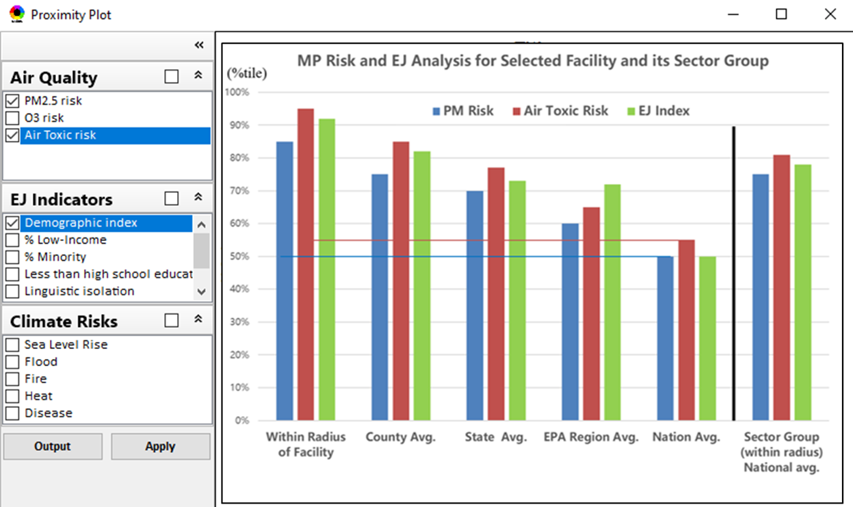
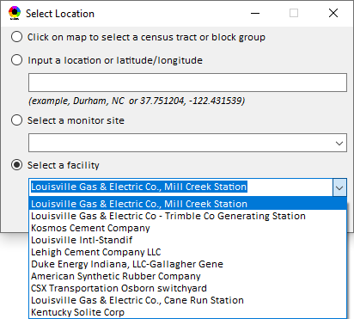
Proximity Analysis: Select “Location” & “Radius”
Select “Radius”
Choice of
Selecting a Location
4

Slide 5
Multi-Pollutant Team
Next Steps
Louisville
Refine BenMAP analysis
Determine control strategies
Develop MP AQMP
Based on Office wide engagements, continue to update NEXUS tool and use it to inform Multi-pollutant, Air Toxics, NAA/Advance controls, and EJ efforts as appropriate
Incorporate climate into MP process
Use NEXUS to develop packets for regions regarding MP areas of concern

