Slide 1
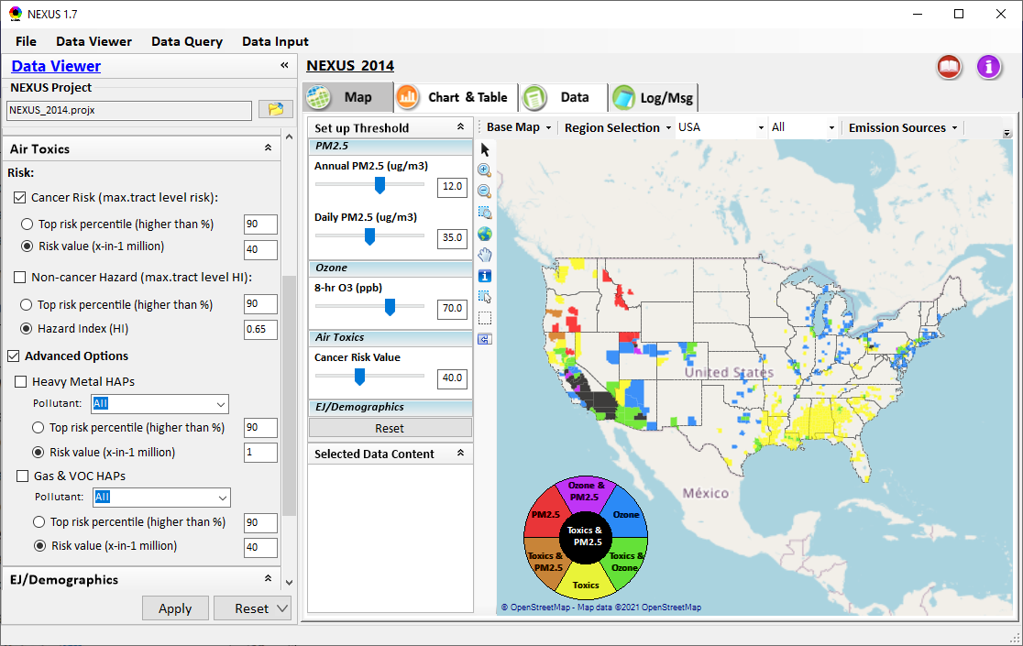
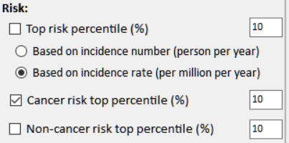
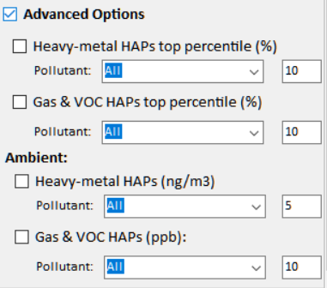
NEXUS Updates: New Air Toxics Metrics
Current
Updated
1

Slide 2
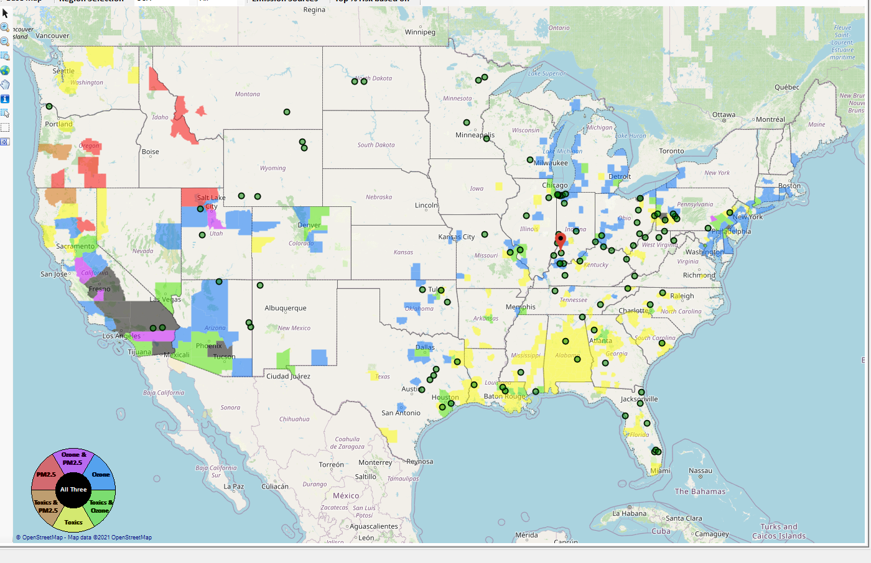
“Zoom-out” of Selected Facility to Sector Group at National Level
Display all facilities within same Sector Group
Provide color scale for MP risk value (e.g., red w/ high MP risk)
Allow to “zoom-in” to individual facilities to conduct proximity analysis (i.e., back to “proximity module”)
2

Slide 3
Screening Proximity Analysis in NEXUS: Tabular Data Summary
Facility: American Synthesis Rubber Co., Louisville, KY Sector Group: Polymers and Resins Production Top Risk Drivers: ETO, Formaldehyde (examples) |  |  |  |  | Selected Options: Radius of Impact: 10km Number of CBSAs: 25 (top MP risk ranking) Air Toxics Risk threshold: 10 (“x”-in-a million)
 | Within Radius of Facility | County Avg. | State Avg. | EPA Region Avg. |  | Nation Avg. | Sector Group (within radius) National avg. | Sector Group (within radius) Top 25 CBSAs
Population total | x,xxx | xx,xxx | xxx,xxx | xxx,xxx |  | 317,xxx,xxx | xxx,xxx | xxx,xxx
PM2.5 risk (%tile) | x% | x% | x% | x% |  | x% | x% | x%
Ozone risk (%tile) | x% | x% | x% | x% |  | x% | x% | x%
Air Toxics risk: Cancer risk (%tile) | x% | x% | x% | x% |  | x% | x% | x%
Cancer risk value (“x”-in-a million)) | x.x | x.x | x.x | x.x |  | x.x | x.x | x.x
Cancer risk value above selected threshold (population %tile) | x% | x% | x% | x% |  | x% | x% | x%
Non-cancer risk (%tile) | x% | x% | x% | x% |  | x% | x% | x%
Non-cancer risk (Hazard Index) | x.x | x.x | x.x | x.x |  | x.x | x.x | x.x
Climate risks: Flood (%tile) | x% | x% | x% | x% |  | x% | x% | x%
Sea level rise (%tile) | x% | x% | x% | x% |  | x% | x% | x%
Fire (%tile) | x% | x% | x% | x% |  | x% | x% | x%
Disease (%tile) | x% | x% | x% | x% |  | x% | x% | x%
EJ/Demographics: Minority group (%tile) | x% | x% | x% | x% |  | x% | x% | x%
Low-income group (%tile) | x% | x% | x% | x% |  | x% | x% | x%
Demographic Index (%tile) | x% | x% | x% | x% |  | x% | x% | x%
Linguistic Isolation (%tile) | x% | x% | x% | x% |  | x% |  | x%
3

