Slide 1

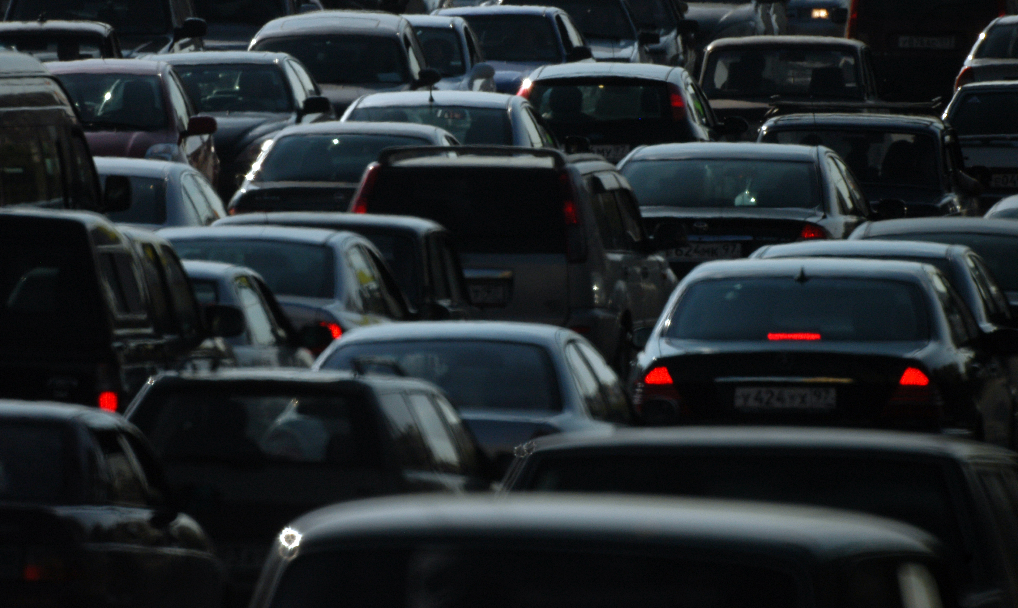

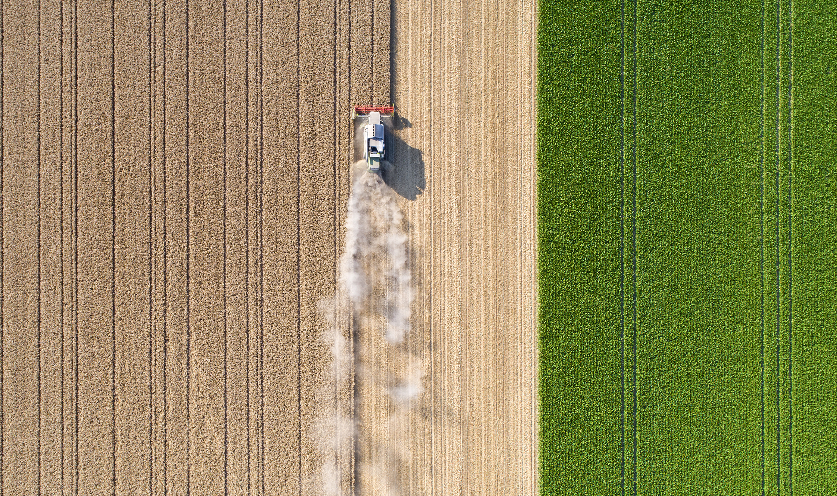
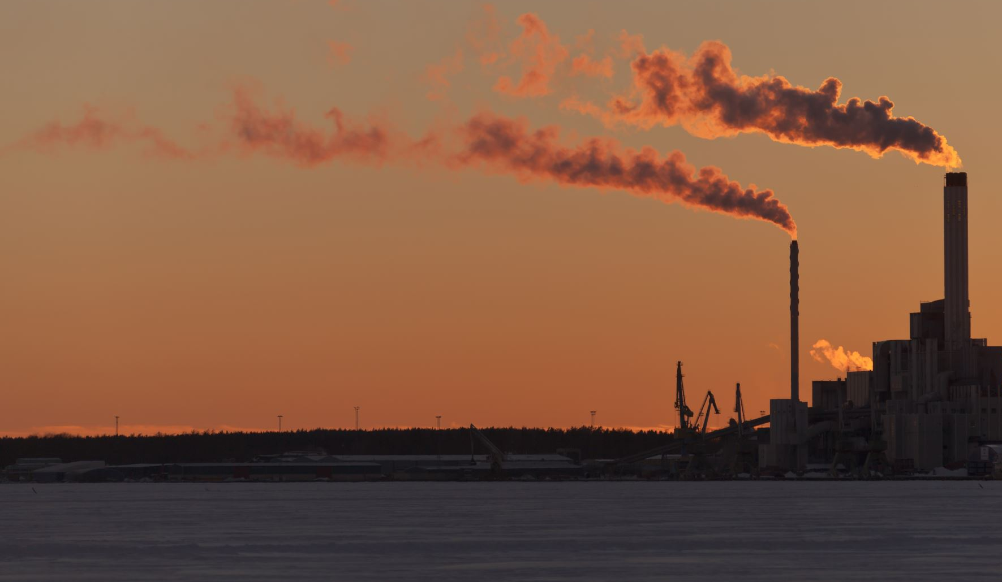
2022 EPA Regulatory Modeling Platform Air Quality Model Performance: 36US3
EPA/OAQPS/AQAD/AQMG

Slide 2

Agenda
2022 Modeling Platform Background
Air Quality Model : CMAQ
  Model domain
  Model configurations
36US3 Model Performance Evaluations
  Overall performance
  Hemispheric CMAQ BC
Next Steps

Slide 3
Goals and Potential Applications of 2022 Modeling Platform
To develop a more contemporary modeling platform including base year data (emissions, met, IC/BCs) and future year emissions projections for potential EPA regulatory analysis
To support state/local/tribal air agencies for SIPs and related implementation efforts, such as modeling for ozone NAAQS SIPs and PM NAAQS implementation

Slide 4
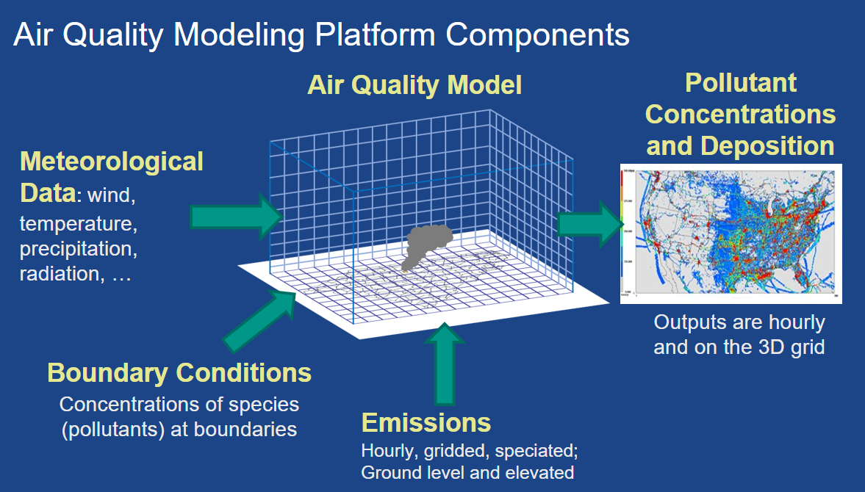

Slide 5
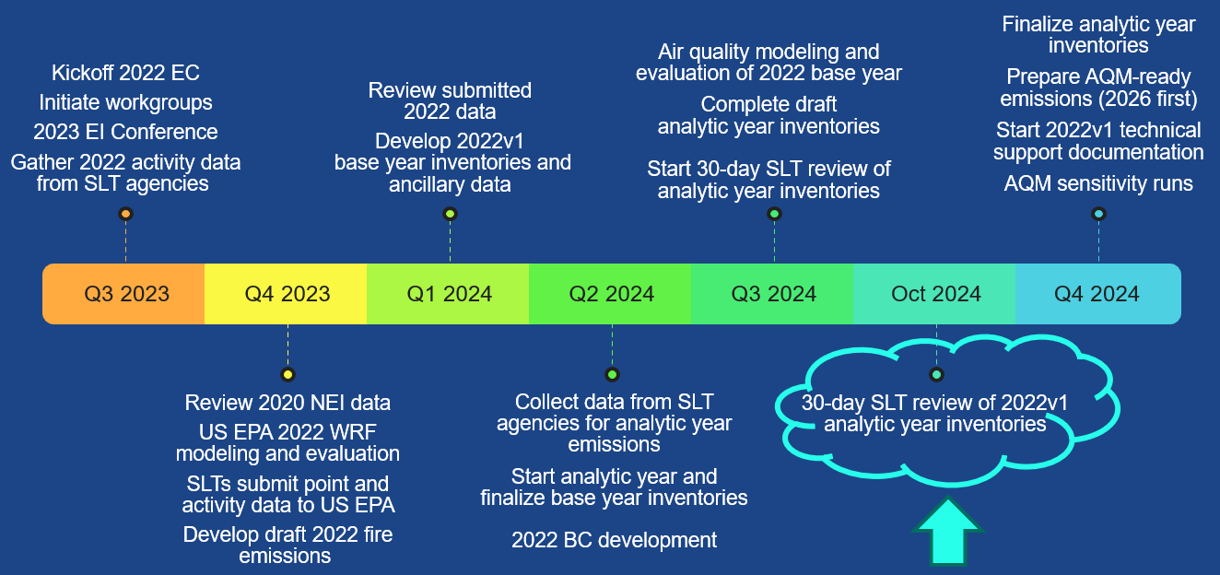
Timeline for 2022v1 Platform Development

Slide 6
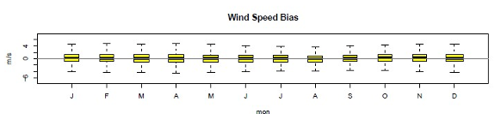
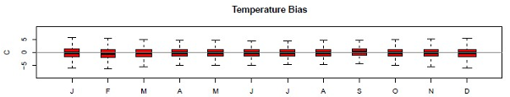
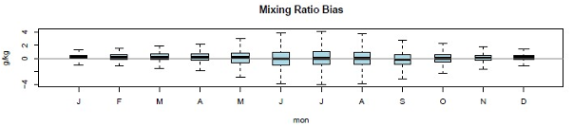
Status of Meteorological data
2022 meteorological data from Weather Research Forecast (WRF) model have been generated, evaluated and ready for use
Performed multiple sensitivity analyses on WRF setups based on feedback from States/MJOs. Based on those analyses, our standard configuration remains preferred
Data have been uploaded to Amazon Web Services (AWS) for download or use in cloud computing
Meteorological model performance TSD is available on SCRAM
wind speed, temperature, mixing ratio bias by month for 36NOAM domain.

Slide 7
Hemispheric/Global Modeling to Develop 2022 Boundary Conditions
Model | Simulation | BCON
GEOS-Chem v14.0.1 | 2022 Complete | 36US3 Complete
Hemispheric CMAQ v5.4+ | 2022 Complete | 36US3 Complete
NASA GMAO GEOS-CF | Daily 1-day hindcasts Daily 5-day forecast | 36US3 Complete
Evaluation
  Sondes: NOAA GML and World Ozone and Ultraviolet Radiation Data Centre
  Surface: CASTNET surface data monitors
  Data are available on Amazon Web Services (AWS) for download or use in cloud computing
Notes:
A column to CF, GC, CQ, think about sonde evaluations

Slide 8
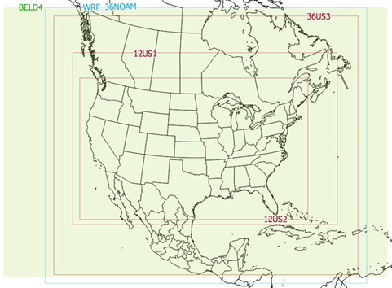
CMAQ Configurations : 36US3, 12US1 & 2
CMAQ version 5.4.0.4
STAGE with bi-directional flux on
  Fertilizer NH3 emission control
Lightning NOx (LNOx) inline calculation on
  First time to include LNOx inline for platform
Inline BEIS biogenic emission on
  Regular application for platform
CB6r5_ae7_aq non-volatile POA
Dust off (detailed info in next slide)
ICON/BCON:
  GEOS-CF: CF BC
  GEOS-Chem: GC BC
  H-CMAQ: CQ BC
Objectives:
  Select a BCON for 12US2
  Check emissions

Slide 9
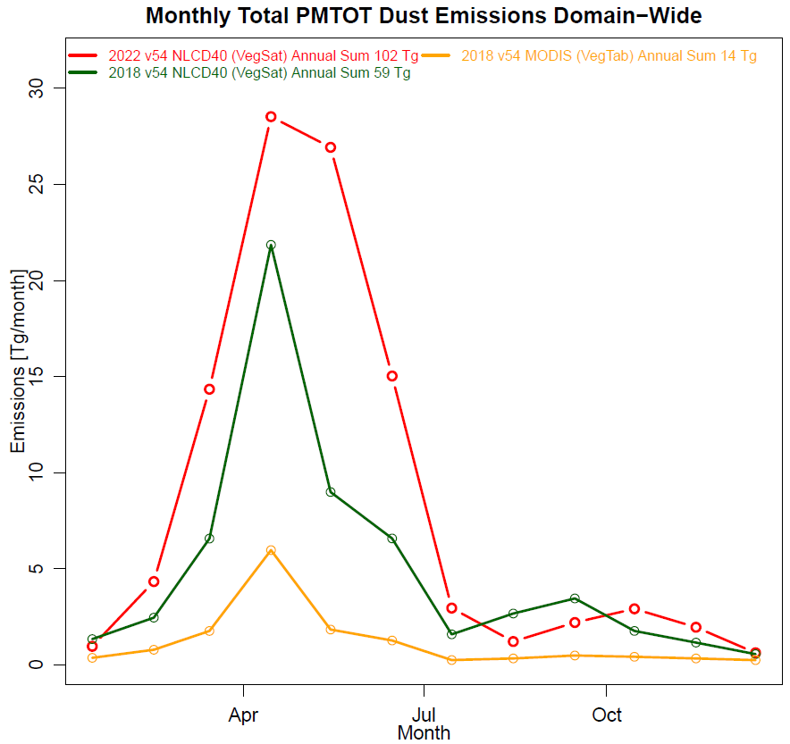
Wind-blown dust
CQ-BC 36US3 WBD inline is off.
In CMAQv5.4, there is a glitch in the source code, WBD emissions are sensitivity to the land use (NLCD 40 vs MODIS)
In this 2022 CQ run, we used MODIS, CQ-HEMI include WBD inline using MODIS land use

Slide 10
2022 CMAQ 36US3 modeling platform high level performance evaluations

Slide 11
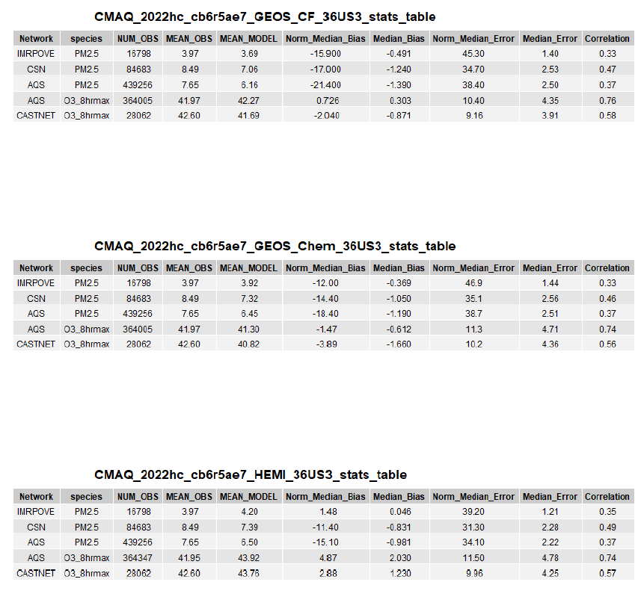
CMAQ 36US3 Model performance: Summary
The CMAQ simulations at 36US3 have similar PM2.5 and O3 performance statistics (surface data) using GEOS-CF, GEOS-Chem, and H-CMAQ BC
Notes:
CASTNET is more proper for MPE for 36US3

Slide 12
CMAQ 36US3 Model performance: O3 season, 8hr_max (May 1 to September 30, 2022)
Network | NUM_OBS | MEAN_OBS | MEAN_MODEL | Norm_Median_Bias | Median_Bias | Norm_Median_Error | Median_Error | Correlation
CMAQ_2022hc_cb6r5ae7_GEOS_CF_36US3
CASTNET | 11463 | 45.51 | 43.93 | -3.46 | -1.58 | 10.6 | 4.83 | 0.65
AQS | 178205 | 44.65 | 44.40 | -0.49 | -0.22 | 11.4 | 5.09 | 0.73
CMAQ_2022hc_cb6r5ae7_GEOS_Chem_36US3
CASTNET | 11463 | 45.51 | 42.71 | -6.24 | -2.85 | 12.2 | 5.57 | 0.62
AQS | 178205 | 44.65 | 43.26 | -3.09 | -1.37 | 12.7 | 5.66 | 0.70
CMAQ_2022hc_cb6r5ae7_HEMI_36US3
CASTNET | 11463 | 45.51 | 46.44 | 2.60 | 1.19 | 10.2 | 4.67 | 0.66
AQS | 178205 | 44.65 | 46.20 | 3.93 | 1.75 | 11.5 | 5.13 | 0.74
The CMAQ simulations at 36US3 using GEOS-CF and H-CMAQ BC have slightly better performance statistics (surface data) than the one using GEOS-Chem
Notes:
Try not to say which model has the worse MPE, the states/MJOs can use any BC they prefer to use if the model designs follow the guideline.

Slide 13
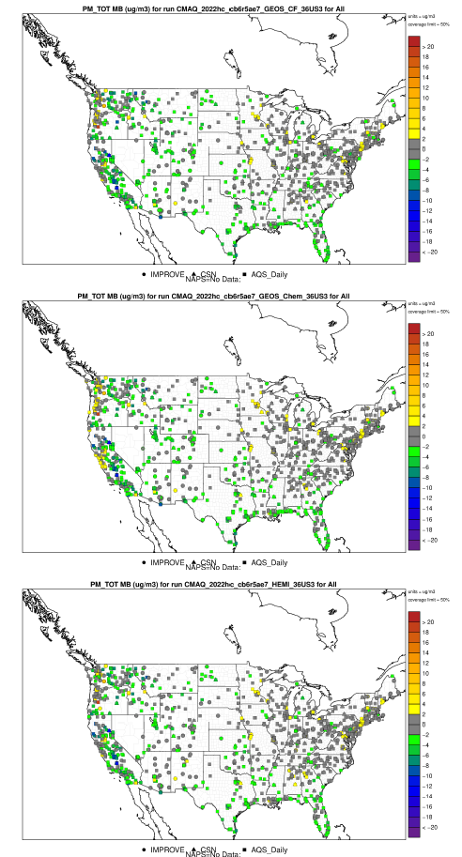
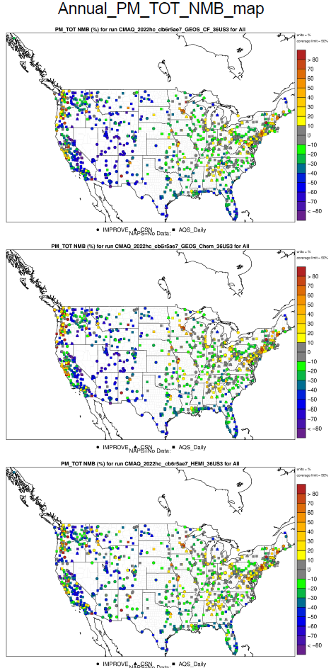
CMAQ 36US3 Model performance: PM2.5 Bias
MB (ug/m3)
NMB (%)
CF BC
GC BC
CQ BC
Overall, the biases are similar among these three 36US3 model runs for PM2.5

Slide 14
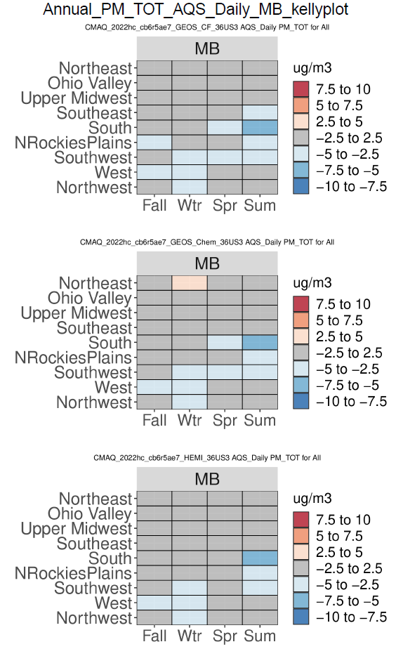
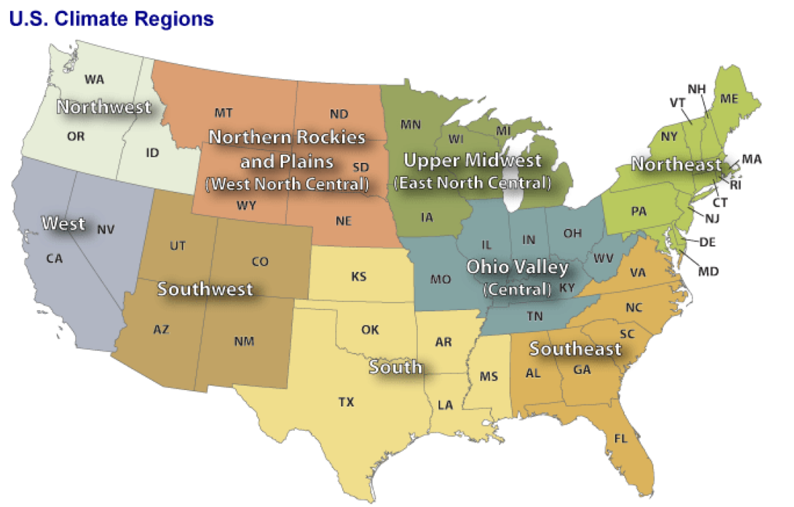
CMAQ 36US3 Model performance: Performance Statistics plots

Slide 15
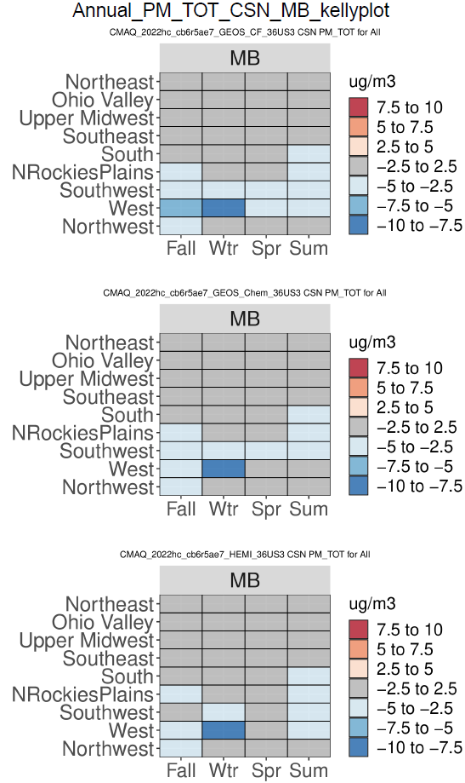
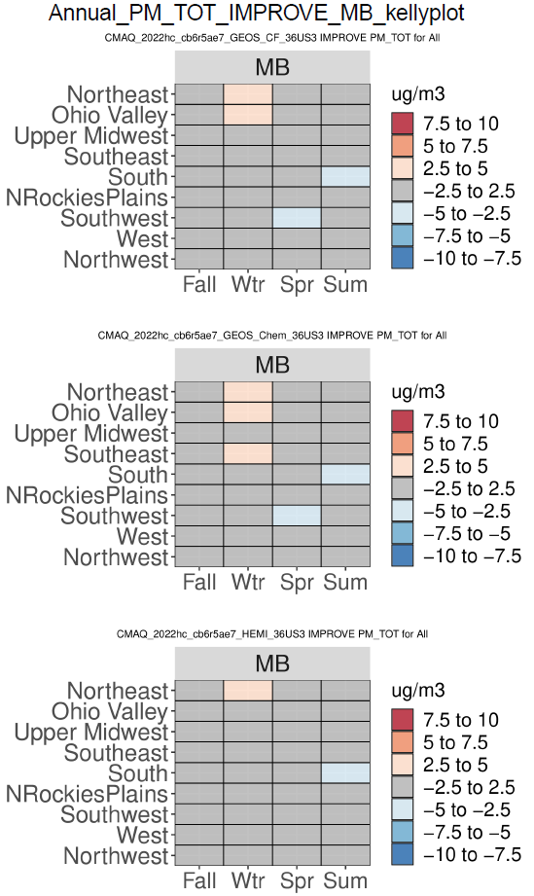
CMAQ 36US3 Performance Statistics Plots: PM2.5 Median Bias
AQS
CSN
IMPROVE
CF BC
GC BC
CQ BC
Overall, the errors are similar among these three 36US3 model

Slide 16
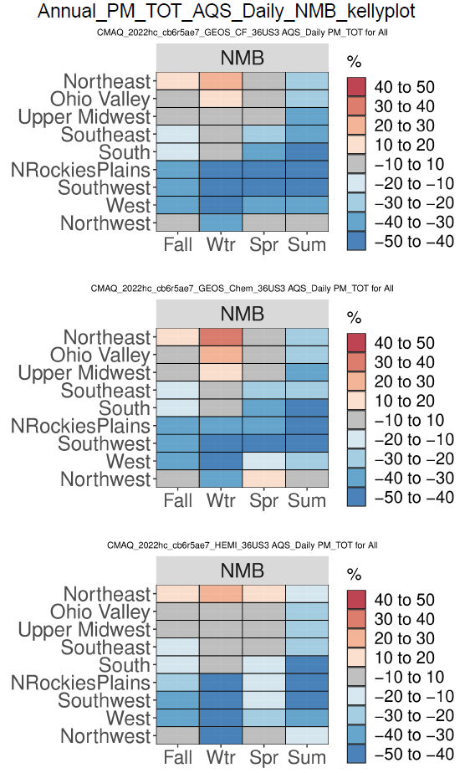
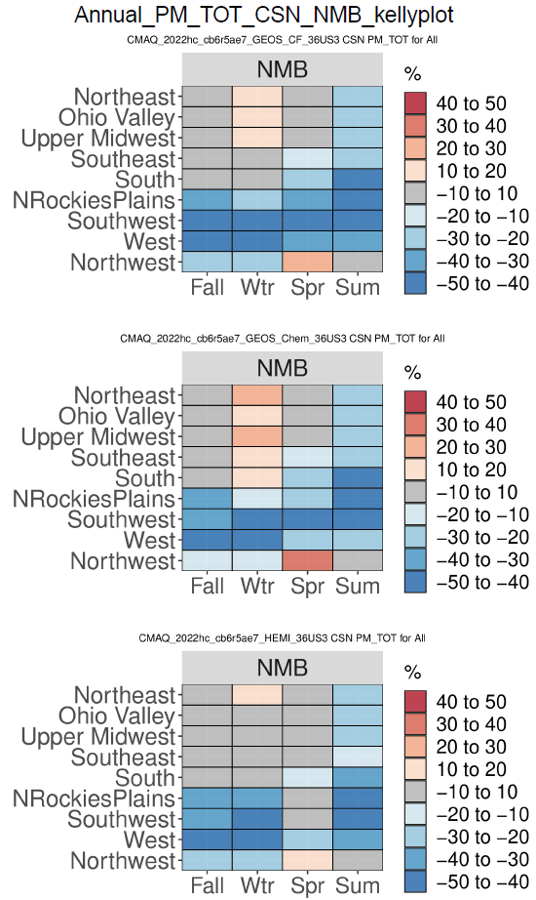
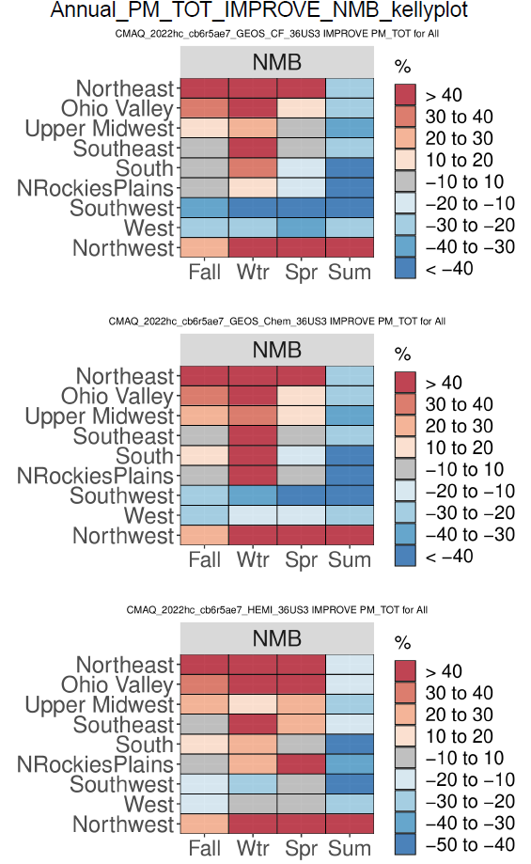
CMAQ 36US3 Performance Statistics Plots: PM2.5 Normalized Mean Bias
AQS
CSN
IMPROVE
CF BC
GC BC
CQ BC
Overall, the NMBs are similar among these three 36US3 model runs except spring. In general, CQ BC predicts slightly higher PM2.5 in spring than other two BC runs

Slide 17
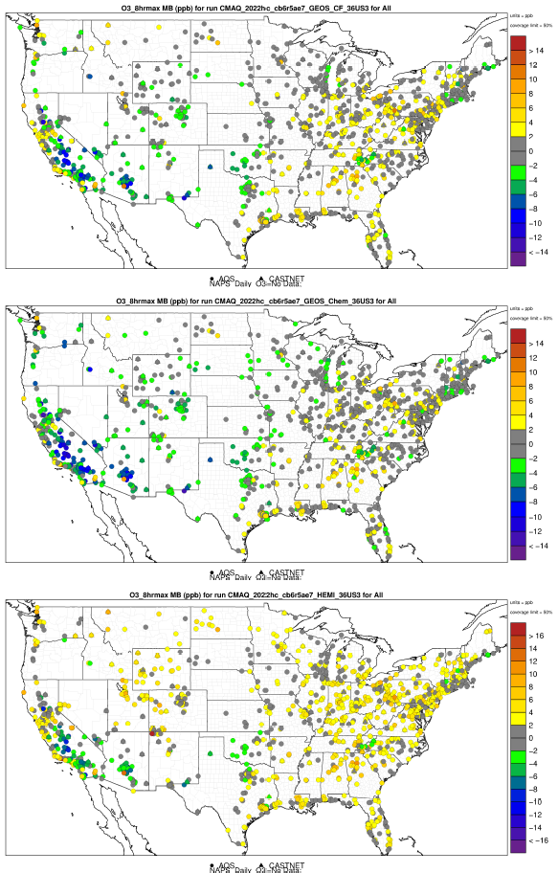
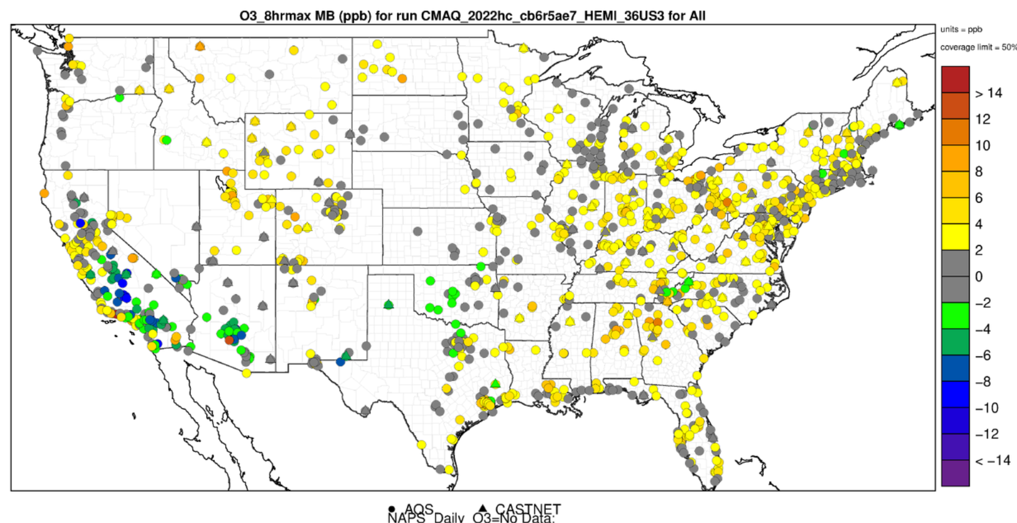
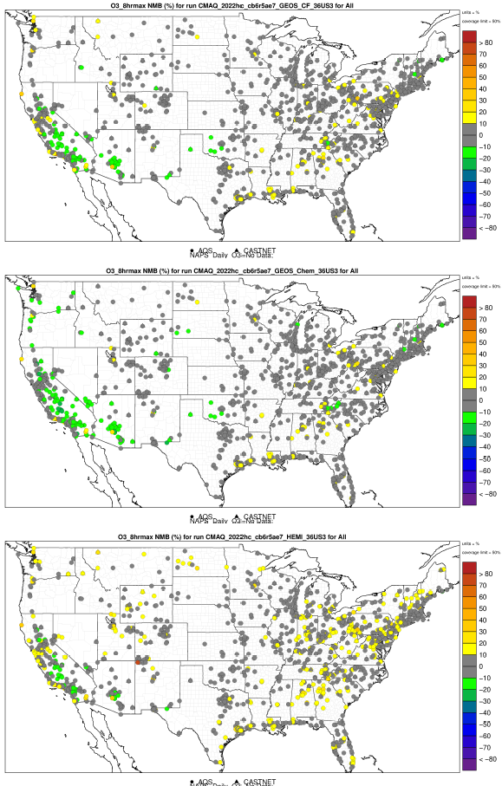
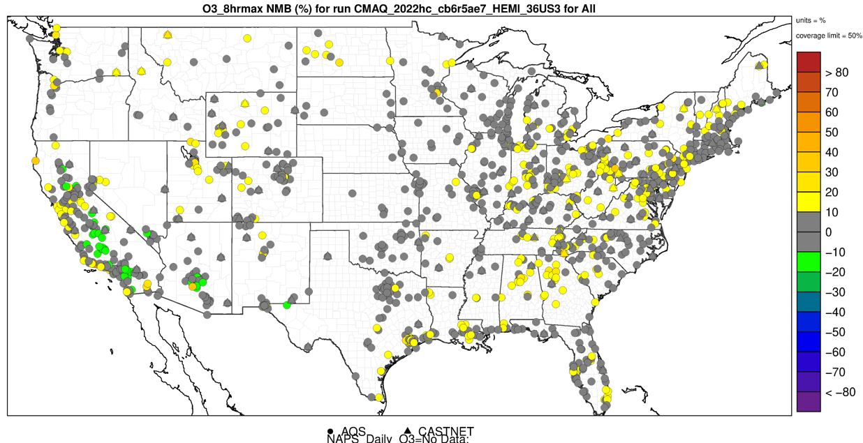
CMAQ 36US3 Model performance: Annual surface O3 MDA8 Bias
MB (ppb)
NMB (%)
CF BC
GC BC
CQ BC
H-CMAQ BC has better performance in west and southwest regions, but overestimates O3_8hrmax in other regions.

Slide 18
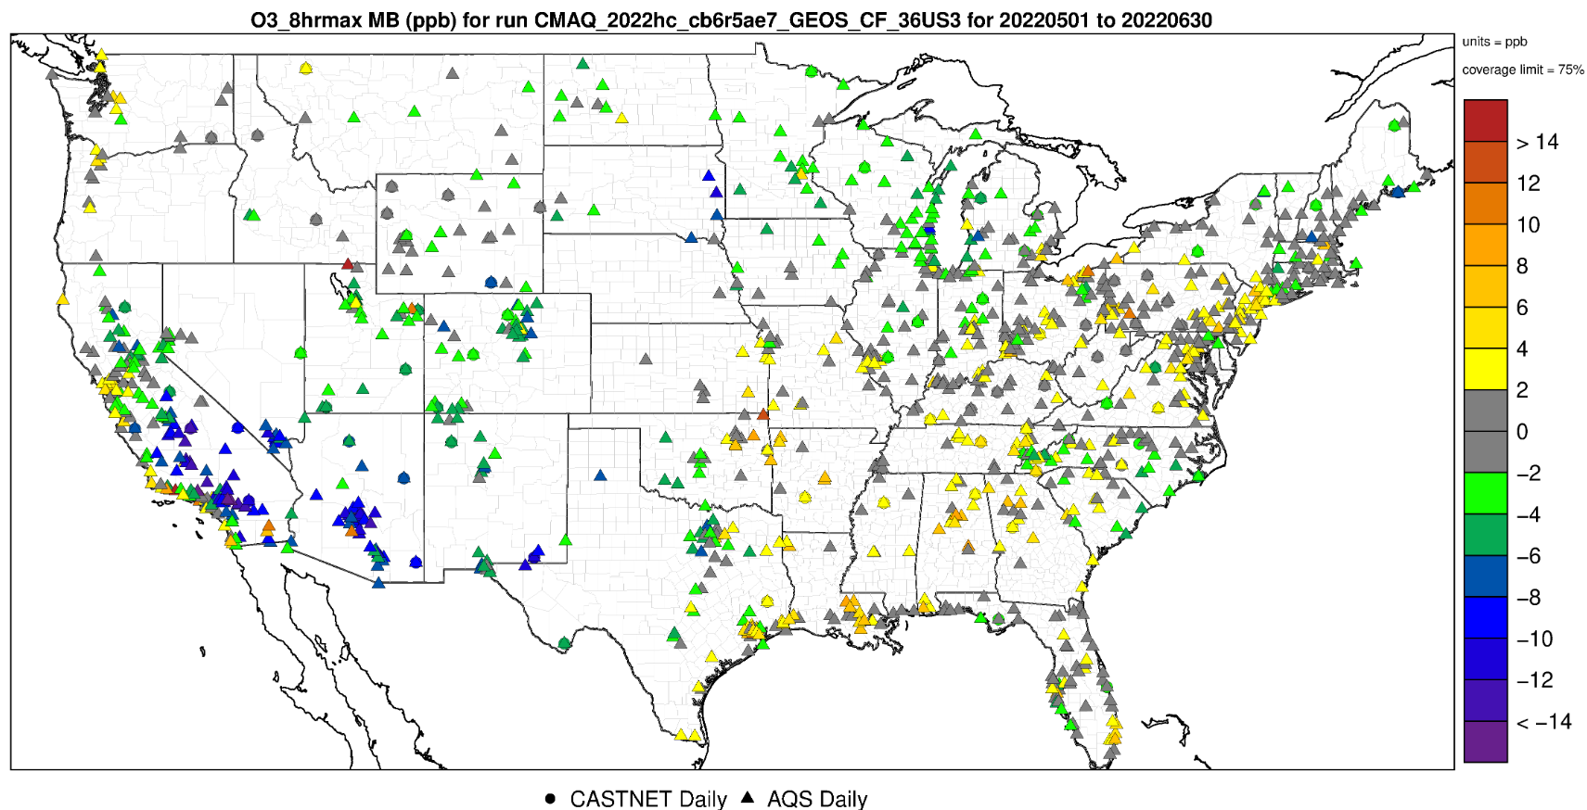
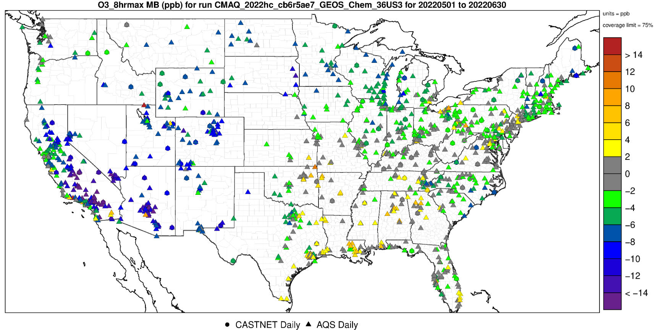
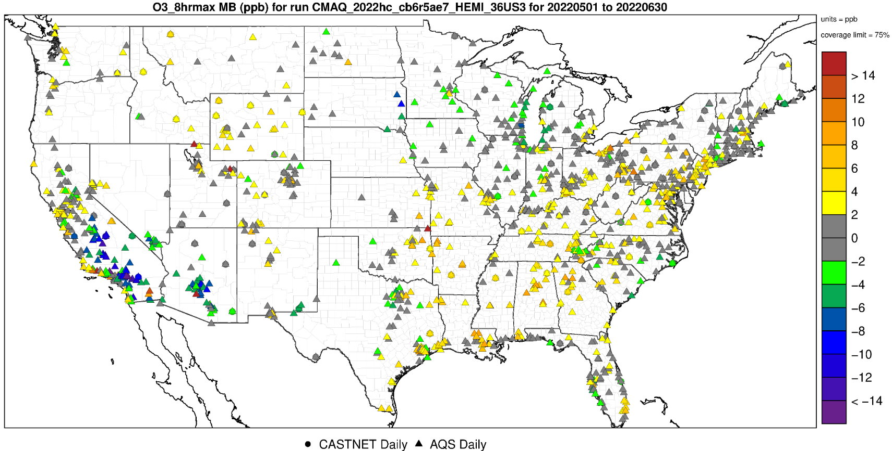
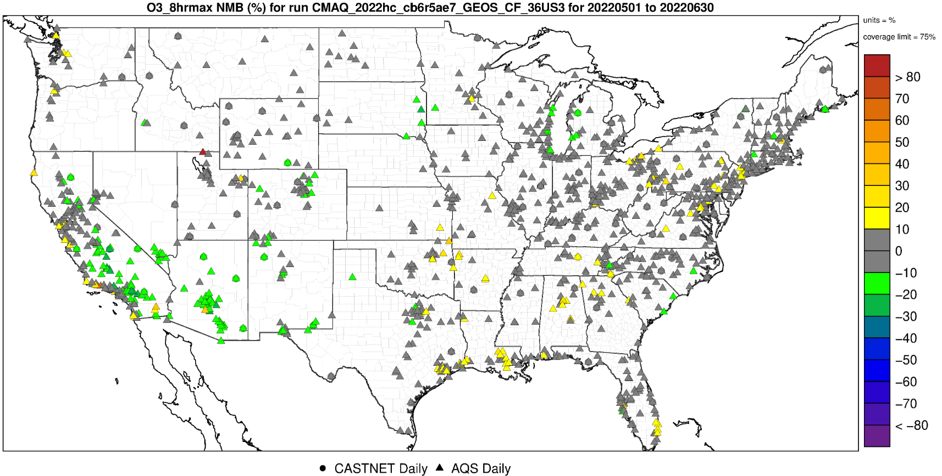
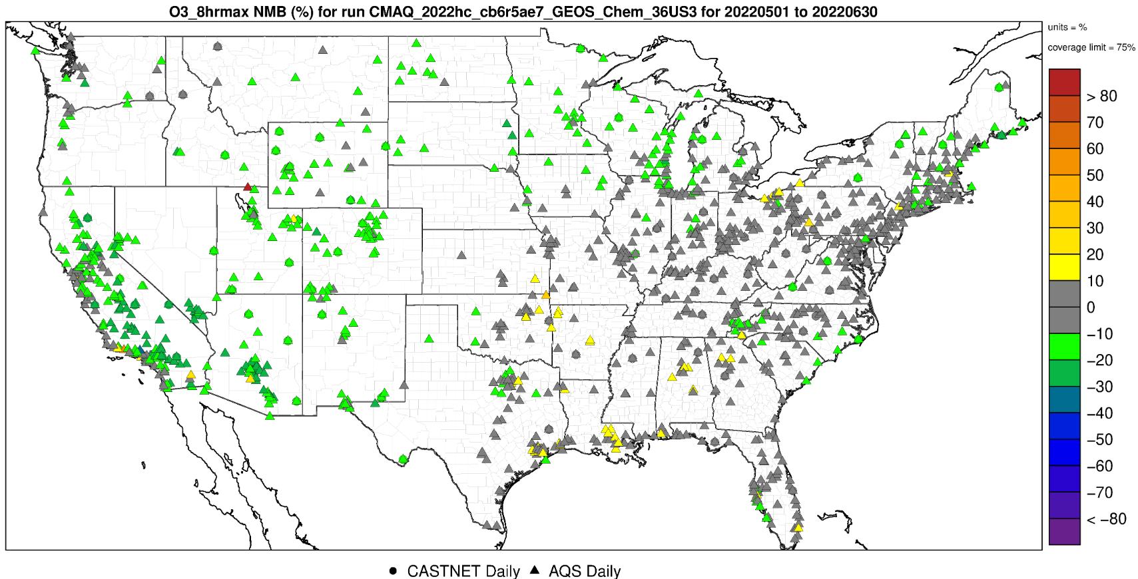
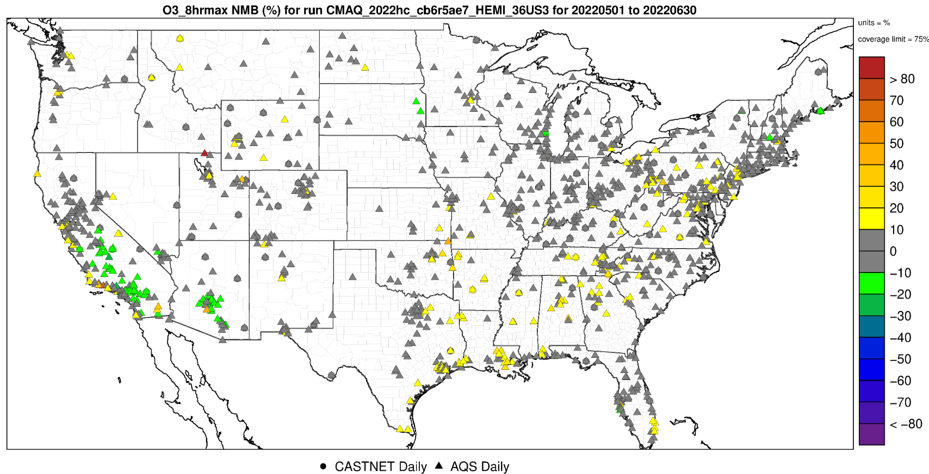
CMAQ 36US3 Model performance: May – June 2022 surface O3 MDA8 Bias
MB (ppb)
NMB (%)
CF BC
GC BC
CQ BC

Slide 19
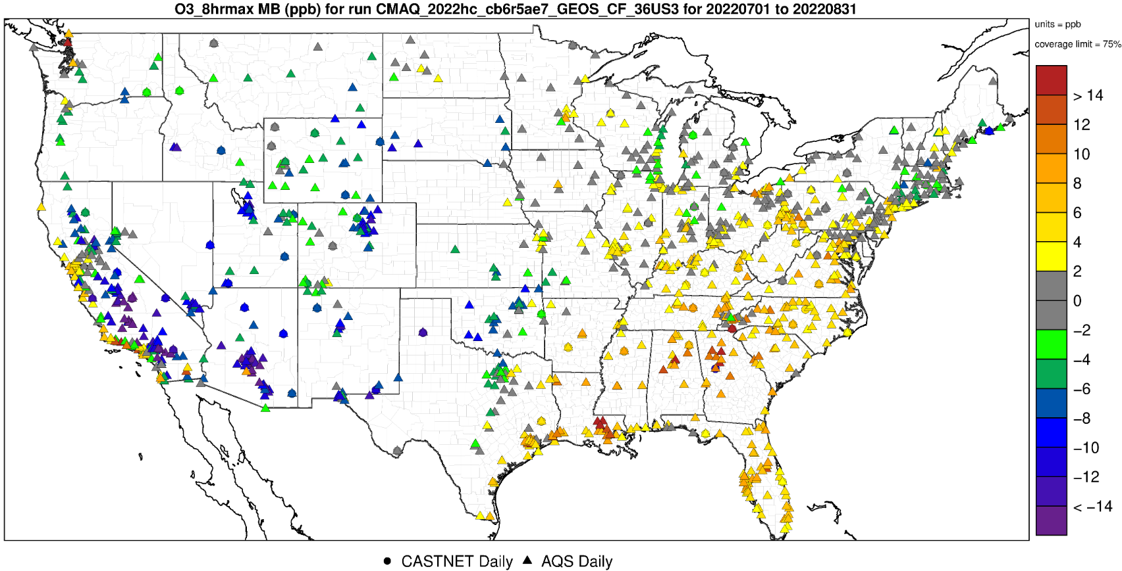
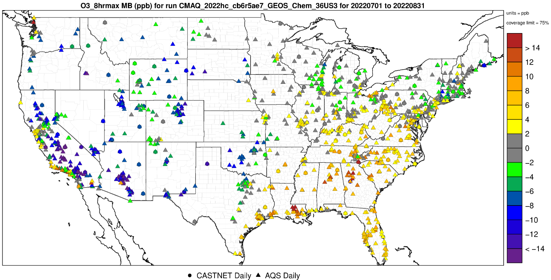
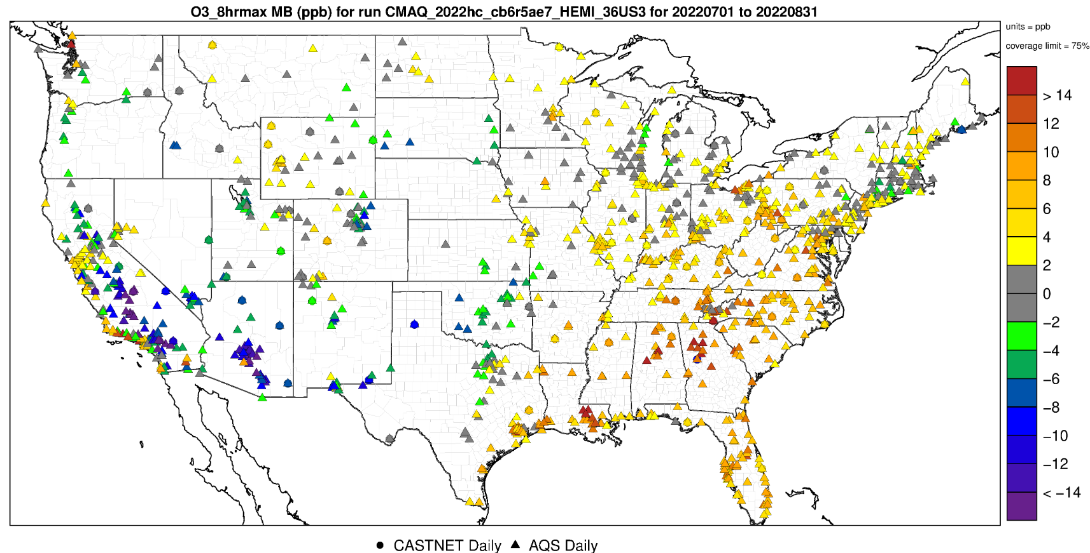
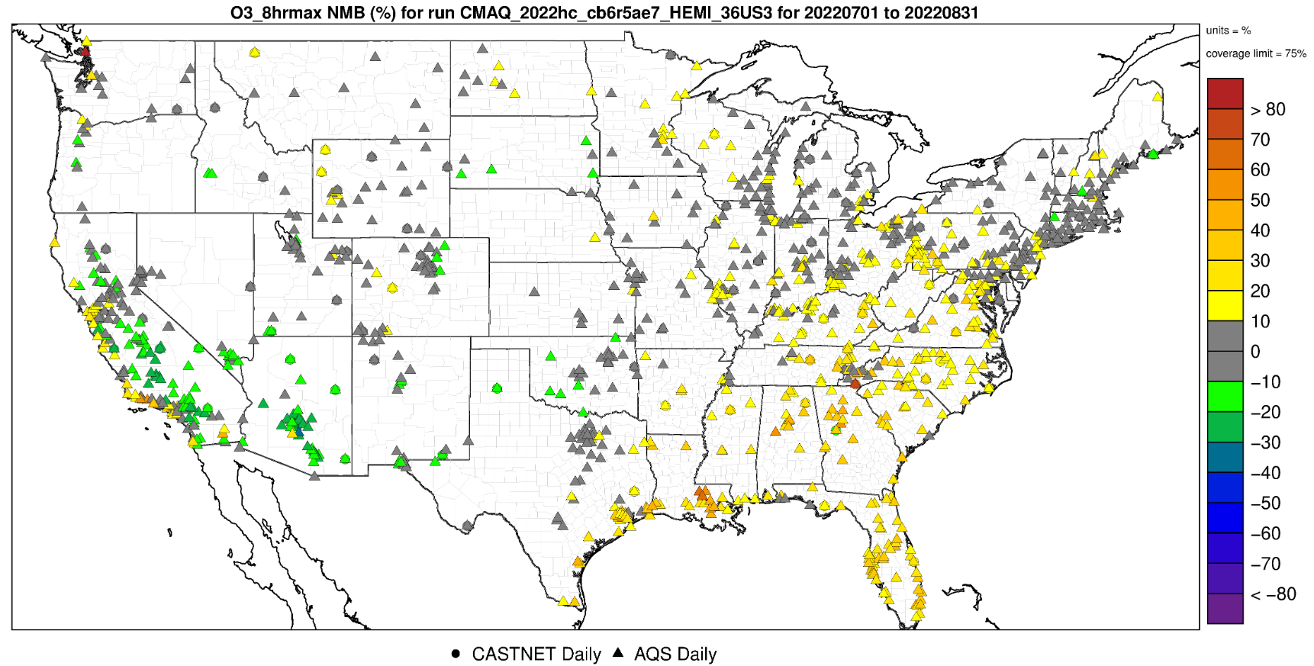
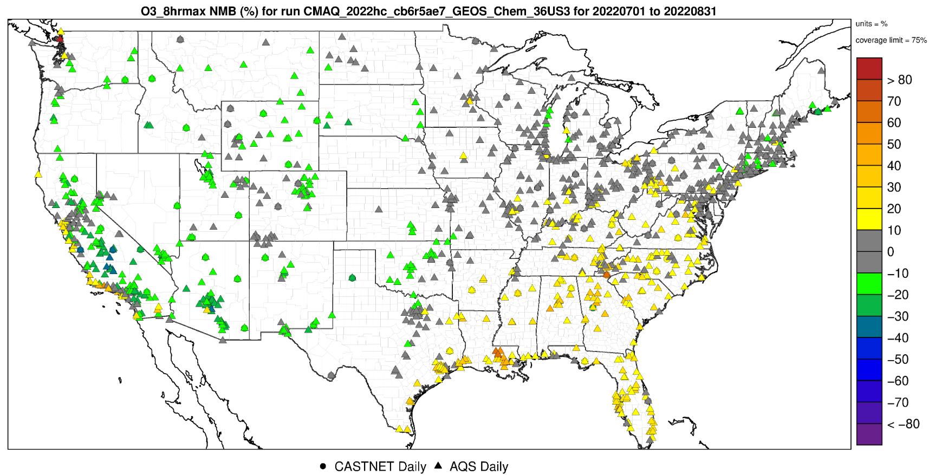
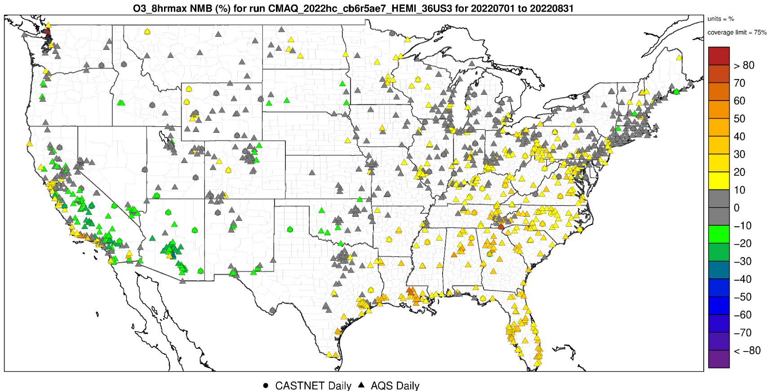
CMAQ 36US3 Model performance: July - August 2022 surface O3 MDA8 Bias
MB (ppb)
NMB (%)
CF BC
GC BC
CQ BC

Slide 20
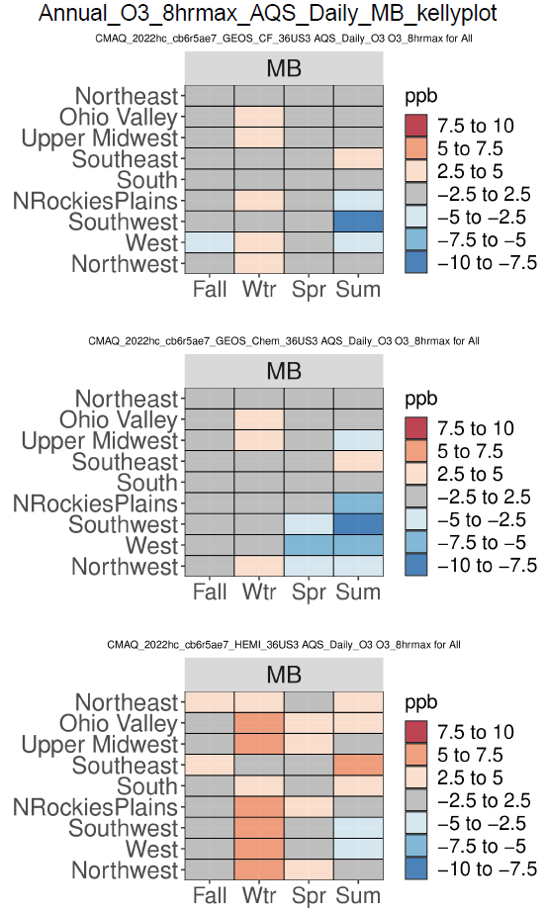
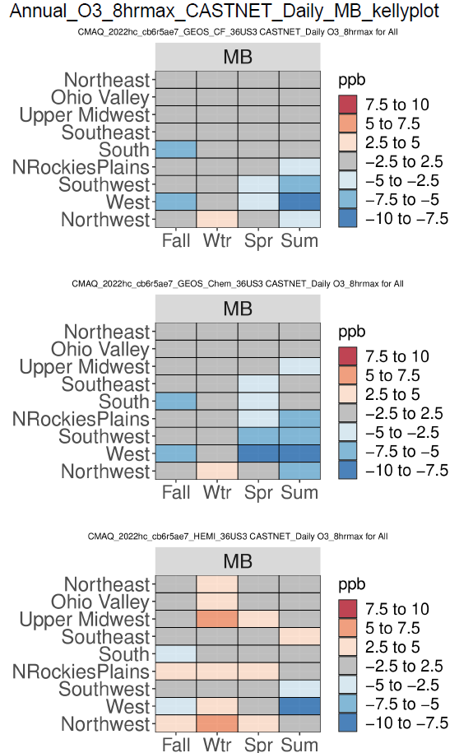
CMAQ 36US3 Performance Statistics Plots: O3 MDA8 Median Bias
AQS
CASTNET
CF BC
GC BC
CQ BC
In general, CQ BC predicts slightly higher O3_8hrmax than other two BC runs.

Slide 21
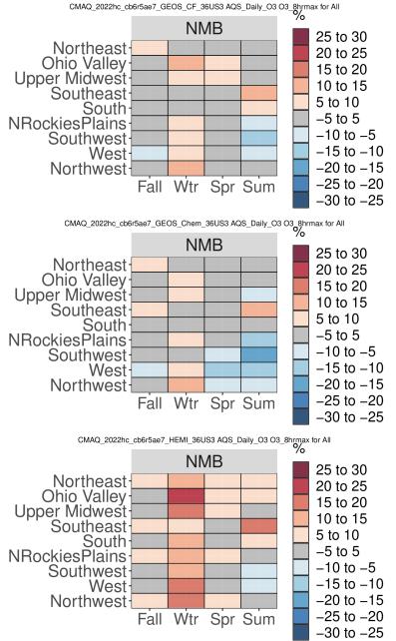
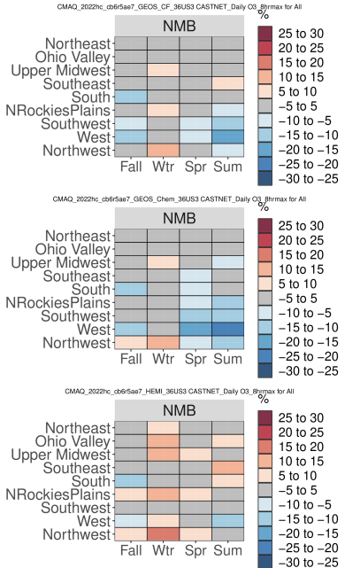
CMAQ 36US3 Performance Statistics Plots: O3 MDA8 Normalized Mean Bias
AQS
CASTNET
CF BC
GC BC
CQ BC
In general, CQ BC predicts slightly higher O3_8hrmax than other two BC runs and has slightly better performance in spring and summer for W and SW regions.

Slide 22
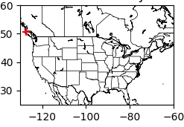
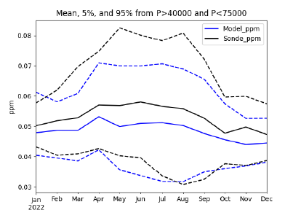
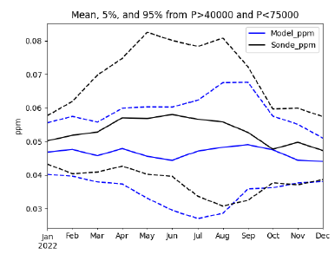
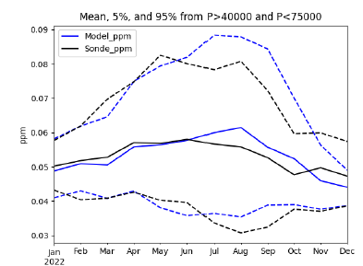
CMAQ 36US3 Model performance: O3 vertical profile in mid-troposphere
CF BC
GC BC
CQ BC
CQ BC has slightly better O3 (5-95%) between 40000 to 75000 Pa compared to sondes.

Slide 23
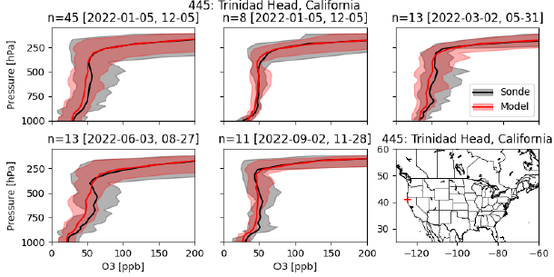
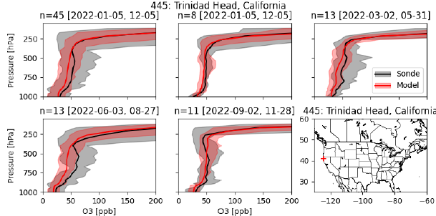
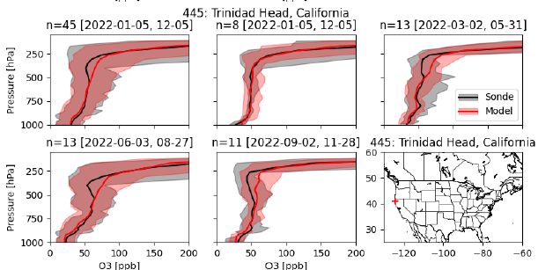
CMAQ 36US3 Model performance: O3 vertical profile near 12US2 BCON
CF BC
GC BC
spring
spring
annual
winter
annual
winter
summer
fall
summer
fall
CQ BC
spring
annual
winter
summer
fall
CQ BC has slightly better agreement of vertical profile of O3 at Trinidad Head, California sonde.

Slide 24
EPA’s Next Steps for CMAQ 12US2 Simulations and Evaluations
The initial CMAQ simulation at 36US3 has similar PM2.5 and O3 performance statistics using BC from simulations using GEOS-CF (CF), GEOS-Chem (GC), and HEMI-CMAQ (CQ) BC.
Detailed model performance
  Slightly better ability to capture O3 peaks in CASTNet and AQS monitors in June/July in the Southwest and West regions .
  Less negative annual bias of PM2.5 in IMPROVE sites in the Southwest and N. Rockies regions.
  Slightly better O3 (5-95%) between 40000 to 75000 Pa compared to sondes.
Flexibility
  Hemispheric CMAQ (and GEOS-Chem) runs are conducted by the EPA and we have more control on the model configurations
For EPA platform development, we are moving forward with a single set of BCs for 12km CMAQ and CAMx runs.
If we see different 12km model performance in CMAQ and CAMx then we could do sensitivity studies with differing BCs if necessary.

Slide 25
2022 modeling platform high level spatial and temporal trends CQ BC CMAQv5.4.0.4

Slide 26
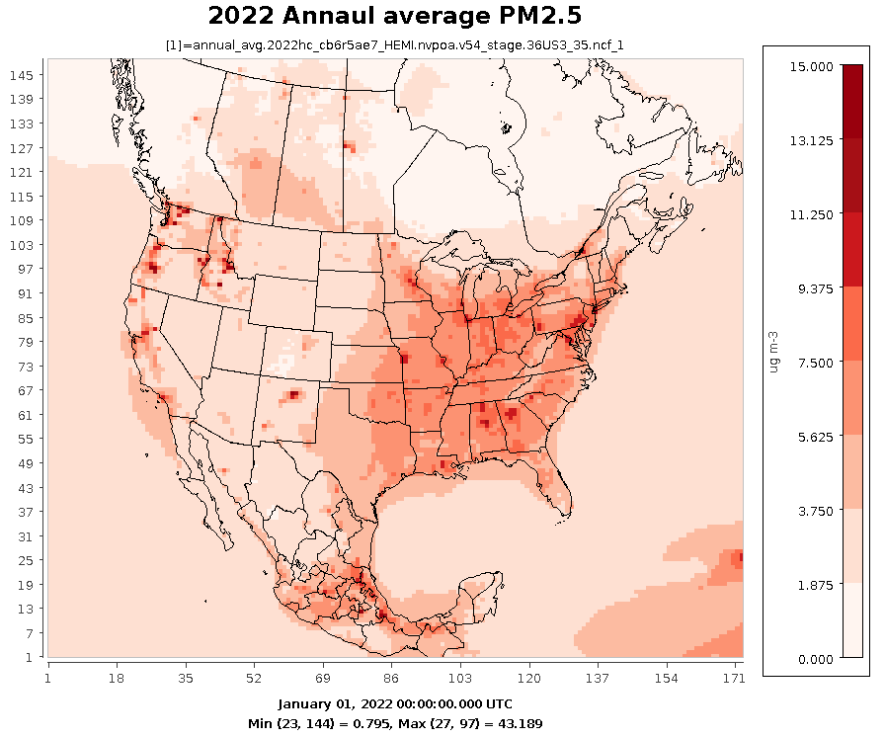
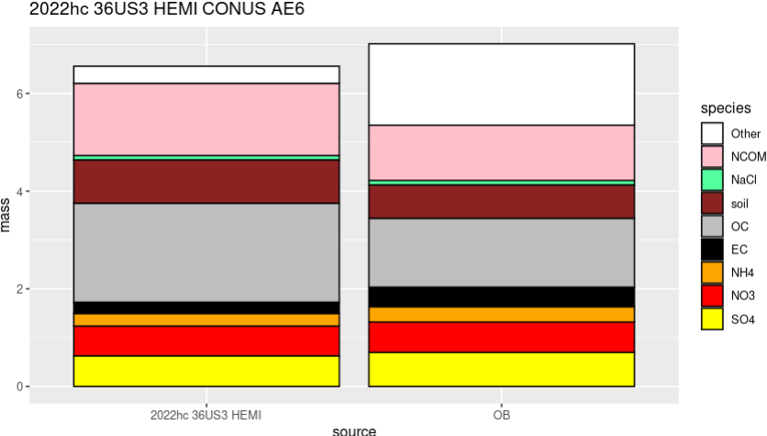
CMAQ 36US3 CQ BC Model: PM2.5 Annual Spatial Pattern
36km resolution, so the model cannot fully capture urban gradients or mountain inversions in the West

Slide 27
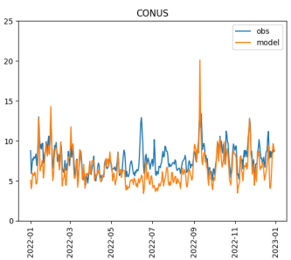




CMAQ 36US3 CQ BC Model: PM2.5 Time Series
PM2.5 ug/m3

Slide 28





CMAQ 36US3 CQ BC Model: PM2.5 Time Series
PM2.5 ug/m3

Slide 29


CMAQ 36US3 CQ BC Model: MDA8 O3 Seasonal Spatial Pattern
Spatial patterns looks different for seasonal mean vs high days

Slide 30





CMAQ 36US3 CQ BC Model: MDA8 O3 Time Series
MDA8 O3 ppb

Slide 31





CMAQ 36US3 CQ BC Model: MDA8 O3 Time Series
MDA8 O3 ppb

Slide 32
Sensitivity CMAQ and CAMx runs
CMAQ
  M3DRY
  Uni-directional flux
  Nitrate photolysis with full halogen chemistry
  Semivolatile POA
  Semivolatile POA with pcSOA
  Wind-blown dust
CAMx
  Uni-directional flux
  NH3 Rscale = 0
  v7.3 with more detailed SOA

Slide 33
Next Steps
36US3 data release to AWS: October 2024
  EPIC and Lightning data
12US2 CMAQ and CAMx model runs and MPEs: November 2024
  Configuration sensitivities
12US2 data release to AWS: Nov - Dec 2024
  CMAQ: EPIC and Lightning data
  CAMx: O3 column and photolysis rate data
  ICON and BCON
Technical Support Document v1: January 2025
2022 modeling platform v2

Slide 34
Any questions?
What are States and MJOs’ plans?

