Slide 1
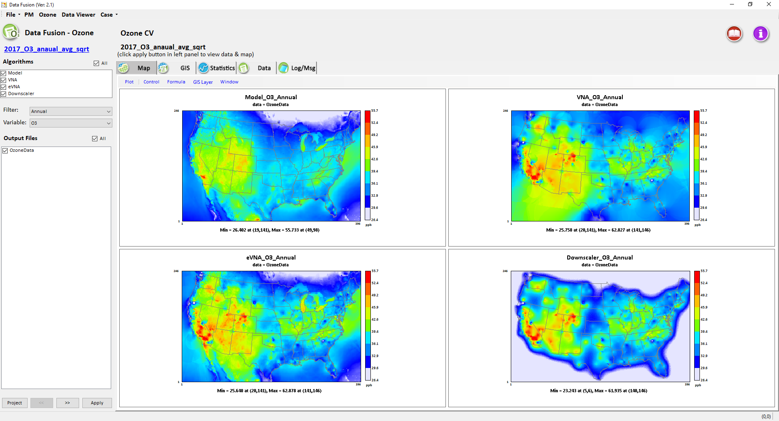
Overview and Demo of OAQPS’s Data Fusion Tool
Applications of Advanced Data Fusion Techniques
Data Fusion
CMAQ
VNA
Monitor
Data
Model
Data
eVNA
Down-scaler
https://gaftp.epa.gov/Air/aqmg/cjang/Data_Fusioin_Tool/DFTool_2.1/
Carey Jang (1) and Jim Kelly (2)
OAQPS/AQAD/Air Quality Modeling Group
ORD briefing, August 31, 2021
Notes:
1

Slide 2
Outline
  Overview of OAQPS’s Data Fusion Tool (Carey Jang)
    Data fusion techniques applied at EPA’s regulatory modeling tools
    Motivation and key features of Data Fusion tool development
  Data Fusion Tool: Live Demo (Carey Jang)
    Model & monitor input data
    Data fusion techniques option
    Spatial & temporal data fusion option
    Cross-validation (Multi-fold, Leave-one-out, Leave-group out & cluster analysis)
  Applications of Advanced Data Fusion Techniques at OAQPS (Jim Kelly)
    Data fusion evaluation and intercomparison for PM NAAQS review
    Application of machine learning and satellite methods to exposure

Slide 3
Data Fusion Techniques Used in O3 and PM2.5 NAAQS Review and Implementation
  REA: Risk & Exposure Assessments (Health & Welfare):
    The Health REA assesses population exposures and health risks for meeting the current standard and potential alternative standards
      VNA used for urban scale hourly O3 assessment
      Downscaler used for national seasonal O3 assessment and annual PM_{2.5} assessment
    The Welfare REA assesses vegetation and ecosystem exposures/risks
      VNA surfaces used for national seasonal O3 assessment
  RIA: Regulatory Impact Assessment:
    Assesses costs & health benefits of attaining proposed standards
      eVNA/VNA & Downscaler used for national annual PM and seasonal O3 assessment
  NAAQS Implementation:
    Attainment demonstration for meeting NAAQS standards
      eVNA & VNA used for PM2.5 and O3 model attainment test
3

Slide 4
Data Fusion Tool
  Motivation:
    To build a standalone DF tool to provide a systematic comparison and in-depth analysis & evaluation of data fusion techniques used to support EPA’s regulatory modeling and other assessments
  Key Features:
    User-friendly: easy-to-use & built-in monitoring database (2002-2017)
    Computationally efficient: generate & compare multiple DF results
    Modular: flexible temporal & spatial domain selection
    Performance evaluation: cross-validation
    Visualization & analysis: graphics/tables/statistics
    Transparent & open-source: research & applications

Slide 5
“Data Fusion” Tool
(Fusing Model and Monitor and/or other data)
Inputs:
Model & Monitor or other data
(dispersion model, satellite data, LUR, etc.)
Spatial: grid & non-grid (GIS)
Temporal: annual/monthly/daily
Techniques:
eVNA, VNA,
Downscaler, etc.
Data
Fusion
Transparent & Open-Source
Cross-Validation
(QA, Multi-fold, Leave-one-out, etc)
Method Development, Research & Applications
Regulatory Assessment
(PM & O3 RIA, REA)
BenMAP-CE,
CDC Health Studies
SMAT-CE
Attainment Test
Notes:
This is a conceptual framework for the potential standalone data fusion tool. The idea is actually coming from EPA so I will let our EPA friends to elaborate.

Slide 6
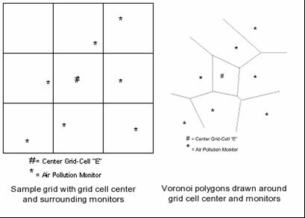
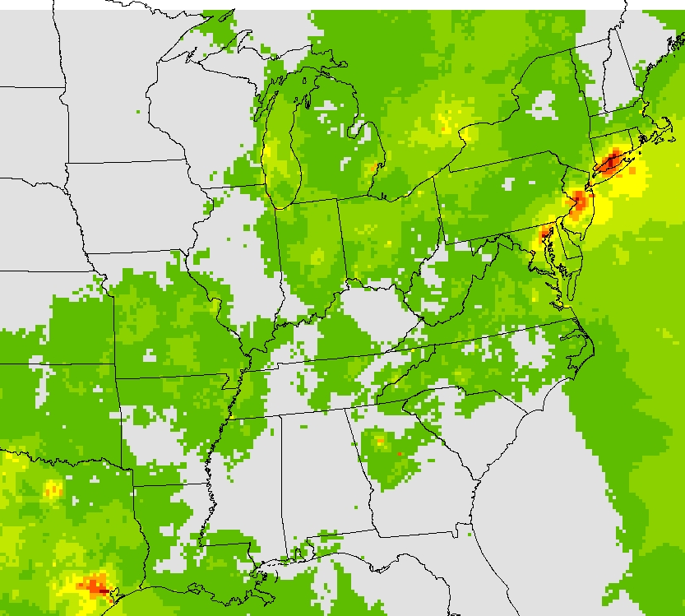
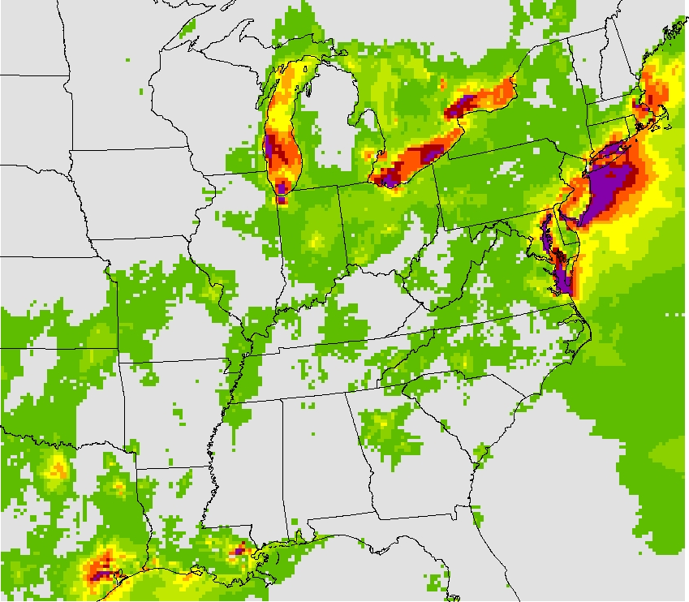
Data Fusion Used in Regulatory Modeling Support Tools
Data fusion (spatial fields) is used in:
  SMAT-CE attainment tool for PM2.5 & O3 attainment test to provide model RRF to monitoring data point (to calculate future Design Value)
  BenMAP-CE benefit tool to calculate health & economic benefits
Spatially interpolated conc. fields - VNA
  monitoring data points interpolated to grid cells
Fused spatial fields (gradient adjusted) - eVNA
  Interpolated monitoring data is combined with gridded model data to adjust fields based on modeled gradients
New DF module in SMAT-CE - Downscaler
Data Fusion
VNA
eVNA
(VNA / eVNA: Voronoi Neighbor Averaging, see Appendix for further details)
(Downscaler: Linear regression spatial modeling with a Bayesian approach
https://www.epa.gov/air-research/downscaler-model-predicting-daily-air-pollution)
Notes:
Linear regression spatial modeling with a Bayesian approach is used to generate uncertainty analysis of each prediction

Slide 7
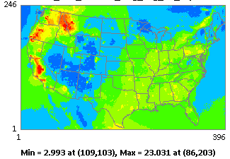

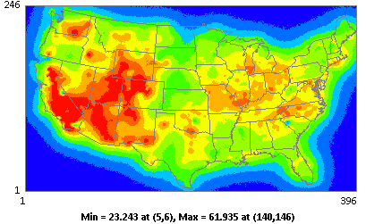

Comparisons of Downscaler (DS) Results:
“MATLAB-DS” (ORD) vs. “DFT-DS” (OAQPS) for 2017 PM2.5 & O3 (CDC case study)
Downscaler_Log_PM2.5_Annual
Downscaler_Square root_O3_Annual
“Data Fusion Tool 2.1” available at EPA’s new FTP site: https://gaftp.epa.gov/Air/aqmg/cjang/Data_Fusioin_Tool/DFTool_2.1/
Carey Jang & Jim Kelly, AQAD/Air Quality Modeling Group
Data Fusion Team meeting, February 2021

Slide 8
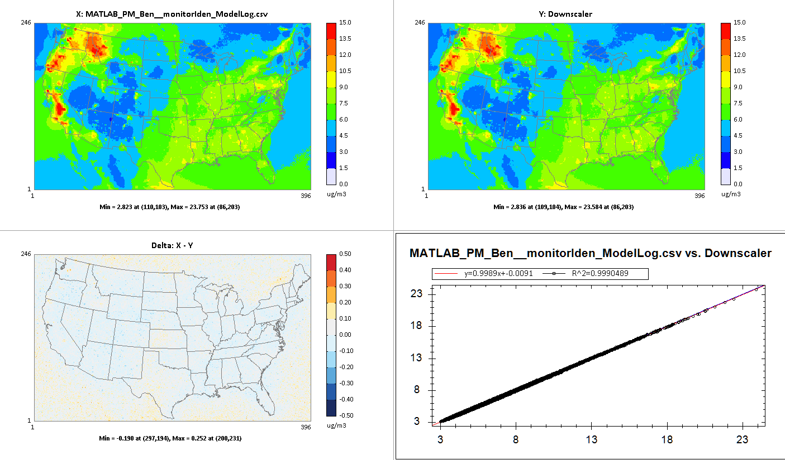
MATLAB-DS vs. DFT-DS Comparison:
PM2.5 (Log option):
MATLAB_Log_PM2.5_Annual
DFT_Log_PM2.5_Annual
X: MATALB
Y: DataFusion 2.1
Difference (X-Y)
MATLAB vs DataFusion 2.1
Data Fusion Tool was able to successfully replicate ORD’s MATLAB Downscaler PM2.5 results using the same data fusion configurations based on 2017 CDC case study and input dataset
8

Slide 9
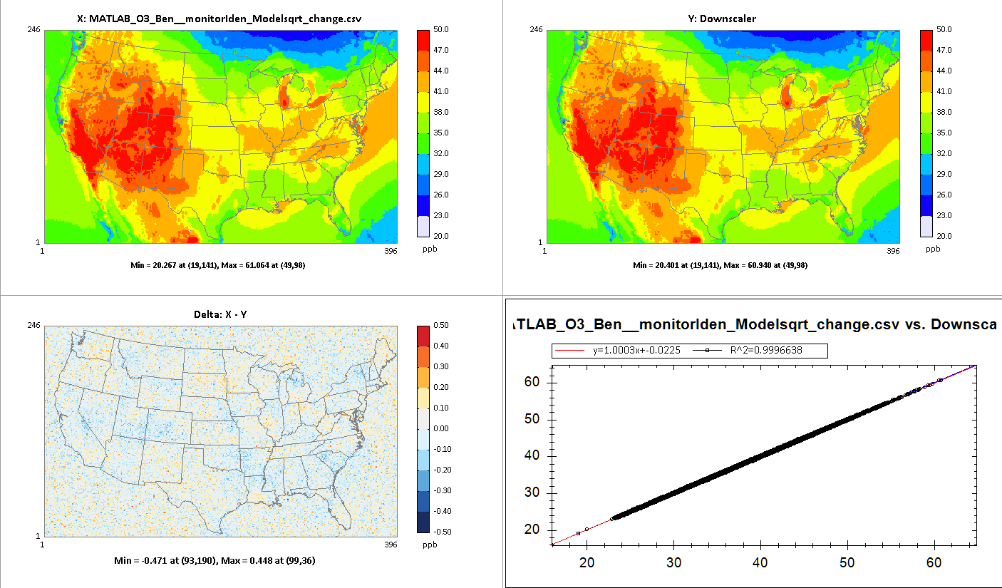
MATLAB-DS vs. DFT-DS Comparison:
O3 (Square Root option):
MATLAB_SquareRoot_O3_Annual
DFT_SquareRoot_O3_Annual
X: MATALB
Y: DataFusion 2.1
Difference (X-Y)
MATLAB vs DataFusion 2.1
Data Fusion Tool was able to successfully replicate ORD’s MATLAB Downscaler O3 results using the same data fusion configurations based on 2017 CDC case study and input dataset
9

Slide 10
Data Fusion Tool
Demo
For Ozone and PM2.5
The Data Fusion Tool v.2.1 package (“Data Fusion Tool_ Setup v2.1.exe” and “Data Fusion Tool_Data v2.1.exe” : run both to install) is available at EPA’s NewFTP site under:
https://gaftp.epa.gov/Air/aqmg/cjang/Data_Fusioin_Tool/DFTool_2.1/
DF Tool demo, Carey Jang
10

Slide 11
Data Fusion Tool: Key Functions and Modules
Data Fusion Tool
Data Input and Configuration
Cross-Validation
Data Viewer
Data Input Option
Fusion Technique Option
Spatial & Temporal Option
Receptor Option
Multi-fold Cross Validation
Leave-one-out Cross Validation
Leave-group-out Cross Validation
Map, GIS, Statistics, Data table, Log/Msg
11

Slide 12
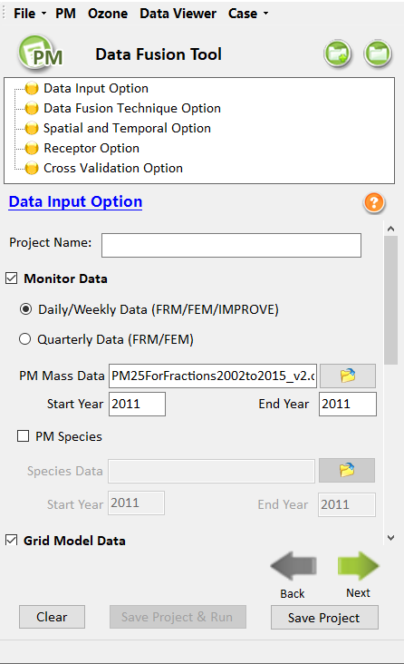
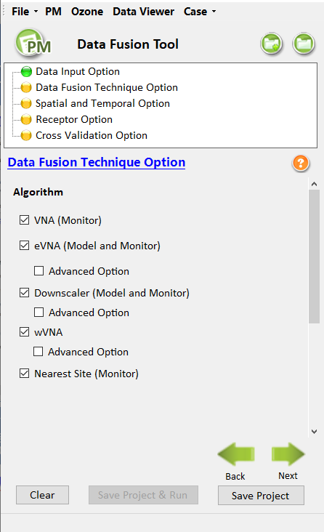
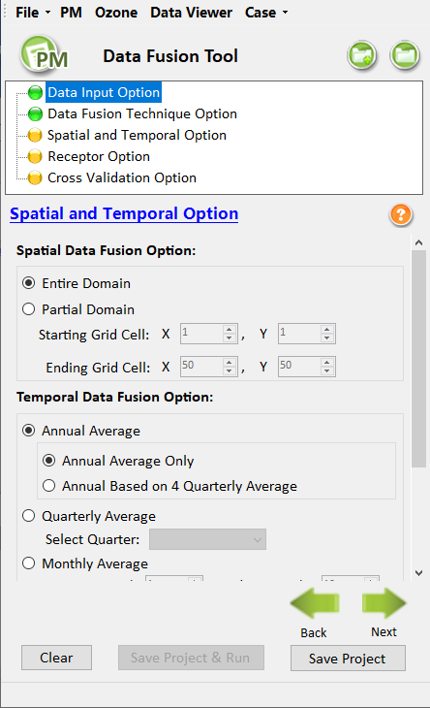
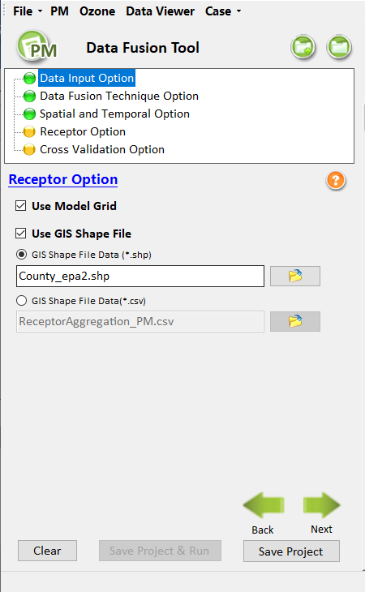
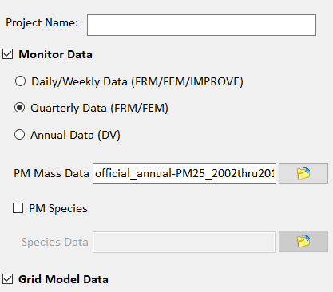
Running Data Fusion Tool
Key Modules and Configurations & Options
Data Input Option
Data Fusion Technique Option
Spatial and Temporal Option
Receptor Option
Model data
Monitor data
Other
eVNA/VNA/wVNA
Downscaler
Nearest Site
Spatial DF option
Temporal DF option
Grid (model)
Non-grid (GIS shapefile)
12

Slide 13
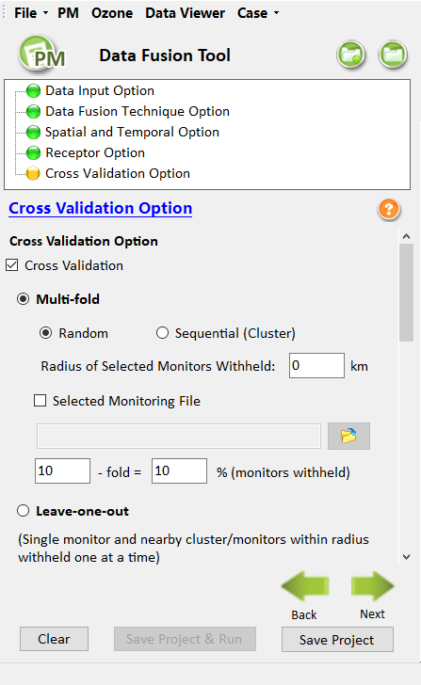
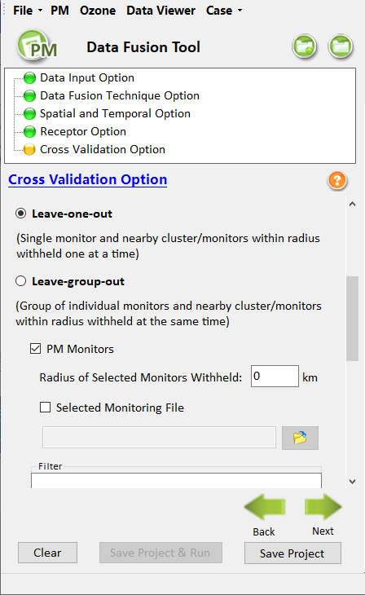
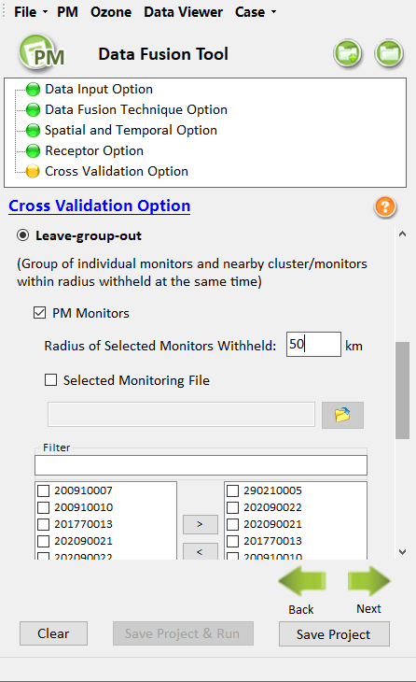
Data Fusion Tool: Cross-Validation Module
Cross-Validation Module
Multi-fold Cross Validation:
All monitoring locations are randomly or sequentially divided into “N” groups across regions. The set of monitors in one group is excluded and then the interpolating algorithm is performed on the remaining monitors. “N”-fold means that the process was repeated “N” times.
Leave-one-out Cross Validation:
It is the most extreme case of “N”-Fold. Single monitor and nearby cluster/monitors within radius withheld one at a time. The procedure is also repeated “N” times.
Leave-group-out Cross Validation:
Leave-group-out is a clustered cross-validation approach. Group of individual monitors and nearby cluster/monitors within radius withheld one at the same time.
“Multi-fold”
w/ Cluster Analysis
“Leave-one-out”
w/ Cluster Analysis
“Leave-group-out”
w/ Cluster Analysis

Slide 14
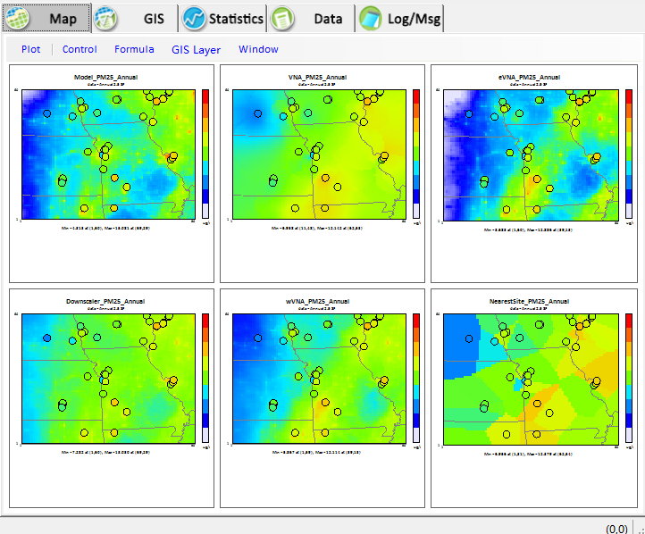
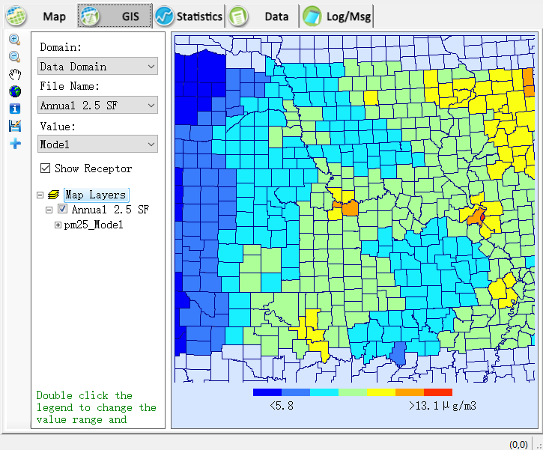
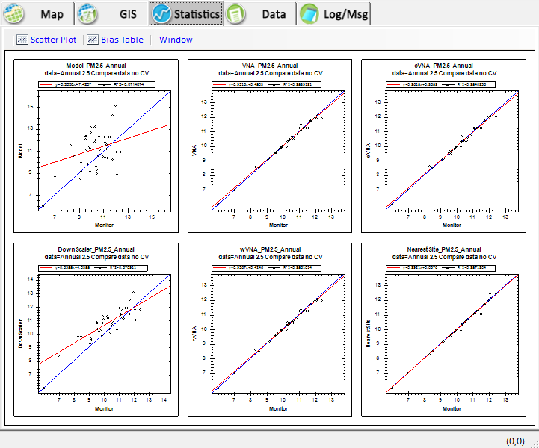
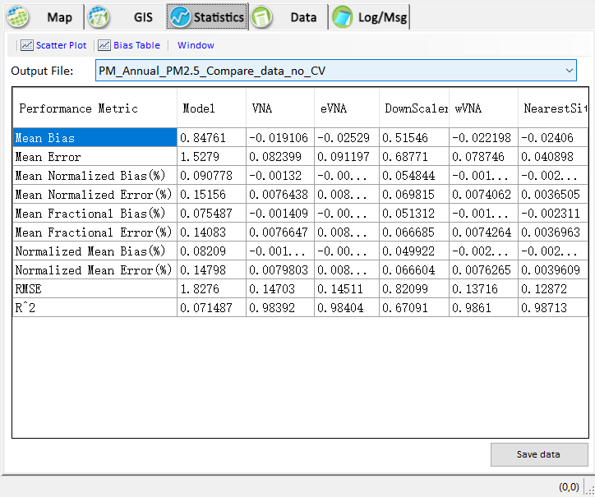
Data Fusion Tool: Data Viewer
Data Viewer Module
Map
GIS
Data
Statistics

Slide 15
Test Cases and Run Time Using Data Fusion Tool
(DF Tool v.2.1 on EPA’s Laptop)
Project name | Run time
2017_PM_annual_avg | ~35 min
2017_PM_12monthly_avg | ~7 hr
2017_PM_Jan_daily_avg | ~12 hr
2017_PM_July_daily_avg | ~12 hr
2017_O3_annual_avg | ~43 min
15

Slide 16
Appendix of
Data Fusion Tool
16

Slide 17
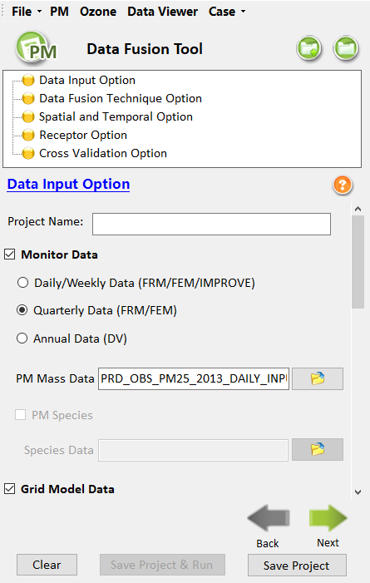
Data Fusion Tool: Data Input Module
Model & Monitoring Data Input Option
(1) Monitor Data File
This file can be PM monitor data or ozone monitor data which derive from monitor site. The format of this file is “.csv”.
Data source:
The monitor data input files were provided by OAQPS/AQAD/AQAG
（2）Grid Model Data File
It supports two kinds of formats: CSV format and IO/API format. Note that the model data year should be consistent with the base year of monitor data. Data source:
Air quality model (e.g., CMAQ, etc.)
For more details, please refer to Data Fusion Tool’s User Manual.

Slide 18
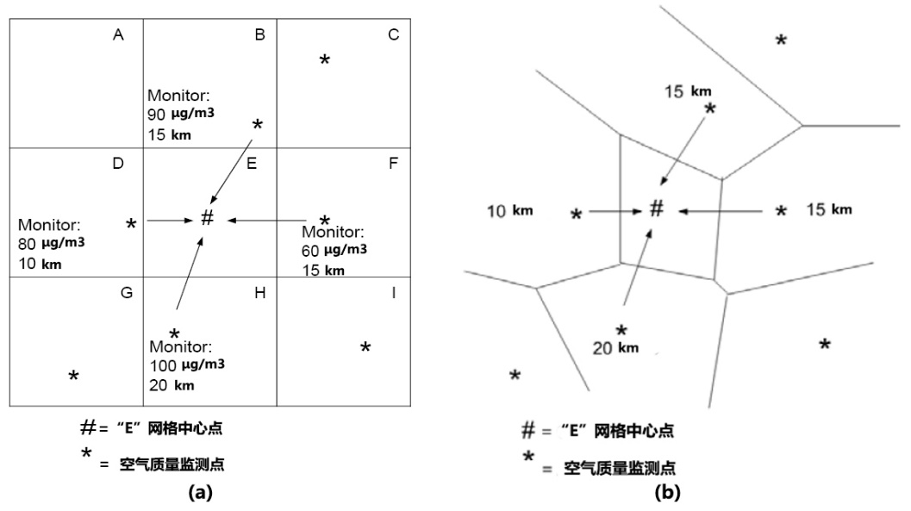


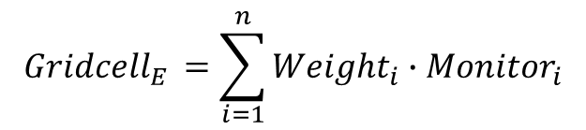
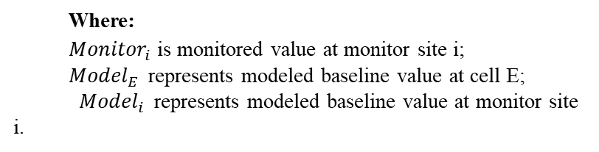
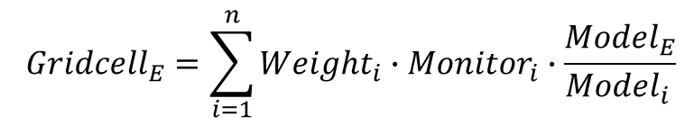
Data Fusion Tool: Data Fusion Techniques
Data Fusion Techniques: VNA and eVNA
B
Model:
100ug/m3
Voronoi Neighbor Averaging (VNA)
D
Model:
95ug/m3
F
Model:
80ug/m3
$${Gridcell}_{E }=\sum_{i=1}^{n}{{Weight}_{i}∙{Monitor}_{i}}$$
H
Model:
120ug/m3
Enhanced Voronoi Neighbor Averaging (eVNA)
$${Gridcell}_{E}=\sum_{i=1}^{n}{{Weight}_{i}∙{Monitor}_{i}∙\frac{{Model}_{E}}{{Model}_{i }}}$$
Where:
${Monitor}_{i}$ is monitored value at monitor site i;
${Model}_{E }$ represents modeled baseline value at cell E;
${Model}_{i }$ represents modeled baseline value at monitor site i.

Slide 19
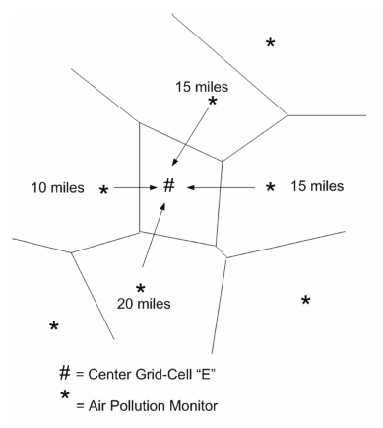



Data Fusion Tool: Data Fusion Techniques
Data Fusion Techniques: wVNA and Nearsite
Weighting Voronoi Neighbor Averaging (wVNA)
$$wVNA=w×eVNA+(1−w)×VNA$$
When w = 0, wVNA = VNA;
when w = 1, wVNA = eVNA
Nearest Site (NS)
$${ Gridcell}_{E }={Monitor}_{nearest}$$
Where:
${Monitor}_{nearest}$ is the nearest monitor’s value to cell E.

Slide 20
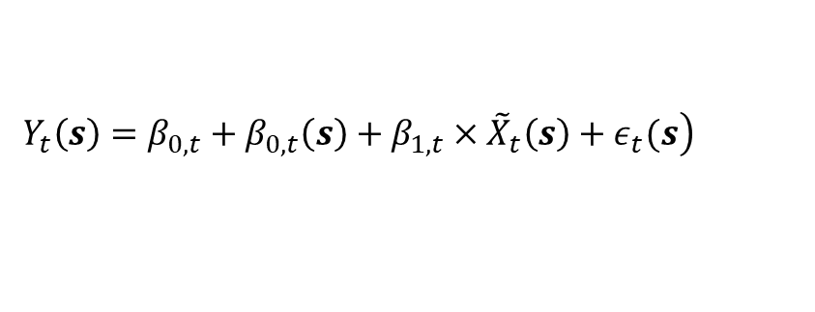
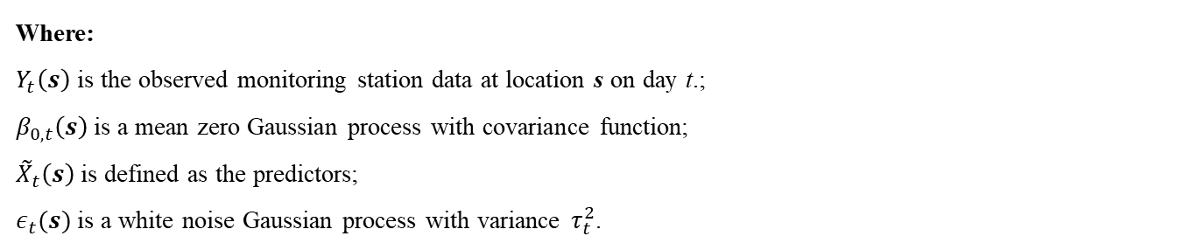
Data Fusion Tool: Data Fusion Techniques
Data Fusion Techniques: Downscaler
A linear regression model based on a Bayesian approach with spatially varying coefficients at a high level. DS uses Markov chain Monte Carlo (MCMC) methods with Gibbs sampling to develop a relationship between observed and modeled concentrations, then use the relationship to predict concentrations at points in the spatial domain.
$$\left.Y_{t}\left(s\right)=β_{0,t}+β_{0,t}\left(s\right)+β_{1,t}×{\tilde{X}}_{t}\left(s\right)+ε_{t}(s\right)$$
Where:
$Y_{t}\left(s\right)$ is the observed monitoring station data at location s on day t.;
$β_{0,t}\left(s\right)$is a mean zero Gaussian process with covariance function;
${\tilde{X}}_{t}\left(s\right)$ is defined as the predictors;
$ε_{t}(s)$ is a white noise Gaussian process with variance $τ_{t}^{2}$.
Downscaler: Further information and example dataset can be found at:
https://www.epa.gov/air-research/downscaler-model-predicting-daily-air-pollution

Slide 21
End of
Data Fusion Tool Demo
21

Slide 22
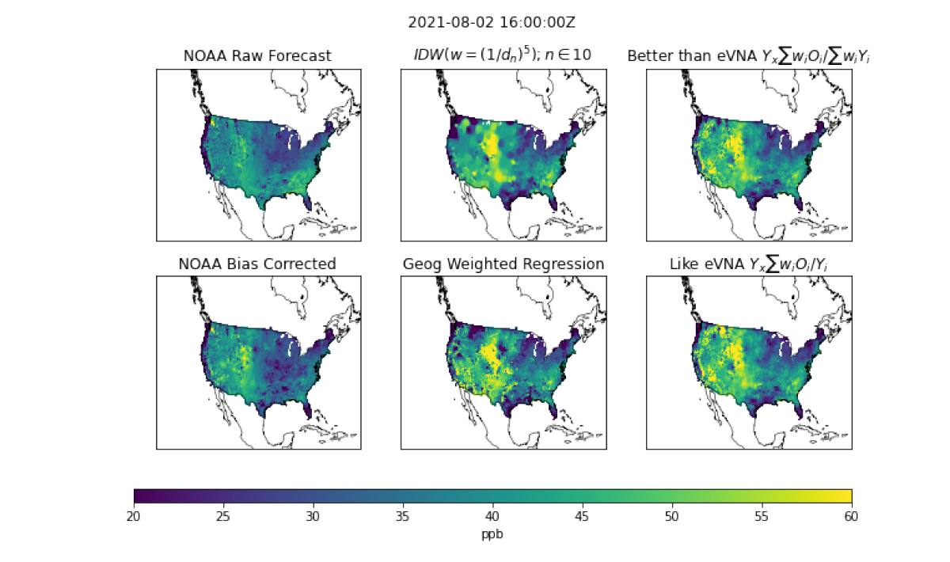
Data Fusion Applications on “AirNow”
Barron Henderson, OAQPS/AQAD/AQMG
22

Slide 23
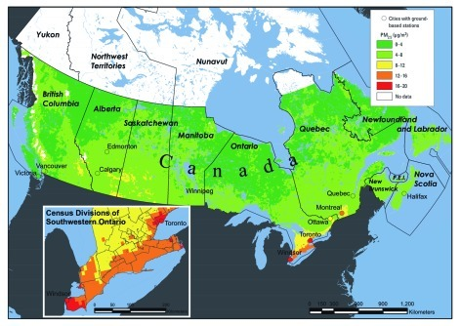
2015 PM NAAQS Review Kickoff Workshop
At the kickoff workshop, a Canadian epi study based on the CanCHEC cohort of 2.1 million adults was identified as important
Associations between mortality and long-term PM_{2.5} exposure were reported at low concentrations (mean: 8.7 μg m⁻³)
PM_{2.5} exposure fields were based on scaling satellite AOD to surface PM_{2.5} using chemical transport modeling (GEOS-Chem)
Mean PM_{2.5} Exposure Concentrations, 2001-2006
Crouse et al. (2012) Environmental Health Perspectives
Jim Kelly, OAQPS/AQAD/AQMG

Slide 24
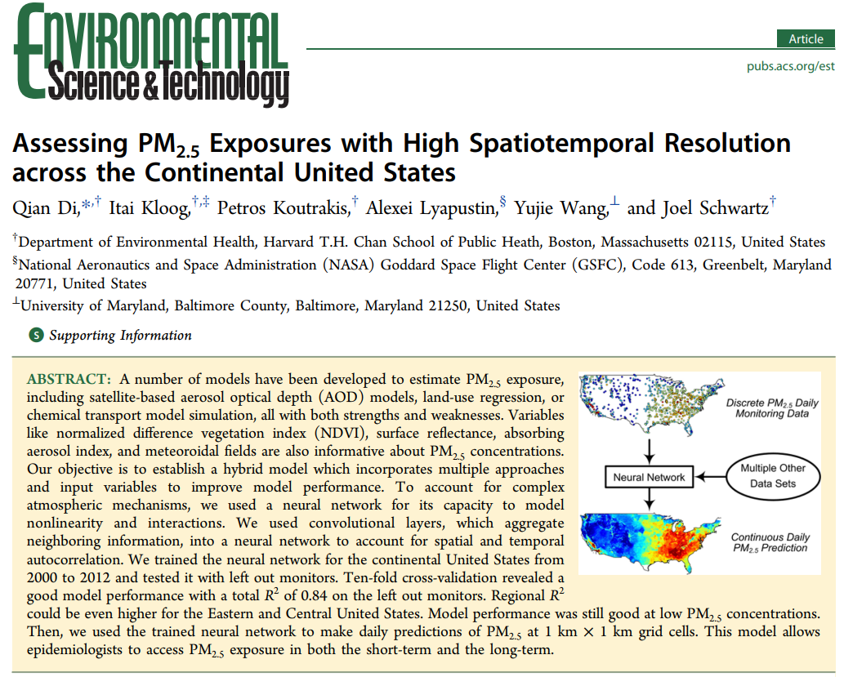
Neural Network Exposure Model (2016)
In 2016, Harvard published national fields of daily PM_{2.5} from 2000 to 2012 at 1-km resolution
The neural network model incorporated monitoring data, a new high-resolution (1-km) satellite retrieval (MAIAC), and 50+ relevant variables
The exposure model achieved high R² (i.e., 0.84) in ten-fold cross-validation
OAQPS began collaborating with Qian Di and Joel Schwartz of Harvard following publication of this article
Di, Schwartz et al. (2016) Environmental Science & Technology

Slide 25
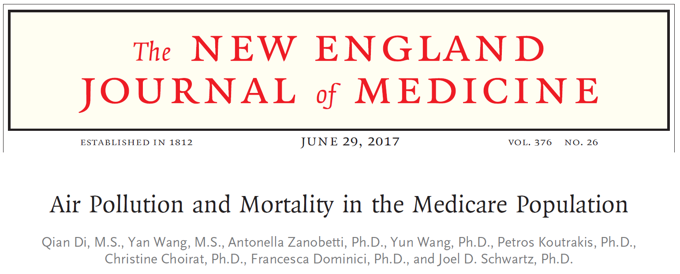
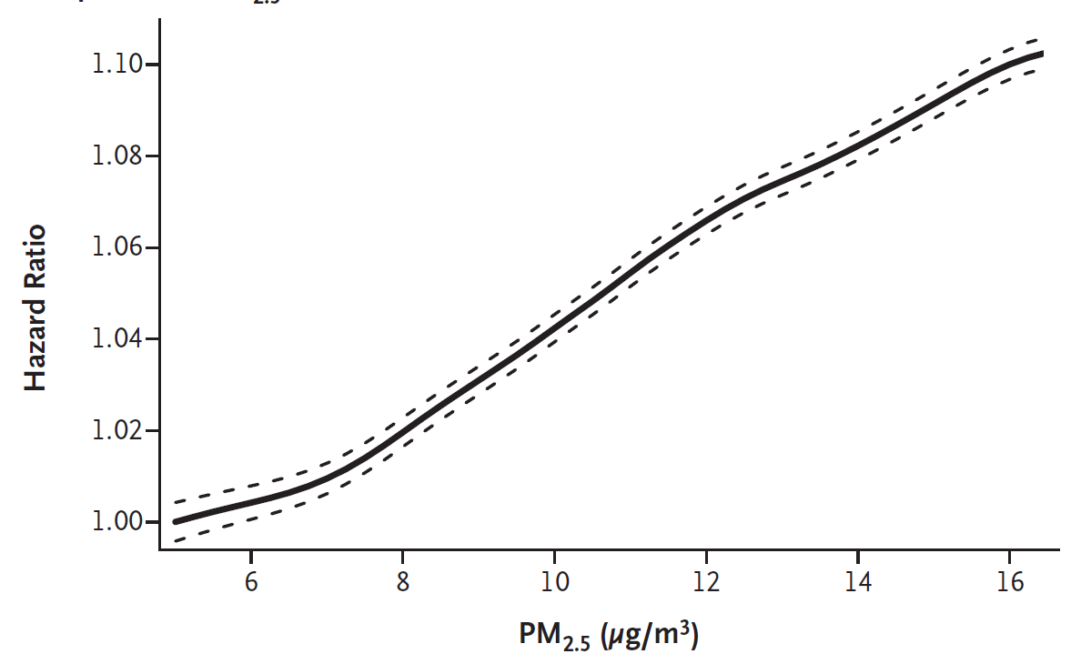
2017 Medicare Study
In 2017, Harvard published the largest PM_{2.5} epi study to date based on 61 million Medicare participants
An association between PM_{2.5} and mortality was reported to be almost linear down to 5 μg m⁻³
Picked up by news media: e.g., NPR, NY Times, LA Times, and Science
The 2017 Medicare study was based on the exposure fields from the Di et al. (2016) neural network study
This and similar studies raised questions about reliability of the exposure fields for epi studies and the implications for standard setting
Di et al. (2017) New England Journal of Medicine

Slide 26
Recent Work on Exposure Fields
New evaluation of methods operationally applied at EPA using the Data Fusion Tool
Intercomparison of exposure fields from the external scientific community
Applications for characterizing exposure disparities

Slide 27
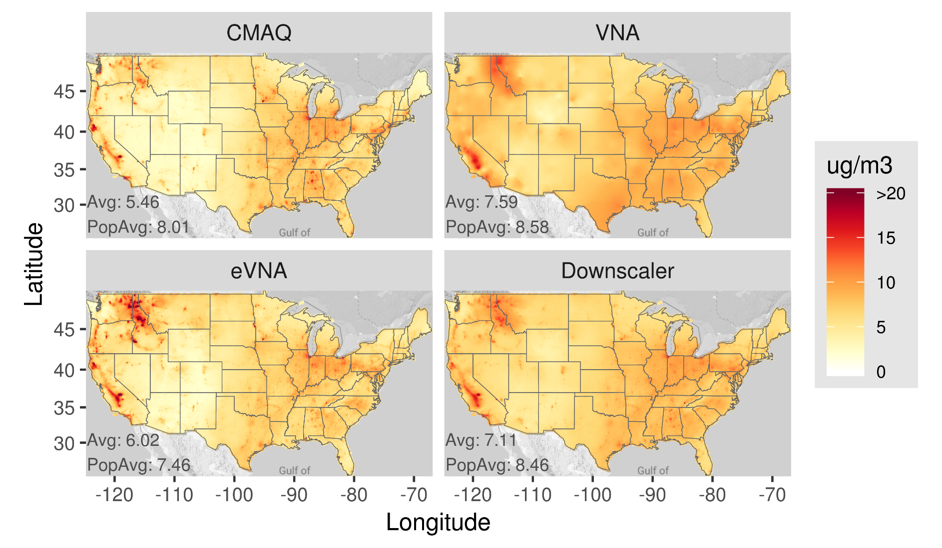
2015 PM_{2.5} from Operational EPA Methods
Voronoi Neighbor Averaging (VNA): interpolation of monitor data
Enhanced-VNA (eVNA): interpolation of monitoring data that has been scaled by CMAQ gradients between the monitor and target grid cell
Downscaler: Bayesian statistical model that regresses CMAQ modeling on monitoring data and makes predictions using a CMAQ input field

Slide 28
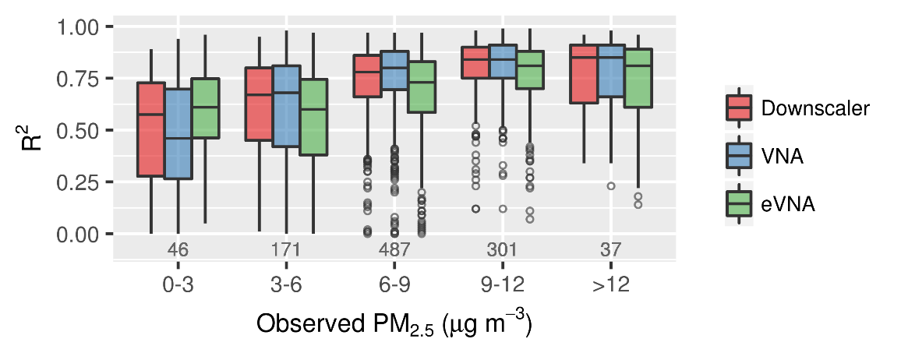
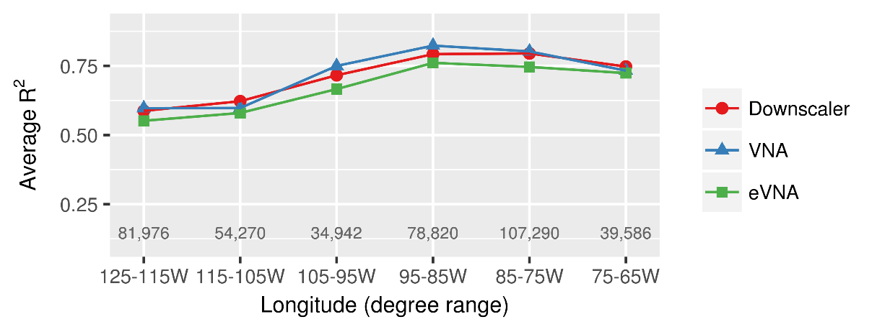
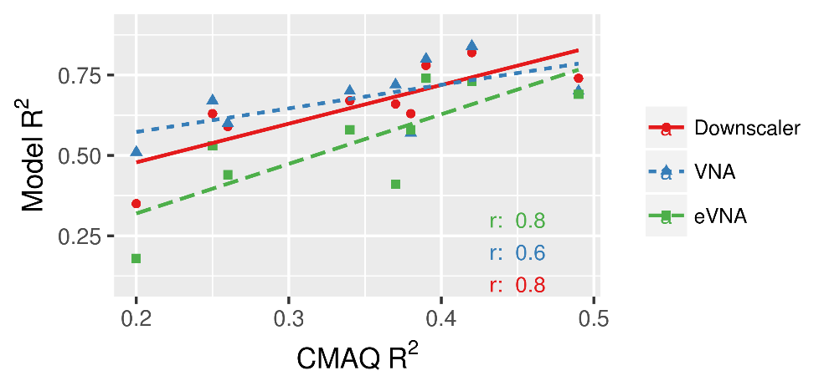
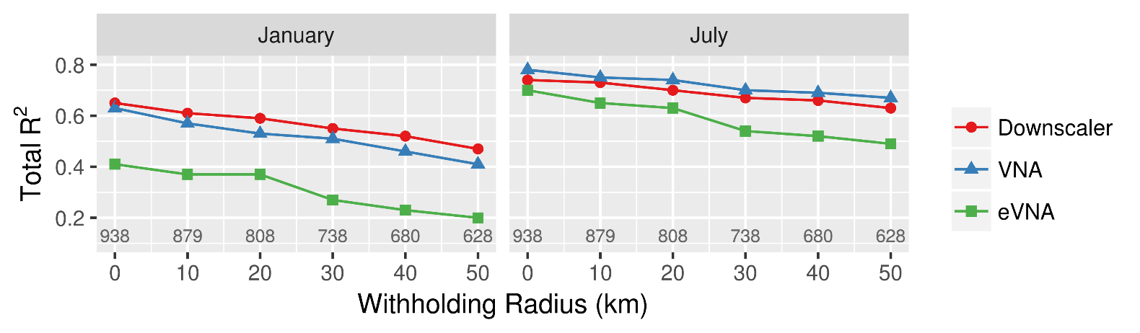
Model Evaluation with Withheld Observations
R² Increases with PM_{2.5} Concentration
R² is Higher in the Eastern U.S.
West
East
R² Increases with CMAQ Performance
R² Decreases with Distance to Nearest Monitor
Kelly et al. (2019) Atmospheric Environment: X

Slide 29
Models Considered in Intercomparison Study
Case | Name | Method Description | Reference
1. | CMAQ | Geophysical process model (v5.0.2) | US EPA (2015); Kelly et al. (2019a)
2. | CAMx | Geophysical process model (v6.3.2) | US EPA (2017)
3. | VNA | Interpolation of PM_{2.5} observations | Abt (2012); Kelly et al. (2019b)
4. | eVNA | Interpolation of obs w/ fusion of CTM results | Abt (2012); Kelly et al. (2019b)
5. | Downscaler | Bayesian statistical regression of CTM predictions and observations | Berrocal et al. (2010); US EPA (2020)
6. | VD2019 | CTM scaling of satellite AOD to surface PM_{2.5} with geographically-wt. regression of residuals | van Donkelaar et al. (2019), modified per V4.NA.02.MAPLE
7. | DI2016 | Neural network model | Di et al. (2016)
8. | HU2017 | Random forest model | Hu et al. (2017)
9. | DI2019 | Ensemble of random forest, gradient boosting, and neural network learners | Di et al. (2019)
Kelly et al. (2021) Environmental Research

Slide 30
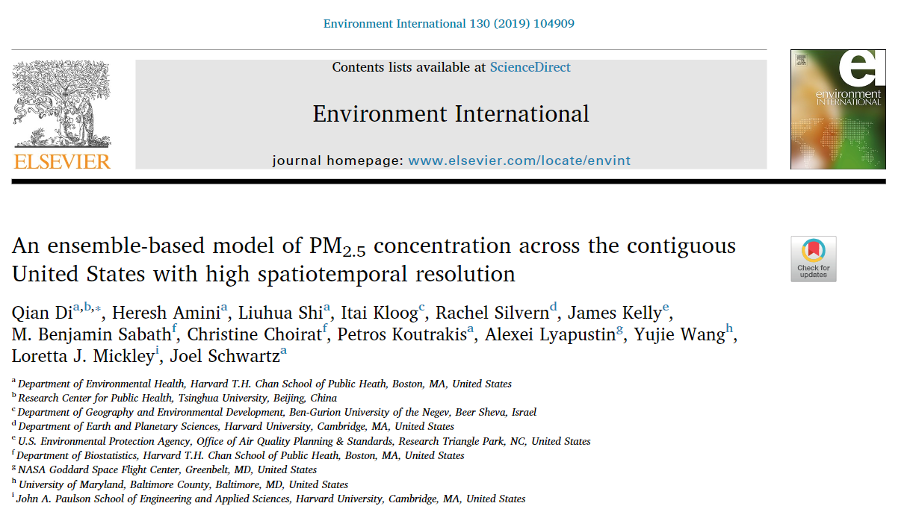
Di et al. (2019): Harvard’s Updated Exposure Model
Harvard’s updated exposure model is an ensemble of three machine learning methods: neural network, random forest, and gradient boosting
AQAD collaborated with Harvard to incorporate our 12-km national CMAQ modeling into their algorithms
Predictions of daily PM_{2.5} fields over the US for 2000-2015 are available at 1-km resolution

Slide 31
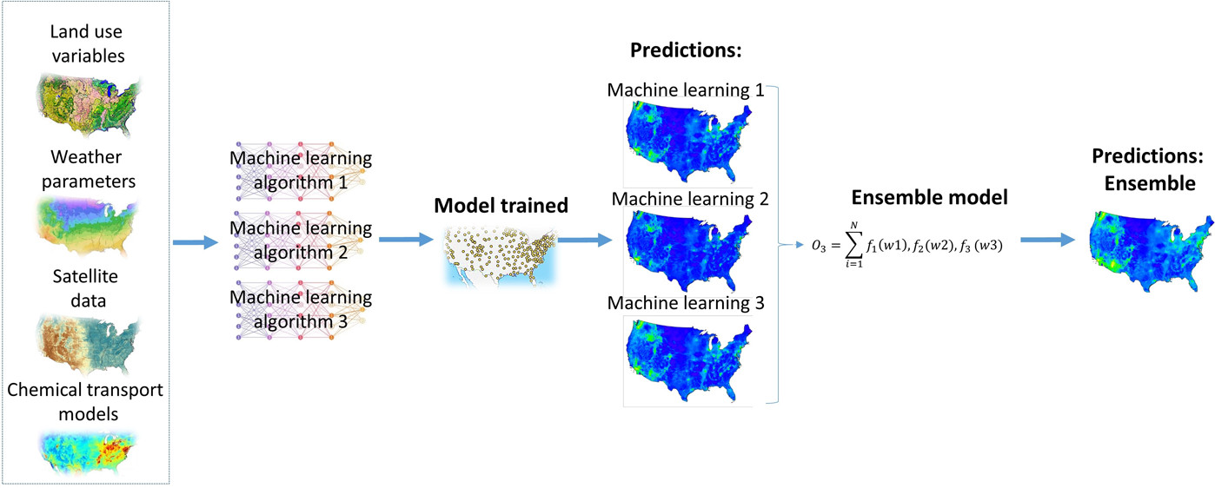
Machine Learning Method
ML models (neural network, random forest, and gradient boosting) are fit to obs using 50+ predictor variables
An optimal ensemble prediction is made from the models accounting for spatial dependence of performance
Di et al. (2019); Di et al. (2020); Requia et al. (2020)

Slide 32
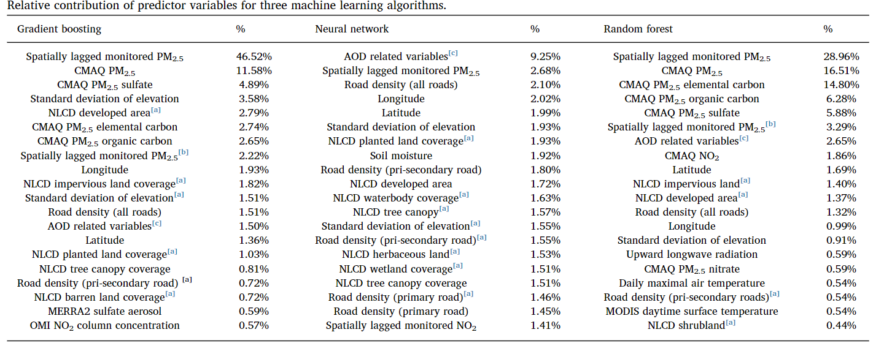
Variable Importance for Harvard’s Updated Approach
Lagged monitor data and CMAQ modeling were important (GEOS-Chem did not make the list)
Satellite data had limited importance -- studies have found that satellite data has limited value in data-rich areas but are critical in poorly monitored parts of the world
Notes:
Only top 20 shown. NN contributions were more distributed over variables. Note AOD importance may be inflated because RF model that incorporated CMAQ was used to fill missing AOD data and the 9.25% is a sum over many variables

Slide 33
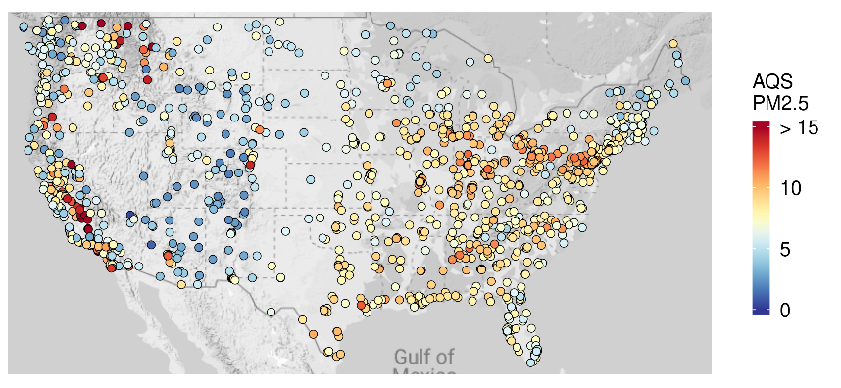
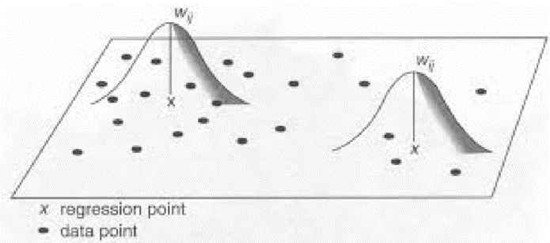

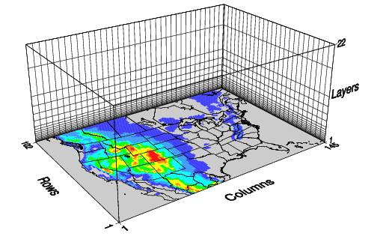
Monitoring
Satellite Method
Satellite AOD is scaled to surface PM_{2.5} using AQ model
Surface PM_{2.5} estimate is then fused with obs using regression
Statistical Fusion
Remote Sensing
Chemical Transport Modeling
24
246
396
van Donkelaar et al. (2019)

Slide 34
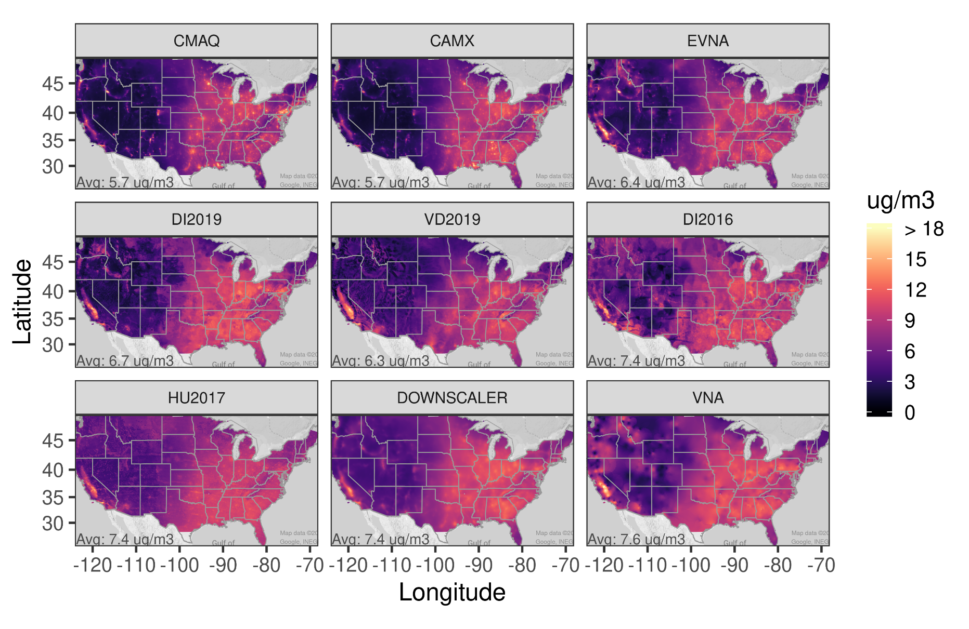
2011 PM_{2.5} Concentrations
Broad agreement in PM_{2.5} spatial variation among models
CMAQ and CAMx have the lowest national average, but high PM_{2.5} in cities
The relatively smooth fields (VNA and Downscaler) have the highest national average

Slide 35
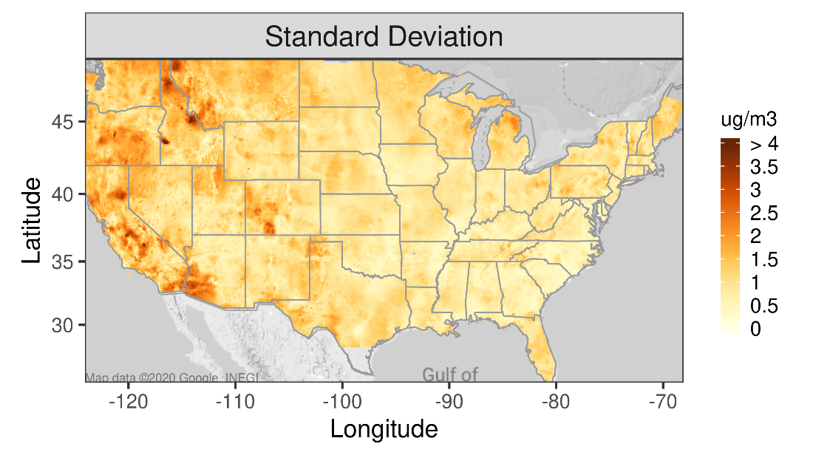
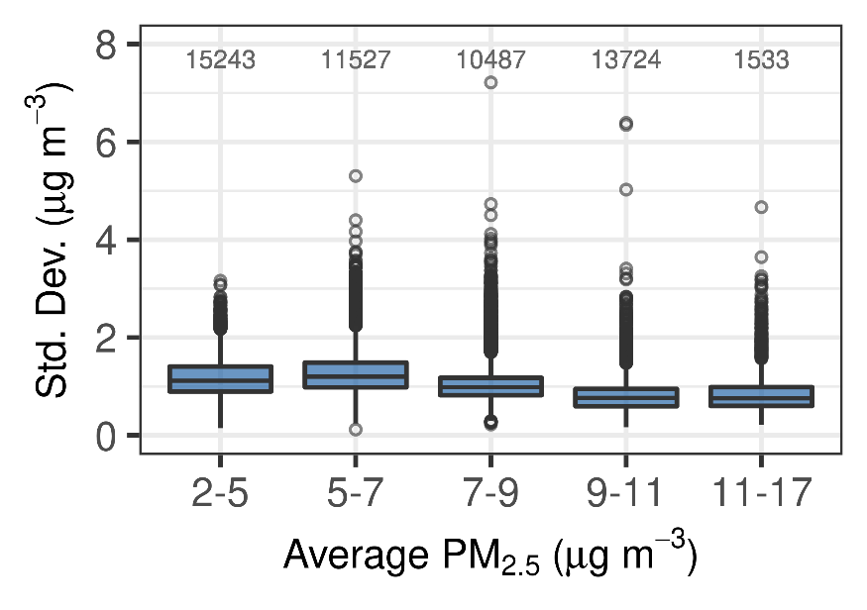
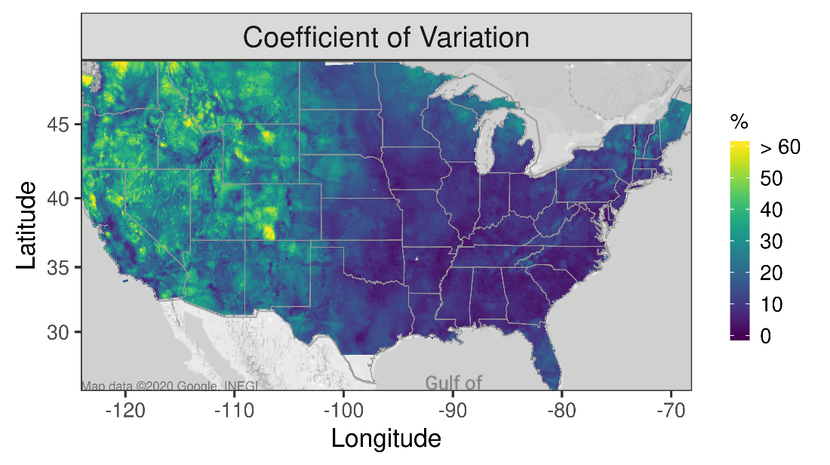
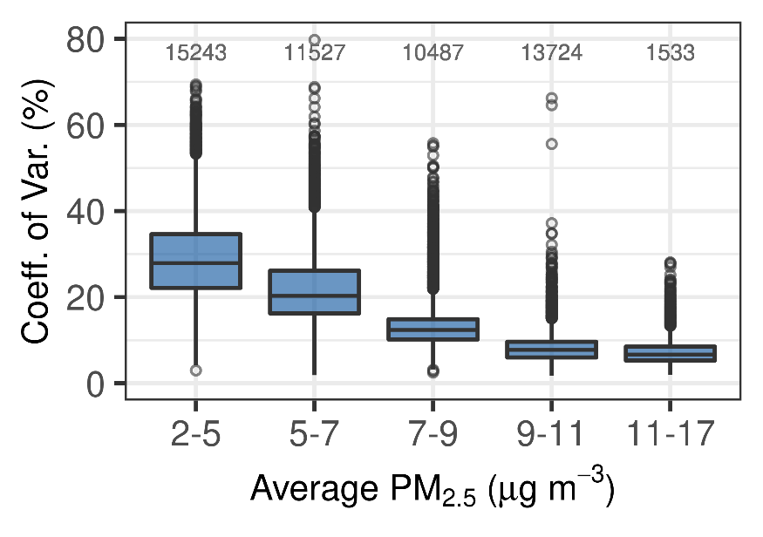
Variability Among Non-CTM Models

Slide 36
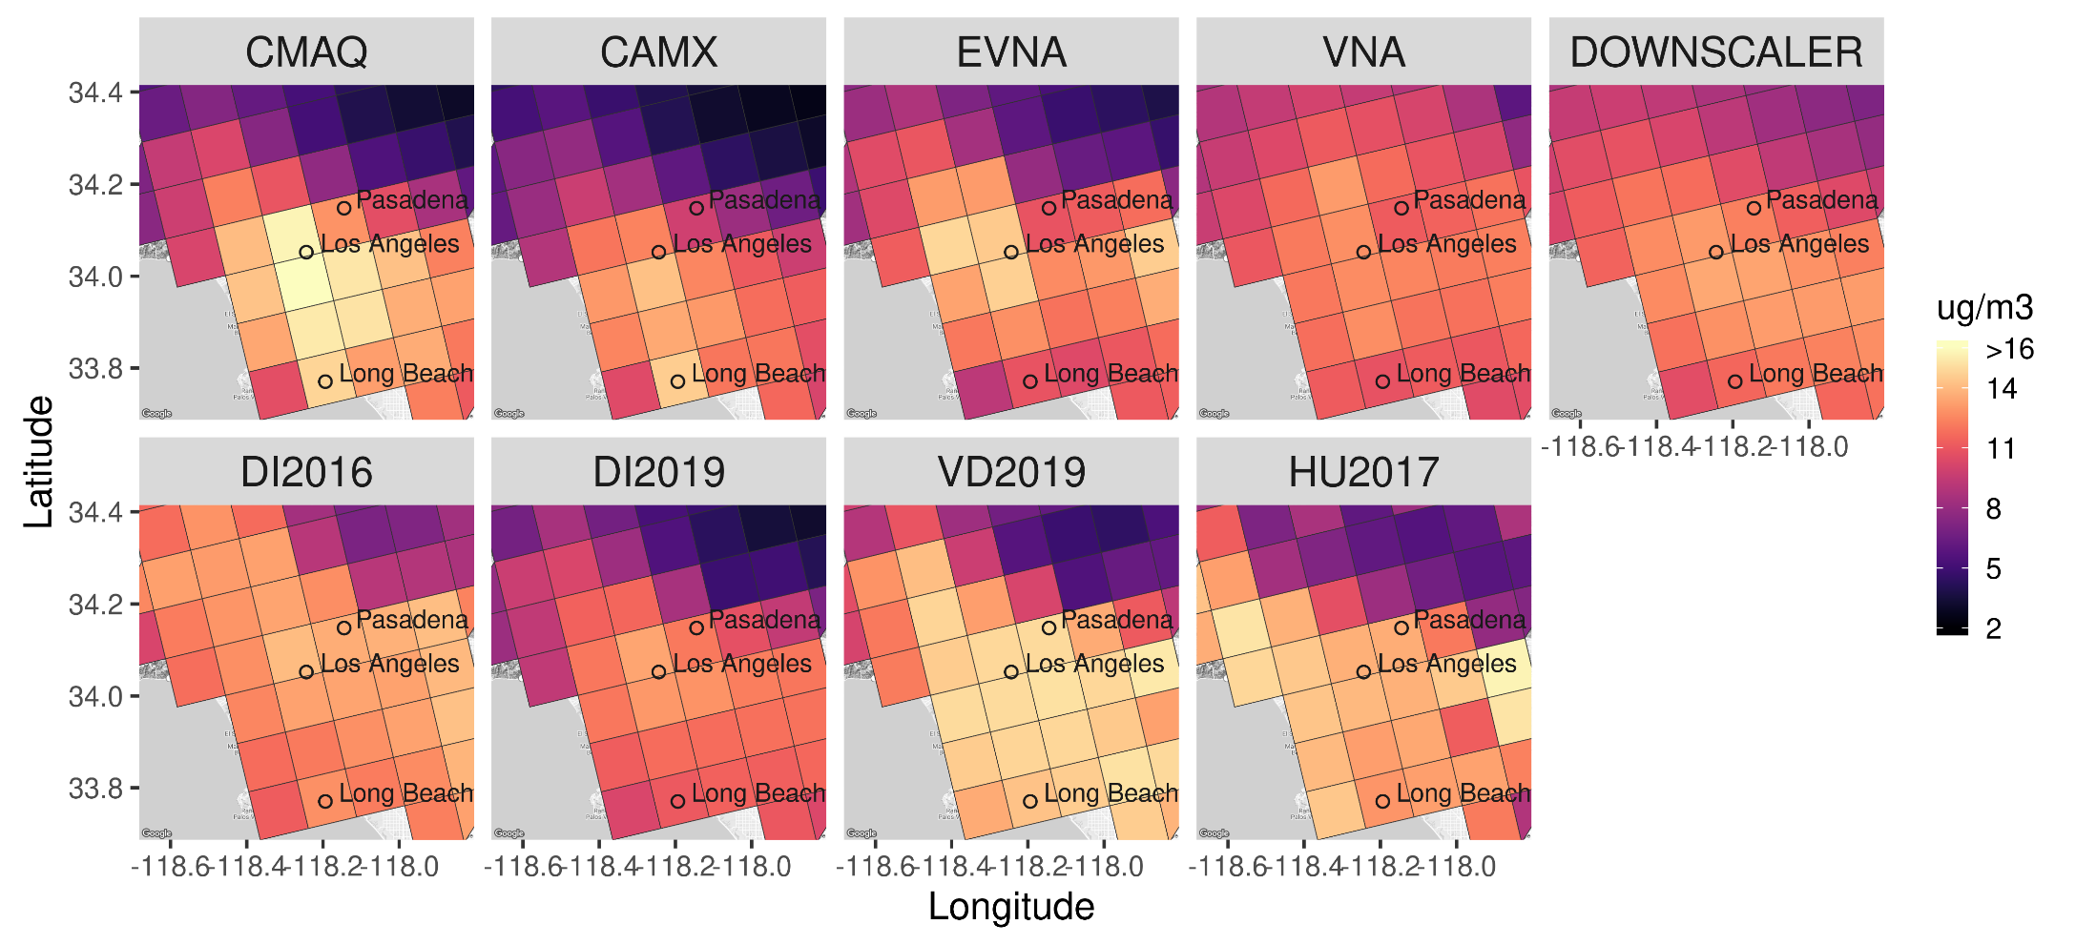
Los Angeles (12-km)

Slide 37

Los Angeles (1-km)

Slide 38


Fused Field Example: Historical Trends in Exposure Disparities based on National Population-Weighted PM_{2.5}
Left: Absolute gap between Black and White groups is decreasing, but highest exposure persists for Black group
Below: Steeper PM_{2.5} decreases in nonattainment areas (NAAs) compared with the national average

Slide 39


Inhaled PM_{2.5} in Los Angeles
Inhaled PM_{2.5} (mg day⁻¹) in 2015
2016 PM_{2.5}, 1-km Grid Spacing
*Inhaled mass: PM_{2.5} x breathing rate x population = (μg/m³) (1 mg/1000 μg) x (m³/person/day) x (# person) = mg/day

Slide 40





Current Examples of EJ Exposure Issues: Use of Satellite Data
NC Hog Farms
High ammonia is indicator of hog farm exposure in high Demo. Index Area
Houston
High NO₂ Concentrations Co-located with high Demographic Index

Slide 41





Future Projections of Exposure Disparities for PM2.5: 2011 to 2028
CMAQ Modeling
Exposure Gap* by State Decreases from 2011 to 2028 but Most-Exposed Groups Persist
Monitoring
Fused PM_{2.5} Field
Project w/ Future
“On-the-Books”
CMAQ Modeling
Remote Sensing
Other Data
*Exposure gap is defined here as the difference in population-weighted concentration between the most and least exposed group (but could be defined differently, e.g., gap between low-income non-white and high-income white)

Slide 42
Summary
New methods for fusing monitoring, modeling, and other data has led to the use of modeled concentration fields in the latest epidemiologic studies
The accuracy of these methods is difficult to establish comprehensively due to the limited available monitoring data
New model evaluation and intercomparisons provided insights on the reliability of the models for policy applications
National concentration fields are useful in informing exposure and health impact studies

Slide 43
Thank you!

