Slide 1

The
Air Quality
Flag Program
Melissa Payne
US EPA
July 10, 2019

Slide 2
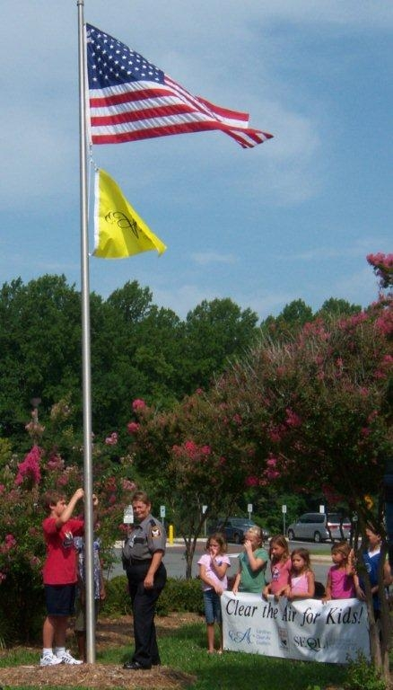
History
    2004- present: San Joaquin Valley starts school flag program
    2010: EPA creates a national program for schools
    May 2015: Expanded to include other organizations

Slide 3
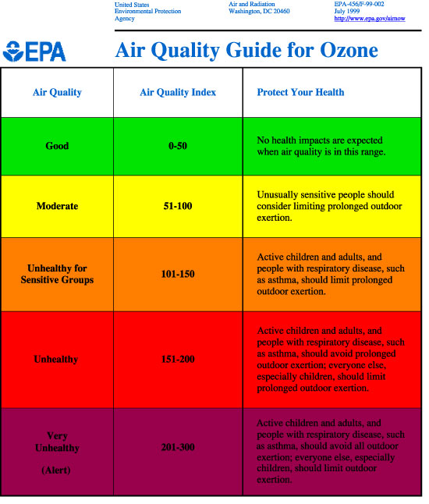

Slide 4
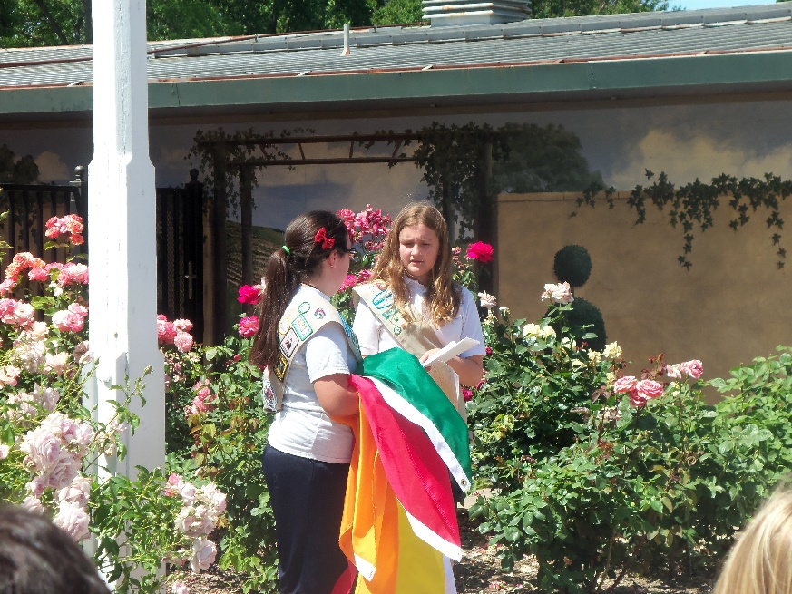
How it Works
School raises a flag each day
The flag color indicates the local
air quality for the day
Students and staff look to the flag and understand what it means
Change activities and behaviors on poor air quality
days

Slide 5
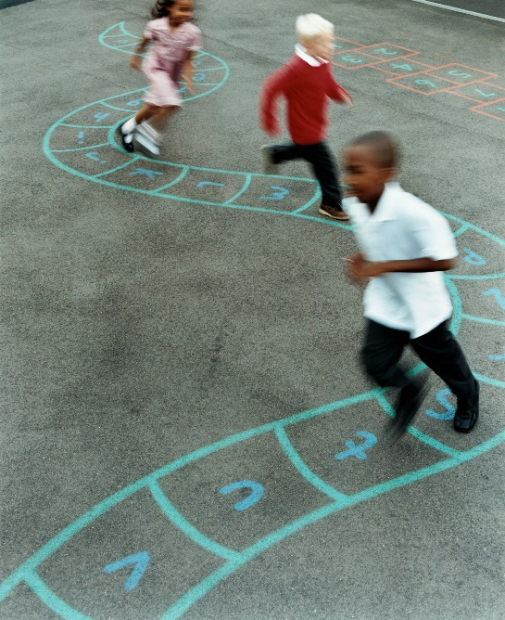




Getting Started
    Purchase flags
    Educate school and community
    Check the daily forecast & fly the flag
    Follow the outdoor activity guidance

Slide 6
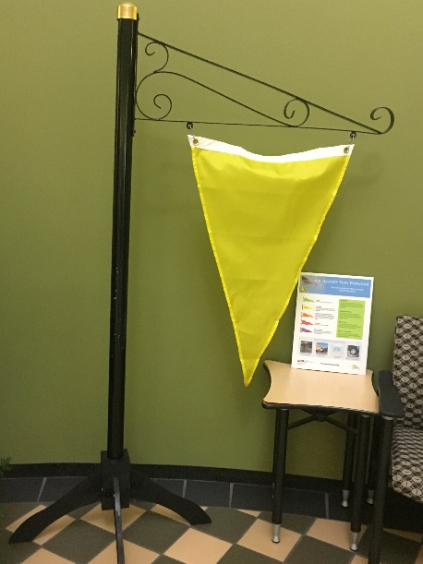
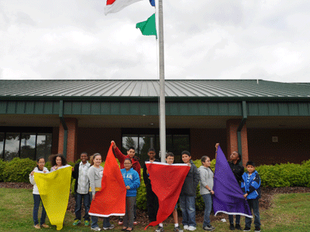
1. Buy Flags
Around $100 for set
Funding: PTA, local health organization, business, state air agencies, EPA regions, grants
Order from local flag vendor
or online
Set of five flags: green,
yellow, orange, red, purple

Slide 7
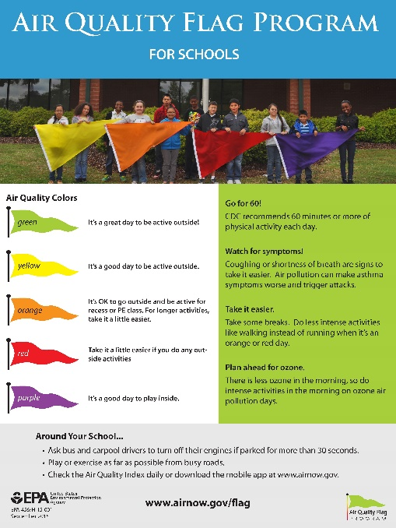
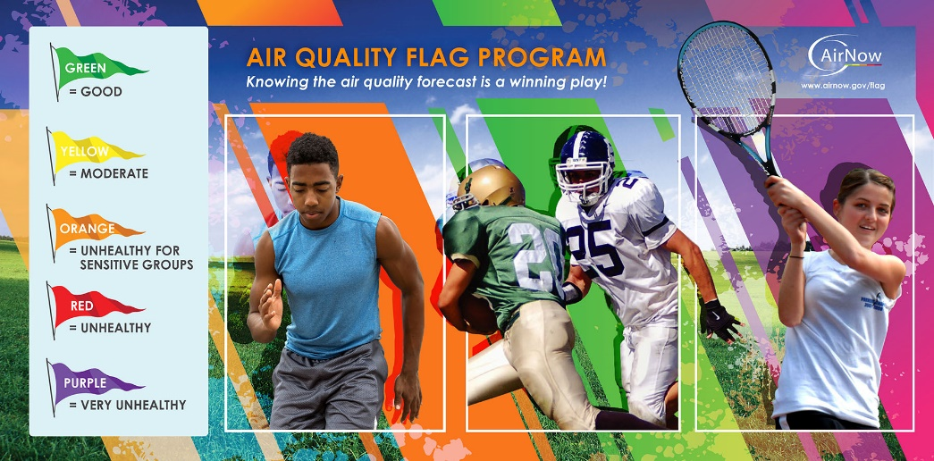
2. Educate
Recruit teacher(s) to be the Coordinator(s)
Teachers, staff, students and parents
Inform the school and community:
    Newsletters
    Emails
    Flyers
    Local newspaper
    Radio station
    Word-of-mouth

Slide 8
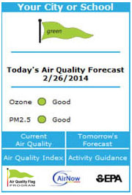
3. Check the Air Quality
Forecast
Check www.airnow.gov
Automatic email:
www.airnow.gov/enviroflash
Free air quality app
Free widget: post the air quality forecast on your school website
Local paper/ TV weather report

Slide 9
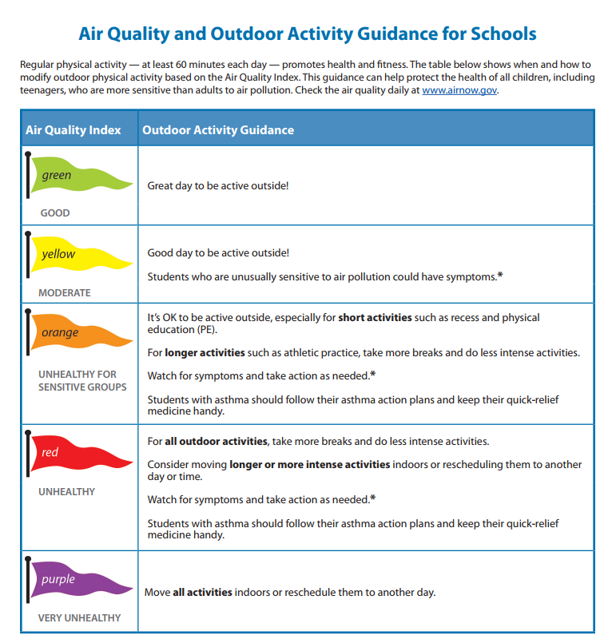
4. Follow the Guidance

Slide 10

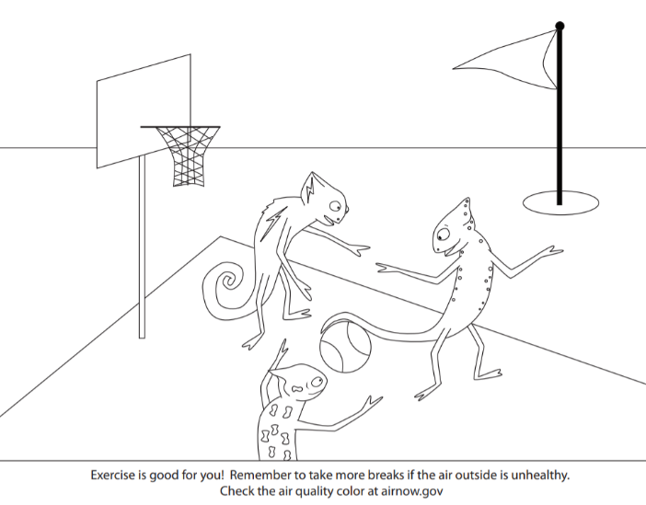

Students: Classroom Activities
Lesson Plans
Games
Activities
Picture Book
Online simulations
Online videos
More resources available at www.airnow.gov/teachers

Slide 11

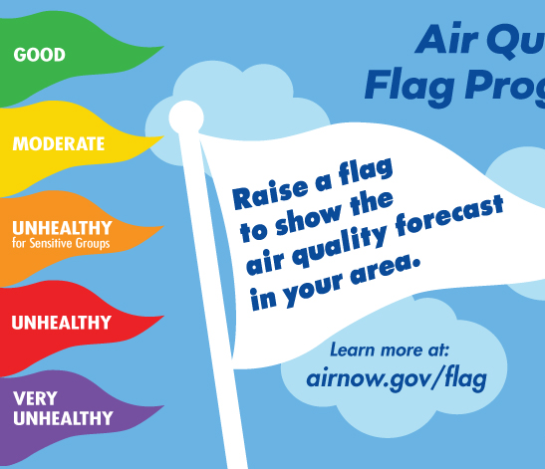
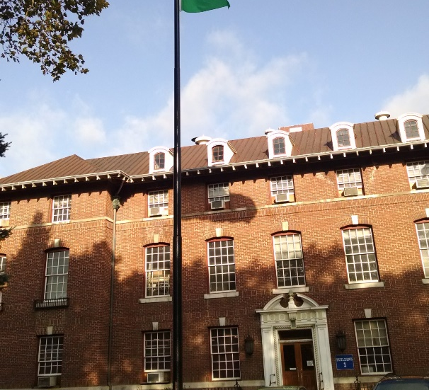
Staff and Parents
Sample employee email
Infographic
Story map
Press release template

Slide 12
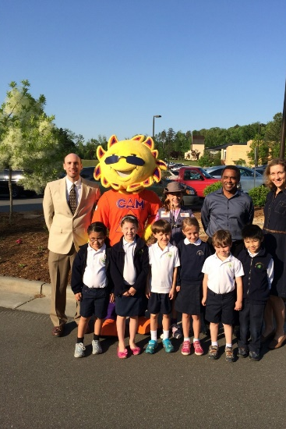
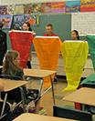
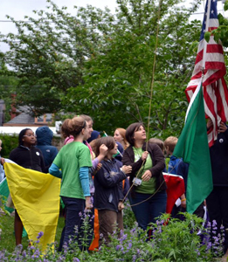
Time for Fun
Events
Games
Classroom activities
And more!

Slide 13
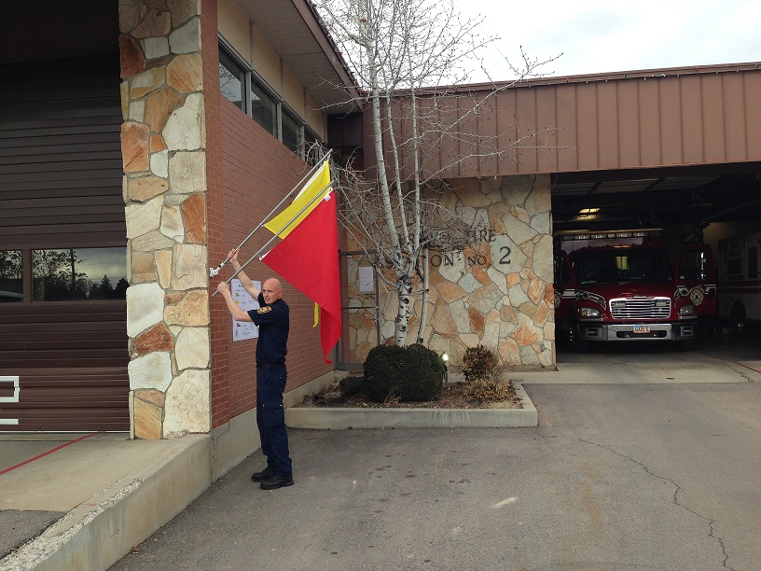
Flag Website
www.airnow.gov/flag
Fact sheet
Coordinator’s handbook
Parent letter
Lesson plans
Posters
Press release template
Student activities
Registration form
List of participating organizations
Story map
Notes:
13

Slide 14
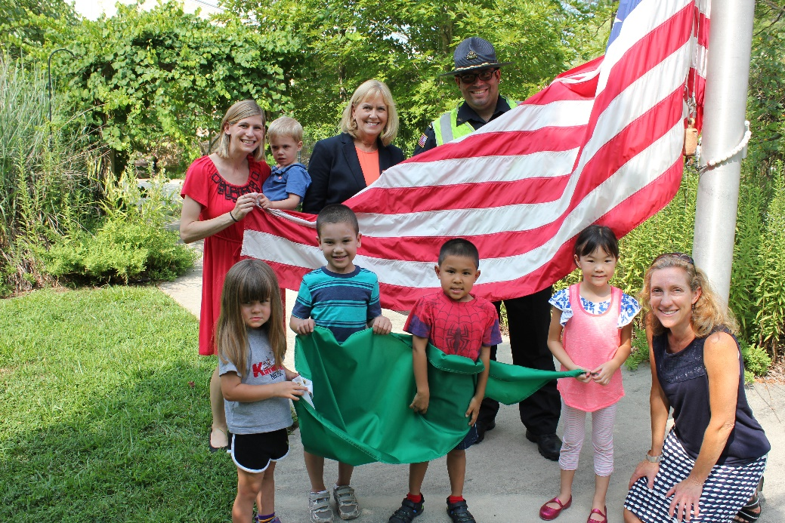
For More Information:
Melissa Payne payne.melissa@epa.gov
Beth Landis landis.Elizabeth@epa.gov
Miki Wayland wayland.michelle@epa.gov
Ellen Wildermann wildermann.ellen@epa.gov

