Slide 1

How Air Pollution Can Affect
Our Health
Air Quality Workshop for Teachers
July 09, 2019
Susan Lyon Stone
Senior Environmental Health Scientist
US EPA Office of Air Quality Planning and Standards
stone.susan@epa.gov

Slide 2
Overview
Health effects of ozone
Health effects of particle pollution
Air Quality Index
AirNow web site
Air Quality Index products
Public health benefits of the Air Quality Index
Information from air quality sensors

Slide 3
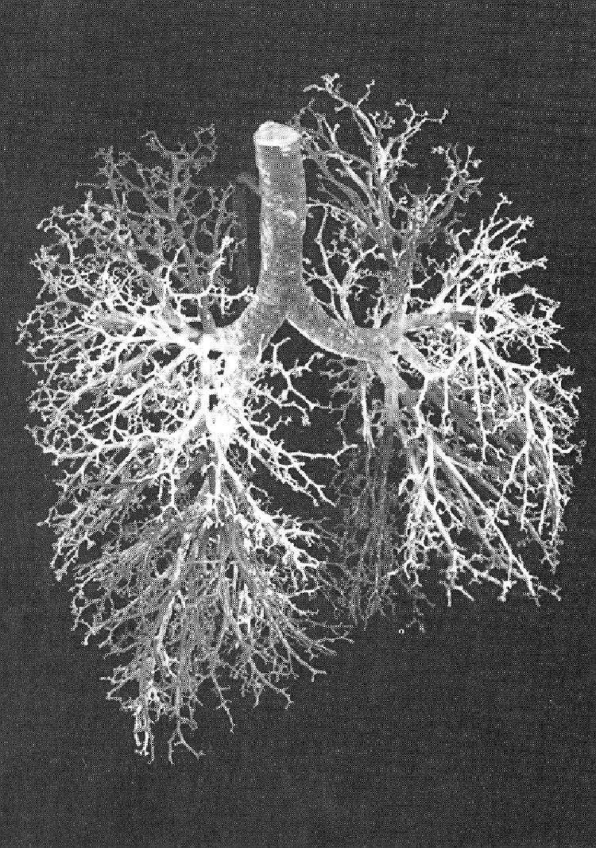
Human Lung
Air conducting
  Trachea
  Bronchi
  Bronchioles
Gas exchange
  Respiratory bronchioles
  Alveoli
3
Notes:
From James’ presentation and the tennis court analogy: The alveolar surface area is commonly compared to the 100 m2 surface area of a tennis court, but that would be for an adult male is varies by the size and age of the individual.
The main point here is that the distance between the air and any associated pollutants and the blood is very short. This has implications to the transport of materials into the blood.

Slide 4
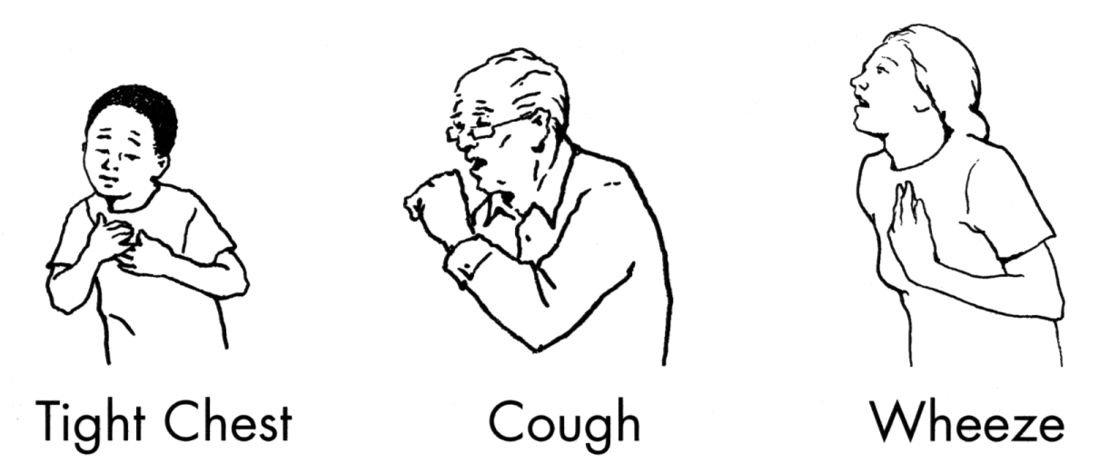
Ozone Irritates Airways
Symptoms
  Cough
  Sore or scratchy throat
  Pain with deep breath
  Fatigue
Rapid onset
Asthma symptoms - greater in people with asthma, also occur in people without asthma

Slide 5
Lung Function Responses Vary Between Individuals
0
FEV1, % CHANGE
-20
-40
-60
BASELINE
2HR
4HR
Frampton, MJ et al., 1997
Notes:
Frampton, MJ; Morrow, PE; Torres, A; Cox, C; Voter, KZ; Utell, MJ. Ozone Responsiveness in Smokers and Nonsmokers. Am J. Resper. Crit. Care Med. 1997; 155:116-121.

Slide 6
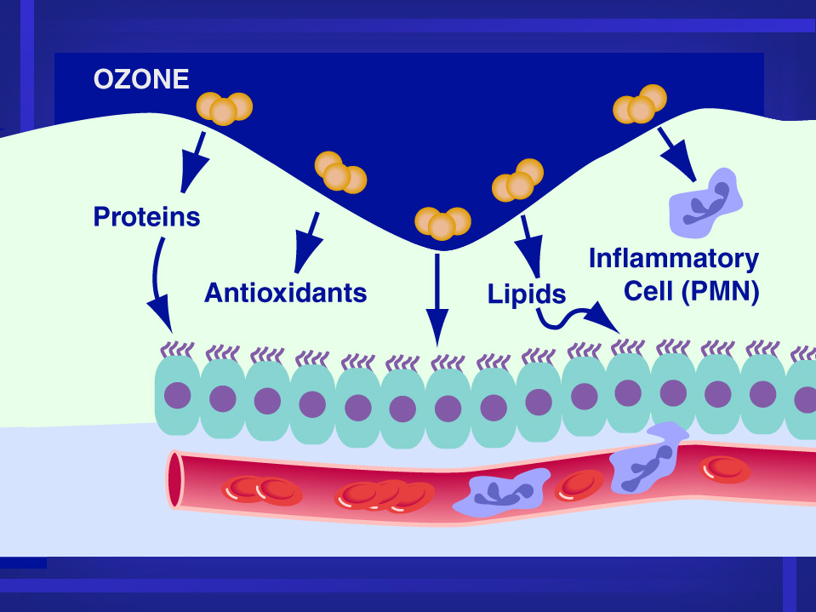

Slide 7
Ozone Causes Inflammation
Ozone reacts completely in surface layer - forms reactive oxygenated molecules
Damages cells that line the airways - inflammation
Effect is greater 24 hours after exposure
Increases permeability of cells that line airways
Influx of white blood cells and proteins
Increases airway reactivity
Concern about repeated exposures

Slide 8
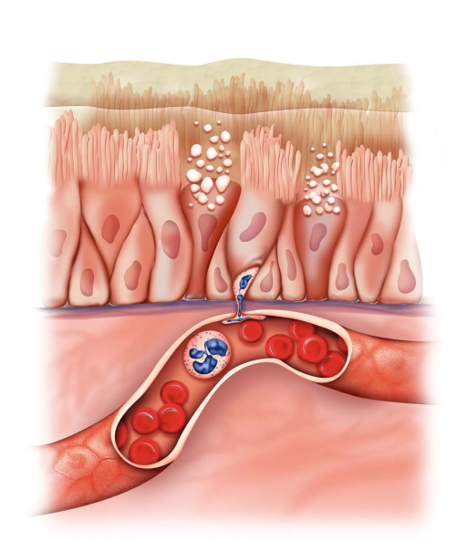
Short-Term O₃ Exposure and Respiratory Effects
Lung function decrements
  Large body of clinical, toxicological, and epidemiologic evidence
  Epidemiologic evidence for children, especially asthmatics
Respiratory symptoms and asthma medication use
  Clinical and epidemiologic evidence
Airway inflammation and oxidative stress
  Large body of toxicological and clinical evidence
  New epidemiologic evidence with parallel findings in asthmatic children
Increased airway permeability, airways hyperresponsiveness, allergic responses, and susceptibility to infection
  Large body of clinical and toxicological evidence
Hospital admissions/ED visits
  Consistent positive associations across endpoints
  Stronger associations during the summer, specifically for asthma and COPD
8

Slide 9
Short-Term O₃ Exposure and
All-Cause (Nonaccidental) Mortality
*Effect estimates standardized to 20 ppb increase in 24-h avg; 30 ppb increase in 8-h max; and 40
ppb increase in 1-h max O₃ concentrations.
9
ISA Figure 6-27

Slide 10
Respiratory Hospital Admissions by Daily Maximum Ozone Level, Lagged One Day
114
112
110
108
106
104
102
Respiratory Admissions
.01 .02 .03 .04 .05 .06 .07 .08 .09 .1
Ozone concentration (ppm)
Burnett et al., 1994

Slide 11
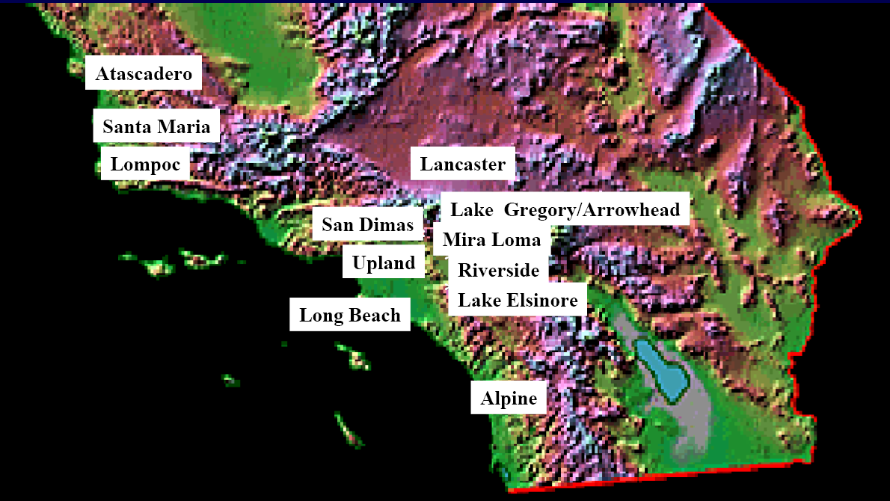
California Children’s Health Study
Prospective Cohort Study of Long-term Exposures

Slide 12
CHS: Ozone and School Absences
20 ppb increase in O₃ associated with an 83% increase in school absences for acute respiratory disease (Gilliland et al., 2001)
Large economic impact of pollution-related school absences (Hall and Lurmann, 2003)

Slide 13
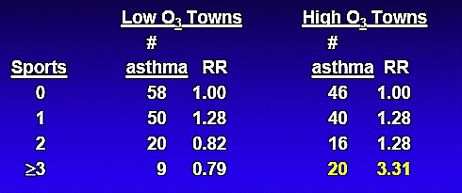
CHS: Ozone and New-onset Asthma
Children living in high O₃ communities who played 3 or more sports, more likely to be diagnosed with asthma than children in low O₃ communities.
McConnell et al., 2002

Slide 14
Sensitive Groups for Ozone
People with asthma and other lung diseases
Children and older adults
Outdoor workers and people who are active outdoors
People with reduced intake of certain nutrients (e.g., vitamins C and E)
People with certain genotypes, related to oxidative stress

Slide 15
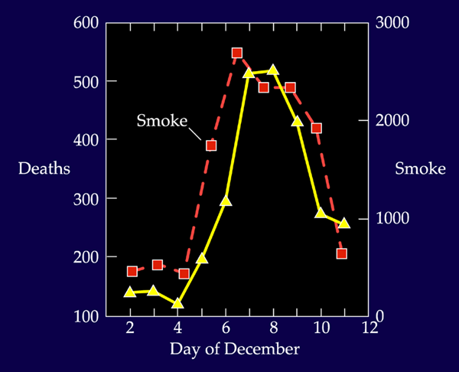

Particle Pollution Disasters
Donora, PA at noon on
Oct. 29, 1948
London buses are escorted by lantern at 10:30 am

Slide 16
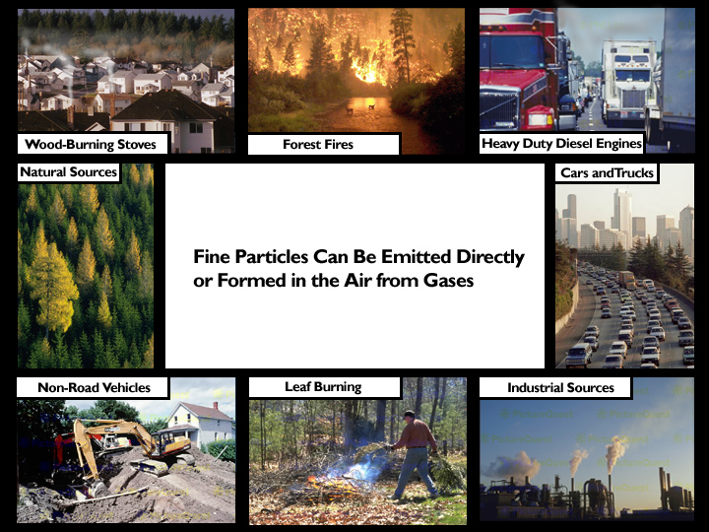
Particle pollution is
a complex mixture
derived from
many sources

Slide 17
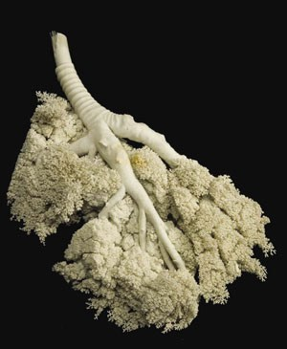
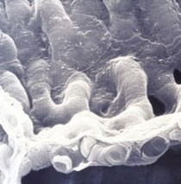
Particle Deposition
Larger particles (> PM₁₀) deposit in the upper respiratory tract
Inhalable particles (< PM₁₀) penetrate into lungs
Some particles (e.g., less than 0.1 um) may enter bloodstream
Particles may react, accumulate, be cleared or absorbed

Slide 18
Effects of PM_{2.5} (short- and long-term exposures)
Cardiovascular
  Epidemiological studies
    Emergency department visits and hospital admissions related with ischemic heart disease and heart failure
    Changes in heart rhythm
  Experimental studies
    Increases in blood pressure
    Changes in heart rhythm
Mortality
  Total (nonaccidental)
  Cardiovascular and respiratory related
Respiratory
  Respiratory disease related emergency department visits and hospital admissions
  Symptoms and medication usage due to asthma and COPD exacerbations
  Long-term exposure PM_{2.5}, not short-term, associated with decrease lung growth and asthma development
18
Notes:
PM2.5 is particle nominally less than 2.5 µm in diameter. Short term exposures are defined as those with durations of hours up to one month, with most studies examining effects related to exposures in the range of 24 hours to 1 week. Long term exposures are defined as those with durations of more than 1 month to years.

Slide 19


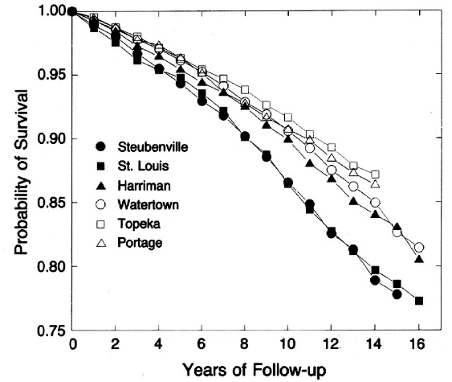
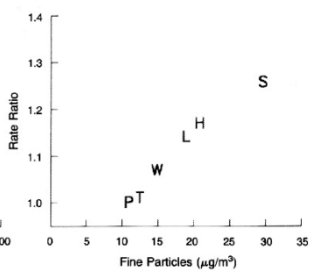
Living in Areas with High Air Pollution Associated with Shorter Life Expectancy
Cleaner cities
Dirtier cities
Linear relationship after control for traditional risk factors
Dockery et al., 1993

Slide 20
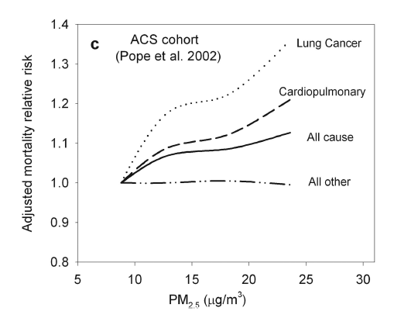
Findings Replicated by Large American Study and Others
>500,000 adults from 151 metropolitan areas
Followed prospectively and controlled for traditional risk factors
American Cancer
Society Cohort
Pope et al 2002
Notes:
Fix citations

Slide 21
Findings Replicated by Large American Study and Others
>500,000 adults from 151 metropolitan areas
Followed prospectively and controlled for traditional risk factors
American Cancer
Society Cohort
Pope et al 2002
Pope and Dockery 2006

Slide 22
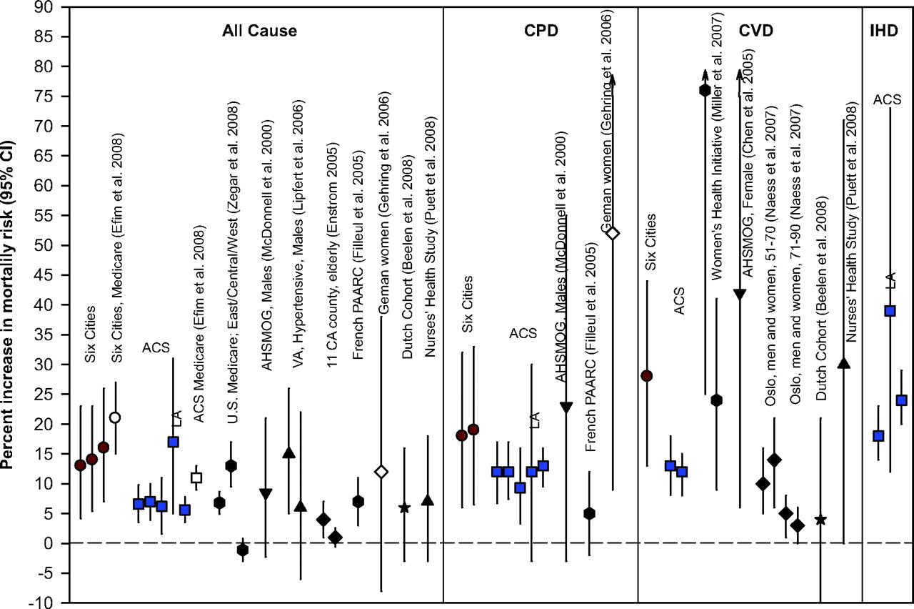
Strongest Associations For Cardiovascular Endpoints
Brook et al. Circulation 2010;121:2331-2378
Notes:
This figure is taken from Particulate Matter Air Pollution and Cardiovascular Disease
An Update to the Scientific Statement From the American Heart Association and can be accessed at https://www.ahajournals.org/doi/full/10.1161/CIR.0b013e3181dbece1
The ISA still has the strongest evidence for CVD, but respiratory evidence is also strong.

Slide 23
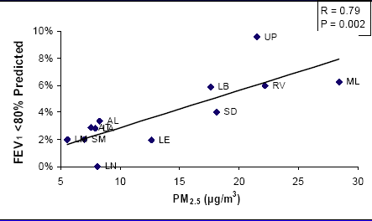
CHS: Low FEV₁ at Age 18 vs. Pollution
Gauderman et al., 2004

Slide 24
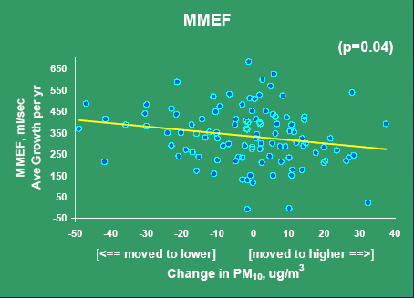
CHS: Lung Function Growth in Movers
Avol et al., 2001

Slide 25
Traffic Exposures
Traffic exposure linked to respiratory symptoms
San Francisco bay area study linked pollution exposures at schools to respiratory symptoms (Kim et al., 2004)
CHS study of residential NO₂, traffic linked to asthma prevalence, symptoms, and medication use (Gauderman et al., 2005)
Bronx, NY, in two schools with varying nearby traffic levels, children reported decrements in FEV₁ in relation to personal PM_{2.5} concentrations averaged in the 12 hours prior to measurement (Spira-Cohen et al., 2011).
El Paso, TX, 5-day average PM_{2.5} concentrations measured outside two schools were associated with poorer asthma control scores (reflecting symptoms and activity levels; Zora et al., 2013).
Notes:
1. among children at two schools in El Paso, TX, 5-day average PM2.5 concentrations measured outside of the schools were
associated with poorer asthma control scores, which reflect symptoms and activity levels (Zora et al., 2013).
2. among children attending two schools with varying nearby traffic levels in the Bronx, NY, Spira-Cohen et al. (2011) reported decrements in FEV1 in relation to personal PM2.5 concentrations averaged in the 12 hours prior to spirometry. The authors did not observe a similar association with PM2.5 exposure estimated from monitors outside of the schools.

Slide 26
Sensitive Groups for PM
People with cardiovascular disease
People with lung disease
Older adults
Children
People of lower socioeconomic status

Slide 27
Air Quality Index
Descriptors | Cautionary Statement
Good 0 – 50 | No message
Moderate 51 – 100 | Unusually sensitive individuals
Unhealthy for Sensitive Groups 101 - 150 | Identifiable groups at risk - different groups for different pollutants
Unhealthy 151 - 200 | General public at risk; sensitive groups at greater risk
Very Unhealthy 201 - 300 | General public at greater risk; sensitive groups at greatest risk

Slide 28

Air Quality Index
Pollutant-specific health effects and cautionary statements address question “who will be affected”
Based on health information supporting EPA’s national ambient air quality standards
  How to use the AQI to lower the dose of inhaled pollution when air quality is poor:
Dose = Concentration x Ventilation rate x Time
  C - be active outdoors when air quality is better
  V - take it easier when active outdoors
  T - spend less time being active outdoors
People with asthma – follow asthma action plan
People with heart disease – check with your doctor
Coaches – rotate players frequently
SINCE PEOPLE RESPOND DIFFERENTLY - pay attention to symptoms!

Slide 29
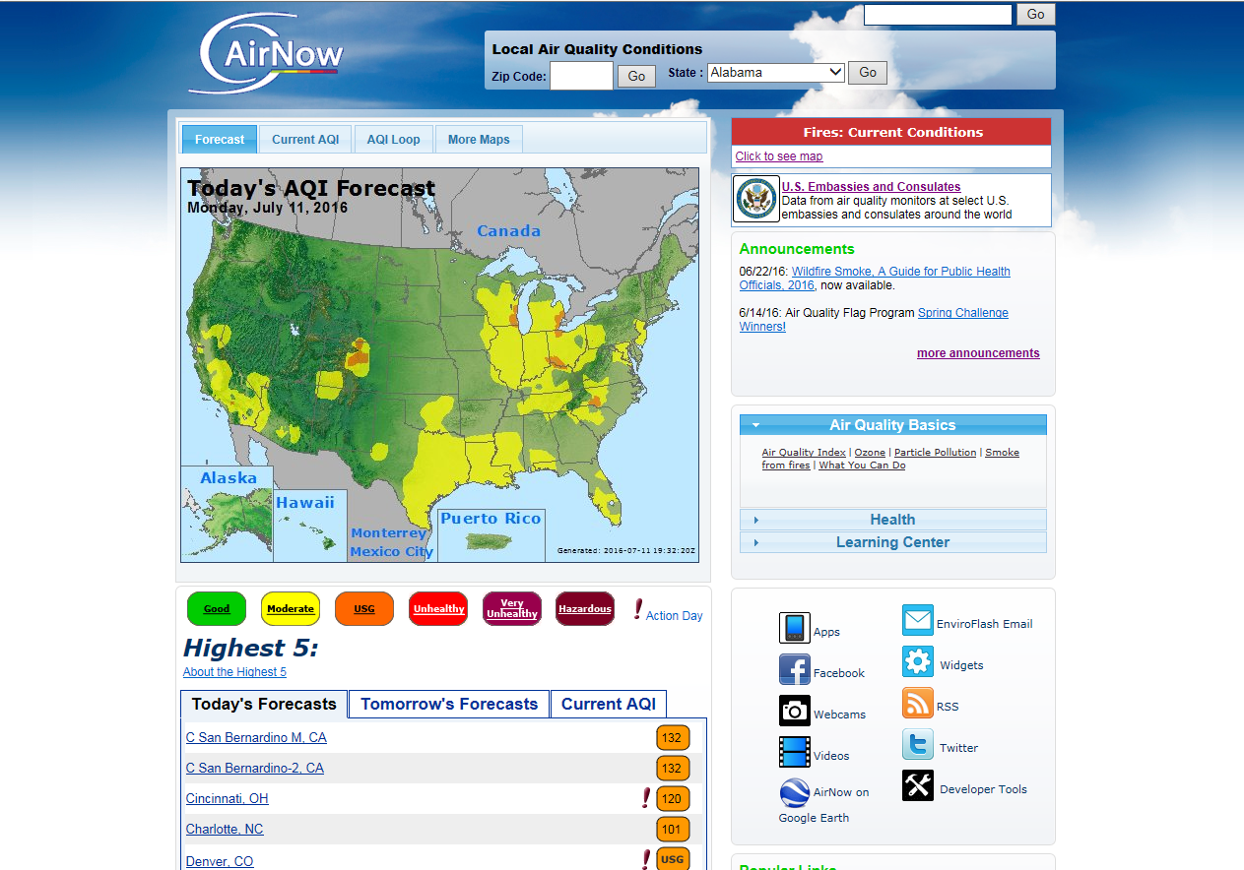
AirNow
www.airnow.gov

Slide 30
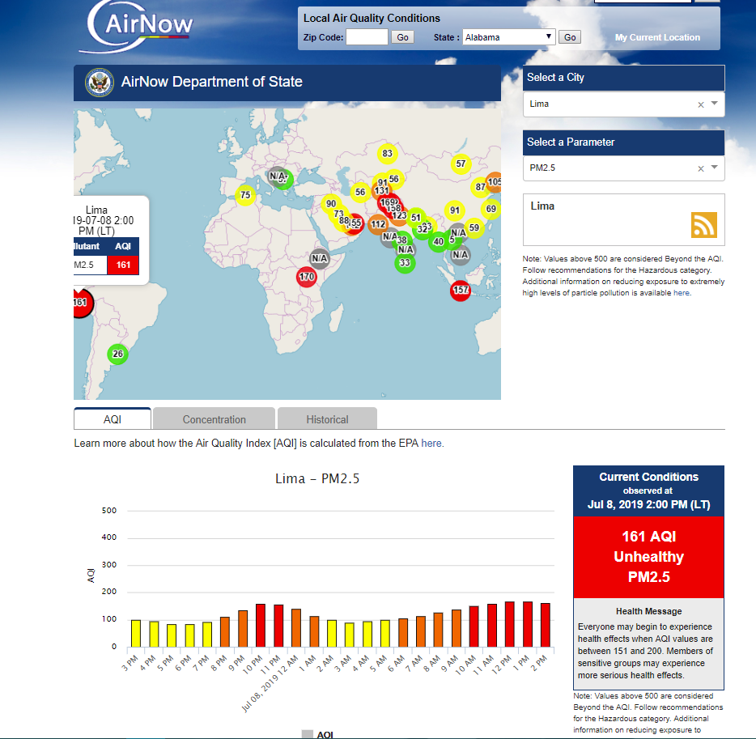
Department of State

Slide 31
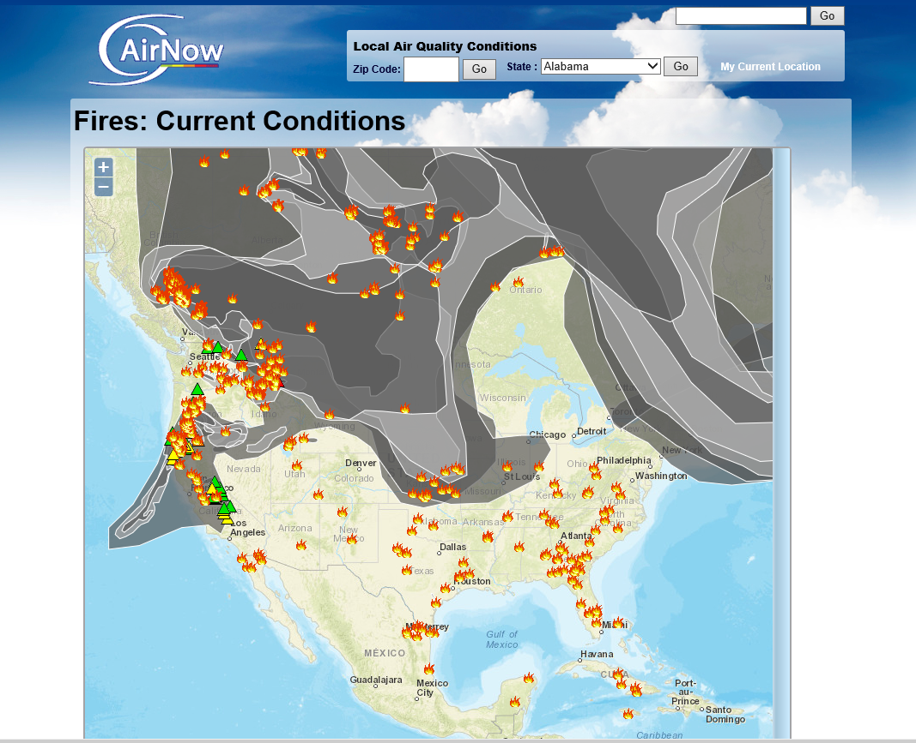
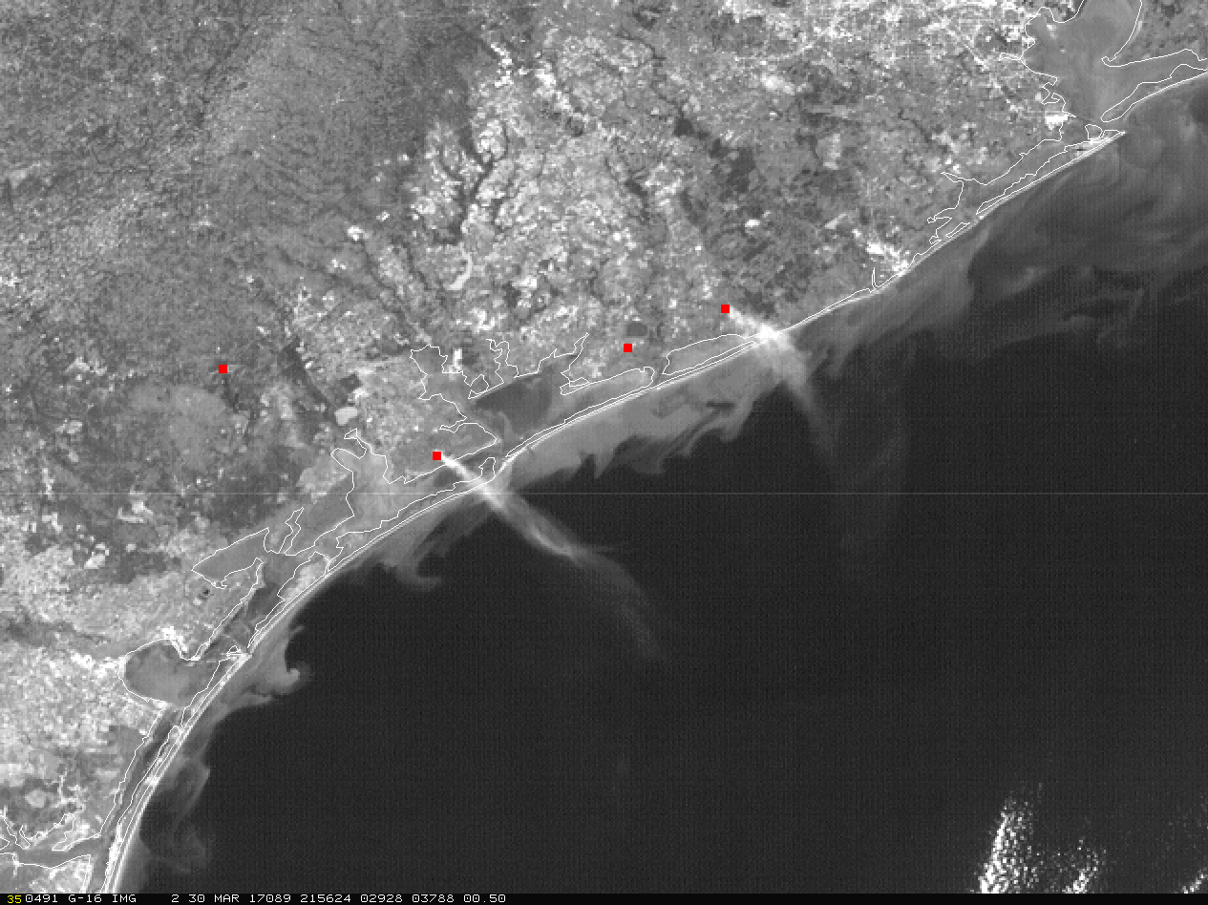
Fires Current Conditions Map
Map shows fire locations and smoke plumes
Map generated by NOAA Hazard Mapping System (HMS)
Map updated about 5 times a day
GOES-16 provides higher resolution images to detect smoke from most fires
Satellite imagery may also identify other potential air quality concerns

Slide 32
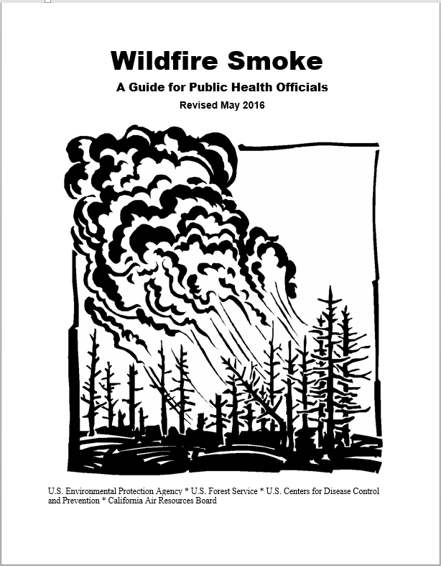
Available on the
Fires: Current Conditions
webpage

Slide 33
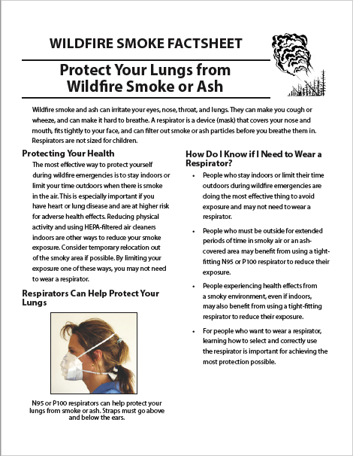
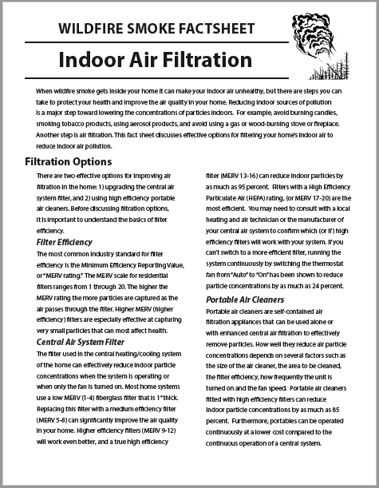
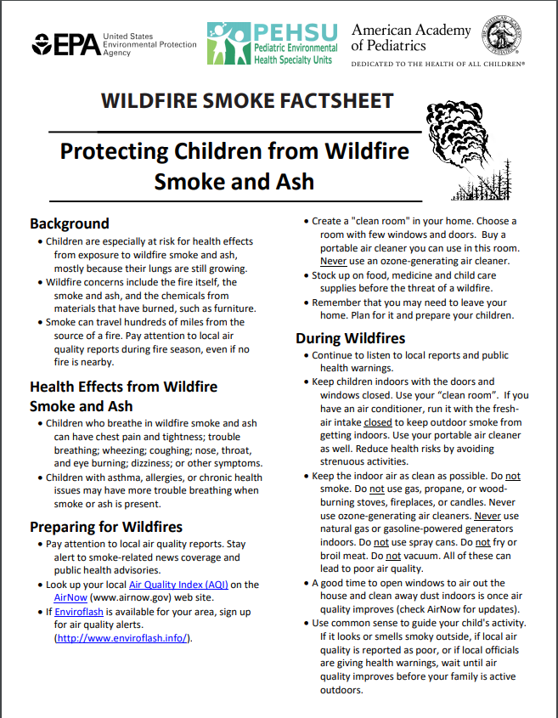
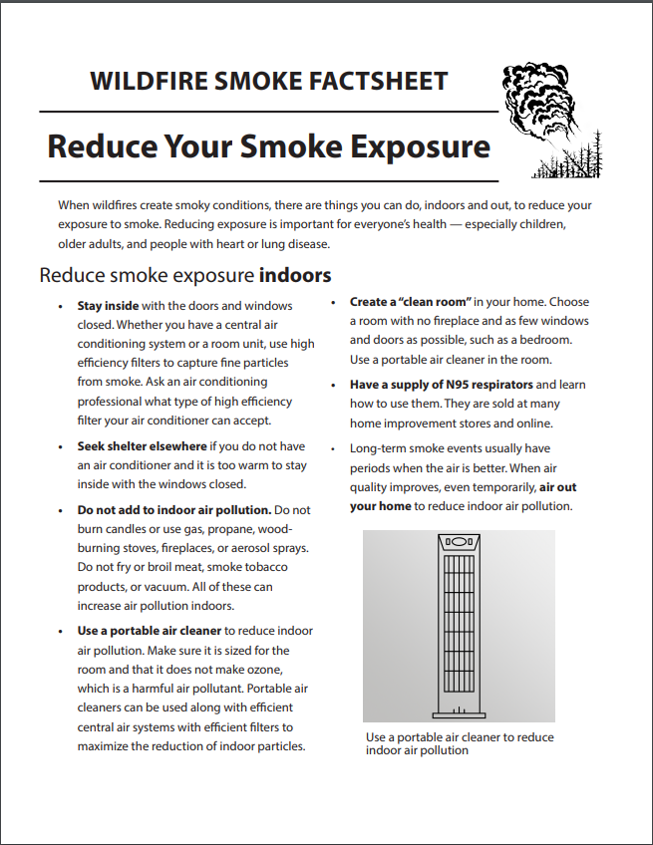
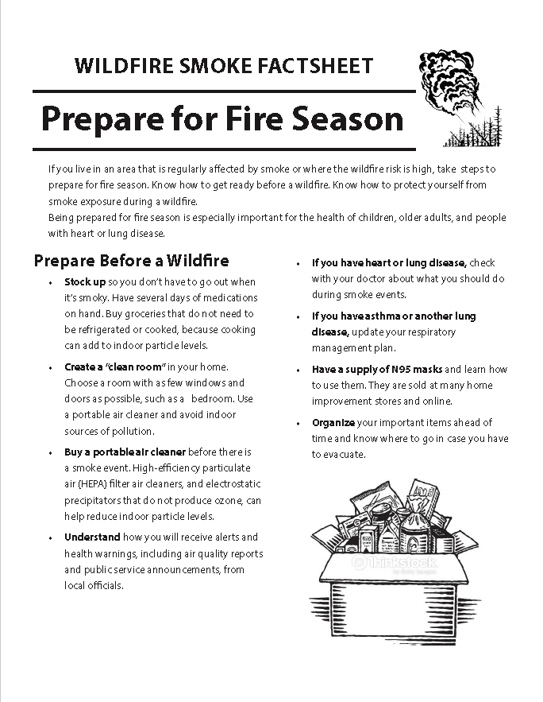
Wildfire Guide Factsheets
Prepare for Fire Season
Reduce Your Smoke Exposure
Indoor Air Filtration
Protect Your Lungs from Wildfire Smoke or Ash
Protecting Children from Wildfire Smoke and Ash
Protect Yourself from Ash
Protect Your Pets - New!
Protect Your Large Animals and Livestock - New!
Almost ready:
After the Fire
Spanish translations - some

Slide 34
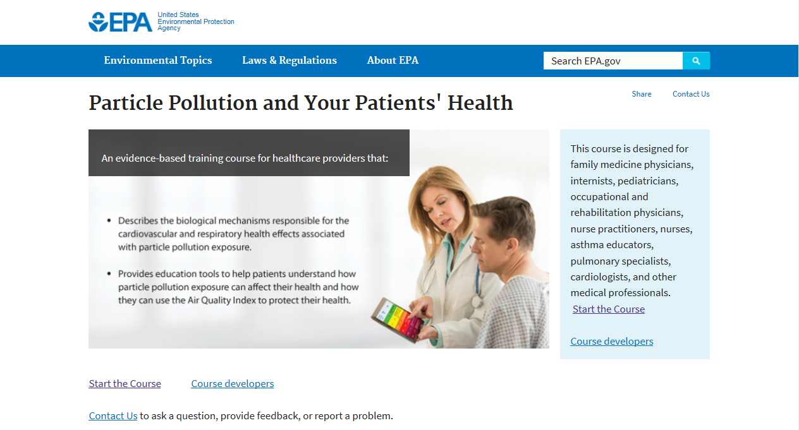
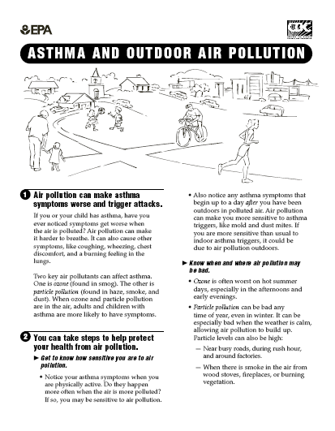
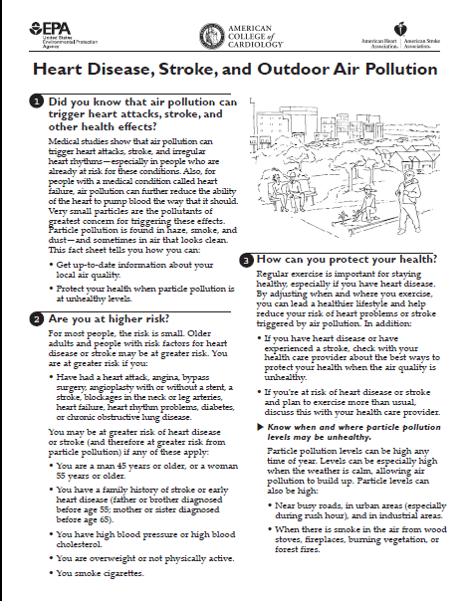
Information for Health Professionals
PM web course
  Medical education credit from CDC for doctors, nurse and health educators
Ozone web course
Medical poster
Fact sheets
  Asthma and lung diseases
  Cardiovascular diseases

Slide 35
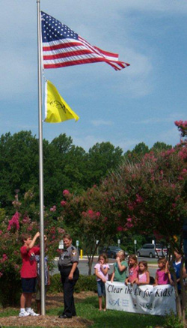
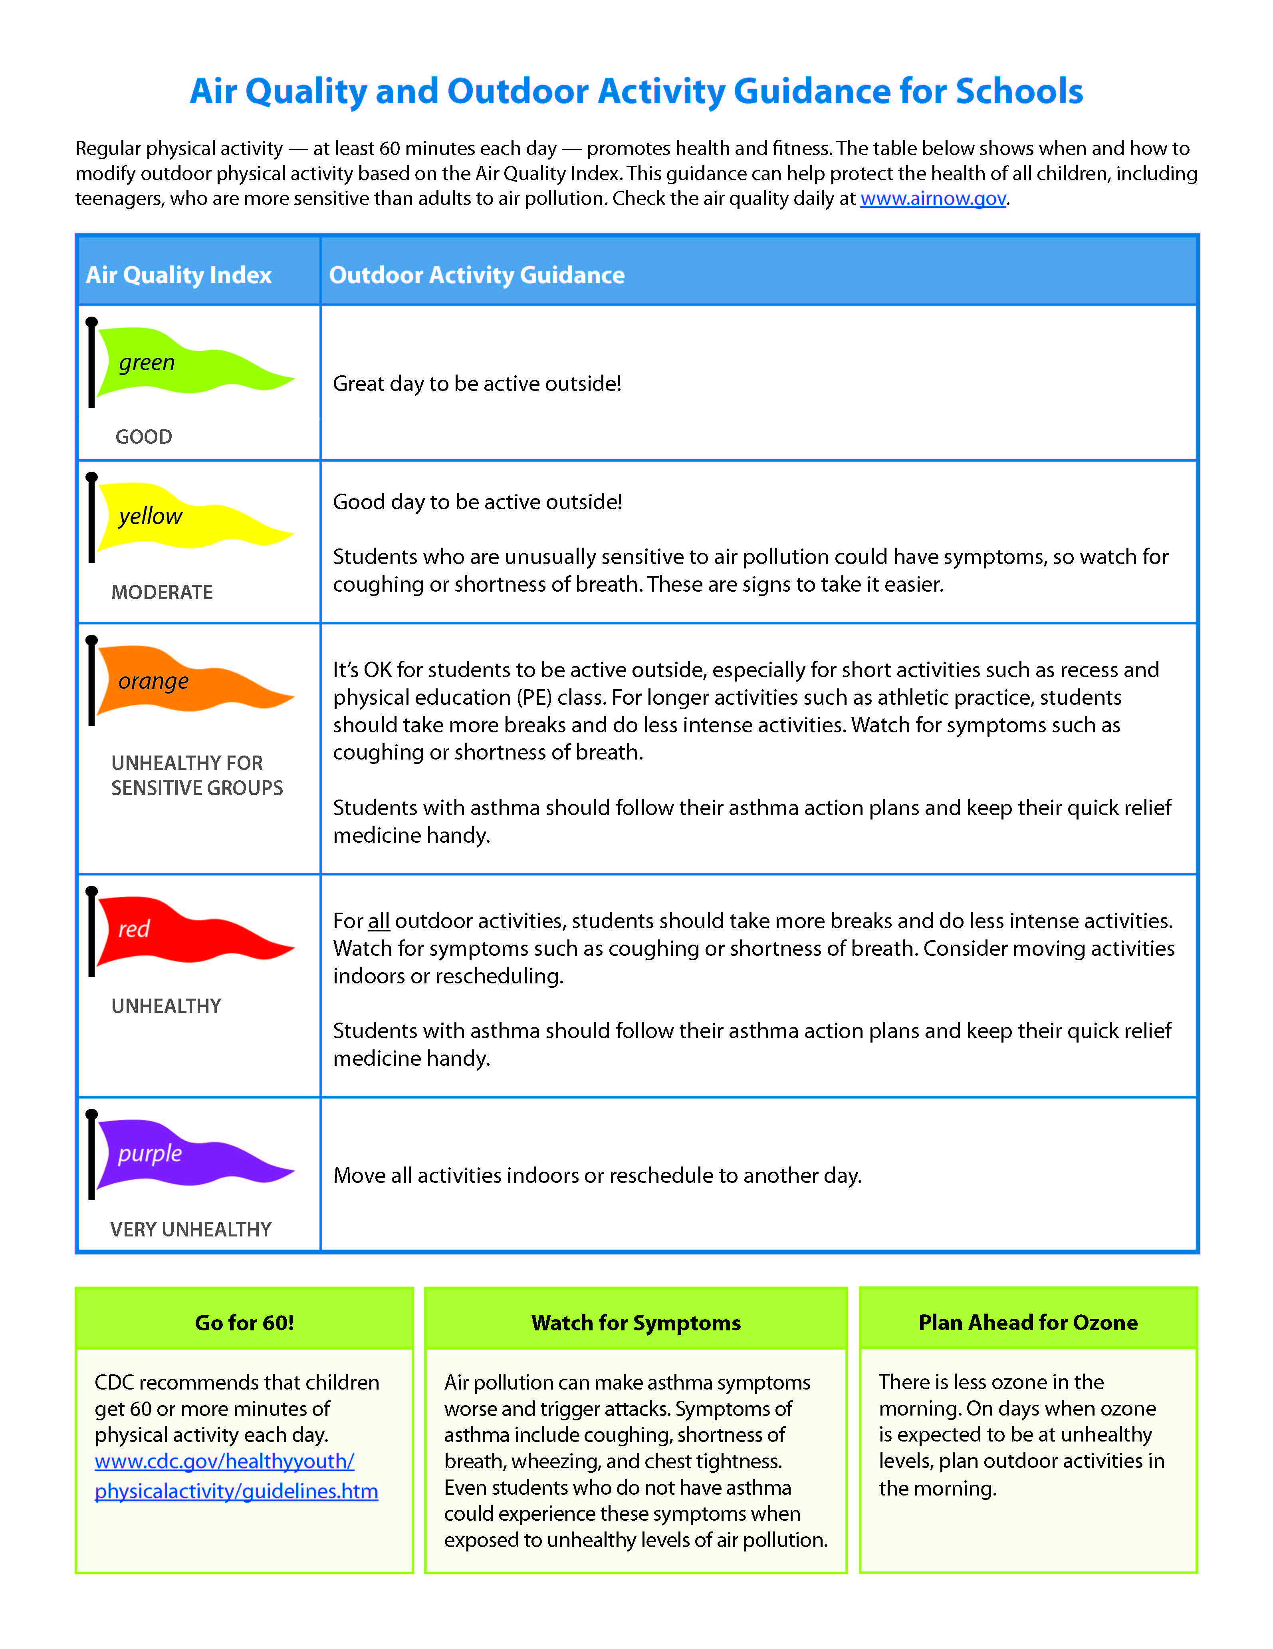
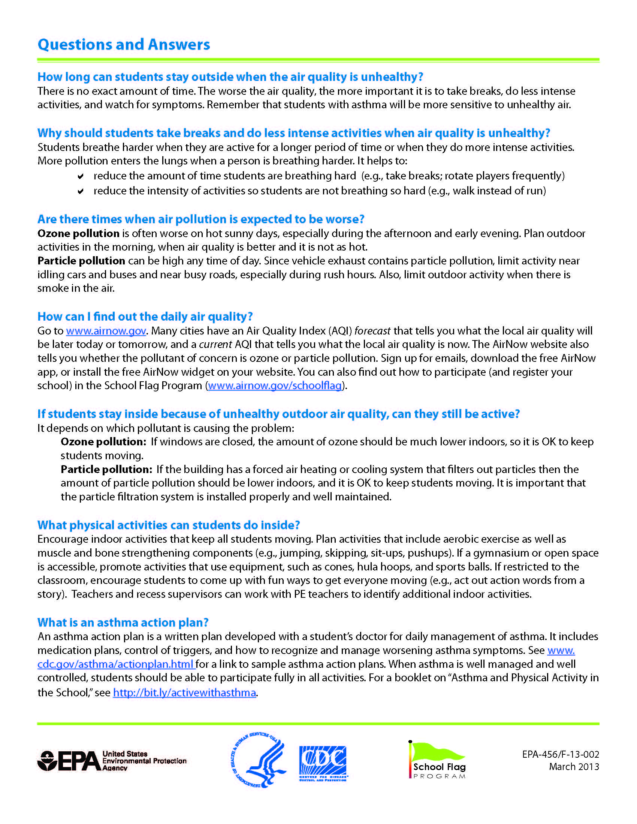

Air Quality Flag Program and School Activity Guidelines
Flag Program
Helps school and community be aware of daily air quality conditions
  Participating schools/public offices raise flag to show the air pollution forecast for that day
  By comparing the colored flags to the Air Quality Index (AQI), people can tell what daily air quality is forecast to be, and schools can adjust activities to reduce children’s exposure to air pollution as needed
Other Products
Air quality and outdoor activity guidelines for schools (with CDC)
Picture book that explains AQI and flag program to children

Slide 36
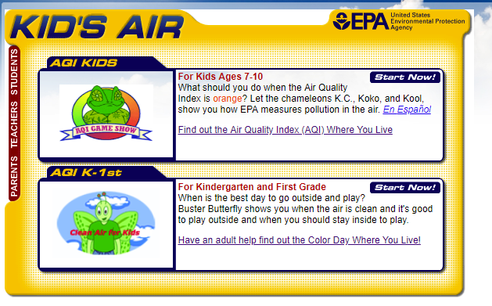
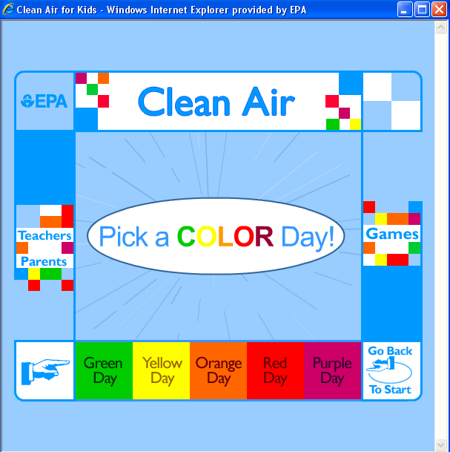
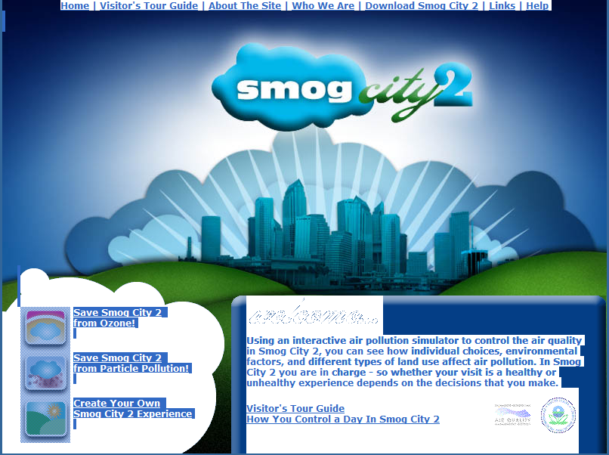
AQI Curriculum for Children and Students
Colorful lessons and games for children and students

Slide 37

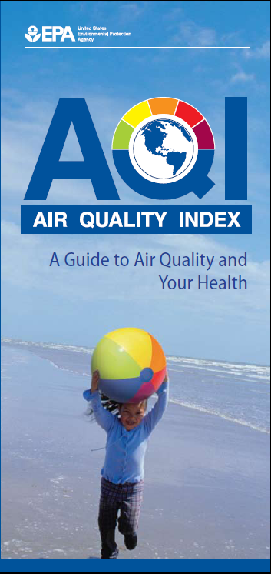
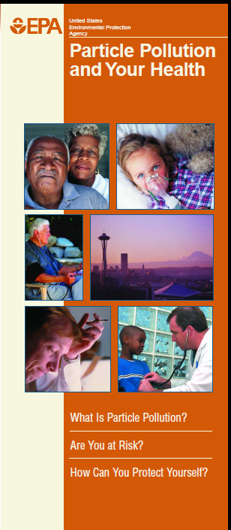
Pollutant-Specific Health and AQI Information

Slide 38
Public Health Benefits of the AQI
Surveys indicated that 50 to 80% of public aware of AQI
  Of those, 50% report taking exposure reduction measures
  People who are at-risk more likely to report taking exposure reduction measures, including older adults, children, and people with heart or lung disease
Activity diary studies provide evidence of exposure reduction
Population-based health studies provide evidence of reductions in hospital admissions and emergency department visits for asthma due to advisories
Activity diary study - Mansfield et al., 2007
Increased asthma HA’s on
high-O₃ days with no alert
Children Ages 5-19
38
Population-based study - Neidell and Kinney 2009

Slide 39
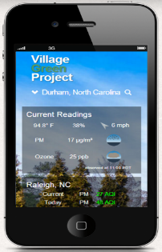

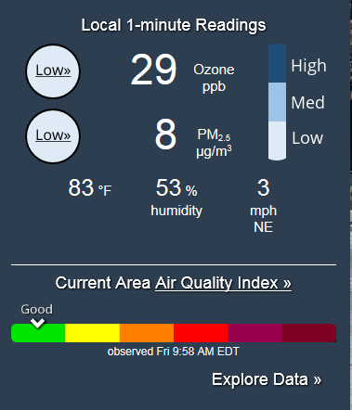


Sensor Concentration ≠ Air Quality Index
Sensor Reading
Concentration
Short term (e.g. 1 minute)
Data Quality Unknown
Air Quality Index
Index Value & Color
Averaged (e.g. 8-hour, 24-hour)
Data Quality Assured

