Slide 1

Teaching with Technology: Using EPA’s EnviroAtlas in the Classroom to Empower Tomorrow’s Decision-Makers
EPA OAQPS Teacher Workshop
July 9, 2019

Slide 2
Jenna Hartley
ORISE Participant hosted by the US EPA Office of Research & Development
BS Environmental Geology | MS Secondary Science Education | MS Environmental Sciences & Engineering
hartley.jenna@epa.gov
@JennaMHartley

Slide 3

Why did we create EnviroAtlas?
EnviroAtlas
Inform efficient, effective, and equitable decision-making
Facilitate systems approach to decision-making
Provide access to consistent environmental, social, and economic data and tools
Synthesize research results and make them accessible
Free
Web-based
Easy to use
No GIS skills required
Notes:
For research, decision making and education

Slide 4
Navigating the EnviroAtlas website epa.gov/enviroatlas

Slide 5
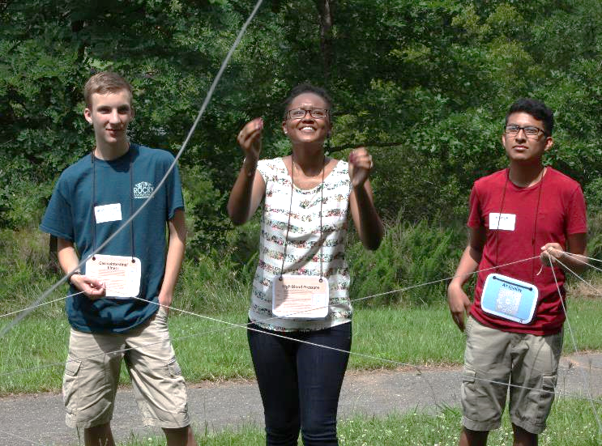
EnviroAtlas Educational Materials
#EPAEnviroAtlasED
Three lesson modules, all with hands-on and outdoor portions
Align with NGSS
Have individual State Science Standards in Appendix of every lesson
Notes:
from prior slide. My goal today is to equip you with what you need to know to present this to teachers in your Regions. Also, even if we don’t have time to do an entire training, I want to give you a feel for the types of trainings that I give to teachers at workshops and conferences.
Discuss Standards (NGSS vs. State Standards). Teachers are expected to fit a lot of content into a short window of time. That content is all derived from the Standards by which their State operates. These Standards dictate exactly what teachers teach—they are a BIG DEAL. In an effort to make things easy for teachers and folks that go out and speak to teachers, I have done a lot of work up front on getting Standards for EVERY State and EVERY grade into all of our lessons. This is a big selling point for these educational modules, since we are making them applicable to anyone in the country by doing this.
JD: Changed title for consistency

Slide 6
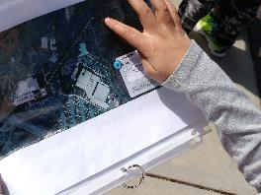
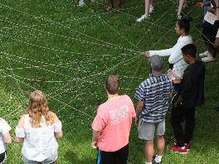
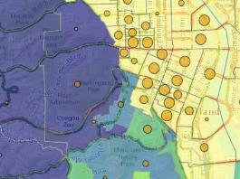
EnviroAtlas Educational Materials
+ 6 new lesson plans on the concept of Ecosystem Services for grades 4-6
K-6
Exploring Your Watershed
Available online!
4-12
Connecting Ecosystems and Human Health
Available online!
9-12+
Building a Greenway: Case Study
Available online!
Notes:
Teachers and schools often have to buy software licenses or group subscriptions in order to be able to use cutting-edge technologies in their classrooms—this is a big market right now. One thing that I say very clearly to teachers is that all of these products and the technological tools that they are designed around are FREE from the EPA. I know you guys know this as EPA employees, but it will be important to mention when you speak to teachers about it.
JD: (added a + on greenway) should this animate the other way, with the +6 appearing??? Seems confusing. I changed

Slide 7
Lesson Plan:
“Introduction to Ecosystem Services”
Grades 4-6

Slide 8
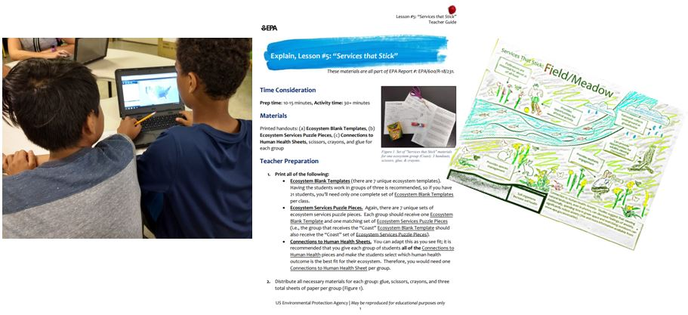
4-6: “Introduction to Ecosystem Services”
Available now on EnviroAtlas website!
All 6 designed to be completed in 30 minutes or less
Indoor, outdoor, technology, art, and hands-on activities
Notes:
Exploratory portion.

Slide 9
The EnviroAtlas Interactive Map
Related Lesson Plans: “Exploring Your Watershed” & “Building a Greenway Case Study”

Slide 10
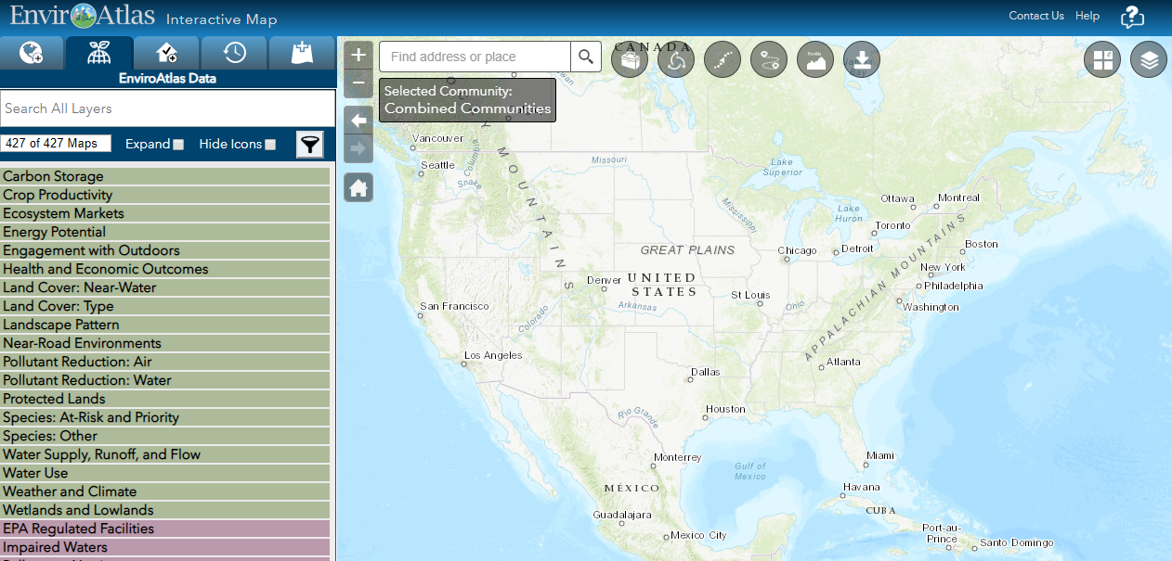
The Interactive Map
Notes:
After a disclaimer, this page will appear.
JD: Replaced your image with most recent

Slide 11
epa.gov/enviroatlas
400+ map layers with National and Community-level data
Notes:
Changed your screenshots and to 400+ maps

Slide 12
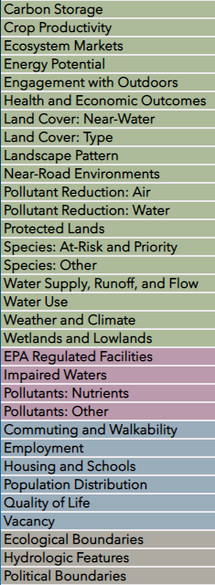
epa.gov/enviroatlas
400+ map layers with National and Community-level data
Notes:
Changed your screenshots and to 400+ maps

Slide 13
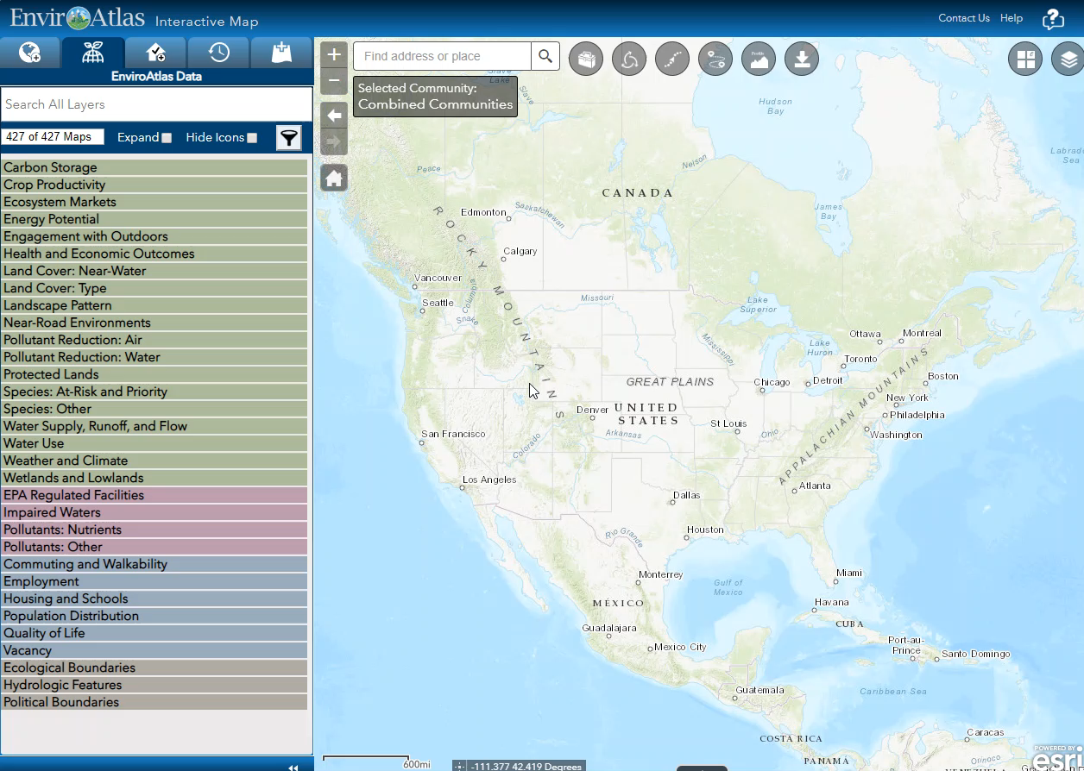

Slide 14
Lesson Plan:
“Exploring Your Watershed”
Grades K-6
Virtual Demo/Video

Slide 15
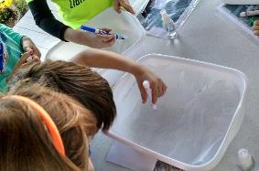
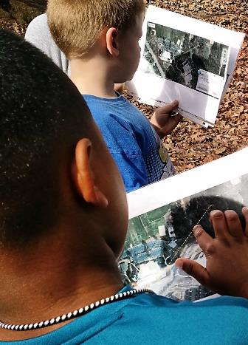
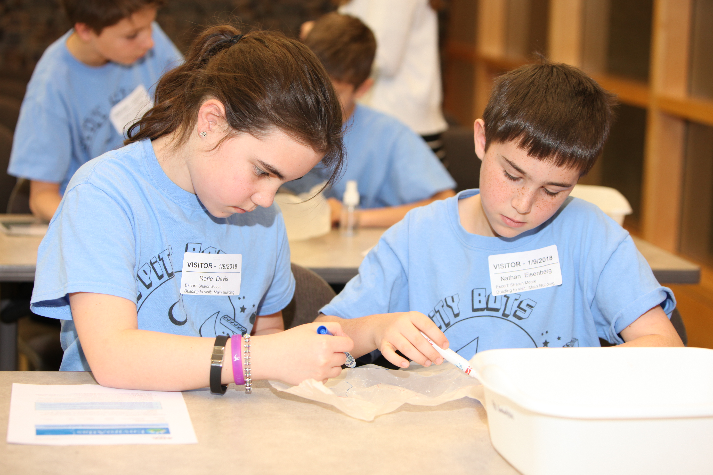
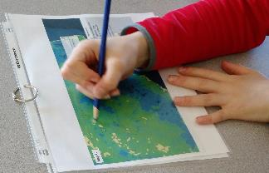
K-6: “Exploring Your Watershed”
Available now on EnviroAtlas website!
Indoor, Hands-on Portion
Outdoor, Exploratory Portion
Mapping Portion
Notes:
Exploratory portion.

Slide 16
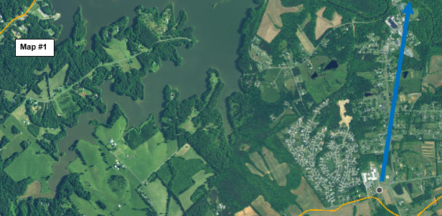
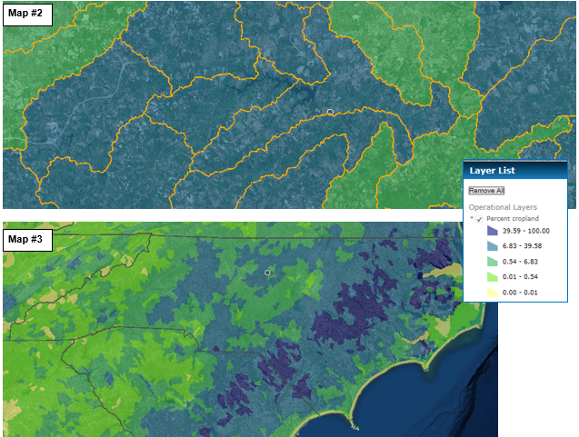
K-6: “Exploring Your Watershed”
Available now on EnviroAtlas website!
Notes:
School is the gray dot, orange lines are watershed lines, map layer is percent cropland.

Slide 17
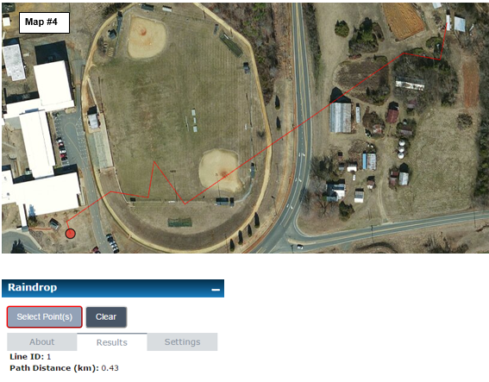
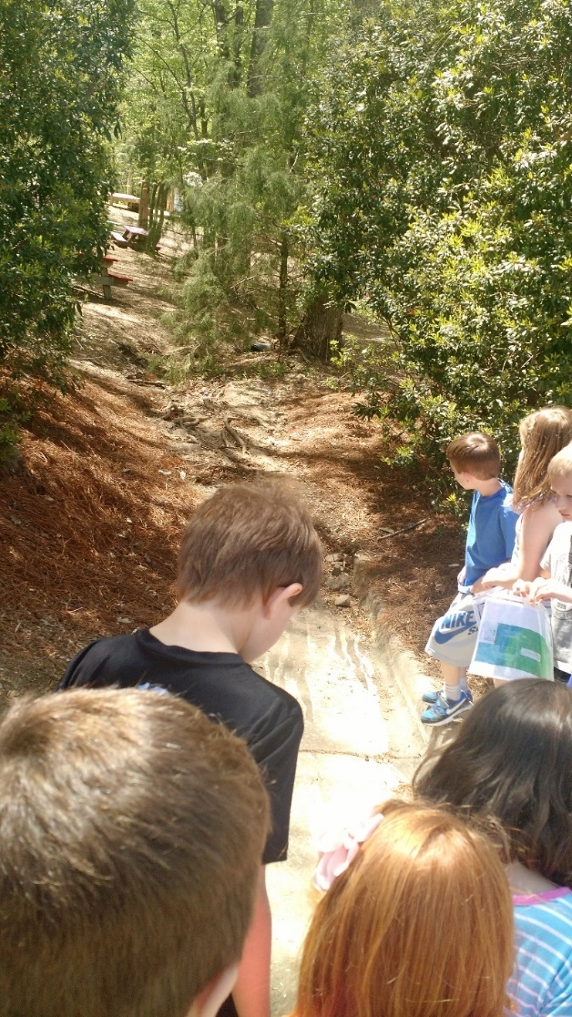
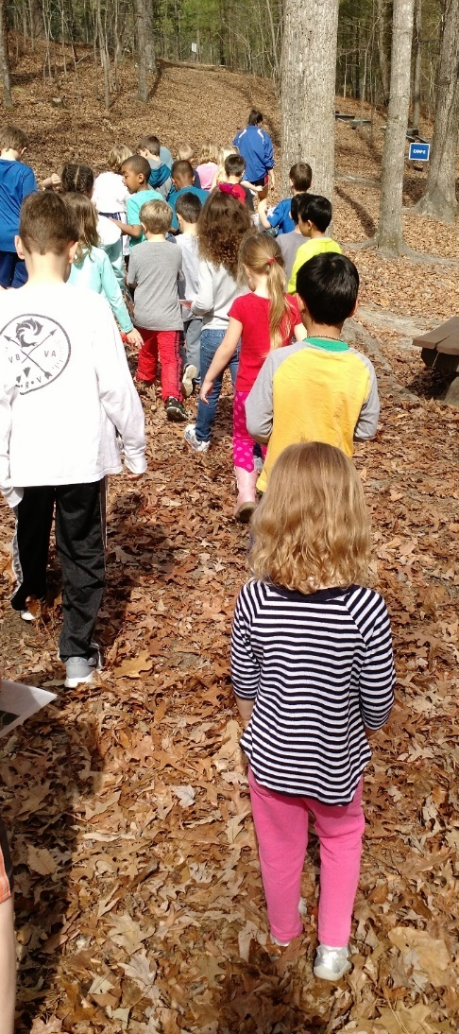
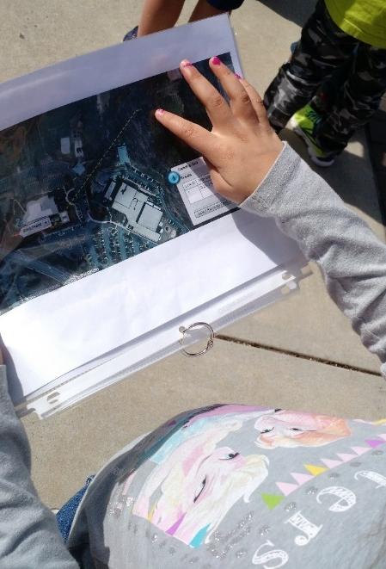
K-6: “Exploring Your Watershed”
Available now on EnviroAtlas website!
Notes:
Discuss stormwater infrastructure.

Slide 18
Lesson Plan:
“Building a Greenway: Case Study”
Grades 9-Undergraduate
Virtual Demo/Video

Slide 19
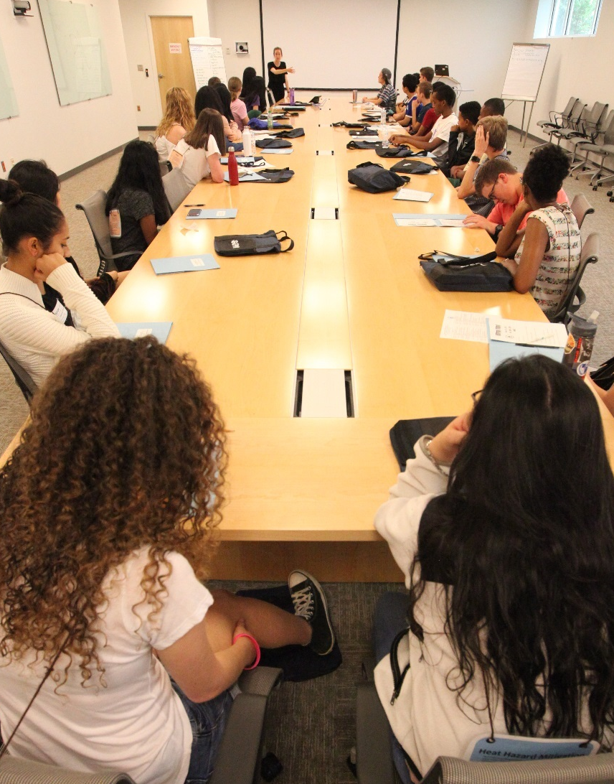
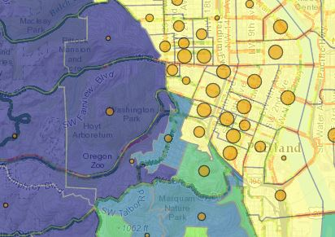
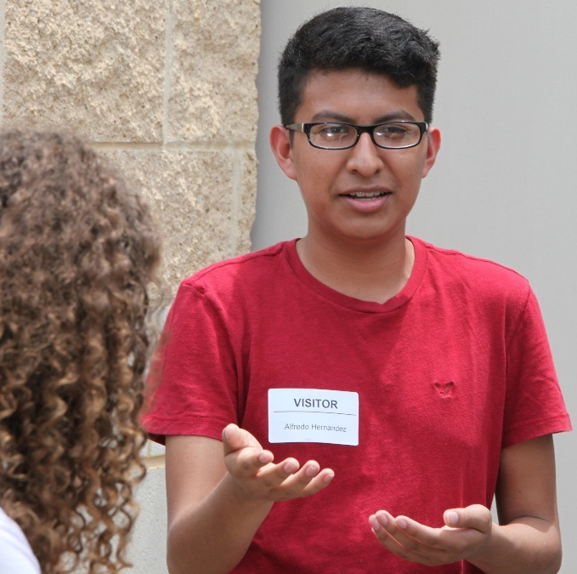
9-12+: “Building a Greenway: Case Study”
Available now on the EnviroAtlas website
Indoor, Hands-on portion with technology and maps
Collaborative, decision-making portion
Notes:
The Greenway Lesson Plan, which is already available for free download, provides students with a set of maps and a role to play as a certain stakeholder in their community. The students then make a case for their position given the maps and their roles in the situation.

Slide 20
The EnviroAtlas Eco-Health Relationship Browser
Related Lesson Plan: “Connecting Ecosystems and Human Health”
Notes:
JD: Added the related lesson plan piece

Slide 21
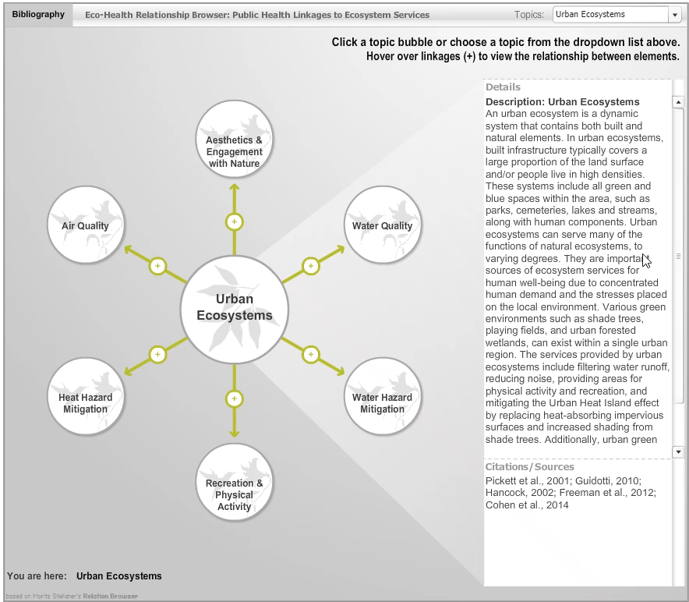

Slide 22
Lesson Plan:
“Connecting Ecosystems and Human Health”
Grades 4-12
Virtual Demo/Video

Slide 23
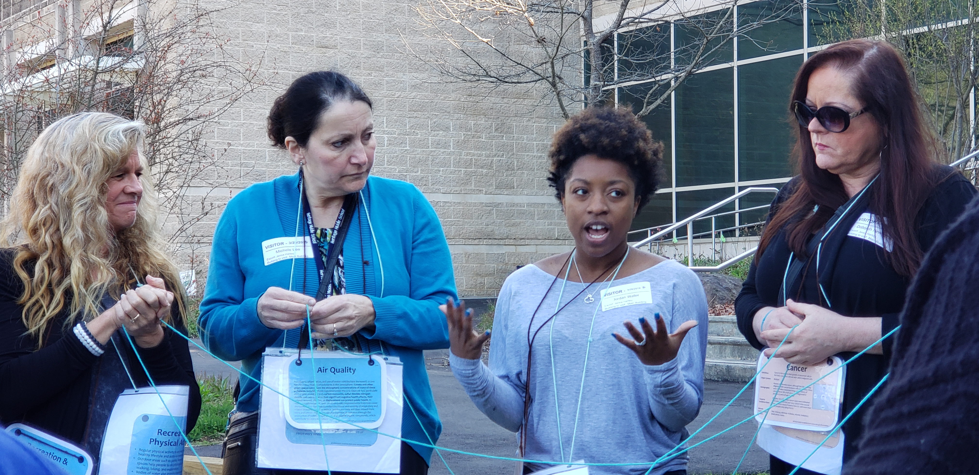
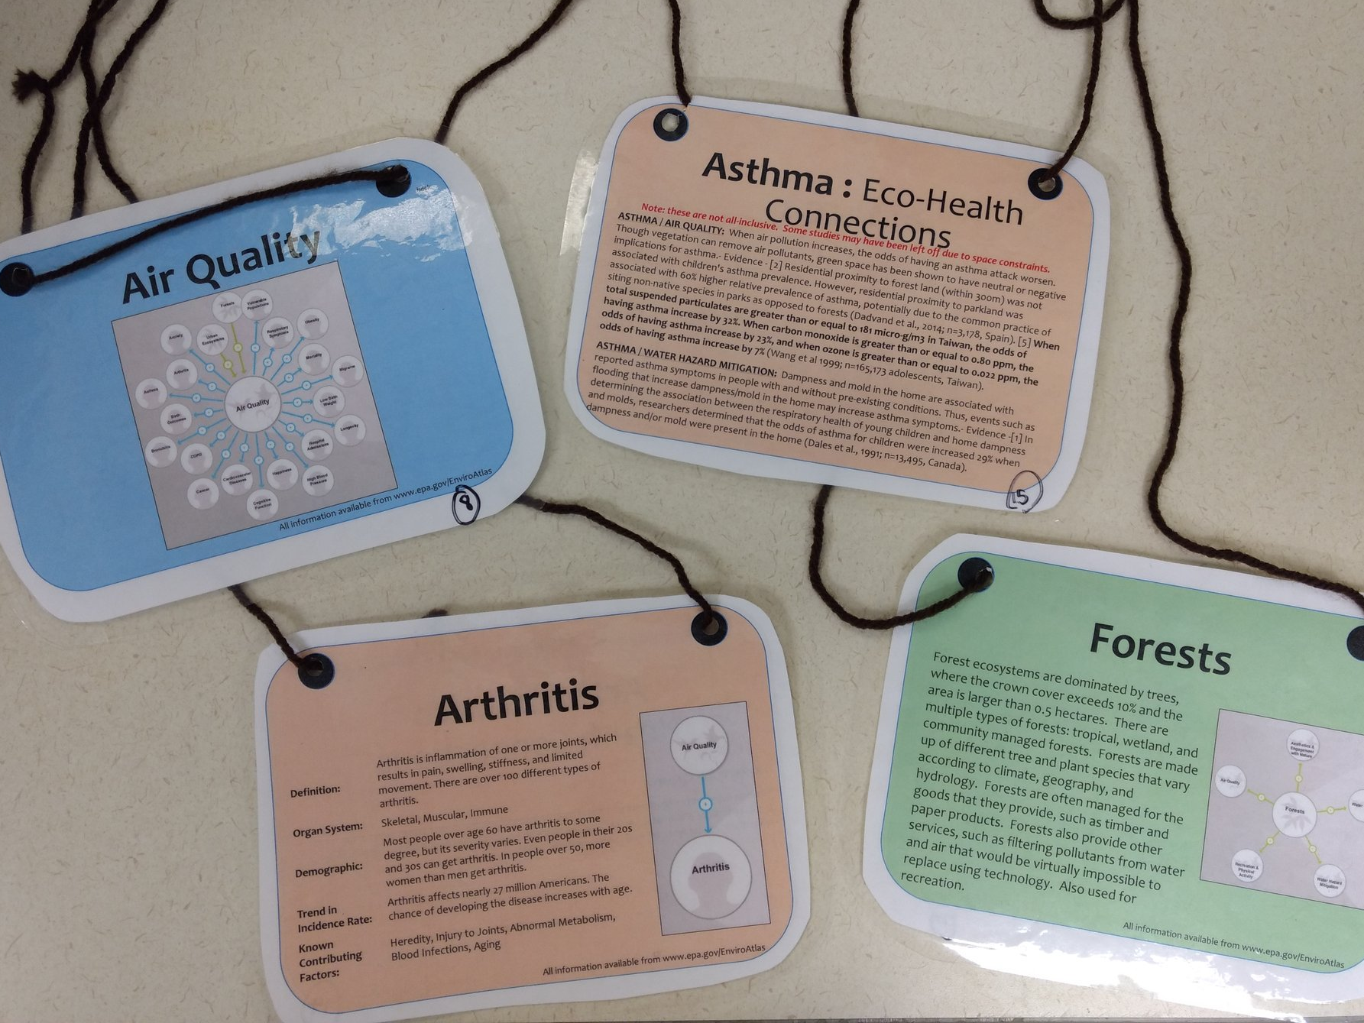
Grades 4-12: “Connecting Ecosystems and Human Health”
Notes:
The students are given notecards like the ones shown here. In the example that I’ll walk you though, the students either have an ecosystem services card (blue), like Air Quality, or a human health card (orange), like arthritis. We have already pulled examples of information from the Eco-Health Browser and put it onto the cards. The cards show just a portion of what is available online, but still paint a picture of the concepts and their associations.

Slide 24
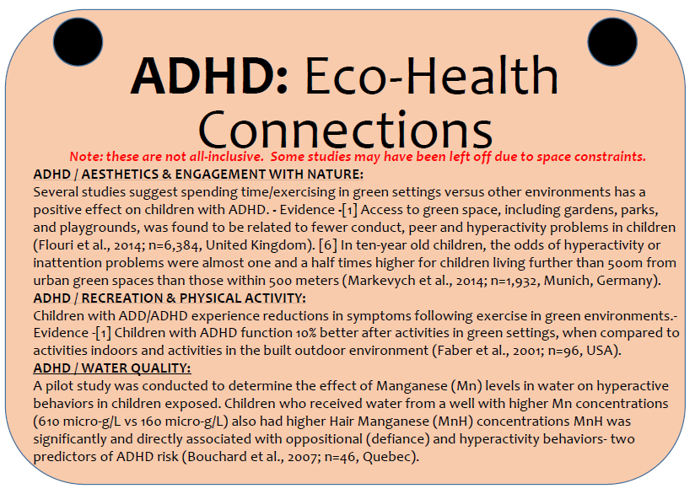
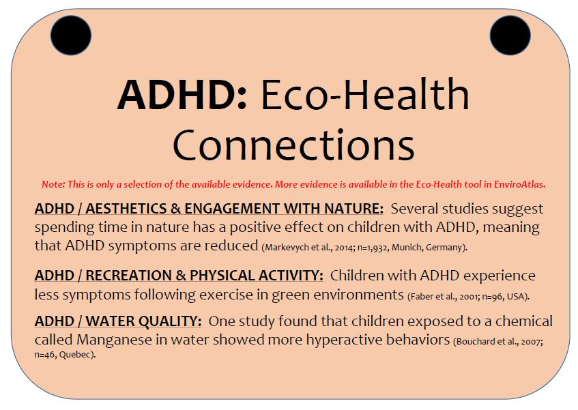
Grades 4-12: “Connecting Ecosystems and Human Health”
Notes:
Here you can see an example of the front and the back of one of the human health outcome cards (ADHD).

Slide 25
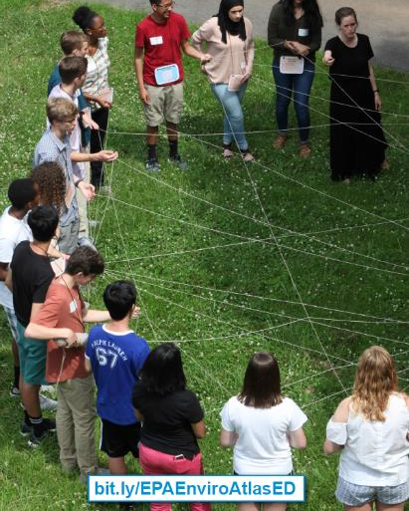
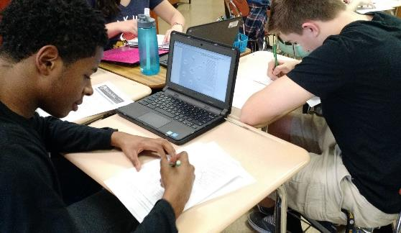
Grades 4-12: “Connecting Ecosystems and Human Health”
Outdoor, Exploratory Portion
Indoor, Hands-on Portion with technology

Slide 26
CONCLUSION
EnviroAtlas is a powerful, robust, high-tech tool (that’s free!).
We’ve built some K-12+ lesson plans that leverage EnviroAtlas (also free!).
We hope you feel more confident and comfortable using EnviroAtlas and the lesson plans.
Notes:
DATA
Tools
Resources
Multiple ways to access
Lesson plans are just a few ways you can use our resources !!

Slide 27
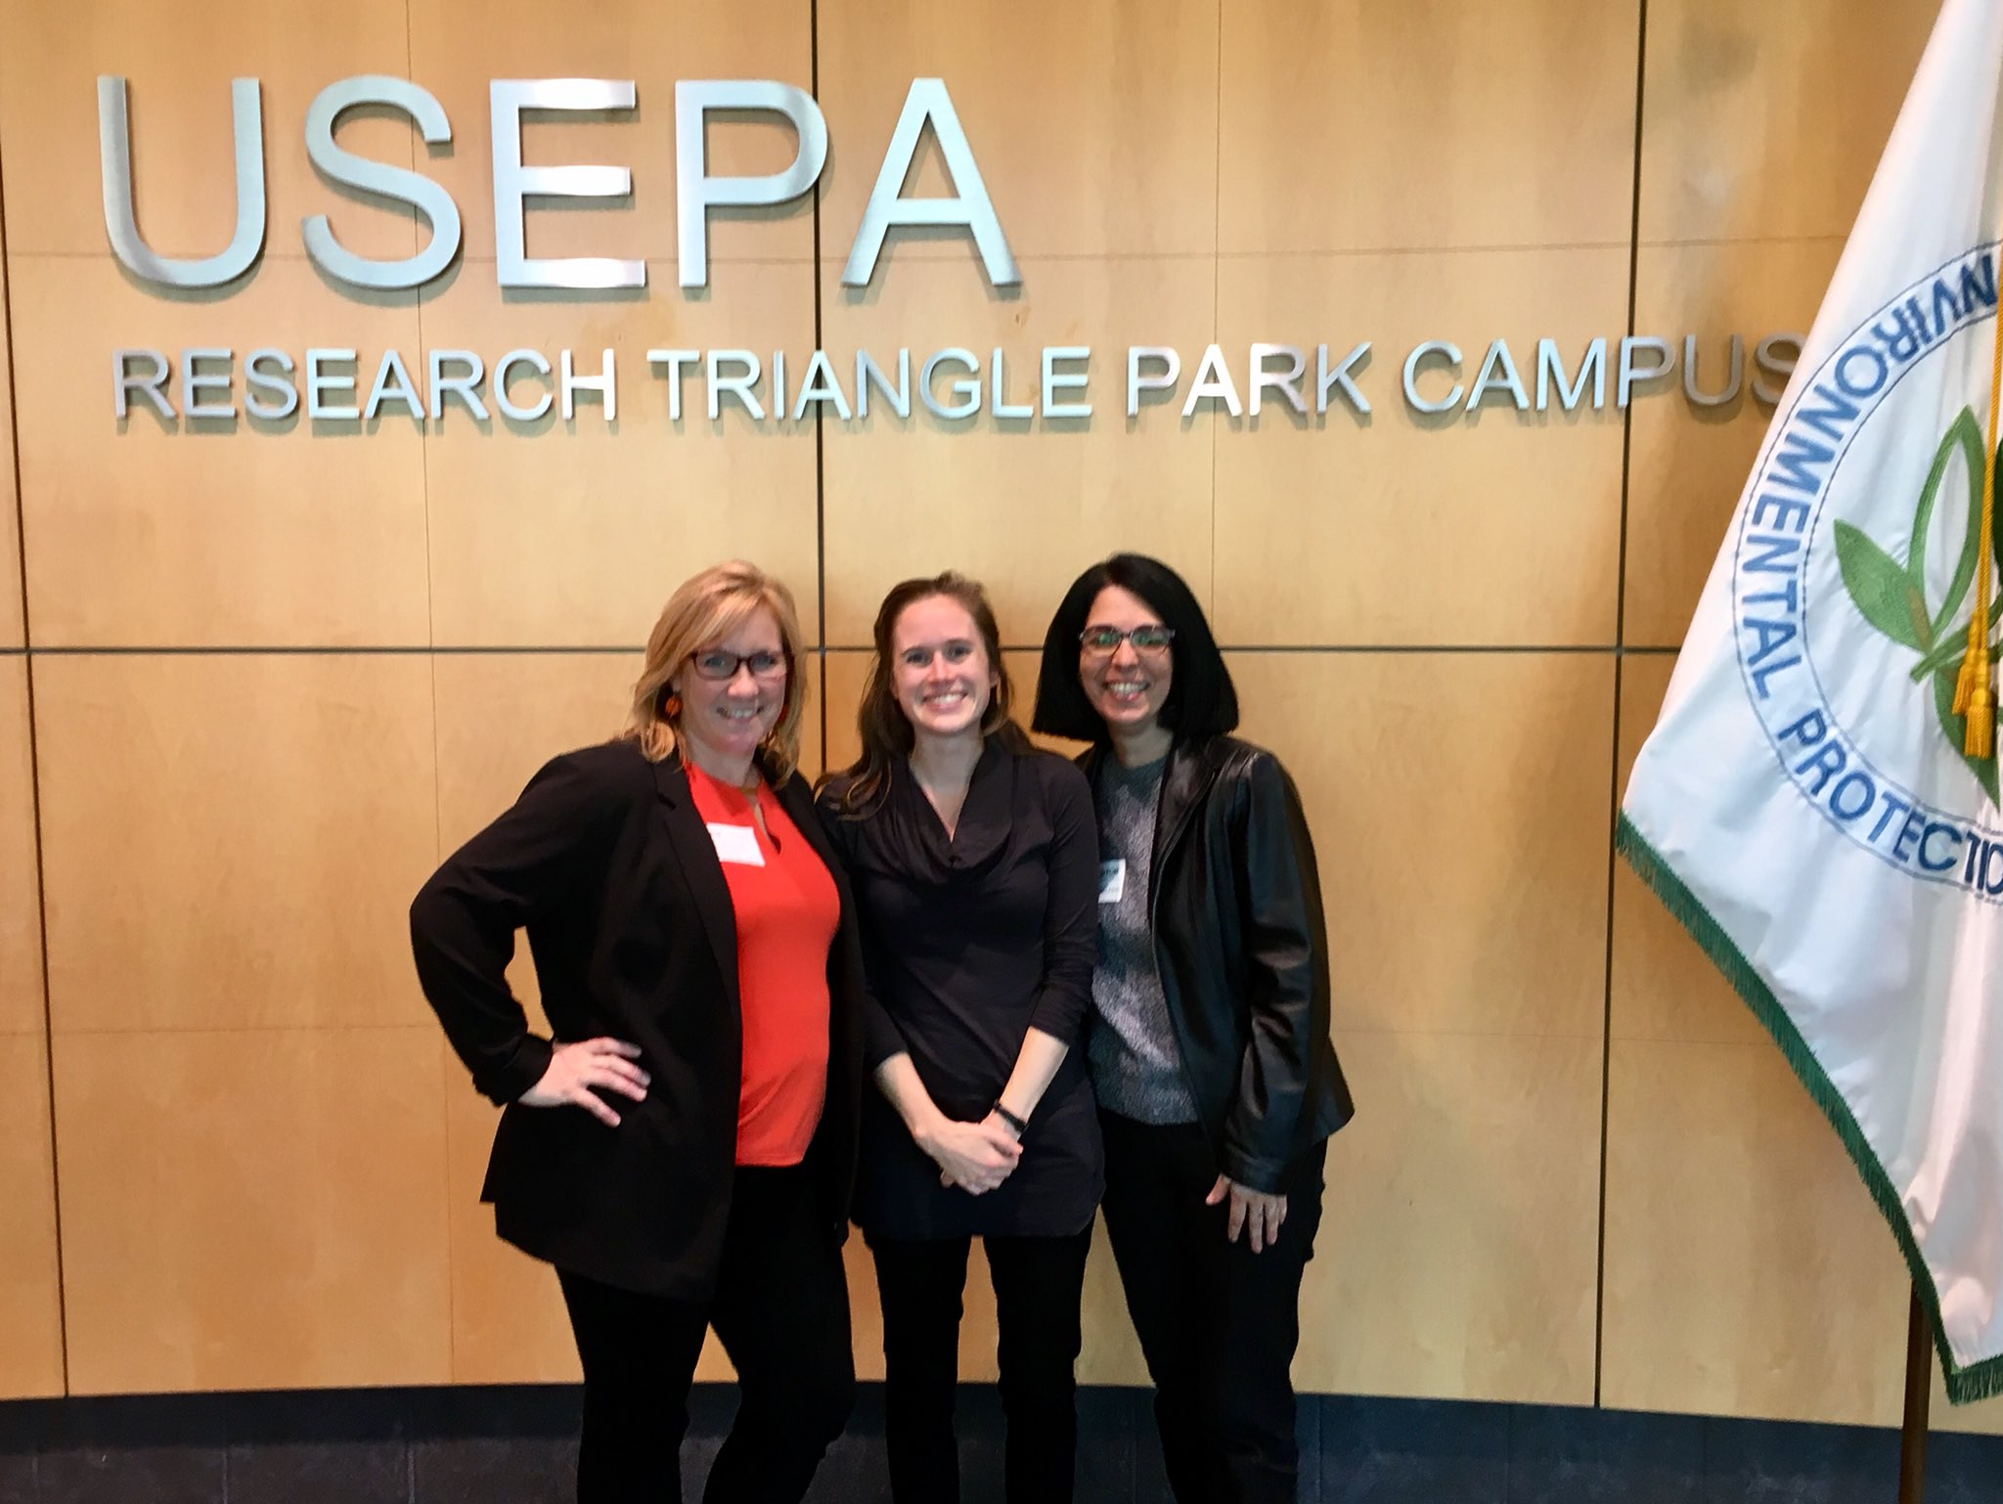
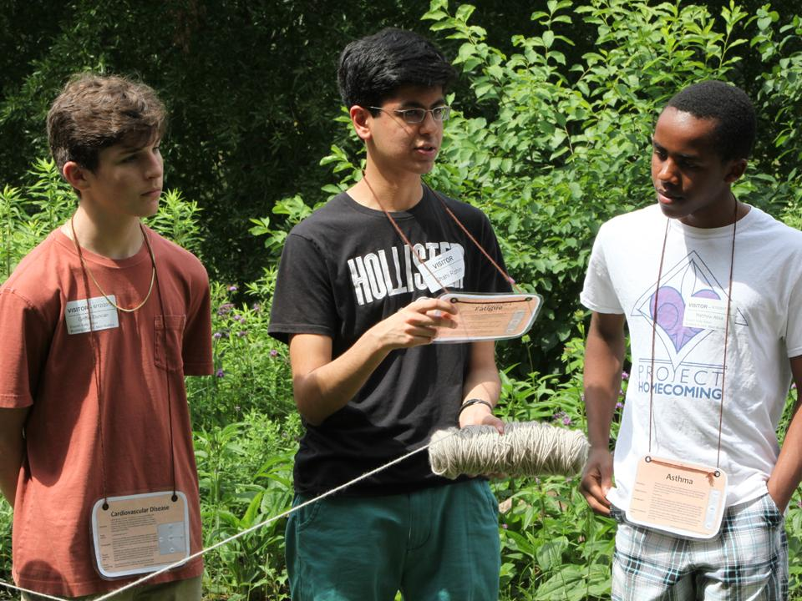
http://bit.ly/EPAEnviroAtlasED
#EPAEnviroAtlasED
“I didn’t realize that protecting the environment meant
protecting the people that I love.”
– 7th grade student from Durham, North Carolina
“I’m excited that these educational materials are free and easily available to students, teachers, and schools. Best of all, the educational resources are also aligned with the State Science Standards.”
–Delaine Machado, K-5 ESL teacher

Slide 28
Have general questions about EnviroAtlas or need assistance?
Email us at:
EnviroAtlas@epa.gov
Access the materials: bit.ly/EPAEnviroAtlasED
#EPAEnviroAtlasEd
Have questions about just the educational materials?
hartley.jenna@epa.gov
@JennaMHartley

